Slide 1
PAX DETECTOR
12/12/2013 MORNIG MEETING
LAYOUT UPGRADE

Slide 2
DETECTOR QUADRANT DESIGN DEVELOPMENT
WORKING GROUP :
V. CARASSITI , P. LENISA , S. MERZLIAKOV , C. WEIDEMANN

Slide 3
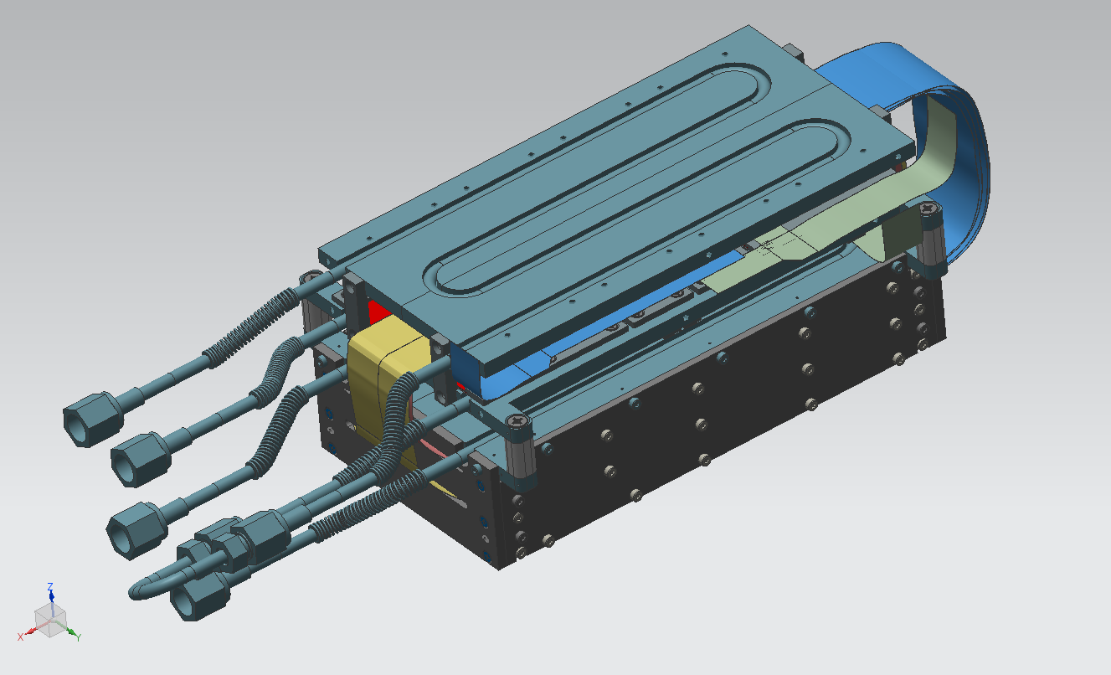
DETECTOR QUADRANT : OVERALL VIEW 1

Slide 4
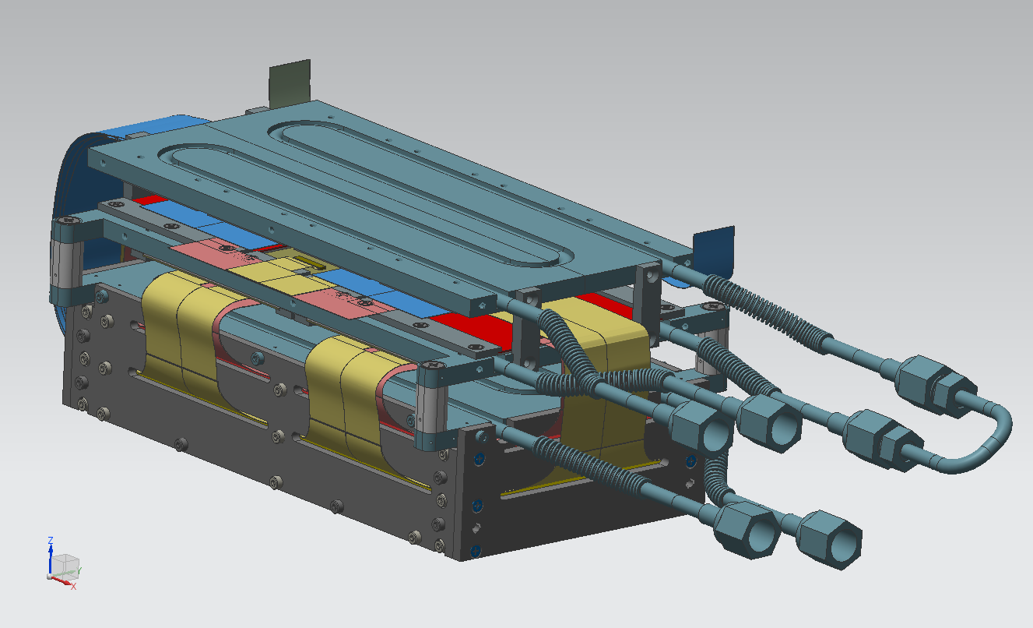
DETECTOR QUADRANT : OVERALL VIEW 2

Slide 5
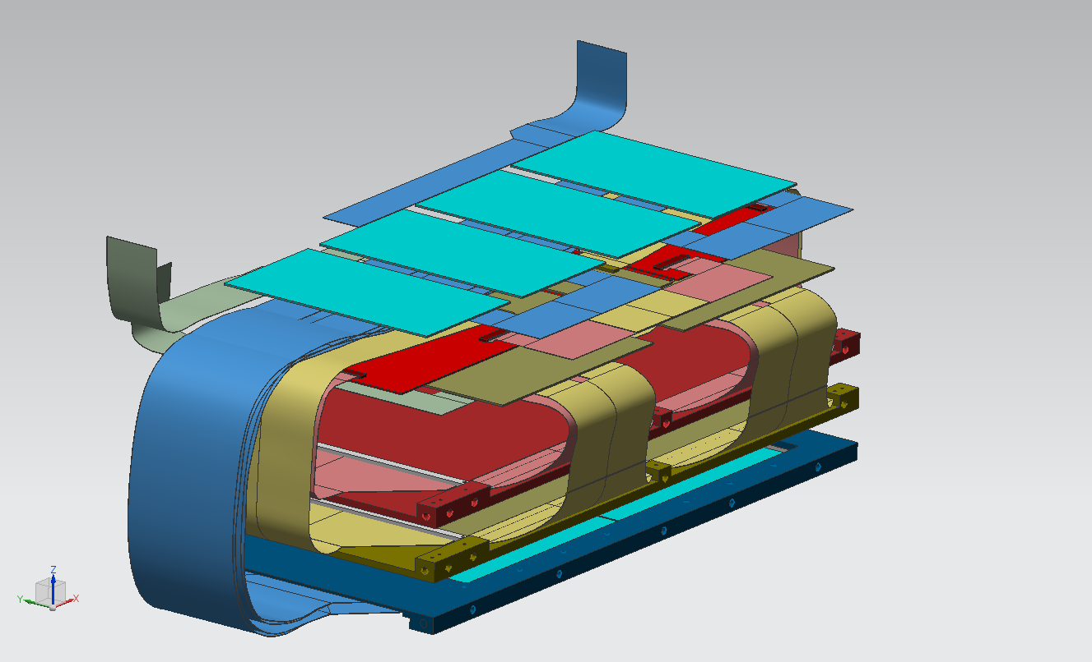
READOUT CONCEPT 1

Slide 6
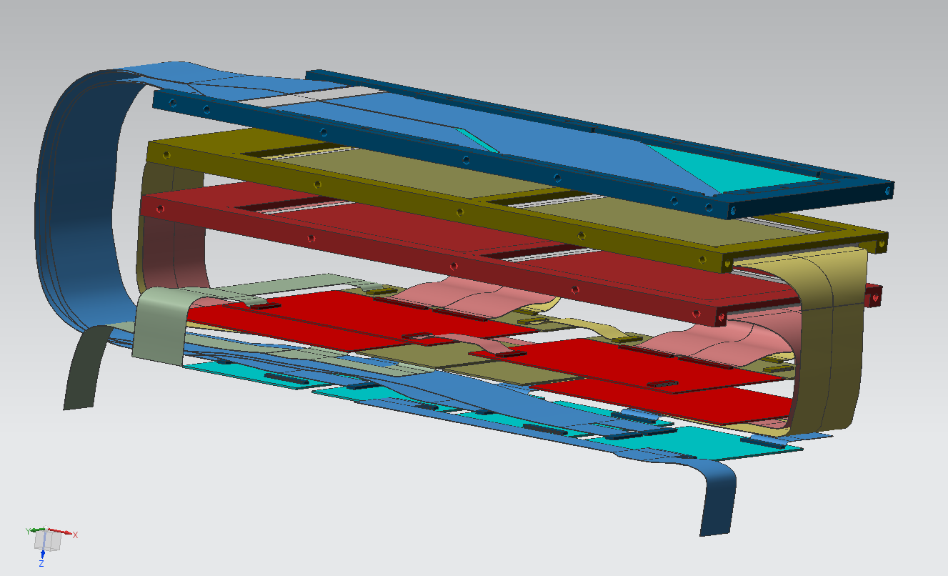
READOUT CONCEPT 2

Slide 7
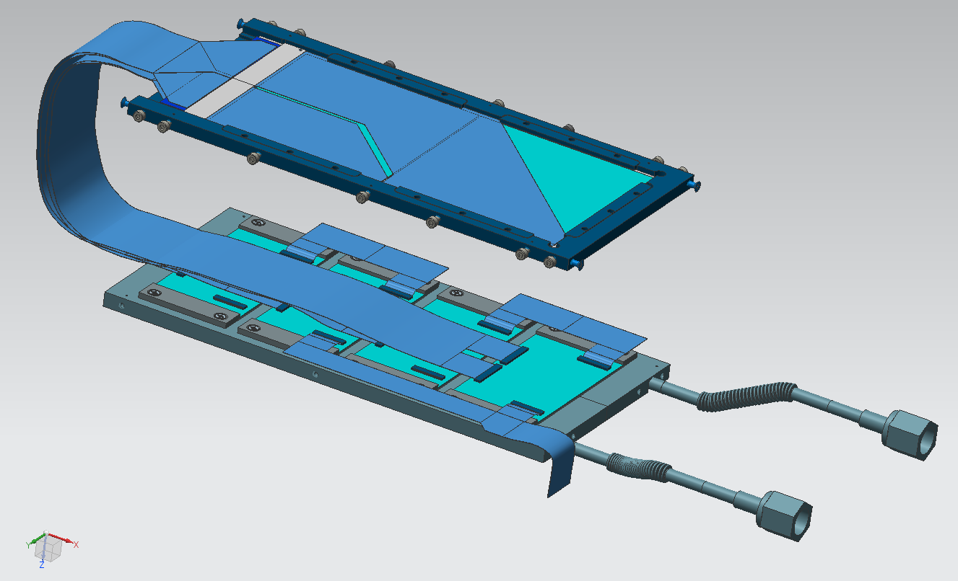
LAYER 1 + READ-OUT

Slide 8
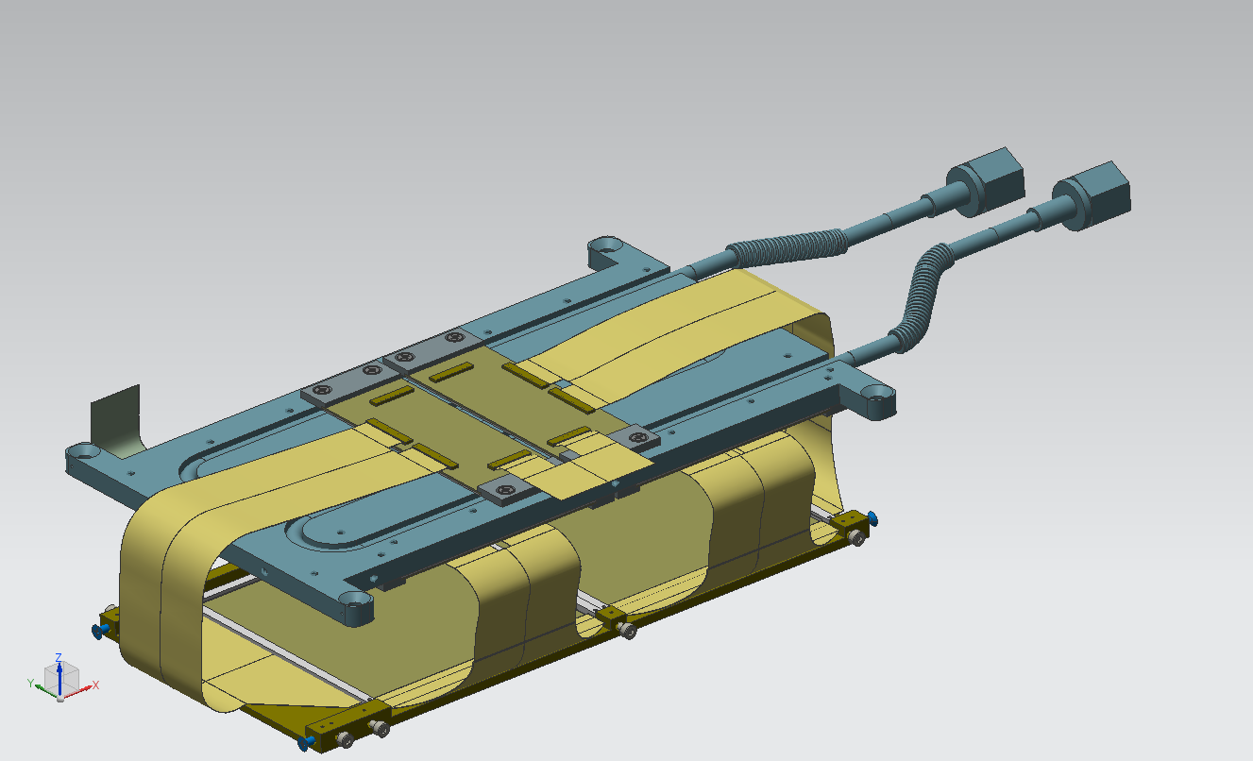
LAYER 2 + READ-OUT 1

Slide 9
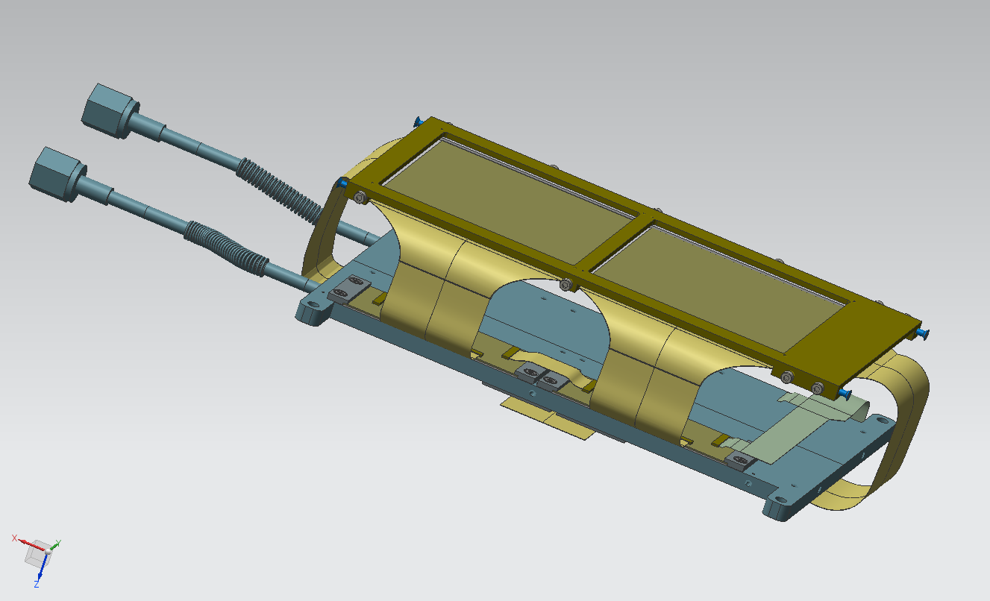
LAYER 2 + READ-OUT 2

Slide 10
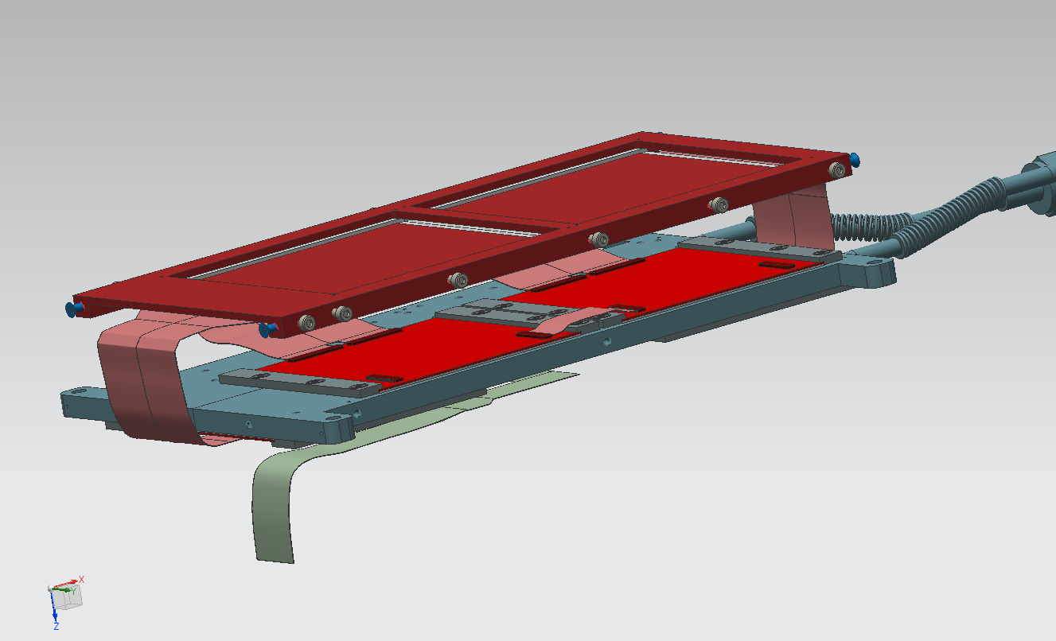
LAYER 3 + READ-OUT 1

Slide 11
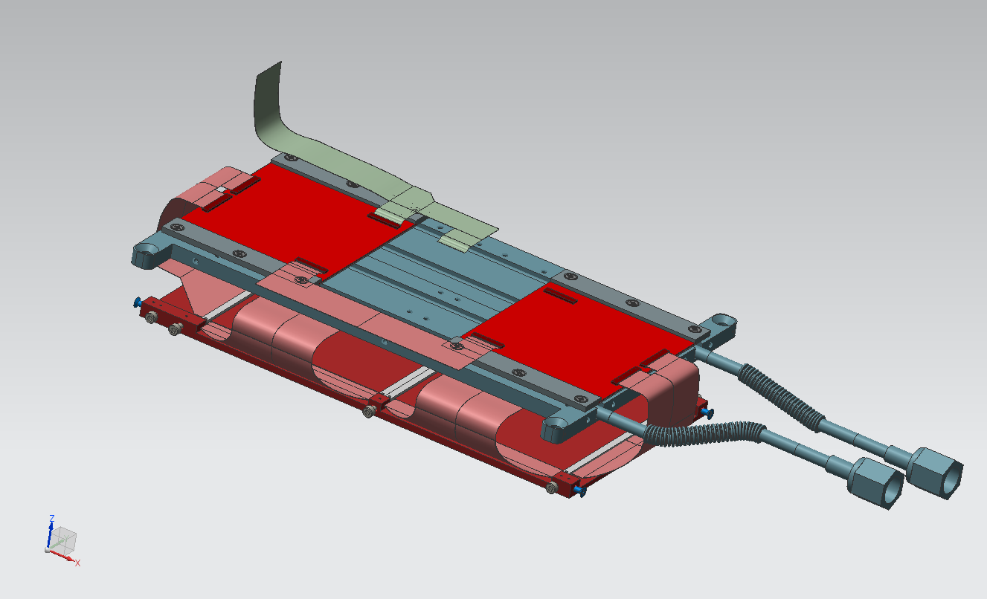
LAYER 3 + READ-OUT 2

Slide 12
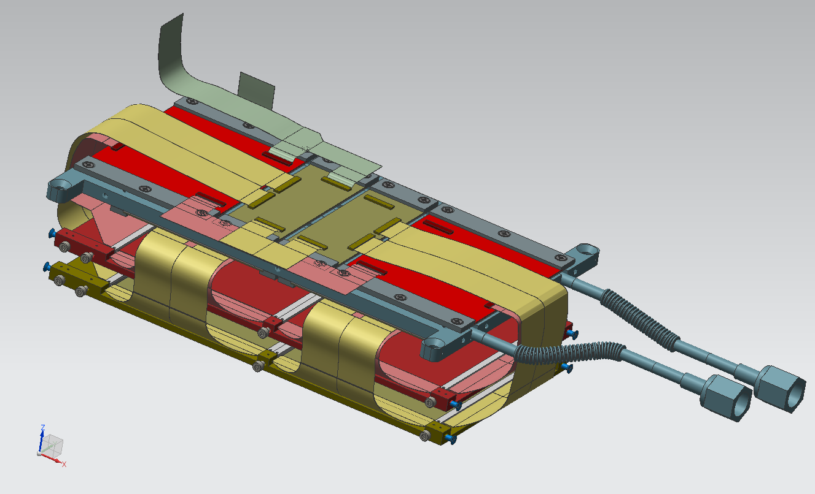
LAYER 2/3 + READ-OUT 2/3 - 1

Slide 13
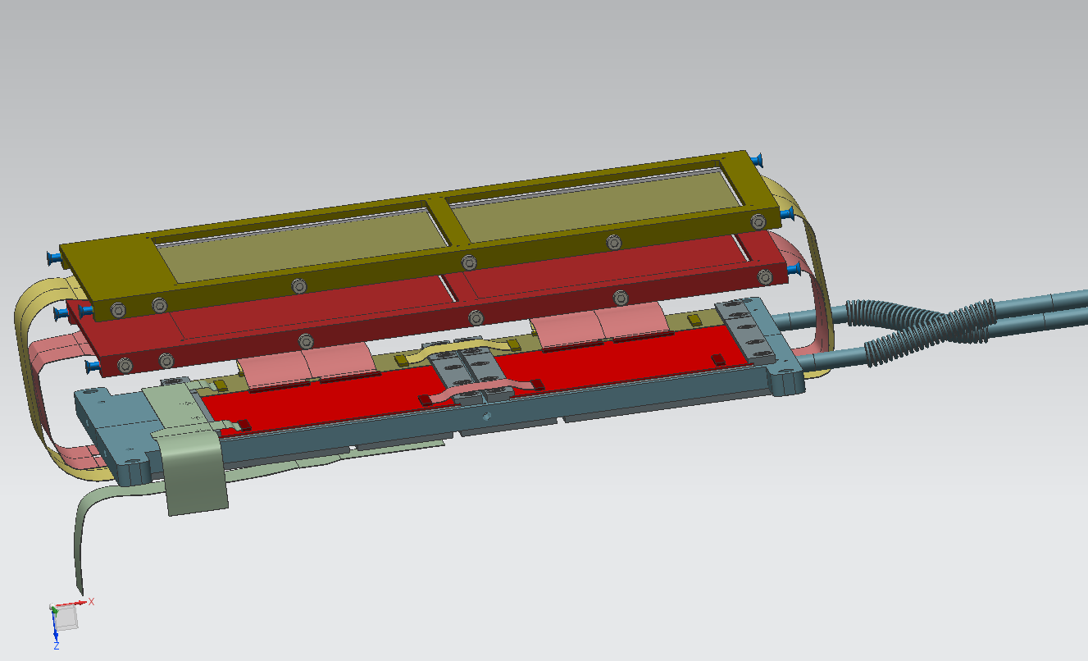
LAYER 2/3 + READ-OUT 2/3 - 2

