Slide 1
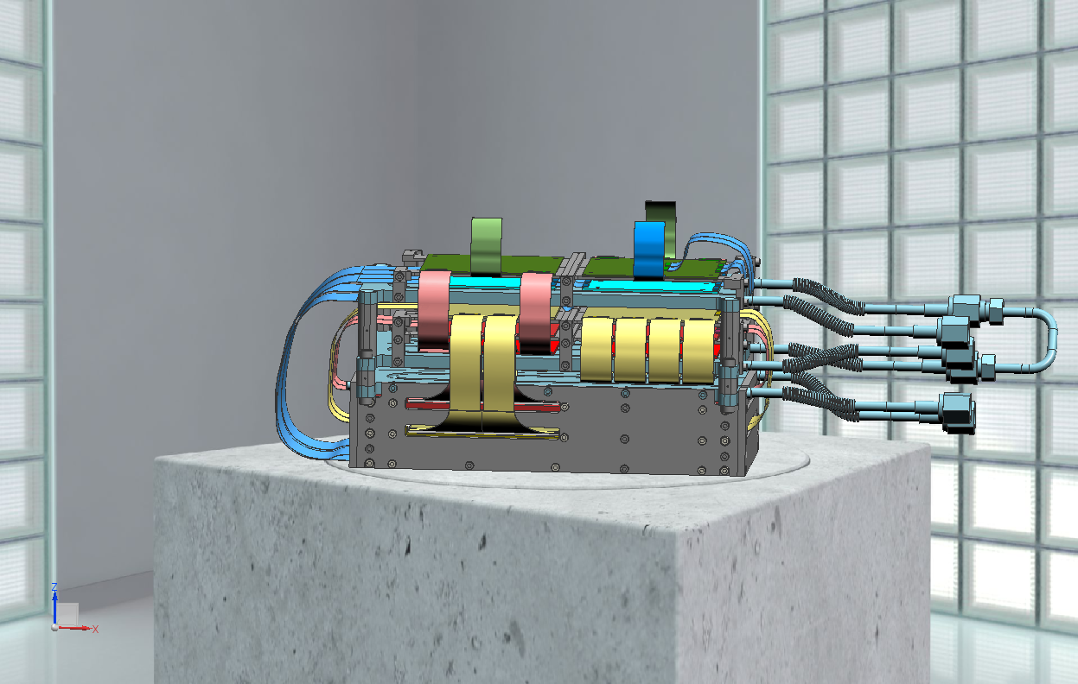
PAX DETECTOR
STATUS REPORT

Slide 2
DETECTOR QUADRANT DESIGN DEVELOPMENT
WORKING GROUP :
V. CARASSITI , P. LENISA , S. MERZLIAKOV , C. WEIDEMANN

Slide 3
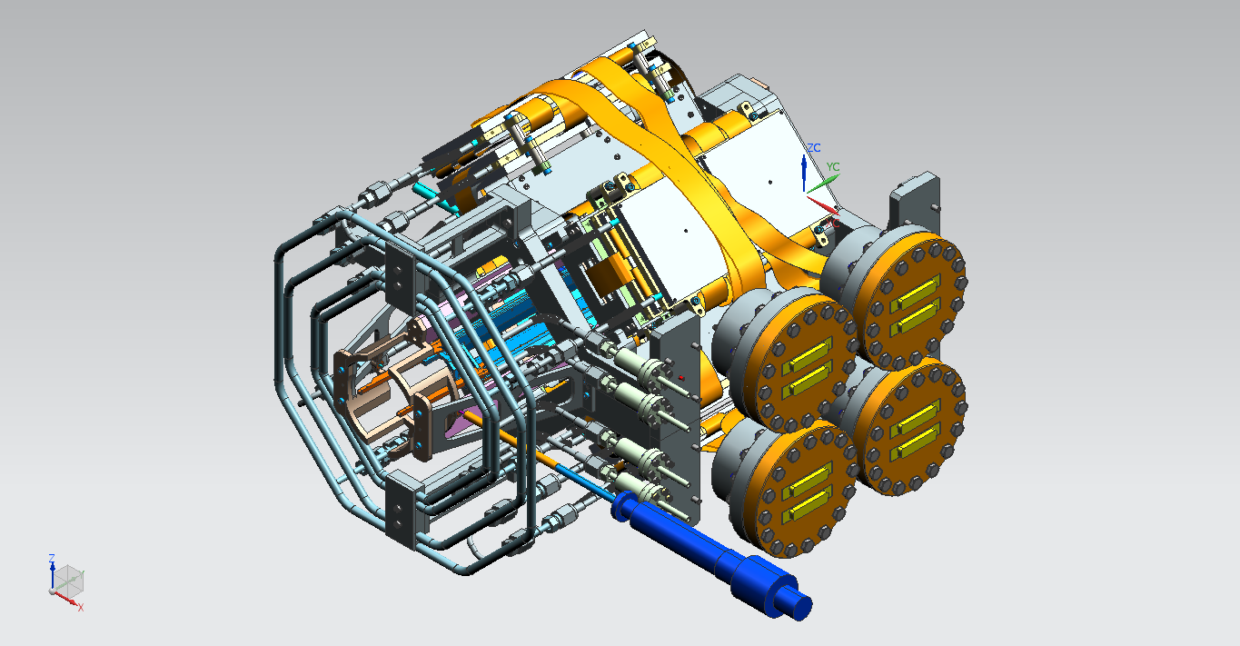
DETECTOR OVERALL VIEW
QUADRANT
TARGET CELL
SUPPORT
COOLING
FEED-THROUGH

Slide 4
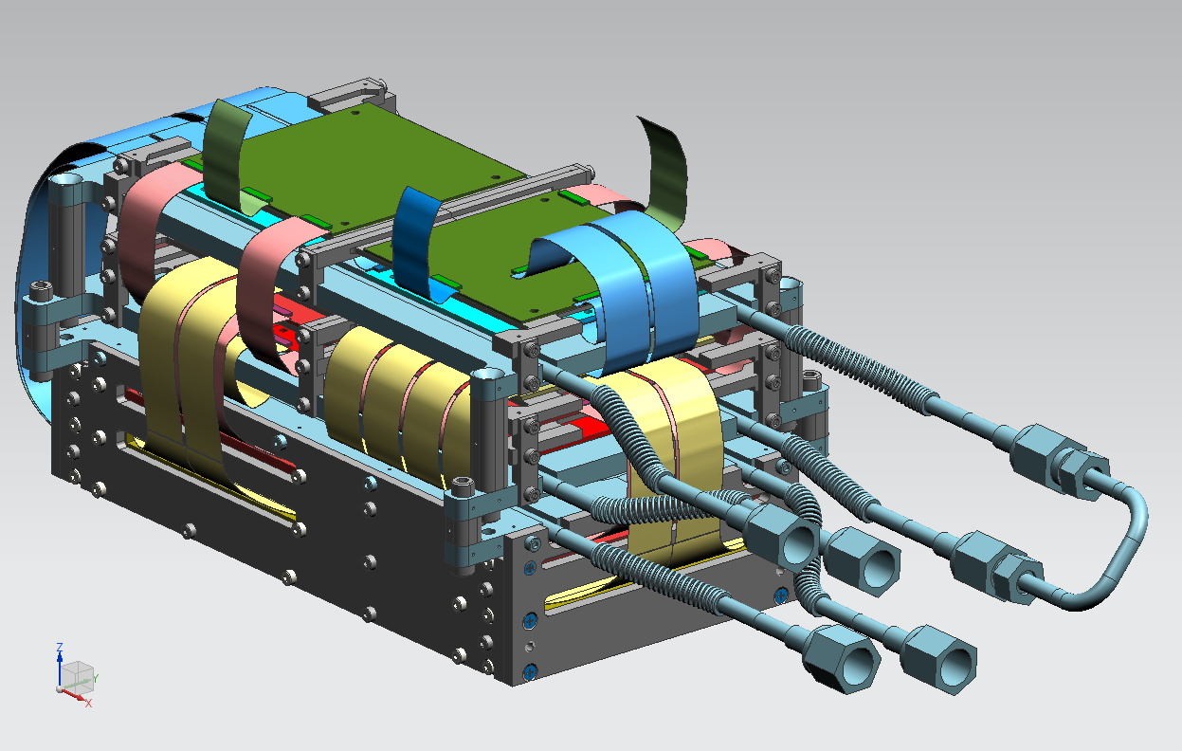
DETECTOR QUADRANT : OVERALL VIEW
READOUT ELECTRONICS
3 READOUT PLANS ( 4 PCB + 2 COUPLING BOARDS EACH LAYER
2 DISTRIBUTOR BOARDS
SENSORS
COOLING BOX INCLUDING
3 LAYERS ( 2 SENSORS EACH LAYER )

Slide 5
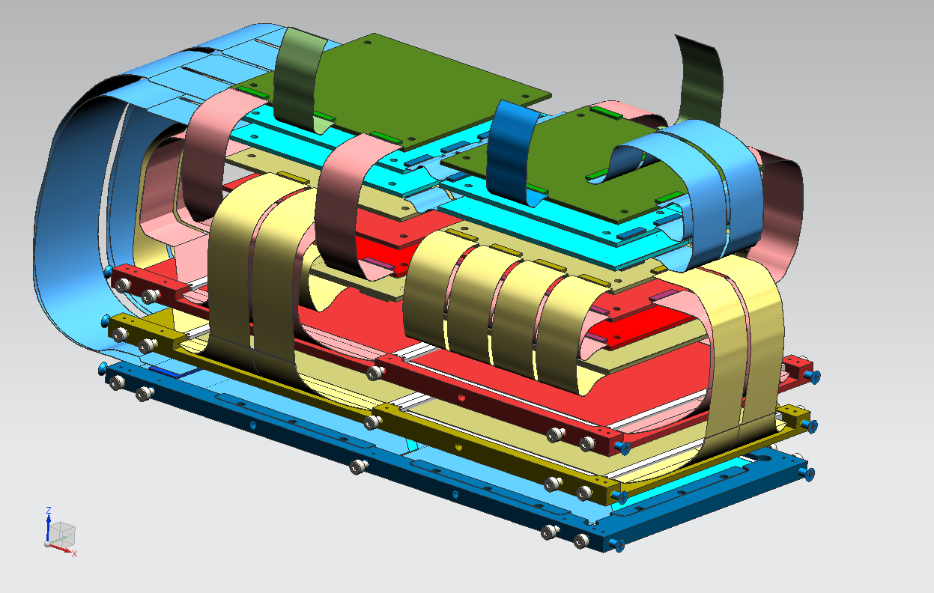
READOUT CONCEPT
DISTRIBUTOR BOARDS
READ-OUT LAYER 1
READ-OUT LAYER 2
SENSORS LAYER 3 : PAX
SENSORS LAYER 2 : PAX
SENSORS LAYER 1 : HERMES
READ-OUT LAYER 3

Slide 6
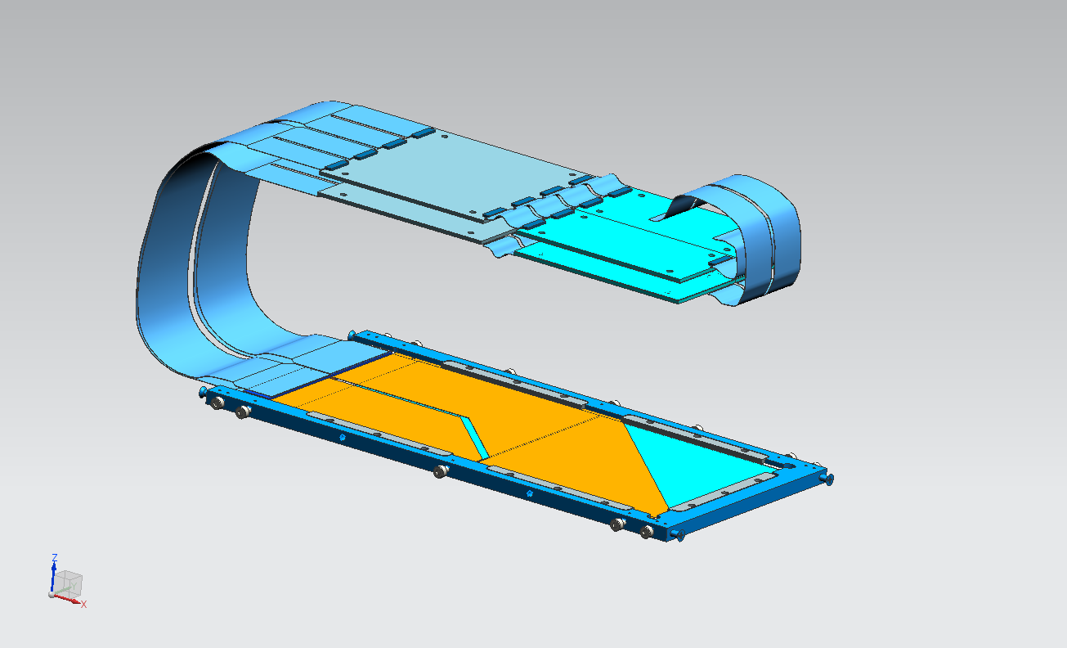
LAYER 1 SENSORS + READ-OUT
COUPLING BOARDS
READ-OUT BOARDS
TO DISTRIBUTOR BOARDS
HERMES SENSORS

Slide 7
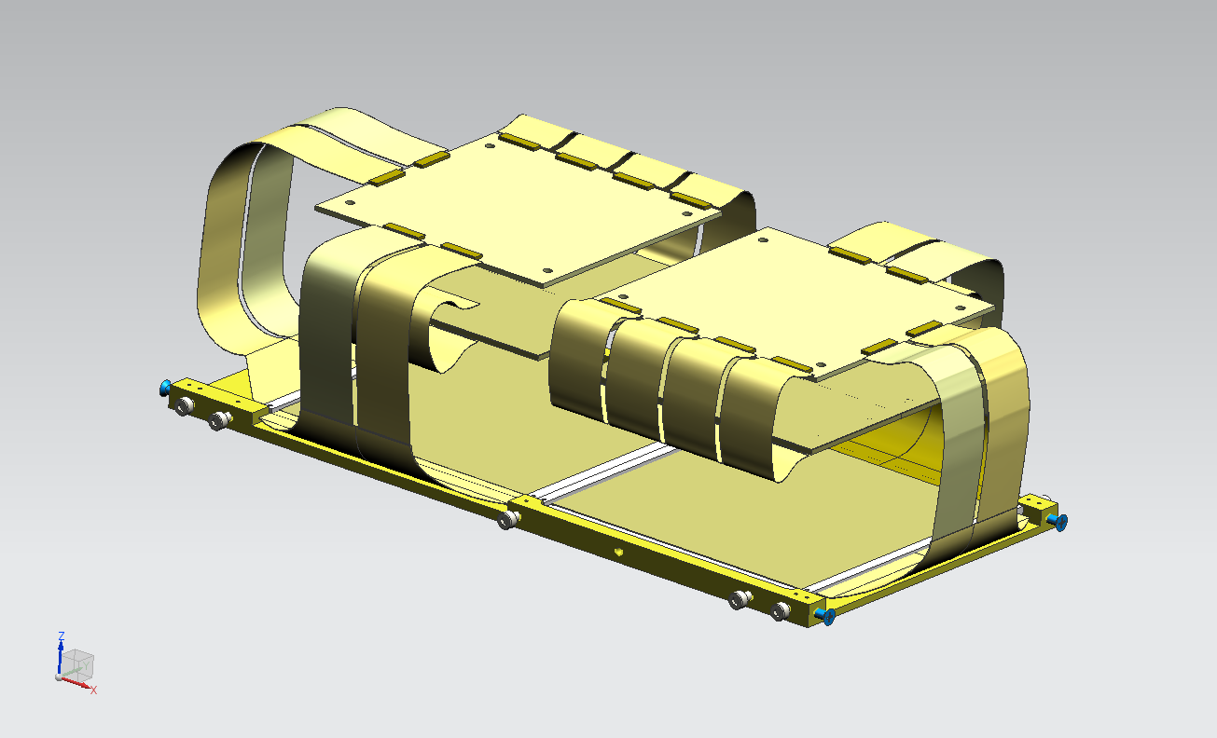
LAYER 2 SENSORS + READ-OUT
COUPLING BOARDS
READ-OUT BOARDS
TO L3 READ-OUT BOARDS
PAX SENSORS

Slide 8
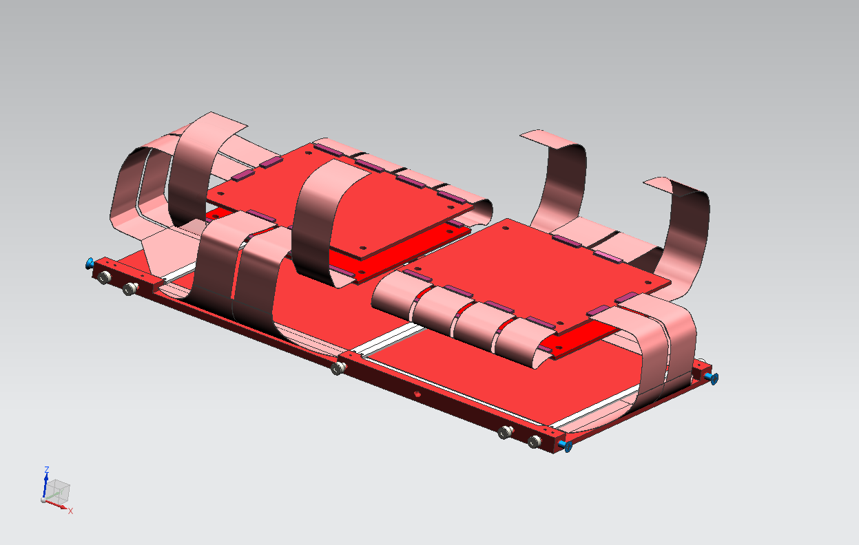
LAYER 3 SENSORS + READ-OUT
ALL THE CONNECTORS
MOVED FROM THE BOTTOM
TO THE TOP VIEW
COUPLING BOARDS
TO DISTRIBUTOR BOARDS
PAX SENSORS
READ-OUT BOARDS

Slide 9
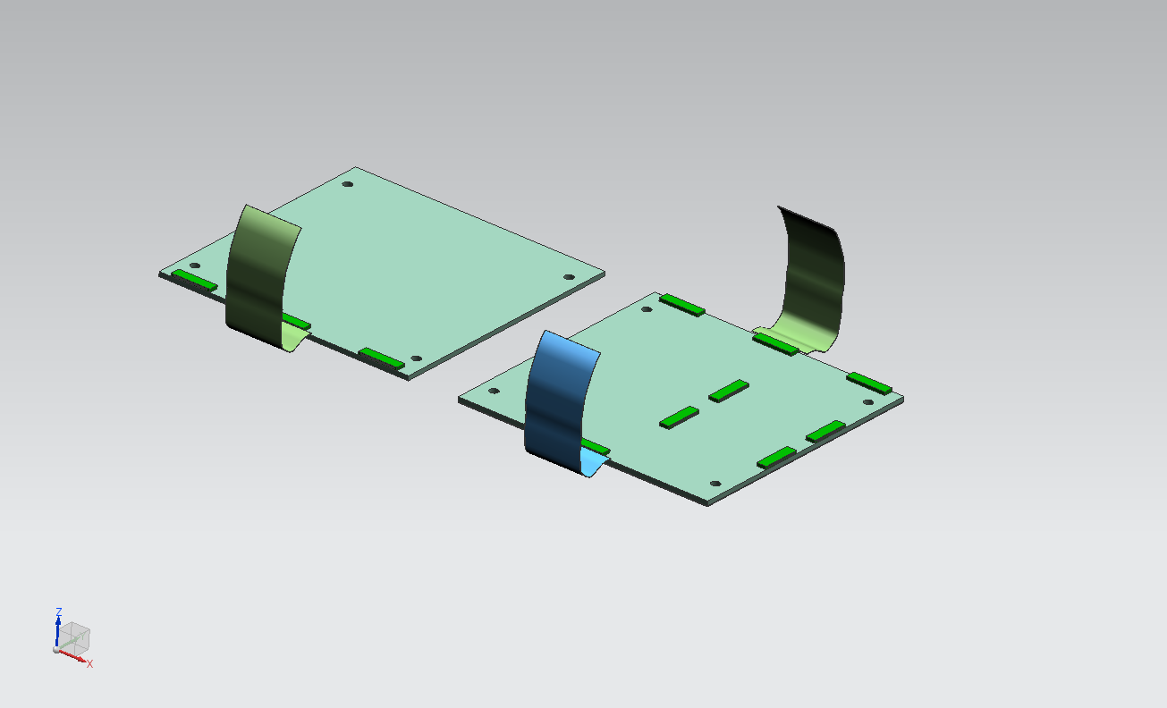
DISTRIBUTOR BOARDS
DISTRIBUTOR BOARDS
TO FEED THROUGHS

Slide 10
DETECTOR QUADRANT ASSEMBLY

Slide 11
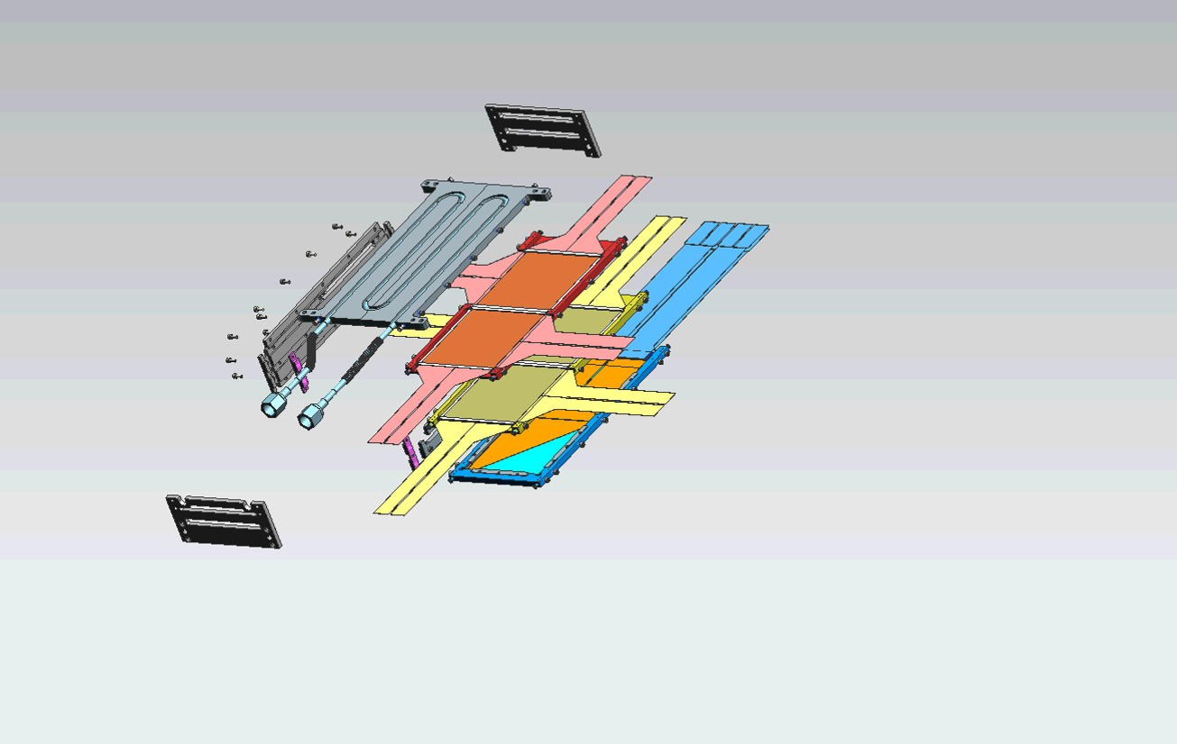
STEP1 – BOX & SENSORS ASSEMBLY

Slide 12
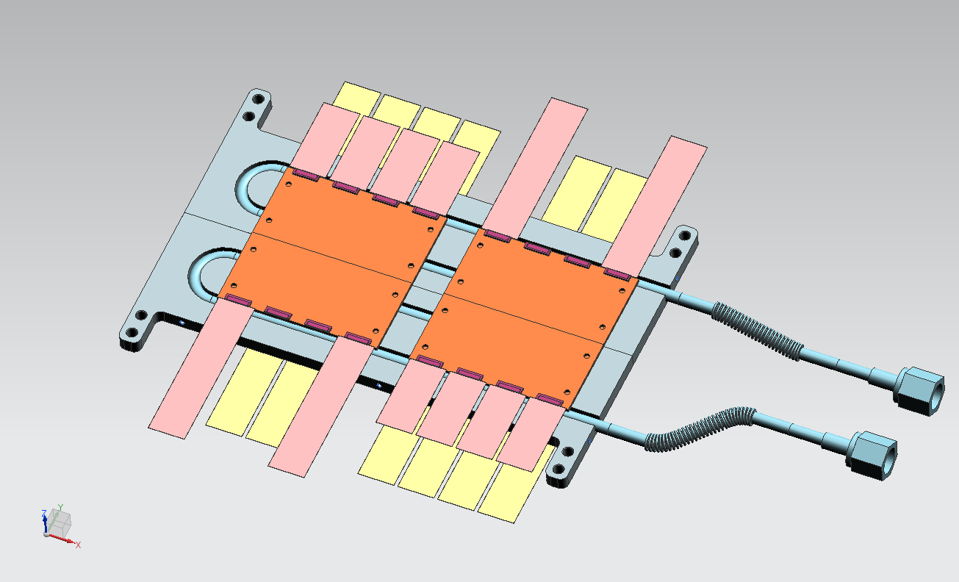
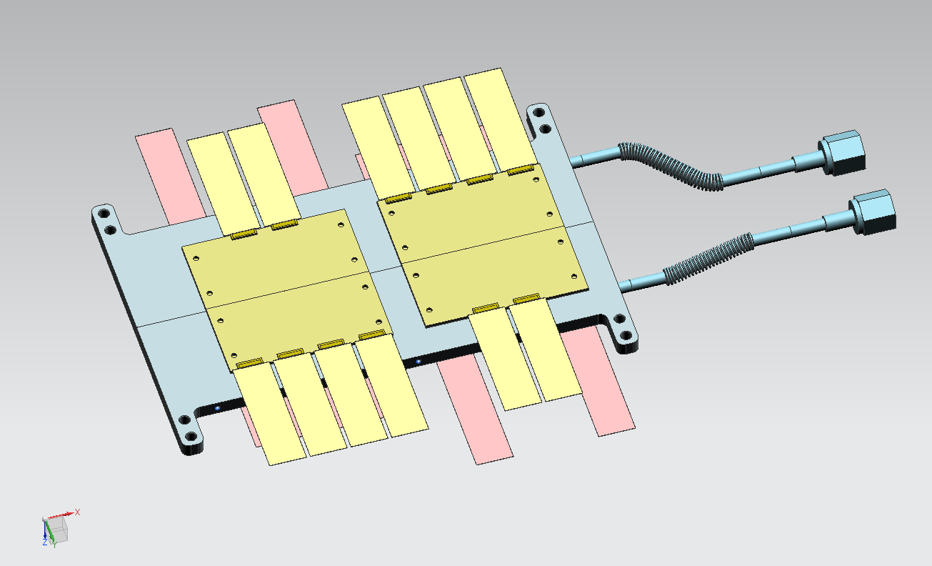
STEP2.0 – READOUT BOARDS L2 & L3 ASSEMBLY
L3 READOUT - TOP
L2 READOUT - BOTTOM
L2 –L3 COLD PLATE

Slide 13
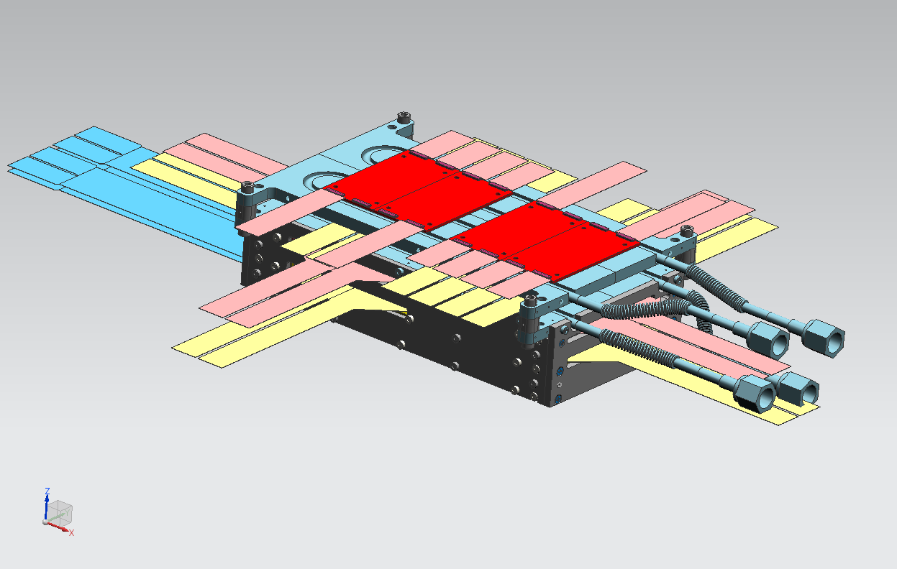
STEP2.1 – COLD PLATE + READOUT BOARDS L2 & L3 ASSEMBLY
L3 READOUT - TOP
L2 –L3 COLD PLATE
L2 READOUT - BOTTOM

Slide 14
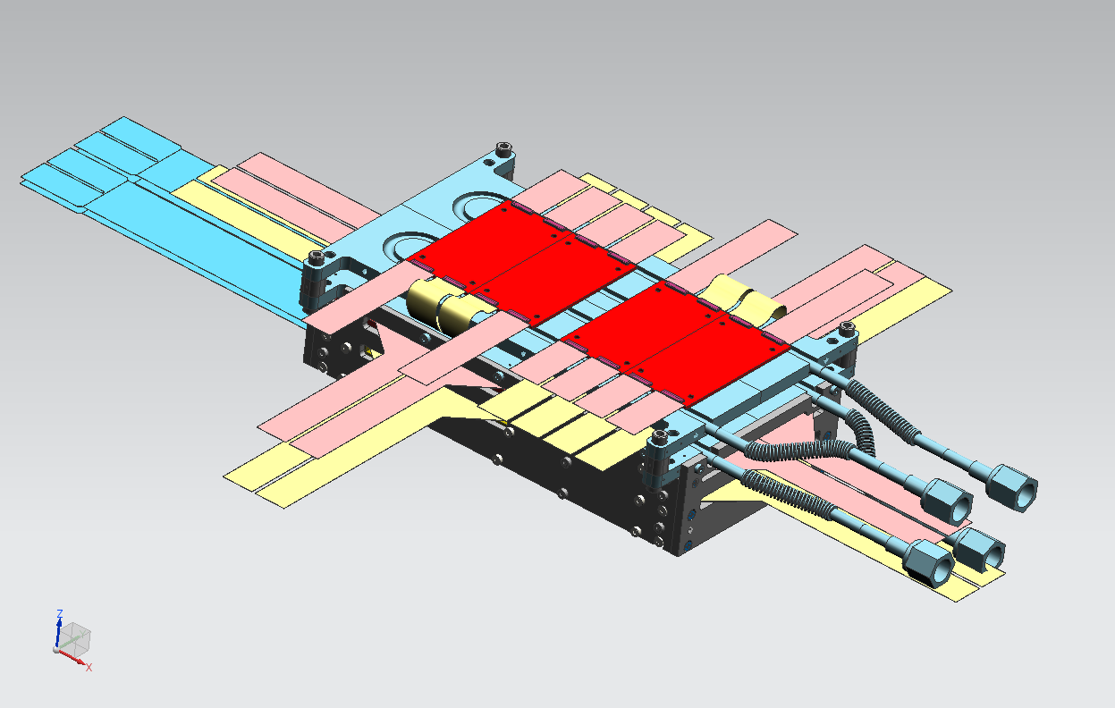
STEP2.2 – COLD PLATE + READOUT BOARDS L2 & L3 ASSEMBLY
CONNECTING L2-L3 READOUT BOARDS

Slide 15
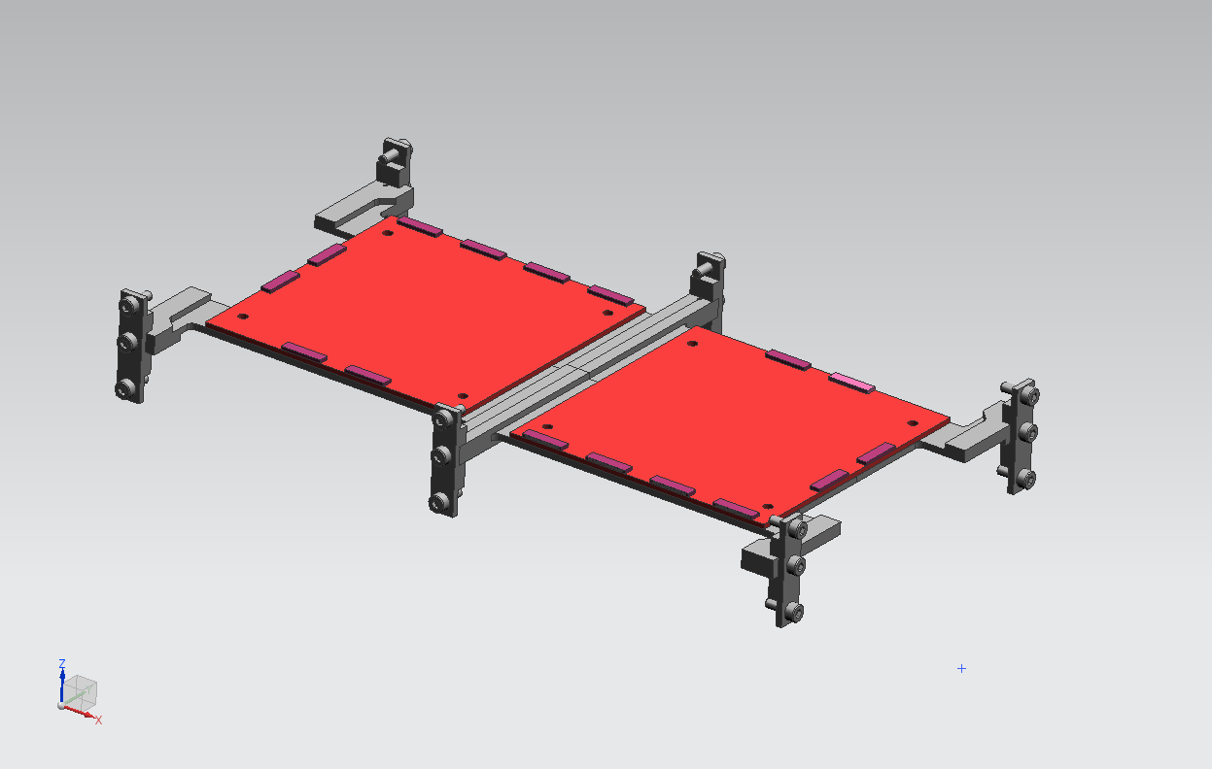
STEP3.0 – COUPLING BOARDS L3 ASSEMBLY
L3 COUPLING BOARDS
COUPLING SUPPORT FRAME

Slide 16
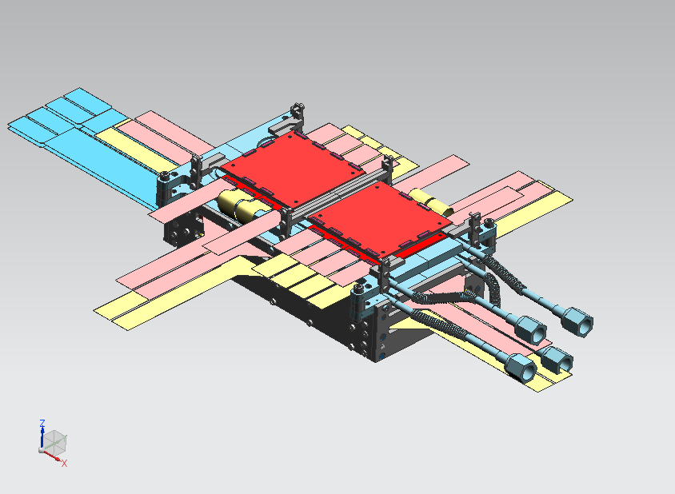
STEP3.1 – READOUT BOARDS L3 & COUPLING BOARDS L3 ASSEMBLY
L3 COUPLING SUPPORT FRAME
L3 COUPLING BOARD

Slide 17
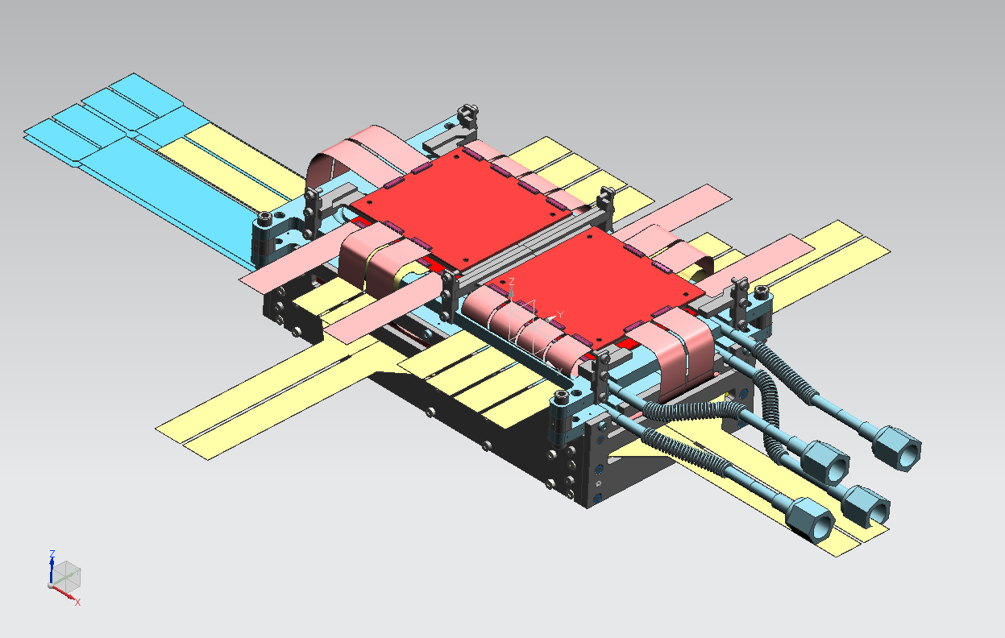
STEP3.2 – READOUT BOARDS L3 & COUPLING BOARDS L3 ASSEMBLY
CONNECTING THE L3 CABLES

Slide 18
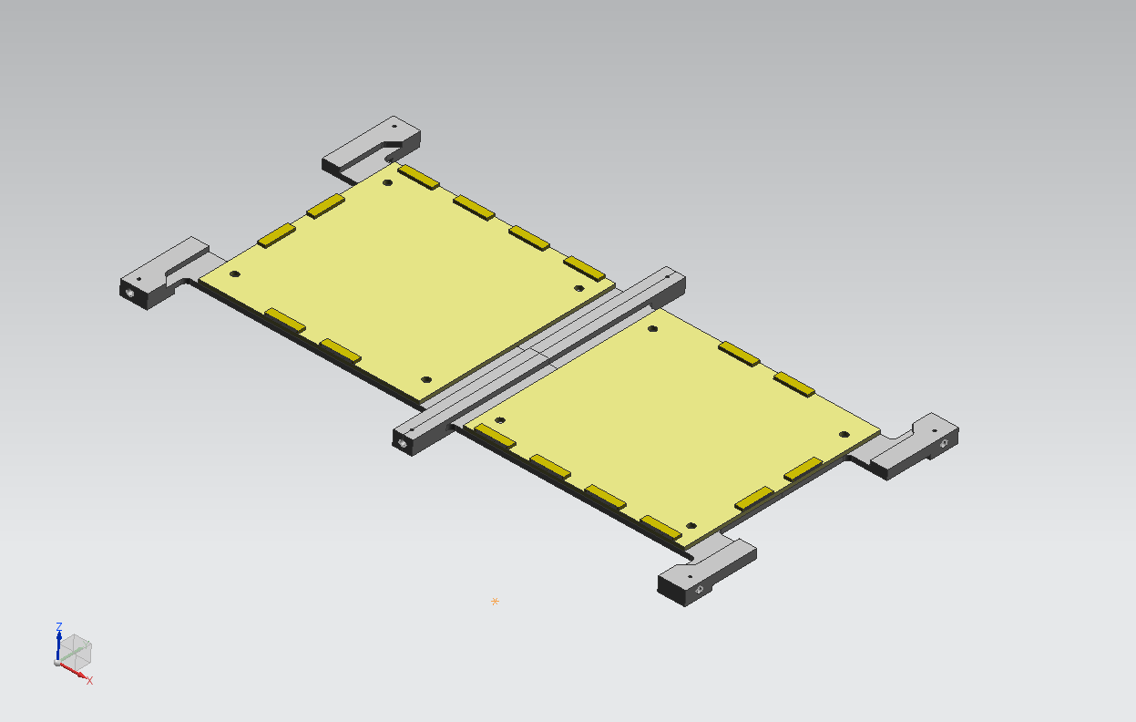
STEP4.0 – COUPLING BOARDS L2 ASSEMBLY
L2 COUPLING BOARDS
COUPLING SUPPORT FRAME

Slide 19
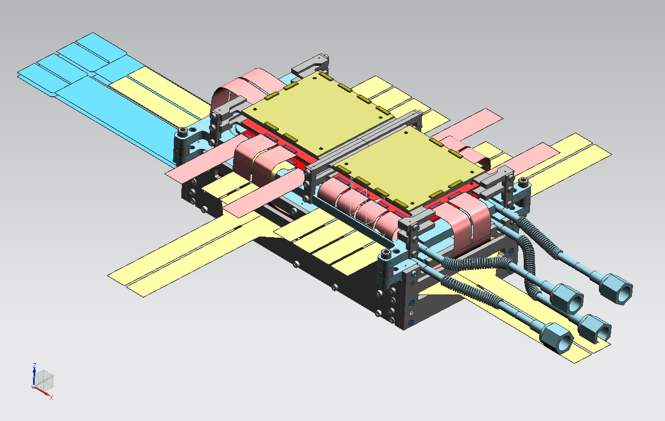
STEP4.1 – COUPLING BOARDS L2 ASSEMBLY
COUPLING SUPPORT FRAME
L2 COUPLING BOARDS

Slide 20
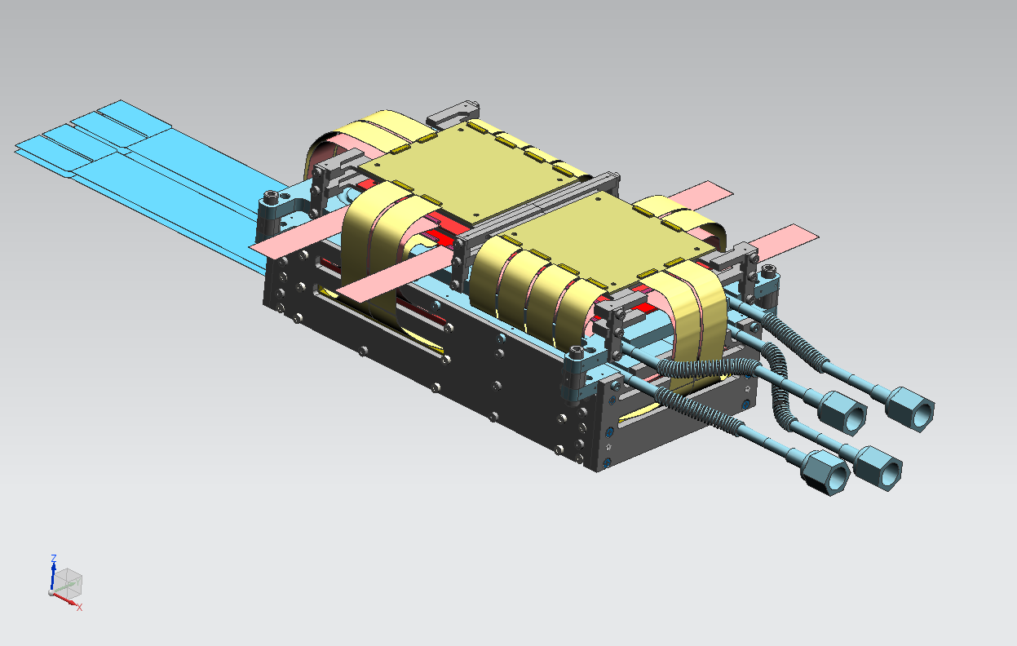
STEP4.2 – READOUT BOARDS L2 & COUPLING BOARDS L2 ASSEMBLY
CONNECTING THE L2 CABLES

Slide 21
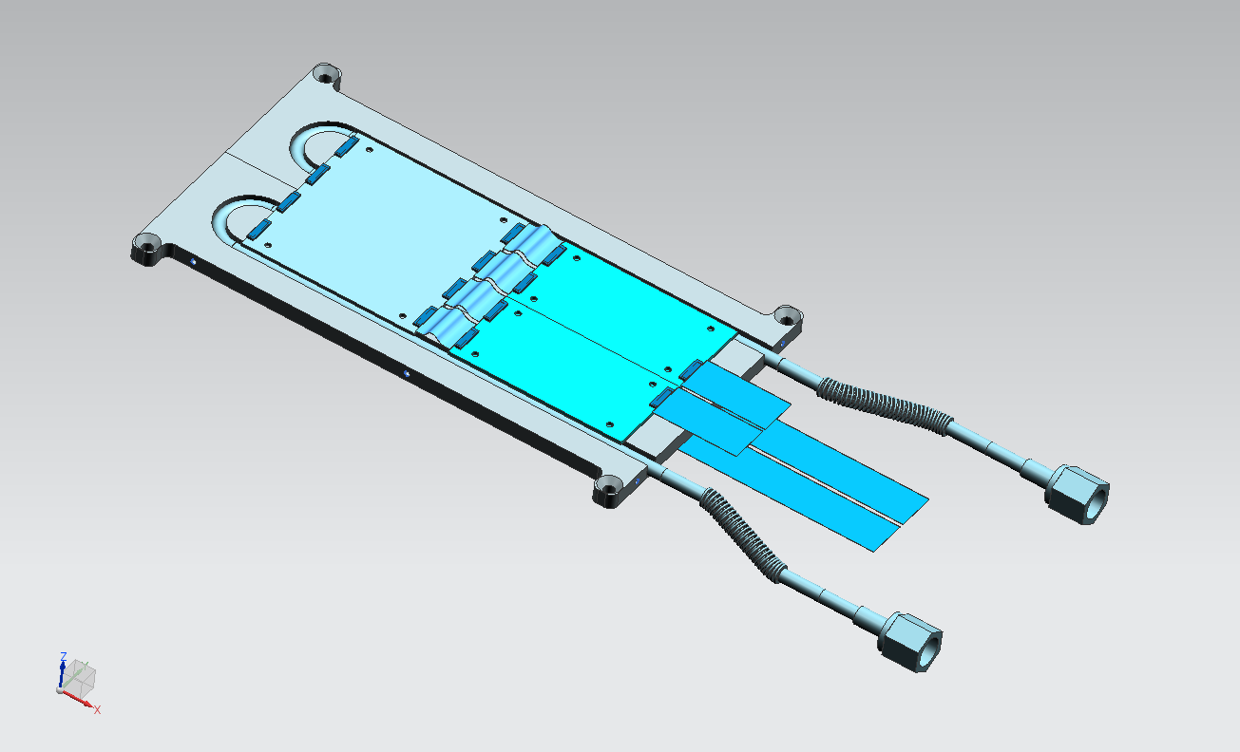
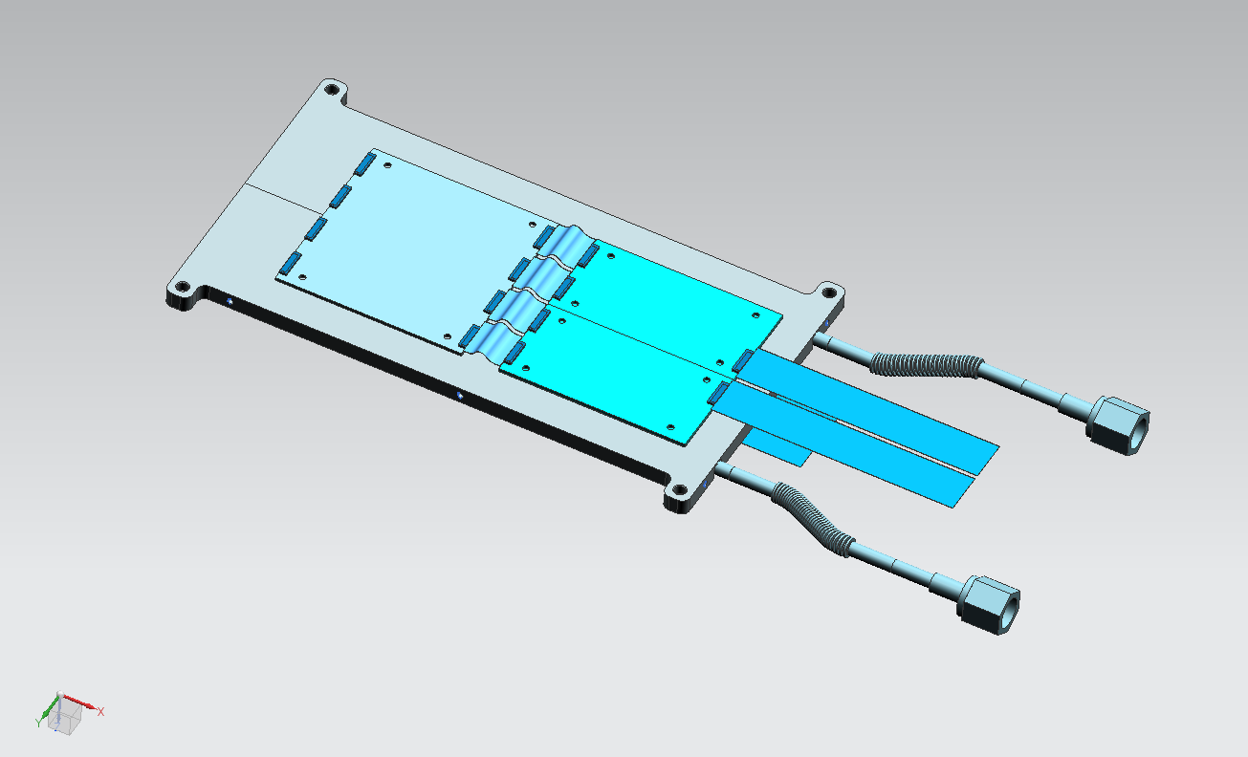
STEP5.0 – COUPLING BOARDS & READOUT BOARDS L1 ASSEMBLY
L1 COUPLING- TOP
L1 READOUT- TOP
FC4-L1 CABLES
FC3-L1 CABLES
L1 COUPLING- BOTTOM
L1 READOUT- BOTTOM
L1 COLD PLATE COUPLING & READOUT FRAME
FC5-L1 CABLES

Slide 22
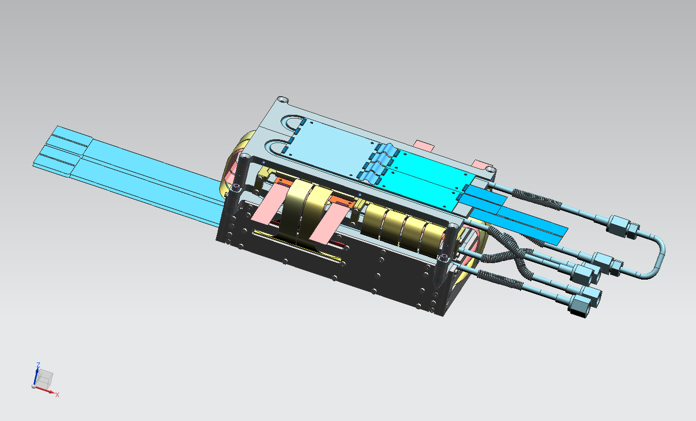
STEP5.1 – COUPLING BOARDS & READOUT BOARDS L1 IN PLACE
FC1-L1 & FC2-L1 CABLES

Slide 23
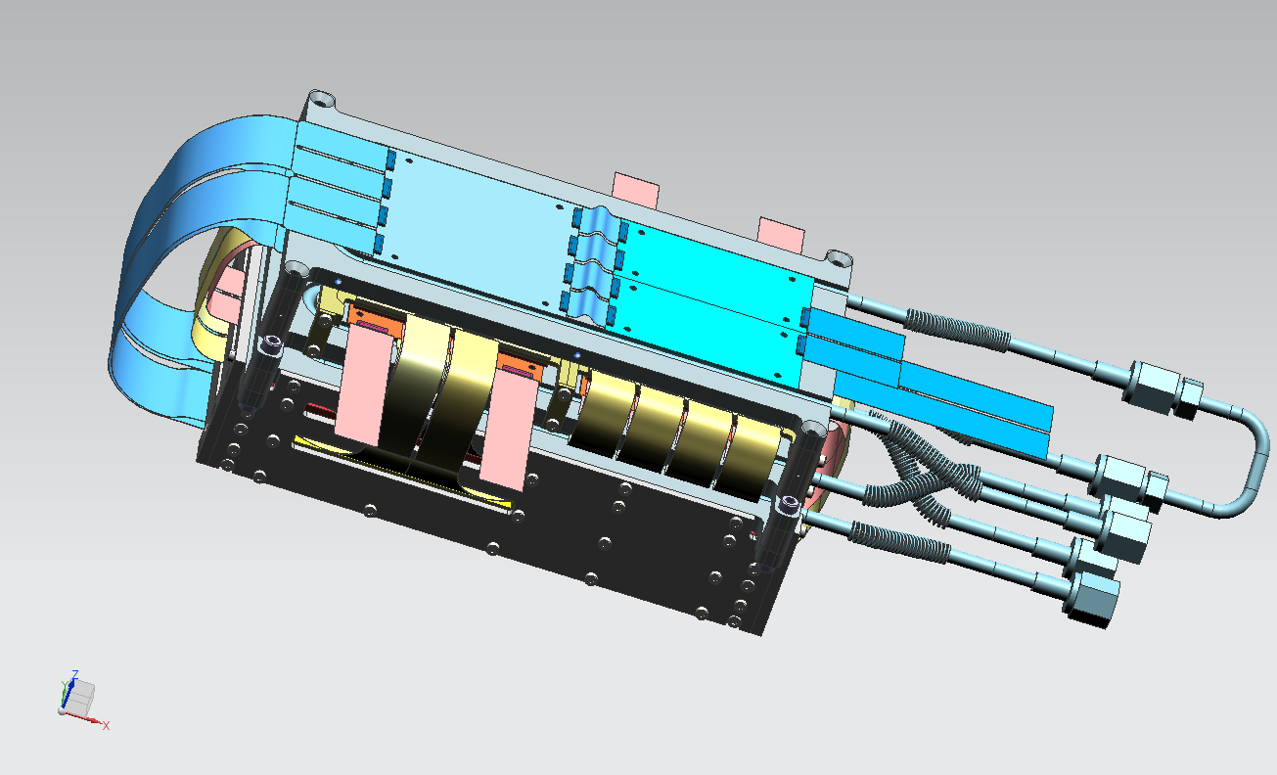
STEP5.2 – COUPLING BOARDS & READOUT BOARDS L1 ASSEMBLY
CONNECTING FC1-L1 & FC2-L1

Slide 24
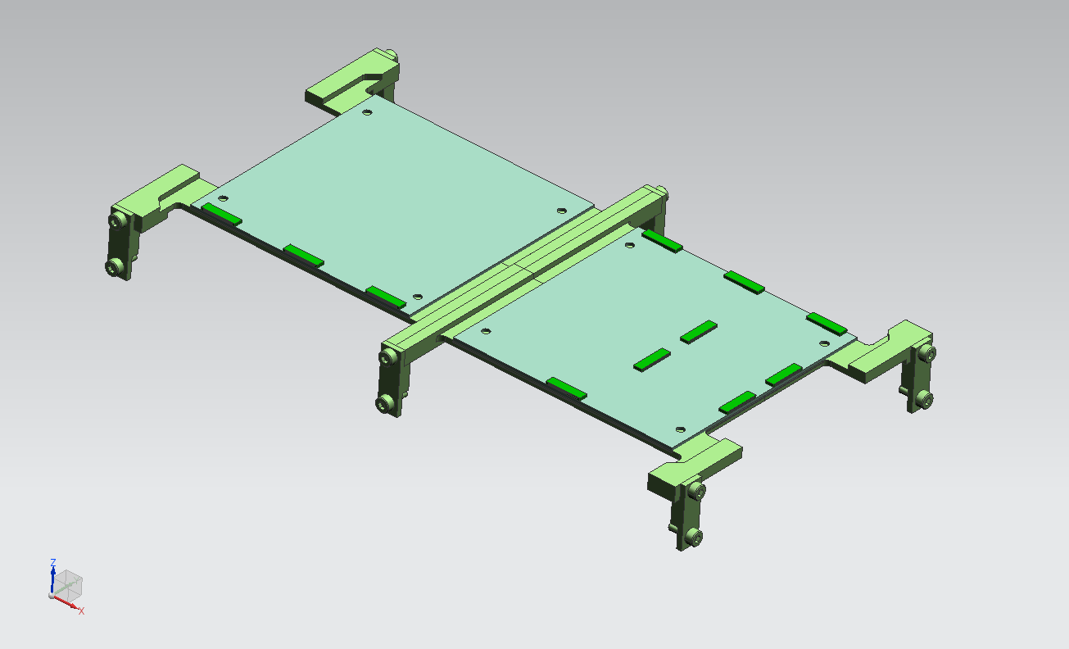
STEP6.0 – DISTRIBUTOR BOARDS ASSEMBLY
DISTRIBUTOR BOARDS
(ONLY ON THE TOP)
DISTRIBUTOR FRAME

Slide 25
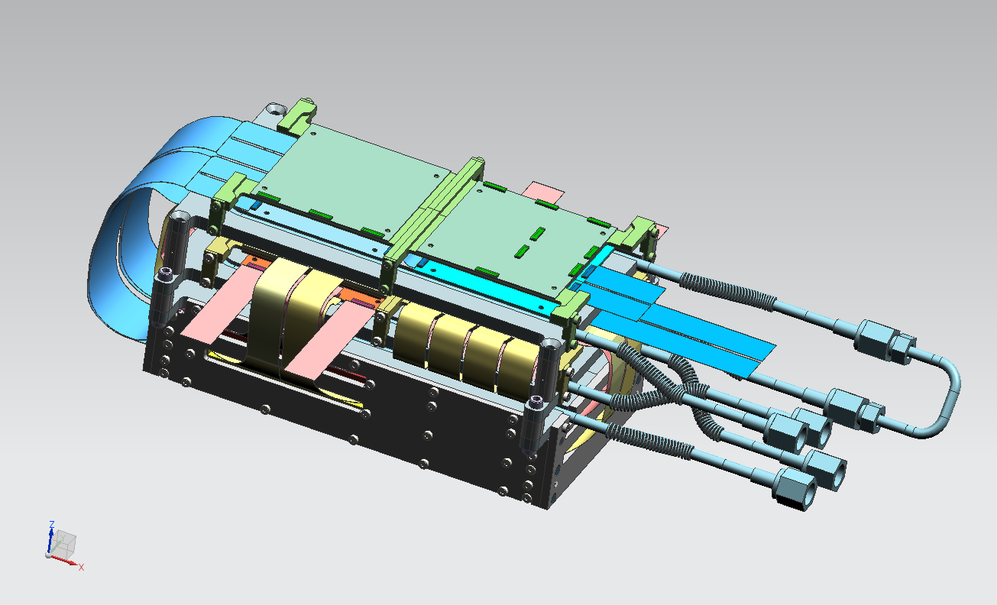
STEP6.1 – DISTRIBUTOR BOARDS IN PLACE

Slide 26
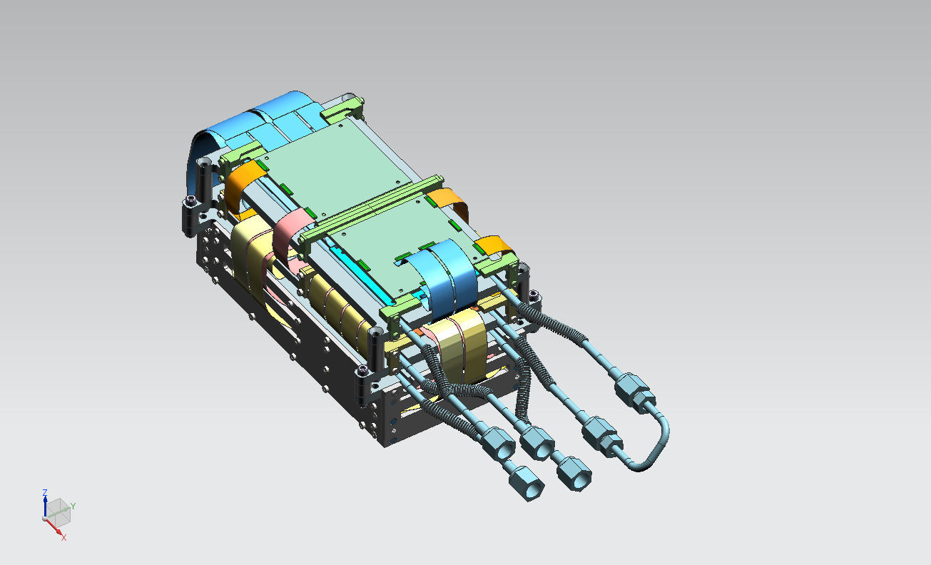
STEP6.2 – DISTRIBUTOR BOARDS ASSEMBLY
CONNECTING THE FC3-L3 CABLES
CONNECTING THE FC4-L1 & FC5-L1 CABLES

Slide 27
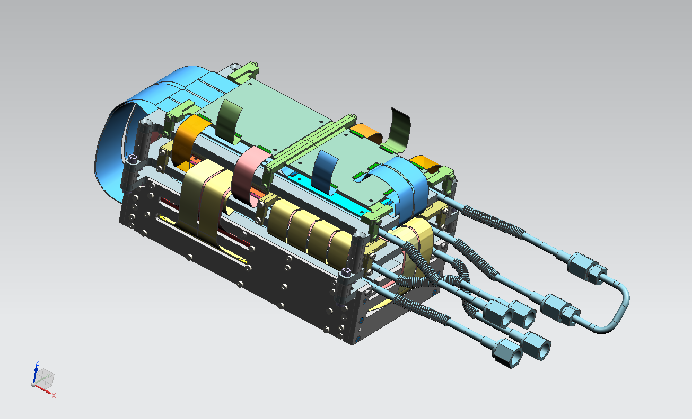
STEP6.3 – DISTRIBUTOR BOARDS ASSEMBLY
CONNECTING THE FEED-THROUGH CABLES

Slide 28
NEAR FUTURE PLANS
MODULE COMMISSIONING (FERRARA)
  COOLING TEST (COLD PLATES AND COOLING BOX PROTOTYPE)
  FATIGUE TEST CHECKING THE ABSENCE OF LEAKS COMING FROM THE TEMPERATURE CYCLES
  TEST CHECKING THE STABILITY AGAINST THE VIBRATIONS WITHIN THE RANGE OF THE COOLING FLOW RATE

