Slide 1
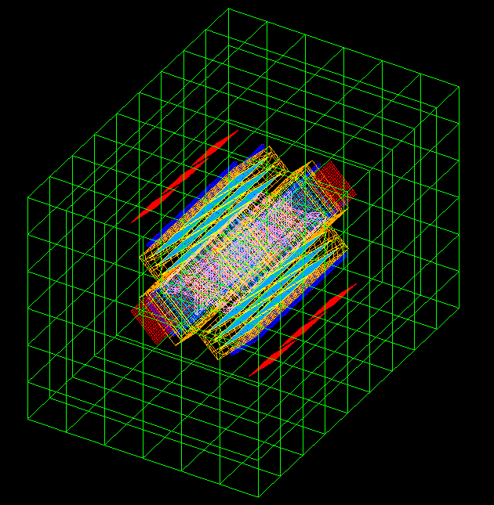
PAX DETECTOR
THERMAL SIMULATION

Slide 2
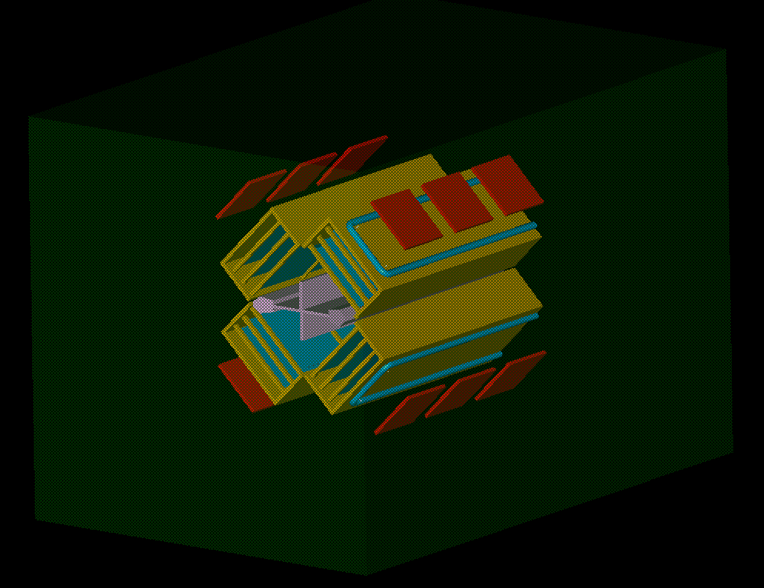
PAX DETECTOR
FEM* ASSEMBLY LAYOUT
ELECTRONIC SUPPORT
COOLING TUBE
TARGET CELL
COOLING PLATE
HEAT FLUX
SILICON SUPPORT
SILICON DETECTOR
VACUUM CHAMBER
* FEM = Finite Element Modeler

Slide 3
MATERIALS
PARTS MATERIALS
PART | MATERIAL
SILICON DETECTOR | SILICON
TARGET CELL | ALUMINUM
SILICON SUPPORT | ALUMINUM
ELECTRONIC SUPPORT | ALUMINUM
VACUUM CHAMBER | STAINLESS STEEL
MATERIAL PROPERTIES
MATERIAL | DENSITY (Kg/m^3) | THERMAL CONDUCTIVITY (W/mK) | EMISSIVITY (*) | SPECIFIC HEAT (J/KgK)
ALUMINUM | 2700 | 237 | 0.09 | 900
STAINLESS STEEL | 7960 | 16,3 | 0,16 | 502
SILICON | 2340 | 115 | 0,9 | 703
(*)
From the Engineering Toolbox (www.engineeringtoolbox.com)

Slide 4
THE ANALISYS
THE FOLLOWING ANALISYS HAVE BEEN PERFORMED :
RADIATION ANALISYS
SIMULATION EVALUATING THE AMOUNT OF HEAT LOAD COMING FROM RADIATION
TEMPERATURE ANALISYS
SIMULATION EVALUATING THE DETECTOR’S TEMPERATURE DISTRIBUTION COMING FROM ELECTRONIC POWER AND RADIATION

Slide 5

RADIATION ANALISYS
SILICON SUPPORT SET AT CONSTANT TEMPERATURE
ELCTRONIC POWER SWITCHED OFF
VACUUM CHAMBER SET AT CONSTANT TEMPERATURE
CONSTANT TEMPERATURE
SILICON SUPPORT
VACUUM CHAMBER

Slide 6
RADIATION ANALYSIS BOUNDARY CONDITIONS
FEM RADIATION ANALYSIS BCs
 | SILICON DETECTOR | SILICON SUPPORT | COOLING TUBE | TARGET CELL | ELECTRONIC & SUPPORT | VACUUM CHAMBER
RADIATIVE THERMAL COUPLINGS | TO ALL PARTS | TO ALL PARTS |  | TO ALL PARTS |  | TO ALL PARTS
CONDUCTIVE THERMAL COUPLINGS | TO SILICON SUPPORT
CONSTANT TEMPERATURES (C°) |  | -20 |  |  |  | 20 ; 40 ; 60
HEAT LOAD (W) |  |  |  |  | SWITCHED OFF
ADDITIONAL INFORMATIONS
§ - SHADOWING CHECKS BETWEEN PARTS PERMORMED

Slide 7
RADIATION ANALYSIS RESULTS
BOUNDARY CONDITIONS
 | SILICON SUPPORT SURFACES CONSTANT TEMP (C°) | VACUUM CHAMBER WALLS CONSTANT TEMP (C°)
1° Analysis | -20 | 20
2° Analysis | -20 | 40
3° Analysis | -20 | 60
RADIATION ANALYSIS RESULTS
PART | 1° ANALYSIS |  | 2° ANALYSIS |  | 3° ANALYSIS
 | AVERAGE TEMP (C°) | POWER (W) | AVERAGE TEMP (C°) | POWER (W) | AVERAGE TEMP (C°) | POWER (W)
SILICON DETECTOR | -18,3 | -22,47 | -17,6 | -21,81 | -16,7 | -21,00
SILICON SUPPORT |  | 63,68 |  | 91,27 |  | 124,7
TARGET CELL | -17 | -0,104 | -15,5 | -0.096 | -13,5 | -0.085
VACUUM CHAMBER |  | -41,10 |  | -69,37 |  | -103,6

Slide 8
TEMPERATURE ANALISYS
COOLING TUBE WALL SET AT CONSTANT TEMPERATURE
ELCTRONIC POWER SWITCHED ON
COOLING TUBE
ELECTRONIC POWER

Slide 9
TEMPERATURE ANALYSIS BOUNDARY CONDITIONS
FEM TEMPERATURE ANALYSIS BCs
 | SILICON DETECTOR | SILICON SUPPORT | COOLING TUBE | TARGET CELL | ELECTRONIC & SUPPORT | VACUUM CHAMBER
RADIATIVE THERMAL COUPLINGS | TO ALL PARTS | TO ALL PARTS |  | TO ALL PARTS | VACUUM CHAMBER & SILICON SUPPORT | TO ALL PARTS
CONDUCTIVE THERMAL COUPLINGS | TO SILICON SUPPORT |  | TO SILICON SUPPORT
CONSTANT TEMPERATURES (C°) |  |  | -20
HEAT LOAD (W) |  |  |  |  | 85
ADDITIONAL INFORMATIONS
§ - SHADOWING CHECKS BETWEEN PARTS PERMORMED
§ - ENVIRONMENT TEMPERATURE = 25 C°

Slide 10
TEMPERATURE ANALYSIS RESULTS
BOUNDARY CONDITIONS
ENVIRONMENT TEMPERATURE = 25 C°
COOLING TUBE WALL TEMP (C°) | ELECTRONIC HEAT LOAD (W)
-20 | 85
ANALYSIS RESULTS
PART | TEMPERATURE (C°) |  | POWER (W)
 | Tmin | Tmax
SILICON DETECTOR | -19,5 | -12,8 | -32,4
SILICON SUPPORT | -20 | -16,6 | -4
TARGET CELL | -11,9 | -11,7 | -1,5
COOLING TUBE WALL | -20 | -20 | 117,2
ELECTRONIC |  |  | -85,00
VACUUM CHAMBER | 28 | 31 | 5,7

Slide 11
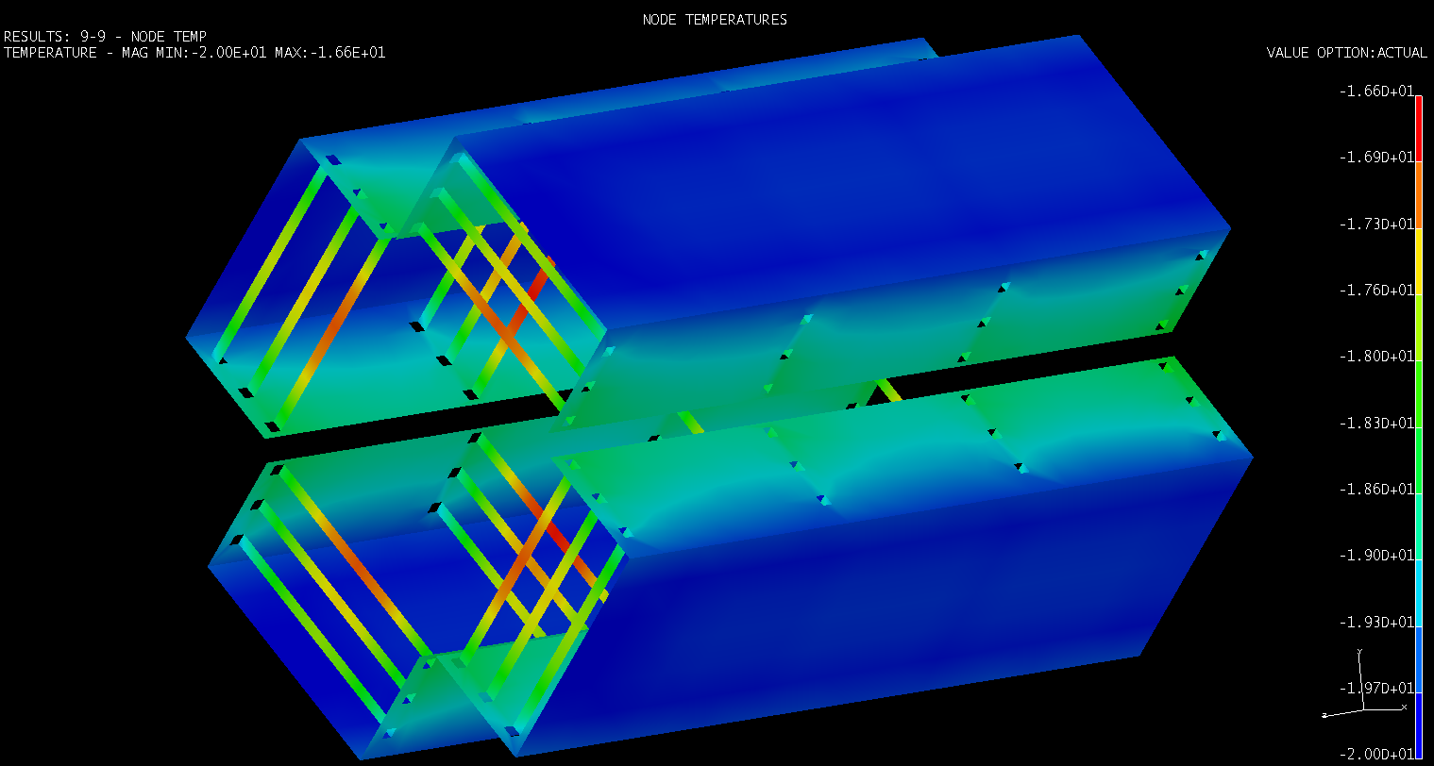
SILICON SUPPORT – TEMPERATURE DISTRIBUTION
Tmin = -20 C° ; Tmax = -16,6 C°

Slide 12
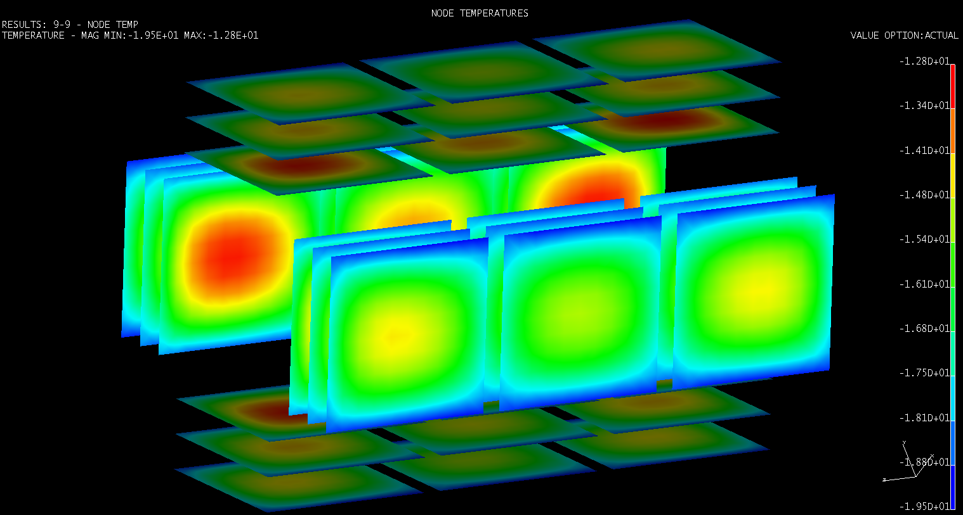
SILICON DETECTOR – TEMPERATURE DISTRIBUTION
Tmin = -19,5 C° ; Tmax = -12,8 C°

Slide 13
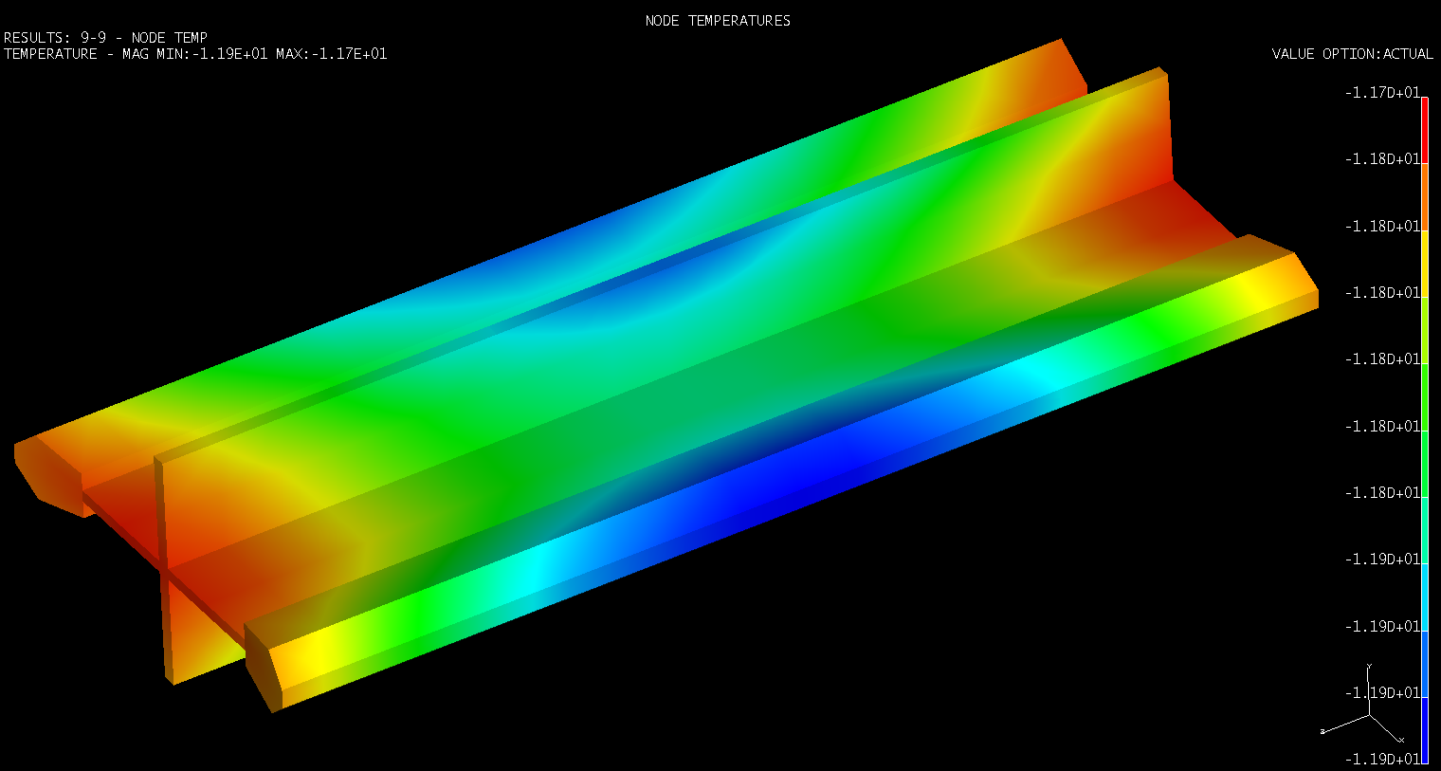
TARGET CELL – TEMPERATURE DISTRIBUTION
Tmin = -11,9 C° ; Tmax = -11,7 C°

Slide 14
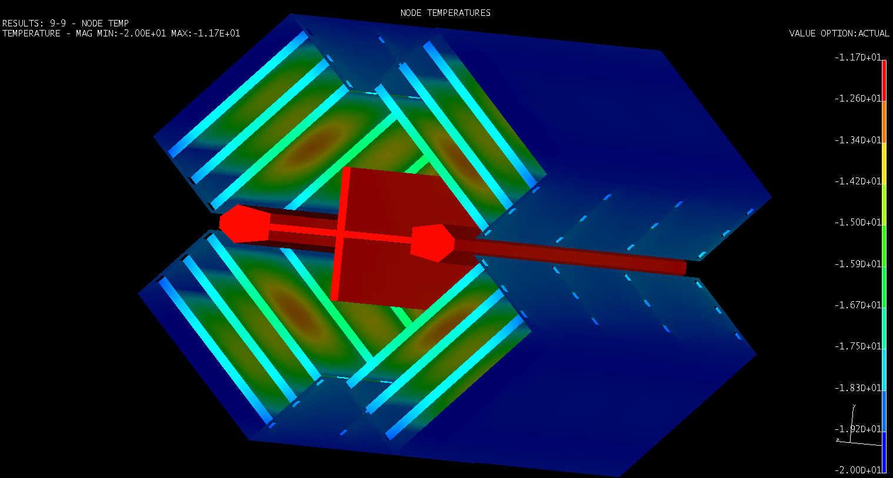
DETECTOR ASSEMBLY – TEMPERATURE DISTRIBUTION

Slide 15
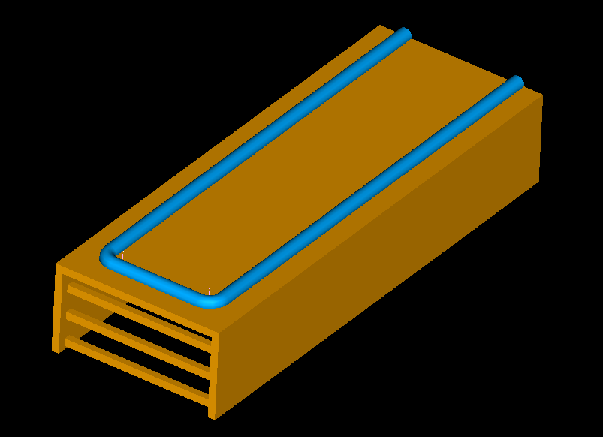
COOLING DESIGN
TOTAL COOLING POWER (4/4)

Slide 16
COOLING DESIGN
COOLING FLUID TEMPERATURE VS CONVECTION COEFFICIENT
COOLING FLUID & CONVECTION COEFFICIENT SELECTION
COOLING FLUID : ETHANOL ALCOHOOL |  | °C | W/m^2C°
Boiling point |  | 78,5
Freezing point |  | -114
Convection coefficient | α |  | 170
Delivery temperature | Td | -41
Wall temperature | Tw | -20
Fluid temperature | Tf = (Td + Tw)/2 | -30,5
ETHANOL PROPERTIES @ Tf and atmospheric pressure
Density (Kg/m^3) | ρ | 832
Specific heat (J/KgK) | Cp | 2215
Thermal conductivity (W/mK) | λ | 0,13
Kinematic viscosity (m^2/s) | ν | 3,23E-06
Kinematic viscosity @ Tw (m^2/s) | νw | 2,88E-06

Slide 17
COOLING DESIGN
FLOW SPEED, FLOW RATE AND PRESSURE LOSS

Slide 18
CONCLUSIONS
A THERMAL ANALISYS INVESTIGATING THE RADIATION EFFECTS ON THE SILICON DETECTOR HAS BEEN DONE.
A SUPPLEMENTARY ANALISYS CONSIDERING BOTH THE ELECTRONIC POWER AND THE RADIATION HAS BEEN ALSO SIMULATED.
AN IMPROVEMENT OF THE ANALISYS RESULTS CAN BE ACHIEVED , GIVEN THE FOLLOWING INFORMATIONS :
AVERAGE WORKING TEMPERATURE OF THE SILICON DETECTOR
VALUE OF THE ELECTRONIC POWER

