Slide 1
LHCb SMOG2 UPGRADE
UNPOLARIZED STORAGE CELL
MECHANICAL DESIGN AND INSTALLATION PROCEDURE

Slide 2
ALLOWED SPACE INSIDE THE VELO VESSEL
RF FOIL
192
200
WAKE FIELD SUPPRESSOR
STORAGE CELL
EXISTING FLANGE
DETECTOR BOX

Slide 3
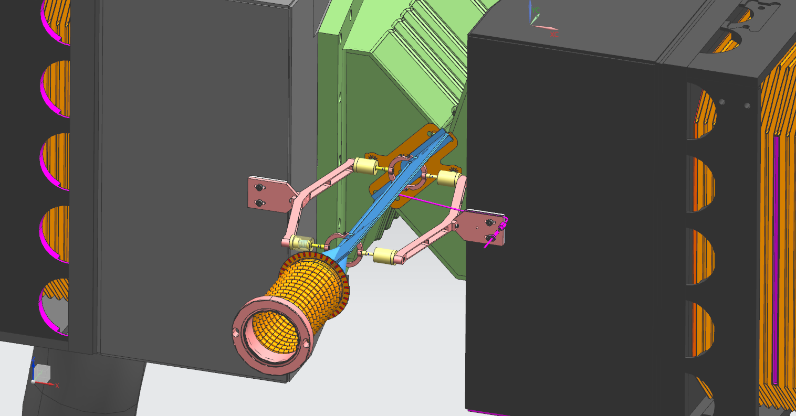
UNPOL STORAGE CELL : CLOSED POSITION VIEW
ELECTRICAL CONNECTION
STORAGE CELL
UNPOL GAS FEED
WAKE FIELD SUPPRESSOR
RF FOIL
DETECTOR BOX

Slide 4
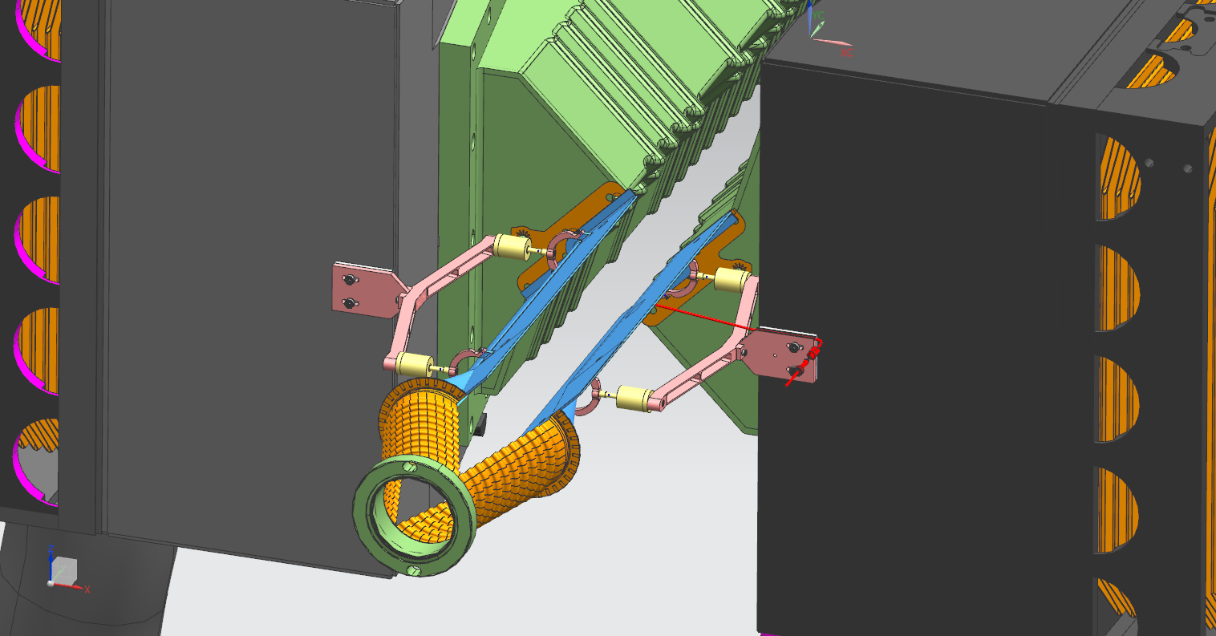
UNPOL STORAGE CELL : OPEN POSITION VIEW
ELECTRICAL CONNECTION
STORAGE CELL
UNPOL GAS FEED
WAKE FIELD SUPPRESSOR
RF FOIL
DETECTOR BOX

Slide 5
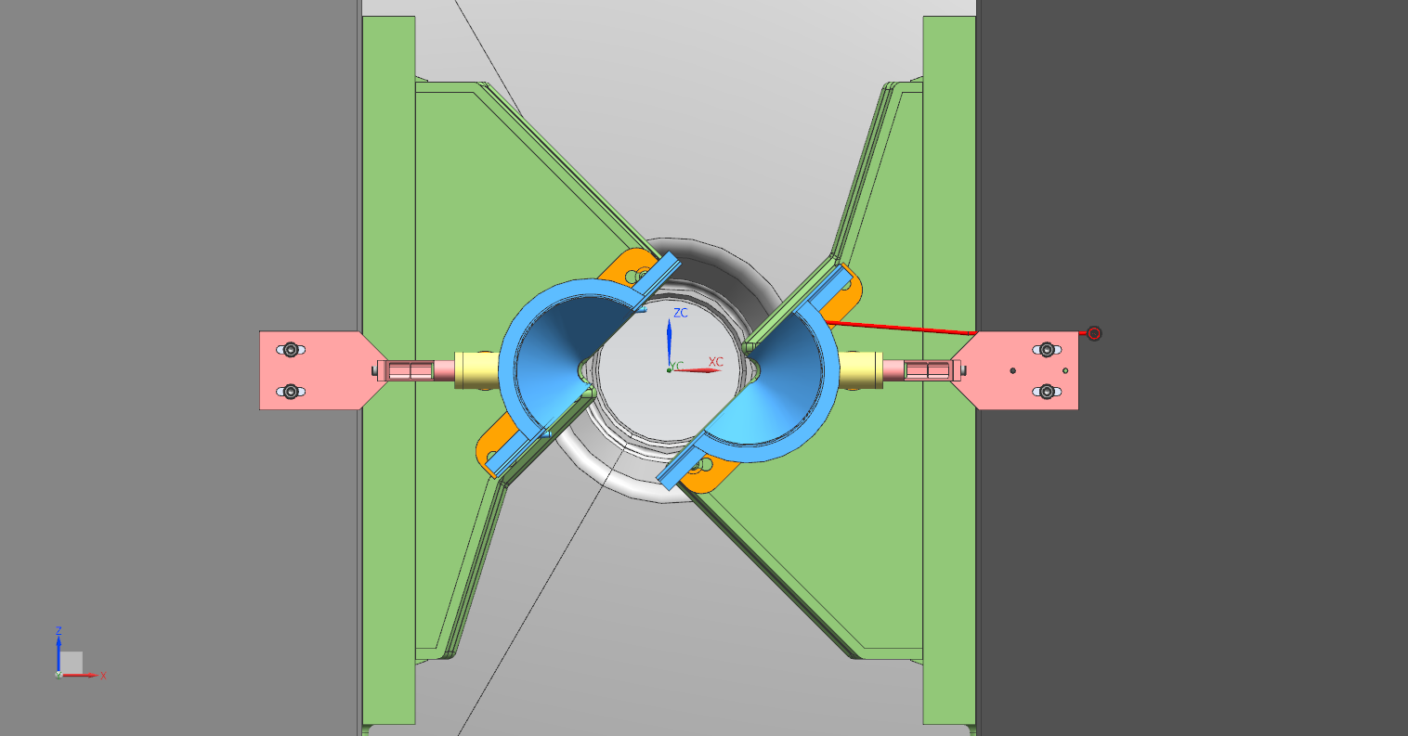
UNPOL STORAGE CELL OPEN : FRONT VIEW
STORAGE CELL
30 mm
30 mm
RF FOIL
DETECTOR BOX

Slide 6
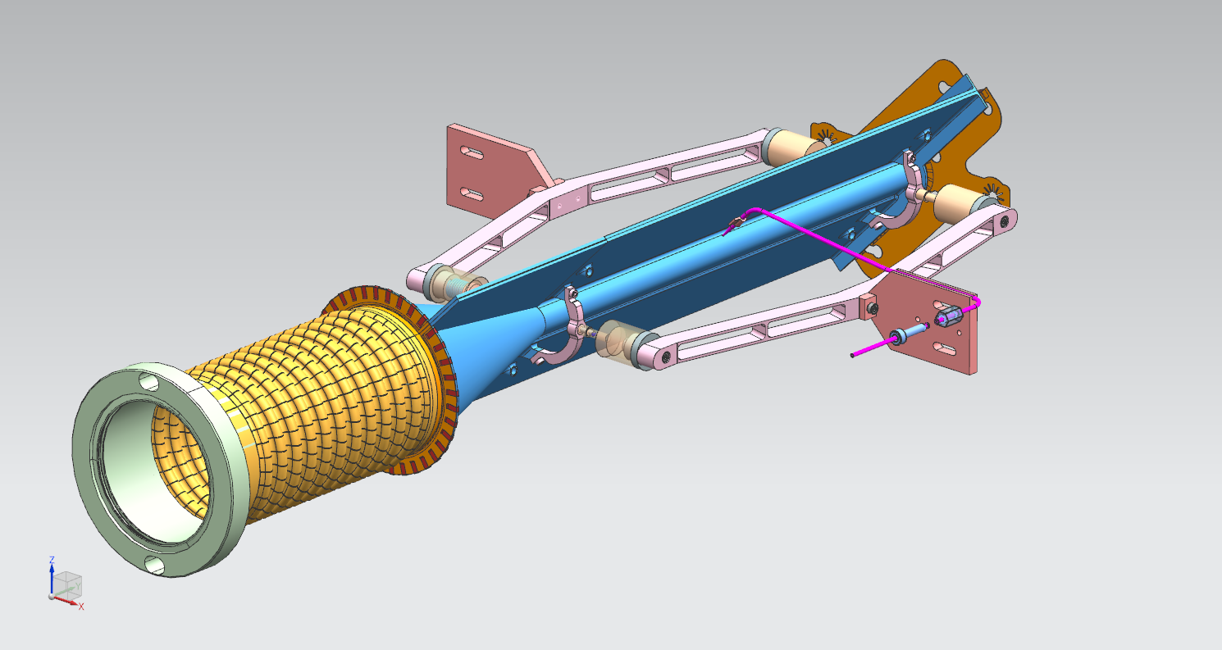
UNPOL STORAGE CELL VIEW1: CLOSED POSITION
ELECTRICAL CONTINUITY BETWEEN CELL AND RF FOIL
FLOATING HALF CELL SUPPORT CONNECTED TO THE DETECTOR BOX
STORAGE CELL
SUSPENSIONS
STORAGE CELL
GAS FEED TUBE IN
THE CELL CENTER
CONICAL TRANSITION
FIXED HALF CELL SUPPORT CONNECTED TO THE DETECTOR BOX
FLEXIBLE WAKE FIELD SUPPRESSOR

Slide 7
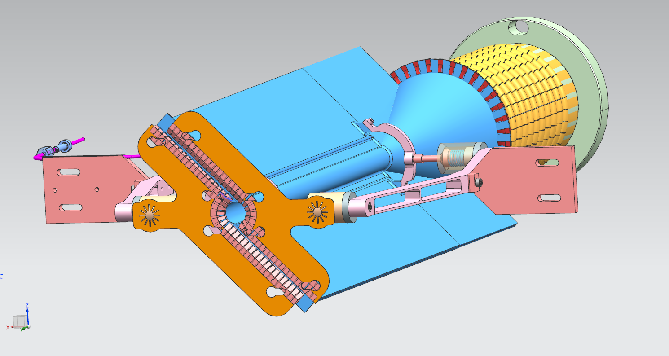
UNPOL CELL CLOSED POSITION – VIEW 2

Slide 8
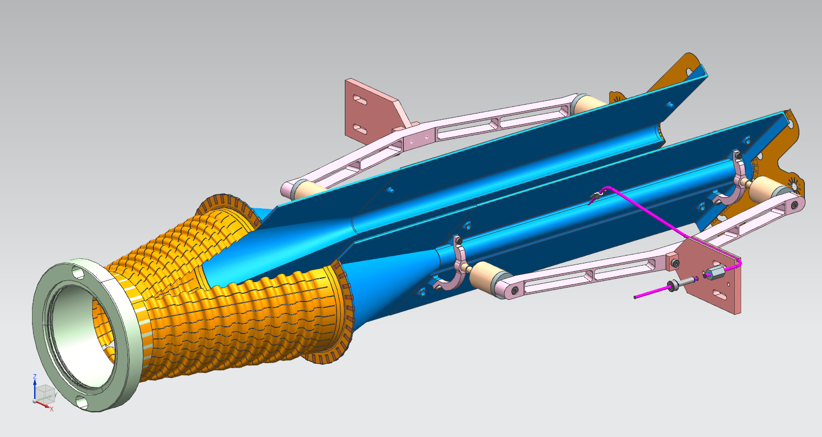
UNPOL CELL OPEN POSITION – VIEW 1

Slide 9
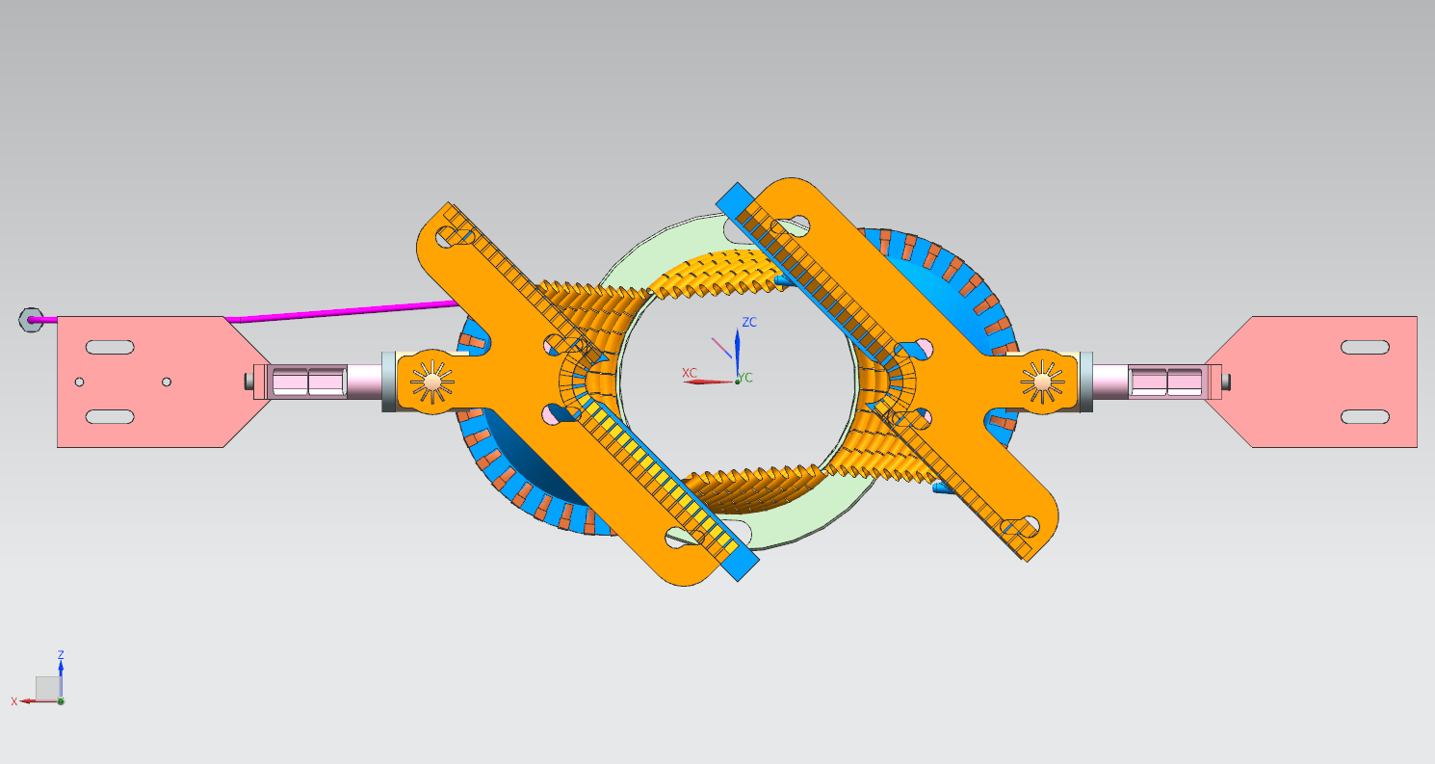
UNPOL CELL OPEN POSITION – VIEW 2

Slide 10
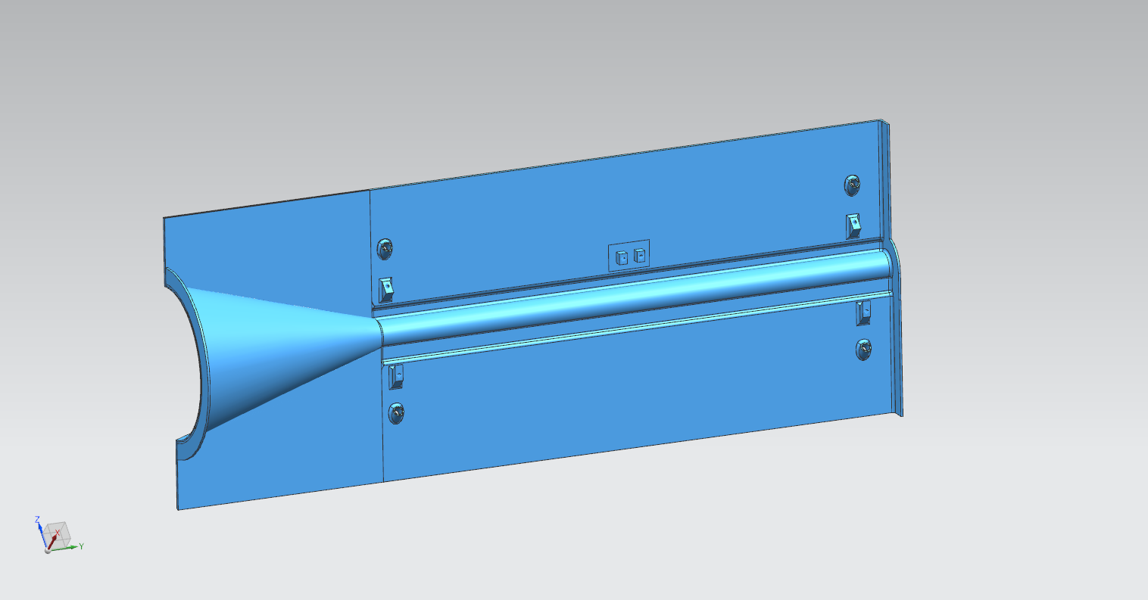
STORAGE CELL DIMENSIONS
200
80
107
Radius = 28 mm
tube 0,2 mm thick
Radius = 5 mm
CONICAL TRANSITION
wing 1,2 mm thick
Flexible WFS connector
Electrical continuity connector

Slide 11
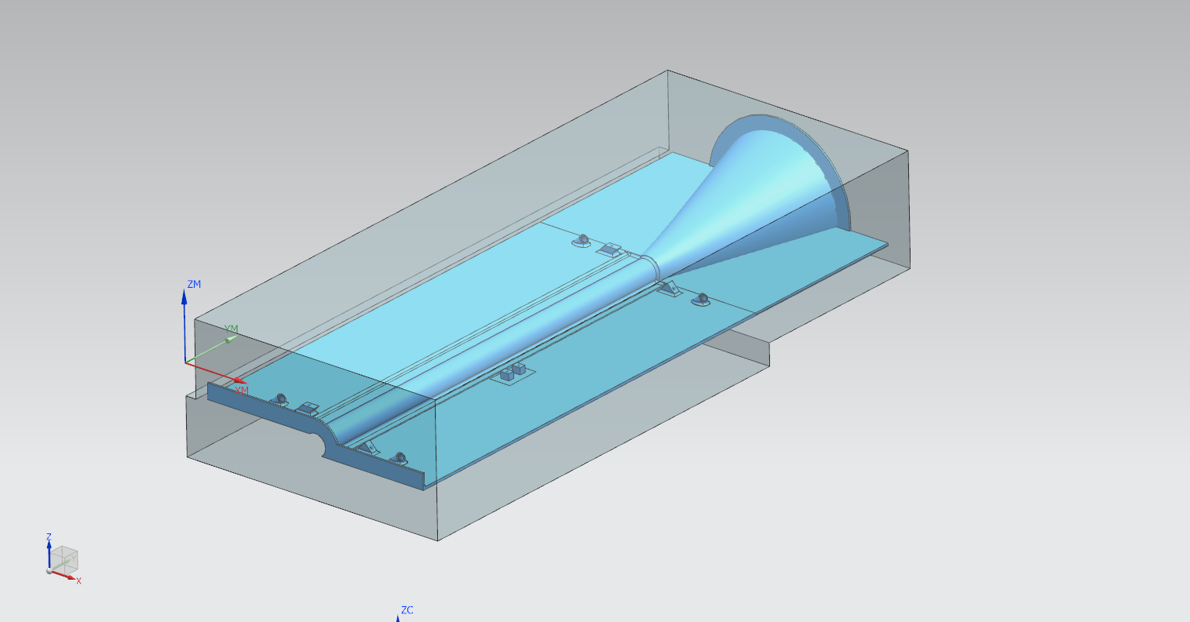
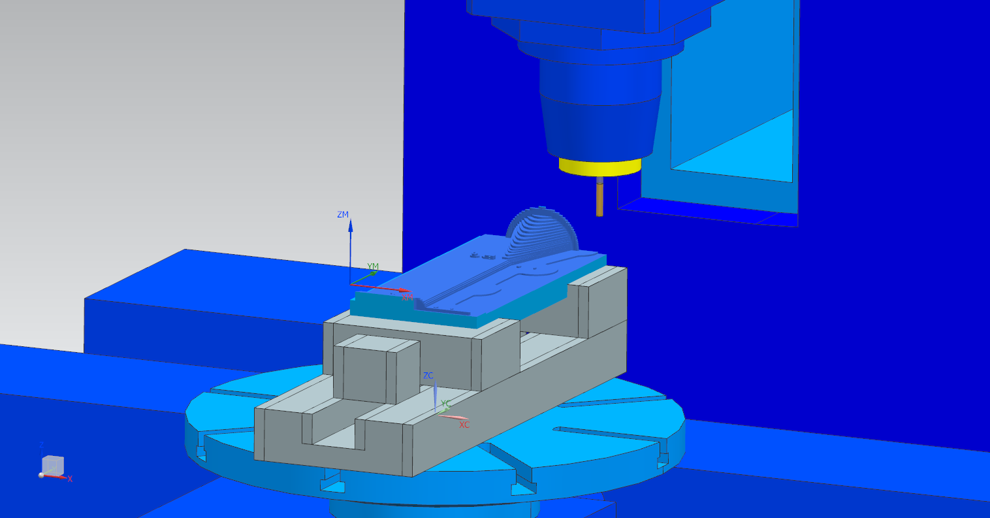
MACHINING PROCESS – OUTER SIDE
BLANK
MACHINING SIMULATION
PART
STRESS RELIEVING HEAT TREATMENT
AFTER THE MILL ROUGH PROCESS :
1 h @ 290°C

Slide 12
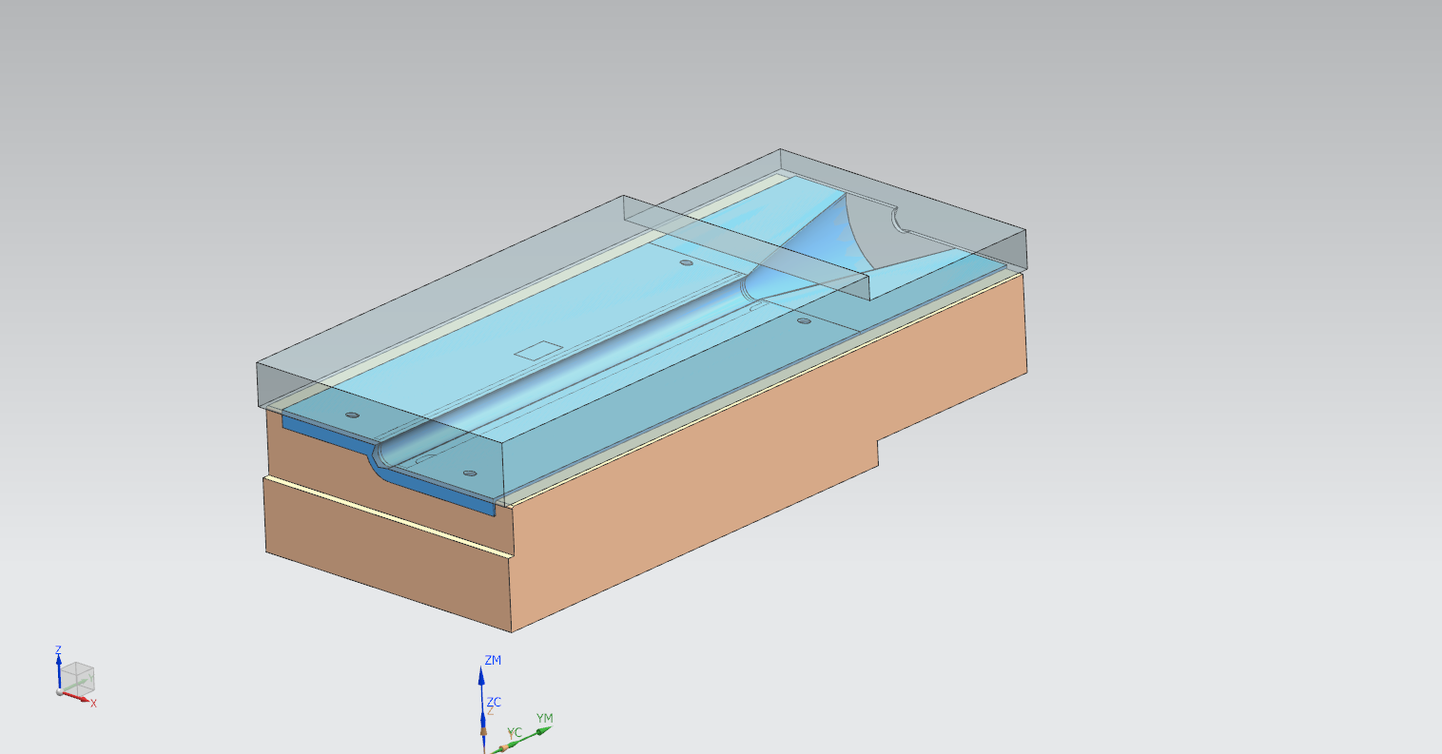
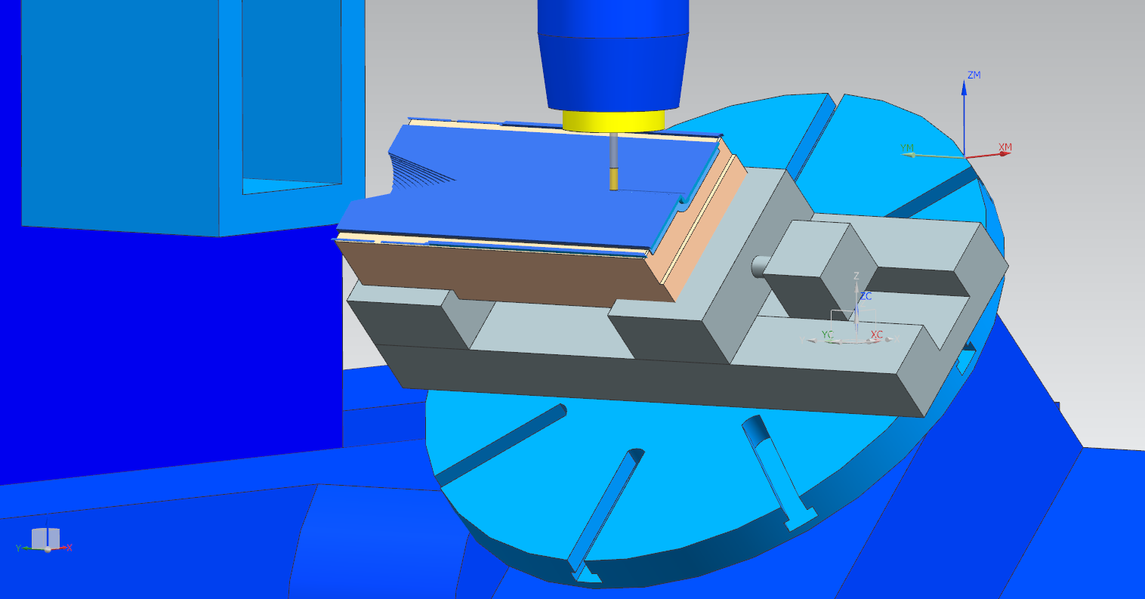
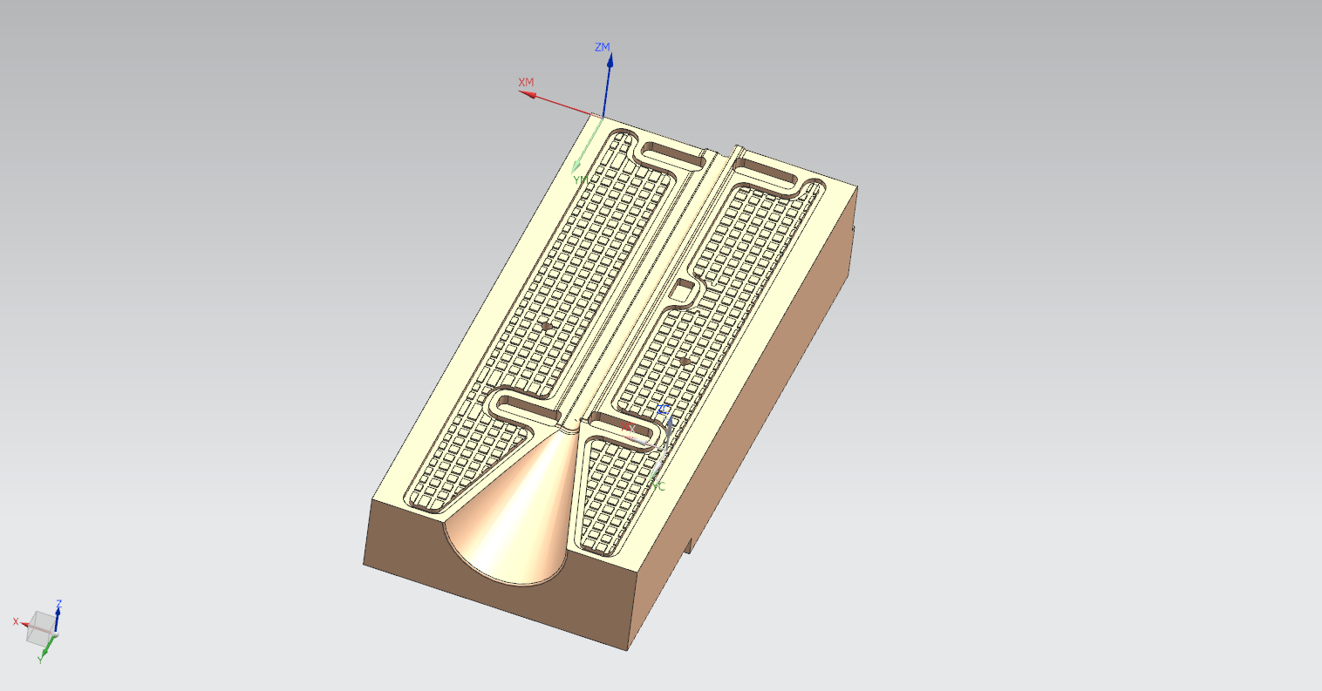
MACHINING PROCESS – INNER SIDE
BLANK
PART
MACHINING SIMULATION
VACUUM PLATE
PART

Slide 13
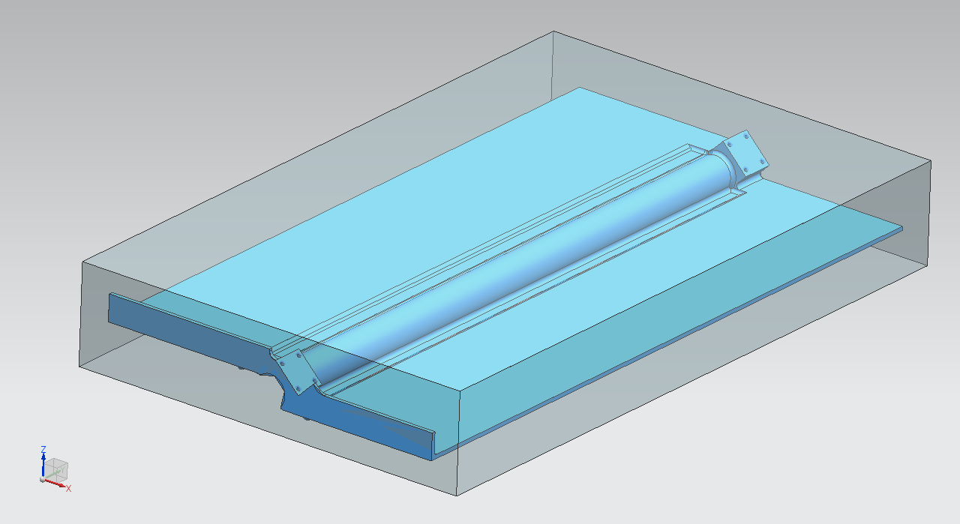
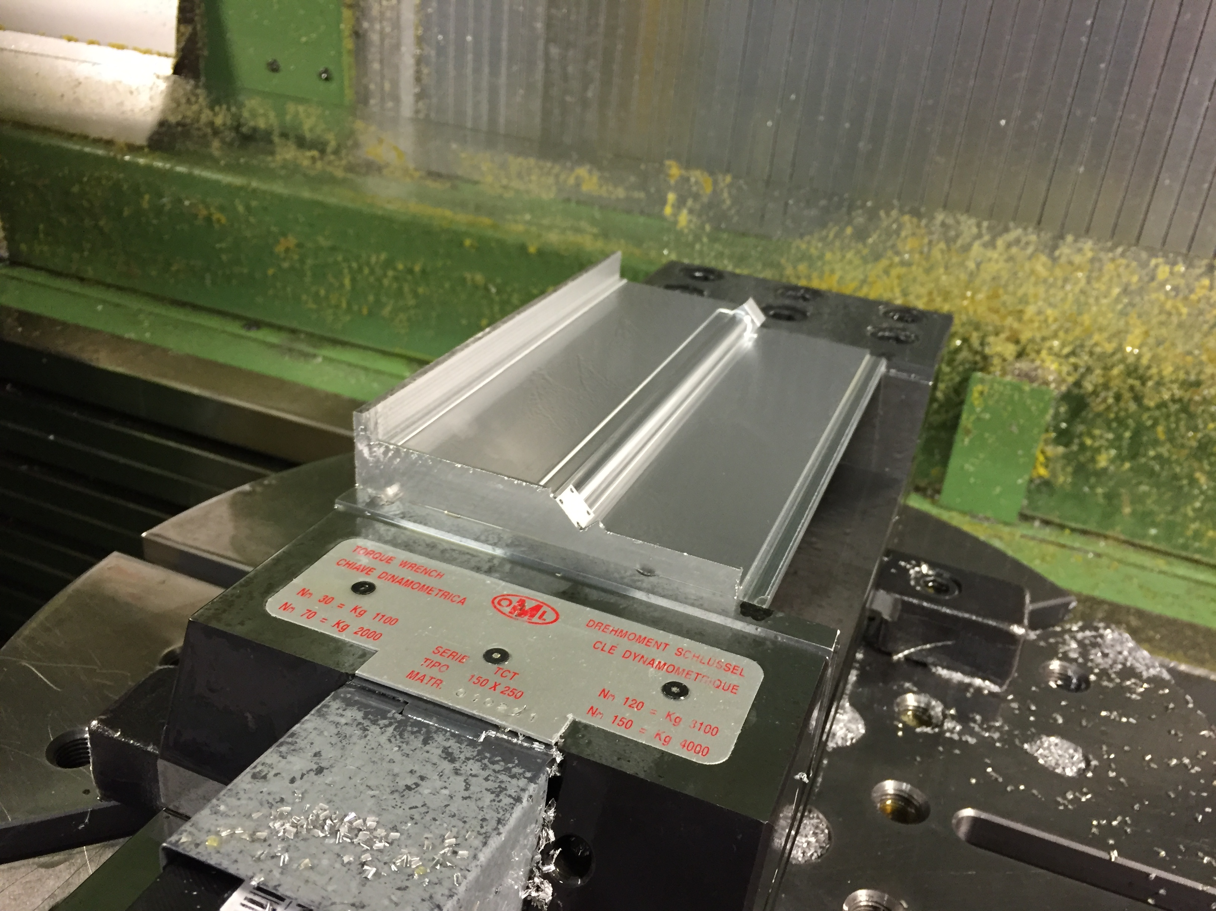
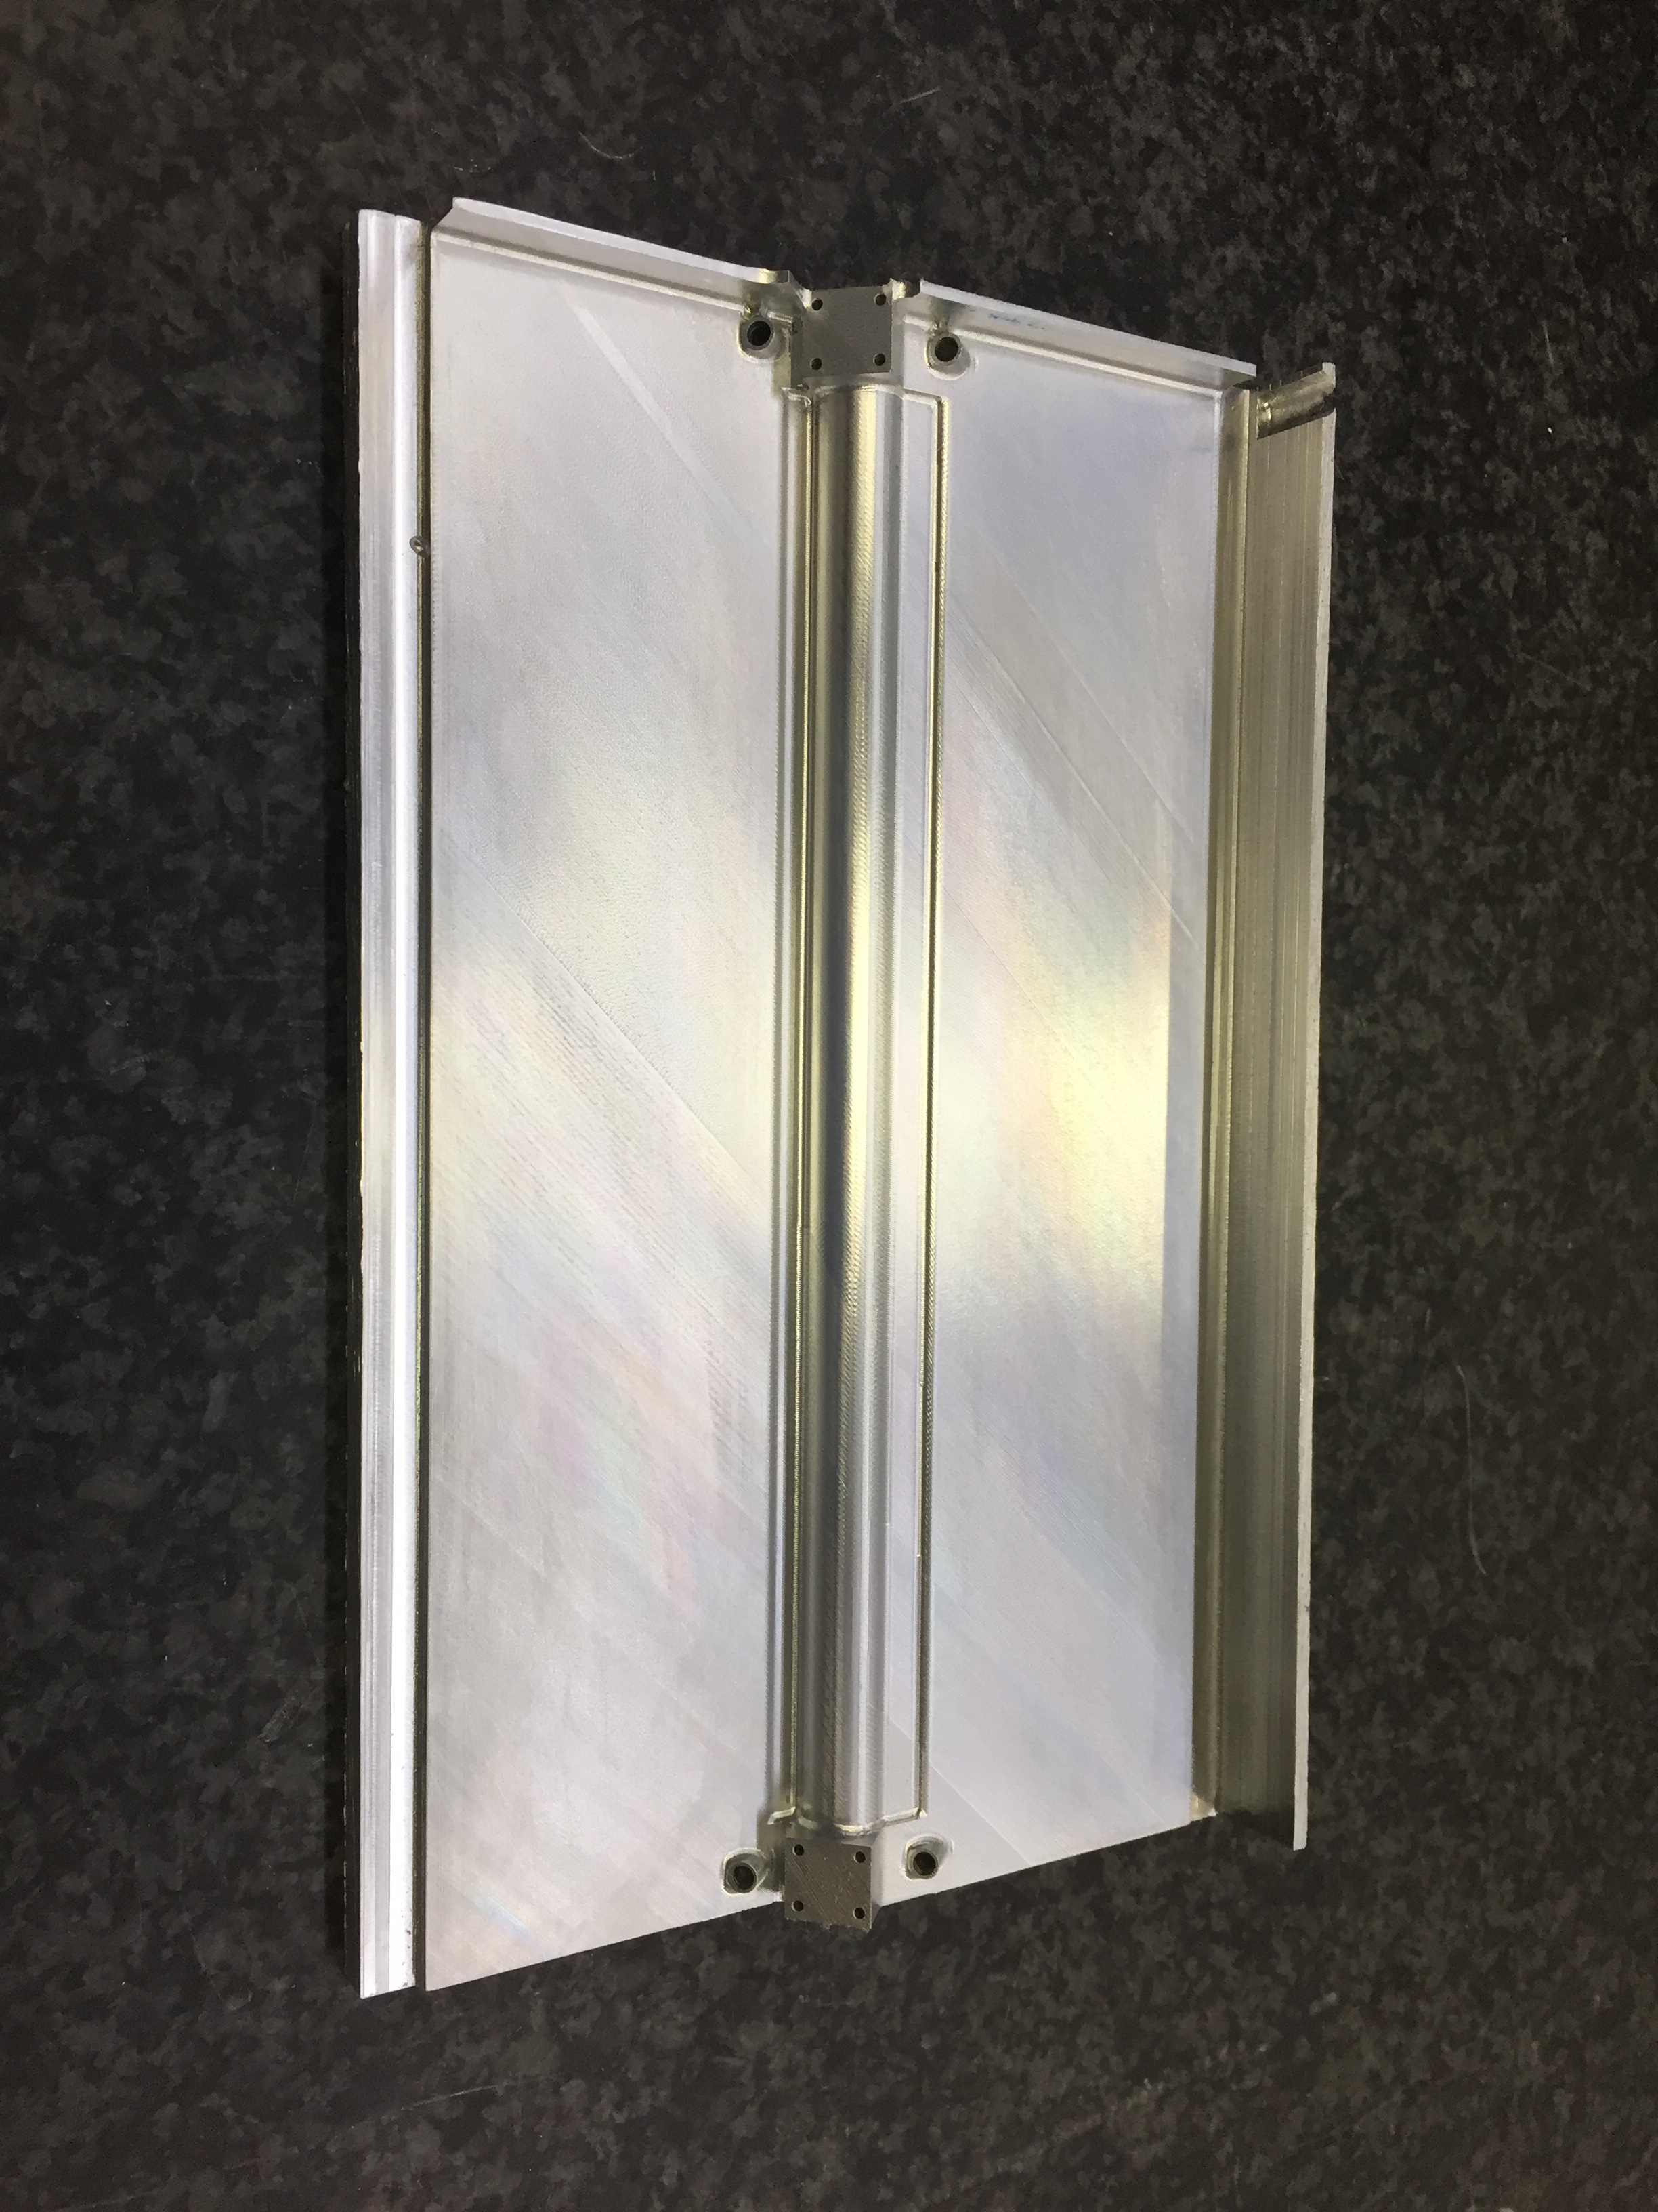
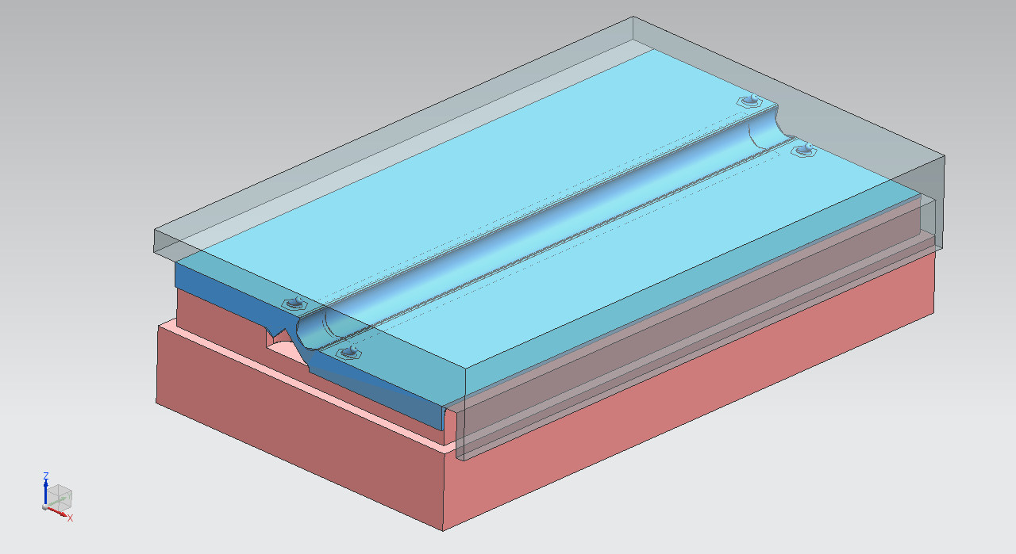
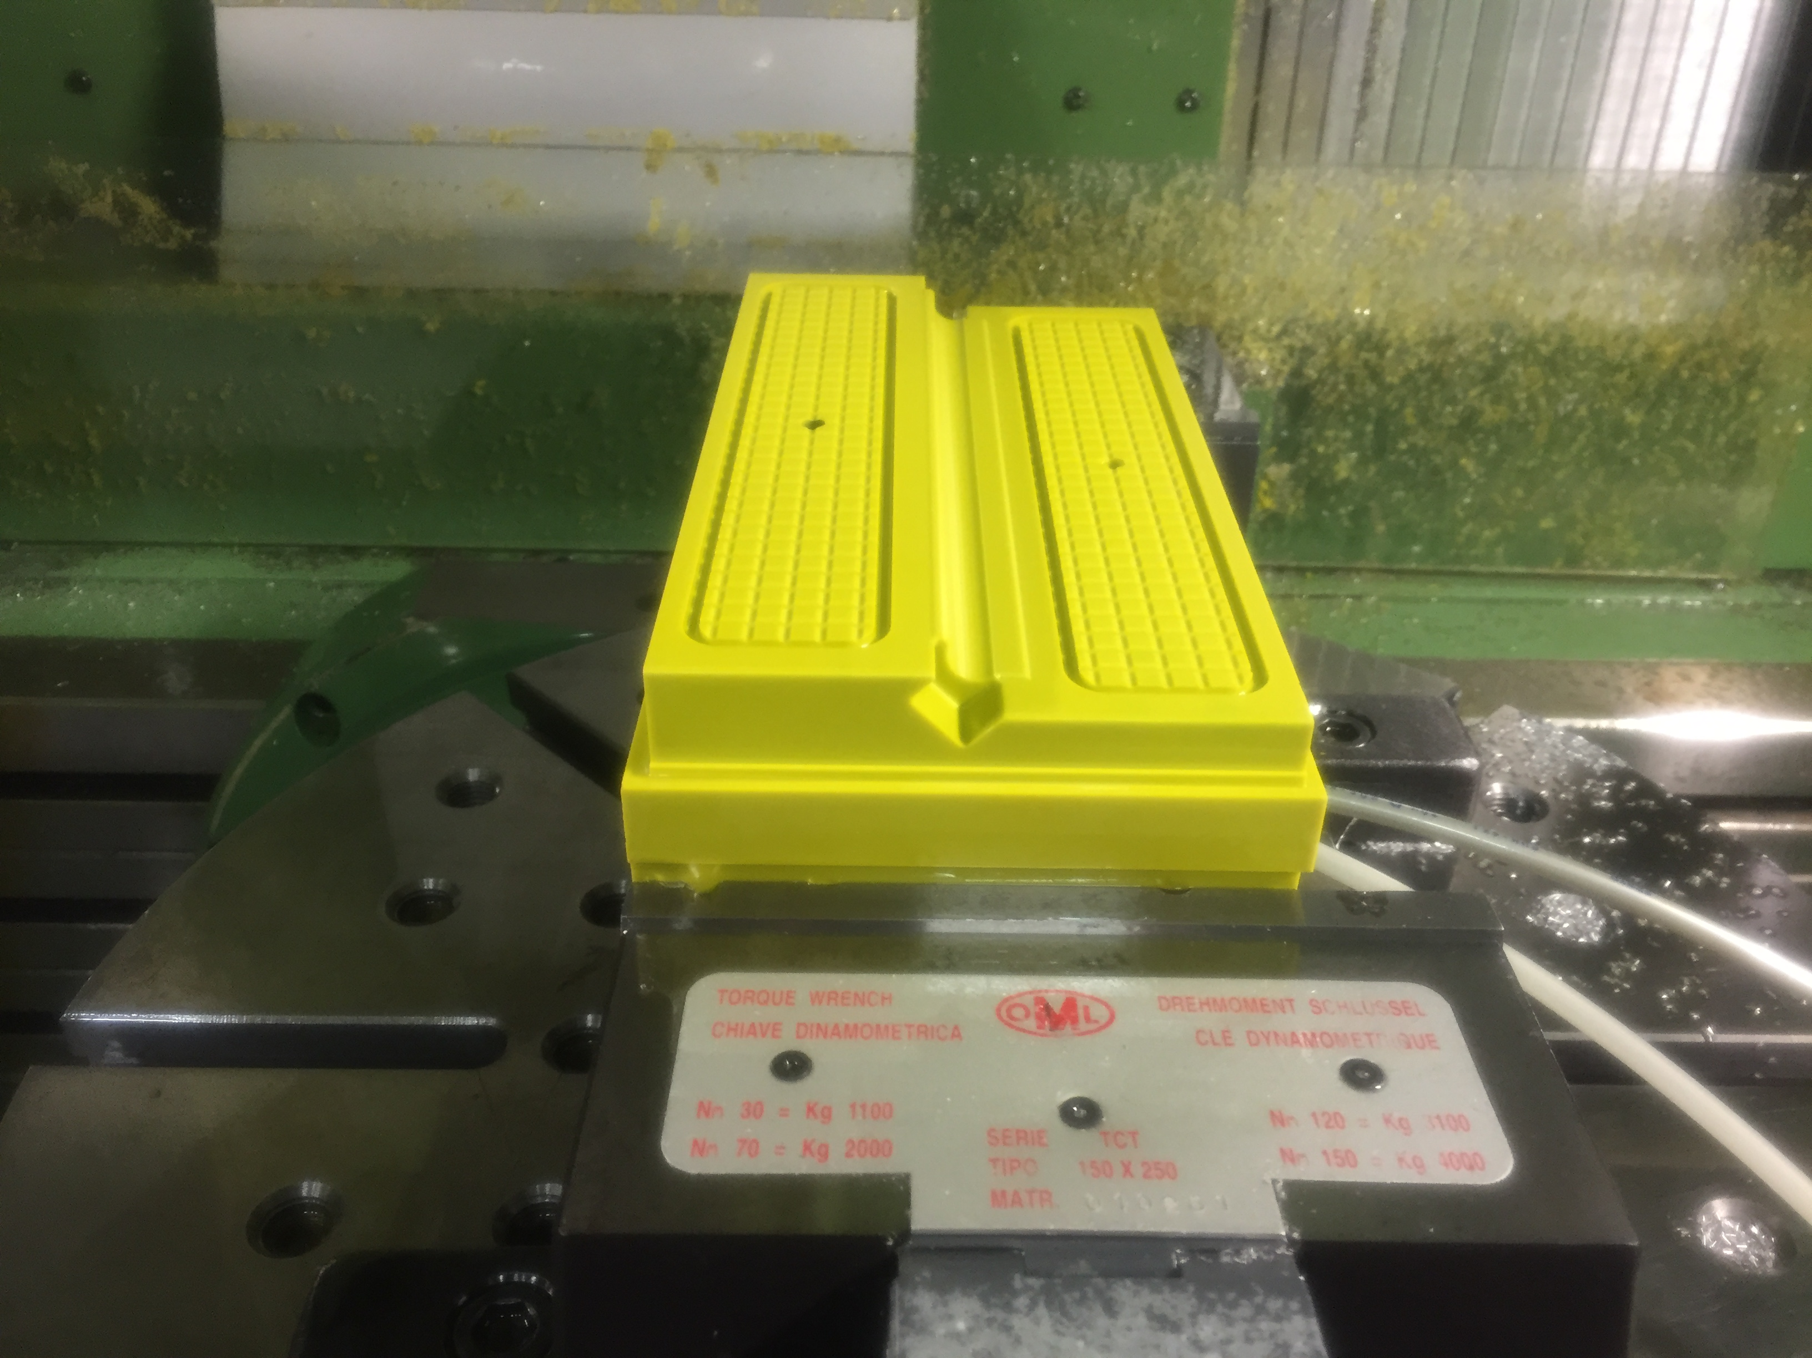
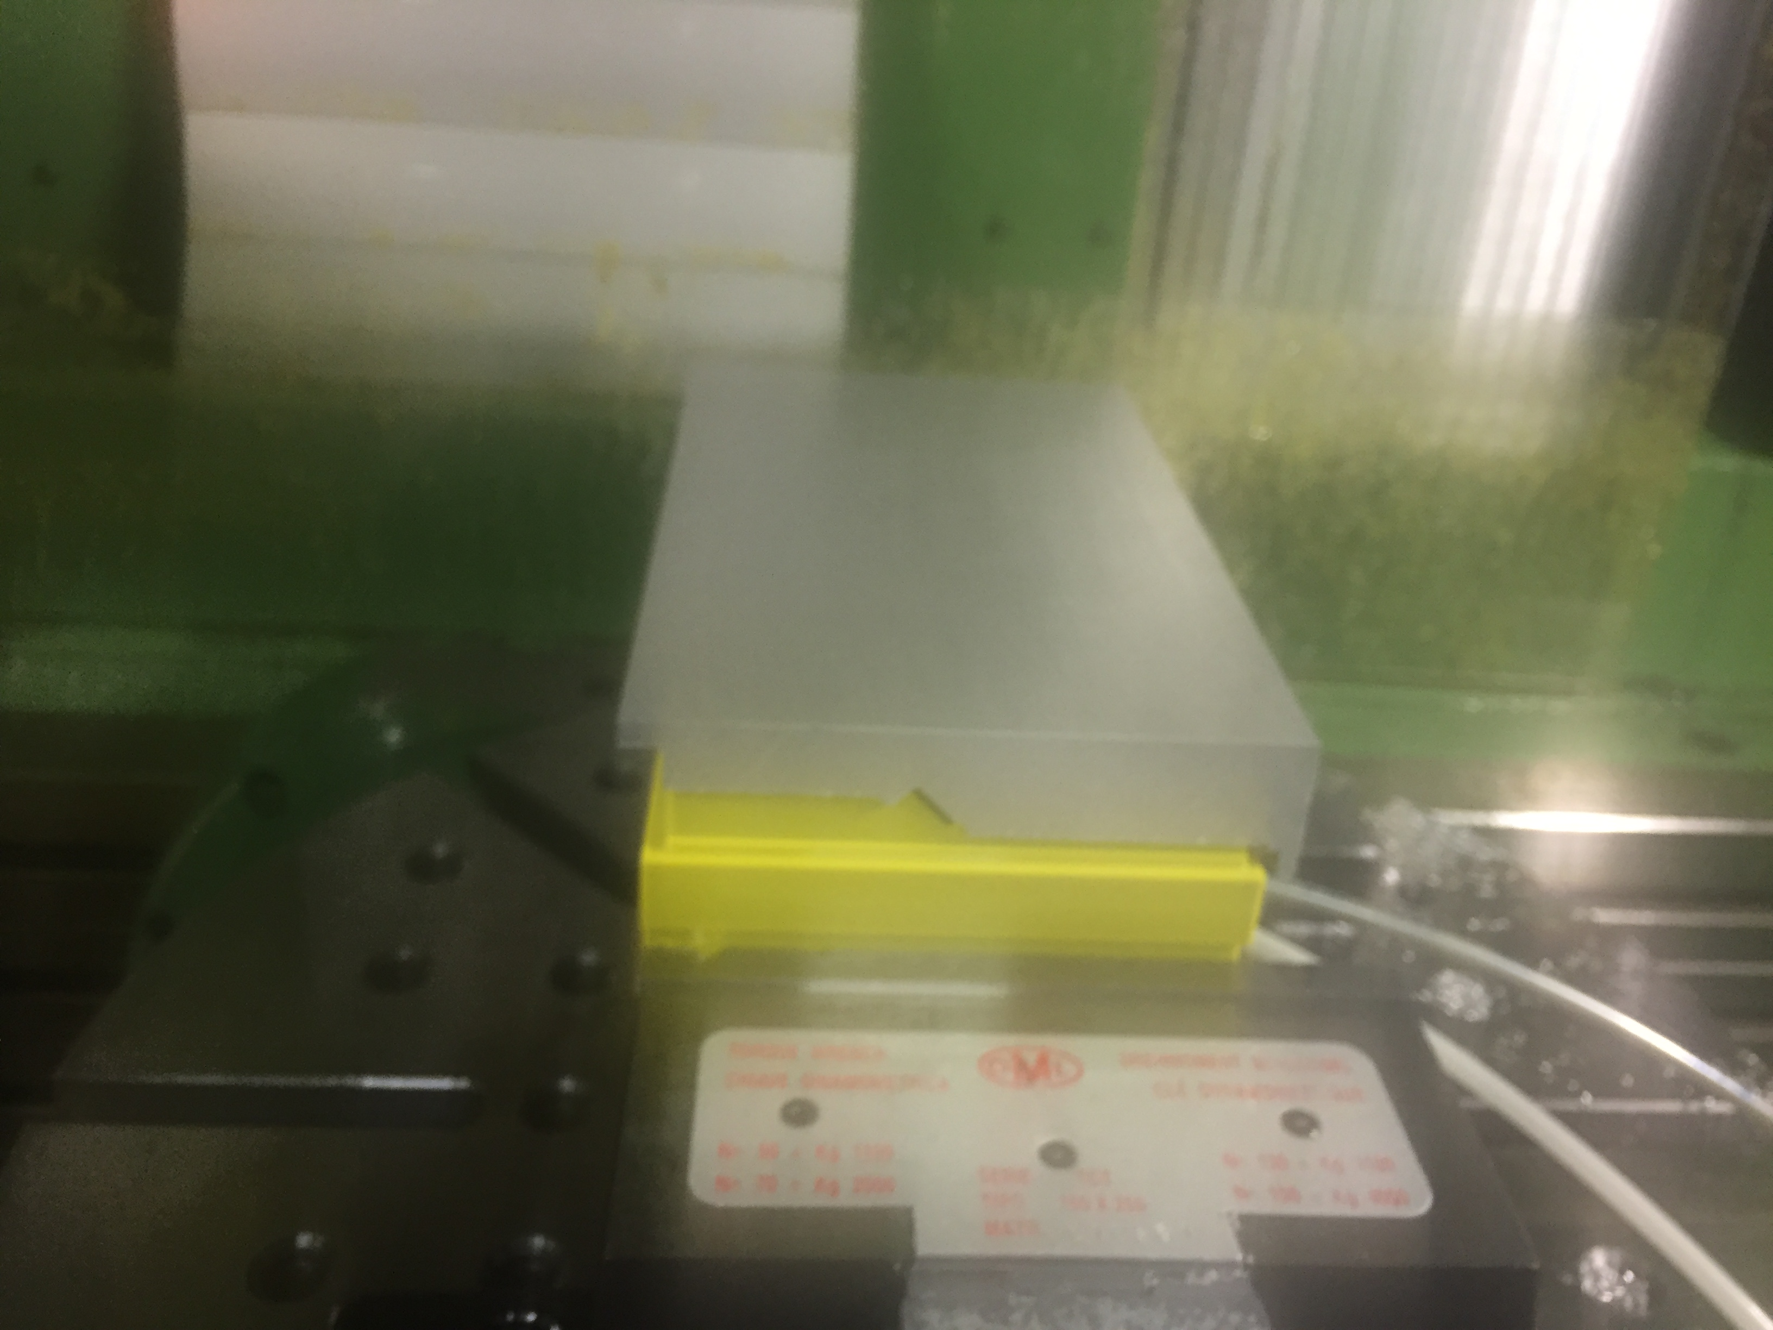
MACHINING PROCESS – FIRST PROTOTYPE

Slide 14
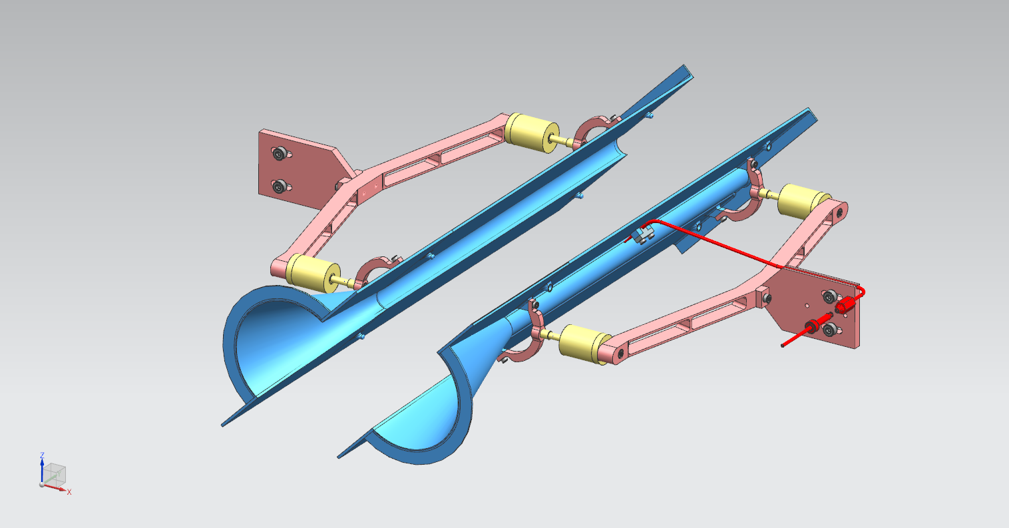
UNPOL STORAGE CELL : OPEN – CLOSING SYSTEM
FLOATING HALF CELL COMPENSATING THE TOLERANCE OF THE DETECOR’S CLOSURE POSITION
FIXED HALF CELL REFERRING THE CLOSURE POSITION

Slide 15
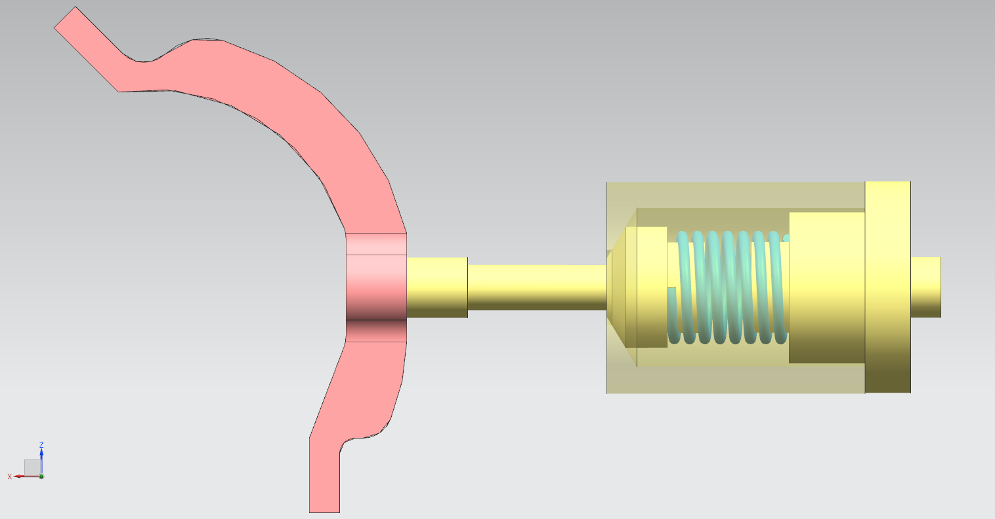
FLOATING SYSTEM – 1
FIXED PARTS CONNECTED BY BARS TO THE DETECTOR BOX
SPRING
FLOATING PART
SUPPORTING THE CELL
THE CONTACT OF THE FLOATING HALF OF THE CELL WITH THE FIXED HALF, IS GIVEN BY THE SPRING COMPRESSION FORCE

Slide 16
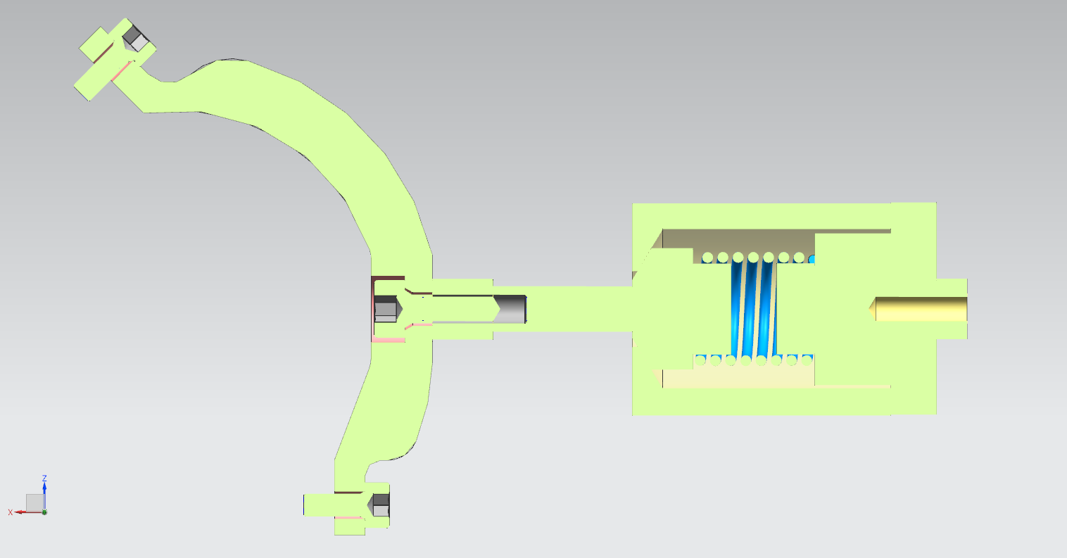
FLOATING SYSTEM – 2
FIXED PARTS CONNECTED BY BARS TO THE DETECTOR BOX
SPRING
FLOATING PART
SUPPORTING THE CELL
CELL load balance force
CELL
load
CONTACT pressure
SPRING compression force
CELL load balance force

Slide 17
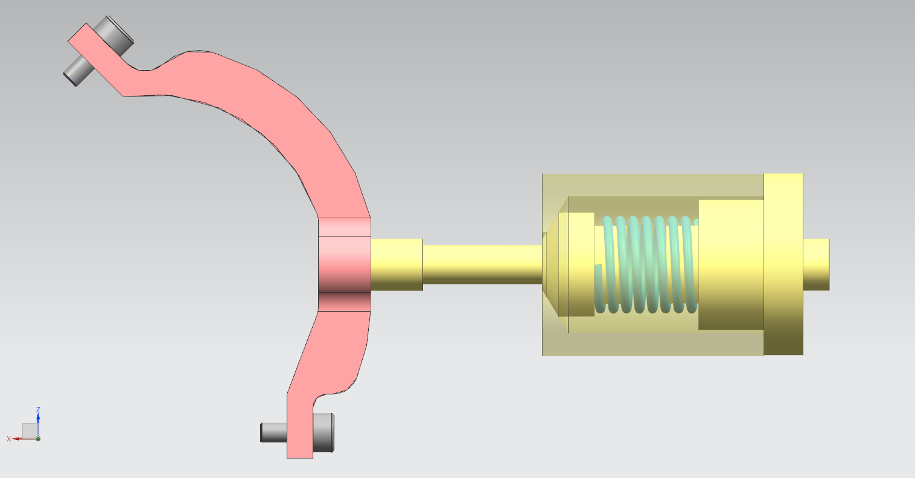
FLOATING SYSTEM – 3
4
4
4
9,5
16,7
3
2
32,3
4
3
14
4

Slide 18
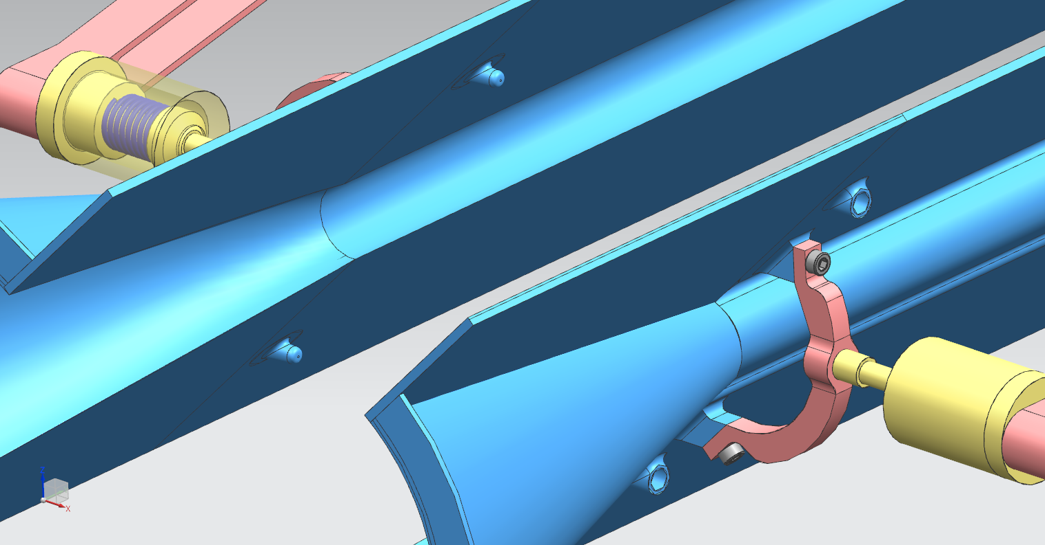
CLOSED POSITION RECOVERING SYSTEM - 1
CONICAL ROUND SHAPED PIN
CILINDRICAL HOLE

Slide 19
CLOSED POSITION RECOVERING SYSTEM - 2
PROTOTYPE TESTING THE MECHANISM

Slide 20
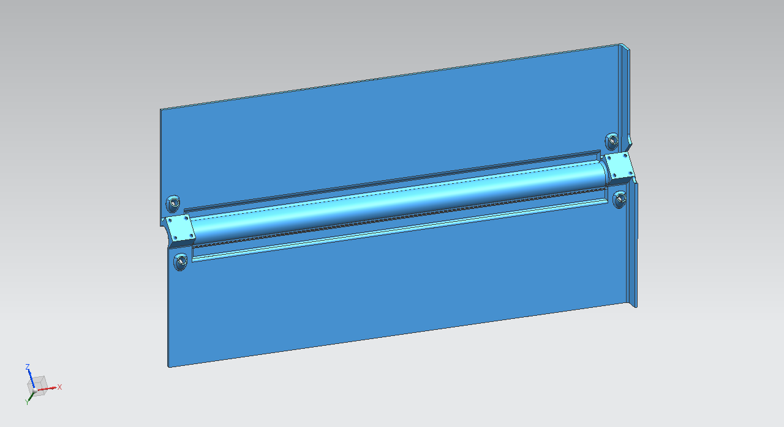
STORAGE CELL : SECOND PROTOTYPE - 1
SECOND PROTOTYPE
STORAGE CELL
FIRST PROTOTYPE
CONICAL TRANSITION

Slide 21
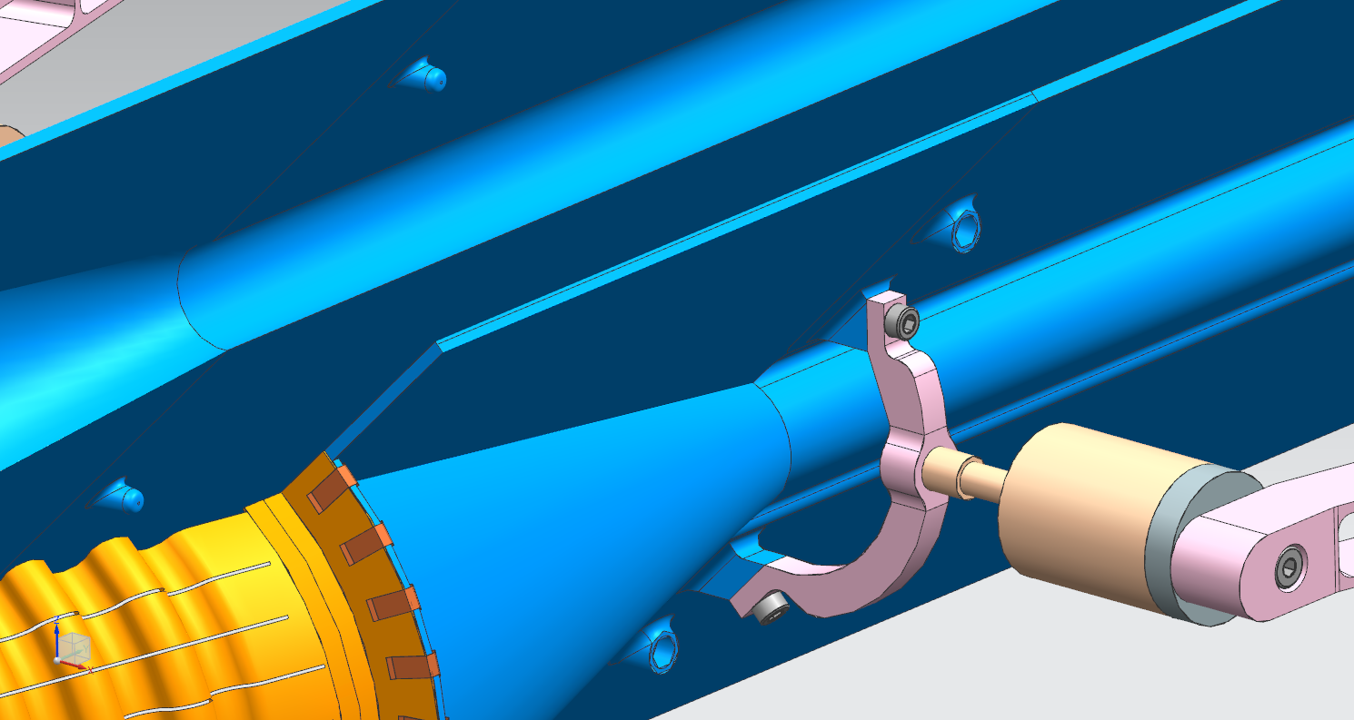
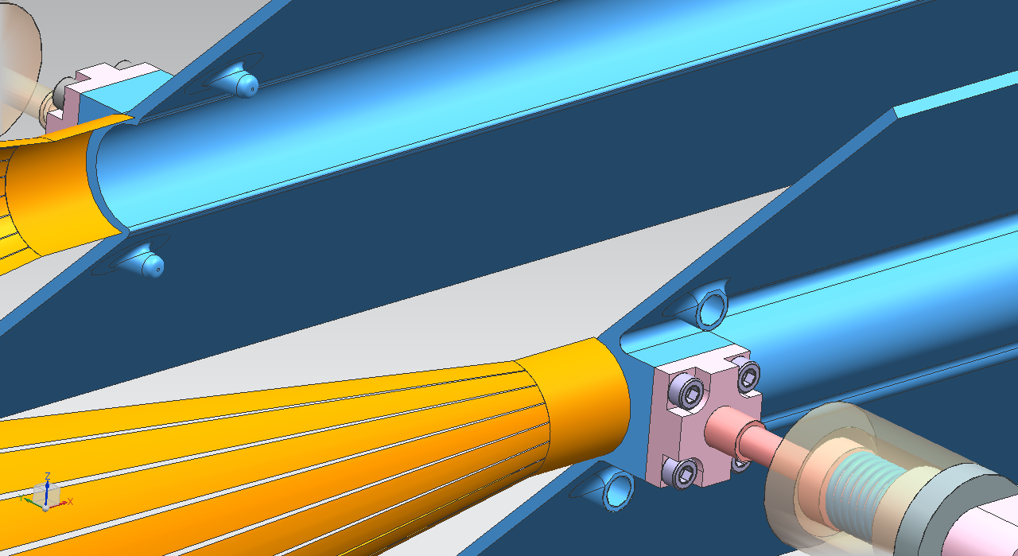
STORAGE CELL : SECOND PROTOTYPE - 2
SECOND PROTOTYPE
FIRST PROTOTYPE
CELL SUPPORT AND CLOSING POSITION SYSTEM FARTHER FROM THE BEAM AXIS

Slide 22
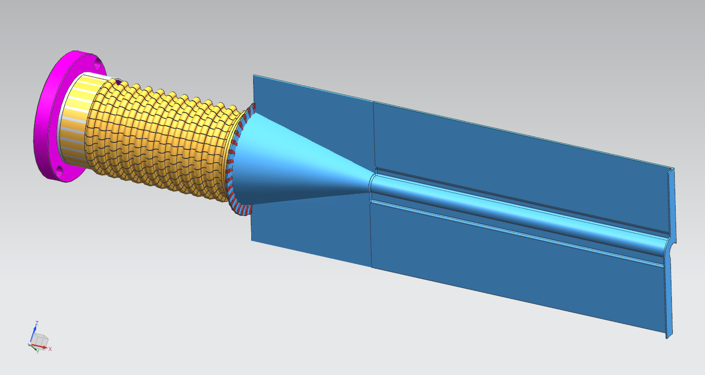
UPSTREAM WAKE FIELD SUPPRESSOR - 1
FLEXIBLE CuBe2 WFS
CONICAL TRANSITION

Slide 23
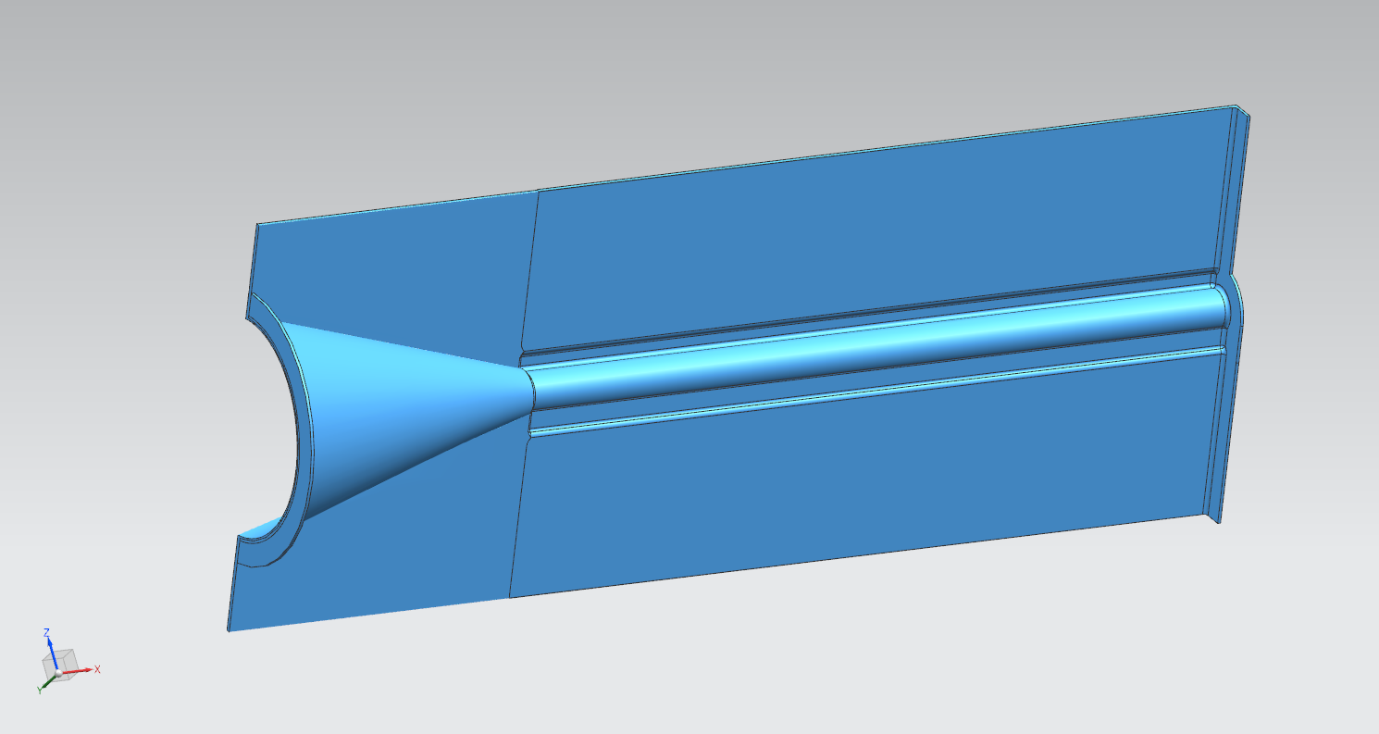
UPSTREAM WAKE FIELD SUPPRESSOR - 2
CONNECTION TO THE FLEXIBLE PART

Slide 24
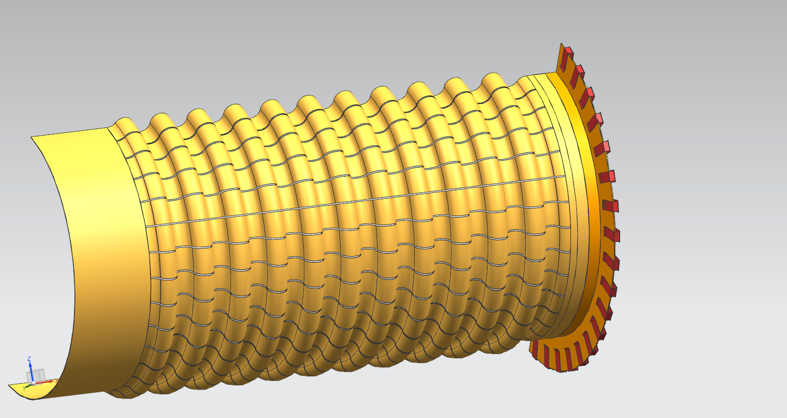
UPSTREAM WAKE FIELD SUPPRESSOR - 3
FLEXIBLE WFS
0,075 mm THICK
CONICAL TRANSITION-FLEXIBLE WFS CONNECTOR
0,2 mm THICK

Slide 25
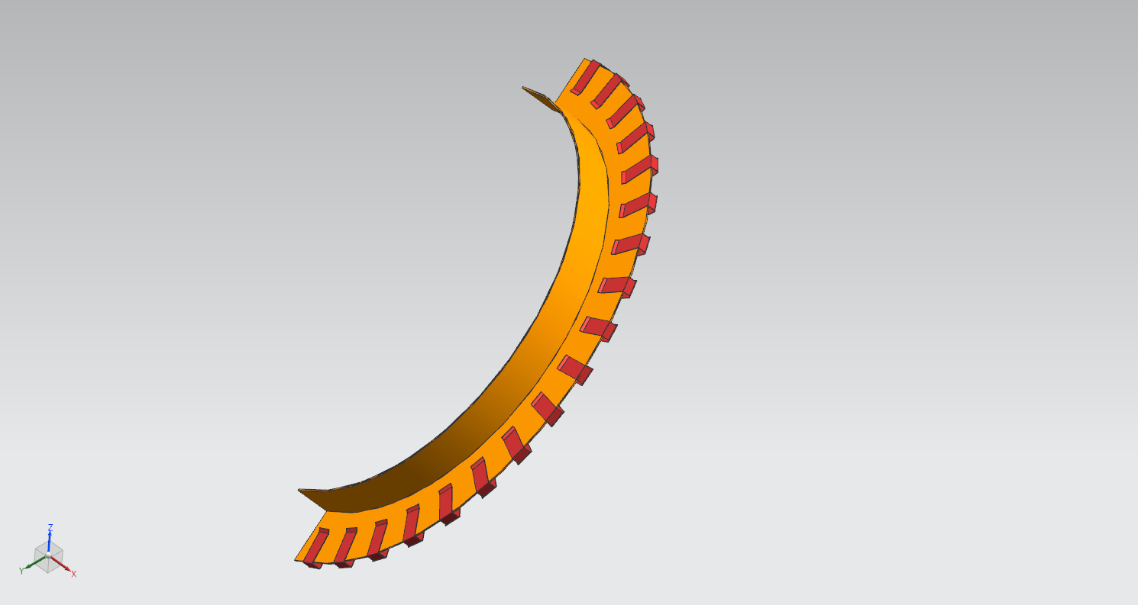
UPSTREAM WAKE FIELD SUPPRESSOR - 4
CuBe2 CONNECTOR
CuBe2 TWISTED CONTACT CLIPS
SPOT WELDED ON THE CONNECTOR

Slide 26
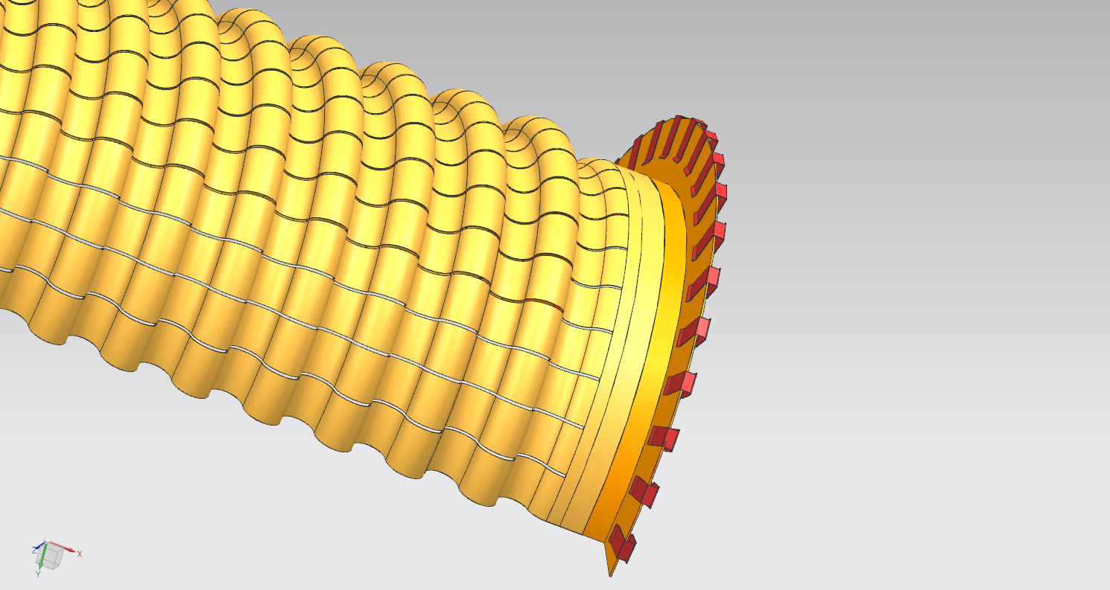
UPSTREAM WAKE FIELD SUPPRESSOR – 5
FLEXIBLE PART SPOT WELDED ON THE CONNECTOR

Slide 27
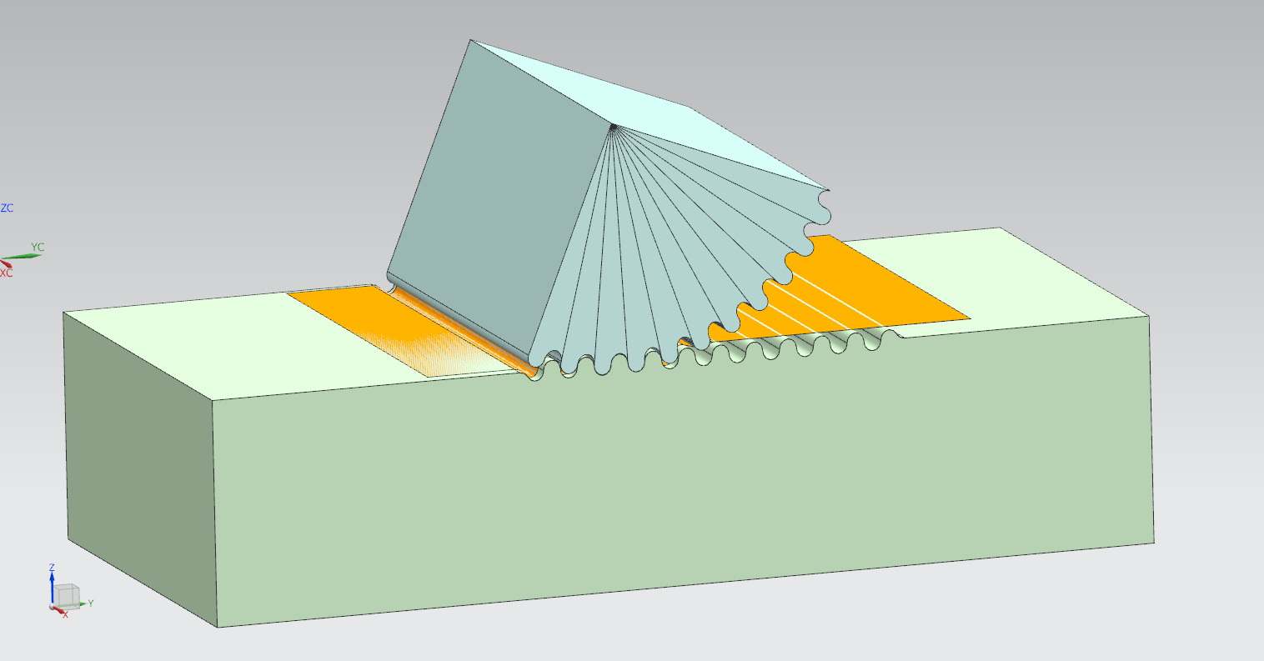
UPSTREAM WAKE FIELD SUPPRESSOR - 6
FORMING WHEEL
DIE BLOCK

Slide 28
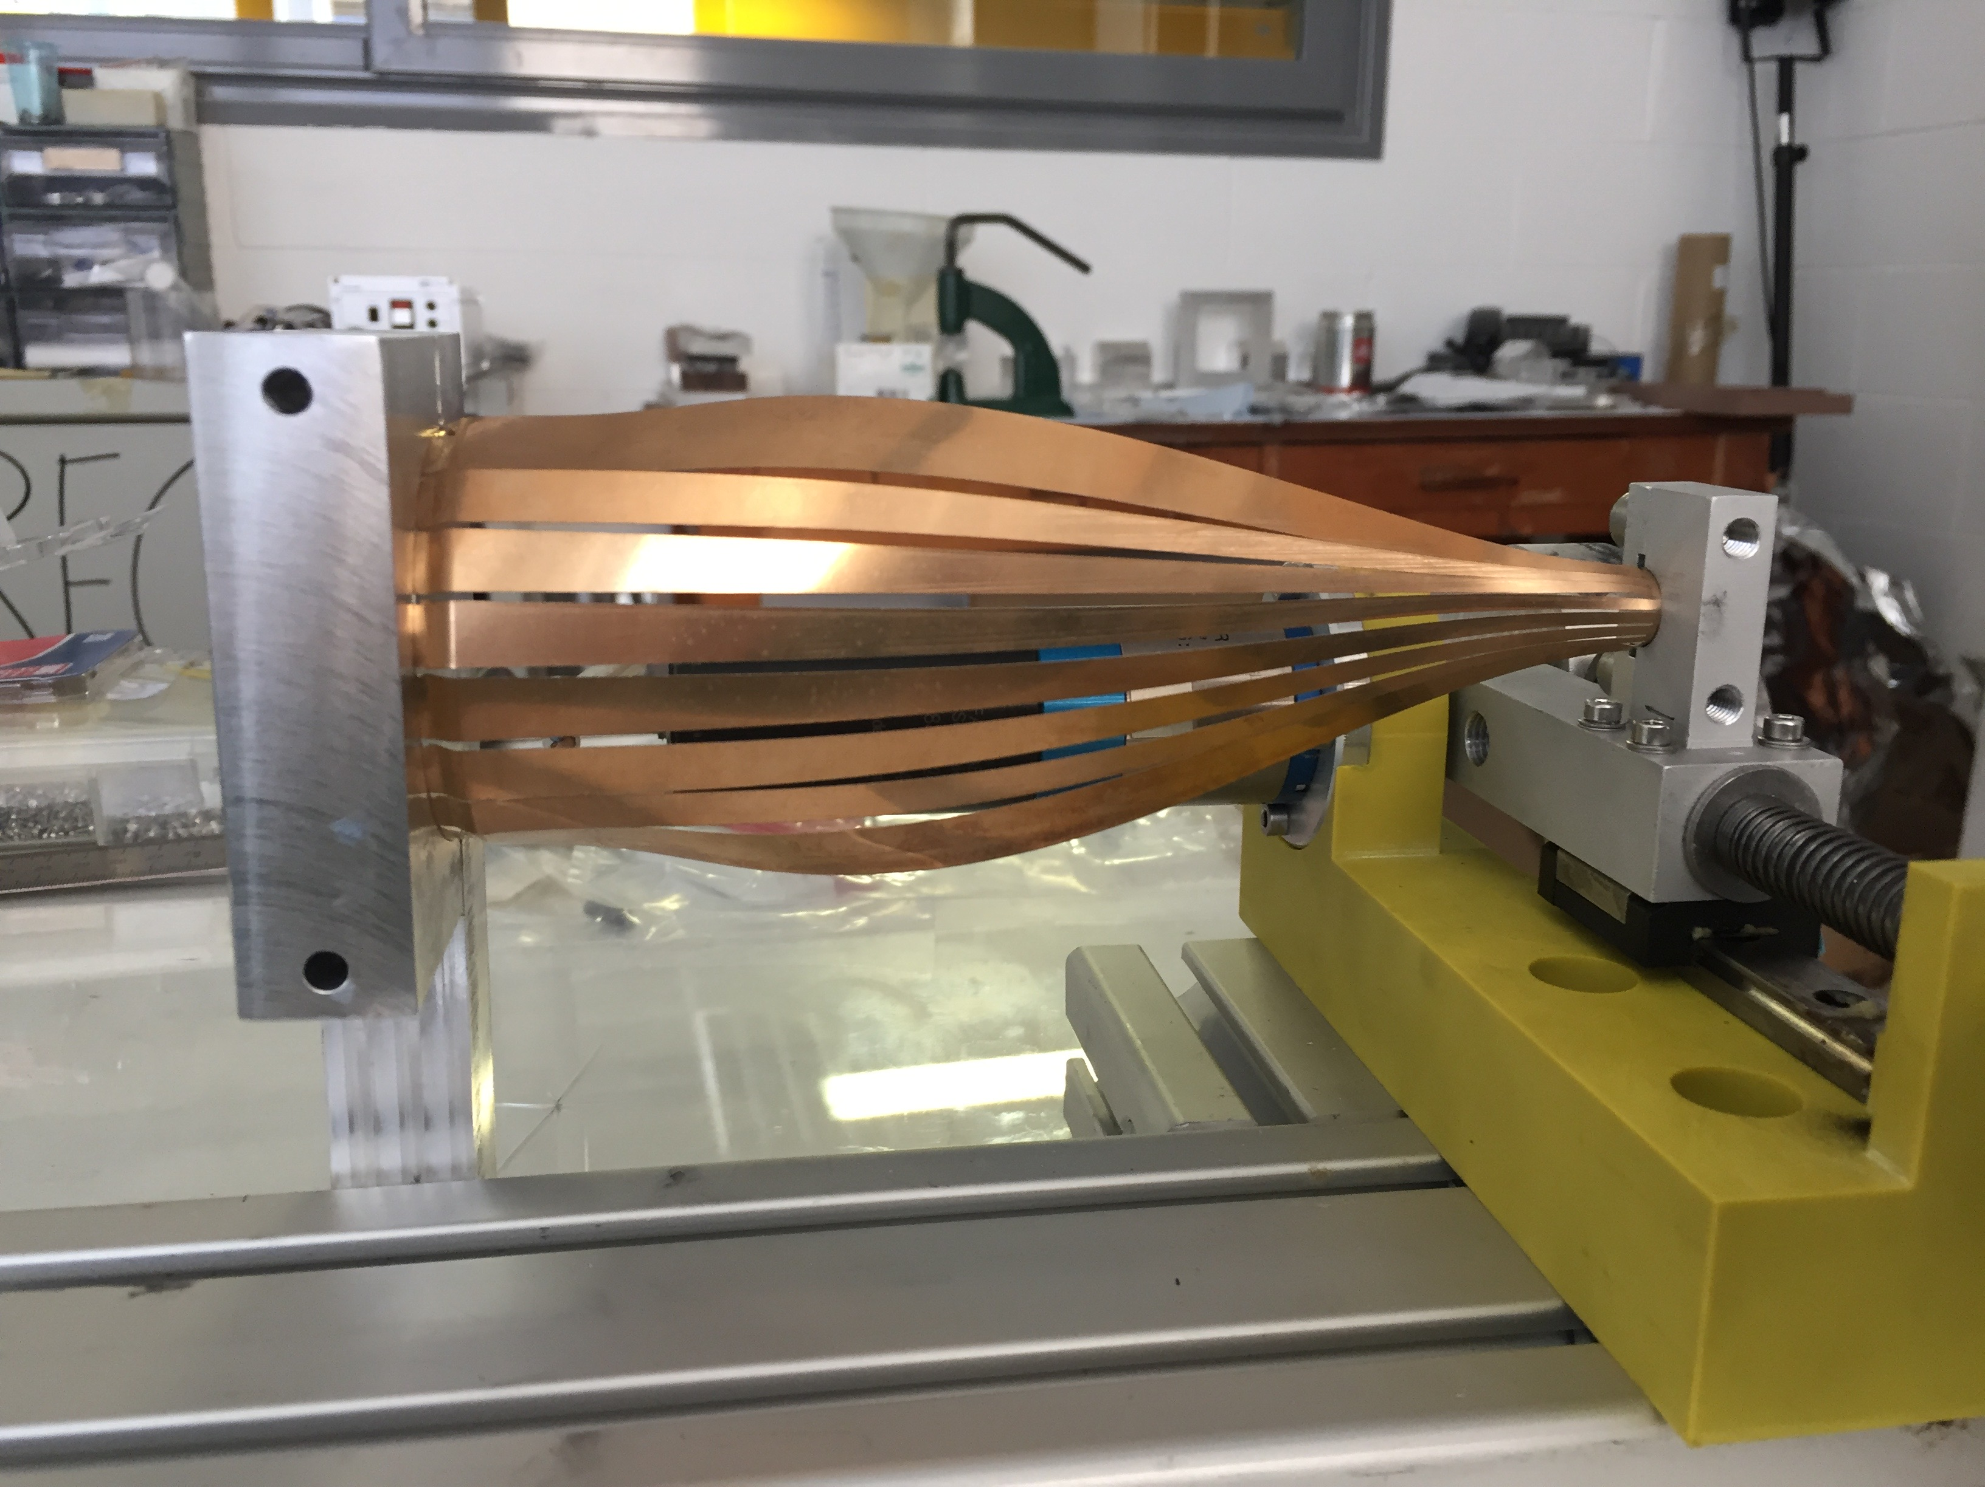
WFS FATIGUE – FIRST PROTOTYPE TEST
MATERIAL TESTED AS DELIVERED : HALF HARD
15000 cycles OK

Slide 29
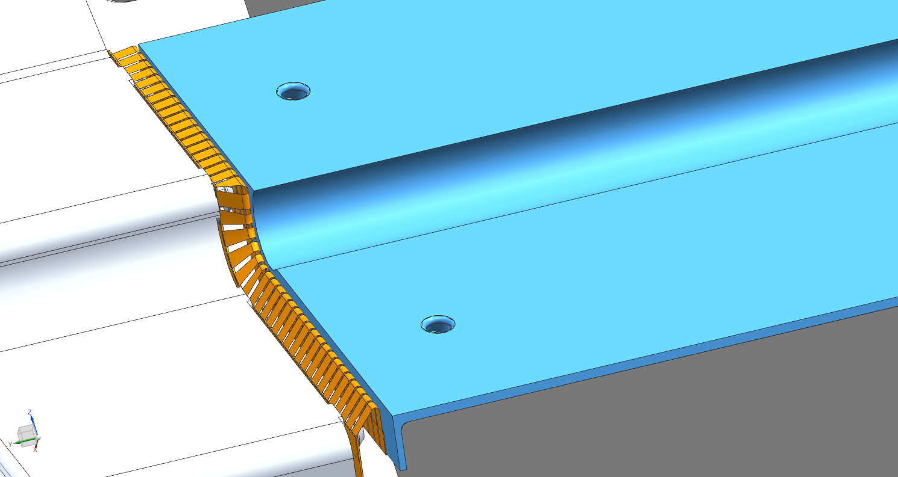
DOWNSTREAM WFS - 1
CuBe2 SHIELD & MOTION COMPENSATOR

Slide 30
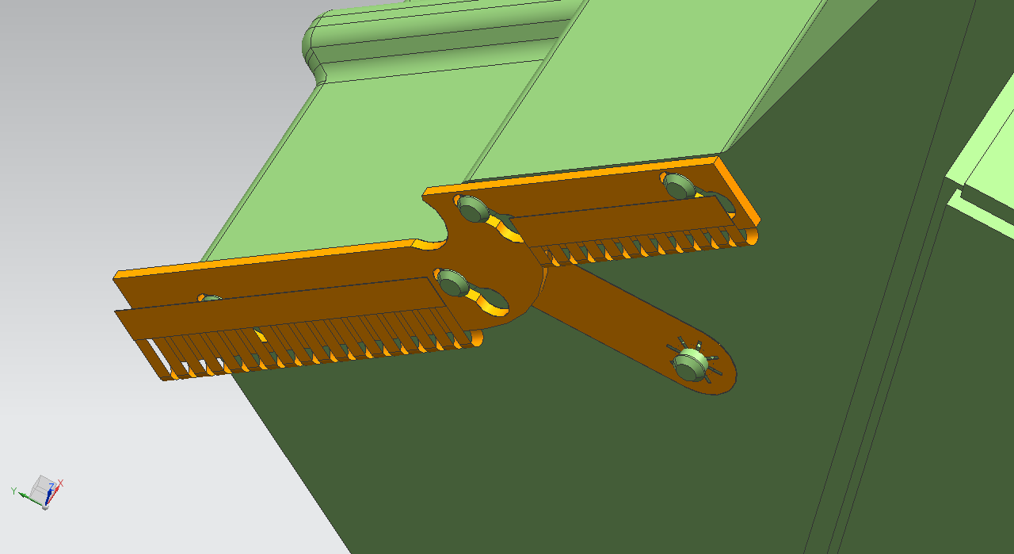
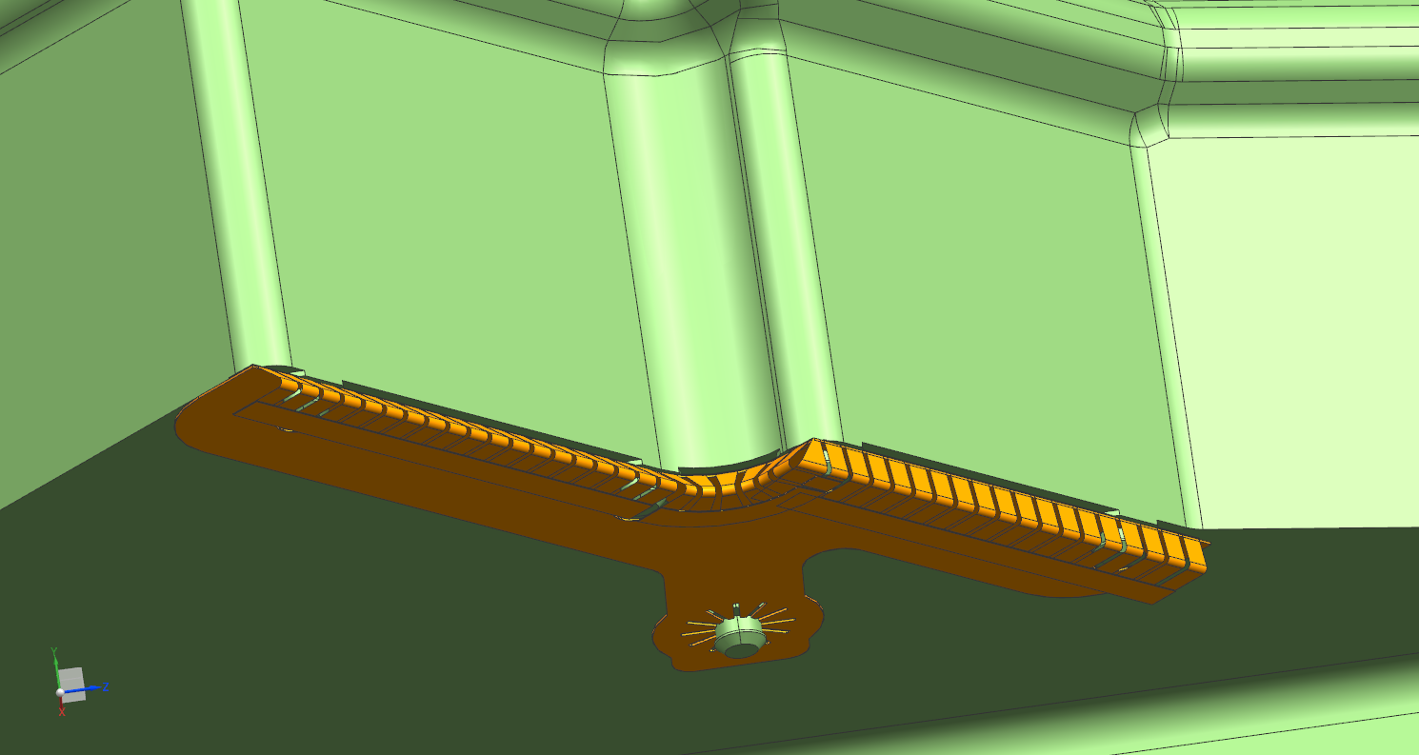
DOWNSTREAM WFS - 2
FIRST PROTOTYPE DESIGN
SECOND PROTOTYPE DESIGN

Slide 31
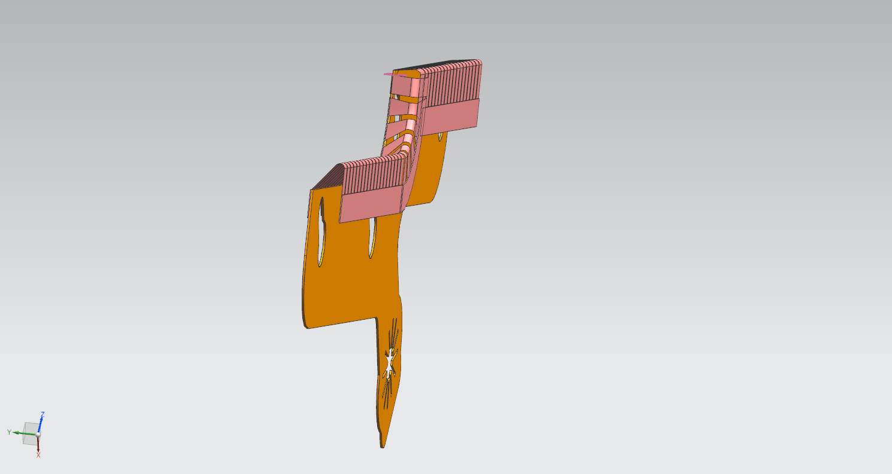
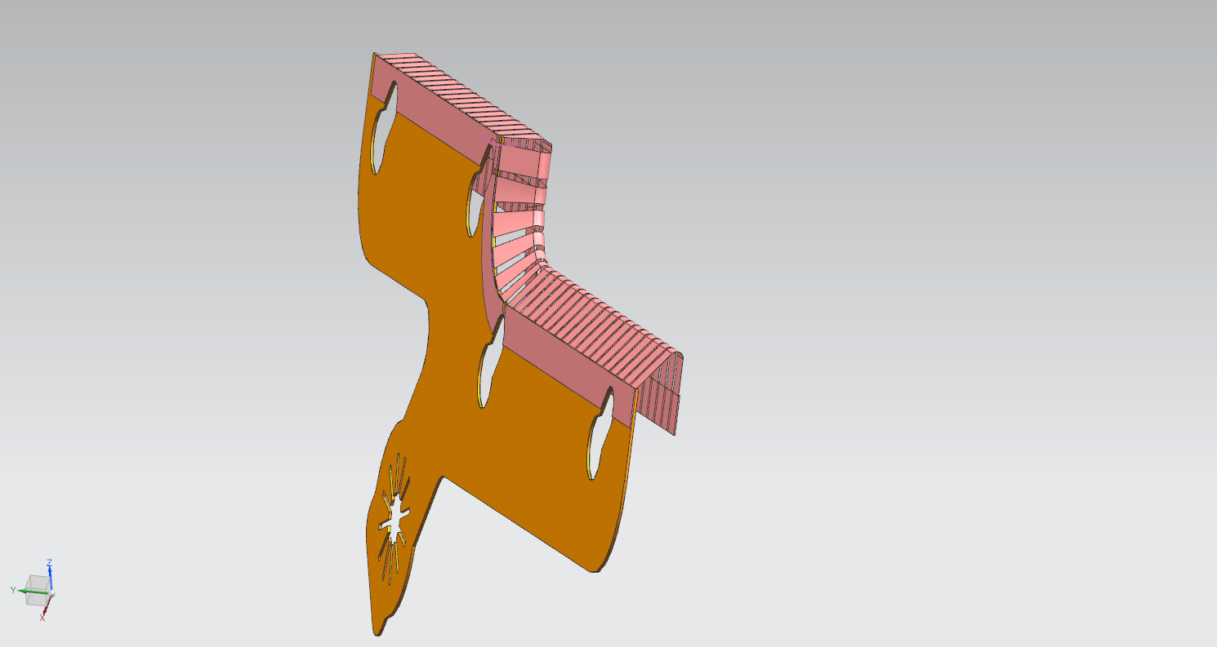
DOWNSTREAM WFS - 3
CONNECTION TO STORAGE CELL
BY CuBe2 TWISTED CLIPS
0,075 mm THICK
SPOT WELDED
CONNECTION TO RF FOIL
BY THE EXISTING MUSHROOM PINS
0,2 mm THICK

Slide 32
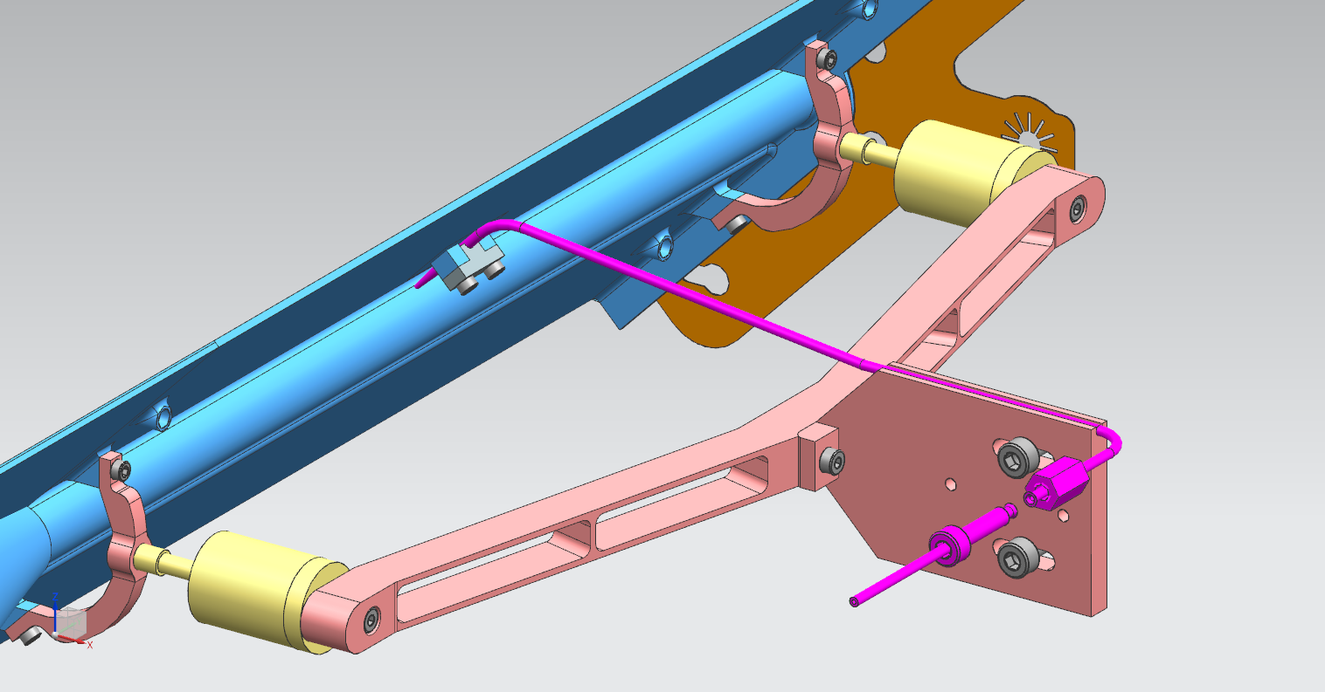
UNPOL STORAGE CELL : GAS FEED
TUBE DIMENSIONS :
Outer diameter = 1,6 mm
Hole diameter = 0,8 mm
STORAGE CELL
TUBE EMBEDDED INTO THE CELL SUPPORT
TUBE CLAMPER
TRANSITION TO THE FLEXIBLE TUBE

Slide 33
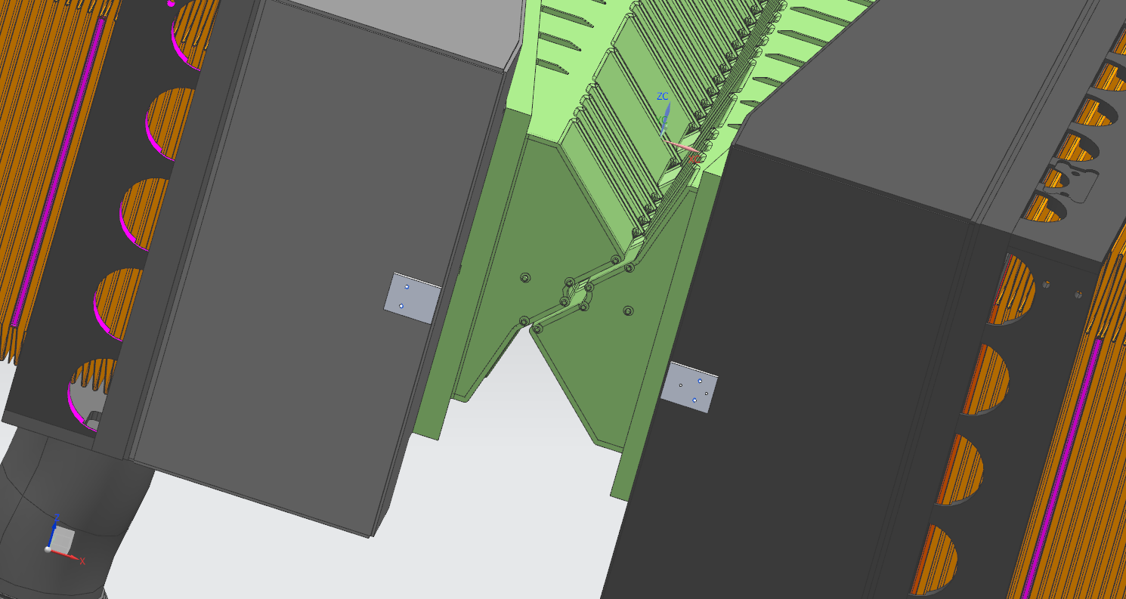
INSTALLATION PROCEDURE : PRELIMINARY OPERATIONS - 1
PLATES SUPPORTING THE TWO HALVES OF THE CELL
WELDED ON THE VELO BOXES

Slide 34
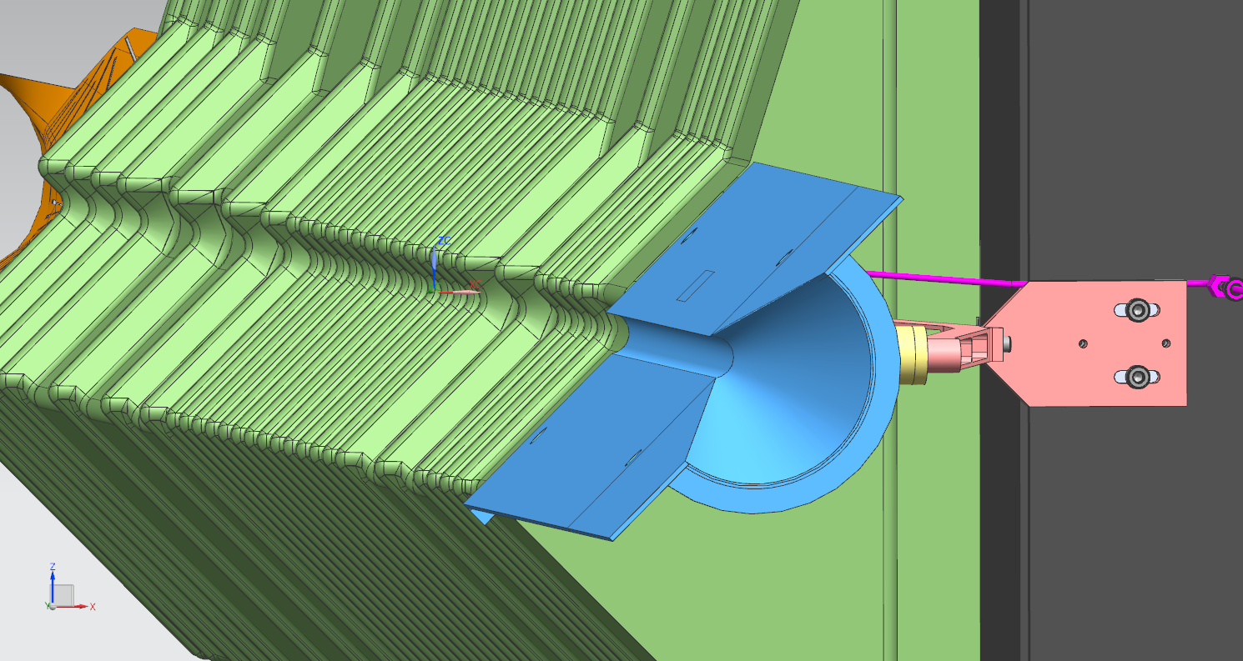
INSTALLATION PROCEDURE : PRELIMINARY OPERATIONS - 2
SURVEY OF THE DETECTOR AND FIXED HALF CELL AXES ALIGNMENT
TEMPORARY MARKERS
DETECTOR AXIS
CELL AXIS
ADJUSTABLE CELL SUPPORT

Slide 35
INSTALLATION PROCEDURE : PRELIMINARY OPERATIONS - 3
VELO INSTALLED AND OPEN

Slide 36
INSTALLATION PROCEDURE - 1
CONNECTION TO THE MUSHROOM PINS
AND TO THE FLANGE
FIXED HALF CELL

Slide 37
INSTALLATION PROCEDURE - 2
CONNECTION TO THE MUSHROOM PINS
AND TO THE FLANGE
FLOATING HALF CELL

Slide 38
INSTALLATION PROCEDURE - 3
THE FLOATING HALF CELL SLIDES BACK

Slide 39
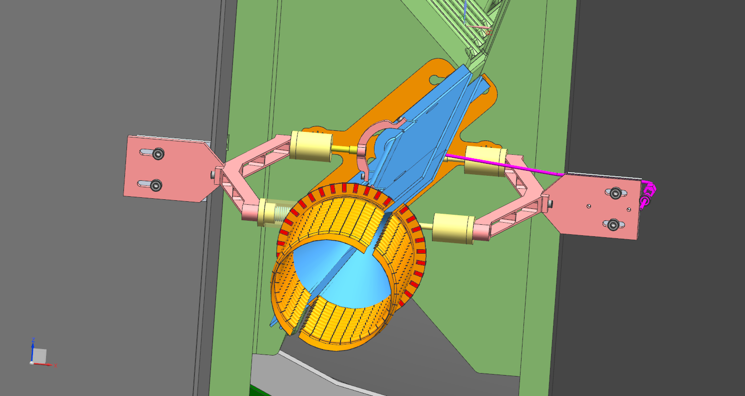
INSTALLATION PROCEDURE - 4
VELO IN CLOSED POSITION

Slide 40
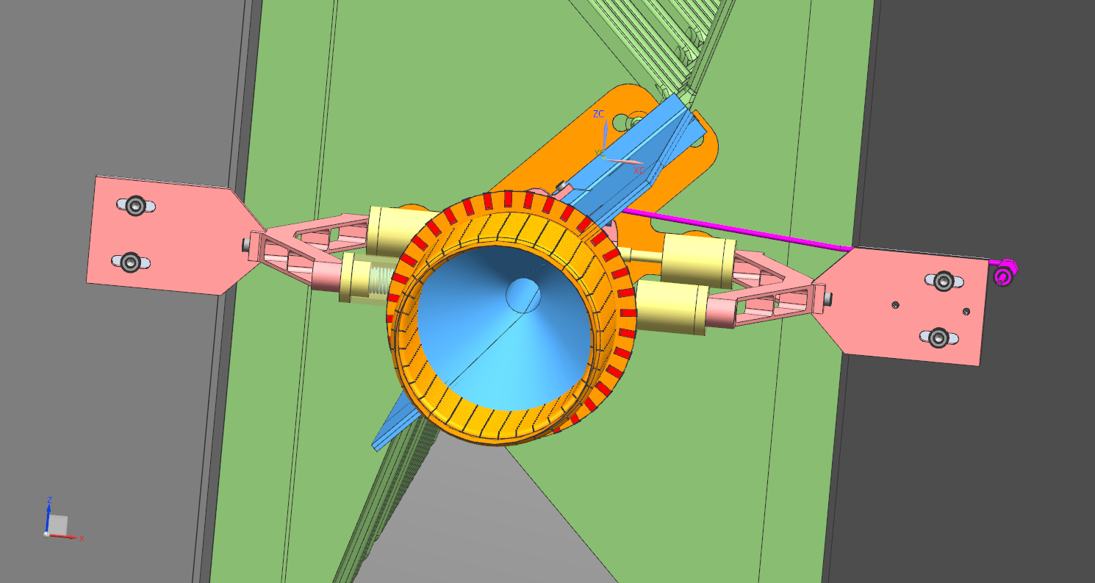
INSTALLATION PROCEDURE - 5
FLOATING HALF CELL IN COMPENSATION POSITION

Slide 41
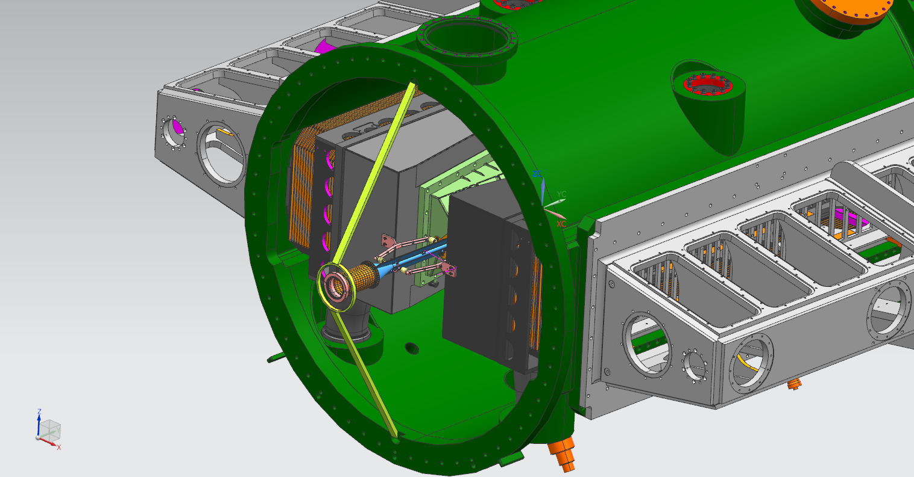
INSTALLATION PROCEDURE – 6
CF200 SERVICE FLANGE :
GAS FEED-THROUGH AND THERMOCOUPLES CONNECTION
MODIFIED SPOKE INSTALLATION

Slide 42
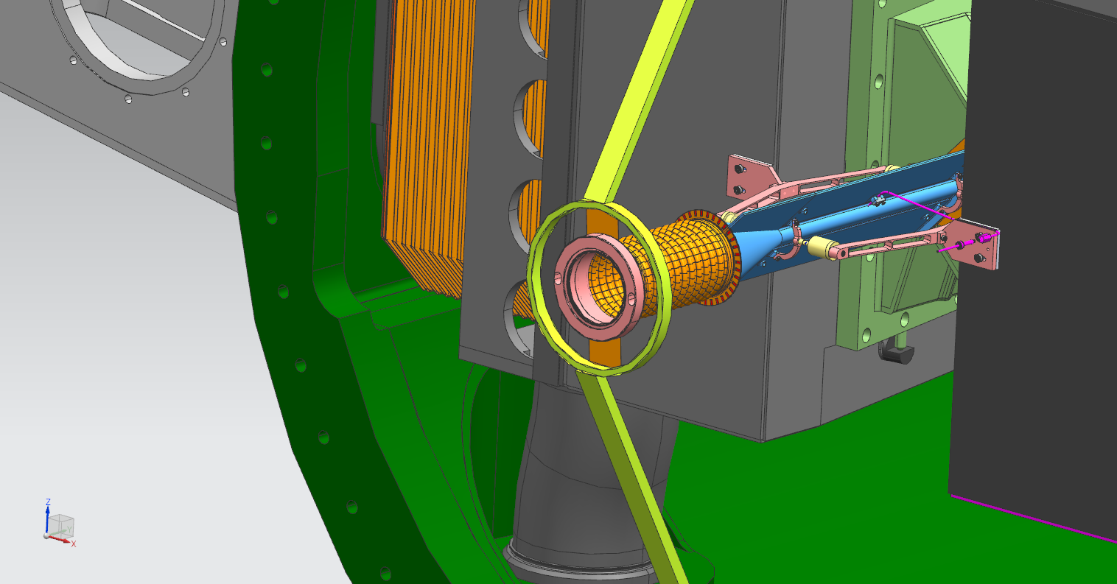
INSTALLATION PROCEDURE – 7
1) WFS , FLANGE AND SUSPENSION ASSEMBLY
2) SUSPENSION – SPOKE RING CONNECTION

Slide 43
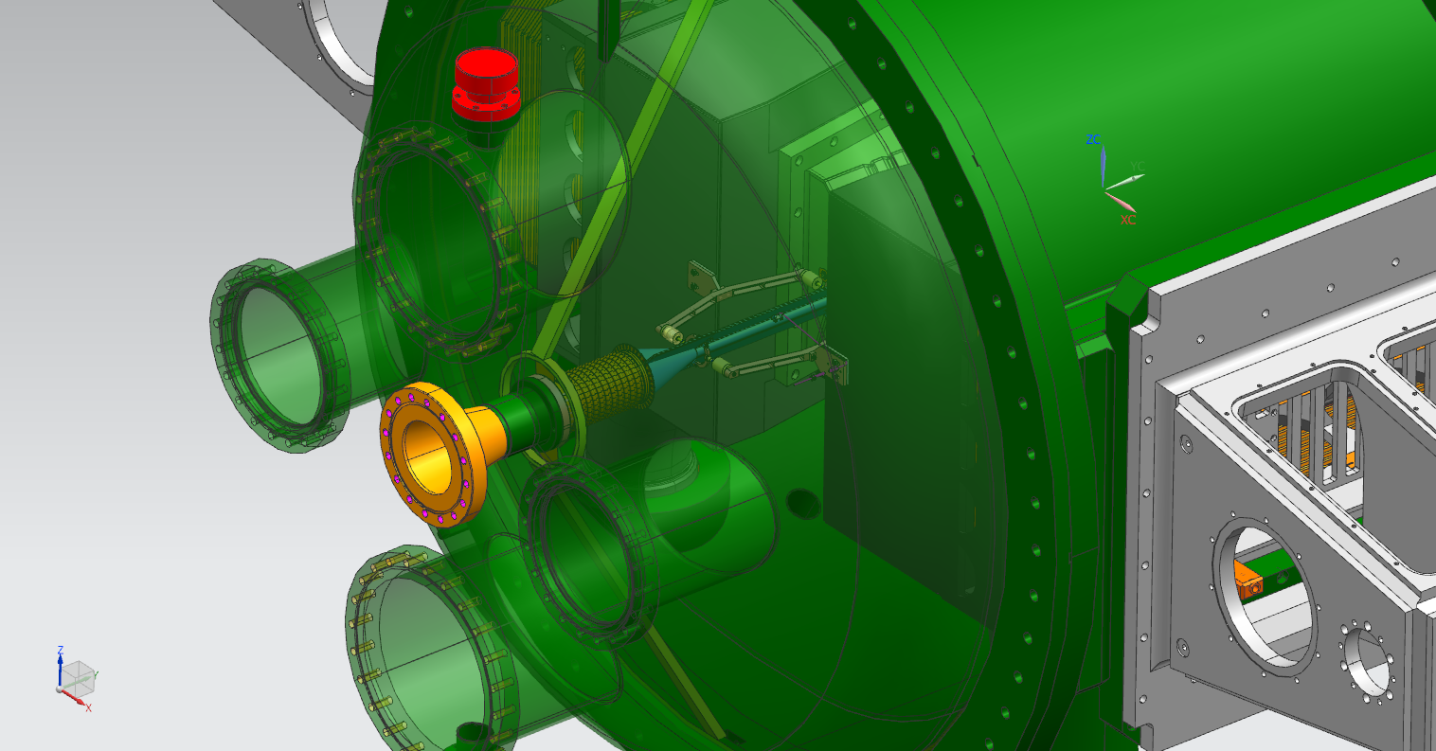
INSTALLATION PROCEDURE – 9
1) ELLIPTICAL FLANGE INSTALLATION
2) FLANGES CONNECTION
SERVICES FOR THE FLANGES CONNECTION

