Slide 1

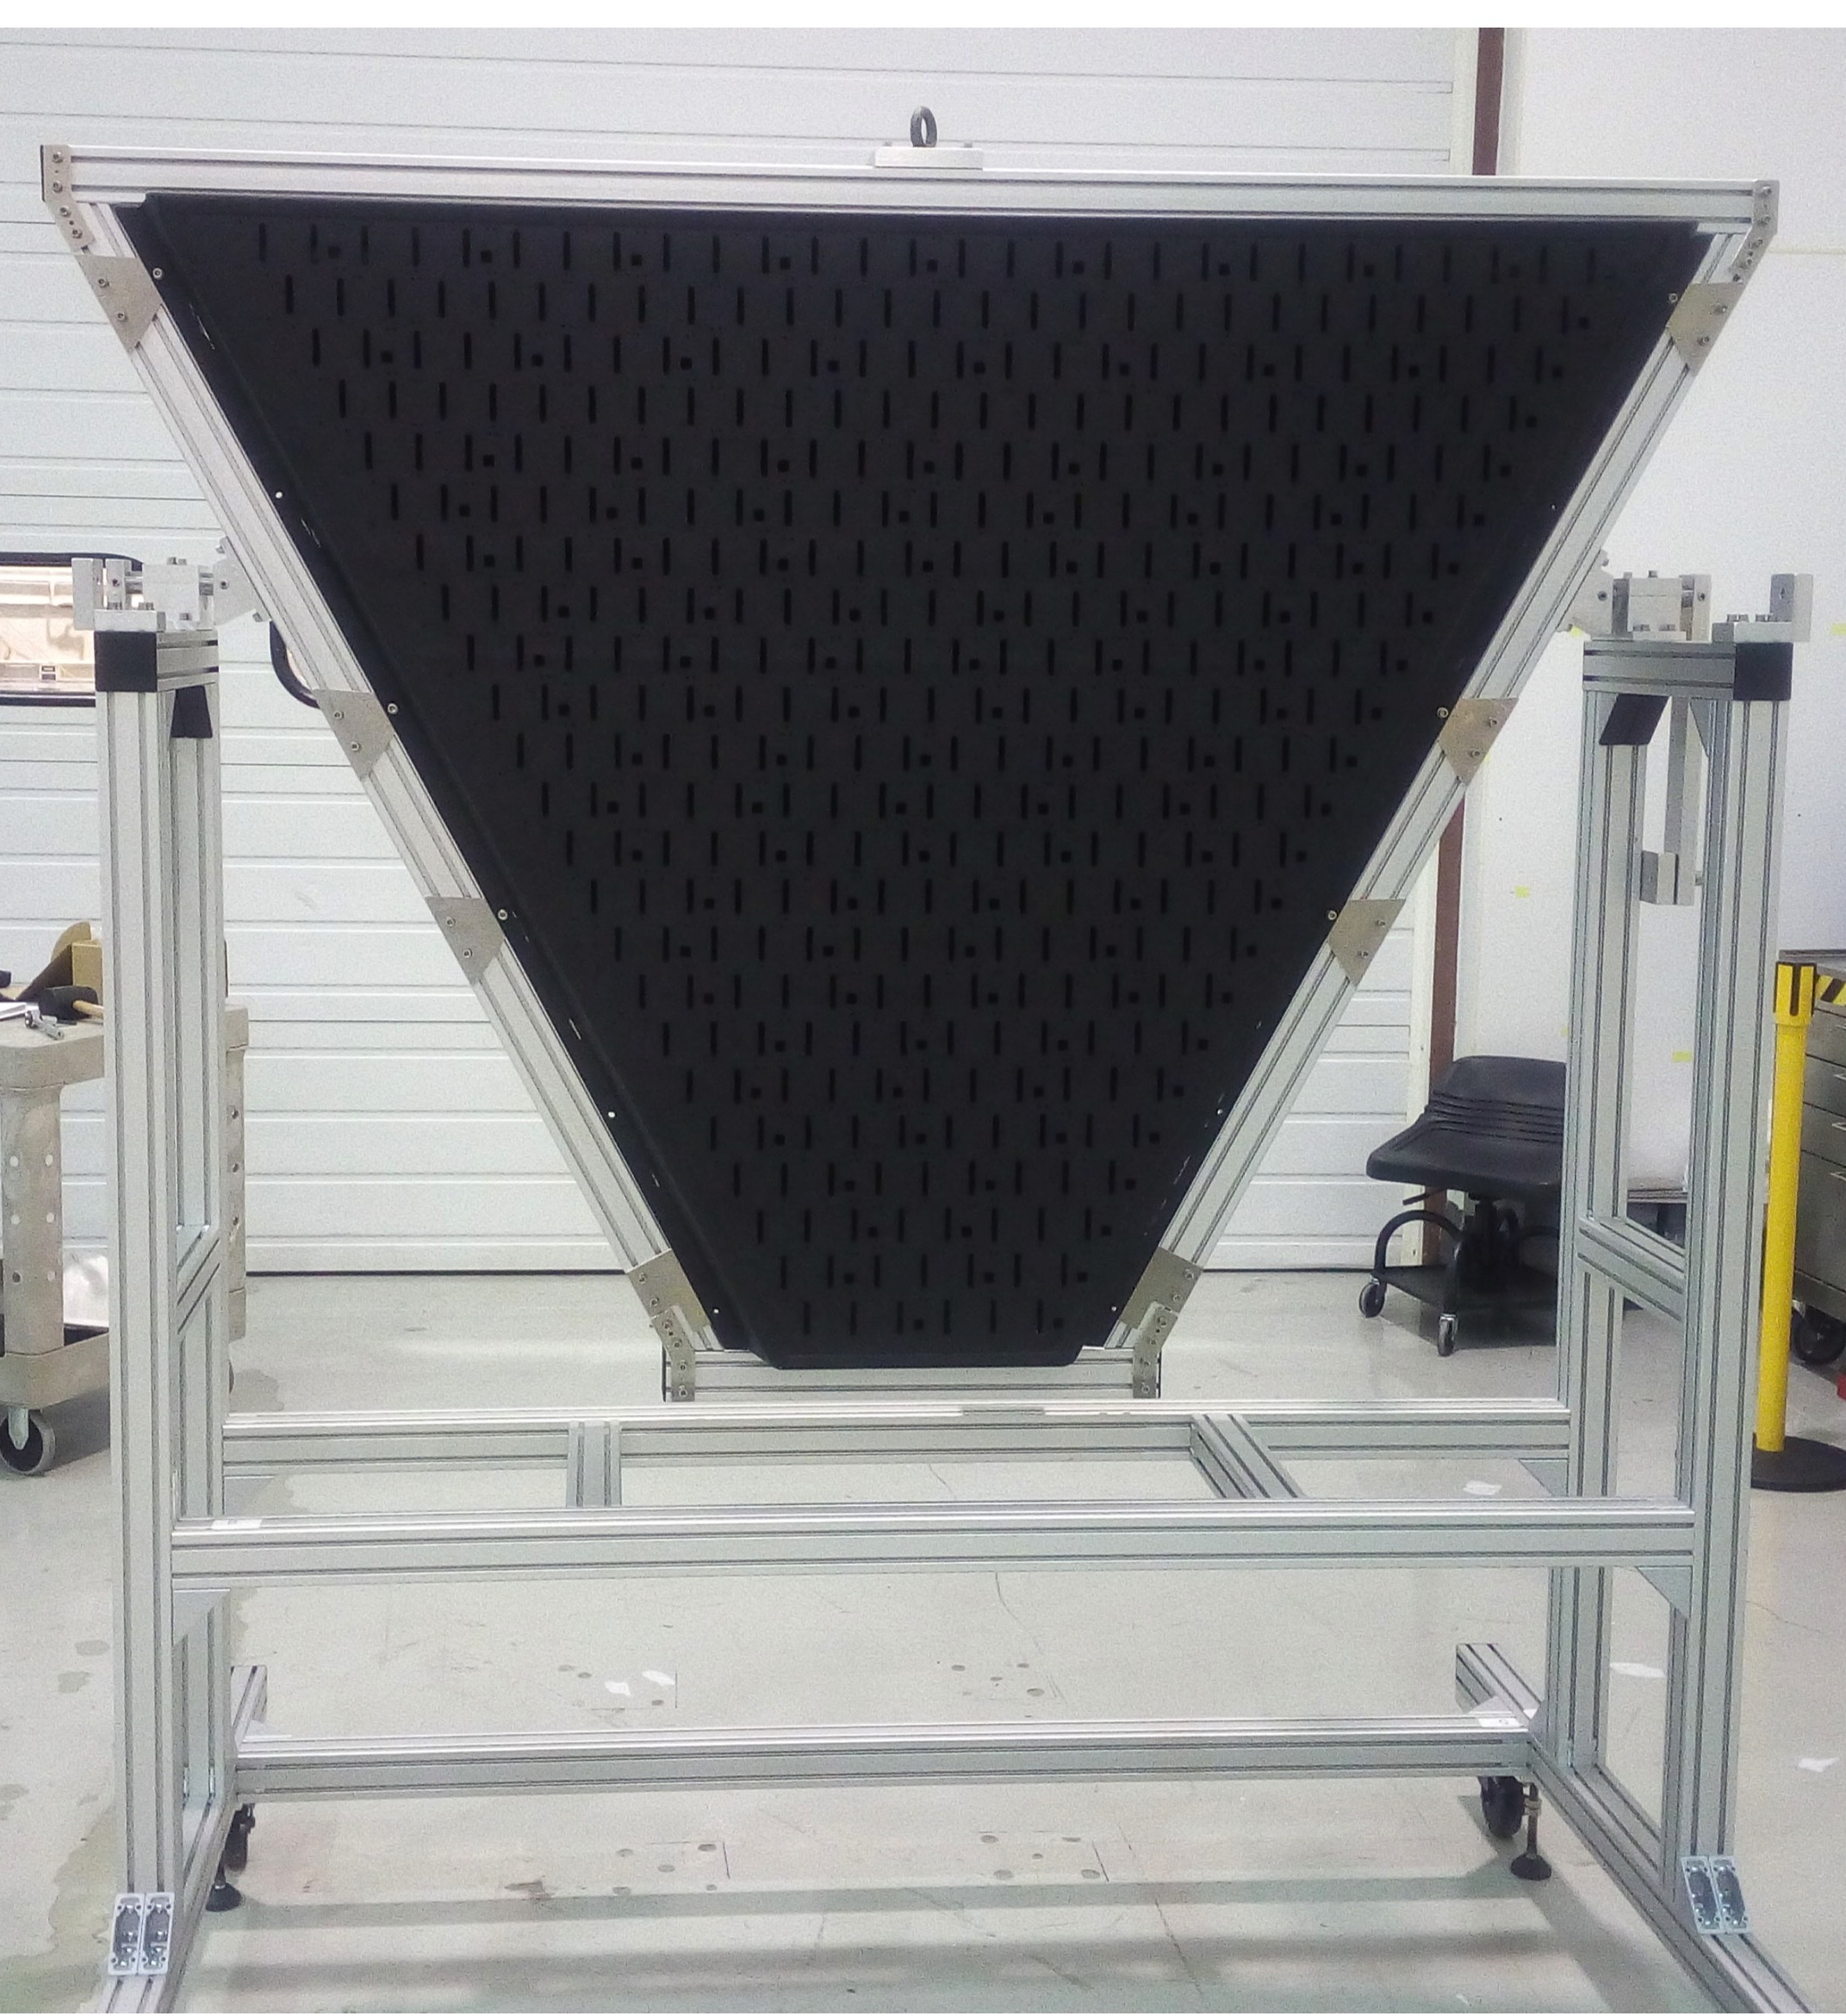
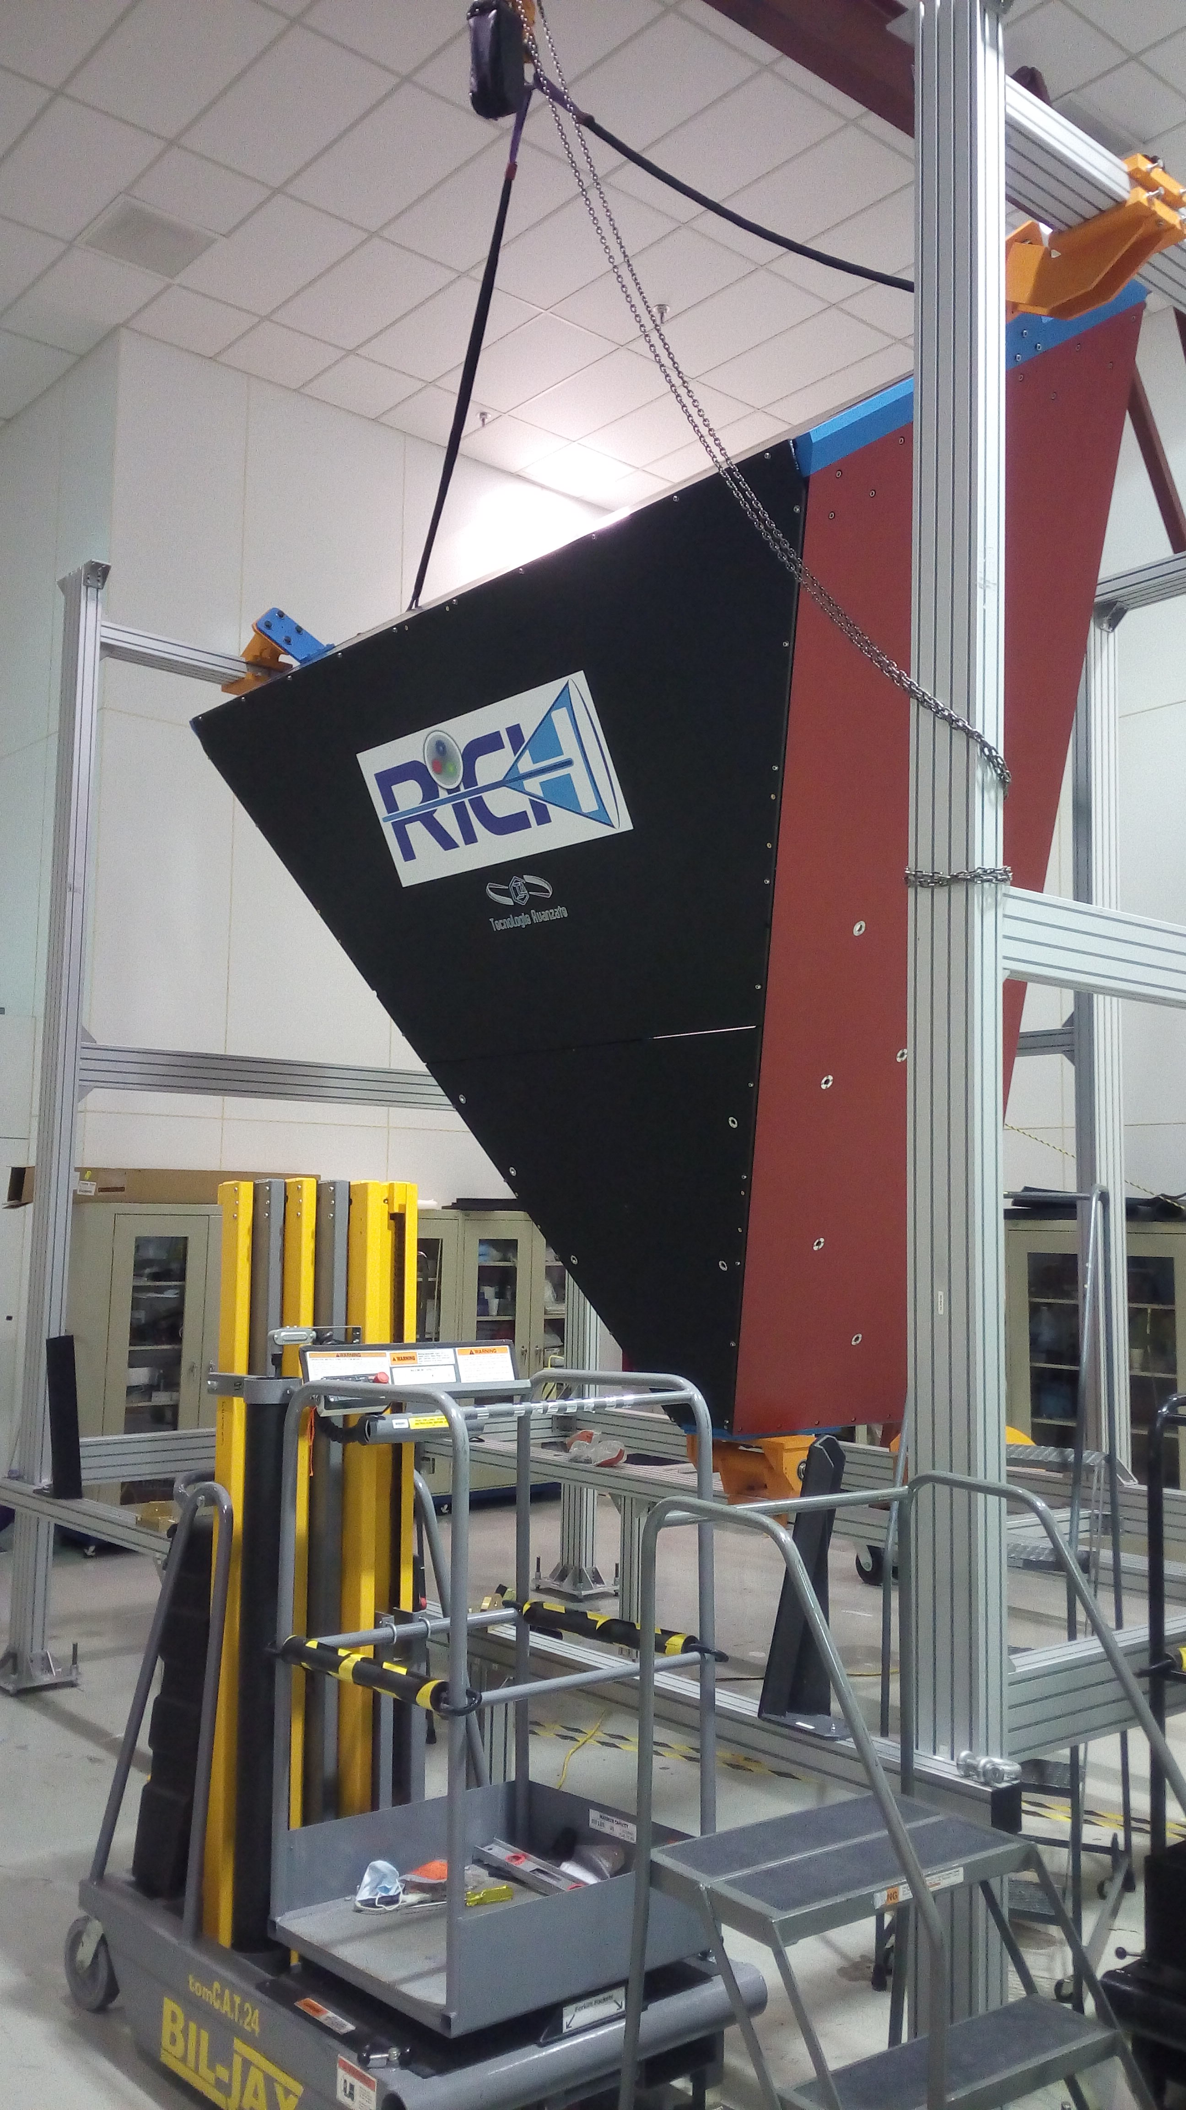
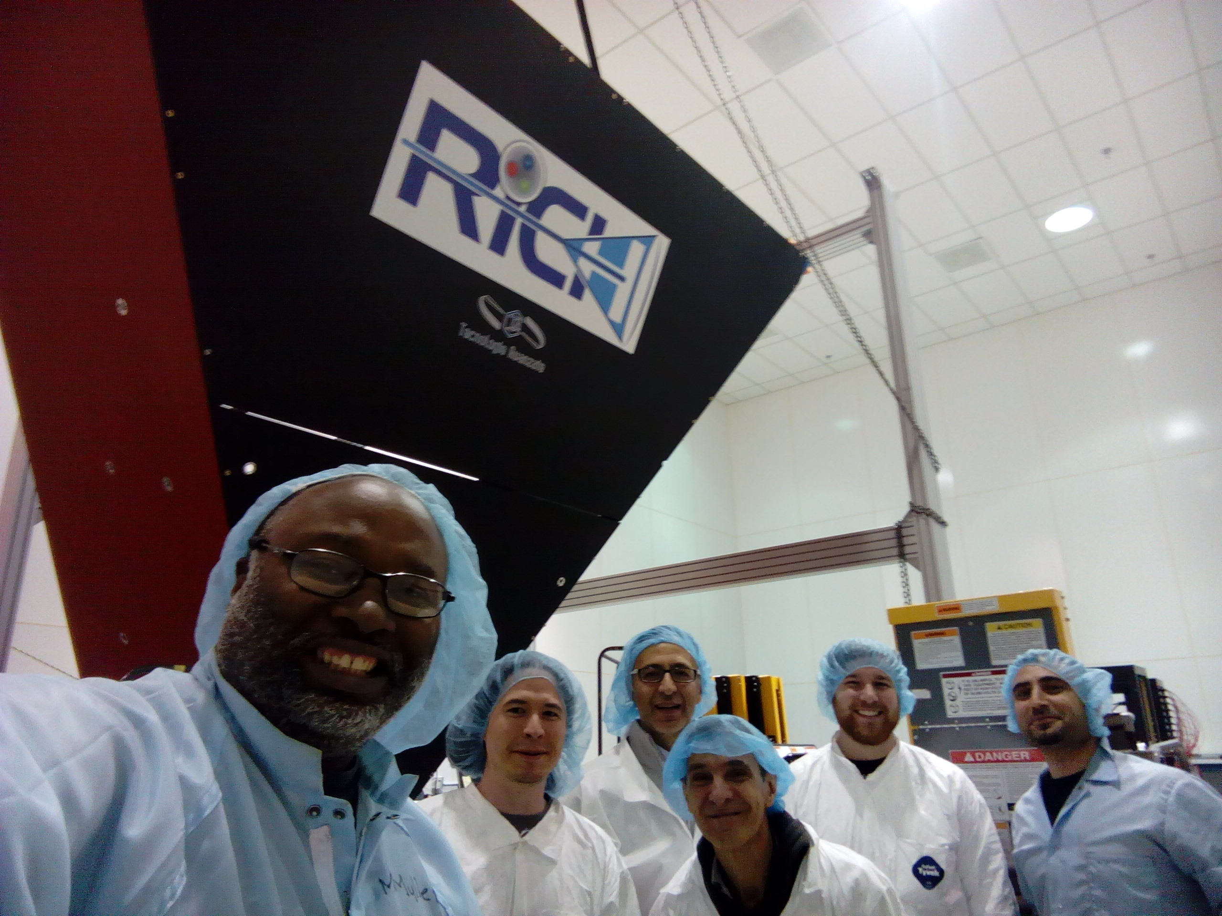
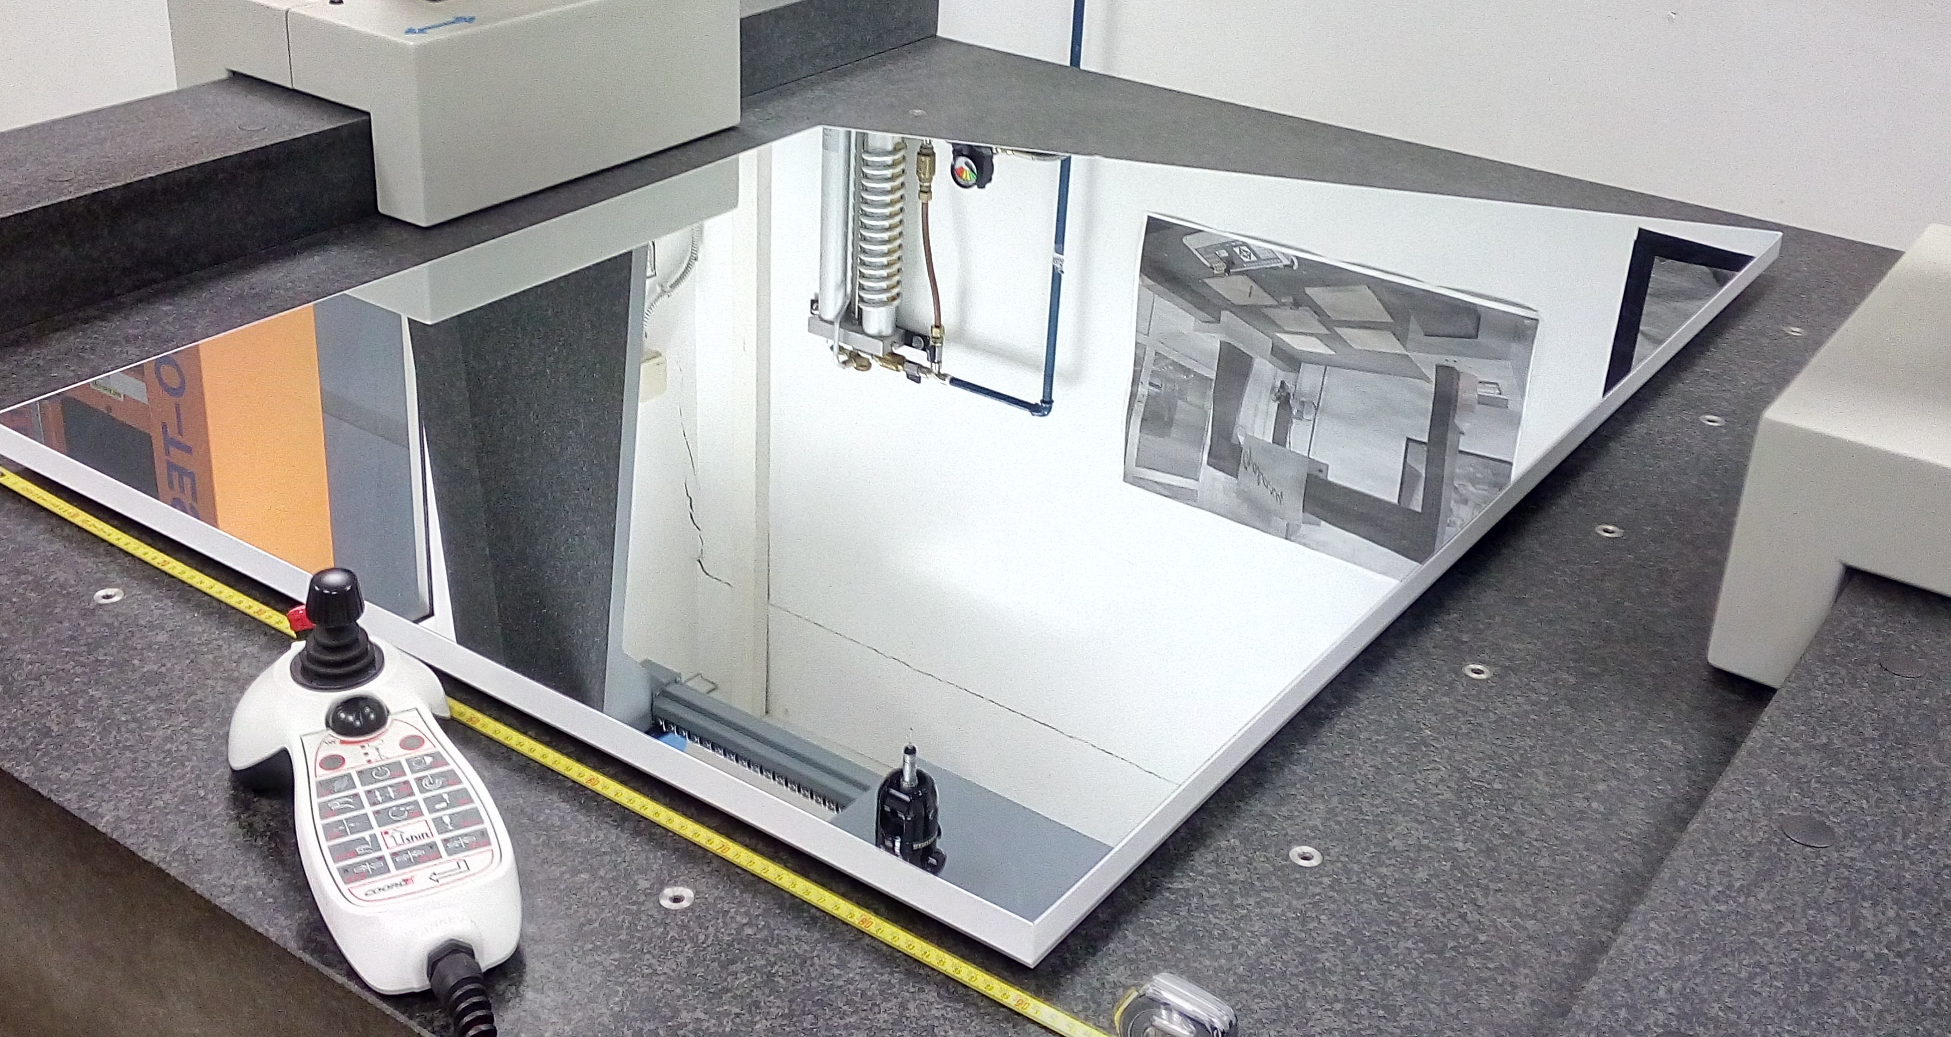
CLAS12
RICH Detector
Hall B
Mechanical structure
- Assembling at JLab ongoing with the help of the DSG
- Support structure for the electronics panel arrived to Jlab
Spherical mirrors:
- All 10 mirrors accepted
- Back to vendor to build support and alignment structure
Electronics panel with support ready at Jlab
Planar mirrors:
- 3/5 lateral mirrors accepted
- 2 front mirrors in production
RICH structure assembled at Jlab!
22/03/17
CLAS collaboration meeting, JLab 11/01-04
1

Slide 2
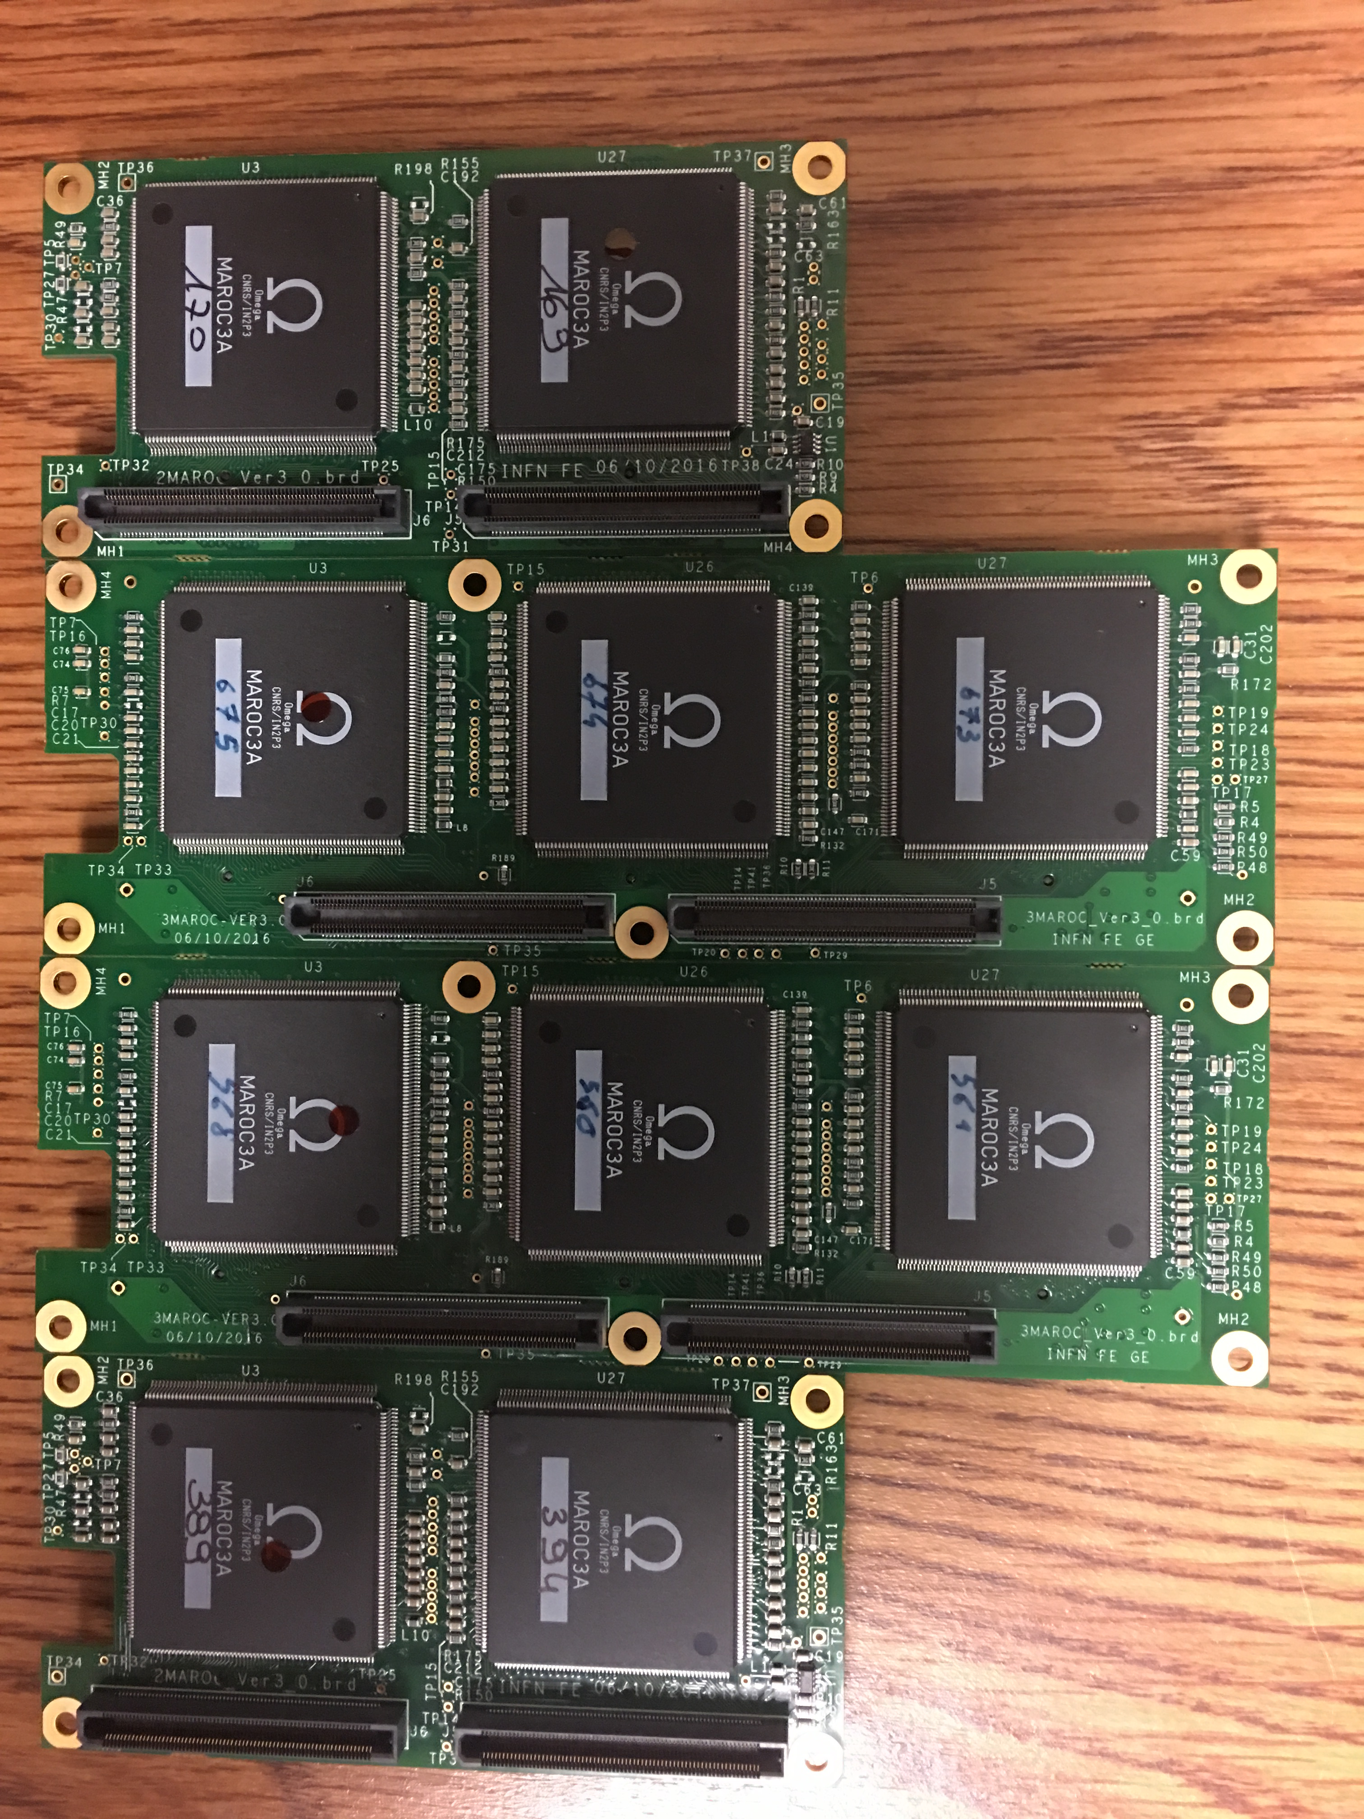
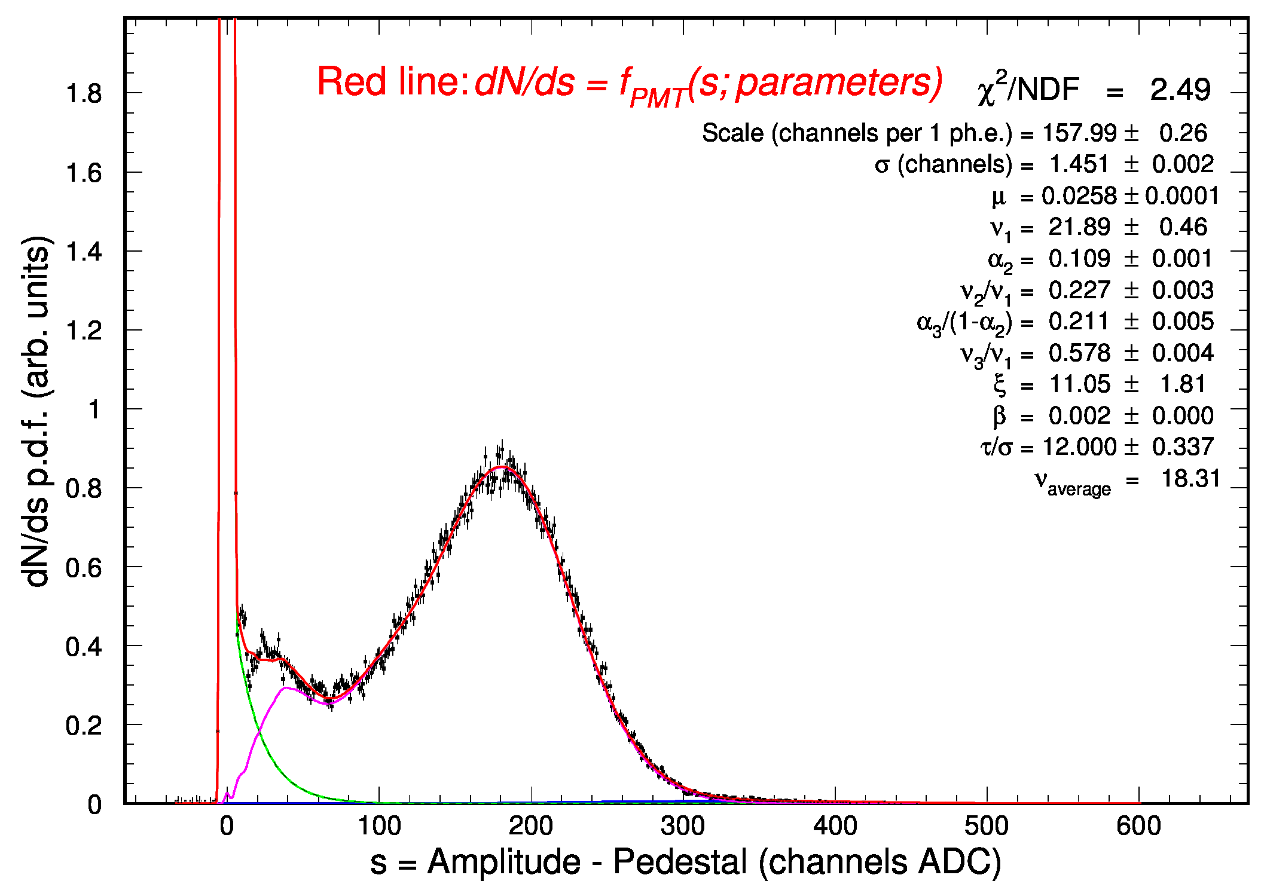
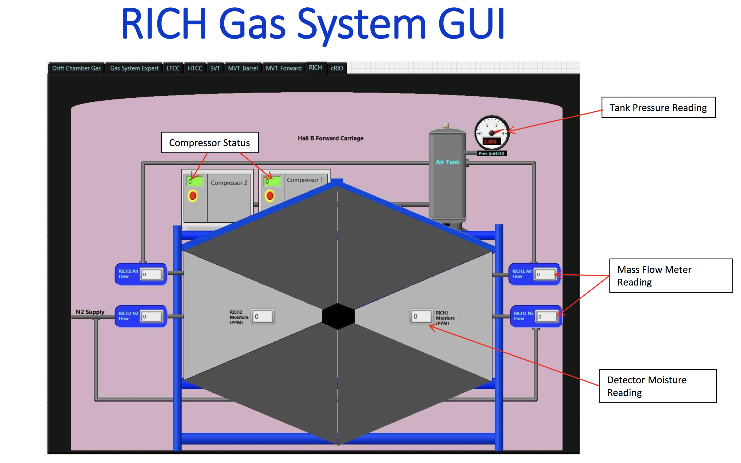
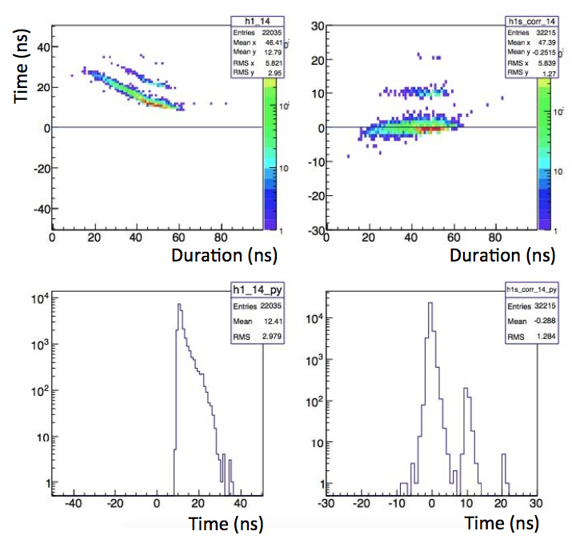
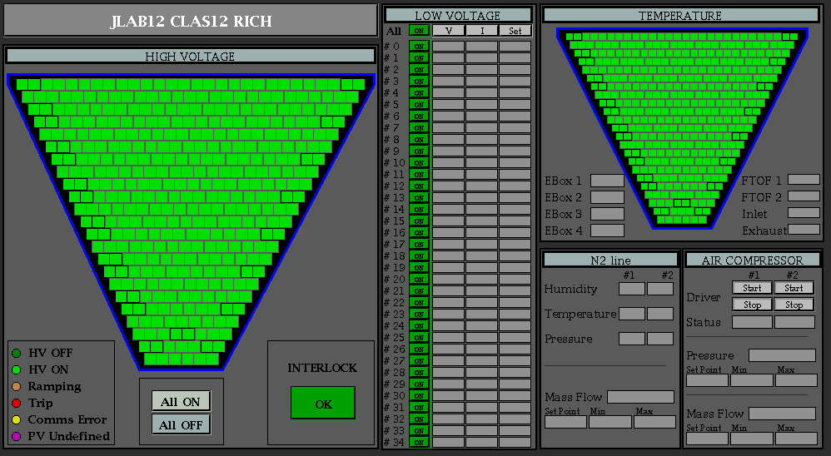
CLAS12
RICH Detector
Hall B
Aerogel:
- Five additional 3cm tiles delivered in January and tested (got >75% of the minimum quantity required)
- 2cm layer production started
Electronics:
All electronics front-end boards are at JLab
Acceptance tests done at the company
- Electronics boards characterization ongoing
- σ(ped)/1phe ~ 1%
One photoelectron spectrum
taken with new front-end
Digital time walk correction
Slow Control design ongoing
On schedule for the installation in Hall B in September 2017
22/03/17
CLAS collaboration meeting, JLab 11/01-04
2

