Slide 1


INFN @ JLab
RM1, CT, BA Nucleon 3D FE, LNF,GE
E07-109 Proton form factor ‘22 E06-112 Quark dynamics ‘18
E17-004 Neutron form factor ‘22 E12-008 TMDs ‘18
E09-018 SIDIS off neutron (³He) ’23 C11-111 TMDs ‘21
C12-009 Dihadron probes ’21
Spectroscopy
GE, RM2, TO, PV
E11-005 ‘18
MESONX
E12-001A ‘18
J/psi and penta-quark
E16-010 ‘18
Hybrid Baryons
Nuclear Potentials
RM1
E17-003 ‘18
Lambda-nn off trithium (³H)
E11-101 ‘19
PREX-II: neutron skin
E15-008 ‘24
Lambda hypernuclei
Tracker
HCAL-J
RICH
HD-ice
Forward
Tagger
Hall-A
Hall-B
Cristal Calorimetry
Dark Sector
GE, CT, PV, LNS, RM2, TO, PD
E11-006 HPS ‘17 E16-001 BDX ‘24

Slide 2
INFN Short Term Program
Hall-A:
Dec 17 - Nov 18: Experiments with tritium target * ✔ DONE
Spring 19: APEX (heavy photon search)
Summer 19: PREX-II (neutron skin ²⁰⁸Pb) *
Summer 19: mini-BDX *
Fall 19: CREX (neutron skin ⁴⁸Ca)
2020: SBS era *
Hall-B:
CLAS12 installed and fully operational
Dec 17 – Jan 18 Engineering run
Feb 18 – Nov 18 RGA: 10.6 GeV beam, unpolarized Hydrogen target * ✔ DONE
Nov 18 – Dec 18 RGK: 6.5 e 7.5 GeV beam, unpolarized Hydrogen target * ✔ DONE
Jan 19 – Mar 19 RGB: 10.6 GeV beam, unplarized Deuterium target *
Jun19 – Sep 19 HPS: 4.5 GeV beam, heavy photon search *
Several upcoming experiments with INFN co-spokesperson ship (*)

Slide 3
Funding Plan
(All but ME) | 2018 Assigned | 2019 Assigned | 2020 Expected | 2021 Expected | 2022 Expected
Tracker (Hall-A) | 25 | 15 | 15 | 10 | 10
FT (HallB) | 20 | 20 | 20 | 15 | 10
RICH (HallB) | 220 | 195 | 240 | 80 | 50
HCAL-J (HallA) | 30 | 30 | 20 | 10 | 10
PolTarg (HallB) | 45 | 30 | 120 | 150 | 150
HPS+BDX (HallA+B) | 70 | 50 | 30+170 | 170 | 170
Calc (HallA+B) | - | 15 | 15 | 15 | 15
Hyper + WACS (Hall-A) | - | - | - | 40 | 20
Total (HallA+B) | 410 | 355 | 630 | 490 | 435
RICH2 Installation in summer 2021
BDX aggressive schedule

Slide 4
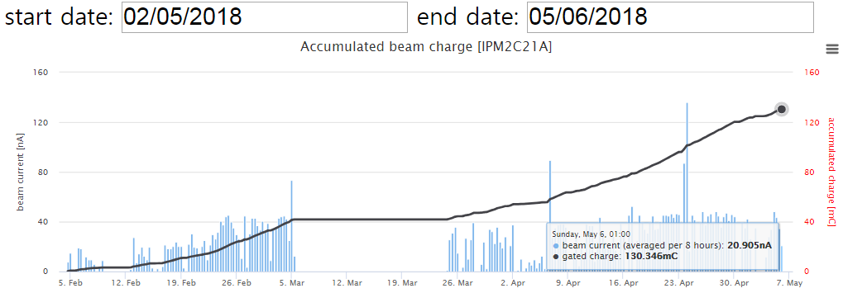
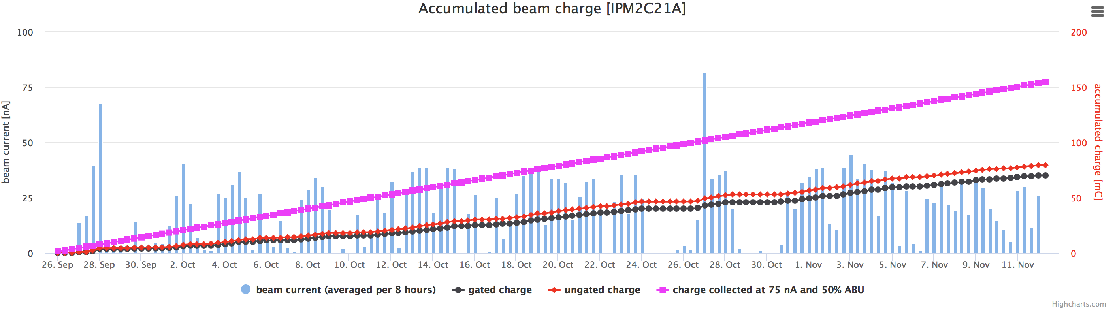
CEBAF @ 12 GeV
Example: Hall-B data-taking
~130mC
Spring 2018
Machine
retuning
Completed detector setting
Start 10.6 GeV RGA data taking
Machine Down
Fall 2018
~80mC

Slide 5
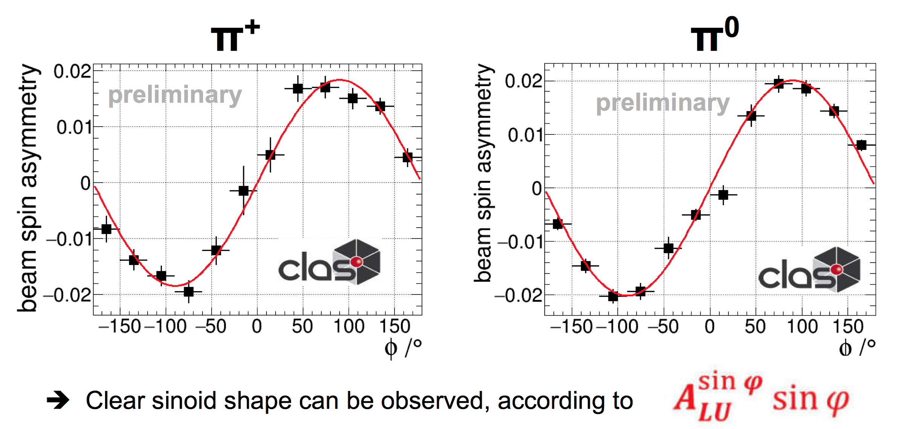
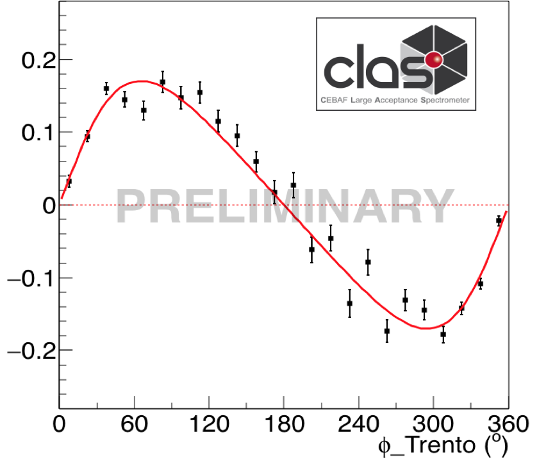
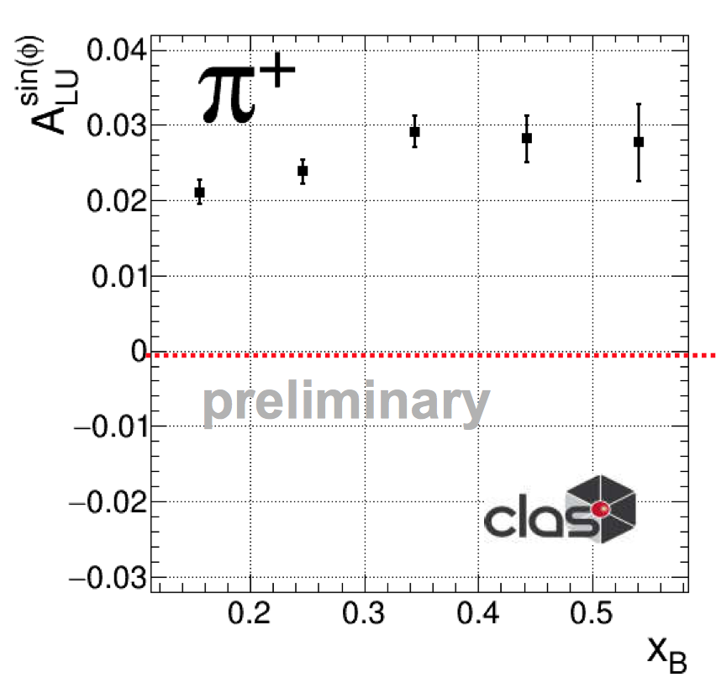
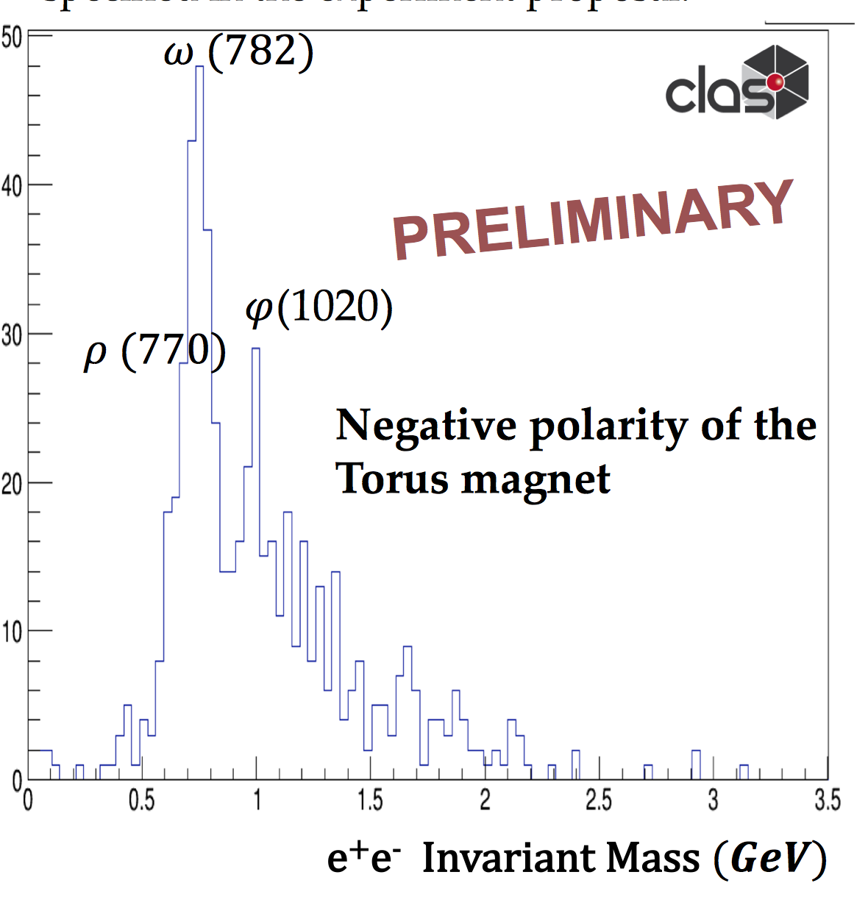
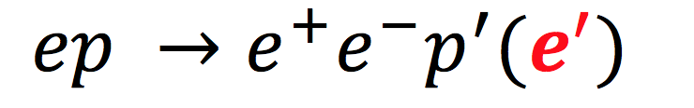
CLAS12 Outcome @ DNP/JPS Meeting
Semi-inclusive channels
Hard exclusive / Spectroscopy
p(e,e’π)X
p(e,e’pγ)
Raw beam spin asymmetry
Raw beam spin asymmetry
TCS & J/psi

Slide 6
INFN @ JLab
INFN presence since the beginning (1991)
Increasing interest in 12 GeV era
~40 FTEs including ~15 students (PhD and post-doc)
MoU: Renovated in September 2017
INFN visit at JLab: A.Masiero, E.Nappi, M.Taiuti,
P.Campana May 23-24 2018
Alessandro Bacchetta: PAC member
Anna Martin: PAC member
INFN Spokespersonship > 20% of approved 12 GeV experiments
Raffaella De Vita: Spokesperson of CLAS collaboration
Hall-B Software Responsible (interim)
Marco Battaglieri: Chair of CLAS Hadron Spectroscopy working group
Program Deputy for the Laboratory
Marco Contalbrigo: Chair of CLAS Deep Processes working group
Marzio De Napoli: Executive Committee member of HPS Collaboration
Andrea Celentano: Chair of HPS Publications and Presentations Committee

