Slide 1

Attività Gruppo III
Paolo Lenisa
Consiglio di Sezione
Ferrara, 5 Luglio 2018

Slide 2


Esperimenti di Gruppo III a Ferrara
JLAB12 (R.L. & R.N: Marco Contalbrigo)
- spin physics
- transverse momentum phenomena (TMDs) & 3D imaging
- GPDs, EM Form Factors
JEDI (R.L. & R.N. Paolo Lenisa)
- EDM, tests of fundamental symmetries

Slide 3
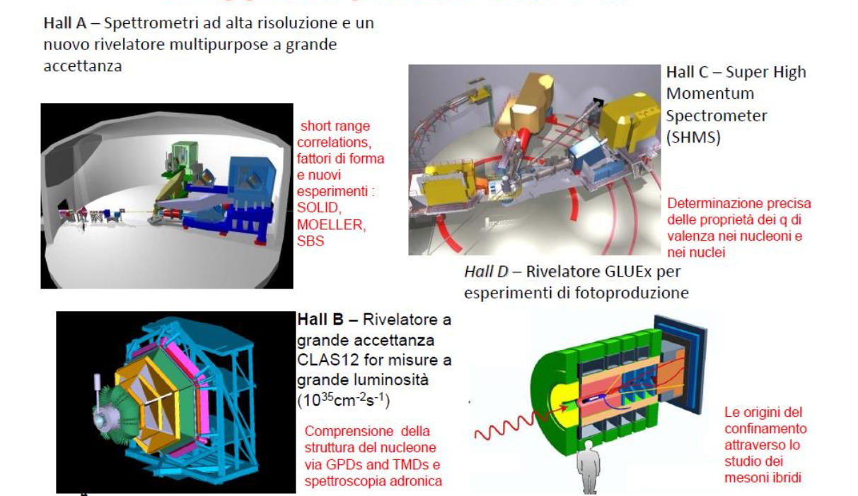
Collaborazione JLab12
Responsabile Locale e Nazionale
M. Contalbrigo

Slide 4
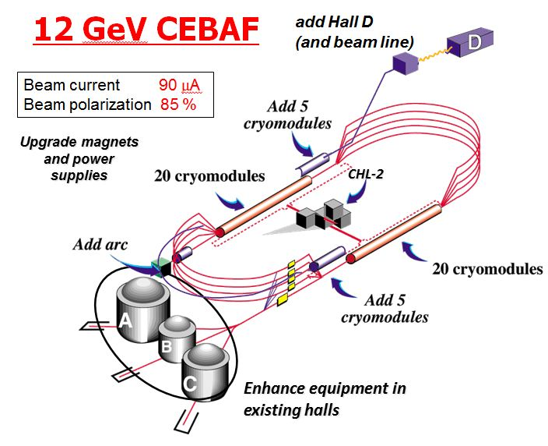
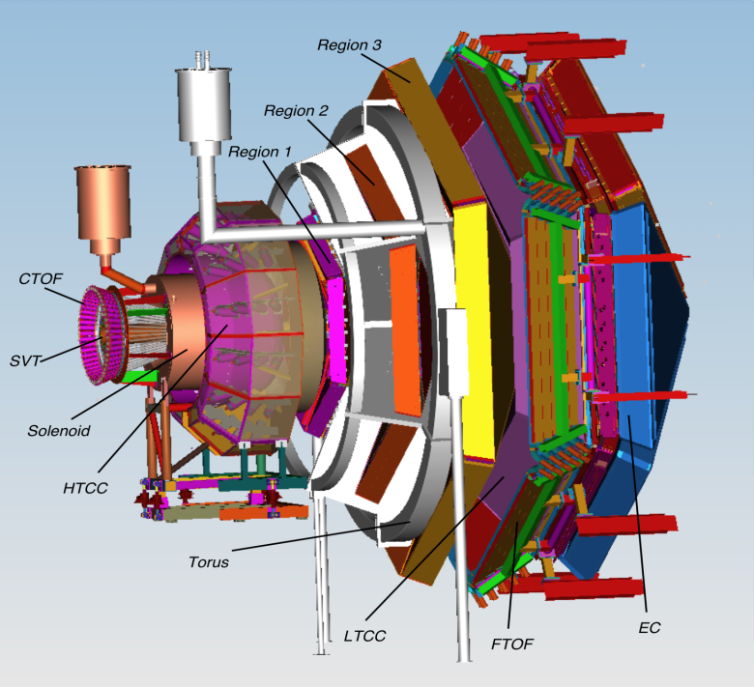
Towards the 12 GeV era
CLAS12 detector
Lumi up to
High polarized electron beams
H and D polarized target
Broad kinematic range
Very good PID
Physics program:
Hadron spectroscopy
Nuclear effects in hadronization
Nucleon structure (TMDs, GPDs)
4

Slide 5
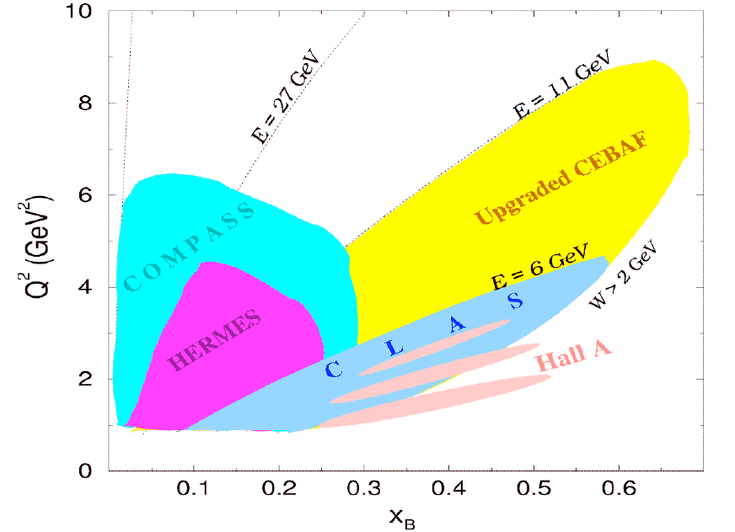
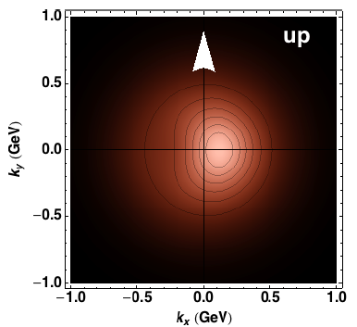
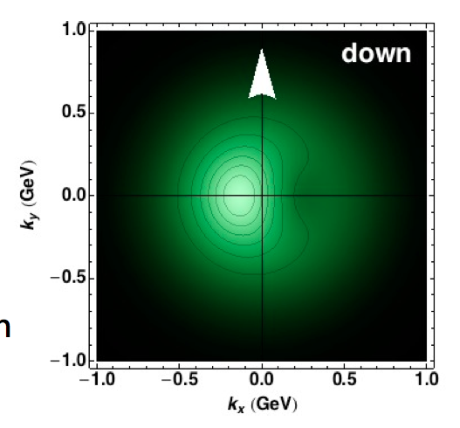
Towards the 12 GeV era
Investigating QCD spin-orbit
and dynamic effects
5

Slide 6
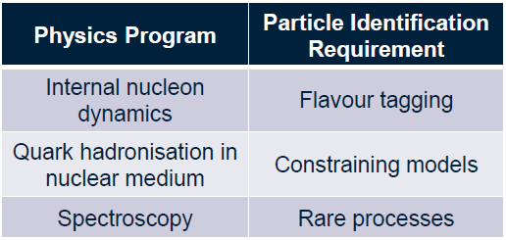


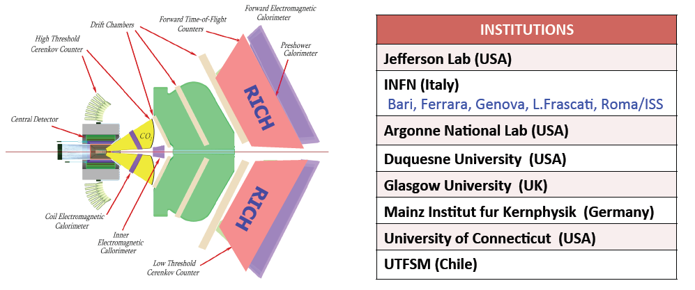
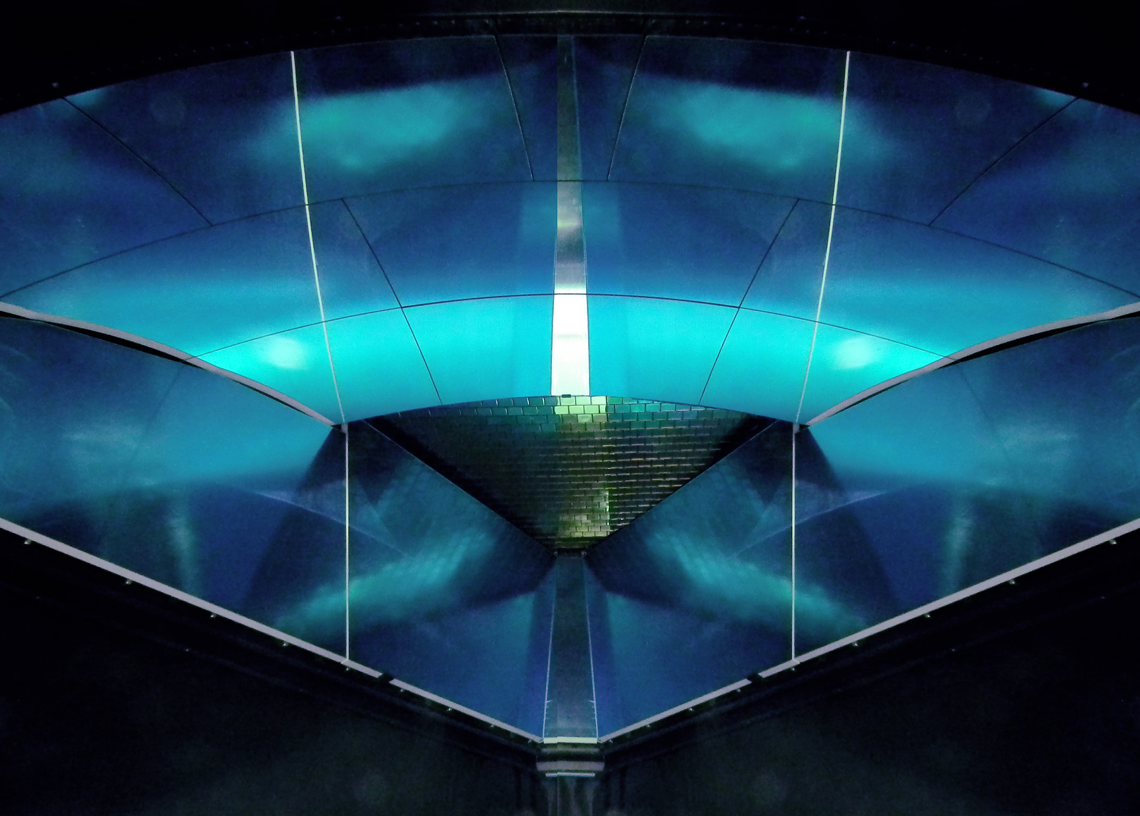
The CLAS12 RICH
INSTITUTIONS
INFN (Italy) Bari, Ferrara, Genova, L.Frascati, Roma/ISS
Jefferson Lab (Newport News, USA)
Argonne National Lab (Argonne, USA)
Duquesne University (Pittsburgh, USA)
George Washington University (USA)
Glasgow University (Glasgow, UK)
J. Gutenberg Universitat Mainz (Mainz, Germany)
Kyungpook National University, (Daegu, Korea)
University of Connecticut (Storrs, USA)
UTFSM (Valparaiso, Chile)
Notes:
6

Slide 7

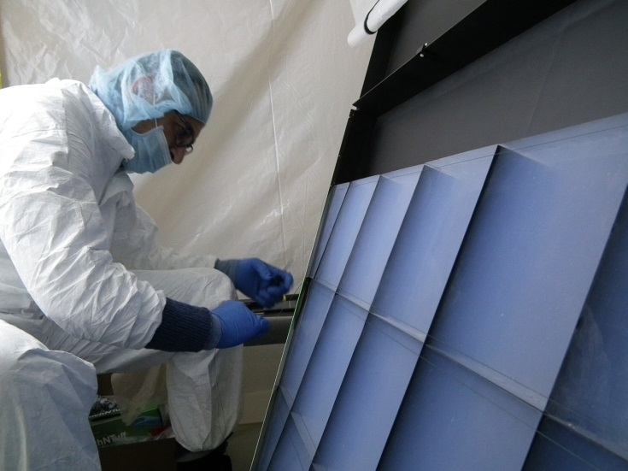
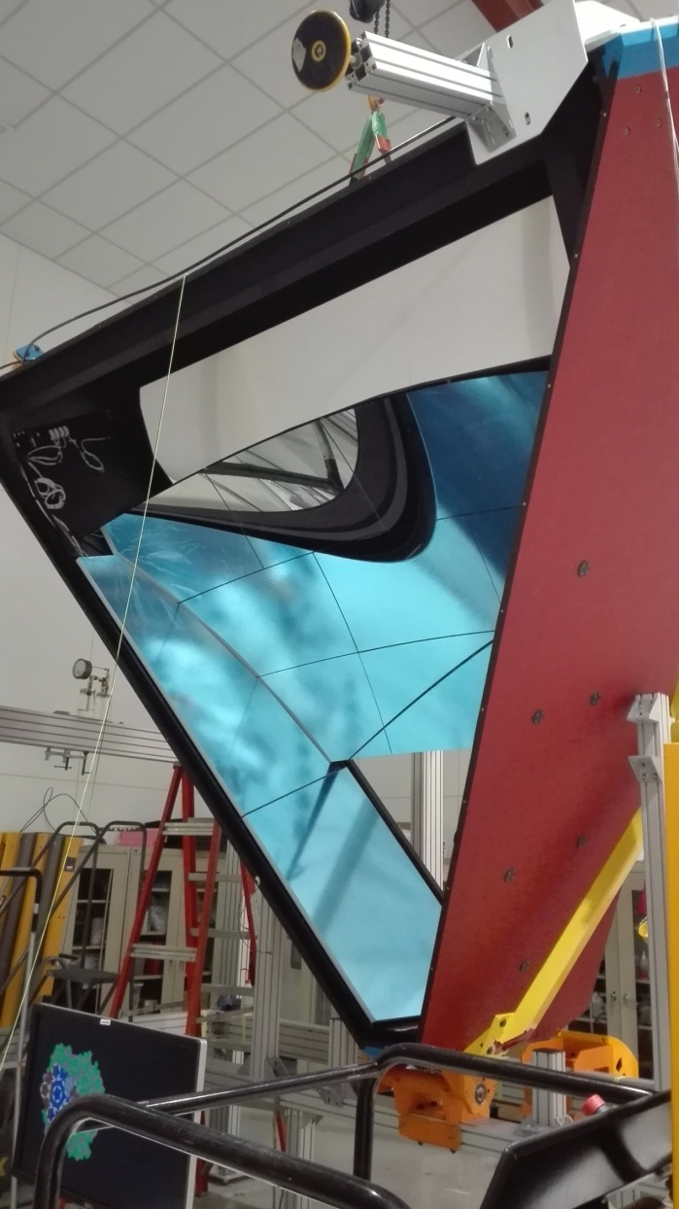
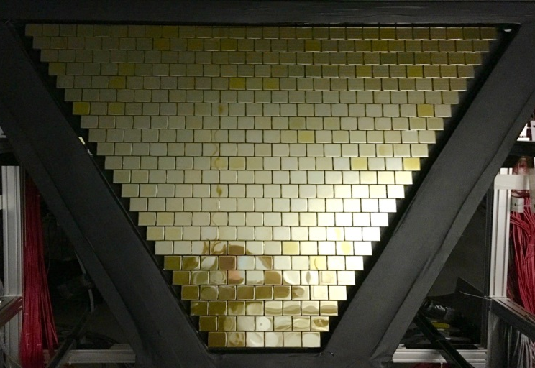
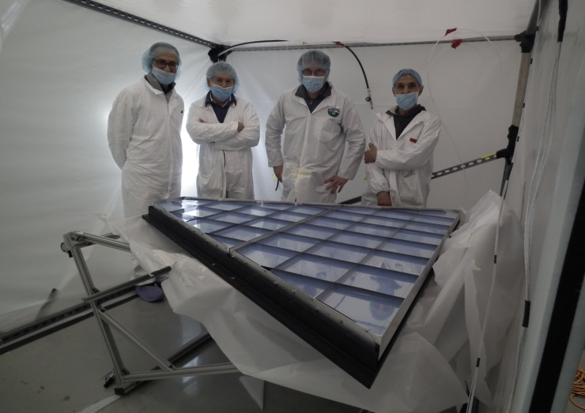
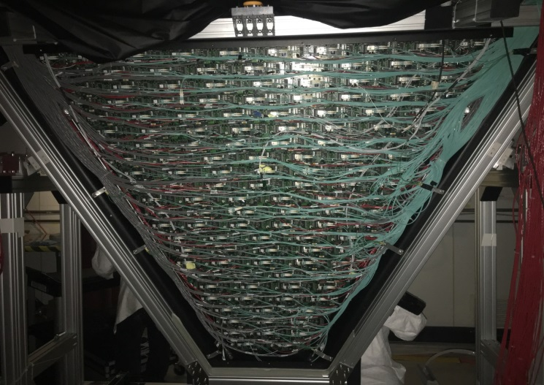
The CLAS12 RICH
First module assembled in November 2017
Notes:
7

Slide 8
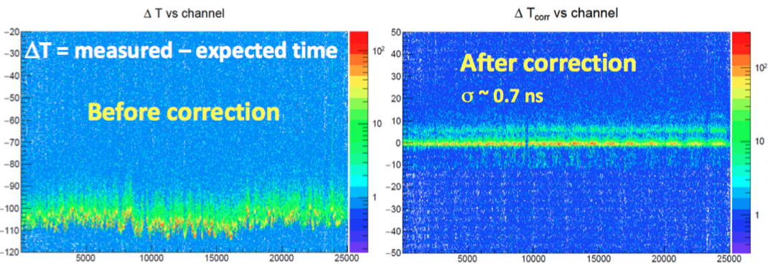
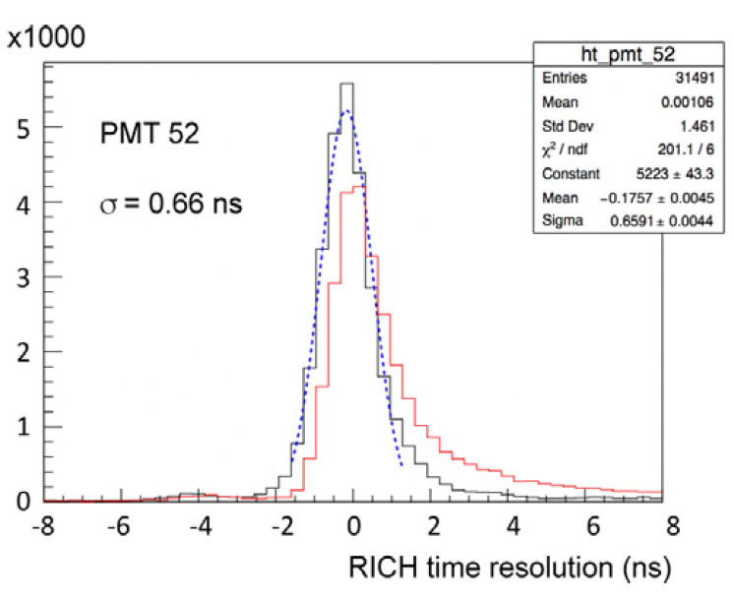
Pedestal rms at the limit of sensitivity (1 DAC)
RICH: Online Peformance
After time-offset (above) and
time-walk (left) correction, the
resolution is better than the
1ns specification
Notes:
8

Slide 9
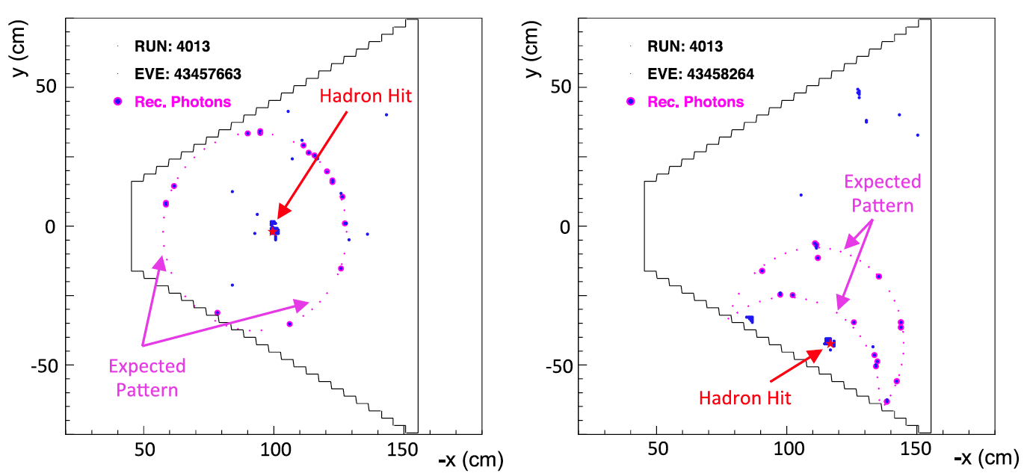
Pedestal rms at the limit of sensitivity (1 DAC)
RICH: Event Reconstruction
Notes:
9

Slide 10
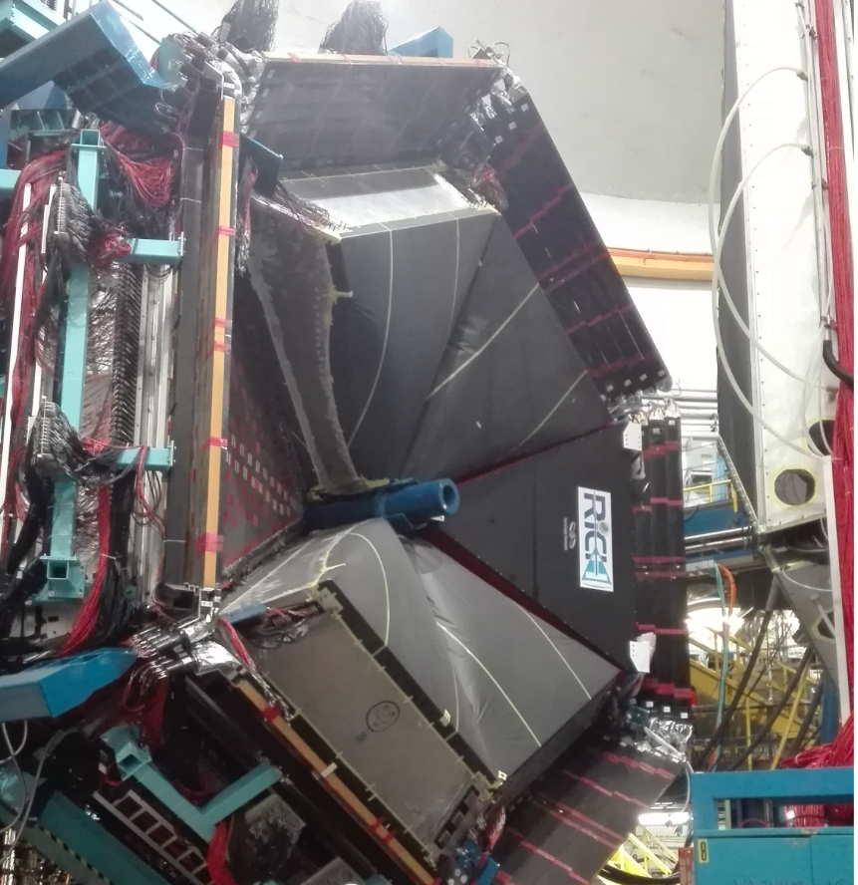
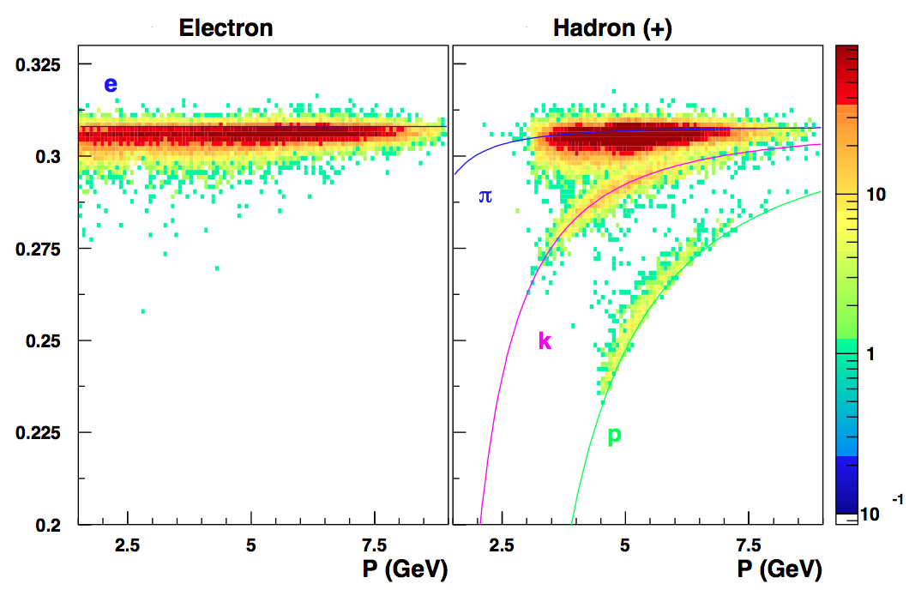
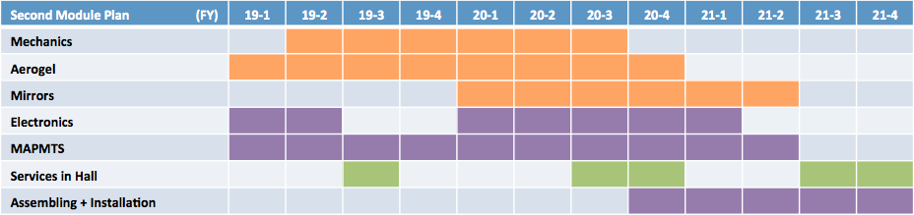
The CLAS12 RICH
Hadron separation, direct photon, RGA data
Second RICH module timeline
P. Lenisa

Slide 11
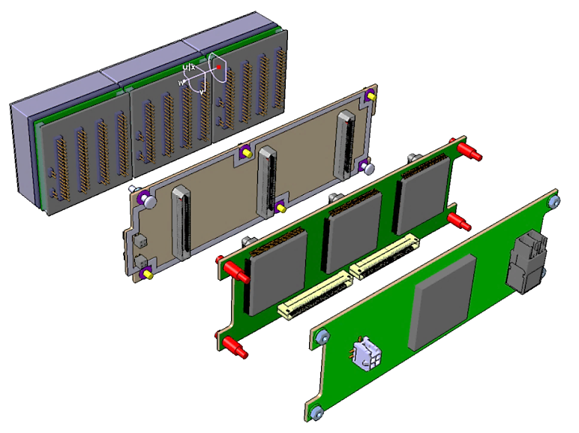
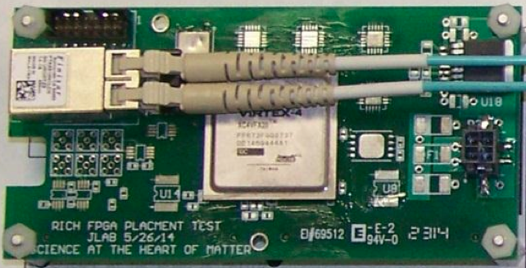
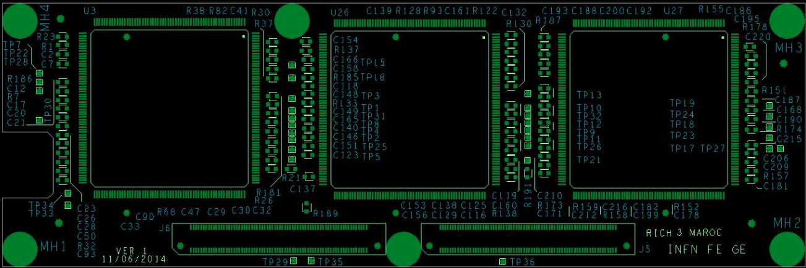
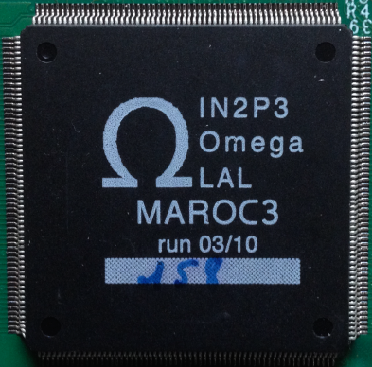
Front-End Electronics
Compact and modular electronics to readout multi-anode PMTs
Several groups (JLab DG) and experiments (Gluex, EIC, SOLID) manifest interest for using it
PMTs
ADAPTER BOARD
FPGA board (Jlab)
ASIC BOARD
FPGA BOARD
ASICs board (Ferrara)

Slide 12
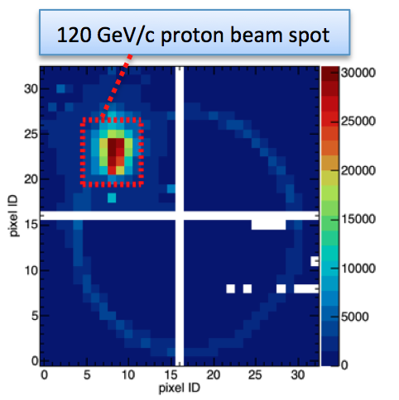
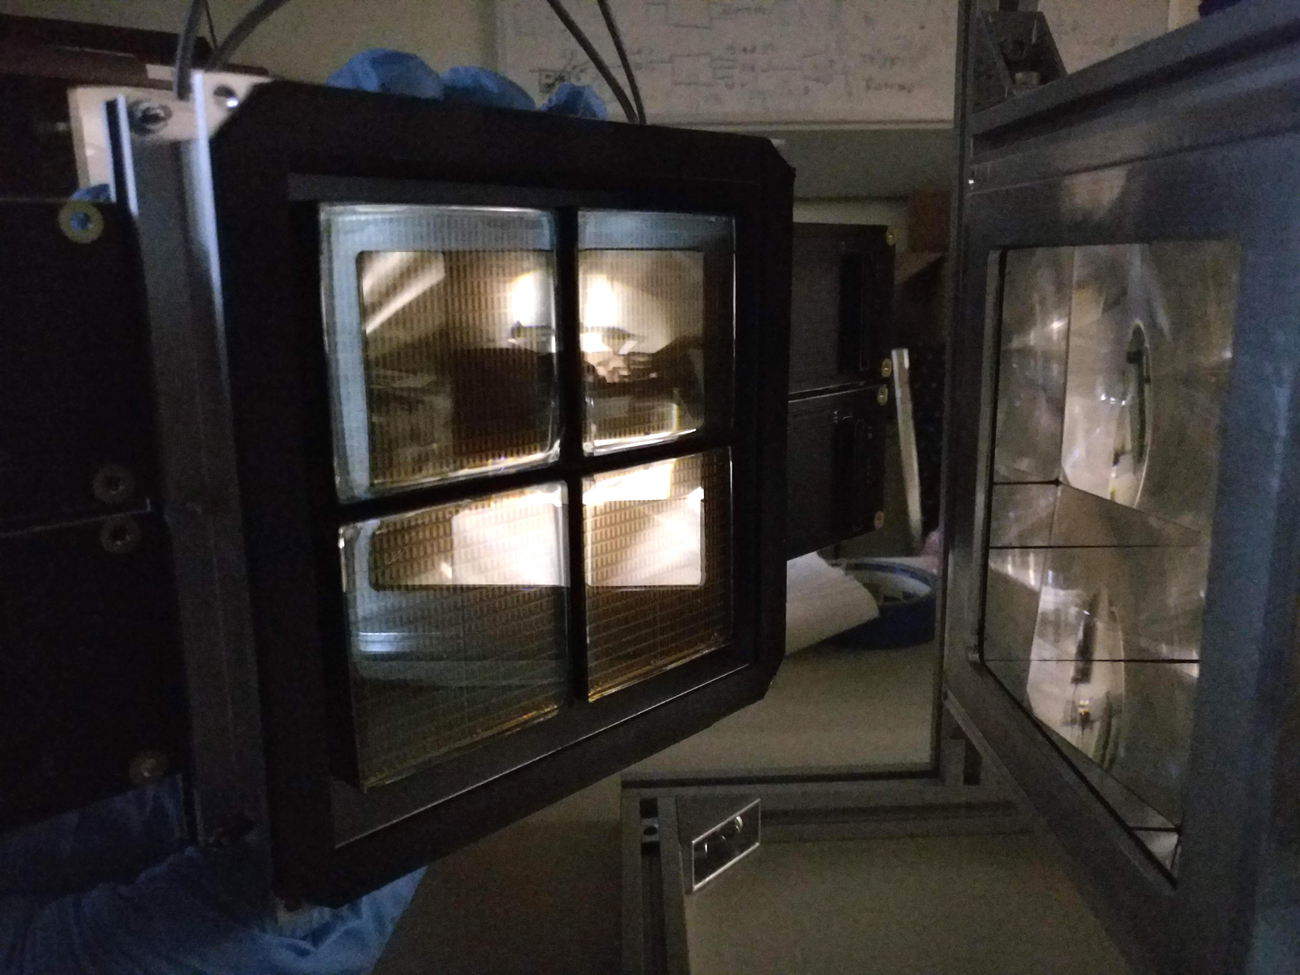
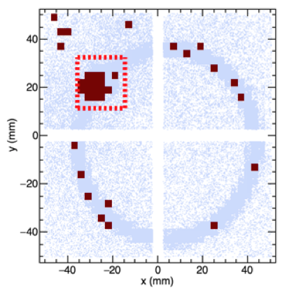
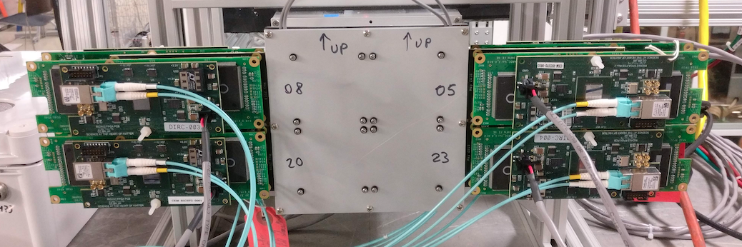
mRICH2 Test (EIC R&D)
Test of a modular RICH using fresnel lens to
- focalize the ring
- reducing gap size to ~ 20 cm
- center the ring
MC
Data
MC

Slide 13
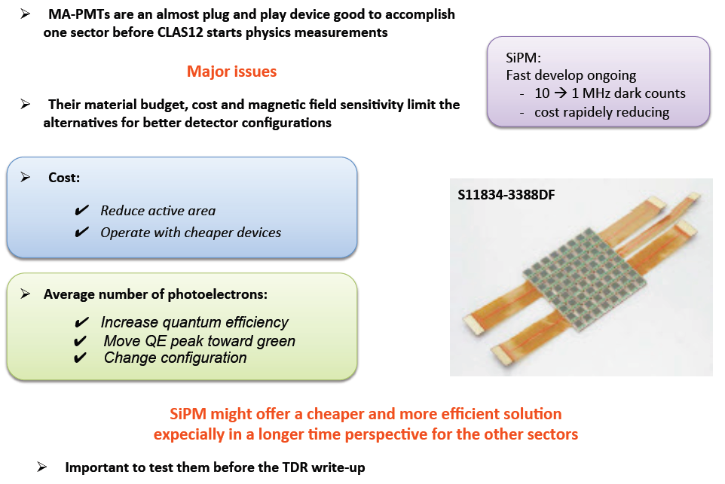
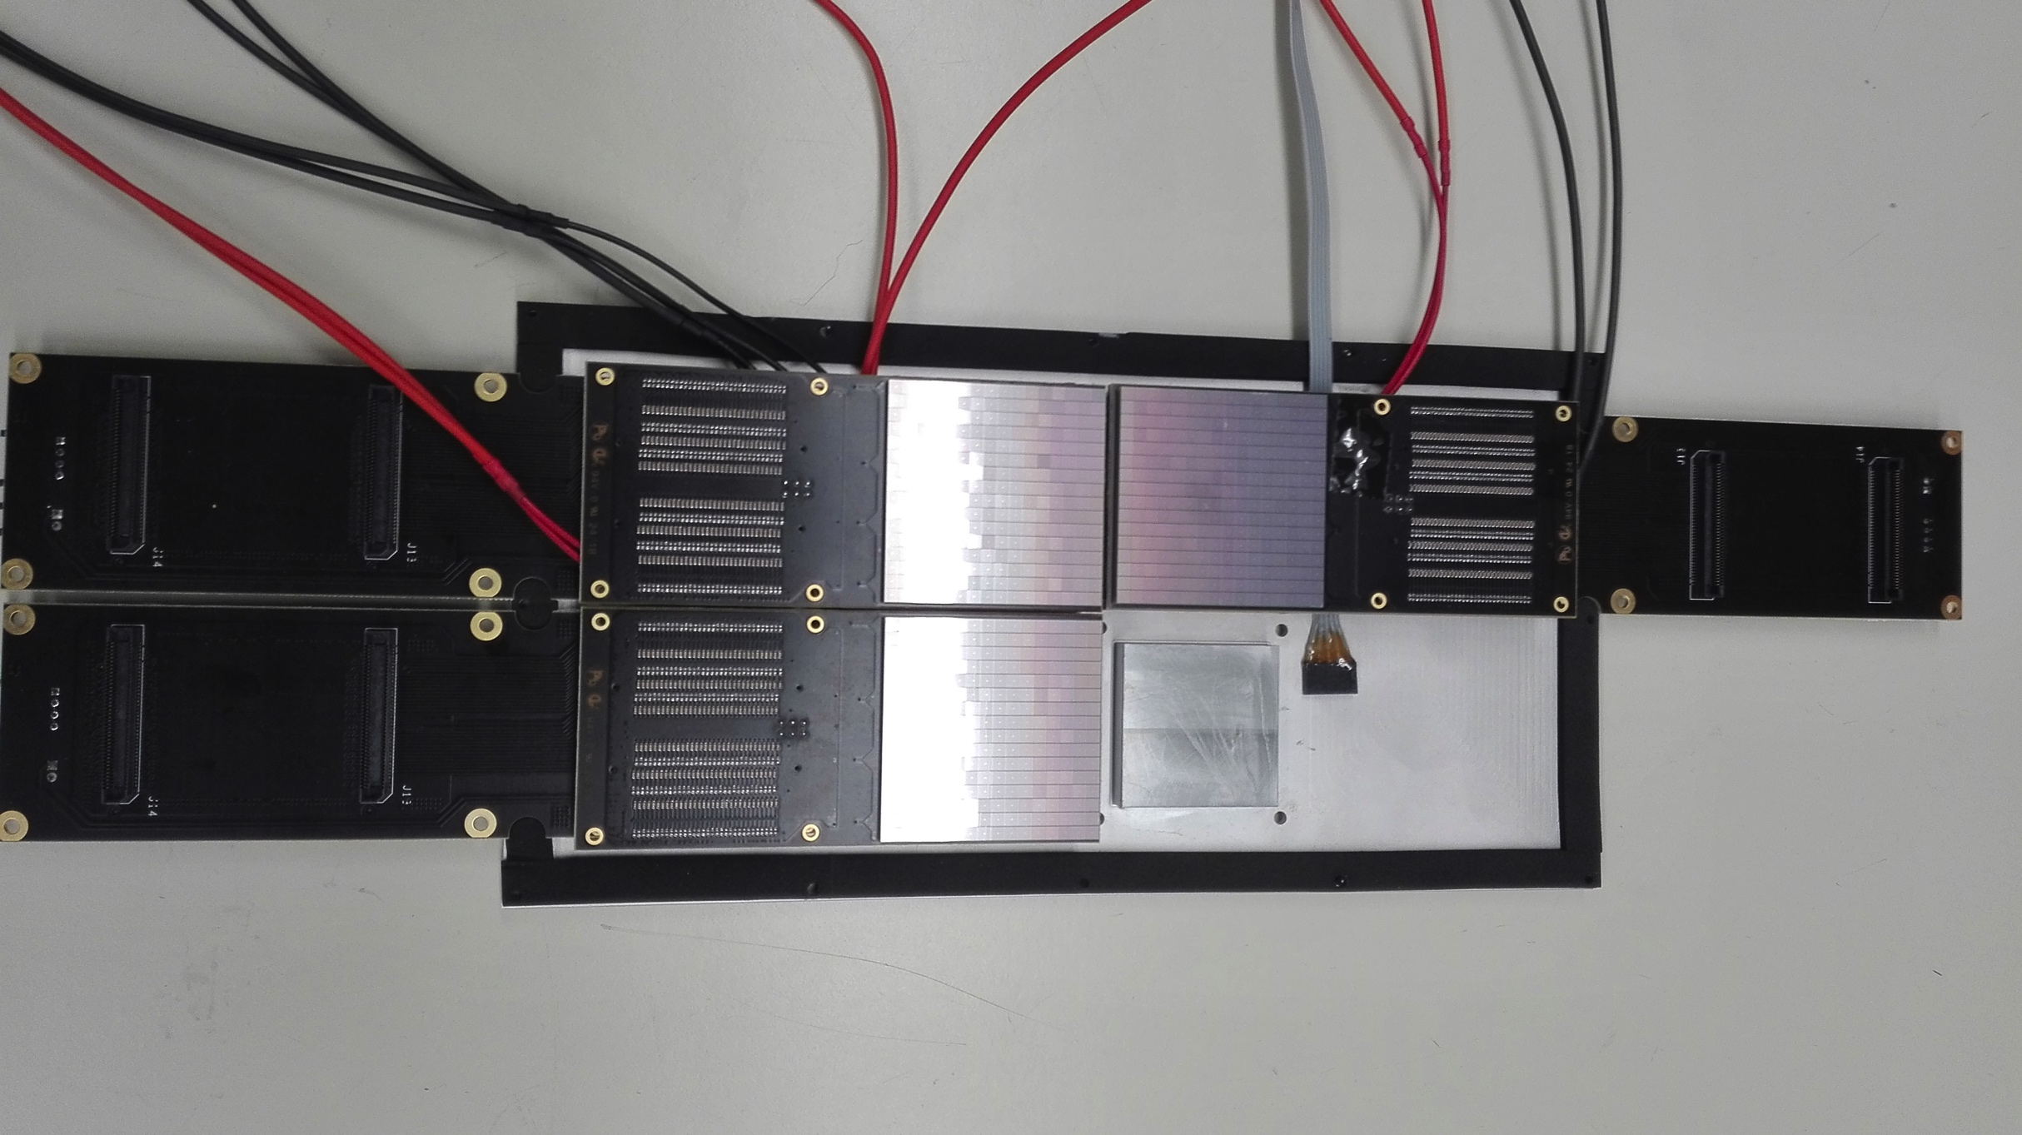
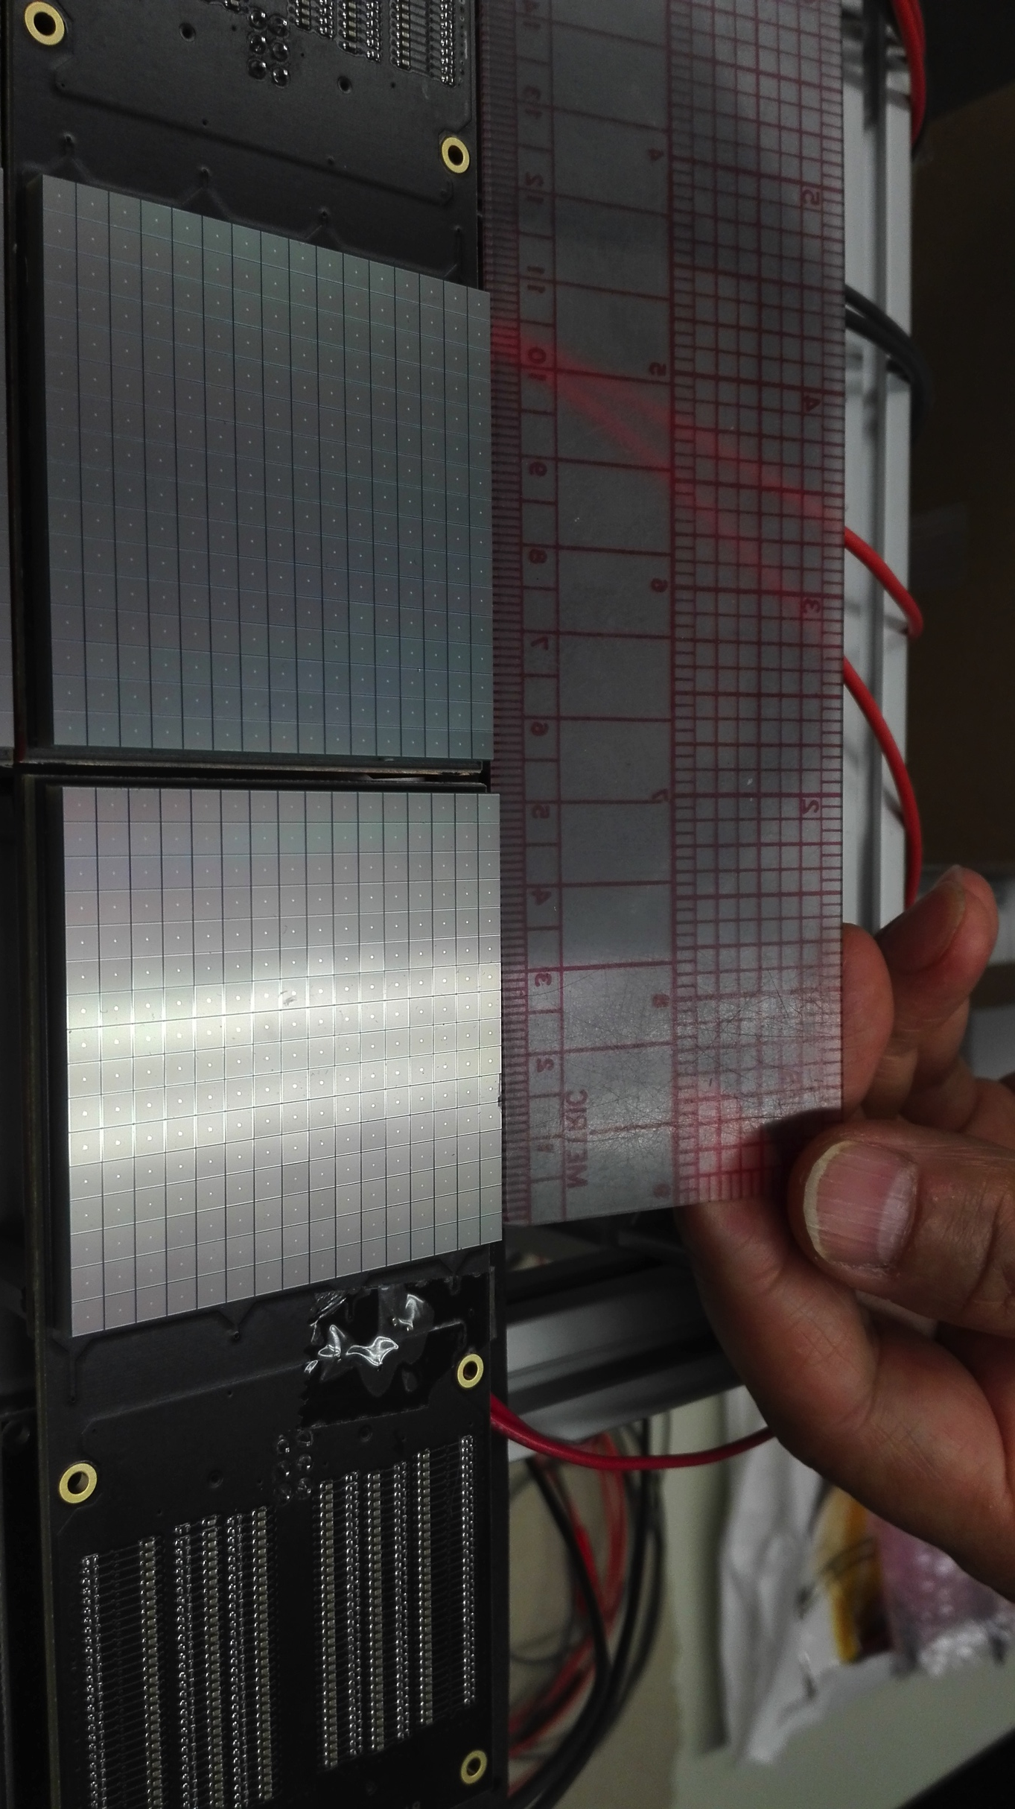
Activity with SiPM
Cooling plate
Machined @ Ferrara
Front-end electronics
designed @ Ferrara
SiPM might offer a cheaper and more efficient solution, expecially in a longer time perspective for other sectors
Notes:
13

Slide 14
RICH Landscape
  Project Premiale CLASMED
  Gluex DIRC (at Jlab Hall-D) using RICH electronics design
  SOLID (Hall-A) going to make tests with our RICH readout
  DOE funded R&D for a future EIC
EIC PID Consortium using RICH electronics for the prototype stage
Ferrara in 2020:
  RICH & CLASMED: M. Contalbrigo Project Coordinator
  Particle ID studies at CLAS12
  Continue construction of the second RICH sector
  Evaluate the SiPM option for Cherenkov applications
  SiPM applications for RICH and Medical Imaging
GOAL: 2nd sector ready for the polarized physics runs in summer 2021

Slide 15
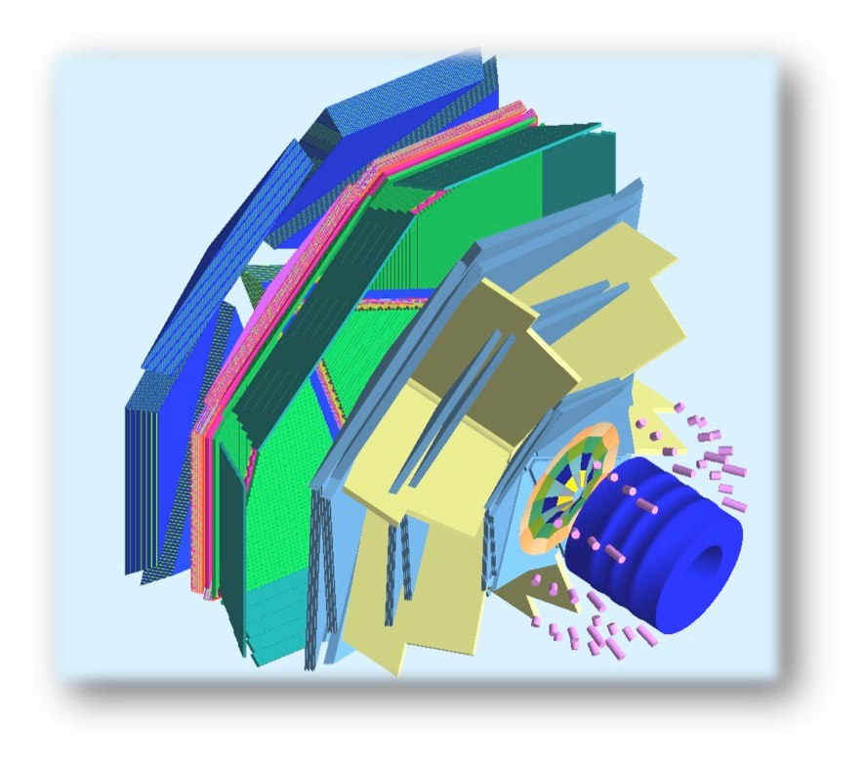
HD-ICE TRANSVERSE TARGET
(L. Barion, G. Ciullo, M. Contalbrigo, P.L., M. Statera, F. Spizzo)
Tracking solenoid
design field 5 T longitudinal
HDice target working field 2 T
4K L-He cryostat
diameter 440 to 942 mm
length 1500 mm
HD-ice Transverse Target:
high polarization
f 25 mm – Length 25 mm
transverse field 0.5-1.25 T
target
superconducting
solenoid
polarized
e⁻ beam
superconducting
torus

Slide 16
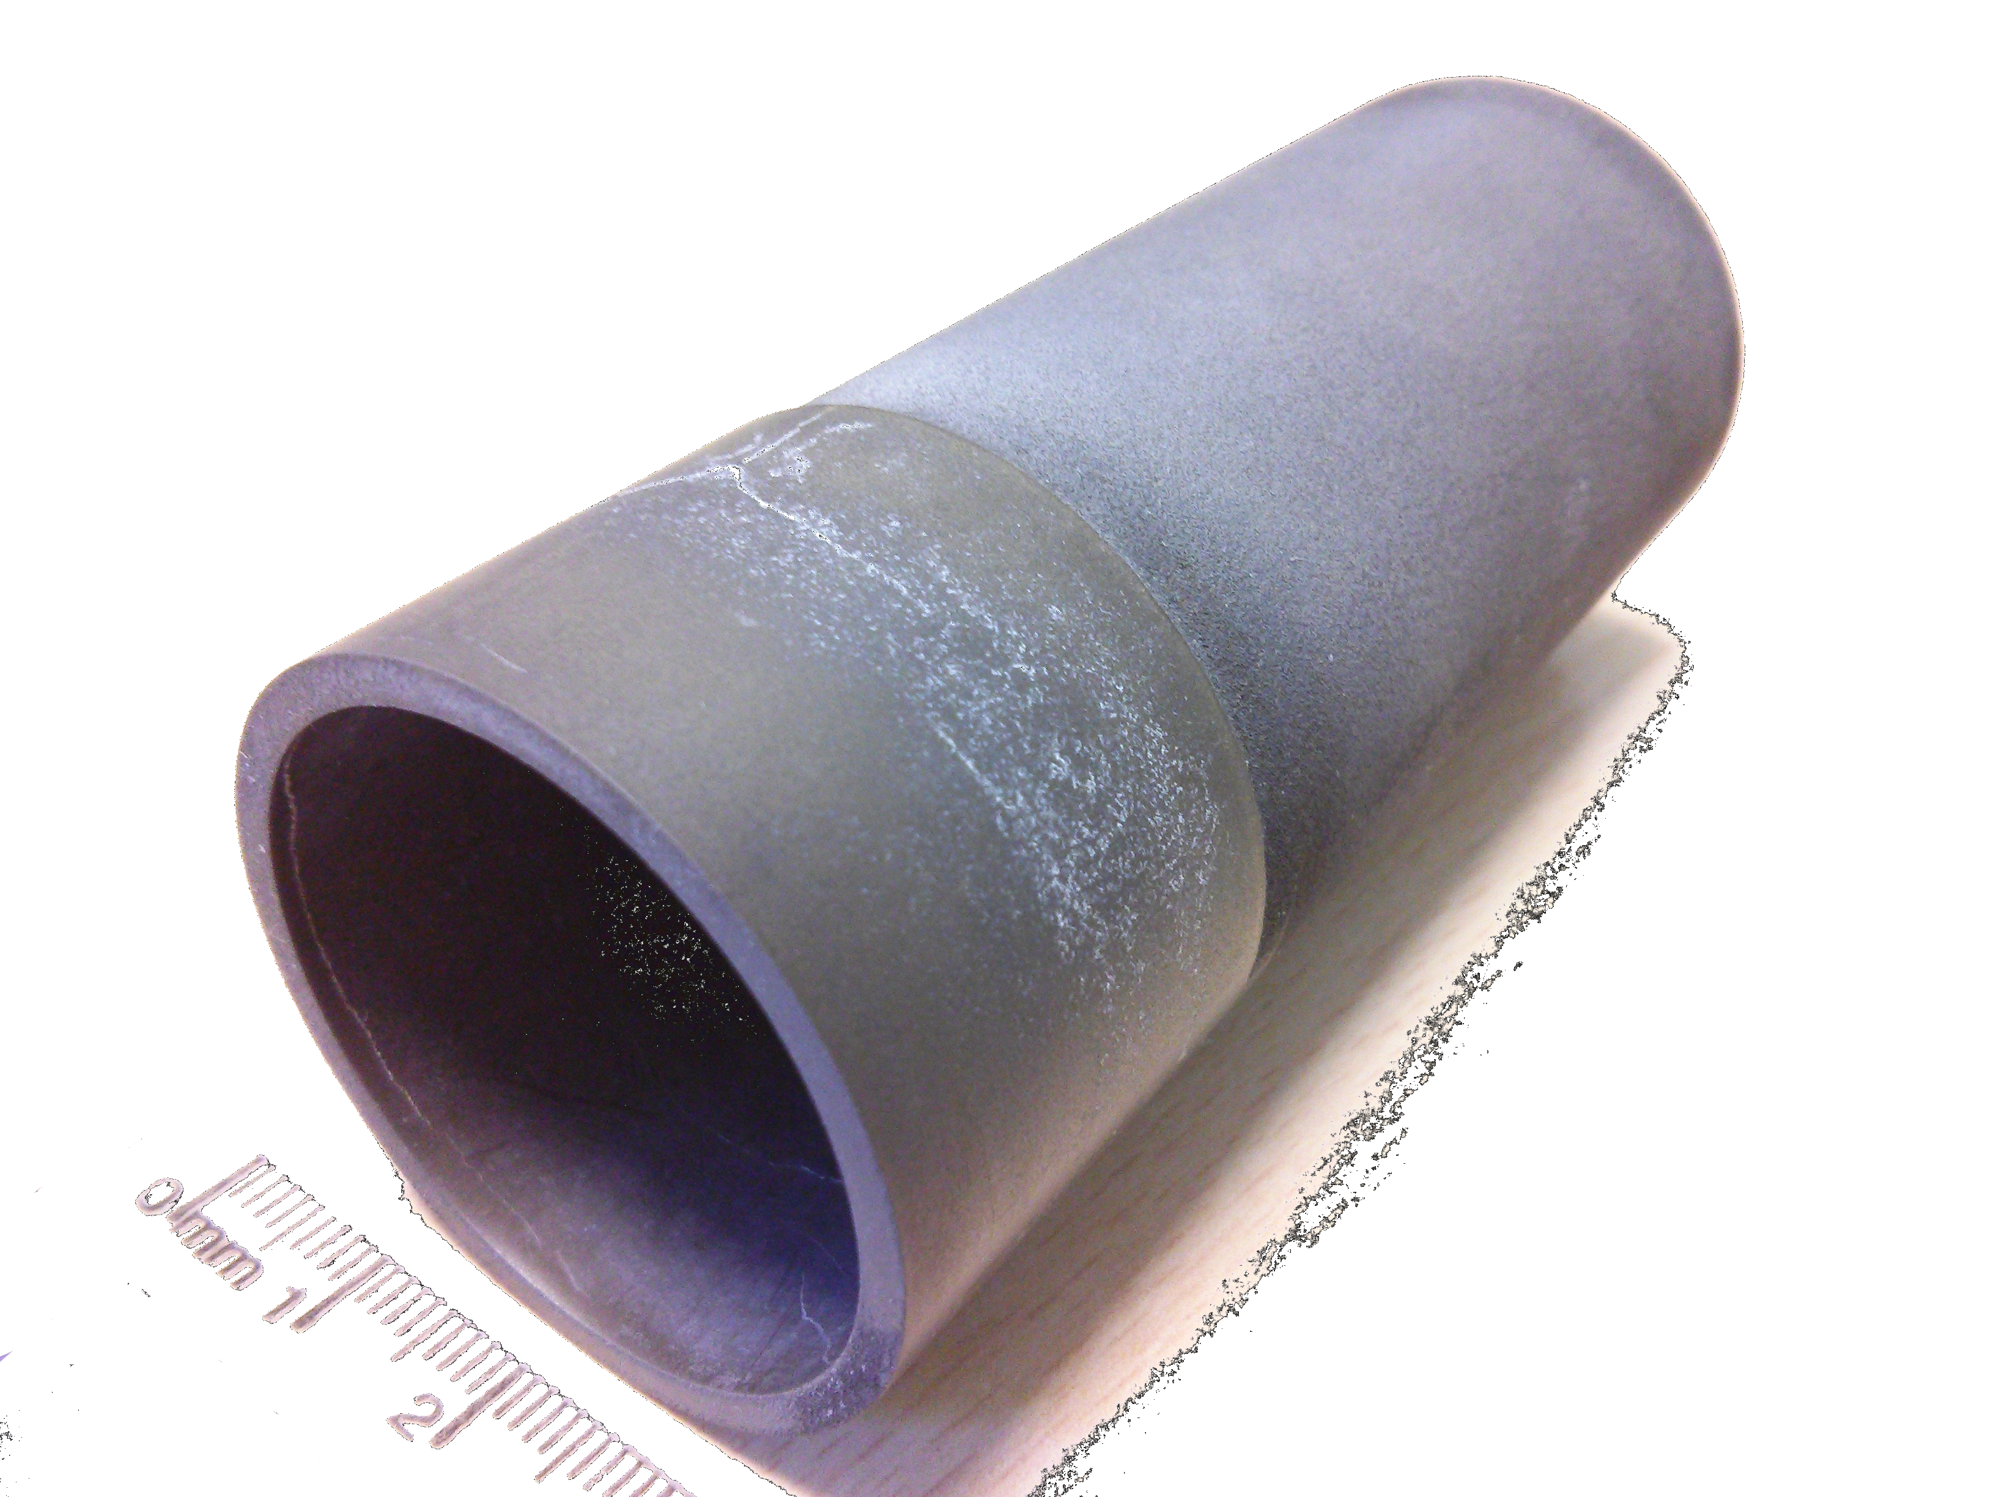
Bulk Transverse Magnet
By
Bz
Bulk cylinder (MgB₂)
longitudinal shield
transverse magnetization
Features
no current leads
Cu free
self tuning
few mm thickness
external magnet for magnetization
existing sample (courtesy of G. Giunchi)
diameter 39 mm
length 90 mm
thickness ~1 mm

Slide 17
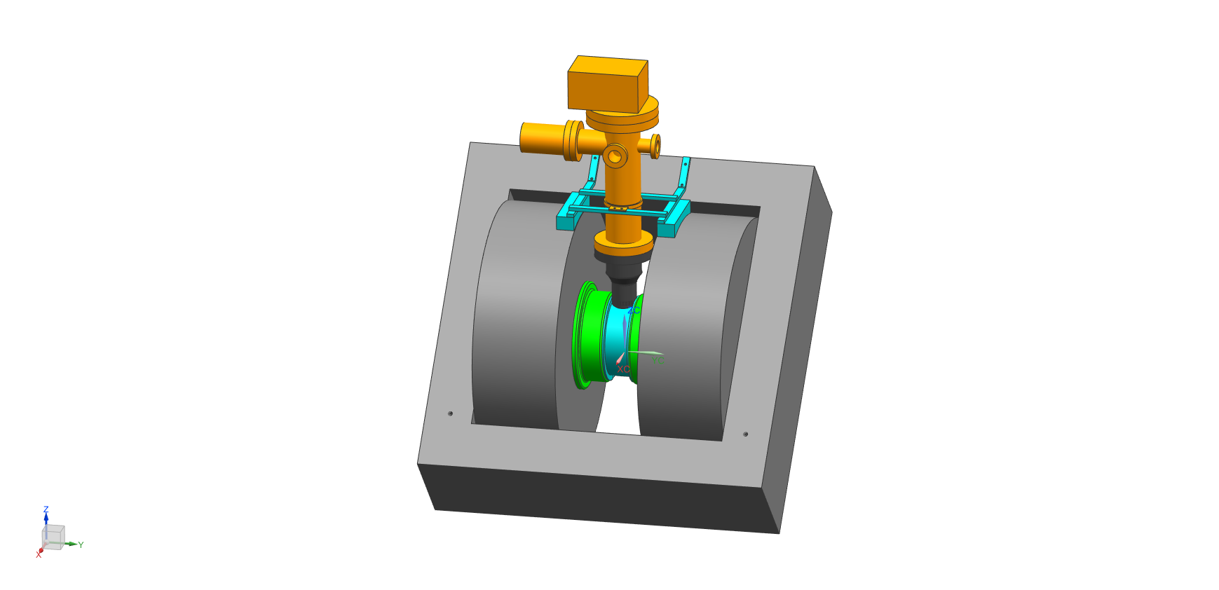
FERRARA SETUP
coldhead
support (316L)
resistive magnet
transverse field
custom poles
max field about 1 T
vacuum chamber (316L and Al)
liquid free cryostat
controlled cylinder temperature
minimum temperature <20 K
ΔB/B < 2 10⁻³ (on cylinder volume)
turbo
Al chamber
chamber (316L)
support (nylon)
pole
(ARMCO)
cylinder
resistive coil
iron yoke

Slide 18
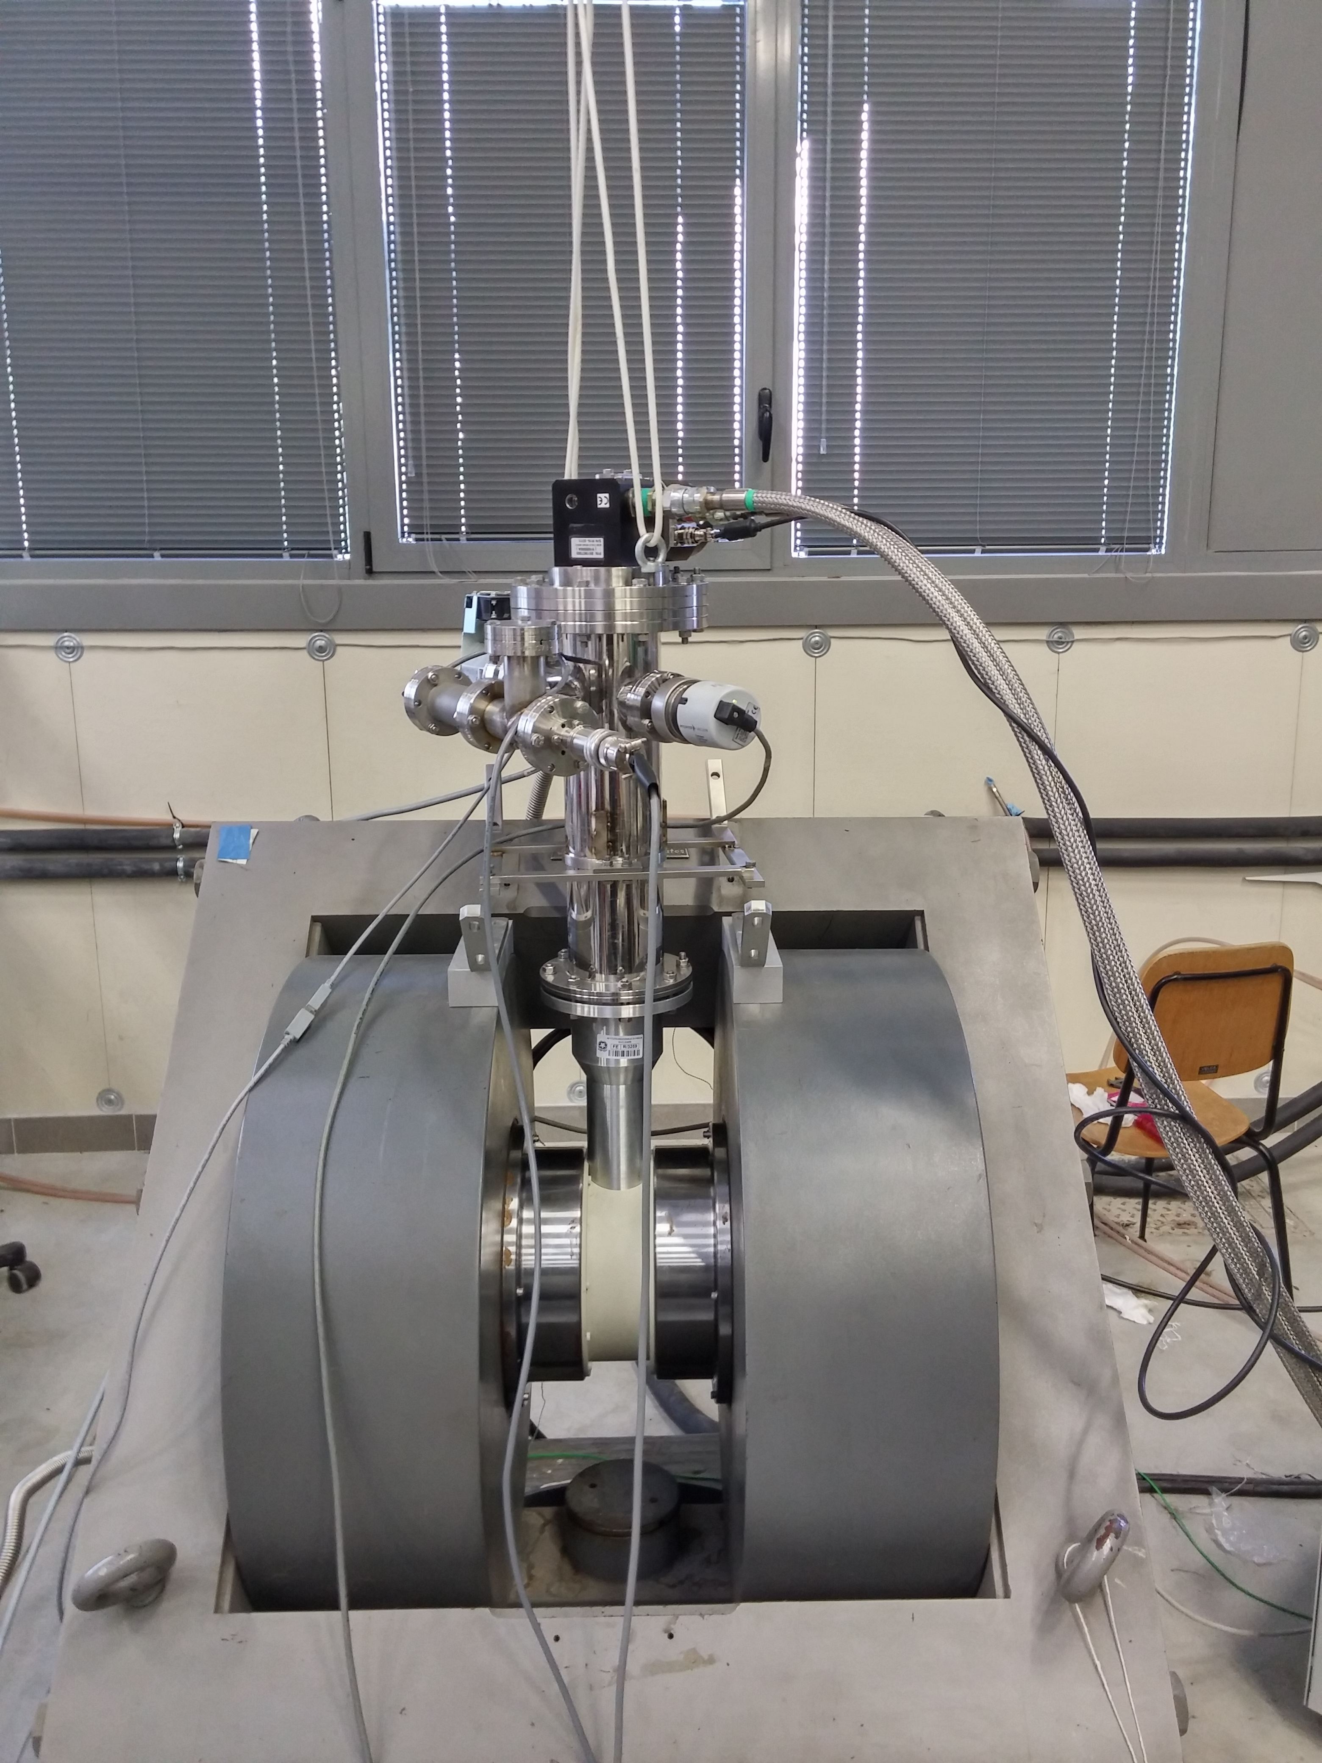
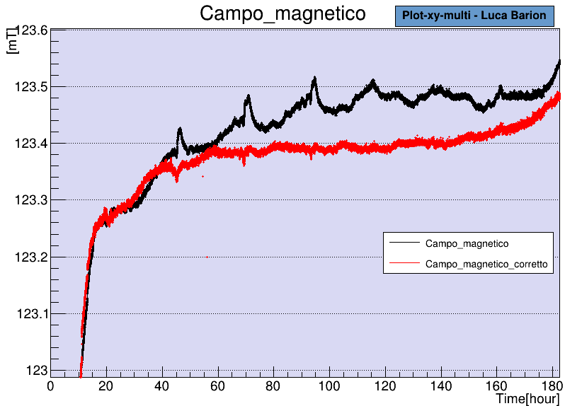
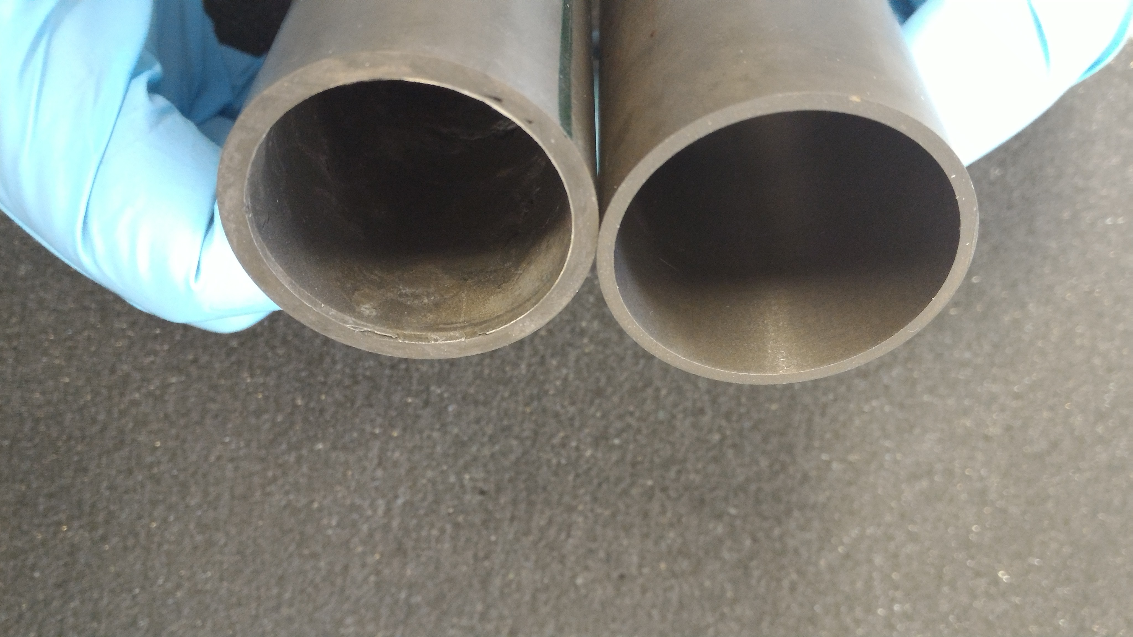
MAGNETIZATION stability
Dipole field frozen for days inside a MgB₂ cylinder

Slide 19
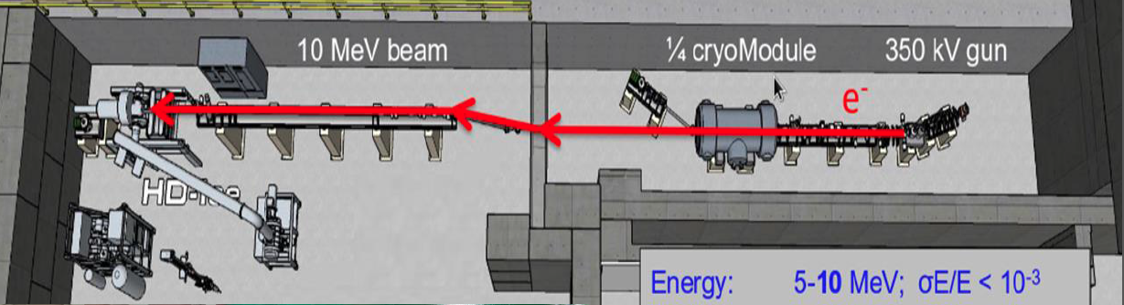
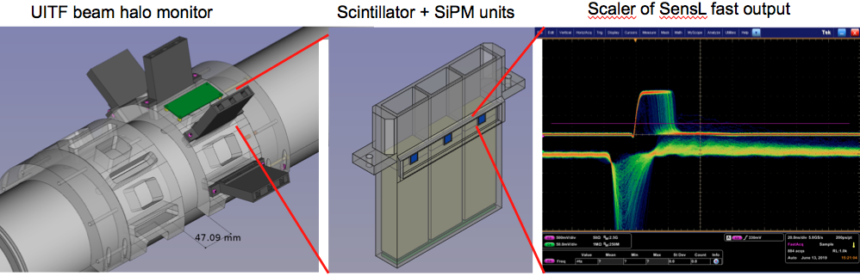
Polarized Target Tests with Electron Beam
In preparation at UITF JLab with beam halo monitor made by Ferrara

Slide 20
Il gruppo di Ferrara @ JLAB12
Responsabilita’:
M. C.: responsabile locale e nazionale di JLab12
M. C. responsabile progetto RICH
M. C. & L.P. Co-spokesperson di diverse proposte di esperimento (PAC34,37,38,39)
Contributi principali:
RICH detector (M.C., A. Movsysian, L. Barion)
- Reconstruction algorithms
- Caratterizzazione proprieta’ ottiche radiatore aerogel (@ SILAB)
- Test su fascio elettronica di lettura (Fermilab)
- SIPM Applications on RICH and Medical Imaging
Configurazione magnetica per HD_Ice target
(M.C., G. Ciullo, L. Barion, F. Sizzo, L. Del Bianco, M. Statera)
Analisi dati (M.C., A. Movsisyan)

Slide 21
JEDI
Jülich Electric Dipole moment Investigations
Polarization technology for precision experiments.
Search for electric dipole-moments in storage rings:
  First measurement of deuteron – EDM at COSY.
  Design Report for a prototype pure electrostatic ring.
In addition:
  Time Reversal Invariance Test at COSY
  Longitudinal spin-filtering test at COSY
  Internal target at LHCb (-> CSN1)

Slide 22
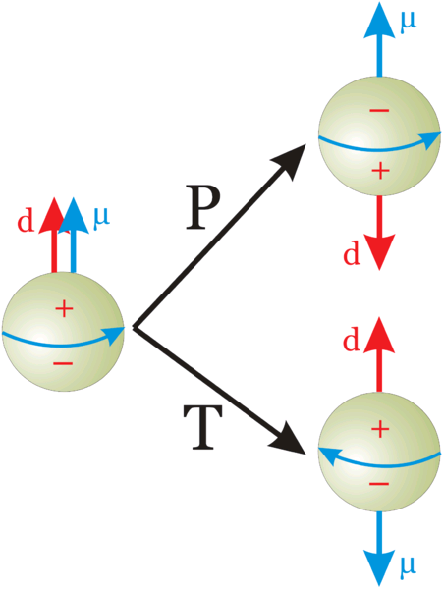
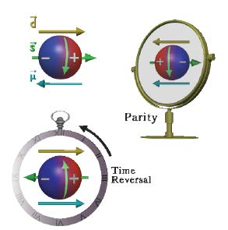
EDM of fundamental particles
Elementary particles (including hadrons) have a definite partiy and cannot have EDM
Unless P and T reversal are violated
s: spin
μ: magnetic dipole moment
d: electric dipole moment
Permanent EDMs violate P and T
Assuming CPT to hold, CP is violated also

Slide 23
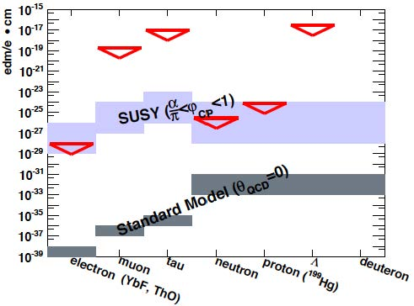
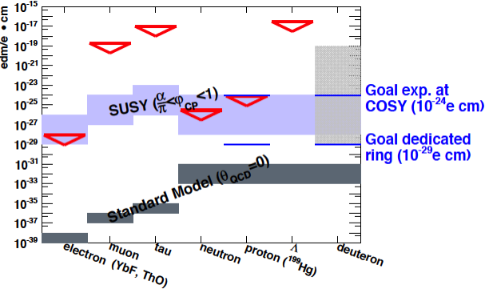
EDM: upper limits

Slide 24
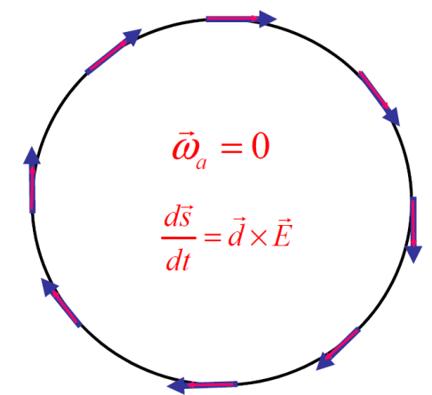
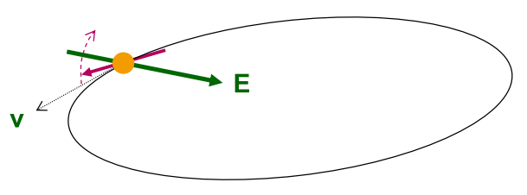

EDM of charged particles: use of storage rings
PROCEDURE
1. Place particles in a storage ring
2. Align spin along momentum ( →freeze horizontal spin precession)
3. Search for time development of vertical polarization
$$\frac{d\vec{s}}{dt}=\vec{d}×\vec{E}$$

Slide 25
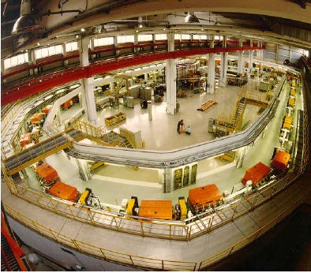
COoler SYnchrotron (FZ-Jülich, GERMANY)
COSY provides polarized protons and deuterons with p = 0.3–3.7 GeV/c
Ideal starting point for charged particles EDM search

Slide 26
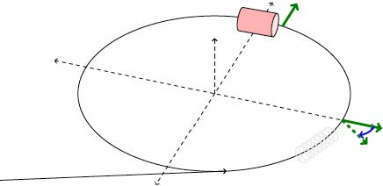
Experimental tests at COSY
1. Inject and accelerate polarized deuterons to 1 GeV/c
2. Flip spin in the horizontal plane with help of solenoid
3. Extract slowly (100 s) beam on target
4. Measure asymmetry and determine spin precession

Slide 27
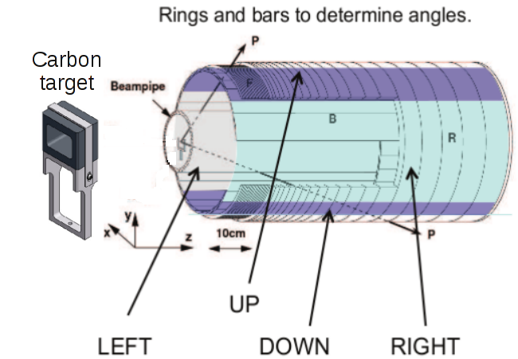
EDDA beam polarimeter
ASYMMETRIES
beam
VERTICAL polarization
Analyzing power
HORIZONTAL polarization
Analyzing power
Beam moves toward thick target continuous extraction
Elastic scattering (large cross section for d-C)

Slide 28
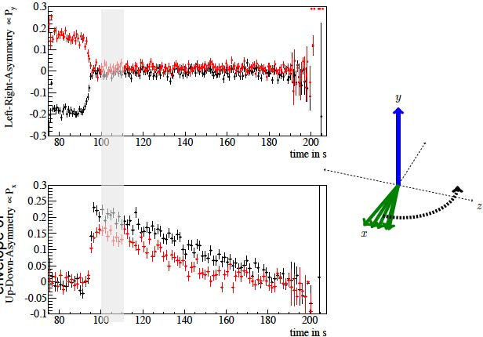
Spin-precession measurement

Slide 29

Spin-precession measurement

Slide 30


Results: spin coherence time
Short Spin coherence time:
Unbunched beam:
  Δp/p=10⁻⁵->Δγ/γ=2x10⁻⁶, T_{rev}=10⁻⁶s
  Decoherence after < 1s
Bunching eliminates 1st order effect in Δp/p:
  SCT τ = 20 s
Long Spin coherence time:
Betatron oscillations cause variation of orbit length
  Correction wit sextupoles
SCT τ > 1000 s

Slide 31

Spin coherence time > 1000 s
(Polarization envelope)

Slide 32

Spin coherence time > 1000 s
(Polarization time behaviour)

Slide 33

Proof of principle experiment using COSY
Goal: demonstrate that SR can be used for a first EDM measurement
Problem: precession caused by magnetic moment:.
- 50 % of time longitudinal polarization || to momentum
- 50 % of time is anti-||
E* in particle rest frame tilts spin (due to EDM) up and down → No net EDM effect

Slide 34

Proof of principle experiment using COSY
Goal: demonstrate that SR can be used for a first EDM measurement
Solution; use of resonant „magic“ Wien-filter in ring (E+vxB=0)
E*=0 → particle trajectory not affected
B*≠0 → magnetic moment is influenced
→ net EDM effect can be observed!

Slide 35


Magic RF Wien filter
Avoids coherent betatron oscillations of beam. .
First direct measurement at COSY.
⇒ E_{R}= - γ x B_{y} „Magic RF Wien Filter“ no Lorentz force
GOAL: 1st ever measurement of deuteron EDM before 2021

Slide 36

Magic RF Wien filter - commissioning

Slide 37

FE contribution: development of a new high-efficieny polarimeter

Slide 38




Development of SiPM based readout system
(L. Barion, S. Basile, R. Malaguti, P.L.)

Slide 39

Complementary measurement:
Test of Time Reversal Invariance at COSY
EDM: test T and P symmetries (T-odd and P-odd)
TRIC: fdirect test of T-symmetry (T-odd P-even)
- Direct tests of Time Reversal Invariance: experimental situation
← Proposed measurement

Slide 40

Concept of the experiment
Vector polarized proton beam vs
Tensor polarized deuteron target
→sensible to A_{y,xz}
Time reversal b) equivalent to:
- inversion of proton beam polarization c)
- inversion of deuteron target polarization d)
Different cross sections for a) vs c) or d) ↦ time reversal violation

Slide 41


Measurement at COSY
PAX installation at COSY:
Atomic beam source (d↑ target)
Openable storage cell
Si-detector (beam polarimetry)
In addition:
- Sensitive beam current monitor
Measurement:
Comparison of beam-lifetimes
Different spin configurations

Slide 42


FE contribution:
realization of a silicon detector and an openable storage cell

Slide 43




Assembly of a single quadrant
(A. Kononov)

Slide 44


Realization and installation of the openable storage cell
(S. Sguerzanti, V. Carassiti)

Slide 45

Detector assembly
(S. Sguerzanti, V. Carassiti. A. Kononov, G. Ciullo)

Slide 46


Polarized target and polarimeter
(G. Ciullo, A. Pesce)
ABS
Breit-Rabi
polarimeter

Slide 47



Successful commissioning
(S. Dymov)
p-d identification
Polarization measurement (Ay)
Polarization along the cell

Slide 48
Responsibilities + external funding
JEDI
Co-Spokesperson: P.L.
SCT data analysis: S. Dymov, D. De Rosa
New polarimeter: S. Basile, L. Barion, V. Carassiti, P.L.
Control system for RF-Wien filter: G. Tagliente (INFN-BA)
TRIC
Management: P.L.
Polarized target and polarimeter: G. Ciullo, A. Pesce, P.L.
Detector: V. Carassiti, S. Dymov, A. Kononov, P.L.
Interlock and slow control: G. Tagliente (INFN-BA)
EXTERNAL FINANCES:
ERC-Advanced Grant: srEDM
  Total sum: 2.4 Meuro
  Duration: 5 Years (2016-21)
New applications: H2020 (2019-21)
  SPIN for FAIR
    Principal Investigator: P. L.
    Host Institution: FZ-Juelich
  LHC-SPIN
    Local Responsible: P.L.
    Host Instituion: CERN

Slide 49
Manpower e richieste fianziarie
Name | JEDI | JLAB | EIC-NET
L. Barion (Post-Doc) | 20 | 80
S. Basile (dottorando) | 100
S. Bertelli (RTD-A) | 80
G. Ciullo (Staff) | 70 | 20
A. Drago (Staff) |  | 20
M. Contalbrigo (Staff) | 20 | 70 | 10
S. Dymov (Post Doc) | 100
A. Kononov (dottorando) | 100
P. Lenisa (Staff) | 75 | 20
A. Movsisian (Post-Doc) |  | 100
L. Pappalardo (RTD-A) |  | 20
A. Pesce (Post Doc) | 100
F. Spizzo (Staff) | 20 | 80
V. Carassiti (staff) | 30
A. Cotta Ramusino (staff) | 10
Total | 725 | 410 | 10
Richieste finanziarie JLab12
Missioni | 60 k€
Trasp. | 5 k€
Inv. | 10 k€
Consumi | 15 k€
Apparati | 100 k€
TOTALE | 190 k€
Richieste finanziarie PAX
Missioni | 60 k€
Consumi | 40 k€
TOTALE | 100 k€

Slide 50
Other activities:
Collaboration with CSN1
“Polarized internal gas target for LHCb”
Physics goals:
  Large-x gluon, antiquark and heavy-quark content in the nucleon and nucleus.
  Dynamics and spin of gluons in (un)polarised nucleons
  Heavy-ion collisions towards large rapidities
(Possible) timeline:
  Design and realization of an openable storage cell for LHC (unpolarized gas)
    Installation in 2020-21
  Design and construction of a polarized target
    Installation in 2024-25

Slide 51

SPIN 2018
23rd International Spin-Physics Symposium
Ferrara, 10-14 September 2018

