Slide 1
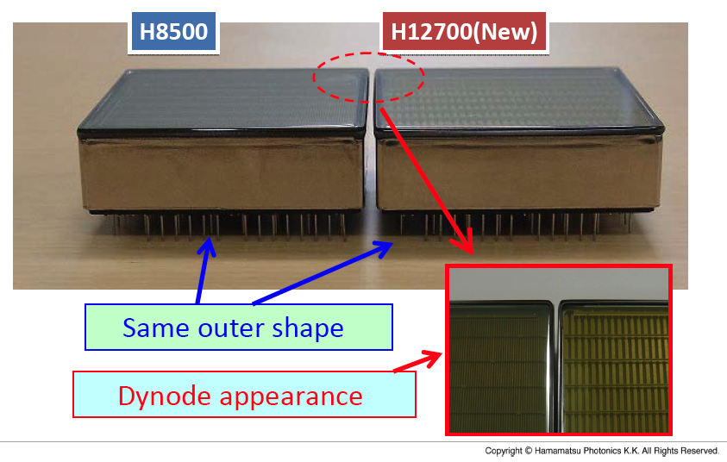
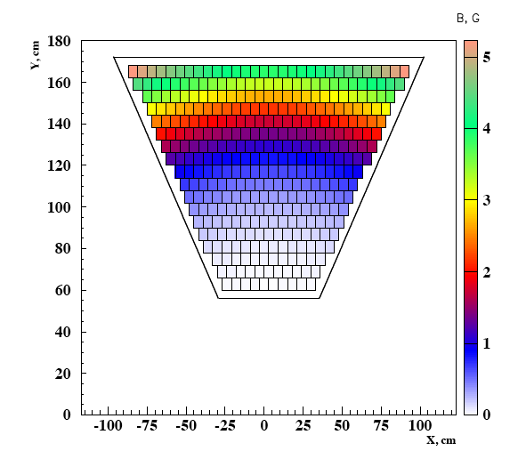

Photon Detectors: MA-PMT
The only option to keep the schedule is the use
of multi-anode photomultipliers (we consider the
promising SiPM technology as the alternative)
✓ Mature and reliable technology
✓ Large Area (5x5 cm²)
✓ High packing density (89 %)
✓ 64 6x6 mm² pixels cost effective device
✓ High sensitivity on visible towards UV light
✓ Fast response
28 H8500:
14 with standard
window (H8500C)
14 with UV window
(H8500C-03)
2 H12700:
za003 and za0014
Torus fringe fields in the
RICH photo-detector area
Contalbrigo M.
1
Notes:
Direzione campo magnetico ? E fringe fields

Slide 2
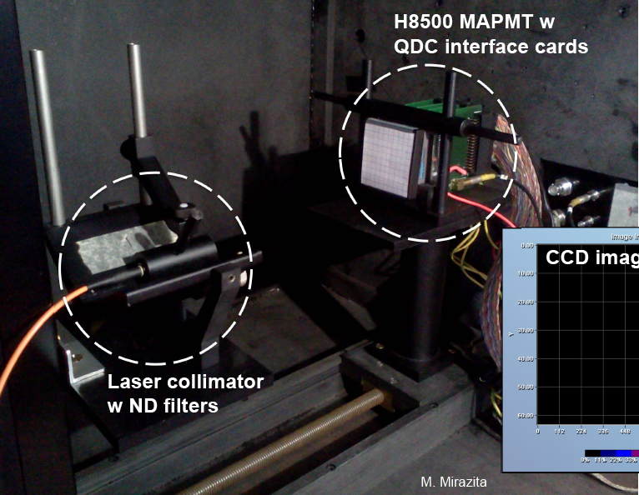
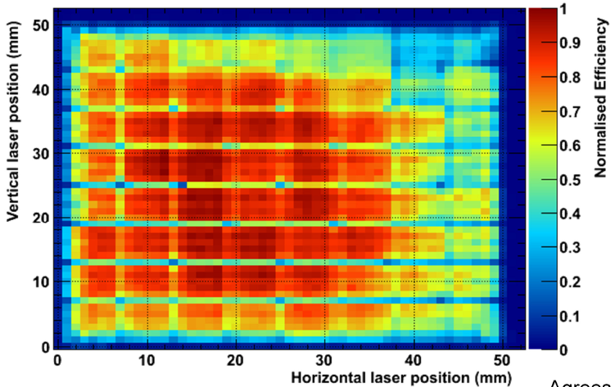
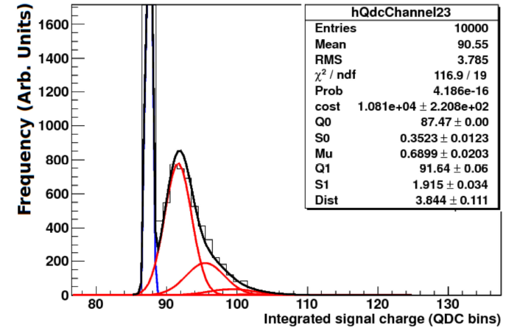
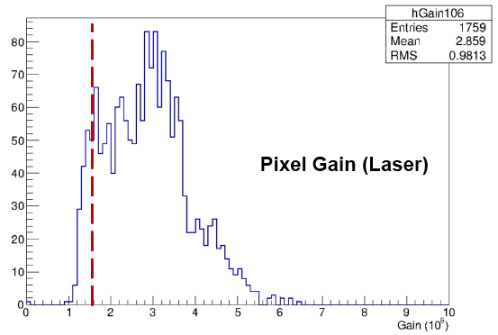
MA-PMT Gain Map
H8500
Gain
SPE Loss
Up to 1:4 pixel gain variation can be
compensated by the read-out electronics
Contalbrigo M.
2
Notes:
Ma e’ vero 1:2 su tutti e i 28 PMTs ? Altrimenti dico cosa non vera.
Quanti sono i canali “morti” e/o quanti casi oltre i 1:2
Vedere che selezione abbiamo per MA-PMTs…. Forse dark count, non uniformita’

Slide 3
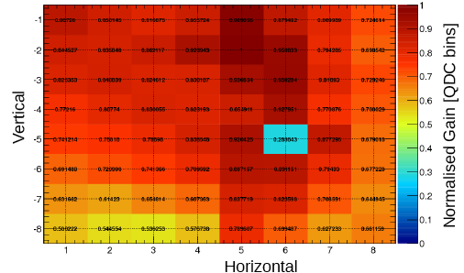
MA-PMT Gain Map
H8500
Gain
SPE Loss
Up to 1:4 pixel gain variation can be
compensated by the read-out electronics
H12700 1:2 gain variation
Contalbrigo M.
3
Notes:
Ma e’ vero 1:2 su tutti e i 28 PMTs ? Altrimenti dico cosa non vera.
Quanti sono i canali “morti” e/o quanti casi oltre i 1:2
Vedere che selezione abbiamo per MA-PMTs…. Forse dark count, non uniformita’

Slide 4
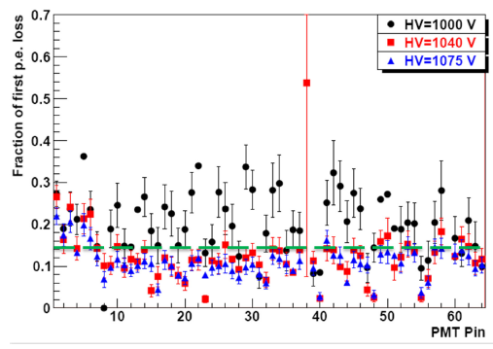
MA-PMT SPE Loss
Gain
SPE Loss
SPE loss limited to ~15% above 1040V
and almost uniform over 28 MA-PMTs
H8500 Pixel SPE Loss
Contalbrigo M.
4
Notes:
Con VME no amplification, n shaper, 3sigma cut
MAROC amplification gain 4 e cut a 5sigma
Add plots con singolo channel ….
Fare scatter plot

Slide 5
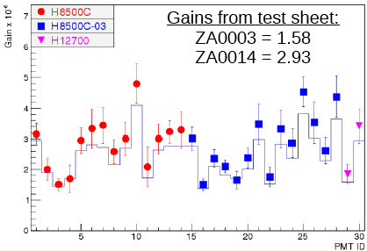
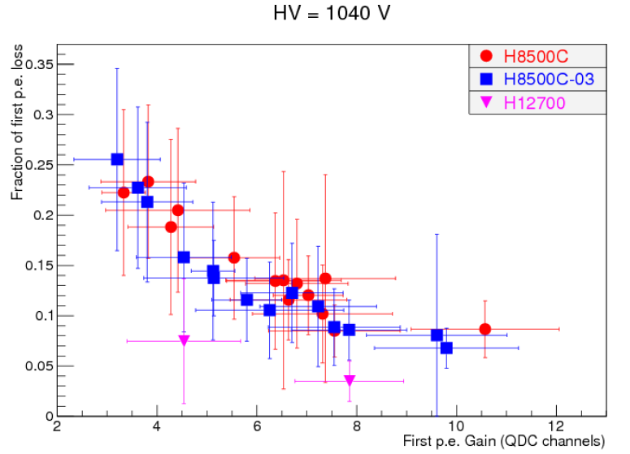
MA-PMT SPE Loss
MA-PMT Gain
Gain x 10⁶
MA-PMT Gain
HV = 1000 V
Gain
SPE Loss
H12700 features a significant better SPE
resolution than H8500 at similar gain
SPE loss limited to ~15% above 1040V
and almost uniform over 28 MA-PMTs
H8500 Pixel SPE Loss
HV = 1040 V
Contalbrigo M.
5
Notes:
Con VME no amplification, n shaper, 3sigma cut
MAROC amplification gain 4 e cut a 5sigma
Add plots con singolo channel ….
Fare scatter plot

Slide 6
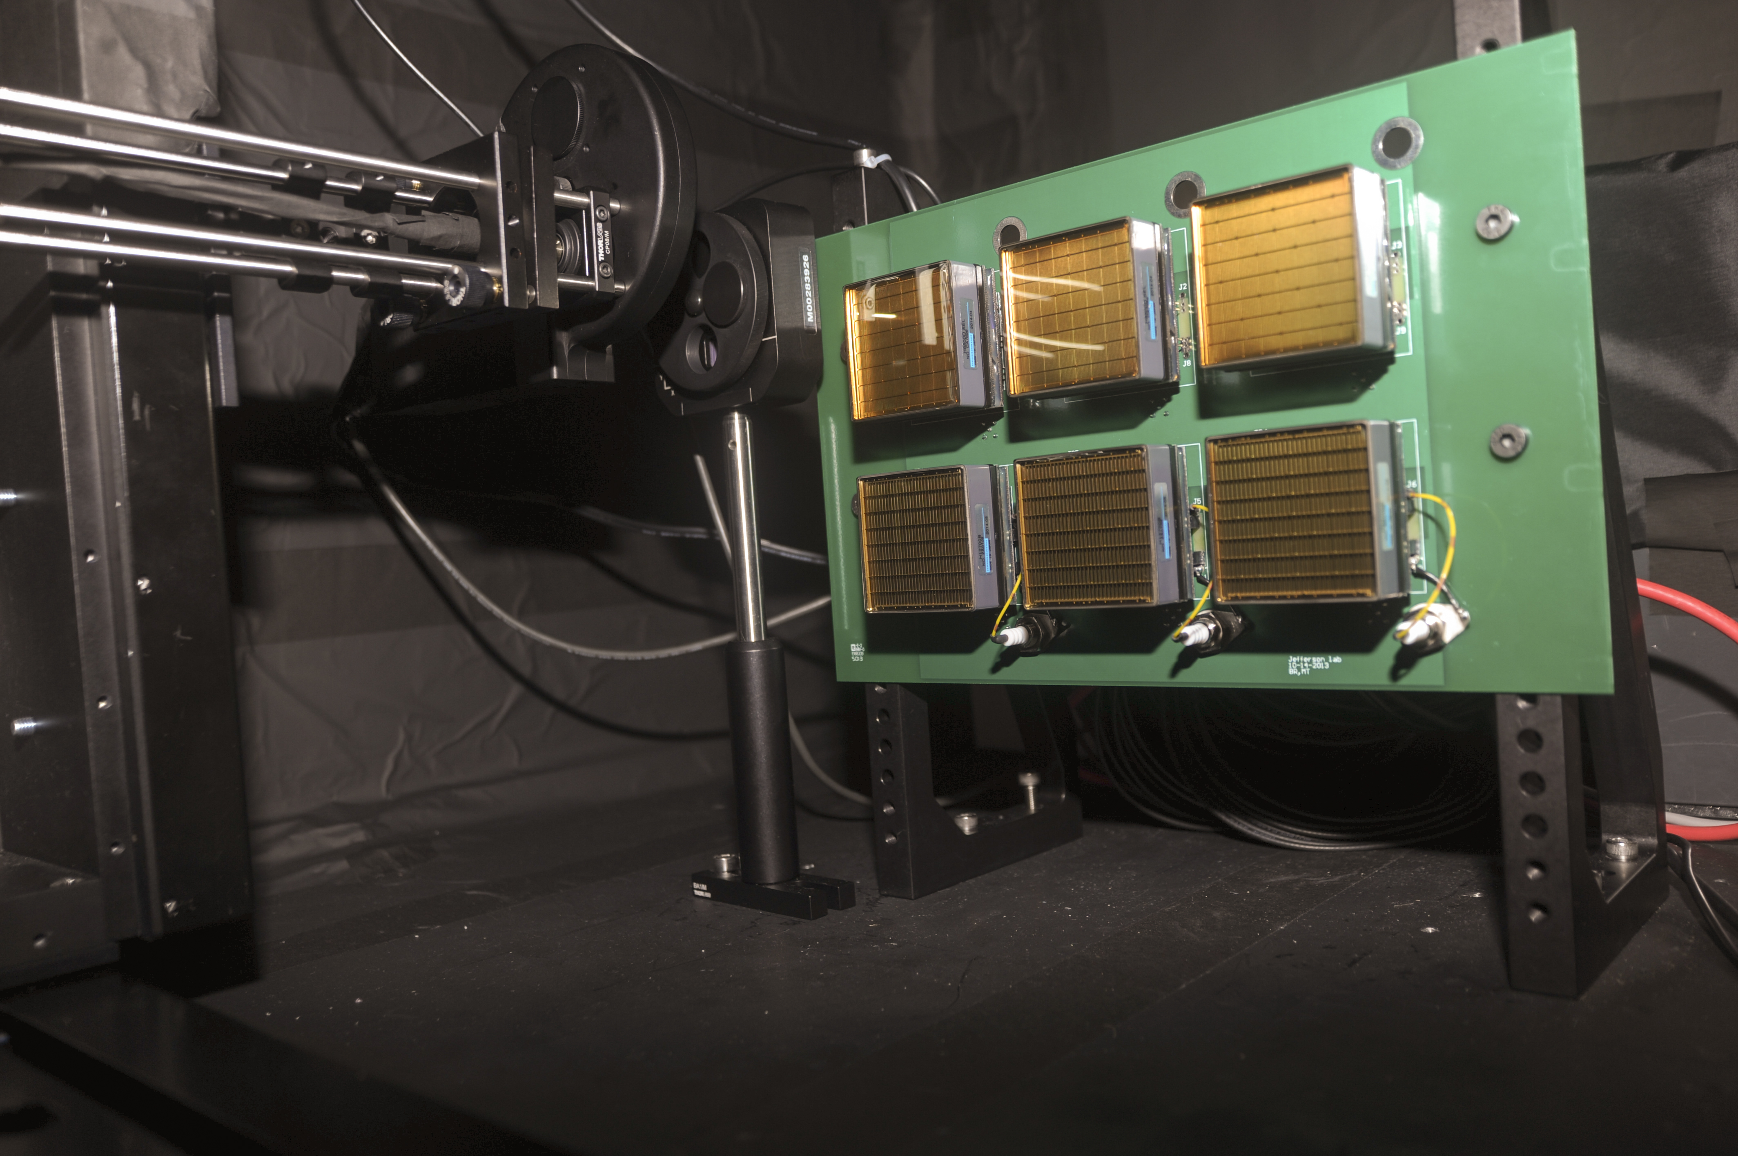
MA-PMT SPE Resolution
Single Photoelectron Spectrum
Q₁
σ₁
H12700
Jlab Test Stand
H8500
Reproduce Hamamatsu gain map
FADC counts
Pixel Number
Pixel #57: typical higher dark current
Contalbrigo M.
6
Notes:
Perce’ sta a 50 Hz il dark count base ? Non dovrebbe stare a 10-15 Hz ?

Slide 7
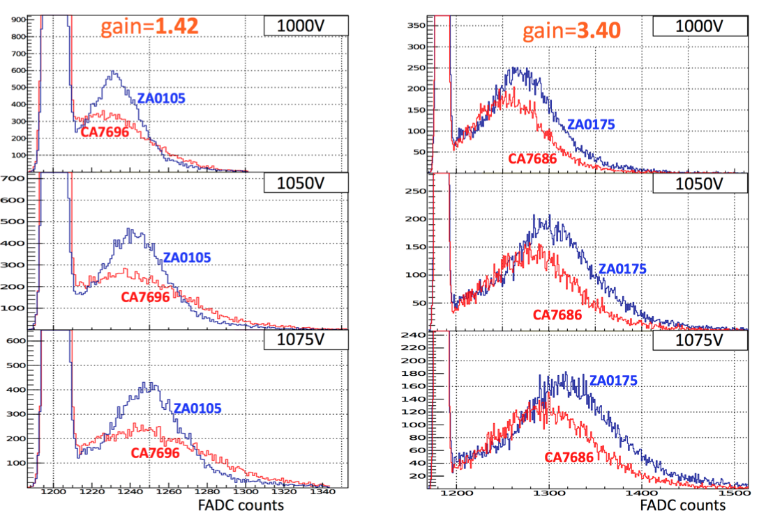
MA-PMT SPE Resolution
Contalbrigo M.
7
Notes:
Perce’ sta a 50 Hz il dark count base ? Non dovrebbe stare a 10-15 Hz ?

Slide 8
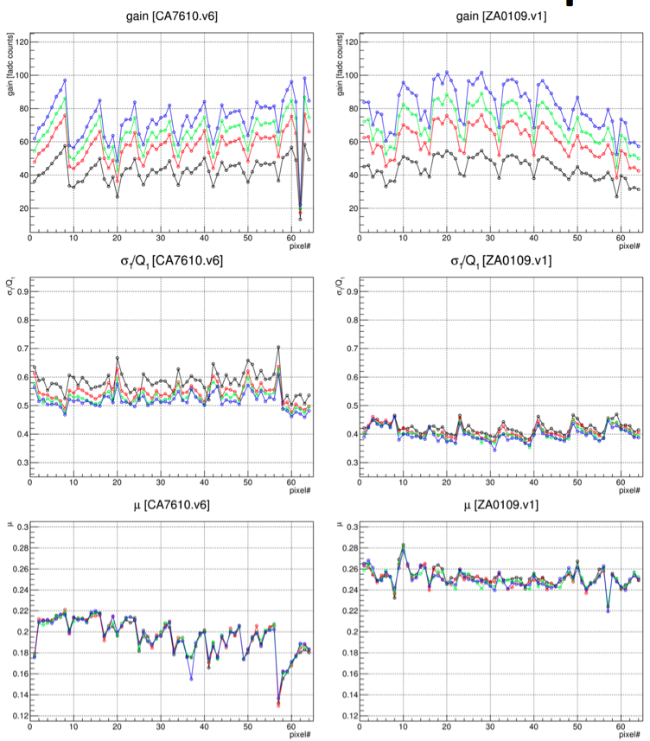
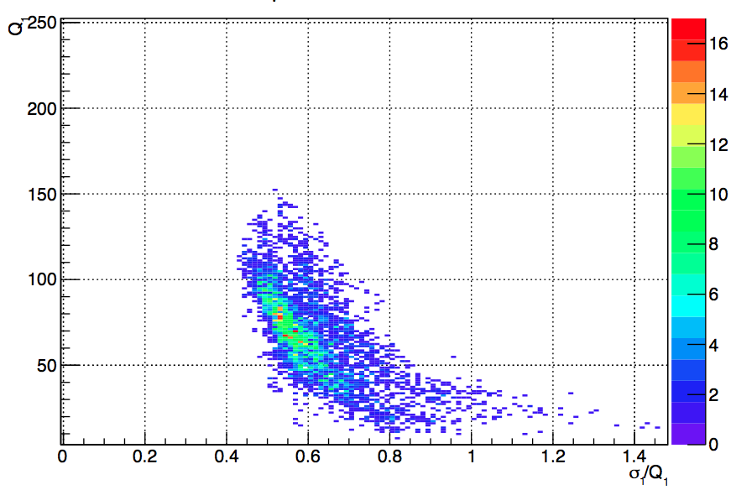
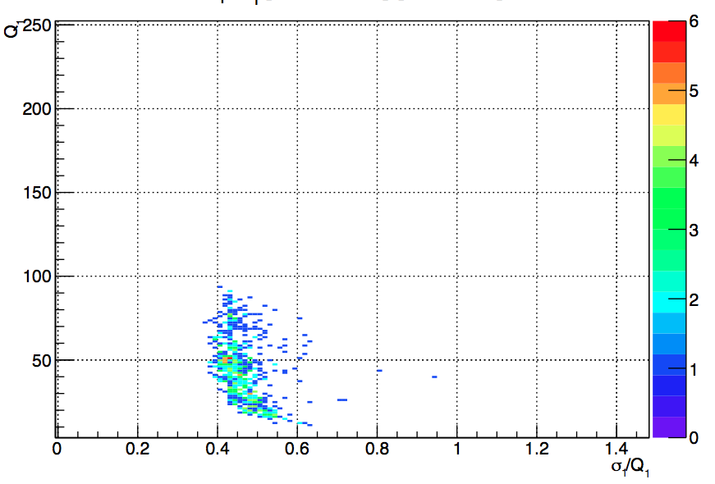
MA-PMT SPE Resolution
Gain
Gain
H8550 @ 1000 V
Resolution
SPE Resolution
Gain
H12700 @ 1000 V
Efficiency ??
SPE Resolution
Contalbrigo M.
8
Notes:
Perce’ sta a 50 Hz il dark count base ? Non dovrebbe stare a 10-15 Hz ?

