Slide 1
Nuove sfide di Fisica Adronica
a JLab ed EIC
Marco Contalbrigo – INFN Ferrara
Congresso Nazionale SIF 2023 - 11-15 Settembre 2023
Contalbrigo M.
Congresso Nazionale SIF, 11 September 2023
1
Notes:
Vanno messi studi innovativi e pubblicazioni

Slide 2


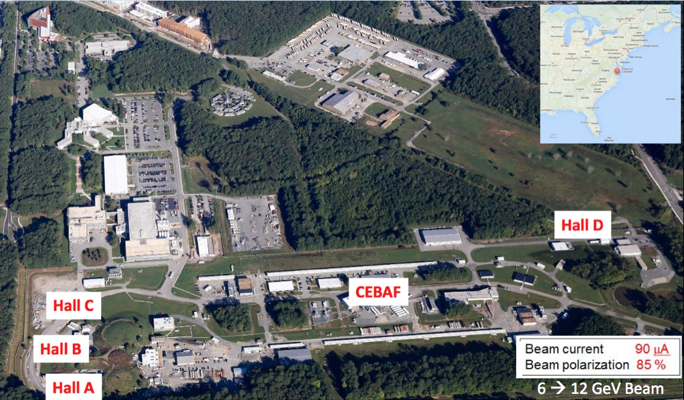
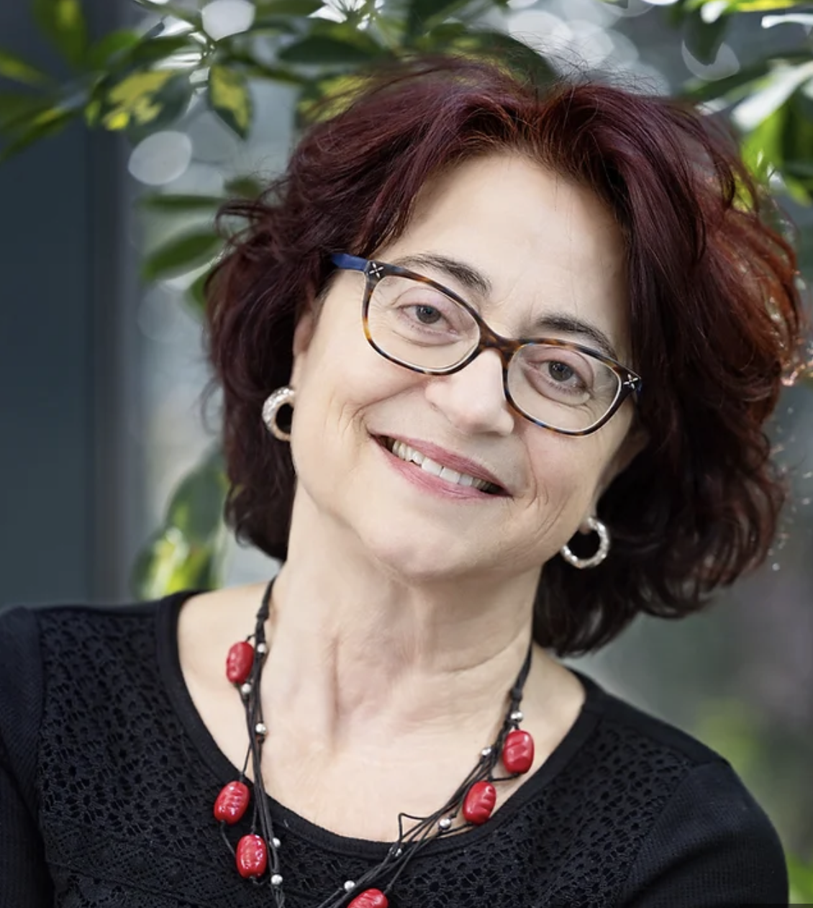
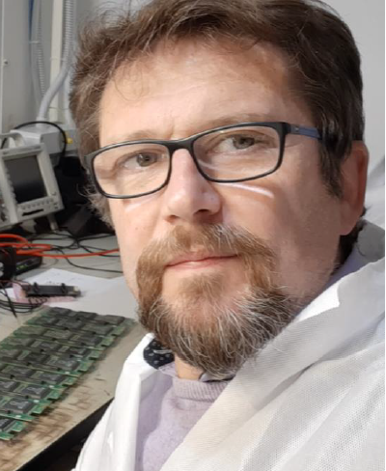
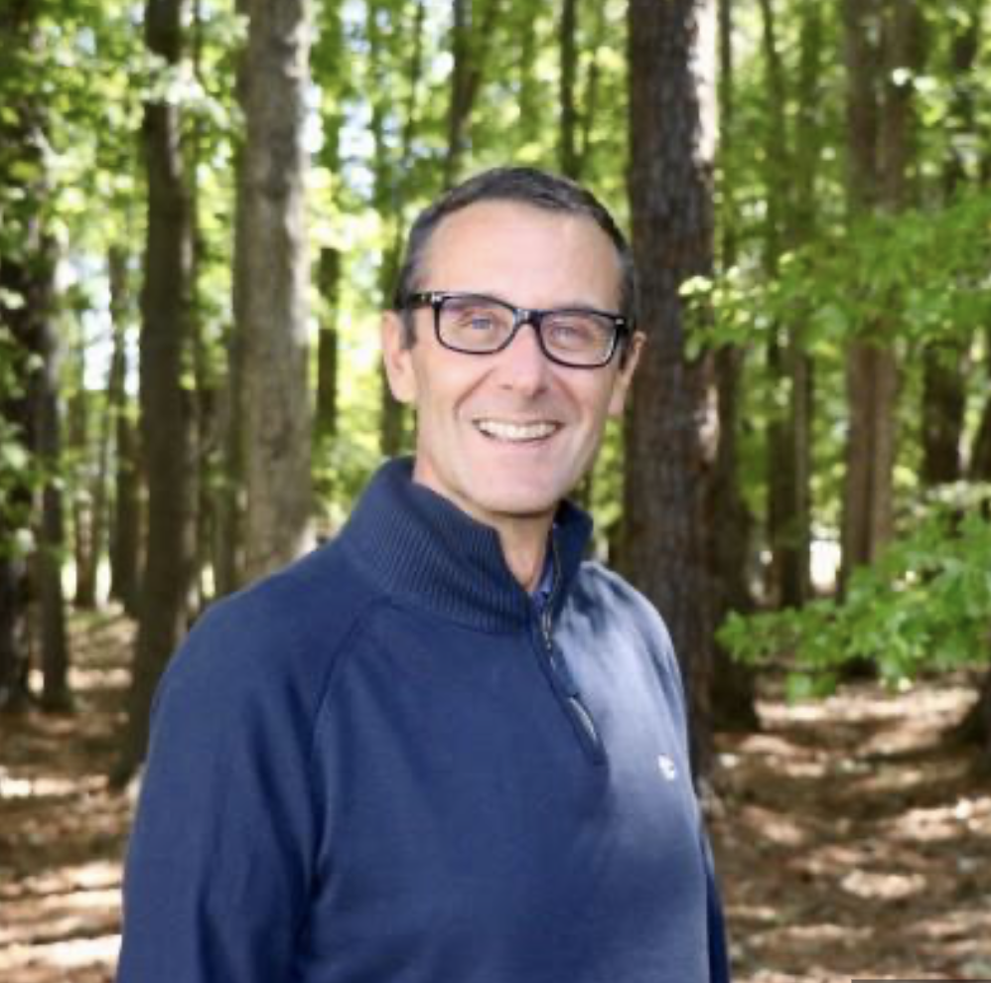
INFN@ JLab
INFN presence from the beginning (1991). Italian spokespersonship: > 20% of approved experiments
Deputy AD
Patrizia
Rossi
JLUO Chair
Marco
Contalbrigo
Hall-B Leader
Marco
Battaglieri
[till 12/21]
Alessandra Filippi: Chair of HPS Editorial Board
HPS Executive Committee member
Lucilla Lanza: CLAS Speaker Committee member
Evaristo Cisbani: SBS Corrdinating Committee member
Marco Mirazita: CLAS Service Work member
Andrea Celentano: HPS Publication Committee member
Raffaella De Vita: Hall-B Software Coordinator and CCC member [till 07/23]
Contalbrigo Marco: CLAS DPWG Chair and CCC member [till 09/22]
Marzio de Napoli: HPS Executive Committee member [till 05/23]
Contalbrigo M.
Congresso Nazionale SIF, 11 September 2023
2
Notes:
Vanno messi studi innovativi e pubblicazioni

Slide 3
INFN 12 GeV Projects
RM1, CT, BA Nucleon 3D FE, LNF,GE
E07-109 Proton form factor ‘22 E06-112 Quark dynamics ‘18
E17-004 Neutron form factor ‘22 E12-008 TMDs ‘18
E09-018 SIDIS off neutron (³He) ’23 C11-111 TMDs ‘21
C12-009 Dihadron probes ’21
Spectroscopy
GE, RM2, TO, PV
E11-005 ‘18
MESONX
E12-001A ‘18
J/psi and penta-quark
E16-010 ‘18
Hybrid Baryons
Nuclear Potentials
RM1
E17-003 ‘18
Lambda-nn off trithium (³H)
E11-101 ‘19
PREX-II: neutron skin
E15-008 ‘24
Lambda hypernuclei
Tracker
HCAL-J
RICH
PolTarget
Forward
Tagger
Hall-A
Hall-B
Cristal Calorimetry
Dark Sector
GE, CT, PV, LNS, RM2, TO, PD
E11-006 HPS ‘17 E16-001 BDX ‘24
Contalbrigo M.
Congresso Nazionale SIF, 11 September 2023
3
Notes:
Vanno messi studi innovativi e pubblicazioni

Slide 4
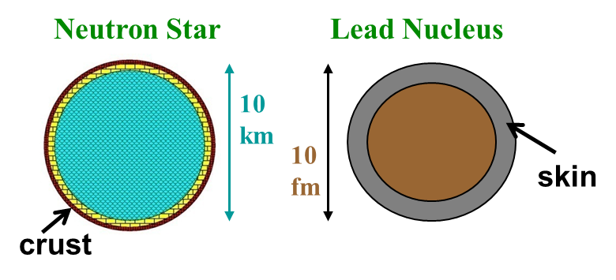
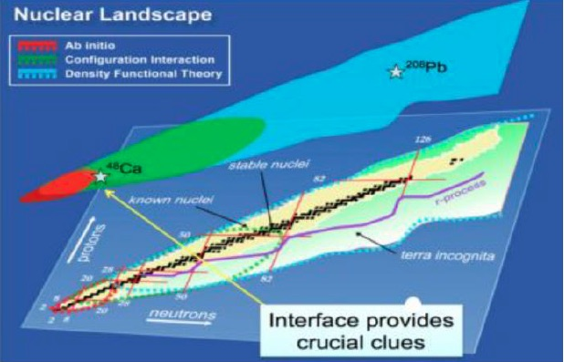
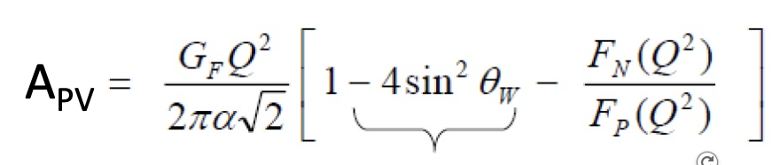
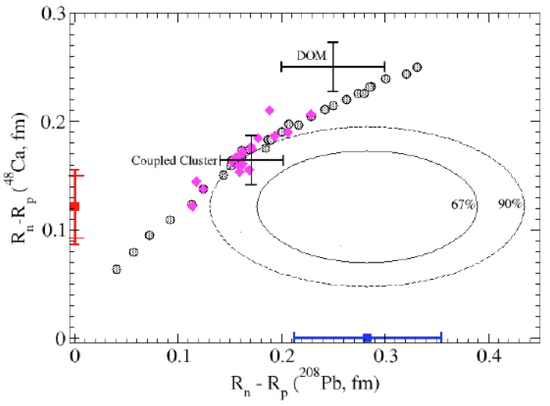
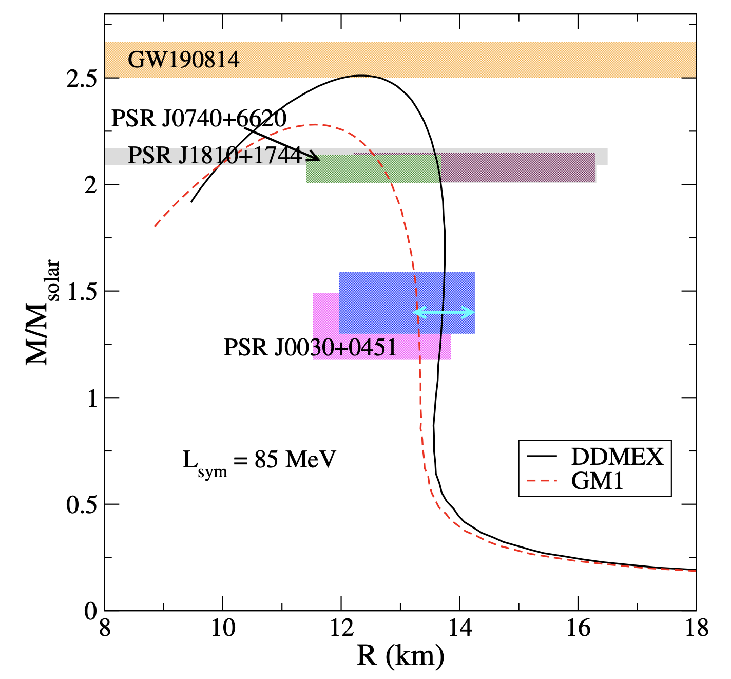
Neutron Skin
Neutron rich matter study at accelerators:
Parity violating asymmetry in electron scattering
to probe neutrons and measure the neutron skin
²⁰⁸Pb well described by density functional theory
Ab initio calculations describe light to medium nuclei
⁴⁸Ca could provide a bridge and differentiate among models
(LIGO)
(JLab)
arXiv: 2308.16449
Contalbrigo M.
Congresso Nazionale SIF, 11 September 2023
4

Slide 5
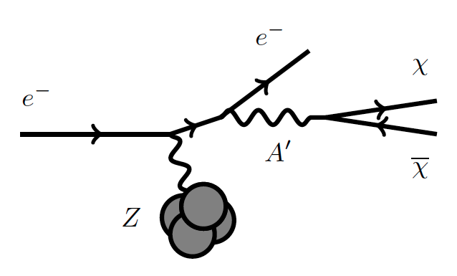
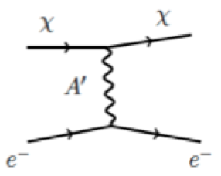
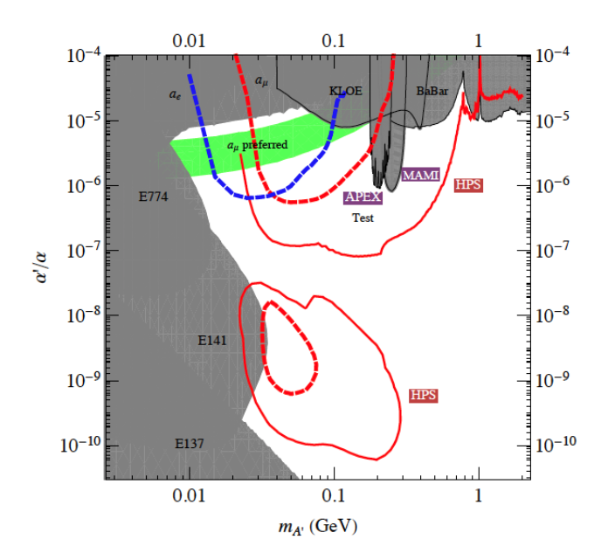
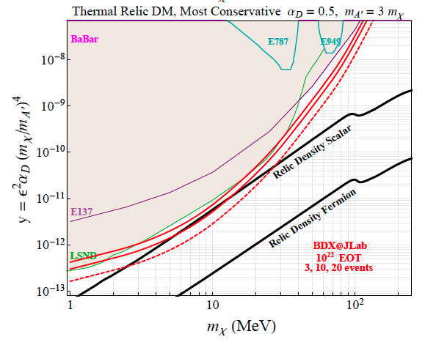
Dark Sector
CEBAF intense high-energy electron beam allows to cover unexplored regions
e+
e-
HPS
BDX
Contalbrigo M.
Congresso Nazionale SIF, 11 September 2023
5

Slide 6
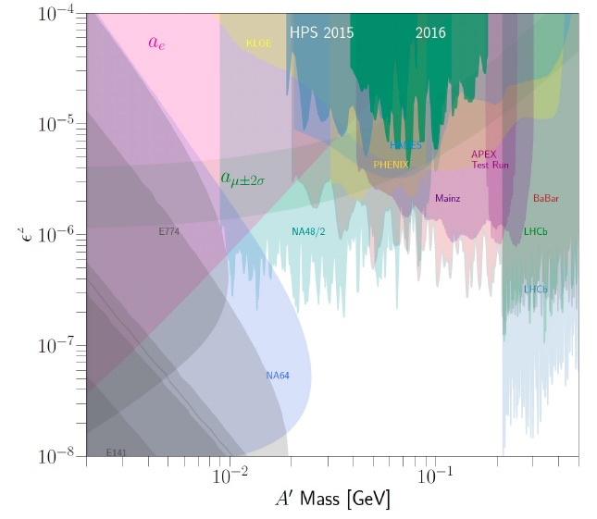
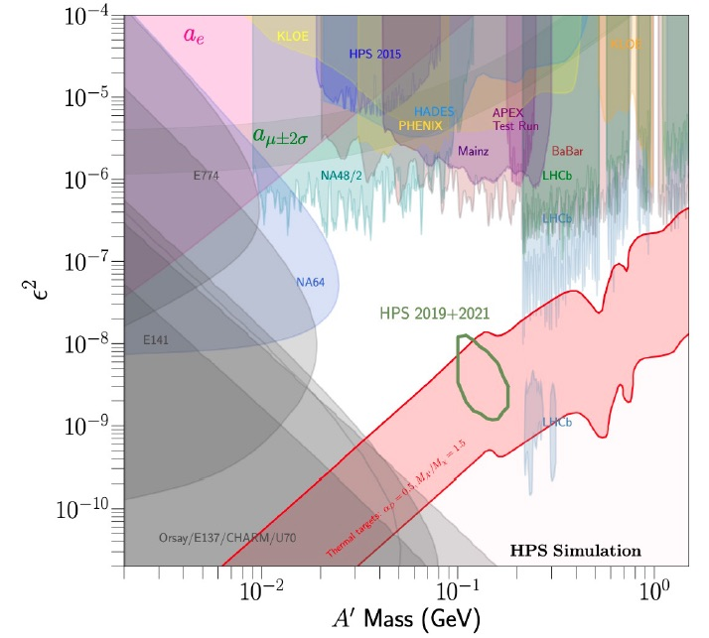
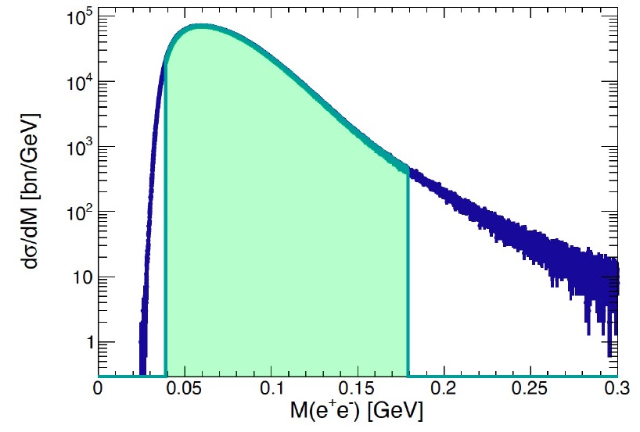
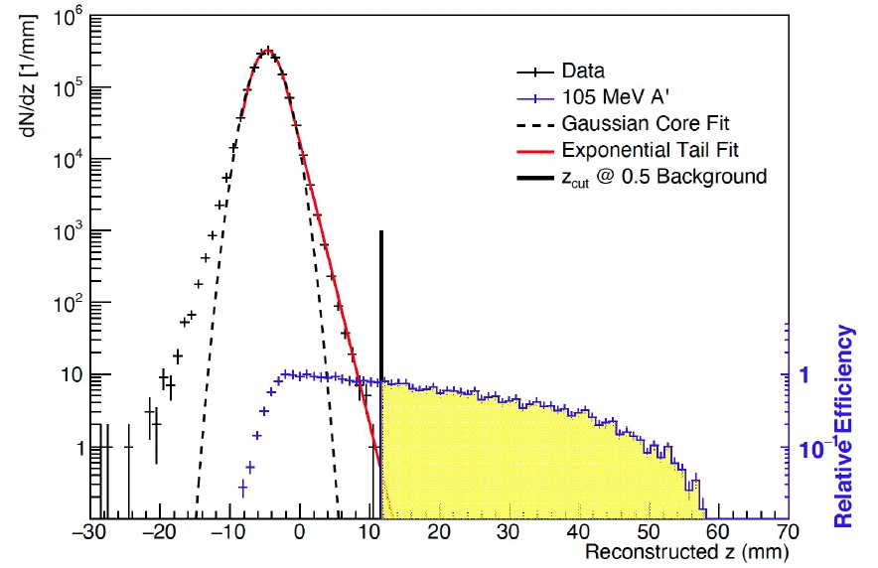
Heavy Photon Search
2016 Run: Analysis completed, drafting paper
2019 Run: Upgraded detector & data-taking completed
arXiv: 2212.10629
Moving towards unexplored regions
with discovery potential
Still 107 PAC-approved data-taking
days left
Mass bump
Detached vtx
Contalbrigo M.
Congresso Nazionale SIF, 11 September 2023
6
Notes:
Vanno messi studi innovativi e pubblicazioni

Slide 7
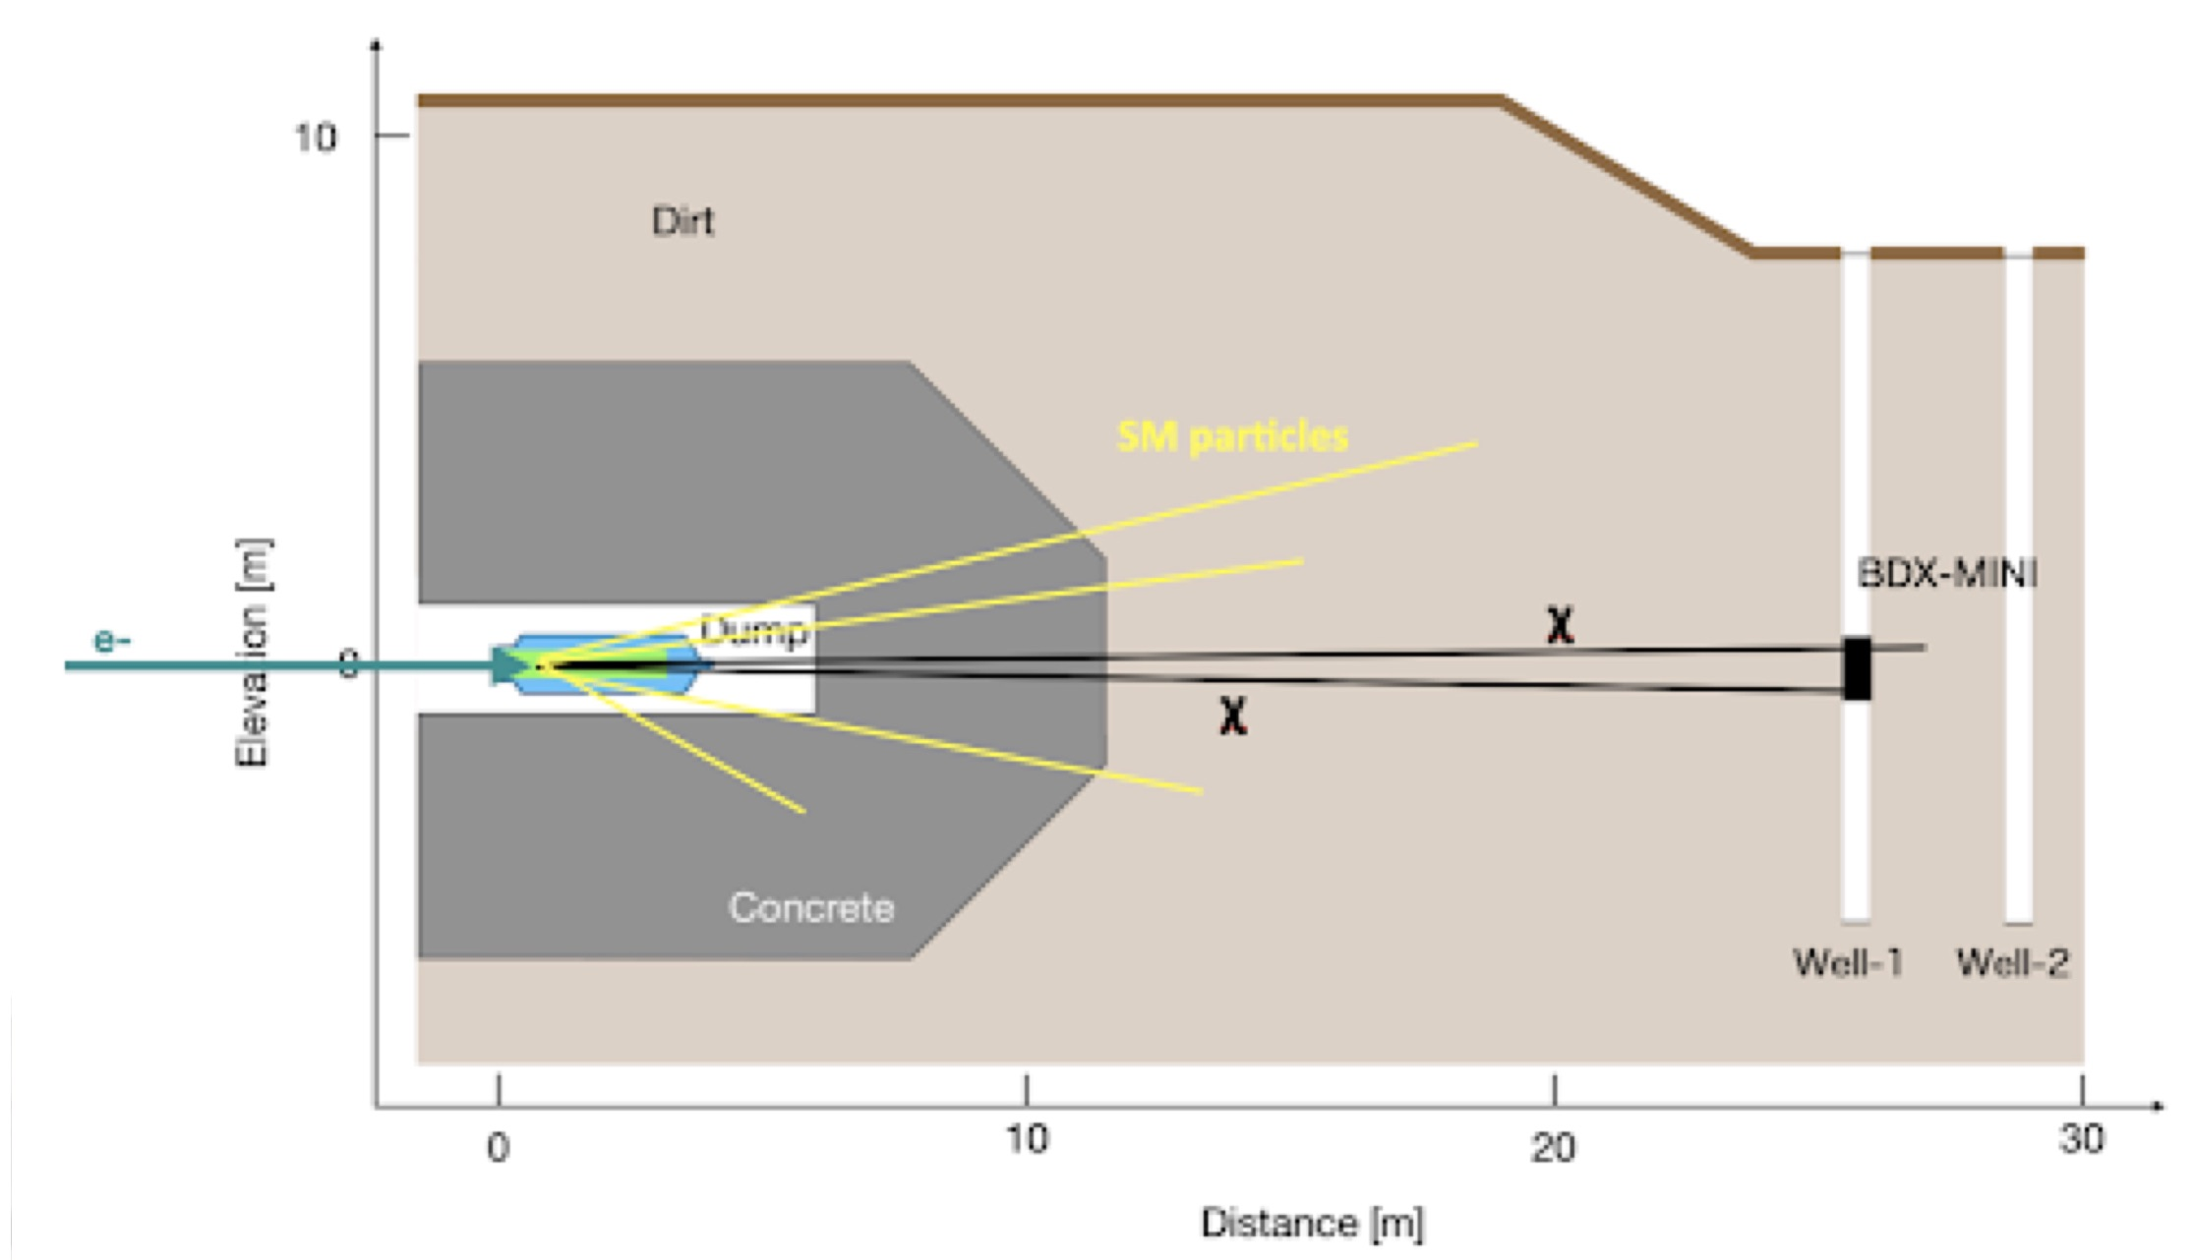
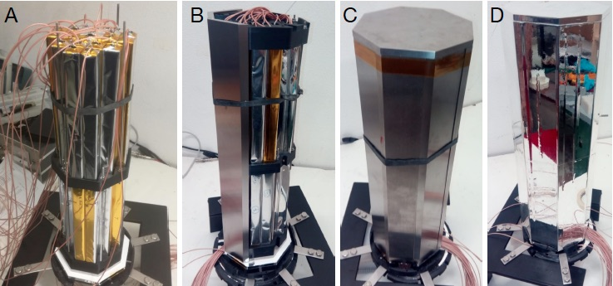
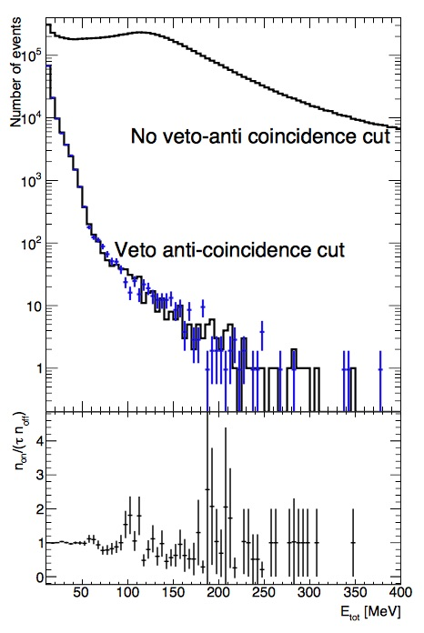
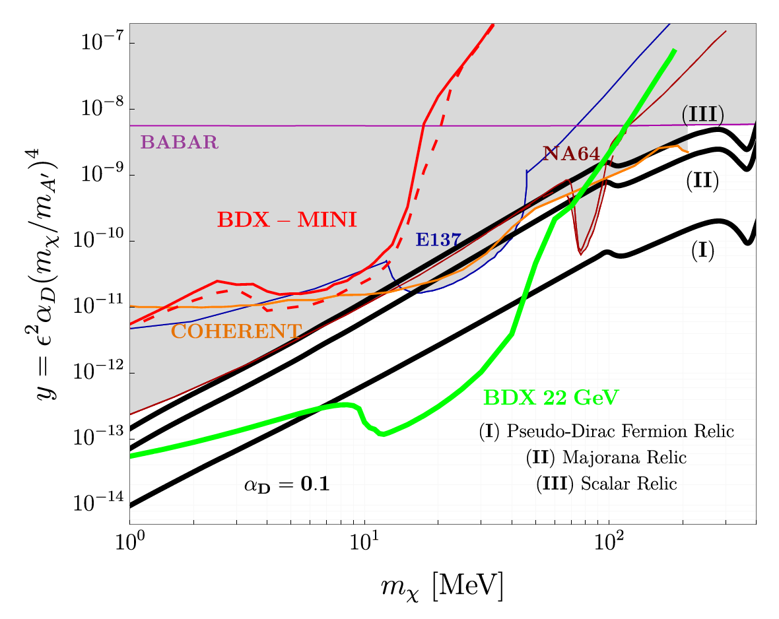
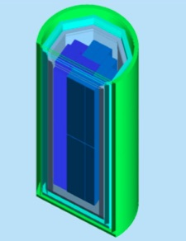
Beam Dump eXperiment
December ‘19 – fall ’20
E_{e} = 2.2 GeV 2.5 x 10²¹ EOT
Despite the small scale, BDX-mini is
competitive with LDM experiments (NA64, E137,..)
After unblinding no excess found
ECAL + veto attivo
Beam off
arXiv: 2208.01387
Contalbrigo M.
Congresso Nazionale SIF, 11 September 2023
7
Notes:
Vanno messi studi innovativi e pubblicazioni

Slide 8
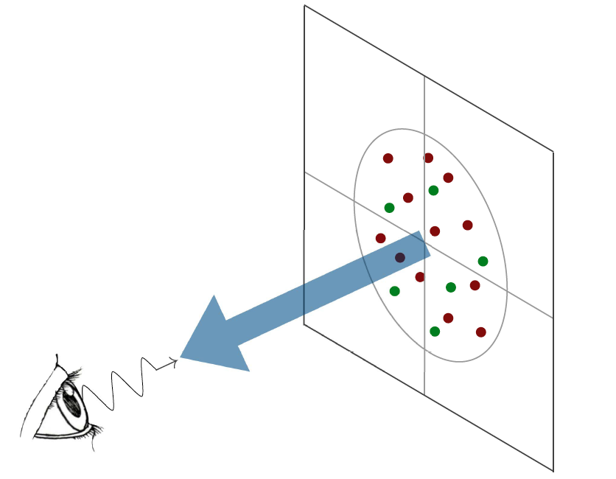
3D Nucleon Structure
Confinement Scale
d²b_{T}
d²k_{T}
Transverse momentum
k_{T}
d²k_{T}
d²b_{T}
b_{T}
Transverse position
High Energy Probe
Hard Scale
Longitudinal momentum
k⁺=xP⁺
Spin
l
Photon Virtuality
Q²
Transverse plane
l
Contalbrigo M.
Congresso Nazionale SIF, 11 September 2023
8
Notes:
Discutere che servono spin (fin dall’iniio → metter qualche simbolo nel disegno ?) e scala perturbativa

Slide 9
The Spin Case
Can QCD be a precision science ?
Should not be confused with pQCD, which already can,
but is not touching the intimate nature of the strong interaction
Single Spin Asymmetries
Proton Spin Budget
A_{N}
pp → πX
?
Contalbrigo M.
Congresso Nazionale SIF, 11 September 2023
9
Notes:
Vanno messi studi innovativi e pubblicazioni

Slide 10
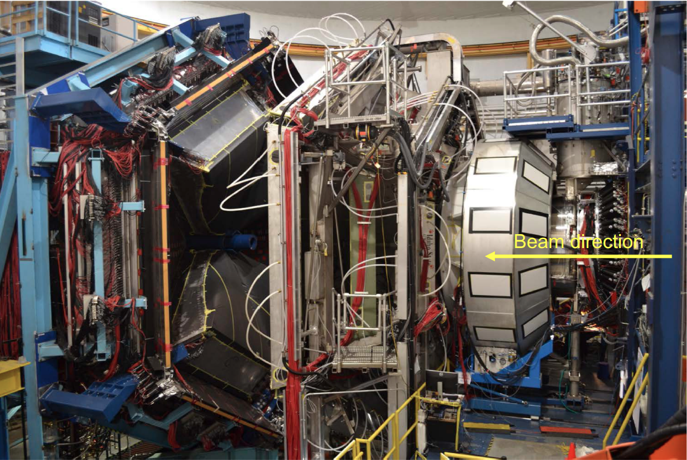
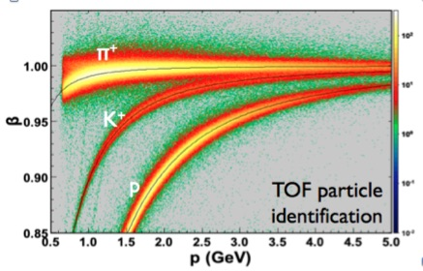
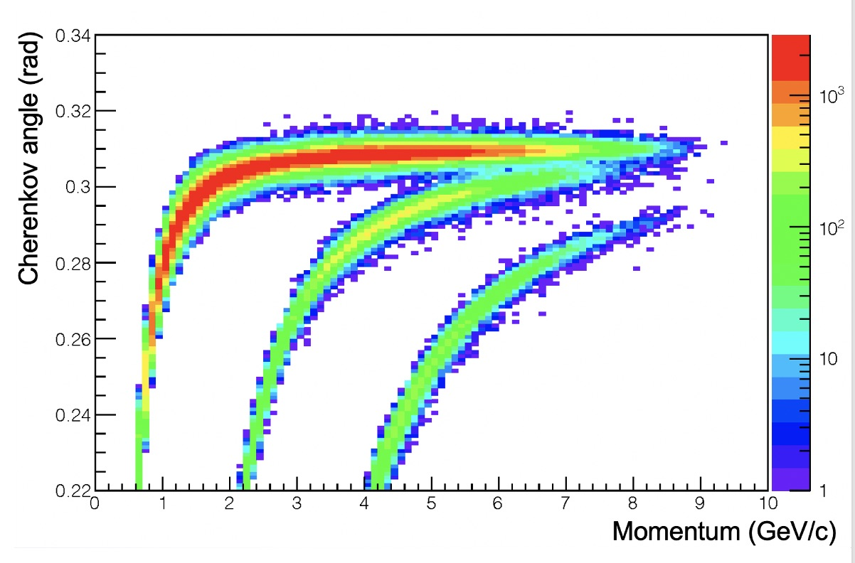
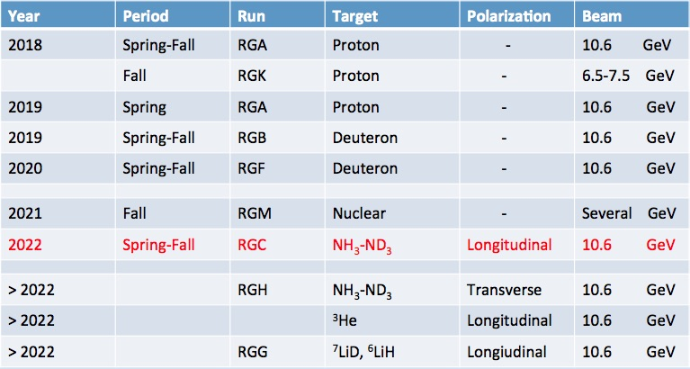
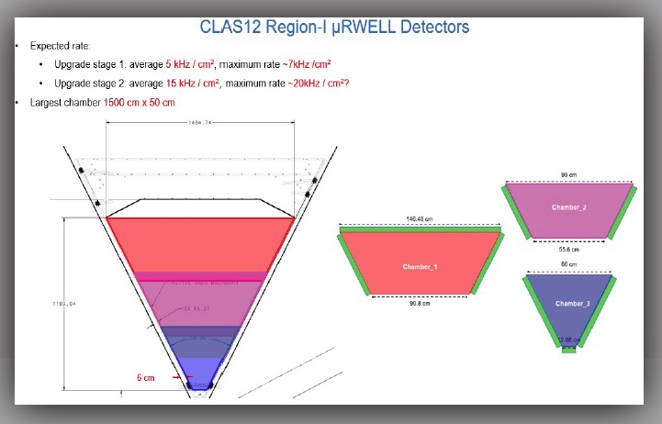
CLAS12 @ JLab
CLAS12 wide coverage, excellent PID, various polarized targets, high luminosity
RICH PID
Luminosity upgrade Stage-1: 2x10³⁵ cm⁻²s⁻¹ 3 years
Stage-2: > 10³⁷ cm⁻²s⁻¹ 7-10 years
Contalbrigo M.
Congresso Nazionale SIF, 11 September 2023
10
Notes:
Vanno messi studi innovativi e pubblicazioni

Slide 11
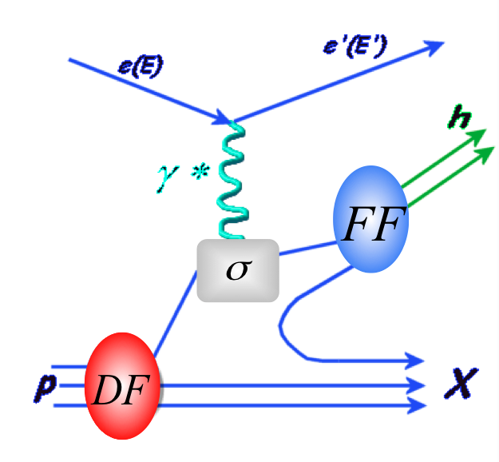
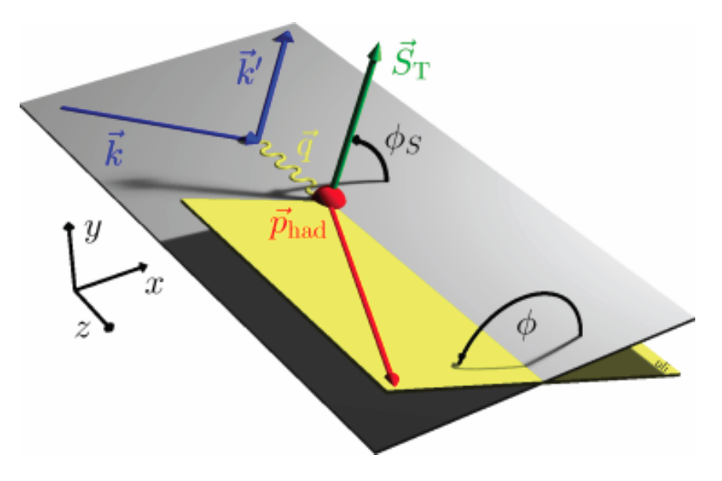
Semi-Inclusive DIS & TMDs
3D momentum and spin-orbit effect:
Parton kinematics and flavor from observed hadron kinematics and type
Distribution and fragmentation convoluted:
Contalbrigo M.
Congresso Nazionale SIF, 11 September 2023
11

Slide 12
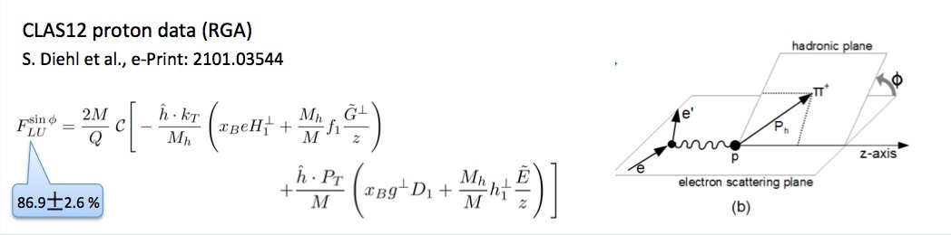
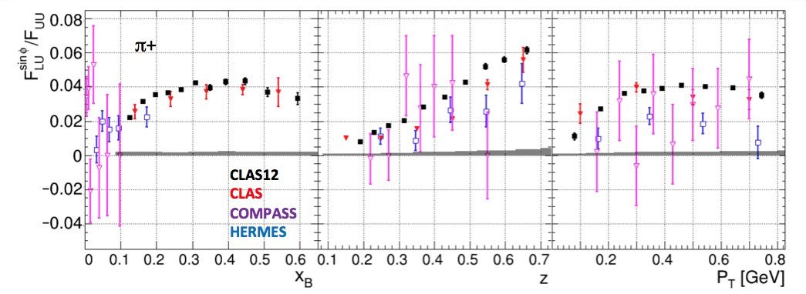
Beam Spin Asymmetry @ CLAS12
Contalbrigo M.
Congresso Nazionale SIF, 11 September 2023
12
Notes:
Vanno messi studi innovativi e pubblicazioni

Slide 13
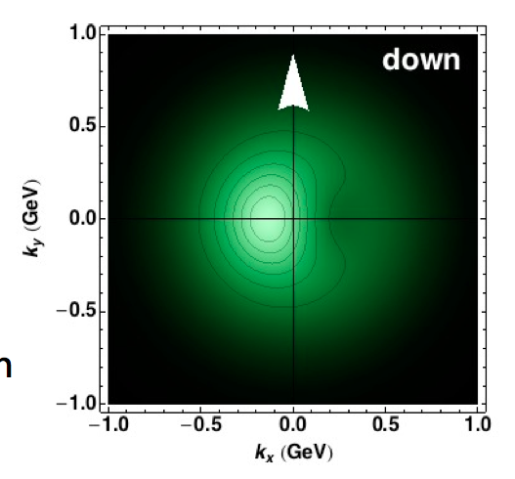
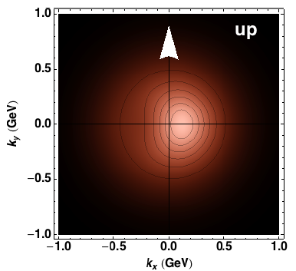
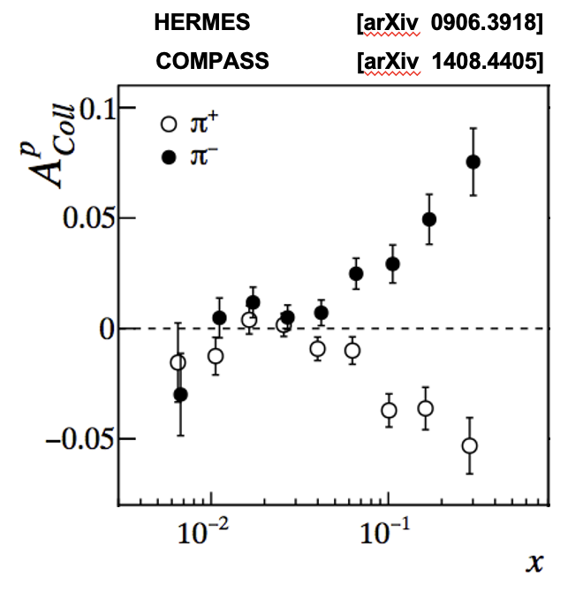
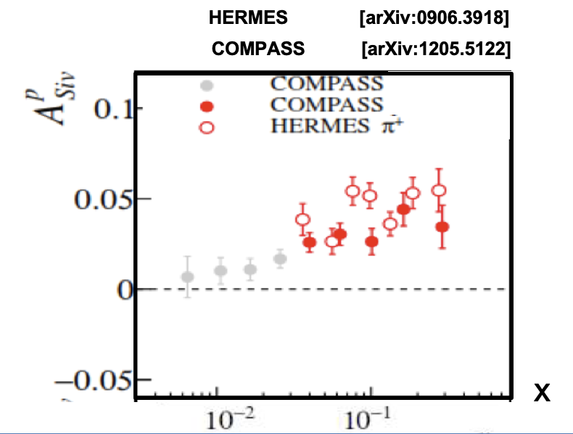
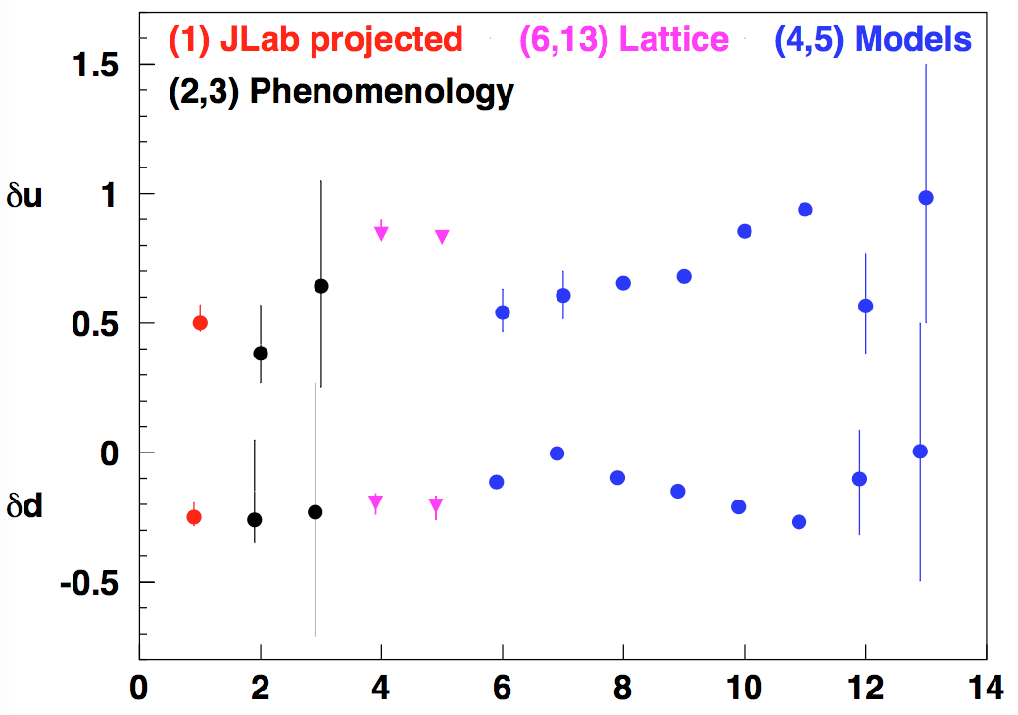
New Phenomena
Spin-orbit in QCD
?
?
Sivers effect:
Correlation between nucleon spin and
collective motion of the partons
Tranversity & Tensor Charge
Fundamental quantity related to BSM searches
(tensor coupling, particle EDM)
Contalbrigo M.
Congresso Nazionale SIF, 11 September 2023
13
Notes:
Vanno messi studi innovativi e pubblicazioni

Slide 14
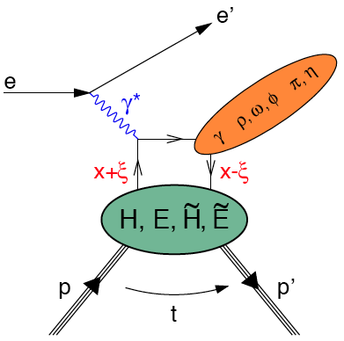
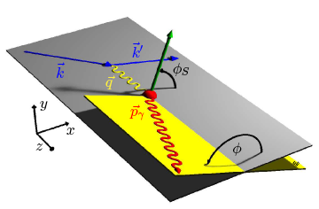
Hard Exclusive & GPDs
Transverse size & nucleon tomography:
Impact parameter derived from the transverse momentum transferred to nucleon
Various final states to prove GPDs and flavors
p
Contalbrigo M.
Congresso Nazionale SIF, 11 September 2023
14
Notes:
Trovare un plot migliore nella presentazione di Luciano ? E formula di Repko P prop alpha_S mq/Q^2

Slide 15
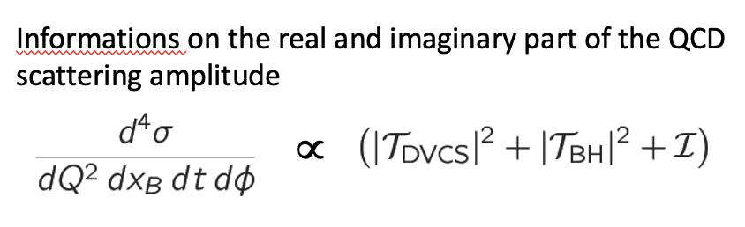
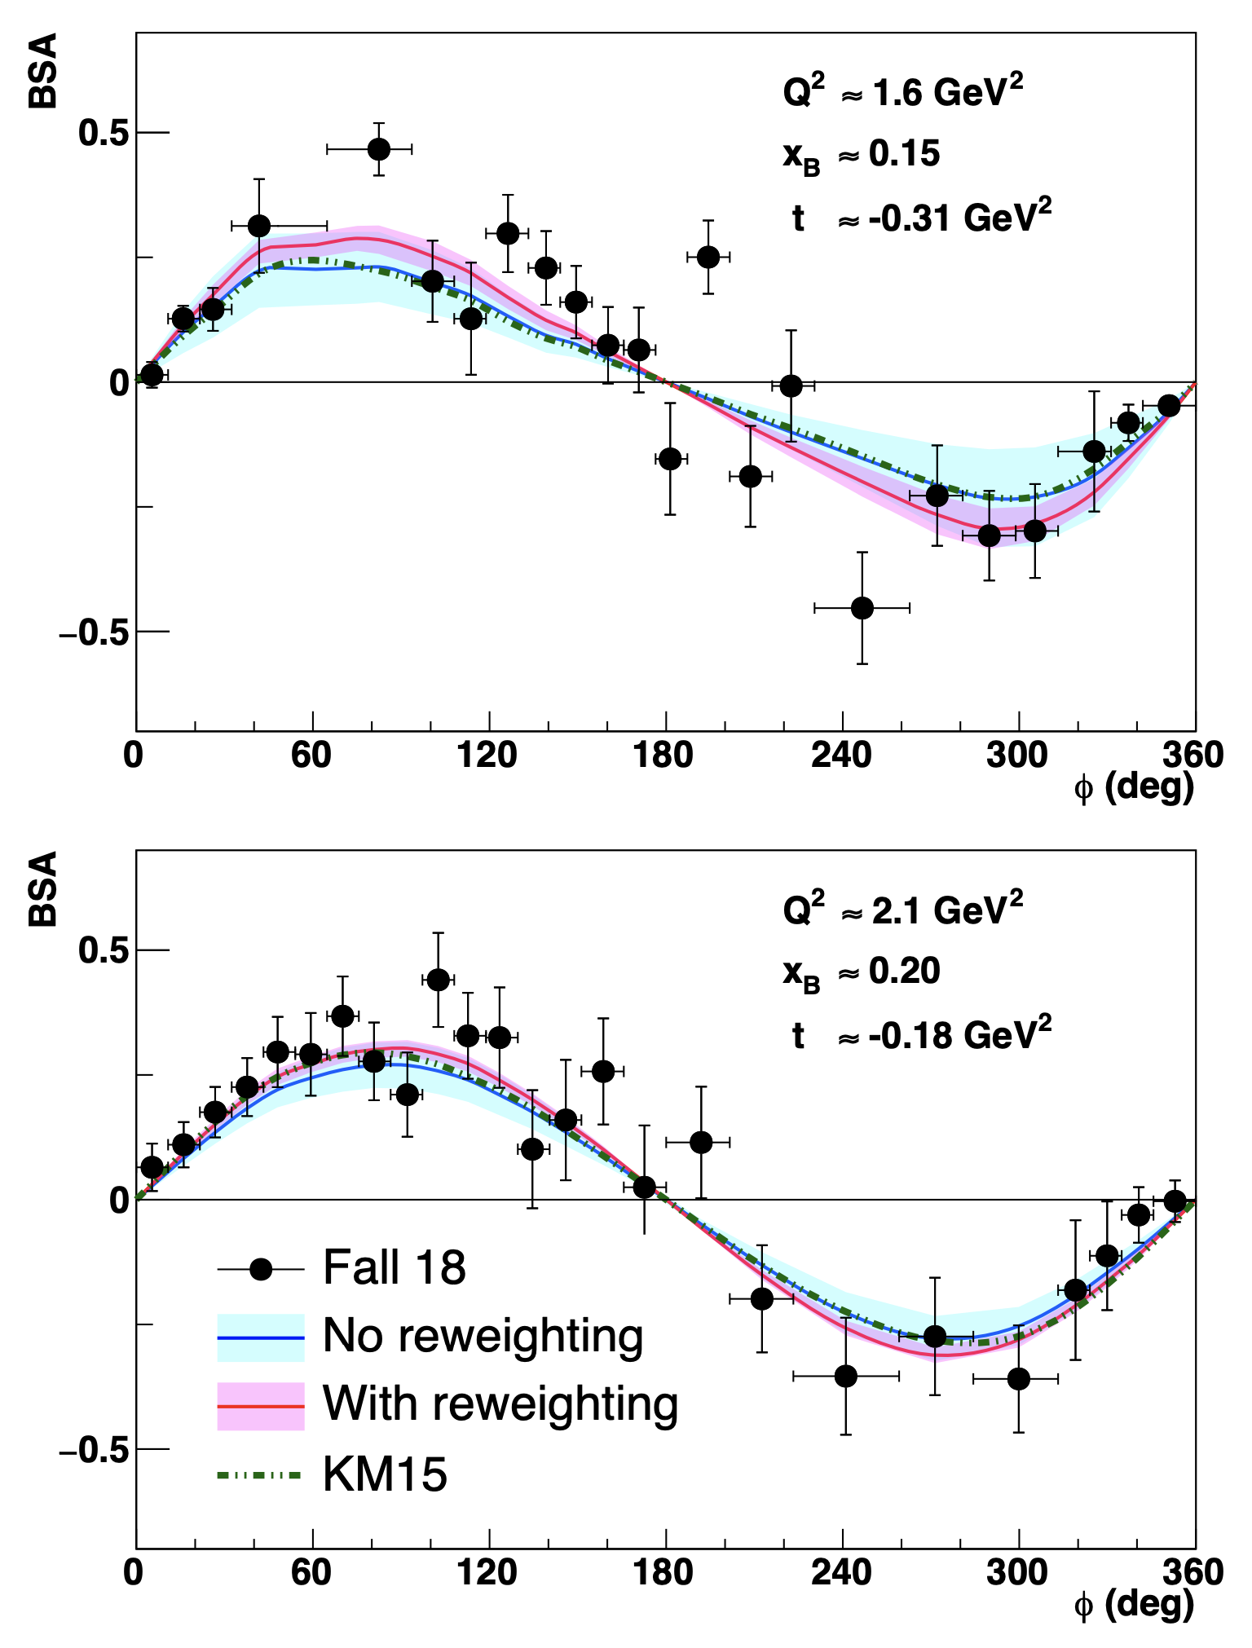
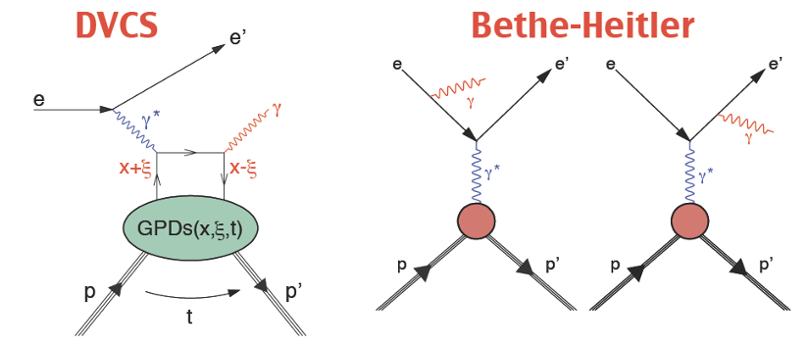
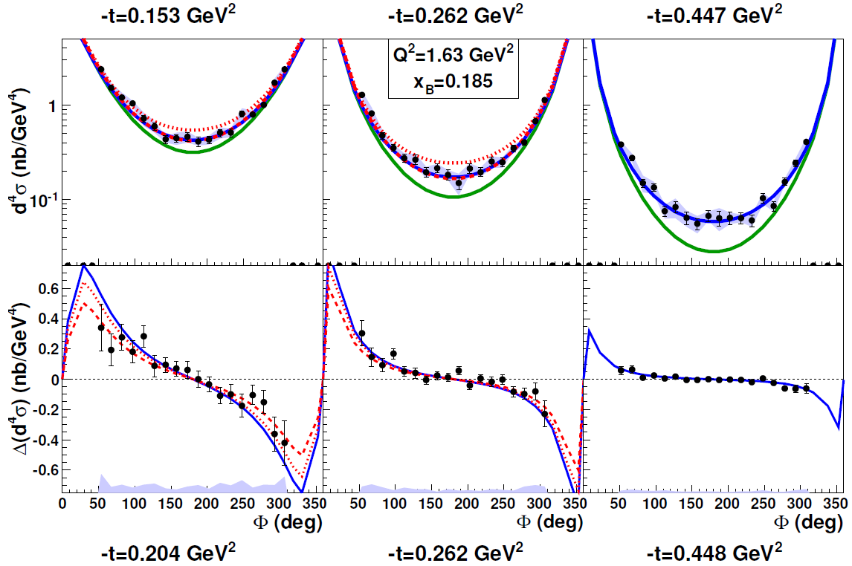
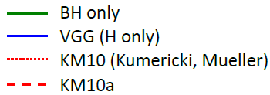
Exclusive Physics @ CLAS12
CLAS12
G. Christiaens et. al. [arXiv: 2211.11274]
CLAS
H.-S. Jo et. al. [arXiv: 1504.02009]
Contalbrigo M.
Congresso Nazionale SIF, 11 September 2023
15
Notes:
Vanno messi studi innovativi e pubblicazioni

Slide 16
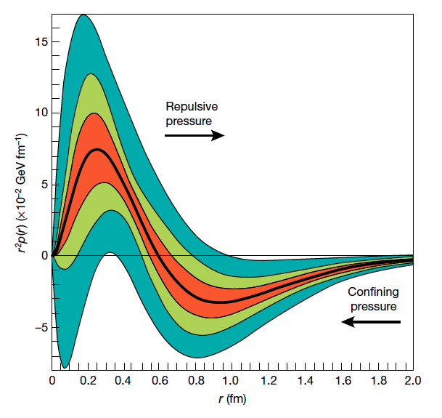
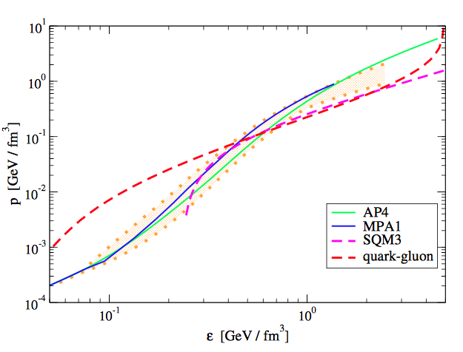
Extreme Matter Conditions
GPDs moments are related to the proton momentum-energy tensor,
e.g. how pressure and momentum are distributed within the nucleon
Pressure inside the nucleon
Neutron star equation of state
V.Burkert++ [Nature 577 (2018)]
S.Liuti++ [arXiv 1812.01479]
Contalbrigo M.
Congresso Nazionale SIF, 11 September 2023
16
Notes:
Da dove tirano le infos ? Quali GODs

Slide 17
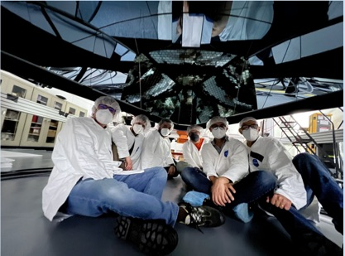
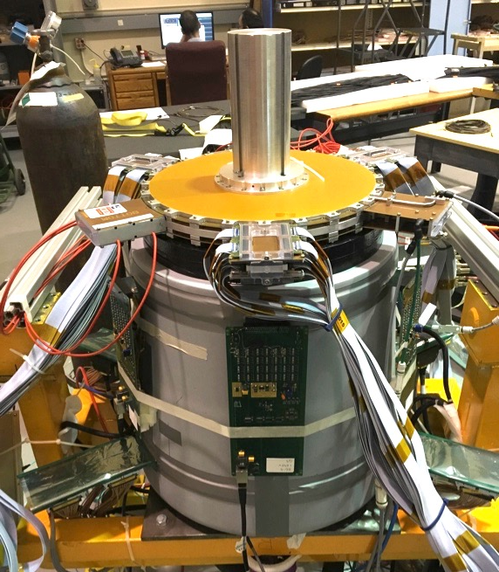
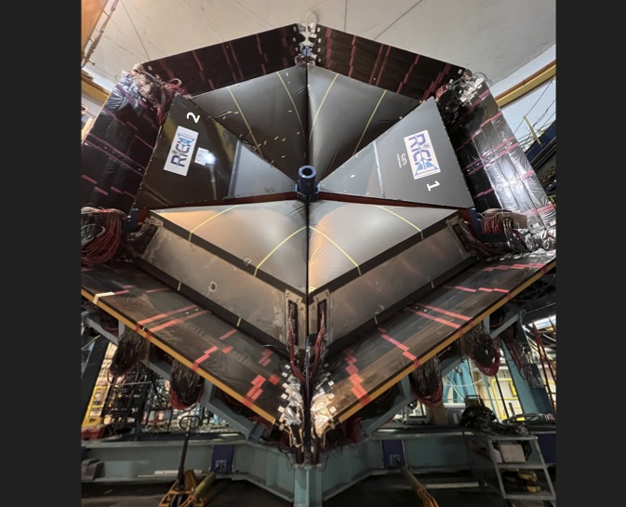
INFN @ CLAS12
Forward Tagger completed in 2018
Small-angle calorimeter (nucleon 3D)
Quasi-real photoproduction regime (spectroscopy)
RICH completed in 2022
Hadron ID in the 3-8 GeV/c momentum range
MIUR priority project (“premiale”)
Contalbrigo M.
Congresso Nazionale SIF, 11 September 2023
17
Notes:
Vanno messi studi innovativi e pubblicazioni

Slide 18
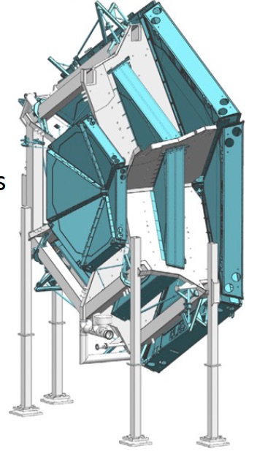



INFN: High-Lumi
Under study @ INFN: Alternative 2D-readout schemes and light assembling
Towards: 50x50 cm² prototype
Study charge collection, time and spatial resolution
Requirements: σ_{s} ~ 100 mm
Δt ~ 10 ns
Eff > 95%
Contalbrigo M.
Congresso Nazionale SIF, 11 September 2023
18
Notes:
Vanno messi studi innovativi e pubblicazioni

Slide 19




INFN: Target Holding Magnet
Under study: New concept
pre-conditioned MgB₂ bulk superconductor
- No coil shaping within experiment
- No current leads, just low T
- Minimum material, large acceptance
Magnetization @ 1 T
Dipole field by a solenoid
Contalbrigo M.
Congresso Nazionale SIF, 11 September 2023
19
Notes:
Vanno messi studi innovativi e pubblicazioni

Slide 20




Landscape
Energy range matching perturbative and non-perturbative regimes
JLab22
Unprecedented fragmentation information
New lattice achievements
C. Alexandrou++ [arXiv: 1902.00857]
Bridge to hadron probes
Contalbrigo M.
Congresso Nazionale SIF, 11 September 2023
20
Notes:
Vanno messi studi innovativi e pubblicazioni

Slide 21




JLab22
Luminosity frontier at 22 GeV [arXiv: 2306.09360]
Broader reach, unprecedent precision
Mechanical properties of the nucleon (energy-momentum tensor)
New evolution kernels (theory fundation)
Contalbrigo M.
Congresso Nazionale SIF, 11 September 2023
21
Notes:
Vanno messi studi innovativi e pubblicazioni

Slide 22


The EIC Project
BNL Accelerator Complex
ePIC Detector
p/A beam
e beam
p: 41 GeV, 100 to 275 GeV
e: 5 GeV to 18 GeV
EIC User Group
ePIC Collider Experiment
Marco Radici Chair of EICUG Steering Committee
Marta Ruspa EICUG Steering Committee member
Cristina Tuve’ Chair of EICUG Election and
Nominating Committee
Silvia dalla Torre ePIC Deputy Spokesperson
Pietro Antonioli Deputy Chair del Membership Committee
Salvatore Fazio ePIC Analysis co-Coordinator
Marco Battaglieri Streaming Computing Model Leader
Marco Contalbrigo Forward RICH Leader 1
Contalbrigo M.
Congresso Nazionale SIF, 11 September 2023

Slide 23




INFN @ ePIC
dRICH
mRWELL
MAPS
Contalbrigo M.
Congresso Nazionale SIF, 11 September 2023

Slide 24

Conclusions
New challenges in hadronic physics and non-perturbative QCD could be addressed by
JLab at 12 and 22 GeV Facility aiming at the intensity frontier
EIC Facility aiming at the energy frontier
New data coming from JLab at high-luminosity and EIC at high-energy should allow to access:
3D structure of ordinary matter
Mechanical properties of the nucleon
Precise Standar Model tests and BSM Physics
Dark matter signals
Nuclear potentials and neutron stars equation of state
…..
A comprehensive study provides access to the peculiar dynamics of the QCD world
Contalbrigo M.
Congresso Nazionale SIF, 11 September 2023
24
Notes:
Vanno messi studi innovativi e pubblicazioni

