Slide 1
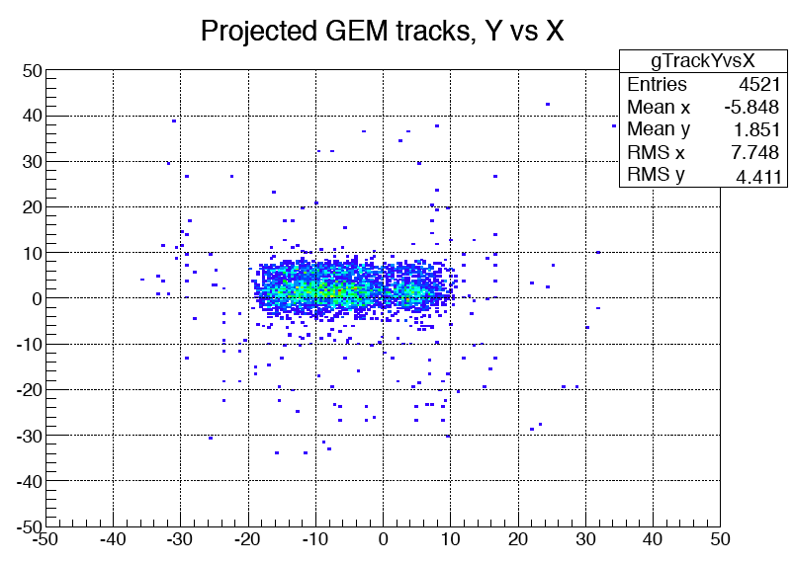
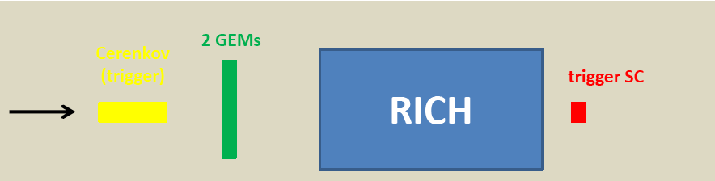




RICH Detector
Cherenkov Ring Profile
January 2013: selected by INFN in the short list to be presented to
the Italian Ministry for dedicated 2.2 MEuro funding
December 2012: extensive test-beam at CERN with hadron beams
Beam ID
Y [mm]
Beam Profile
Δt with trigger
K
π
ADC channels
X [mm]
Threshold
Gas Cherenkov
SiPM
Beam
few % of kaons

Slide 2
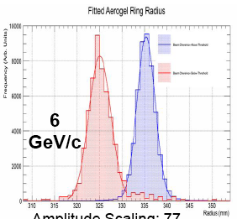
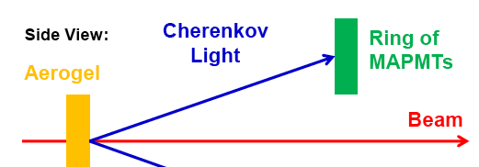
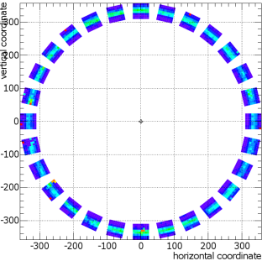
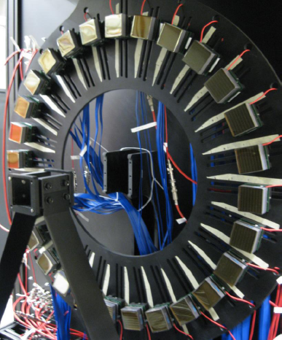
RICH Prototype: Direct Light
Kaon
(x 77)
Aerogel n=1.05, Beam P = 6 and 8 GeV/c
> 4σ
separation
at 6 GeV/c
Pion
Radius [mm]
> 3σ separation at 8 GeV/c with not-UV PMT
8 GeV/c
σ [mrad]
Only PMT w/o UV window (50 %)
DATA & MC consistent
law
Expected working point
N p.e.

Slide 3
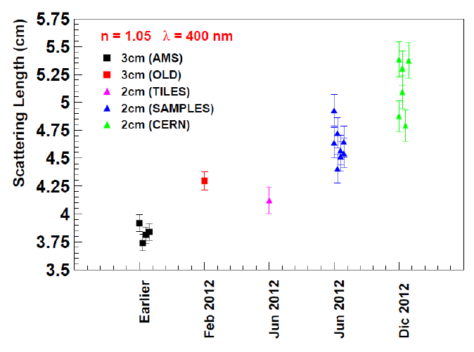
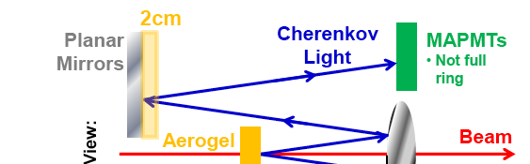
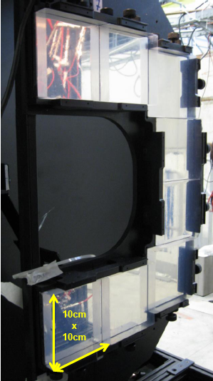
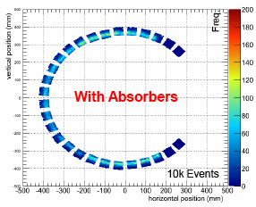
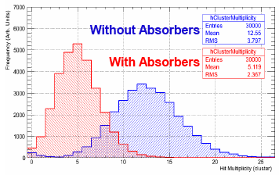
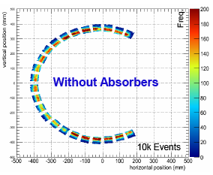
RICH Prototype: Reflected Light
Aerogel improvement in Time
Aerogel n=1.05, Beam P = 6 GeV/c
HTCC
mirror
60% p.e. yield loss matches the requirements
Mirror +
Aerogel
Mirror + Aerogel
Mirror + Aerogel
Mirror only
Mirror only
N p.e.

