Slide 1
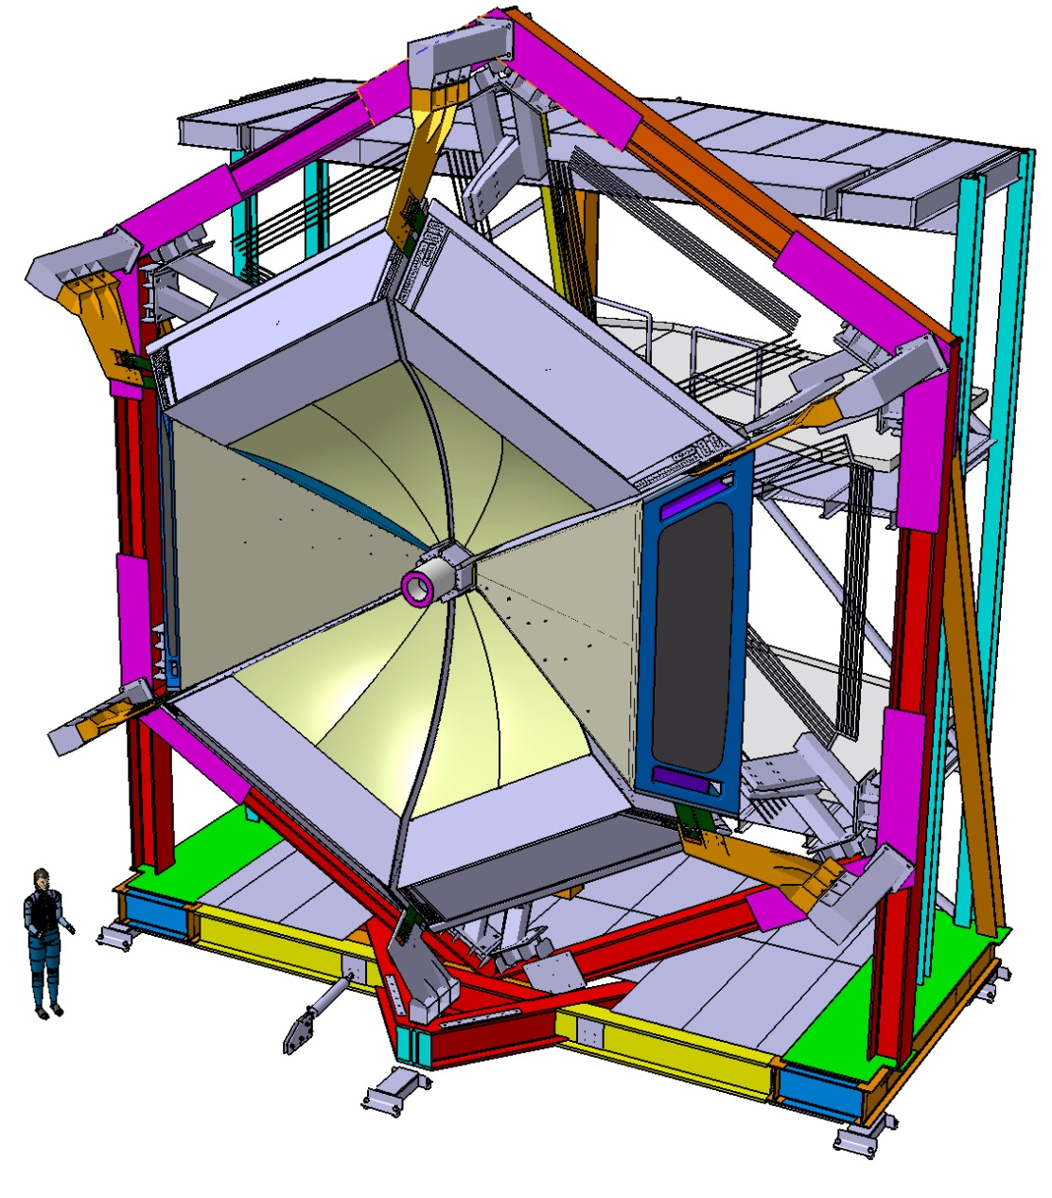
Aerogel mass production for the CLAS12 RICH:
Novel characterization methods and Optical Performance
Contalbrigo Marco
INFN Ferrara
RICH 2016, September 9th 2016, Bled

Slide 2
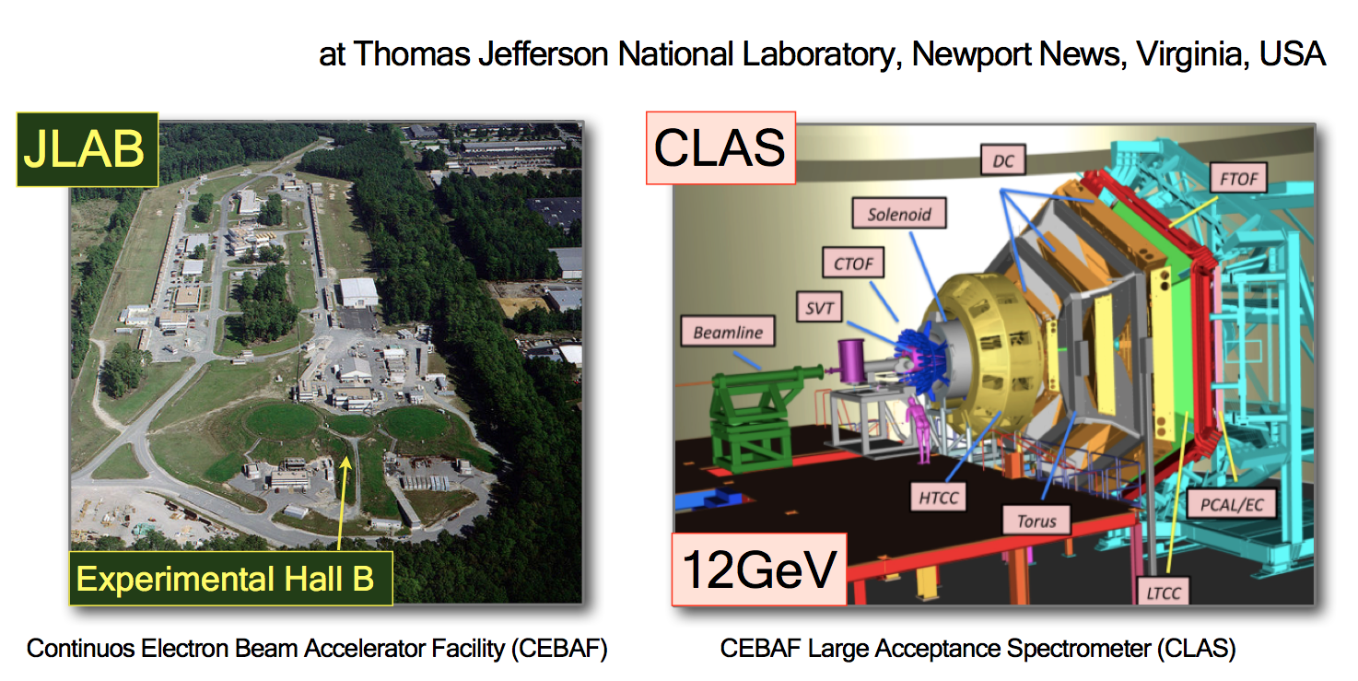
The CLAS12 RICH
CLAS12
RICH goal: π/K/p identification from 3 up to 8 GeV/c and 25 degrees
~4σ pion-kaon separation for a pion rejection factor ~ 1:500
Contalbrigo M.
RiCH 2016, 9th September 2016, Bled
2

Slide 3
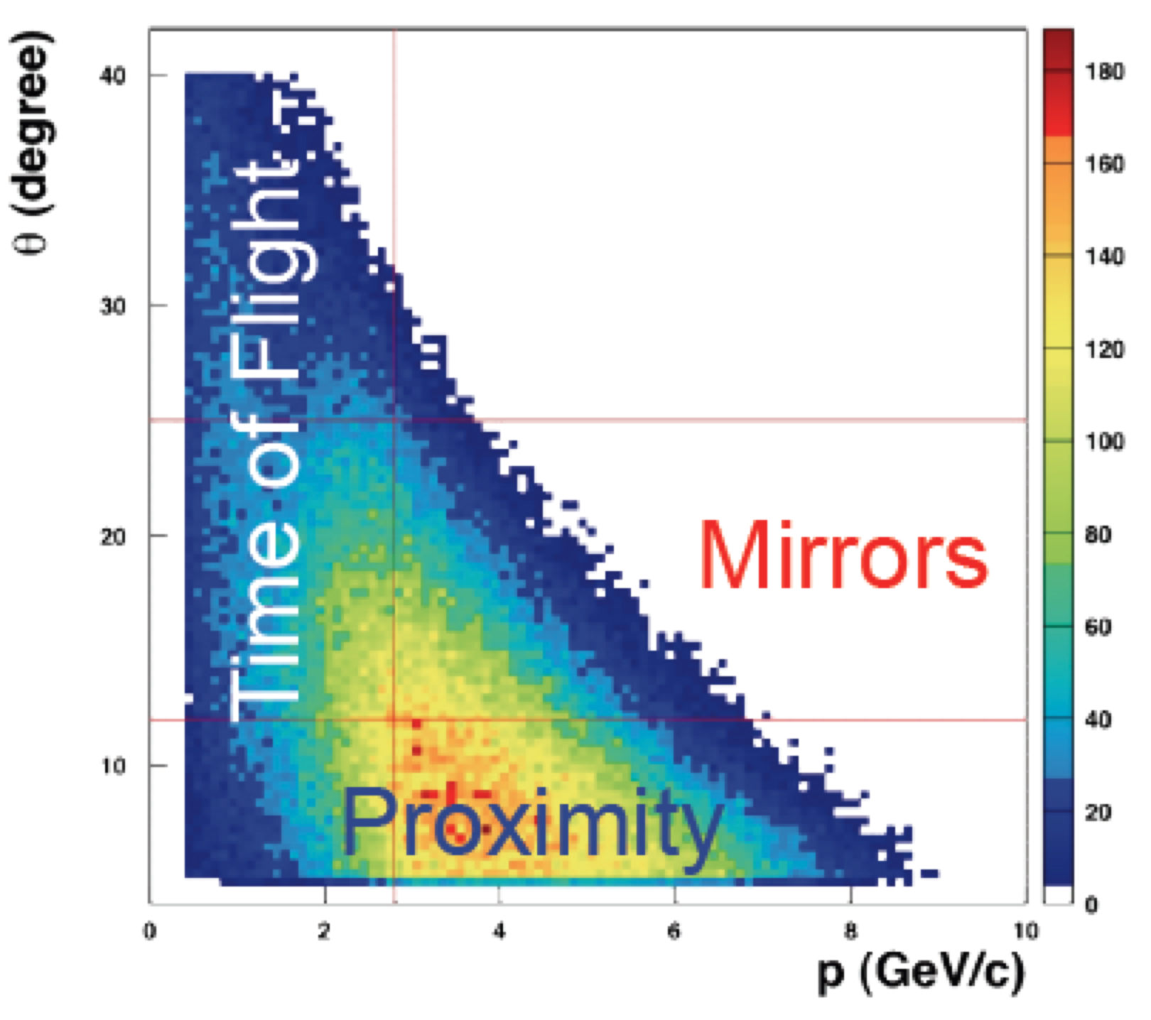
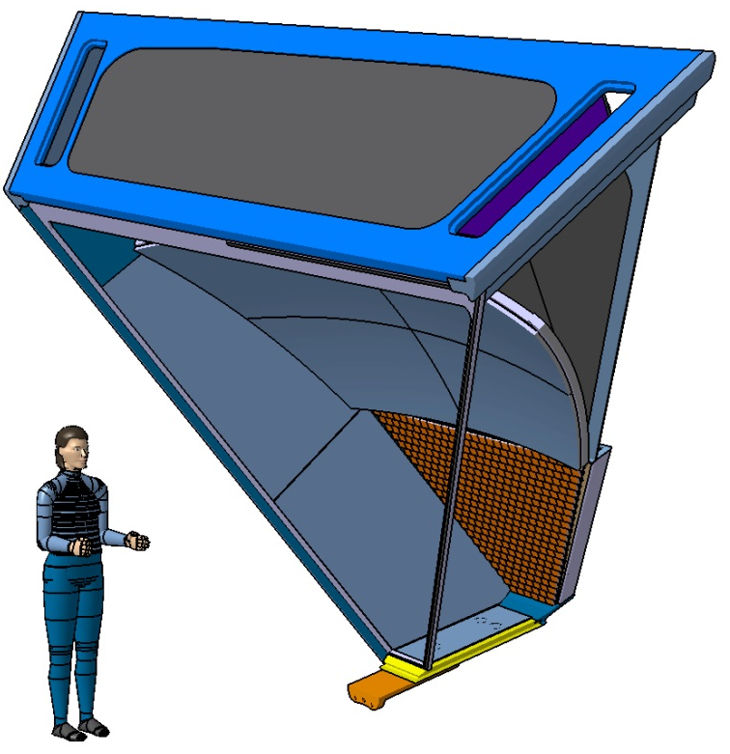
The Hybrid Optics Design
Direct rings and best performance for high momentum particles
spherical
mirror
6 cm
gap
γ
plane
mirror
π
2 cm
photon detector
aerogel
Reflected rings for less demanding low momentum particles
π
4.2 m
spherical
mirror
6 cm
γ
plane
mirror
gap
3.7 m
2 cm
photon detector
aerogel
π
Minimize active area (cost) to about 1 m²
Material budget concentrated where TOF is less effective
Focalizing mirrors allow thick radiator for good light yield
Time resolution < 1 ns to distinguish direct and reflected patterns
1.2 m
Beam
Contalbrigo M.
RiCH 2016, 9th September 2016, Bled
3

Slide 4
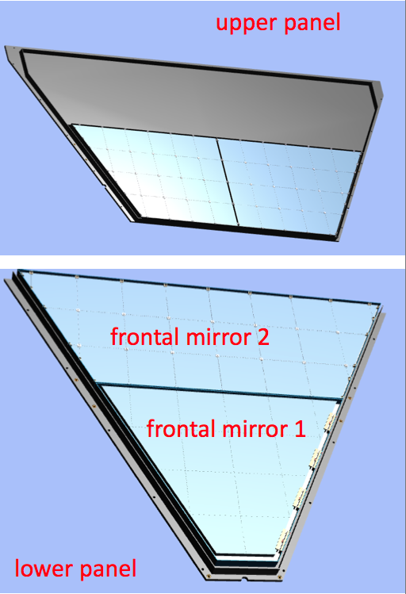
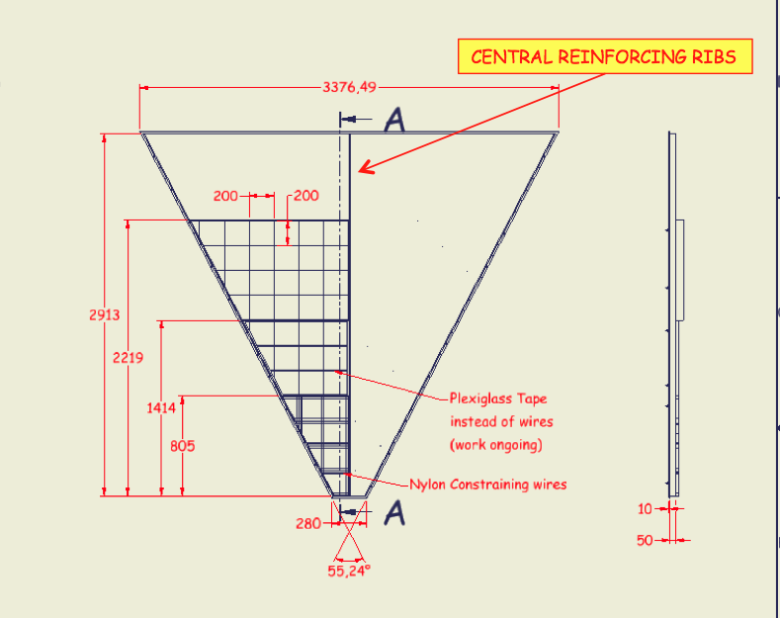
Aerogel Production
72 (3 cm thick ) and 22 (2 cm thick) full squared tile + 30 shaped ones
High transparency and large refractive index (n=1.05) to ensure photon yield
Large area 20 x 20 cm² to reduce losses at the edges, variable thickness (2 and 3 cm)
44 x 2 tiles
3 + 3 cm
32 tiles
2 cm
Contalbrigo M.
RiCH 2016, 9th September 2016, Bled
4

Slide 5
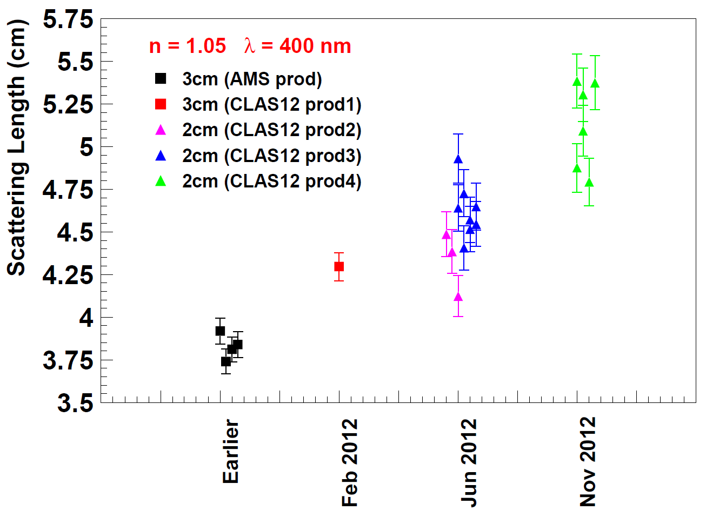
Aerogel Radiator
Collaboration with Budker and Boreskov Institutes of Novosibirsk
Flexible geometry, mass production capability
Achieved ~ 0.0050 μm⁴ cm⁻¹ clarity for large tiles (LHCb had 0.0064 μm⁴ cm⁻¹ for n=1.03)
A₀ > 95 %
Dominated by
Absorption coeff.
<L_{sc}> ~ 50 mm
Dominated by
Scattering length
Hygroscopic aerogel requires special care and dry N₂ atmosphere
Contalbrigo M.
RiCH 2016, 9th September 2016, Bled
5

Slide 6
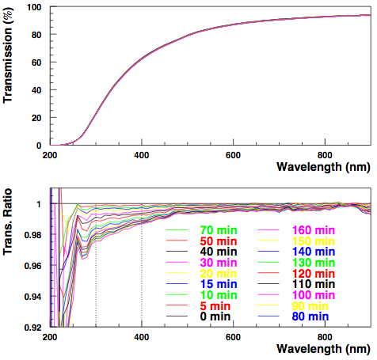
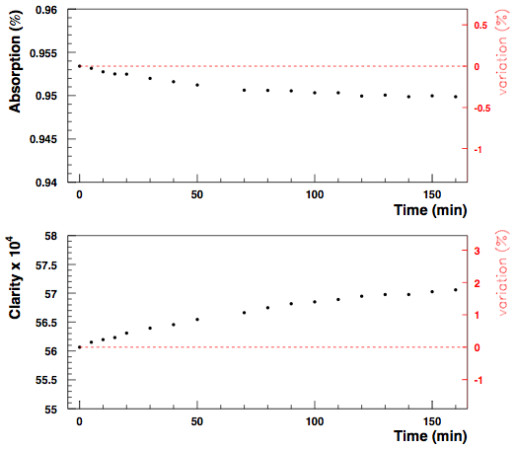
Aerogel Characteristics in the Air
Transmission vs Time
Absorption and Clarity @ 400 nm
Monitoring the time dependence of the transmission of aerogel tile
in environment of non-zero relative humidity (~ 40 %)
Contalbrigo M.
RiCH 2016, 9th September 2016, Bled
6

Slide 7
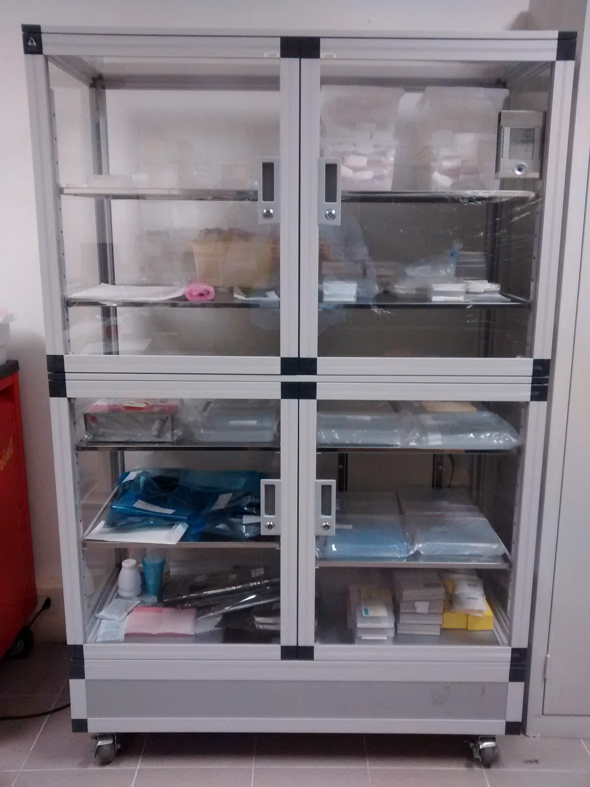
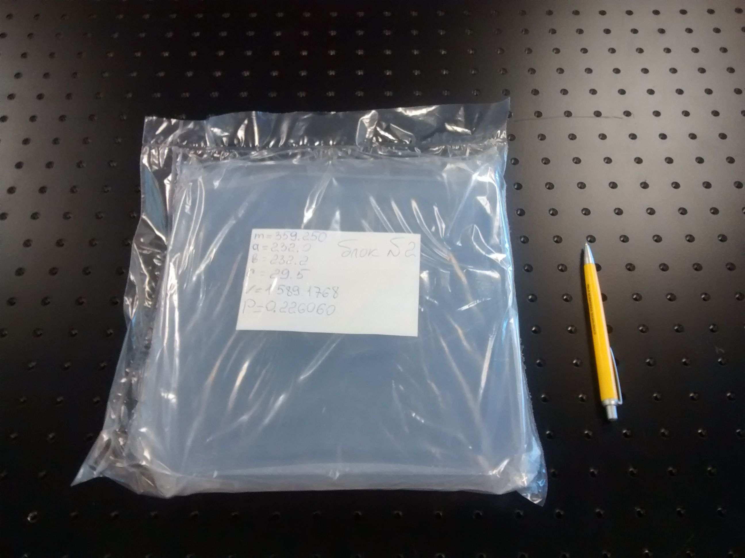
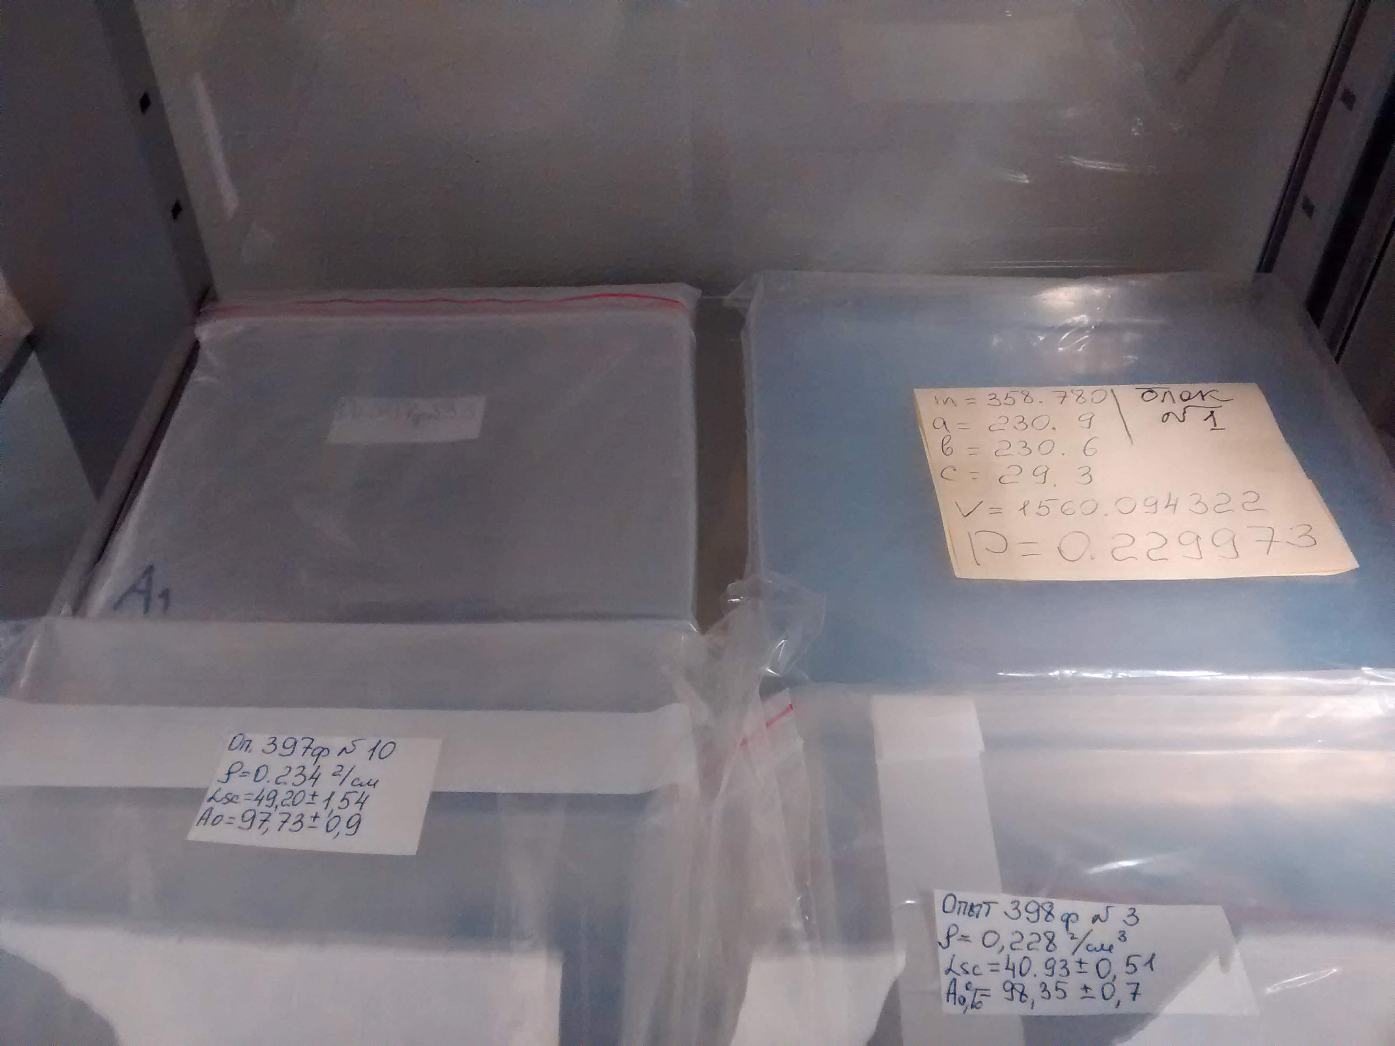
Aerogel Storage
Within sealed envelops and inside a dry-cabinet (few % RH)
Contalbrigo M.
RiCH 2016, 9th September 2016, Bled
7

Slide 8
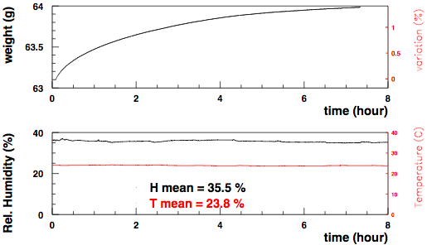
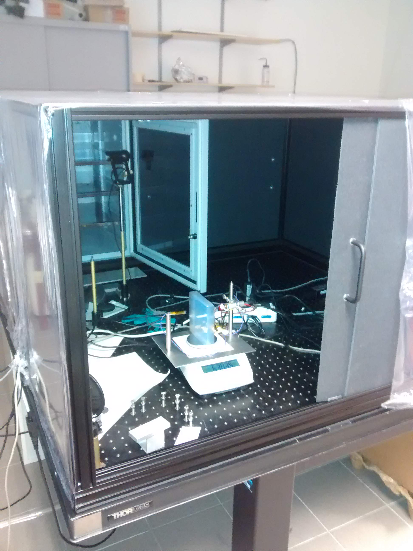
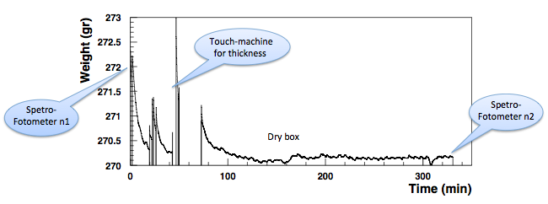
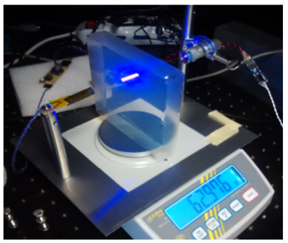
Aerogel Weight
In Air ( ≈ 40 % RH)
Inside Dry-Box ( ≈ 1 % RH)
(hours)
Contalbrigo M.
RiCH 2016, 9th September 2016, Bled
8

Slide 9
Aerogel Specifications
OPTICAL:
Density 0.223 < ρ < 0.245 gr/cm³
Refractive index (n²=1+0.438 ρ) 1.0477 < n < 1.0523
Scattering length L_{sc} > 43 mm
Absorption coefficient A>0.95
MECHANICAL:
No bubbles, crackes; chips limited to less than 1 % area
Side to side length variation ΔL_{side} < 0.25 mm
Tile to tile thickness variation ΔH_{tile} < 1.5 mm
Surface planarity ΔS_{surf} < 1 % of lateral side
Contalbrigo M.
RiCH 2016, 9th September 2016, Bled
9

Slide 10
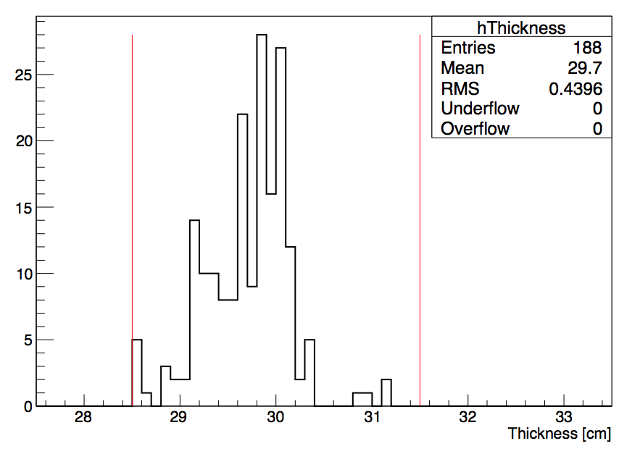
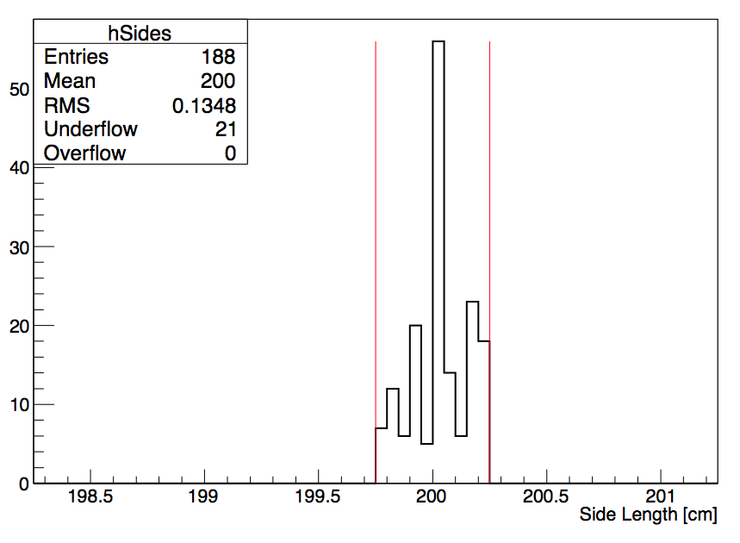
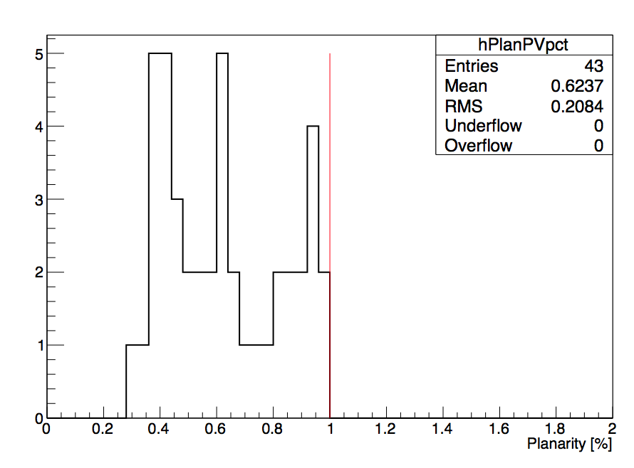
Mechanical Performance
From diamond wire to diamond wheel cut to
improve speed and precision, reduce defects (cracks)
Tendency to bend during baking procedure
(significant fraction of rejected tiles)
Contalbrigo M.
RiCH 2016, 9th September 2016, Bled
10

Slide 11
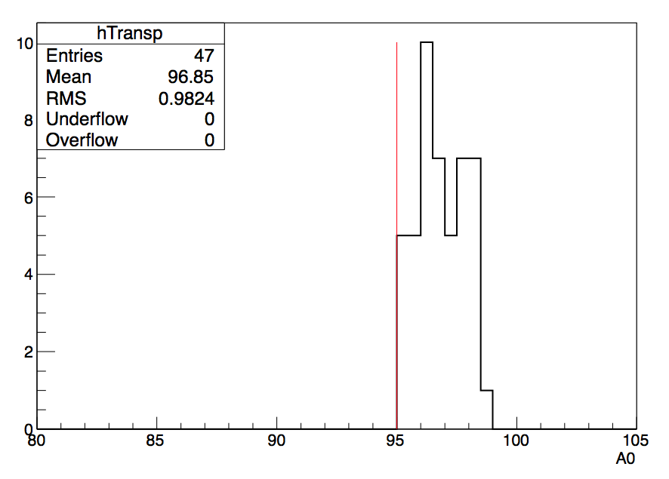
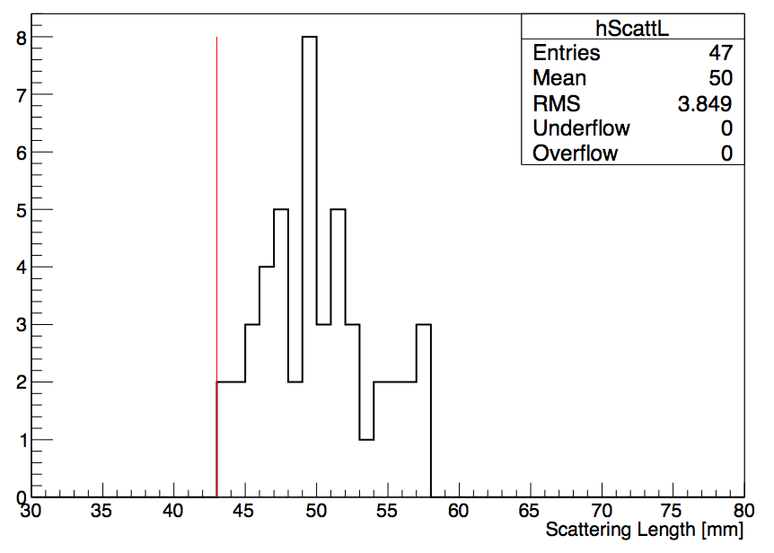
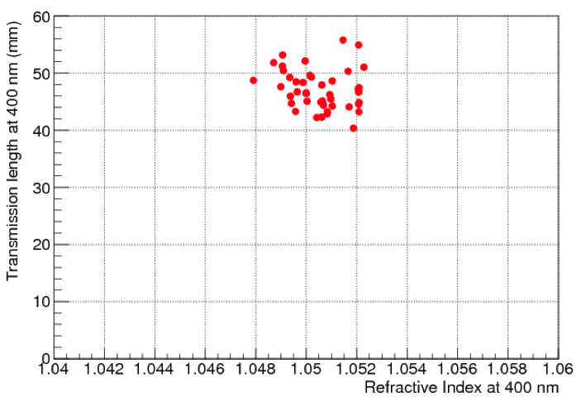
Optical Performance
A₀ ~ 97 %
<L_{sc}> ~ 50 mm
In line with R&D achievements
Contalbrigo M.
RiCH 2016, 9th September 2016, Bled
11
Notes:
Cercare foto di Tayler o nostra con aerogel

Slide 12
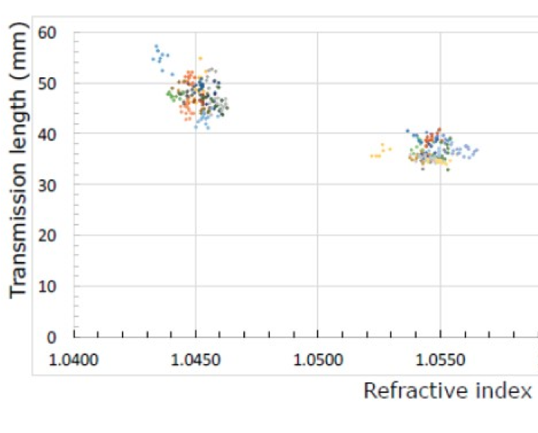
Optical Performance
A₀ ~ 97 %
<L_{sc}> ~ 50 mm
BELLE-II
In line with R&D achievements
See talk of R. Pestotnik on Monday
Contalbrigo M.
RiCH 2016, 9th September 2016, Bled
12
Notes:
Cercare foto di Tayler o nostra con aerogel

Slide 13
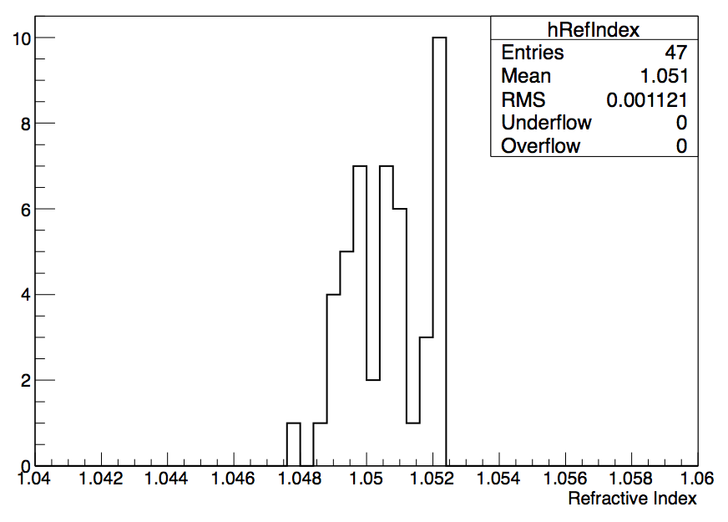
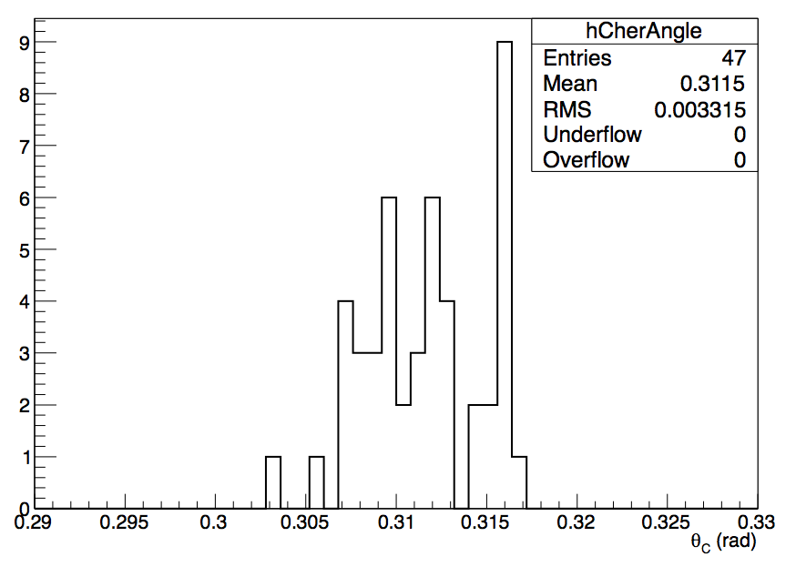
Refractive Index
RMS ~ 3 mrad
Spread in refractive index corresponds to ~ 3 mrad of Cherenkov dispersion
Tile by tile index of refraction will be accounted for into the reconstruction
program to suppress the spread in refractive indexes (Cherenkov angles)
Contalbrigo M.
RiCH 2016, 9th September 2016, Bled
13

Slide 14
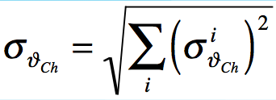
CLAS12 RHIC: Resolution
Resolution | Direct (mrad) | Reflected (mrad)
Emission Point | 1.7 | 1.7
Readout Accuracy | 2.1 | 1.0
Chromatic Aberration | 3.0 | 2.5
Aerogel Optical Prop. | ≤ 1 | ≤ 2
Mirror System |  | ≤ 1
σ_{θ} (1 p.e.) | 4.2 | 3.9
Requirements | Direct | Reflected
Max. momentum | 8 GeV/c | 6 GeV/c
σ_{θ} (4σ separation) | 1.4 mrad | 2.5 mrad
Np.e. Yield | ≥ 10 | ≥ 3
Validated with large scale prototype
Studied in laboratory
N_{p.e.}
Contalbrigo M.
RiCH 2016, 9th September 2016, Bled
14

Slide 15
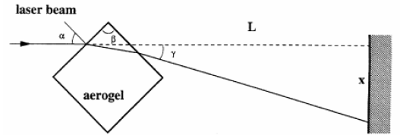
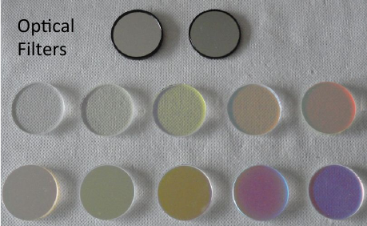
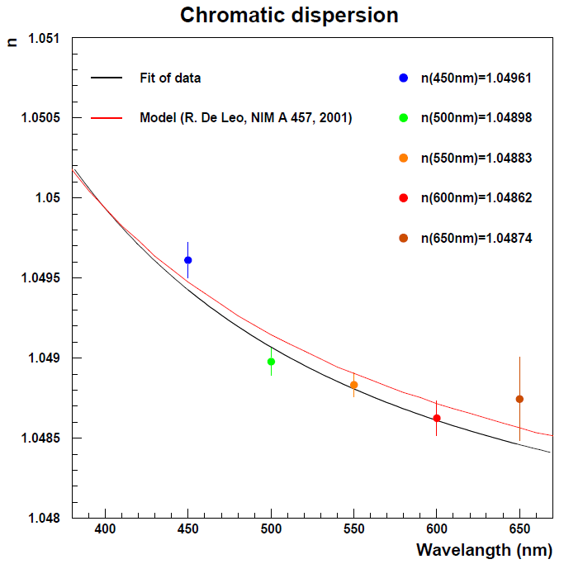
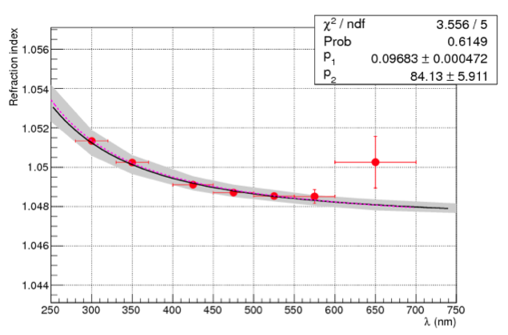

Aerogel Chromatic Dispersion
Measured by prisma method:
Measured by prototype with optical filters:
$$δ$$
Expected value from density:
n(400nm) = [1+0.438ρ]^{1/2} = 1.0492
Contalbrigo M.
RiCH 2016, 9th September 2016, Bled
15
Notes:
Qual e’ il packing factor di HERMES ?
Refraction or refractive ?

Slide 16
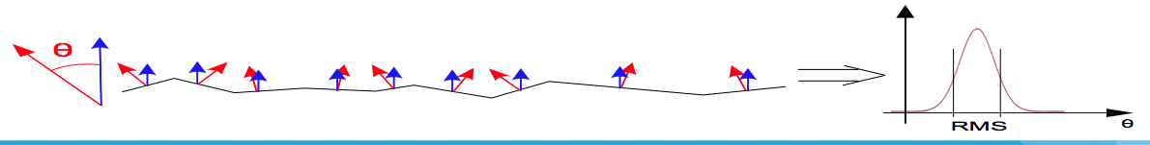
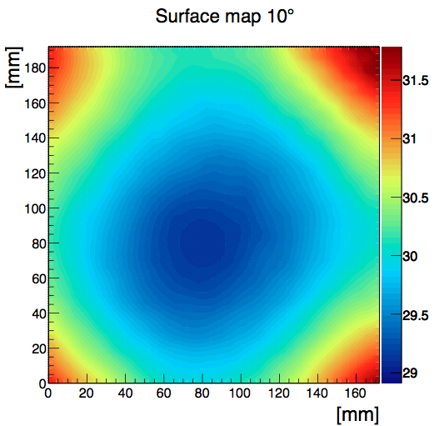
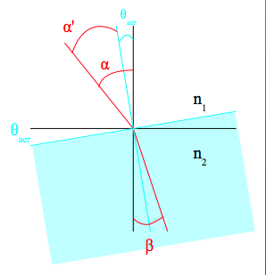
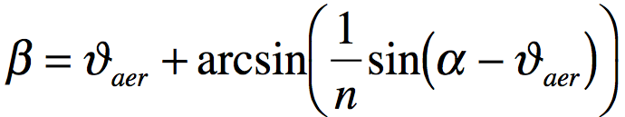
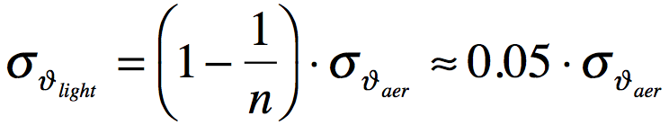
Aerogel Surface Quality
σ_{θaer}
Refraction from a surface
with local normal deviation θ
Contribution on light dispersion
at small incident angles
Contalbrigo M.
RiCH 2016, 9th September 2016, Bled
16

Slide 17
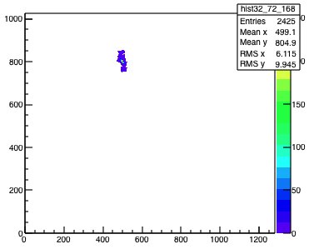
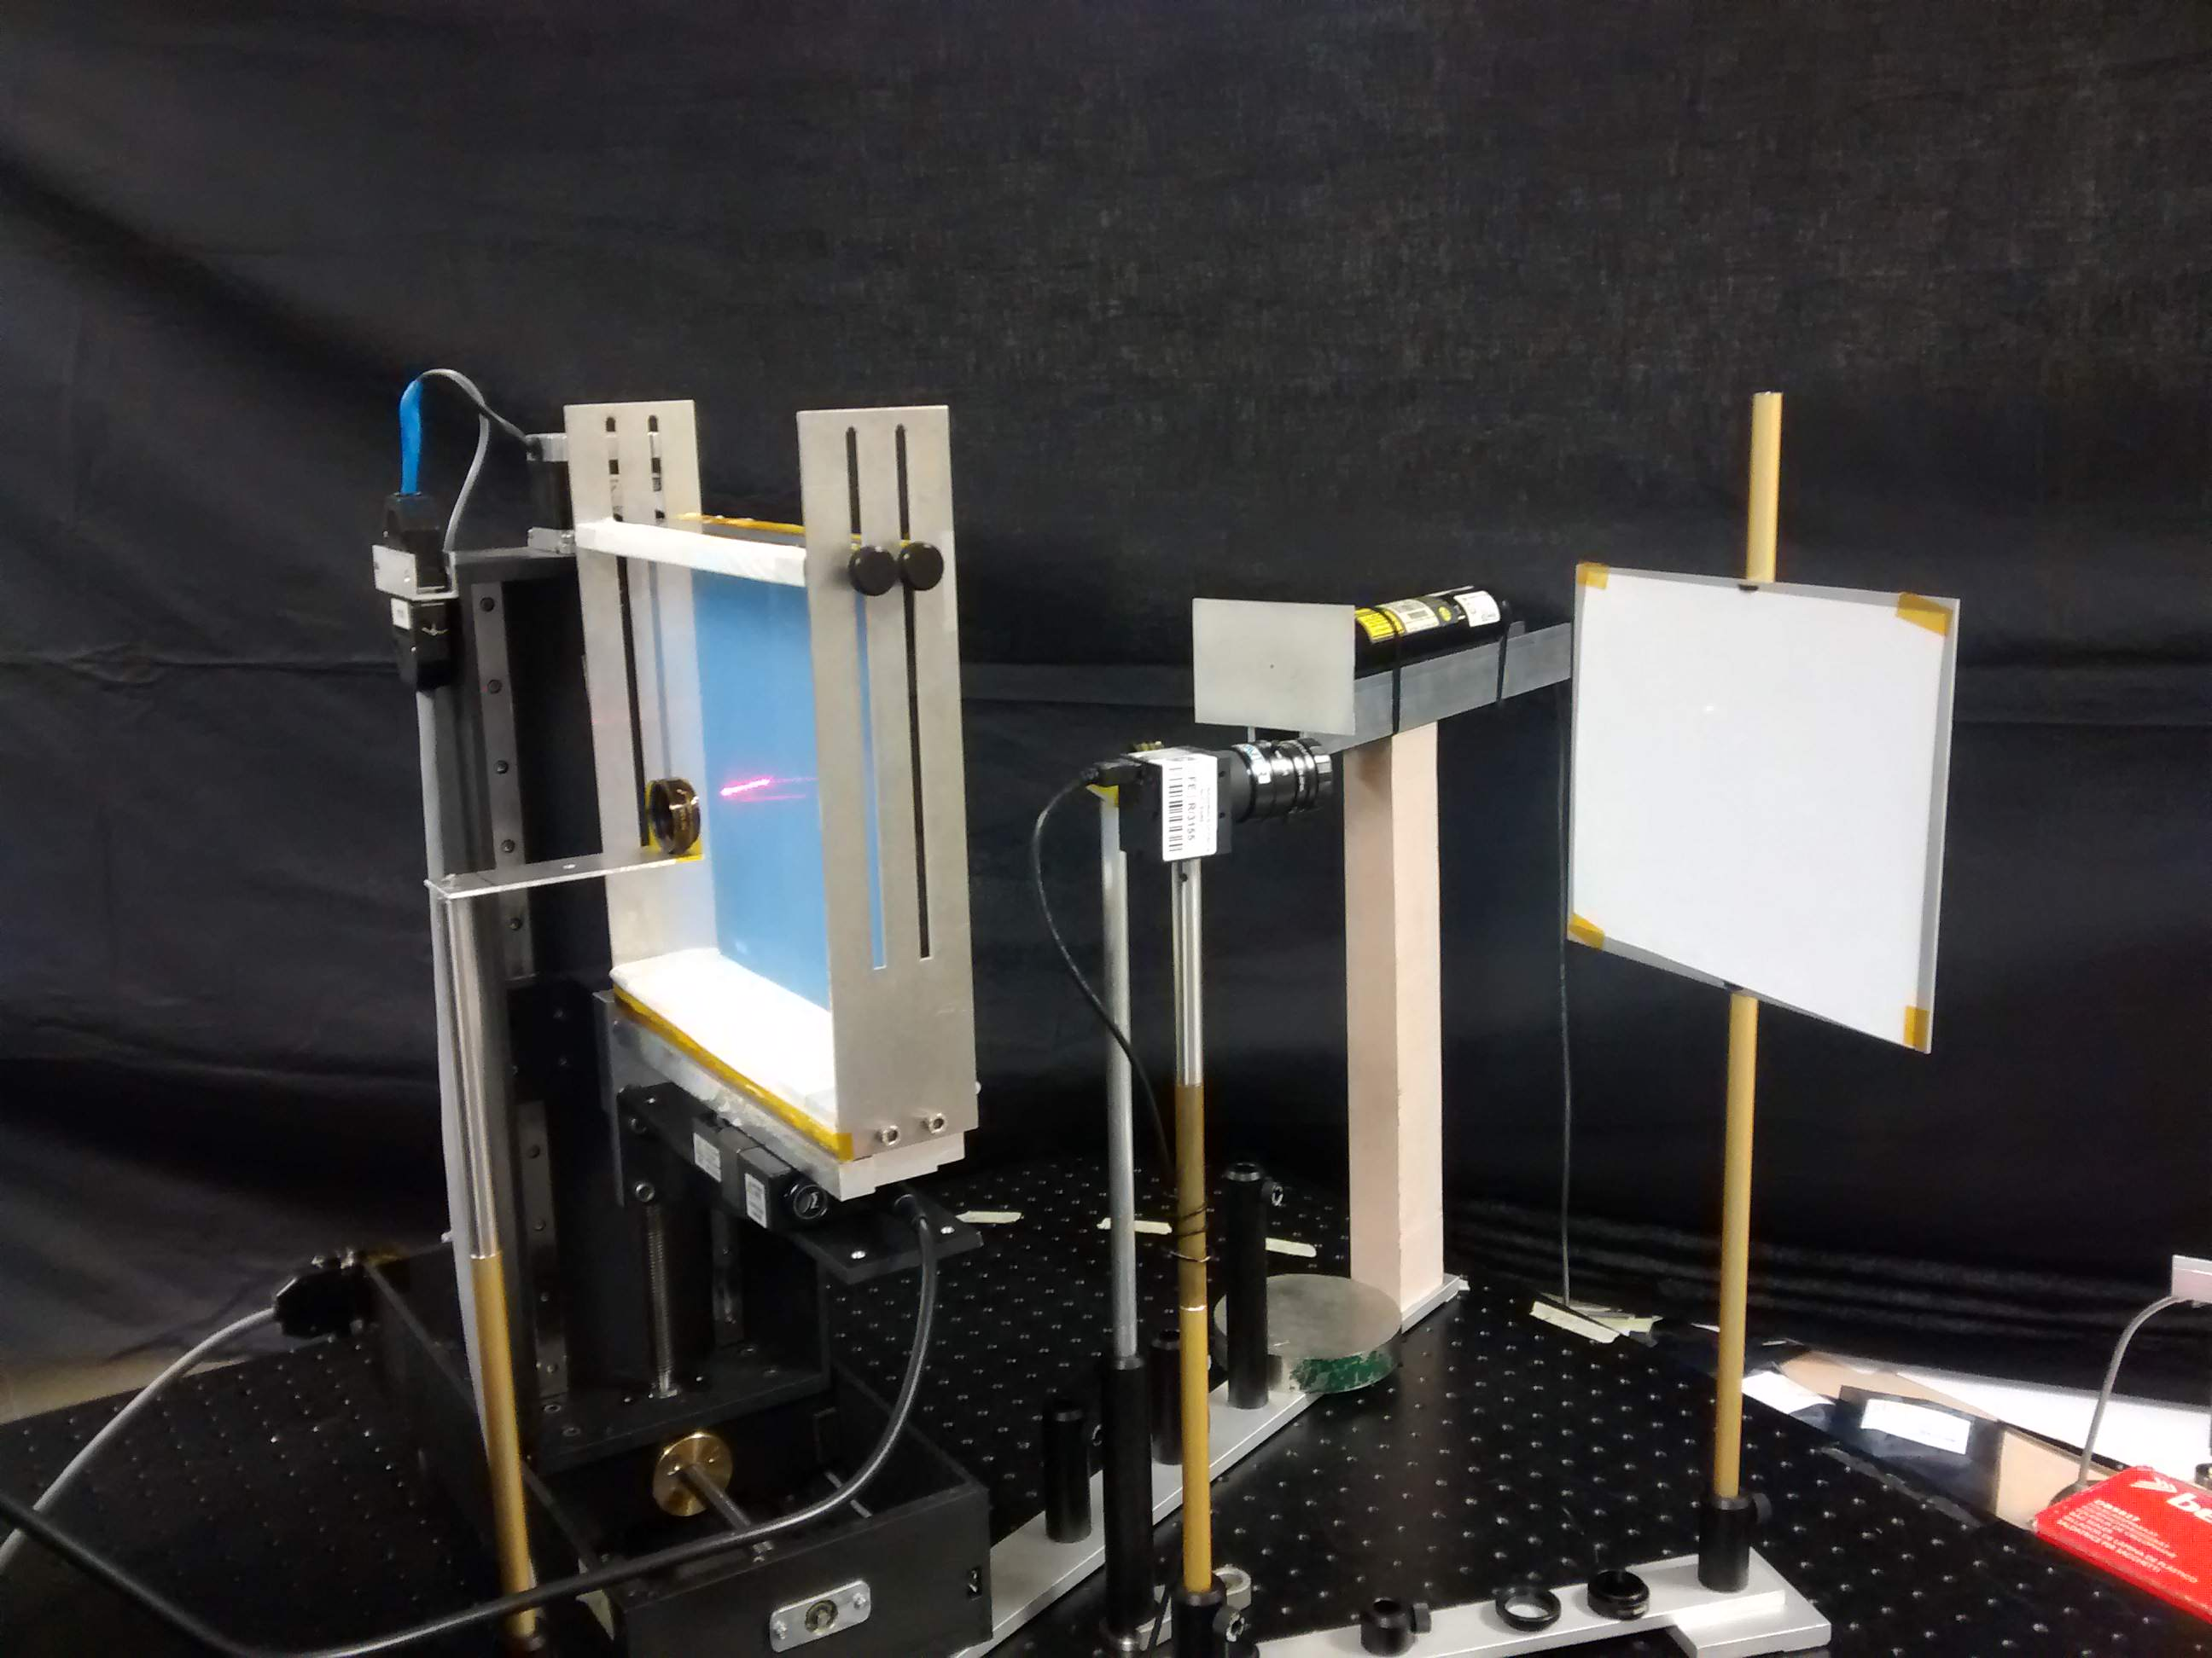
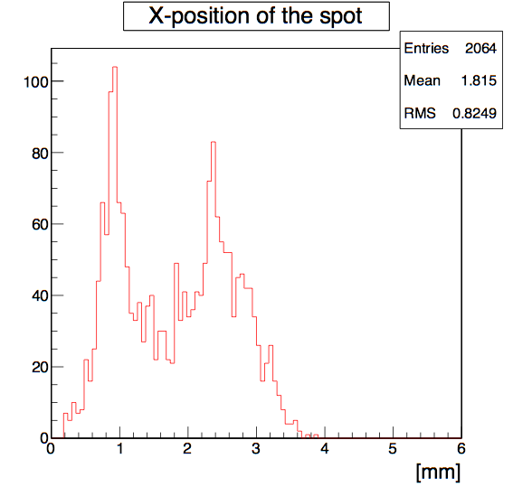
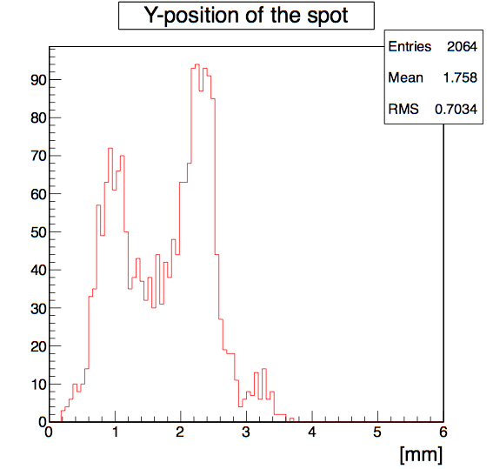
Aerogel Surface Scan
Scan of aerogel surface
Aerogel
Screen
  . . . . . . . . . . . . .
  . . . . . . . . . . . . .
  . . . . . . . . . . . . .
  . . . . . . . . . . . . .
  . . . . . . . . . . . . .
  . . . . . . . . . . . . .
  . . . . . . . . . . . . .
  . . . . . . . . . . . . .
Laser
laser
screen
Distributions of X & Y positions of the spot
CCD camera
motor
x-y axis movable table
CCD camera [ThorLabs DCU 224c]
- sensitive area [5.95-4.76 mm]
- resolution [1280-1024 pixels]
- pixel size 4.65 μm
Contalbrigo M.
RiCH 2016, 9th September 2016, Bled
17

Slide 18
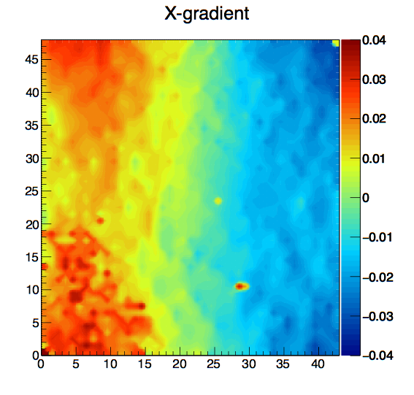



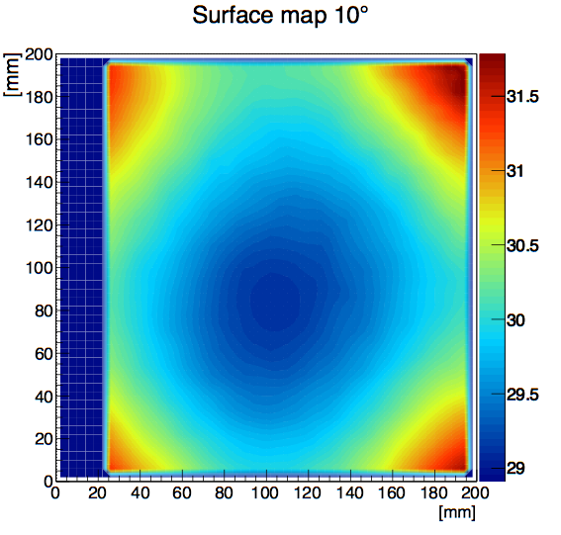
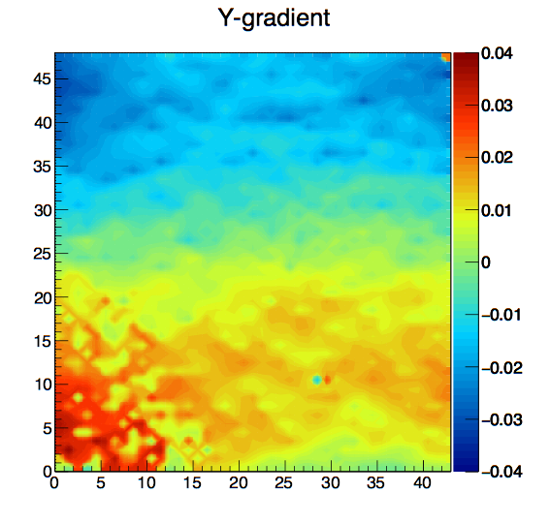
Aerogel Surface Planarity
From laser spot shits to surface gradients
[rad]
From surface gradients to surface map by linear regression
[rad]
Consistent with Russian vendor planarity evaluation
Validated with touch machine measurements
Contalbrigo M.
RiCH 2016, 9th September 2016, Bled
18

Slide 19
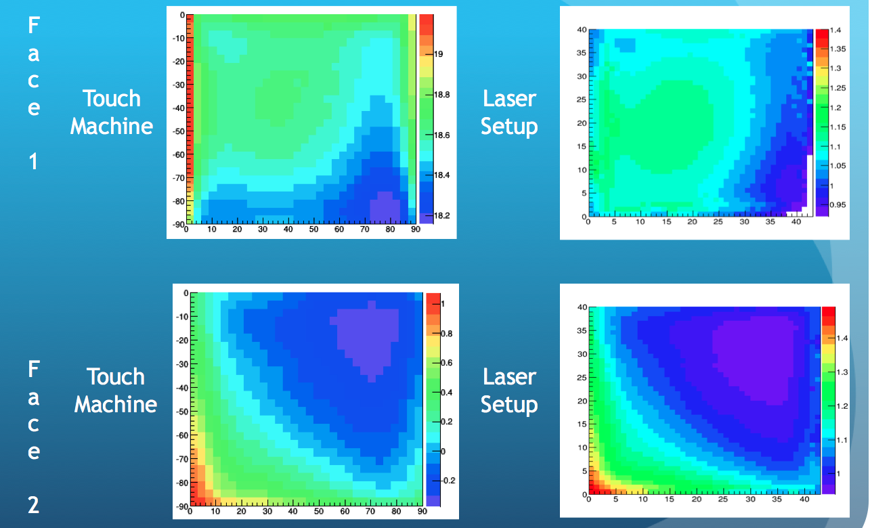
Surface Measurement Validation
Possibility to derive the thickness profile
Contalbrigo M.
RiCH 2016, 9th September 2016, Bled
19

Slide 20
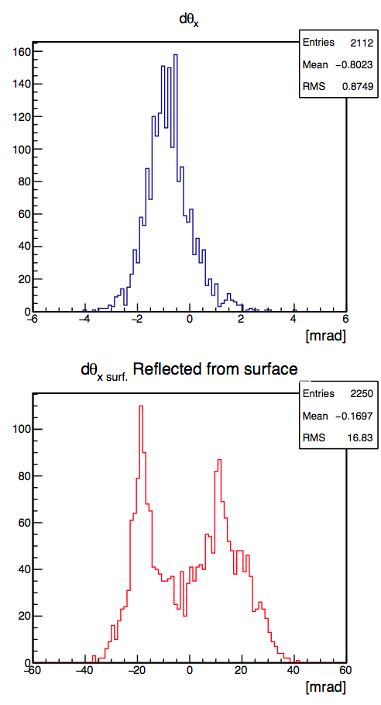
Light Dispersion vs Aerogel Surface Quality
Mirror
Aerogel
Screen
Laser
σ ~ 0.9 mrad
σ ~ 16 mrad
Aerogel
Screen
Laser
Acceptable light dispersion even
for poor planarity ΔS_{surf} = 1.25 %
Contalbrigo M.
RiCH 2016, 9th September 2016, Bled
20

Slide 21
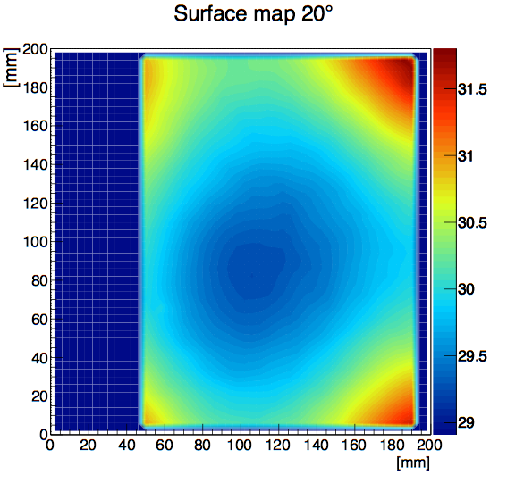
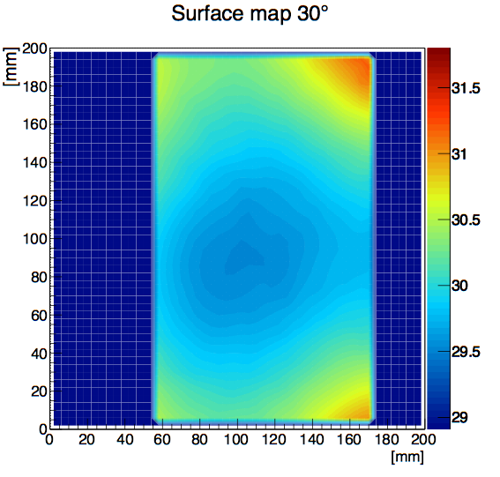
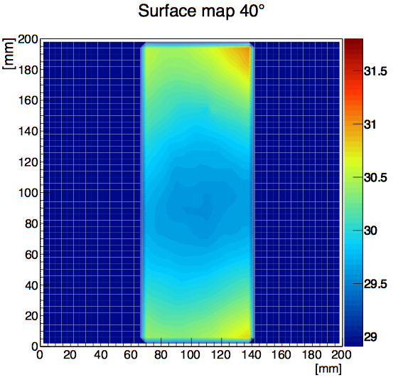
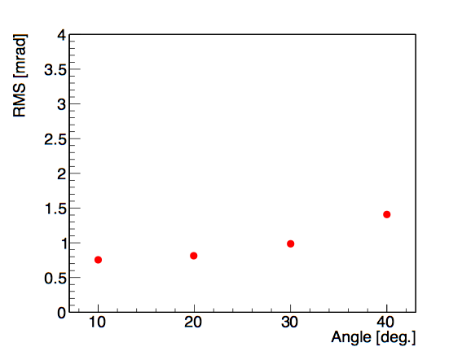
Aerogel Surface Map
[mm]
Light dispersion as a function of incident angle:
[mm]
Contalbrigo M.
RiCH 2016, 9th September 2016, Bled
21

Slide 22
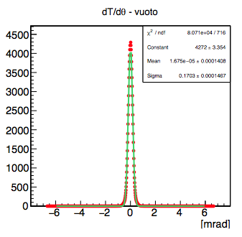
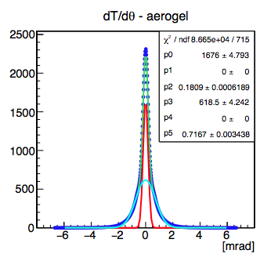
Forward Scattering
Description of the setup
Scattering of the light in the medium due to
the anisotropy of the dielectric properties
caused by density microscopic fluctuations
30 mm
R
Laser Beam
Analysis steps:
- Reference beam profile taken without aerogel
- Extract laser beam profile and compare
with reference measurement
- Extract angular dependence of light intensity
after passage through the aerogel
CCD Camera
Take the average X & Y profiles of the spot
σ = 0.170
σ = 0.180
σ = 0.716
Contalbrigo M.
RiCH 2016, 9th September 2016, Bled
22

Slide 23





Forward Scattering
Angular dependence of the measured intensity:
Stack
Differential of the measured intensity:
Typical fraction of light above 2 mrad ≤ 1 %
Negligible scattering
at angles relevant for Cherenkov resolution
Contalbrigo M.
RiCH 2016, 9th September 2016, Bled
23

Slide 24

Conclusions
Aerogel mass production for CLAS12 RICH is ongoing
✔ Storing (in dry cabinets) and handling procedures
has been defined for the hygroscopic material
✔ Steadily improvement of the process
✔ Non invasive techniques employed to
verify light propagation into the material
✔ Tools for measurements and monitoring
the aerogel characteristics show stable
performance in line with the project design
Contalbrigo M.
RiCH 2016, 9th September 2016, Bled
24

