Slide 1
The Large Area CLAS12
Ring-Imaging Cherenkov Detector
Contalbrigo Marco
INFN Ferrara
14th ICATPP Conference, 25th September 2013

Slide 2
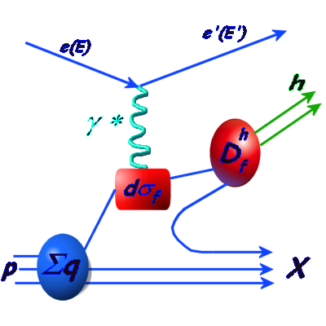
The 3D Spin Nucleon Structure
Inclusive DIS
X
SFs (x,Q²)
Structure functions
(unpolarized, helicity)
Sum over quark charges
Contalbrigo M.
14th ICATPP, 25th September 2013, Como
2

Slide 3
The 3D Spin Nucleon Structure
Inclusive DIS
Semi-inclusive DIS
X
SFs (x,Q²)
PDFs (x, Q²) & FFs (z,Q²)
Structure functions
(unpolarized, helicity)
Sum over quark charges
Parton distributions
Flavor sensitivity
Contalbrigo M.
14th ICATPP, 25th September 2013, Como
3

Slide 4
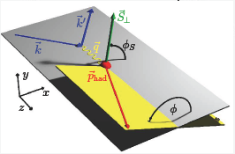
The 3D Spin Nucleon Structure
Inclusive DIS
Semi-inclusive DIS
X
SFs (x,Q²)
PDFs (x, Q²) & FFs (z,Q²)
TMDs (x,z,P_{h} ,φ,φ_{S},Q²)
_{T}
Structure functions
(unpolarized, helicity)
Sum over quark charges
Parton distributions
Flavor sensitivity
Transverse momentum
dependent parton distrib.
Spin-Orbit effects
Rich and Involved phenomenology !!
Contalbrigo M.
14th ICATPP, 25th September 2013, Como
4

Slide 5
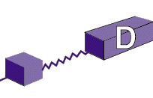
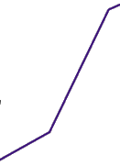
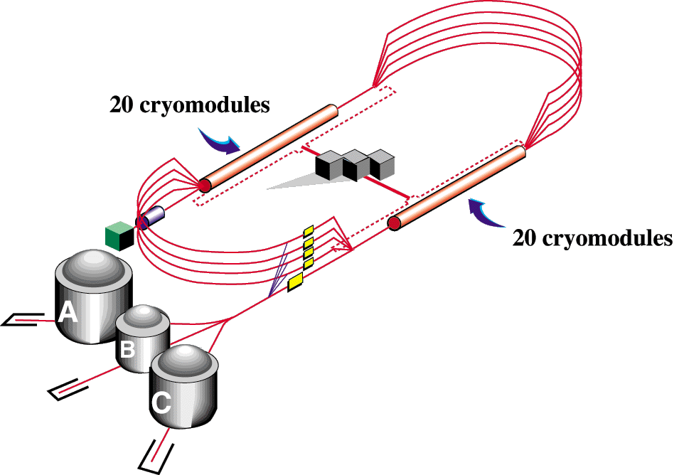
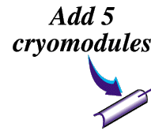

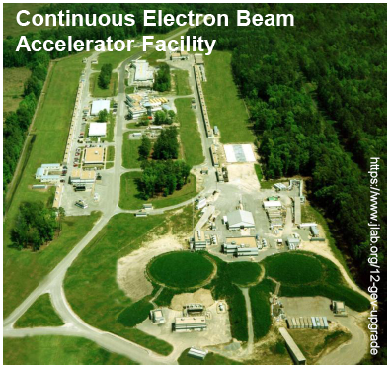
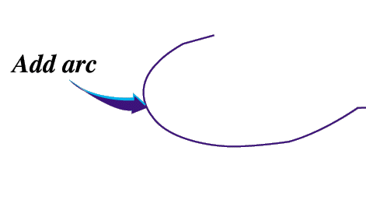

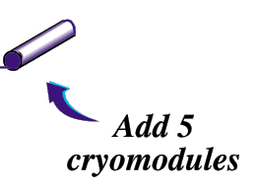
CEBAF Upgrade at Jefferson Lab
Beam Energy 12 GeV
Beam current 90 μA
Beam polarization 85 %
add Hall D
(and beam line)
Upgrade magnets and power supplies
CHL-2
Enhance equipment in existing halls
Contalbrigo M.
14th ICATPP, 25th September 2013, Como
5

Slide 6
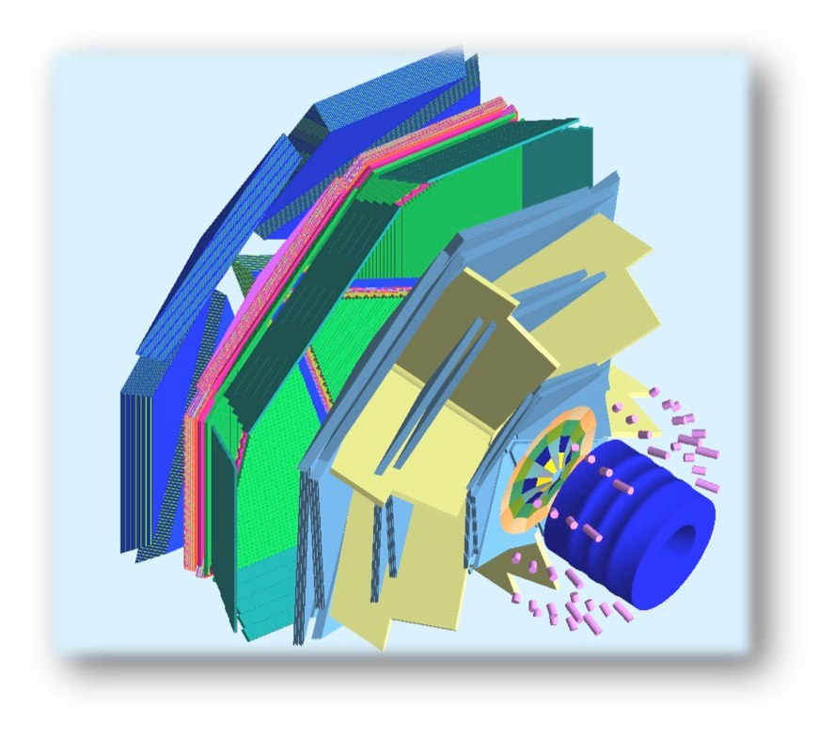
The CLAS12 Spectrometer
Ongoing upgrade of the CLAS detector.
First beam expected in 2016.
FTOF
DC
R3
R2
R1
Highly polarized 12 GeV electron beam
EC
Luminosity up to 10³⁵ cm⁻² s⁻¹
RICH
H and D polarized targets
HTCC
Broad kinematic range coverage
(current to target fragmentation)
RICH: Hadron ID
for flavor separation
(common to SIDIS approved exp.)
Beam
PCAL
Torus
Solenoid
PAC30 report (2006): Measuring the kaon asymmetries is likely to be
as important as pions …. The present capabilities of the present
CLAS12 design are weak in this respect and should be strengthened.
Contalbrigo M.
14th ICATPP, 25th September 2013, Como
6

Slide 7
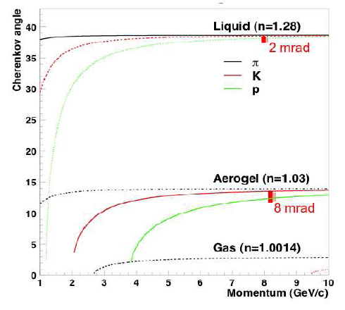
CLAS12 Momentum Range
Kaon flux 1 order of magnitude lower than π → π rejection 1:500 required
Aerogel mandatory to separate hadrons in the 3-8 GeV/c momentum range with the required large rejection factors
  collection of visible Cherenkov light
Use of PMTs: challenging project, need to minimize detector area covered with expensive photodetectors
Ratio K/π ~ 0.1-0.15
SIDIS
kinematics
TOF
Contalbrigo M.
14th ICATPP, 25th September 2013, Como
7

Slide 8
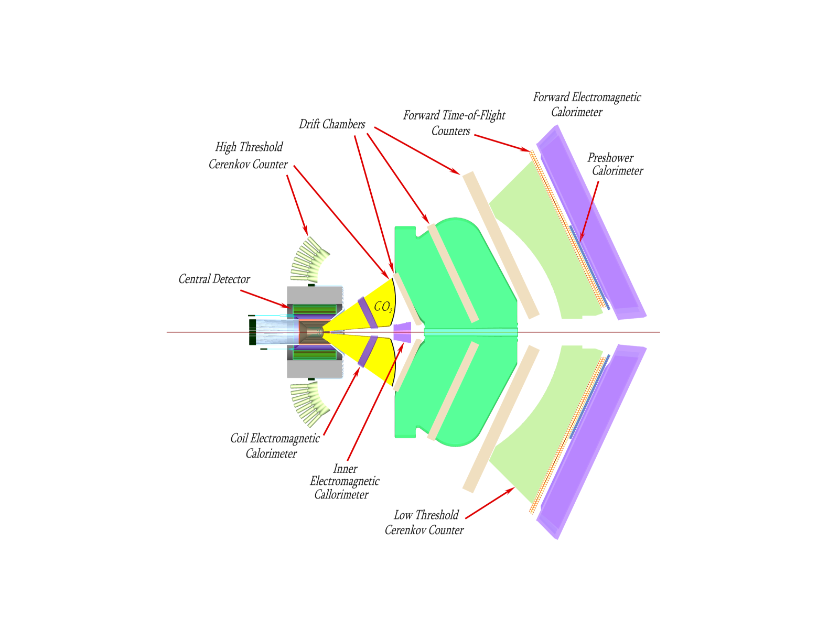
The CLAS12 RICH Project
RICH goal: π/K/p identification from 3 up to 8 GeV/c and 25 degrees
~4σ pion-kaon separation for a pion rejection factor ~ 1:500
INSTITUTIONS
INFN (Italy) Bari, Ferrara, Genova, L.Frascati, Roma/ISS
Jefferson Lab (Newport News, USA)
Argonne National Lab (Argonne, USA)
Duquesne University (Pittsburgh, USA)
Glasgow University (Glasgow, UK)
J. Gutenberg Universitat Mainz (Mainz, Germany)
Kyungpook National University, (Daegu, Korea)
University of Connecticut (Storrs, USA)
UTFSM (Valparaiso, Chile)
RICH
RICH
RICH
Contalbrigo M.
14th ICATPP, 25th September 2013, Como
8

Slide 9
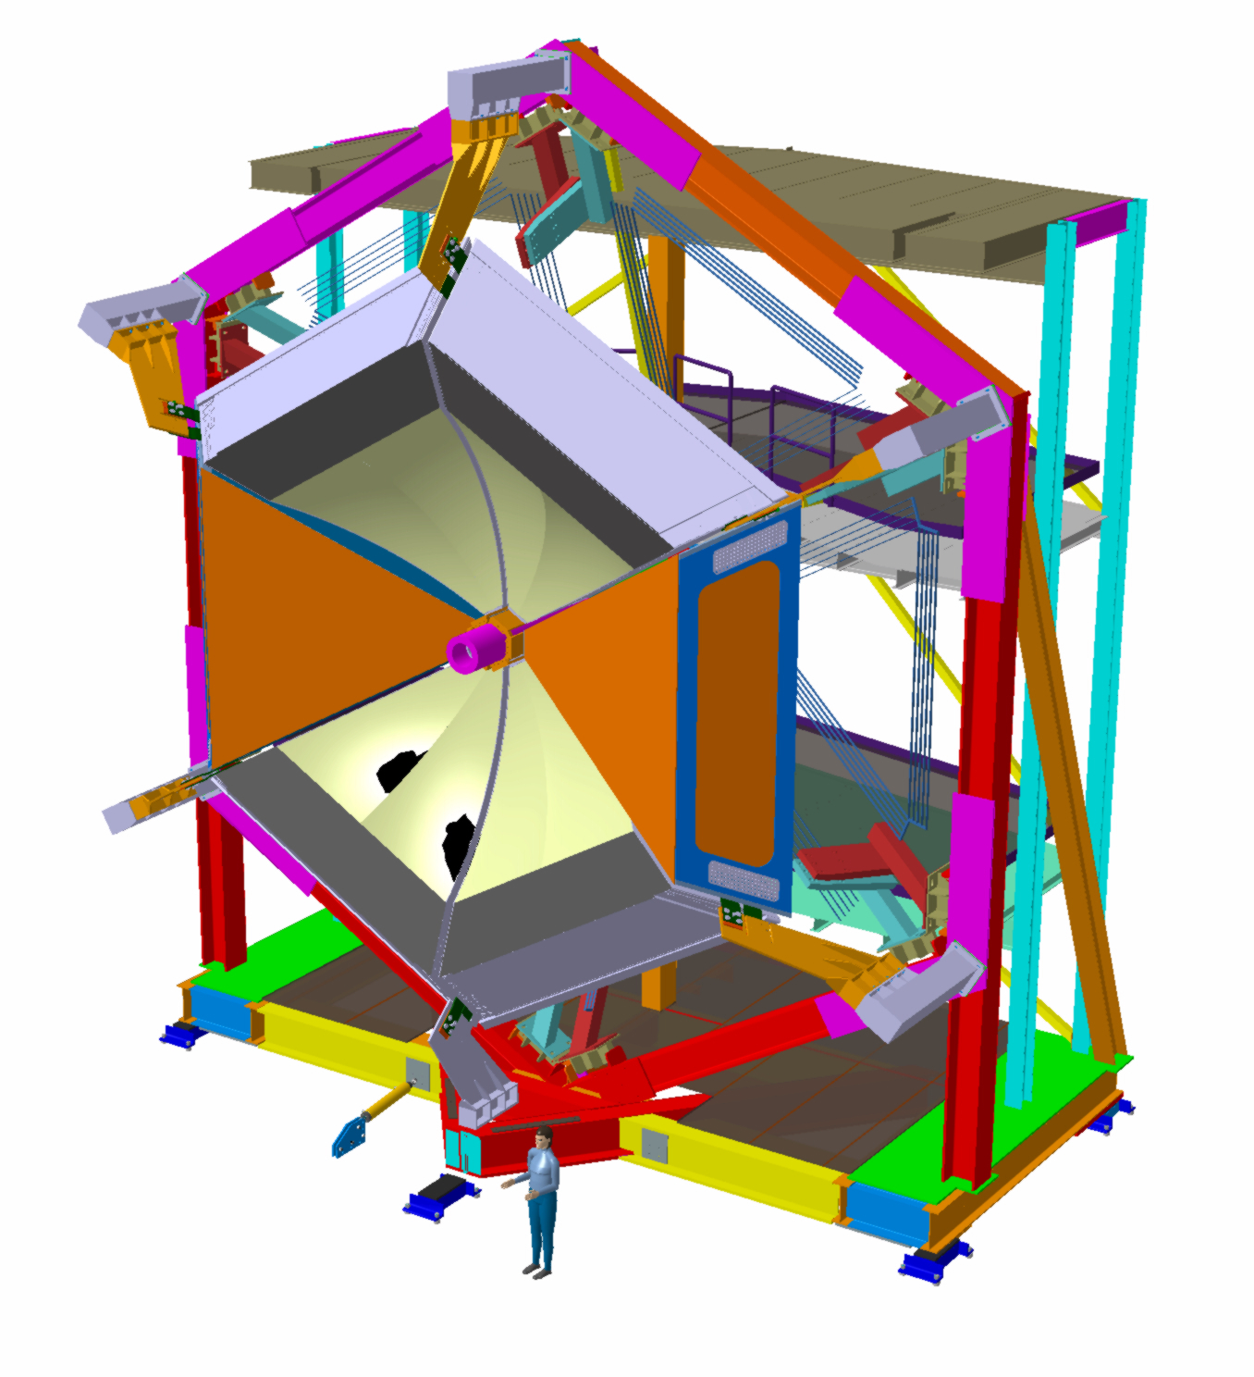
RICH Base Configuration
1st sector allows:
✓ to start physics with un-polarized and
longitudinal polarized target
✓ full coverage of the relevant azimuthal
angle φ (w.r.t virtual photon)
2nd sector allows:
✓ to extend the kinematical coverage
into the most interesting regions
(high-Q² and high-P_{T})
✓ the symmetric arrangement needed to control
systematic effects in precision measurements
with polarized targets
(i.e. double ratio method)
Crucial for the study of parton dynamics
related to angular momentum and spin-orbit
effects with flavor sensitivity.
Contalbrigo M.
14th ICATPP, 25th September 2013, Como
9
Notes:
9 vs 8

Slide 10
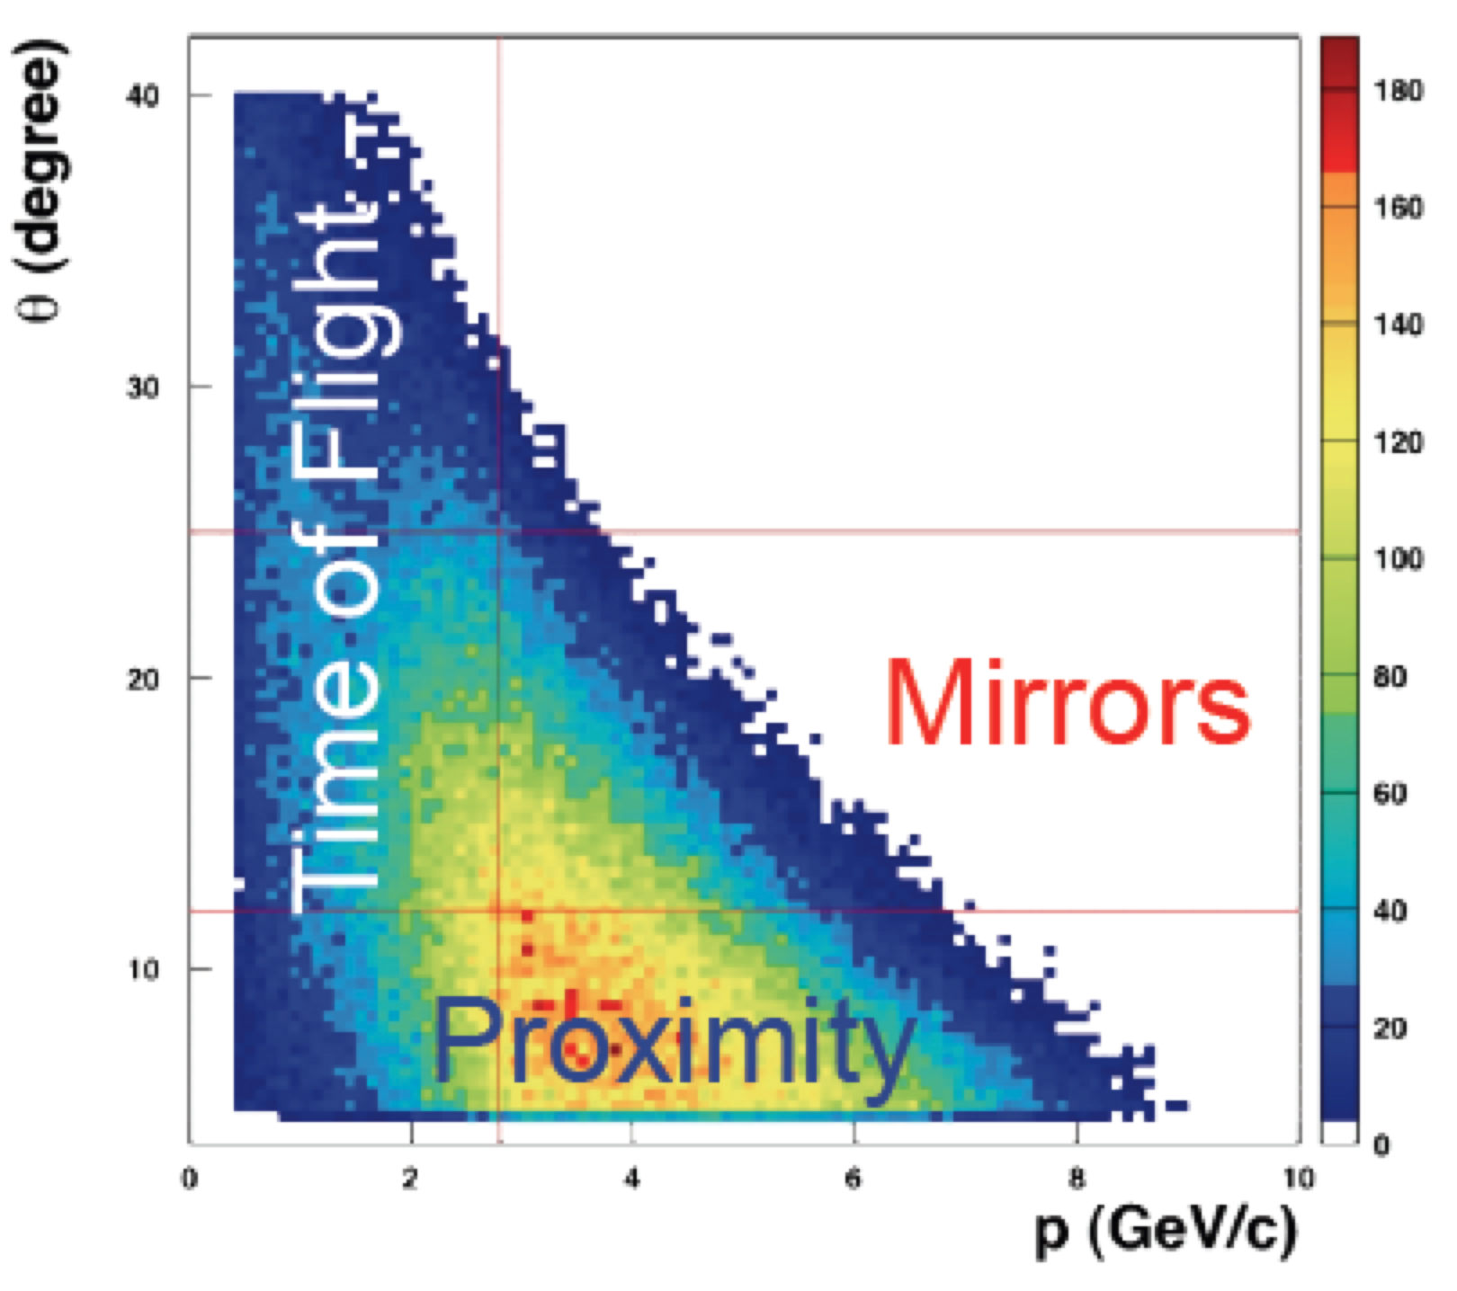
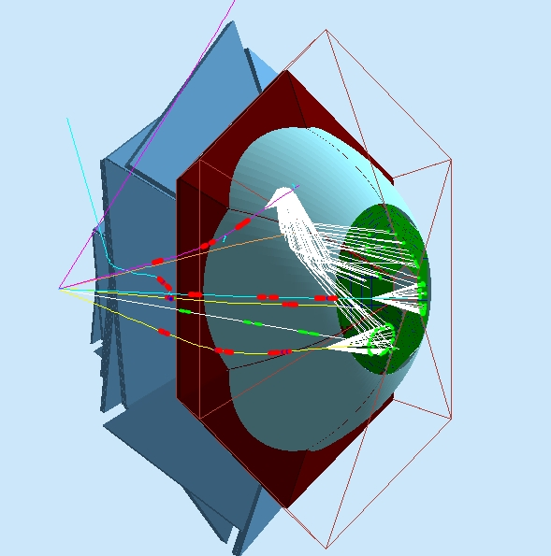
The Hybrid Optics Design
Direct rings/best performance for high momentum particles
spherical
mirror
3 cm
6
gap
γ
plane
mirror
π
1 cm
photon detector
2
aerogel
Aerogel
Planar
mirrors
Spherical mirrors
Photo-detectors
Contalbrigo M.
14th ICATPP, 25th September 2013, Como
10

Slide 11
The Hybrid Optics Design
Direct rings/best performance for high momentum particles
spherical
mirror
3 cm
6
gap
γ
plane
mirror
π
1 cm
photon detector
2
aerogel
Reflected rings for less demanding low momentum particles
Aerogel
π
Planar
mirrors
spherical
mirror
Spherical mirrors
3 cm
6
γ
plane
mirror
gap
1 cm
photon detector
2
aerogel
Minimize active area (cost)
Material budget concentrated where TOF is less effective
Focalizing mirrors allow thick radiator for good light yield
Photo-detectors
Contalbrigo M.
14th ICATPP, 25th September 2013, Como
11

Slide 12
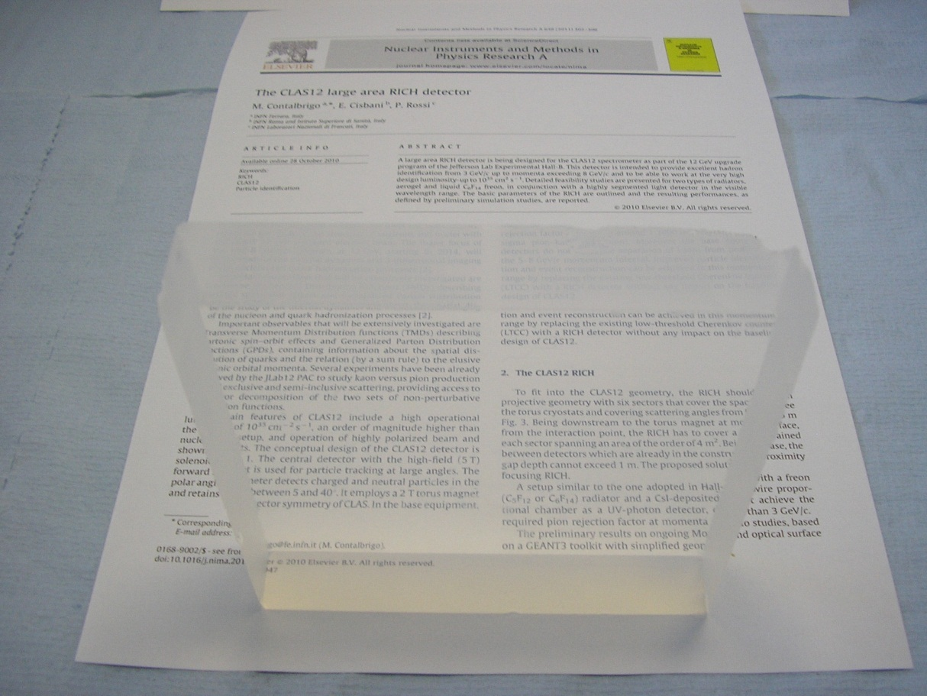
Aerogel Radiator
Contalbrigo M.
14th ICATPP, 25th September 2013, Como
12

Slide 13
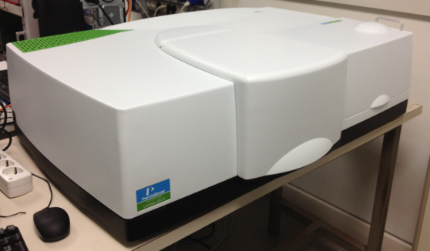
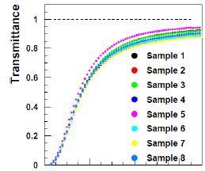
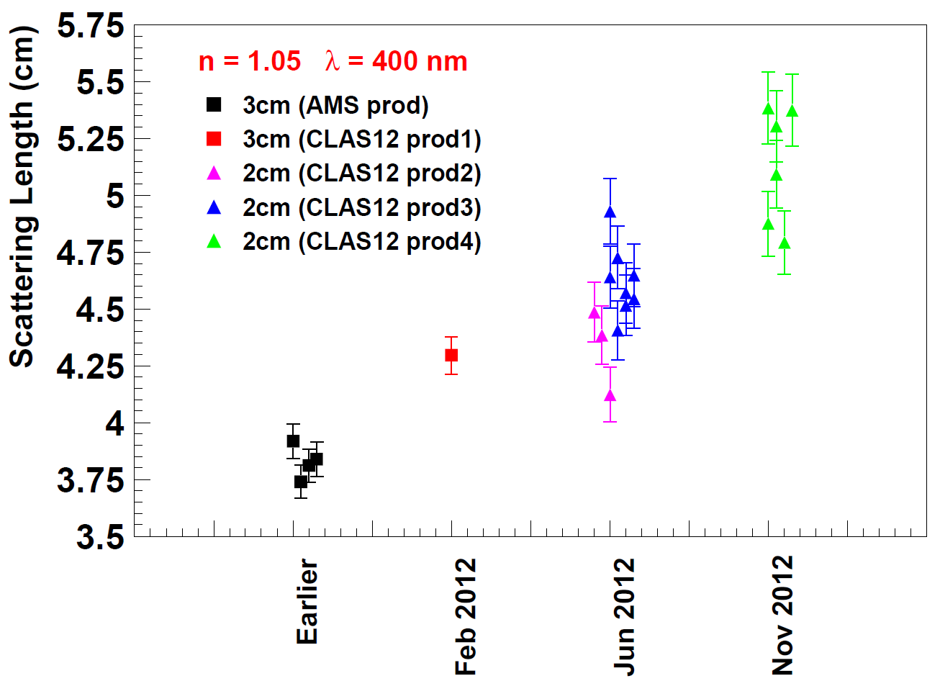

Aerogel Transmittance
Achieved clarity for large tiles at n=1.05
~ 0.00050 μm⁴ cm⁻¹
(LHCB has 0.0064 μm⁴ cm⁻¹ for n=1.03)
In collaboration with Budker and Boreskov
Institutes of Novosibirsk
Contalbrigo M.
14th ICATPP, 25th September 2013, Como
13
Notes:
Qual e’ il packing factor di HERMES ?
Refraction or refractive ?

Slide 14
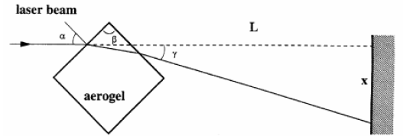
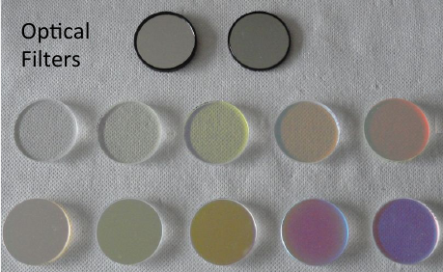
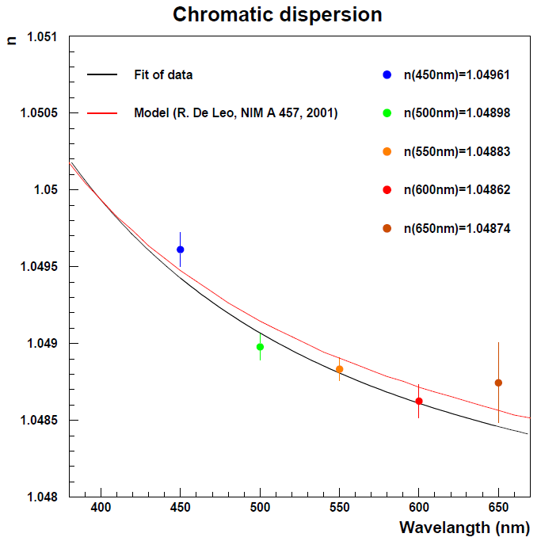
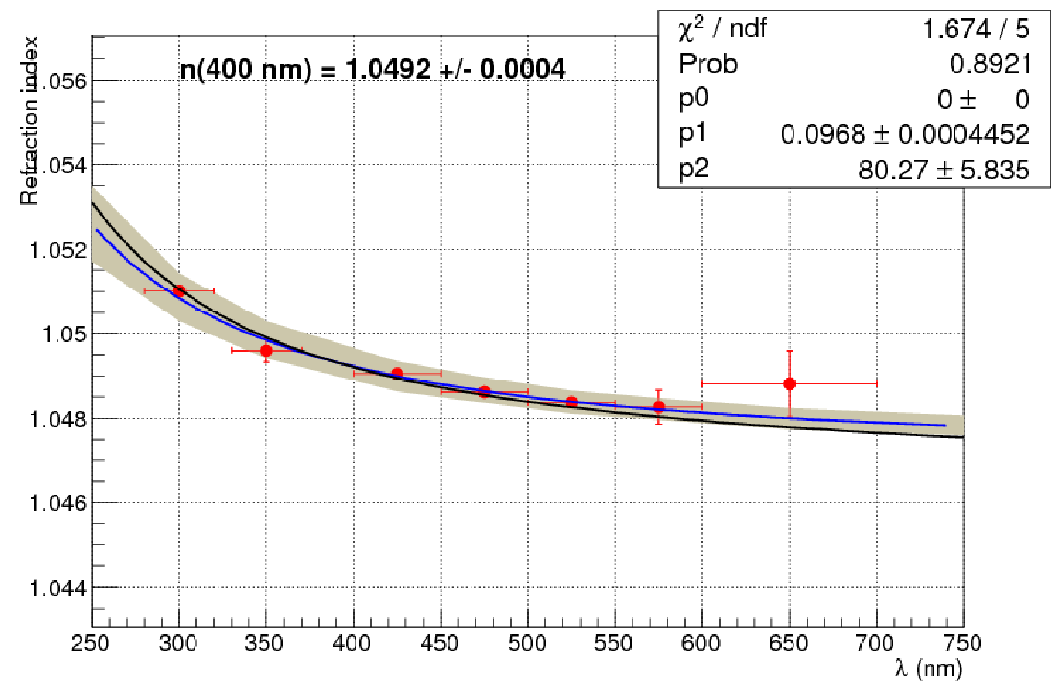

Aerogel Chromatic Dispersion
Measured by prisma method:
Measured by prototype with optical filters:
$$δ$$
fit
MC
Expected value from density:
n²(400nm) = 1+0.438ρ
n(400nm) = 1.0492
Contalbrigo M.
14th ICATPP, 25th September 2013, Como
14
Notes:
Qual e’ il packing factor di HERMES ?
Refraction or refractive ?

Slide 15

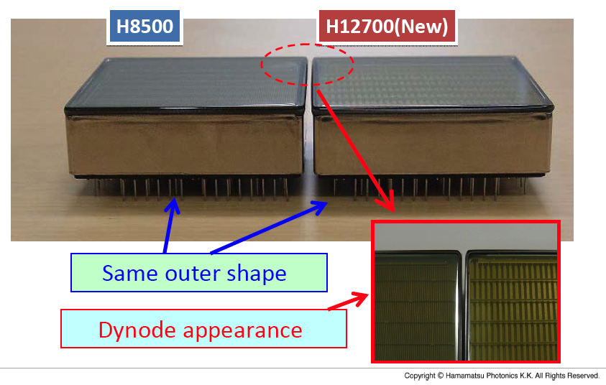
Photon Detectors: MA-PMT
✓ Mature and reliable technology
✓ Large Area (5x5 cm²)
✓ High packing density (89 %)
✓ 64 6x6 mm² pixels cost effective device
✓ High sensitivity on visible towards UV light
✓ Fast response
The only option to keep the schedule is the use
of multi-anode photomultipliers (we consider the
promising SiPM technology as the alternative)
Contalbrigo M.
14th ICATPP, 25th September 2013, Como
15
Notes:
9 vs 8

Slide 16
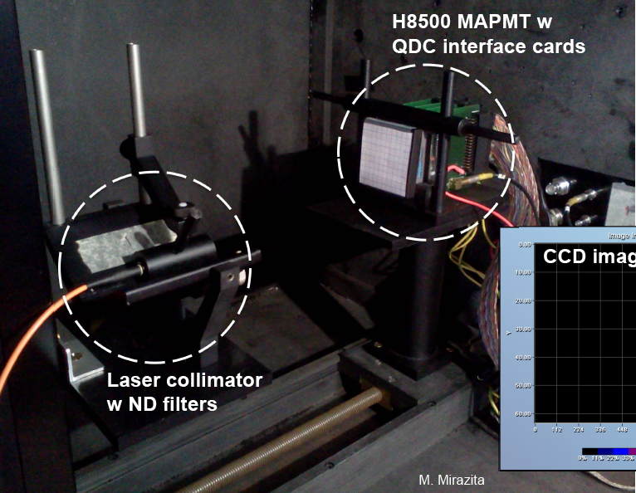
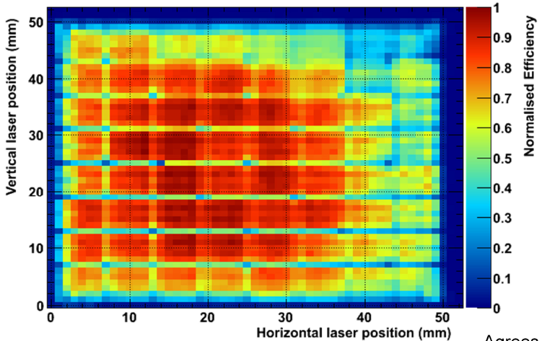
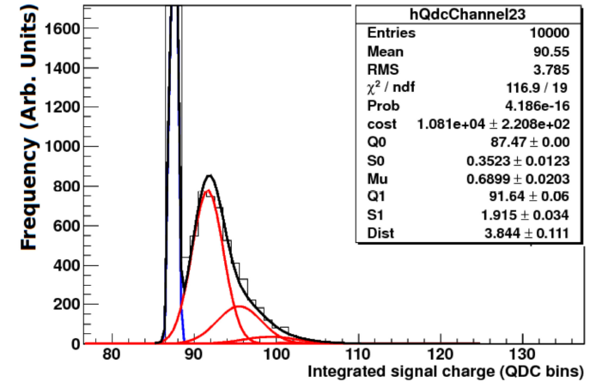
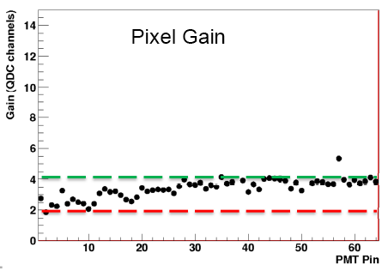
MA-PMT Gain Map
Pixel Gain: 1:2 variation can be easily
compensated by the read-out electronics
Gain
Contalbrigo M.
14th ICATPP, 25th September 2013, Como
16
Notes:
9 vs 8

Slide 17
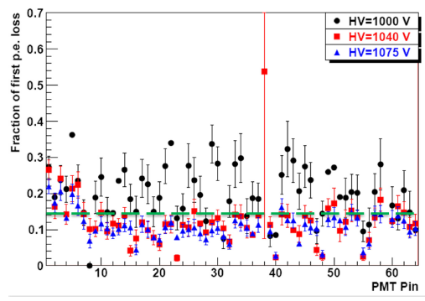
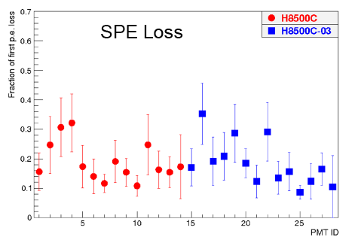
MA-PMT SPE Loss
Pixel SPE Loss
SPE loss limited to ~15% above 1040V
and uniform over 28 MA-PMTs
MA-PMT SPE Loss
SPE Loss
Contalbrigo M.
14th ICATPP, 25th September 2013, Como
17
Notes:
9 vs 8

Slide 18
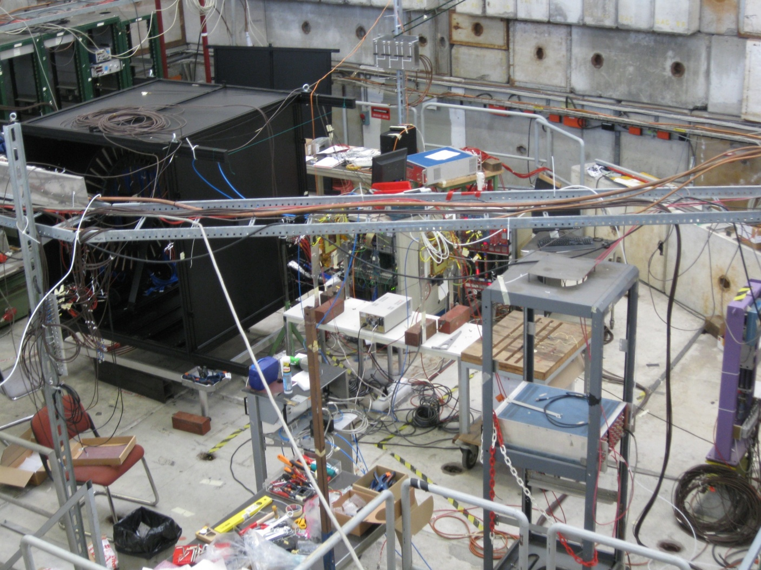
RHIC Prototype at CERN-T9
GEM
chamber
layout
RICH
beam
K
Gas
Cherenkov
signal
π
GEM
GEM
RICH
beam
threshold gas Cerenkov
(π/K separation)
pions
few % kaons
scintillators
(trigger)
Contalbrigo M.
14th ICATPP, 25th September 2013, Como
18

Slide 19
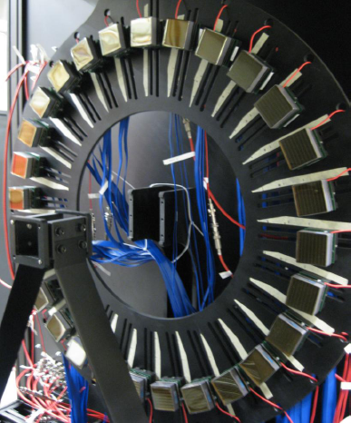
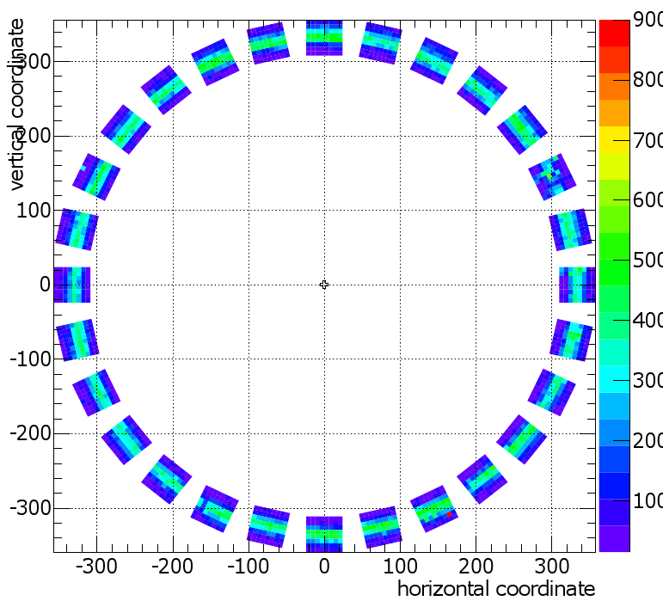
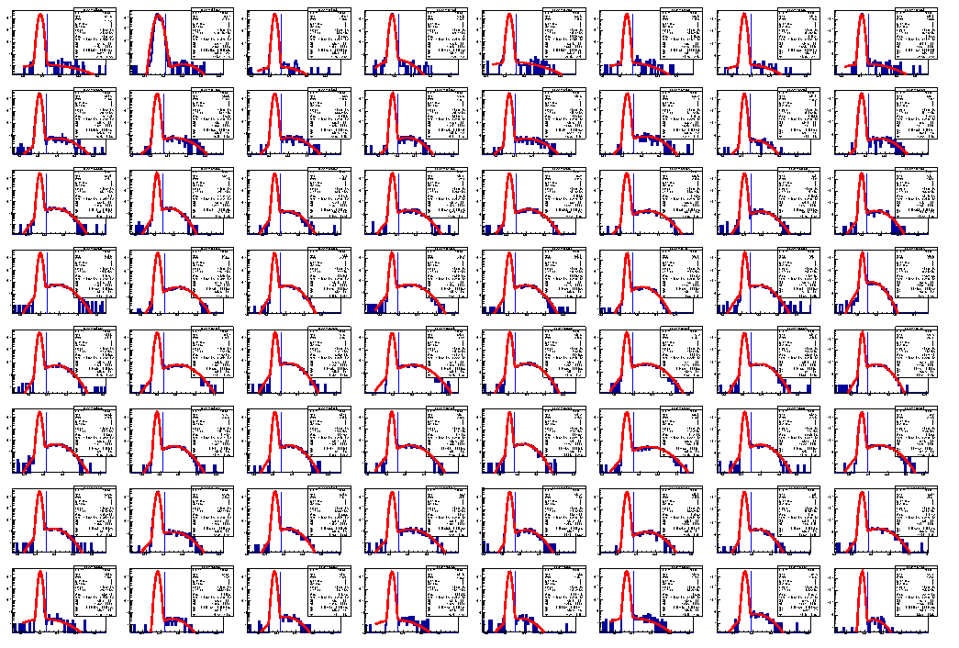
RHIC Prototype: Direct Light Case
1m gap
Aerogel: n=1.05
2cm thickness
H8500
Radiator
beam
8 GeV beam
Contalbrigo M.
14th ICATPP, 25th September 2013, Como
19

Slide 20
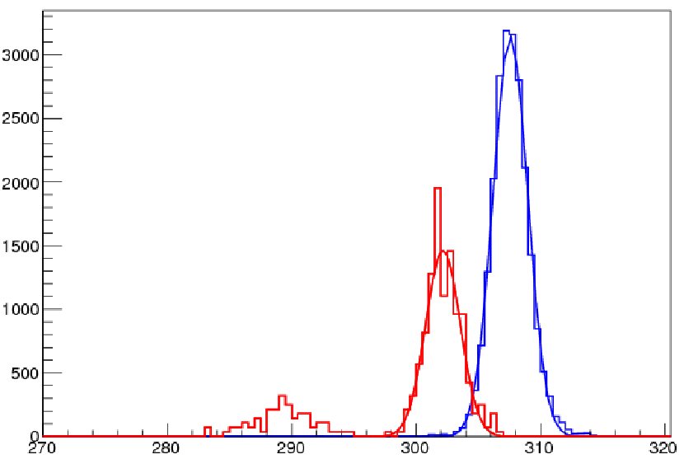
RHIC Prototype: Direct Light Case
Clear hadron separation up to the
CLAS12 maximum momentum
1m gap
Aerogel: n=1.05
2cm thickness
π
H8500
p=8 GeV/c
Radiator
K
beam
8 GeV beam
p
Contalbrigo M.
14th ICATPP, 25th September 2013, Como
20

Slide 21
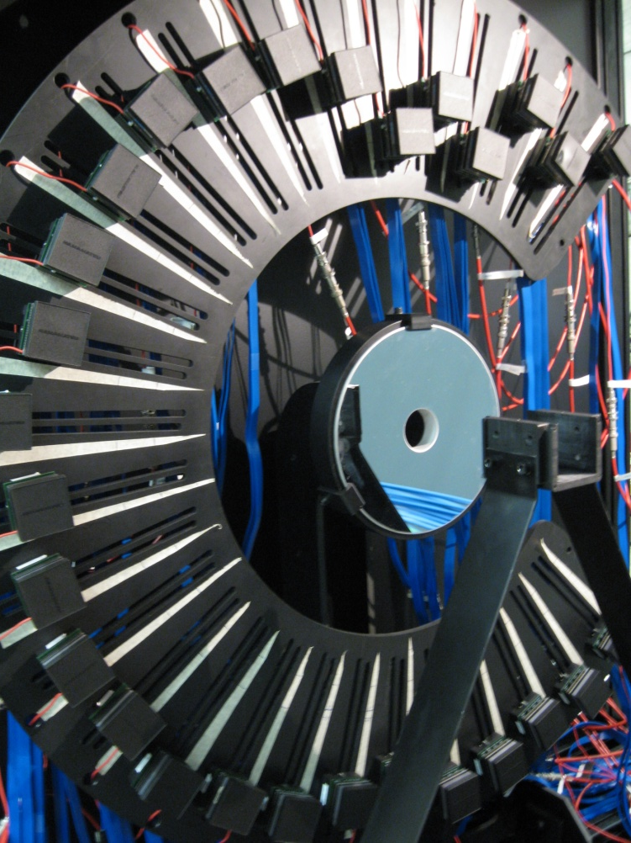
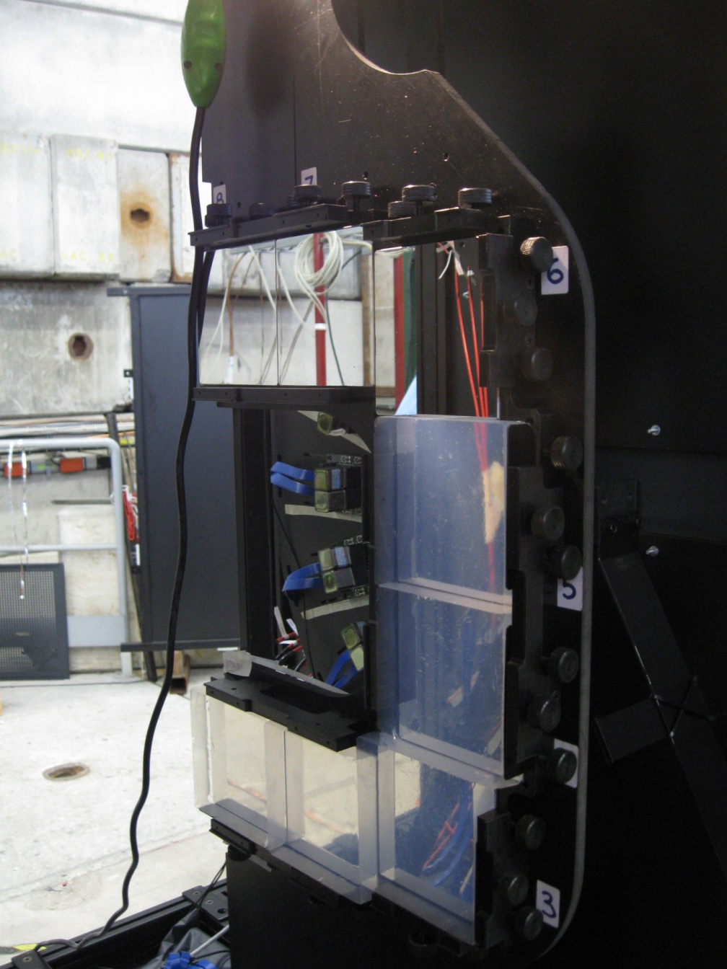
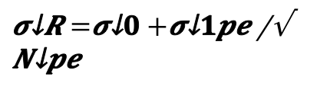
RHIC Prototype: Reflected Light Case
H8500
mirrors + aerogel
plane mirror
6 GeV beam
beam
Radiator
curved mirror
Aerogel: n=1.05
6cm thickness
$$σ_{R}=σ_{0}+\frac{σ_{1pe}}{\sqrt{N_{pe}}}$$
Contalbrigo M.
14th ICATPP, 25th September 2013, Como
21

Slide 22
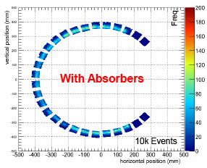
RHIC Prototype: Reflected Light Case
Aerogel: n=1.05
2cm thickness
H8500
mirrors + aerogel
plane mirror
6 GeV beam
beam
Radiator
curved mirror
Aerogel: n=1.05
6cm thickness
$$σ_{R}=σ_{0}+\frac{σ_{1pe}}{\sqrt{N_{pe}}}$$
Contalbrigo M.
14th ICATPP, 25th September 2013, Como
22

Slide 23
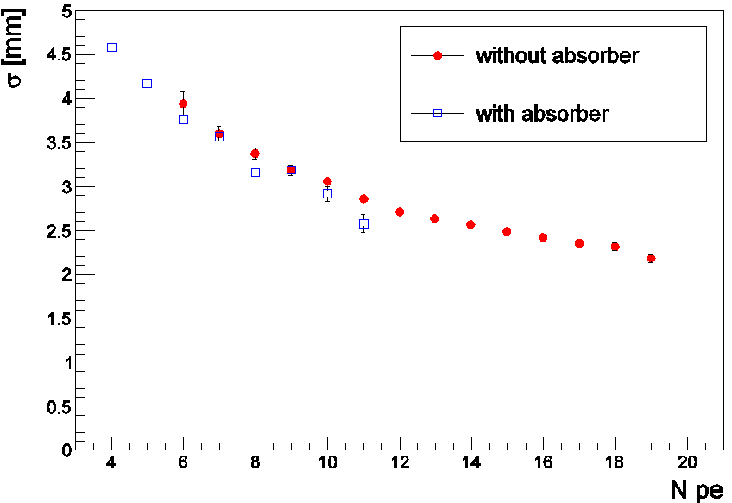
RHIC Prototype: Reflected Light Case
Aerogel: n=1.05
2cm thickness
With absorbers: sizeable fraction of light survives
H8500
<N>=13.1
<N>=5.3
mirrors + aerogel
plane mirror
6 GeV beam
beam
Radiator
curved mirror
with
absorbers
without
absorbers
Aerogel: n=1.05
6cm thickness
and resolution is not significantly degraded
Arbitrary units
$$σ_{R}=σ_{0}+\frac{σ_{1pe}}{\sqrt{N_{pe}}}$$
Contalbrigo M.
14th ICATPP, 25th September 2013, Como
23

Slide 24
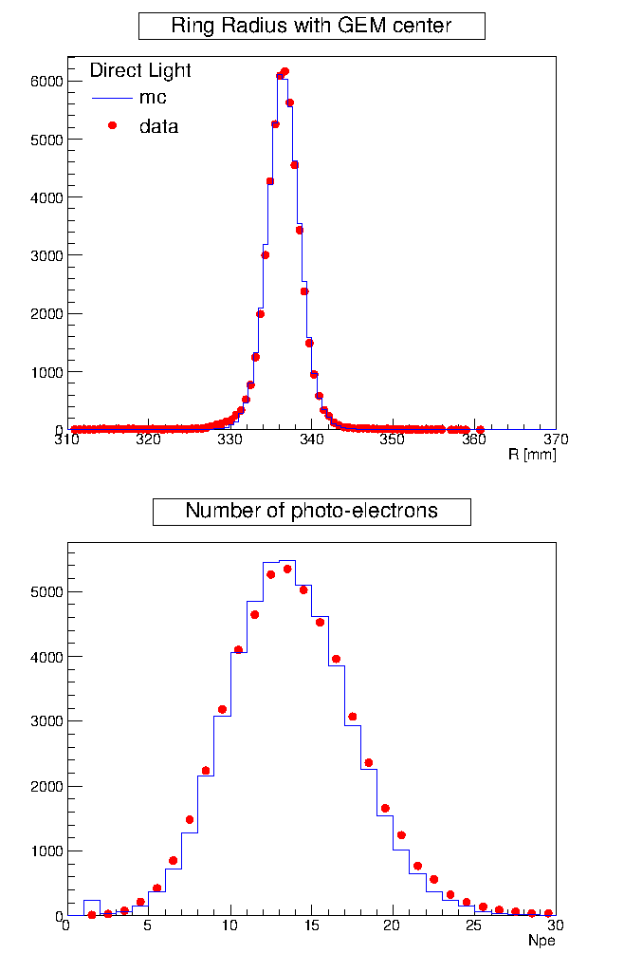
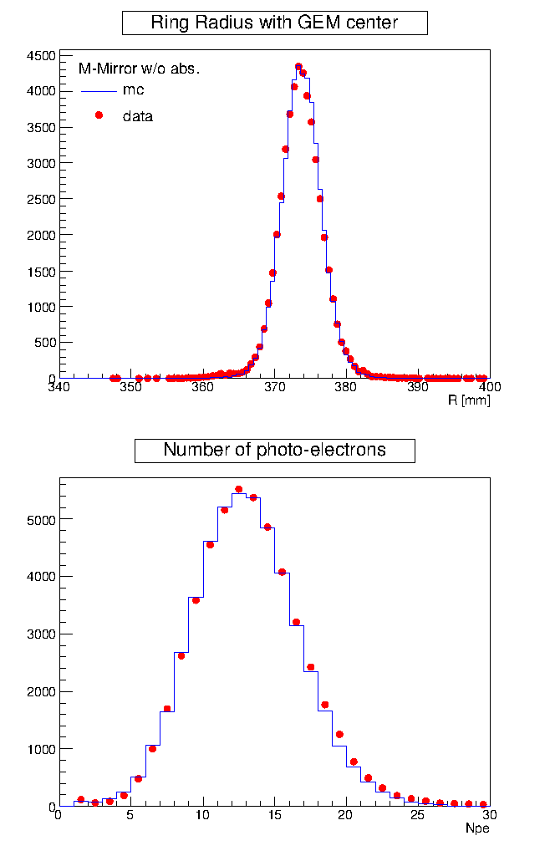
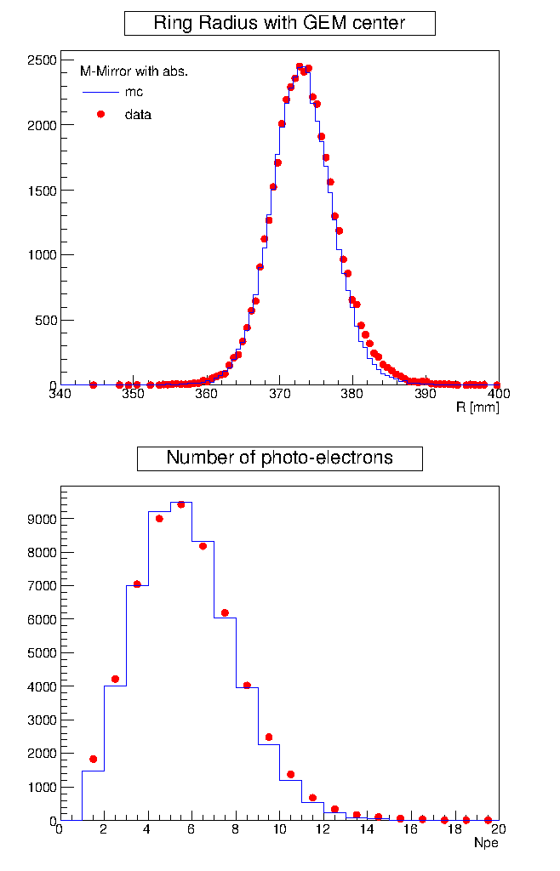
RICH Simulations
reflected light setup
direct light setup
without absorbers
with absorbers
Based on measured optical characteristics and validated with RICH prototype data
Contalbrigo M.
14th ICATPP, 25th September 2013, Como
24

Slide 25
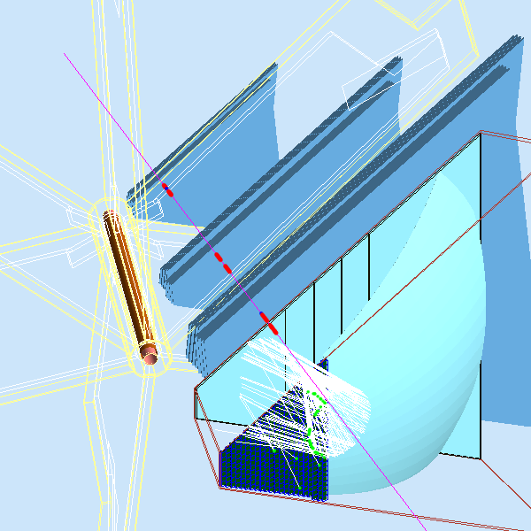
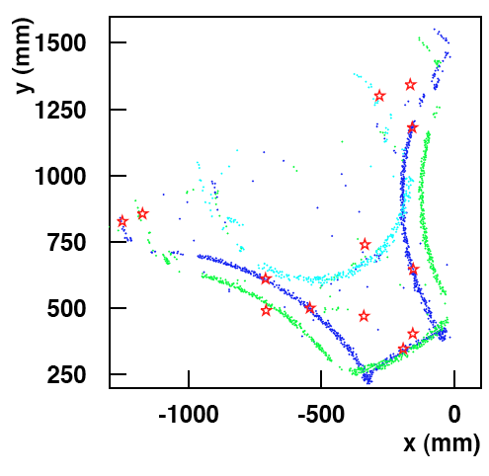
The CLAS12 Hadron ID
One charged particle per sector in average:
Non trivial RICH light patter due to reflections:
patter recognition and likelihood ID required
pion kaon proton
Contalbrigo M.
14th ICATPP, 25th September 2013, Como
25

Slide 26
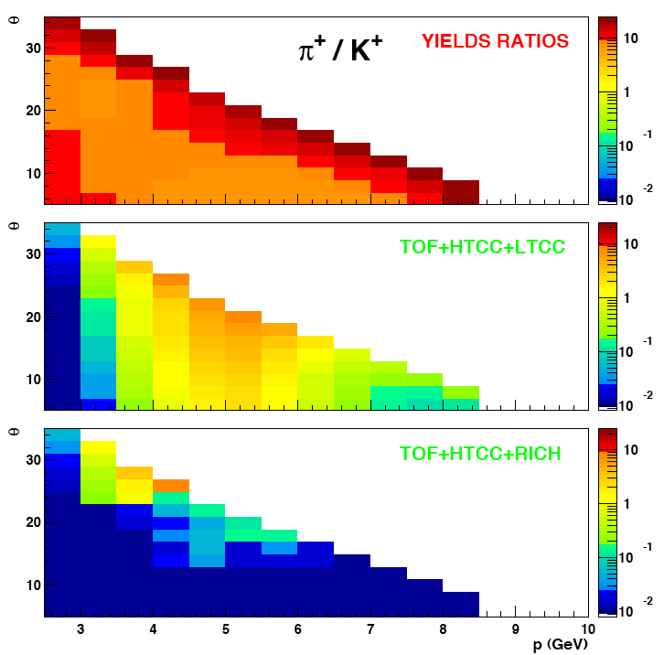
The CLAS12 Hadron ID
One charged particle per sector in average:
pion >> kaon everywhere
TOF + HTCC
~1:500 rejection
from x5 to ~1%
Non trivial RICH light patter due to reflections:
patter recognition and likelihood ID required
pion kaon proton
+ RICH
few % pion
contamination
Even with a not yet optimized tuning of pattern recognition
and likelihood ID, the π contamination is of the order of 1%
Contalbrigo M.
14th ICATPP, 25th September 2013, Como
26

Slide 27
RICH Project Landscape
2010: ✔ Concept of Design and Technology
2011: ✔ Tests of components and small prototype
2012: ✔ Extensive tests with large-scale prototype
2013: ✔ June: Technical Review
✔ August: TDR
✔ September: Project Review with DOE
Starting the construction phase
GOAL: 1st sector ready by the end of 2016
Contalbrigo M.
14th ICATPP, 25th September 2013, Como
27
Notes:
9 vs 8

Slide 28
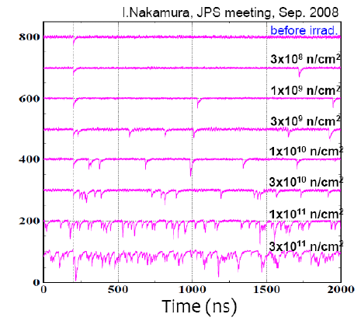
Photon Detectors: SiPM
Measured fluence @ Belle:
90/fb → 1-10 10⁹ n/cm²
Expected fluence @ Belle-2:
50/ab → 2-20 10¹¹ n/cm²
Expected fluence @ LHCB-2:
1 year → 6 10¹¹ n/cm²
Fluence at CLAS12 allows the use of SiPM for future upgrades:
✓ fast develop in performances (dark count ~ 1 Mhz for 3x3 mm² devices)
✓ fast reduction in price (already comparable with MA-PMTs over 1 m²)
✓ require dedicated R&D for electronics and cooling
Contalbrigo M.
14th ICATPP, 25th September 2013, Como
28
Notes:
9 vs 8

Slide 29
The SiPM Test Prototype
1.5 m coaxial cables
to the electronics
Commercial SiPM matrix with
a pre-amplification stage
Beam
Water-cooled Peltier cell
for temperature control
[-25 : +25 Celsius]
Custom SiPM matrices with
a pre-amplification stage
Contalbrigo M.
14th ICATPP, 25th September 2013, Como
29
Notes:
9 vs 8

Slide 30
The Custom SiPM Matrix @ +25º
Equalization of the
single SiPM is critical
High threshold
Medium threshold
Low threshold
10⁻³ level is
challenging
Signal occupancy (%)
Vbias
Peak RMS
Background occupancy (%)
Vbias
Vbias
Contalbrigo M.
14th ICATPP, 25th September 2013, Como
30
Notes:
9 vs 8

Slide 31
The Custom SiPM Matrix@-25º
For a 12 cm radius Cherenkov cone and
a 3 mm SiPM pixel, an occupancy of 4 %
corresponds to about 24 p.e.
High threshold
Medium threshold
Low threshold
In a +/- 3 ns window
Comparable with H8500
Largely insensitivity to
Vbias and discriminator
threshold
Signal occupancy (%)
Vbias
Peak RMS
Background occupancy (%)
Vbias
Vbias
Contalbrigo M.
14th ICATPP, 25th September 2013, Como
31
Notes:
9 vs 8

Slide 32
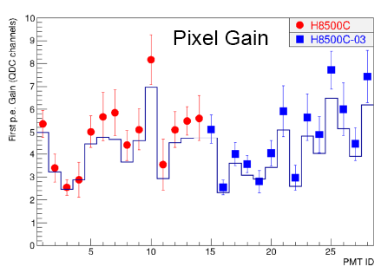
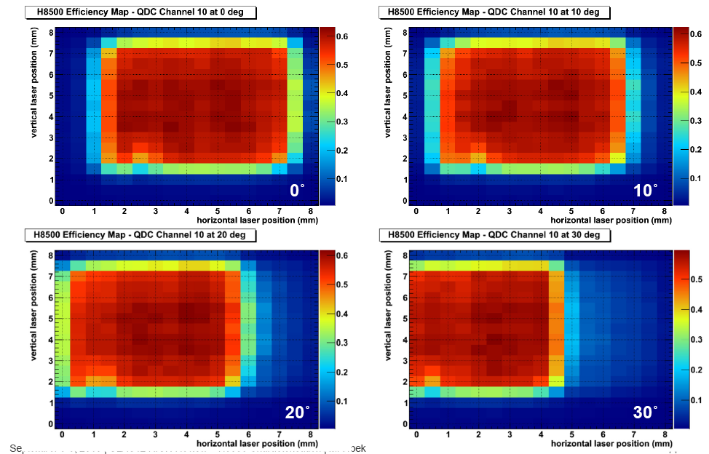
MA-PMT Gain Map
Pixel Gain:
Efficiency Map:
PMT average gain:
Incident angle scan:
Contalbrigo M.
14th ICATPP, 25th September 2013, Como
32
Notes:
9 vs 8

Slide 33
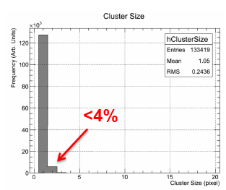

MA-PMT Efficiency and X-talk
~ 15% SPE Loss :
~ 3% Cross-Talk:
Contalbrigo M.
14th ICATPP, 25th September 2013, Como
33
Notes:
9 vs 8

