Slide 1
Photon Imaging with the Modular
And Multipurpose Readout Electronics
of the Large-Area CLAS12 RICH
Contalbrigo Marco
INFN Ferrara
On behalf of the CLAS12 RICH Group
8th NDIP Conference, 7th July 2017, Tours - France
Notes:
Mettere tutti I nomi ?

Slide 2
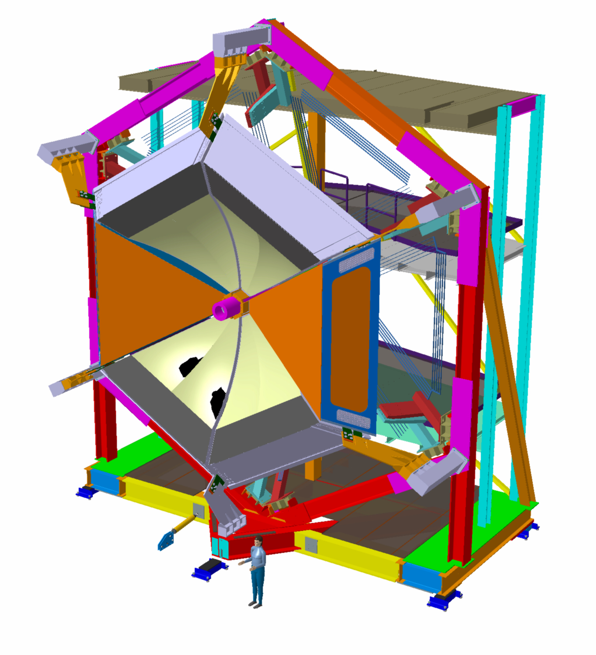
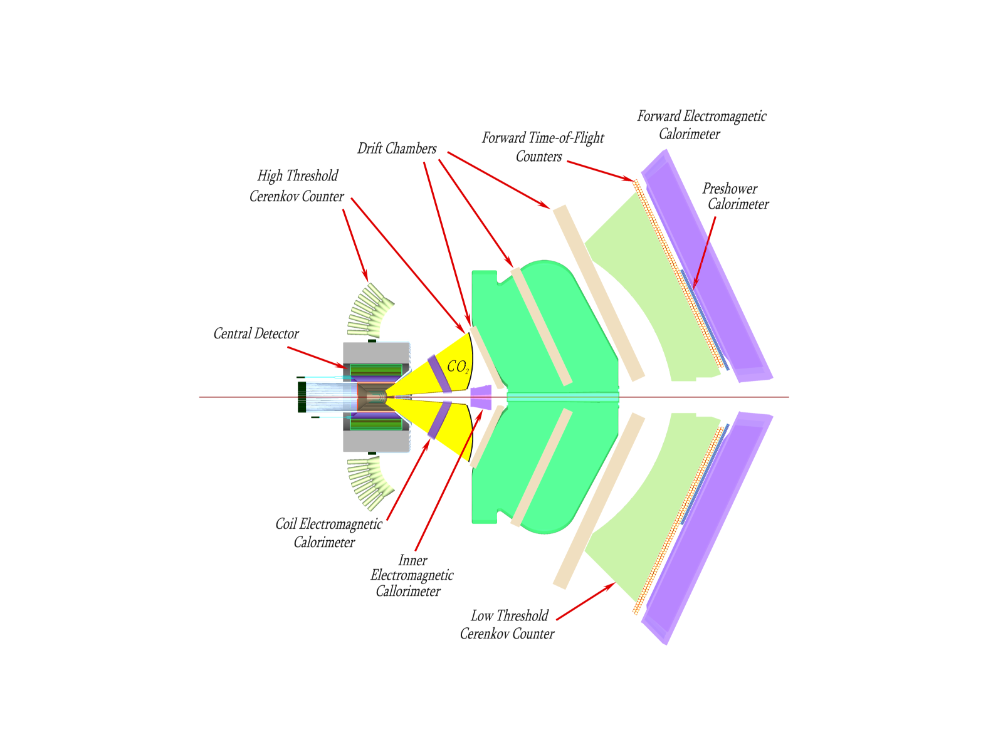
The CLAS12 Spectrometer
Upgrade of the CLAS detector at Jefferson Lab almost complete.
First beam expected in fall 2017.
RICH
Beam
RICH
1st sector by October 2017
2 sectors to accomplish physics program
Highly polarized 12 GeV electron beam
3D structure of the nucleon by
polarized deep-inelastic scattering
Luminosity up to 10³⁵ cm⁻² s⁻¹
Hadron ID wanted for flavor separation
H and D polarized targets
Crucial for the study of parton dynamics related to angular momentum and spin-orbit effects with flavor sensitivity.
Broad kinematic range coverage
Contalbrigo M.
8th NDIP Conference, 7th July 2017, Tours - France
2

Slide 3
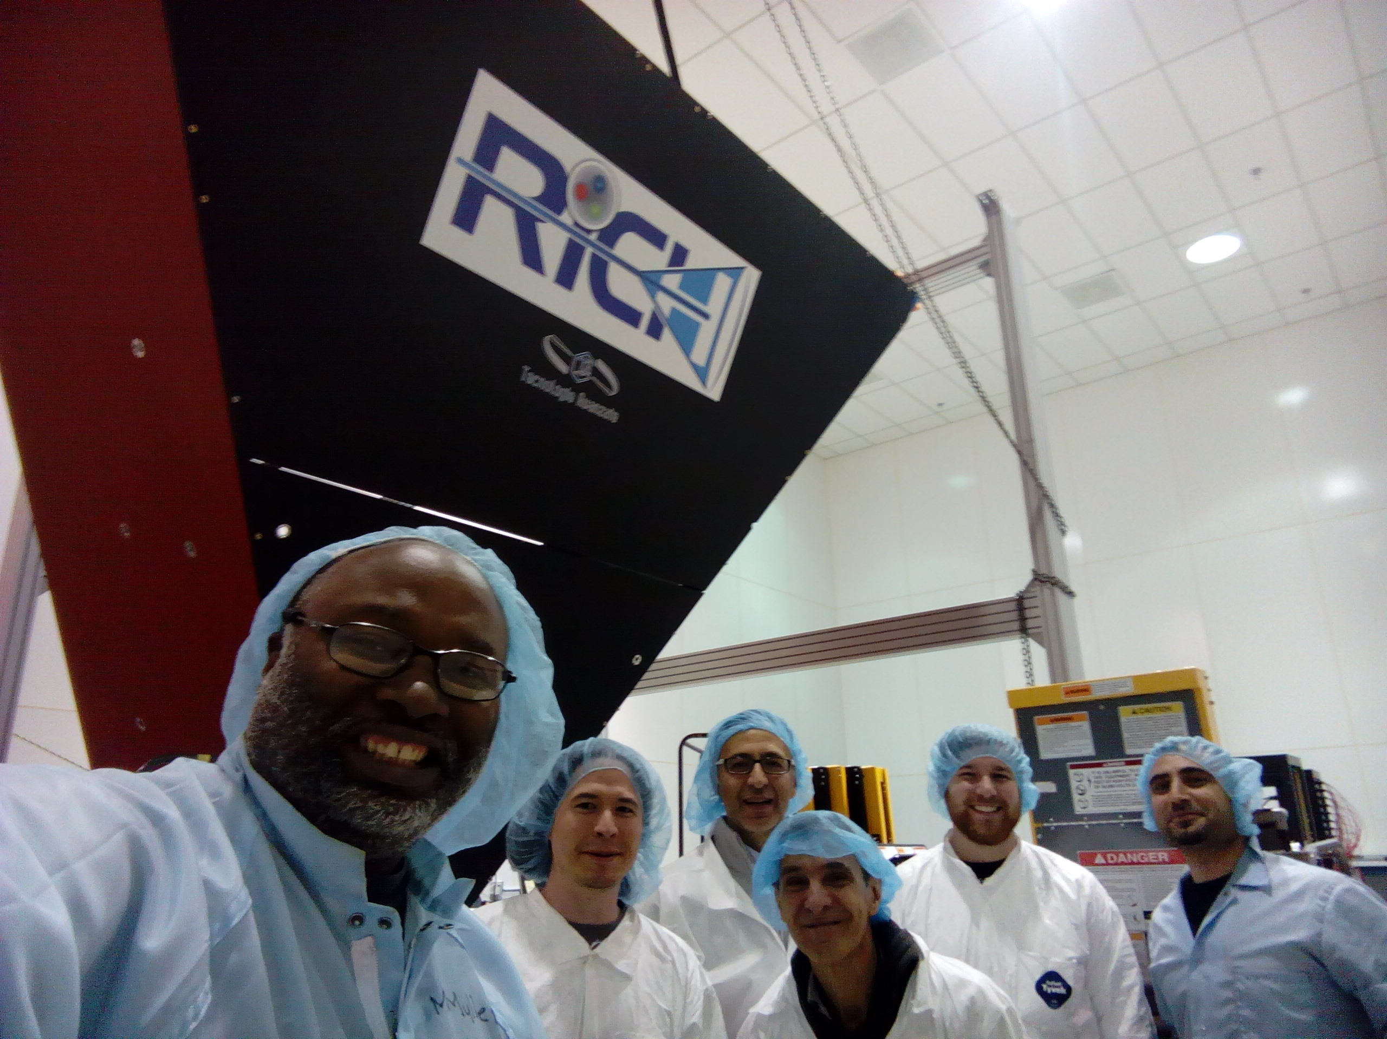
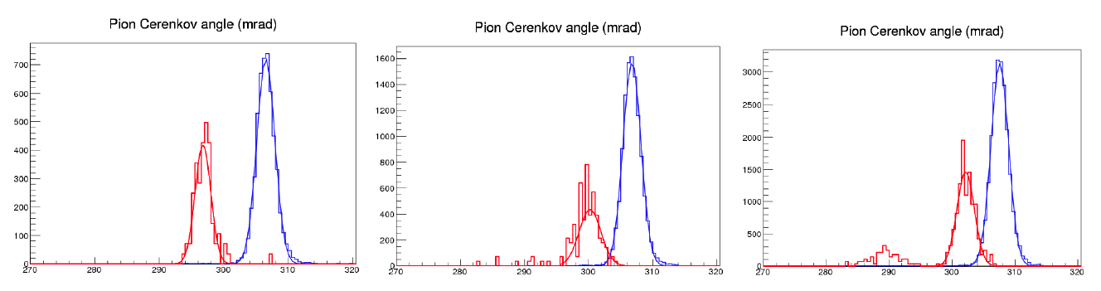
CLAS12 RICH
INSTITUTIONS
INFN (Italy) Bari, Ferrara, Genova, L.Frascati, Roma/ISS
Jefferson Lab (Newport News, USA)
Argonne National Lab (Argonne, USA)
Duquesne University (Pittsburgh, USA)
George Washington University (USA)
Glasgow University (Glasgow, UK)
J. Gutenberg Universitat Mainz (Mainz, Germany)
Kyungpook National University, (Daegu, Korea)
University of Connecticut (Storrs, USA)
UTFSM (Valparaiso, Chile)
Prototype results:
6 Gev/c
π
7 Gev/c
8 Gev/c
k
p
Cherenkov angle (mrad)
Contalbrigo M.
8th NDIP Conference, 7th July 2017, Tours - France
3
Notes:
Vanno messi studi innovativi e pubblicazioni

Slide 4
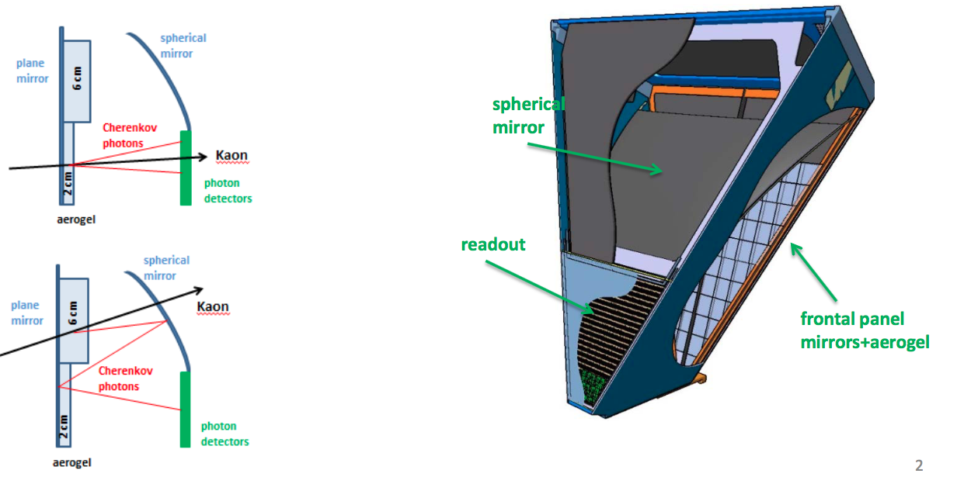
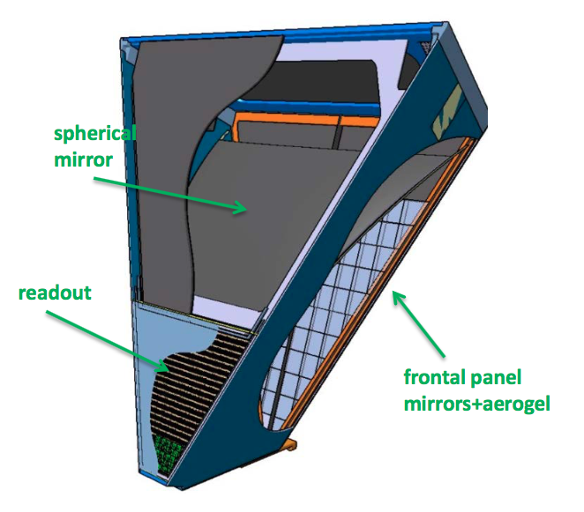
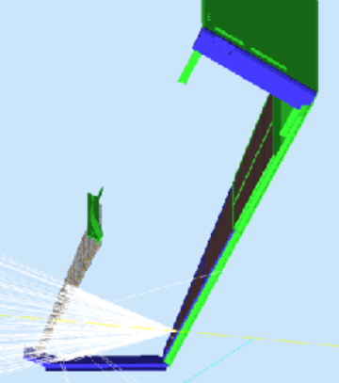
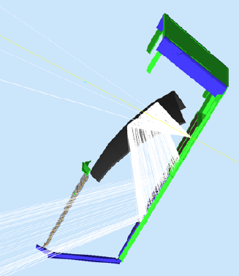
RICH Design
Goal: separate kaons from pions and protons in the momentum range 3-8 GeV/c
Aerogel radiator to match the momentum
Hybrid-optic to minimize the instrumented area
Working with VIS and near-UV photons (MAPMTs or SiPMs)
Contalbrigo M.
8th NDIP Conference, 7th July 2017, Tours - France
4
Notes:
Dire meglio chi fa cosa.

Slide 5
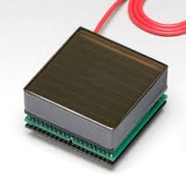
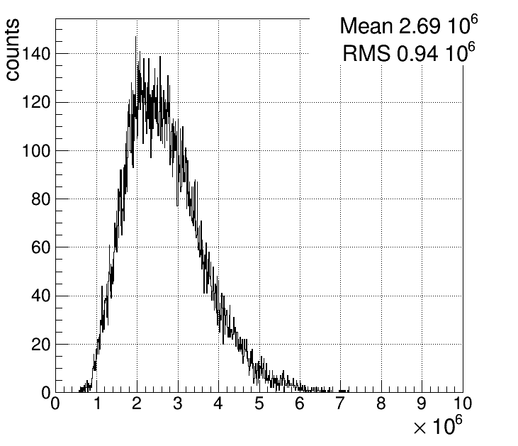
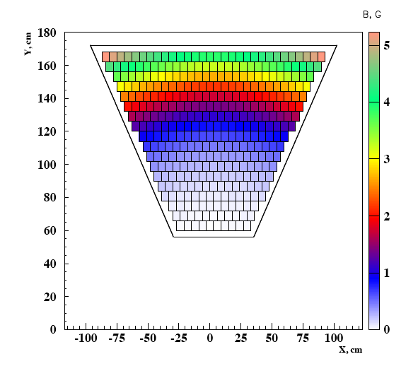
Photon Sensor: MA-PMT
MA-PMT
< 1 cm spatial resolution
< 1 ns time resolution
Compatible with the low torus fringe field
Average MA-PMT gain ~ 2.7 10⁶
Corresponds to SPE ~ 400 fC
✓ 64 6x6 mm² pixels cost effective device
✓ High sensitivity on VIS towards UV light
✓ Mature and reliable technology
✓ Large Area (5x5 cm²)
✓ High packing density (89 %)
✓ Fast response
✓ Expensive technology
8th NDIP Conference, 7th July 2017, Tours - France
5
Notes:
Dire meglio chi fa cosa.

Slide 6
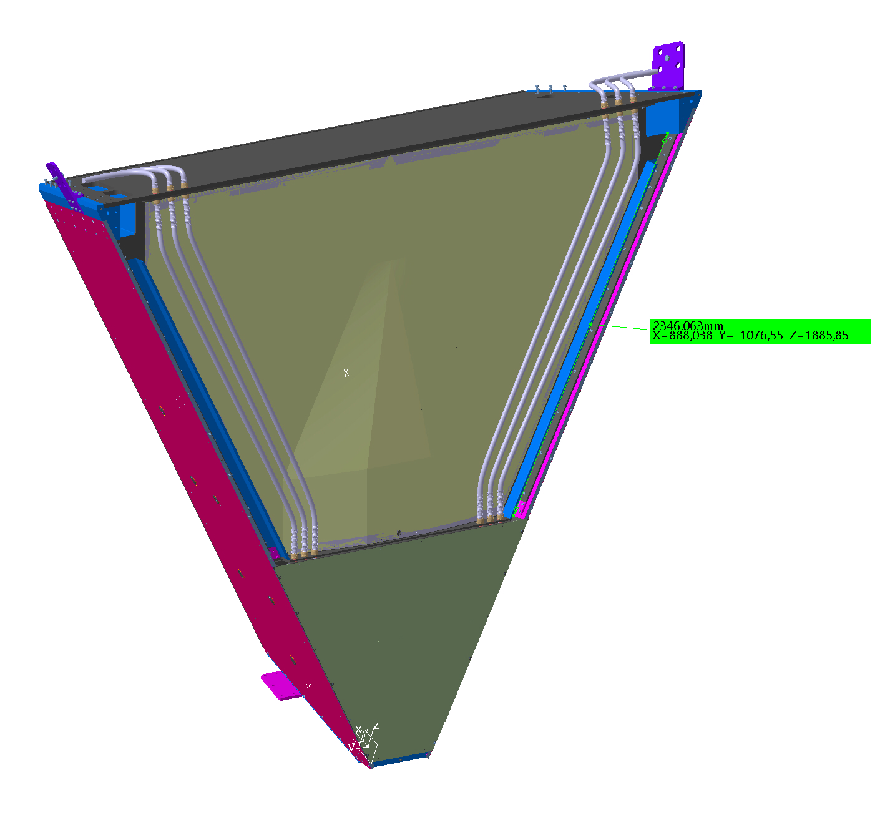
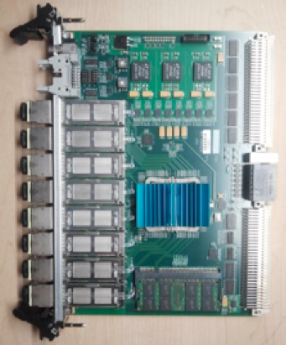
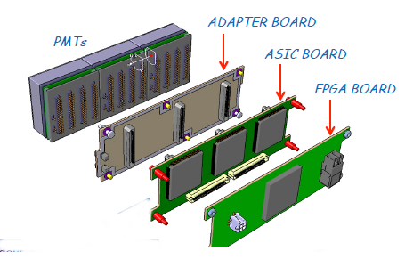
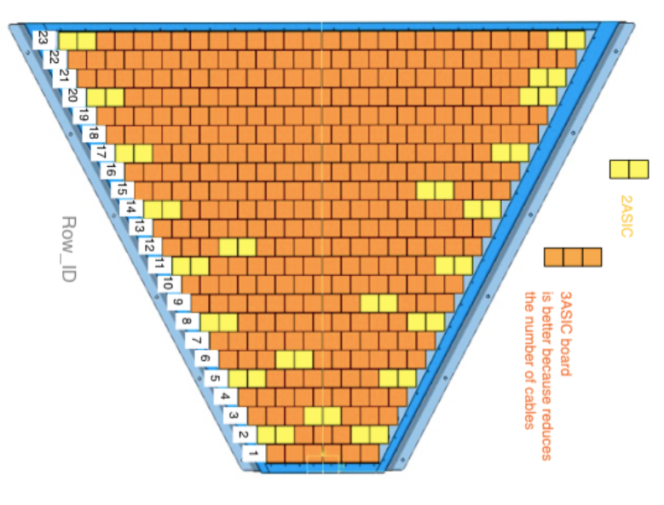
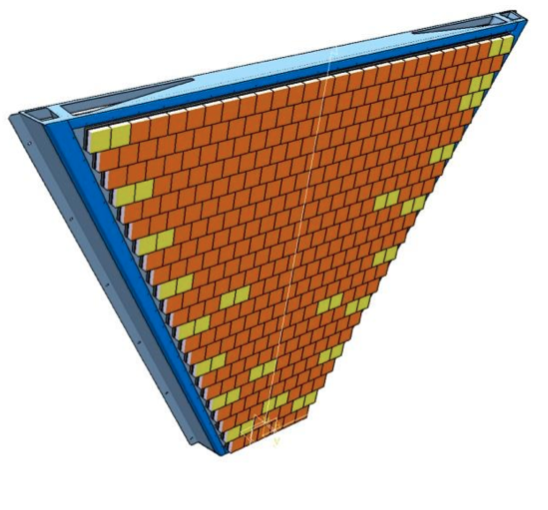
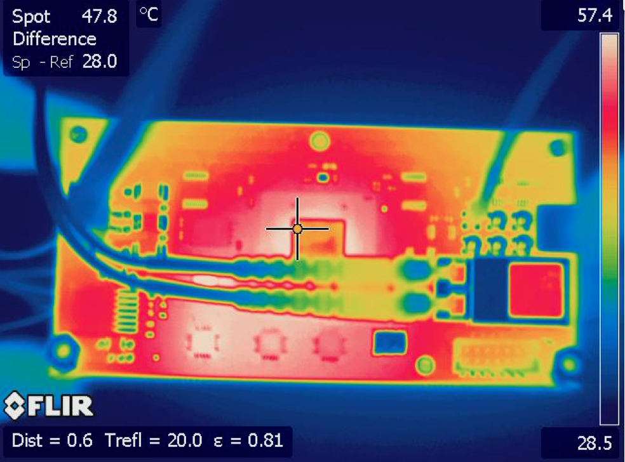
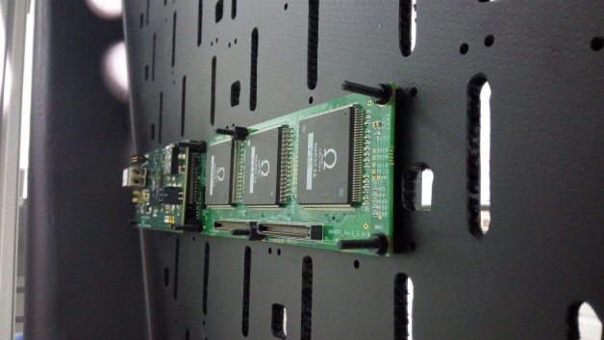
RICH Readout Electronics
Services
Air Cooling
Readout Electronics
Compact (matches sensor area)
Modular Front-End (Mechanical adapter, ASIC, FPGA)
Scalable fiber optic DAQ (TCP/IP or SSP)
Tessellated (common HV, LV and optical fiber)
SSP Fiber-Optic DAQ
Tile power dissipation ~ 3.5 W
Contalbrigo M.
8th NDIP Conference, 7th July 2017, Tours - France
6
Notes:
Immagine electronic panel e scheda ottica

Slide 7
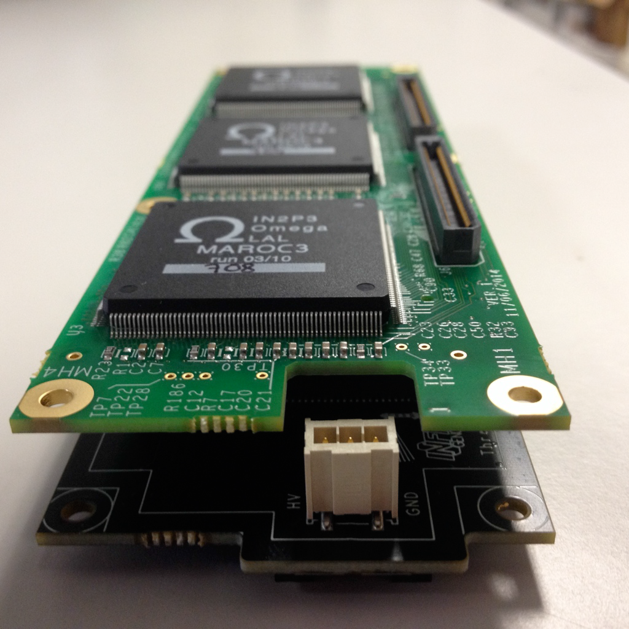
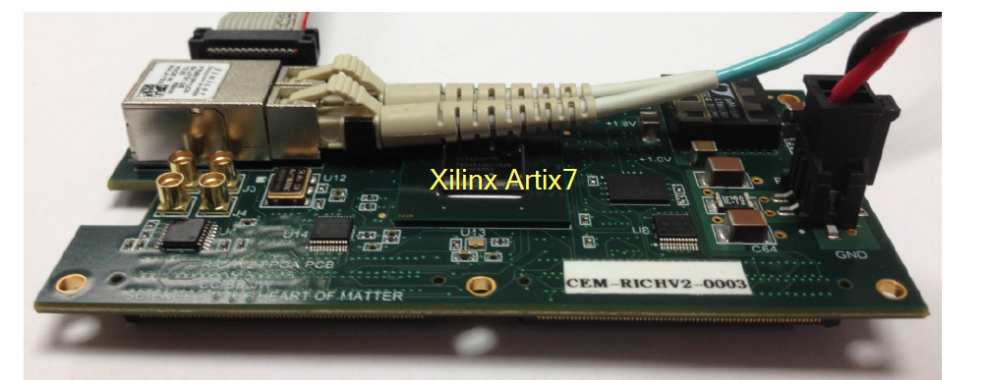
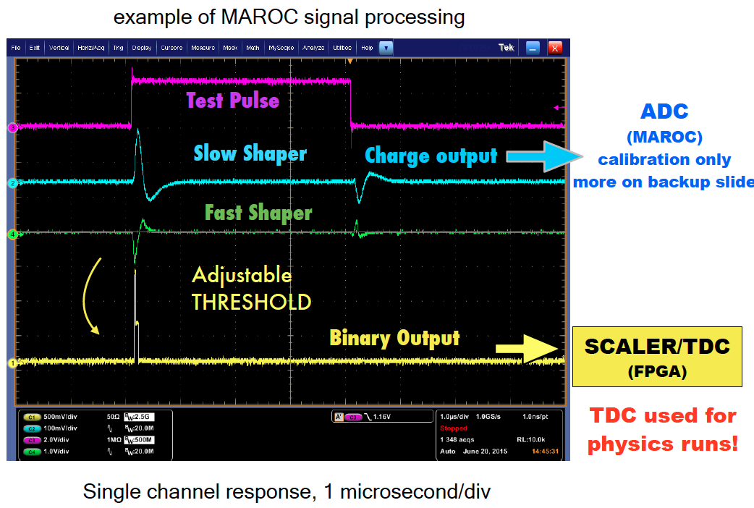
RICH Front-End Electronics
Analog: Charge (1 fC)
Digital: Time (1 ns)
Trigger latency (8 μs)
Optical ethernet (2.5 Gbps)
Trigger: external
internal
self
On-board pulser
Contalbrigo M.
8th NDIP Conference, 7th July 2017, Tours - France
Contalbrigo M.
7
Notes:
Aggiungere range di validita’ per fattorizzazione GPDs

Slide 8
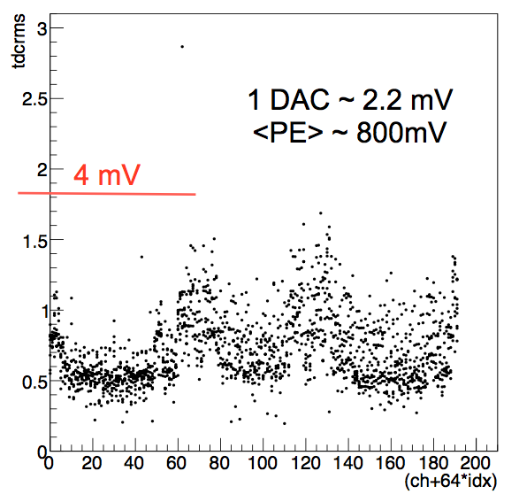
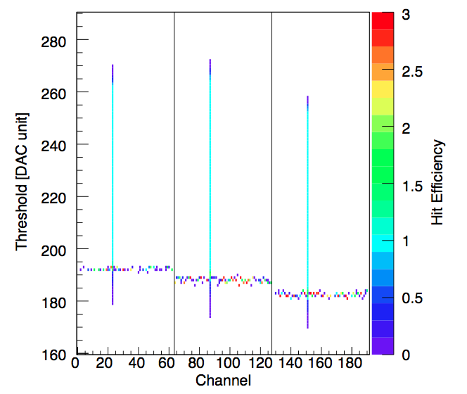
FE Electronics: Digital Readout
During Acceptance tests
During Internal Pulser Calibration
Pedestal level as seen by a test-point
As seen by RICH readout
Discrimination down to 20 fC, i.e. few % of SPE, allows sensor characterization
Contalbrigo M.
8th NDIP Conference, 7th July 2017, Tours - France
8
Notes:
Vedere presentazione Matteo

Slide 9
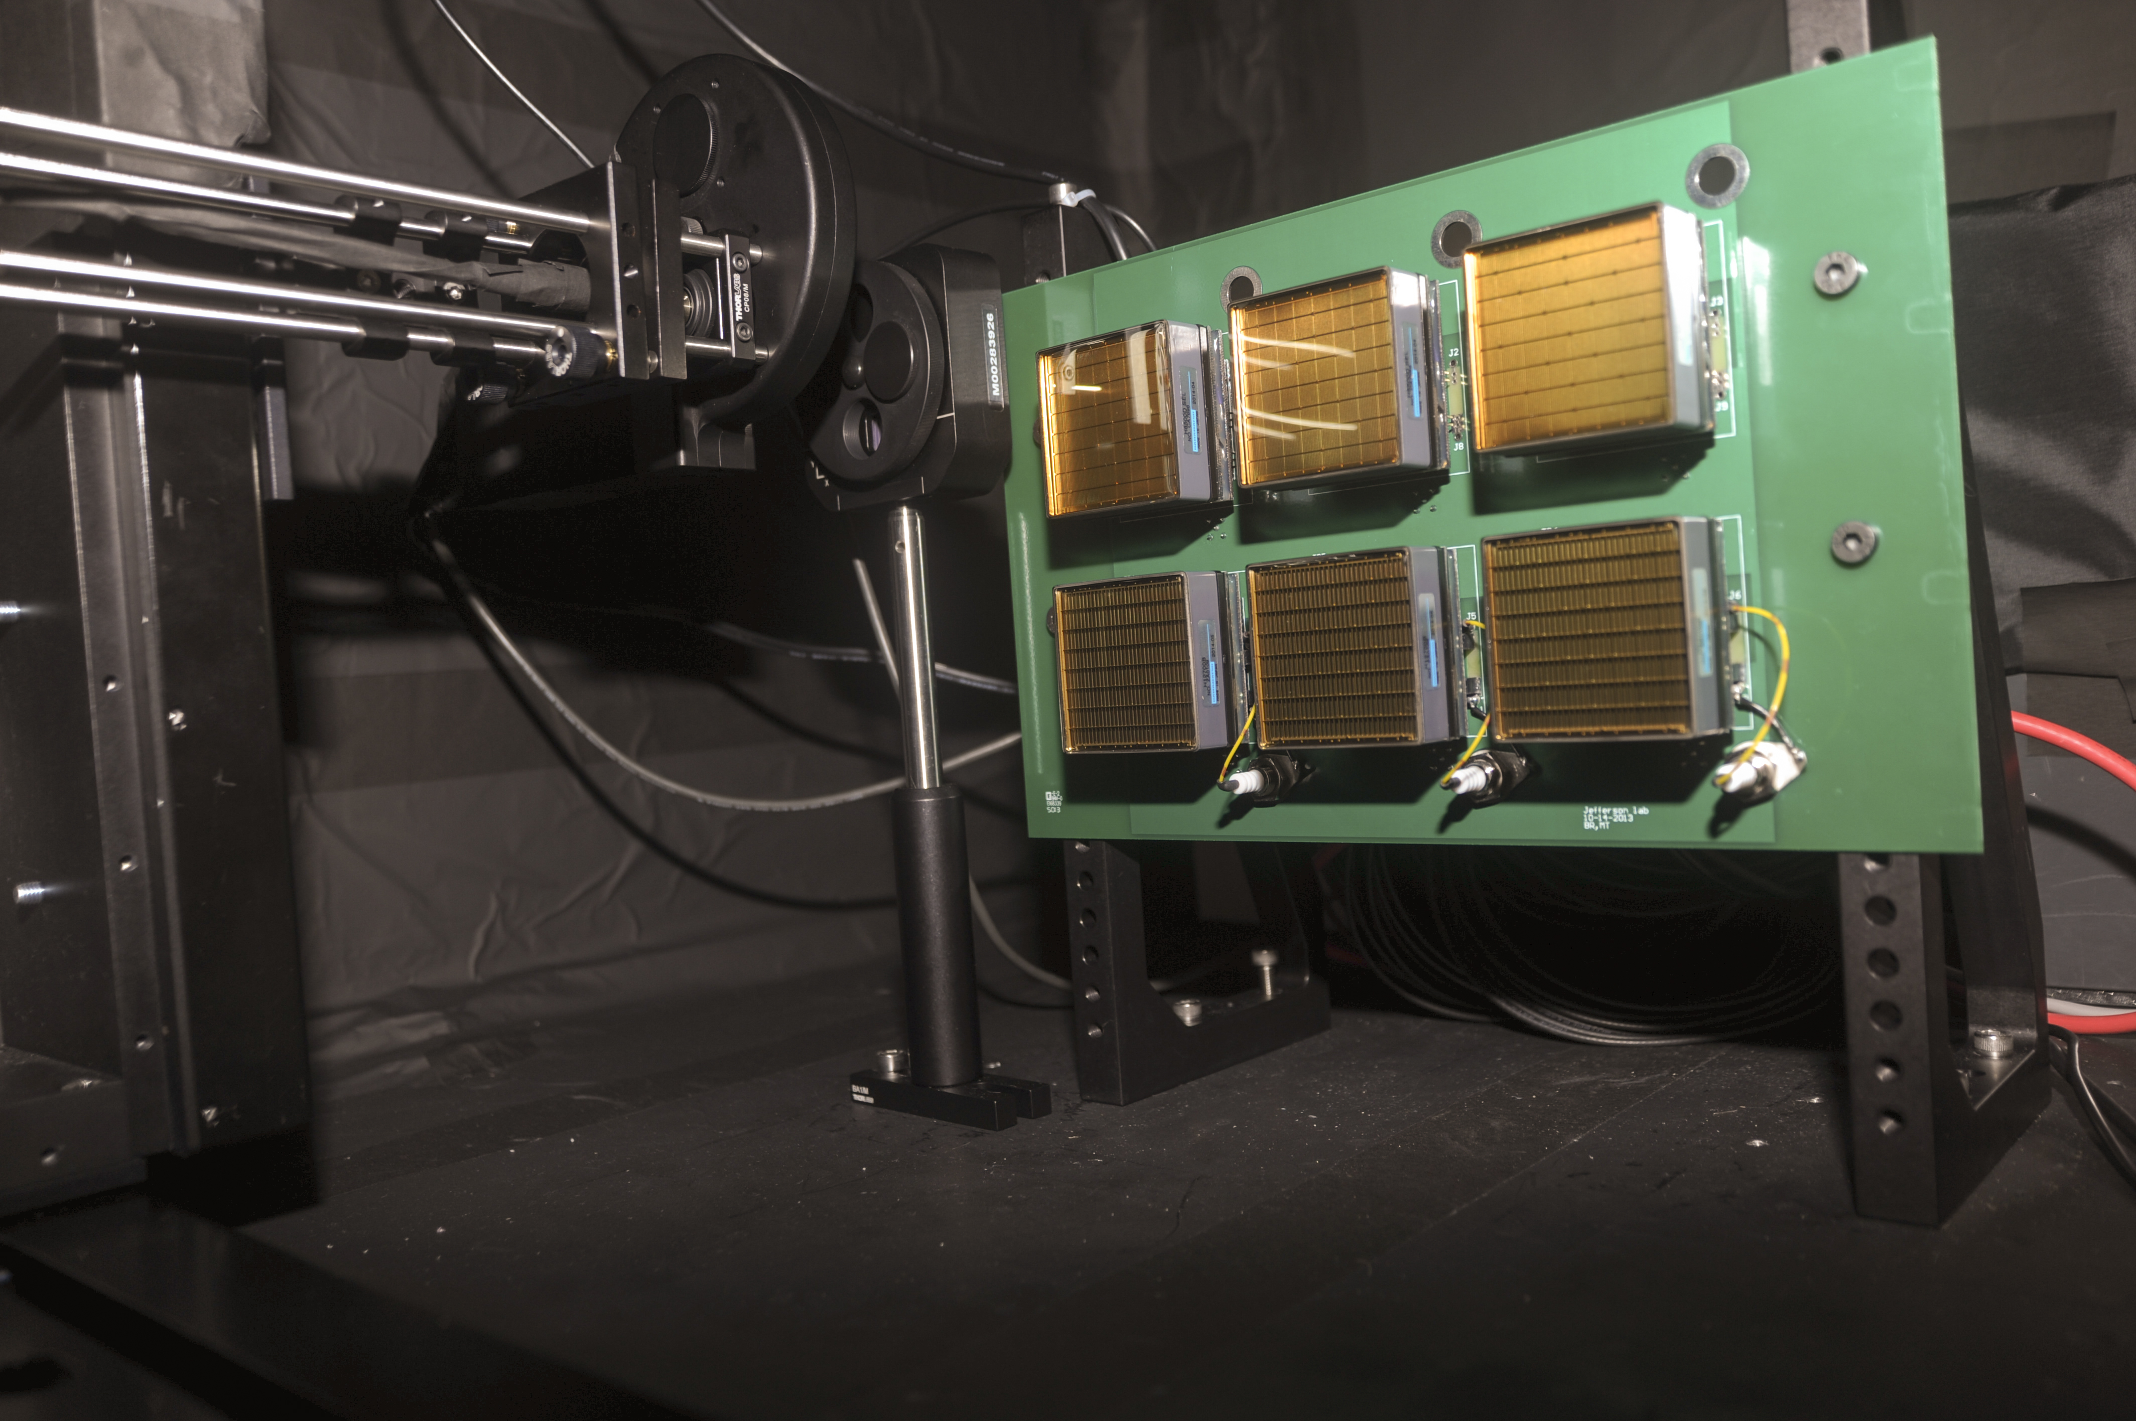
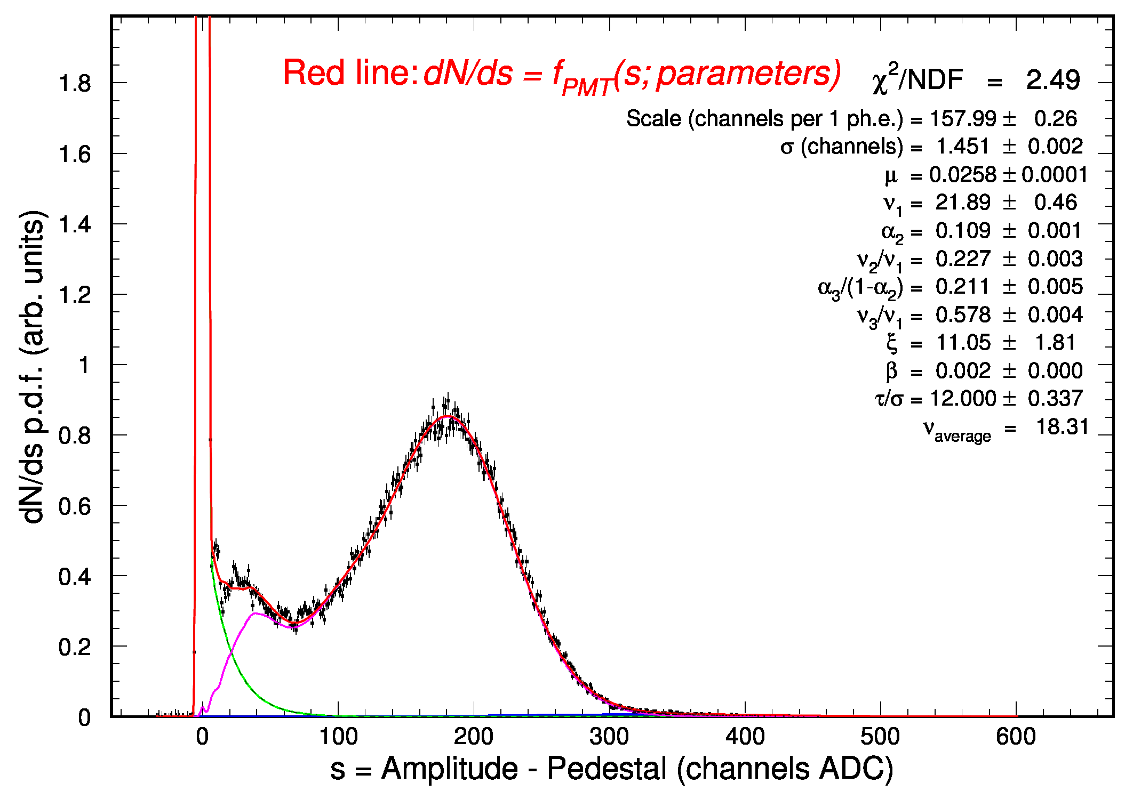
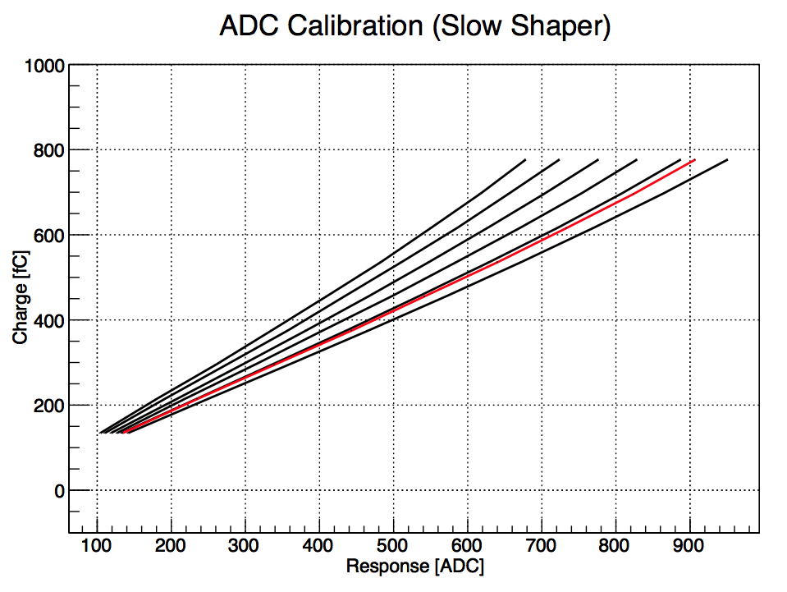
FE Electronics: Charge
Multiplexed readout up to 50 kHz
High resolution SPE spectrum
Viable for efficiency and gain monitors
In conjunction with timing, allows the
study of PMT discharge and cross-talk
Gain
Contalbrigo M.
8th NDIP Conference, 7th July 2017, Tours - France
9
Notes:
Dire meglio chi fa cosa.

Slide 10
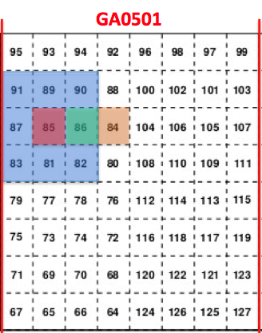
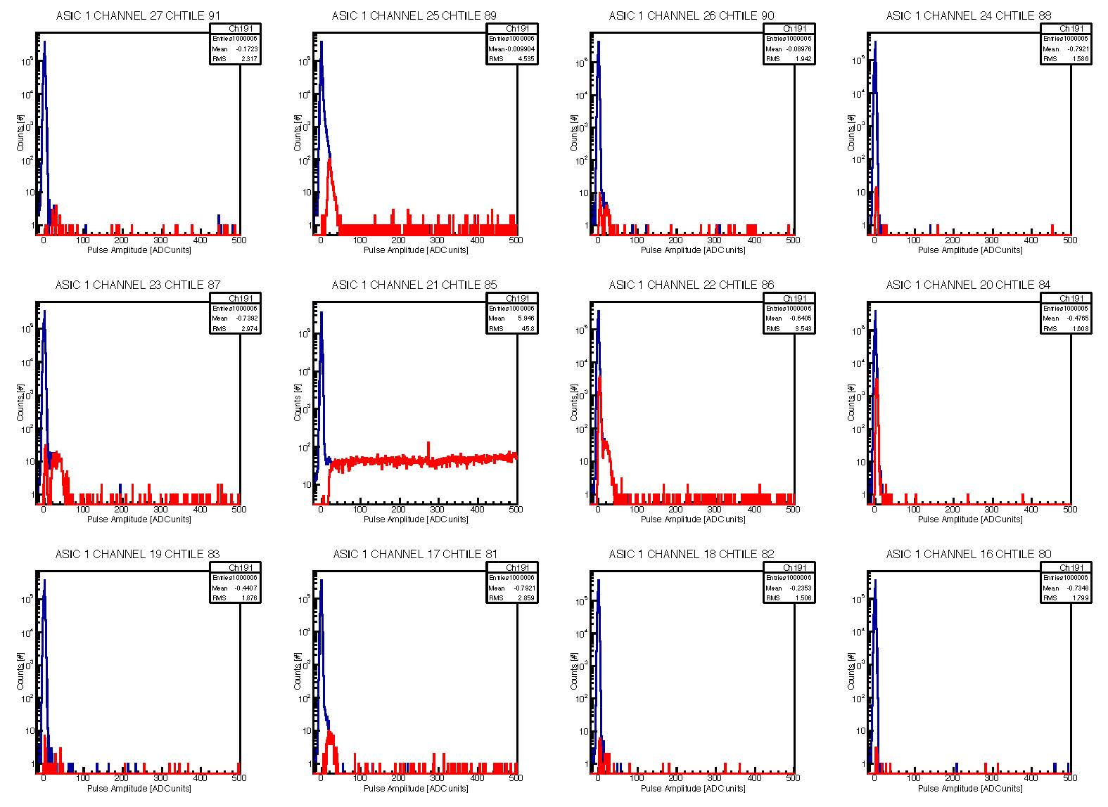
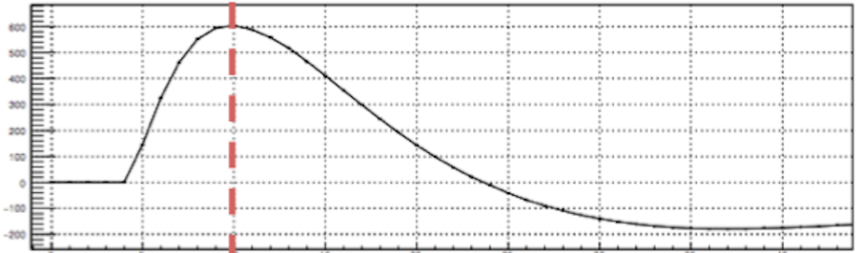
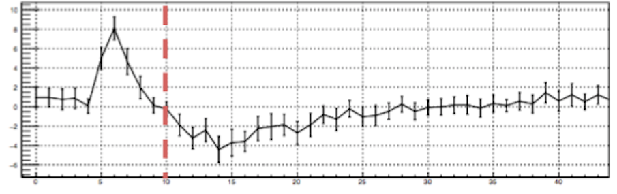
RICH Electronic: Cross-talk
Sensor
~ 20 fC
~ 1/80 SEP
Electronic
Signal
Cross-talk
Sampling time
8th NDIP Conference, 7th July 2017, Tours - France
10
Notes:
Dire meglio chi fa cosa.

Slide 11
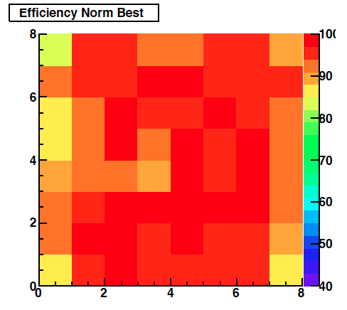
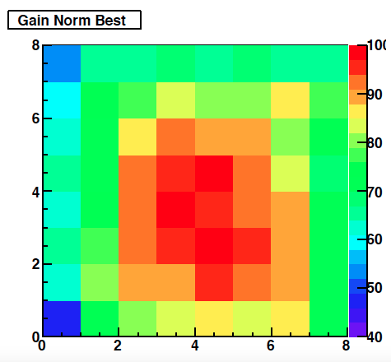
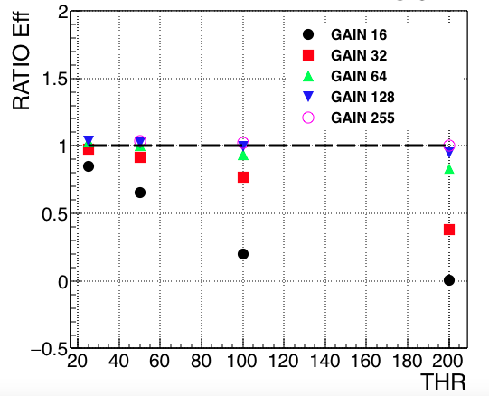
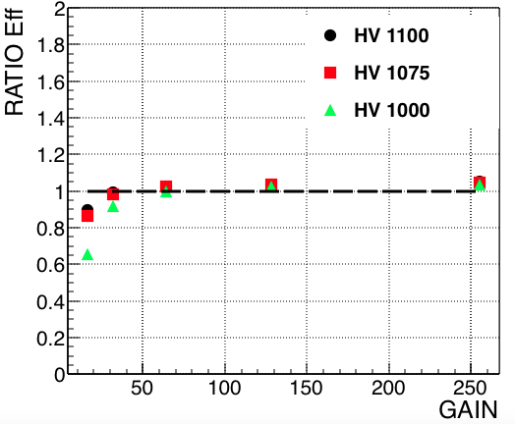
FE Electronics: SPE Discrimination
Relative efficiency map
Relative gain map
x ¼
x ½ MAROC
x 1 GAIN
x 2
x 4
Eff. ratio
Eff. ratio
Maroc
Gain
Threshold
0 0.5 1 2 4
Contalbrigo M.
8th NDIP Conference, 7th July 2017, Tours - France
11
Notes:
Mettere legame con duration / mappa efficienza pixels ?

Slide 12
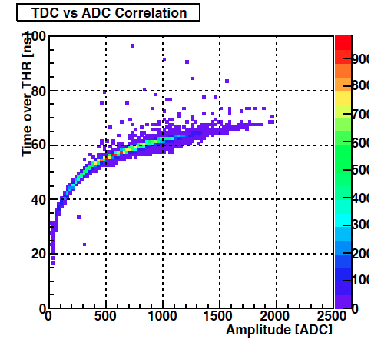
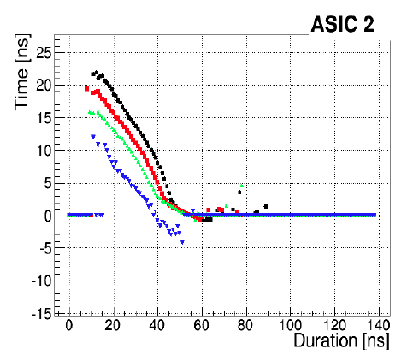
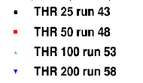
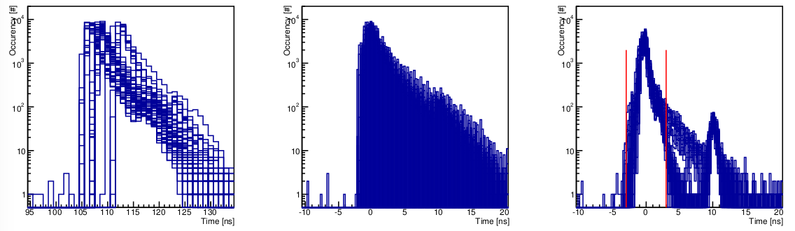
FE Electronics: SPE Timing
Time over threshold relates to charge
Typical time-walk with charge
1
Tme [ns]
Time over THR [ns]
ADC amplitude [DAC]
Duration [ns]
Channel by channel time calibration: -offsets -walk
± 3ns
Occupancy (#)
PMT
Laser
Time (ns)
Contalbrigo M.
8th NDIP Conference, 7th July 2017, Tours - France
12
Notes:
Fare una immagine del PMT sulla risoluzione

Slide 13
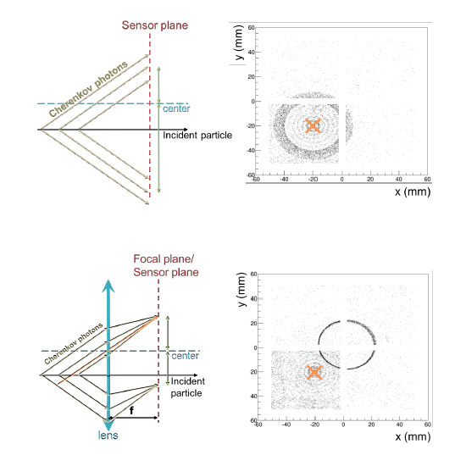
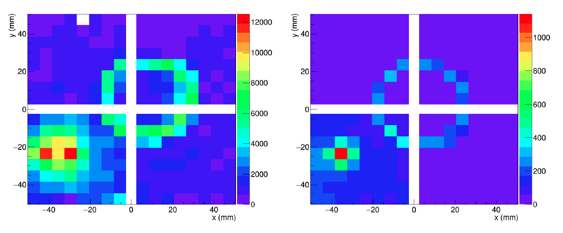
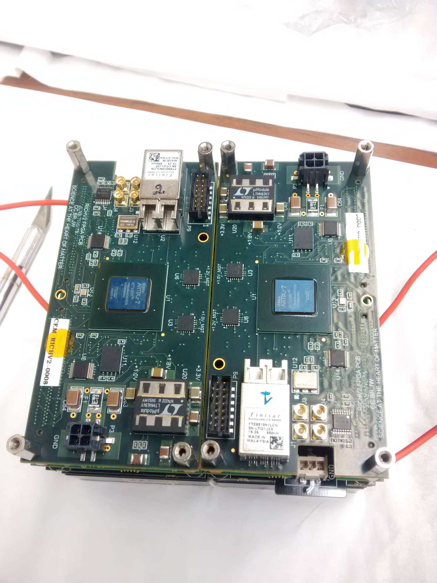
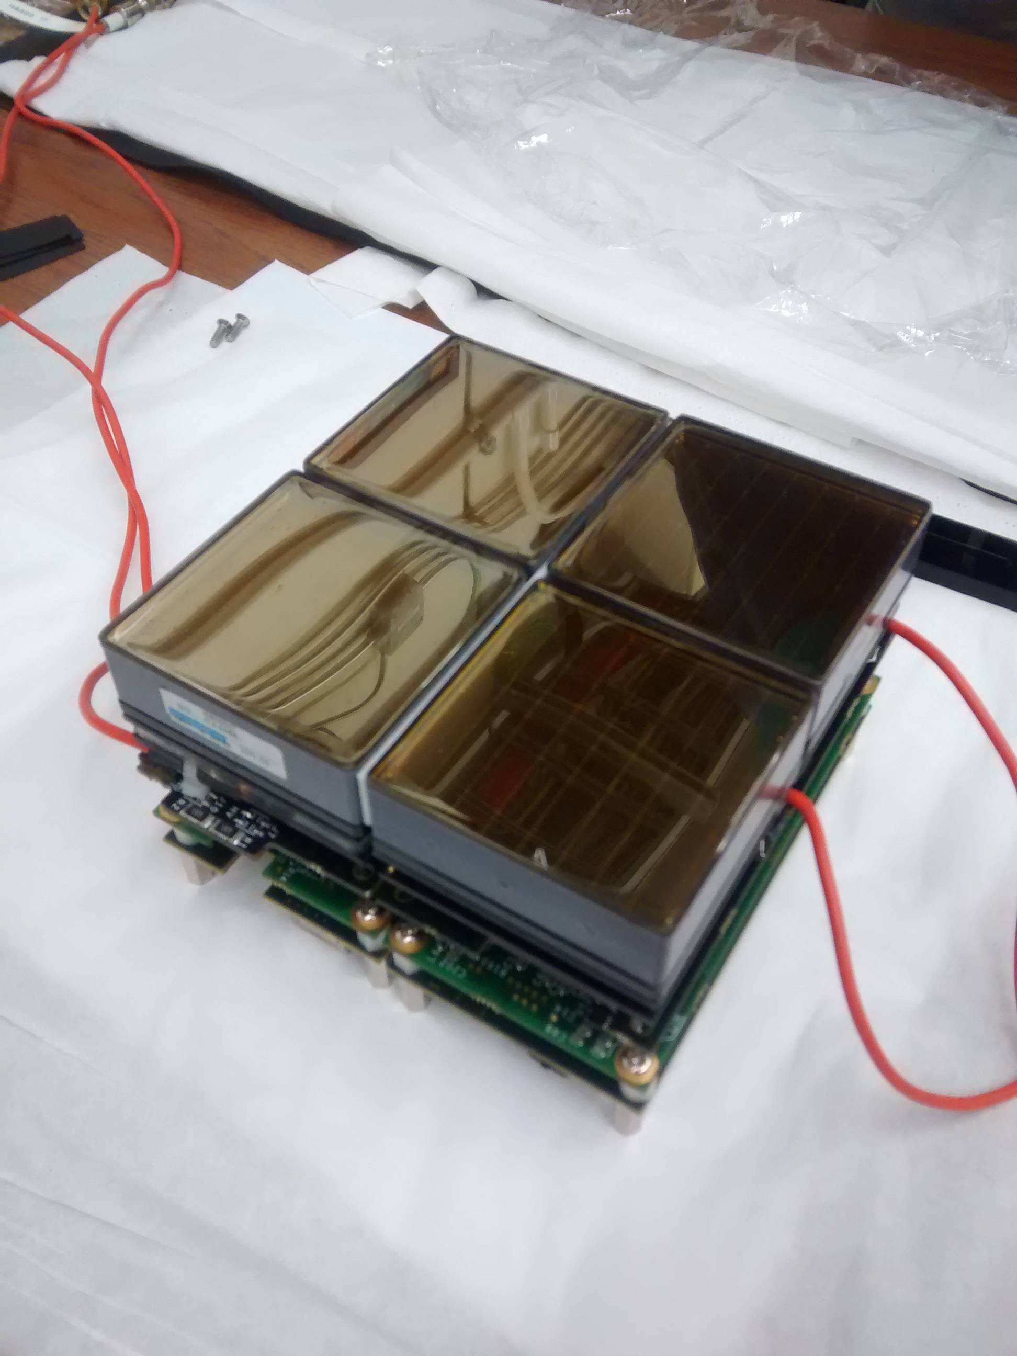
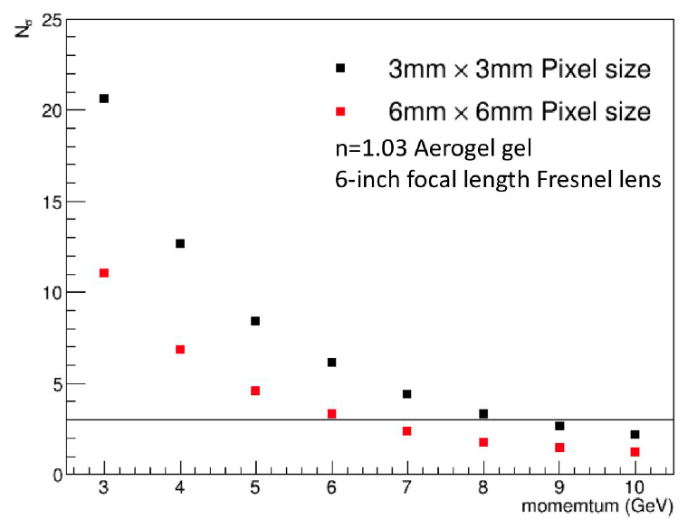
Application: Modular RICH @ EIC
Fresnel lens focalization concept for
a compact (short gap) device
Test beam of small EIC mRICH prototype Fermilab – April 16
DATA
MC
Impinging
particles
CLAS12 MAPMTs and readout electronics
Contalbrigo M.
8th NDIP Conference, 7th July 2017, Tours - France
13

Slide 14
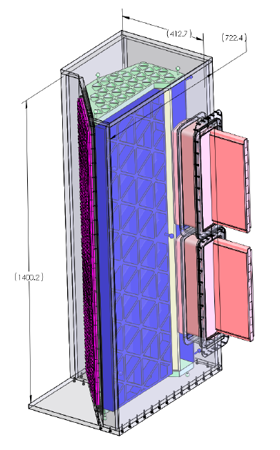
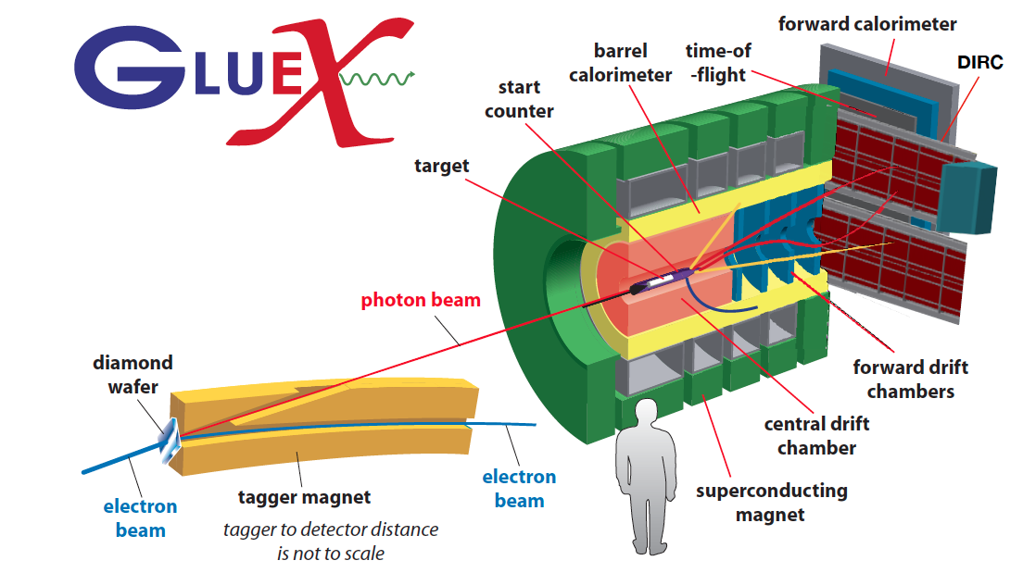
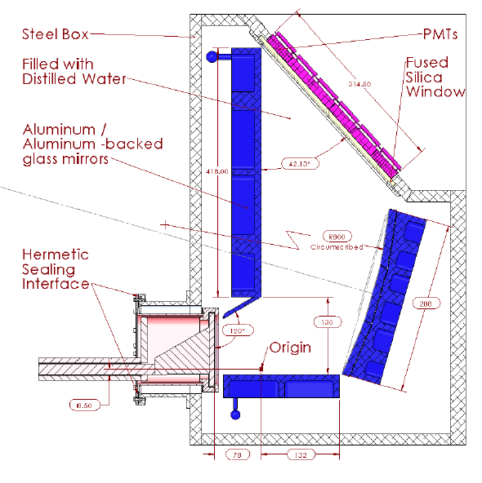
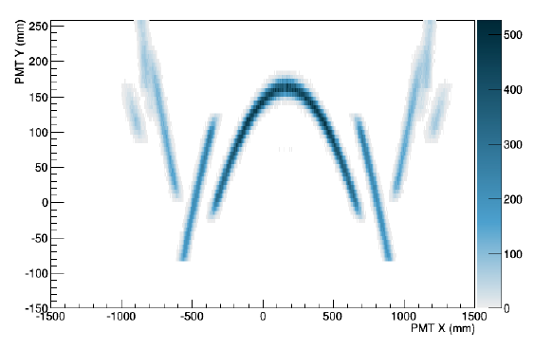
Application: DIRC @ GlueX
Hadron discrimination up to 4 GeV/c
H12700 +
CLAS12
readout
Contalbrigo M.
8th NDIP Conference, 7th July 2017, Tours - France
14
Notes:
Dire meglio chi fa cosa.

Slide 15
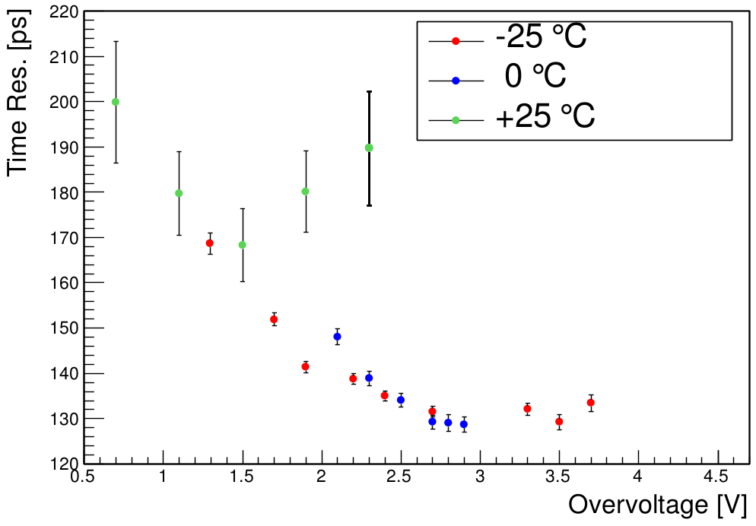
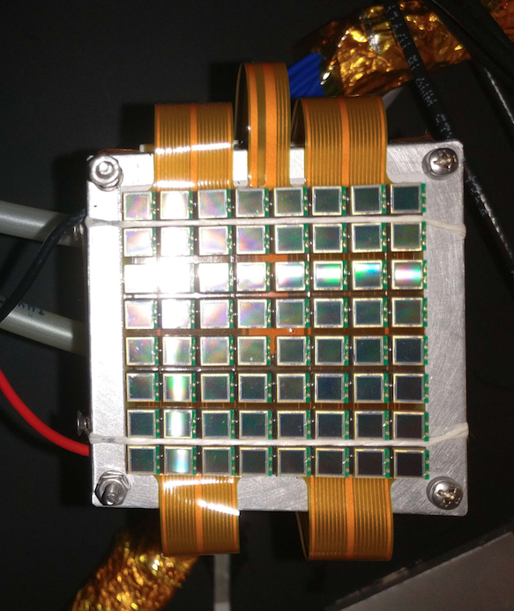
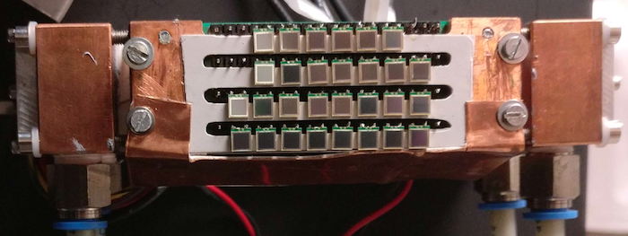

Photon Sensor: SiPM
SiPMs
✓ Mass production technology
✓ Photon counting
✓ Excellent time resolution
✓ Compatible with magnetic field
✓ High dark rate
✓ Low radiation tolerance
Work at low temperature
Beam
Contalbrigo M.
8th NDIP Conference, 7th July 2017, Tours - France
15

Slide 16





Photon Sensor: SiPM
Single-photon capability after irradiation ?
S12572 standard technology
S13360 trench technology
S13360 Before Irradiation
S12572
S13360 After Irradiation
S12572 (few CLAS years)
Enea
JLab
Contalbrigo M.
8th NDIP Conference, 7th July 2017, Tours - France
16

Slide 17



FE Electronics: SiPM
Photon counting with
ADC charge measurement
Single photon discrimination with
TDC time measurement
Time [ns]
2 p.e.
Duration [ns]
Contalbrigo M.
8th NDIP Conference, 7th July 2017, Tours - France
17
Notes:
Dire meglio chi fa cosa.

Slide 18
Conclusions
The CLAS12 RICH is designed to provide hadron identification in the 3 to 8 GeV/c momentum range
A hybrid-optic design has been adopted to minimize the instrumented area
Flat-panel multi-anode PMTs are being used for the first module
SiPMs are being investigated for the second module
The readout electronics is designed to offer
Modular Front-End (Mechanical adapter, ASIC, FPGA)
Scalable fiber optic DAQ (TCP/IP or SSP)
Compact and tessellated geometry (common HV, LV and optical fiber)
Flexible trigger logic (external, auto, self)
Discrimination down to few % of SPE
Time resolution of 1 ns
Charge measurement (multiplexed ADC or time-over-threshold)
Multi purpose electronics: in use also for GlueX DIRC and EIC R&D
Contalbrigo M.
8th NDIP Conference, 7th July 2017, Tours - France
18
Notes:
Dire meglio chi fa cosa.

