Slide 1
RICH studies for CLAS12
Contalbrigo Marco
Luciano Pappalardo
INFN Ferrara
L. Pappalardo
1

Slide 2
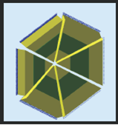
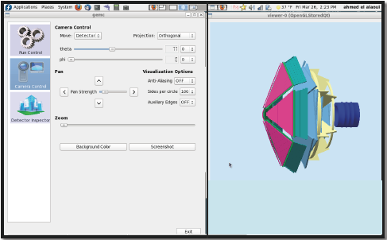
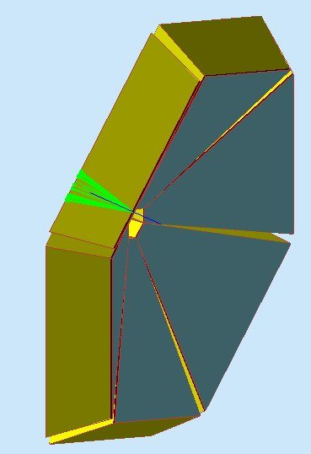
Moving to gemc
General framework: GEMC (Maurizio, JLab) + RICH impl. (Ahmed, Argonne)
GEANT4 toolkit for a complete simulation:
realistic geometry / detailed optic effects
full Cherenkov ring simulation chain
track multiplicity / background
L. Pappalardo
2
Notes:
2

Slide 3
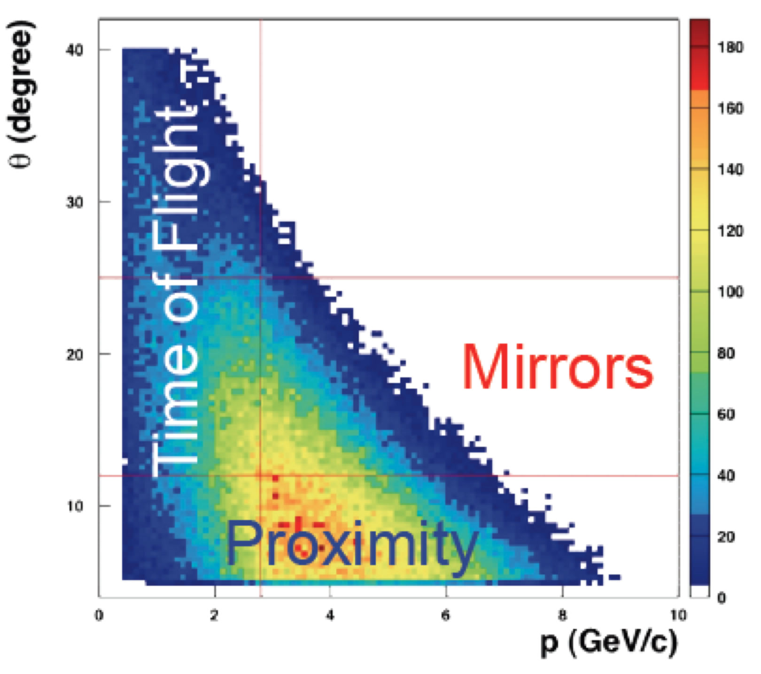
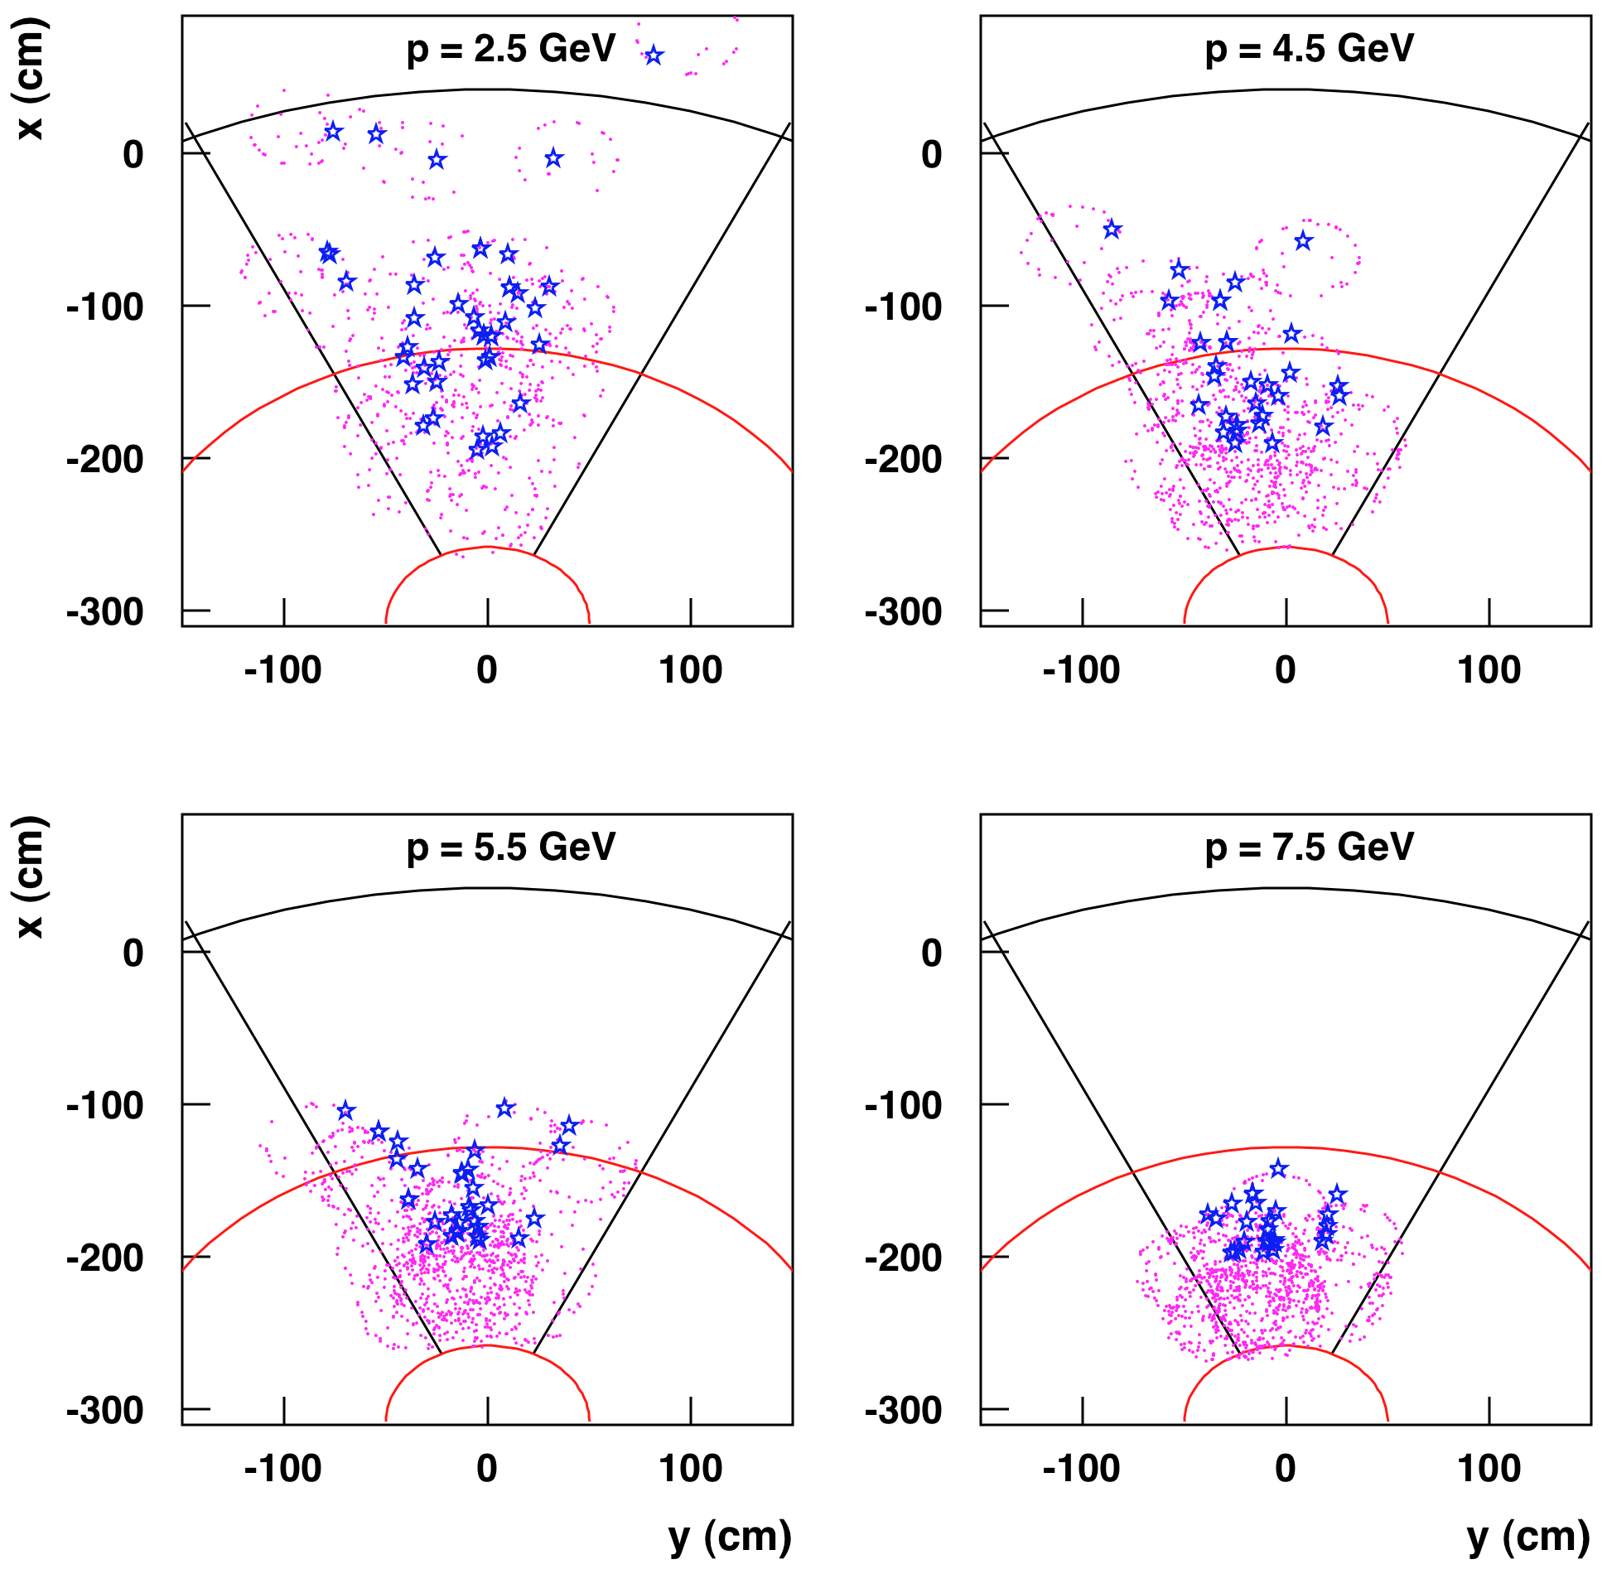
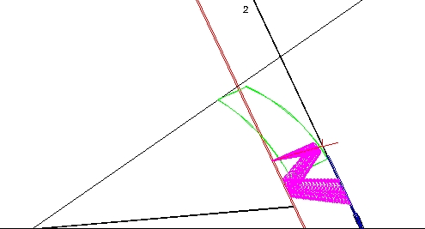
The focusing mirror system
Low material budget
Goals:
instrument only forward region
reduce active area (~1 m²/sect)
minimize interference with TOF system
Direct & reflected photons
L. Pappalardo
3
Notes:
3

Slide 4
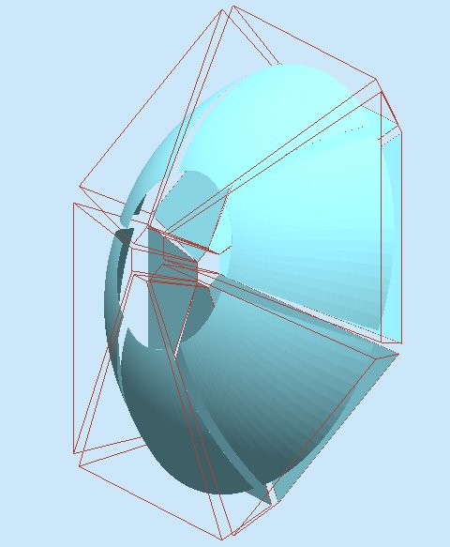
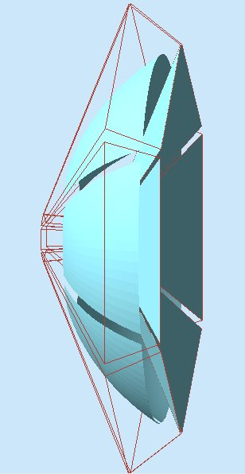
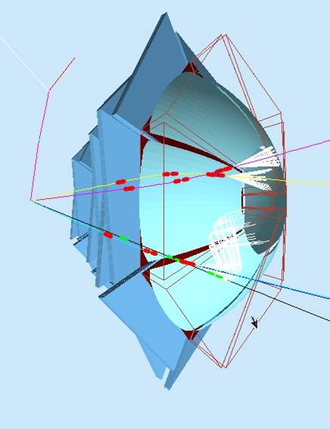
The focusing mirror system
elliptical mirror within gap volume for backward reflections
plane mirror just beyond radiator for forward reflections
combined reflections focalize Cerenkov photons onto photon-detector plane
L. Pappalardo
4
Notes:
4

Slide 5
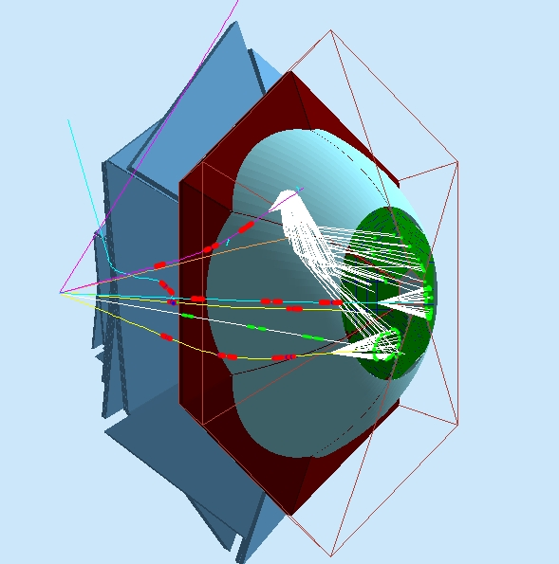
Progresses done (1)
Optimization of mirror geometry to minimize the “dead region” (reflected photons were not focalized on detector at certain intermediate angles)
Optimization of RICH geometry -> joint sectors
In all studies ~1m² photon detector per sector
L. Pappalardo
5

Slide 6
Progresses done (2)
Investigate multi-layer (2 or more) aerogel options: e.g. thicker radiator at larger angles (more photons produced in case of reflection) to compensate for absorption in multiple crossing of radiator material
spherical
mirror
3 cm
plane
mirror
gap
1 cm
aerogel
photon detector
→ Thickness 2-4-6-8-10 cm
L. Pappalardo
6

Slide 7
Progresses done (3)
Investigate different configurations (semi-reflective mirror in front of aerogel)
Reconstruction algorithm (so far only used for systematic studies on number of p.e.)
spherical
mirror
3 cm
aerogel
gap
1 cm
photon detector
Semi-reflective plane mirror
→ …but no real improvements in number of p.e.
L. Pappalardo
7

Slide 8
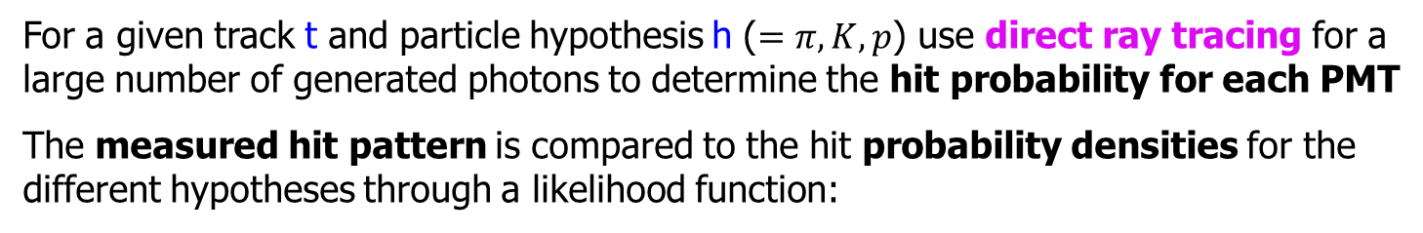
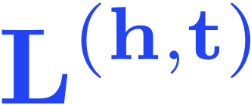






The reconstruction algorithm
(the hypothesis that maximizes is assumed to be true)
is the hit pattern from data
= 1 if the ith PMT is hit
= 0 if the ith PMT is not hit
is the probability of a hit given the kinematics of track t and hypothesis h
is the probability of no hit
is the total number of expected PMT hits
is a background term

Slide 9
The reconstruction algorithm
Mirror: 14-25º
PMTs: UBA
200 trials per point
Aerogel:
- n=1.06
- thick. increasing
with radius:
2-4-6-8-10 cm
L. Pappalardo
9

Slide 10
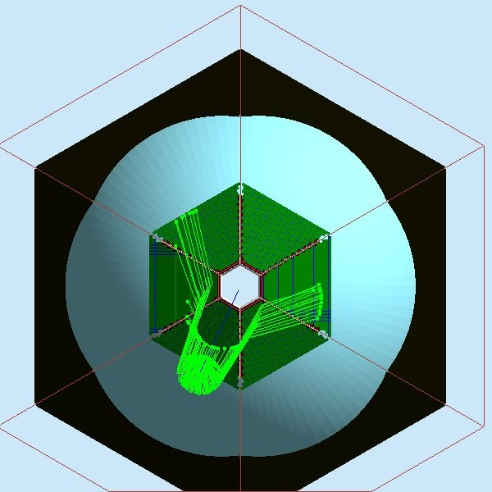
The reconstruction algorithm
Hit prob > 3 10⁻³
Mirror: 14-25º
PMTs: UBA
200 trials per point
Aerogel:
- n=1.06
- thick. increasing
with radius:
2-4-6-8-10 cm
Reflected
Hit prob
Event
photon hits
Hadron expected
patterns (200 trials)
Direct
L. Pappalardo
10

Slide 11
LH_{π}-LH_{k,p} : Mirror 14-25º PMTs: UBA
200 trials per point
Aerogel:
- n=1.06
- thick. increasing
with radius:
2-4-6-8-10 cm
Low angles more challenging
The same with increased
number of trials
L. Pappalardo
11

Slide 12
Average N p.e. : Mirror 14-25º PMTs: UBA
200 trials per point
Aerogel:
- n=1.06
- thick. increasing
with radius:
2-4-6-8-10 cm
N p.e. > 5 for reflected rings
N p.e. > 12 for direct rings
L. Pappalardo
12

Slide 13
Average N p.e. : Mirror 14-25º PMTs: UBA
200 trials per point
Aerogel:
- n=1.06
- thick. increasing
with radius:
2-4-6-8-10 cm
n=1.06 better for patter
recognition in the presence
of backgrouns
n=1.06
L. Pappalardo
13

Slide 14
Average N p.e. : Mirror 14-25º PMTs: UBA
200 trials per point
Aerogel:
- n=1.06
- thick. increasing
with radius:
2-4-6-8-10 cm
Mirror is mandatory for positive
hadrons and gives benefit for
negative hadrons at large angles
and small energy
L. Pappalardo
14

Slide 15
Average N p.e. : Mirror 14-25º
200 trials per point
Aerogel:
- n=1.06
- thick. increasing
with radius:
2-4-6-8-10 cm
At least SBA PMTs are needed
L. Pappalardo
15

Slide 16
Average N p.e. : PMTs: SBA
200 trials per point
Aerogel:
- n=1.06
- thick. increasing
with radius:
2-4-6-8-10 cm
Mirror up to 35º:
Worse for positive hadrons
Better for negative hadrons
L. Pappalardo
16

Slide 17
Average N p.e. : Aerogel thickness (SBA)
Mirror 14-35
PMT: SBA
200 trials per point
Aerogel:
- n=1.06
- thick. increasing with radius:
2-4-6-8-10 cm
2-2-10-10-10 cm
3-5-5-10-10 cm
2-4-6-6-6 cm
With 2-10 middle-angles improve
With 3-10 only small angles improve
L. Pappalardo
17
Notes:
Mettere specchi sulla :w
pipe!

Slide 18
Average N p.e. : Aerogel thickness (SBA)
Mirror 14-35
PMT: SBA
200 trials per point
Aerogel:
- n=1.06
- thick. increasing with radius:
2-4-6-8-10 cm
2-2-10-10-10 cm
3-5-5-10-10 cm
2-4-6-6-6 cm
With 2-10 middle-angles improve
With 3-10 only small angles improve
L. Pappalardo
18
Notes:
Mettere specchi sulla :w
pipe!

Slide 19
Average N p.e. : Aerogel thickness (SBA)
Mirror 14-35
PMT: SBA
200 trials per point
Aerogel:
- n=1.06
- thick. increasing with radius:
2-4-6-8-10 cm
2-2-10-10-10 cm
3-5-5-10-10 cm
2-4-6-6-6 cm
With 2-10 middle-angles improve
With 3-10 only small angles improve
L. Pappalardo
19
Notes:
Mettere specchi sulla :w
pipe!

Slide 20
Average N p.e. : Mirror Geometry (SBA)
Mirror 14-35
PMT: SBA
200 trials per point
Aerogel:
- n=1.06
- thick. increasing with radius:
6-6-6-10-10 cm
- varied semiaxes:
370 vs 370 cm (standard)
340 vs 340 cm
340 vs 370 cm
No big sensitivity on curvature
L. Pappalardo
20
Notes:
Vedere se mirror parte da PIPE

Slide 21
Average N p.e. : Semi-reflective Mirror (SBA)
Mirror 14-35
PMT: SBA
200 trials per point
Aerogel:
- n=1.06
- thick. increasing with radius:
6-6-6-10-10 cm
Same Np.e. with increased
aerogel thickness (reduced
Cereknov angle resolution)
Can improve high angles only
L. Pappalardo
21
Notes:
Vedere se mirror parte da PIPE

Slide 22
Average N p.e. : Semi-reflective Mirror (SBA)
Mirror 14-35
PMT: SBA
200 trials per point
Aerogel:
- n=1.06
- thick. increasing with radius:
6-6-6-10-10 cm
Same Np.e. with increased
aerogel thickness (reduced
Cereknov angle resolution)
Can improve high angles only
L. Pappalardo
22
Notes:
Vedere se mirror parte da PIPE

Slide 23
Average N p.e. : Semi-reflective Mirror (SBA)
Mirror 14-35
PMT: SBA
200 trials per point
Aerogel:
- n=1.06
- thick. increasing with radius:
6-6-6-10-10 cm
Same Np.e. with increased
aerogel thickness (reduced
Cereknov angle resolution)
Can improve high angles only
L. Pappalardo
23
Notes:
Vedere se mirror parte da PIPE

Slide 24
Average N p.e. : Mirrors around Pipe (SBA)
Mirror 14-35
PMT: SBA
200 trials per point
Aerogel:
- n=1.06
- thick. increasing with radius:
6-6-6-10-10 cm
Improve a little for negatives
at low angles
L. Pappalardo
24
Notes:
Vedere se mirror parte da PIPE

Slide 25
RICH performances: Mirror 14-35 SBA MA-PMTs
At low momentum the likelihood fails in events with few p.e.
(mimicing a proton close to Cerenkov threshold)
Negative 3-3.5 GeV/c @ 23º
L. Pappalardo
25

Slide 26
RICH performances: Mirror 14-35 SBA MA-PMTs
At large angles, positive particles got smaller number of p.e.
(larger cross talk with protons)
Positive 3.5-4 GeV/c @ 20º
L. Pappalardo
26

Slide 27
RICH performances: Mirror 14-35 SBA MA-PMTs
At large momentum a small pion-kaon contamination emerges
(pion and kaon rings start to touch each other)
Positive 6-7 GeV/c @ 11º
L. Pappalardo
27

Slide 28
RICH performances: Mirror 14-35 SBA MA-PMTs
The pion mis-identification stays below 1 % at highest momenta
Positive 7-10 GeV/c @ 5º
L. Pappalardo
28

Slide 29
Conclusions
Aerogel provides a good pion/kaon separation up to 8 GeV/c
Systematic studies performed with a GEANT3-based simulation provided an optimal configuration for the RICH in terms of pions/kaons separation
RICH simulation is now being performed with GEMC (GEANT4-based)
- realistic geometry & optic effects
- mirror system (different geometries tested)
- joint sectors
- multi-aerogel thickness
- semi-reflective plane mirror
A new reconstruction algorithm allows for quantitative studies (ongoing):
n of p.e. for different configurations
π/K/p separation
Given the complex geometry, large surface to cover and torus bending, some
compromise has to be found. It would depend on a realistic background estimate.
L. Pappalardo
29

Slide 30
Back up

Slide 31
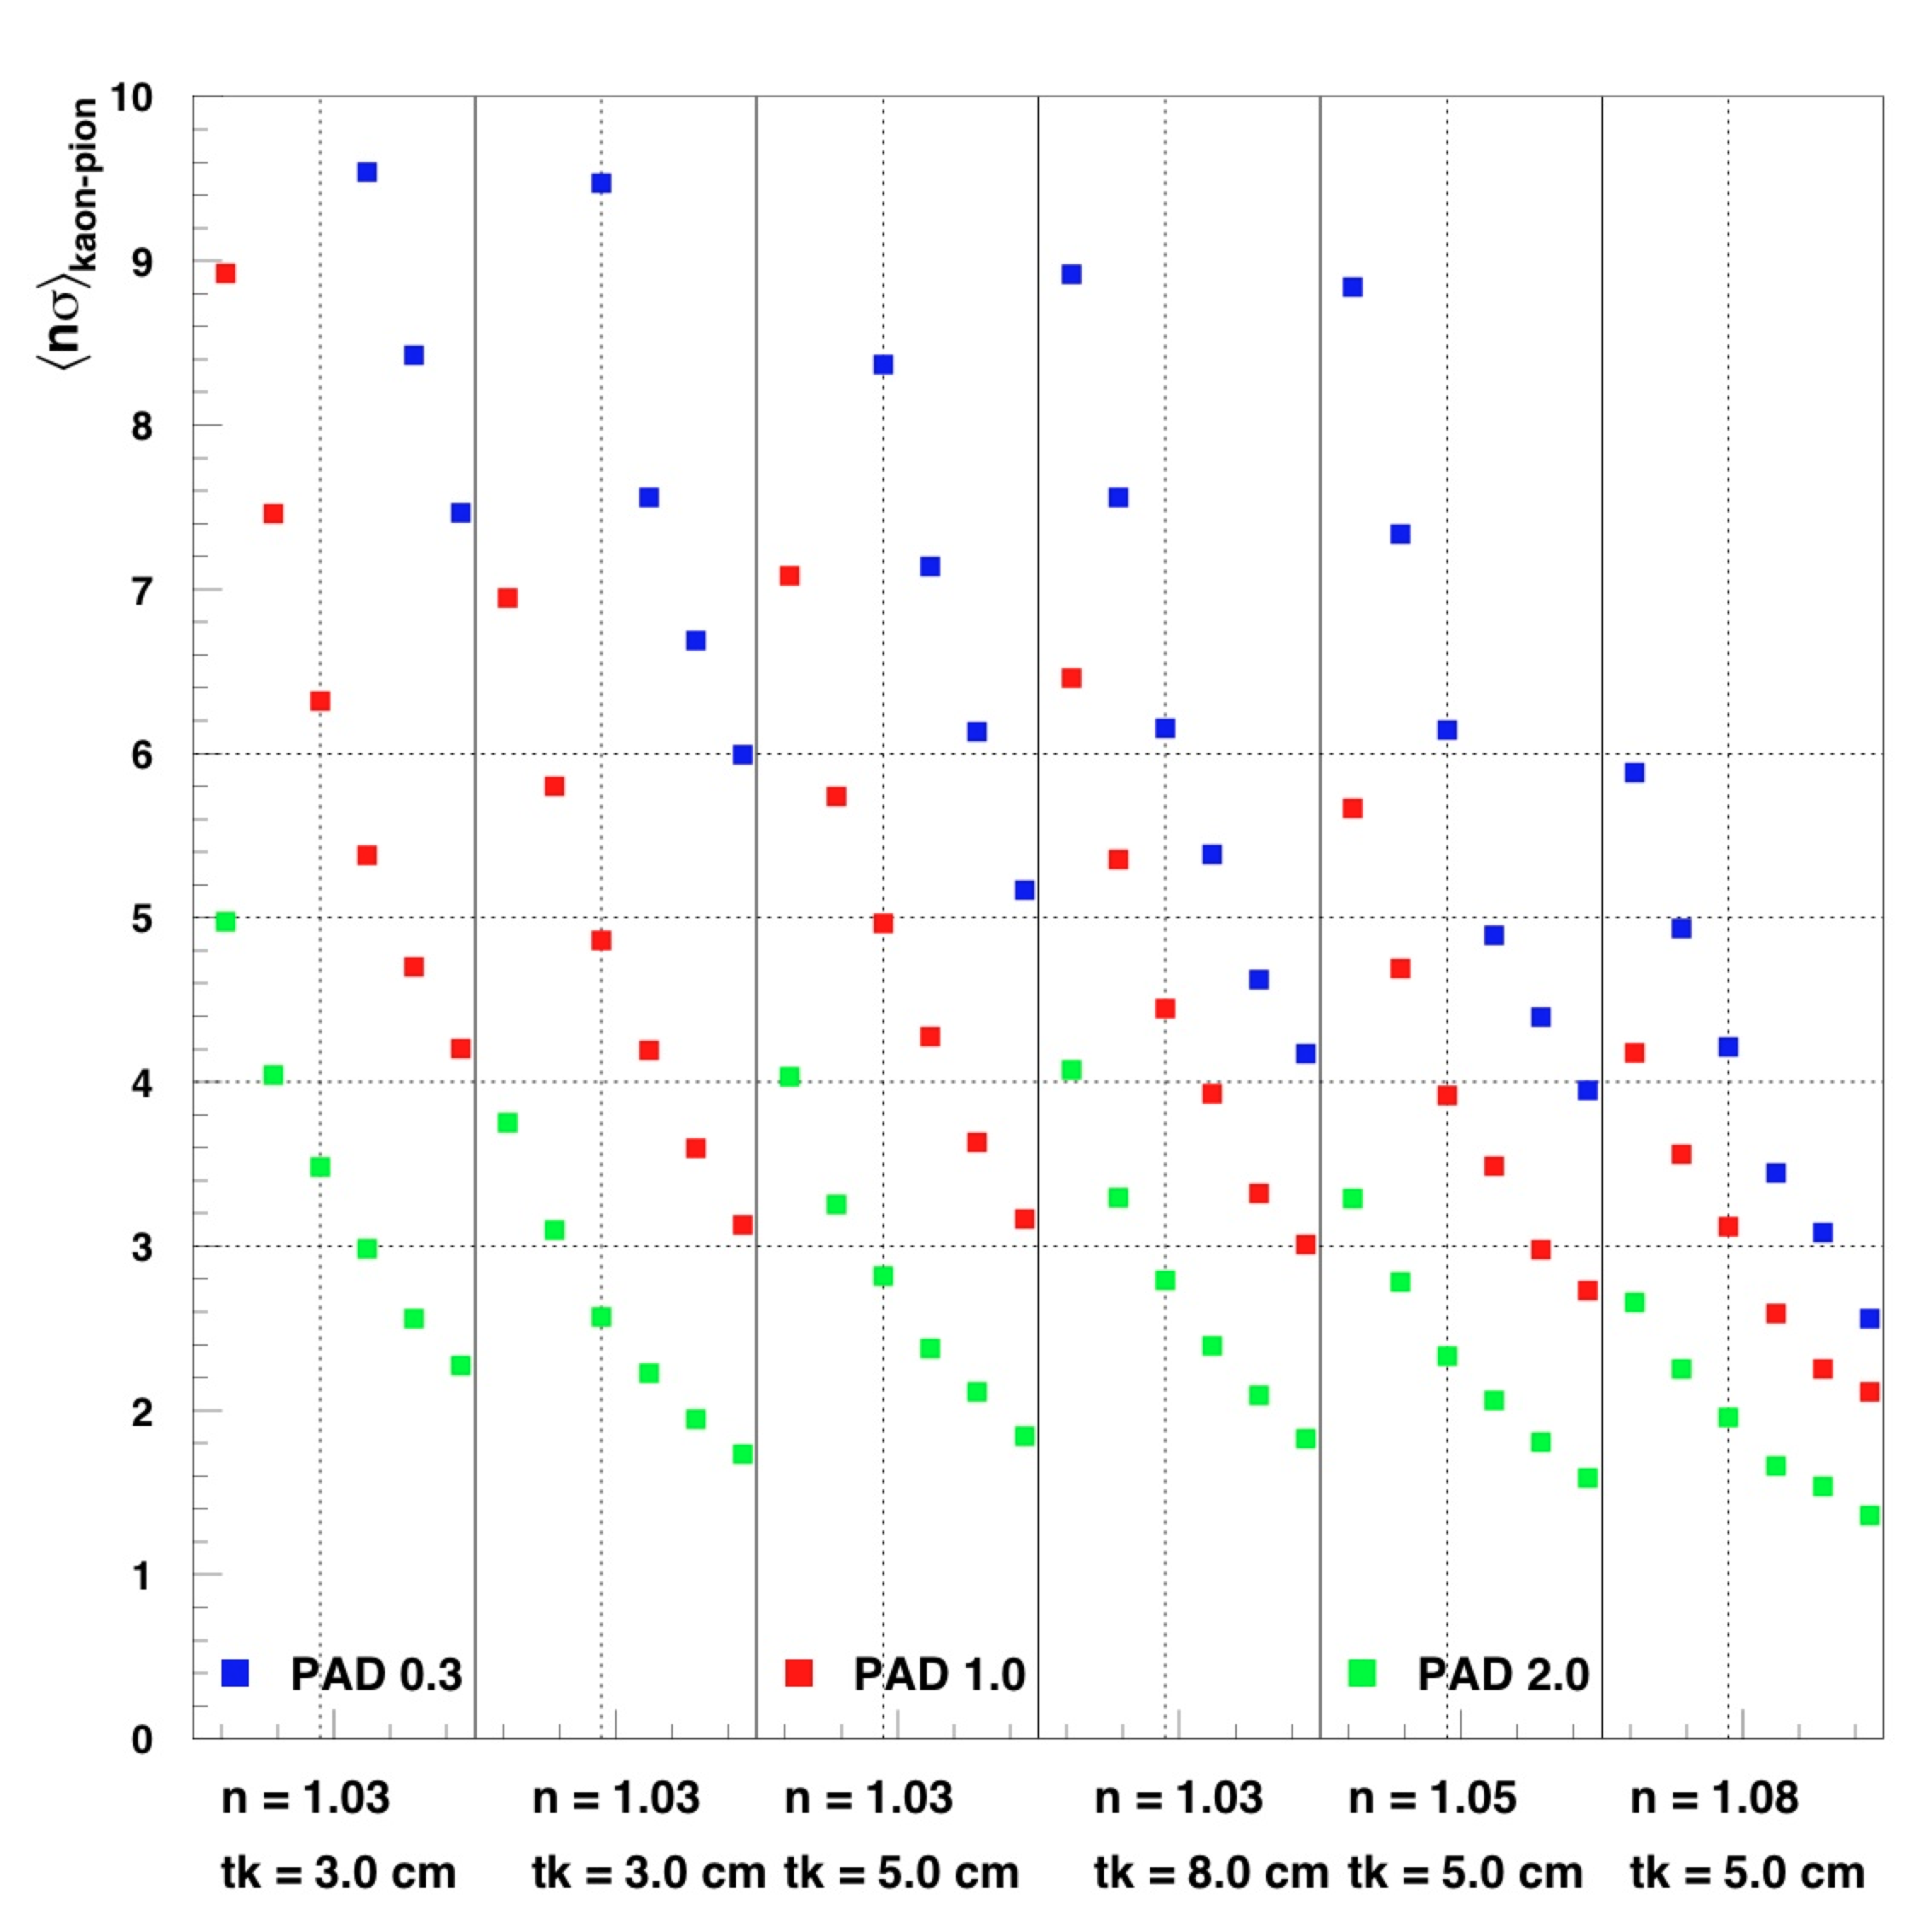
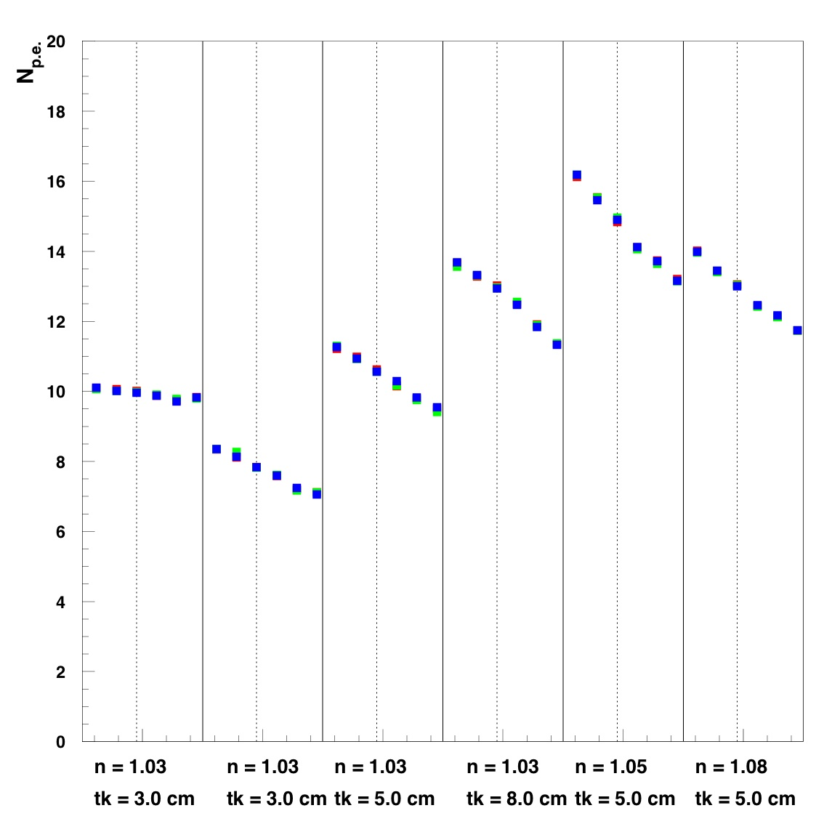
Mean p/K separation (5-8 GeV/c)
- small photo-detector pads (∼ 0.3 cm)
- small radiator thickness (∼ 3 cm)
- relatively small refraction index (∼ 1.03)
Optimal
geometry
5 8 5 8 5 8 5 8 5 8 5 8
P (GeV/c)
L. Pappalardo
JLAB12 Coll. Meeting Nov. 2010
31
Notes:
Fino a che energia lavora bene l’aerogel di HERMES ?
31

Slide 32
Mean p/K separation (5-8 GeV/c)
- small photo-detector pads (∼ 0.3 cm)
- small radiator thickness (∼ 3 cm)
- relatively small refraction index (∼ 1.03)
Optimal
geometry
5 8 5 8 5 8 5 8 5 8 5 8
P (GeV/c)
L. Pappalardo
JLAB12 Coll. Meeting Nov. 2010
32
Notes:
Fino a che energia lavora bene l’aerogel di HERMES ?
32

Slide 33
Average N p.e. : PMTs: UBA
Mirror 14-25º
Mirror 14-35º
Worse for positive hadrons
Better for negative hadrons
L. Pappalardo
33

Slide 34
LH_{π}-LH_{k,p} : PMTs: UBA
Mirror 14-25º
Mirror 14-35º
Worse for positive hadrons
Better for negative hadrons
L. Pappalardo
34

Slide 35
Average N p.e. : Mirror Angle Coverage (UBA)
100 trials per point
Aerogel:
- n=1.06
- thick. increasing with radius:
2-4-6-8-10 cm
M35 is acceptanble but slightly
worse for positive and does
not improve at large angles ?!
L. Pappalardo
35
Notes:
Vedere se le dimensioni sono a partire da PIPE
Vedere come mai ho Npe a piu’ di 25 gradi nel caso pos m25

Slide 36
Average N p.e. : Mirror Semi-axes (UBA)
100 trials per point
Aerogel:
- n=1.06
- thick. increasing with radius:
2-4-6-8-10 cm
Symmetric Ellipsoide
Semi-Axes focalizing onto the
photon detector best in Npe
L. Pappalardo
36

