Slide 1
RICH Integration in CLAS12
Contalbrigo Marco
INFN Ferrara
Rich Technical Review, 5 September 2013

Slide 2
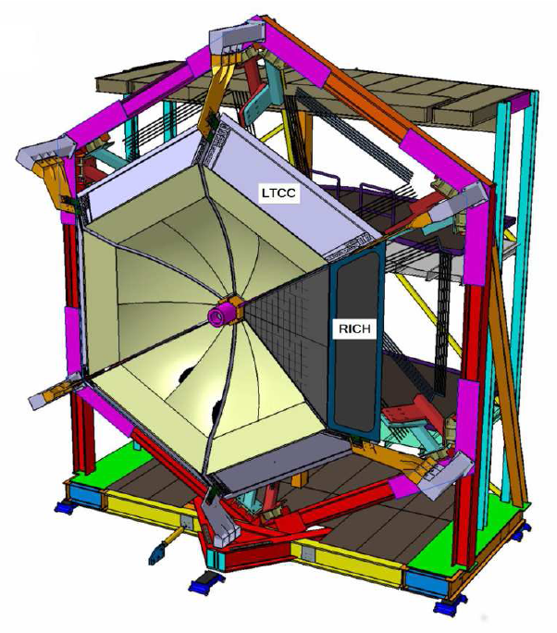
RICH Project Goal
1st sector ready by the end of 2016
Designed to fit into
the LTCC clearance
on the same joints of
the forward carriage
Contalbrigo M.
Rich Technical Review, 5th September 2013, JLab
2
Notes:
9 vs 8

Slide 3
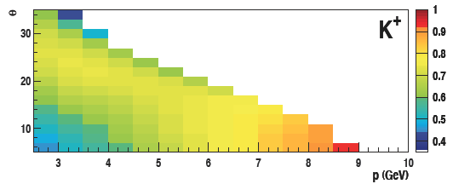
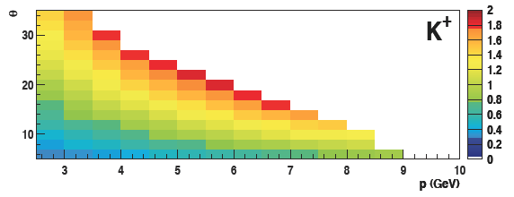
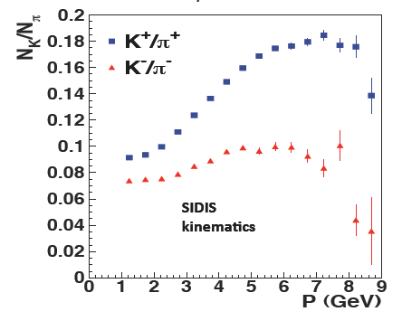
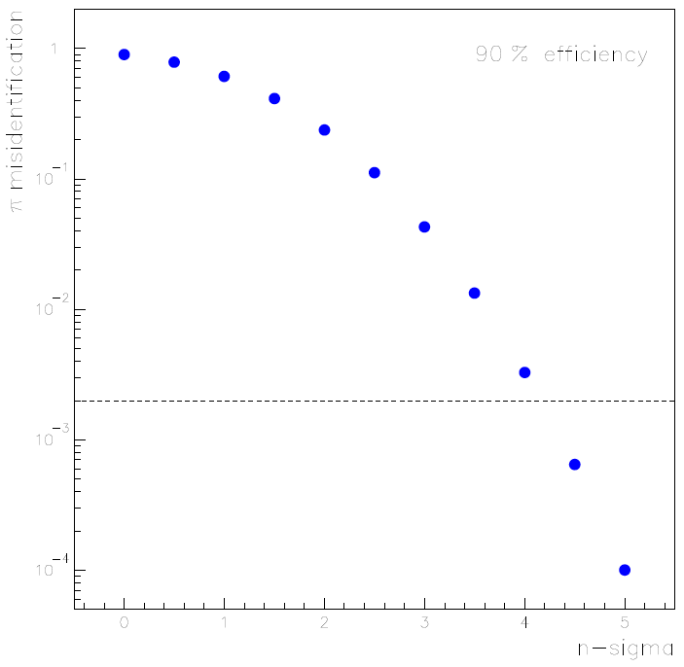
RICH Project Goal
z distribution
Full momentum coverage from 3 up to 8 GeV/c
Pion rejection above 3 GeV/c
Proton rejection above 5 GeV/c
Angular coverage reaching
above 20 and up to 25 degrees
P_{T} distribution
π mis-ID
1
90% kaon efficiency
10⁻¹
Contamination limited at the few % level
Pion rejection close to 500
Proton rejection close to 100
10⁻²
10⁻³
10⁻⁴
0
1
2
3
4
5
n-sigma separation
Contalbrigo M.
Rich Technical Review, 5th September 2013, JLab
3
Notes:
9 vs 8

Slide 4
Commissioning & Calibration
Use no-track events:
Internal trigger on SPE dark-counts for digital threshold setting
Random trigger for dark-count (no beam) and background (with beam) studies
Vary beam intensity for occupancy studies
Pedestal stability & Common noise studies with analog readout
Use Electron Tracks:
Mimic pion signal (almost saturated at 4-5 GeV/c)
Alignment (i.e. with drift-chambers and among mirrors)
Aerogel refractive index map
Mirror aberration corrections
Tune of the pattern-recognition and reconstruction algorithms
Efficiency and mis-identification probability
Use meson and hyperon decays to validate RICH performances:
K_{S} for pions
φ for kaons
Λ for protons
Contalbrigo M.
Rich Technical Review, 5th September 2013, JLab
4
Notes:
9 vs 8

Slide 5
Operation
Gas system (standard solutions exist):
⬥ Dry atmosphere for the hydrophilic aerogel preservation
⬥ Slight overpressure to prevent contamination
Slow Control (part of the general CLAS12 design):
⬥ HV and LV power supply monitor
⬥ Gas monitor: temperature, pressure, humidity
⬥ RICH stability monitor (i.e. on pedestals, occupancy,
basic signals like high-energy electrons )
Contalbrigo M.
Rich Technical Review, 5th September 2013, JLab
5
Notes:
Capire se serve box sealed o no

Slide 6
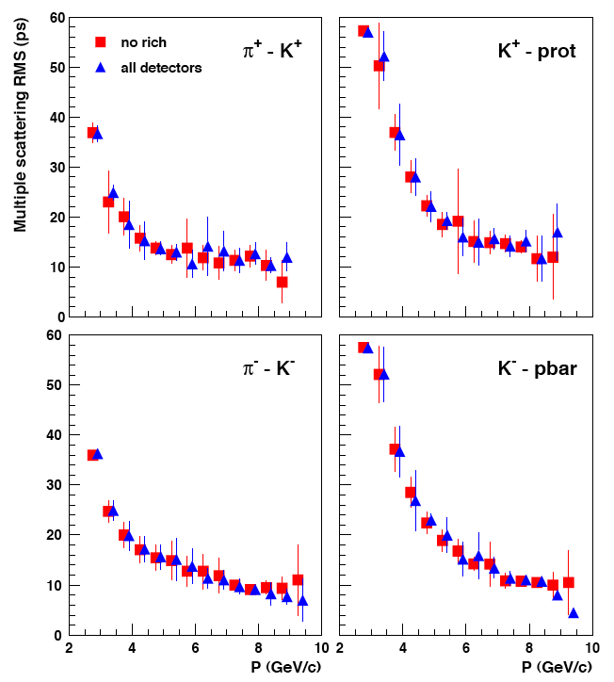
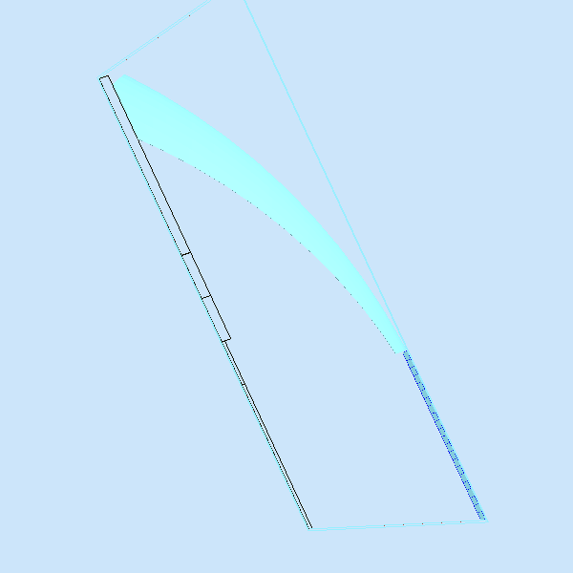
Interference with Other Detectors
RICH material budget:
✓ Just in front of FTOF wall:
multiple scattering spread << of the FTOF time resolution
~ 0.01-0.04 X₀ from
2-6 cm aerogel
~ 0.008 X₀ from 20mm
CFRP mirrors
FTOF resolution limit
~ 0.01 X₀ from
CFRP+glass mirror
h
~ 0.25 X₀ from PMTs
and F-E Electronics
Contalbrigo M.
Rich Technical Review, 5th September 2013, JLab
6
Notes:
9 vs 8

Slide 7
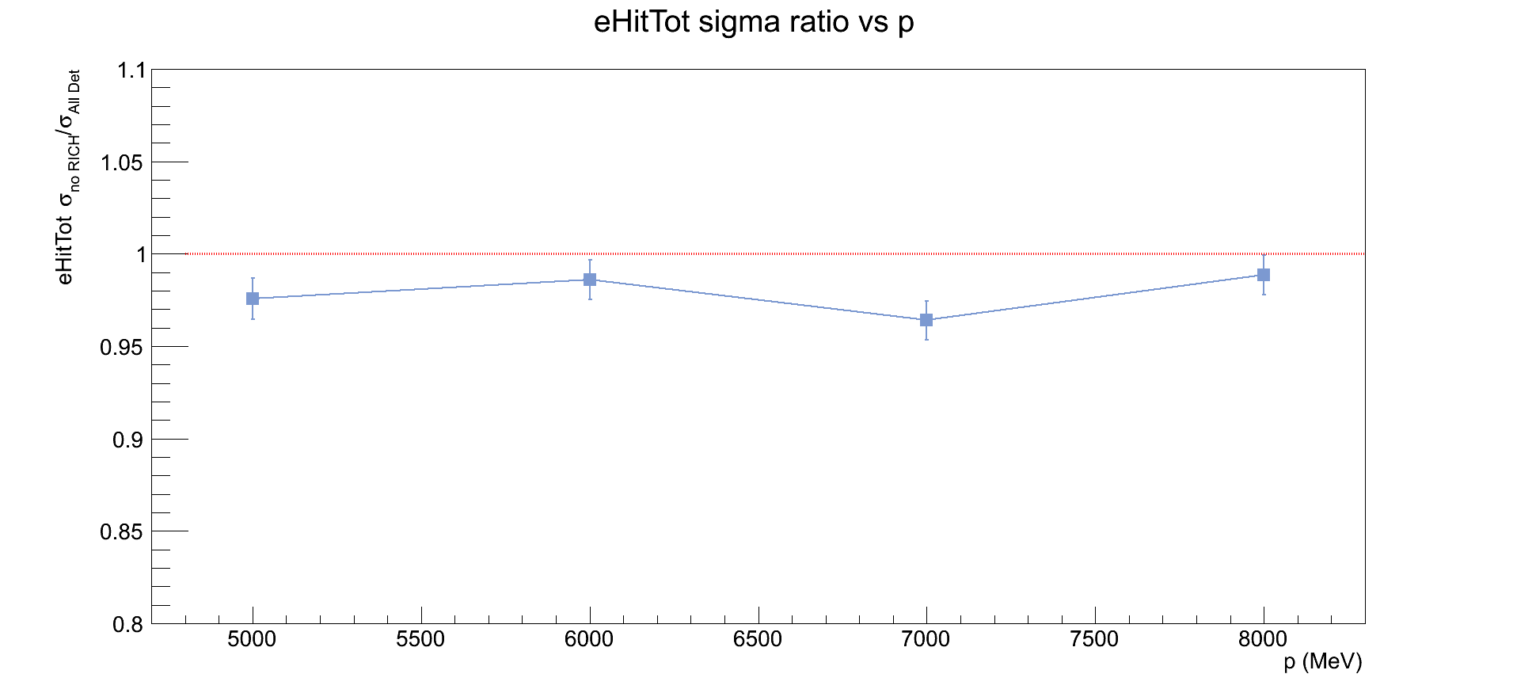
Interference with Other Detectors
RICH material budget:
comparable with ~0.26 X₀ of FTOF and much less than preshower ~5 X₀
energy spread << 10%/√E sampling calorimeter resolution
~ 0.01-0.04 X₀ from
2-6 cm aerogel
~ 0.008 X₀ from 20mm
CFRP mirrors
~ 0.01 X₀ from
CFRP+glass mirror
h
~ 0.25 X₀ from PMTs
and F-E Electronics
Contalbrigo M.
Rich Technical Review, 5th September 2013, JLab
7
Notes:
9 vs 8

Slide 8
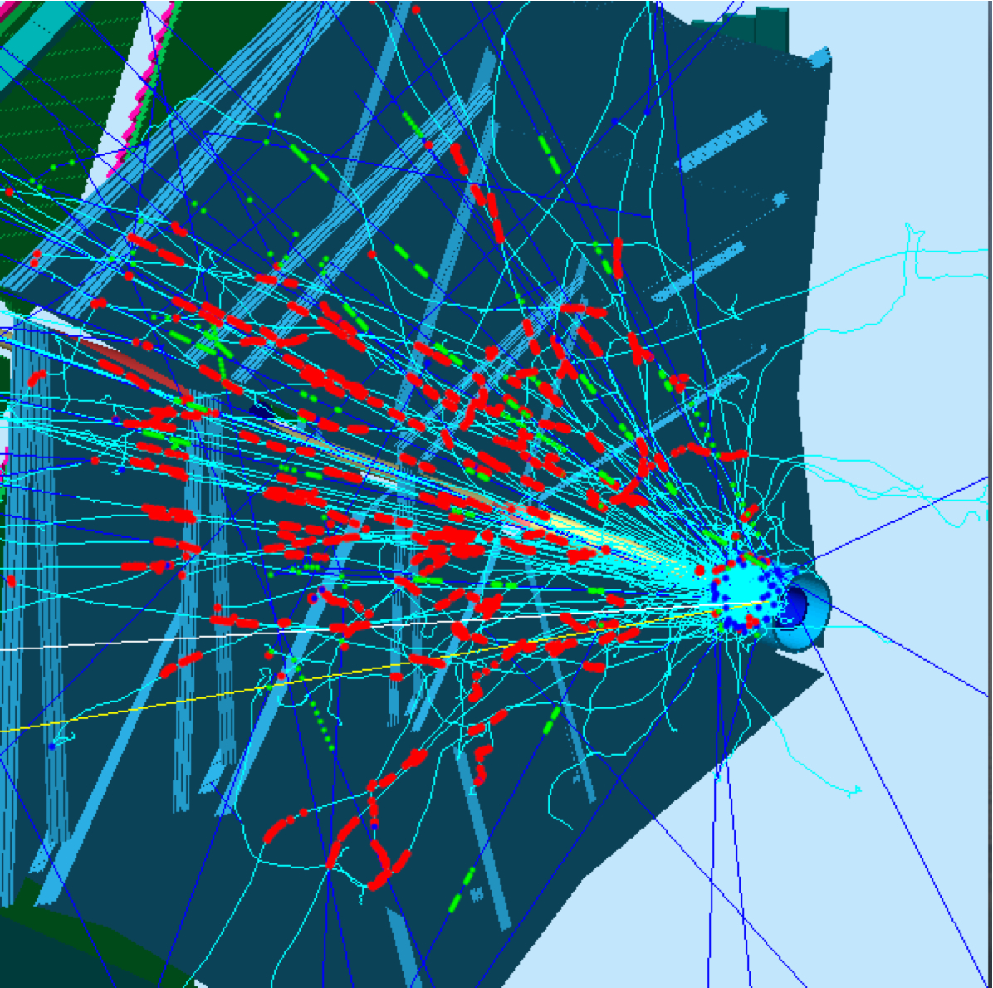
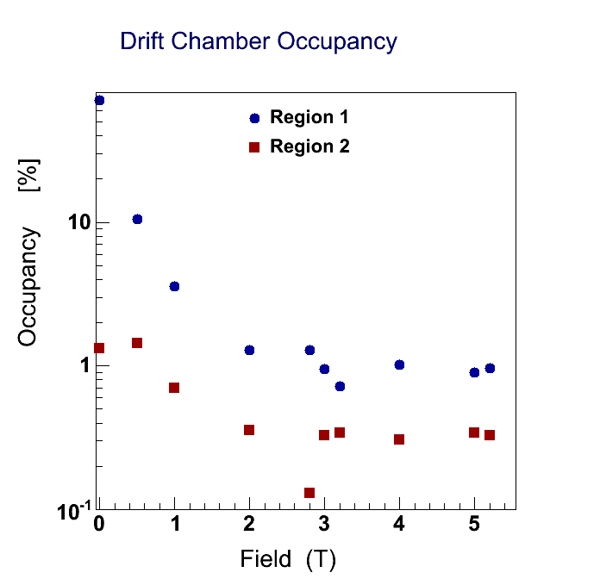
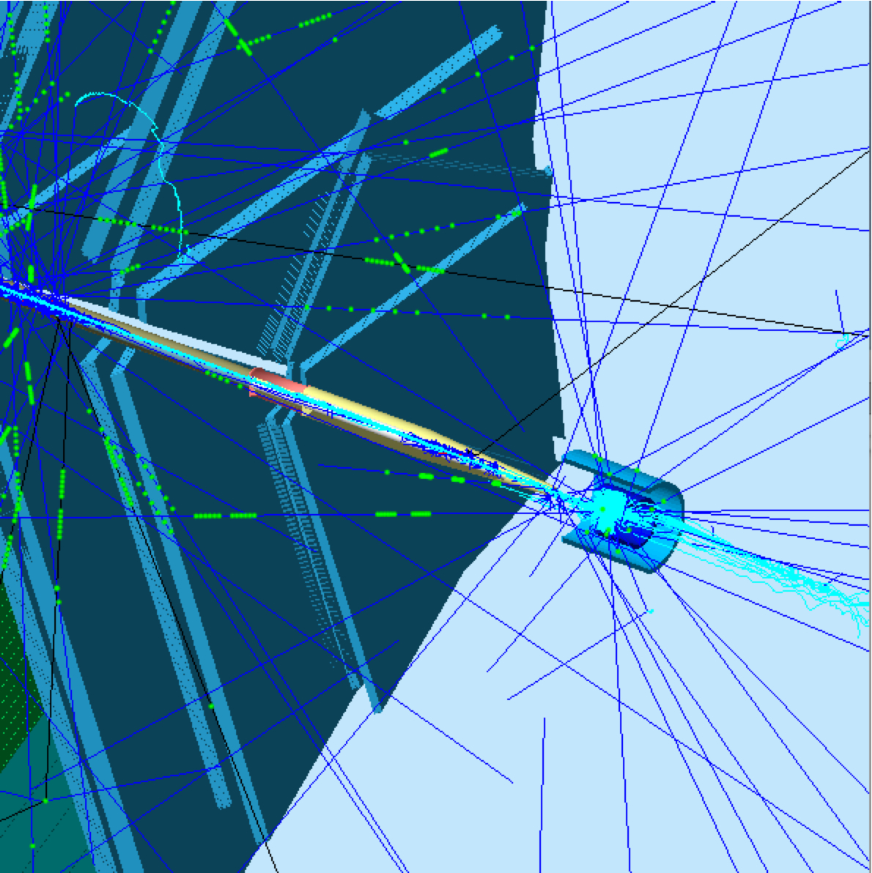
Drift Chamber Occupancy
No target field
L = 10³⁵ cm⁻² s⁻¹
DIS rate: 1-10 kHz
Severe Moeller background
- 10-100 k within 250 ns
- contained by central solenoid
- showering into long-range photons
With target field
Contalbrigo M.
Rich Technical Review, 5th September 2013, JLab
8
Notes:
Add to access several combinations of GPDs
Sapere radiation lenght del NMR coil

Slide 9
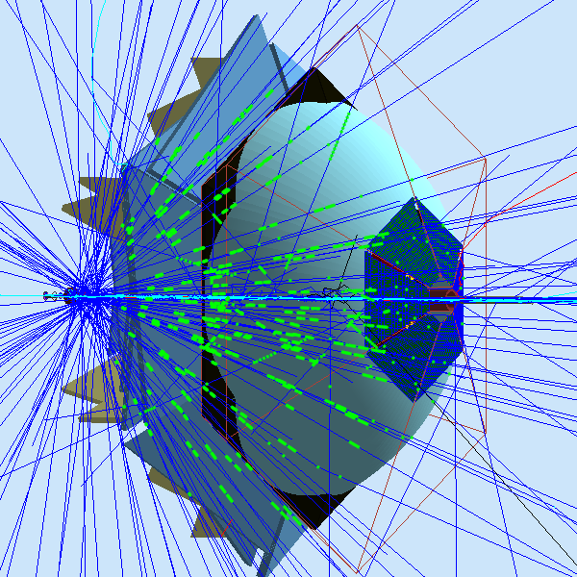
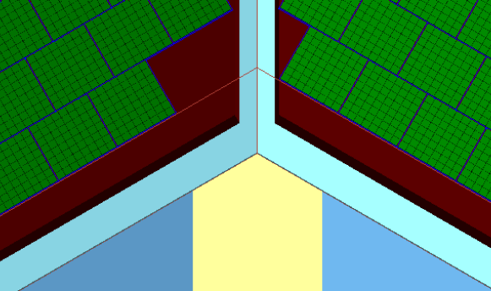
The RICH Background
Major source of backgrounds
Photons conversions into the aerogel
or in the PMT glass window
producing Cerenkov light
Contalbrigo M.
Rich Technical Review, 5th September 2013, JLab
9

Slide 10
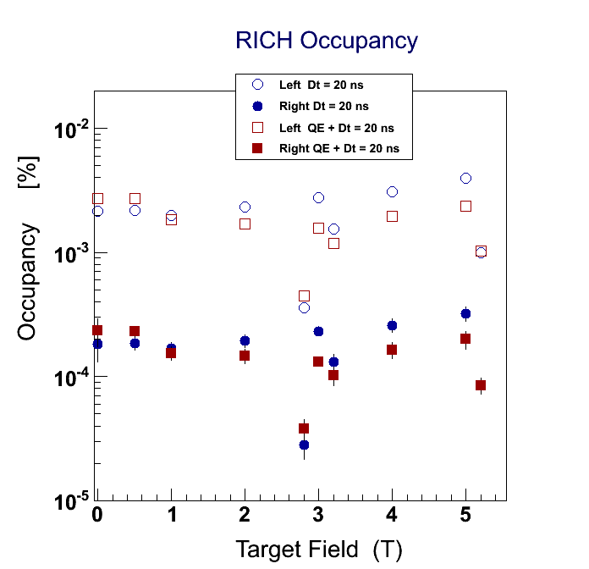
The RICH Occupancy @ L=10³⁴
Studies done for the physics run with transverse target indicates the
Moeller background is under control up to the maximum luminosity
thanks to RICH position, segmentation and fast readout
Value used in the simulation
20 ns in-time window
Target transverse magnet torque
Correlation in space neglected
20 ns in-time window
+ H8500 Q.E.
Contalbrigo M.
Rich Technical Review, 5th September 2013, JLab
10

Slide 11
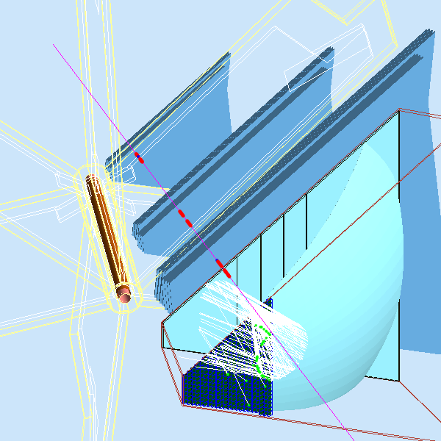
RICH Reconstruction
Verify and optimize the performances
Reconstruction algorithm on place
Ongoing: tuning of parameters to
optimize the performances
Contalbrigo M.
Rich Technical Review, 5th September 2013, JLab
11
Notes:
9 vs 8

Slide 12
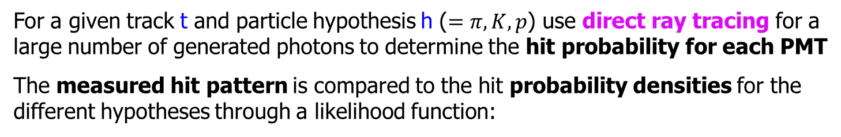
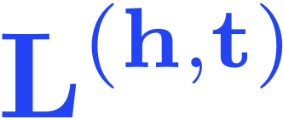






The Likelihood Method
(the hypothesis that maximizes is assumed to be true)
is the hit pattern from data
= 1 if the ith PMT is hit
= 0 if the ith PMT is not hit
is the probability of a hit given the kinematics of track t and hypothesis h
is the probability of no hit
is the total number of expected PMT hits
is a background term (assumed to be 10⁻⁴, fine with Moeller prelim. studies)
Contalbrigo M.
Rich Technical Review, 5th September 2013, JLab
12

Slide 13
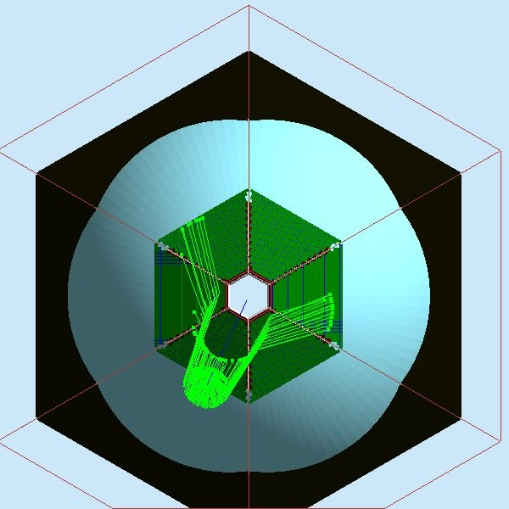
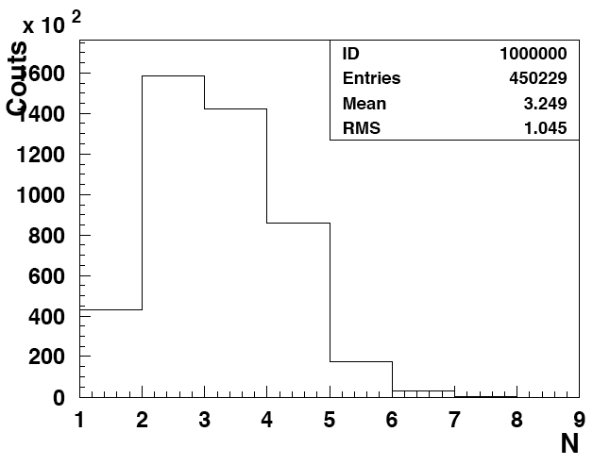
Hit prob > 3 10⁻³
The RICH Reconstruction Algorithm
pion kaon proton
y (mm)
Reflected
Hit probability
Event
photon hits
Hadron expected
patterns (200 trials)
Direct
X (mm)
Standard techniques available but important to optimize:
Geometry together with Likelihood parameters
(background, time coincidence window, p.d.f precision)
Charged Hadron Multiplicity
Poor ID confidence Good
Control with
Goodness Estimator
0
1
Contalbrigo M.
Rich Technical Review, 5th September 2013, JLab
13

Slide 14
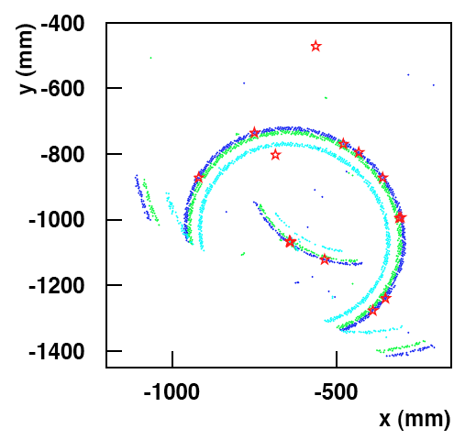
Events in CLAS12
Corresponds to a 1:500
rejection factor
P = 6.3 GeV/c θ = 6 degrees R_{QP} = 0.59
pion kaon proton
PMTs
LH tuning not optimized yet
Mirror
Good ID thanks to high photon yield
R_{QP} reflects close Cherenkov rings
Contalbrigo M.
Rich Technical Review, 5th September 2013, JLab
14
Notes:
9 vs 8

Slide 15
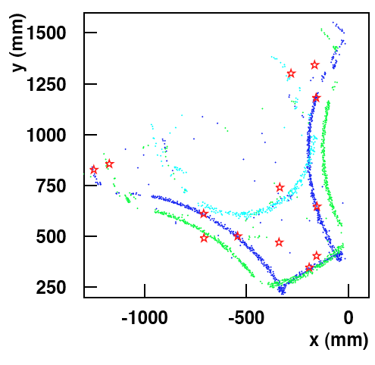
Events in CLAS12
Out-bending particles
P = 3.7 GeV/c θ = 22 degrees R_{QP} = 0.98
pion kaon proton
LH tuning not optimized yet
Mirror
PMTs
Good ID thanks to separate patterns
Un-identifications reflect photon yield
Contalbrigo M.
Rich Technical Review, 5th September 2013, JLab
15
Notes:
9 vs 8

Slide 16
Events in CLAS12
In-bending particles
P = 3.7 GeV/c θ = 22 degrees R_{QP} = 0.98
pion kaon proton
LH tuning not optimized yet
Mirror
PMTs
Good ID thanks to separate patterns
Un-identifications reflect photon yield
Contalbrigo M.
Rich Technical Review, 5th September 2013, JLab
16
Notes:
9 vs 8

Slide 17
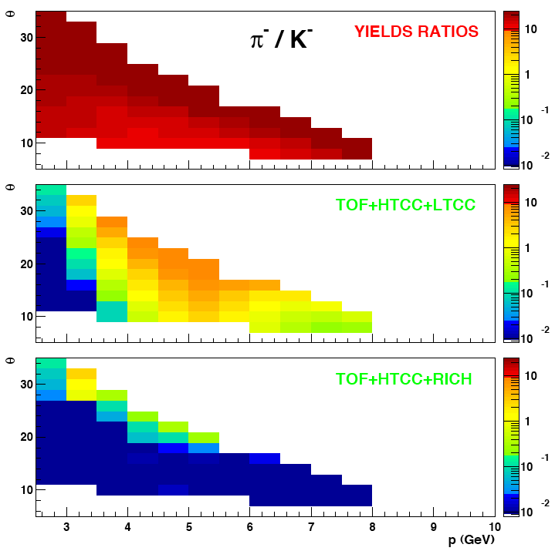
CLAS12 Combined PID
Pion contamination in the kaon sample for In-bending Particles
SIDIS particle flux
within acceptance
pion >> kaon everywhere
TOF +HTCC pion rejection
for 90% kaon efficiency
pion >> kaon in a broad region
~1:1000 rejection
from x10 to ~1%
TOF+HTCC+RICH
pion rejection
Even with a tuning not yet
optimized the pion
contamination is of
the order of 1%
Contalbrigo M.
Rich Technical Review, 5th September 2013, JLab
17
Notes:
9 vs 8

Slide 18
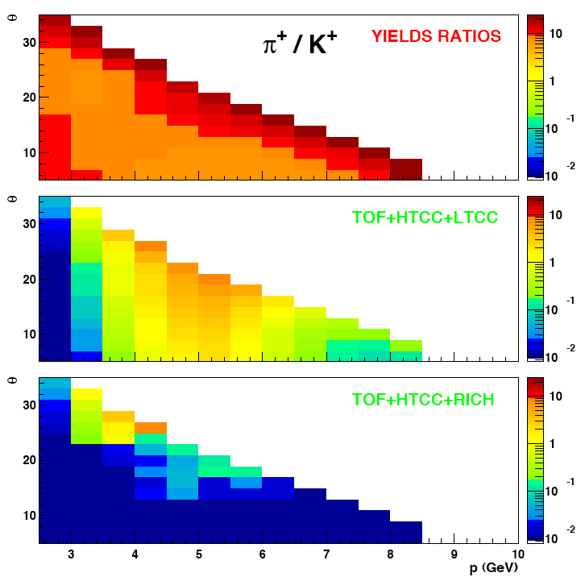
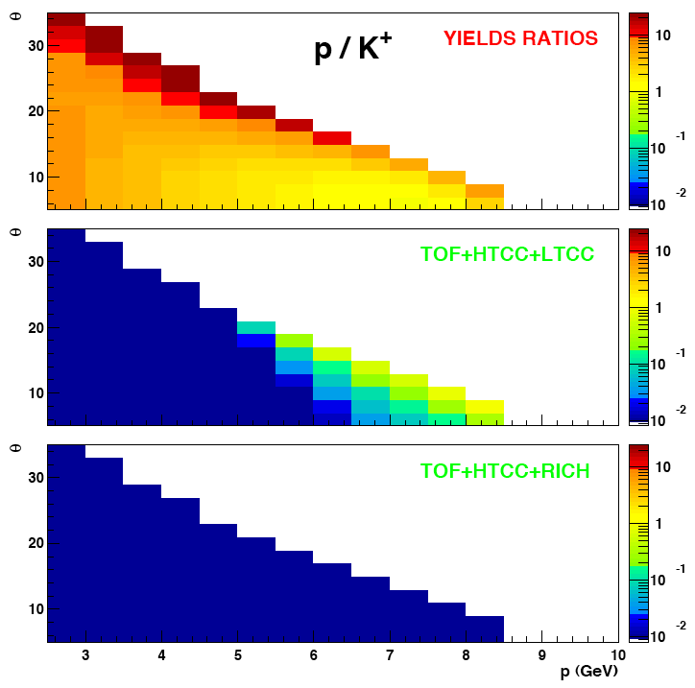
CLAS12 Combined PID
Pion contamination in the kaon sample for Out-bending Particles
~1:500 rejection
from x5 to ~1%
Contalbrigo M.
Rich Technical Review, 5th September 2013, JLab
18
Notes:
9 vs 8

Slide 19
RICH Requirements
z distribution
✔ Full momentum coverage
from 3 up to 8 GeV/c
Pion rejection above 3 GeV/c
Proton rejection above 5 GeV/c
Angular coverage reaching
✔ above 20 and
✔ up to 25 degrees
(optimization in progress)
P_{T} distribution
π mis-ID
1
90% kaon efficiency
10⁻¹
✔ Contamination limited at the few % level
Pion rejection close to 500
Proton rejection close to 100
10⁻²
10⁻³
Confirmed by prototype
measurements
10⁻⁴
0
1
2
3
4
5
n-sigma separation
Contalbrigo M.
Rich Technical Review, 5th September 2013, JLab
19
Notes:
9 vs 8

Slide 20
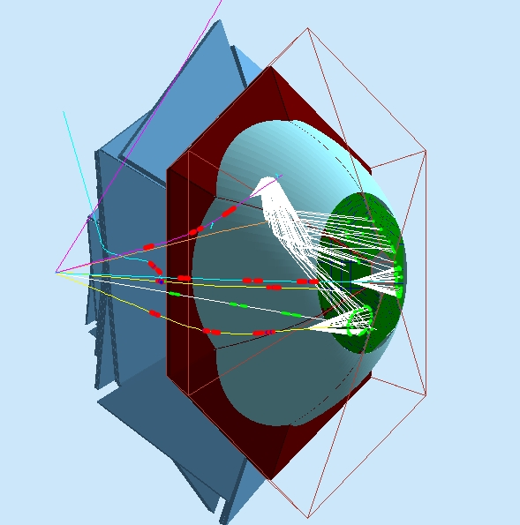
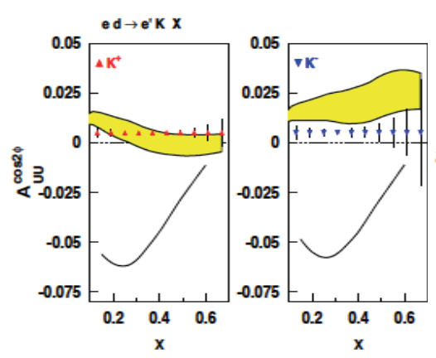
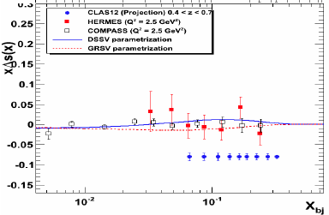
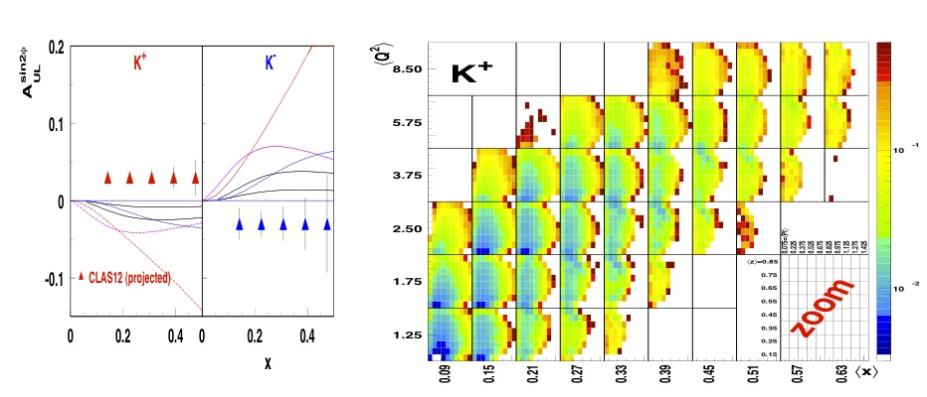
Kaon Program @ CLAS12
E12-09-08: Studies of Boer-Mulders Asymmetry in Kaon Electroproduction with Hydrogen and Deuterium Targets
RICH detector for flavor separation of quark spin-orbit
correlations in nucleon structure and quark fragmentation
E12-09-09:
Studies of Spin-Orbit Correlations in Kaon Electroproduction in DIS with polarized hydrogen and deuterium targets
CLAS12
CLAS12
E12-09-07:
Studies of partonic distributions using
semi-inclusive production of Kaons
Contalbrigo M.
Rich Technical Review, 5th September 2013, JLab
20
Notes:
Prendeire talks di Hafidi e/o Francesca ?

Slide 21
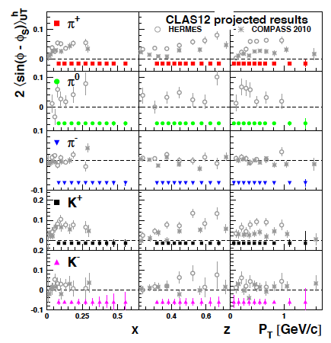
Kaon Program @ CLAS12
C12-11-111:
Transverse spin effects in
SIDIS at 11 GeV with a
Transversely polarized target
using the CLAS12 Detector
RICH detector for
flavor separation in
covering so far
unexplored quark
valence region
Contalbrigo M.
Rich Technical Review, 5th September 2013, JLab
21
Notes:
Bacup quelle per pretzelosity e wrom gear

Slide 22
Conclusions
Interference with CLAS12:
⬥ Designed to fit into the LTCC clearance
⬥ No impact on the downstream detector performances
⬥ Background occupancy at a manageable level
RICH Operation:
⬥ Use physics triggers for commissioning and calibration
⬥ Use well-known maximum-likelihood methods to
reconstruct the not-trivial Cherenkov signal pattern
⬥ Use CLAS12 standard solutions for gas system and slow-control
The RICH detector allows hadron ID in the full CLAS12 kinematics
ensuring the approved physics program to be accomplished
Contalbrigo M.
Rich Technical Review, 5th September 2013, JLab
22
Notes:
9 vs 8

