Slide 1
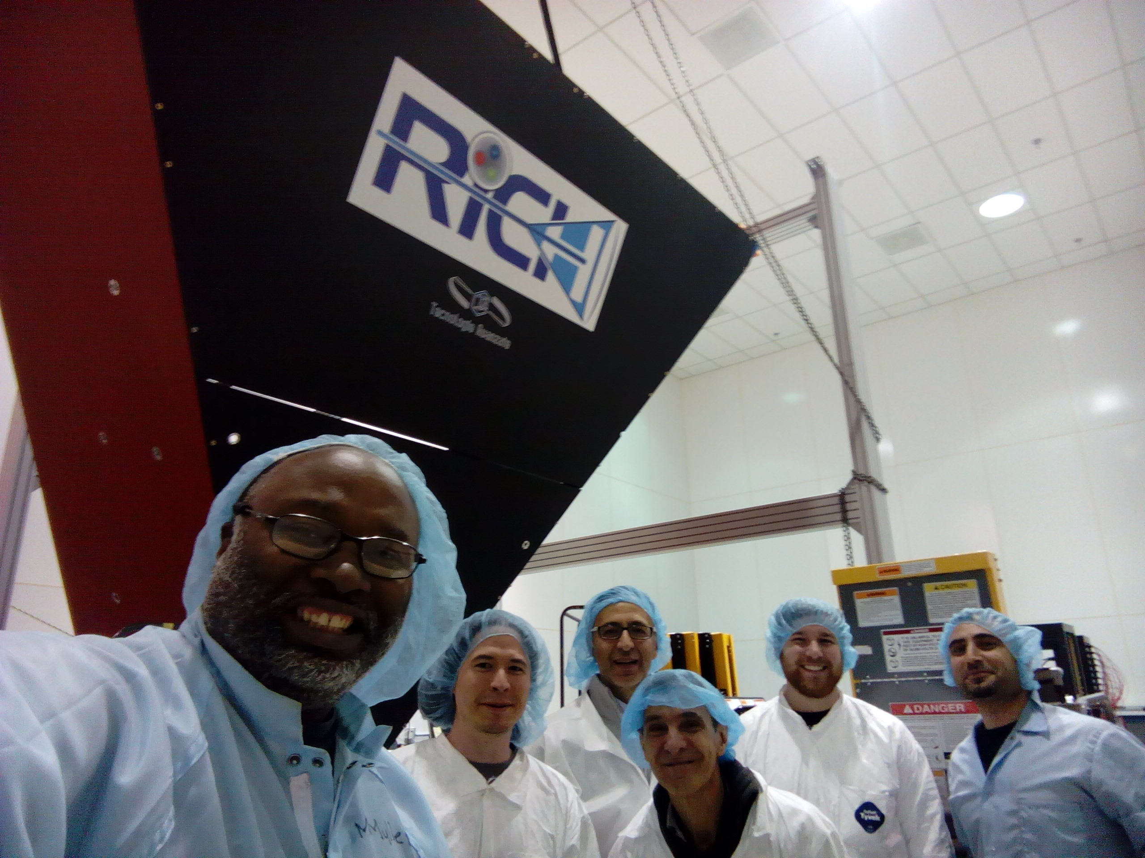
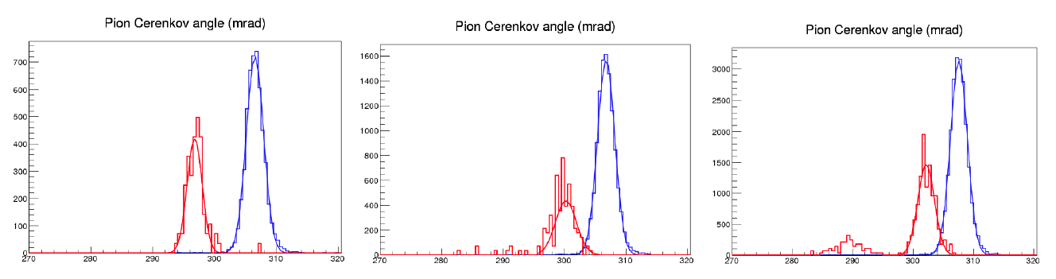
CLAS12 RICH
INSTITUTIONS
INFN (Italy) Bari, Ferrara, Genova, L.Frascati, Roma/ISS
Jefferson Lab (Newport News, USA)
Argonne National Lab (Argonne, USA)
Duquesne University (Pittsburgh, USA)
George Washington University (USA)
Glasgow University (Glasgow, UK)
Kyungpook National University, (Daegu, Korea)
University of Connecticut (Storrs, USA)
UTFSM (Valparaiso, Chile)
Goal: extend CLAS12 hadron identification up to 8 GeV/c. Prototype results below:
6 Gev/c
π
7 Gev/c
8 Gev/c
k
p
Cherenkov angle (mrad)
Assembling ongoing, installation foreseen in November 2017
Contalbrigo M.
HALL-B Meeting, 11 September 2017, JLab
Notes:
Vanno messi studi innovativi e pubblicazioni

Slide 2
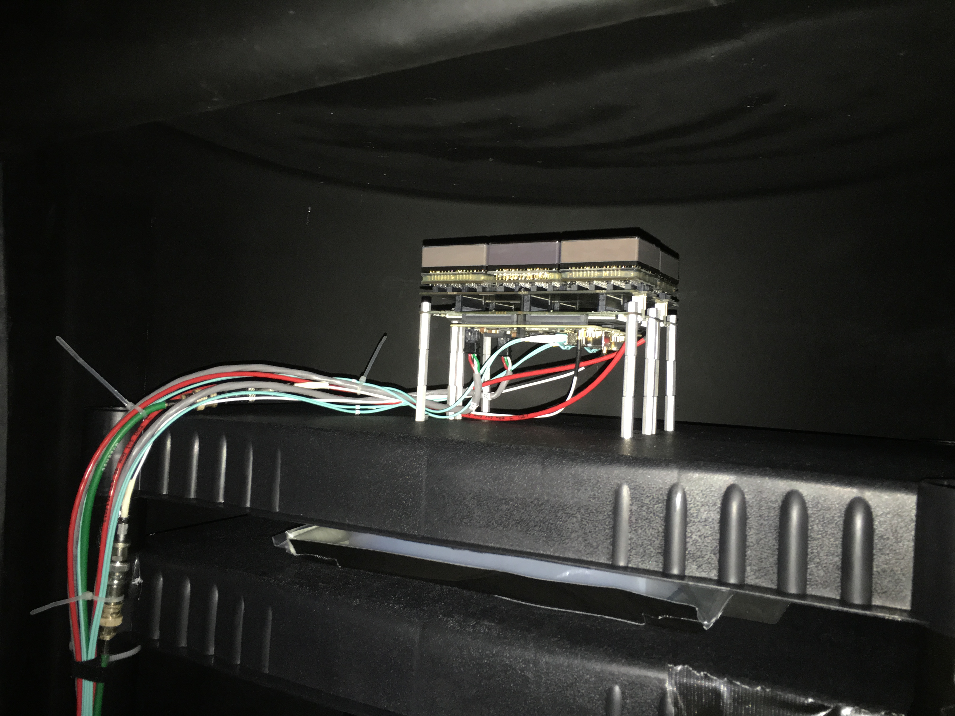
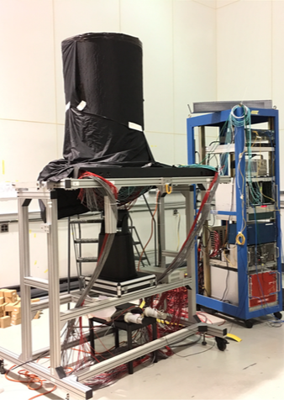
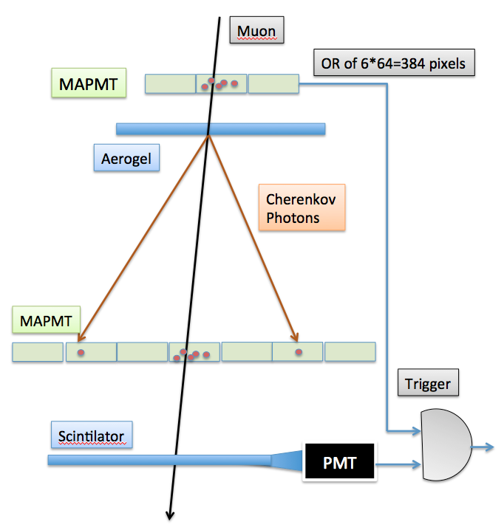
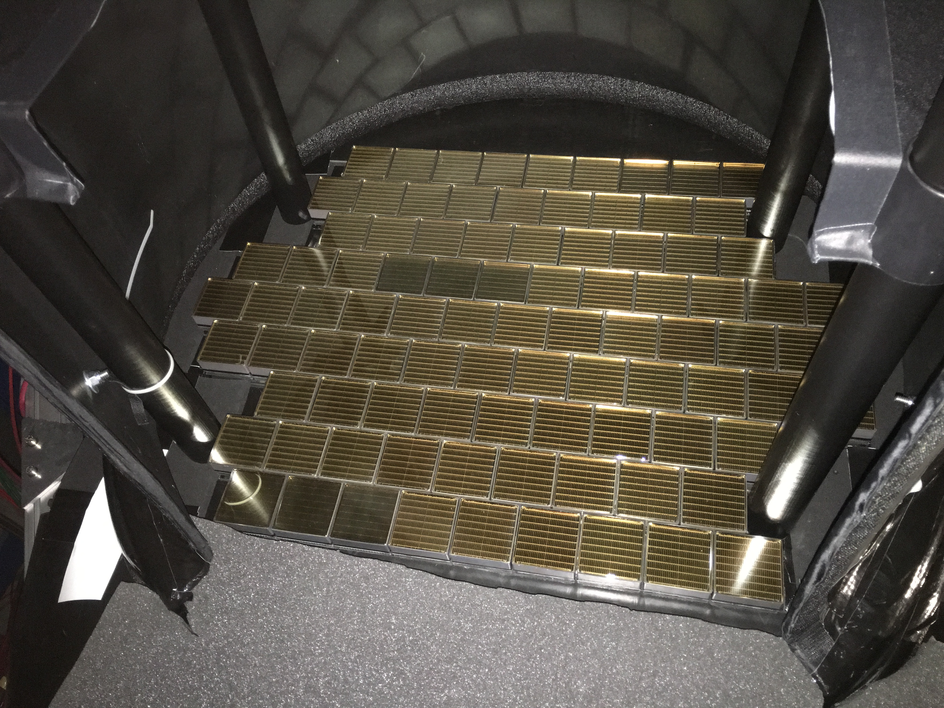
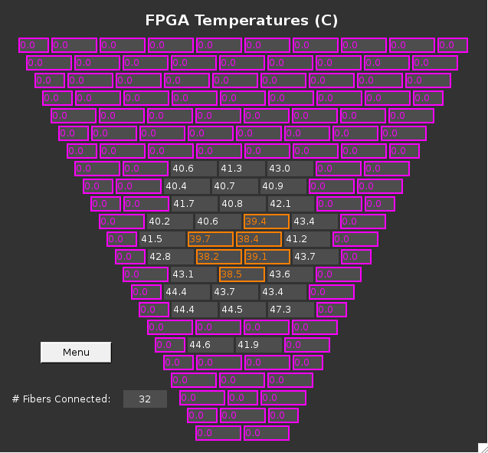
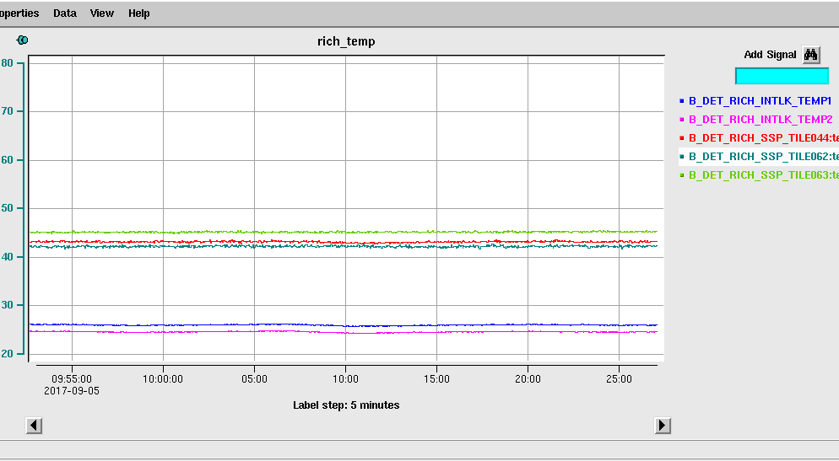
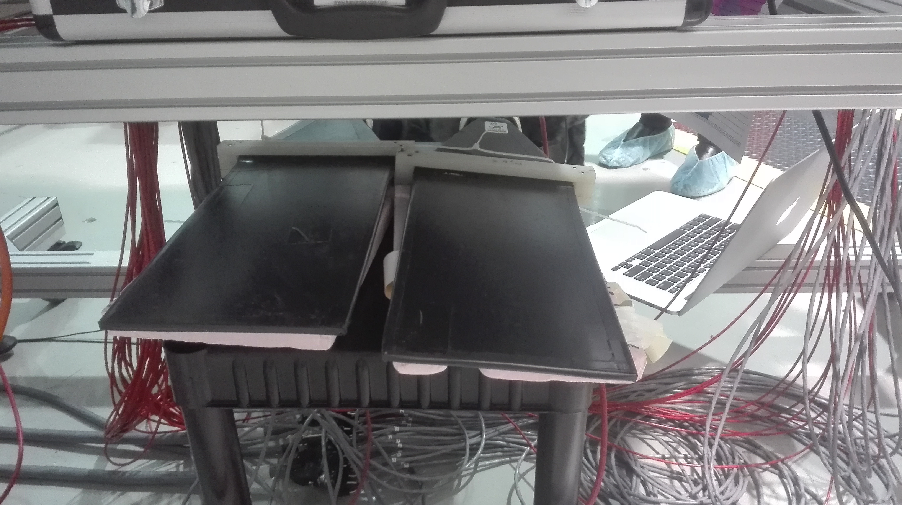
Cosmic Run
Trigger and tracking station
PMT plane
Scintillator pads
Contalbrigo M.
HALL-B Meeting, 11 September 2017, JLab
Notes:
Dire meglio chi fa cosa.

Slide 3
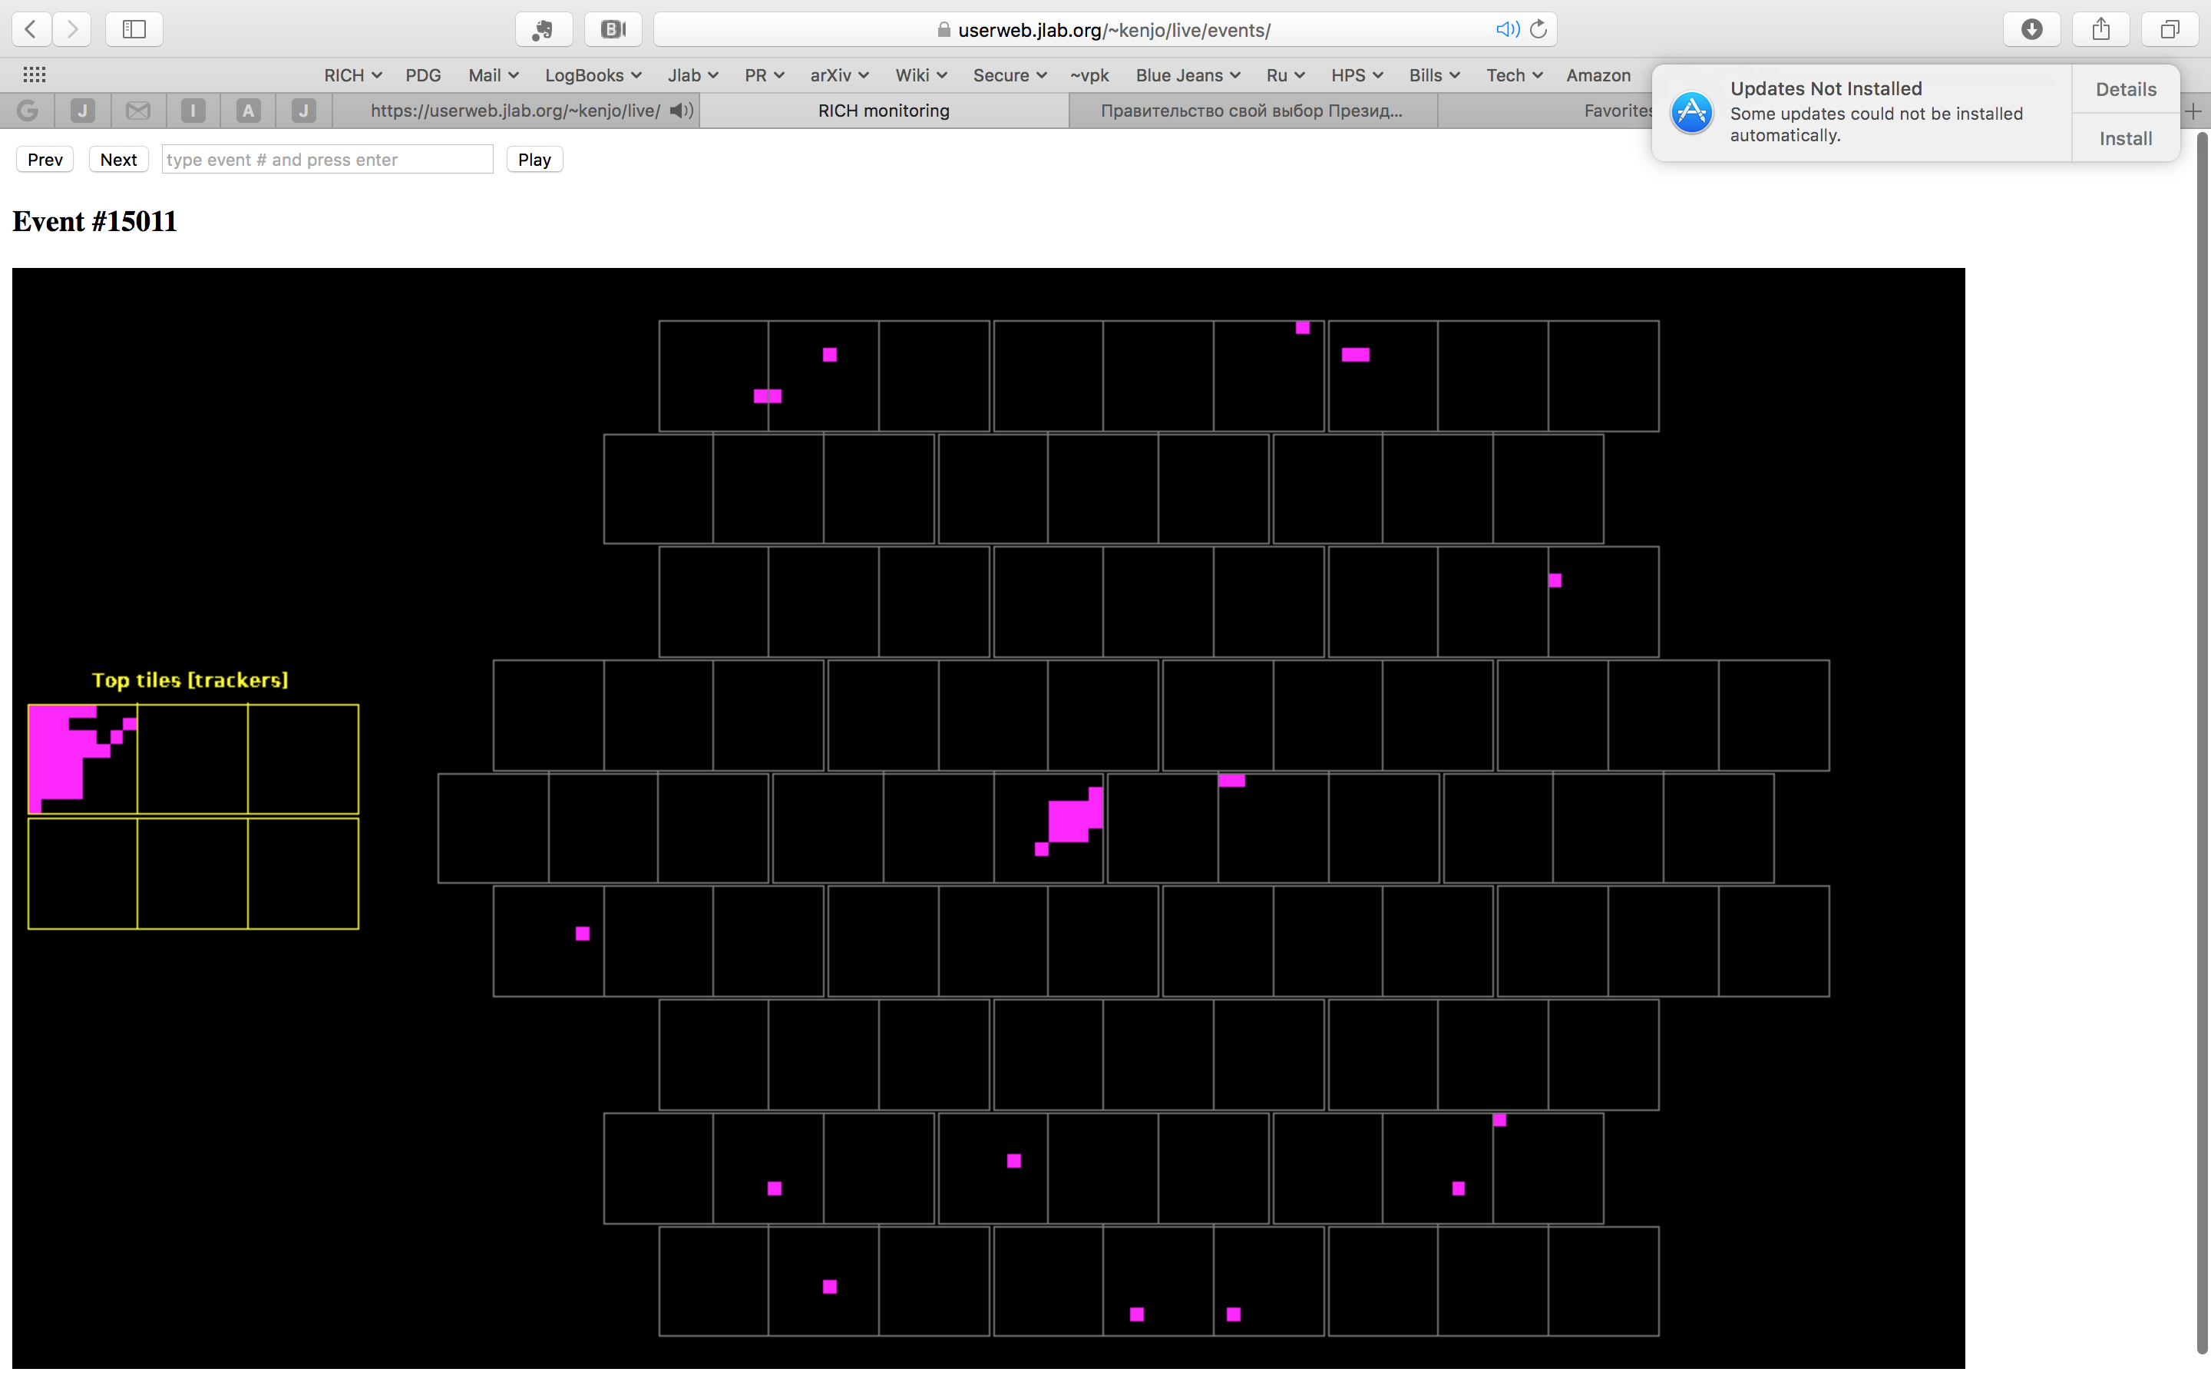
Online Event Display
No background suppression: 1 microsec readout window
Contalbrigo M.
HALL-B Meeting, 11 September 2017, JLab
3

Slide 4
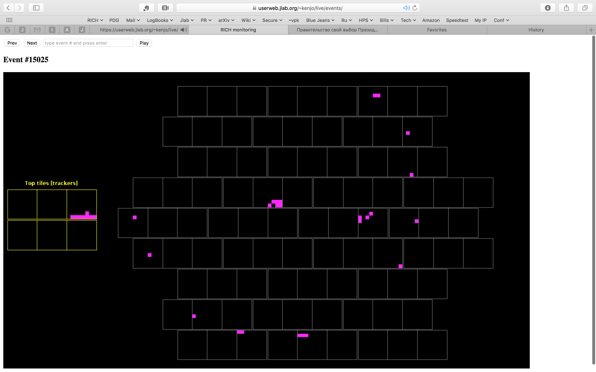
Online Event Display
Contalbrigo M.
HALL-B Meeting, 11 September 2017, JLab
4

Slide 5
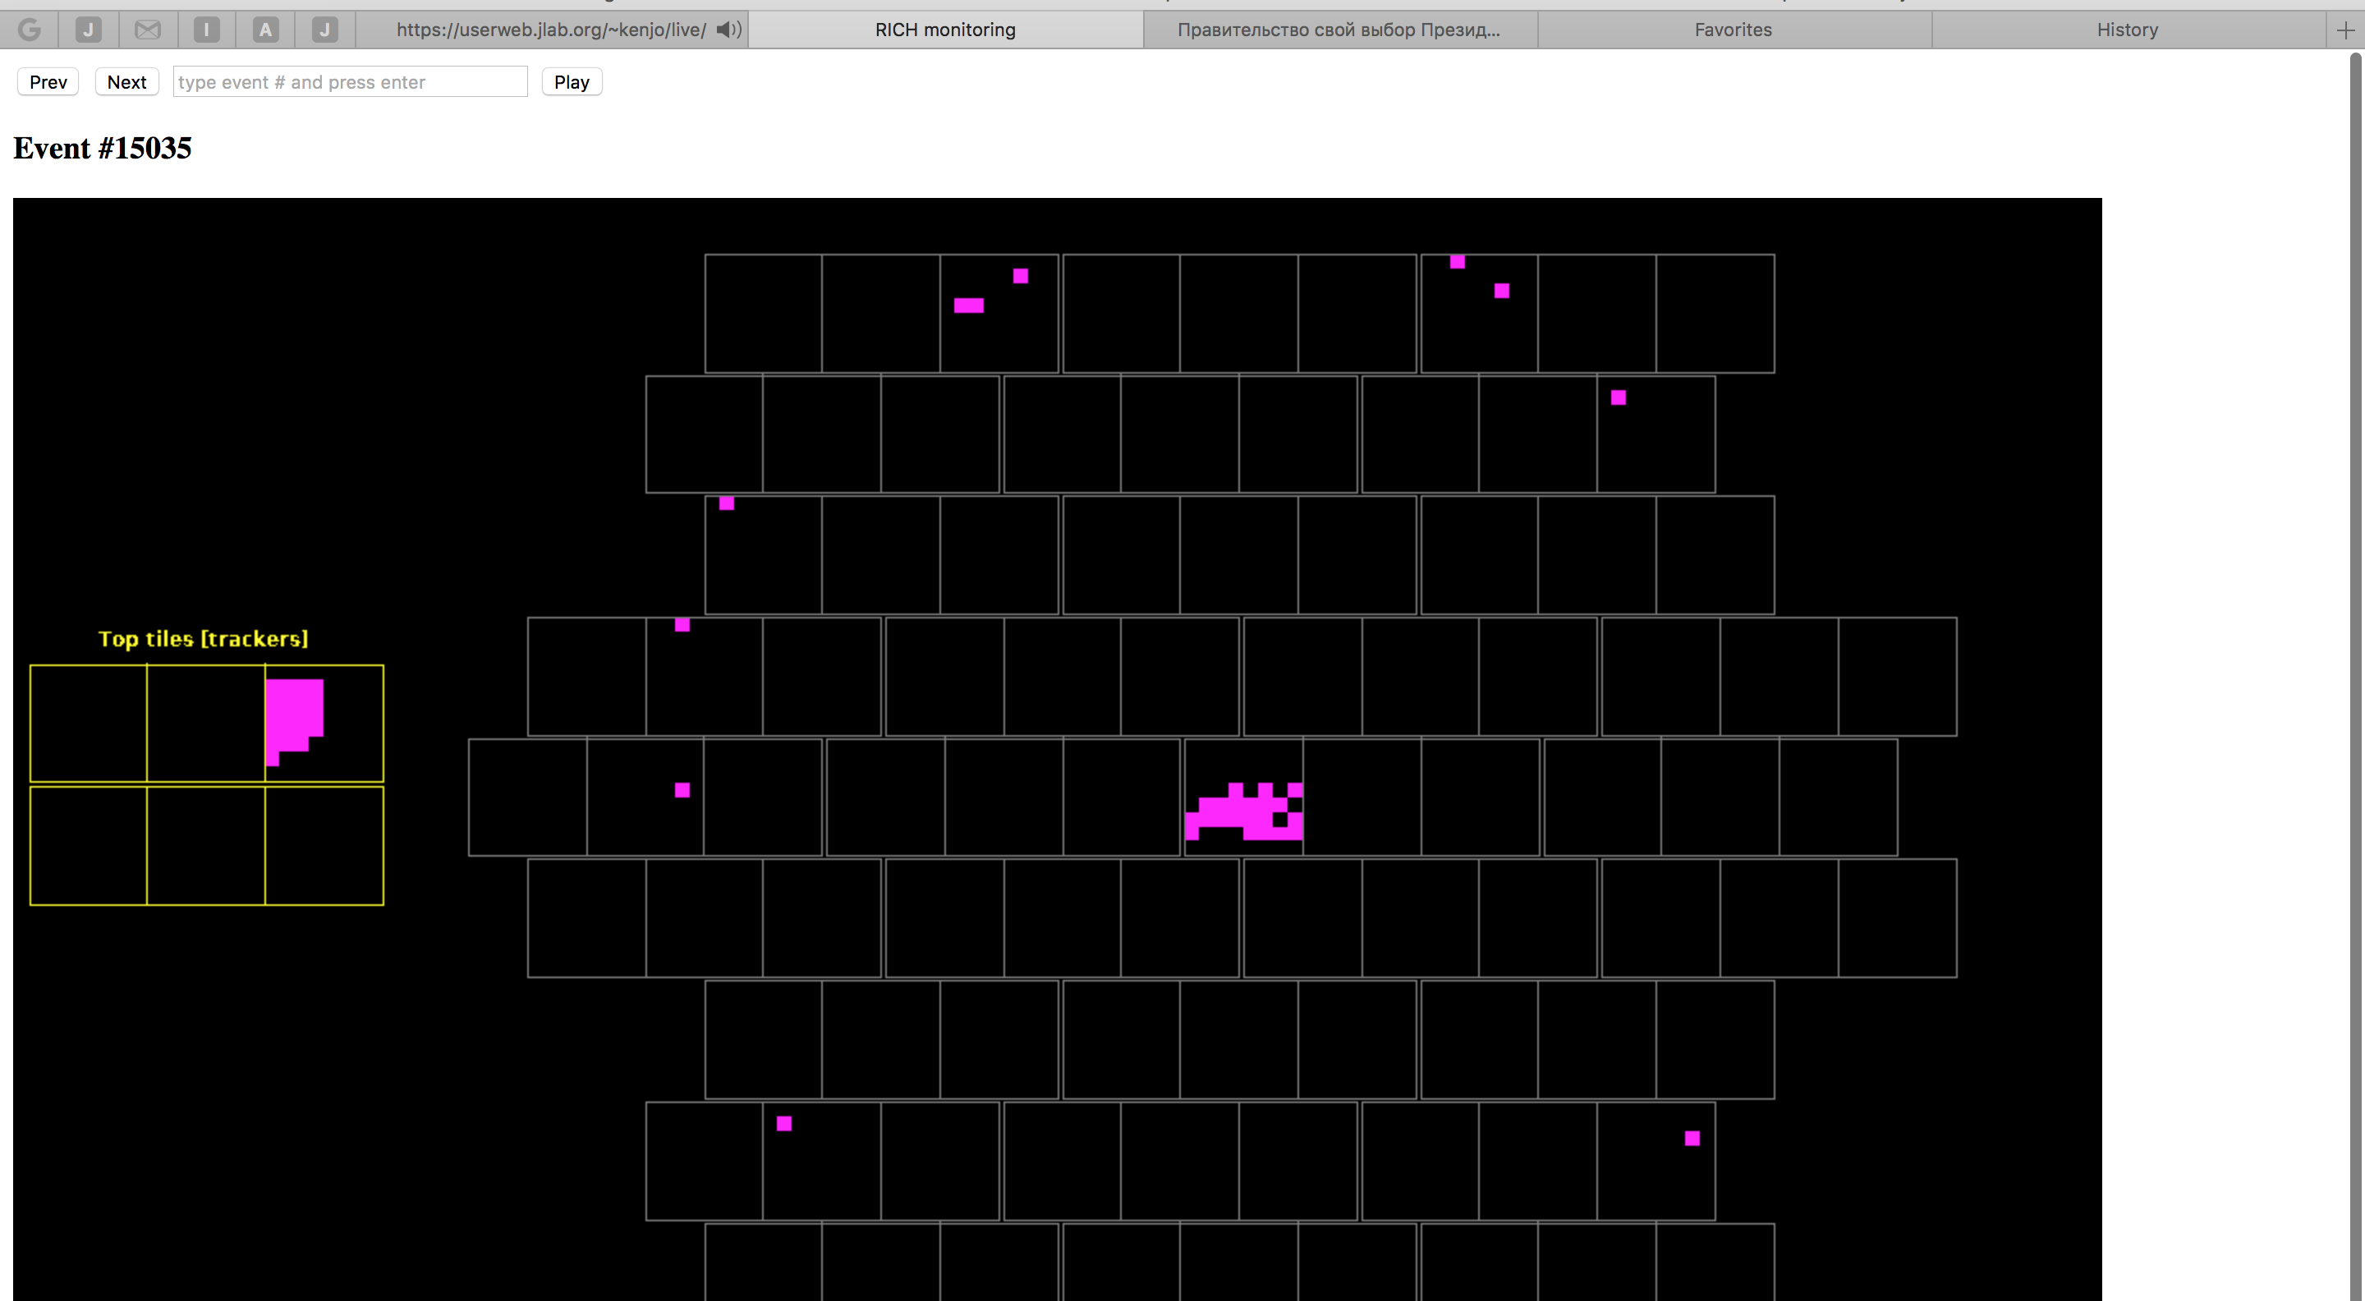
Online Event Display
Contalbrigo M.
HALL-B Meeting, 11 September 2017, JLab
5

