Slide 1
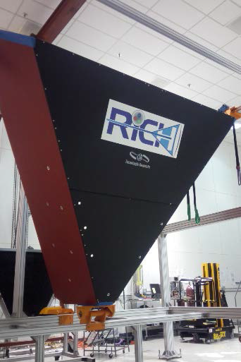
RICH Detector
M. Contalbrigo
INFN Ferrara
CLAS Collaboration Meeting
13-16 June 2017
Notes:
Dire meglio chi fa cosa.

Slide 2
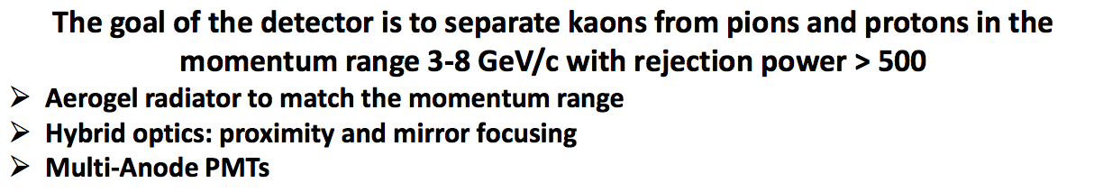
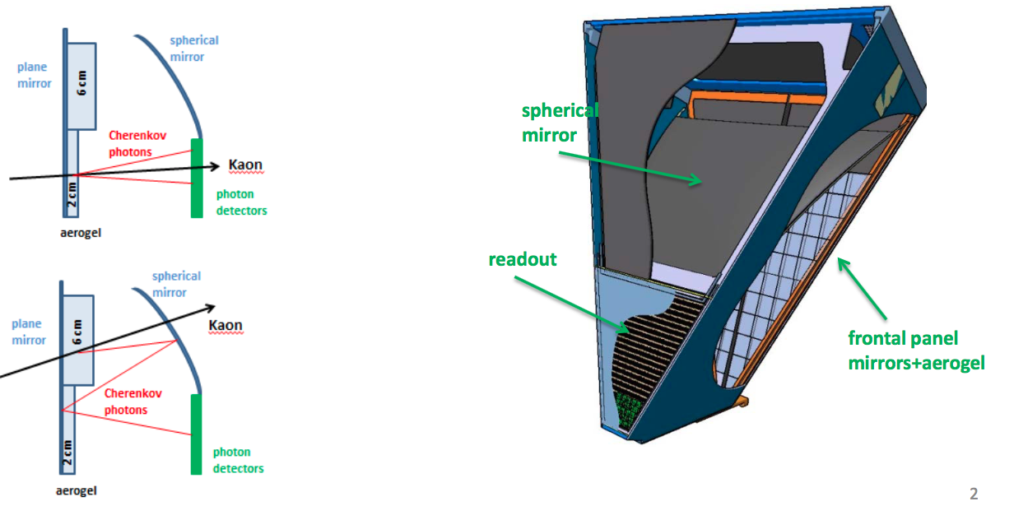
RICH Design
Contalbrigo M.
CLAS12 Meeting, 13 June 2017, JLab
2
Notes:
Dire meglio chi fa cosa.

Slide 3
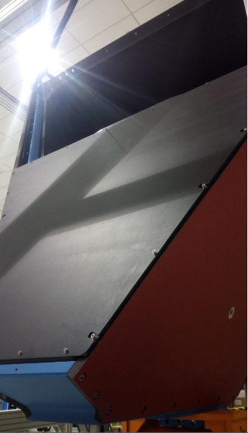
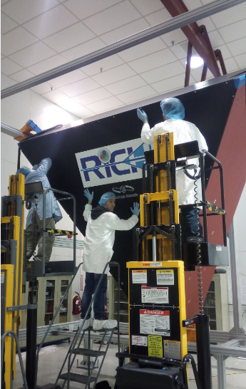
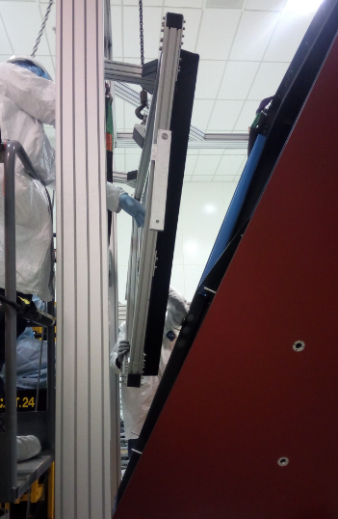
Mechanic Assembling
✓ External RICH vessel assembled in EEL-124
✓ Entrance, exit and electronic panels ready
Thanks to DSG group!
Entrance bottom
Entrance top
Electronic Panel
Contalbrigo M.
CLAS12 Meeting, 13 June 2017, JLab
3
Notes:
Dire meglio chi fa cosa.

Slide 4
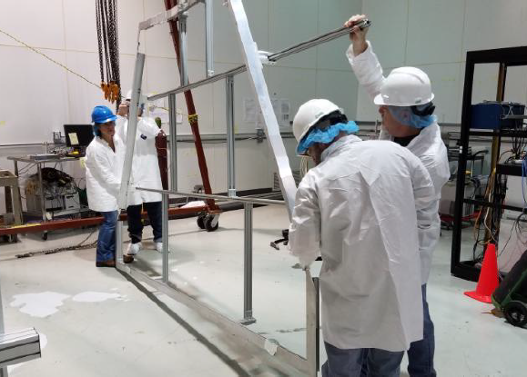
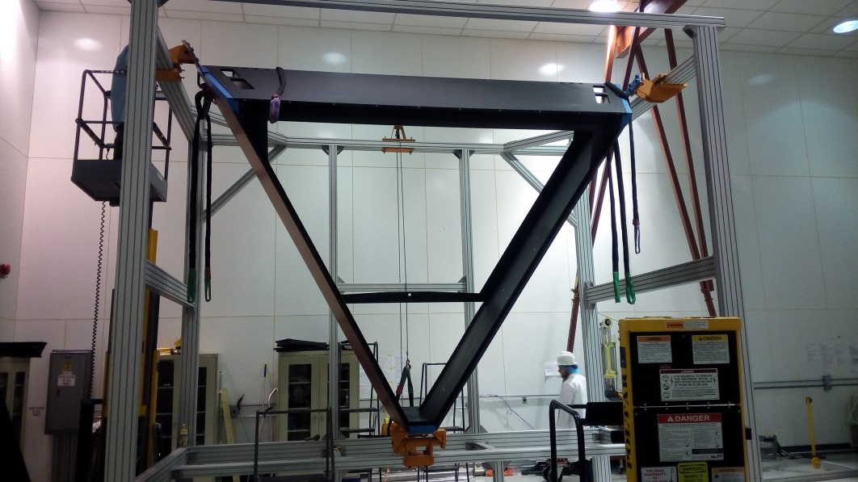
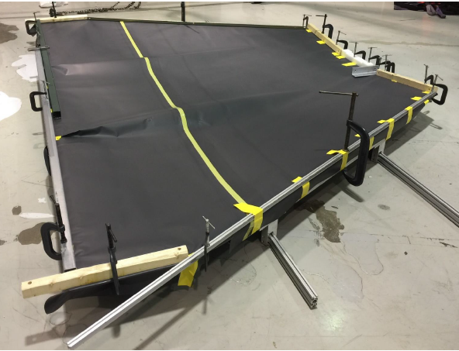
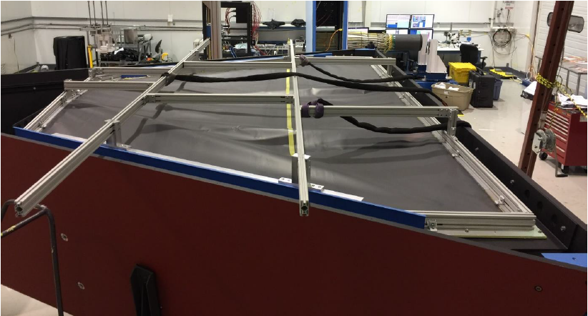
Exit Panel
External Al structure + Tedlar (DSG + Argonne)
Contalbrigo M.
CLAS12 Meeting, 13 June 2017, JLab
4
Notes:
Dire meglio chi fa cosa.

Slide 5
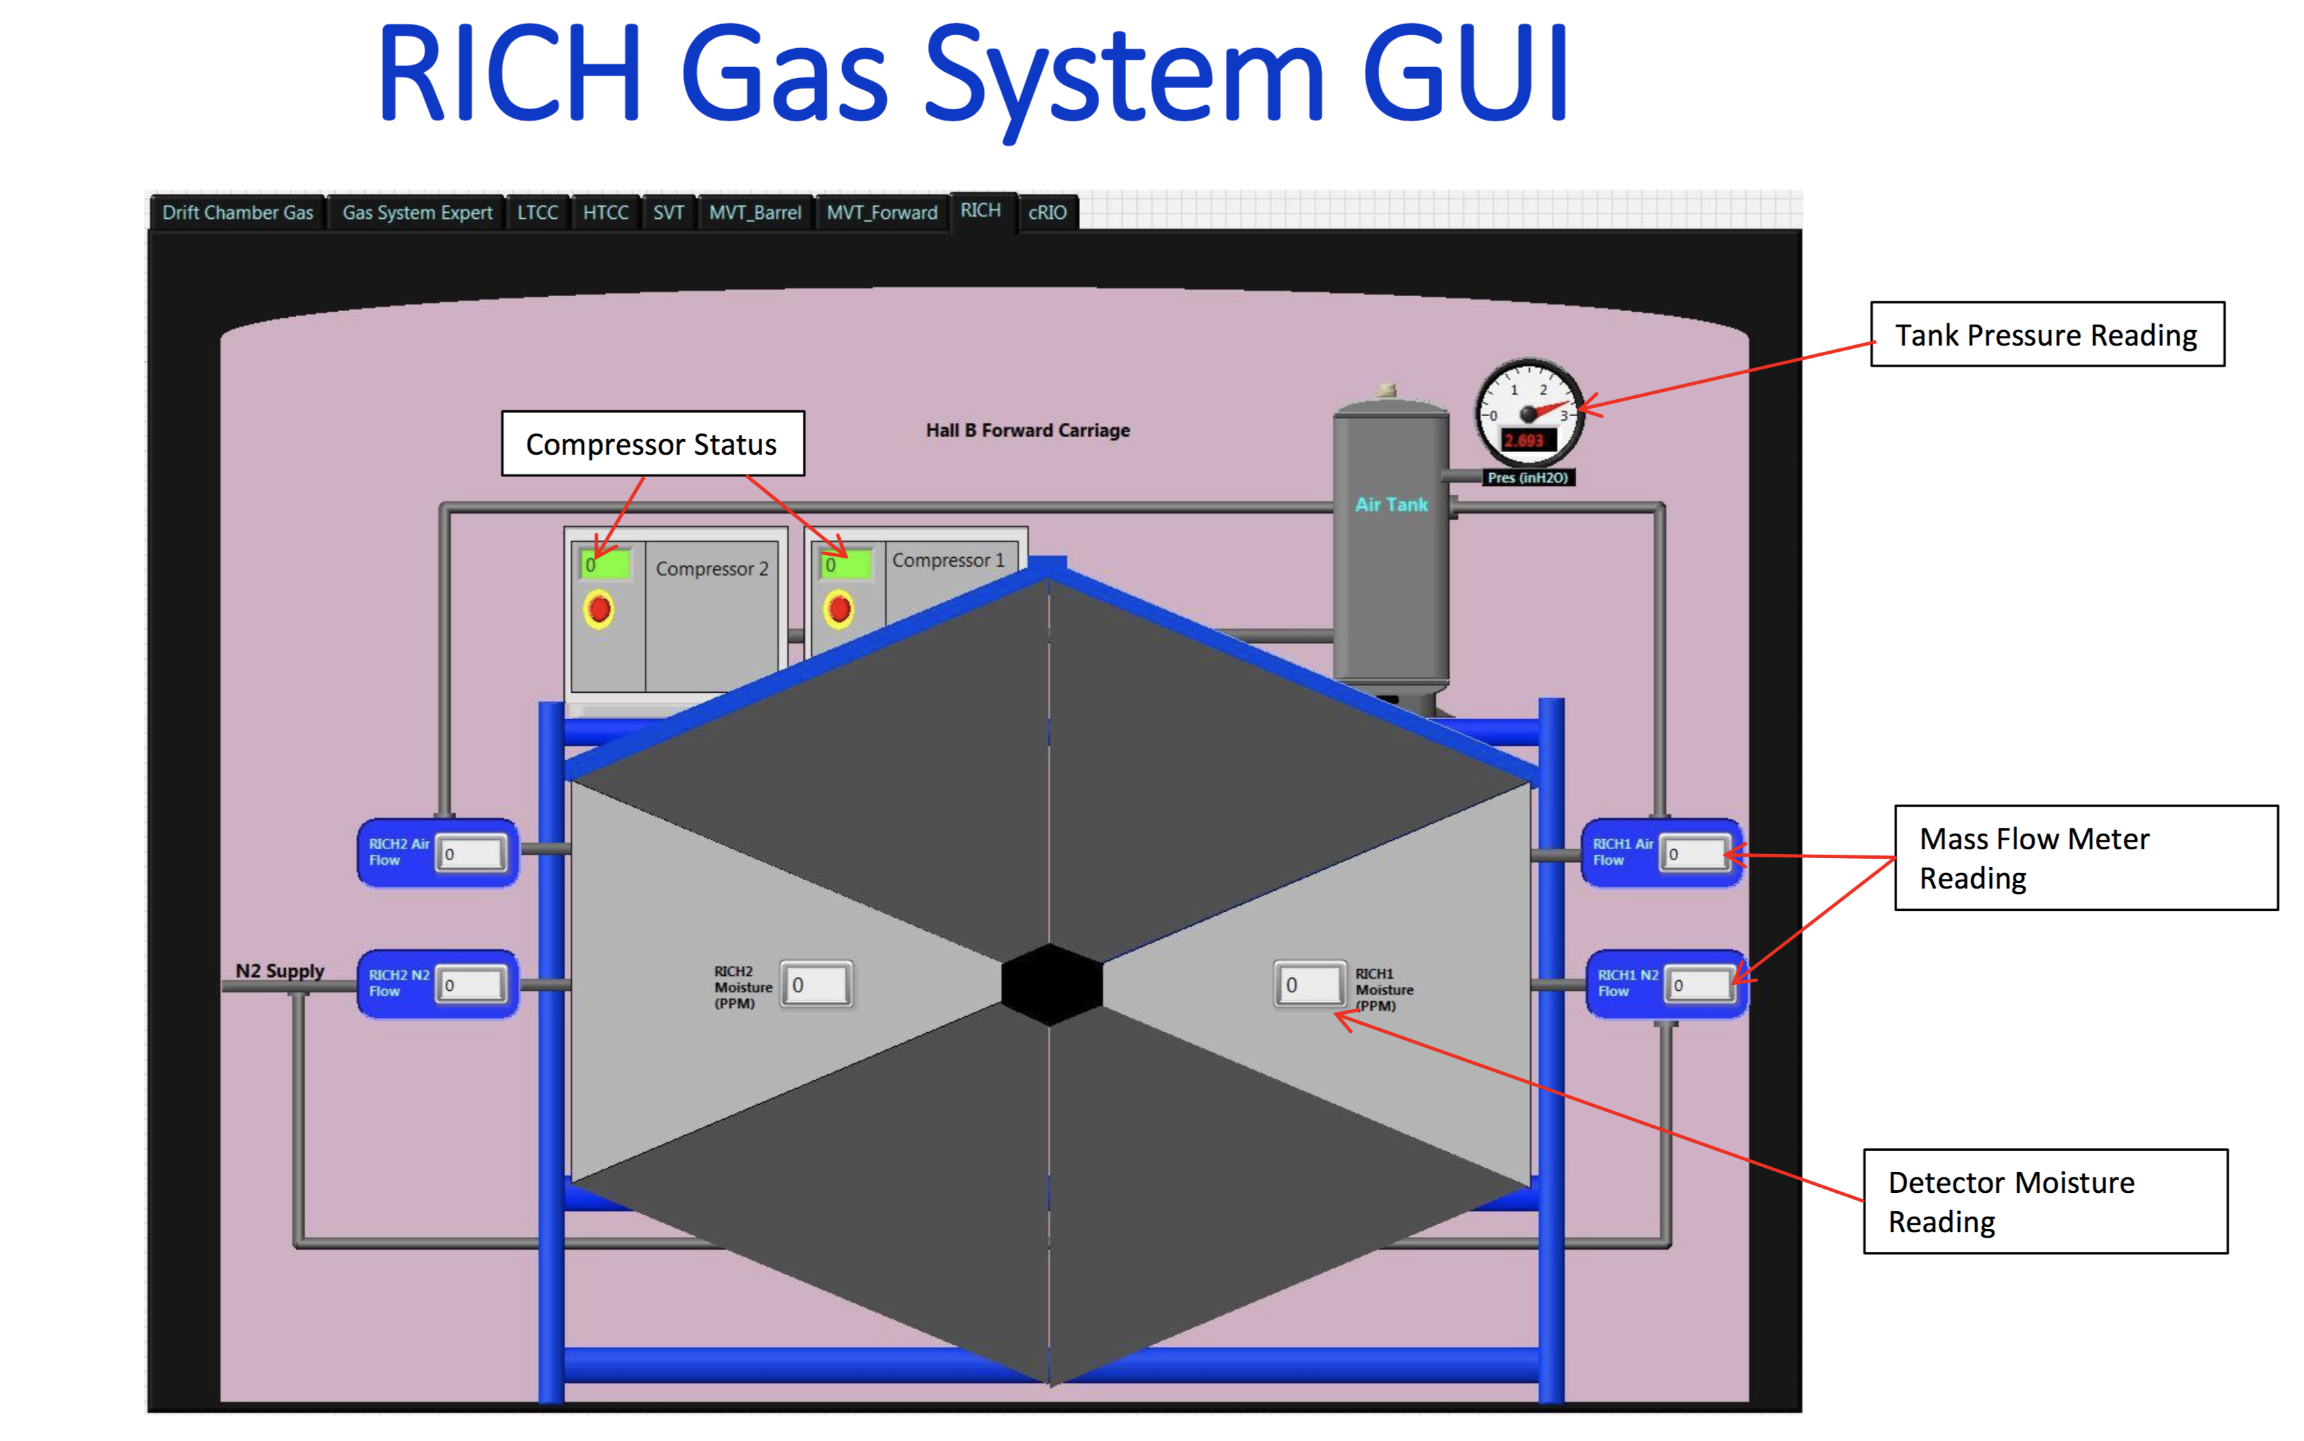
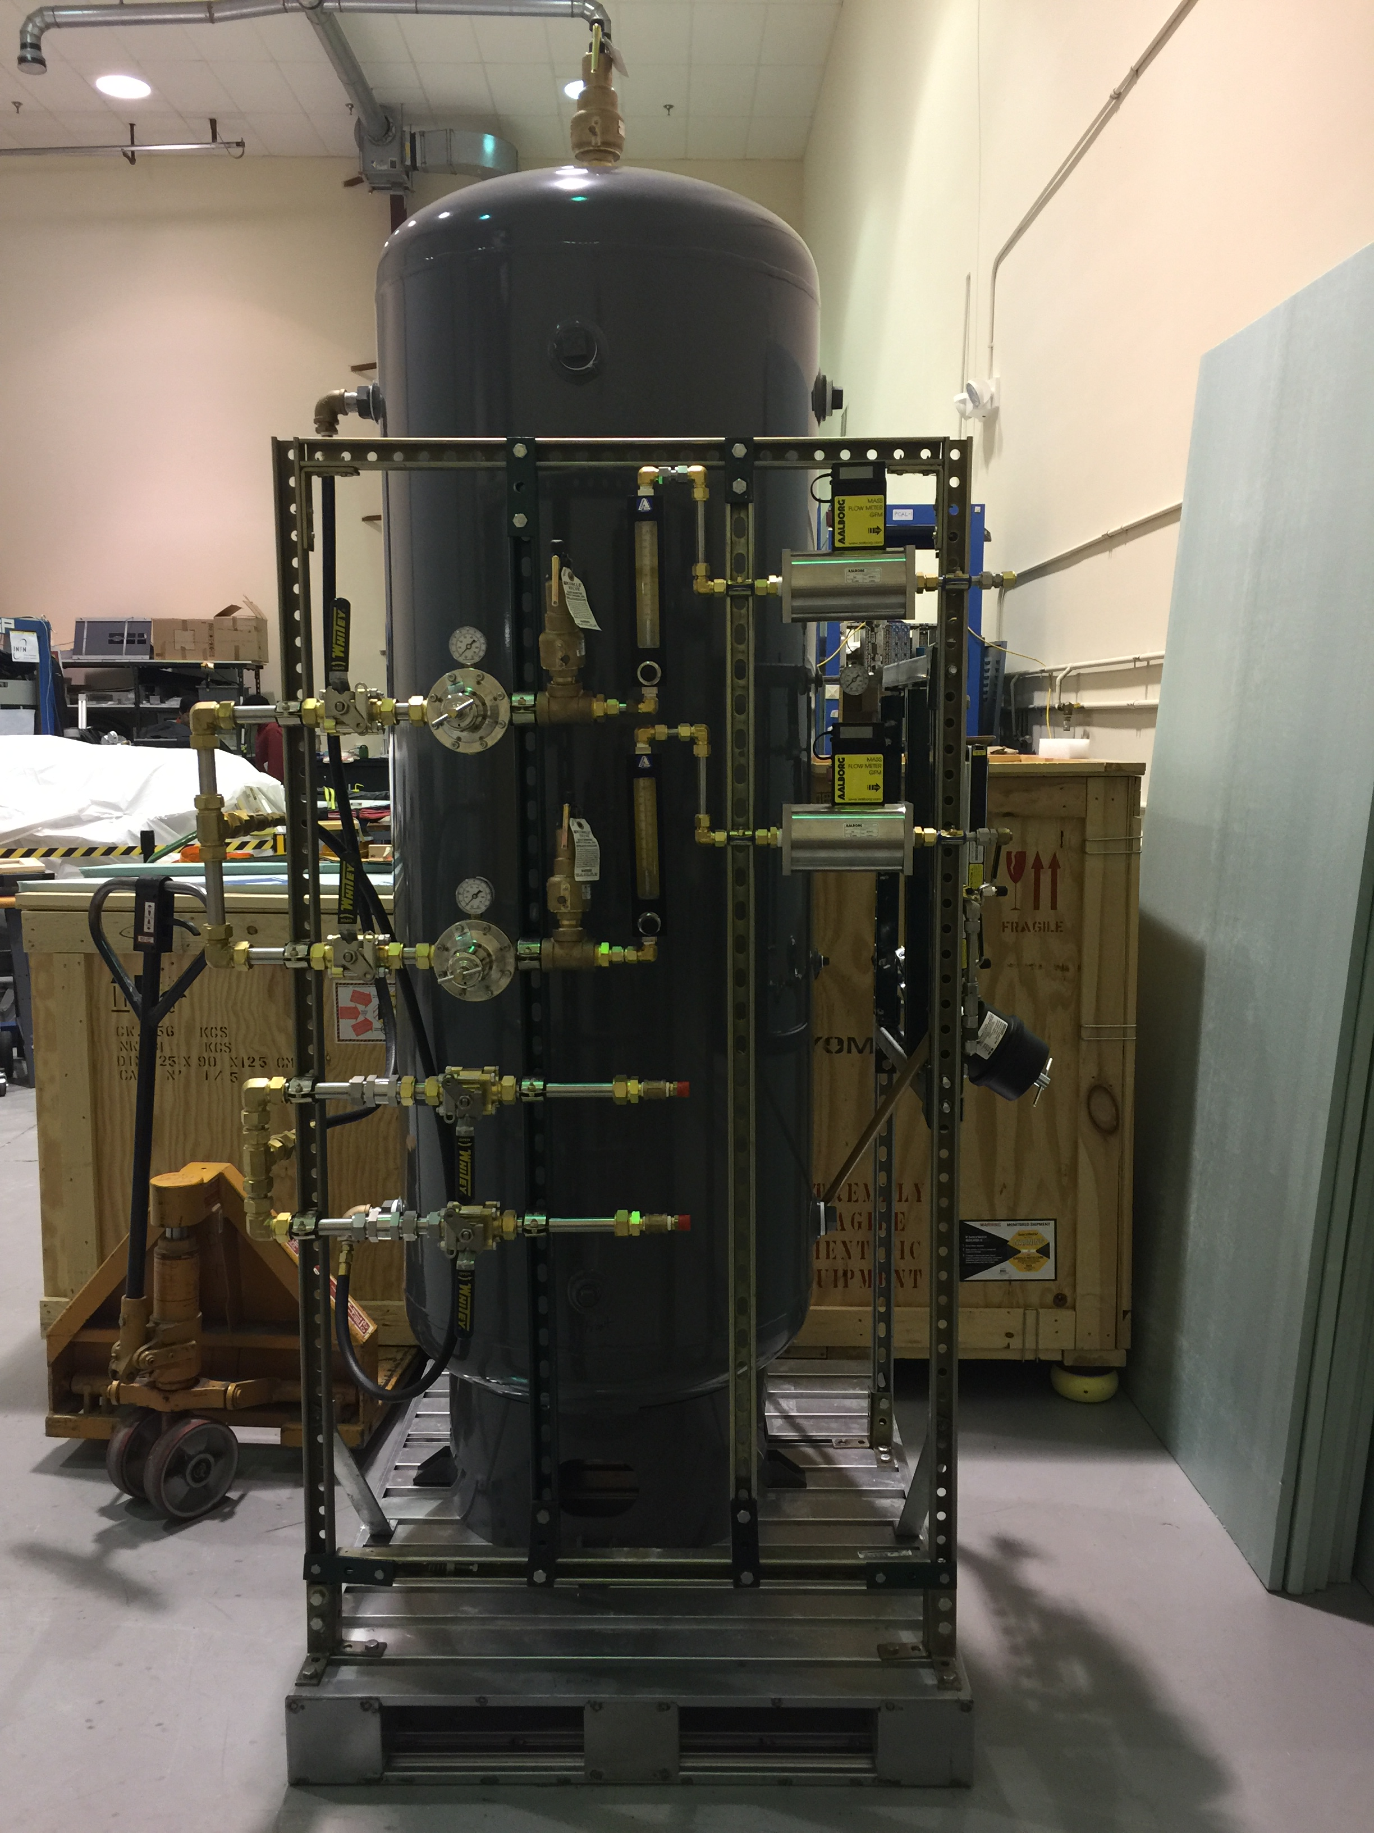
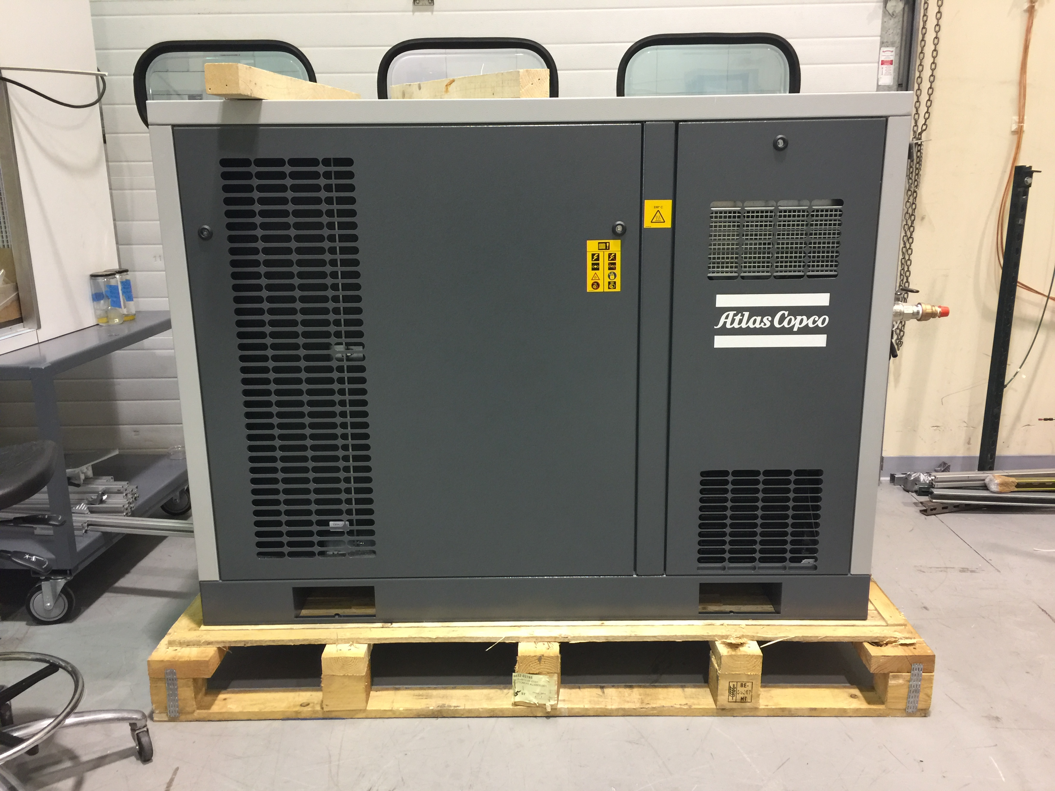
Gas System
✓ Gas system being installed in EEL-124 (DSG)
Operative test foreseen in August 17
with fully instrumented electronic panel
Gas System GUI
Air Tank and Gas Line Controls
Clean Air Compressor
Contalbrigo M.
CLAS12 Meeting, 13 June 2017, JLab
5
Notes:
Dire meglio chi fa cosa.

Slide 6
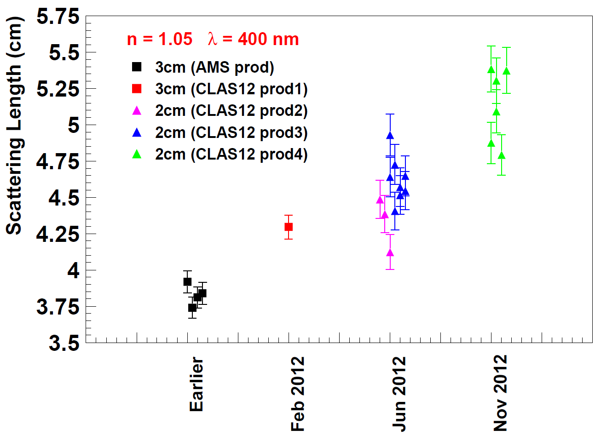
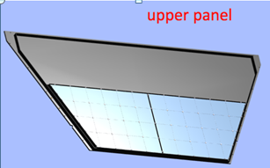
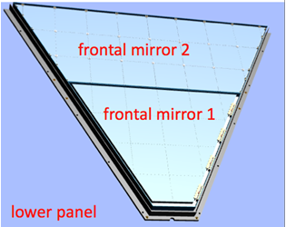
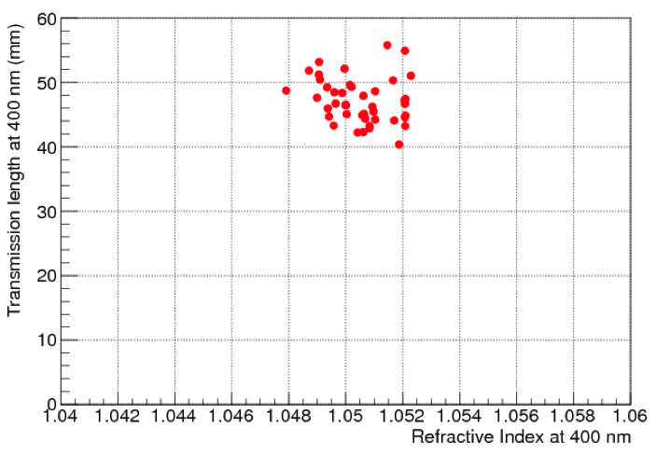
Aerogel
✓ Production of 3 cm: minimal quantity achieved
All delivered tiles within specifications
✓ Production of 2 cm: ongoing
Completion expected beginning of August
CLAS12 R&D
(n=1.05)
HERMES
(n=1.03)
CLAS12
Production
(n=1.05)
<L_{sc}> ~ 50 mm
Difference between our measurement and passport values
Contalbrigo M.
CLAS12 Meeting, 13 June 2017, JLab
6
Notes:
Dire meglio chi fa cosa.

Slide 7
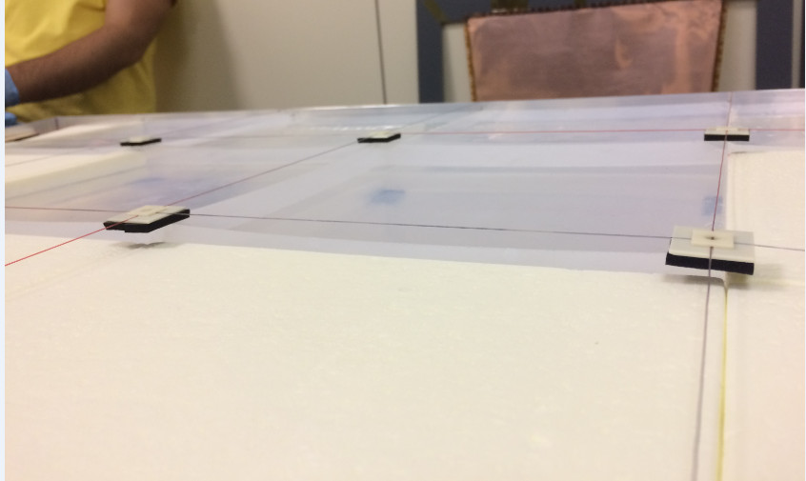
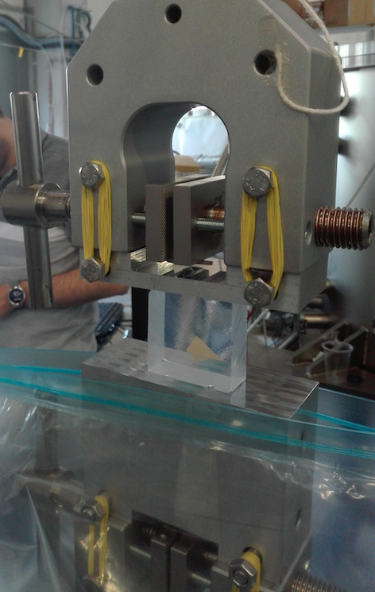
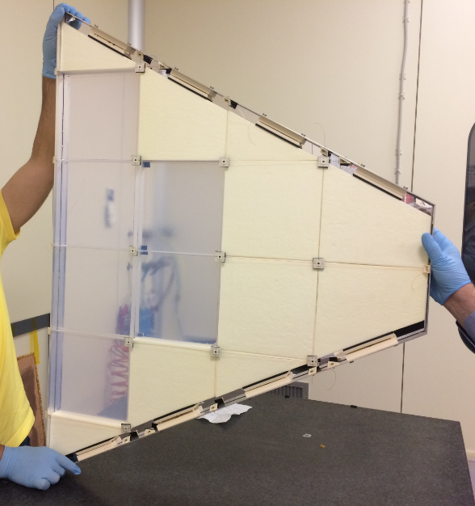
Aerogel
✓ Mechanical stress tests
Can sustain compressions much bigger than planned
✓ First assembly test performed
Safe rotations up to 10º beyond vertical
Contalbrigo M.
CLAS12 Meeting, 13 June 2017, JLab
7
7
Notes:
Dire meglio chi fa cosa.

Slide 8
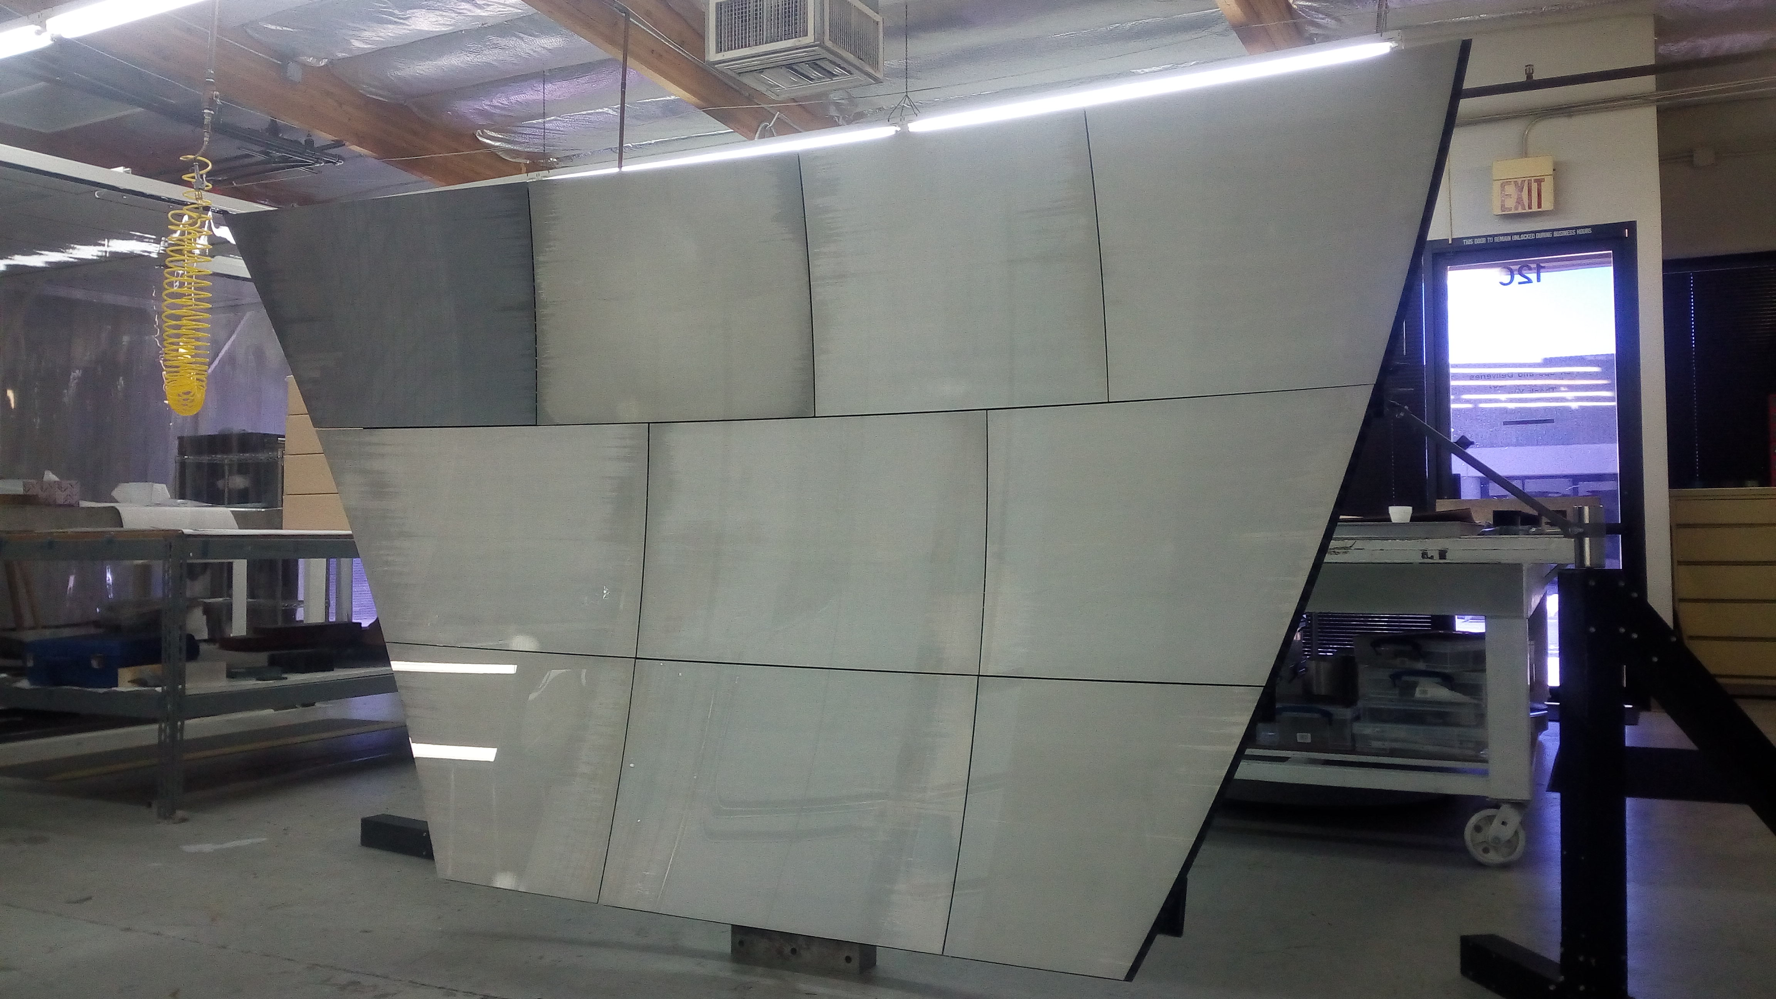
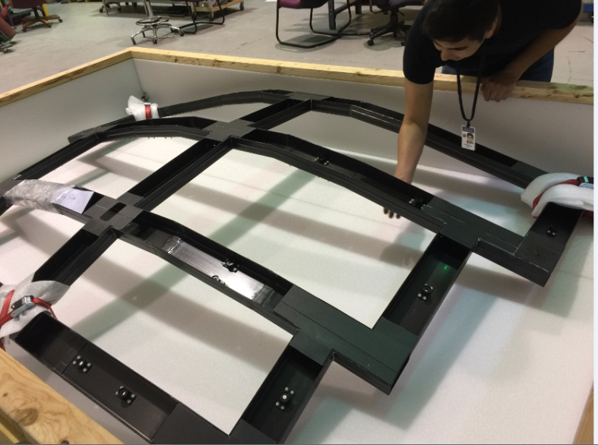
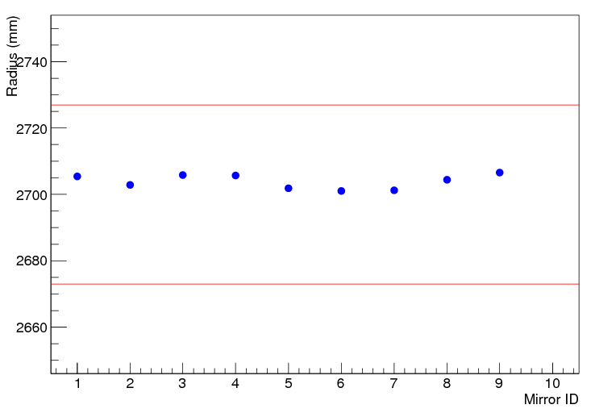
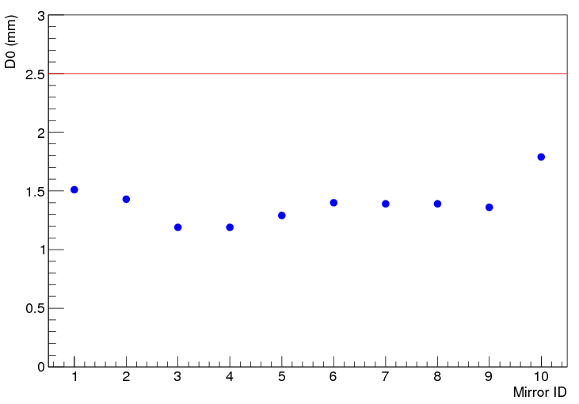
Spherical Mirrors
✓ All 10 mirror produced
30% less areal density vs LHCb
Specifications met
✓ Support structure delivered
✓ Coating ongoing @ ECI
Radius, specs ± 1 %
Reflected spot size, specs < 2.5 mm
Contalbrigo M.
CLAS12 Meeting, 13 June 2017, JLab
8
Notes:
Dire meglio chi fa cosa.

Slide 9
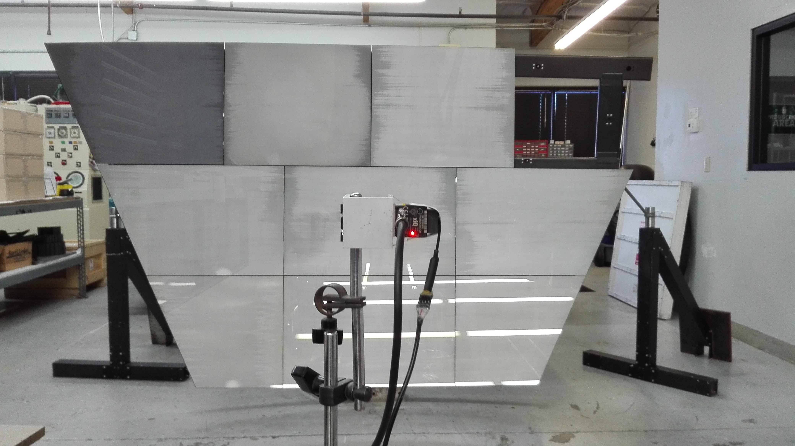
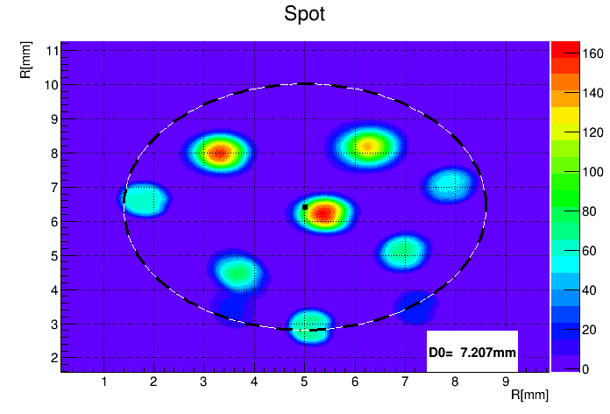
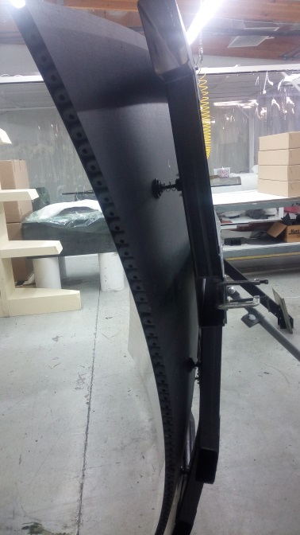
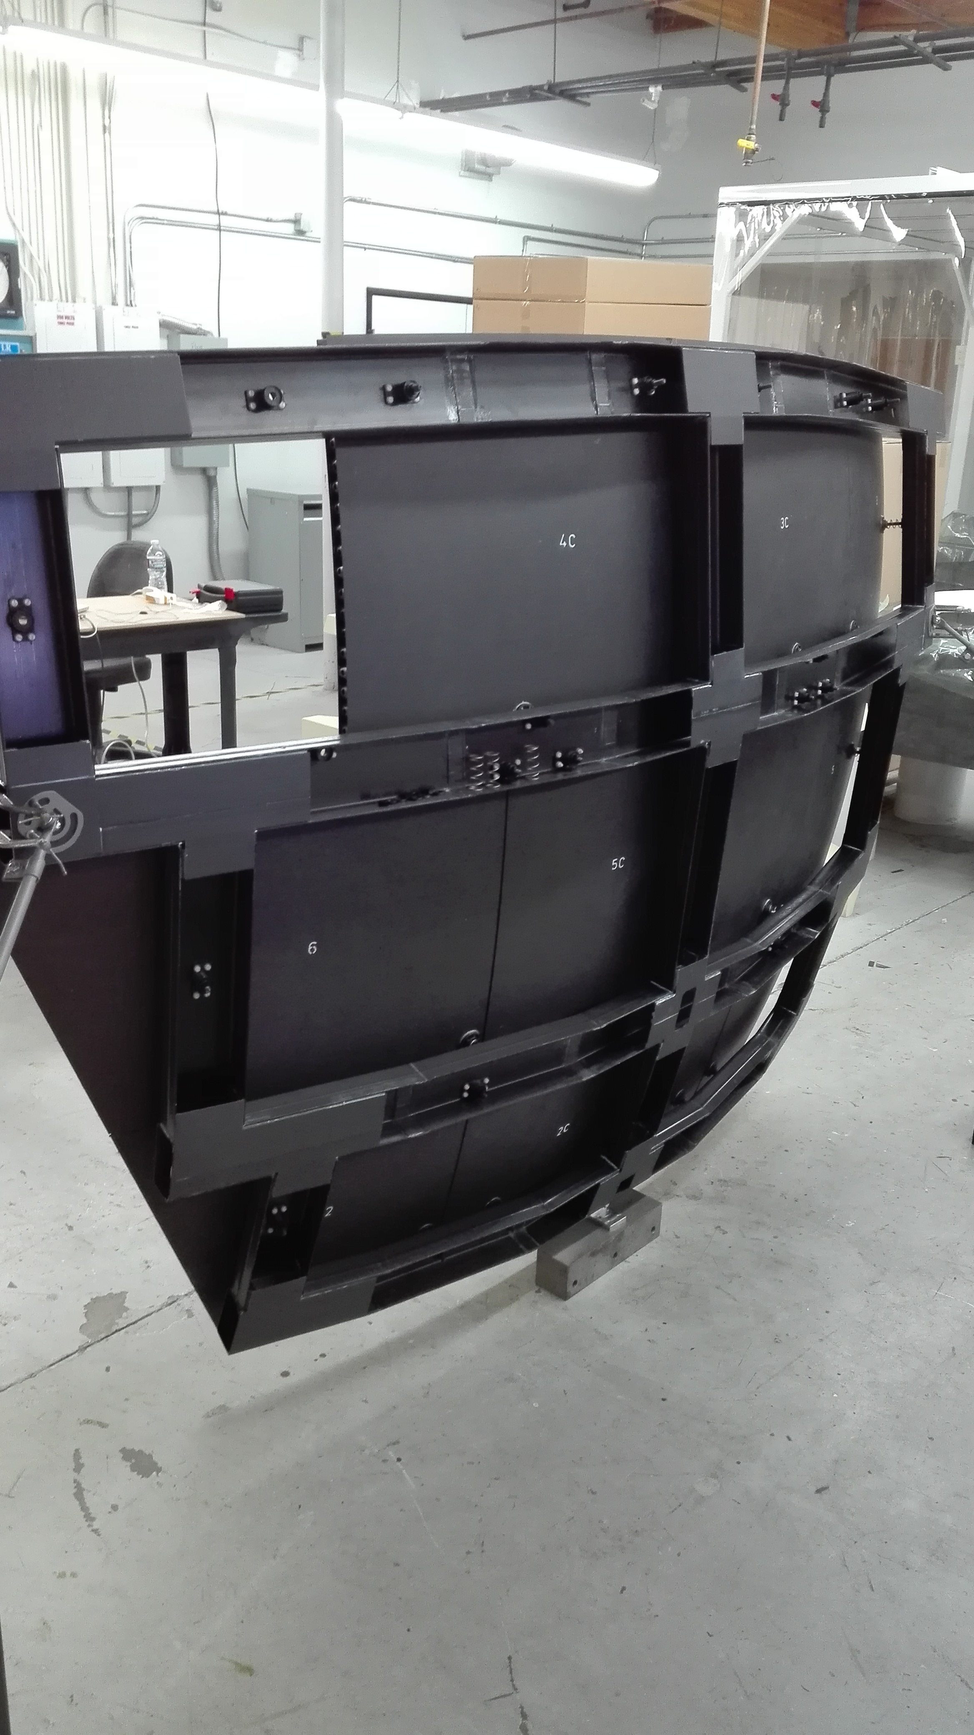
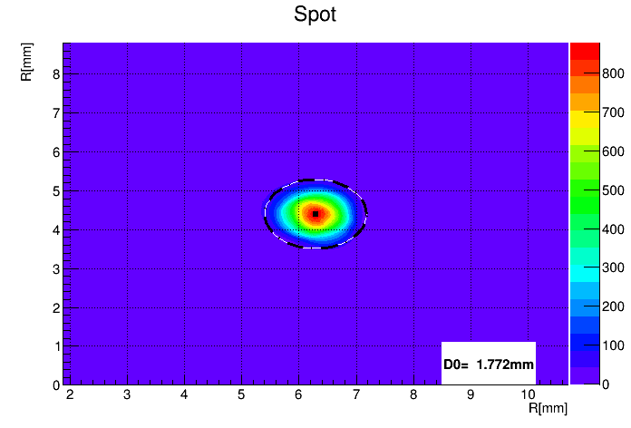
Alignment
✓ Effective procedure (~ 20 min)
Uncoated 3.5 m² composite mirror achieves a
point-like image comparable to single mirror
<< 5 mm specs
Before alignment
After alignment D0 = 1.7 mm
Contalbrigo M.
CLAS12 Meeting, 13 June 2017, JLab
9
Notes:
Dire meglio chi fa cosa.

Slide 10
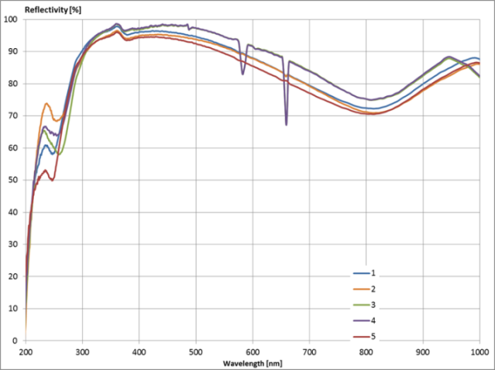
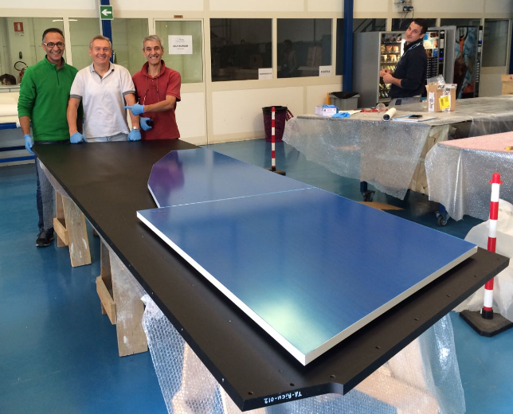
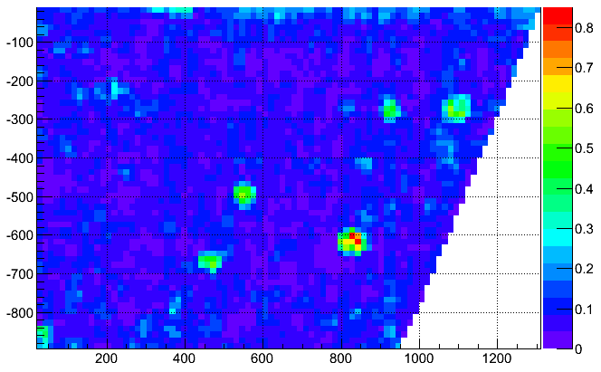
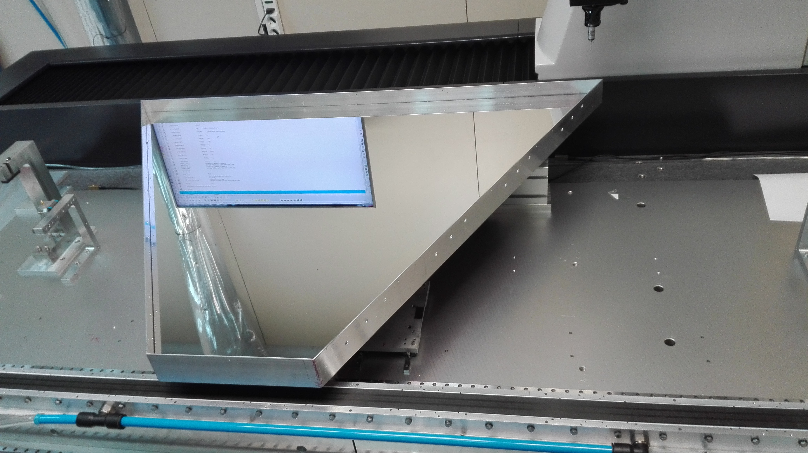
Planar Mirrors
✓ Lateral mirror produced (3/5 accepted + spares)
Glass skin + Al honeycomb core
Material budget comparable to CFRP @ 1/10 cost
✓ Assembling validated
✓ Front mirror production starting
Demo under mechanical tests
Process cleaning being improved
Reflectivity specs: > 90% at 400 nm
Max. PMT
sensitivity
Lateral mirror
assembling test
Slope of surface from CMM machine
Surface mapping
with CMM machine
Contalbrigo M.
CLAS12 Meeting, 13 June 2017, JLab
10
Notes:
Dire meglio chi fa cosa.

Slide 11
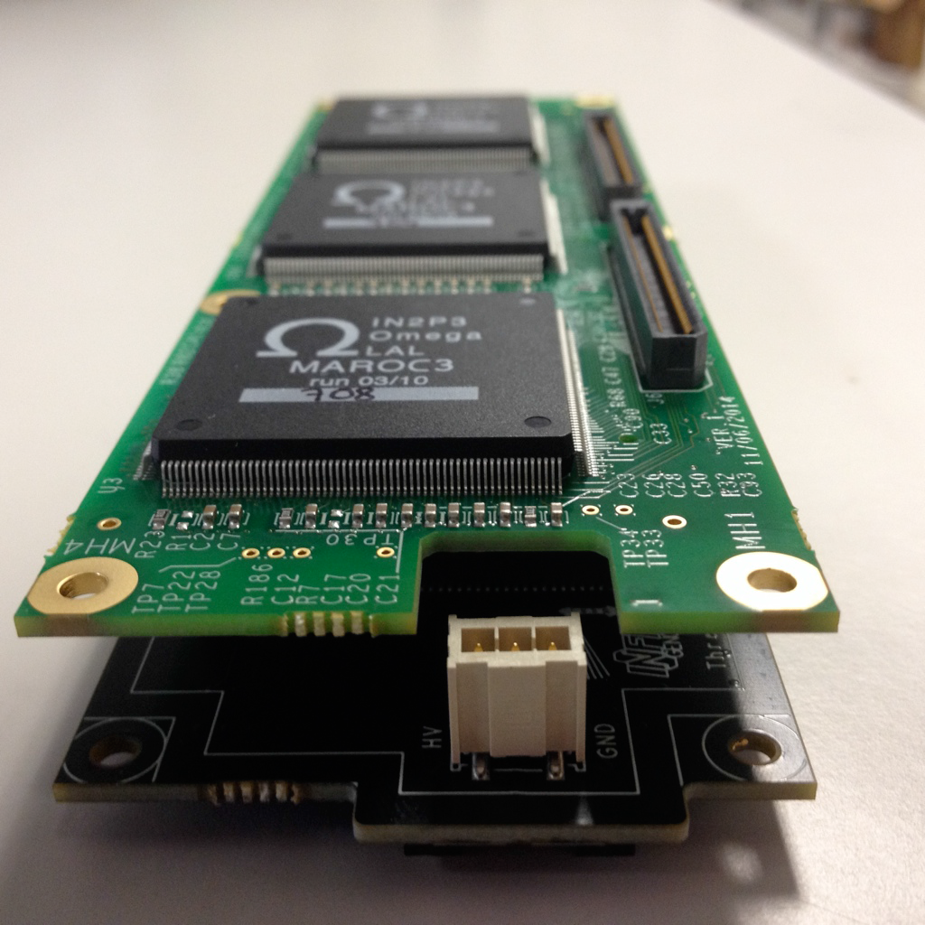
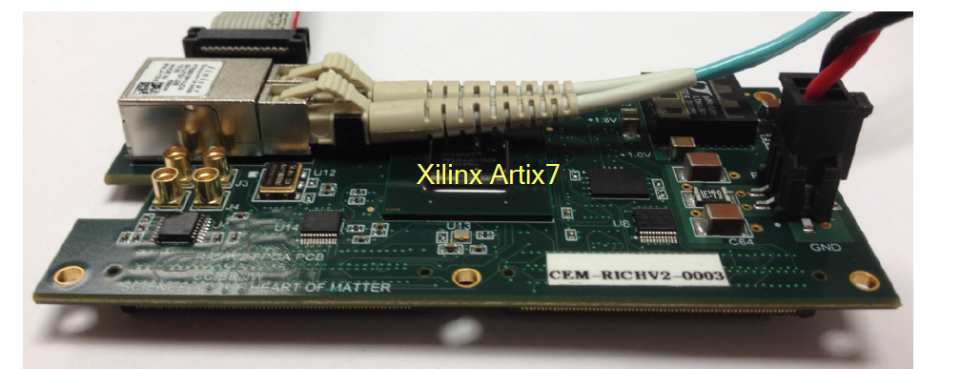
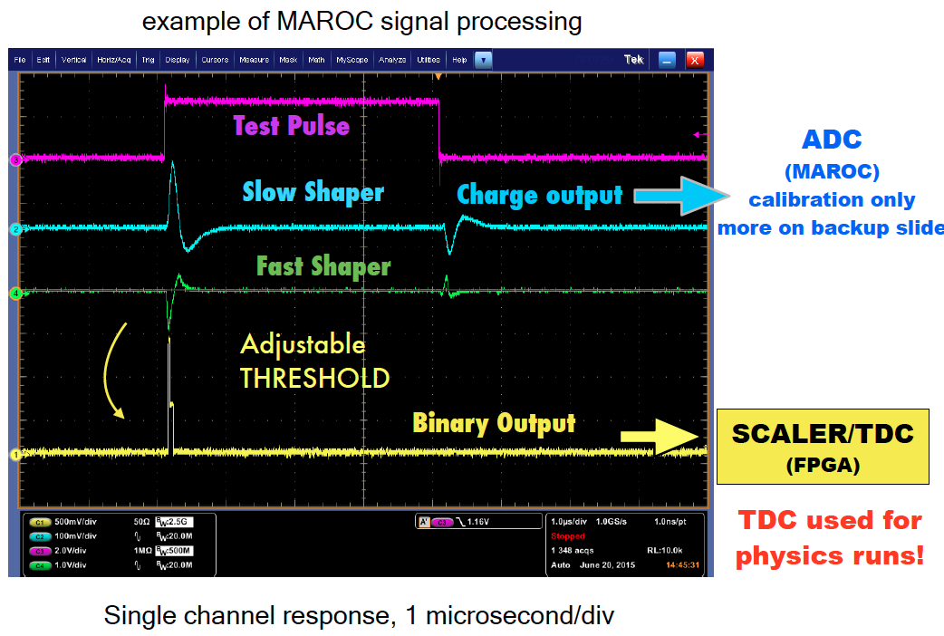
RICH Front-End Electronics
In collaboration with FE group
Analog: Charge (1 fC)
Digital: Time (1 ns)
Trigger latency (8 μs)
Optical ethernet (2.5 Gbps)
Trigger: external
internal
self
On-board pulser
Contalbrigo M.
CLAS12 Meeting, 13 June 2017, JLab
Contalbrigo M.
11
Notes:
Aggiungere range di validita’ per fattorizzazione GPDs

Slide 12
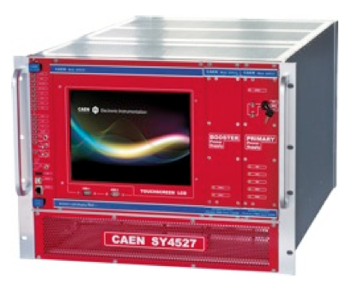
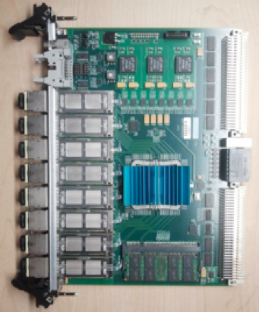
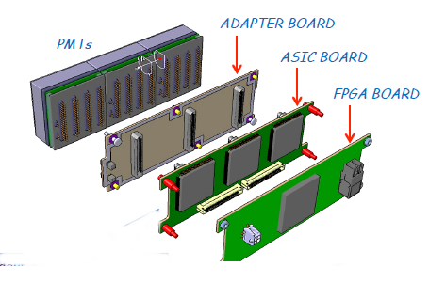
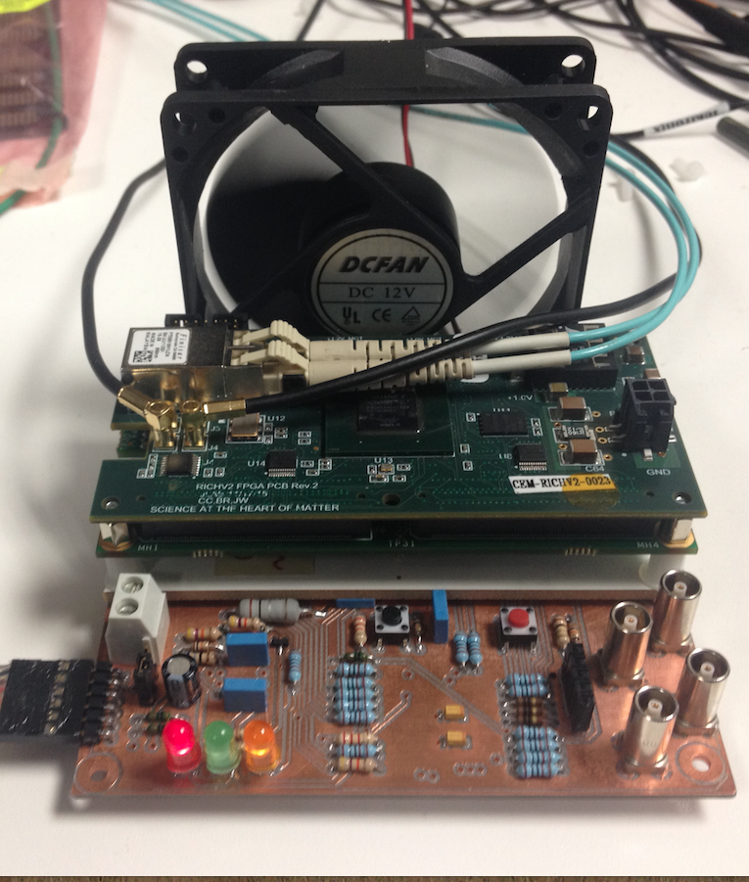
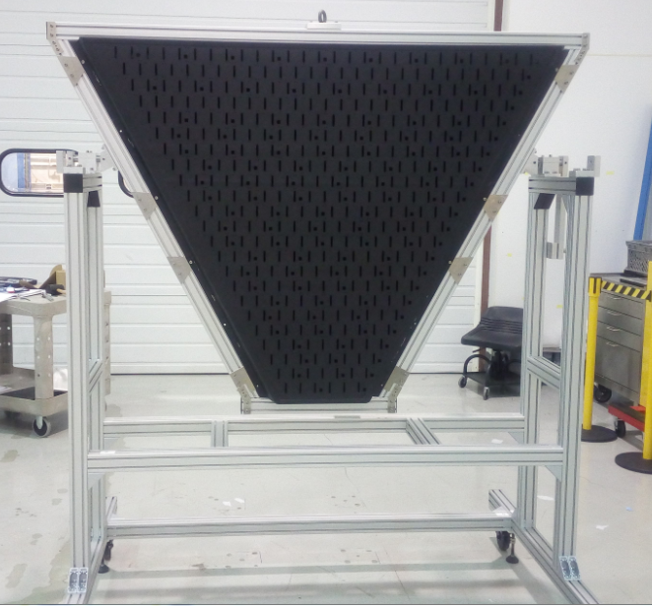
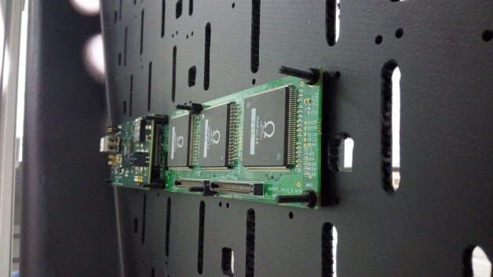
Readout Electronics
✓ Front-end production complete
Acceptance test performed
✓ Electronic Panel ready for assembling
✓ Completion of readout services by August
Power mainframe in use
SSP readout under test (Cody, Ben, Matteo)
SY4527 LV & HV Power Supply
(compatible with EPICS)
5 SSP Fiber-Optic DAQ
(compatible with CLAS12)
Contalbrigo M.
CLAS12 Meeting, 13 June 2017, JLab
12
Notes:
Dire meglio chi fa cosa.

Slide 13
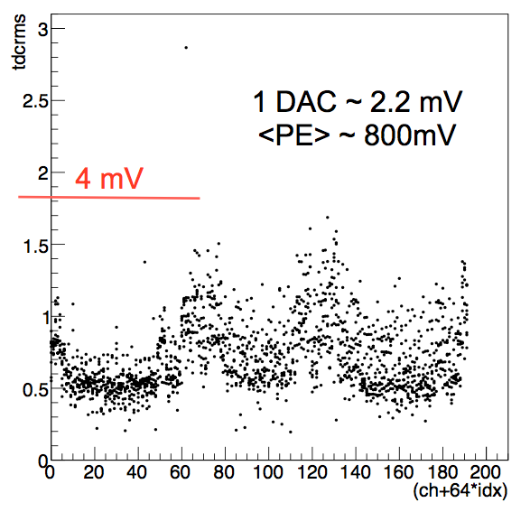
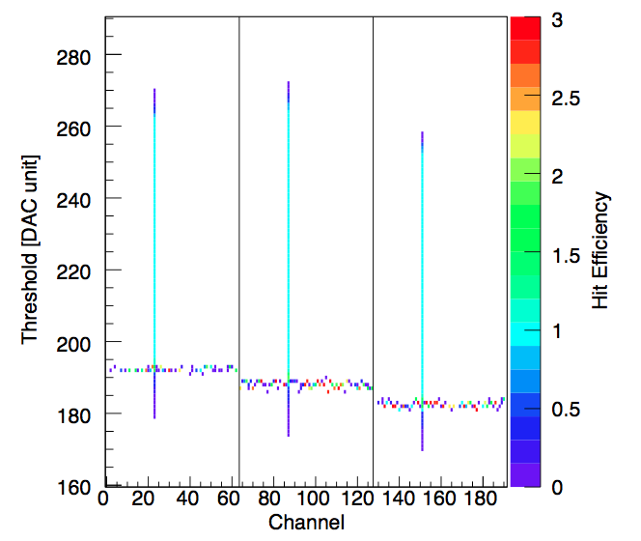
FE Electronics: Digital Readout
During Acceptance tests
During Internal Pulser Calibration
Pedestal level as seen by a test-point
As seen by RICH readout
Discrimination down to 20 fC, i.e. few % of SPE, allows sensor characterization
Contalbrigo M.
CLAS12 Meeting, 13 June 2017, JLab
13
Notes:
Dire meglio chi fa cosa.

Slide 14
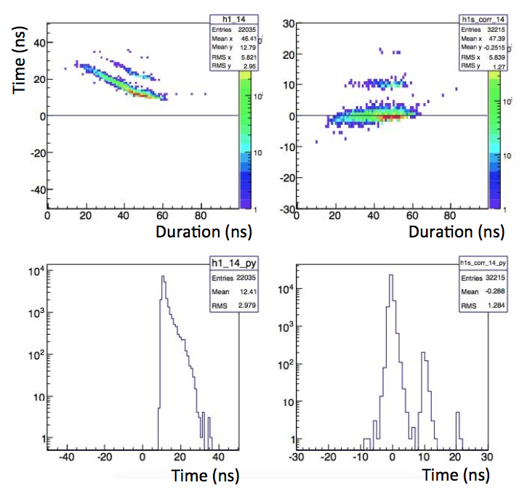
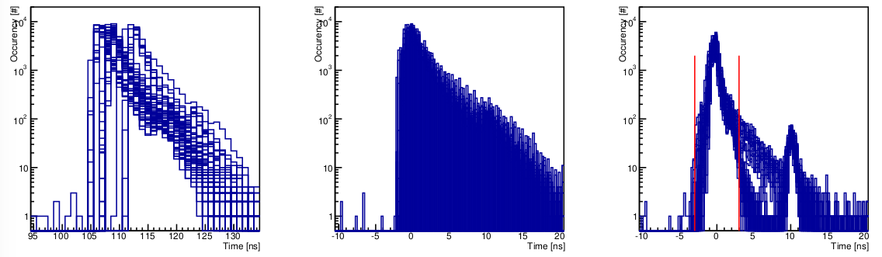
FE Electronics: Timing
Typical time-walk with charge
Time offset and walk corrected
Channel by channel time calibration: -offsets -walk
± 1ns
Occupancy (#)
PMT
Laser
Time (ns)
Contalbrigo M.
CLAS12 Meeting, 13 June 2017, JLab
14
Notes:
Dire meglio chi fa cosa.

Slide 15
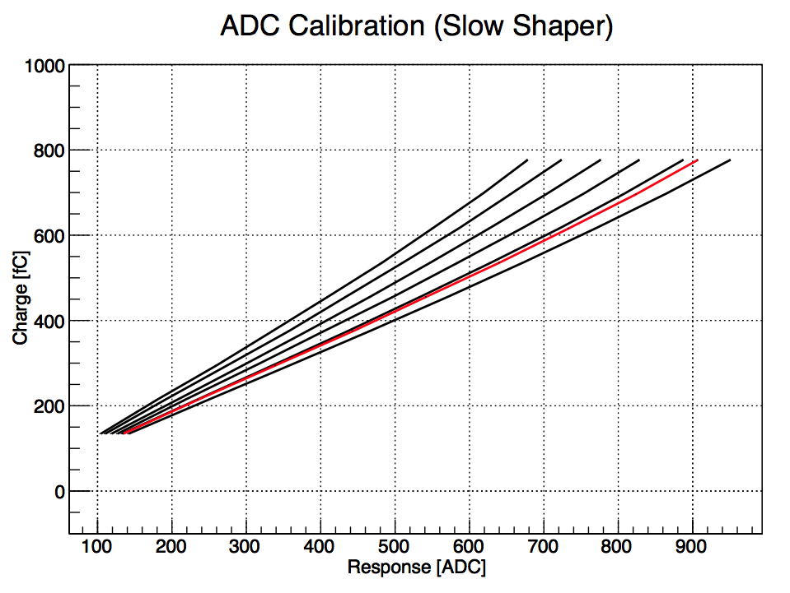
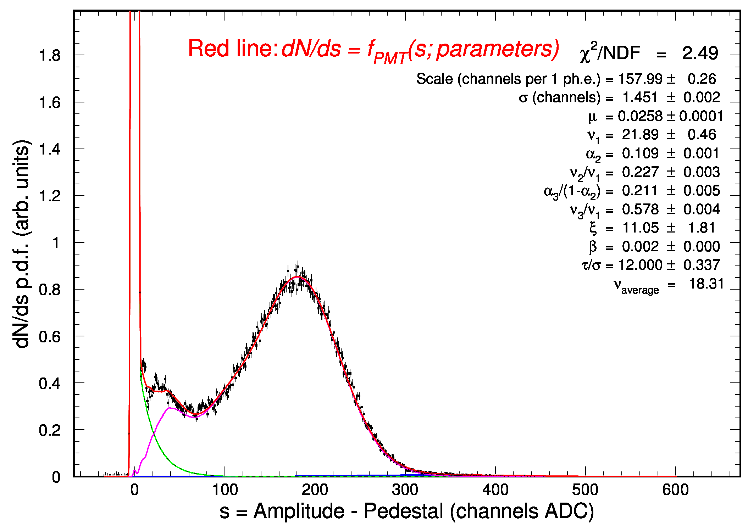
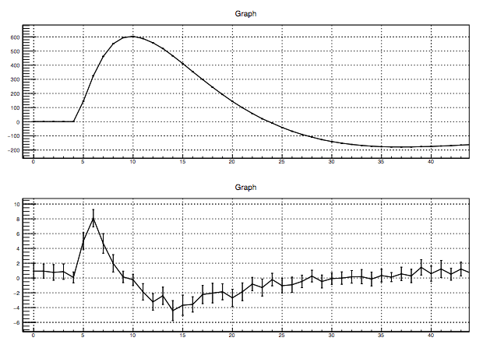
FE Electronics: Charge
Multiplexed readout up to 100 kHz
High resolution SPE spectrum
Viable for efficiency and gain monitors
In conjunction with timing, allows the
study of PMT discharge and cross-talk
Charge = shaper amplitude at the sampling time
Signal
Gain
Cross-talk
Sampling time
Contalbrigo M.
CLAS12 Meeting, 13 June 2017, JLab
15
Notes:
Dire meglio chi fa cosa.

Slide 16
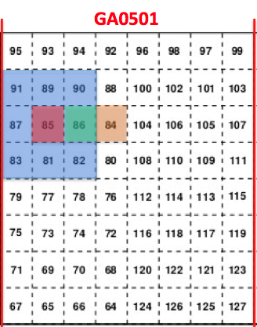


RICH Electronic: Cross-talk
Sensor
~ 20 fC
~ 1/80 SEP
Electronic
16
Notes:
Dire meglio chi fa cosa.

Slide 17




Cosmic Run
Phase 1 (June-July):
- fixed geometry
- 32 readout tiles (30 on the ring, 2 for tracking)
- SVT black cover
Goal: full readout chain
Phase 2 (August):
- Full panel instrumented
- Custom light-tight box
- Various track patterns
Goal: RICH readout commissioning
Important to define/commission
space and time alignment
photon vs track signals
gemc simulations
coat-java reconstruction
monitor suite
slow control
event display
calibration suite
Contalbrigo M.
CLAS12 Meeting, 13 June 2017, JLab
17
Notes:
Dire meglio chi fa cosa.

Slide 18




RICH Software
RICH geometry is implemented in the software mostly from CAD through mesh files
- a detailed, consistent and updated description of the detector can be obtained
- simulation and reconstruction shared the same database
Possible conflicts with optical photon tracking not yet solved
(mother volume, spherical mirror)
Digitization of the MAPMT response:
- calculate the pixel ID
- interface to CCDB
- apply efficiency
- simulated ADC and TDC spectra
Event reconstruction started
- match with DC information in coat-java
- photon tracing algorithm
(tested with prototype and cosmic runs)
- event display
Strong crew: Matteo, Ilaria, Marco, Giovanni,
Justin, Morgen, Elise, Aram, Andrey, …
Photon Energy
Direct ring example
Contalbrigo M.
CLAS12 Meeting, 13 June 2017, JLab
18
Notes:
Dire meglio chi fa cosa.

Slide 19



Gemc Digitization
ADC conversion:
- gaussian smeared conversion of
Npe in charge collection
- linear conversionin ADC units
TDC conversion:
- 1 ns gaussian smearing of the
leading time
- time duration proportional to charge
Will be made more realistic following
electronics calibration
Contalbrigo M.
CLAS12 Meeting, 13 June 2017, JLab
19
Notes:
Dire meglio chi fa cosa.

Slide 20




Cosmic Run Simulations
Tracking on MA-PMT
Cherenkov angle
4σ K-p
separation
Contalbrigo M.
CLAS12 Meeting, 13 June 2017, JLab
20
Notes:
Dire meglio chi fa cosa.

Slide 21



Monitor & Calibration Suite
Converting the stand alone version developed
in Duquesne to the CLAS standard
  Same java libraries are used,
  so smooth transition expected
To be checked if the original
flexibility can be fully exported
Monitor suite under development
Basic slow control suite ready
Contalbrigo M.
CLAS12 Meeting, 13 June 2017, JLab
21
Notes:
Dire meglio chi fa cosa.

Slide 22
Summary and Timeline
Mechanics: Key elements assembled
Adapting installation tools (cart and strong back)
Services Gas system approved and being assembled
Power lines and DAQ under procurement (already available for ¼ of the panel)
Electronics Production done
Calibration ongoing
Staged cosmic run for commissioning
Aerogel 3cm procurement done (minimum quantity)
2cm production completion planned in August
Mirrors Spherical Mirrors and support structure delivered
Coating ongoing
Planar Lateral 1.6mm skin mirrors produced
Improving process (cleaning) for frontal 0.7mm skin mirrors
Software gemc simulations being refined
coatjava reconstruction under development
monitor/calibration suites under development
working to test (part of) calibration in July challenge
Installation foreseen in September 2017
Contalbrigo M.
CLAS12 Meeting, 13 June 2017, JLab
22
Notes:
Dire meglio chi fa cosa.

