Slide 1
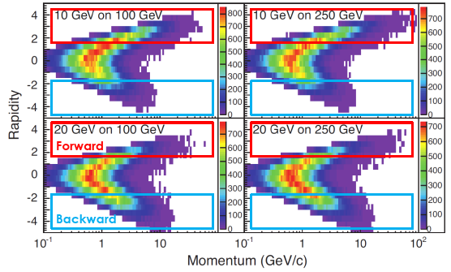
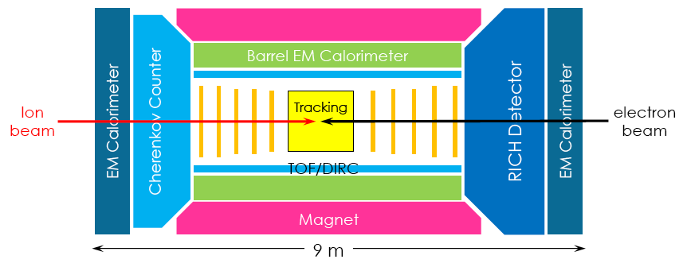
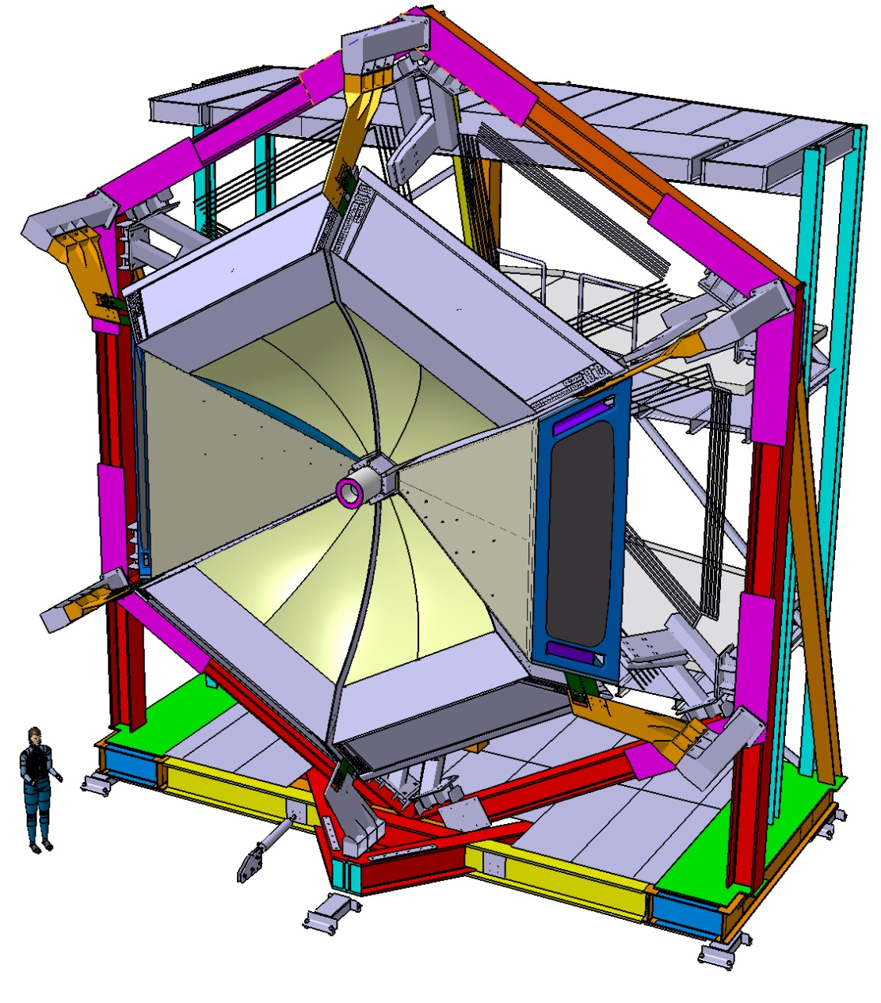
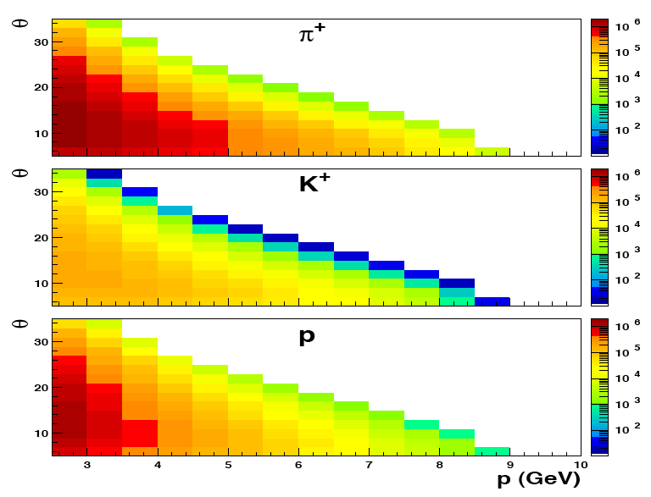
RICH Detectors for Particle ID
Semi-inclusive DIS to study 3D nucleon structure and hadronization; Hadron ID for flavor sensitivity
Typical Detector @ EIC:
RICH technology to cover
few-GeV forward hadron momenta
π
π
π
π
θ
30
CLAS12 RICH @ JLab:
Base configuration: 2 sectors
~1 m² photon detector per sector
Extension to additional sectors only possible
with cost-effective photon-detectors
20
10
θ
30
20
10
θ
30
20
Similar RICH requirements -> development of JLab applies to EIC
10
3
5
7
9
p (GeV)
F. Sabatie
Bochum Meeting
1

Slide 2
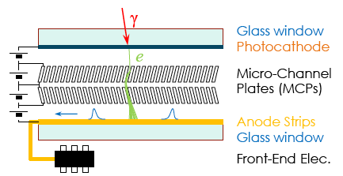
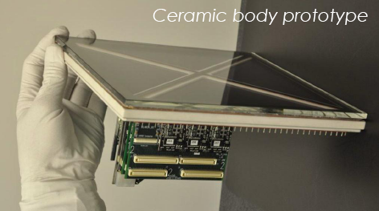
Cost-Effective Photon Detectors
Project goal: cost-effectiveness, compact size, excellent time resolution, good tolerance to magnetic field
Based on novel devices undergoing rapid evolution in performance gain and cost reduction
Silicon Photomultipliers
(in collaboration with manufacturers, e.g. FBK, Italy)
Performance comparable to a MA-PMT
T = -25º
Micro-channel Large-Area Picosecond Photon-Detectors (in collaboration with JLab, USA)
Rapid evolution of the technology needs extensive characterization and dedicated readout electronics
F. Sabatie
Bochum Meeting
2

Slide 3
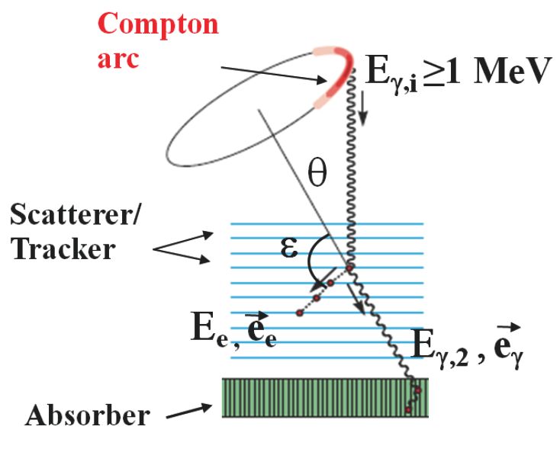
Application: Medical Imaging
Project goal: large area coverage to limit and control the patient assumed dose
Compton Camera: 3D imaging without tomography by gamma tracking
(in collaboration with Italian Health Institute, ISS)
Proof-of-principle use of cost-effective devices:
GEM or micro-megas as tracker
SIPM or LAPP as photon detector
Potential Benefits:
Higher efficiency than SPECT
No intrinsic limit to spatial resolution
(e.g. positron range in PET)
Broad applicability
broader set of radionuclides than PET
real-time dose control in radiotherapy
Complex, no clinic system in operation yet
Perfect application challenge
for HPH detector R&D activities
Compton Arc
0.1 MeV
Tracker/Scatterer
Adsorber + Photon Detector
F. Sabatie
Bochum Meeting
3

Slide 4
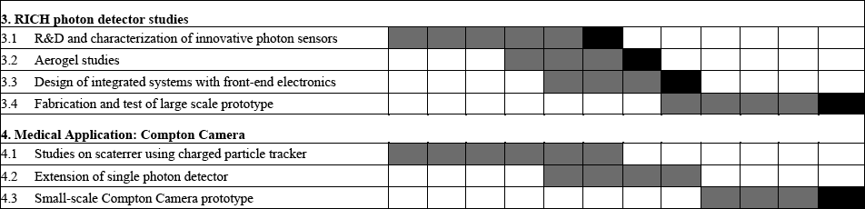
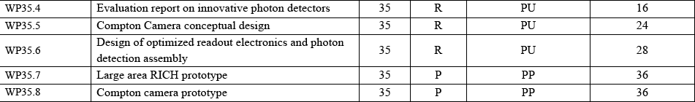
Description of Work
Tasks and subtasks:
Deliverables:
F. Sabatie
Bochum Meeting
4

