Slide 1

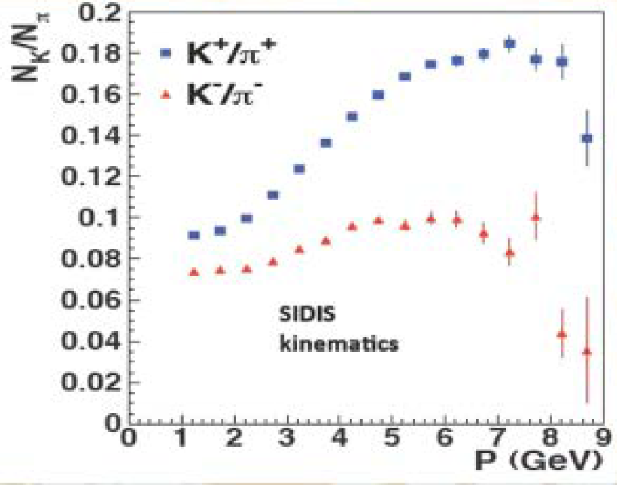
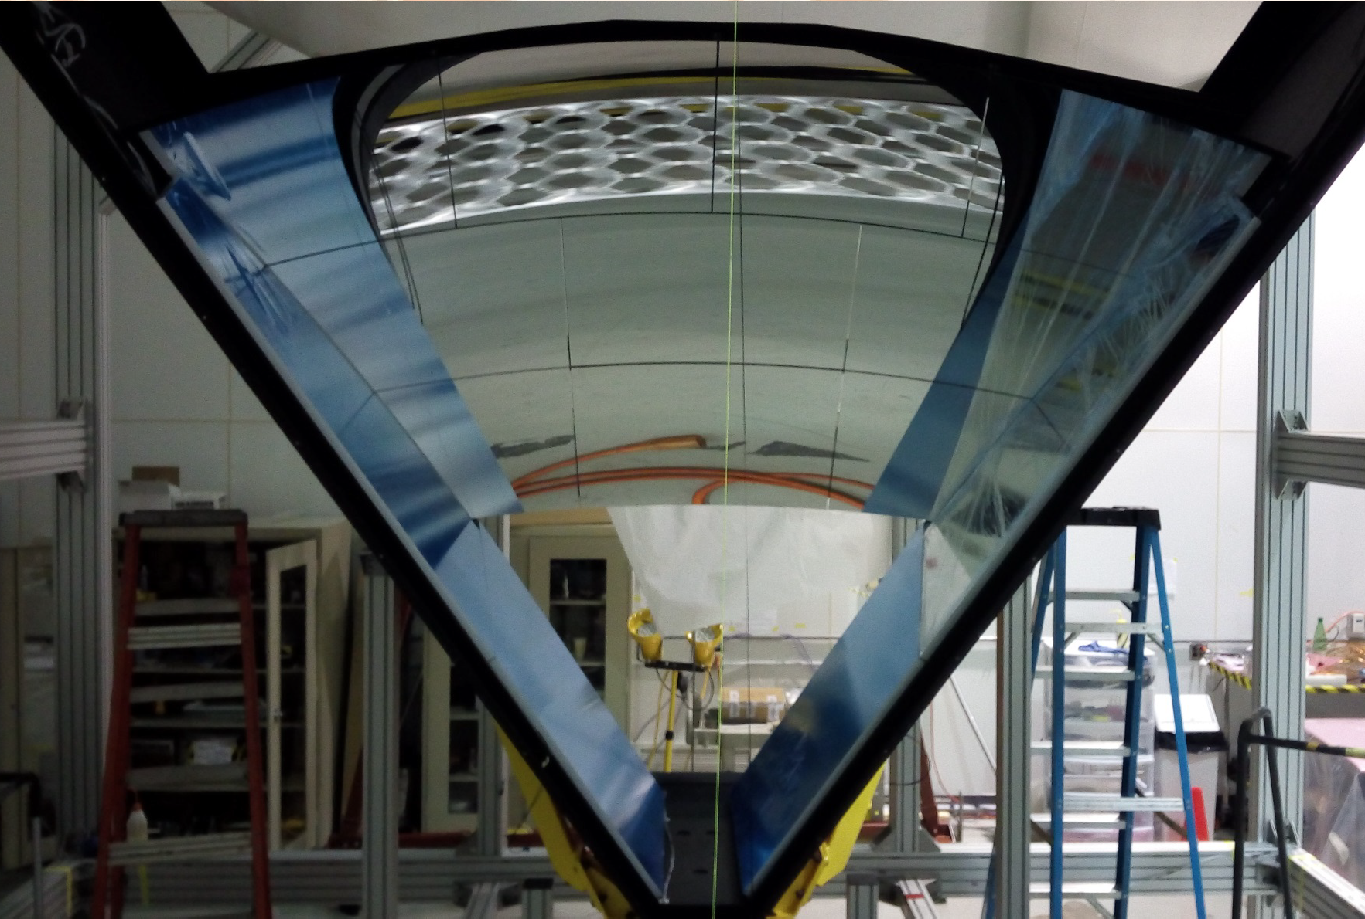
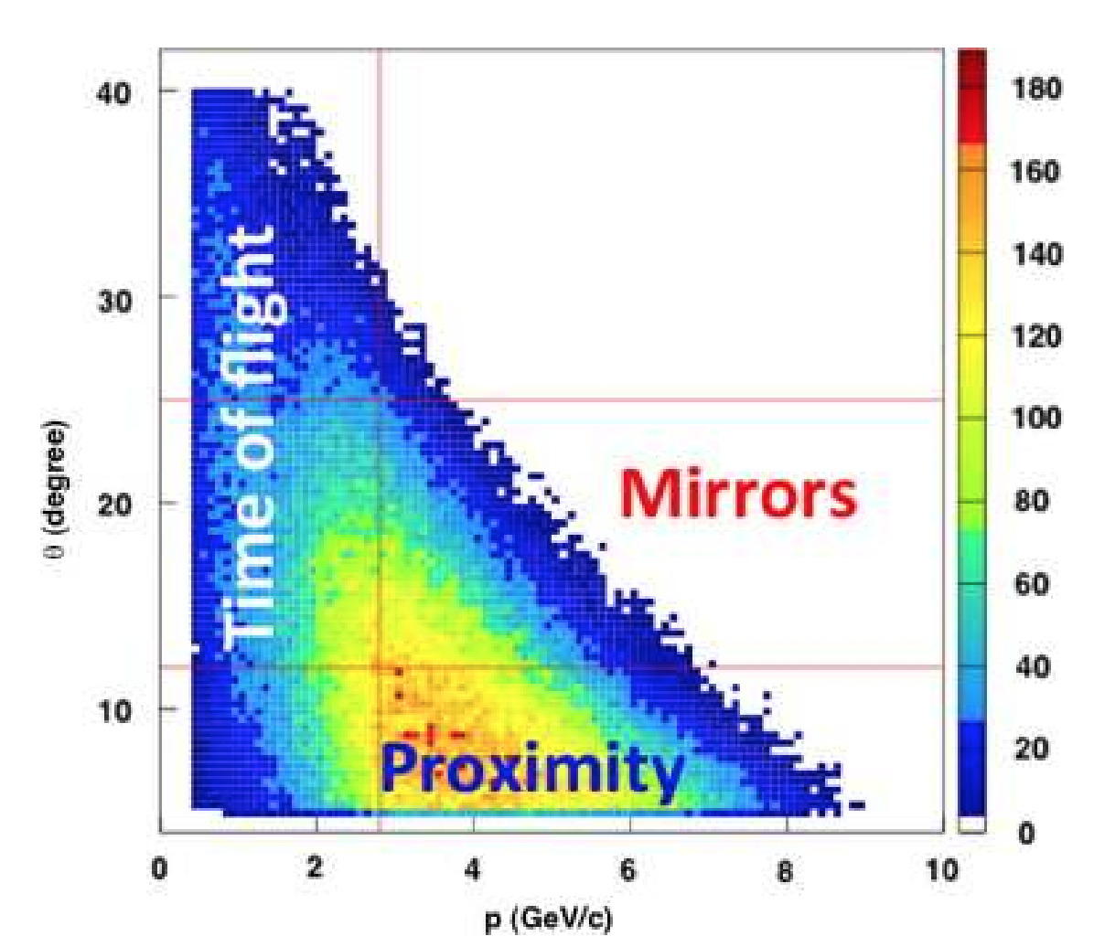
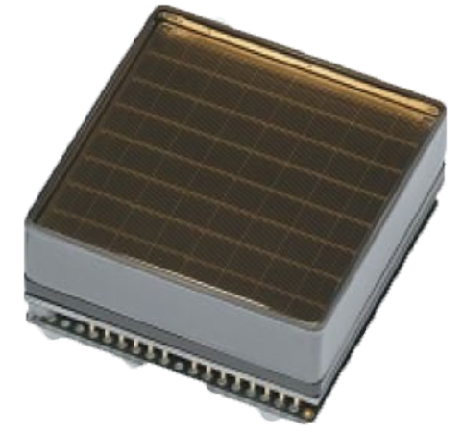
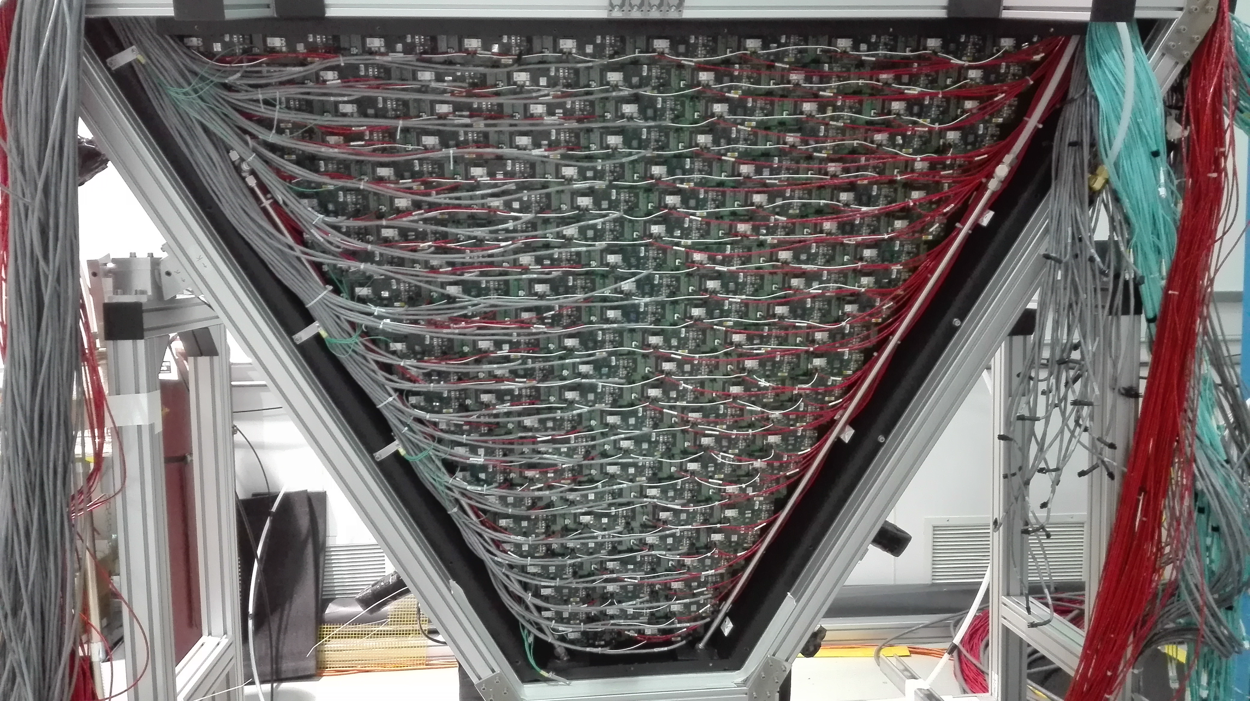
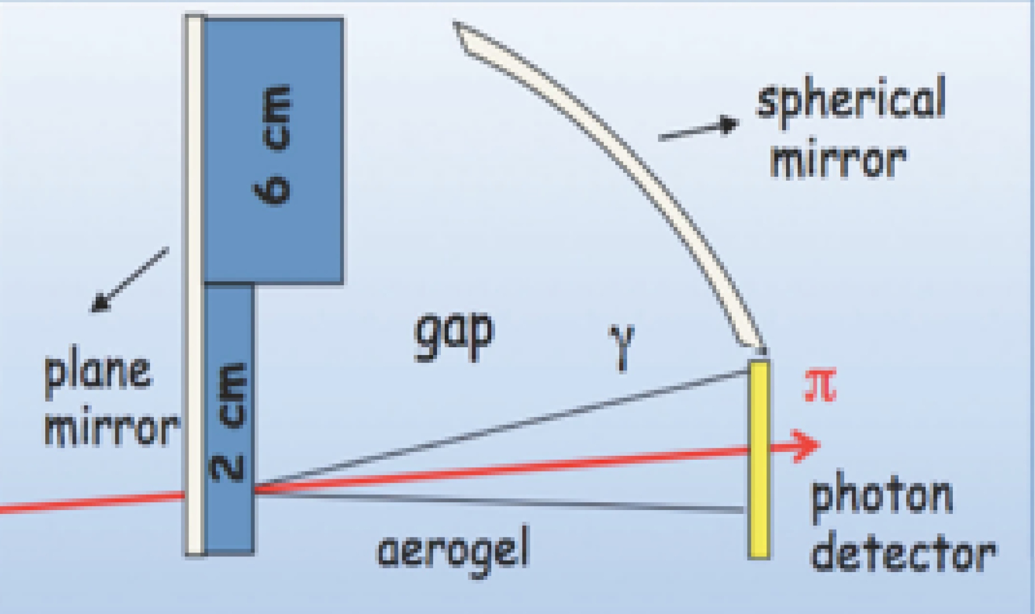
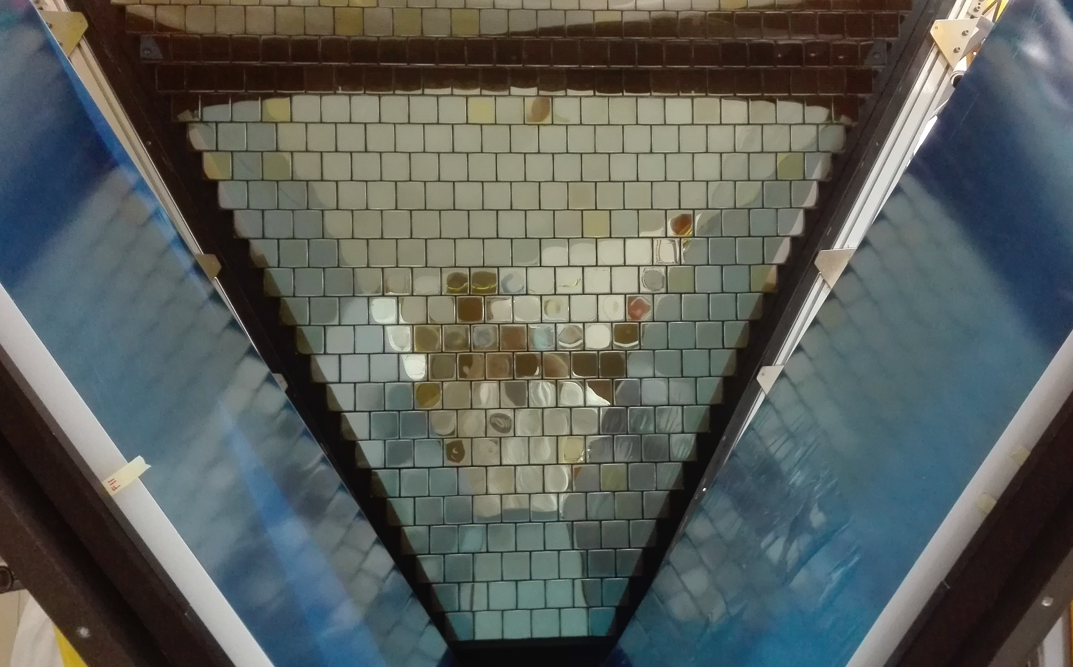
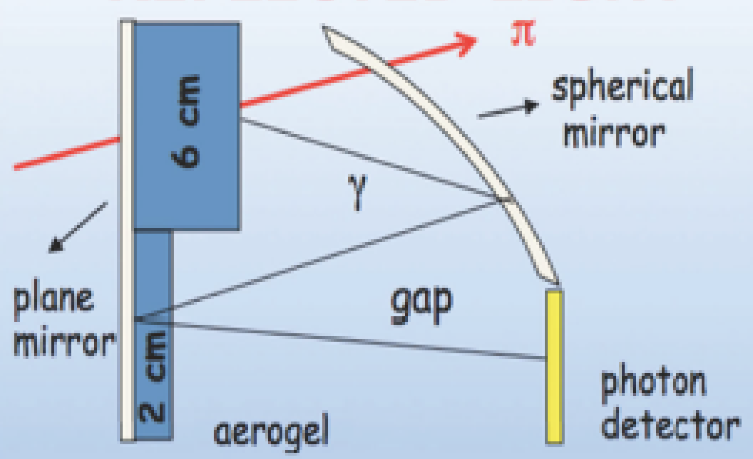
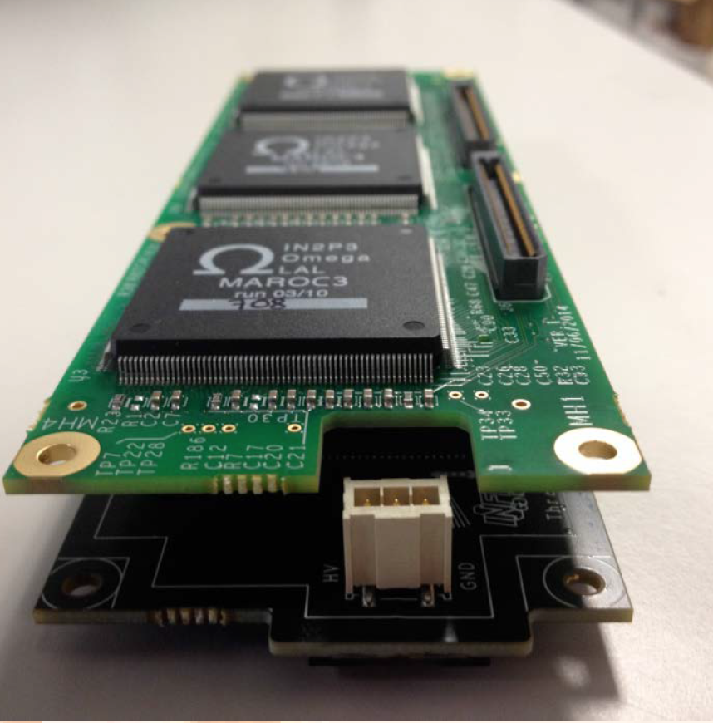
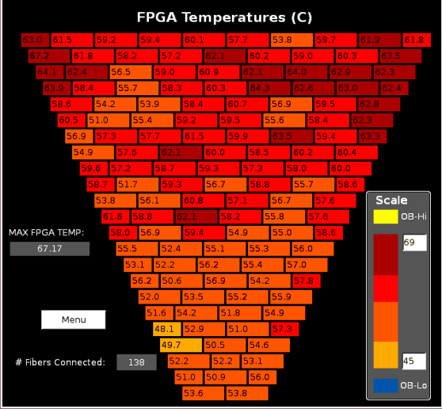


THE CLAS12
An International Collaboration:
INFN (Italy), JLab (USA), ANL (USA) , Duquesne Univ. (USA) The George Washington Univ. (USA), Univ. of Connecticut (USA),
Kyungpook National Univ. (Republic of Korea), Univ. Tecnica Federico Santa Maria (Chile), Univ. of Glasgow (UK).
The Ring Imaging Cherenkov detector (RICH) is designed to improve the
CLAS12 Particle Identification (PID) in the momentum range 3-8 GeV/c
Kaon Identification
Aerogel Radiator
Complex Mirror System
Improving CLAS12 PID
Only option in this momentum range
Used to reduce the instrumented detection
area
A good PID is required for 4 approved
experiments.
- Large single brick area: 20cm x 20cm
- Refractive index: n=1.05
- Emitted Light : Visible & UV
- 10 CFRP Spherical Mirrors (R=2.7 m)
- 4 Frontal Planar Mirrors (glass-skin)
- 7 Lateral Planar Mirrors (glass)
π/K production ≈ 10
π/K
rejection power> 500
The RICH is necessary for
the PID in the momenta
range 3-8 GeV/c
TOF provides PID
up to 3 GeV/c
Threshold Cherenkov
Counters provide PID
above 8 GeV/c
Hybrid Geometry
MA-PMTs
Front-End Electronics
Hamamatsu H12700 & H8500
Innovative hybrid design
to reduce cost and material budget
First detector using H12700
Direct detection of Cherenkov light
Single Photon Sensitivity
Pixel size : 5.8 mm
Packing Factor: 89%
Maximum quantum efficiency: Visible light
The Italian Contribution to the Thomas Jefferson National Accelerator Facility
Angles: θ < 13°
Momenta:3-8 GeV/c
Reflection of Cherenkov Light
MAROC3 readout chip:
Angles:
Momenta:3-6 GeV/c
13° < θ < 25°
64 Channels
Multiple reflections.
Double passage in
aerogel.
Digital readout
Single channel configurability
DAQ Electronics:
FPGA serving group of 2/3 MAROCS
Project status
1st module assembled in 2017
1s module installed in CLAS12
in January 2018
First Phase of Run Group-A
data taking completed
(Jan-May2018)
2nd module under constrution,
installation foreseen by 2020
Italian Institutions at JLAB
INFN Bari, Uni & INFN Catania, Uni & INFN Ferrara, Uni & INFN Genova, INFN LNF,
Uni & INFN Padova, Uni Roma Sapienza & INFN Roma, Italian National Institute of Health ,
Uni & INFN Roma Tor Vergata, Uni Sassari & INFN Cagliari, INFN Torino

