Slide 1
Hall-B Run Group H
CLAS12 Experiments with a Transversely Polarized Target
Contalbrigo Marco - INFN Ferrara
JLab PAC53 Meeting, 23th July 2025
M. Contalbrigo
JLab PAC53 Meeting – 23rd July 2025
1

Slide 2
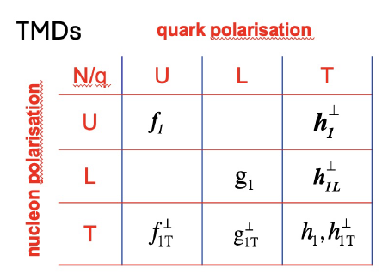
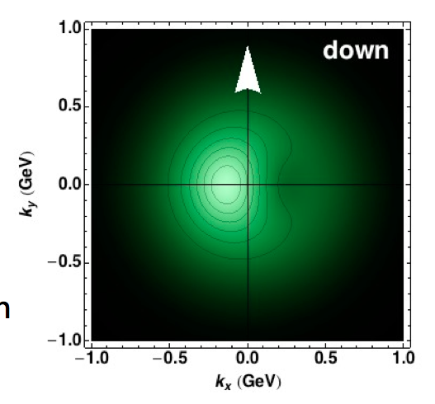
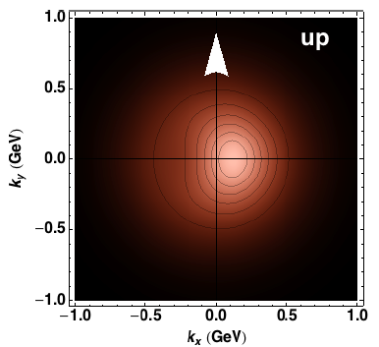
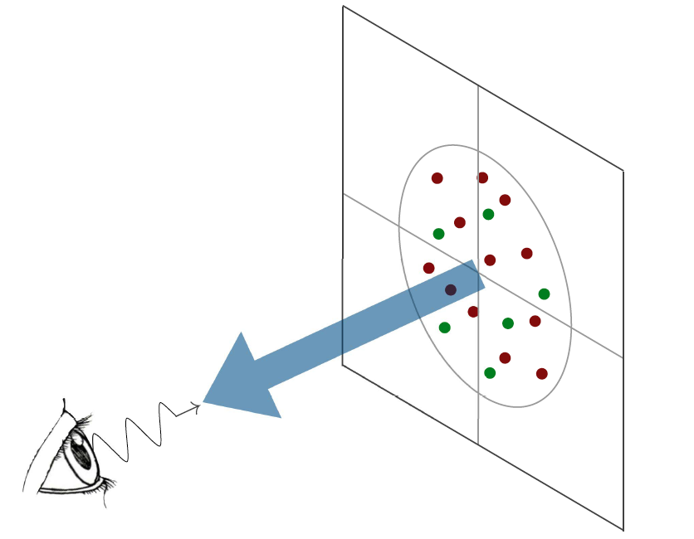
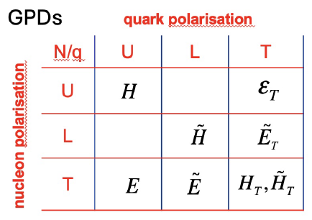
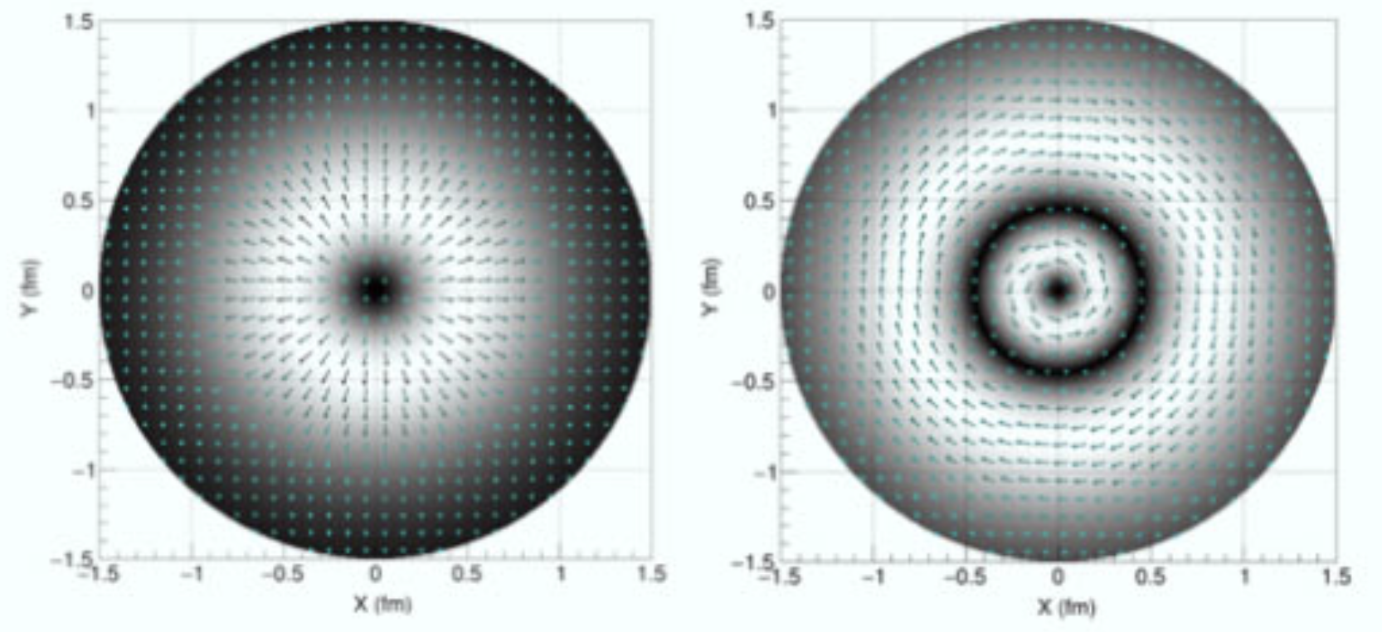
3D Nucleon Structure by DIS
TMD (x, k_{T})
Confinement Scale
Transverse momentum
GPD (x, b_{T})
k_{T}
b_{T}
Transverse position
Longitudinal momentum
k⁺=xP⁺
Spin
l
High Energy Probe
Hard Scale
Photon Virtuality
Q²
Transverse plane
l
Credit: A. Bacchetta
M. Contalbrigo
JLab PAC53 Meeting – 23rd July 2025
2
Notes:
Vanno messi studi innovativi e pubblicazioni

Slide 3
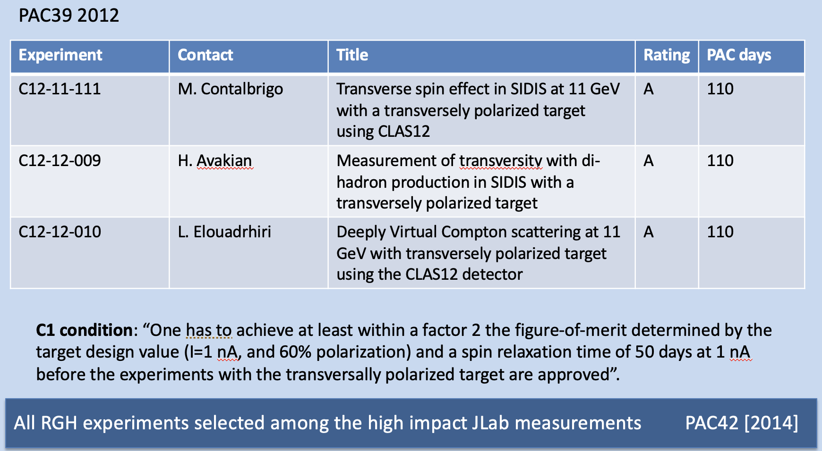

Run Group H
Access to unique
observables in
SIDIS hadron
SIDIS Di-hadron
DVCS
Gather unprecedented
information on
Transversity
Tensor charge
Sivers,
GPD E
quark OAM
RGH experiment status (with HDice) confirmed at PAC48 in 2020 (during jeopardy process)
with C1 condition on target performance
RGH status modified to C2 in 2024 (during jeopardy process) to properly evaluate the target change
✓ GEANT simulations ✓ Impact study ✓ Systematics
$h_{1T}^{⊥}$, $g_{1T}^{⊥},$ $H_{1}^{⊥}$
M. Contalbrigo
JLab PAC53 Meeting – 23rd July 2025
3

Slide 4
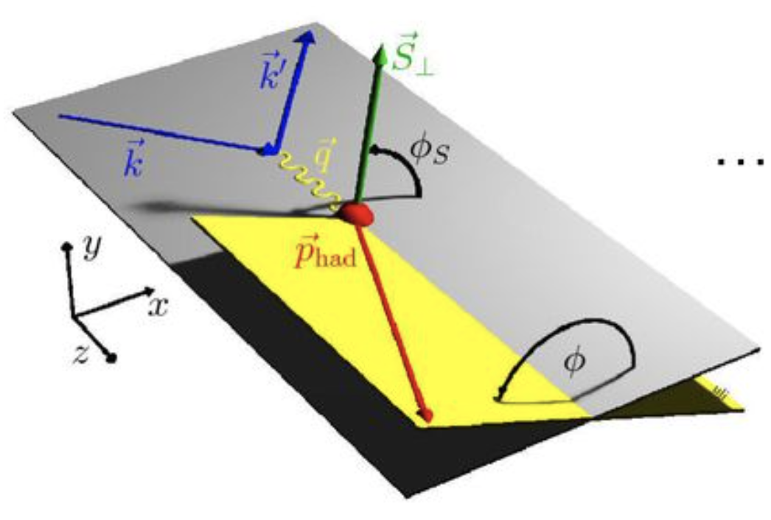
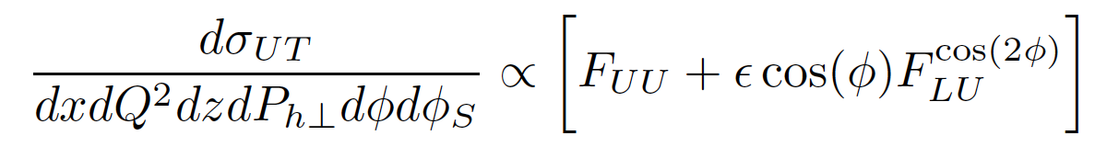
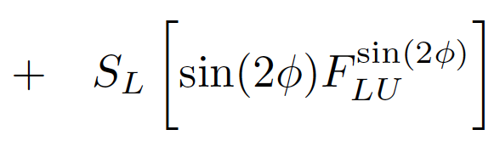
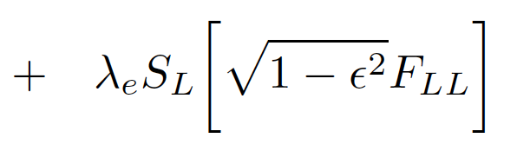
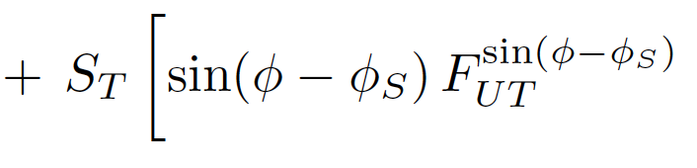
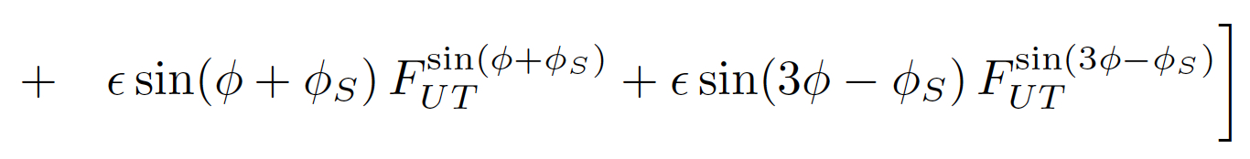
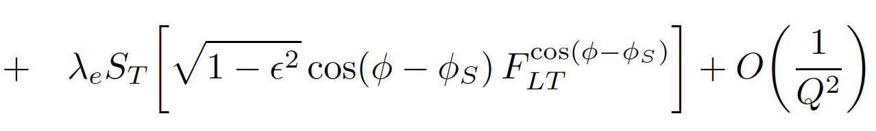
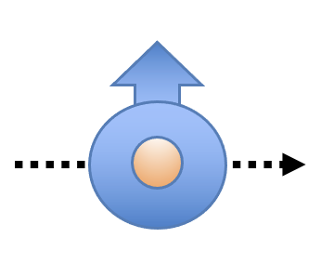
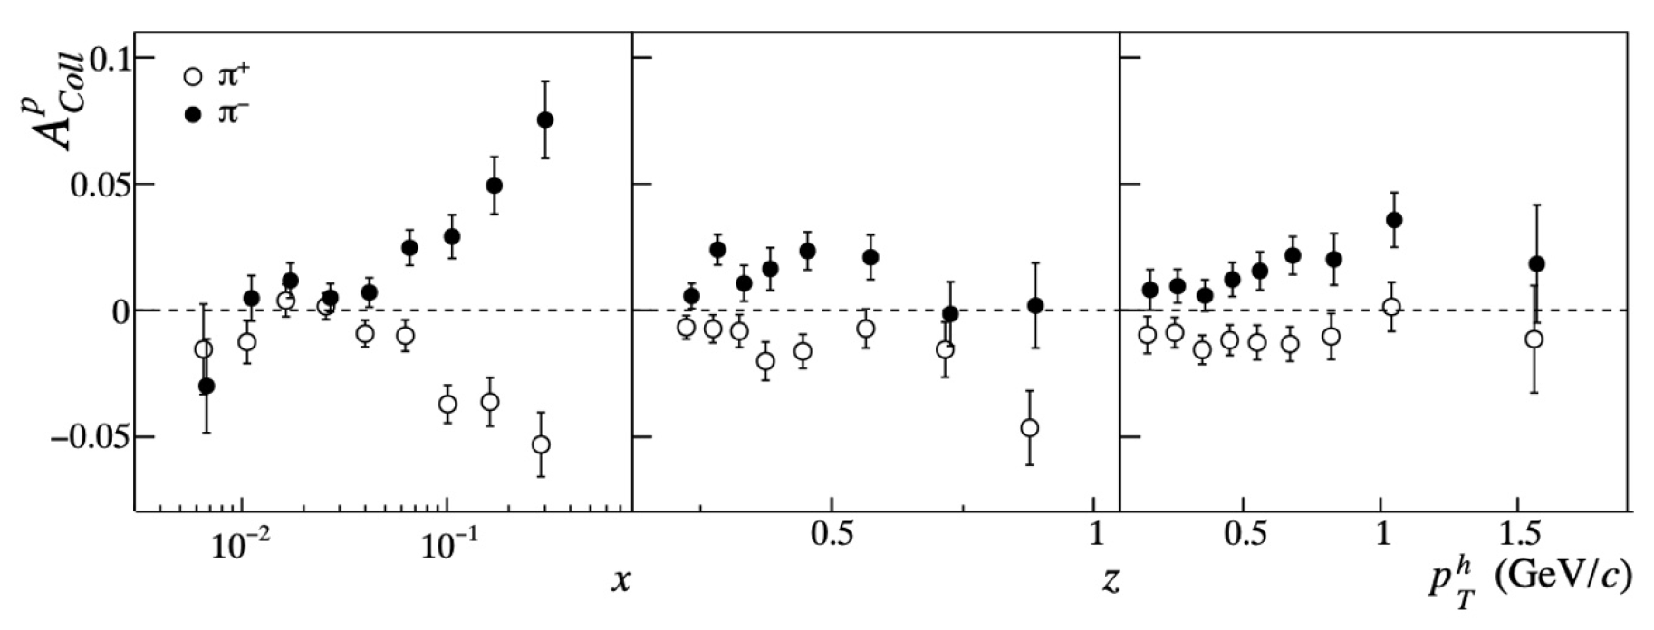
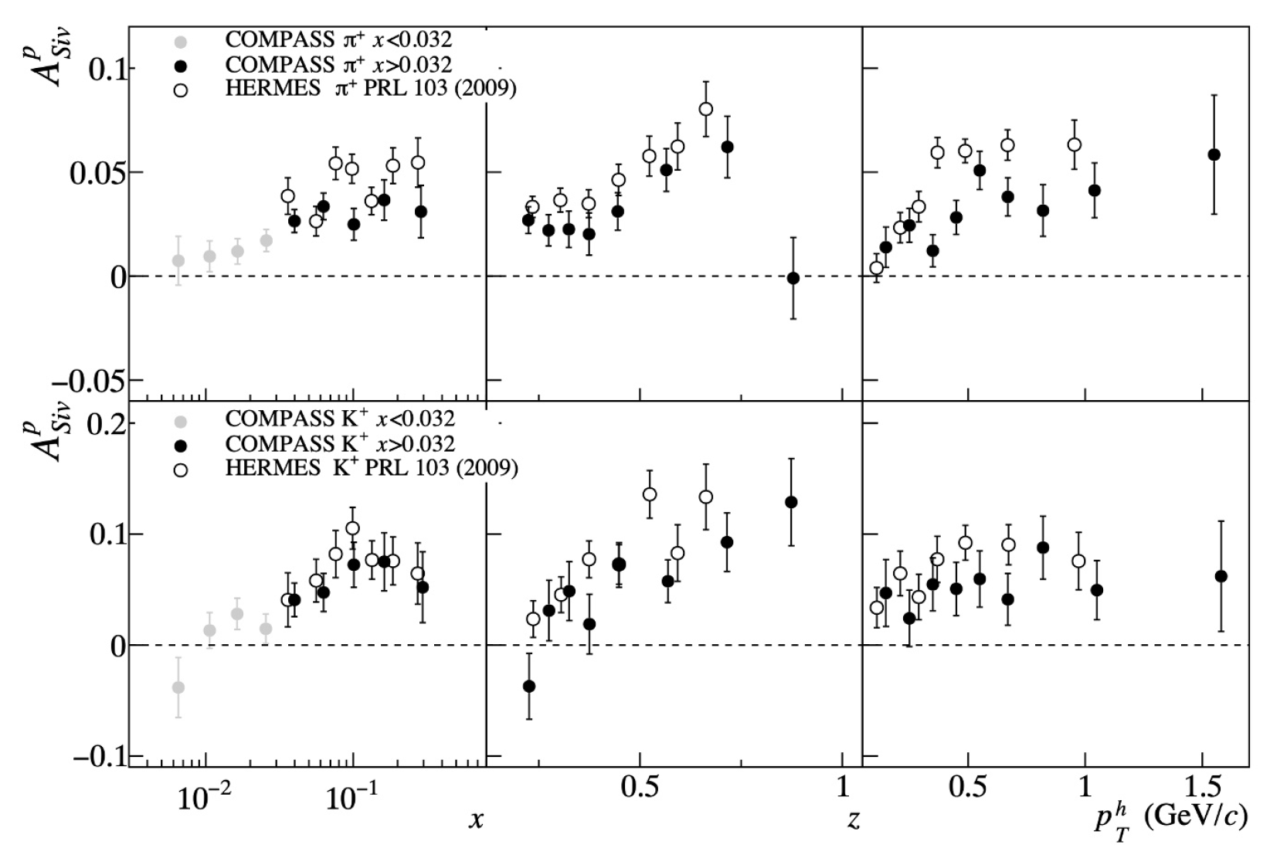
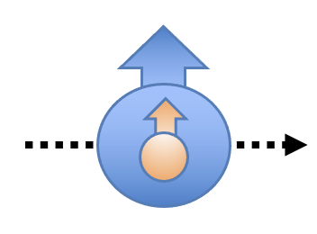
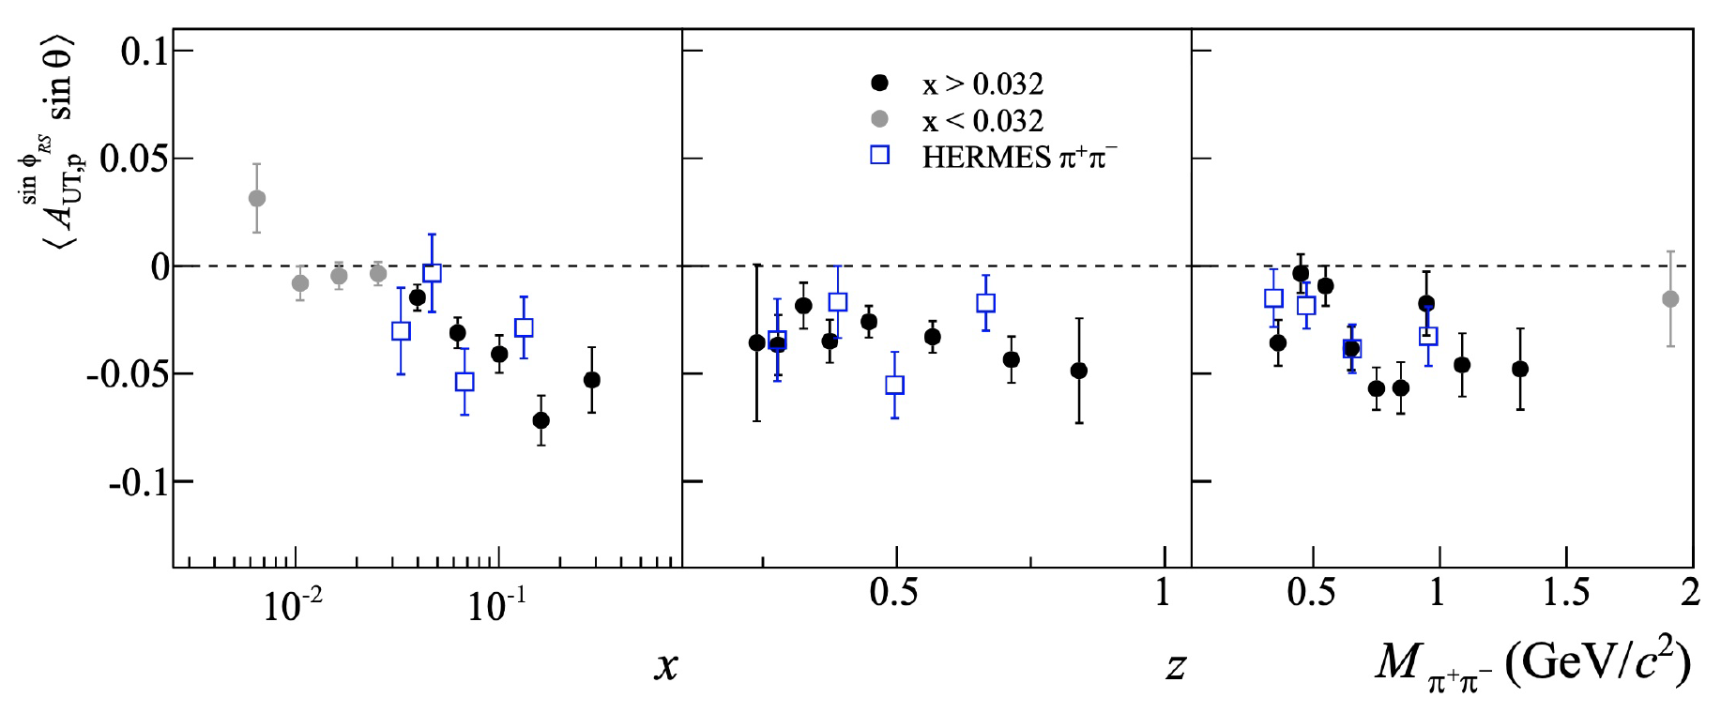
Semi-Inclusive DIS
ep e’hX, e’hhX
C. Adolph, PLB 744 (2015) 250
Sivers
C. Adolph, PLB 744 (2015) 250
Transversity
G.D. Alexeev, PLB 845 (2023) 138155
M. Contalbrigo
JLab PAC53 Meeting – 23rd July 2025
4
Notes:
Nota son tutti 1D

Slide 5
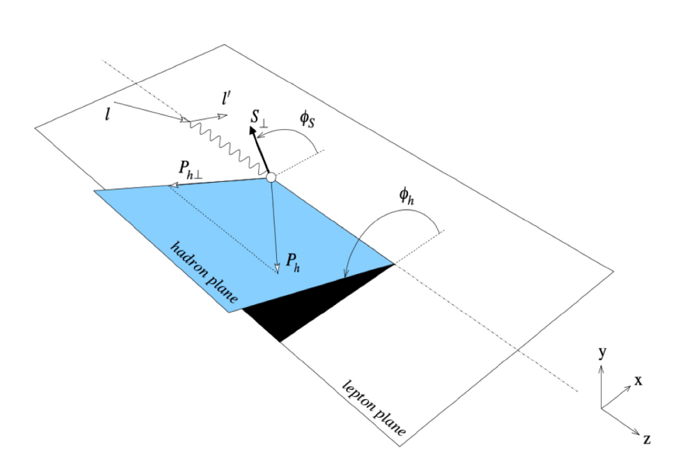
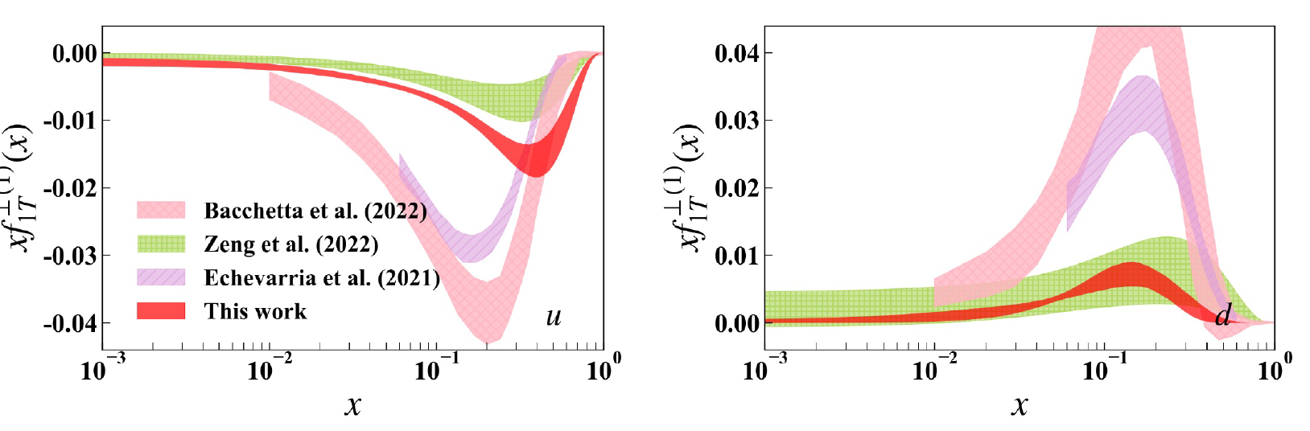
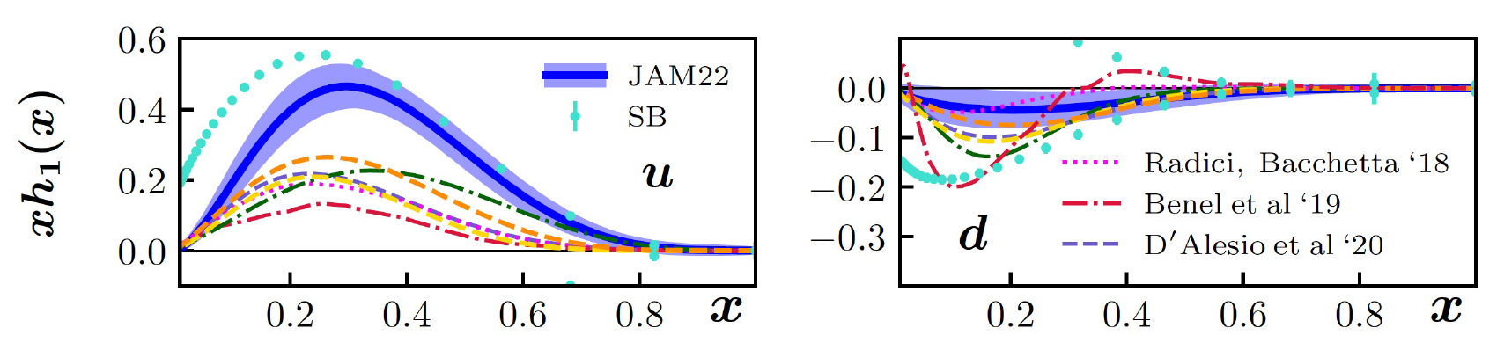
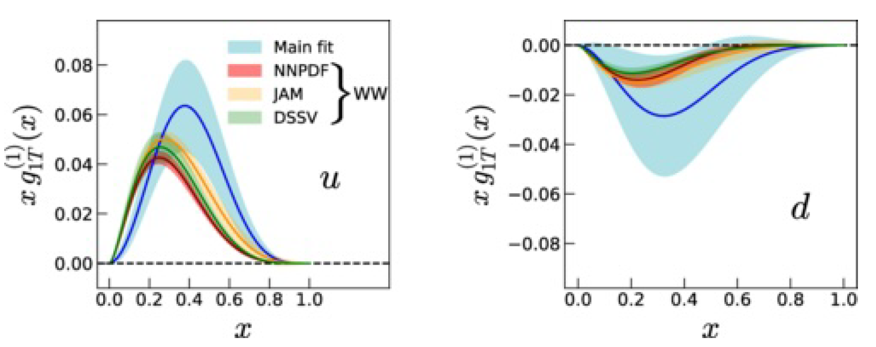
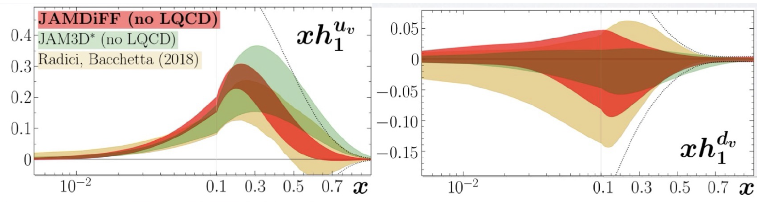
What we know: TMDs
ep e’hX, e’hhX
Large sensitivity expected in the valence region
Lack of data above x = 0.3 and no fully differential (4D) analysis available so far
CLAS12 can be the first experiment to achieve a 4D analysis in the valence region
Sivers
Transversity from single hadron SIDIS
Kotzinian-Mulders
Transversity from di-hadron SIDIS
M. Contalbrigo
JLab PAC53 Meeting – 23rd July 2025
5

Slide 6
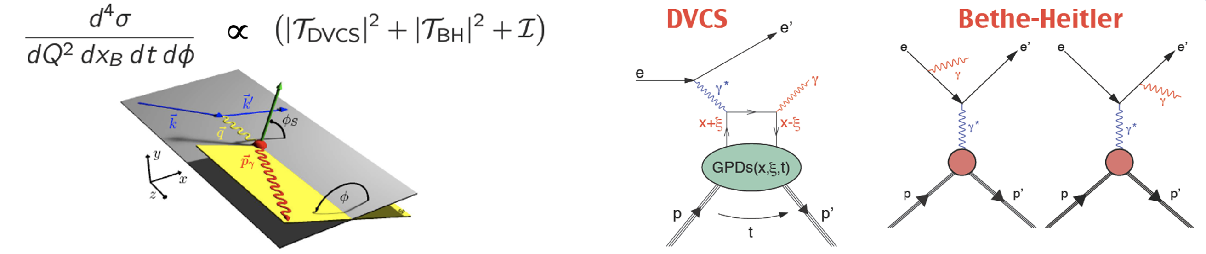
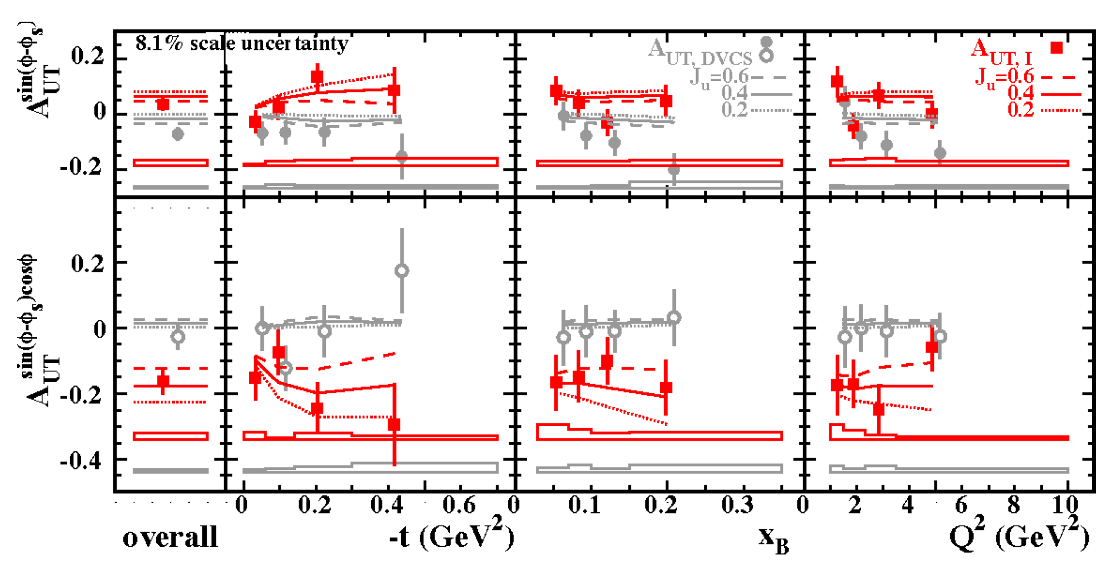
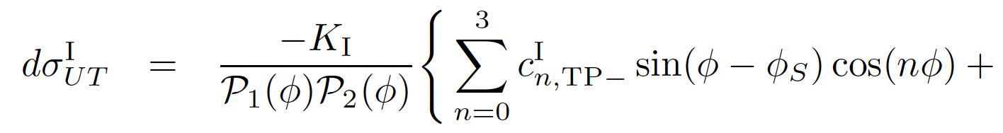
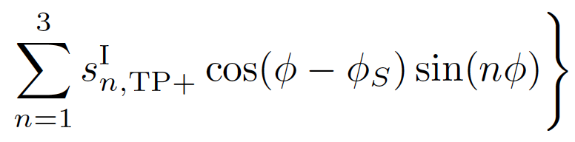
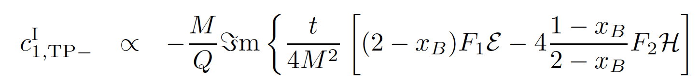
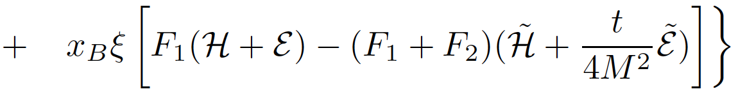
Deep Virtual Compton Scattering
ep → e’ p’ γ
Rare access to Imε CFF with no kinematic suppression
A. Airapetian, PLB 74 (2011) 15
M. Contalbrigo
JLab PAC53 Meeting – 23rd July 2025
6
Notes:
Trova il plot di Adam con HERMES aperti

Slide 7
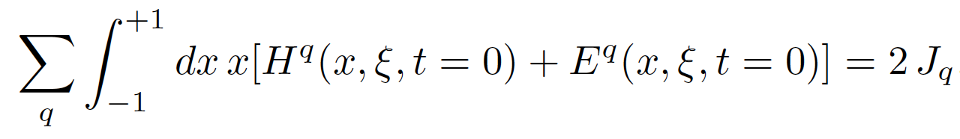
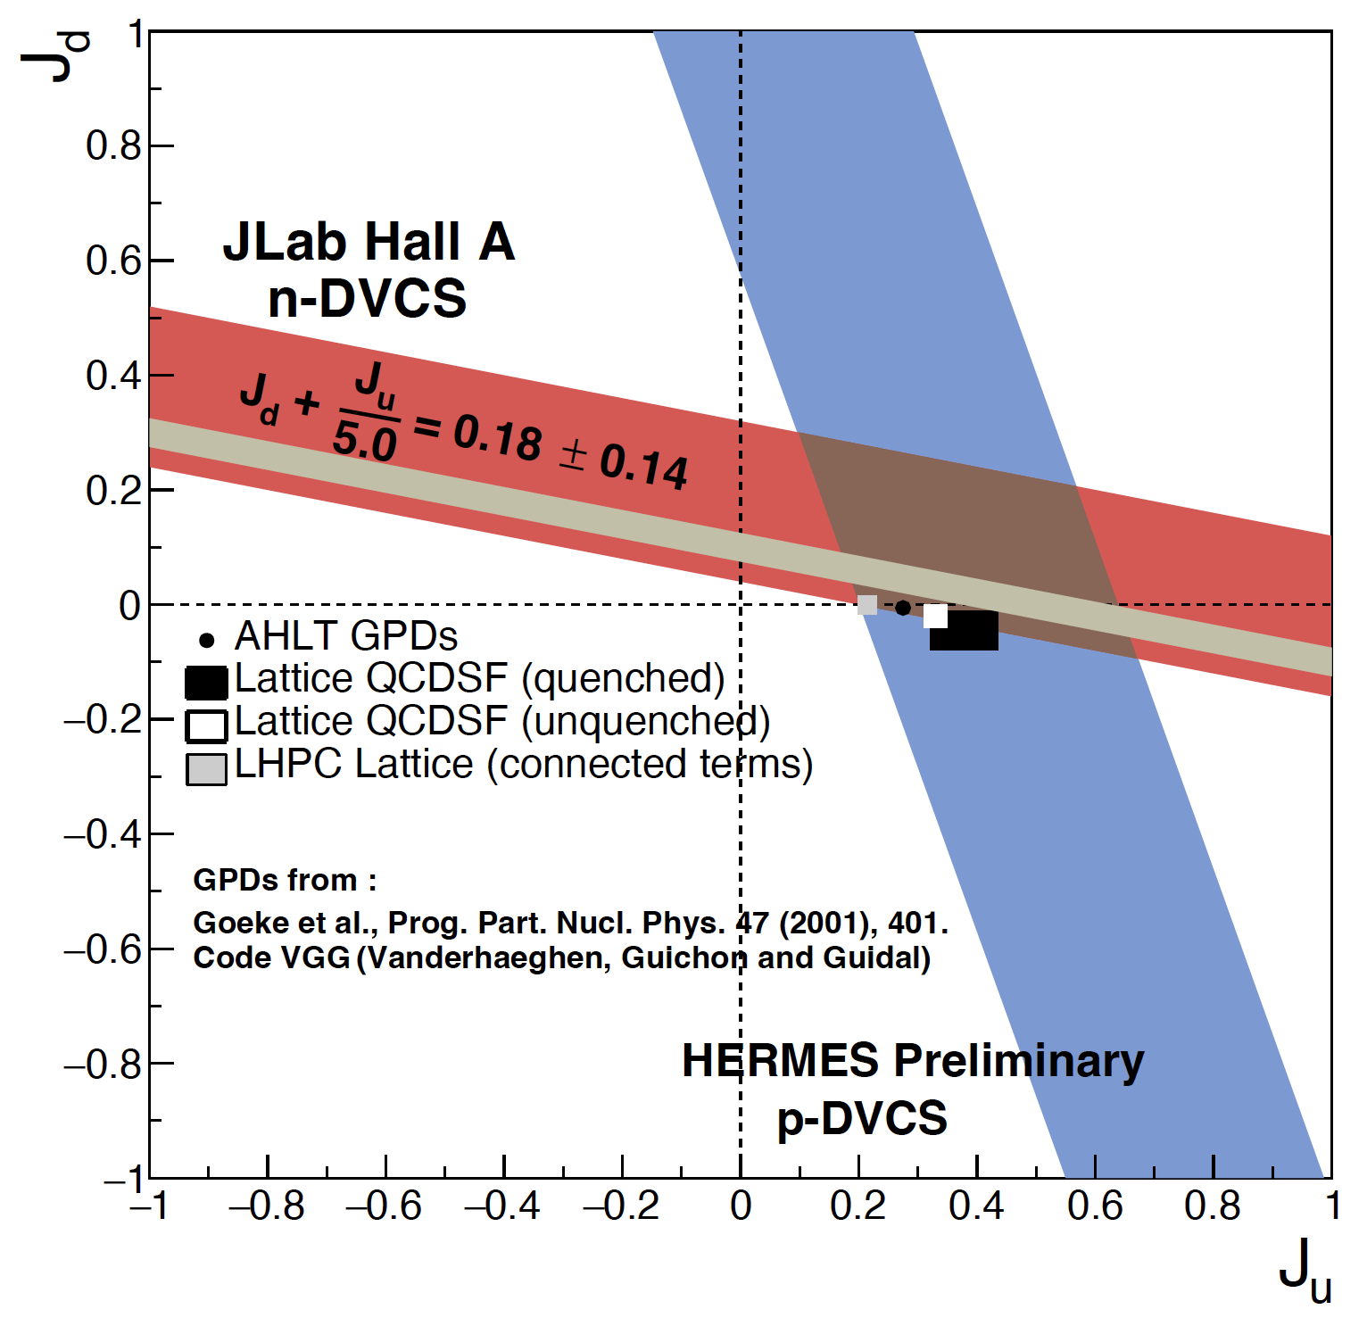
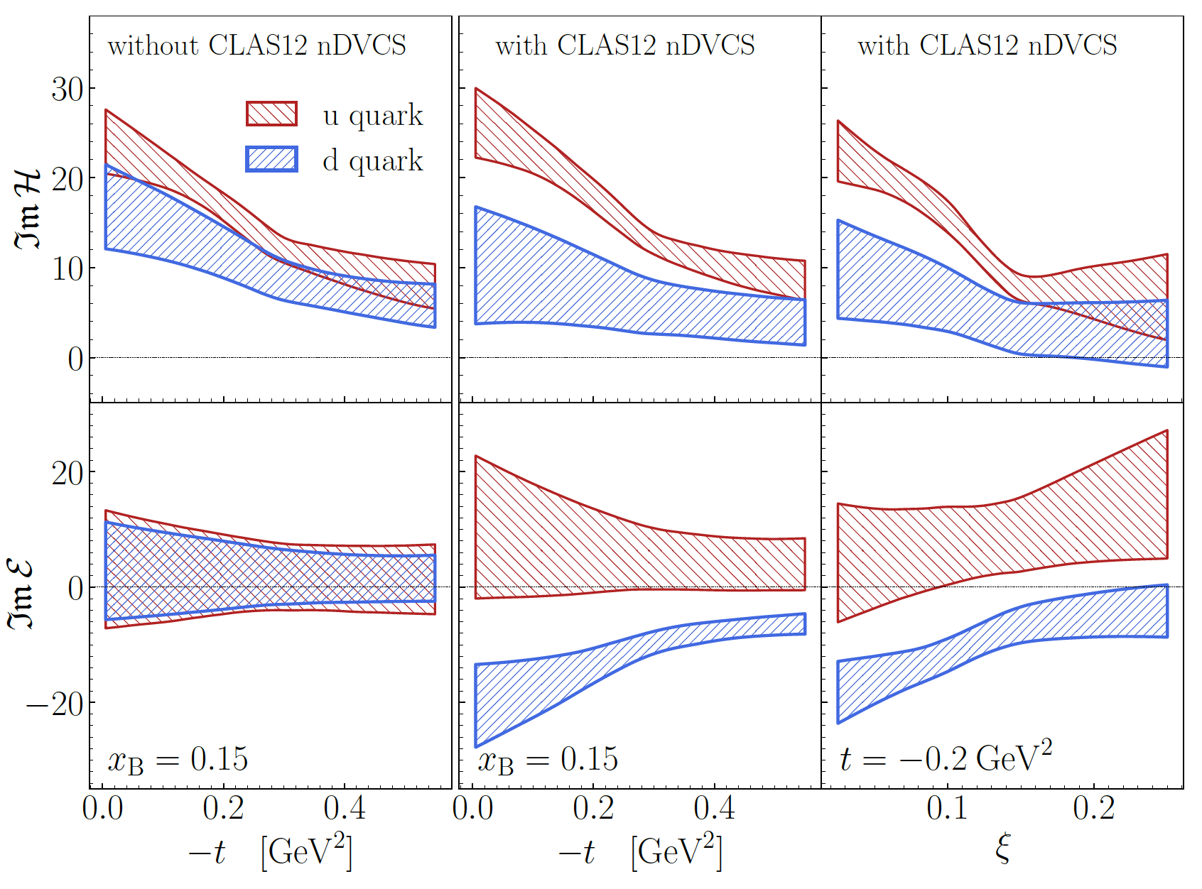
What we know: GPDs
GPD E is essential to pin down the quark dynamics (OAM)
It is poorly known expecially for the u-quark flavor
CLAS12 can be the first experiment in exploiting both
A_{LU} measurement on neutron with
A_{UT} measurement on proton
CLAS12 RGB measurement of A_{LU} on neutron, Phys.Rev.Lett. 133 (2024) 21, 211903
A_{LU}
CLAS12 A_{LU}
A_{UT}
M. Contalbrigo
JLab PAC53 Meeting – 23rd July 2025
7

Slide 8
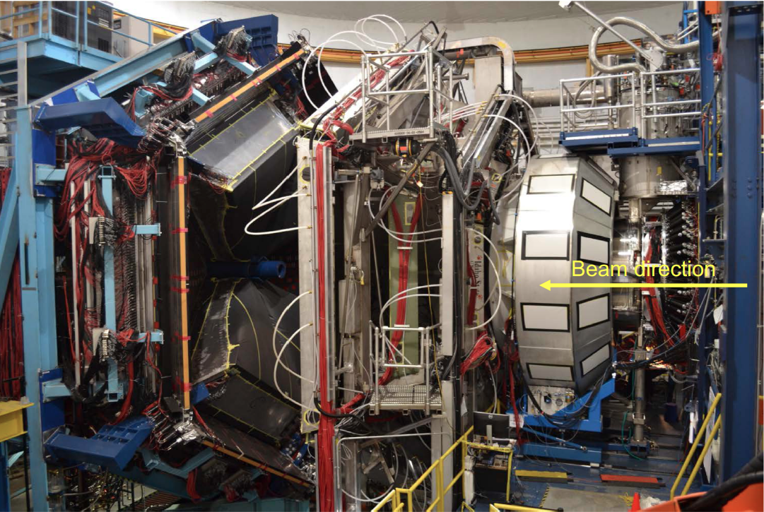
Run Group H
Large acceptance spectrometer. Operational since 02/18
RICH
Target / Recoil
10 m
Luminosity up to 10³⁵ cm⁻² s⁻¹
Highly polarized electron beam
Polarized targets
Broad kinematic range coverage
(current to target fragmentation)
Available or well-known technology
No specific R&D required
M. Contalbrigo
JLab PAC53 Meeting – 23rd July 2025
8

Slide 9
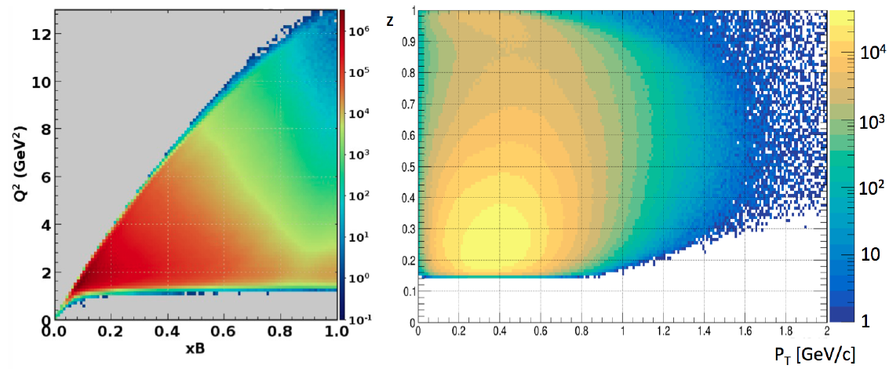
CLAS12 Kinematic Reach
Features: wide phase space cover, excellent PID and statistics optimized for a multi-D analysis
- disentangle kinematical correlations
- verify expected dependences (e.g. in Q²) and isolate peculiar regimes (e.g. in z)
- study transition regions (e.g. in P_{T})
M. Contalbrigo
JLab PAC53 Meeting – 23rd July 2025
9
Notes:
Chiedere ad Harut/Matthew di controllare la copertura con accettanza RGH

Slide 10
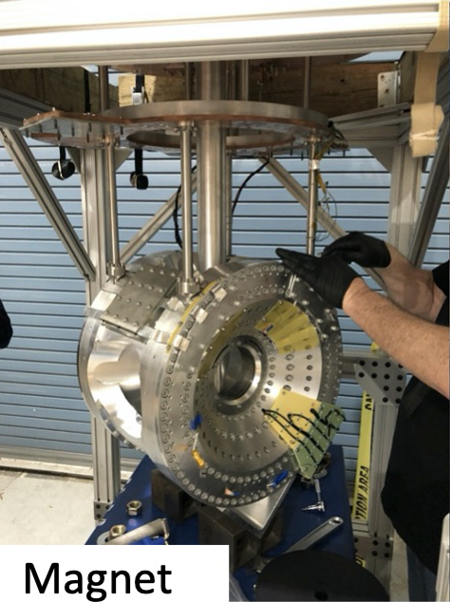
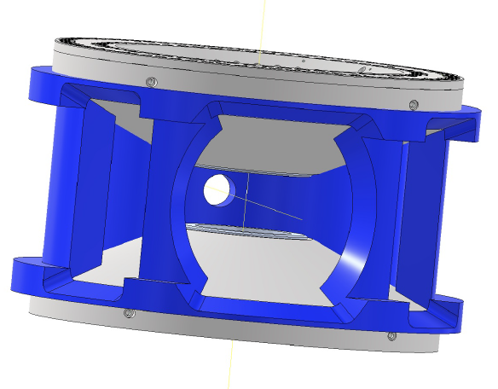
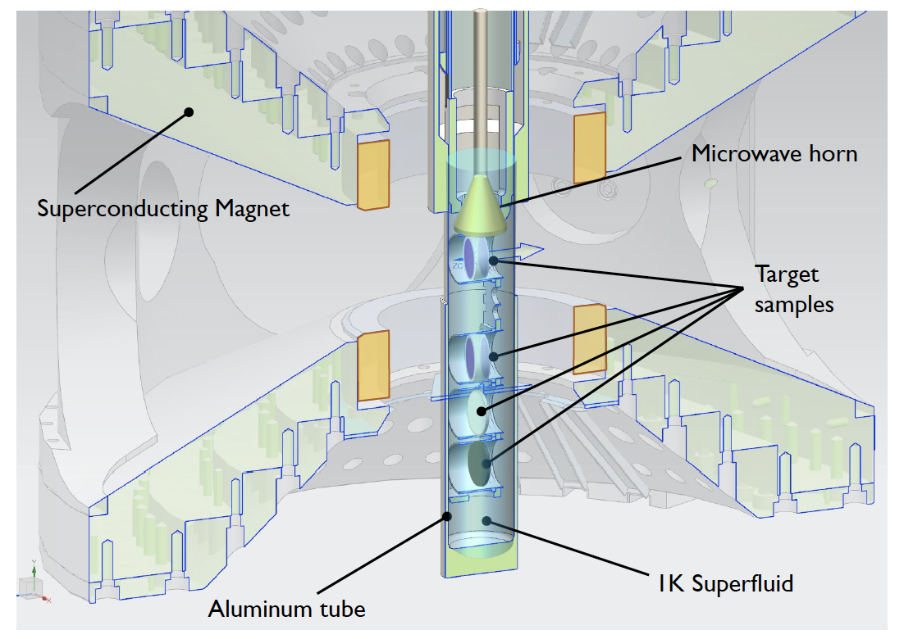
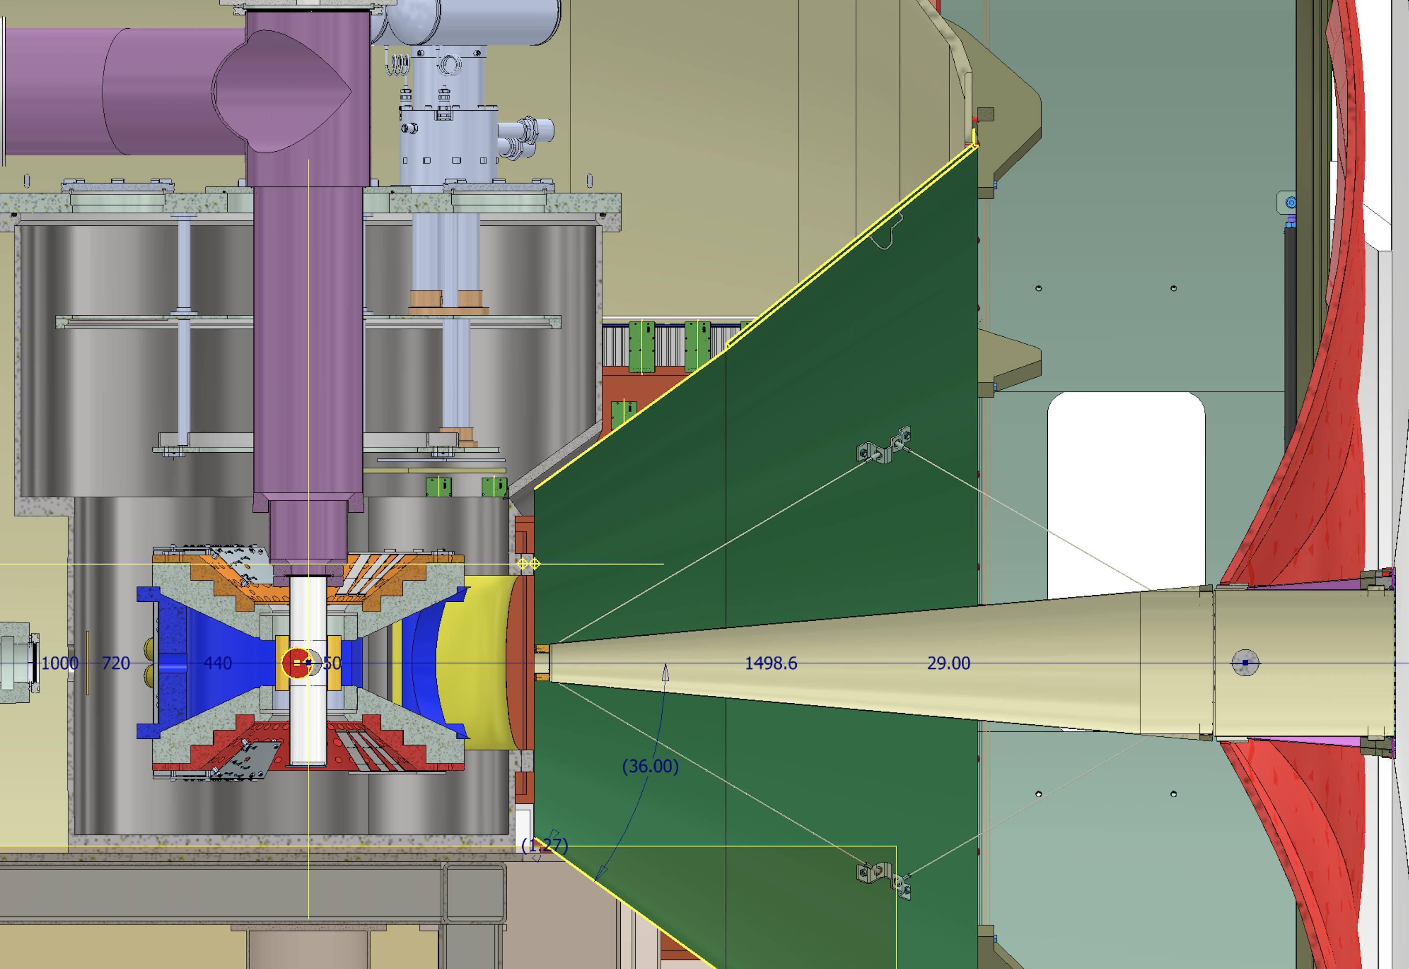

RGH Target & Magnet
Most viable solution to prioritize physics
Consolidated dynamically polarized NH₃ technology
Designed based on already successful realizations
Hall-A G2p-Gep target (replica optimized for HTCC )
Hall-C E12-15-005 magnet (replica optimized for recoil detection)
5T dipole
acceptance:
$± 25o$ vertical
$$± 65o. horizontal$$
M. Contalbrigo
JLab PAC53 Meeting – 23rd July 2025
10
Notes:
Mettere foto magnete ? Serve shielding no FT

Slide 11
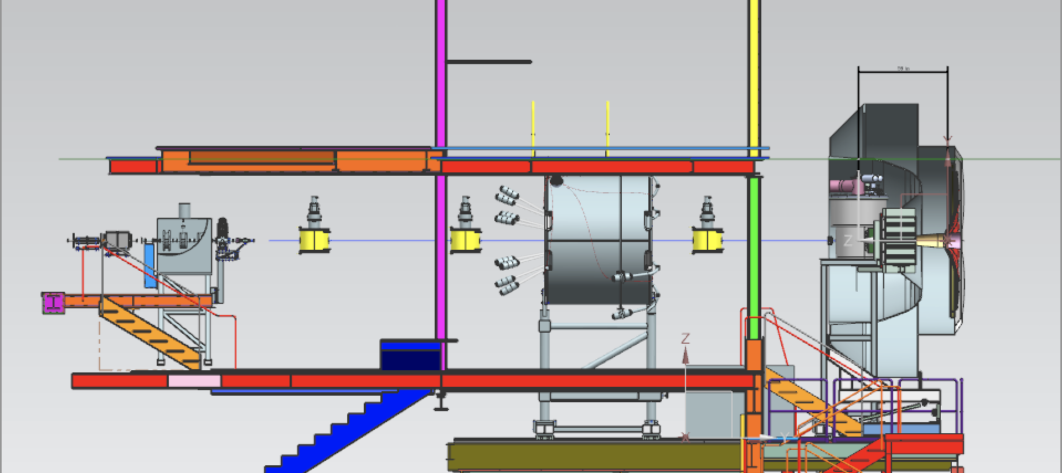
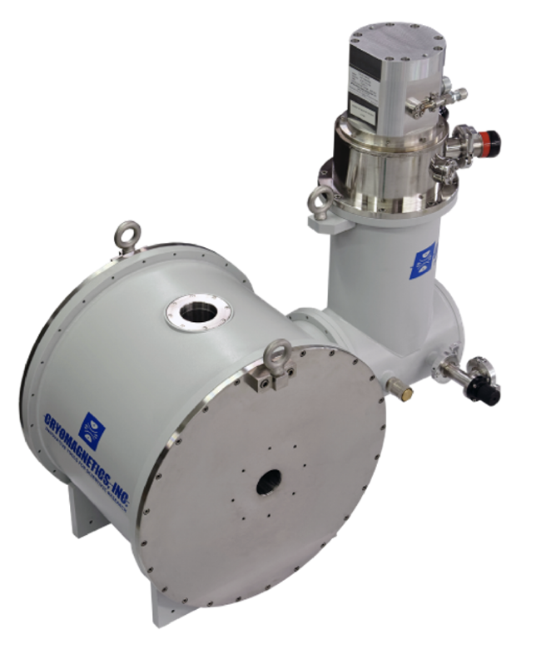
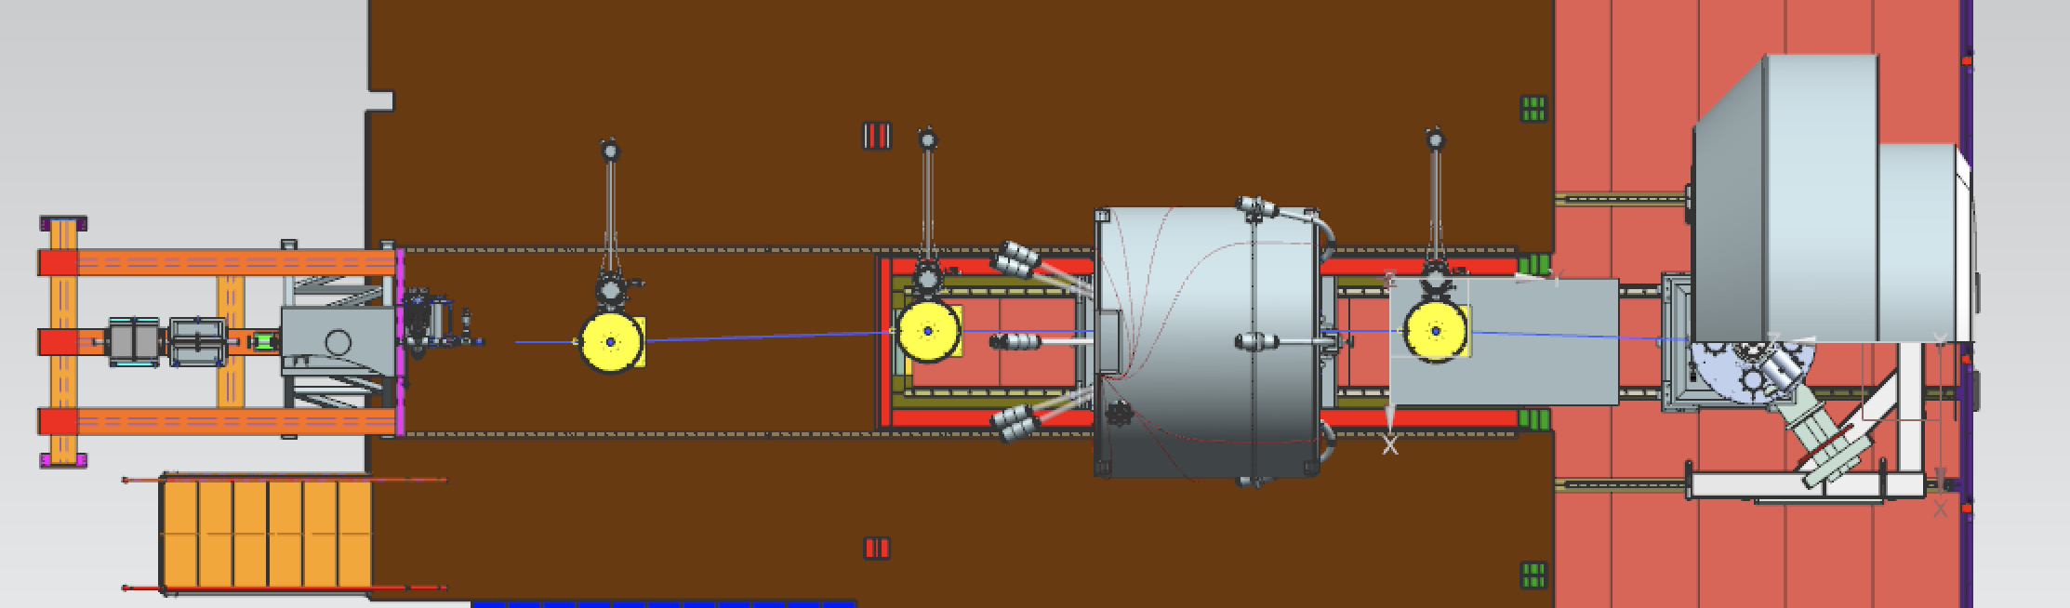
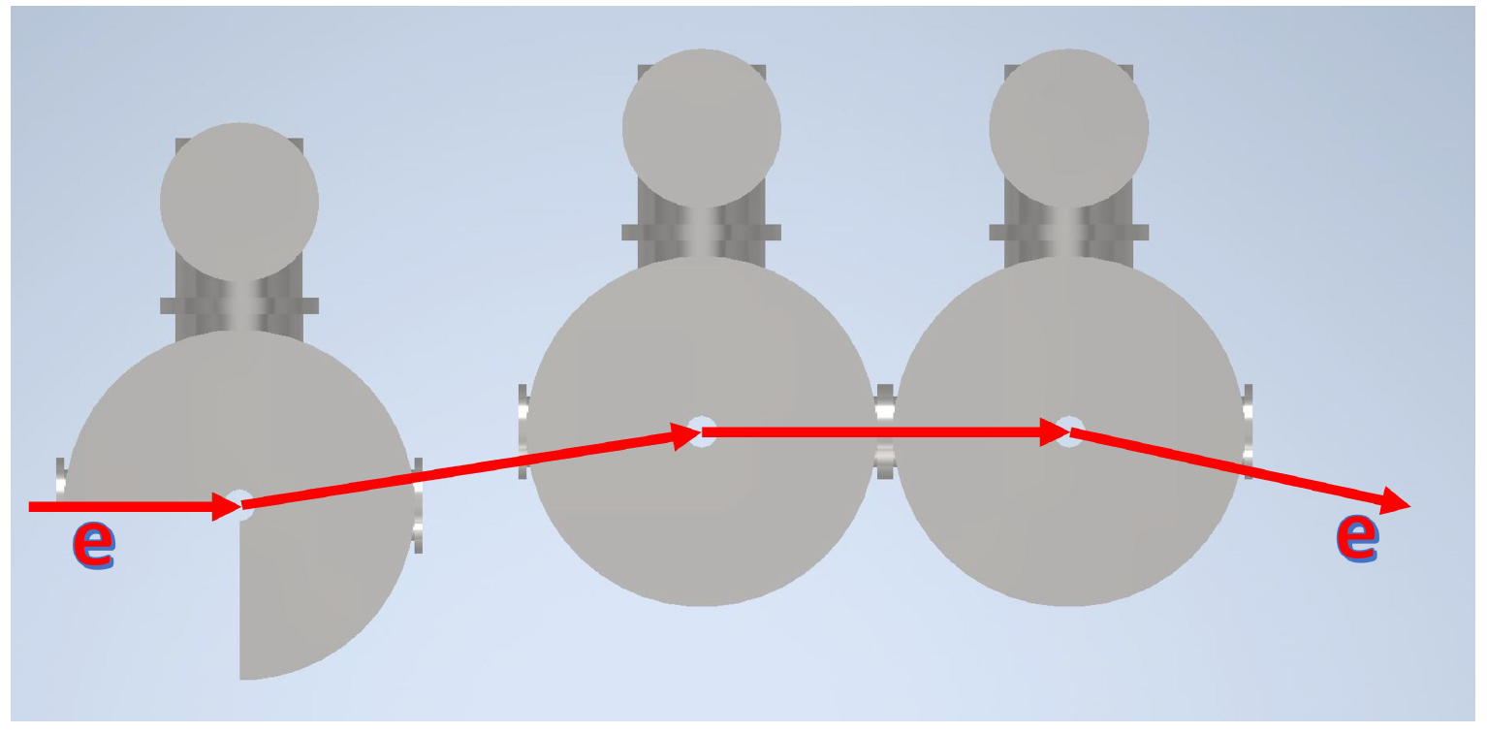
RGH Beam Line
Based on
existing 0.7 cm raster
commercial 7.5T magnets
CryoMagnets Inc.
CryoMagnets Inc.
2nd Raster
BPM
Chicane1
Chicane2
Chicane3
Target
✓ space
✓ synchrotron radiation
✓ beam rastering
M. Contalbrigo
JLab PAC53 Meeting – 23rd July 2025
11

Slide 12
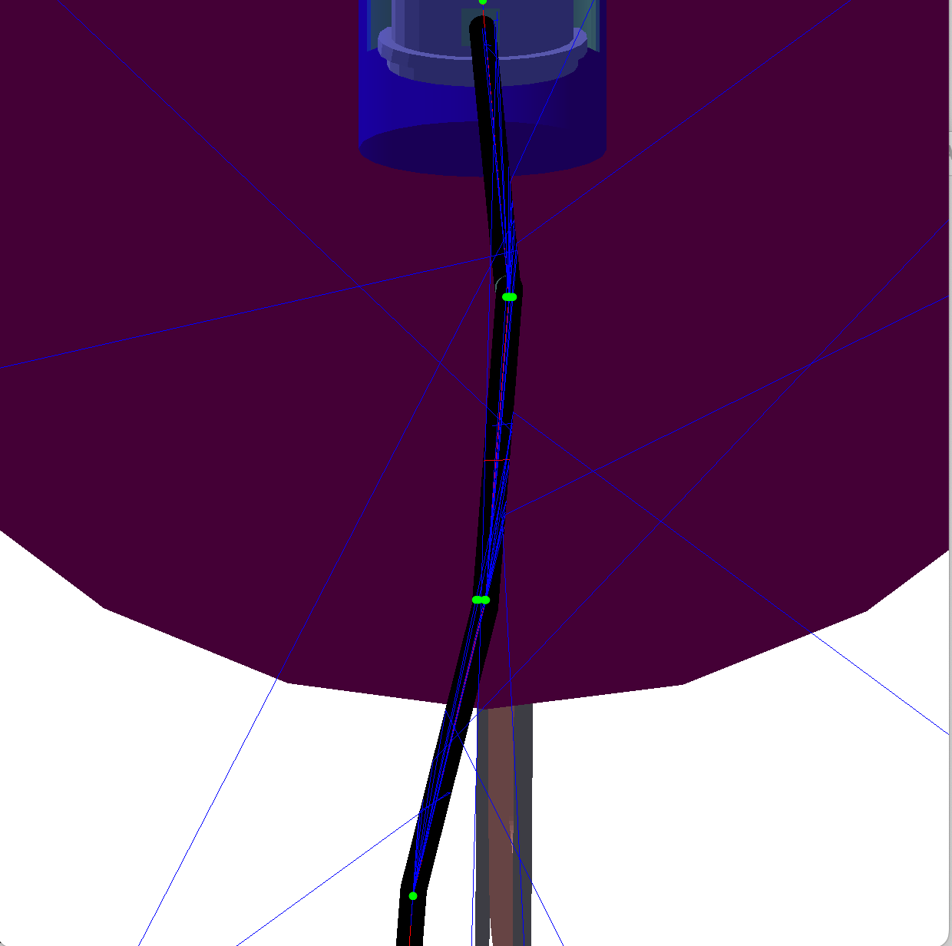
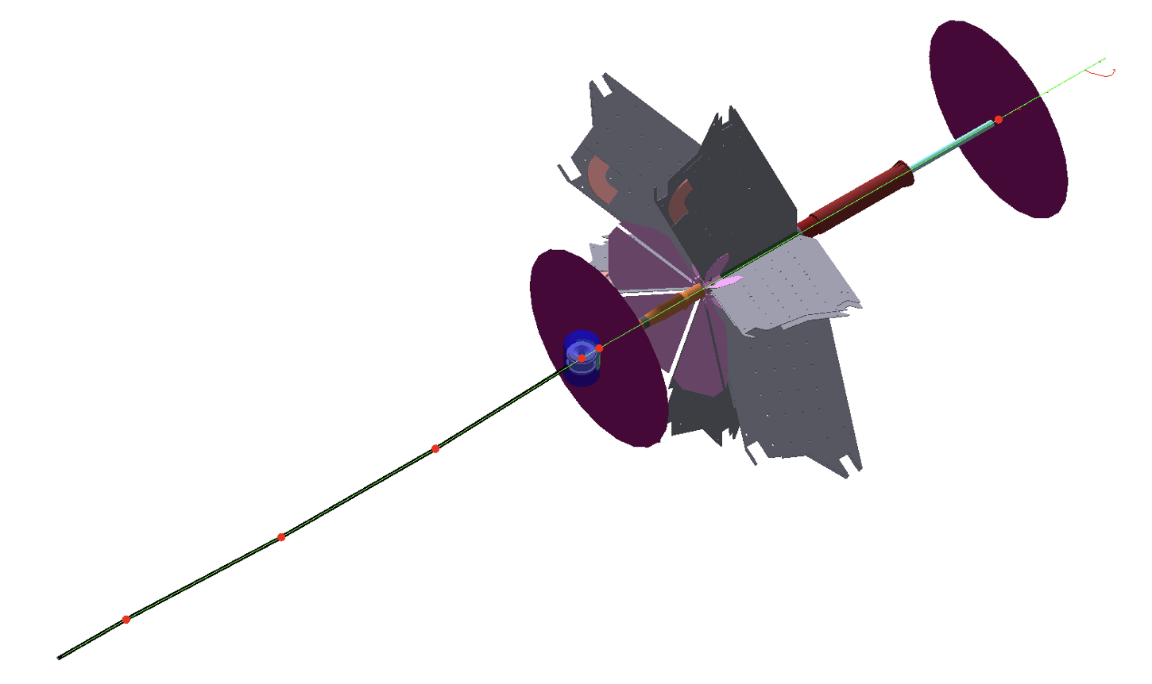
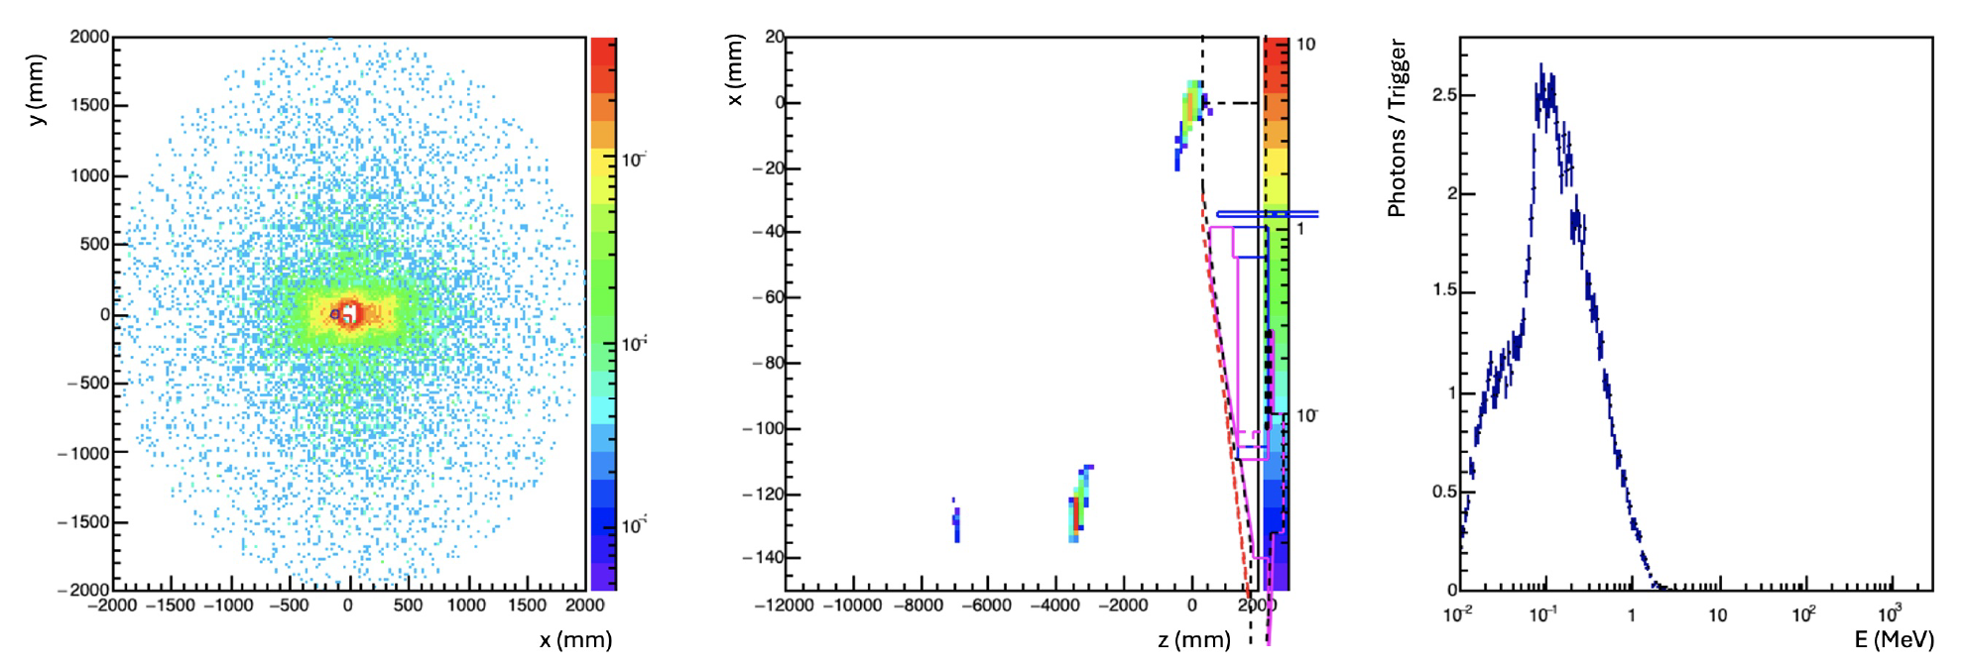
Geant Simulation: RGH Beam Line
Front
CLAS12 GEANT simulation framework
FD front
flux counter
FD back
flux counter
target
chicane-3
chicane-2
Beam pipe + 1 cm lead in the proper locations suppress synchrotron radiation to a negligible level
chicane-1
M. Contalbrigo
JLab PAC53 Meeting – 23rd July 2025
12

Slide 13
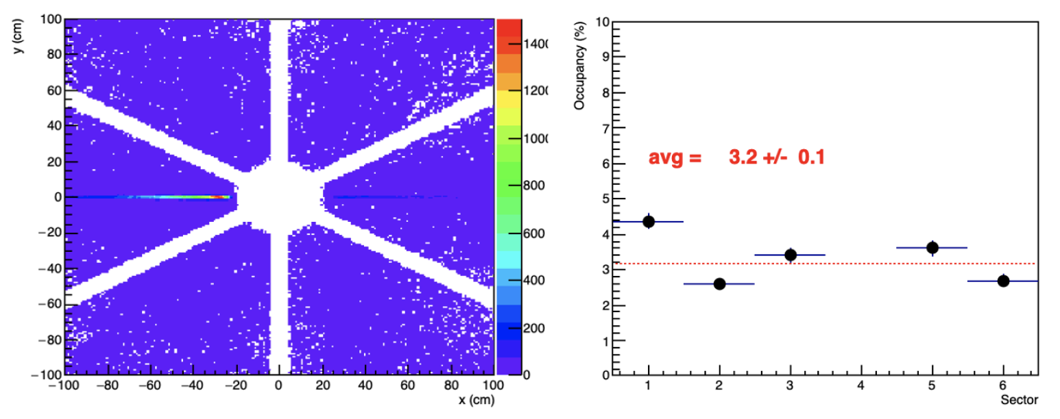
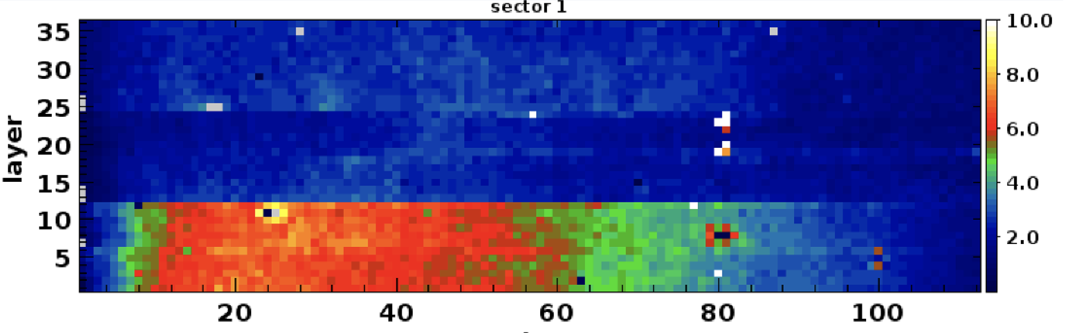
Geant Simulation: DC Occupancy
CLAS12 GEANT simulation framework
RGH MC (NH₃)
Assume to switch
OFF DC in sector 4 and
move RICH in sector 3
x2 with
CLAS12 gate
RGC DATA (NH₃)
Present performance*
Typical DC occupancy
measured at CLAS12
*No high-lumi
M. Contalbrigo
JLab PAC53 Meeting – 23rd July 2025
13
Notes:
Pensare a risposta per sheet of flame di la’

Slide 14
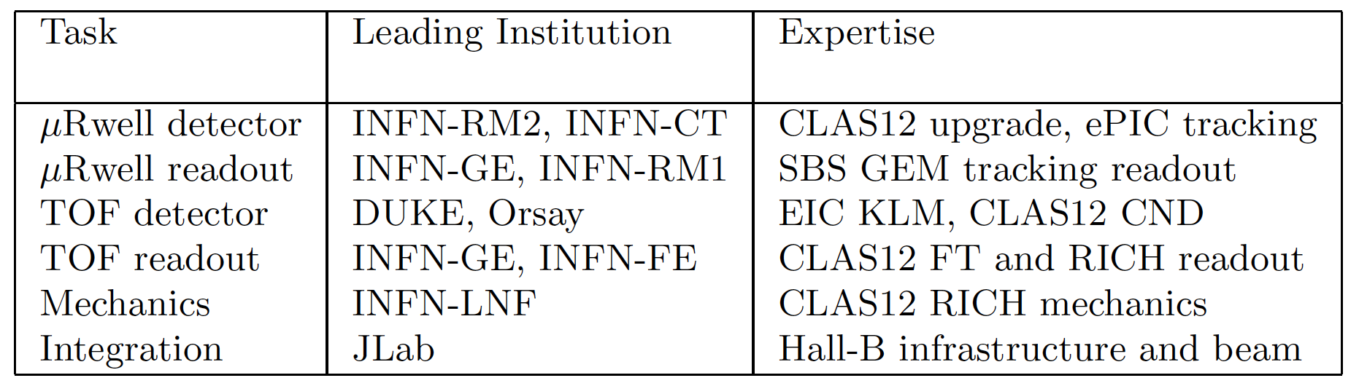

Target & Recoil Detector
u-Rwell
TOF
1 m
M. Contalbrigo
JLab PAC53 Meeting – 23rd July 2025
14

Slide 15



Recoil Tracking
GEM-μRwell to provide 2D information with 100 μm resolution
✓ Wanted gain/efficiency is preserved below 600 V safe bias
✓ 5 ns time resolution can be achieved from signal shape fit
✓ TPC-like readout to correct the impinging angle has been proven
✓ Suitable APV25 readout available
3 mm gas gap
PCB read-out
$μ−$Rwell
GEM
cathode
μRwell as spin off of the high-lumi project (various prototypes up to 40 x 46 cm² exist)
Test-beam at CERN in Oct ’24
M. Contalbrigo
JLab PAC53 Meeting – 23rd July 2025
15

Slide 16


Recoil TOF
Scintillating bars + SiPM to tag particles with 100 ps resolution
✓ Flexible geometry to provide spatial matching and control of accidentals
✓ Compact layout
✓ Suitable readout exist (MAROC or PETIROC chip)
T. Rostomyan, NIMA 986 (2021) 164801 – MUSE experiment
Proven to match 100 ps by PANDA and MUSE R&D
M. Contalbrigo
JLab PAC53 Meeting – 23rd July 2025
16

Slide 17



Geant Simulation: Recoil Performance
MHz/cm²
MHz/cm²
tracker
MHz/cm²
MHz/ch
Recoil technology can cope
with the background rates
Background has a minimal impact: similar recoil resolution, few percent effiicency loss
σ_{φ} (deg)
With background
σ_{θ} (deg)
σ_{p}/p
No background
Still basic reconstruction algorithm
provides a conservative estimate
Recoil reconstruction is adequate
even in the presence of background
M. Contalbrigo
JLab PAC53 Meeting – 23rd July 2025
17

Slide 18

Geant Simulation: Recoil Performance
Recoil technology can cope
with the background rates
π⁰ contamination is at the level of RGC (~ 30%)
# Events
epγ
# Events
# Events
epπ⁰
Still basic reconstruction algorithm
provides a conservative estimate
Recoil reconstruction is adequate
even in the presence of background
Δt (GeV)
Θ(γ,X) (deg)
P^{miss} (GeV)
_{ep->epγX}
M. Contalbrigo
JLab PAC53 Meeting – 23rd July 2025
18

Slide 19




Impact Study: 4D Map
100 PAC days requested to achiveve the first 4D (x, Q², z, p_{T}) measurement
SIDIS π⁺
M. Contalbrigo
JLab PAC53 Meeting – 23rd July 2025
19
Notes:
Pensare a risposta per sheet of flame di la’

Slide 20



Impact Study: Tensor Charge from SIDIS
Fundamental quantity related to BSM physics: EDM and tensor coupling
Projections with and without CLAS12 di-hadron pseudo-data (with lattice inputs)
100 PAC days requested to be competitive in precision to lattice for δu
M. Contalbrigo
JLab PAC53 Meeting – 23rd July 2025
20

Slide 21



Impact Study: OAM from DVCS
PARTONs
100 PAC days requested to get unprecedented access to elusive quark angular momenta
Supersede the only other A_{UT} measurement
Pair with A_{LU} measurement done by RGB on neutron
VGG
x = 0.370, Q²=4.81
Superior discrimination
power between various
OAM model hypotheses
x = 0.150, Q²=2.44
x = 0.182, Q²=2.69
x = 0.301, Q²=2.99
HERMES
x = 0.126, Q²=1.77
x = 0.180, Q²=1.90
x = 0.270 Q²=1.96
M. Contalbrigo
JLab PAC53 Meeting – 23rd July 2025
21
Notes:
Trova il plot di Adam con HERMES aperti

Slide 22

Impact Study: Compton Form Factors
Analysis of Melany Higuera Angulo using GEPARD framework (LDRD project) and relevant data + RGH pseudo-data
100 PAC days requested to reduce by 2/3 the uncertainty on Imε
M. Contalbrigo
JLab PAC53 Meeting – 23rd July 2025
22
Notes:
Trova il plot di Adam con HERMES aperti

Slide 23



Systematics
RGH measurements are expected to be dominated by the statistical uncertainty
Target spin state can be regularly rotated by microwave-induced swap preserving acceptance
RGH luminosity 5 x 10³³ cm² s⁻¹ is 1/20 of the nominal CLAS12 luminosity
Consolidated methods based on previous experience
Inputs from previous CLAS12 experiments will reduce assumptions in systematics
To be noted: previous high-luminosity CLAS12 experiments provide a solid benchmark e.g.,
unpolarized cross section terms will be constrained by RGA/RGB and target dilutions by RGC
Conservative systematics are derived from previous relevant realizations and analyses,
with a cross-check for RGH acceptance peculiarities.
DVCS
SIDIS
single
hadron
SIDIS
di- hadron
JLab PAC53 Meeting – 23rd July 2025
23
Notes:
Trova il plot di Adam con HERMES aperti

Slide 24

Beam Request
RGH implements the target configuration which is most sensitive to the 3D nucleon structure study
and capitalizes on CLAS12 with a complete set of target polarizations
100 (physics) + 25 (ancillary) PAC days requested to achieve unprecedent precision in the valence region
100 days of physics run to achieve the RGH goals
5 days for commissioning and alignment
8+2 days for background studies (target dilutions)
10 days for target annealing and target replacements
M. Contalbrigo
JLab PAC53 Meeting – 23rd July 2025
24
Notes:
Trova il plot di Adam con HERMES aperti

Slide 25
PAC Review
Theory Report
RGH measurements are critical for the studies of transverse spin phenomena in QCD with high impact physics such
as the elusive nucleon tensor charge that is relevant for a broad community including LQCD and BSM physics.
TAC Report
No major technical hurdle.
In the replies, proponents clarified details on: chicane, beam monitor, and beam polarization uncertainty.
PAC Readers
Scientific goals are well aligned with the 2023 NSAC Long Range Plan, preceding and complementing the EIC program.
Awareness of current literature, competing efforts, and theoretical frameworks.
Rare opportunity to get unprecedented access to the parton dynamics in the valence region with a multi-D framework
Acknowledgment of CLAS12 demonstrated capability, established target technology, full GEANT simulation.
In the replies, proponents clarified details on:
Instrumentation (vibrations, field mapping, precision in target re-position, chicane geometry, target spin swap,..)
Systematics (background subtraction, unpolarized terms, longitudinal photon component, acceptance effects, radiative effects,…)
M. Contalbrigo
JLab PAC53 Meeting – 23rd July 2025
25
Notes:
Trova il plot di Adam con HERMES aperti

Slide 26
PAC Review
Thank you very much to you and your colleagues for the detailed answers and additional plots.
In addition, we would be happy to understand how the acceptance stability will be ensured and whether the MC will be used to simulate the impact of possible acceptance variations. We can discuss about that point during the PAC next week.
Fiducial cuts will be implemented at the analysis level to select the detector regions of suitable stability. During the calibration procedure of the various CLAS12 subsystems, dead or inefficient channels are flagged, on a run-by-run basis, in the calibration database, and this is done also for the Monte Carlo. These dead/inefficient channels are then eliminated in the reconstruction, for both data and MC. Run-dependent simulations are then produced, which include the run-dependent dead or inefficient detector channels. We don't foresee major differences in the way the acceptance will vary during RGH with respect to previously run CLAS12 experiments. CLAS12 is a quite stable setup overall.
M. Contalbrigo
JLab PAC53 Meeting – 23rd July 2025
26
Notes:
Trova il plot di Adam con HERMES aperti

Slide 27

Recoil Tracking Readout
Enough (> 10 k) spare channels exist from INFN GEM project for SBS in Hall-A
Based on the well-known APV25 chip + SSP DAQ (upgraded version of MPD under study)
✓ Able to cope with 500 kHz/cm² and 60% occupancy
✓ Same system used with the μRwell prototypes
new
M. Contalbrigo
JLab PAC53 Meeting – 23rd July 2025
27

Slide 28



Recoil TOF Readout
Enough (> 1 k) spare channels from RICH readout to be updated to ALERT firmware to get < 100 ps readout jitter
RICH readout
✓ MAROC dynamic range can
cope with multi-photon signals
✓ Clock distribution supports
100 ps readout precision
Option to adopt CLAS12-ALERT readout
✓ PETIROC has a better
dynamic range (multi-photons)
✓ Clock distribution supports
50 ps readout precision
M. Contalbrigo
JLab PAC53 Meeting – 23rd July 2025
28

Slide 29

TMD Regime
M. Contalbrigo
JLab PAC53 Meeting – 23rd July 2025
29
Notes:
Trova il plot di Adam con HERMES aperti

Slide 30


CLAS12 Phase Space
M. Contalbrigo
JLab PAC53 Meeting – 23rd July 2025
30
Notes:
Trova il plot di Adam con HERMES aperti

Slide 31


Simulation Check
M. Contalbrigo
JLab PAC53 Meeting – 23rd July 2025
31
Notes:
Trova il plot di Adam con HERMES aperti

Slide 32

Beam Line Test at 1 nA
M. Contalbrigo
JLab PAC53 Meeting – 23rd July 2025
32
Notes:
Trova il plot di Adam con HERMES aperti

Slide 33

Beam Line Test at 1 nA
M. Contalbrigo
JLab PAC53 Meeting – 23rd July 2025
33
Notes:
Trova il plot di Adam con HERMES aperti

Slide 34




Magnet Configuration
Torus vs target
Minimal forces generated by mutual interaction of magnets
Target vs chicane
Target vs torus
M. Contalbrigo
JLab PAC53 Meeting – 23rd July 2025
34
Notes:
Trova il plot di Adam con HERMES aperti

Slide 35


3D Model
M. Contalbrigo
JLab PAC53 Meeting – 23rd July 2025
35
Notes:
Trova il plot di Adam con HERMES aperti

Slide 36

Recoil Dimensions
CLAS12 Forward Detector
HTCC
Recoil
Beam
M. Contalbrigo
JLab PAC53 Meeting – 23rd July 2025
36
Notes:
Trova il plot di Adam con HERMES aperti

Slide 37




RGH Recoil Detector
Spatial resolution O(100 μm) with μ-Rwell tecnology under development for the CLAS12 high-lumi project
X
TB 2023
50 x 50 cm²
Time resolution O(100 ps) with scintillating technology (CLAS12 TOF) or in synergy with other projects (e.g. INFN fast tracker)
X
y (mm)
TB 2024
x (mm)
M. Contalbrigo
JLab PAC53 Meeting – 23rd July 2025
37

Slide 38

CLAS12 Highlights: DVCS
G. Christiaens at al., Phys.Rev.Lett. 130 (2023) 21, 211902
Sensitive to GPDs and the 3D structure of the nucleon
With respect the past: - extended range in the valence region well inside the DIS regime
- superior statistics instrumental for multidimensional study & model assessment
38
M. Contalbrigo
JLab PAC53 Meeting – 23rd July 2025
38
Notes:
KMM15 e’ simile a PARTONs

Slide 39


CLAS12 Highlights: Di-hadron SIDIS
T.B. Hayward at al., Phys.Rev.Lett. 126 (2021) 152501
Sensitive to TMDs and the strong-force correlations in hadron formation
With respect the past: - extended range in the valence region well inside the DIS regime
- superior statistics instrumental for multidimensional study
- large acceptance for elusive correlations
39
M. Contalbrigo
JLab PAC53 Meeting – 23rd July 2025
39

Slide 40

SOLID
NH₃ target
L = 10³⁵ cm⁻² s⁻¹
Sheet-of-flame bakground
Forward Angle Detector
covers 8º-15º in polar angle
Large Angle Detector
Covers 15º-24º in polar angle
JLab PAC53 Meeting – 23rd July 2025
40

