Slide 1
Ferrara Group
2018 Activity:
Members:
CLAS6 Analysis:
DVCS xsec from e16/e1f
Exclusive and SIDIS at 12 GeV
CLAS12 Hardware:
RICH:
Project Coordination
FE Electronics for SiPM
SiPM Study for Single-Photon Detection
SiPM cooling system
Aerogel Characterization
Mirror Characterization
HD-ice:
Holding Magnet Configuration
Solenoid test in Milano
Test-beam at JLab Irradiation Facility
M. Contalbrigo | INFN | 80%
P. Lenisa | Ass. | 20%
G. Ciullo | Ass. | 20%
F. Spizzo | Ass. | 80%
L. Barion | Post. Doc. | 70%
A. Movsisyan | Post. Doc. | 100%
L. Pappalardo | Post. Doc. | 20%
I. Balossino | PhD | 100%
A. Drago | Ass. | 20%
FTE |  | ~ 5
M. Statera | Tec. Ass.
R. Malaguti | Tec. INFN
S. Squerzanti | Tec. INFN
Contalbrigo M.
Jlab12 Italia, 8thJune 2017, Roma
1

Slide 2
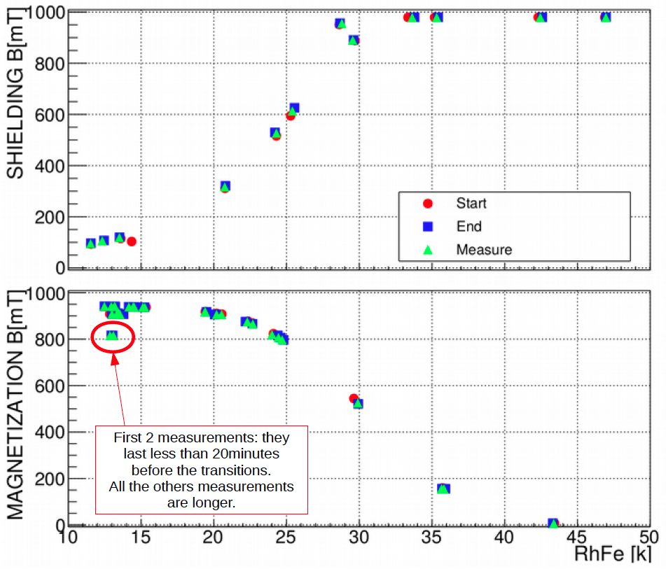
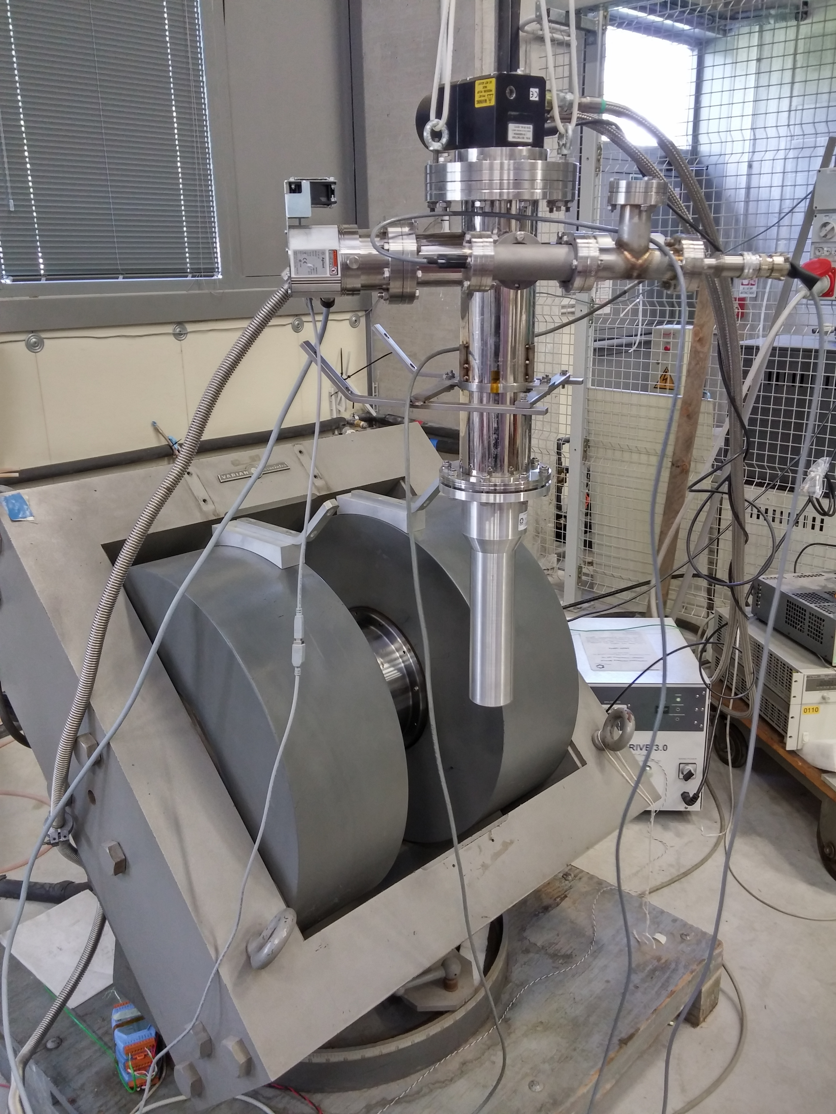
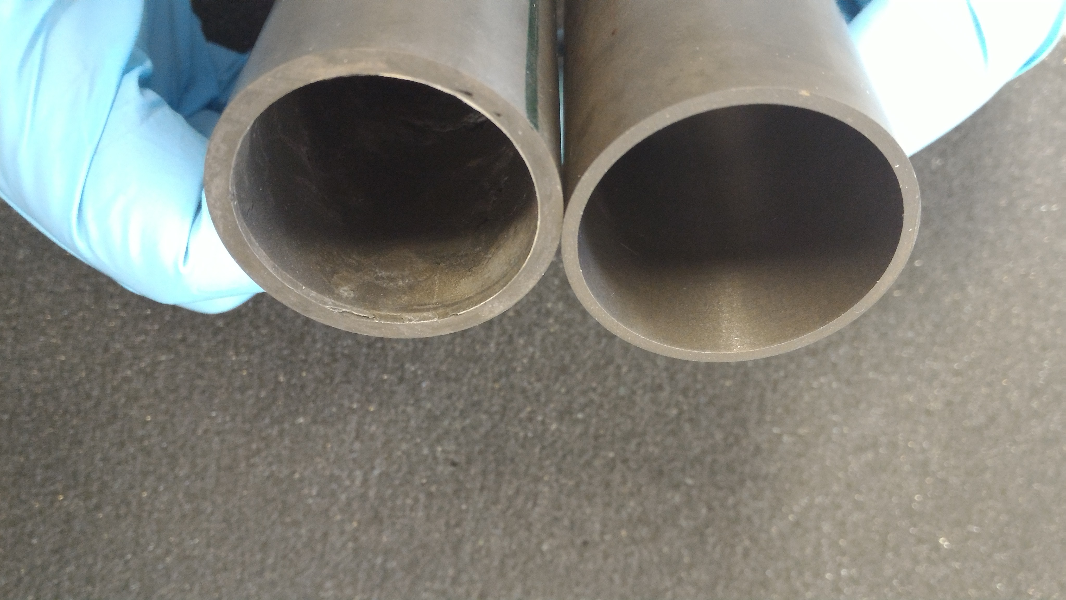
MgB₂ Target Magnet
Test bench @ Ferrara
2017 Milestone: 06-31-17
Next: Migliorie cooling
Mappa campo
Doppio campo (dipolo+solenoide)
Contalbrigo M.
Jlab12 Italia, 8thJune 2017, Roma
2
Notes:
Aggiungere range di validita’ per fattorizzazione GPDs

Slide 3
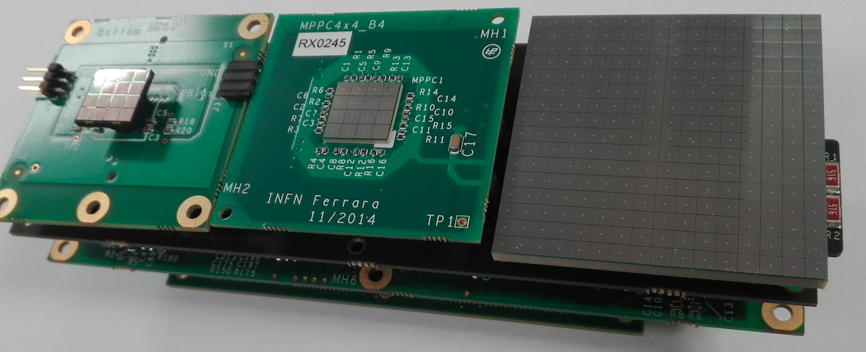
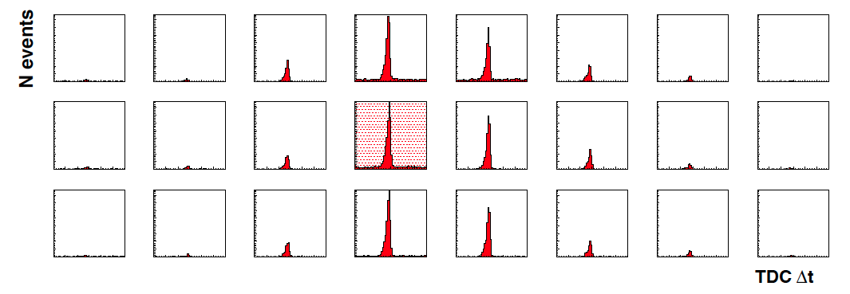
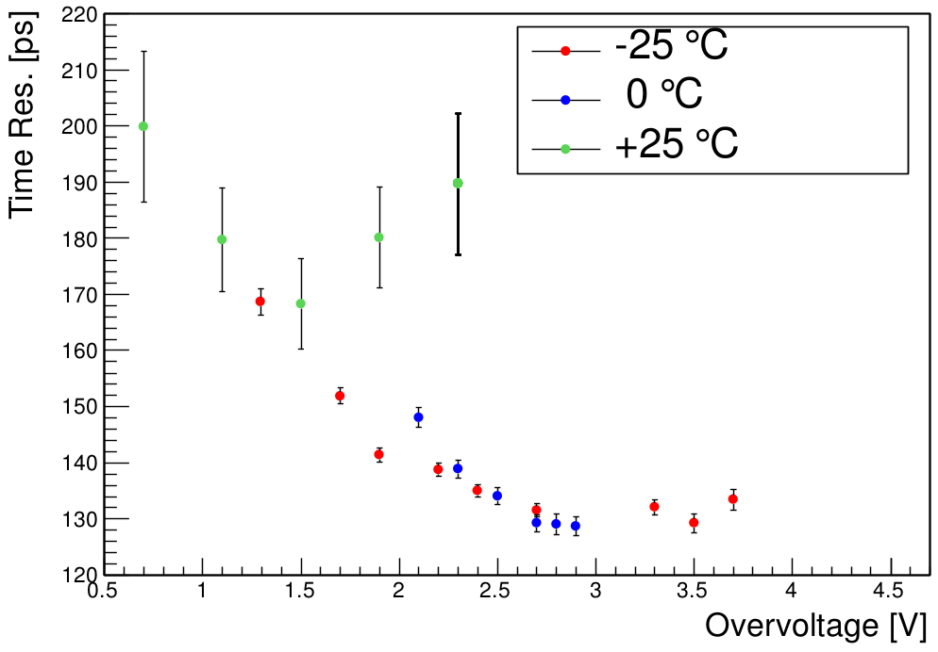
SiPM Single-Photon Counting
Contalbrigo M.
Jlab12 Italia, 8thJune 2017, Roma
3
Notes:
Aggiungere range di validita’ per fattorizzazione GPDs

Slide 4
Richieste
Electronics 80 Chip elettronica
Hdice 5 Holder sonde hall per mappatura
10 Miglioramento cooling
15 Test MgB₂ con doppio fascio:w
Missioni 80
Consumo 5
Trasporti 6
Contalbrigo M.
Jlab12 Italia, 8thJune 2017, Roma
4

