Slide 1
JLab12 (R.N. & R.L.: Marco Contalbrigo)
Nucleon structure and spin physics
Transverse momentum phenomena (TMDs) & 3D imaging
GPDs & EM Form Factors of the nucleon
M. Contalbrigo elected in the Chair Line of the JLab User Organization
(1600 users from US and all over the World)
L. L. Pappalardo - C.d.S. INFN Ferrara – 06/07/2021

Slide 2
Jlab12 Italia (R.N. & R.L. M. Contalbrigo)
L. L. Pappalardo - C.d.S. INFN Ferrara – 06/07/2021

Slide 3
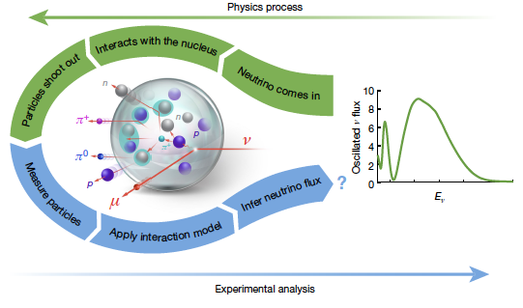
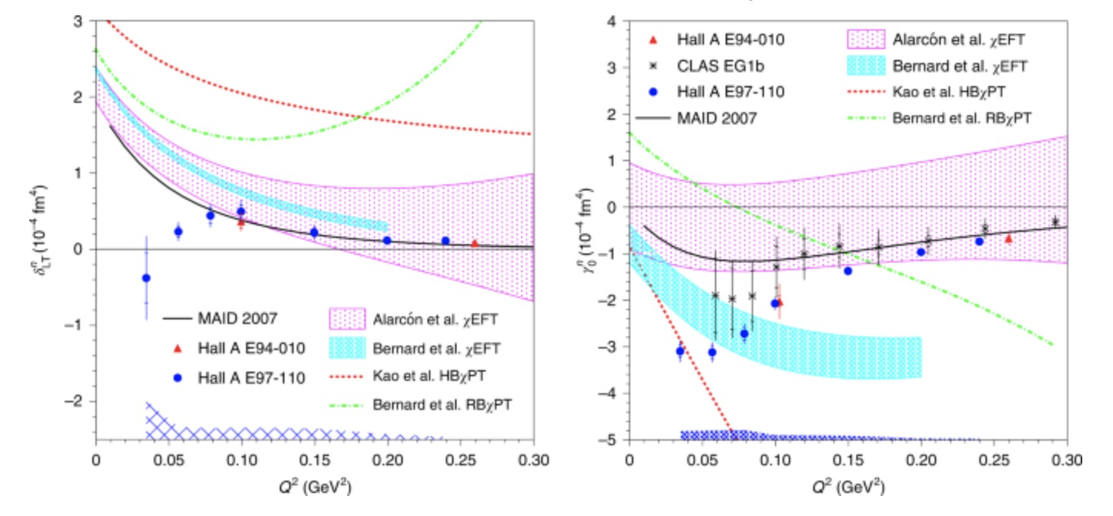
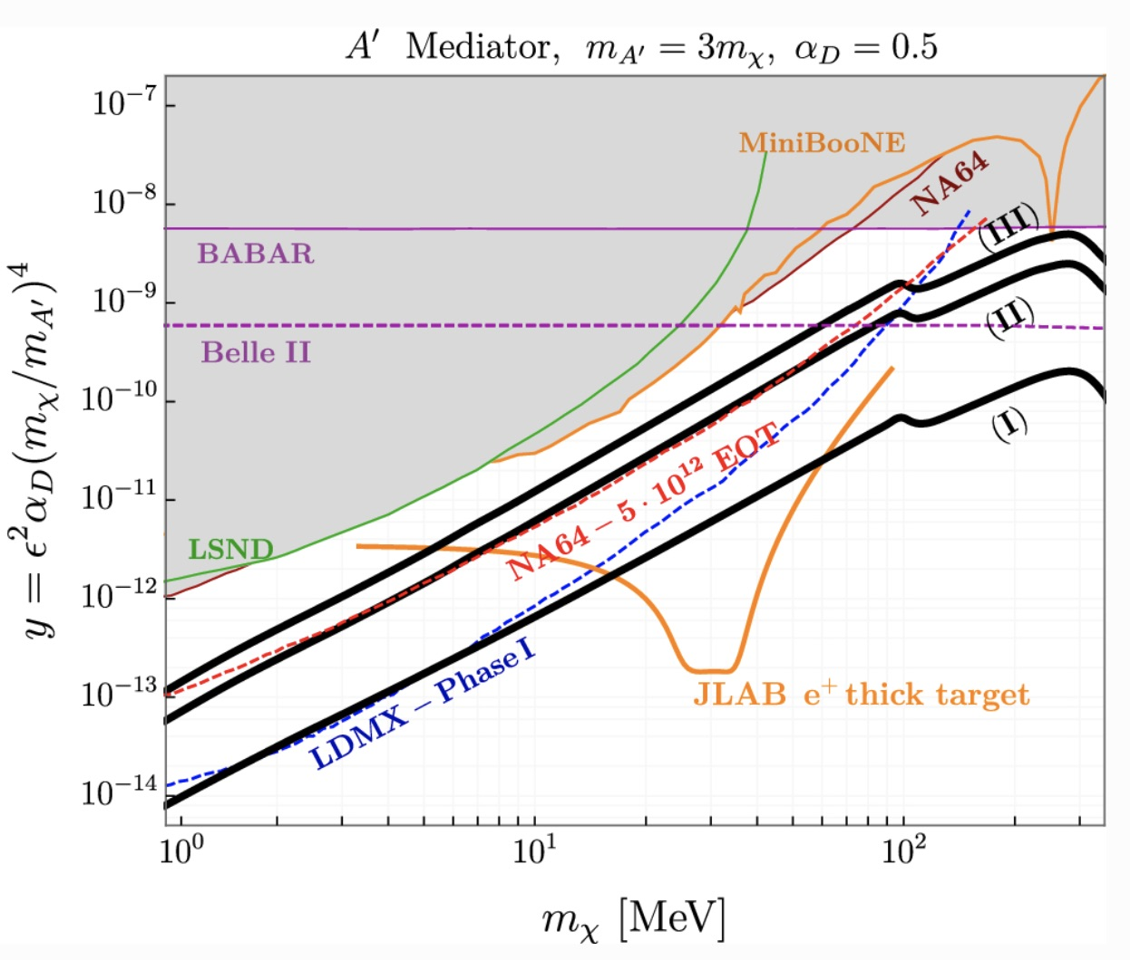
CLAS12: PRL 126 (2021) 152501
Observation of beam spin asymmetries in
the process ep→e’π⁺π⁻X with CLAS12
First CLAS12 publication on the nucleon 3D structure: access quark-gluon correlations in the target or during fragmentation, using as probe the beam spin asymmetry in electron scattering of a proton target.
CLAS: Nature 599 (2021) 565-570
Electron-beam energy reconstruction for neutrino oscillation measurements
CLAS has studied the capability of phenomenological
models to infer the initial neutrino (lepton) energy from the observed scattering products .
Hall-A: Nature Phys. 17 (2021) 687-692
Measurement of the generalized spin polarizabilities of the neutron in the low-Q² region
Hall-A measurement quantifies the neutron's spin precession under electromagnetic fields at very low energy-momentum transfer, when the strong interaction of partons inside the nucleon makes them highly correlated.
CLAS: Nature Phys. 17 (2021) 736-741
Measurement of proton spin structure at long distances
CLAS has measured spin-dependent properties of the proton at the scale of the nucleon dimensions, using as probe electrons at medium energies scattering off a longitudinally polarized proton target at exceptionally low transfer momenta.
PREX-II: PRL 126 (2021) 17, 172502
Accurate Determination of the Neutron Skin Thickness of ²⁰⁸Pb through Parity-Violation in Electron Scattering
PREX has performed an improved measurement of the neutron skin in lead. This has implications for the equation of state of neutron rich matter, up to the extreme conditions of neutron stars, where the derived shape constraints are complementary to the gravitational interferometers.
Dark matter: EPJA 57 (2021) 253
Light dark matter searches with positrons
Complementary strategies to search for light-dark matter exploiting high-luminosity positron beams,
as possibly available in future at JLab.
L. L. Pappalardo - C.d.S. INFN Ferrara – 06/07/2021

Slide 4
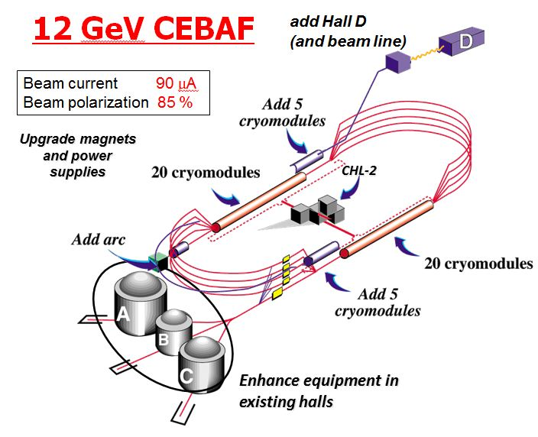
CLAS12 Experiment in Hall-B
L. L. Pappalardo - C.d.S. INFN Ferrara – 06/07/2021

Slide 5
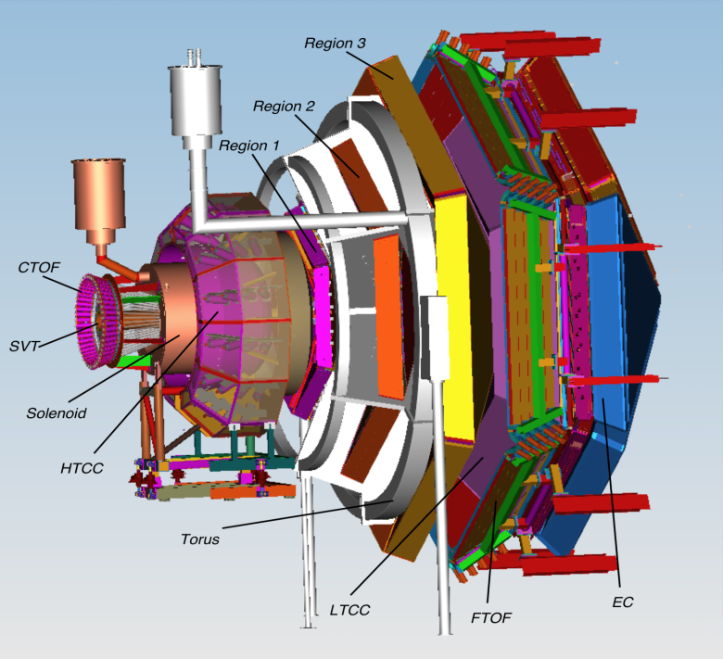
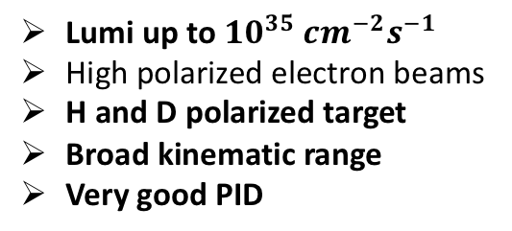
CLAS12 Experiment in Hall-B
CLAS12 detector
Lumi up to ${10}^{35} {cm}^{−2}s^{−1}$
High polarized electron beams
H and D polarized target
Broad kinematic range
Very good PID
L. L. Pappalardo - C.d.S. INFN Ferrara – 06/07/2021

Slide 6
CLAS12 Experiment in Hall-B
CLAS12 detector
Lumi up to ${10}^{35} {cm}^{−2}s^{−1}$
High polarized electron beams
H and D polarized target
Broad kinematic range
Very good PID
Physics program:
Hadron spectroscopy
Nuclear effects in hadronization
Nucleon structure (TMDs, GPDs)
L. L. Pappalardo - C.d.S. INFN Ferrara – 06/07/2021

Slide 7
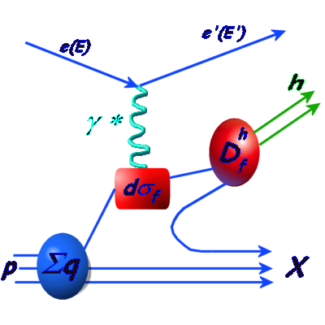
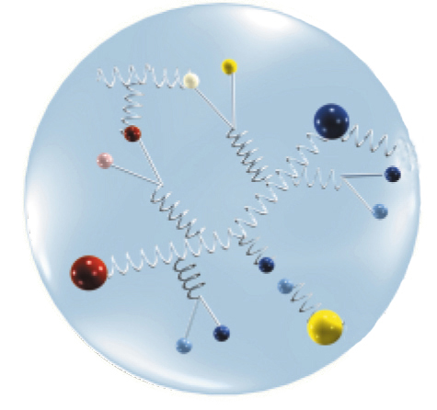
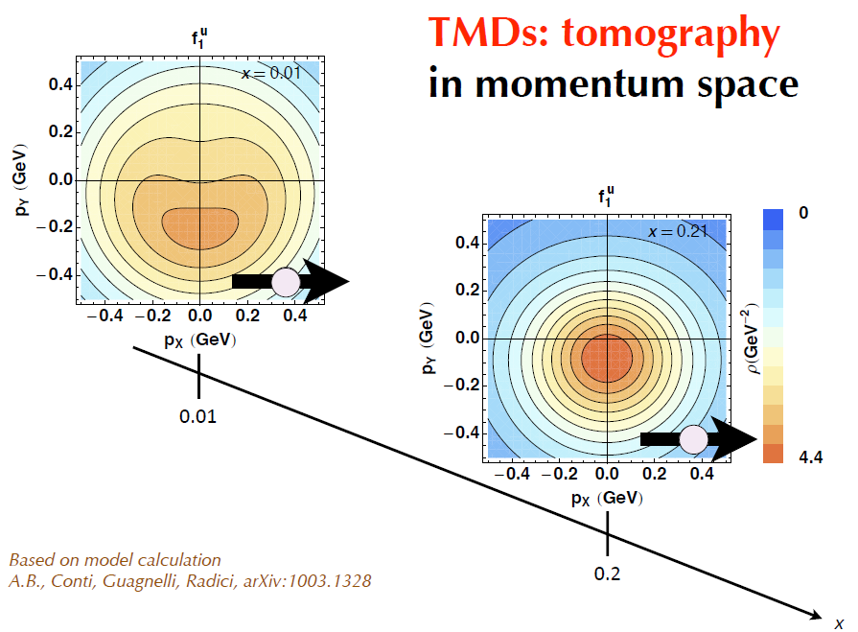
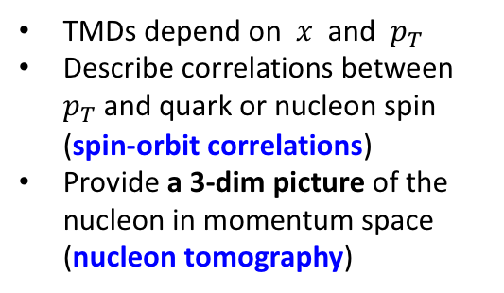
CLAS12 Experiment in Hall-B
TMDs depend on $x$ and $p_{T}$
Describe correlations between $p_{T}$ and quark or nucleon spin (spin-orbit correlations)
Provide a 3-dim picture of the nucleon in momentum space (nucleon tomography)
FF
L. L. Pappalardo - C.d.S. INFN Ferrara – 06/07/2021

Slide 8
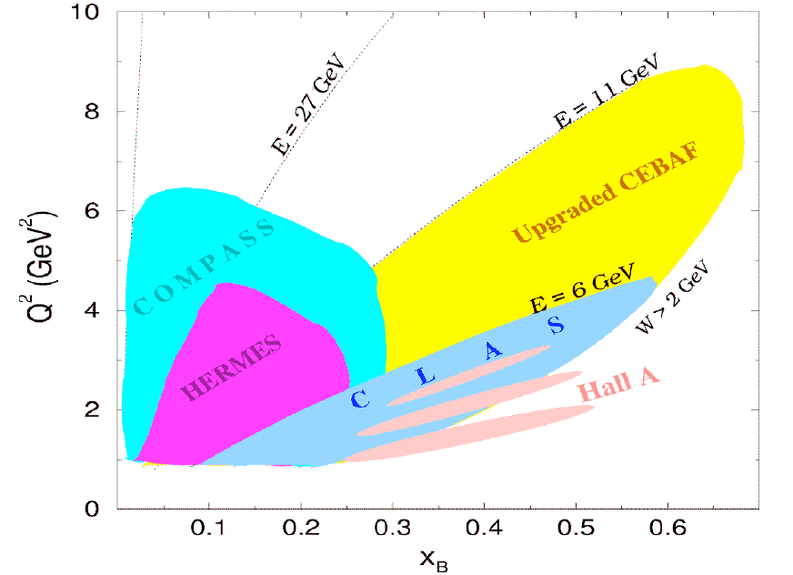
CLAS12 Experiment in Hall-B
TMDs depend on $x$ and $p_{T}$
Describe correlations between $p_{T}$ and quark or nucleon spin (spin-orbit correlations)
Provide a 3-dim picture of the nucleon in momentum space (nucleon tomography)
FF
L. L. Pappalardo - C.d.S. INFN Ferrara – 06/07/2021

Slide 9

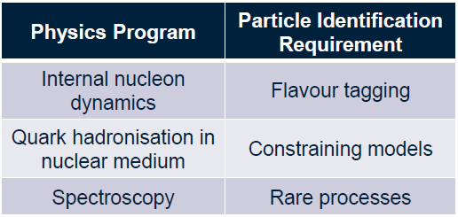


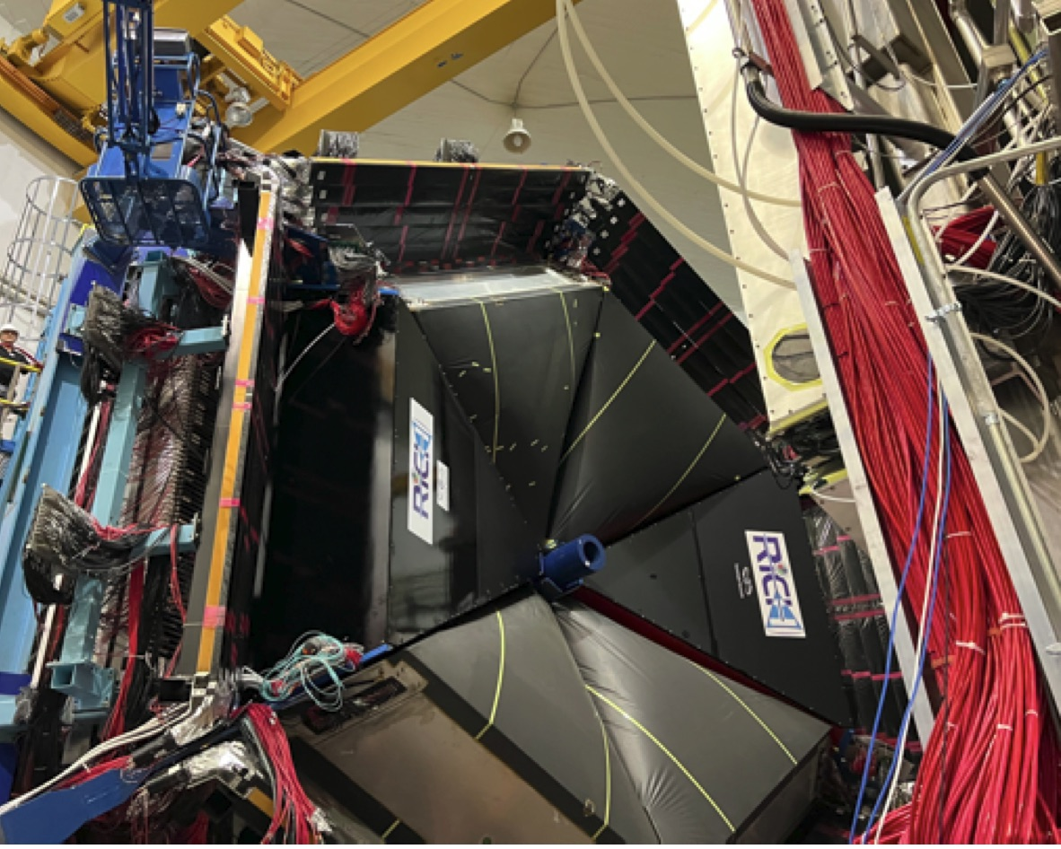
The RICH detector project (INFN)
INSTITUTIONS
INFN (Italy) Bari, Ferrara, Genova, L.Frascati, Roma/ISS
Jefferson Lab (Newport News, USA)
Argonne National Lab (Argonne, USA)
Duquesne University (Pittsburgh, USA)
George Washington University (USA)
Glasgow University (Glasgow, UK)
J. Gutenberg Universitat Mainz (Mainz, Germany)
Kyungpook National University, (Daegu, Korea)
University of Connecticut (Storrs, USA)
UTFSM (Valparaiso, Chile)
L. L. Pappalardo - C.d.S. INFN Ferrara – 06/07/2021

Slide 10
The RICH Front-End electronics
Compact and modular electronics to readout multi-anode PMTs
Adopted by GlueX DIRC and EIC eRD14, under test for SOLID, possible applications under study
FPGA Board (JLab)
ASIC Board (Ferrara)
Developed (Roberto M.) for RICH1 & RICH2
Also adopted by other experiments (Gluex, SOLID, EIC R&D...)
L. L. Pappalardo - C.d.S. INFN Ferrara – 06/07/2021

Slide 11
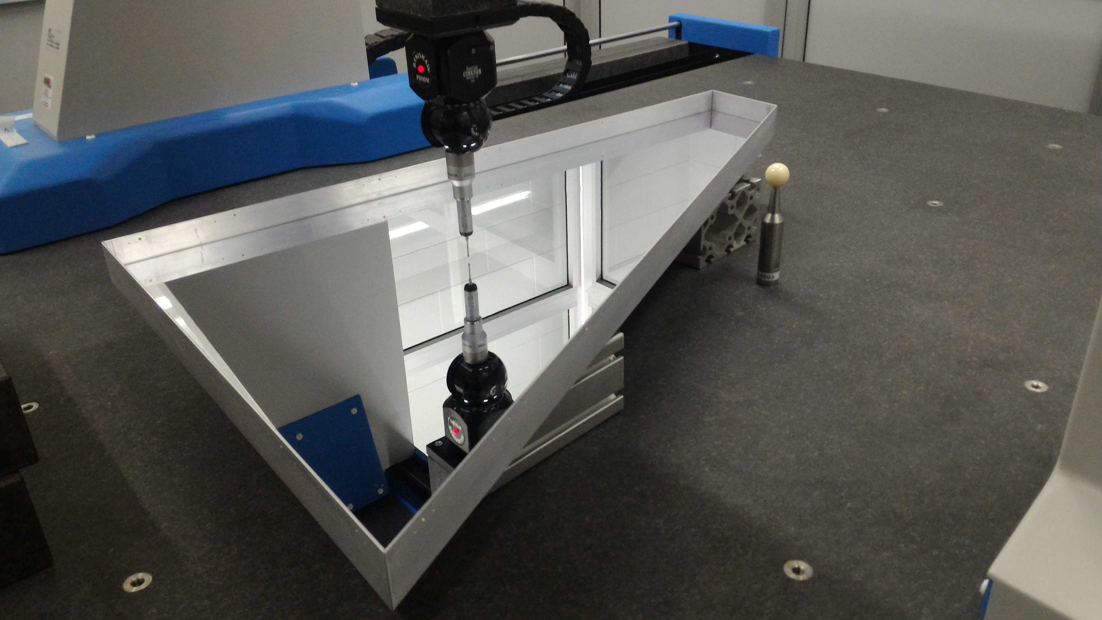
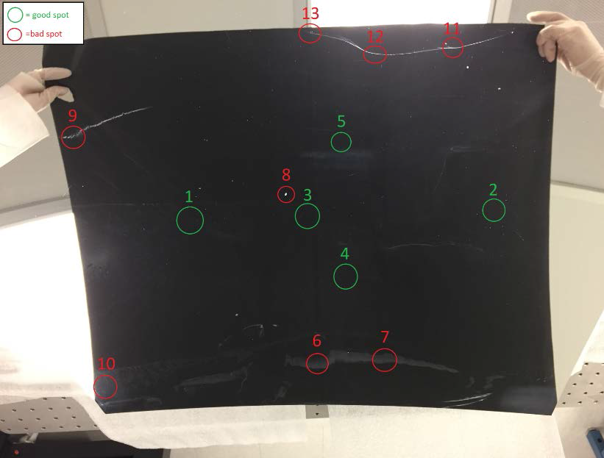
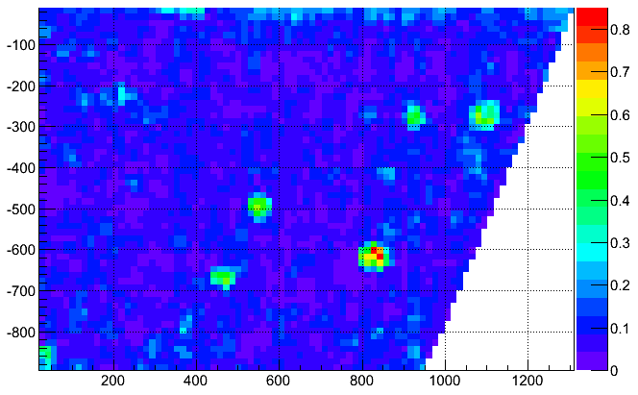
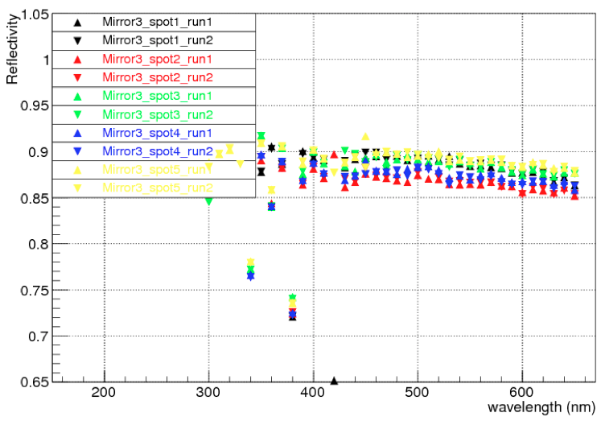
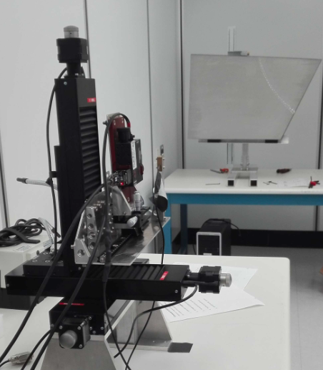
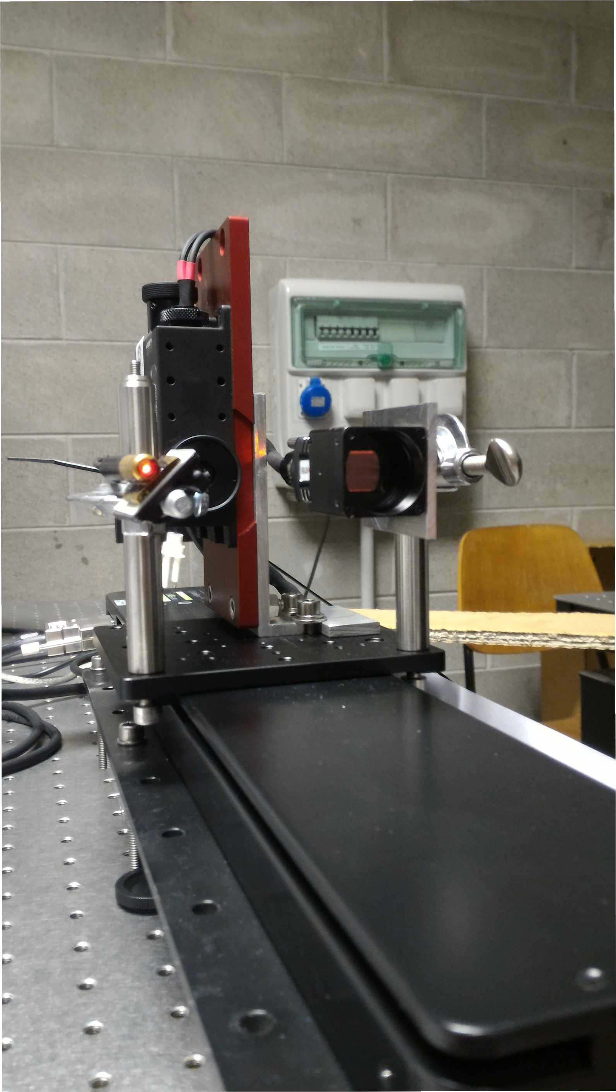
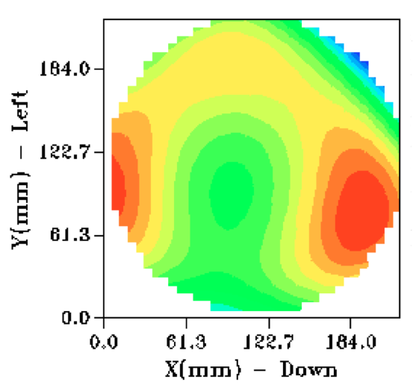
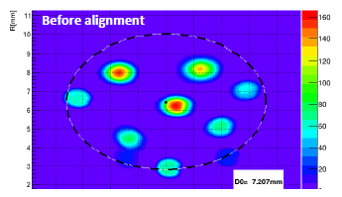
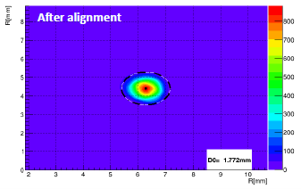
Ferrara Lab
Existing facility to study detailed mirror optical properties (surface map, radius of curvature, reflectivity)
Planarity
Reflectivity
Shack-Hartmann: Aberrations
Point Image: Alignment
L. L. Pappalardo - C.d.S. INFN Ferrara – 06/07/2021

Slide 12
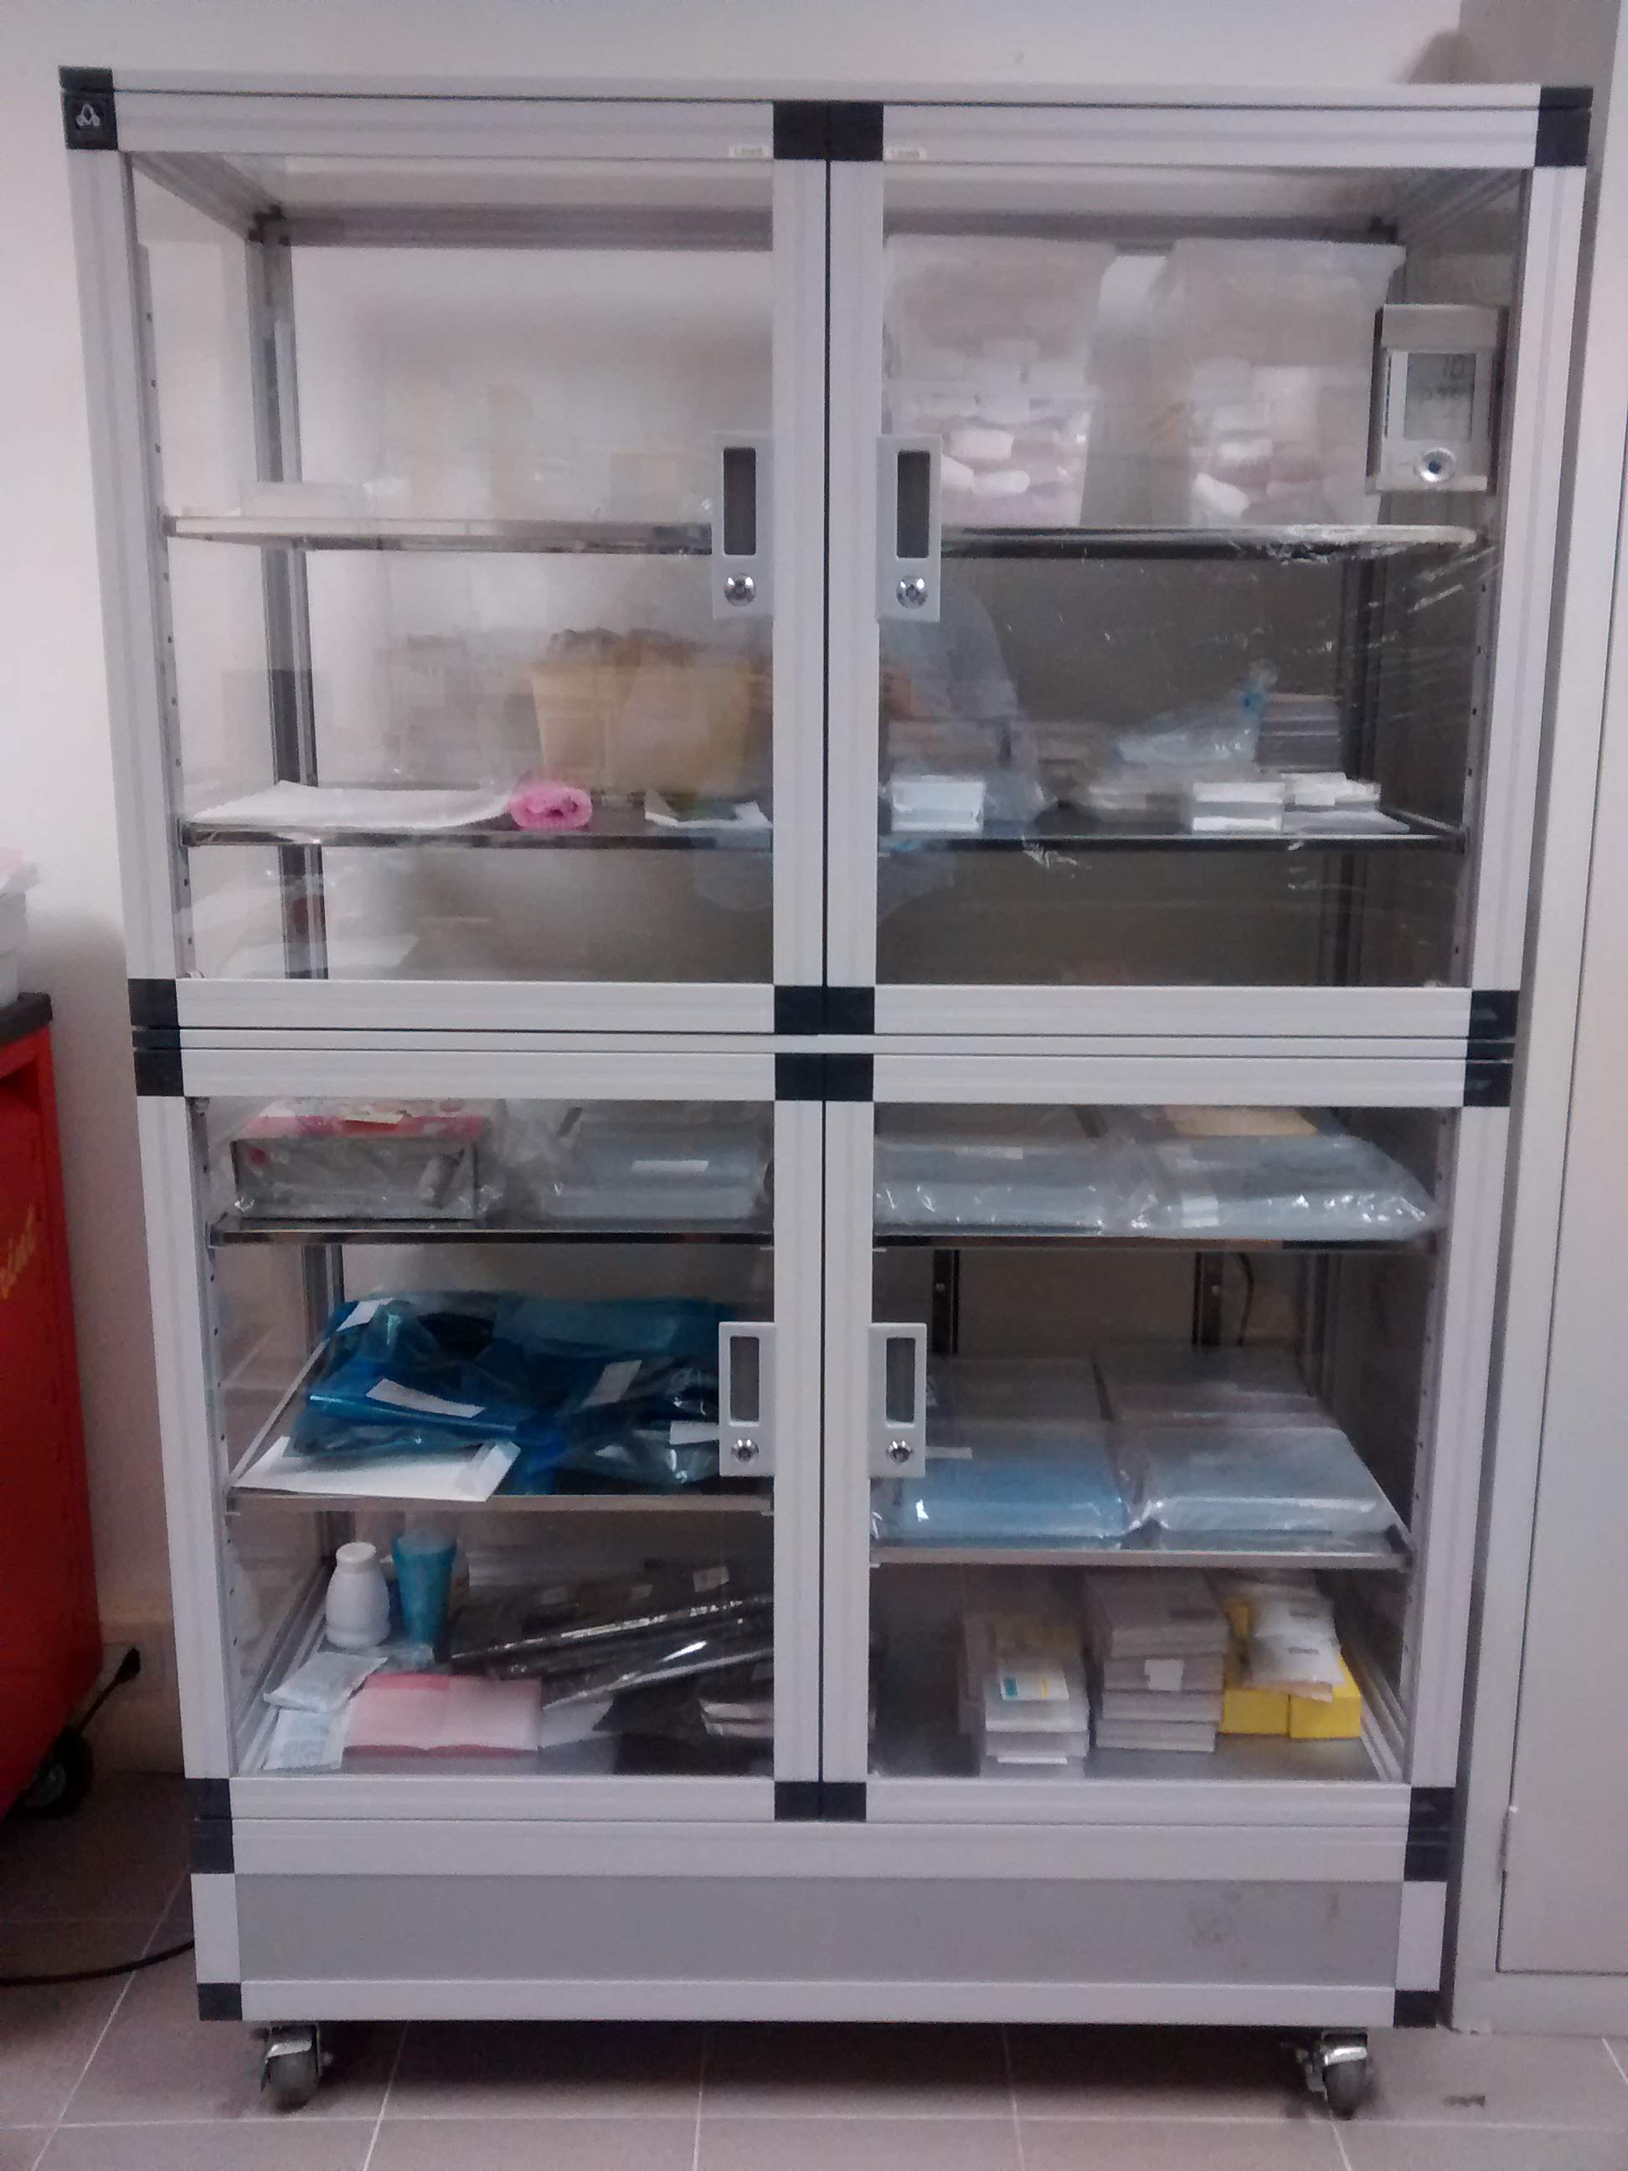
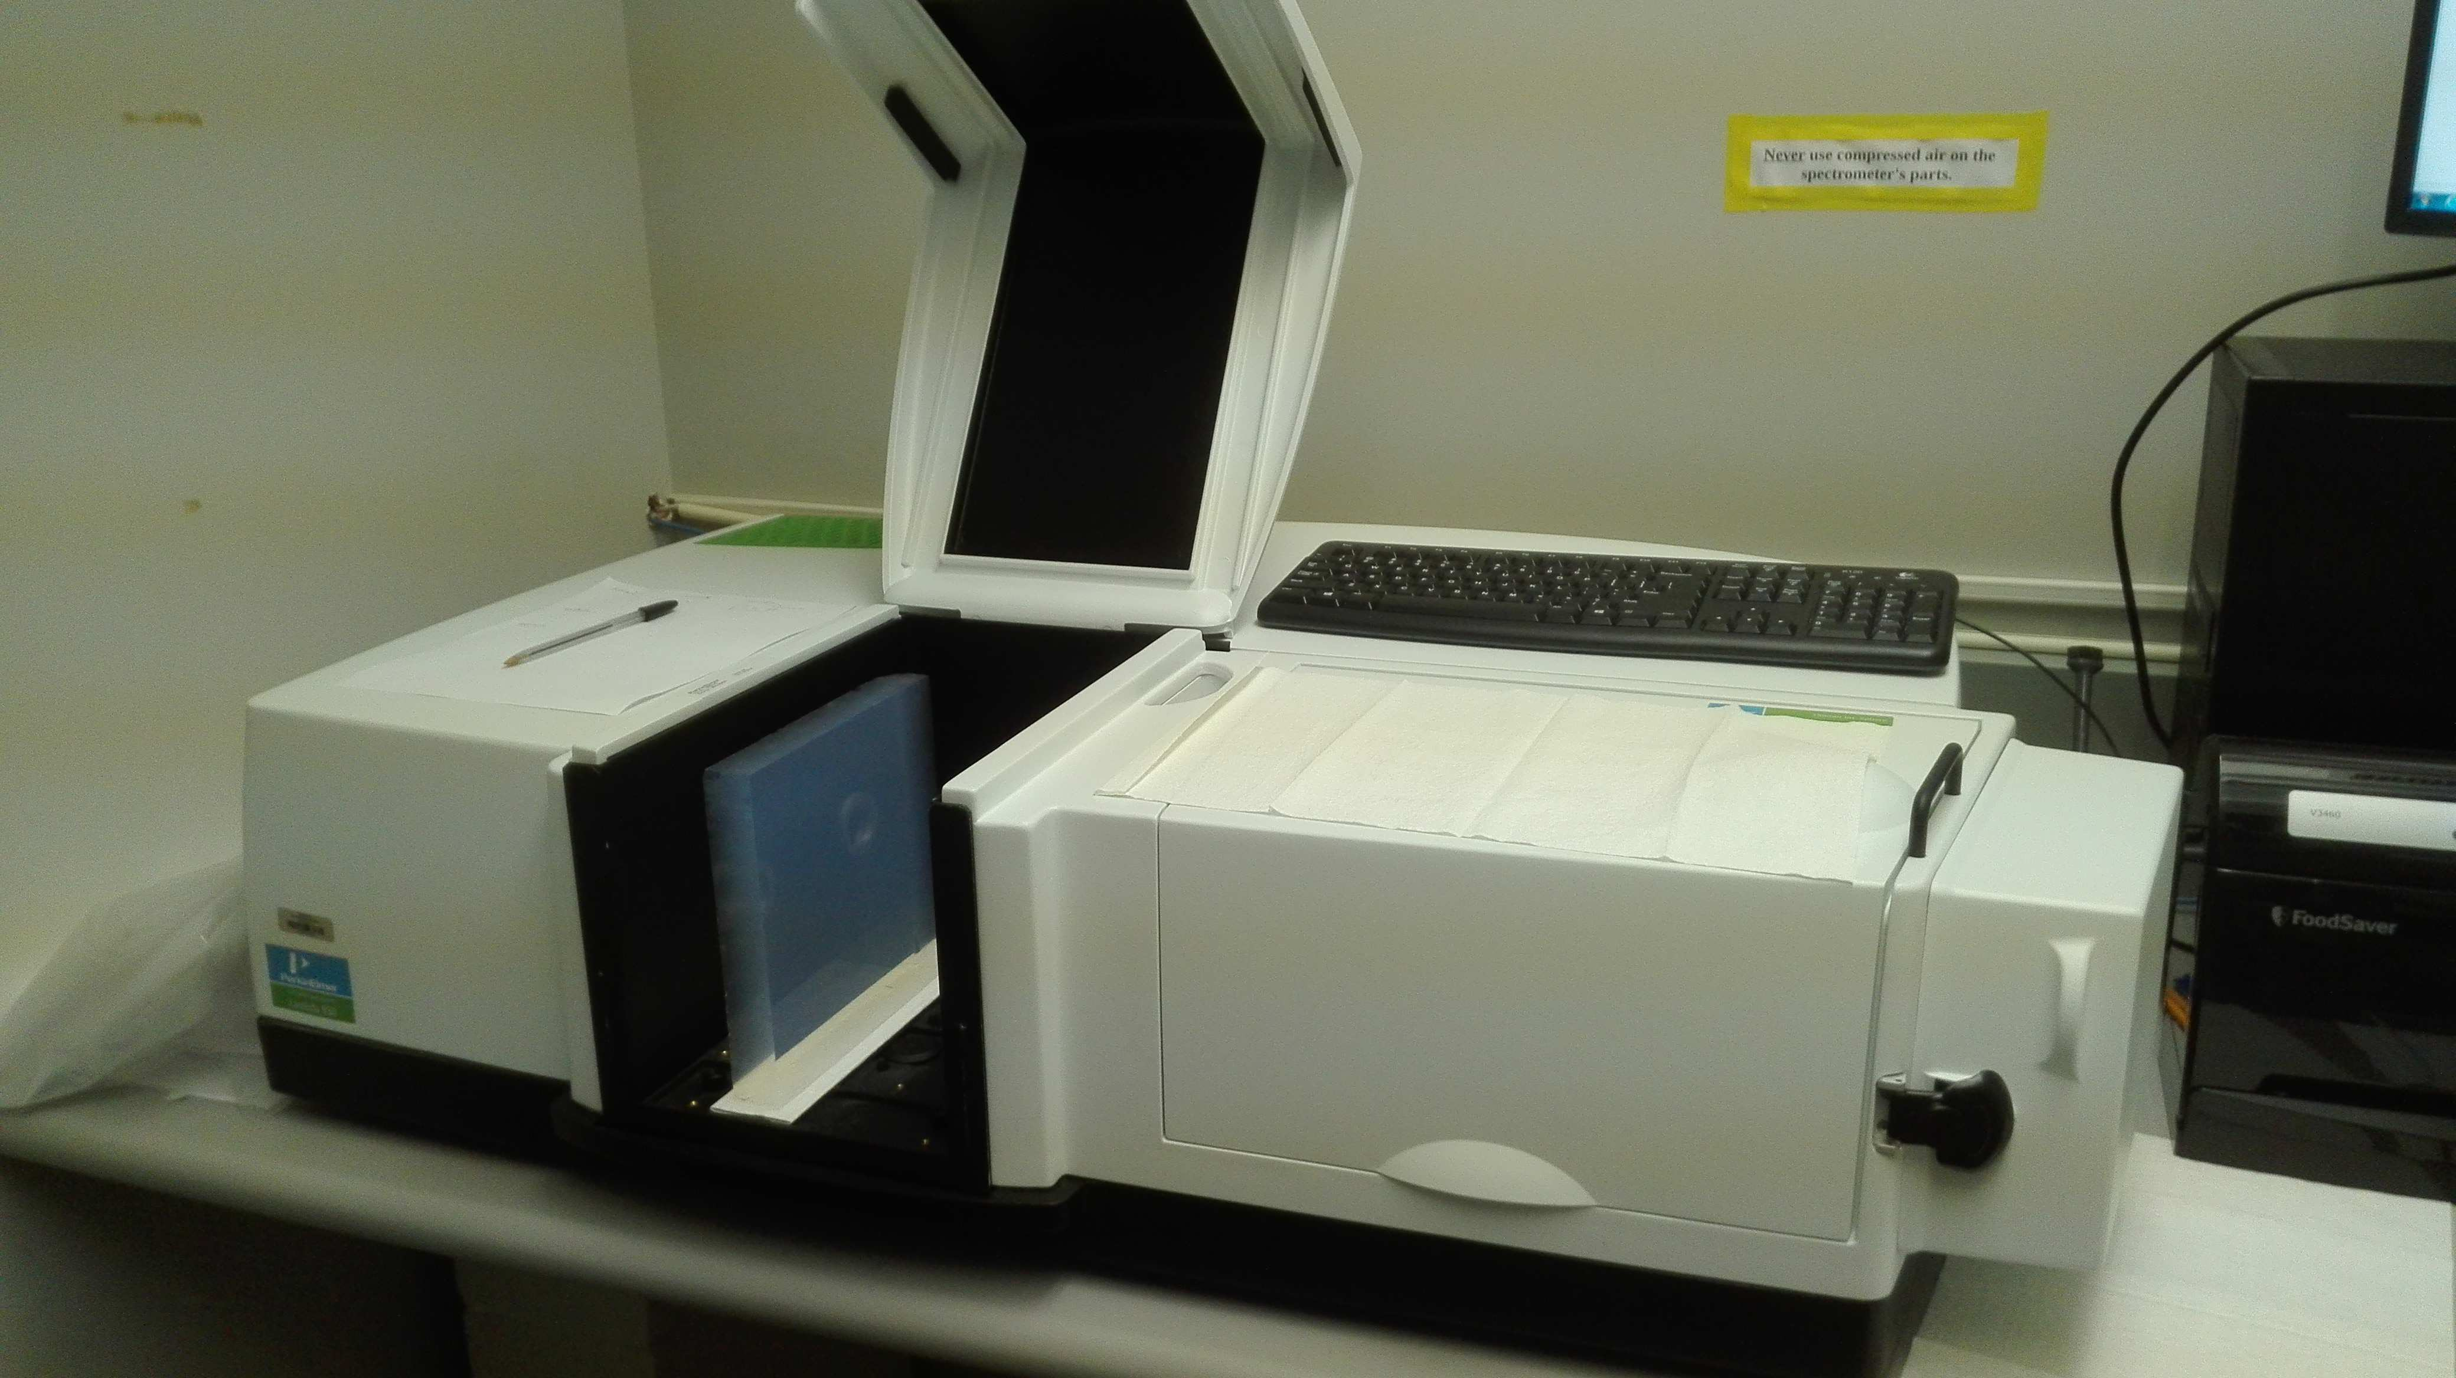
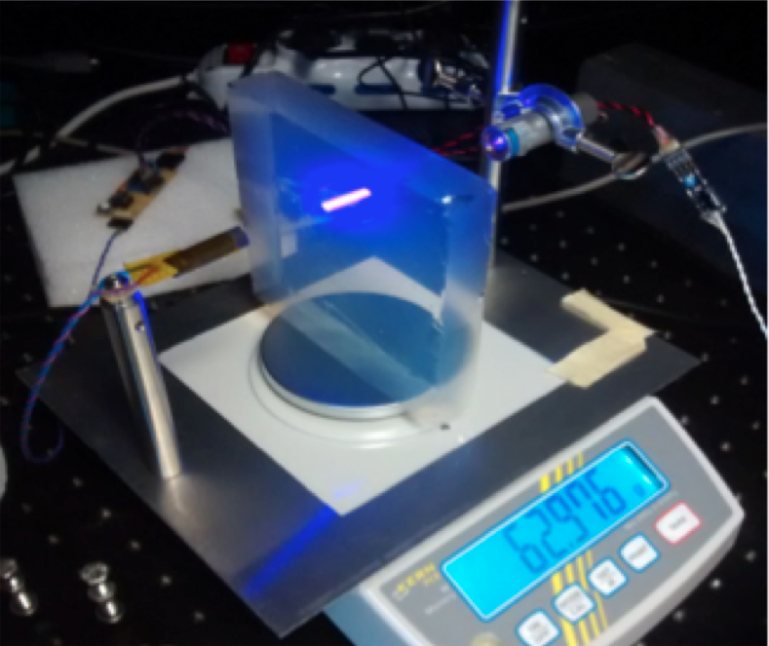
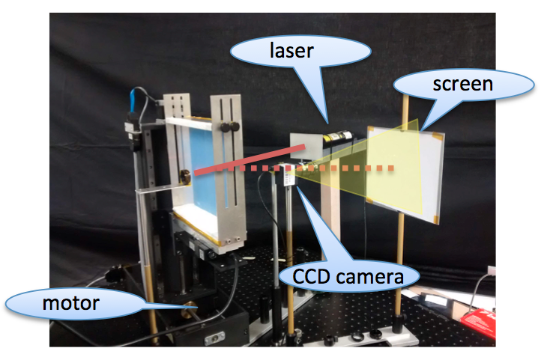
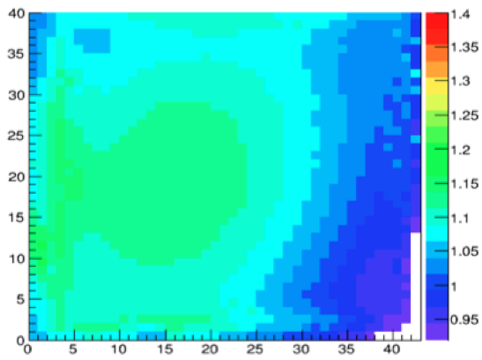
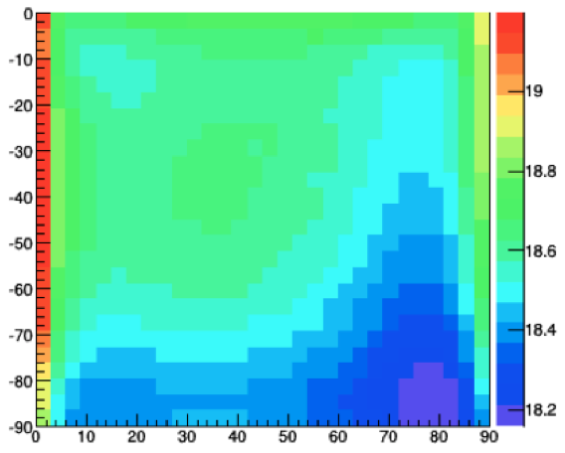
Ferrara Lab
Existing facility to study detailed aerogel optical properties
(refractive index, surface planarity, forward scattering)
safe handling and Interplay with gas radiator
Controlled storage
Spectrophotometer Characterization station
Surface map by laser setup vs touch machine
L. L. Pappalardo - C.d.S. INFN Ferrara – 06/07/2021

Slide 13
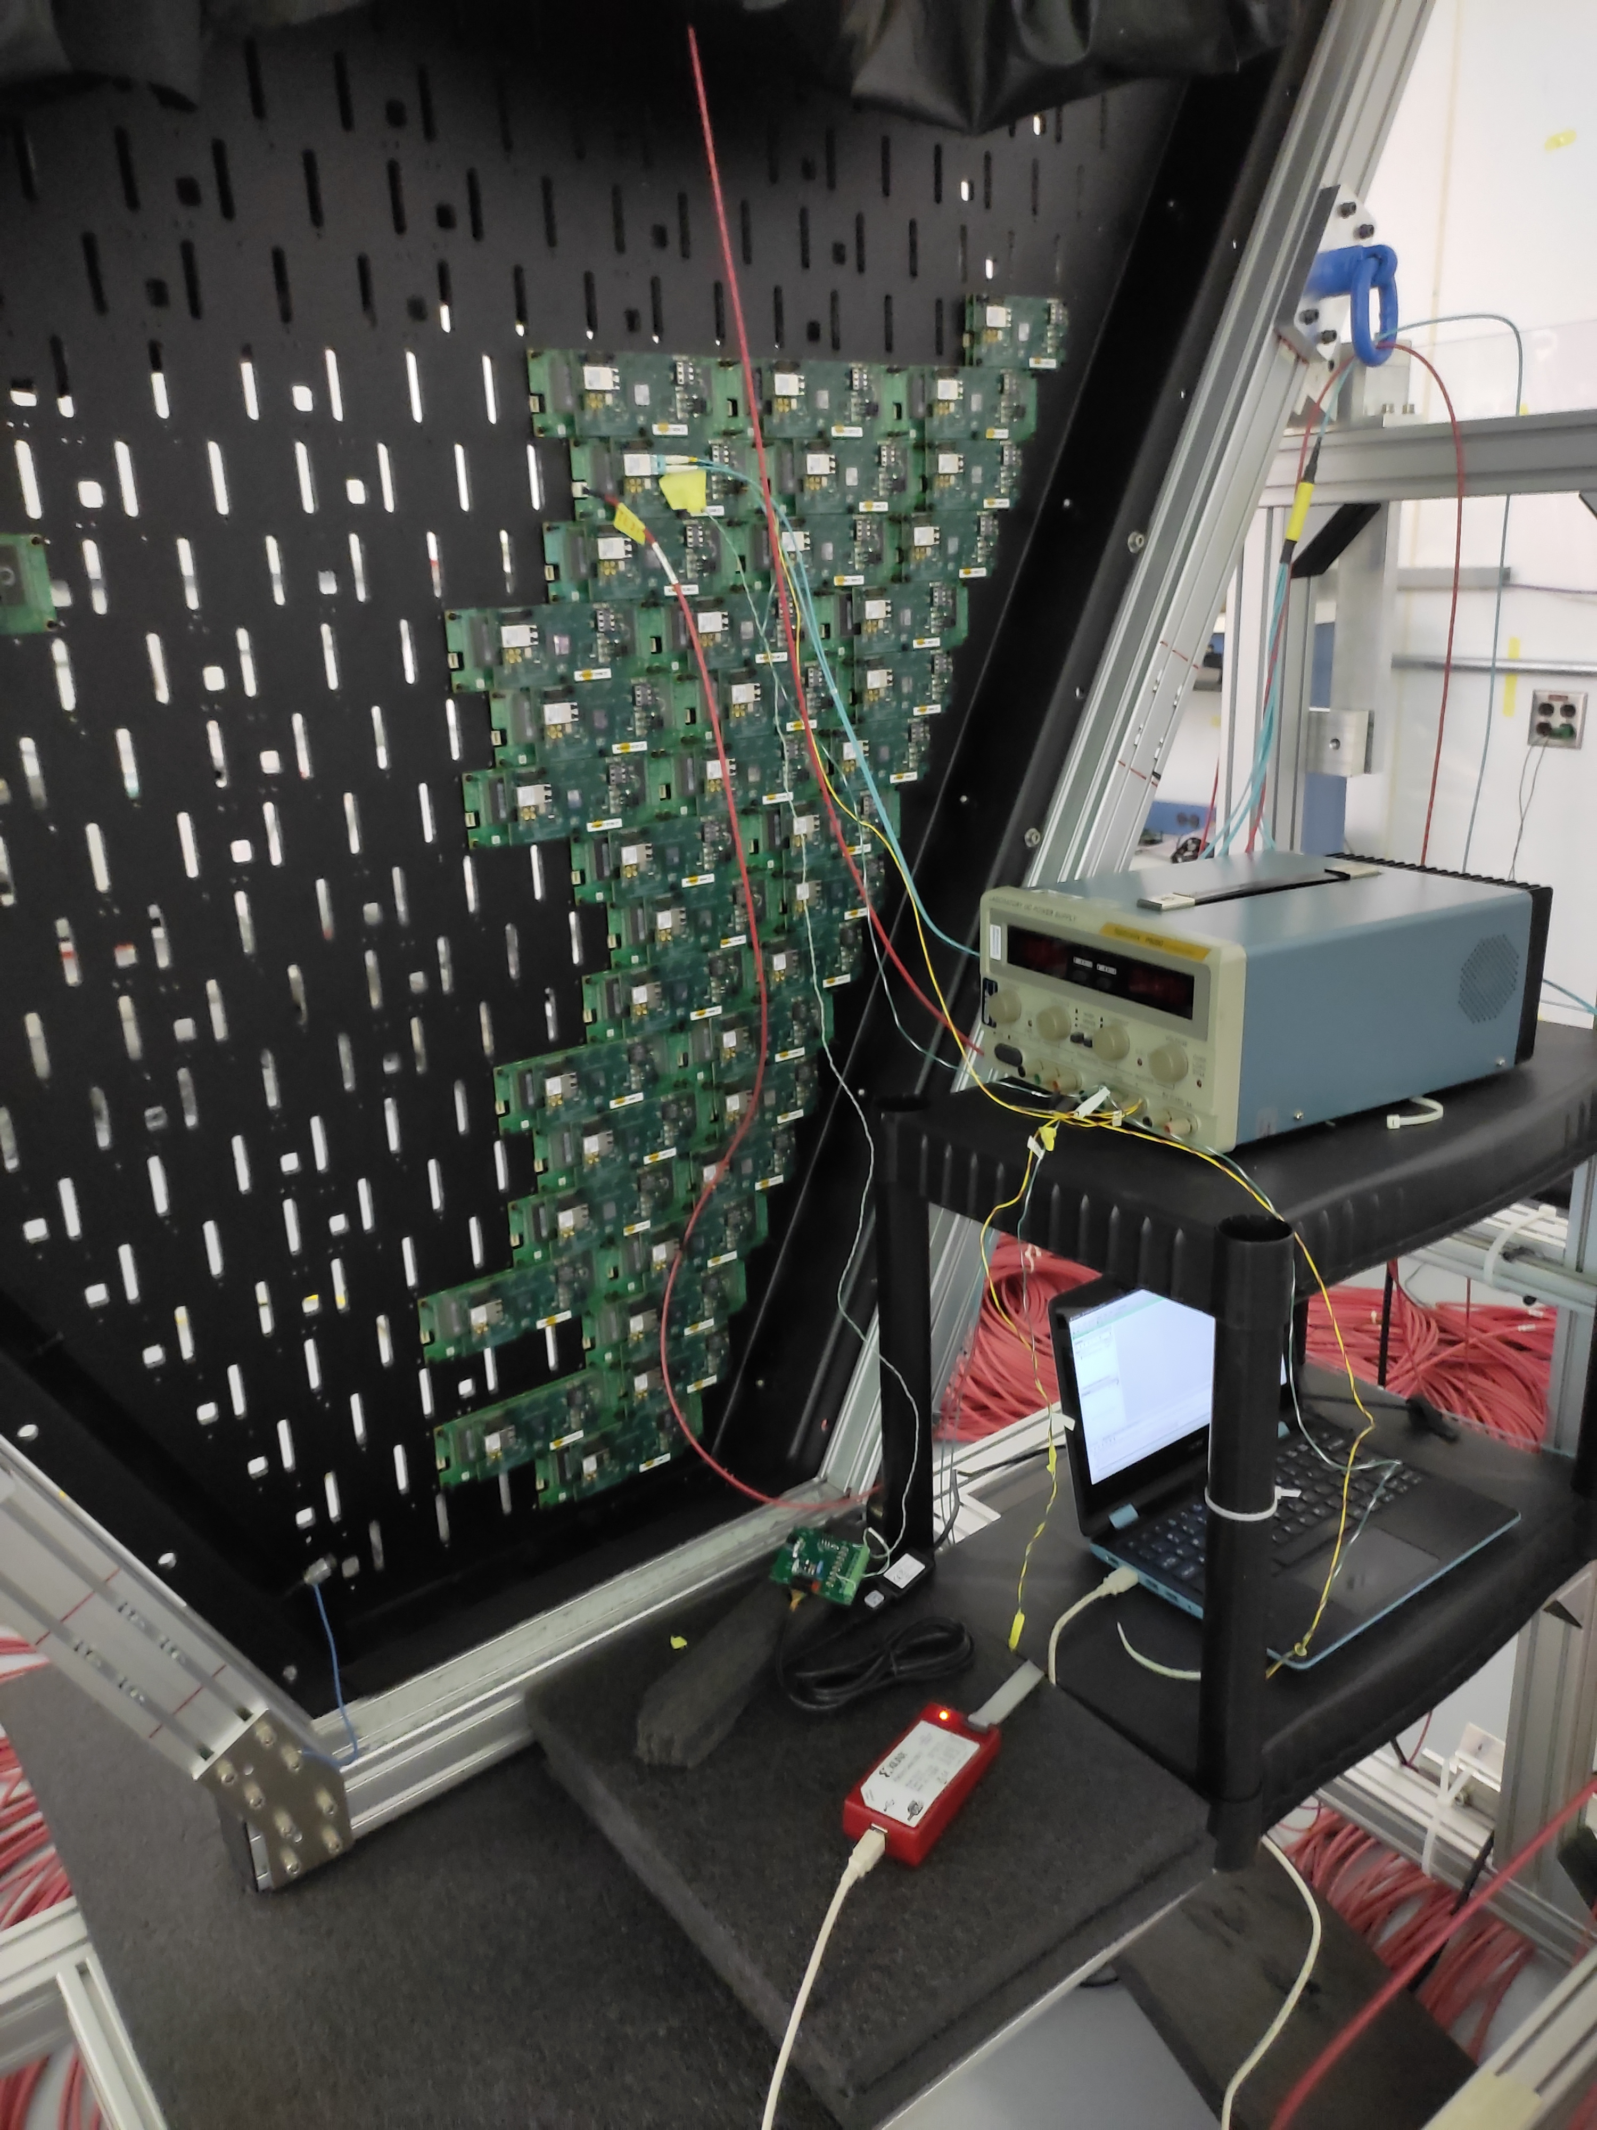
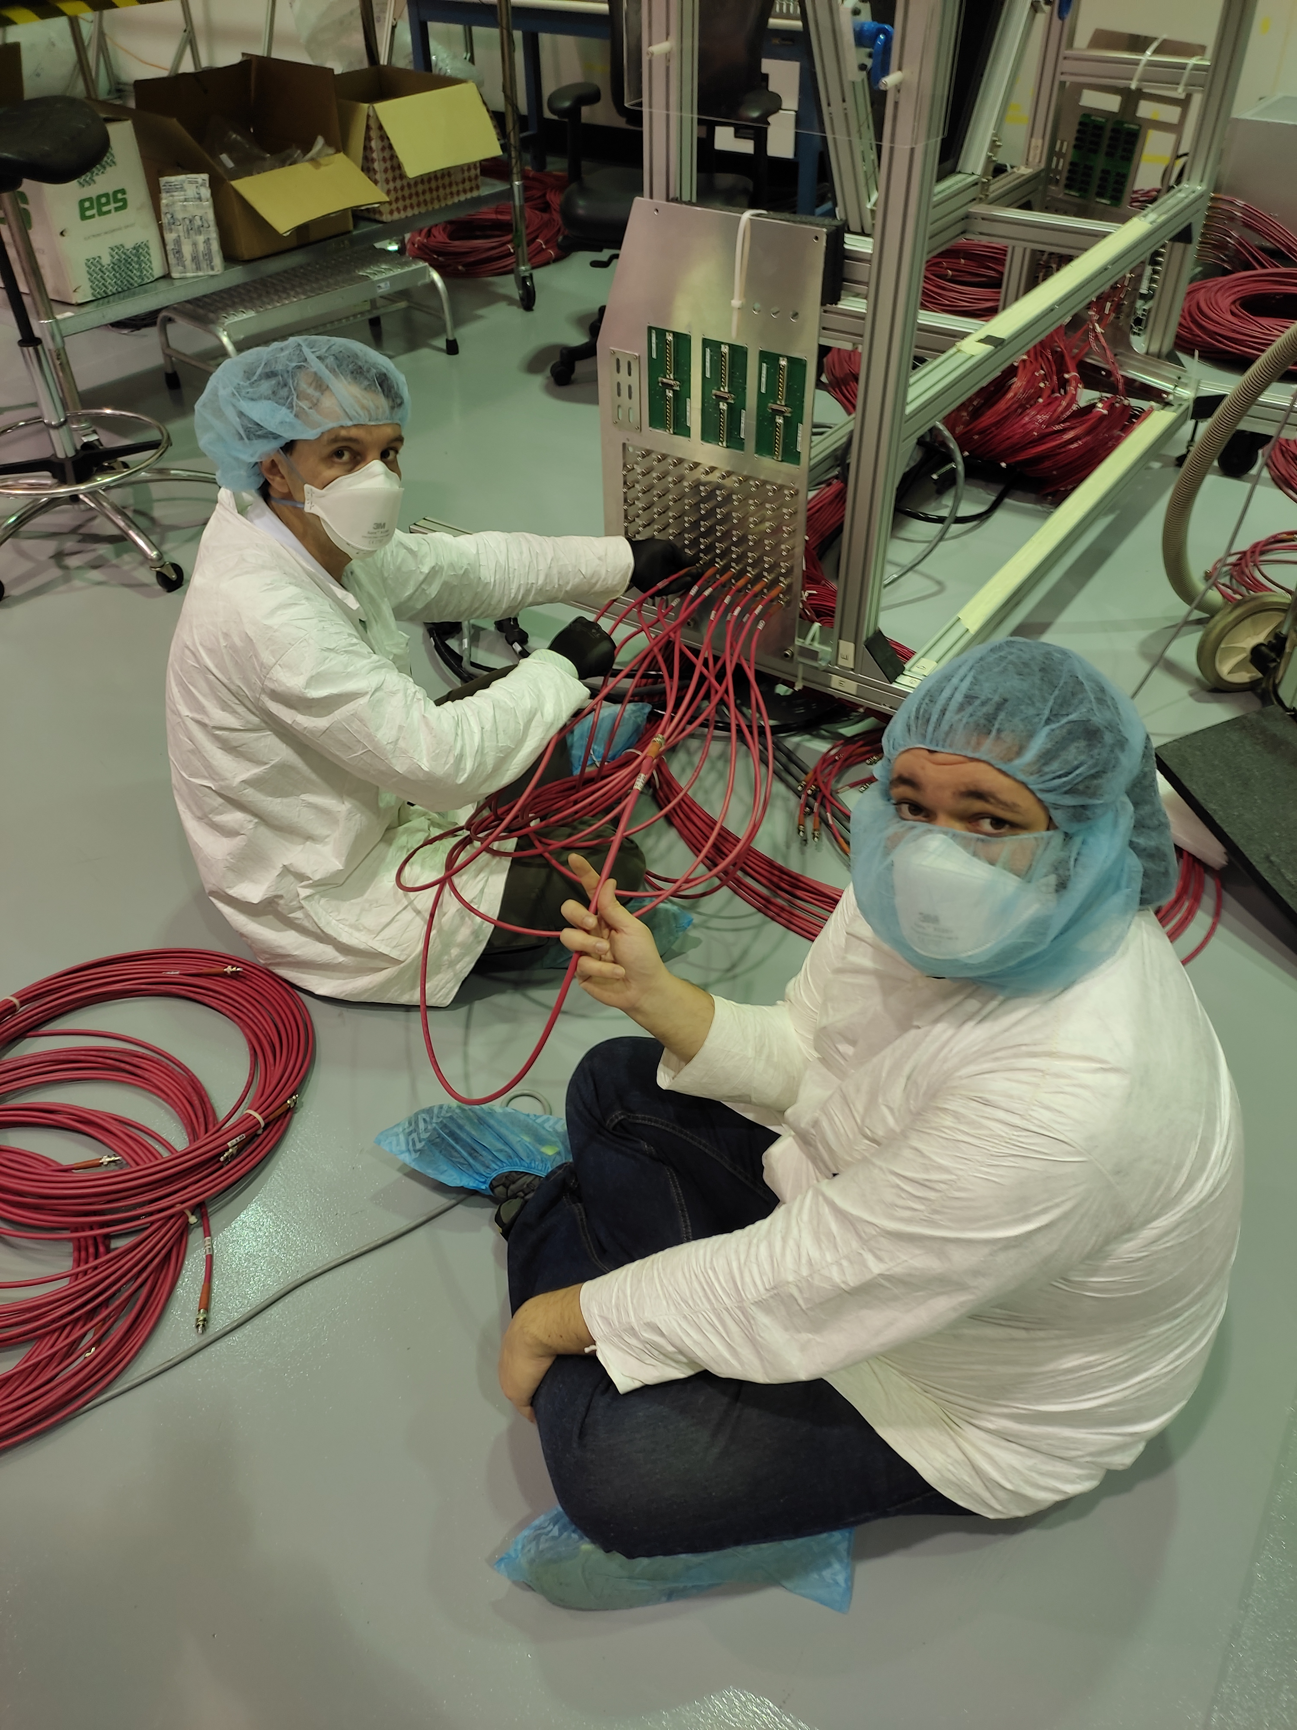
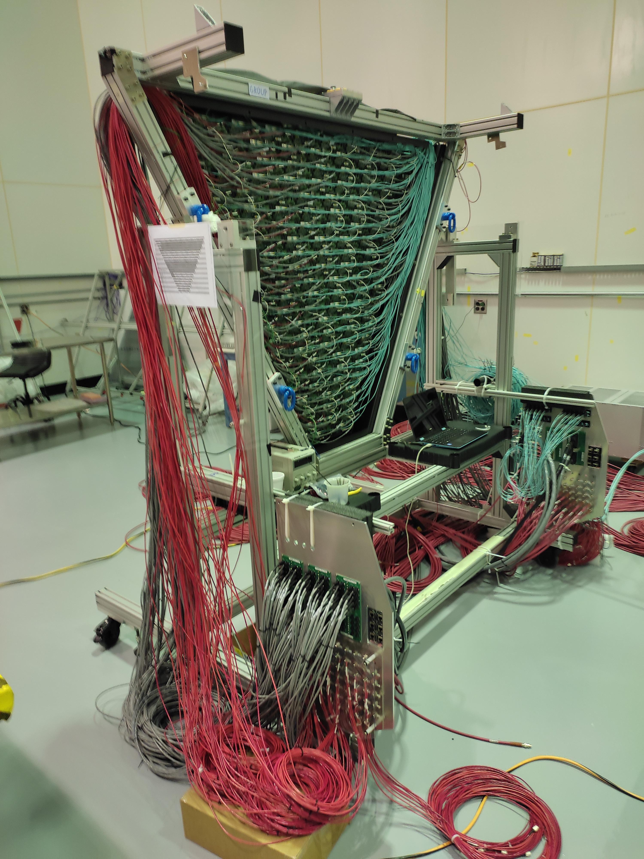
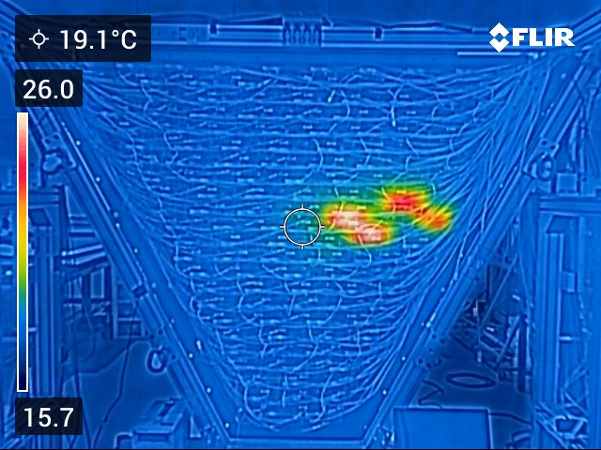
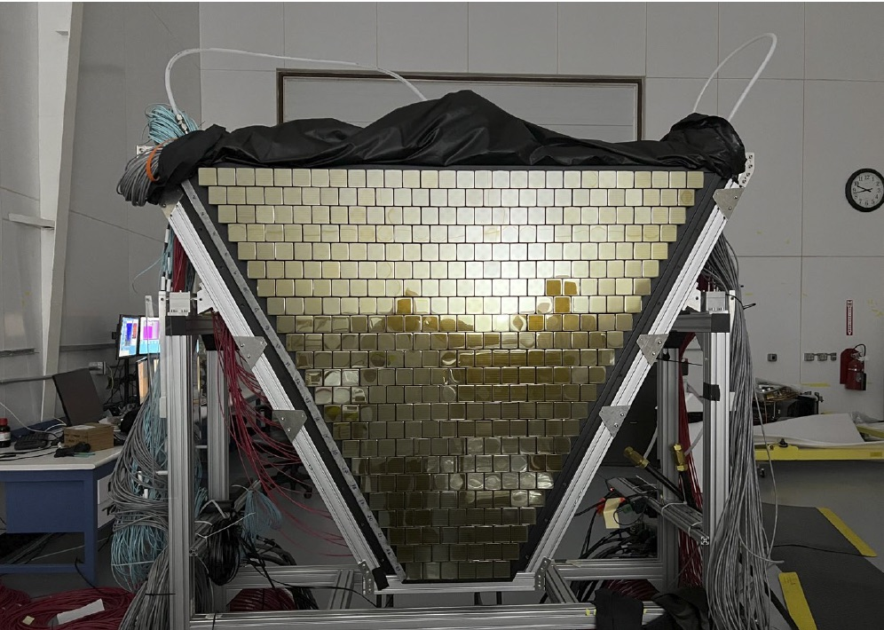
The RICH2 Detector Plane
L. L. Pappalardo - C.d.S. INFN Ferrara – 06/07/2021

Slide 14
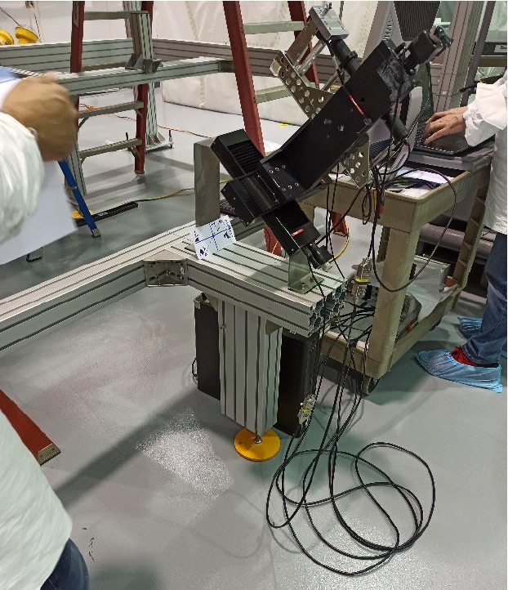
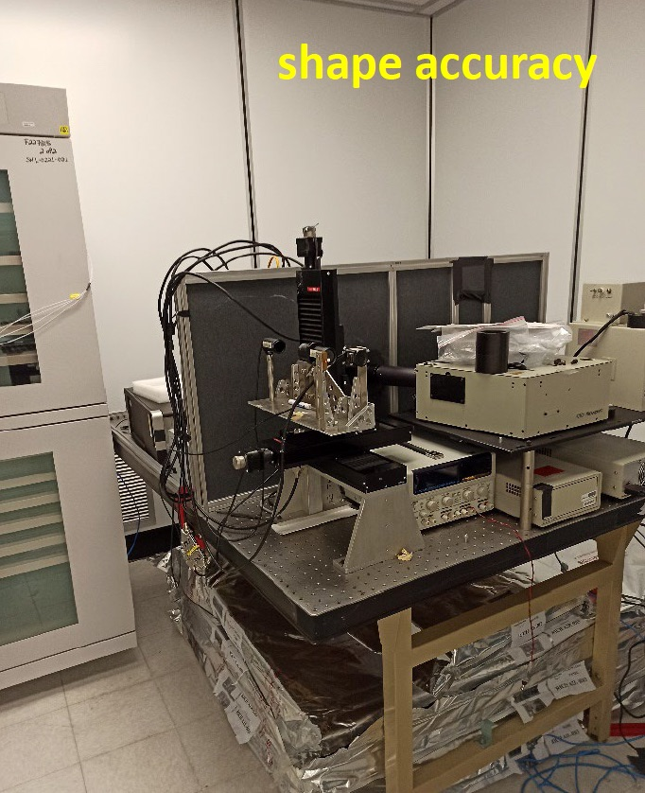
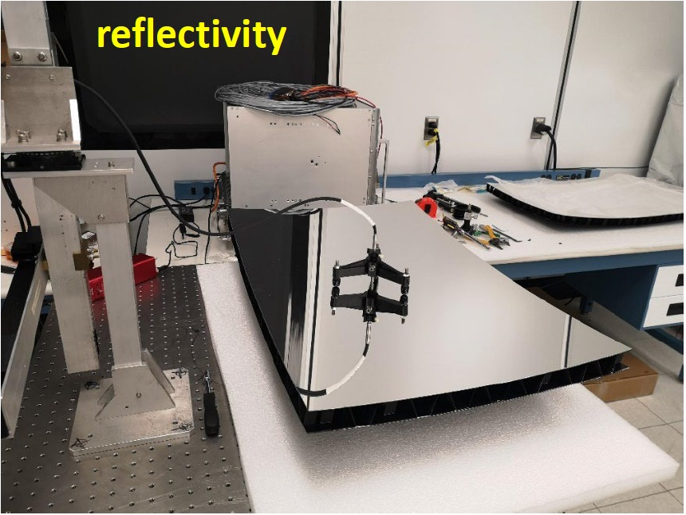
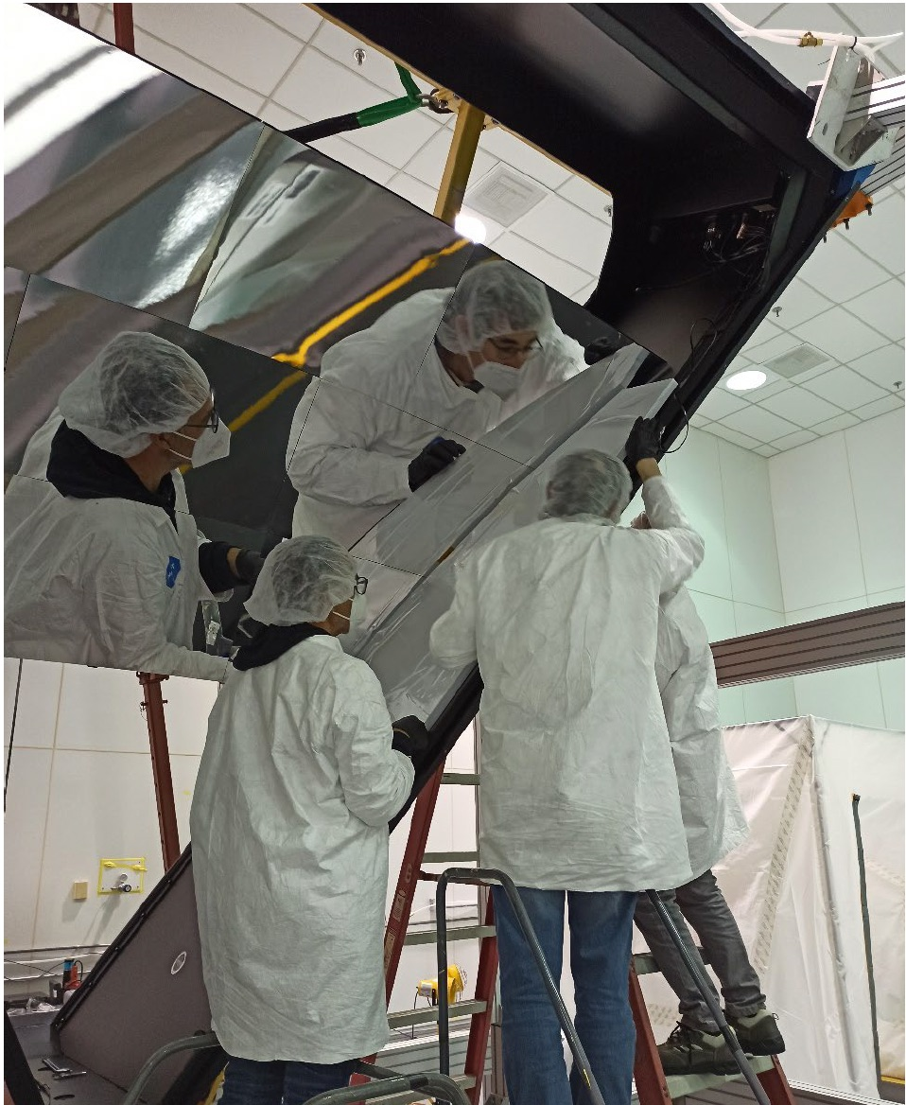
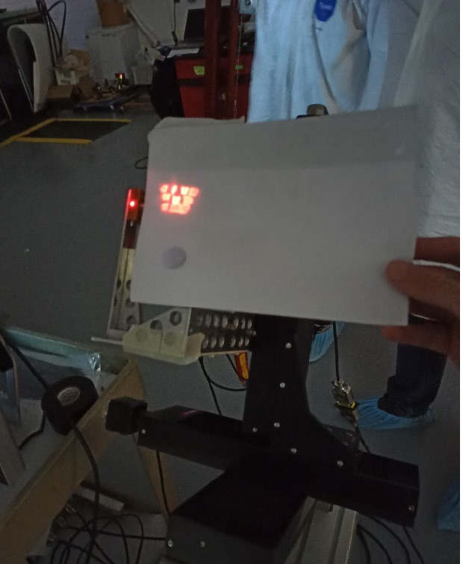
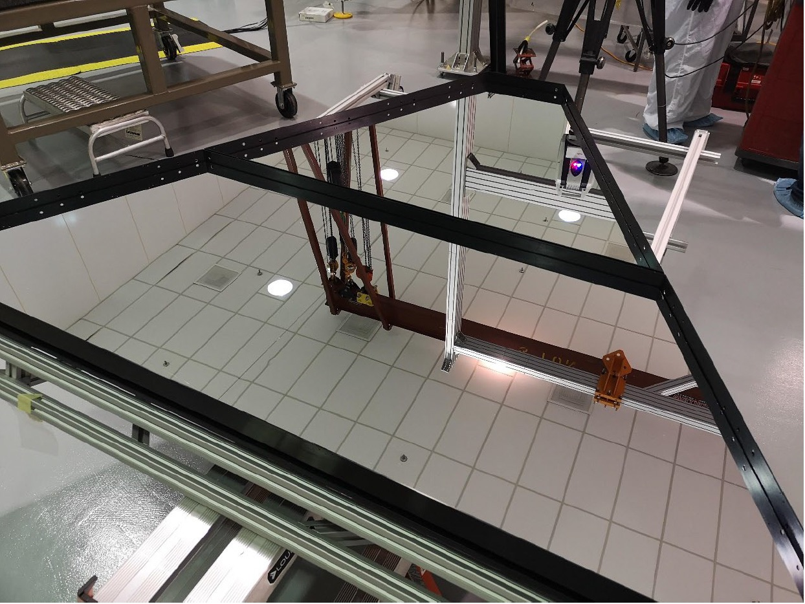
The RICH2 Mirror System
alignment
L. L. Pappalardo - C.d.S. INFN Ferrara – 06/07/2021

Slide 15
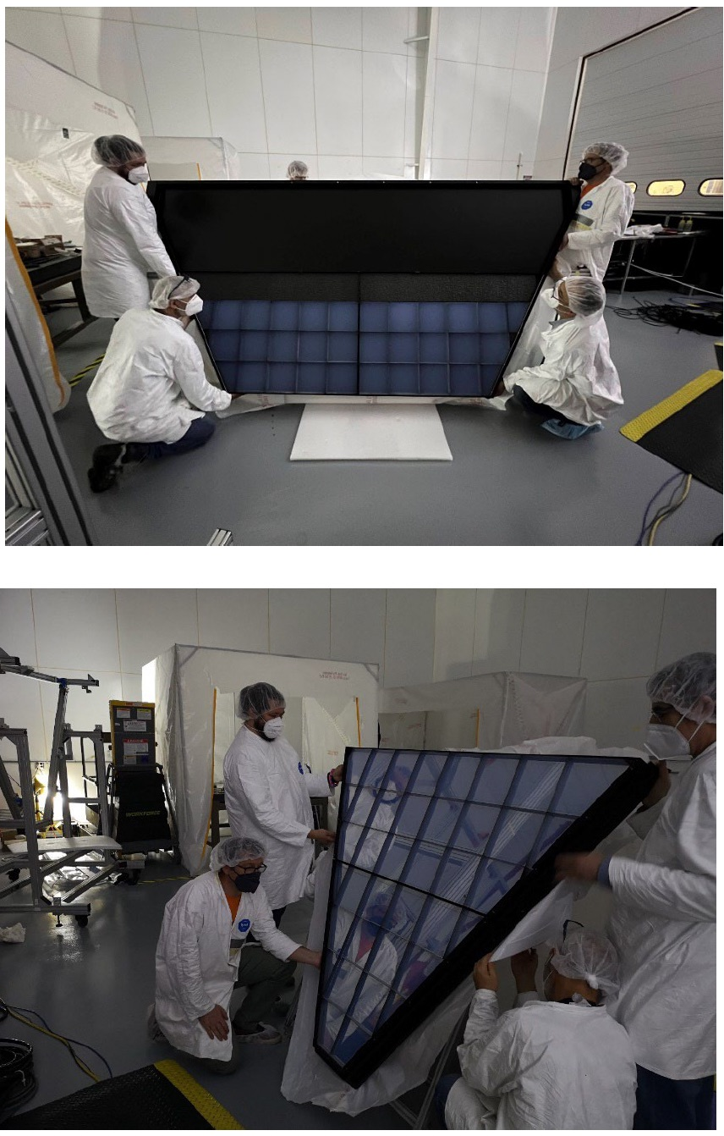
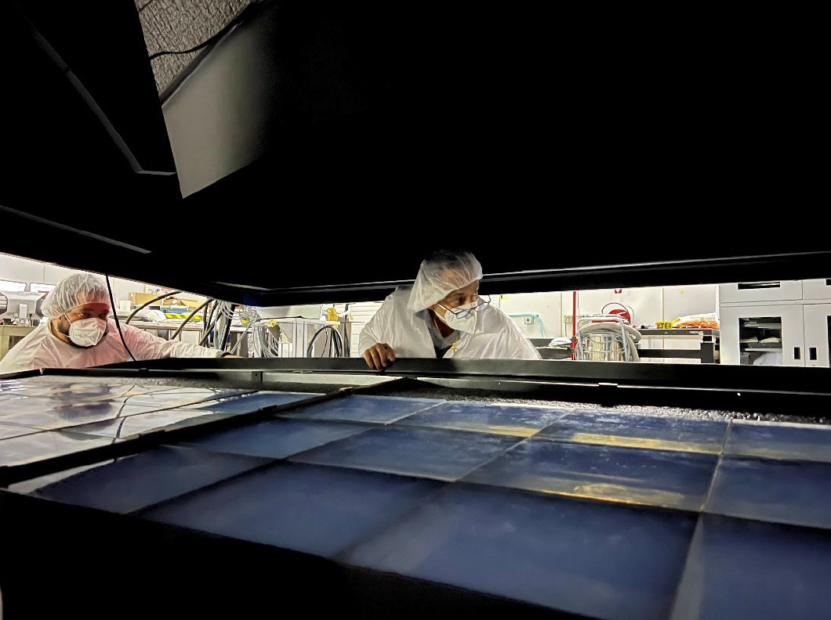
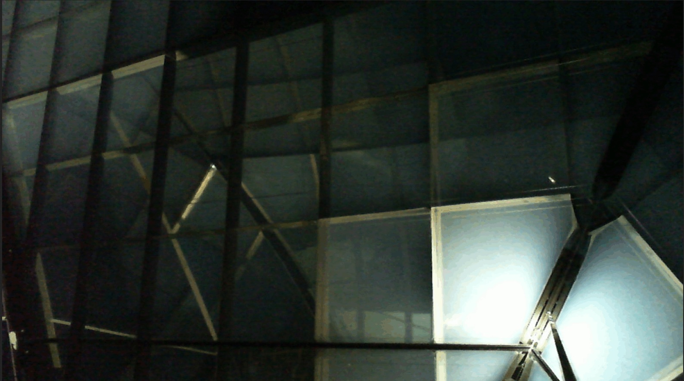
The RICH2 Aerogel
L. L. Pappalardo - C.d.S. INFN Ferrara – 06/07/2021

Slide 16
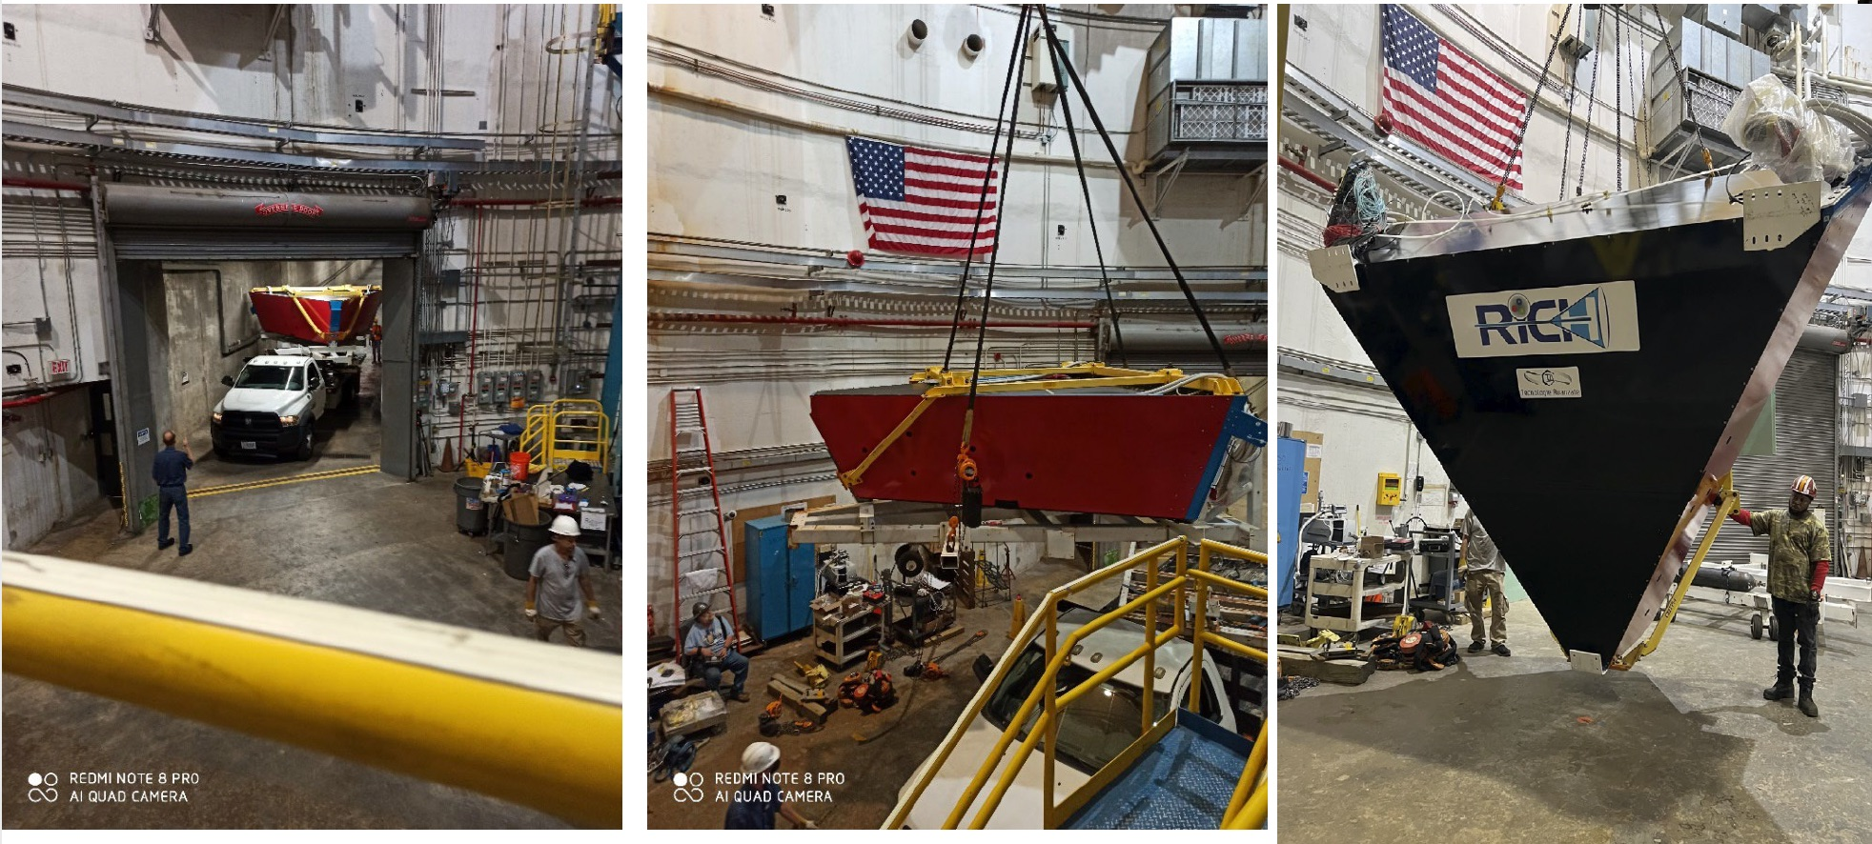
The RICH2 Installation (June 2022)
Major achievement: RICH2 ready in time for the start of polarized target experiments despite COVID restrictions
L. L. Pappalardo - C.d.S. INFN Ferrara – 06/07/2021

Slide 17
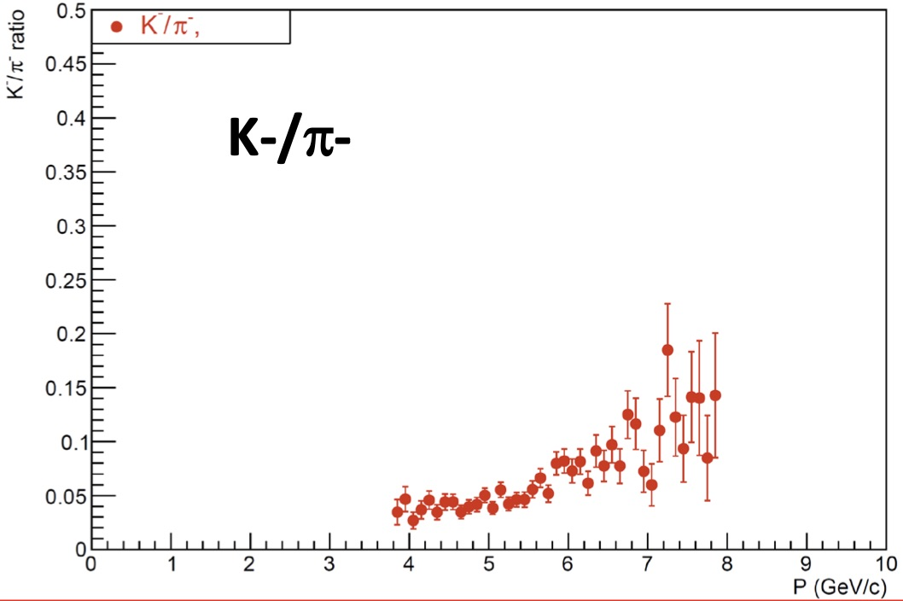
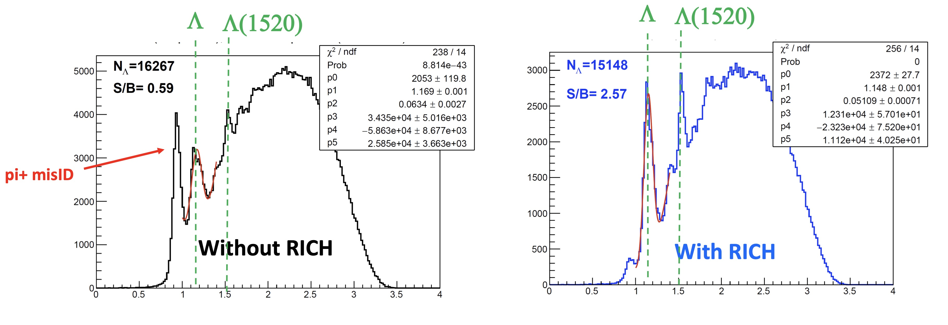
RICH Preformance
RICH PID used to benchmark simulations for 1st
CLAS12 publications
Performance being studied with physics channels
Missing mass in ep → e’ K⁺ X
with electron and kaon identified by CLAS12
Phase space and performance being improved
with new alignment and calibrations + RICH2.
DATA validating MC
for 1st publications
MM (GeV)
MM (GeV)
L. L. Pappalardo - C.d.S. INFN Ferrara – 06/07/2021

Slide 18
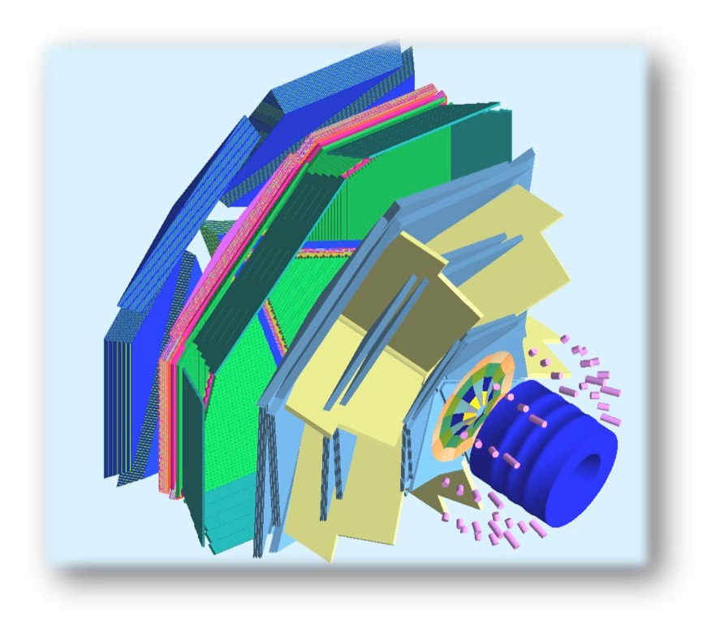
The Transverse target
Internal Target
To maintain transverse spin polarization
within the CLAS12 solenoid and preserve wide acceptance for the final-state particles, new magnetic solutions are required.
target
superconducting
solenoid
polarized
e⁻ beam
superconducting
torus
L. L. Pappalardo - C.d.S. INFN Ferrara – 06/07/2021

Slide 19
The Transverse target
Internal Target
To maintain transverse spin polarization
within the CLAS12 solenoid and preserve wide acceptance for the final-state particles, new magnetic solutions are required.
Tracking solenoid
design up to 5 T longitudinal
4K L-He cryostat
length 1500 mm
target
Transverse Target:
high polarization
d 25 mm – Length 25 mm
transverse field up to 2 T
superconducting
solenoid
polarized
e⁻ beam
superconducting
torus
L. L. Pappalardo - C.d.S. INFN Ferrara – 06/07/2021

Slide 20
Transverse target: bulk transverse magnet
A hollow bulk superconductor is able to provide a transverse holding field inside, while adjusting its internal currents to shield any outside field, without the need of a current supply!
L. L. Pappalardo - C.d.S. INFN Ferrara – 06/07/2021

Slide 21
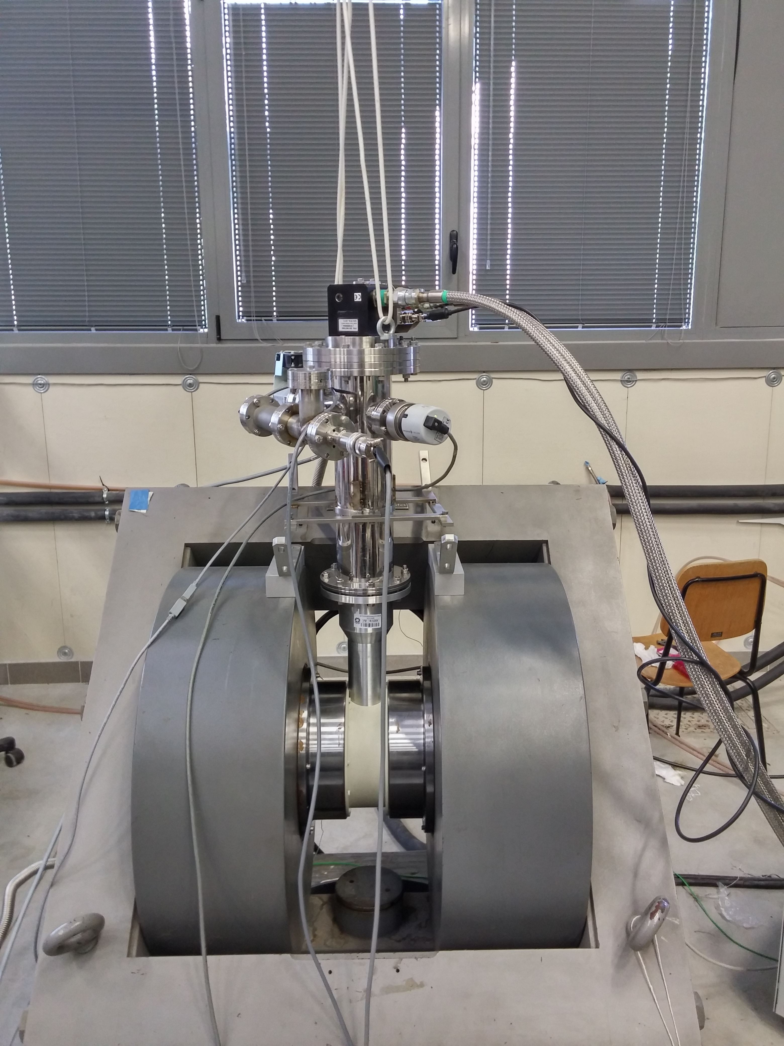
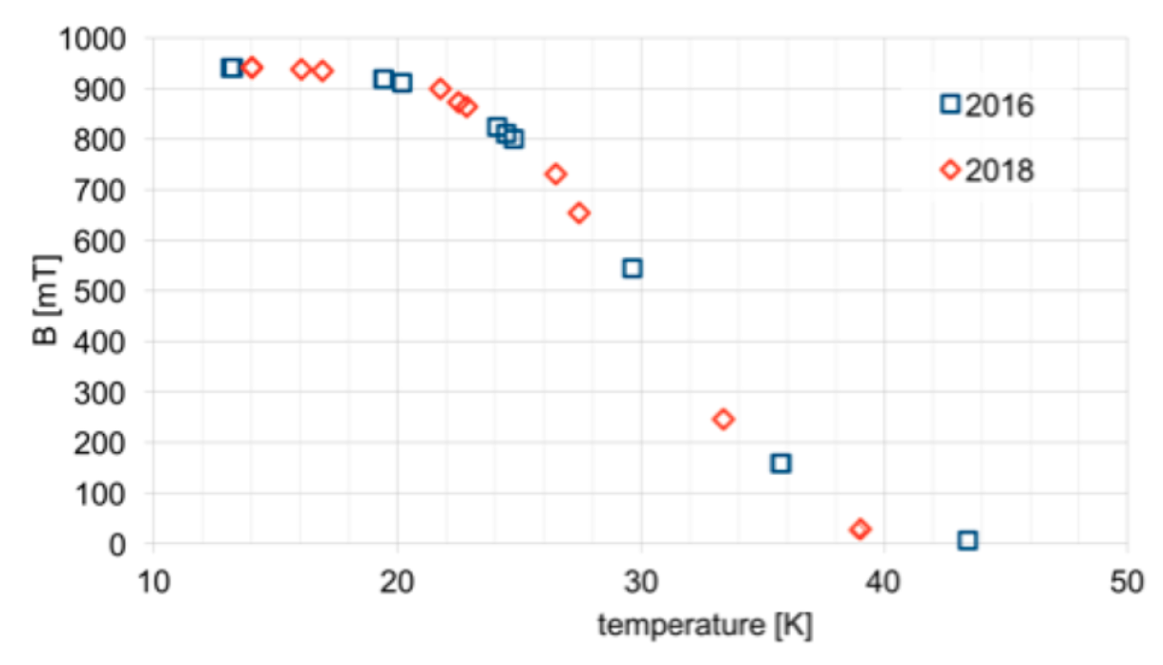
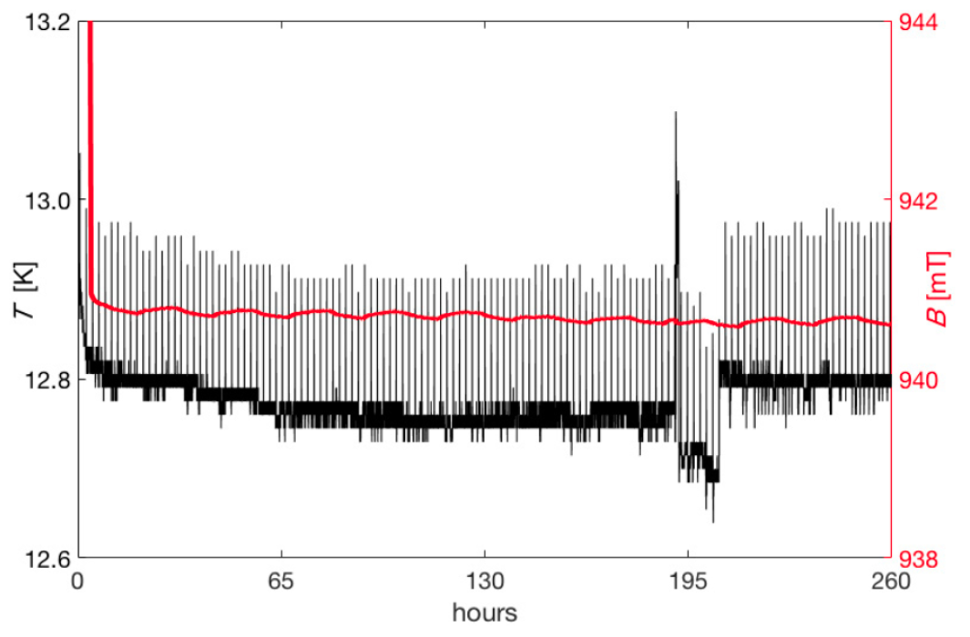
Transverse target: the Ferrara setup
Dipole field frozen for days inside a MgB₂ cylinder:
After cooling down the MgB2 cylinder inside a dipole field of about 1T, the external field is zeroed and the dipole field at the center of the cylinder measured.
With the decrease of the temperature below the transition point, an increasing fraction of the original field is trapped.
At the minimum temperature of 12.8 K reachable by the setup, a field of about 940 mT is preserved for days, without any significant degradation
Field vs
Temperature
L. L. Pappalardo - C.d.S. INFN Ferrara – 06/07/2021

Slide 22
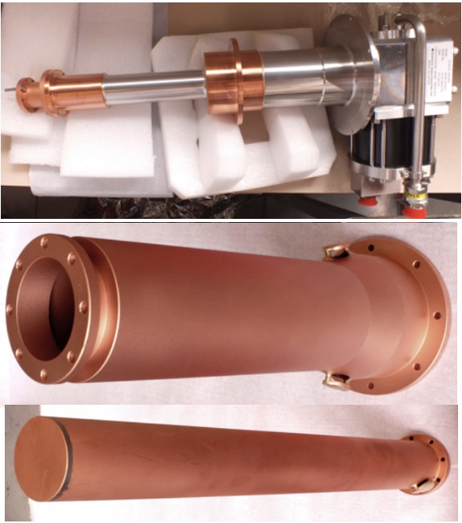


Transverse target: the new cryostat
New support (M. Cavallina)
New cold head:
lower and more stable
temperature working point
New cold stage:
reduced mass
space for cabling
L. L. Pappalardo - C.d.S. INFN Ferrara – 06/07/2021

Slide 23



Transverse target: the new sensor holder
New sensor holder: (M. Cavallina)
3 points x 2 orientation
center
off axis
downstream
From Teflon to Al for heat sink
New fast access
for MgB₂ sample exchange
L. L. Pappalardo - C.d.S. INFN Ferrara – 06/07/2021

Slide 24

Transverse target: the new steps
Field mapping and temperature vs field scan
Study MgB2 performance vs thickness and granularity
Organize a 2x field (transverse holding, longitudinal screen) test in
collaboration with INFN – LASA (MI)
L. L. Pappalardo - C.d.S. INFN Ferrara – 06/07/2021

Slide 25
CLAS12 @ High-Luminosity
Ferrara: study mechanical stability for minimal material budget (M. Melchiorri)
L. L. Pappalardo - C.d.S. INFN Ferrara – 06/07/2021

Slide 26
Il gruppo di Ferrara @ JLab
Responsabilita’:
M. C.: responsabile locale e nazionale di JLab12
M. C. : chair-elect of the Jlab User Organization
M. C.: membro CLAS Coordination Committee
M. C. responsabile progetto RICH
M. C. & L.P. Co-spokesperson di diverse proposte di esperimento (PAC34,37,38,39)
Contributi principali
Data analysis
- Coordination of deep-process group
- Data processing
RICH detector
- Reconstruction algorithms
- Second RICH module construction
Magneti superconduttori
- Configurazione magnetica per transverse target
- Frozen field con magneti a bulk di superconduttore
High-luminosity
- Study micro-Rwell mechanical stability with light structure
- Laboratory test
L. L. Pappalardo - C.d.S. INFN Ferrara – 06/07/2021

Slide 27

EIC-NET (R.L.: Marco Contalbrigo)
INFN Network for preliminary studies on the EIC project
M. Contalbrigo in co-coordinator of the dRICH R&D EIC Program (eRD102)
Dual-radiator RICH for the EIC hadron end-cap (project led by INFN)
L. L. Pappalardo - C.d.S. INFN Ferrara – 06/07/2021

Slide 28

EIC_NET
Electron Ion Collider:
CD0 Announced in January 2020
“Yellow Report” in preparation
“Expression of Interest” survey done
“Call for Detectors” call ongoing
Strong interest in Italian nuclear physics
community (theory and experiment)
Increasing R&D effort
INFN Ferrara working with the PID R&D
L. L. Pappalardo - C.d.S. INFN Ferrara – 06/07/2021

Slide 29


EIC_NET: The dual RICH
dRICH has been a common reference in the forward region since EIC Yellow Report
p/A beam
e beam
p: 41 GeV, 100 to 275 GeV
e: 5 GeV to 18 GeV
L. L. Pappalardo - C.d.S. INFN Ferrara – 06/07/2021

Slide 30


EIC_NET: The dual RICH
≥3σ π/k separation
∼ 2 ÷ 50 GeV/c
Two test-beam apporved at CERN in 2022:
Sep. SPS T4-H8: high-momentum > 20 GeV/c
Oct. PS T10: low-momentum < 15 GeV/c
in conjunction with ALICE PID
Extended 3-60 GeV momentum range
Prototype under construction:
INFN FE, BO, CT, LNF, LNS,RM1, TO, TS
L. L. Pappalardo - C.d.S. INFN Ferrara – 06/07/2021

Slide 31



EIC_NET:
The dual RICH Prototype
Mirror alignment system
Detector box
(M. Cavallina)
Detector support cart
(off. Meccanica)
L. L. Pappalardo - C.d.S. INFN Ferrara – 06/07/2021

Slide 32

dRICH Prototype
3m
Goals:
Study dual radiator performance and interplay
Study specifications and alternatives for optical components
Test alternate single-photon detection systems
Design parameters and optimization
Basic system
commissioned
in 2021 runs
L. L. Pappalardo - C.d.S. INFN Ferrara – 06/07/2021

Slide 33


GEM Tracking
A tracking system based on two GEM detectors was used during the test beam
to track the beam particles for measuring alignment and beam divergence.
The combination of the dRICH optical information and GEM track information
allows to correct data on an event by event analysis.
L. L. Pappalardo - C.d.S. INFN Ferrara – 06/07/2021

Slide 34


dRICH Prototype Imaging
A tracking system based on two GEM detectors was used during the test beam
to track the beam particles for measuring alignment and beam divergence.
The combination of the dRICH optical information and GEM track information
allows to correct data on an event by event analysis.
Without GEM
With GEM
L. L. Pappalardo - C.d.S. INFN Ferrara – 06/07/2021

Slide 35



dRICH-gas Performance
$$y=\sqrt{\frac{{p_{0}}^{2}}{x}+{p_{1}}^{2}}$$
Gas | Data | Simulation
p0 [mm] | 1.5 | 1.1
p1 [mm] | 0.22 | 0.07
Avg photon | 12.8 | 11.3
Fitting function:
p0 = single photon resolution
p1 = single particle resolution constant term
L. L. Pappalardo - C.d.S. INFN Ferrara – 06/07/2021

Slide 36


EIC_NET: The SiPM program
Cherenkov imaging with commercial MPPC and MAROC readout
Next: Cherenkov imaging with irradiated SiPM and ALCOR (DarkSide) chip
L. L. Pappalardo - C.d.S. INFN Ferrara – 06/07/2021

Slide 37



EIC_NET: The SiPM program
Dark counts @ -30º (before annealing)
L. L. Pappalardo - C.d.S. INFN Ferrara – 06/07/2021

Slide 38
EIC_NET: responsabilità
Responsabilita’:
M. C.: responsabile locale EIC_NET
M.C.: co-coordinator eRD102
M. C.: IAC POETIC (Physics Opportunities at EIC) Conference
Contributi principali:
dRICH detector
- Prototyping
- Optical component characterization
- SiPM irradiation program
Electronics
- MAROC (reference) + ALCOR (INFN development)
L. L. Pappalardo - C.d.S. INFN Ferrara – 06/07/2021

Slide 39
Richieste ai Servizi
Servizio Meccanico
JLAB12
TTarget: traliccio di supporto per test con doppio campo magnetico disegno e realizzazione esterna
High-Lumi: supporto per stazione di test con μ-rwell
FE laboratory: supporto per misure e stazioni di test
EIC_NET
dRICH: meccanica del prototipo
SiPM: meccanica per il raffreddamento dei sensori
EIC: contributo piano di rivelazione basato su SiPM+ALCOR
Servizio Elettronico
JLAB12
Ttarget: piccoli contributi alle misure con magneti superconduttori
High-Lumi: supporto per stazione di test con μ-rwell
FE laboratory: supporto per misure e stazioni di test
EIC_NET
dRICH: supporto in preparazione ai test-beam e misure di laboratorio
SiPM: contributo piano di rivelazione basato su SiPM + ALCOR
L. L. Pappalardo - C.d.S. INFN Ferrara – 06/07/2021

Slide 40
Manpower e richieste finanziarie per 2021
Anagrafica e afferenze (Ric. + Tecnol.)
Servizio meccanico ed elettronico
Name | JEDI | JLab12 | EIC_NET
N. Canale (dottorando) | 100
G. Ciullo (staff) | 70 | 20
M. Contalbrigo (staff) |  | 75 | 20
S. Dymov (post-doc) | 100
L. Del Bianco (staff) |  | 100
A. Kononov (dottorando) | 100
P. Lenisa (staff) | 75 | 20
A. Maragno (dottoranda) | 100
L. Pappalardo (RTD-B) |  | 30
A. Pesce (post-doc) | 100
A. Seleev (assegnista) | 100
R. Shankar (dottorando) | 100
F. Spizzo (staff) |  | 80 | 20
S. Vallarino (dottorando) |  | 100
V. Carassiti | 10
A. Cotta Ramusino (staff) | 10
TOTALE/100 | 8.6 | 4.2 | 0.4
Name | JEDI | JLab12 | EIC_NET
L. Barion |  | 25 | 75
M. Cavallina | 10 | 10
M. Gambetti | 10
R. Malaguti |  | 20
M. Melchiorri |  |  | 10
S. Squerzanti |  | 20
TOTALE/100 | 0.2 | 0.5 | 0.1
Richieste finanziarie (k€)
Name | JEDI | JLab12 | EIC_NET | Dot.3
Missioni | 57 | 45 | 15 | 8
Trasp. |  | 5
Inv. | 9 |  |  | 15
Consumi | 34.5 | 15 | 17 | 6
Apparati |  | 20
Altro |  |  |  | 3
TOTALE | 100.5 | 85 | 32 | 32
L. L. Pappalardo - C.d.S. INFN Ferrara – 06/07/2021

