Slide 1
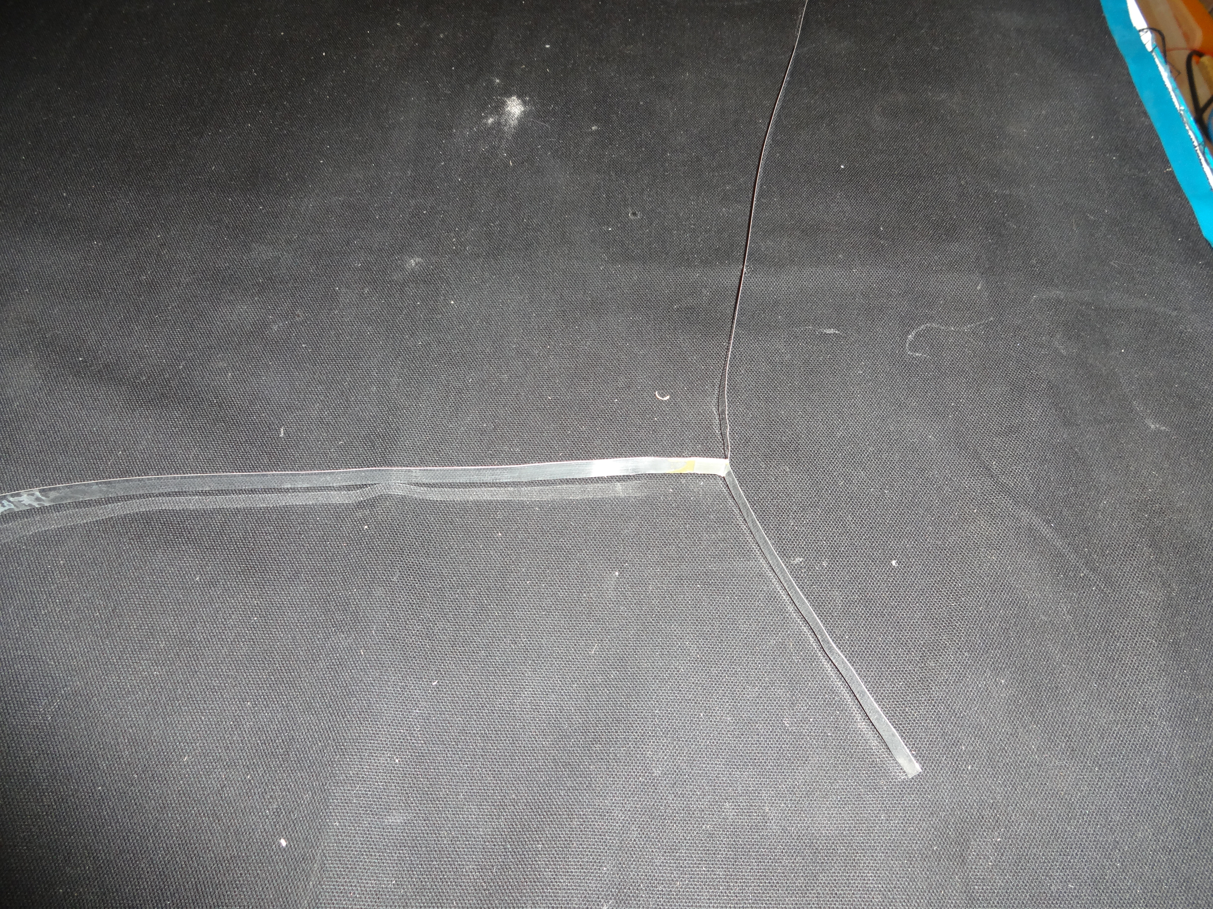
NA62 RICH
RIBBONS TEST - STATUS REPORT

Slide 2
BALANCING THE MIRROR
mirror
2T
R
Dt
P
dowel

Slide 3
MATERIALS (GLUED JOINT)
MATERIAL PROPERTIES
MATERIAL | DENSITY (Kg/m^3) | ELASTIC MODULUS (MPa) | POISSON’S RATIO | TENSILE STRENGTH R_{m} (MPa) | YELD STRENGTH R_{p0,2}(MPa) | SHEAR STRENGTH R_{t} (MPa) | PEELING STRENGTH R_{ps} (N/mm) | FLEXURAL STRENGTH R_{F} (MPa) | FLEXURAL MODULUS (MPa)
ALUMINUM 6082 ANNEALED (ANTICORODAL) | 2700 | 70000 | 0,345 | 110 | 60 | 63
EPOXY (ARALDITE 2012) | 1180 |  |  |  |  | 34 | 5,5 | 46 | 1654
RIBBON DIMENSIONS :
THICKNESS = 0,2 mm
WIDTH = 10 mm

Slide 4
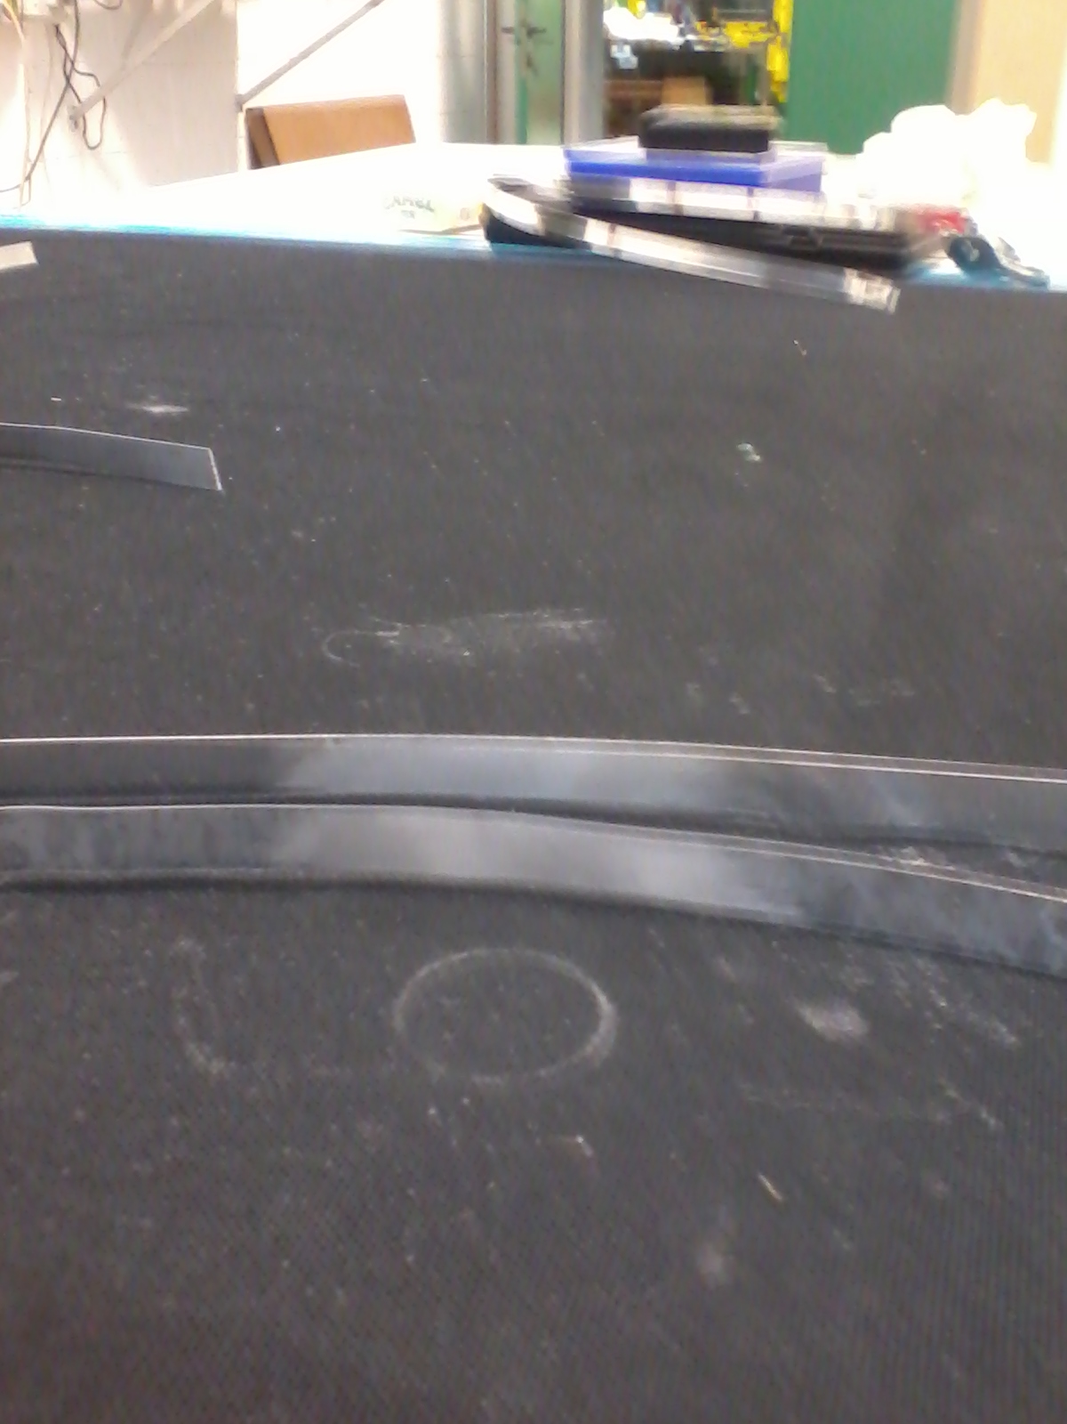
BONDING THE ALUMINUM RIBBONS
PREPARATION OF THE JOINTS :
ALUMINUM JOINTS ABRADED AND DEGREASED
SAMPLES & HELP IN TEST SETUP
BY STEFANO SQUERZANTI
(MECHANICAL SERVICE)
CURING TIME : 2 h @ 80°C

Slide 5
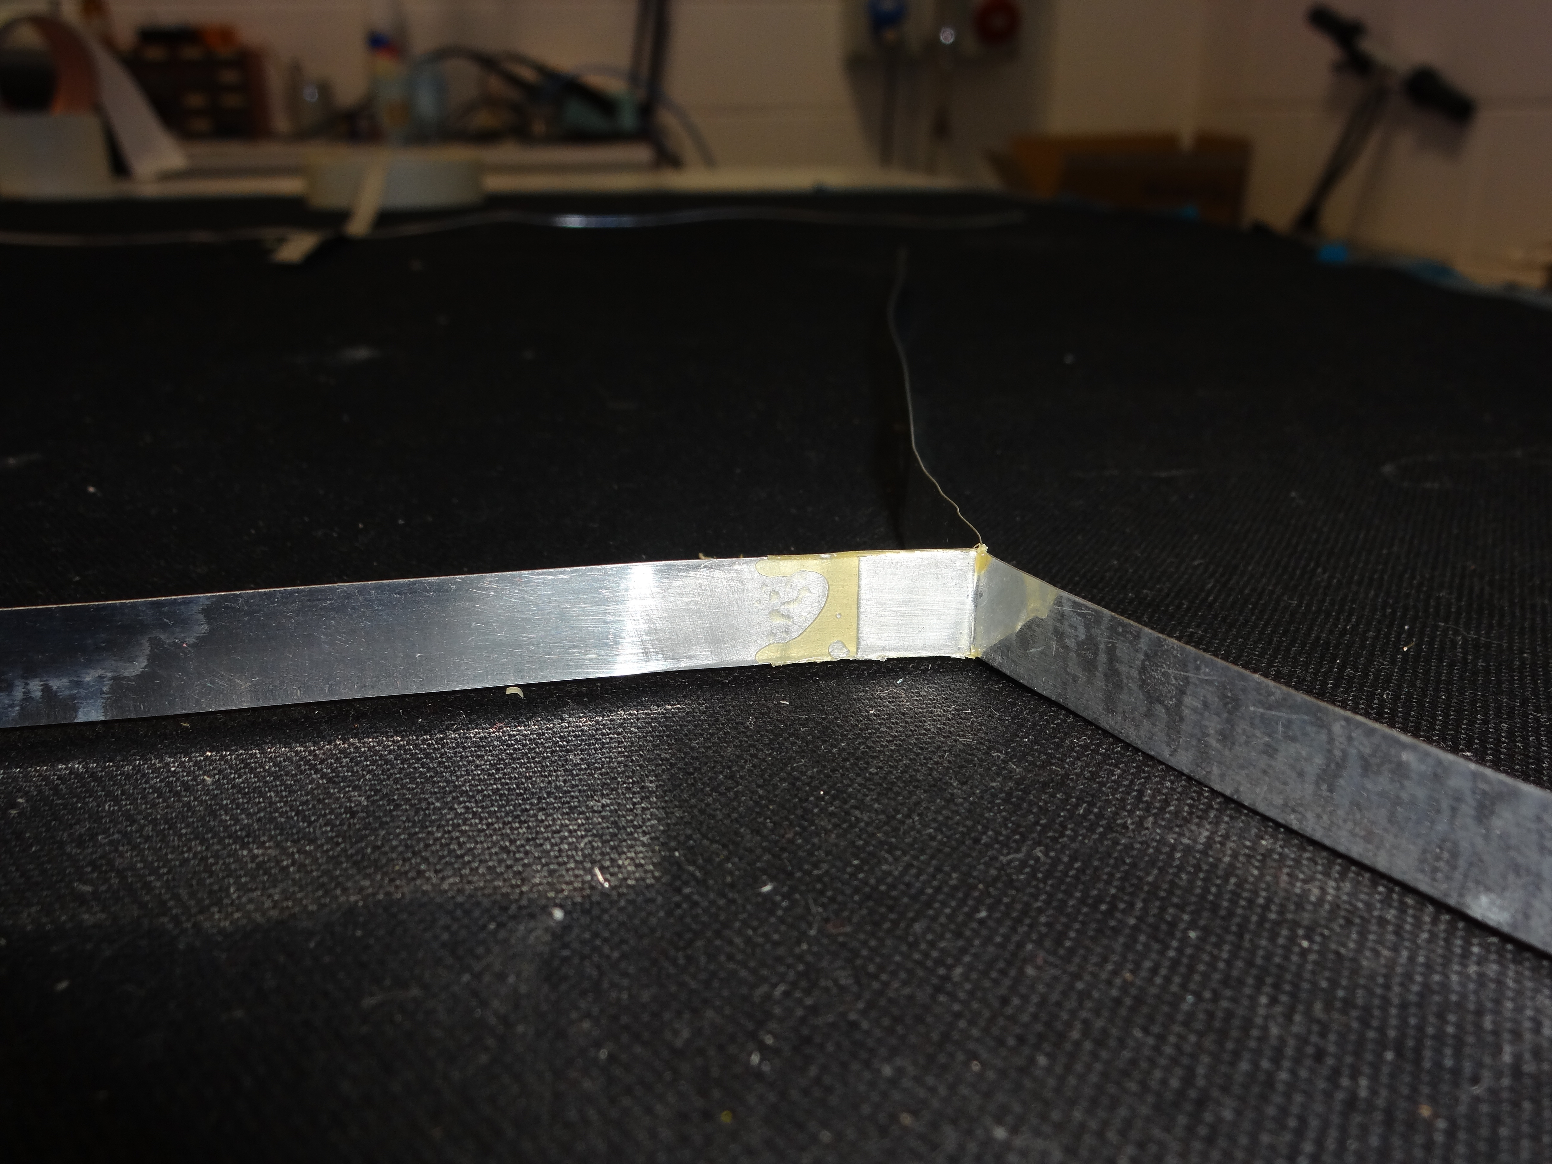
GLUED JOINT V1 – SIMPLY JOINED SURFACES
LENGTH OF THE JOINT = 10 mm

Slide 6
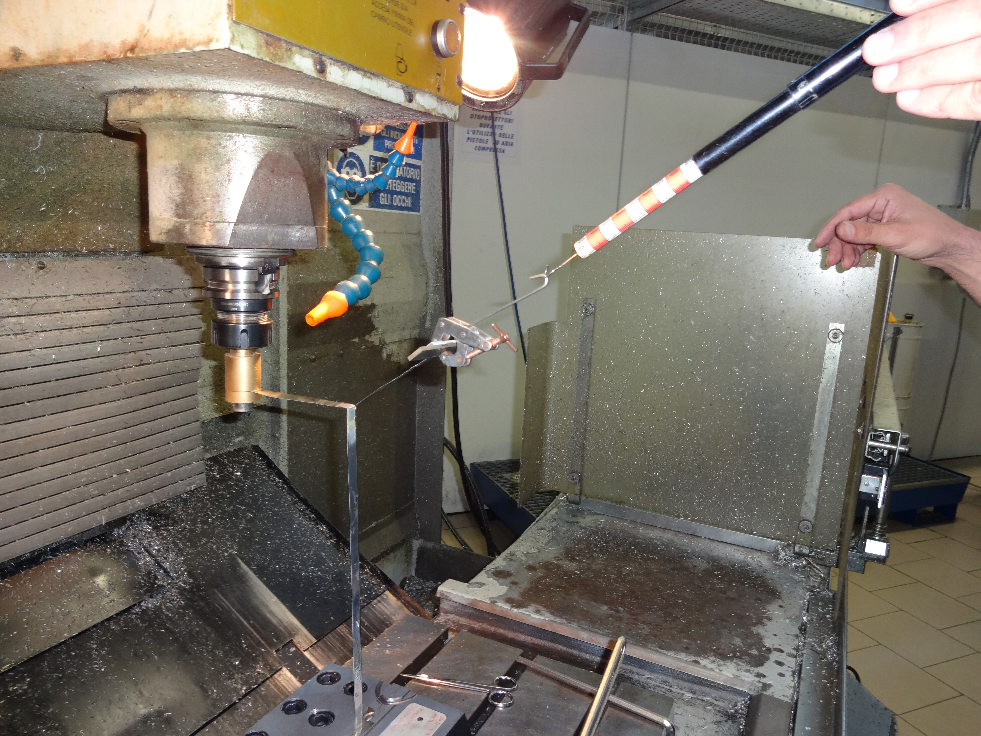
GLUED JOINT V1 – TEST SETUP
PULLING TEST

Slide 7
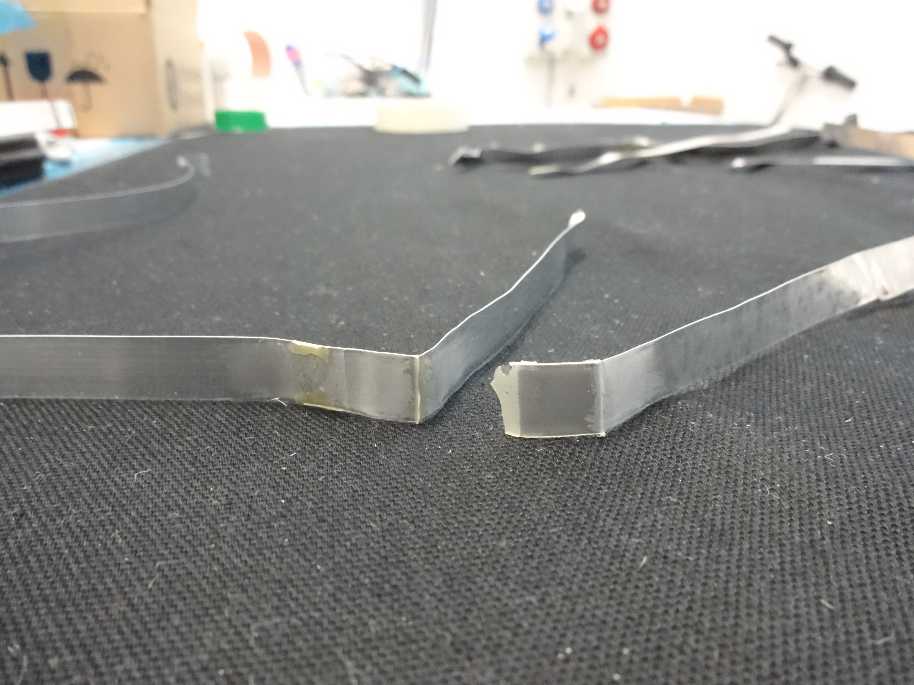
GLUED JOINT V1 – TEST RESULTS
T (motor)
F/
√
2
T (mirror)
F/
F
(transmission)
√
2
THE JOINT BREAKS @ F = 80 N
Safety factor = F/T = 80/2,8 = 28
PEELING FORCE = 80/1,41 = 57 N
( ACCORDING TO THE GIVEN PEELING STRENGTH)

Slide 8
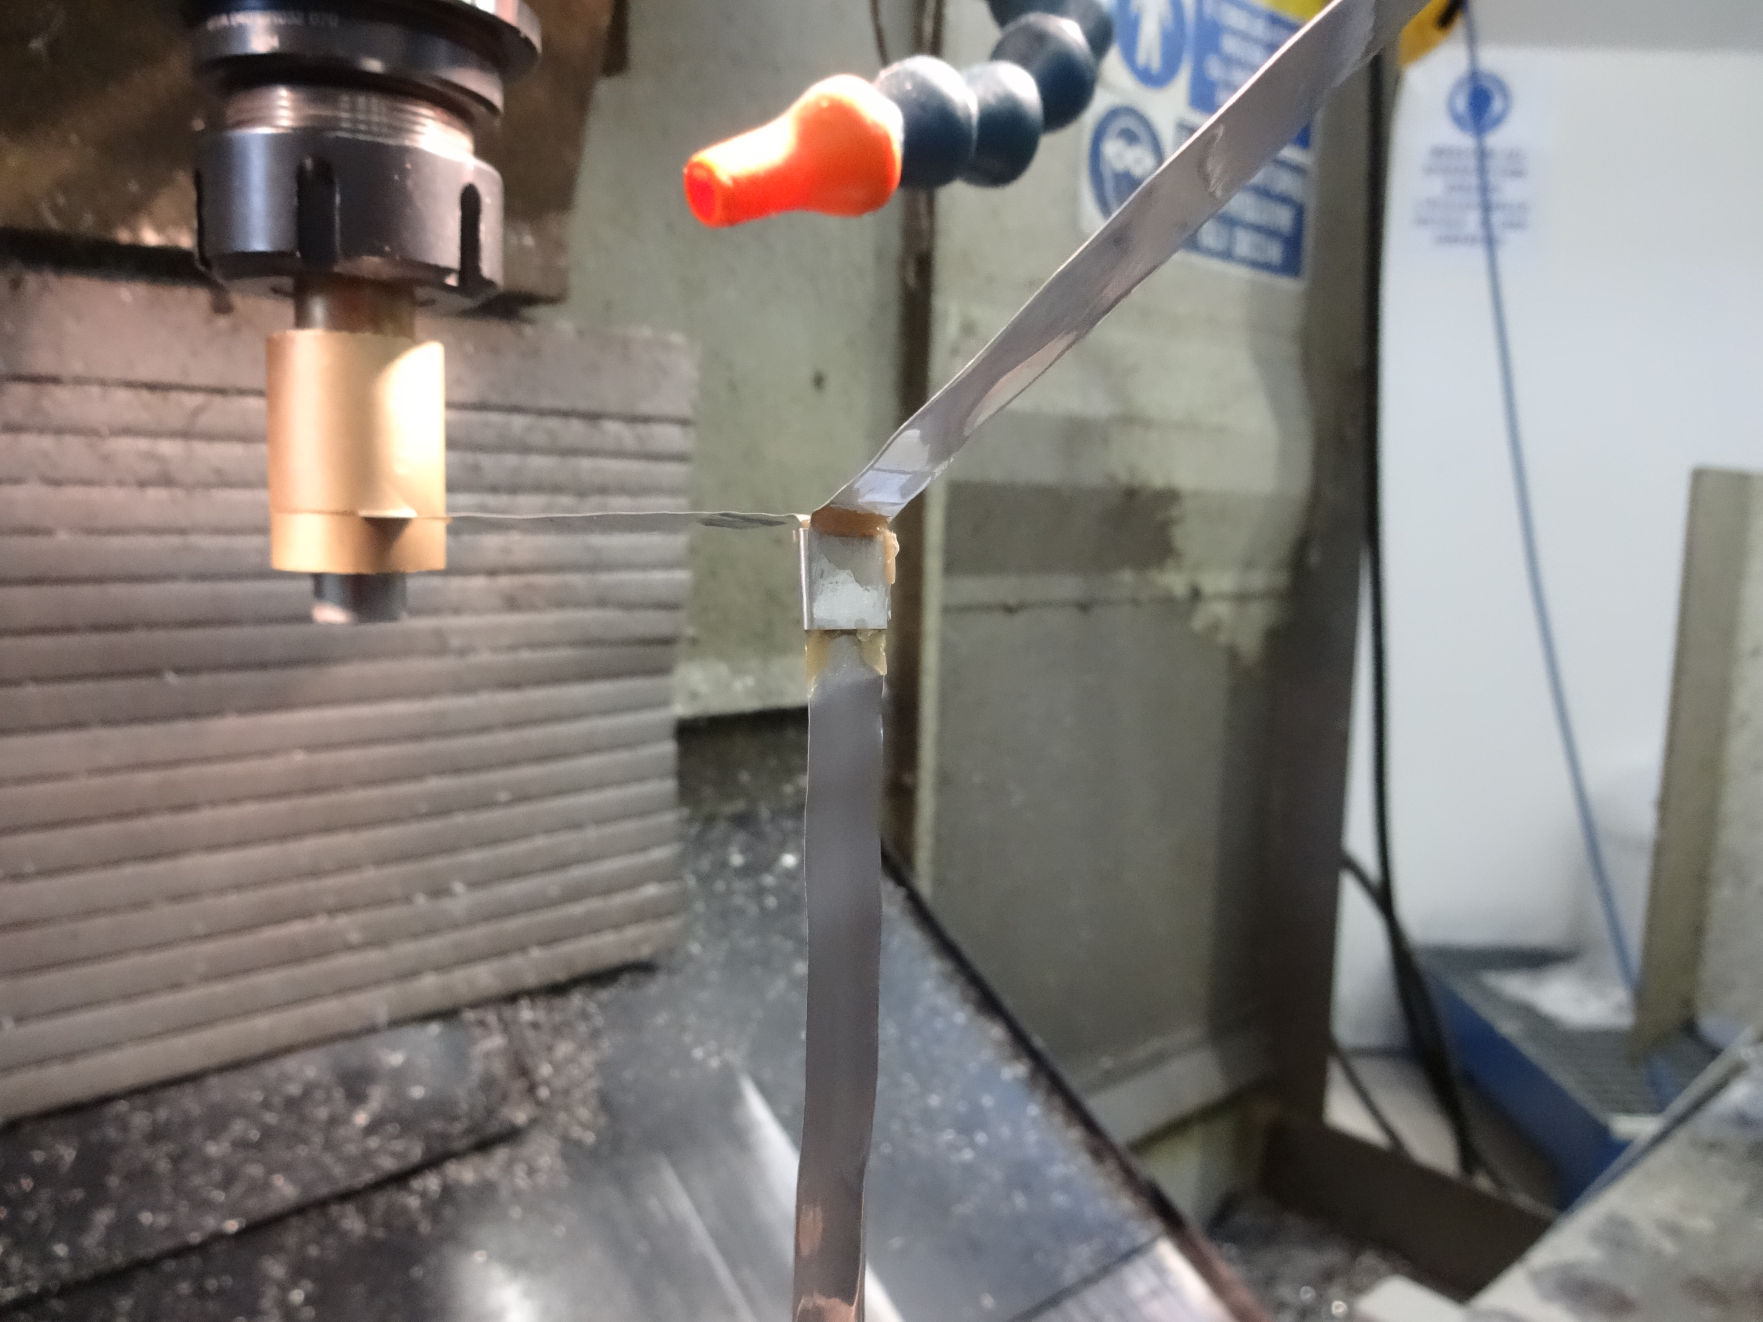
GLUED JOINT V2 – JOINED & TIED SURFACES
LENGTH OF THE JOINT = 10 mm
GLUED A PIECE OF RIBBON FASTENING THE JOINT

Slide 9
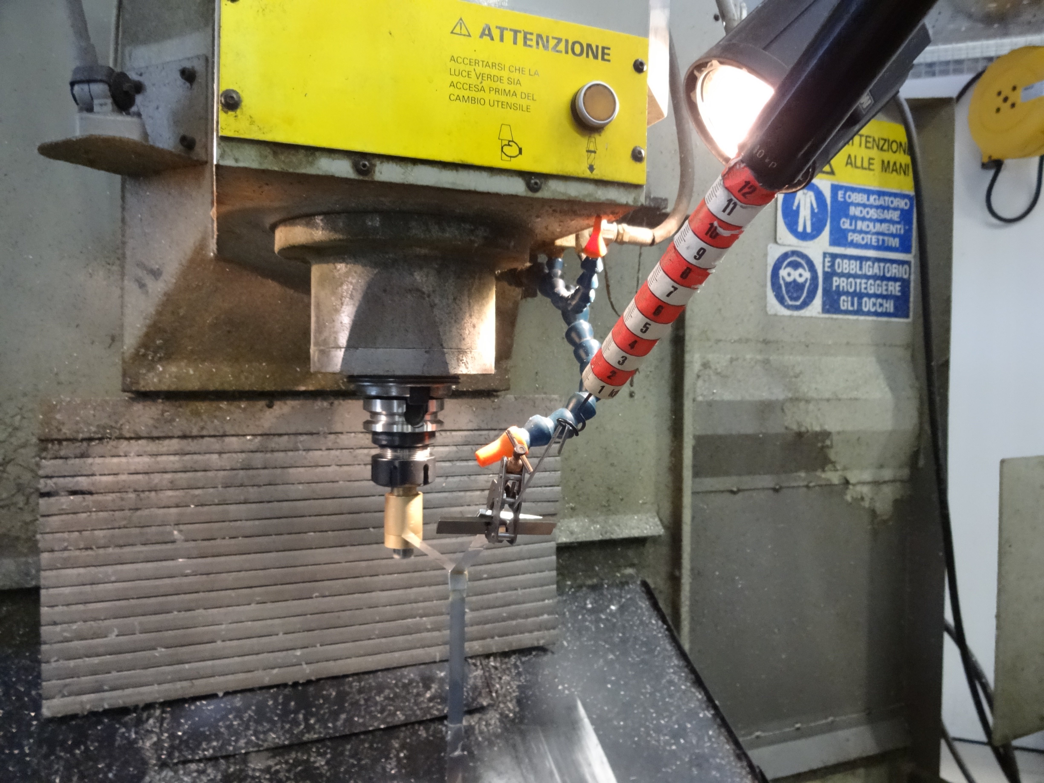
GLUED JOINT V2 – TEST RESULTS
REACHED 120 N (max load allowed by the dynamometer)
THE JOINT DOESN’T BREAK

Slide 10
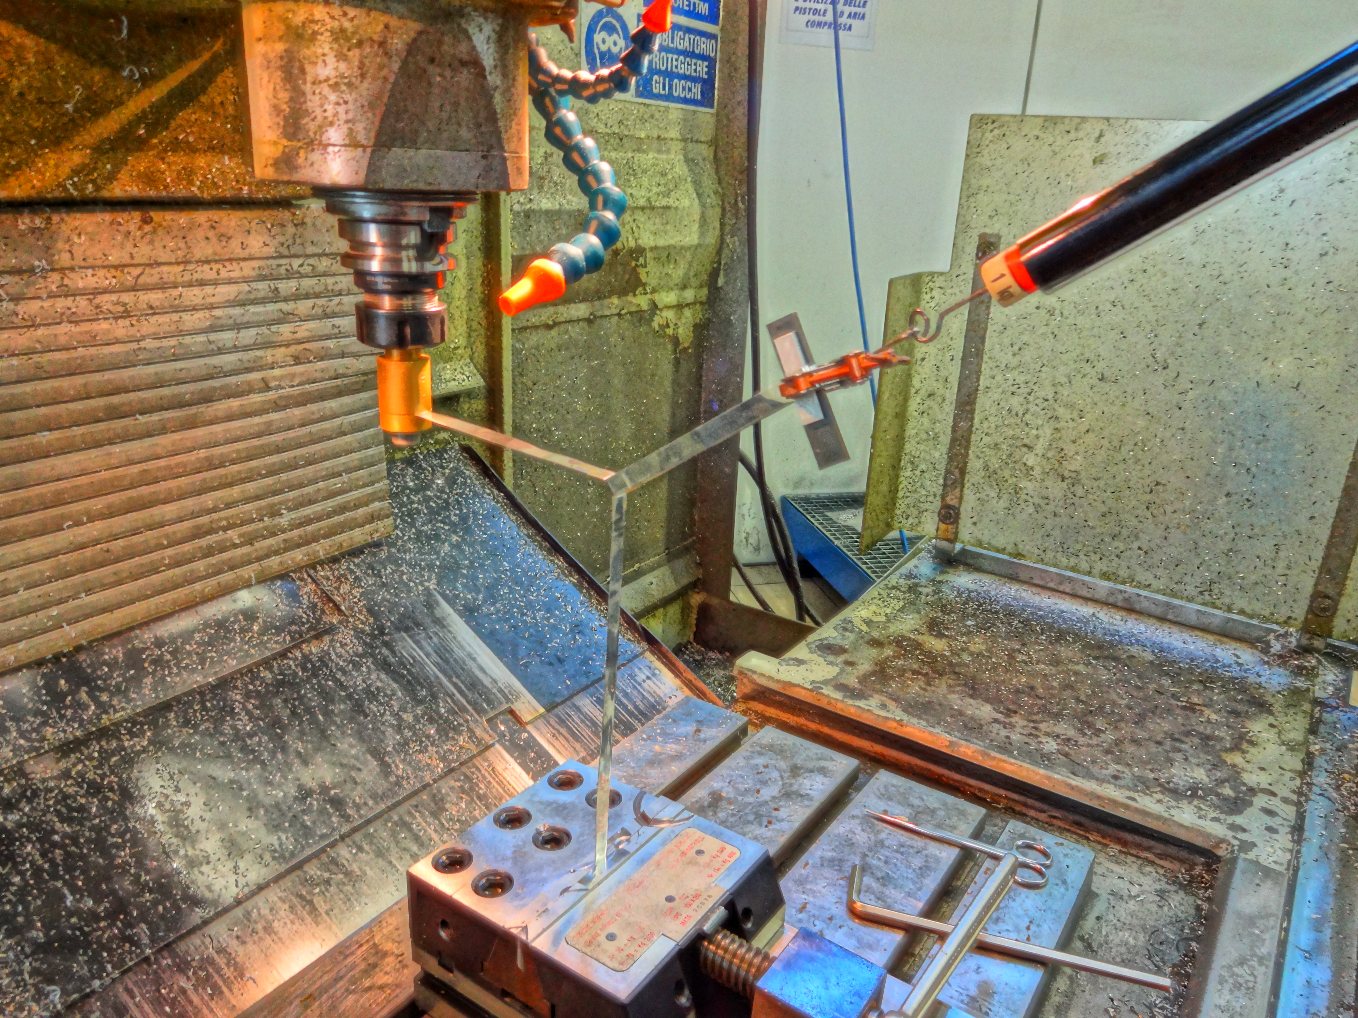
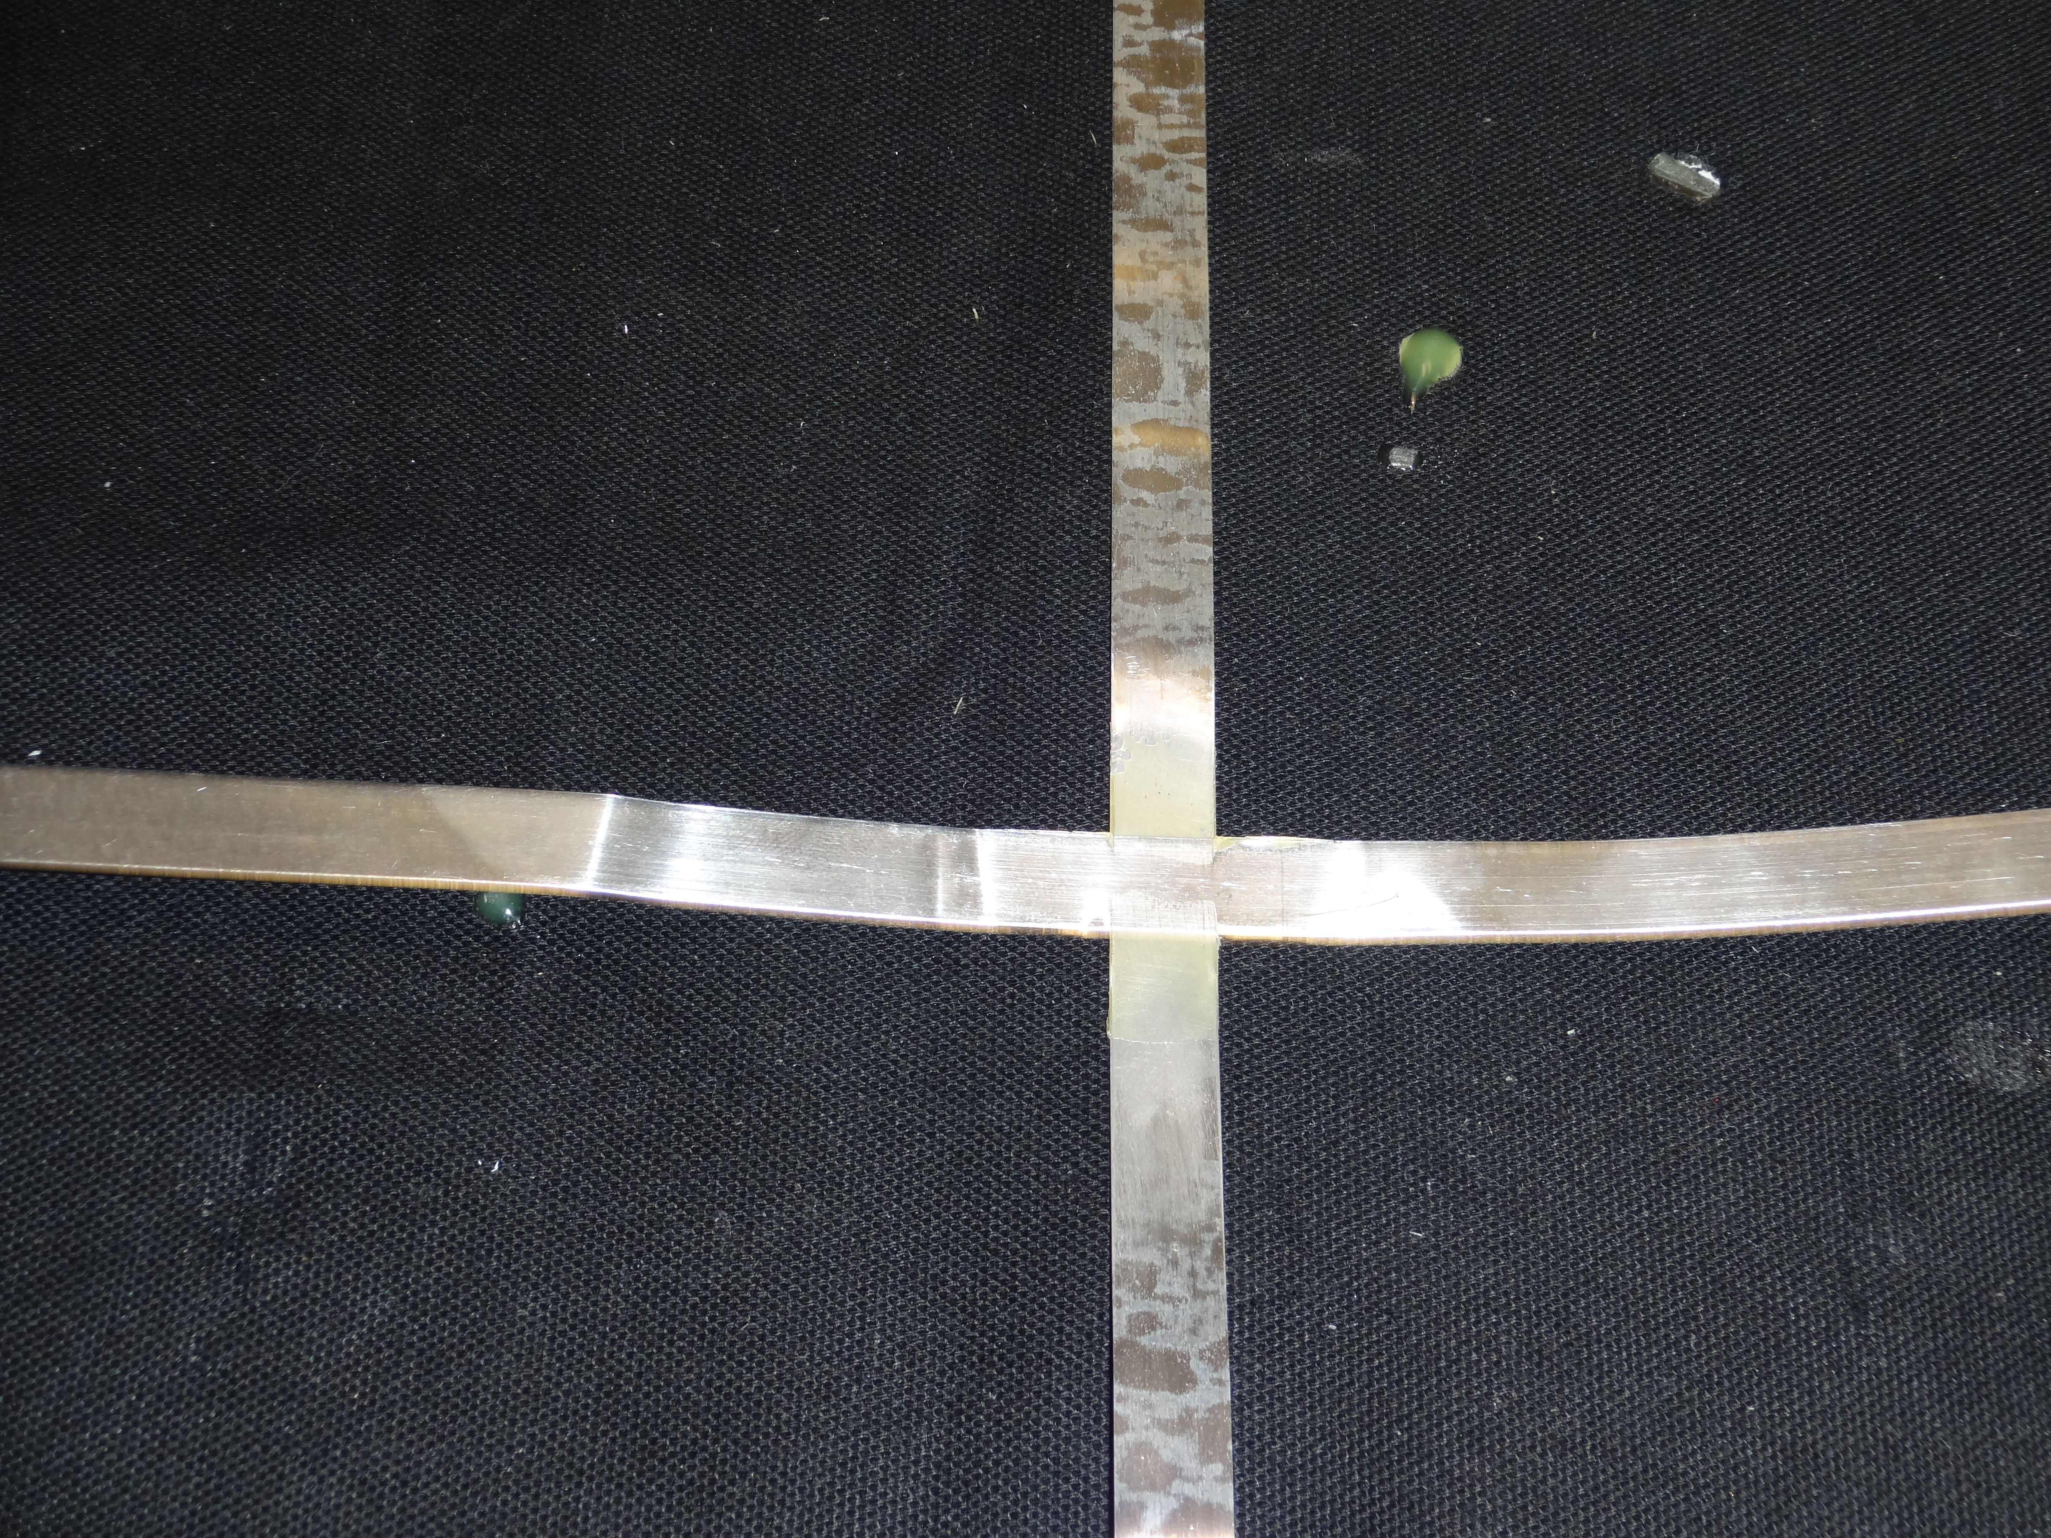
GLUED JOINT V3 – BELTED JOINT
LENGTH OF THE JOINT = 10 mm
GLUED A PIECE OF RIBBON BELTING THE JOINT

Slide 11
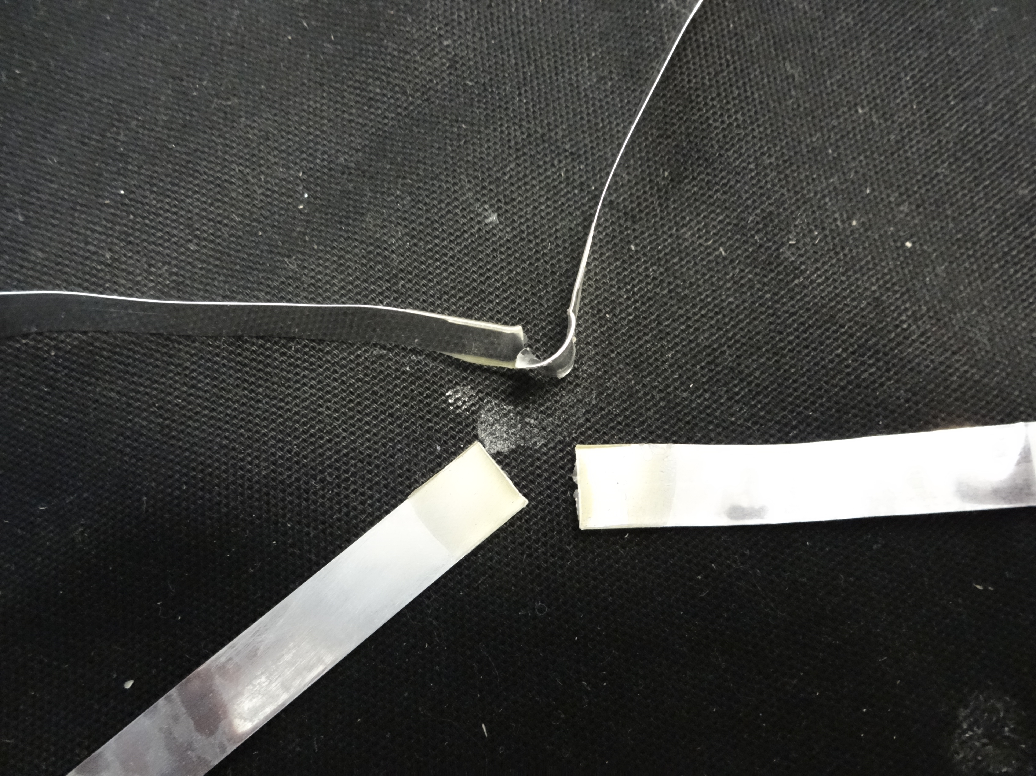
GLUED JOINT V3 – TEST RESULTS
THE JOINT BREAKS @ 110 N
The shearing load drives the break
A = 2x0,2x10 = 4 mm^2 cross section of the two edges
Ts = 110/4 = 27,5 Mpa shearing stress
Tsa = 34 Mpa shearing yelding stress

