Slide 1
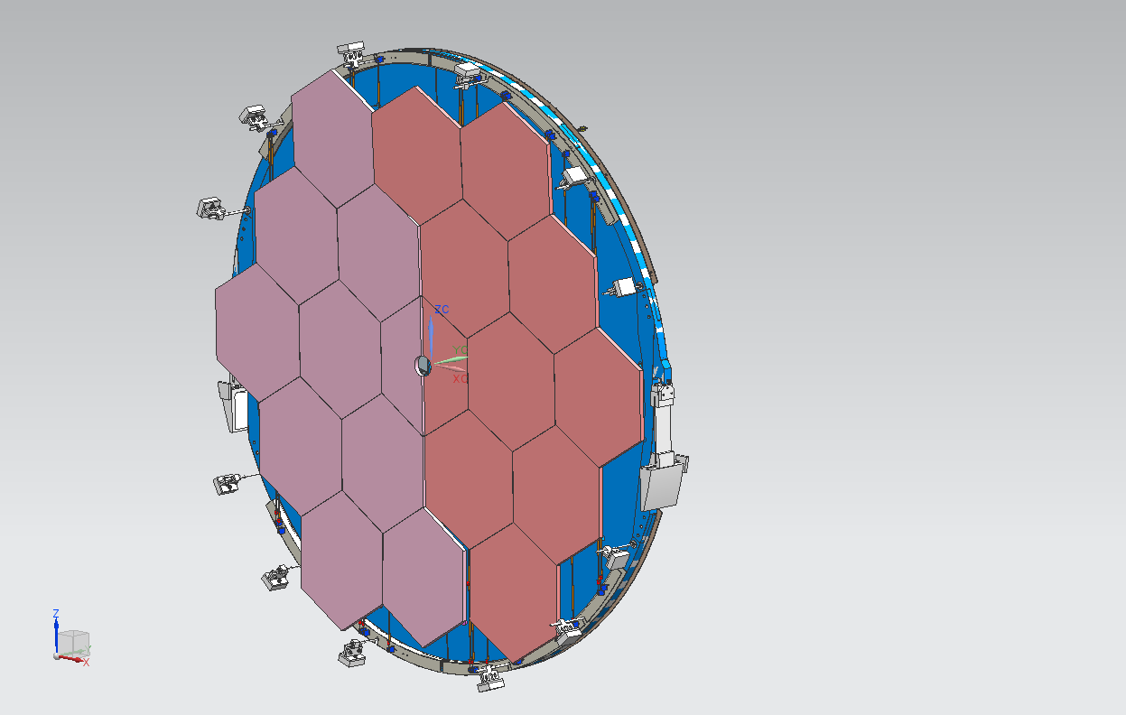
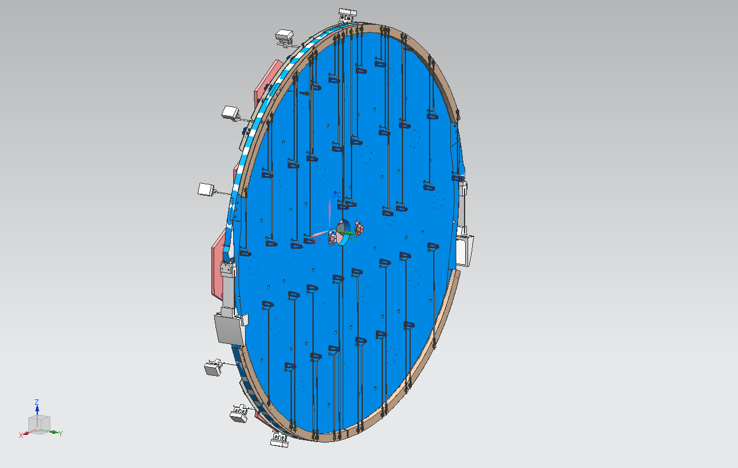
NA62 RICH
STATUS REPORT

Slide 2
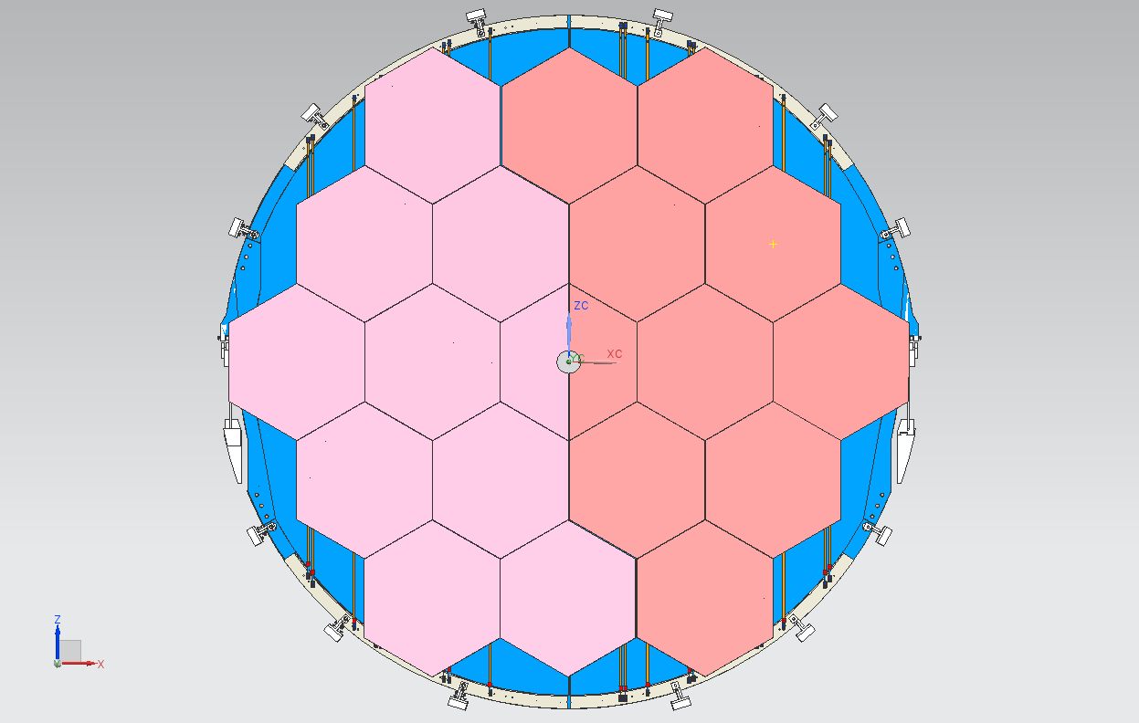
THE MIRRORS– FRONT VIEW

Slide 3
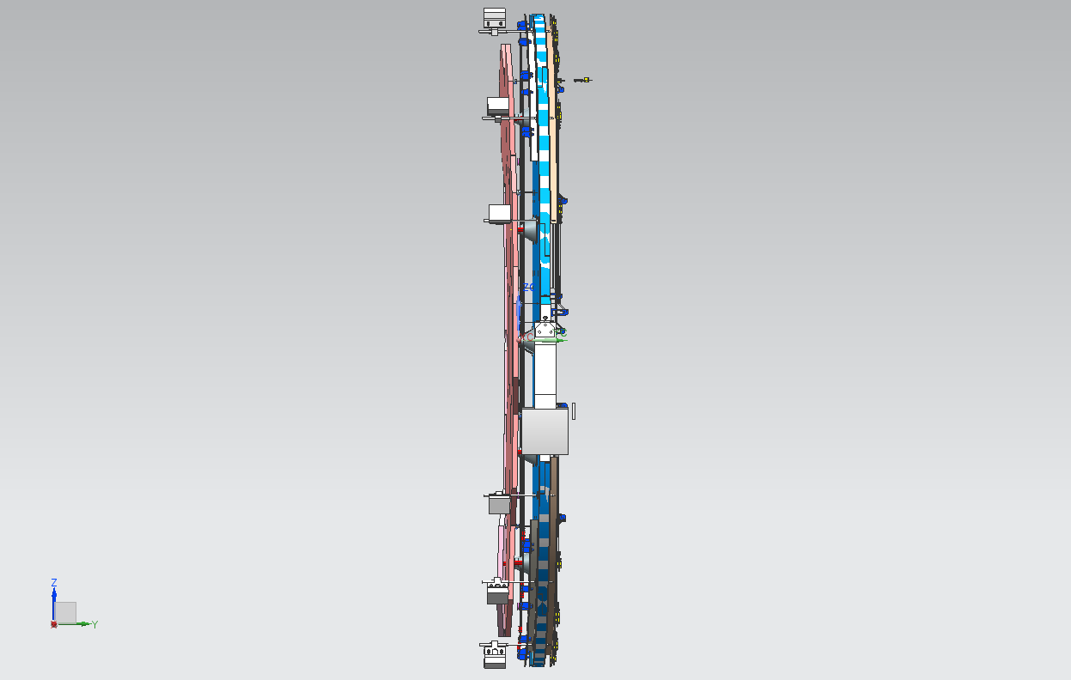
THE MIRRORS– SIDE VIEW RIGTH

Slide 4
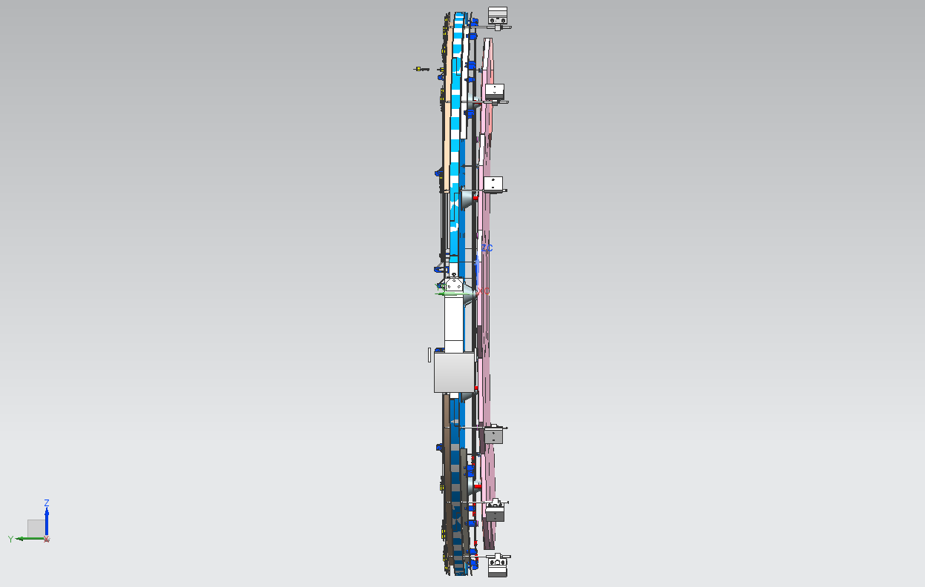
THE MIRRORS– SIDE VIEW LEFT

Slide 5
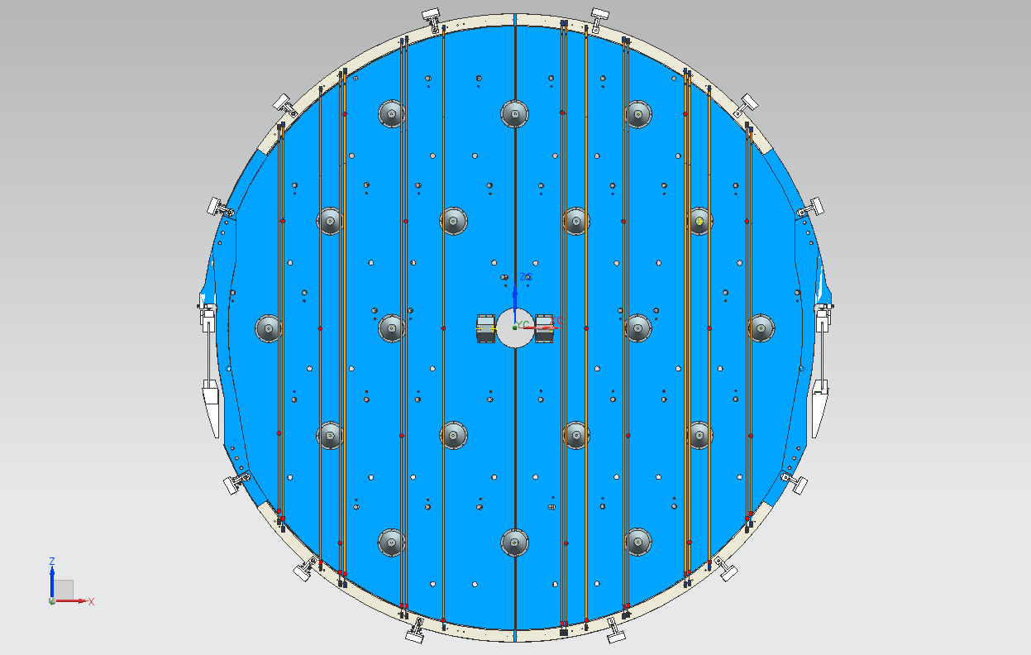
STABILIZING RIBBONS & MIRROR SUPPORTS

Slide 6
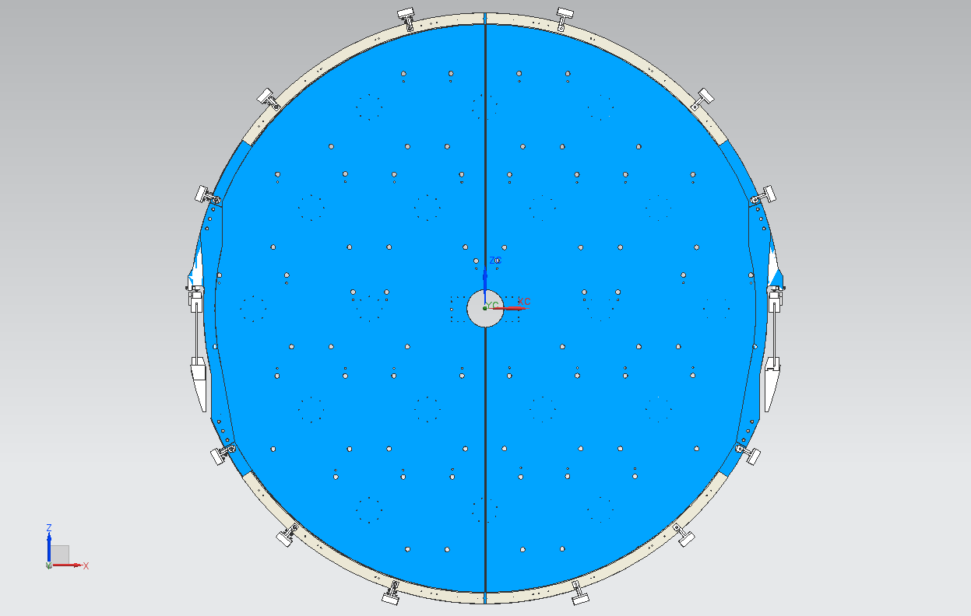
THE HOLES ON THE SUPPORTING PANELS

Slide 7

THE HOLES ON THE SUPPORTING PANELS - DETAIL
TENSIONING RIBBON
TRANSMISSION SUPPORT
MIRROR SUPPORT (CONE)
PLANE B

Slide 8
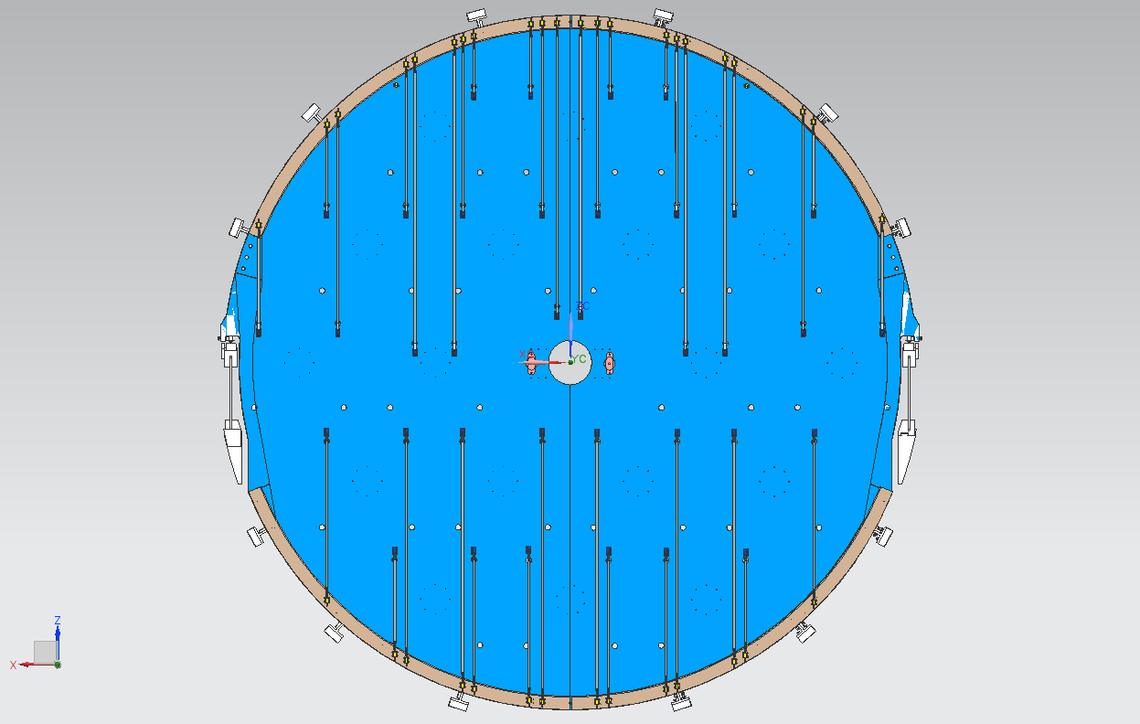
THE TENSIONING RIBBONS

Slide 9
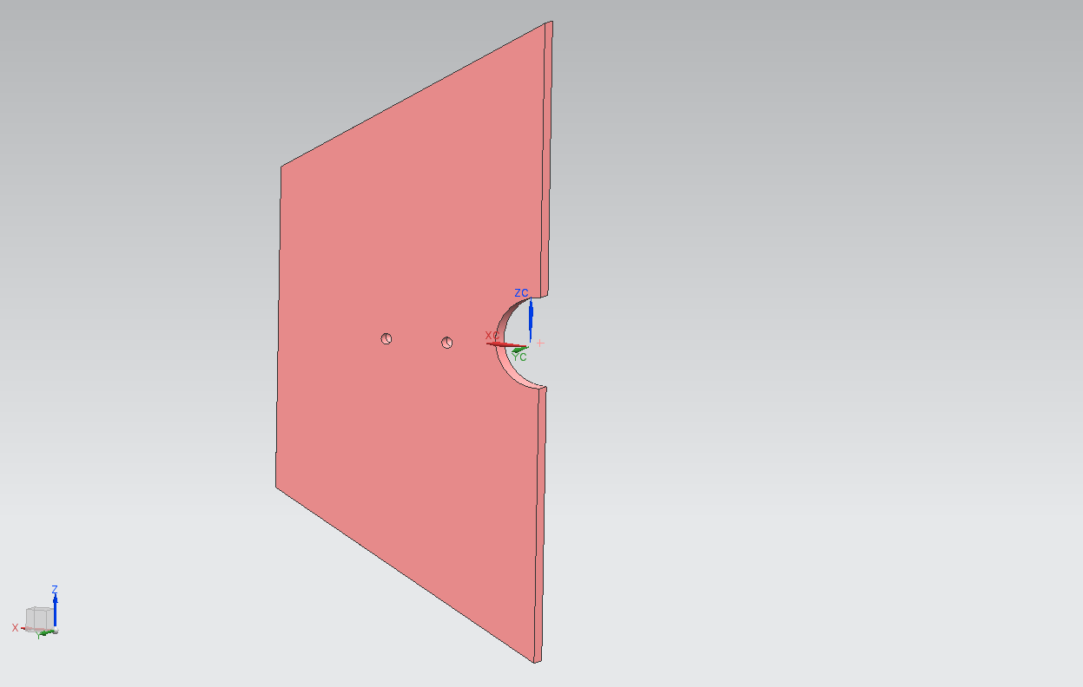
THE HALF CENTRAL MIRROR
TWO DOWELS

Slide 10
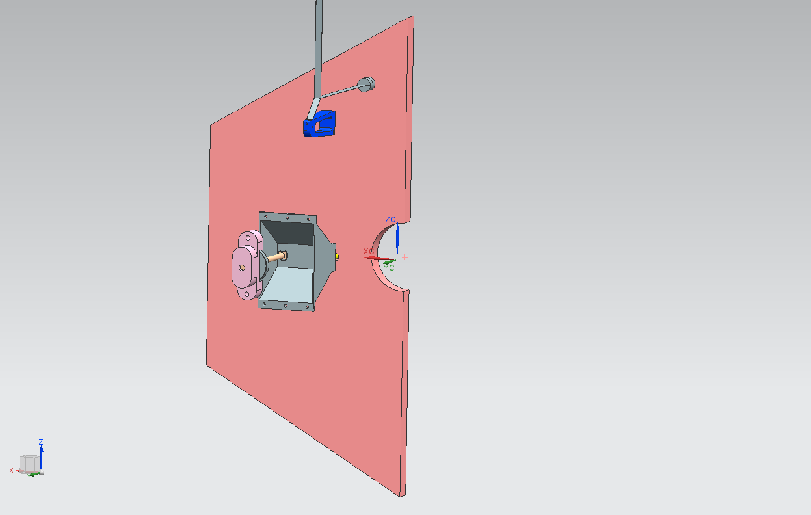
THE HALF CENTRAL MIRROR
TENSIONING RIBBON
(HORIZONTAL AXIS ROTATION)
SLIDING DOWEL SYSTEM
(VERTICAL AXIS ROTATION)
MIRROR SUPPORT

Slide 11
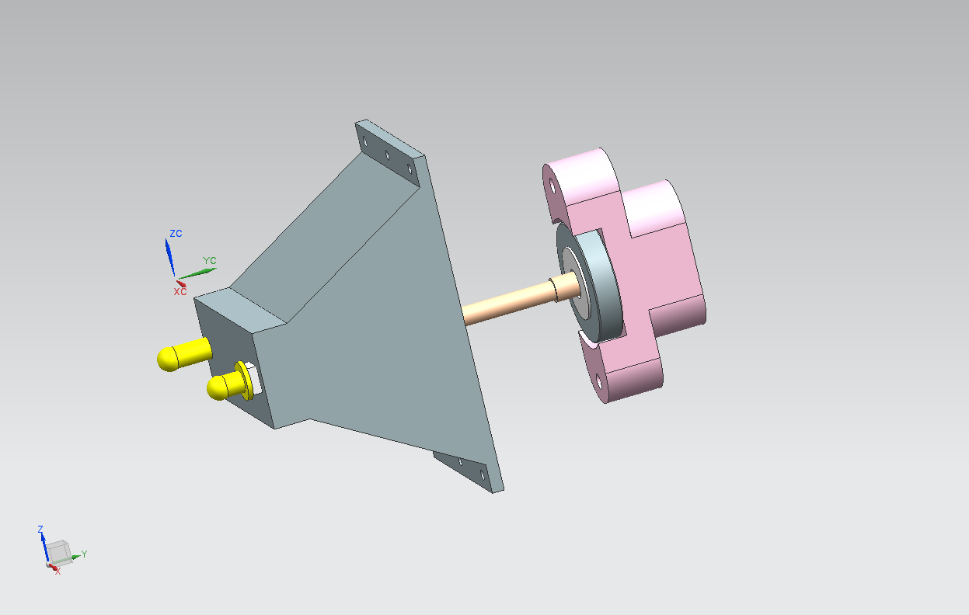
THE SLIDING DOWEL SYSTEM - DETAIL
KNOB SUPPORT
FIXED DOWEL
ACTUATING BAR
KNOB
SLIDING DOWEL
MIRROR SUPPORT

Slide 12
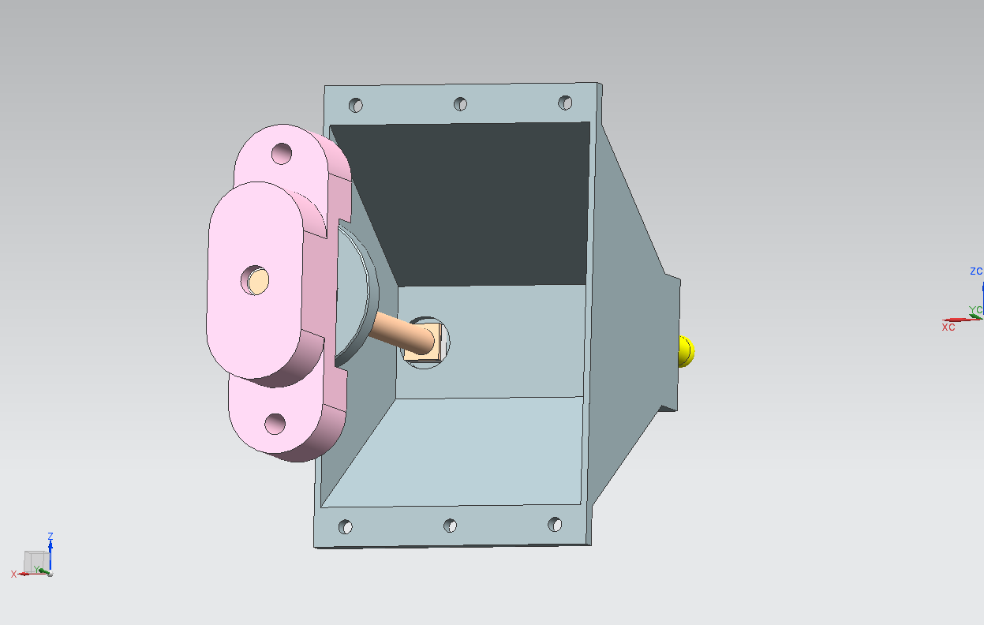
THE SLIDING DOWEL SYSTEM - DETAIL

Slide 13
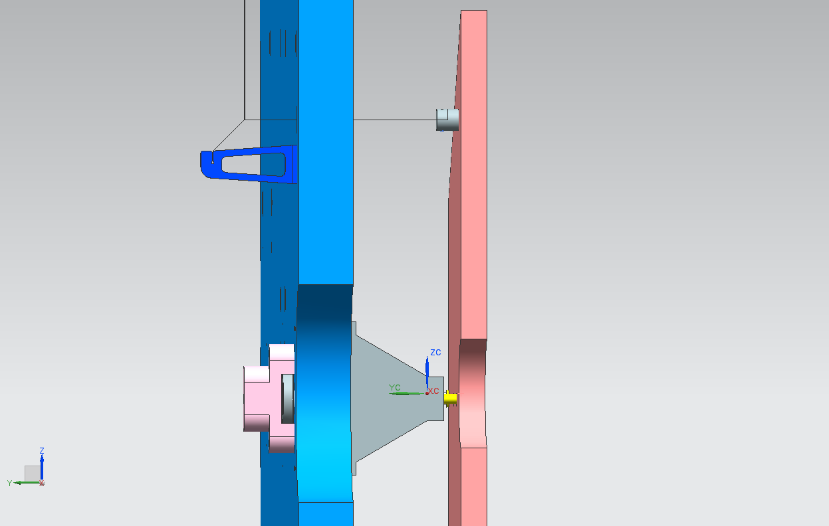
THE HALF MIRROR IN PLACE

Slide 14
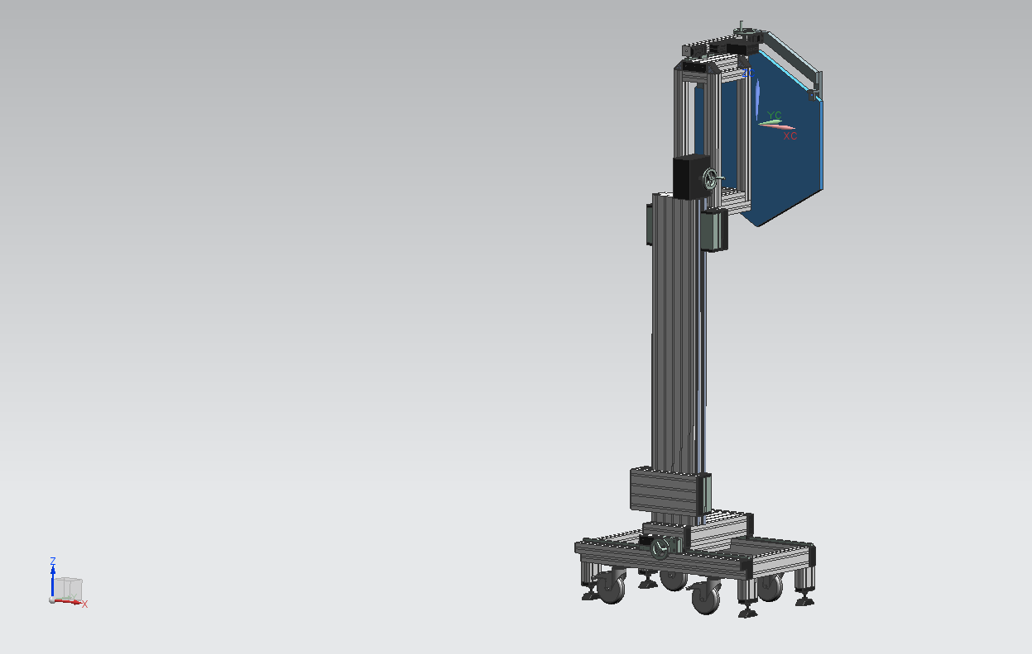
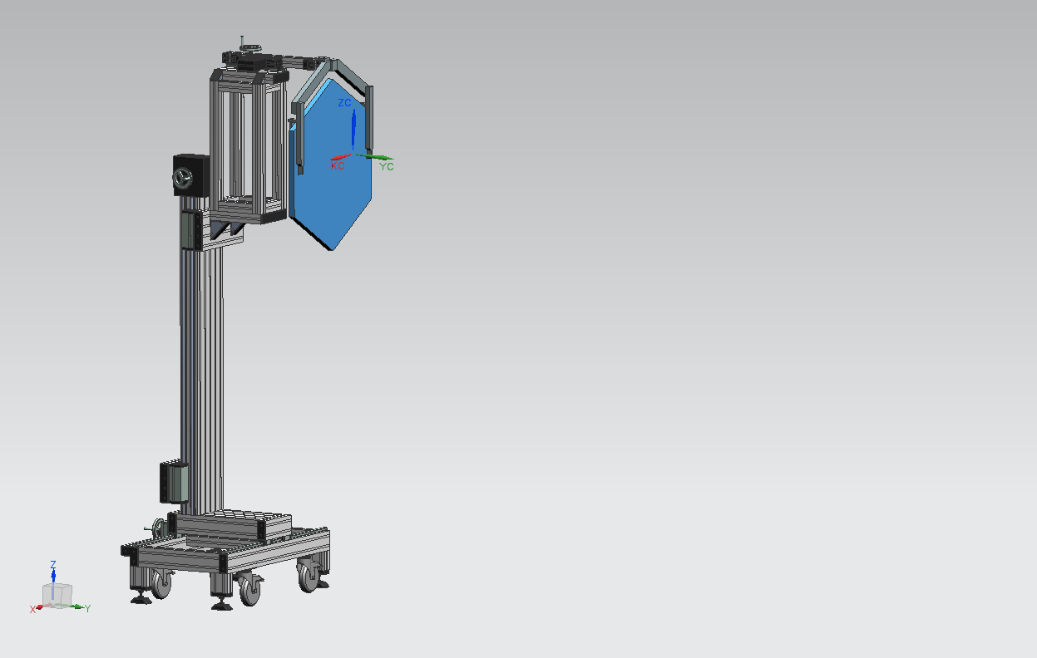
THE TOOLING ASSEMBLING THE MIRROR – FINAL UPGRADE

