Slide 1
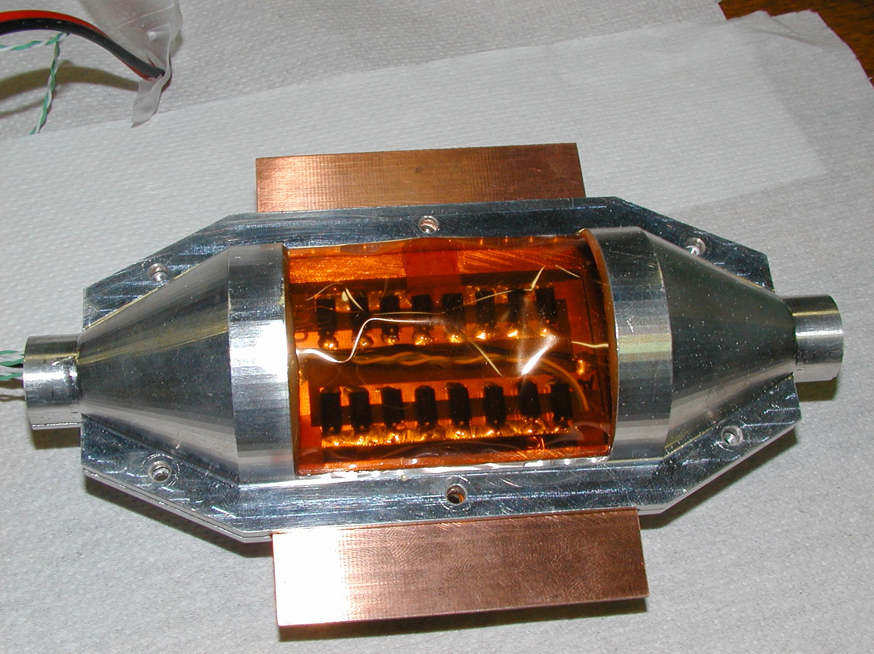
NA62 SILICON PIXELS DETECTOR
COOLING VESSEL PROTOTYPE
STATUS REPORT

Slide 2
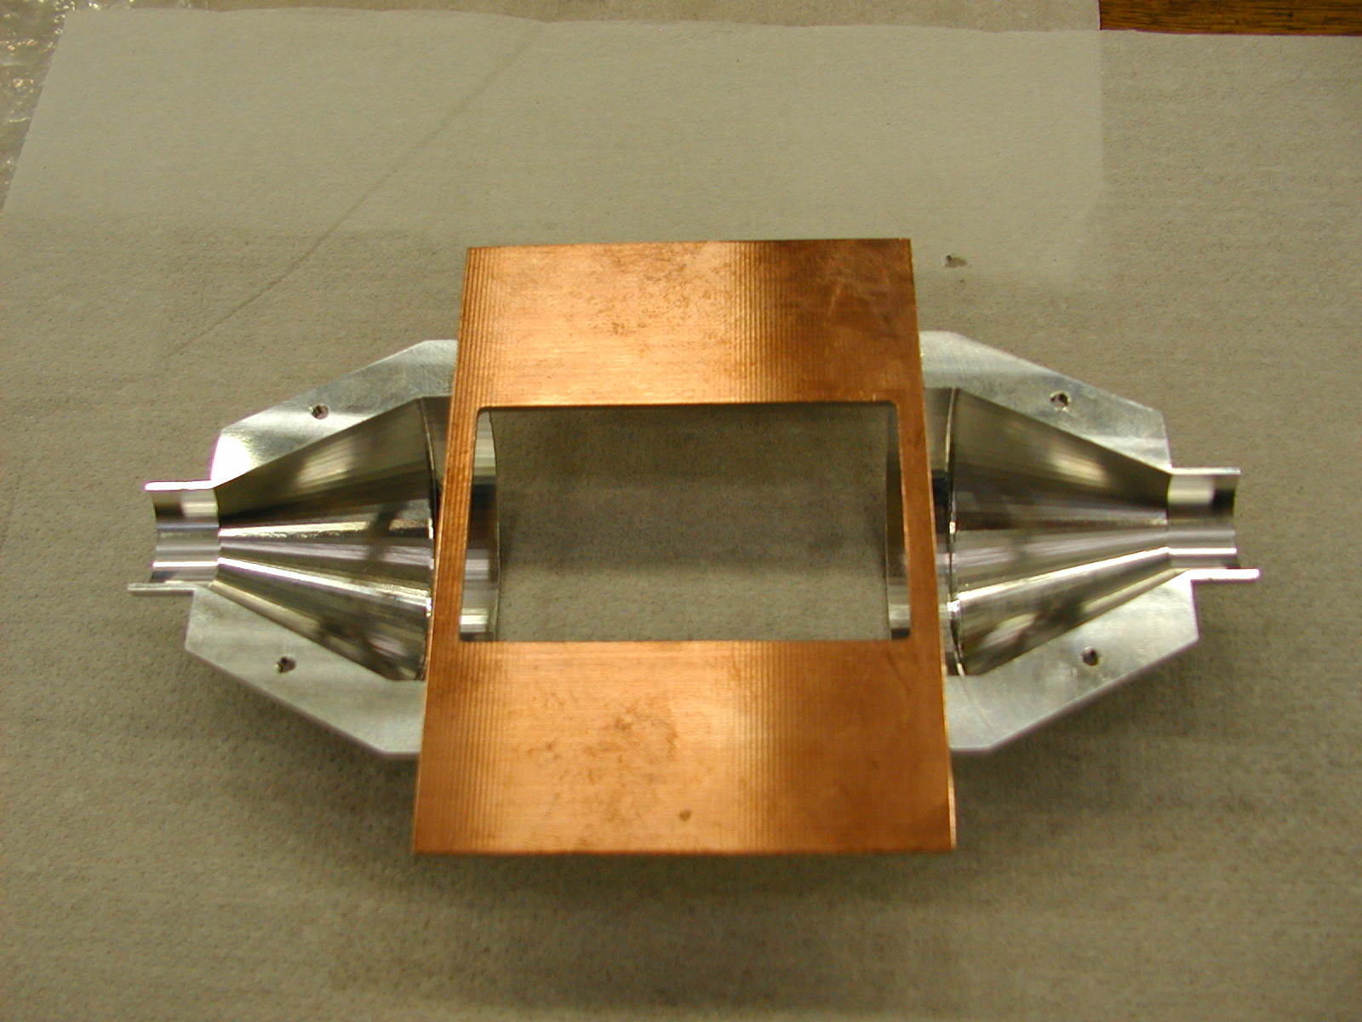
MATERIALS
PARTS MATERIAL
PART | MATERIAL
PCB | GLASS FIBER
VESSEL WALL | KAPTON TYPE H
VESSEL FRAME | ALUMINUM
RESIN | EPOXY (ARALDITE 2012)

Slide 3
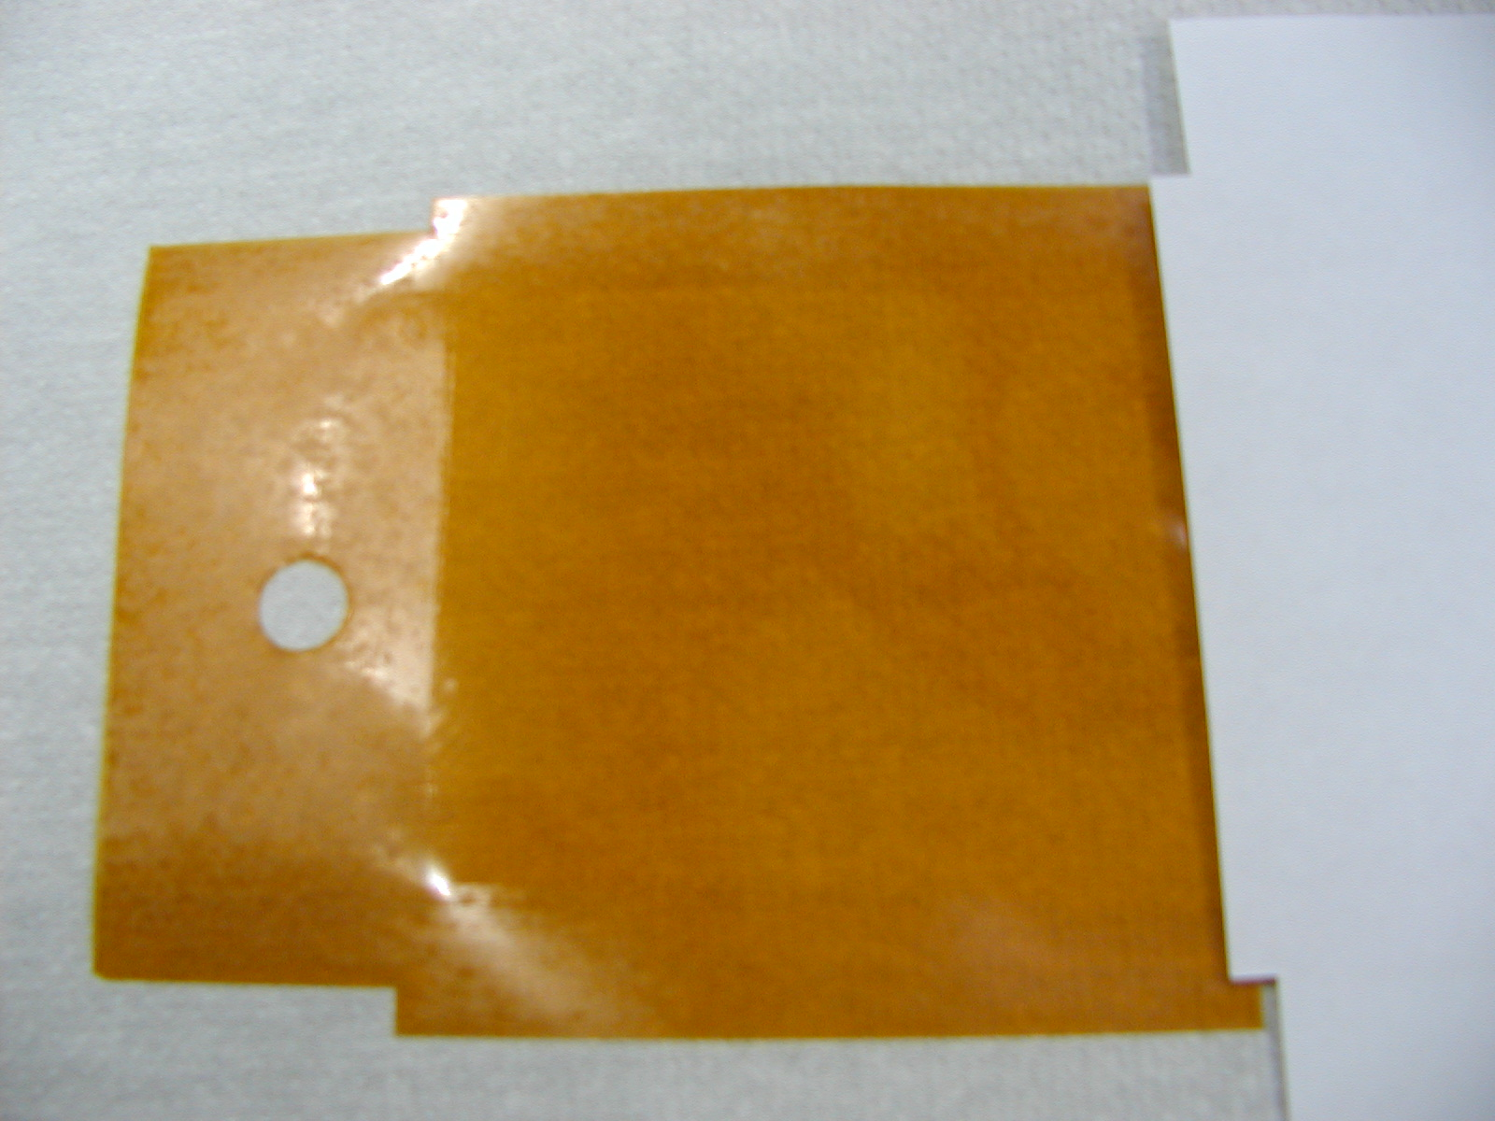
MATERIALS
MATERIAL PROPERTIES
MATERIAL | DENSITY (Kg/m^3) | THERMAL CONDUCTIVITY (W/mK) | CTE (K^-1) | ELASTIC MODULUS (Pa) | POISSON’S RATIO | TENSILE STRENGTH (Pa)
GLASS FIBER | 2076 | 0,83 | 6,7E-06 | 45E+09 | 0,28 | 48E+06
KAPTON TYPE H | 1420 | 0,16 | 45E-06 | 2,5E+09 | 0,34 | 230E+06
ALUMINUM | 2700 | 237 | 23,5E-06 | 70,6E+09 | 0,345 | 120E+06
EPOXY (ARALDITE 2012) | 1180 | 0,22 | 30E-06 | 2,5E+09 | 0,34 | 60E+06

Slide 4
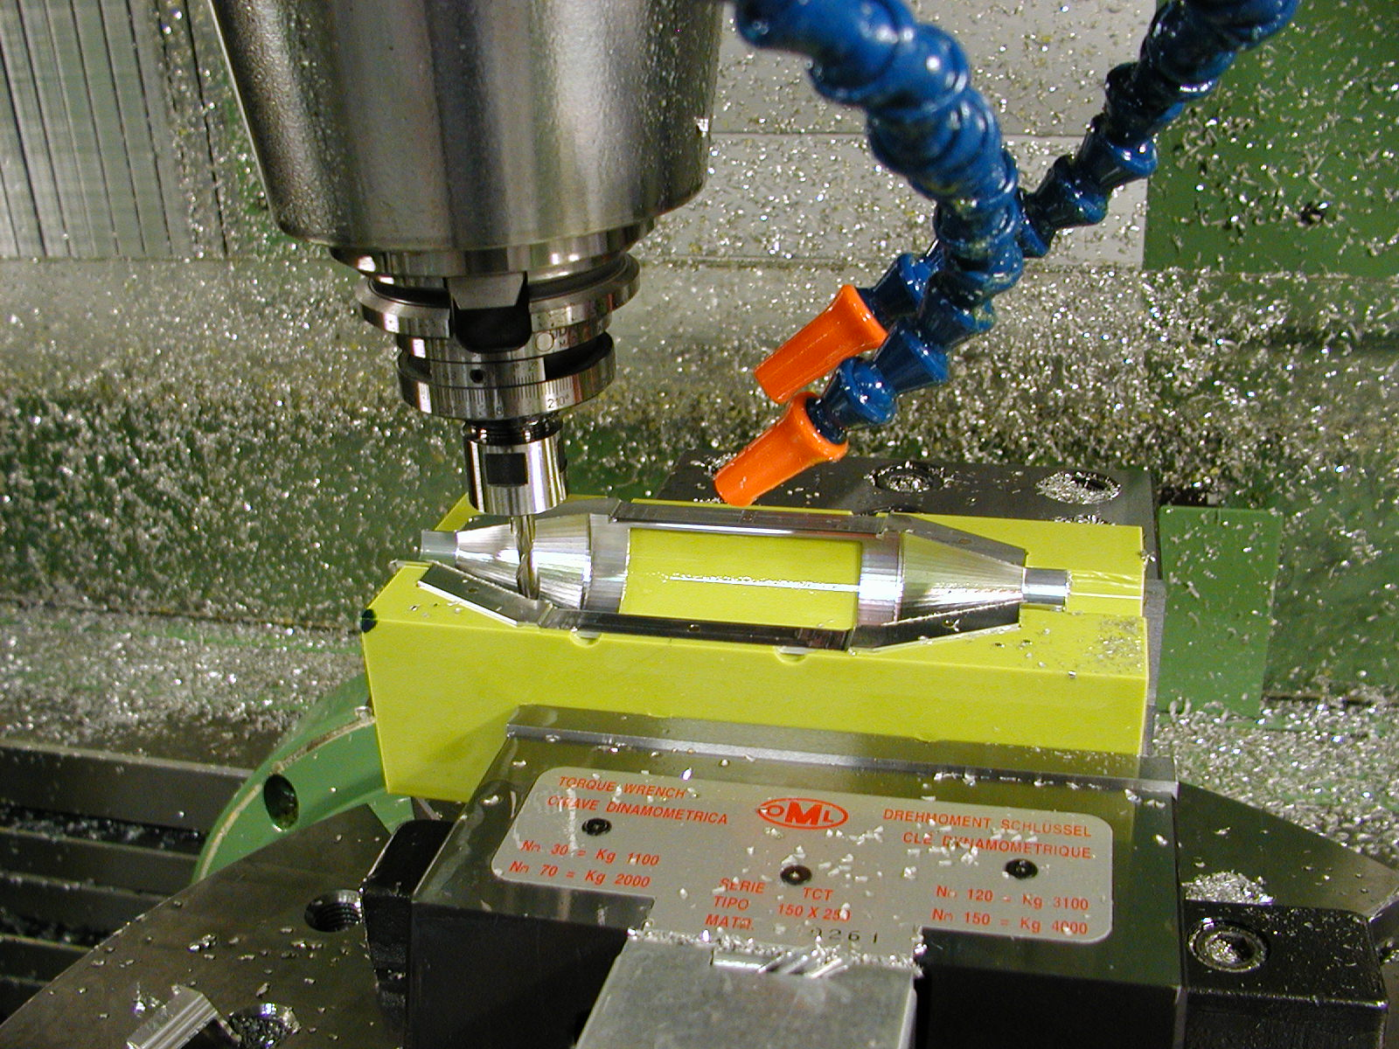
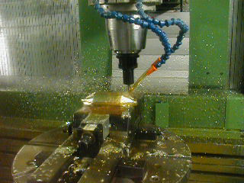
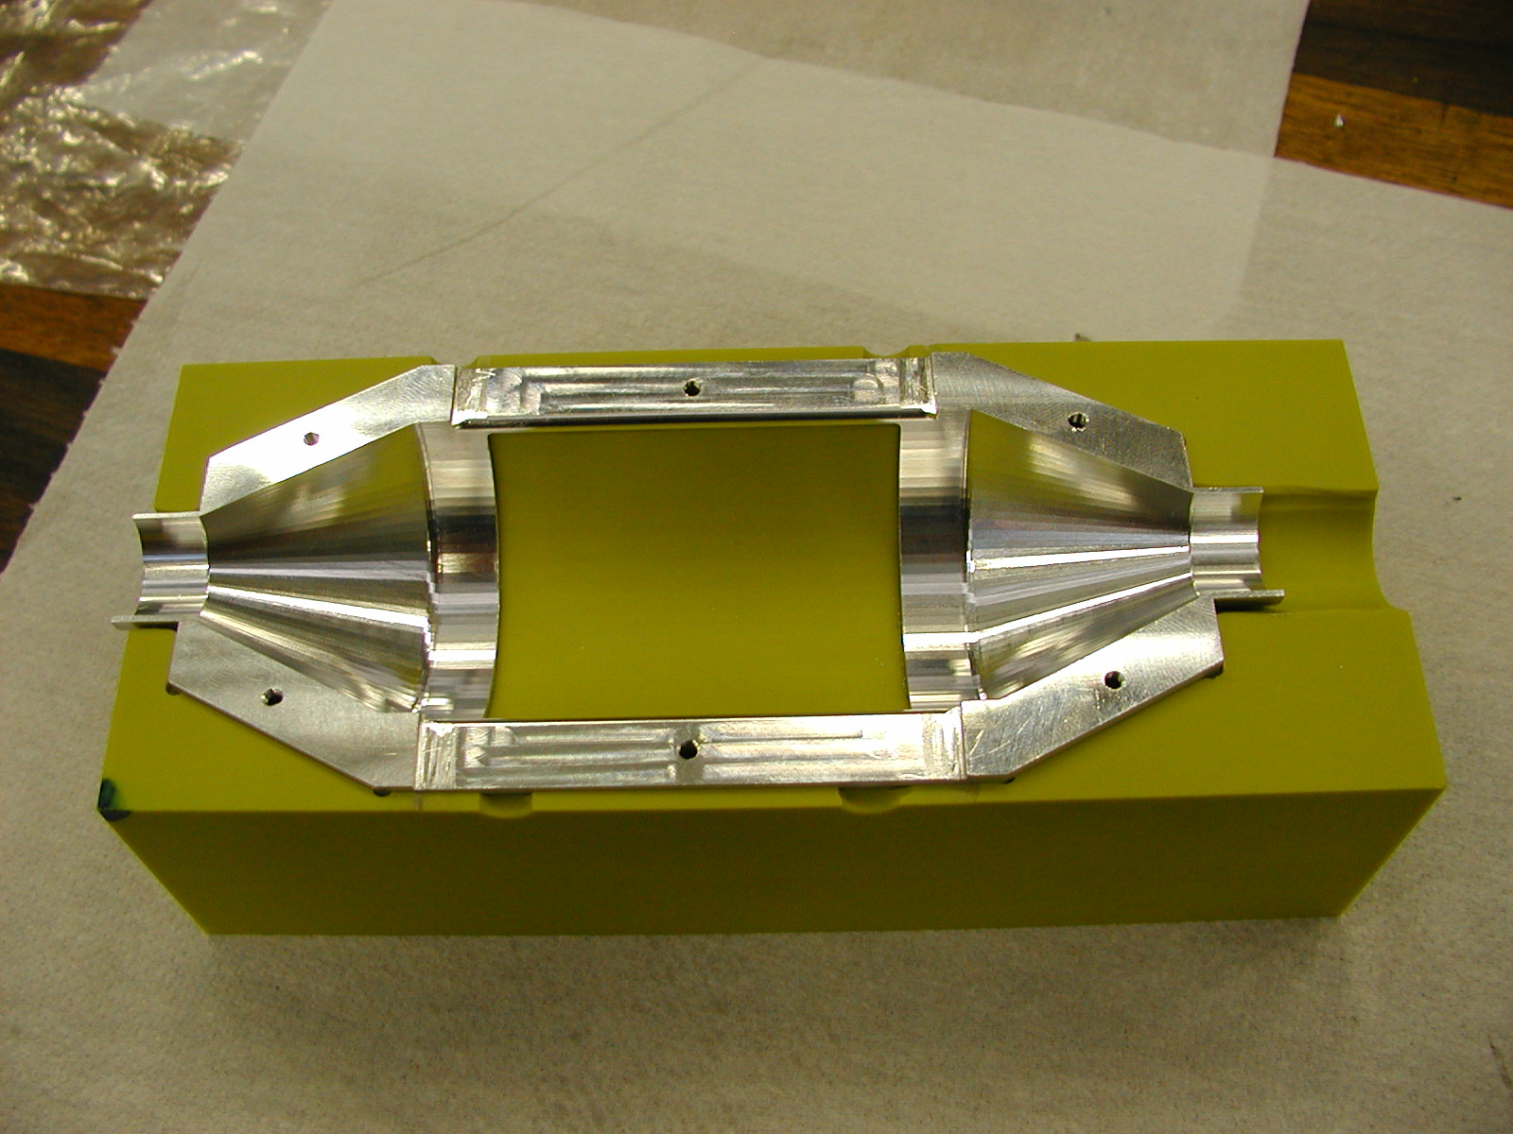
MAKING THE PARTS
THE ALL PARTS MADE BY
FERRARA WORKSHOP

Slide 5
TESTS @ ROOM TEMPERATURE
THE FOLLOWING TESTS HAVE BEEN DONE :
KAPTON CREEP
KAPTON FAILURE PRESSURE
QUALITY OF THE JOINT KAPTON-RESIN-ALUMINUM

Slide 6
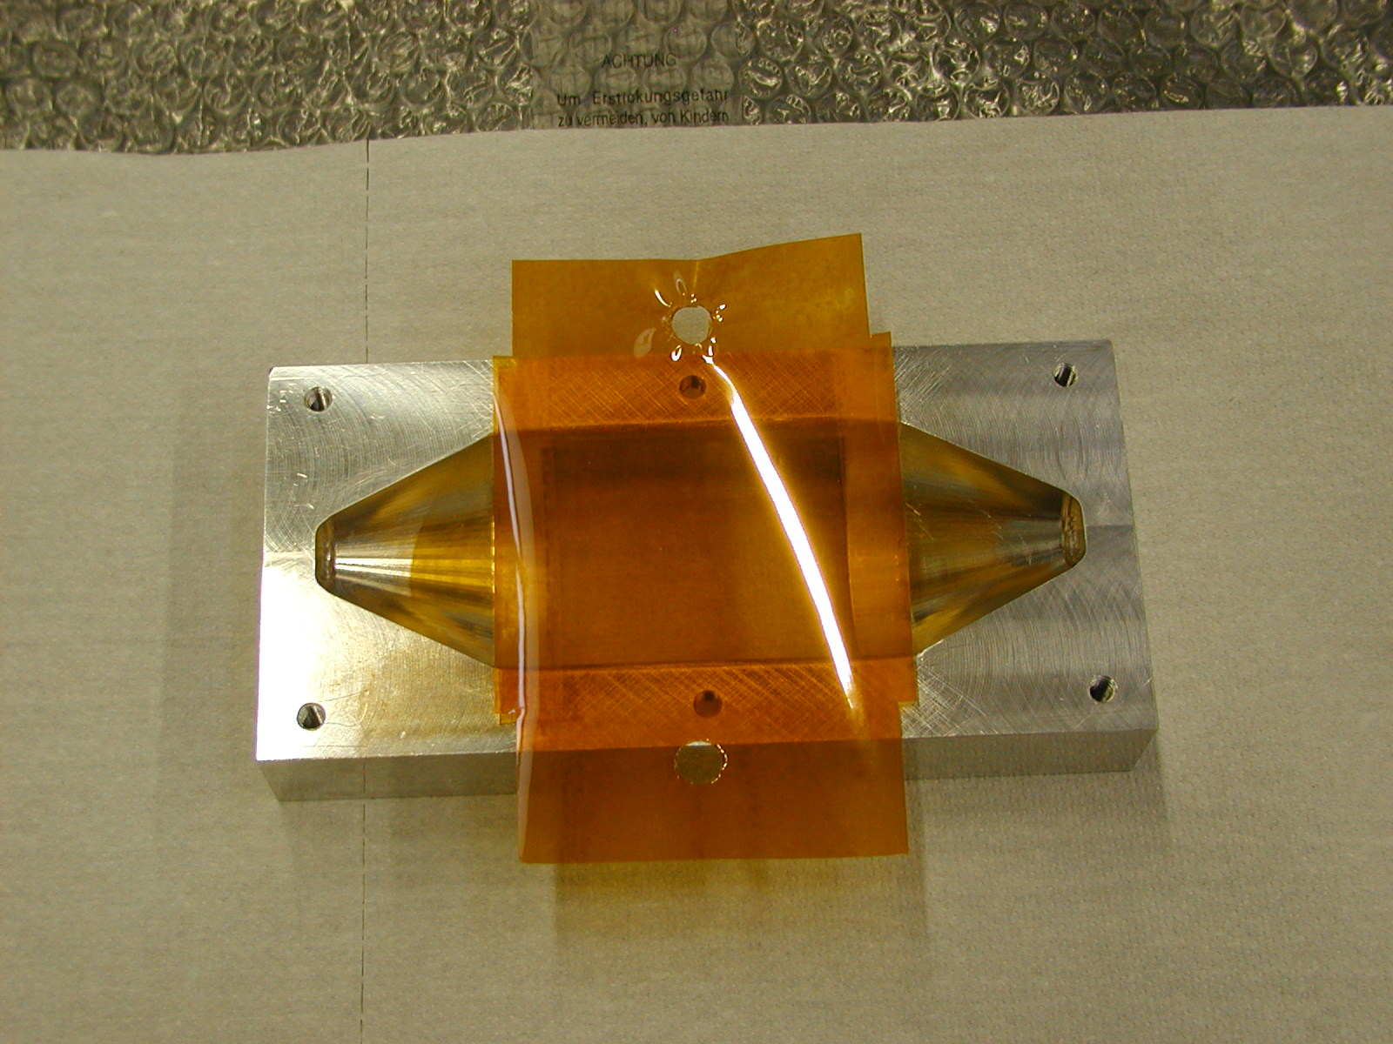
BONDING ALUMINUM FRAME & KAPTON FOIL
PREPARATION OF THE JOINTS :
ALUMINUM JOINT ABRADED AND DEGREASED
KAPTON JOINT LIGHTLY ABRADED AND DEGREASED
CURING TIME : 16 h @ 40°C

Slide 7
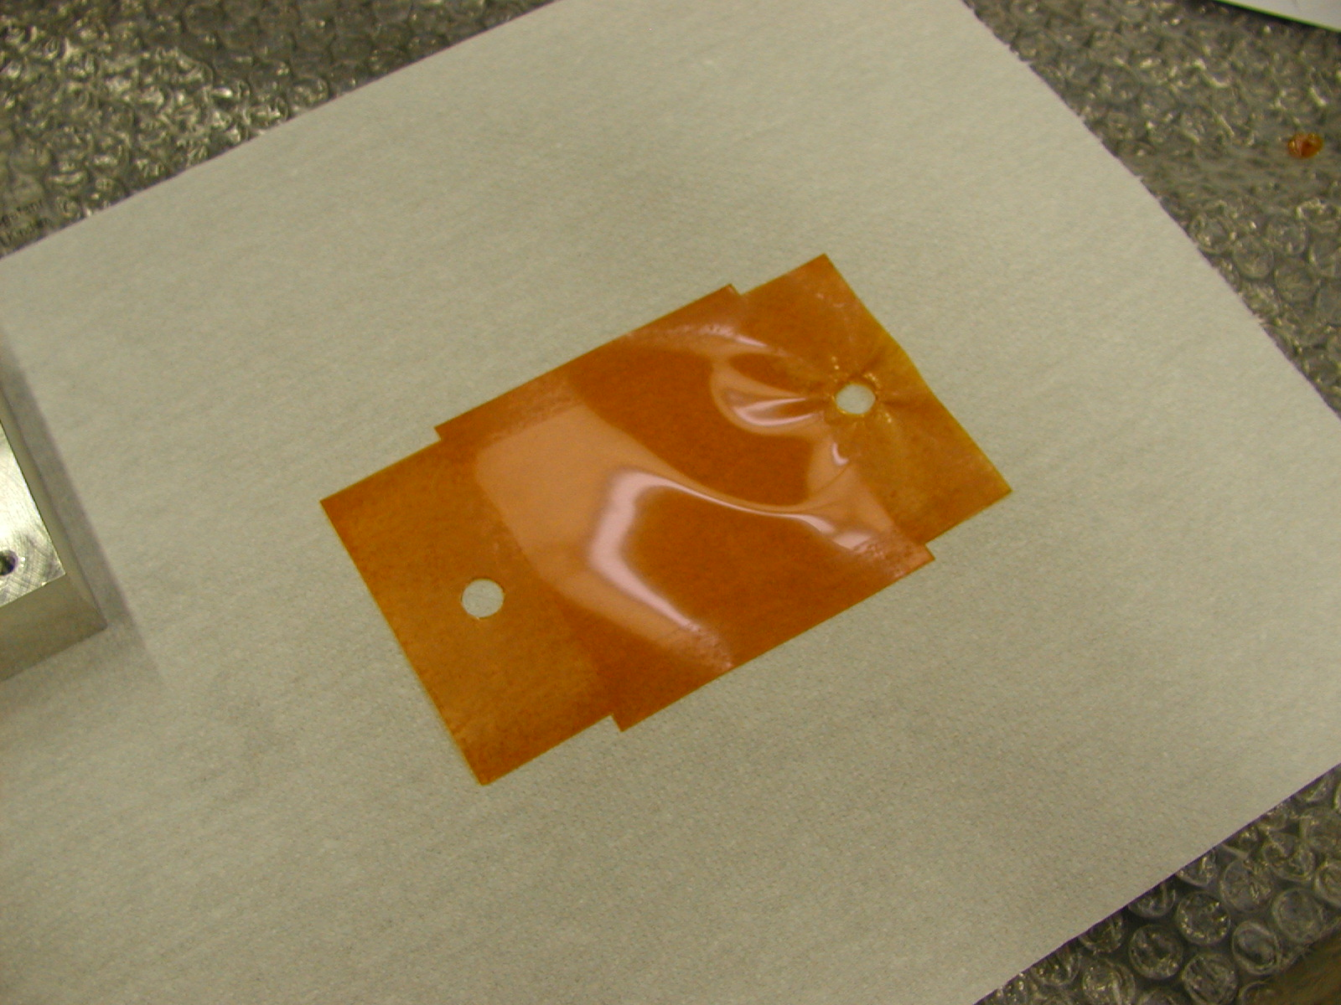
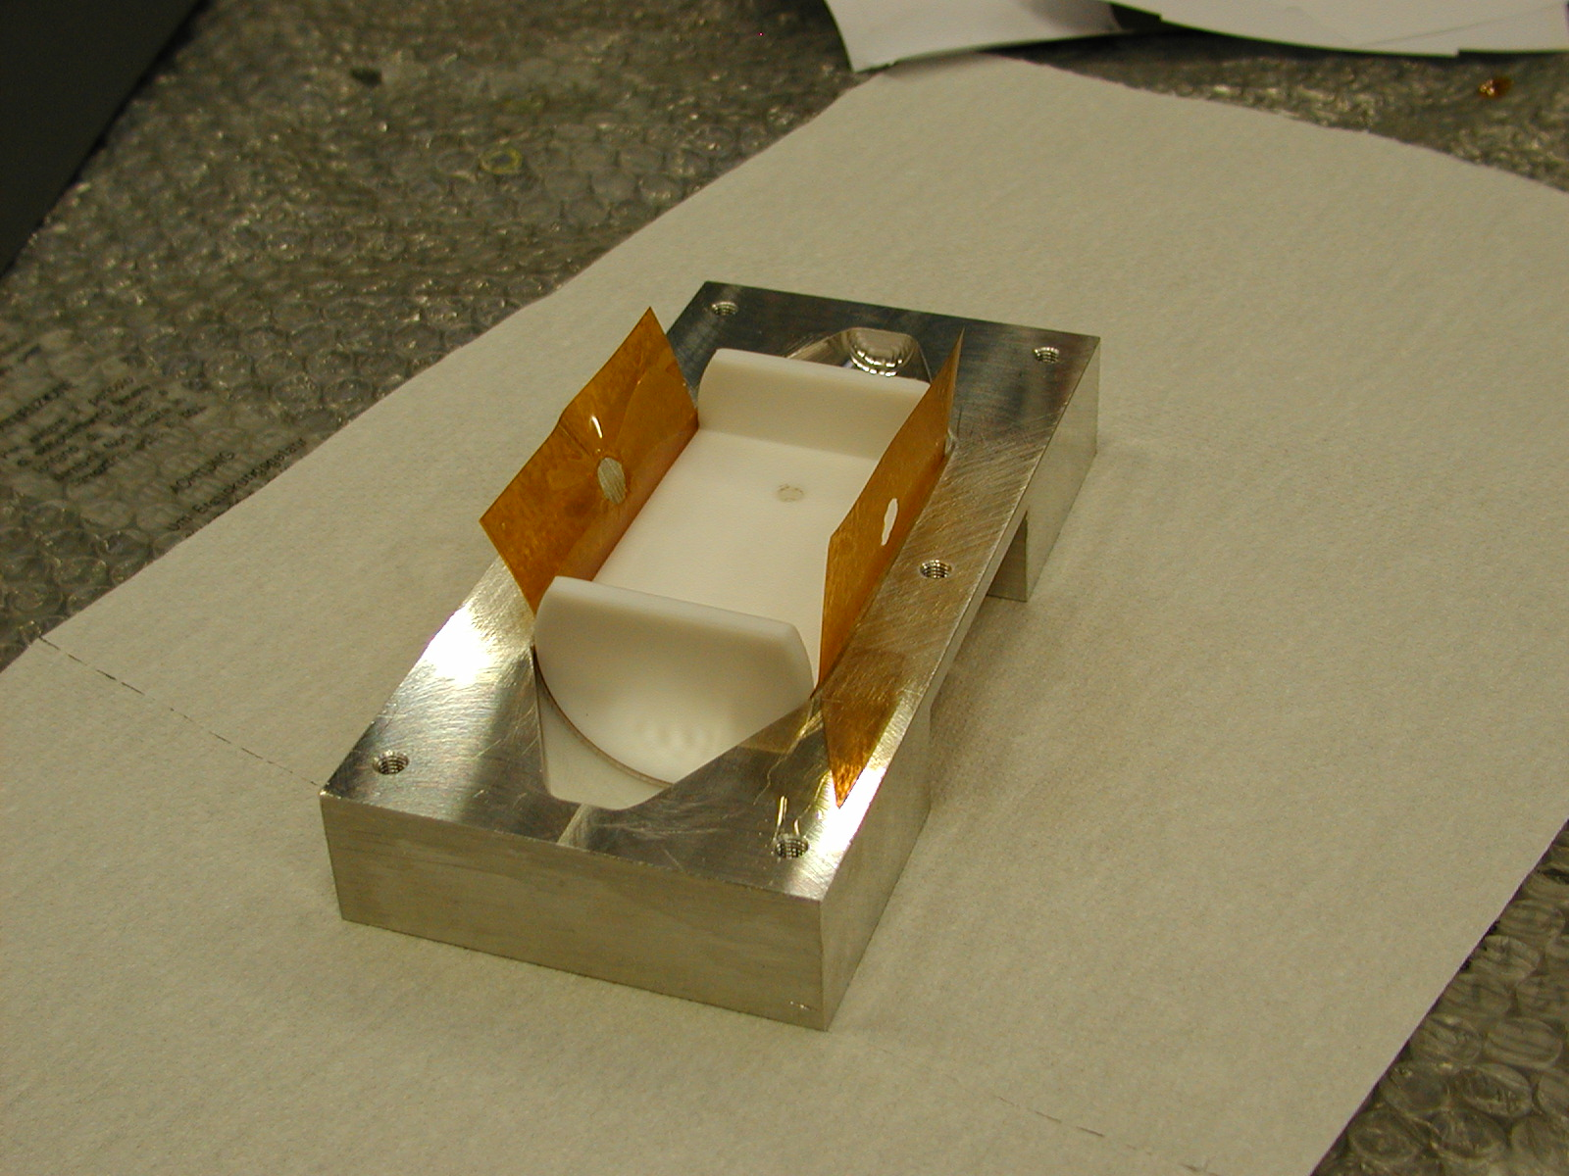
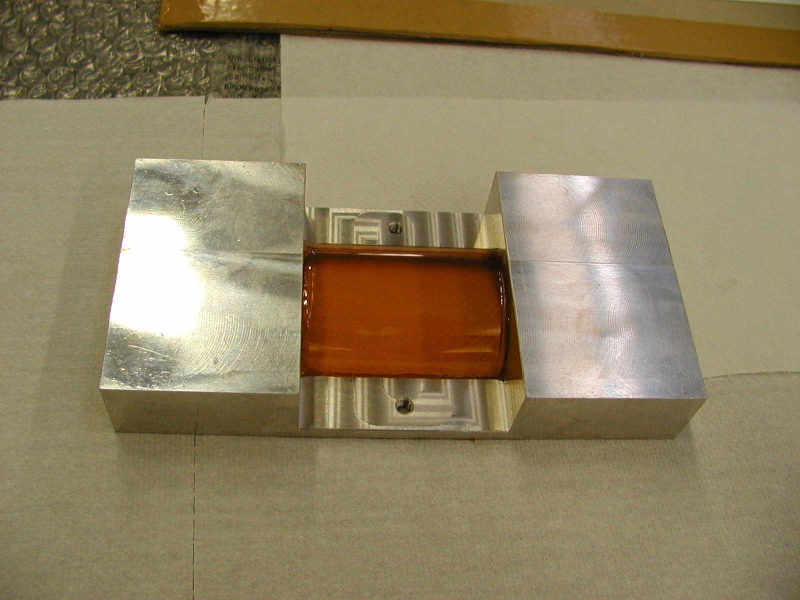
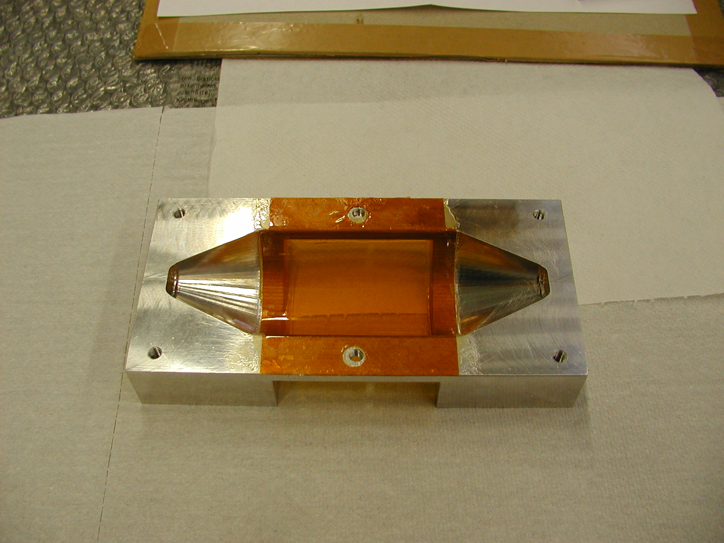
BONDING ALUMINUM FRAME & KAPTON FOIL

Slide 8
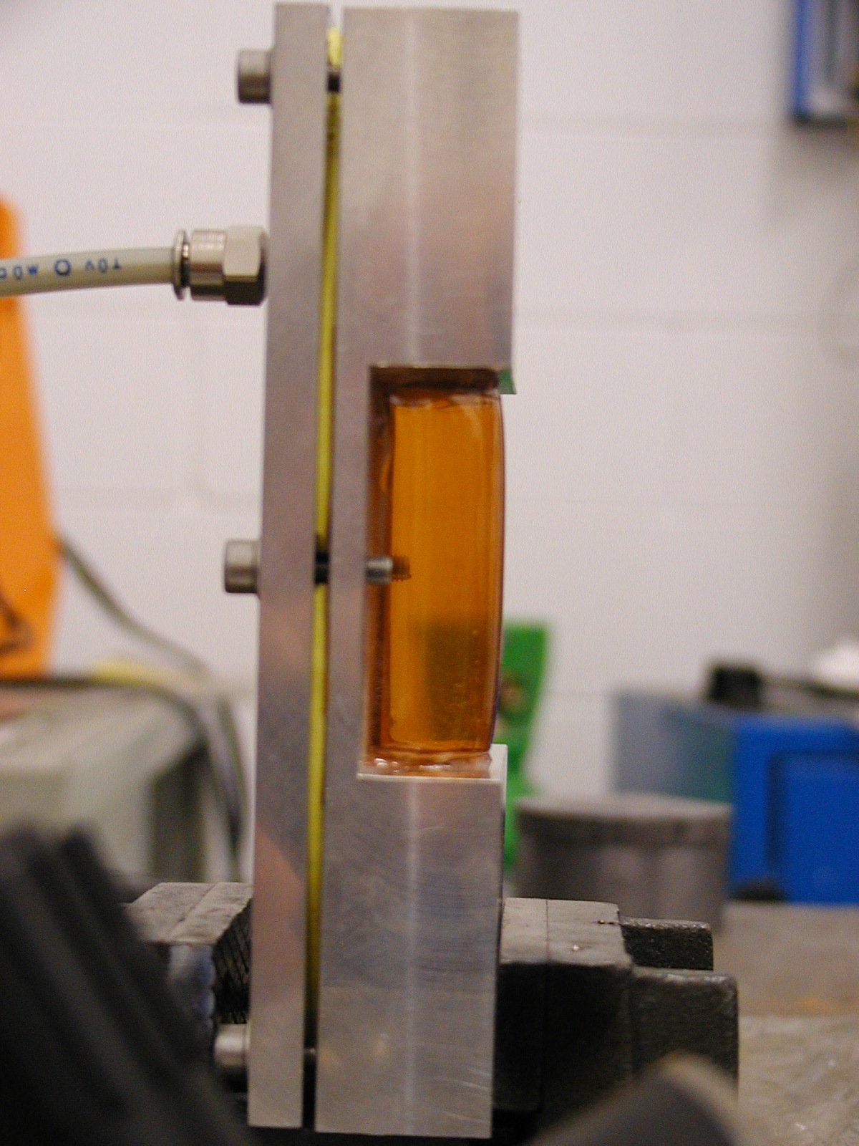
KAPTON CREEP TEST
Working pressure Wp = 1 bar
Test pressure Tp = 2Wp = 2 bar
AFTER TWO WEEKS @ Tp NO EVIDENCE
OF CREEP
SMALL RESIDUAL DEFORMATION AFTER
VENTING

Slide 9
KAPTON FAILURE PRESSURE
STRESS ON THE VESSEL
BOUNDARY CONDITIONS
Pi = 0,1 Mpa (inner pressure)
Pe = 0 (outher pressure)
s = 5E-05 m (wall thickness)
Di = 47E-03 m (inner diameter)
FAILURE PRESSURE CALCULATION
EQUIVALENT TENSILE STRESS
(Guest criterion)

Slide 10
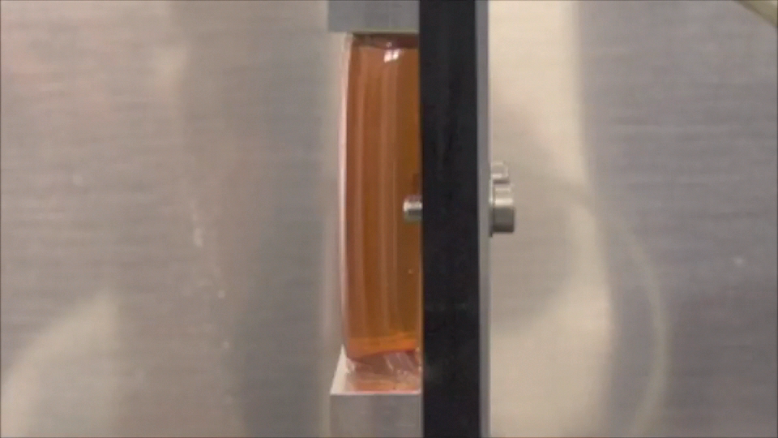
KAPTON FAILURE PRESSURE TEST
FAILURE PRESSURE = 5 bar ACCORDING TO CALCULATION

Slide 11
JOINT KAPTON-RESIN-ALUMINUM
LENGTH OF THE OVERLAP CALCULATION

Slide 12
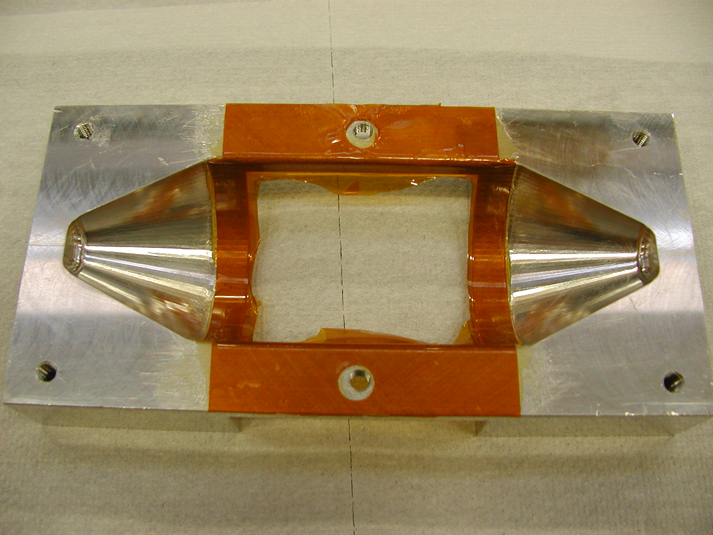
JOINT KAPTON-RESIN-ALUMINUM
THE JOINT AFTER KAPTON FAILURE

Slide 13
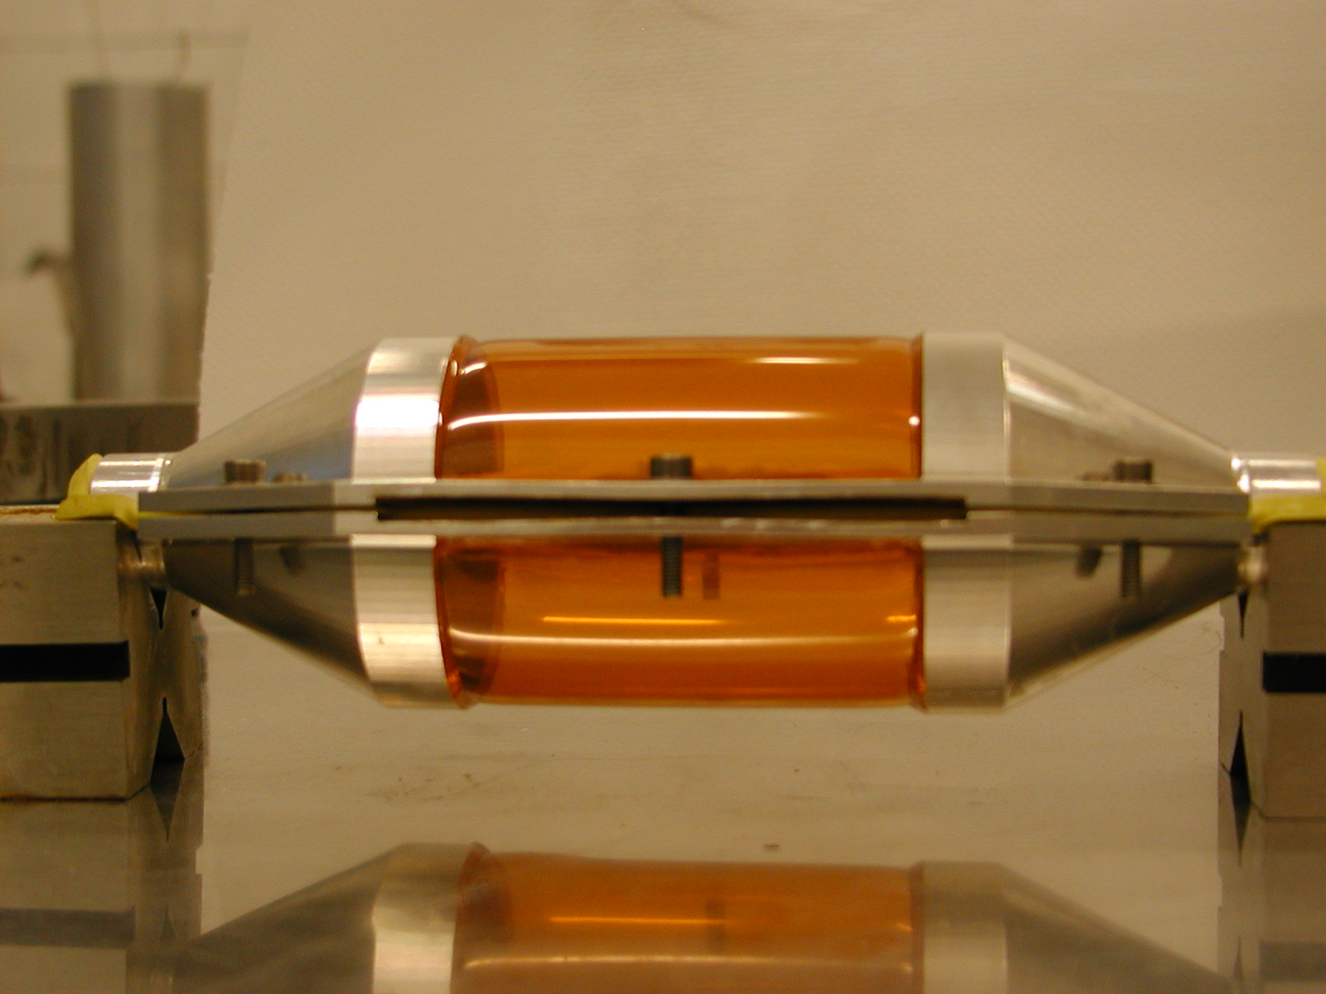
COOLING VESSEL
THE COOLING VESSEL @ 1,5 bar

Slide 14
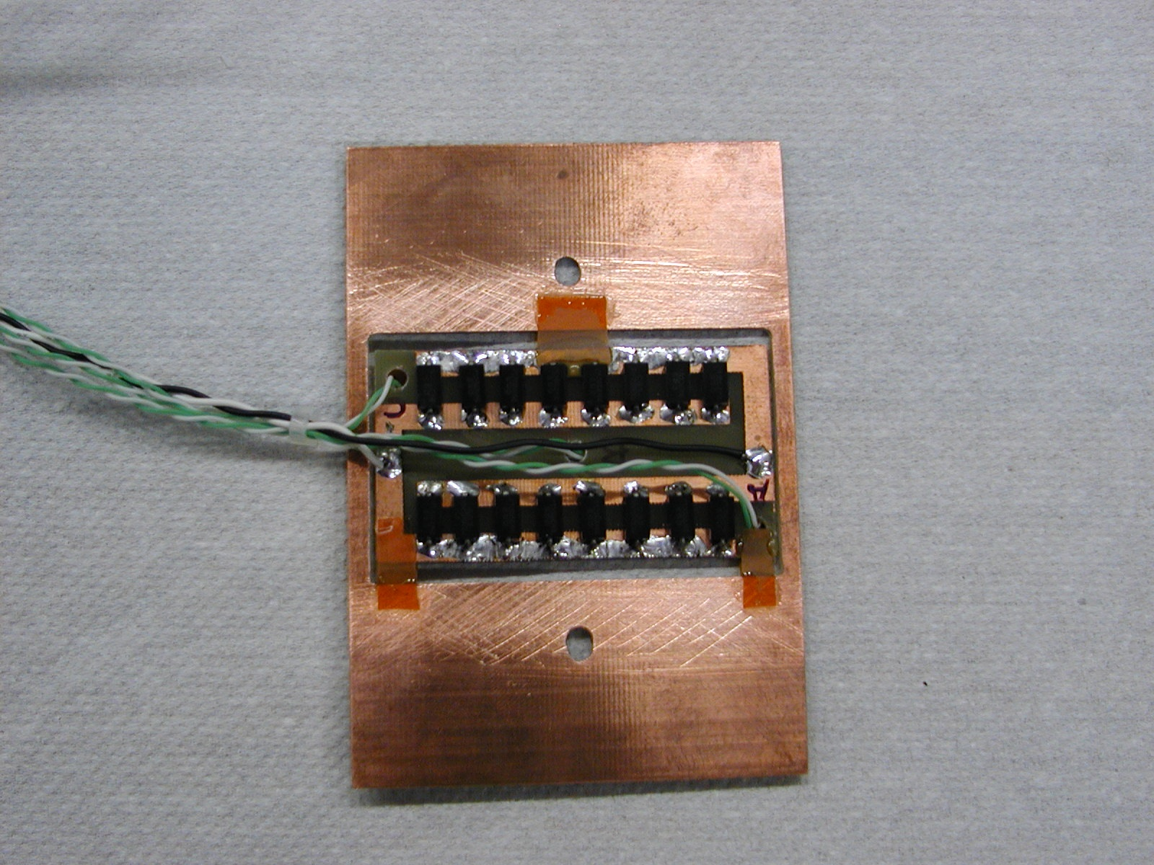
THE POWER OF THE DETECTOR
3 THERMOCOUPLES K TYPE
(from -50°C to +250°C)
16 RESISTORS 222 Ω – 2W

Slide 15
THE ASSEMBLY

Slide 16
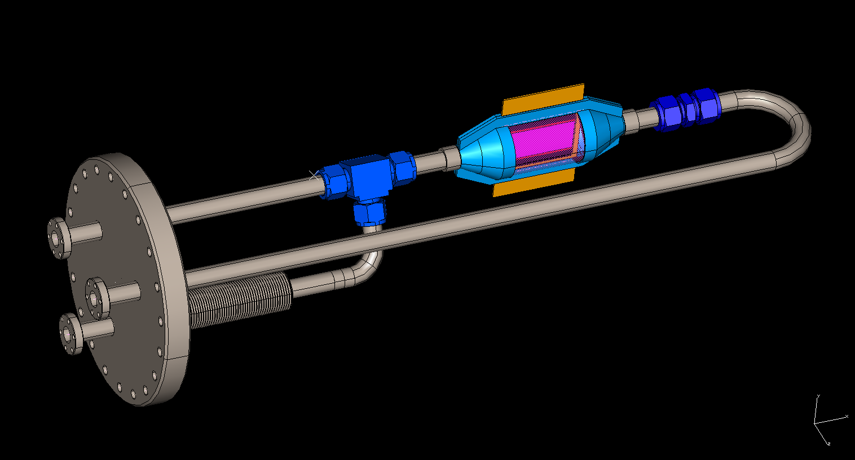
NEXT STEP : CECKING THE COOLING IN VACUUM
COOLING VESSEL
NITROGEN IN-OUT
ELECTRICAL CONNECTIONS & POWER SUPPLY
DN 160 CF FLANGE

Slide 17
ACKNOLEDGEMENTS
SPECIAL THANKS TO :
COTTA ANGELO (electronic service)
EVANGELISTI FEDERICO (mechanical service)
LANDI LUCA (mechanical service)
PADOAN CLAUDIO (electronic service)
STATERA MARCO (mechanical service)

