Slide 1
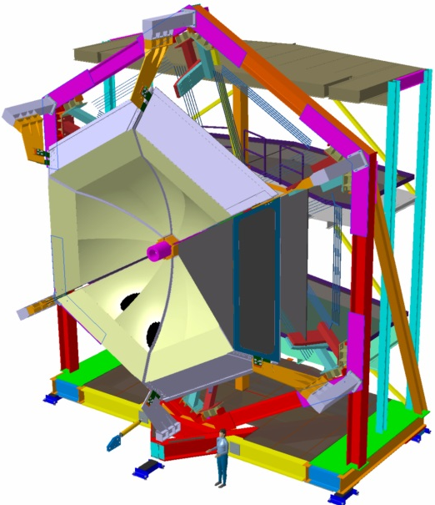
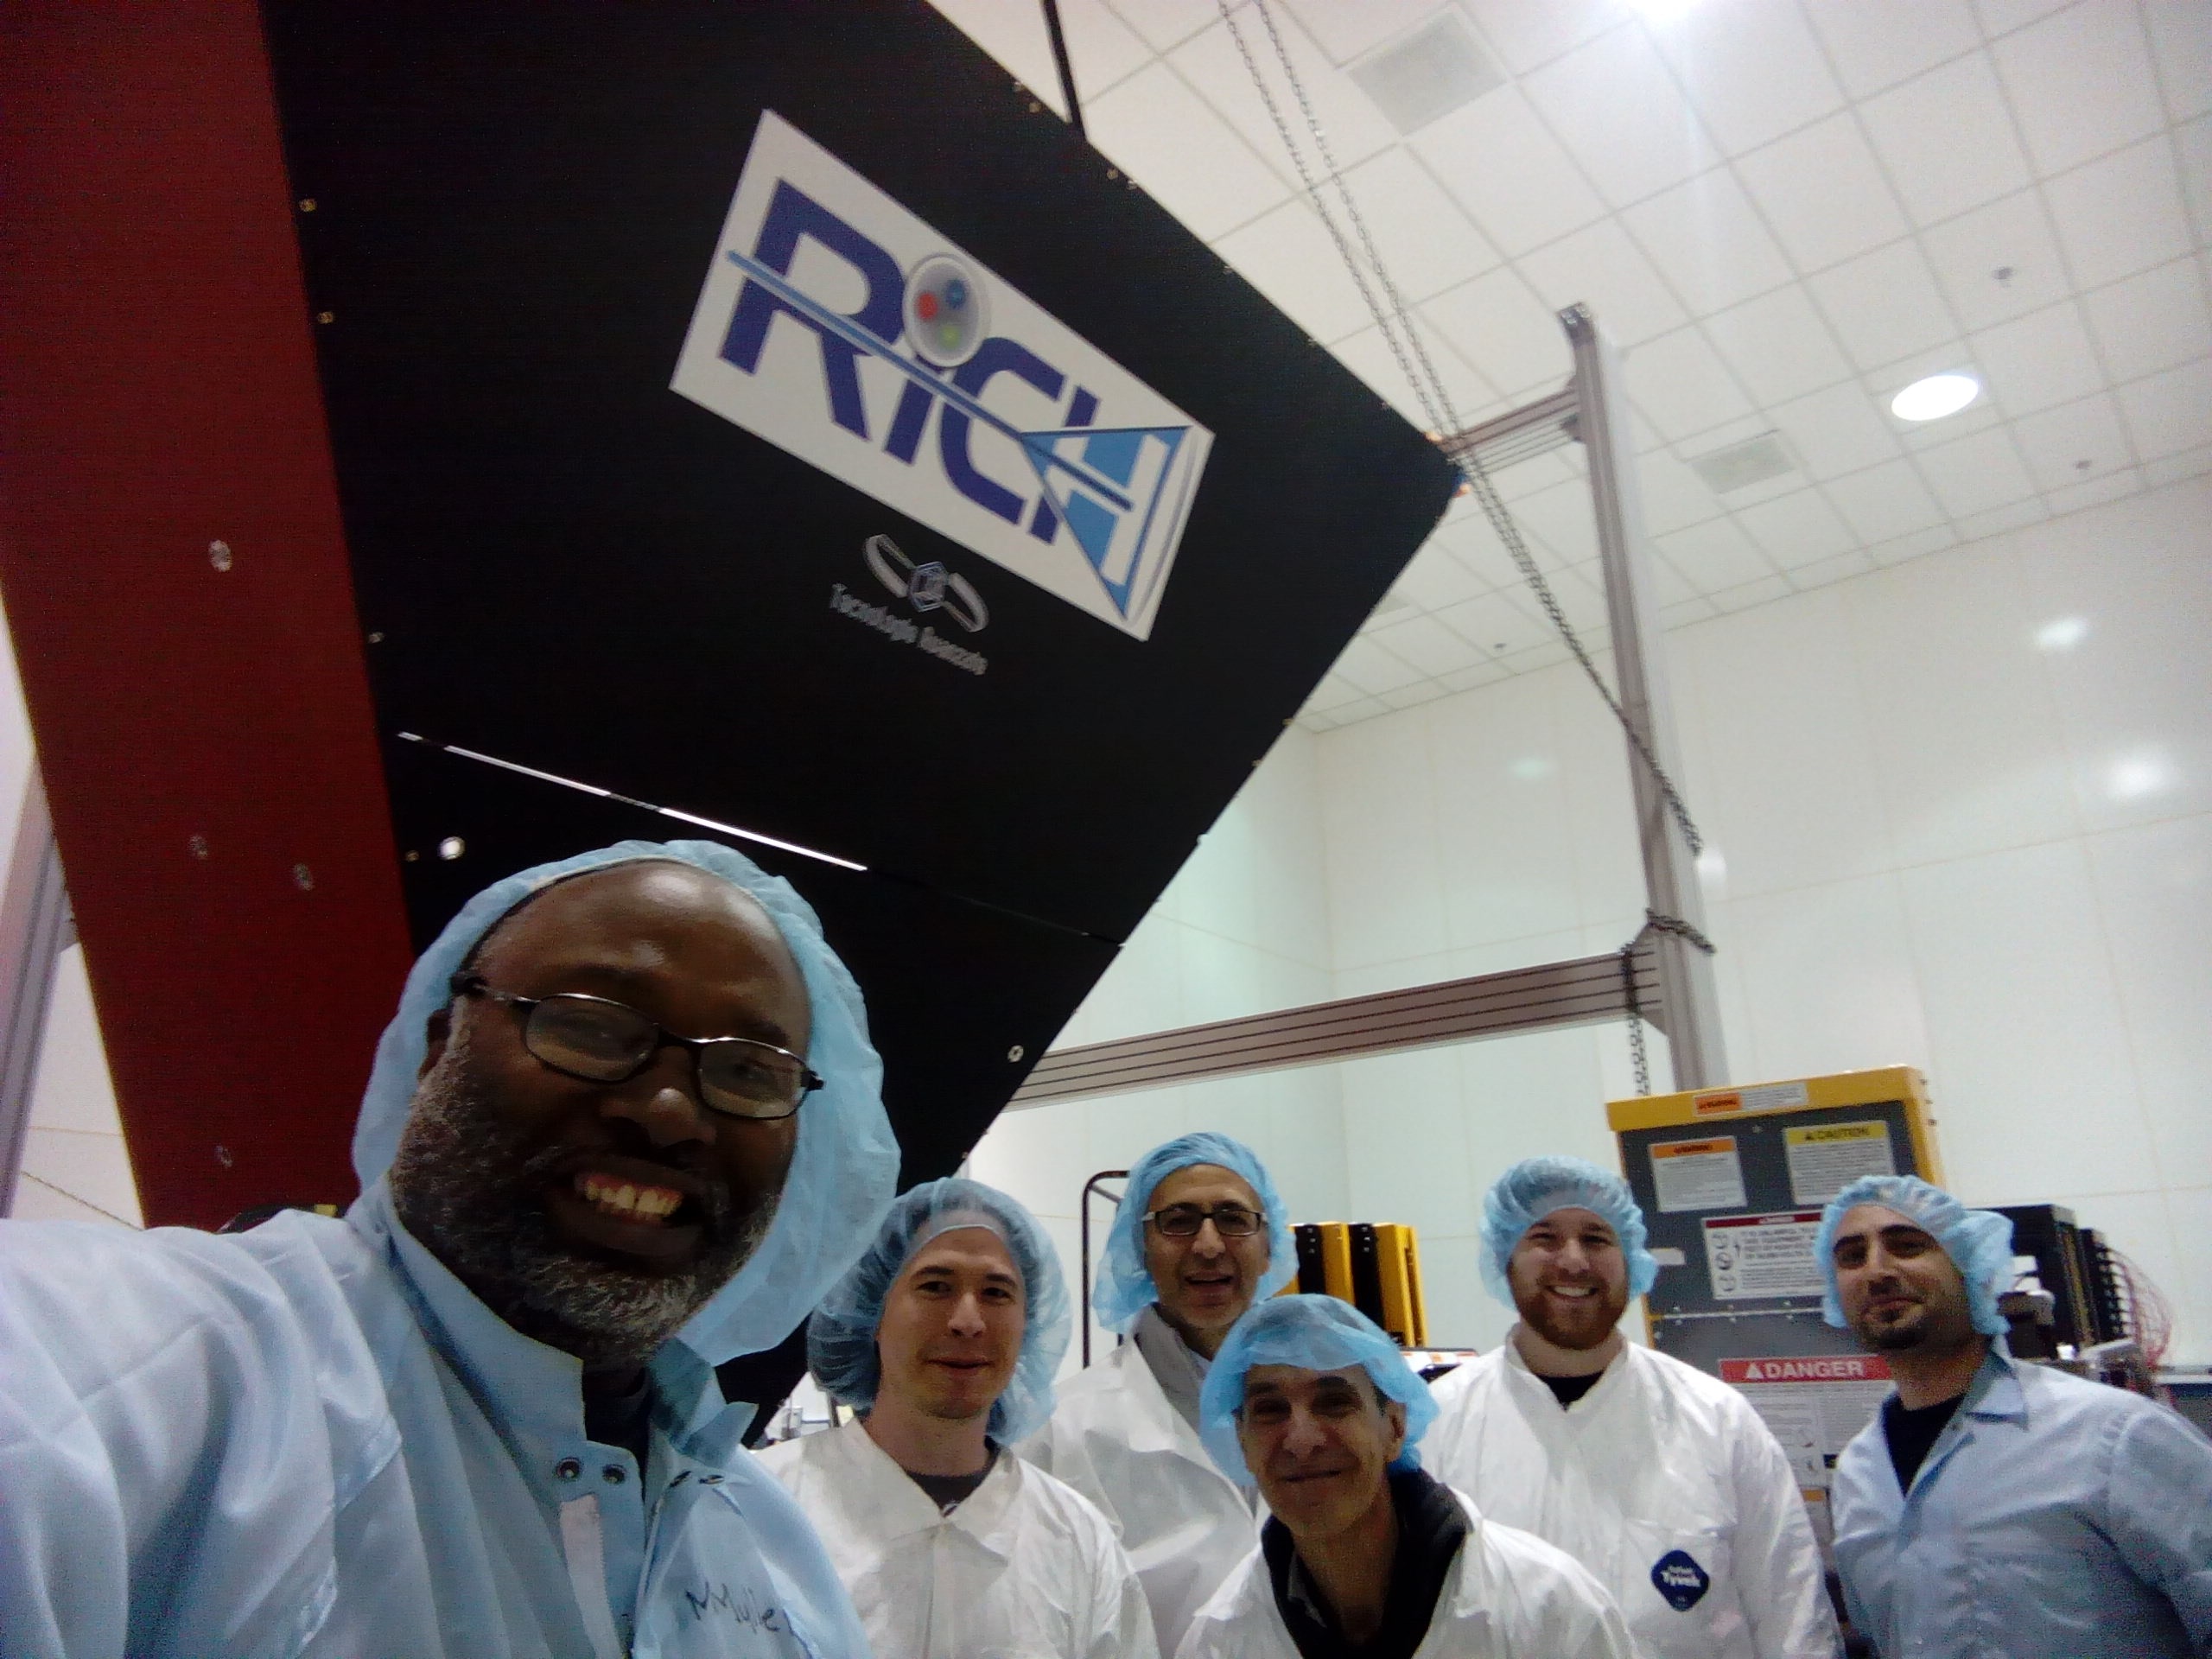
CLAS12 – RICH
The Ring Imaging Cherenkov detector (RICH) is designed to improve CLAS12 particle identification in the momentum range 3-8 GeV/c and will replace one sector of the existing LTCC detector.
The RICH design incorporates aerogel radiators, visible light photon detectors, and a focusing mirror system which will be used to reduce the detection area instrumented by photon detectors to ~1 m² . Multi-anode photomultiplier tubes (MA-PMTs) provide the required spatial resolution and match the aerogel Cherenkov light spectrum (visible and near-ultraviolet region).
For forward scattered particles (θ< 13º) with momenta 3 - 8 GeV/c, a proximity imaging method with thin (2 cm) aerogel and direct Cherenkov light detection will be used.
For larger incident particle angles of 13º<θ<25º and momenta of 3 - 6 GeV/c, the Cherenkov light will be produced by a thicker aerogel (6 cm), focused by a spherical mirror, undergo two further passes through the thin radiator material and a reflection from planar mirrors before detection.
RICH - TECHNICAL PARAMETERS
PARAMETER | DESIGN VALUE
Momentum range | 3-8 GeV/c
π/K rejection factor | Not less than 500
Κ/p rejection factor | Not less than 100
Angular coverage | 5º to 25º
Cherenkov light radiator | Aerogel
Aerogel refraction index | 1.05
Photodetector | 64 channels photomultipliers (MA-PMTs)
Number of PMTs | 391
Total number of readout channels | 25024
Electronics | MAROC3 and FPGA on detector boards fully integrated into the CLAS12 DAQ
Data transfer to CLAS12 DAQ | Fiber optics cables
Spherical mirror | Carbon-fiber-reinforced polymer (CFRP) Radius of curvature =2700 mm Area= 3.38 m²
Flat mirror | Sandwich with glass skin (0.7+0.7 mm) and Al honeycomb core 8.6 mm thick

Slide 2
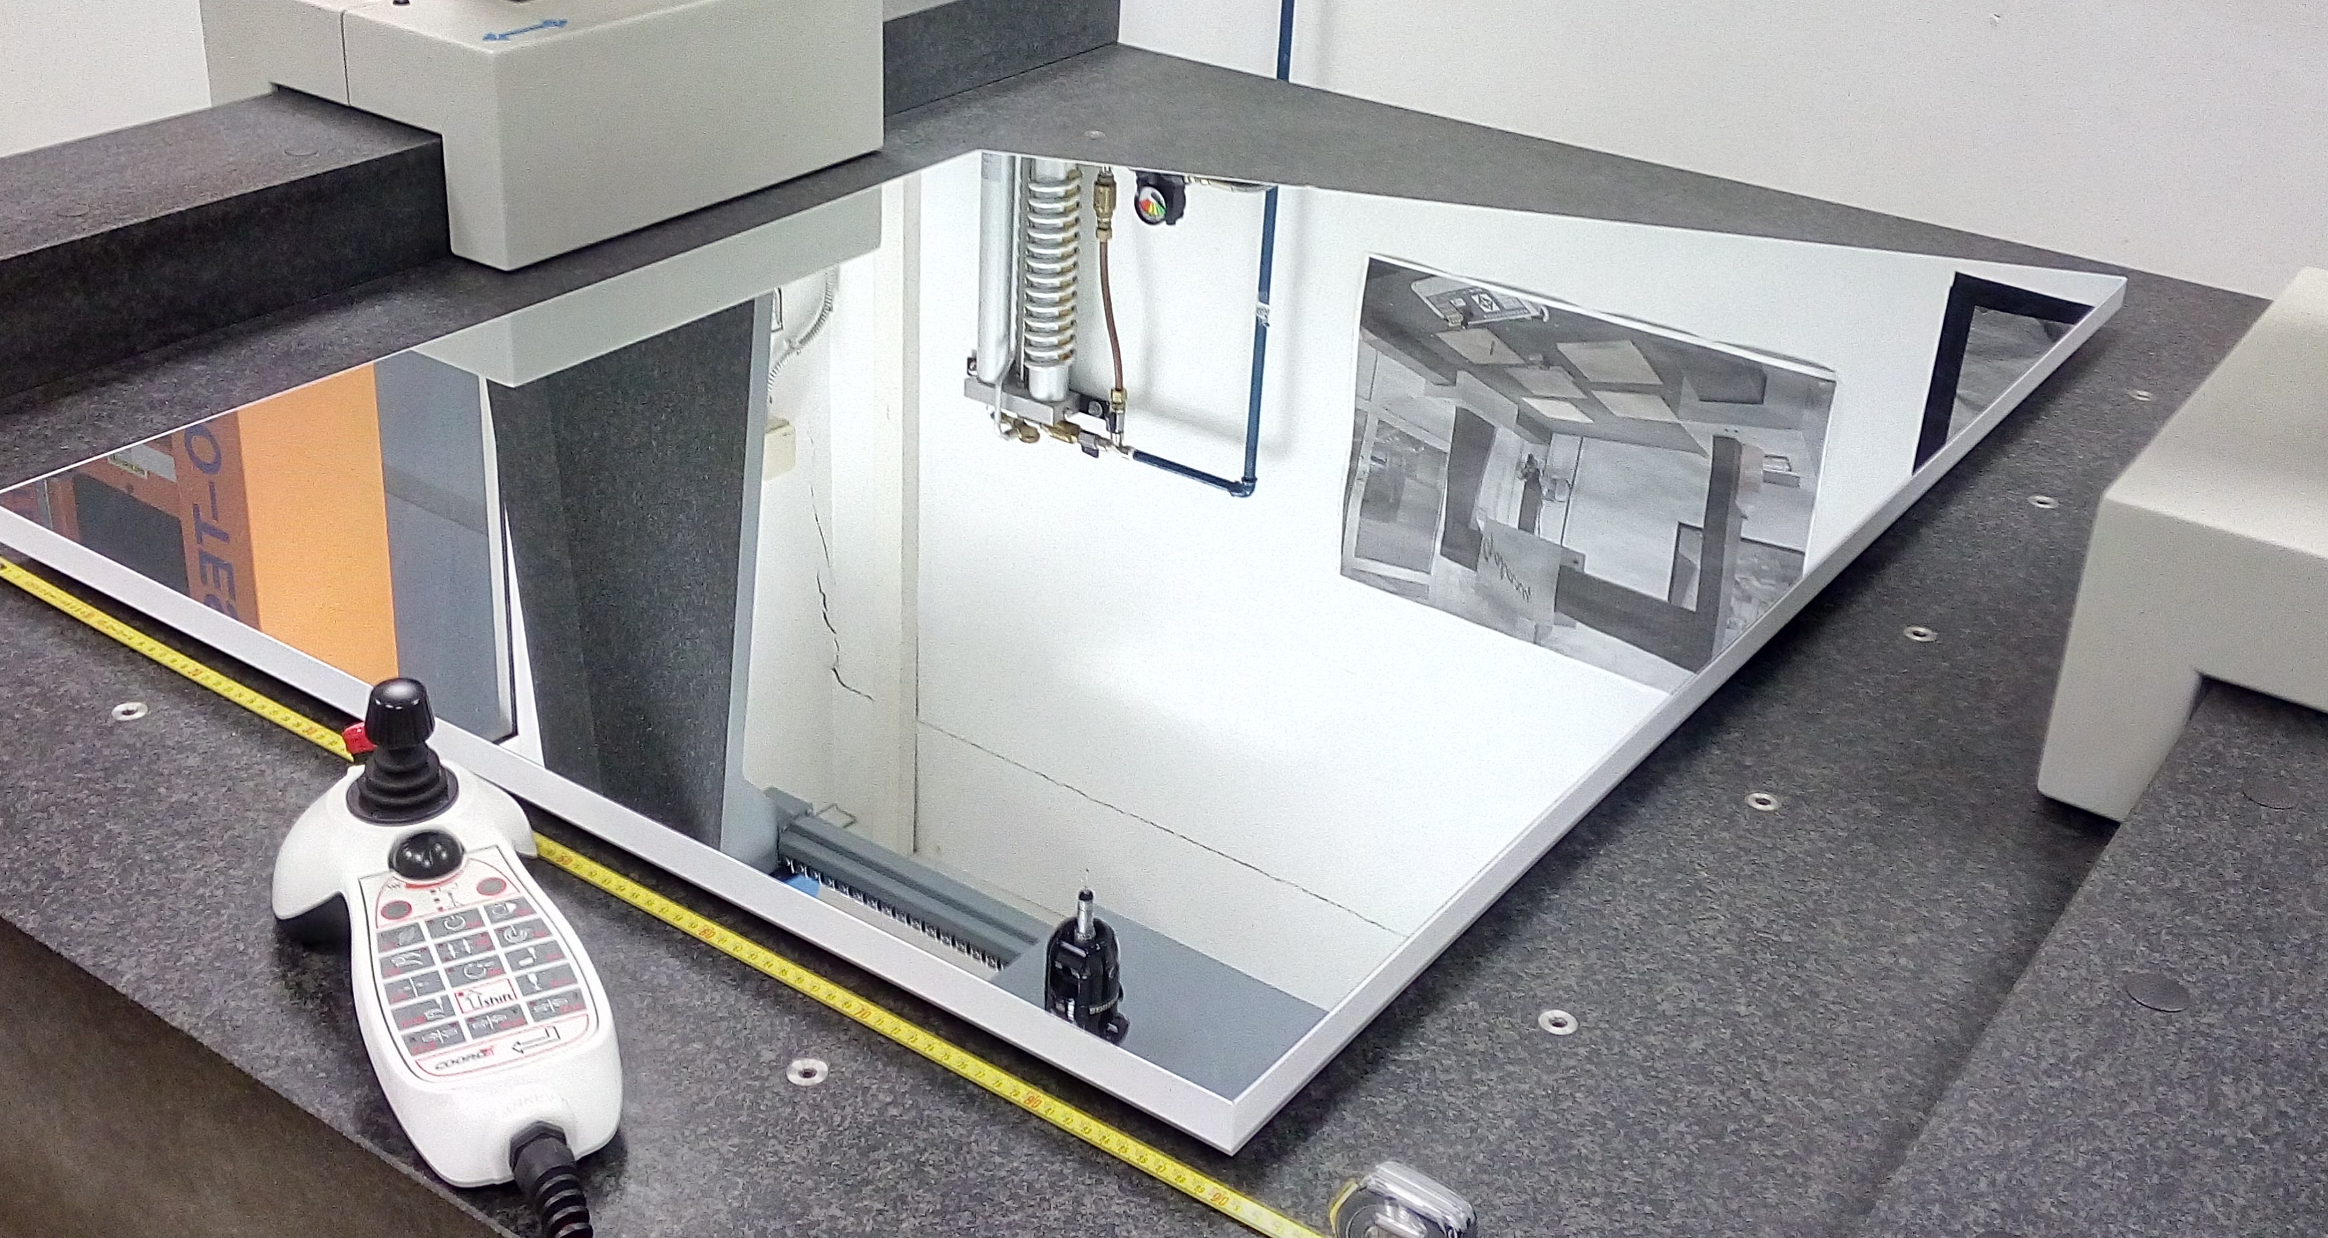
Construction Strategy and Project Leadership
The RICH collaboration includes INFN (Italy), JLab, Argonne National Lab, Duquesne University (DUQ), University of Connecticut (UCONN), George Washington University (GWU), Kyungpook National University (Republic of Korea), Universidad Tecnica Federico Santa Maria (Chile), University of Glasgow (UK).
The detector components (aerogel, PMTs, mirrors and electronics) will be tested at the collaboration institutions.
The whole assembly will take place at JLab.
RICH electronic panel ready for assembling
Significant dates
2012-2013: Test-beam with electrons (Frascati-INFN) and hadrons (CERN).
June 2013: Hall-B review.
Sep. 2013: Physics Division review with DOE observers.
Sep. 2013: RICH project started.
Sep. 2013: Hamamatsu contract awarded.
Oct. 2015: Mid-term project review.
Jun. 2016: Readiness review.
Mar. 2017: RICH mechanic structure assembled.
MA-PMTs
RICH planar mirror fulfilling specs
Aerogel
Project Status
Electronics: Production done. Acceptance test done. Characterization ongoing. Typical pedestal width at the level of 1% SPE signal.
Aerogel: got >75 % of the 3cm minimum quantity required. Production of the 2cm layer started.
Planar Mirrors: 3/5 lateral mirrors accepted. 2 front mirror in production.
Spherical mirrors: all 10 mirrors accepted. Back to vendor to build support and alignment structure.
Mechanics: RICH mechanic structure assembled at JLab. Electronic Panel assembling structure ready. Exit window, patch panels, installation tools in preparation.
MA-PMTs: 80 H8500 and 350 H12700 PMTs delivered by Hamamatsu and tested at JLab. All MA-PMTs match the specifications.
Contact: P. Rossi, project manager (rossi@jlab.org) 757-269-7740
M. Contalbrigo (mcontalb@fe.infn.it), V. Kubarovsky (vpk@jlab.org), M. Mirazita (marco.mirazita@lnf.infn.it)
V. D. Burkert, Hall B leader (burkert@jlab.org) 757-269-7540

