Slide 1
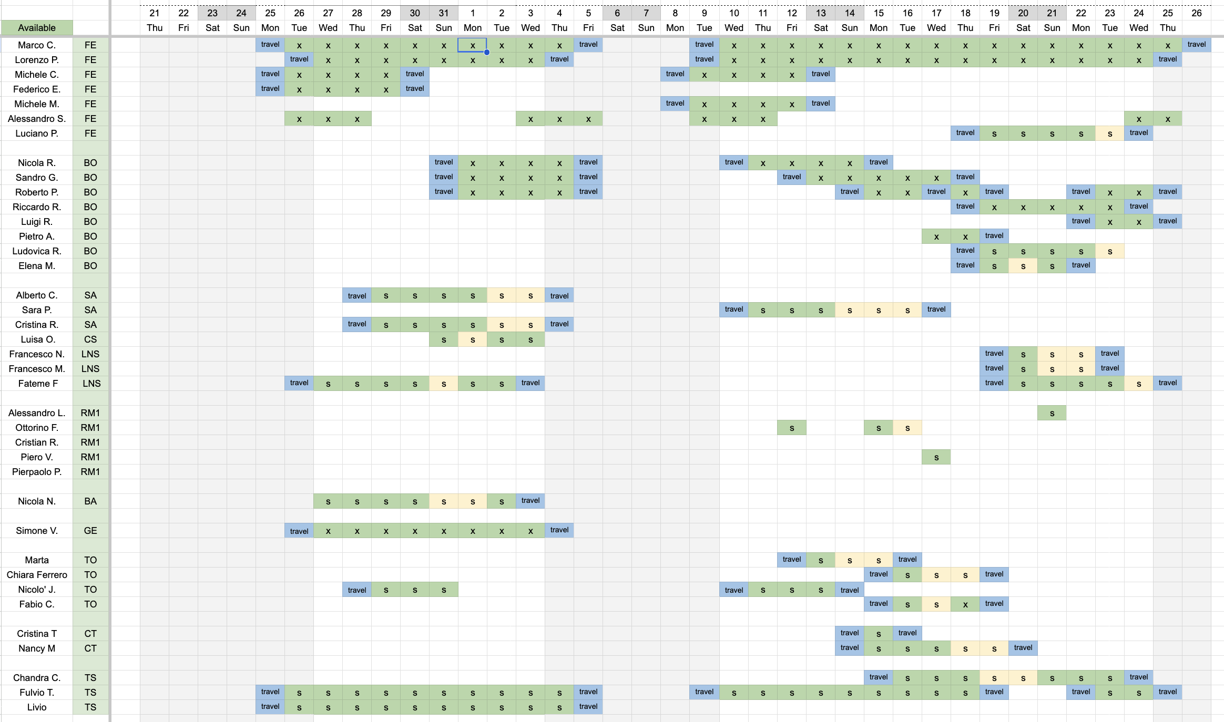
dRICH Test-Beam
Significant effort to cover 1 month of activity. Distribute partecipation. Nice bootcamp for new/young collaborators.
Extra
PS (20-180 GeV/c)
SPS (2-11 GeV/c)
M. Contalbrigo
dRICH Meeting, July 8th, 2026
1

Slide 2
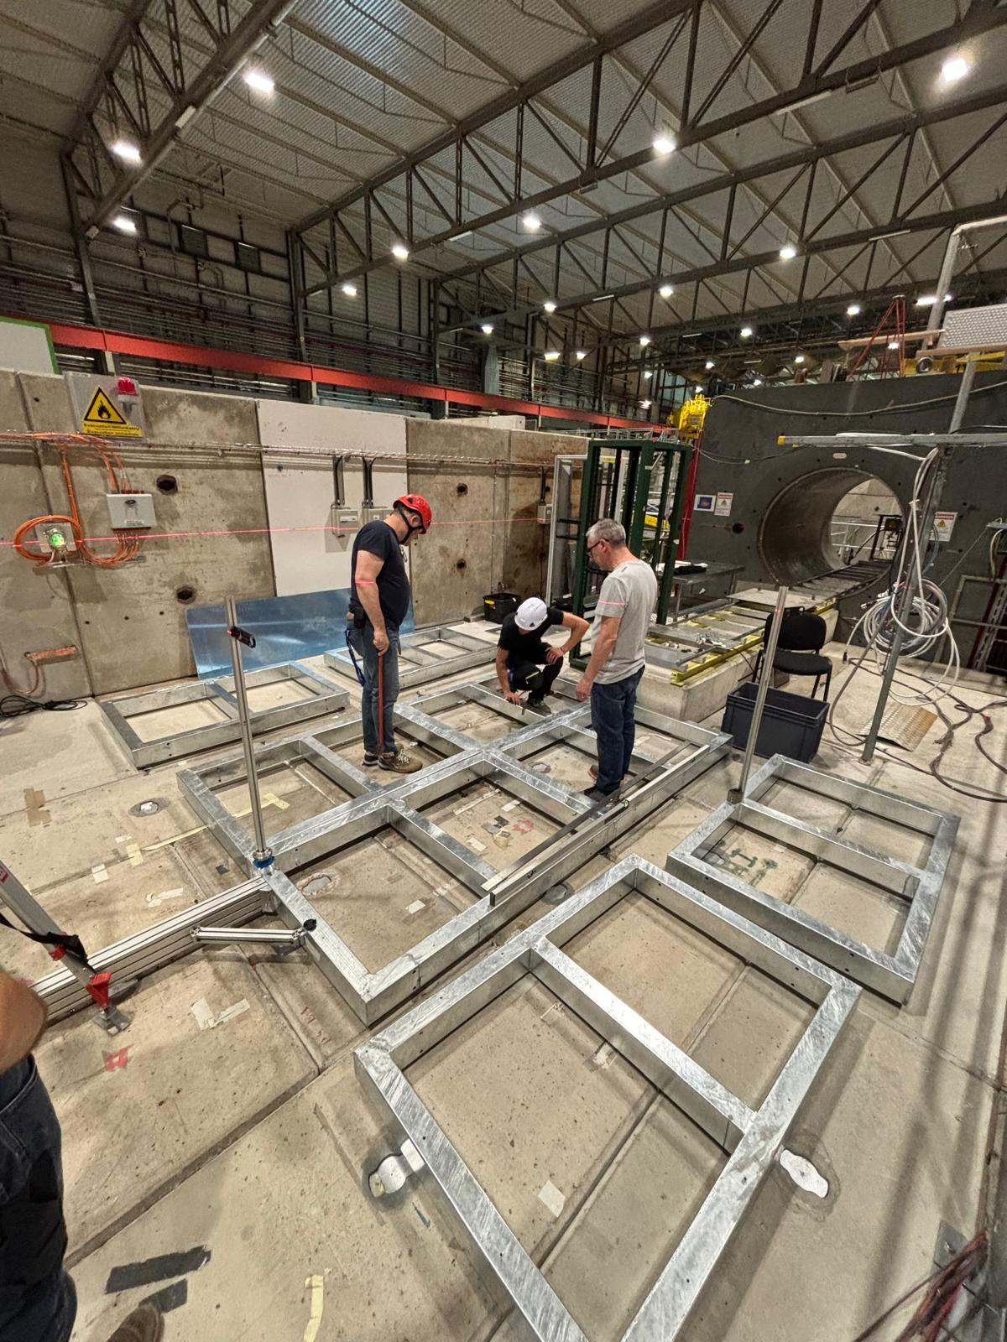
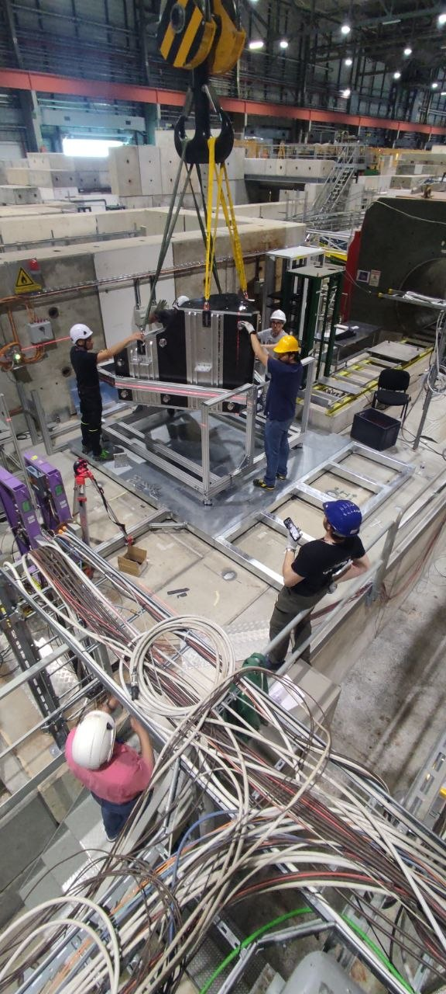
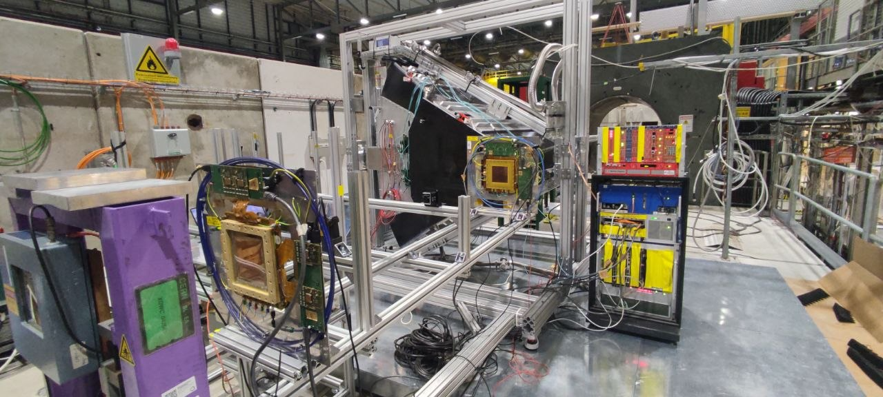
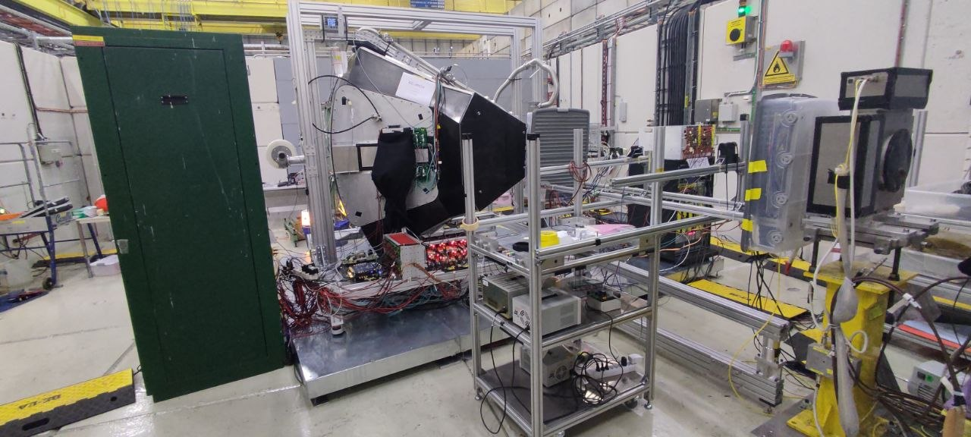
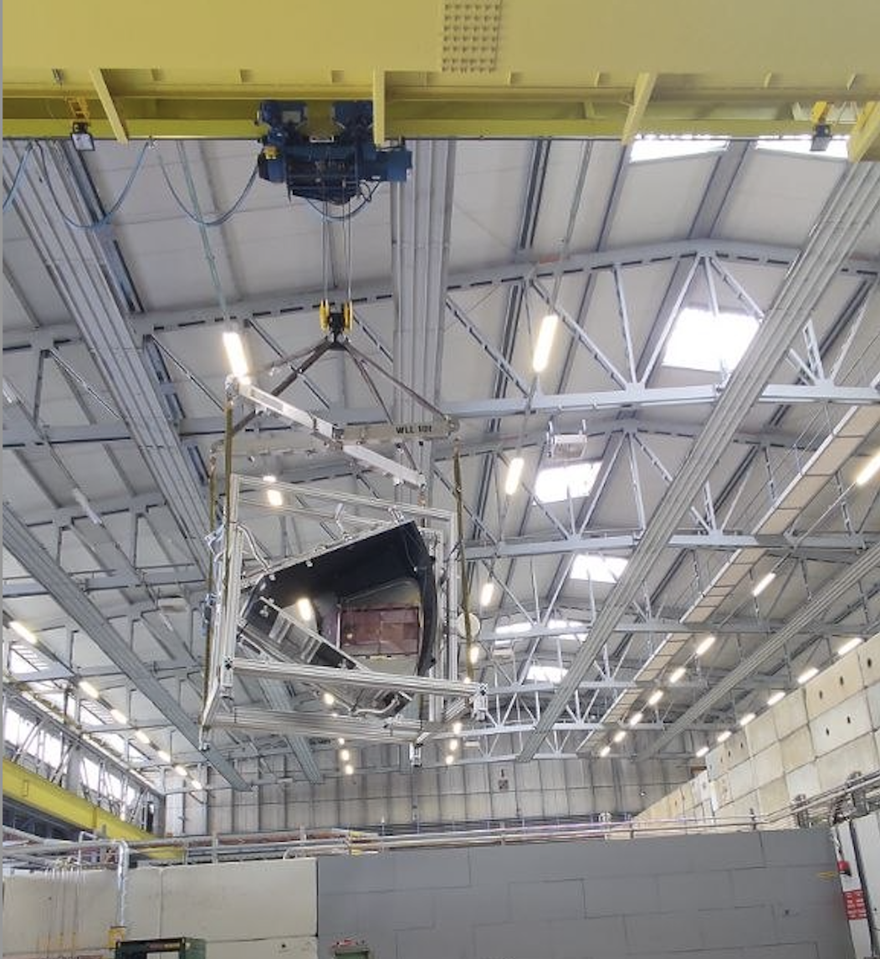
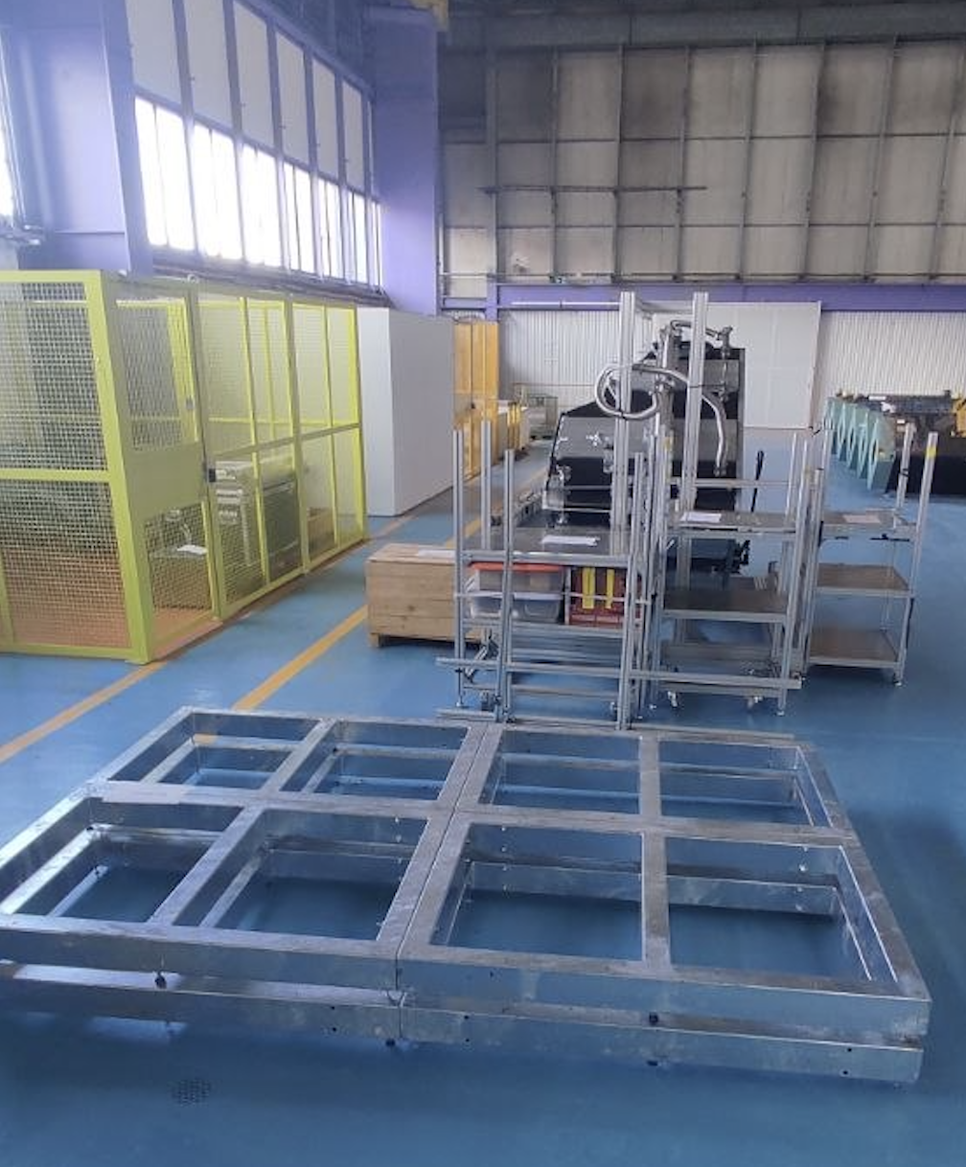
Real-Scale Prototype
SPS – 1.5 week
PS – 2 weeks
M. Contalbrigo
dRICH Meeting, July 8th, 2026
2

Slide 3
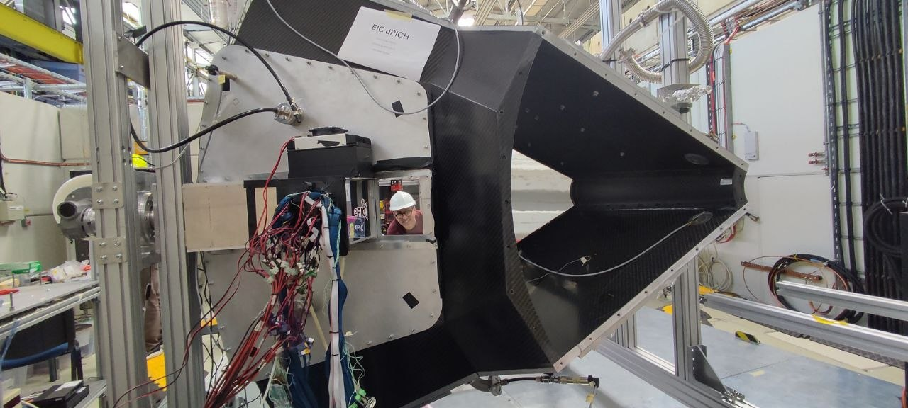
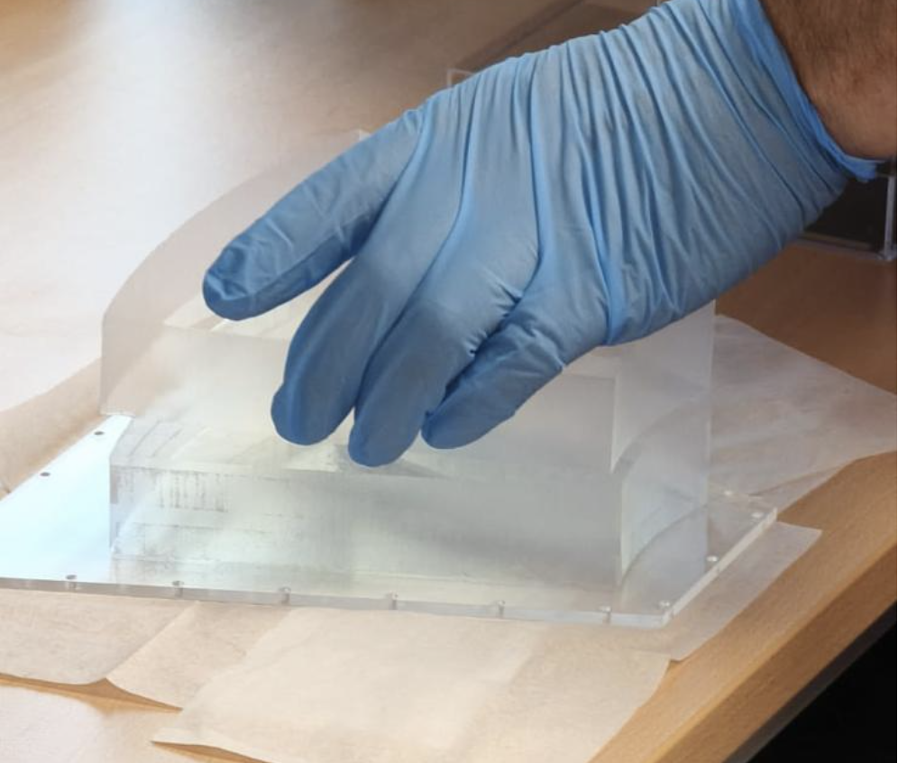
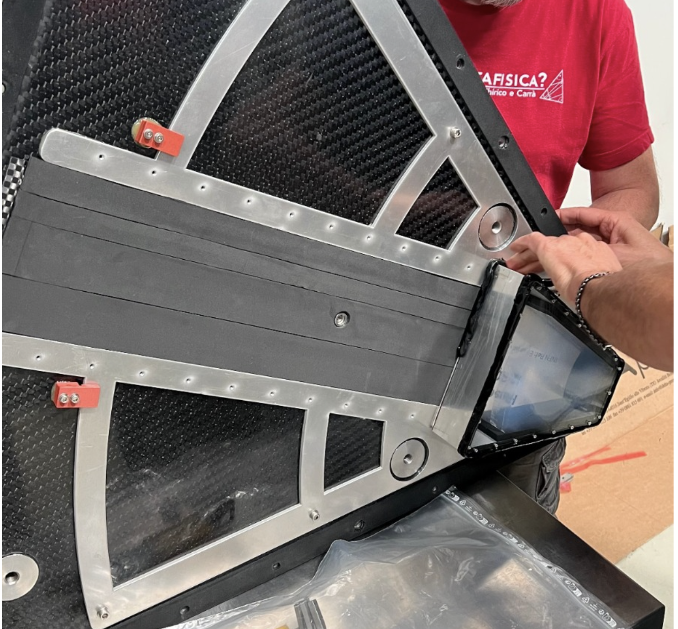
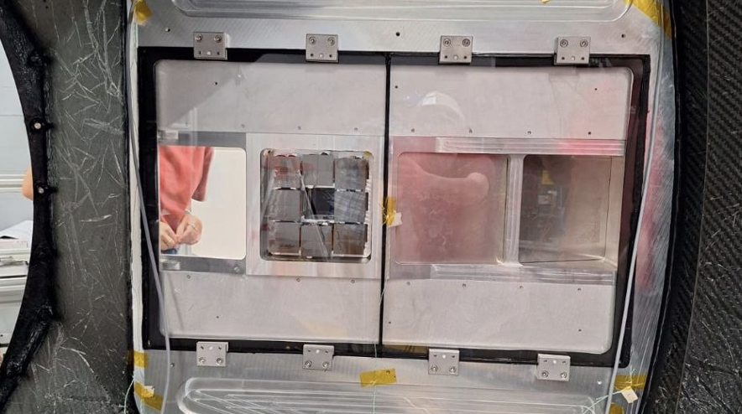
Real-Components at Test-Beam
SiPM detector box Carbon fiber mirror
Aerogel demonstrator
Quartz window and curved active surface mockup
M. Contalbrigo
dRICH Meeting, July 8th, 2026
3

Slide 4
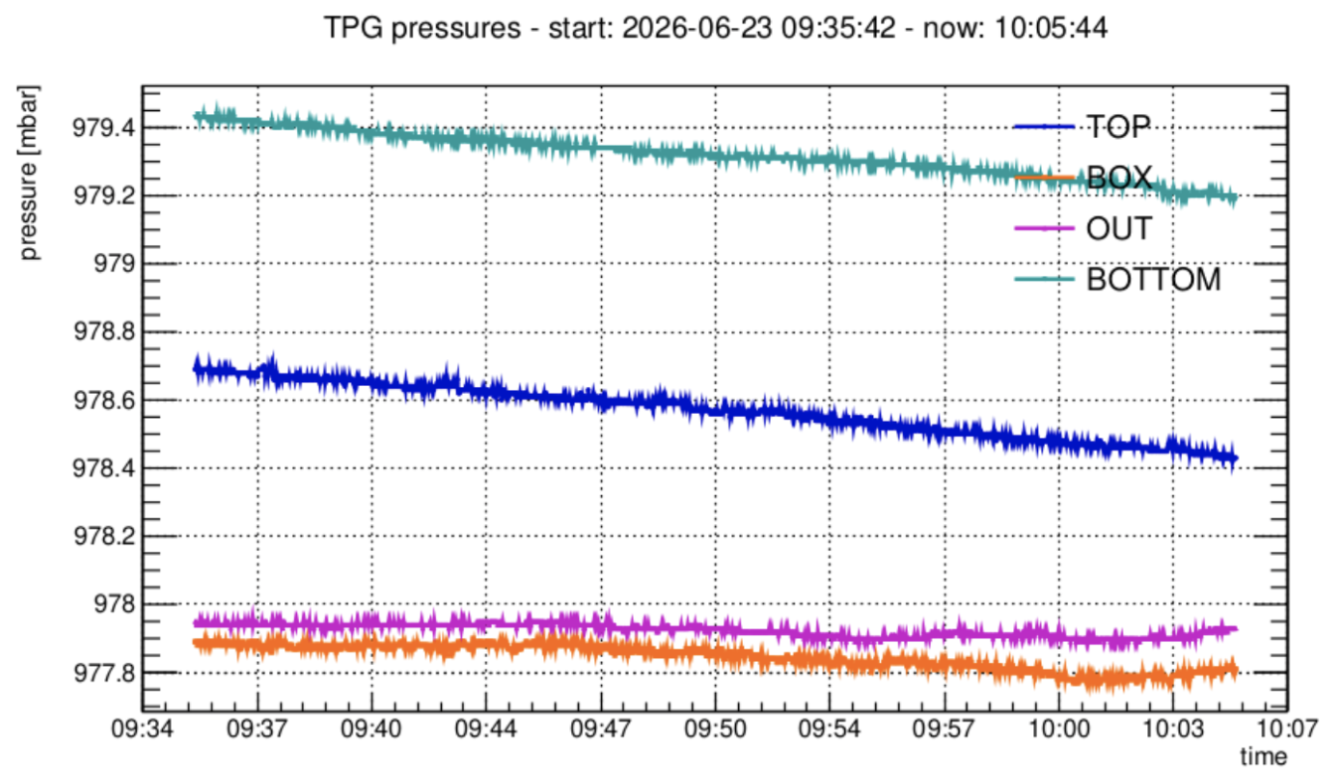
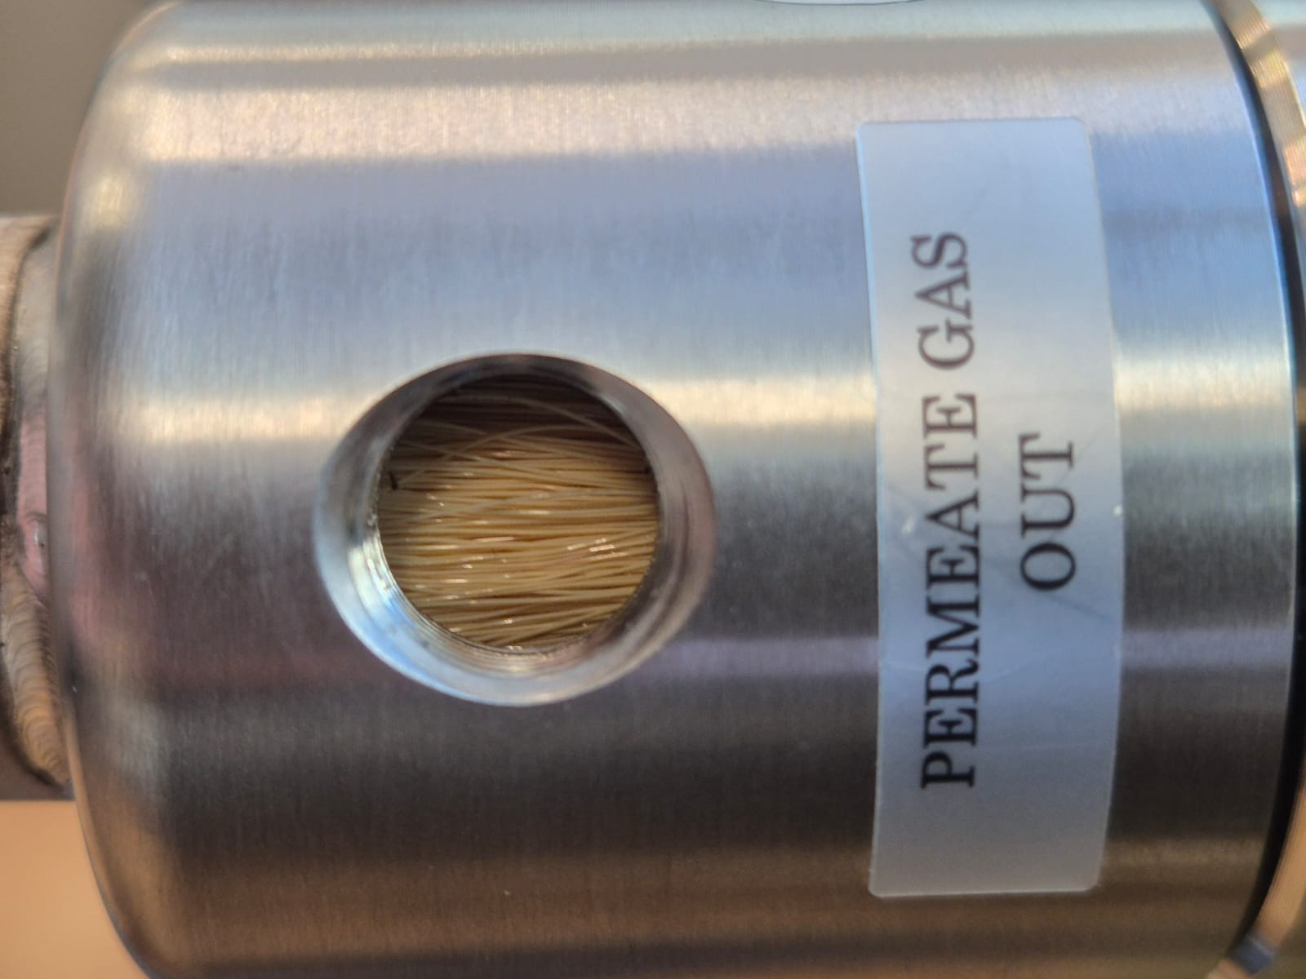
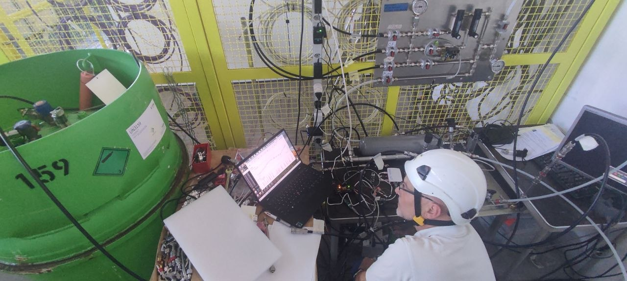
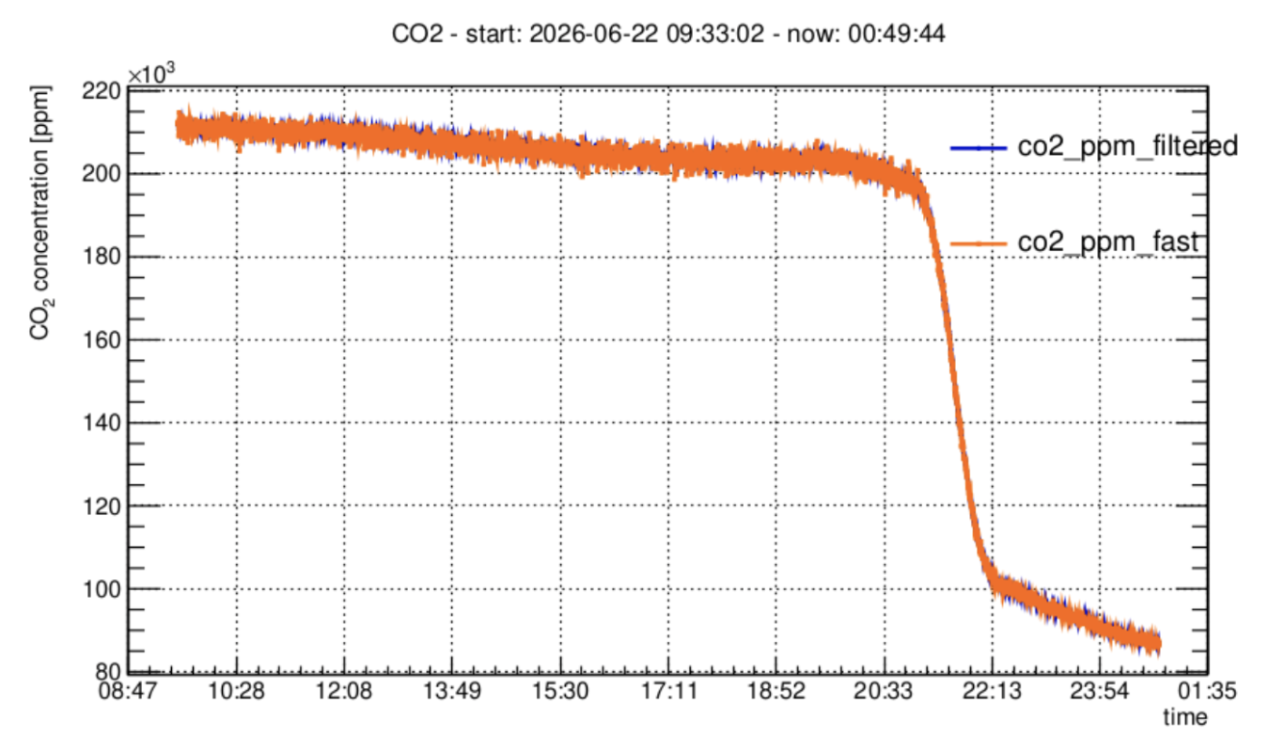
Gas System at Test-Beam
Real-scale volume is 2 m³ (1/6 of dRICH):
a full gas-system is required
C0-C10 membranes
Successful gas operations:
Air --> N₂ flushing --> CO₂ filling --> C₂F₆ filling
Succesfull purging and recovery of C₂F₆
Re-use of the same gas in the two test-beams
Gas weight
Δp vs atmosphere
Validation of the C₂F₆ gas system concept
Recovery
Gas panel
CO₂ purging
M. Contalbrigo
dRICH Meeting, July 8th, 2026
4

Slide 5
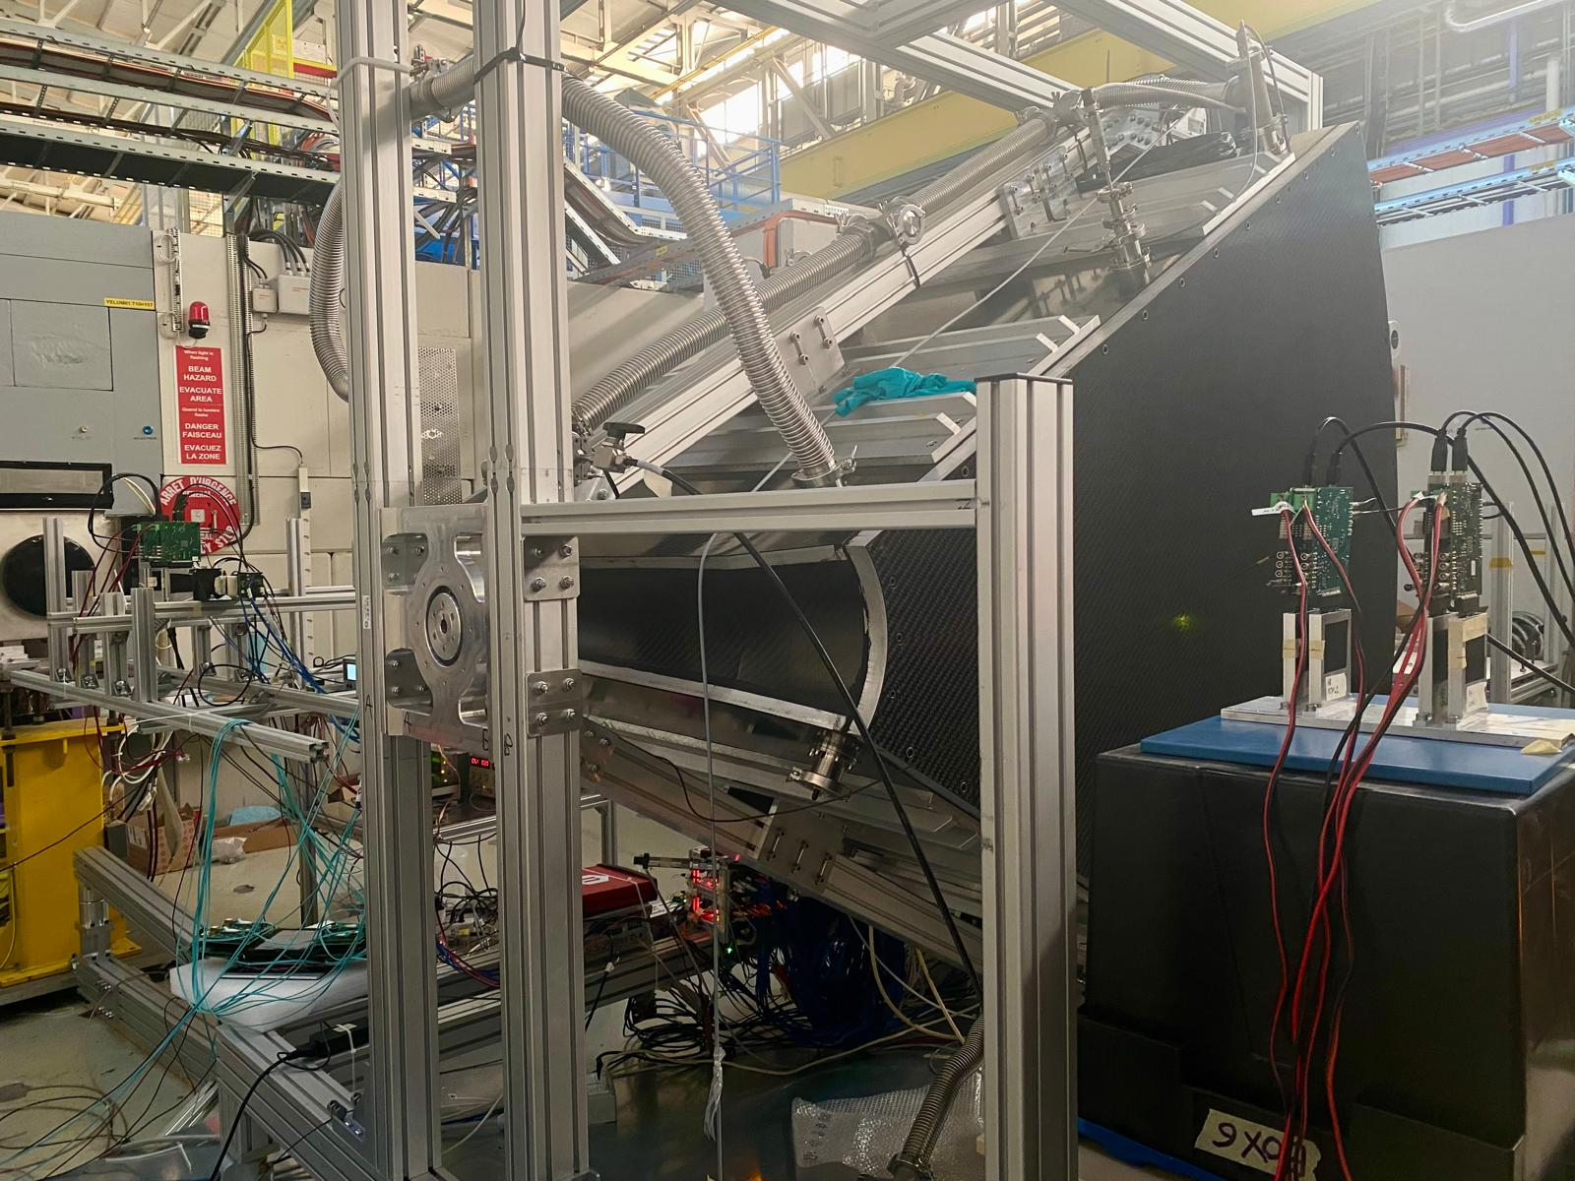
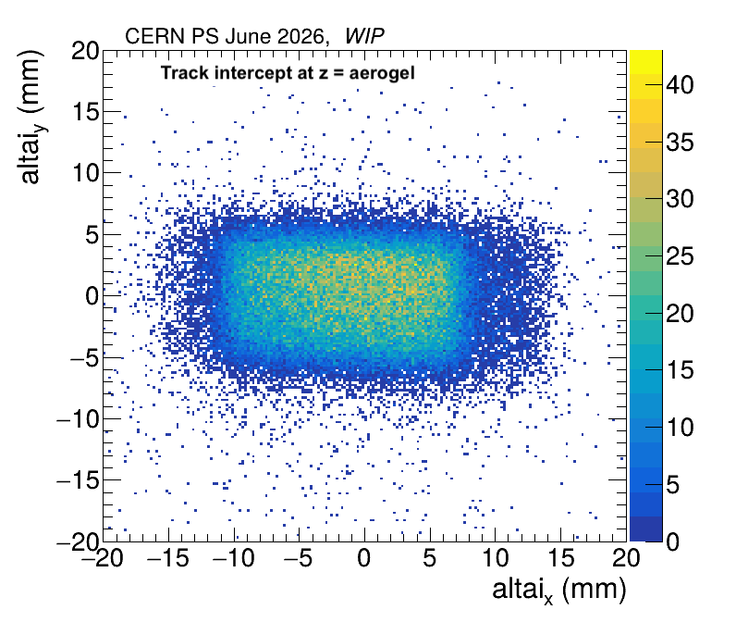
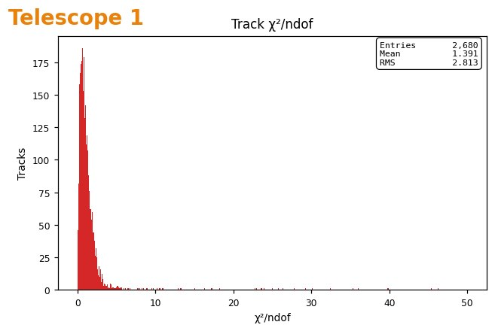
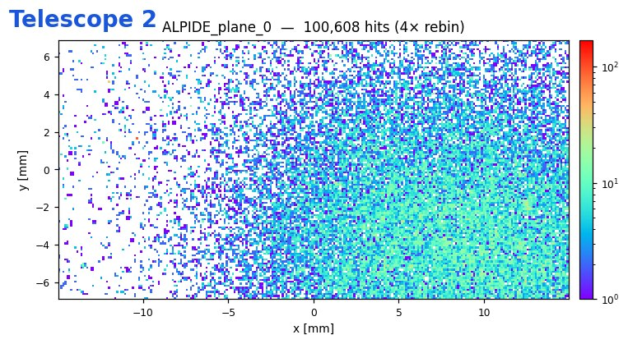
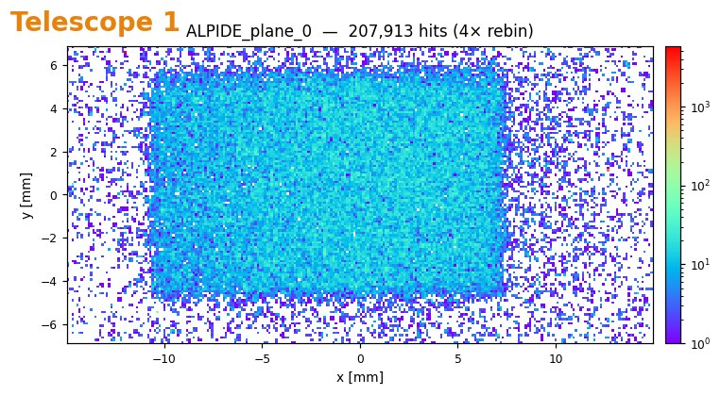
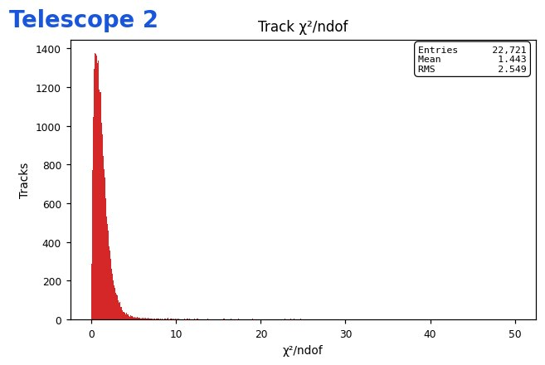
Tracking at Test-Beam
Beam track information propagated to the aerogel mid-point
Front and back traking for
- multi-track events
- multiple-scattering study
- beam divergence study
M. Contalbrigo
dRICH Meeting, July 8th, 2026
5

Slide 6
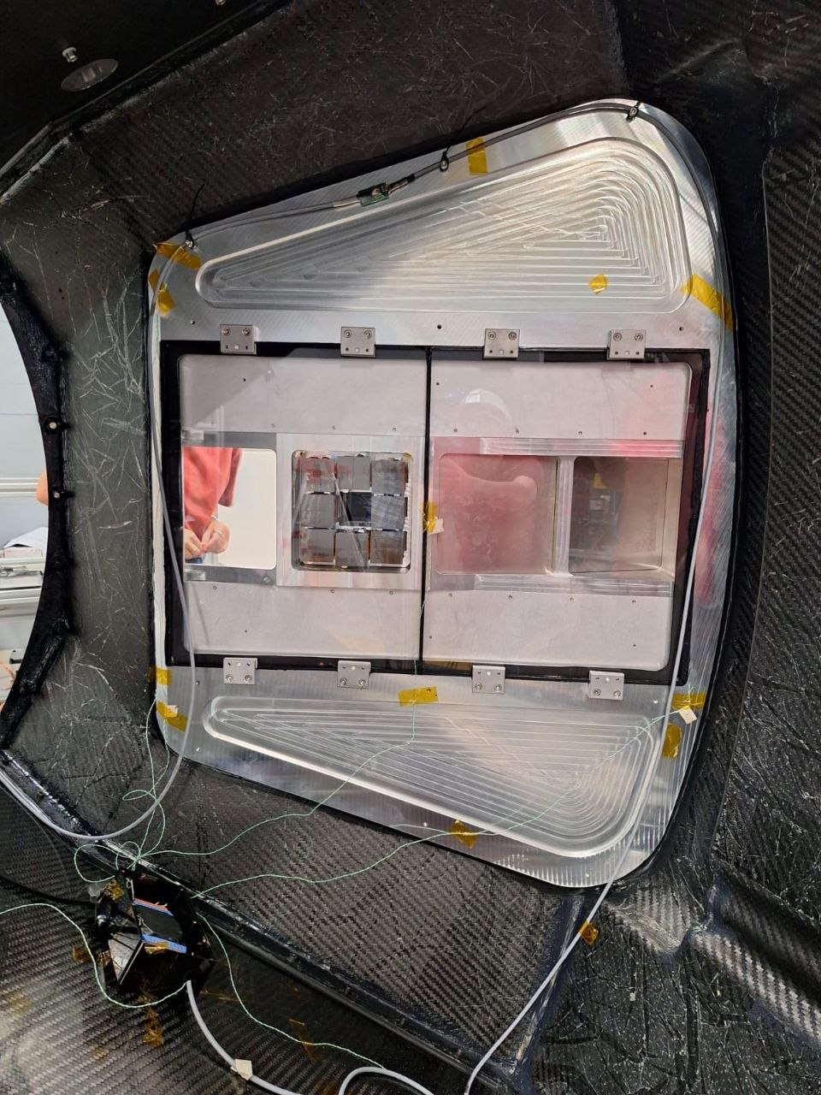
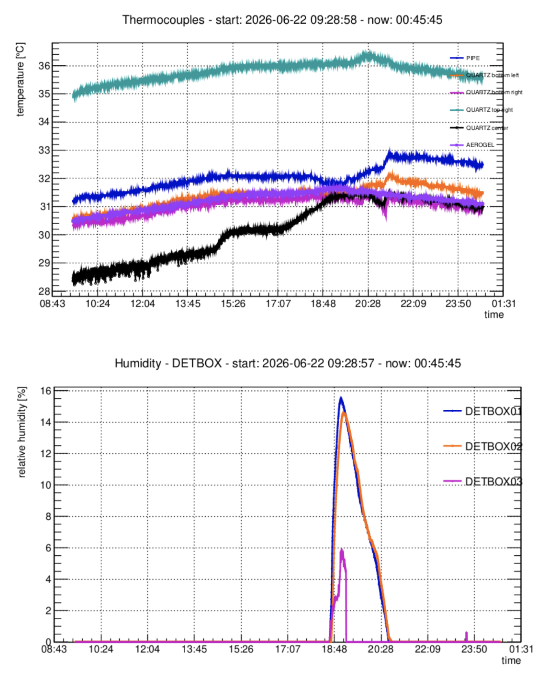
Slow Control at Test-Beam
Monitor of temperature gradients,
gas contaminants (H₂O, CO₂) and
gas stratification / mixing
CO₂
Open
T
T
H/T
H/T
H/T
T
T
T
T
H/T
M. Contalbrigo
dRICH Meeting, July 8th, 2026
6

Slide 7
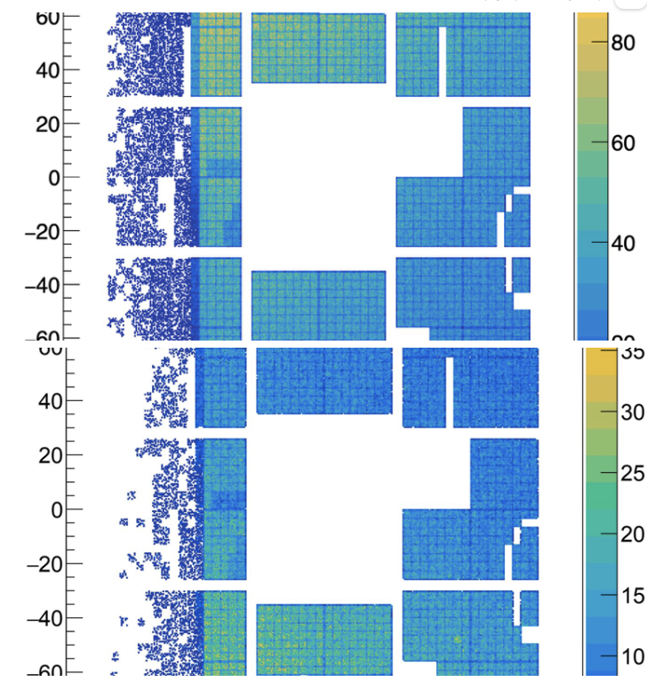
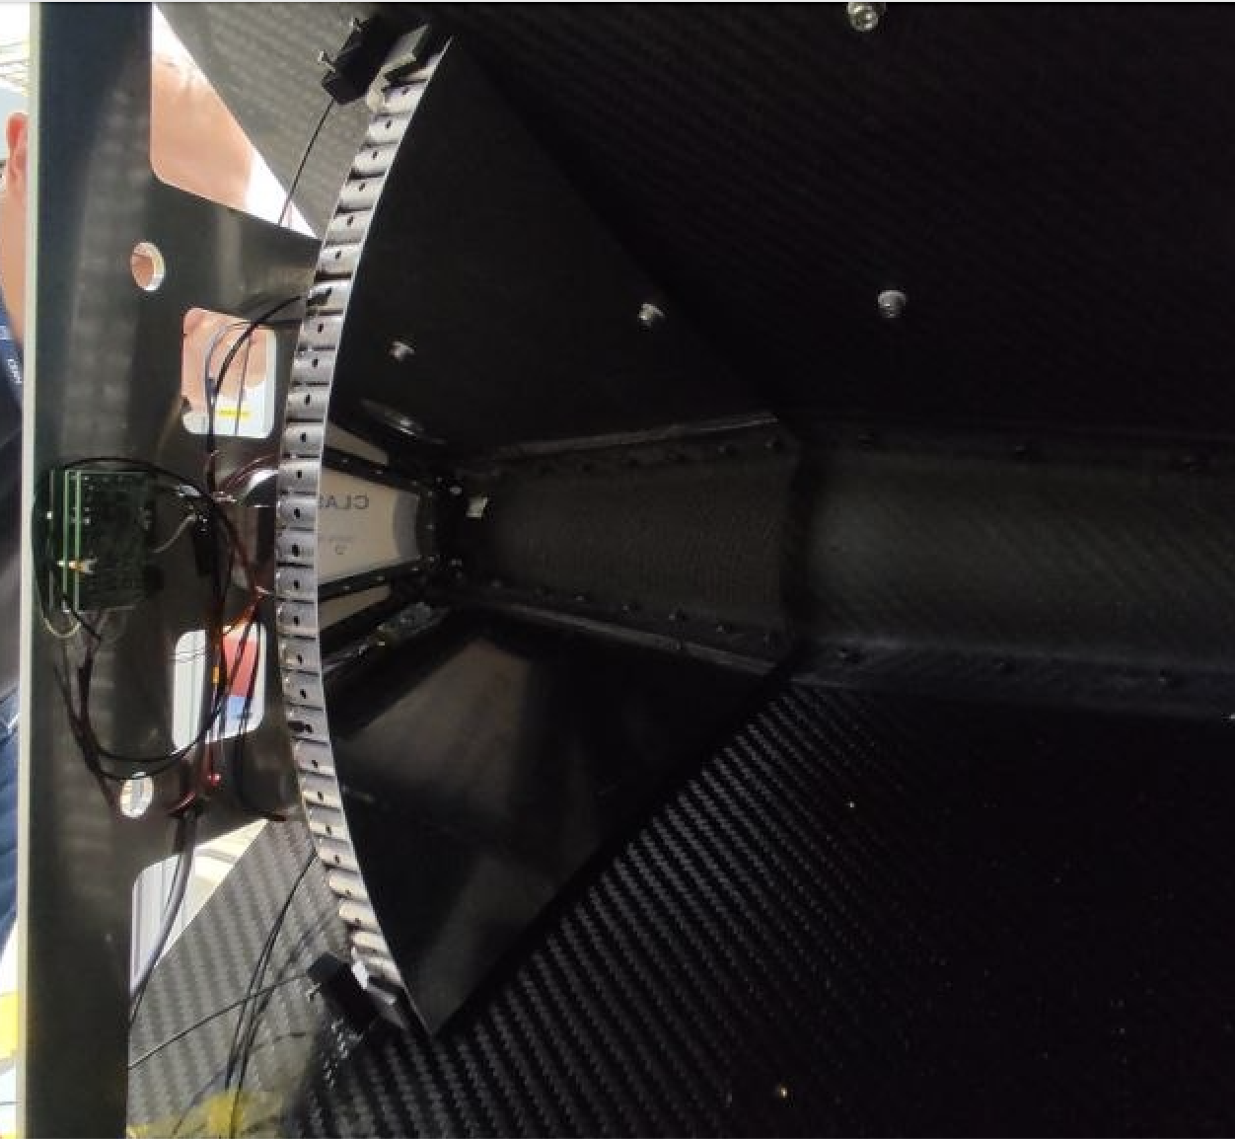
Calibration at Test-Beam
Done several runs with different bias overvoltage and thresholds.
Single (leading) time vs time-over-threshold readout.
Tested a prototype of fiber distributor for a pico-second pulsed laser
to accomplish an online time calibration.
M. Contalbrigo
dRICH Meeting, July 8th, 2026
7

Slide 8
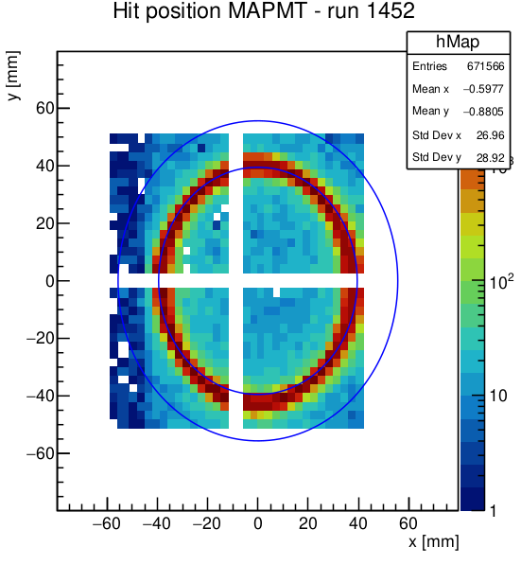
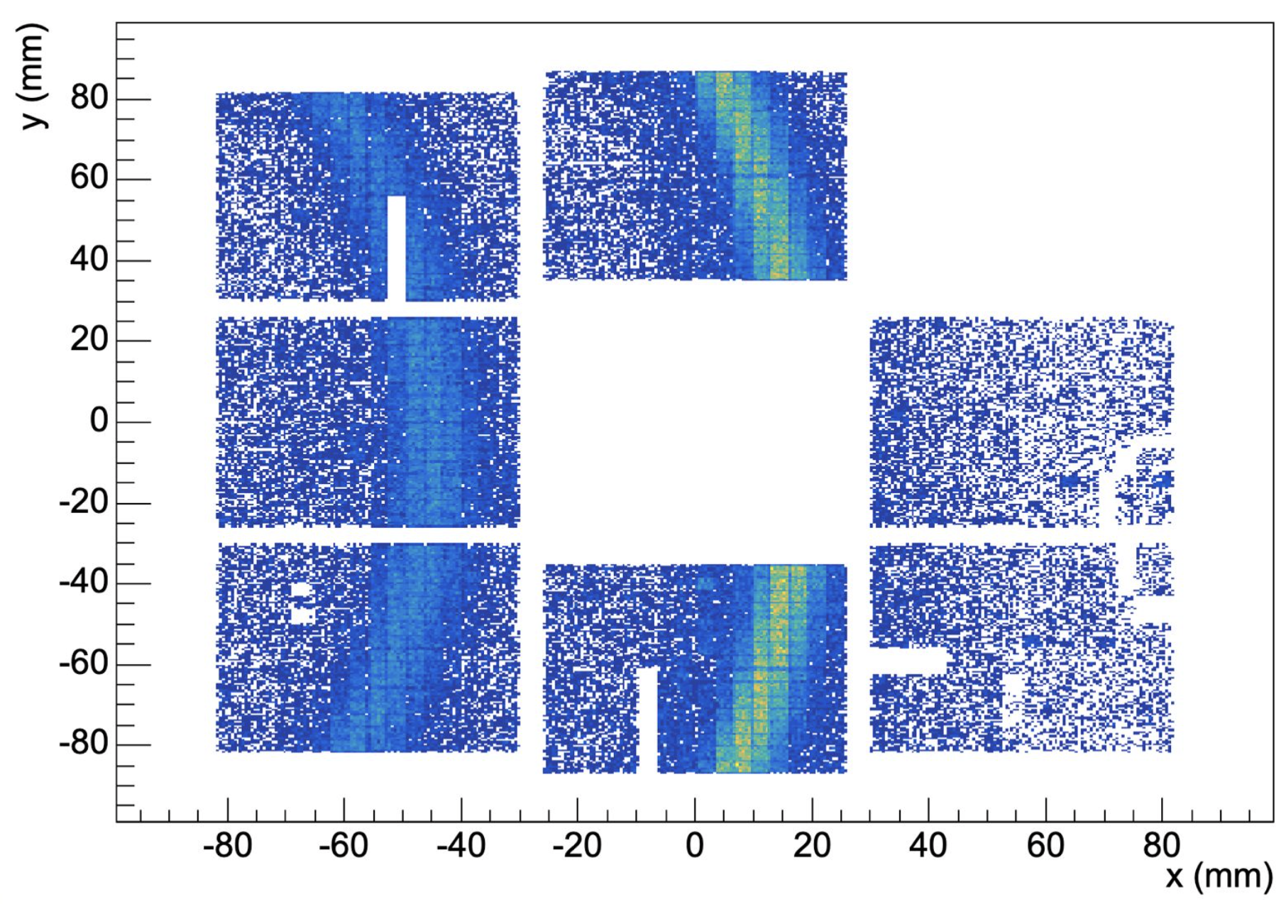
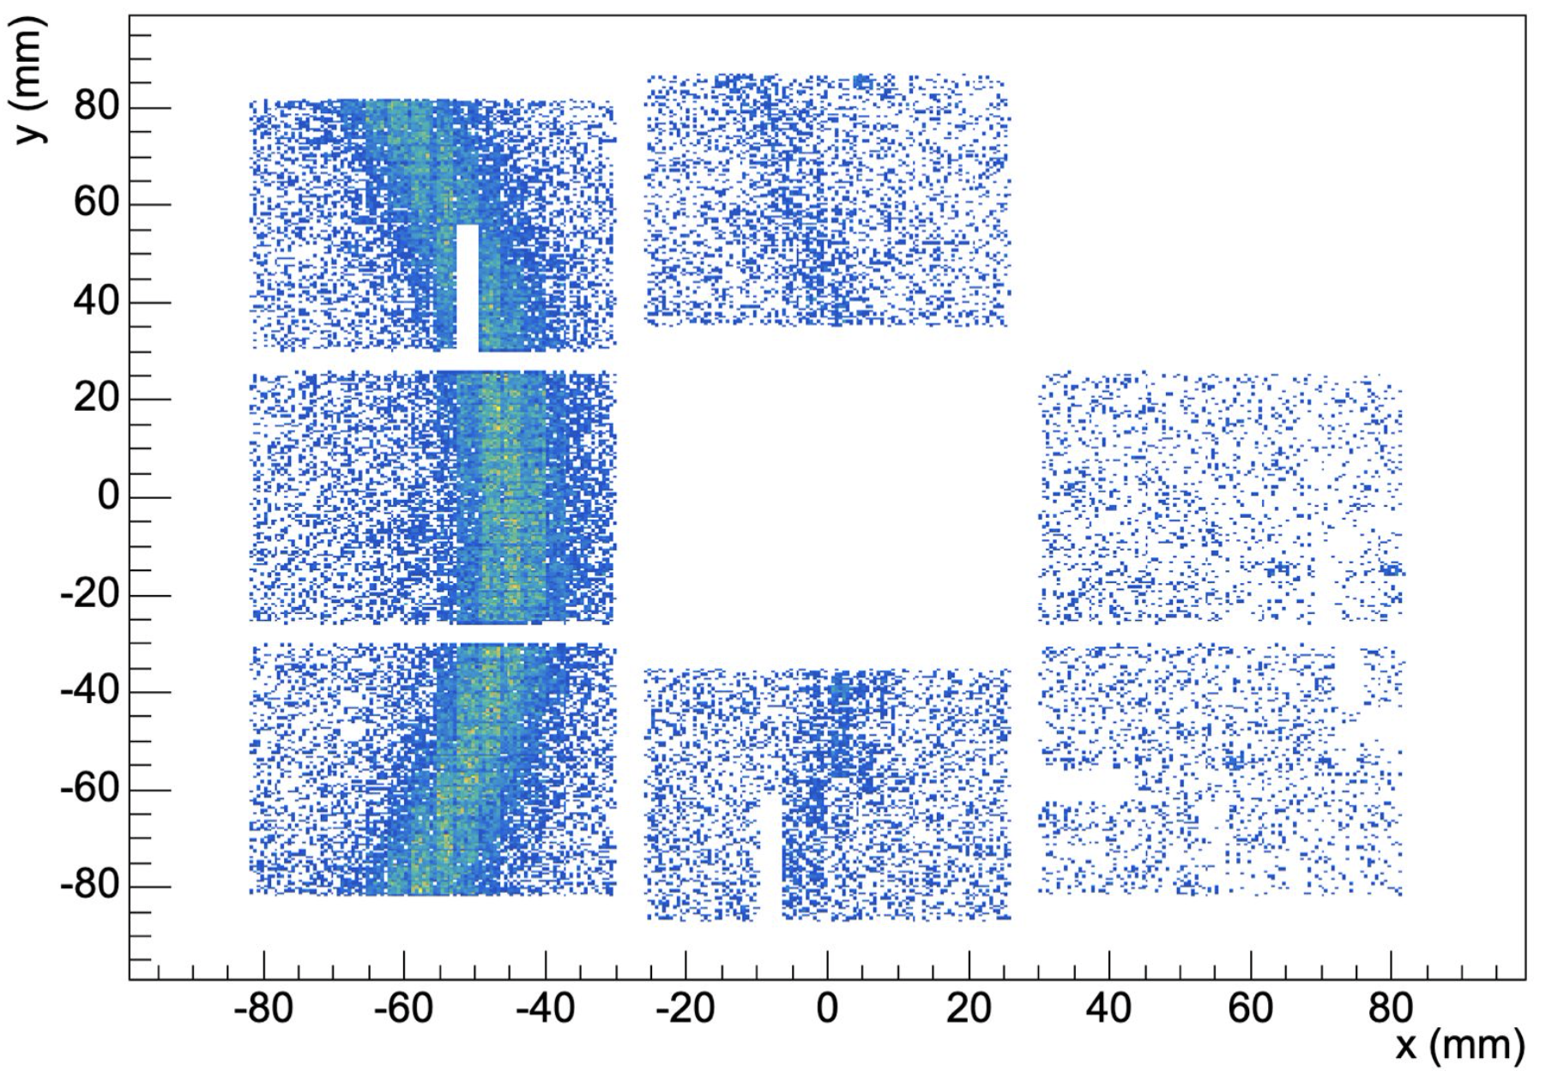
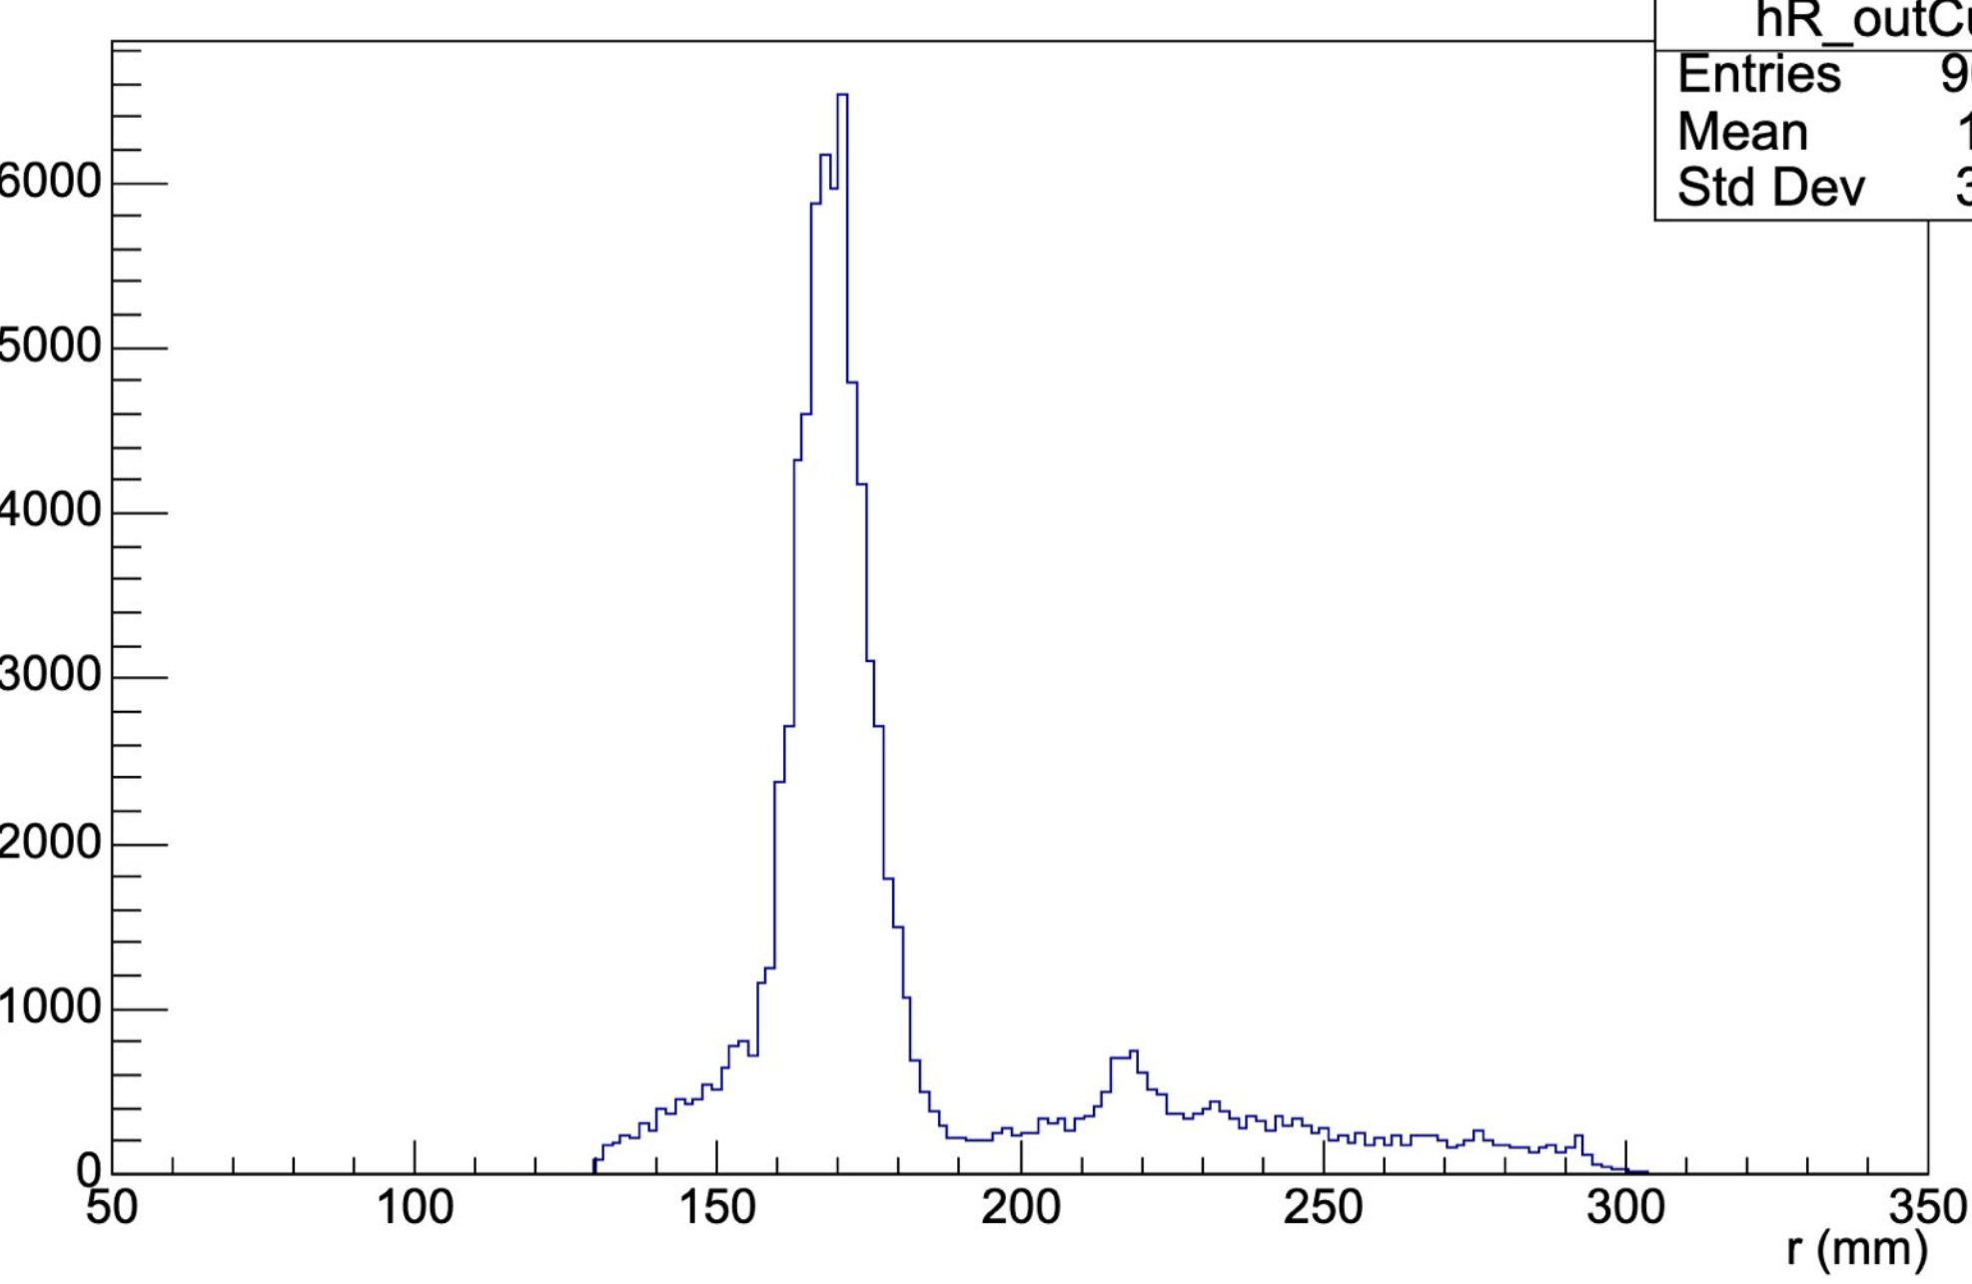
Highlights at Test-Beam
Highlight SPS: performance (MaPMTs) in the ball-park of ePIC simulations
Highlight PS: 2% kaons ID on aerogel after tagging pions/electrons with gas
PRELIMINARY
Beam | N. photoelectrons | Singl-photon resolution | Track resolution
180 GeV/c proton | 20 | 1.3 | 0.45
ePIC | 18 | 1.2 | 0.3
PRELIMINARY
Before tagging
After tagging
Projection
M. Contalbrigo
dRICH Meeting, July 8th, 2026
8

Slide 9
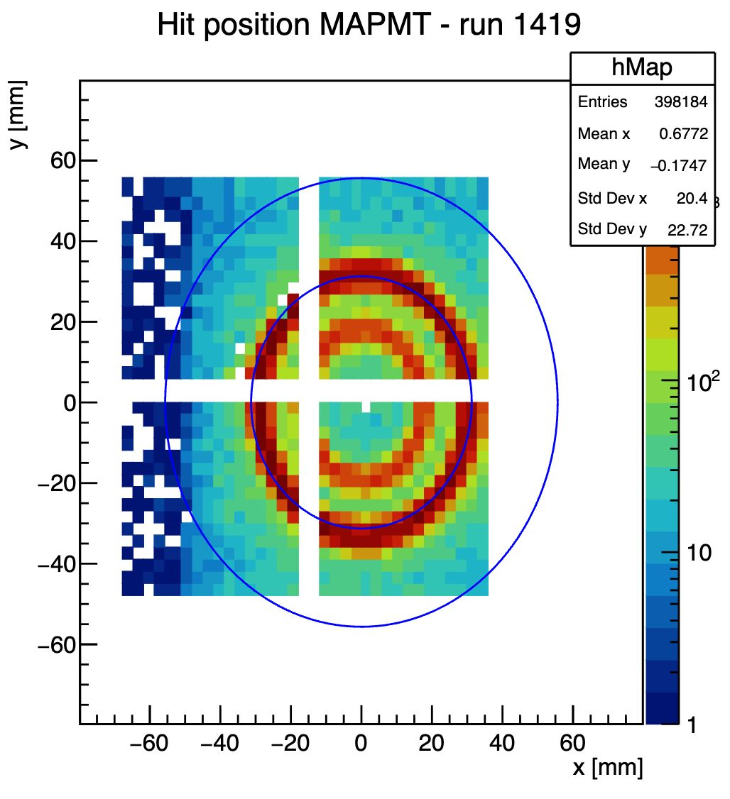
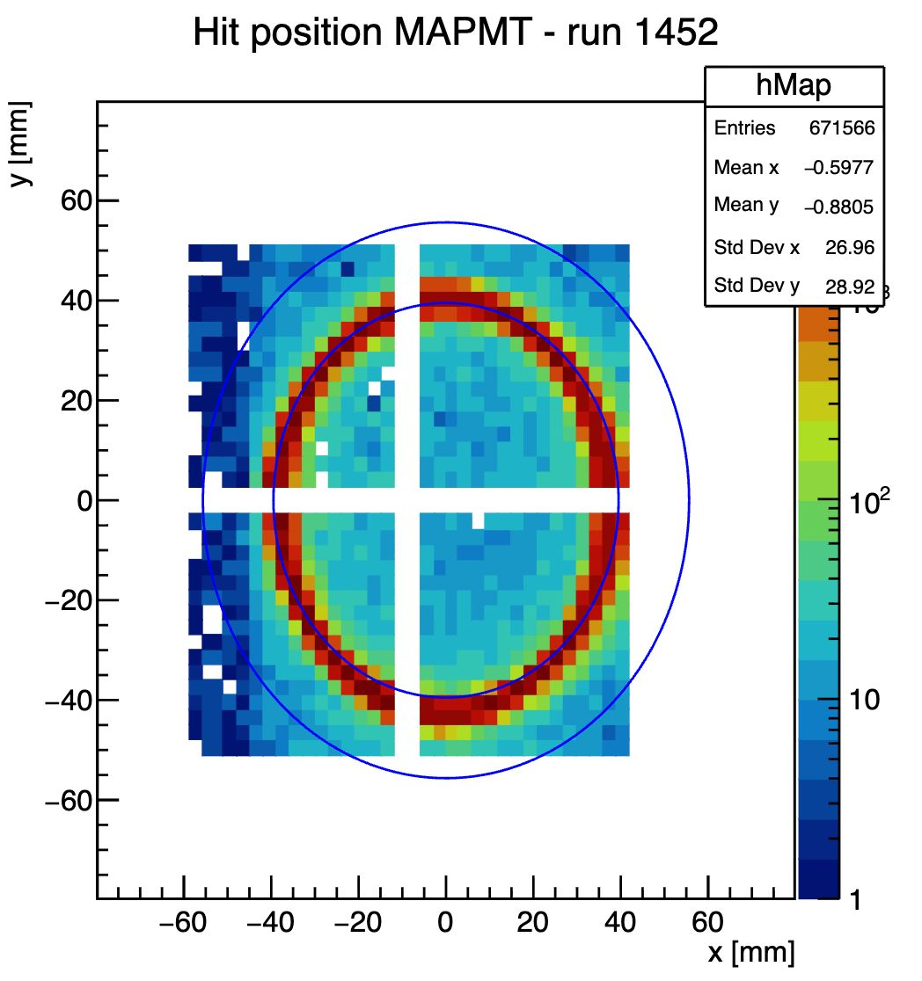
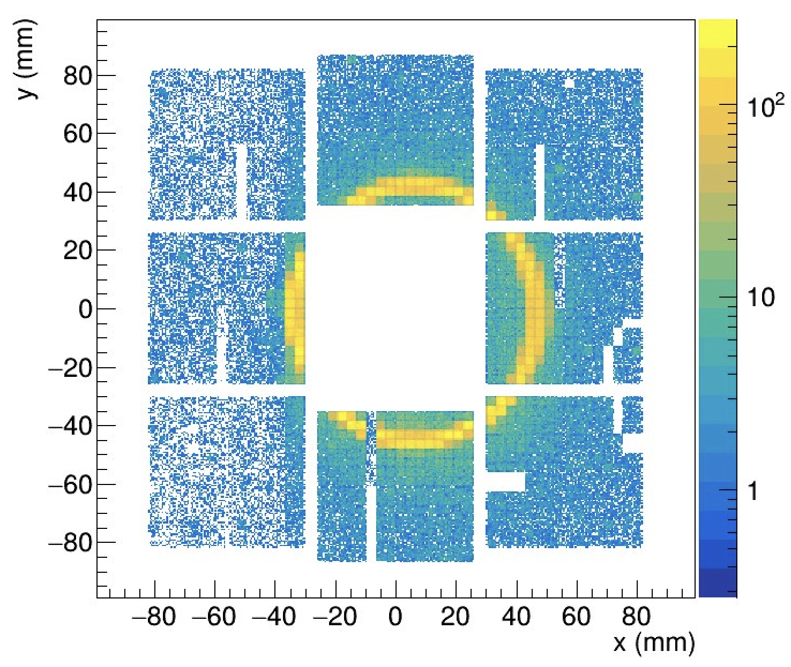
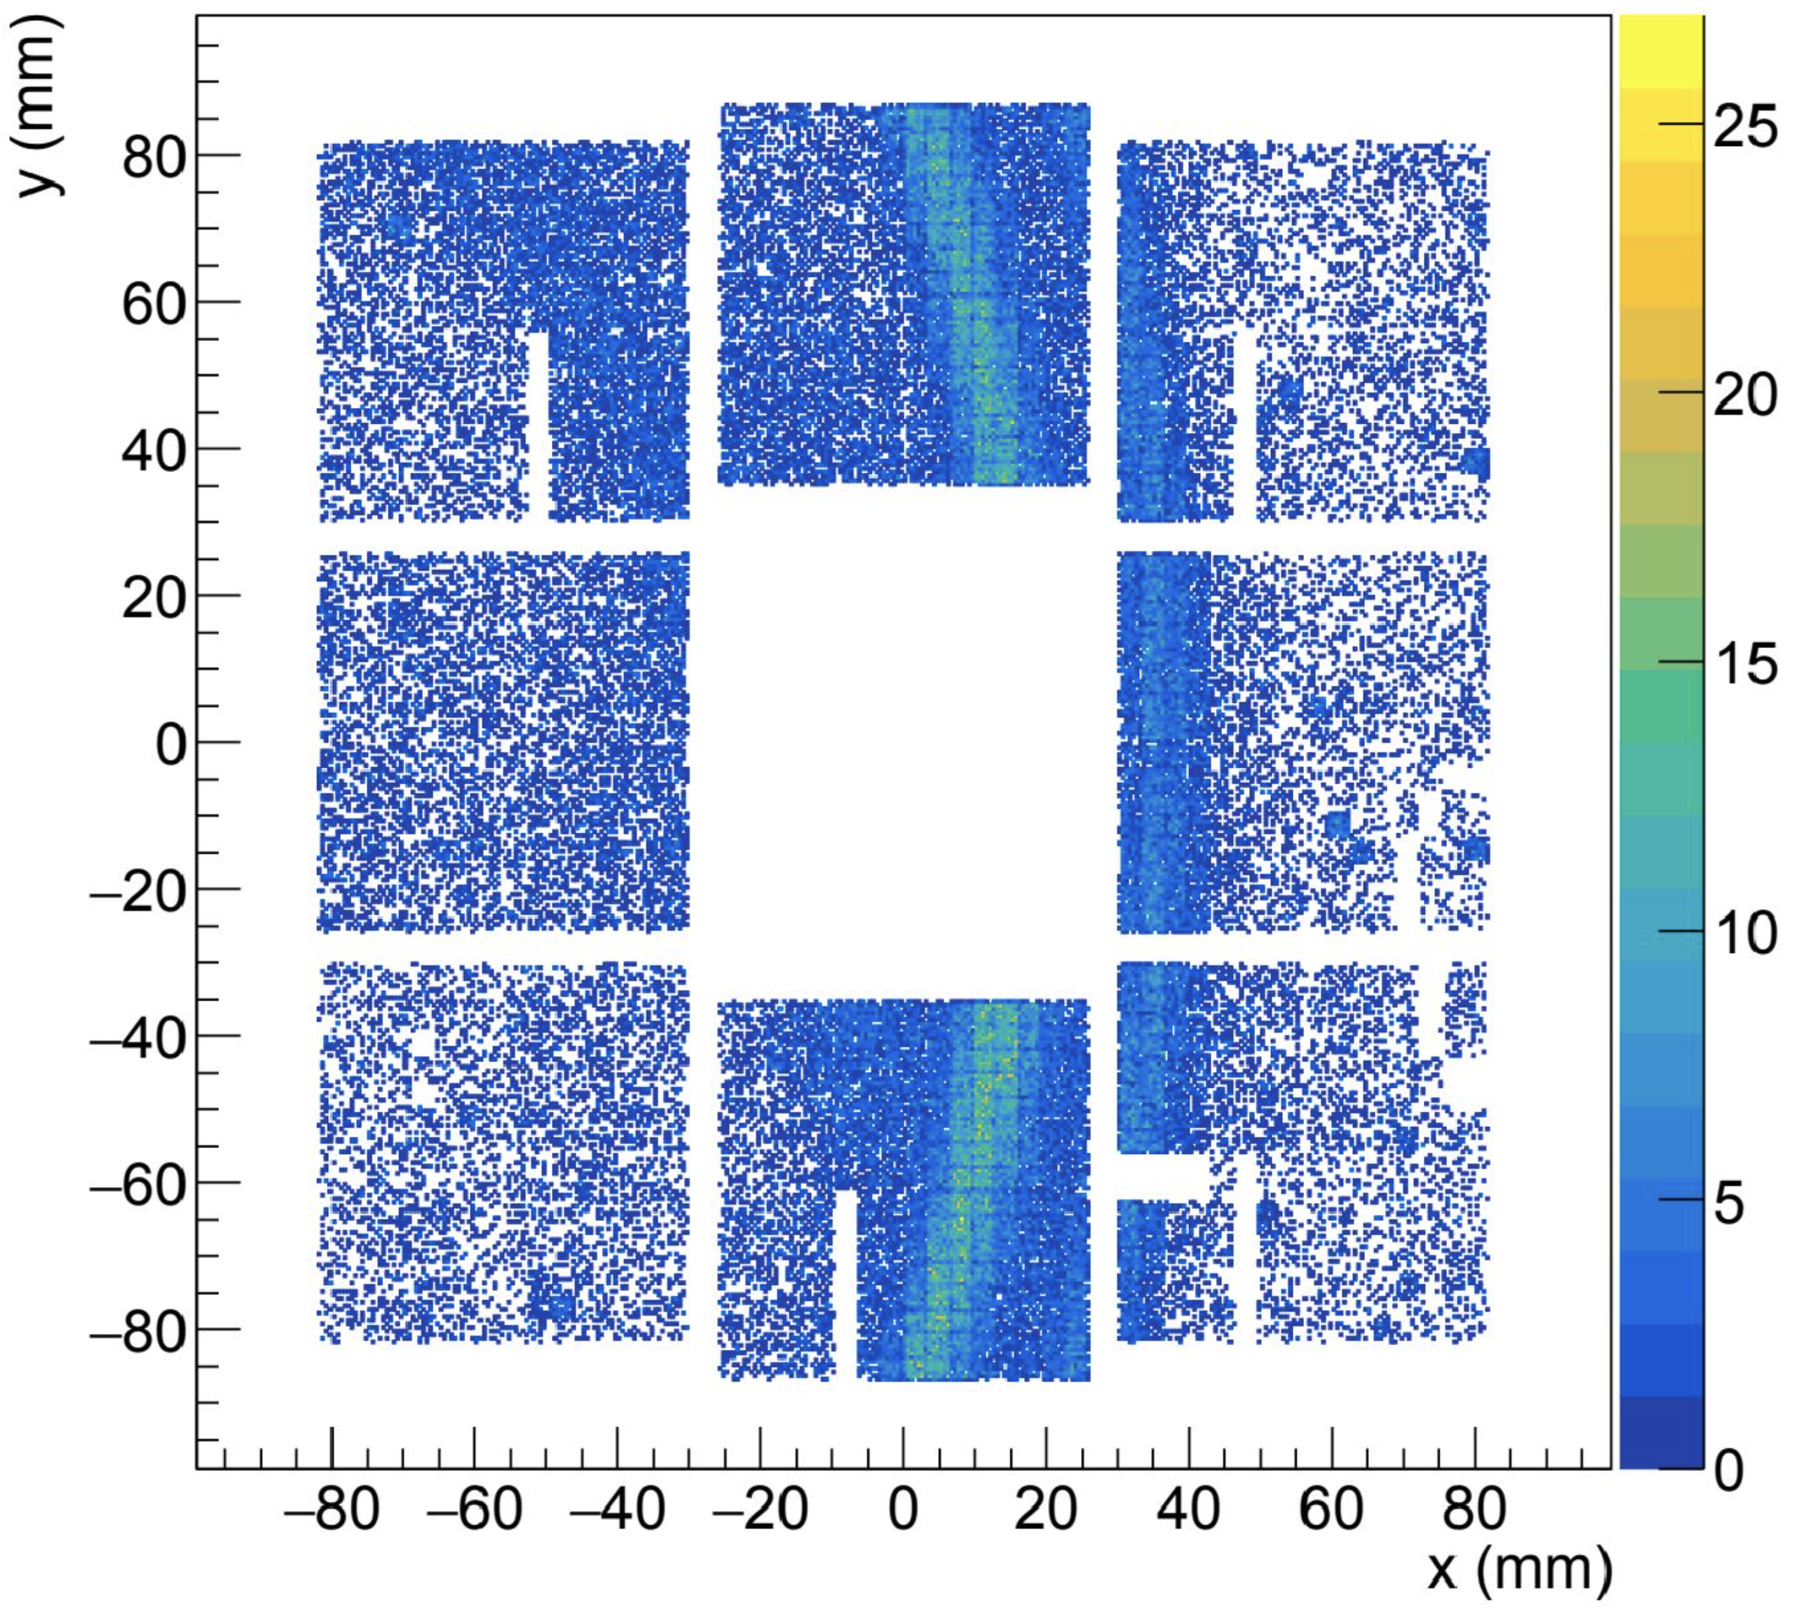
Conclusions
Vibrant community engaged in realizing and running an almost complete experiment mimicking ePIC
Successful test-beam collecting all the ongoing developments
CO₂ at 40 GeV/c
C₂F₆ at 180 GeV/c
C₂F₆ at 180 GeV/c
Aerogel at 10 GeV/c
M. Contalbrigo
dRICH Meeting, July 8th, 2026
9

