Slide 1
JLab12 (R.L.: Marco Contalbrigo)
Nucleon structure and spin physics
Transverse momentum phenomena (TMDs) & 3D imaging
GPDs & EM Form Factors of the nucleon
M. Contalbrigo PI of the CLAS12 RICH detector
M. Contalbrigo contact person for RGH group of experiment
with transversely polarized target
INFN-FE: RICH detector for particle–identification
Transversely polarized target
L. L. Pappalardo - C.d.S. INFN Ferrara – 04/07/2025

Slide 2
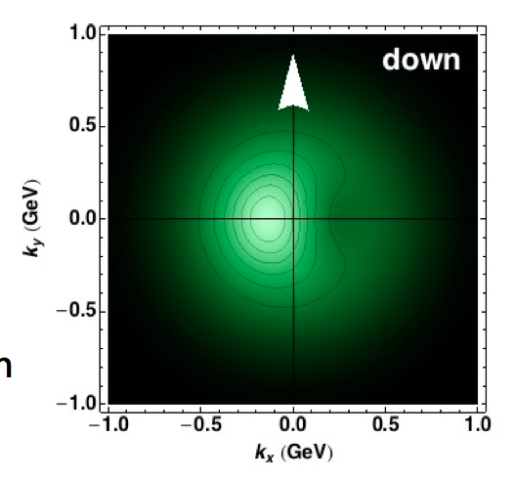
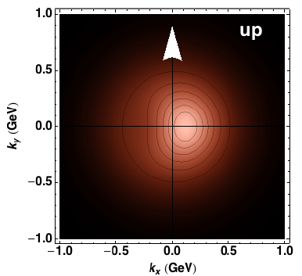
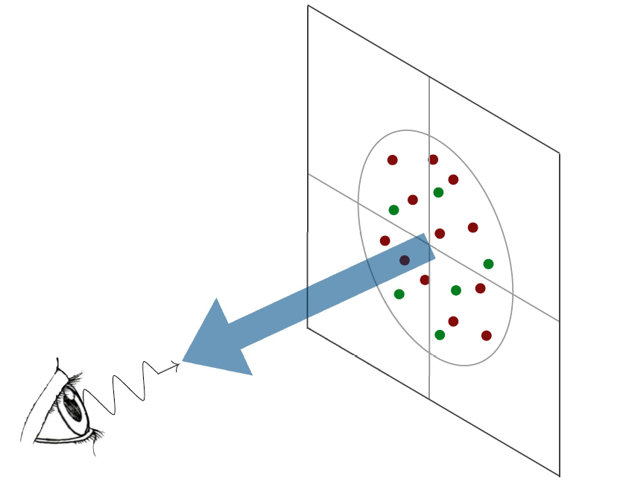
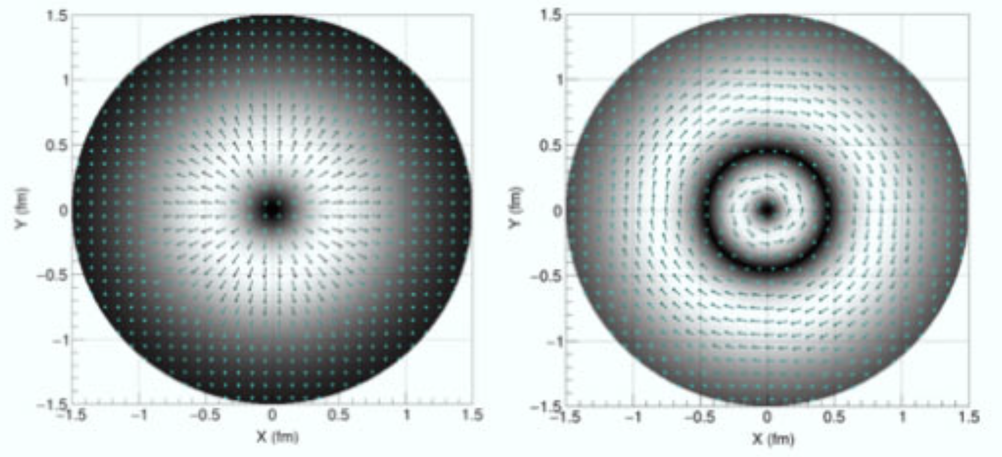
3D Nucleon Structure
Access to the strong-force dynamics
at the scale of confinement
PDF (x, k_{T})
Confinement Scale
Transverse momentum
GPD (x, b_{T})
k_{T}
b_{T}
Transverse position
Longitudinal momentum
k⁺=xP⁺
Spin
l
High Energy Probe
Hard Scale
Photon Virtuality
Q²
Transverse plane
l
Credit: A. Bacchetta
L. L. Pappalardo - C.d.S. INFN Ferrara – 04/07/2025

Slide 3
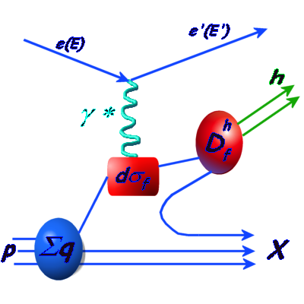
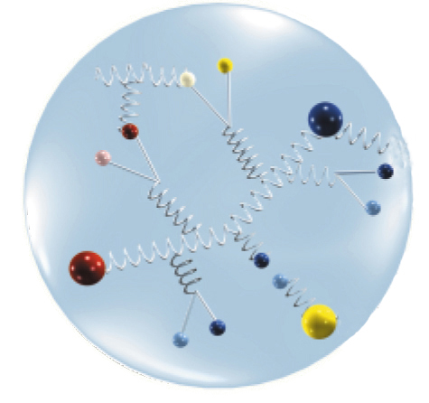
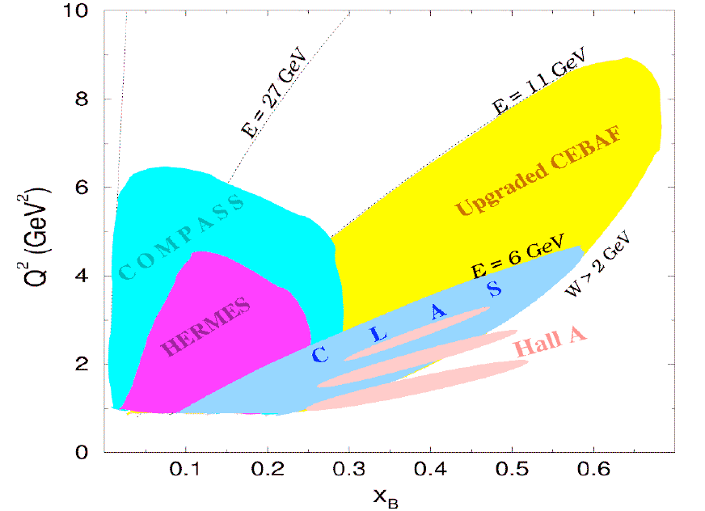
CLAS12 Experiment in Hall-B
TMDs depend on $x$ and $p_{T}$
Describe correlations between $p_{T}$ and quark or nucleon spin (spin-orbit correlations)
Provide a 3-dim picture of the nucleon in momentum space (nucleon tomography)
FF
L. L. Pappalardo - C.d.S. INFN Ferrara – 04/07/2025

Slide 4
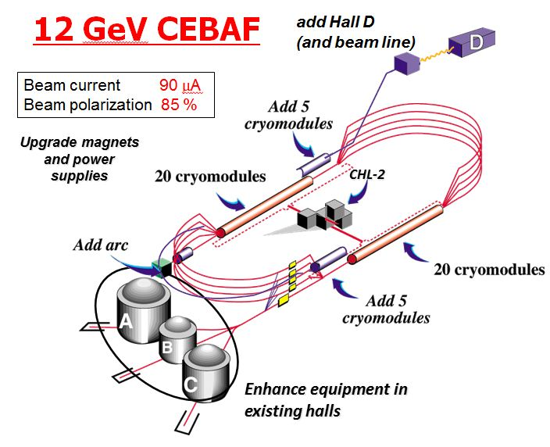
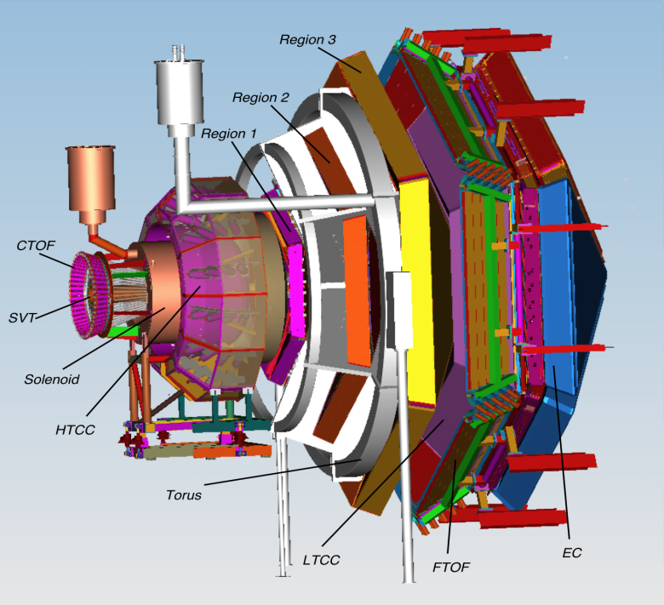
CLAS12 Experiment in Hall-B
CLAS12 detector
Lumi up to ${10}^{35} {cm}^{−2}s^{−1}$
High polarized electron beams
H and D polarized target
Broad kinematic range
Very good PID
Physics program:
Hadron spectroscopy
Nuclear effects in hadronization
Nucleon structure (TMDs, GPDs)
L. L. Pappalardo - C.d.S. INFN Ferrara – 04/07/2025

Slide 5
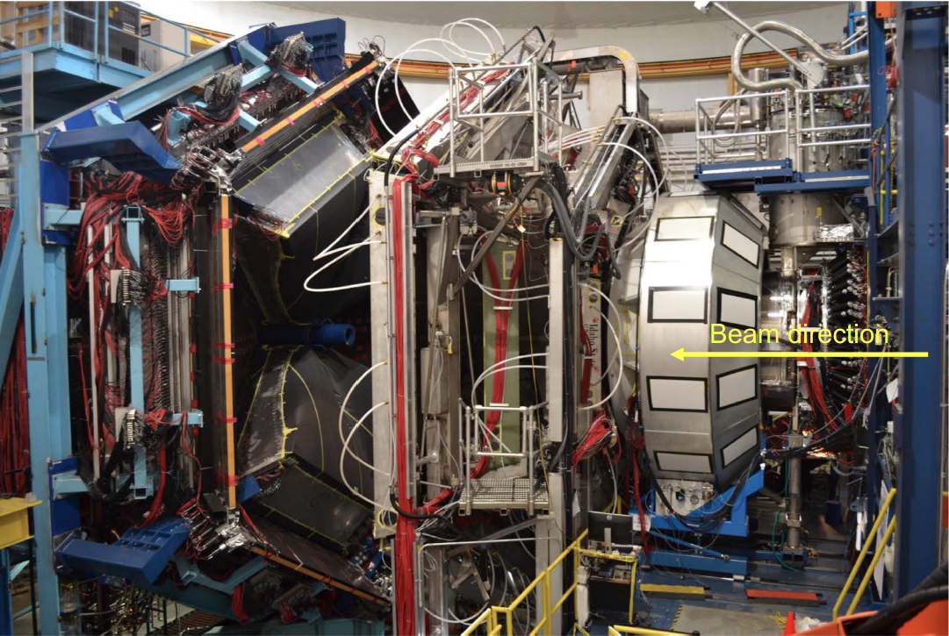
CLAS12 and INFN-FE
RICH
Target / Recoil
10 m
Luminosity up to 10³⁵ cm⁻² s⁻¹
Highly polarized electron beam
Polarized targets
Broad kinematic range coverage
(current to target fragmentation)
Available or well-known technology
No specific R&D required
L. L. Pappalardo - C.d.S. INFN Ferrara – 04/07/2025

Slide 6
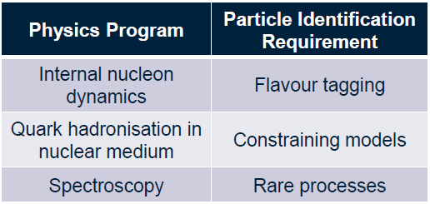
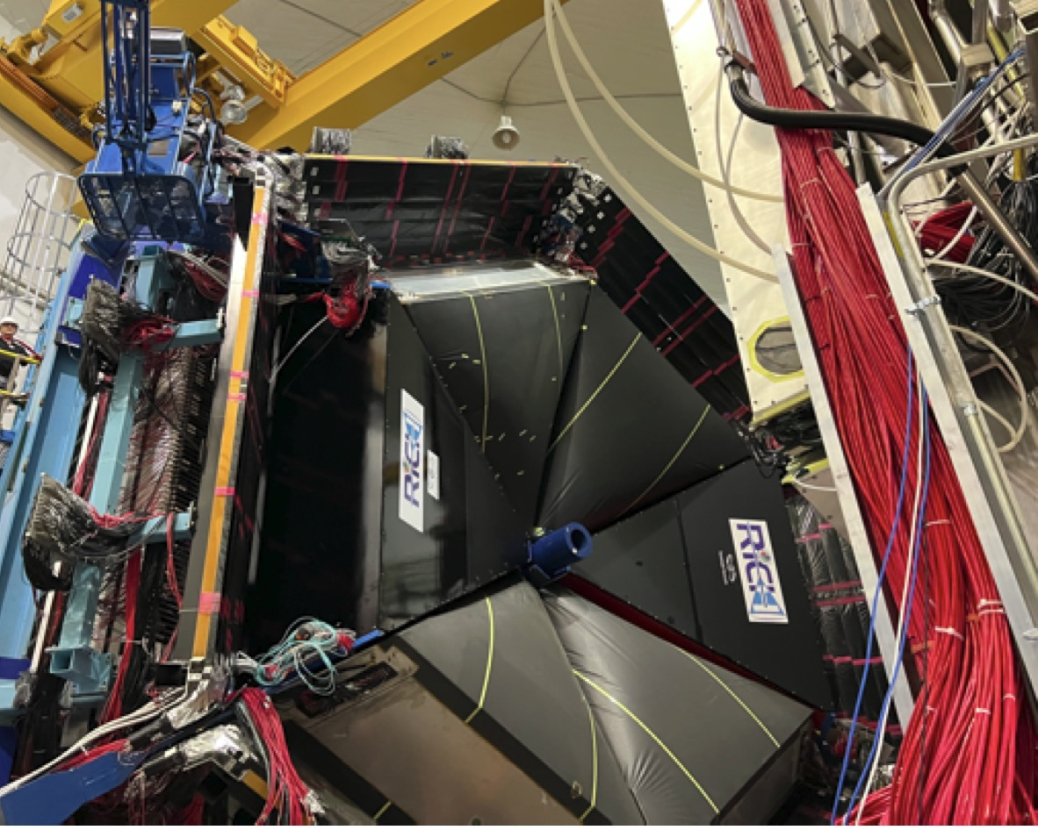
The RICH detector project (INFN)
Goal:
Completed with 2nd module in June 2022
Ognoing: data-taking & calibration
alignment finalization of 2nd module
INSTITUTIONS
INFN (Italy) Bari, Ferrara, Genova, L.Frascati, Roma/ISS
Jefferson Lab (Newport News, USA)
Argonne National Lab (Argonne, USA)
Duquesne University (Pittsburgh, USA)
George Washington University (USA)
Glasgow University (Glasgow, UK)
J. Gutenberg Universitat Mainz (Mainz, Germany)
Kyungpook National University, (Daegu, Korea)
University of Connecticut (Storrs, USA)
UTFSM (Valparaiso, Chile)
L. L. Pappalardo - C.d.S. INFN Ferrara – 04/07/2025

Slide 7
The RICH Front-End electronics
Compact and modular electronics to readout multi-anode PMTs
FPGA Board (JLab)
ASIC Board (Ferrara)
Adopted by other experiments:
Gluex, SOLID, EIC R&D, RGH Recoil, …
Adapted to different sensors:
Multi-anode PMT H12700, H13700
SiPM array S12642, H13361
Developed thanks to Roberto M., L. Barion
L. L. Pappalardo - C.d.S. INFN Ferrara – 04/07/2025

Slide 8
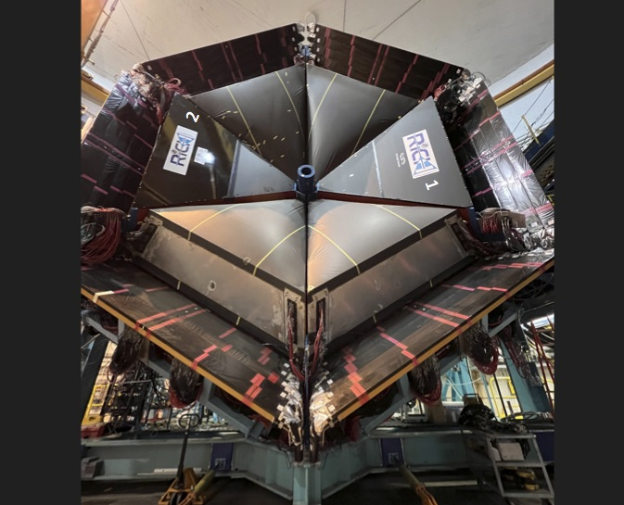
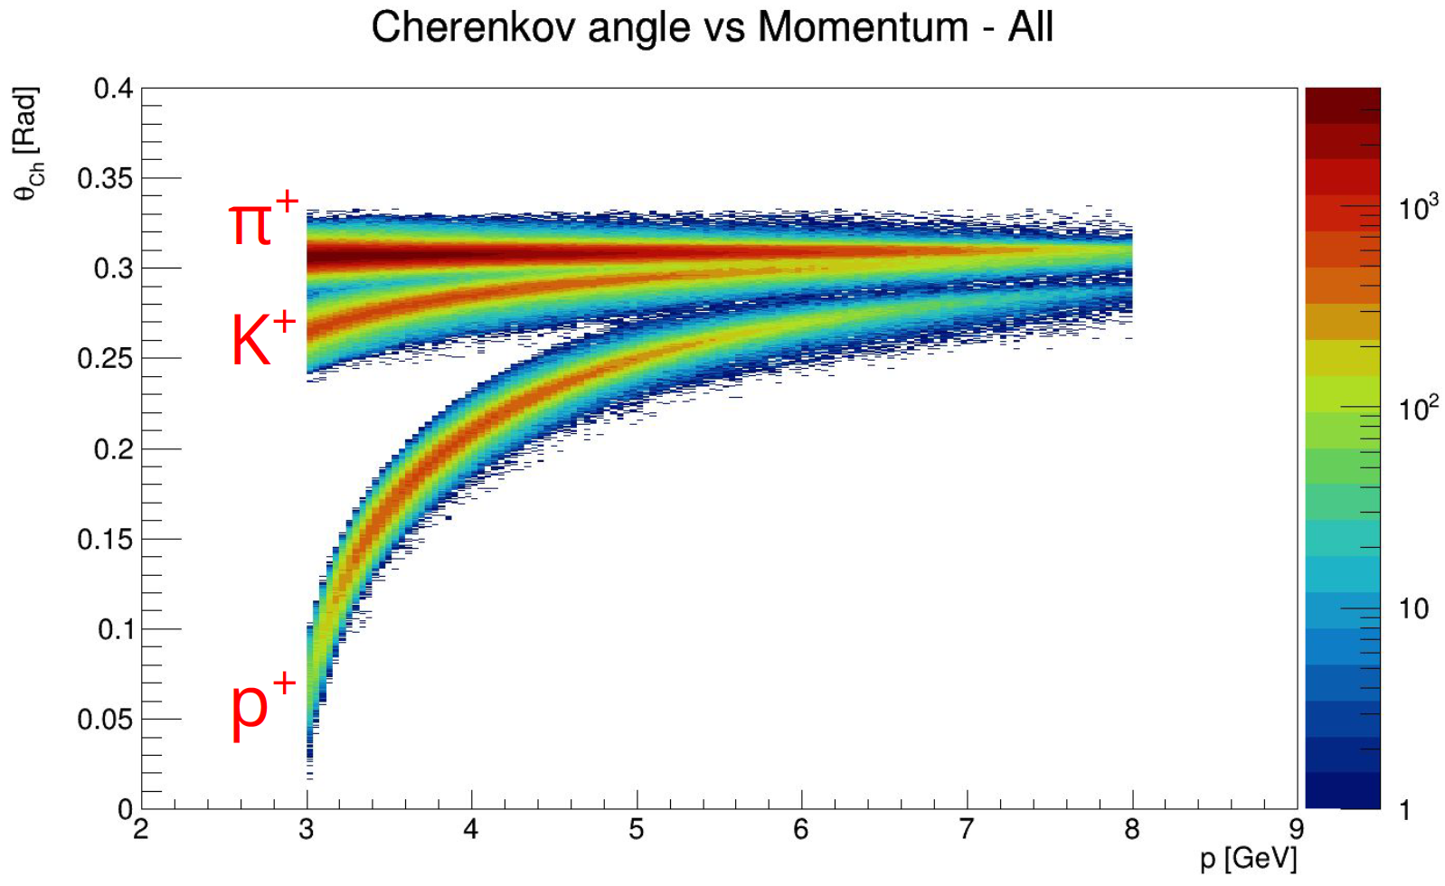
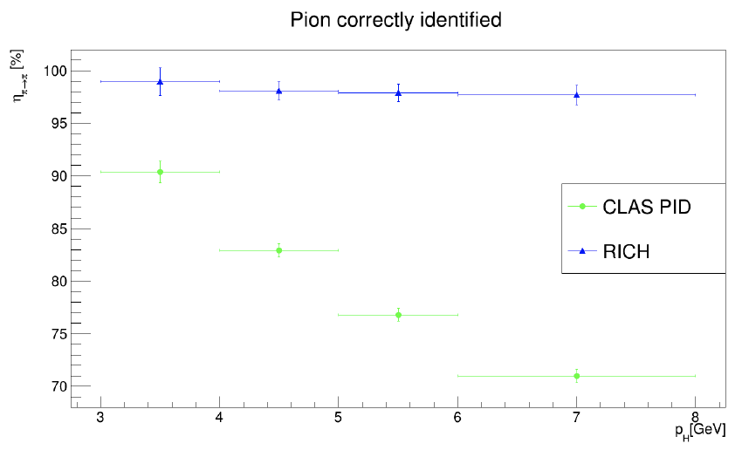
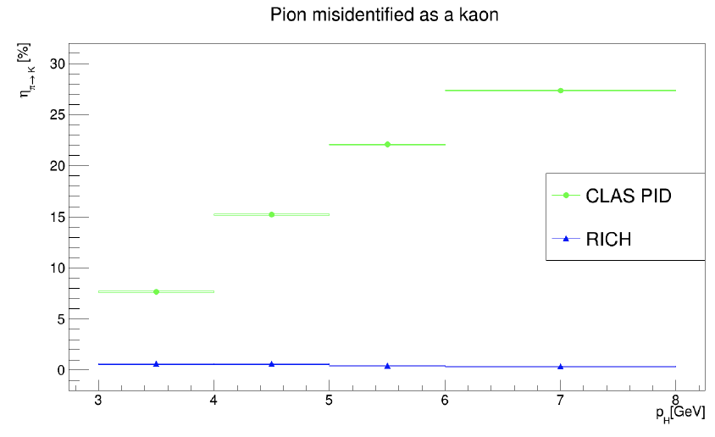
The RICH Reconstruction
Ognoing: data taking & calibration
alignment finalization of 2nd module
L. L. Pappalardo - C.d.S. INFN Ferrara – 04/07/2025

Slide 9
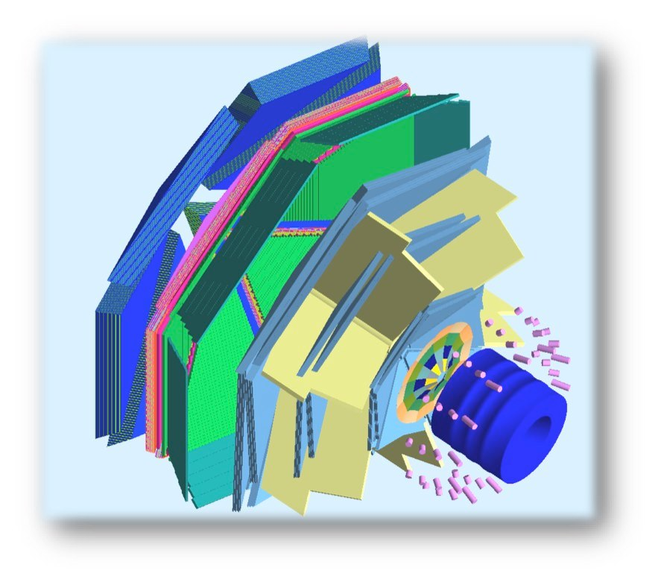
The Transverse target
Internal Target
To maintain transverse spin polarization
within the CLAS12 solenoid and preserve wide acceptance for the final-state particles, new magnetic solutions are required.
Tracking solenoid
design up to 5 T longitudinal
4K L-He cryostat
length 1500 mm
target
Transverse Target:
high polarization
d 25 mm – Length 10 mm
transverse field up to 2 T
superconducting
solenoid
polarized
e⁻ beam
superconducting
torus
L. L. Pappalardo - C.d.S. INFN Ferrara – 04/07/2025

Slide 10
Transverse Target: Bulk Transverse Magnet
Alternative to the use of a massive 5 T magnet to increase acceptance (for recoil)
A hollow bulk superconductor is able to provide a transverse holding field inside, while adjusting its internal currents to shield any outside field, without the need of a current supply!
Spin-off: Polarized Fusion (Polfusion & PREFER)
magnetization
L. L. Pappalardo - C.d.S. INFN Ferrara – 04/07/2025

Slide 11
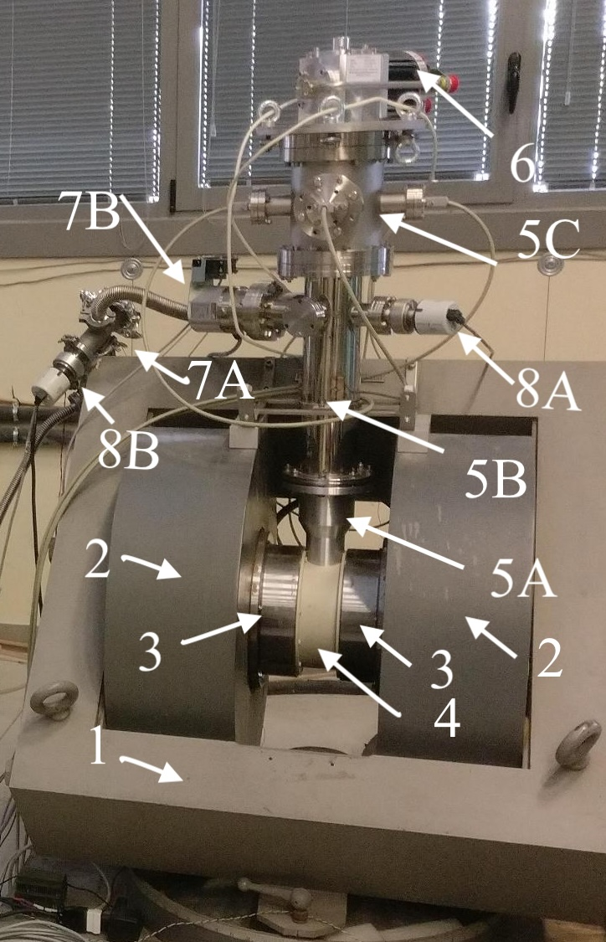
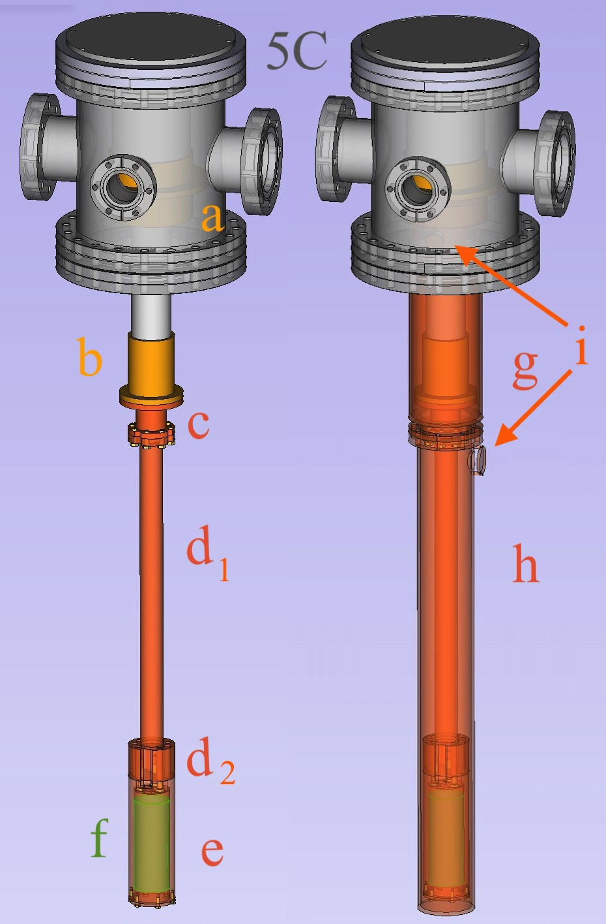
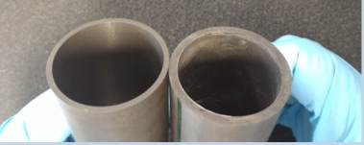
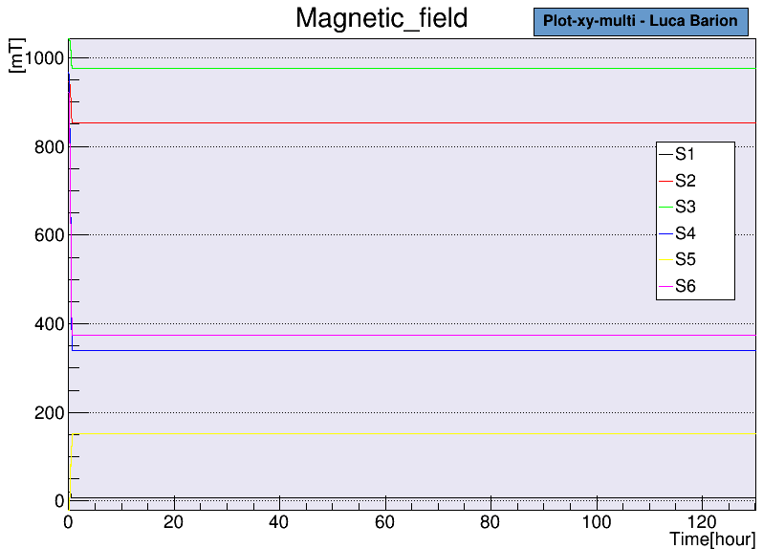
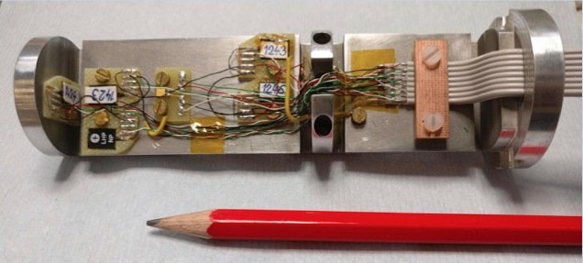
Transverse Target: The New Cryostat
New concept:
pre-conditioned bulk superconductor
- new cryostat
- new holder probe (6x)
- smart MgB2 sample exchange
Magnetization @ 1 T: Prof of principle
Developed thanks to L. Barion, M. Cavallina
L. L. Pappalardo - C.d.S. INFN Ferrara – 04/07/2025

Slide 12
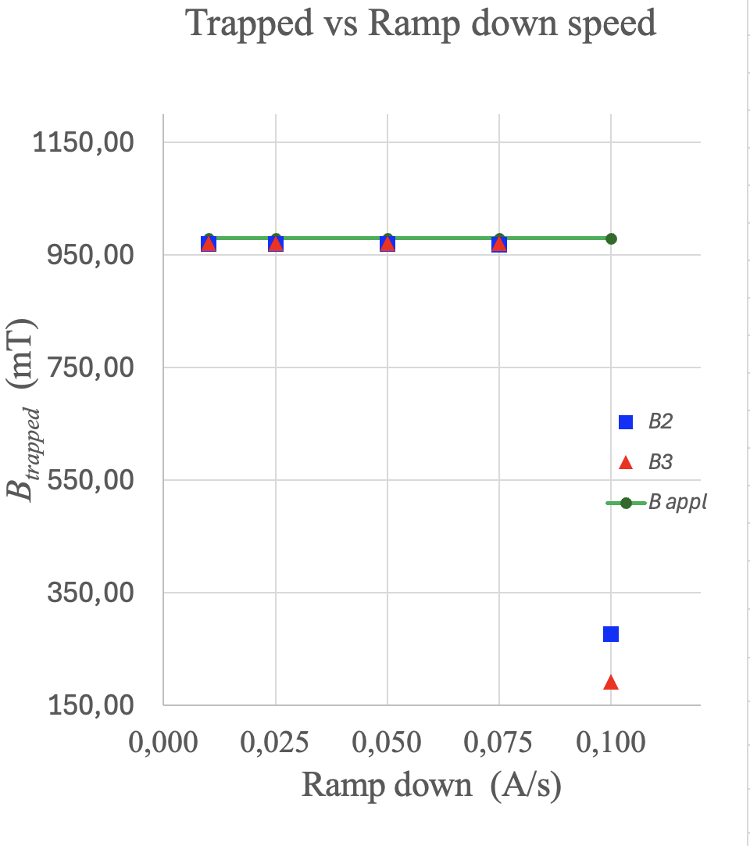
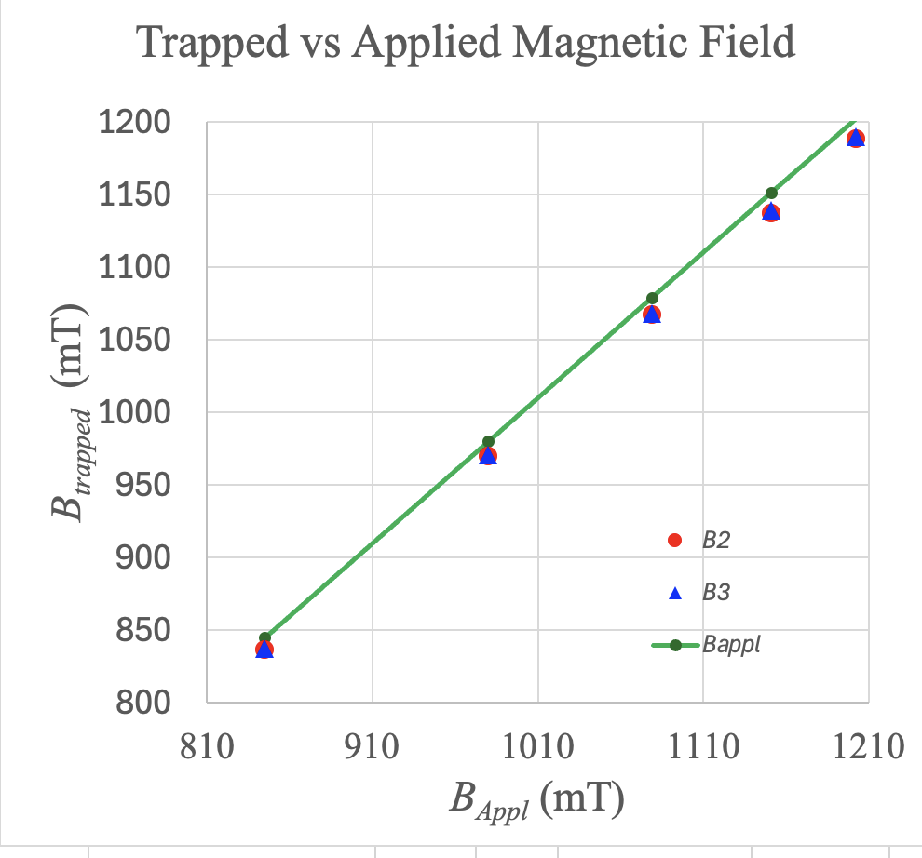
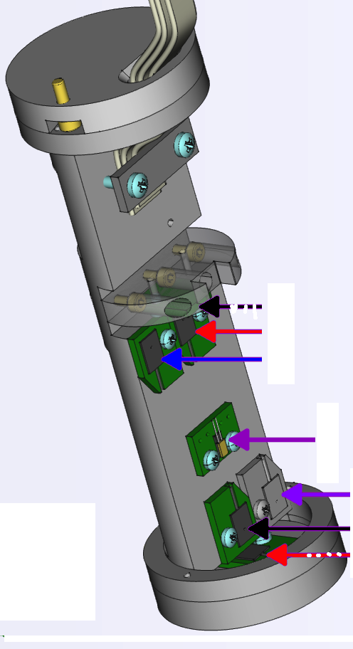
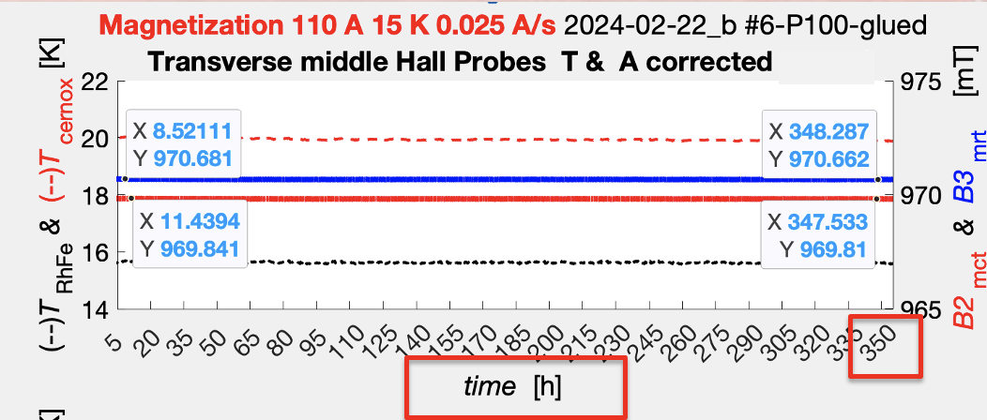
Transverse target: Systematic Studies
B₂
B₃
L. L. Pappalardo - C.d.S. INFN Ferrara – 04/07/2025

Slide 13
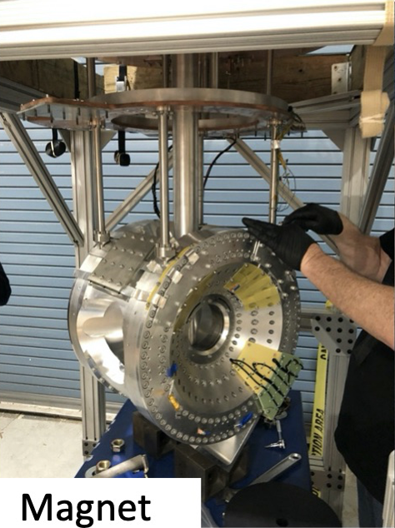
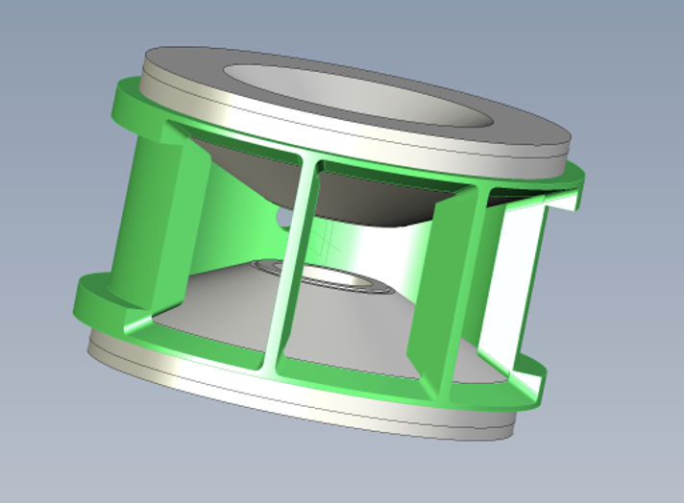
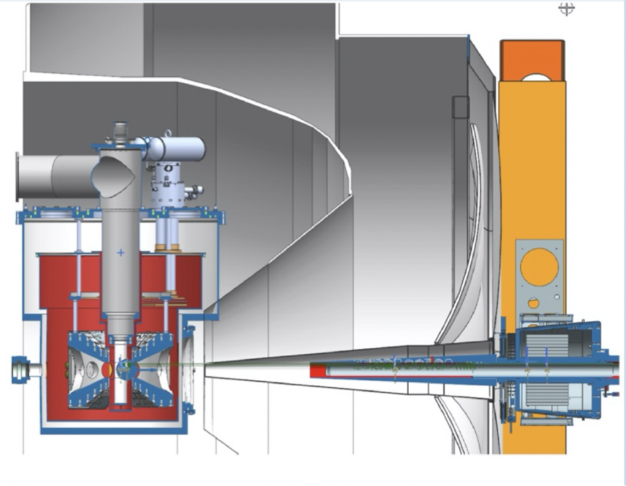
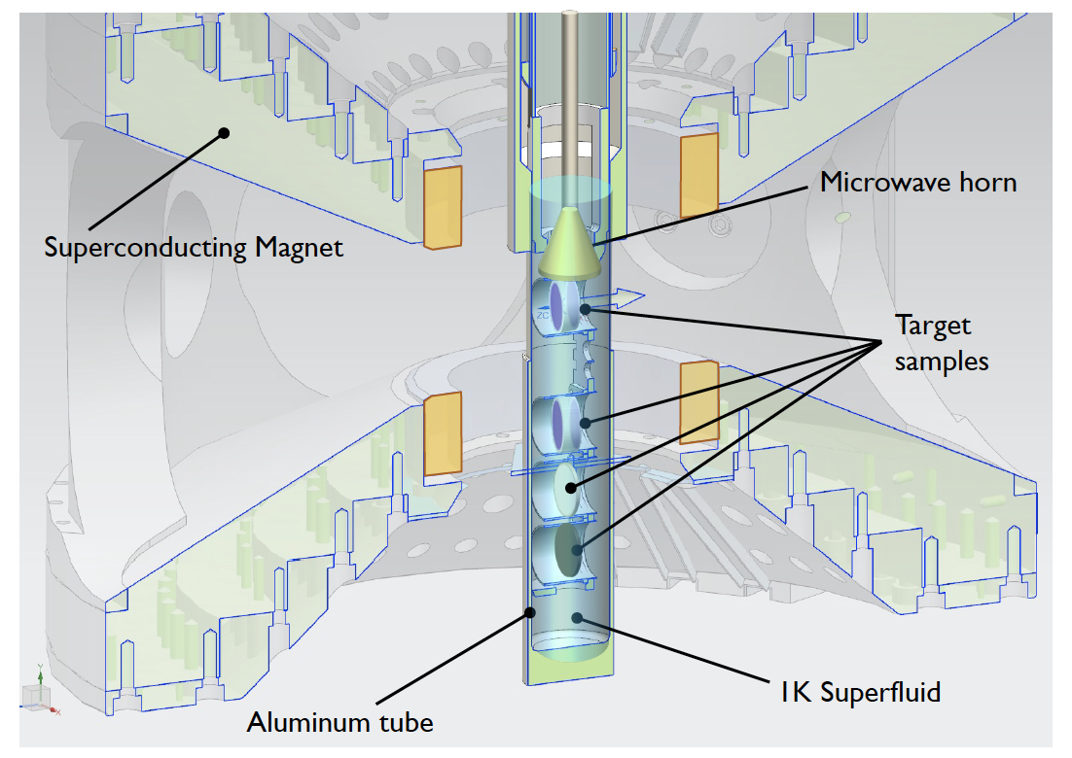
RGH Target
HDice (frozen-spin) has not meet RGH specifications
Most viable solution to prioritize physics vs R&D
Consolidated dynamically polarized NH₃ technology
Designed based on already successful realizations
Hall-A G2p-Gep target (copy optimized for HTCC )
Hall-C E12-15-005 magnet (copy optimized for recoil detection)
5T dipole
acceptance:
$± 25o$ horizontal
$$± 65o. horizontal$$
L. L. Pappalardo - C.d.S. INFN Ferrara – 04/07/2025

Slide 14
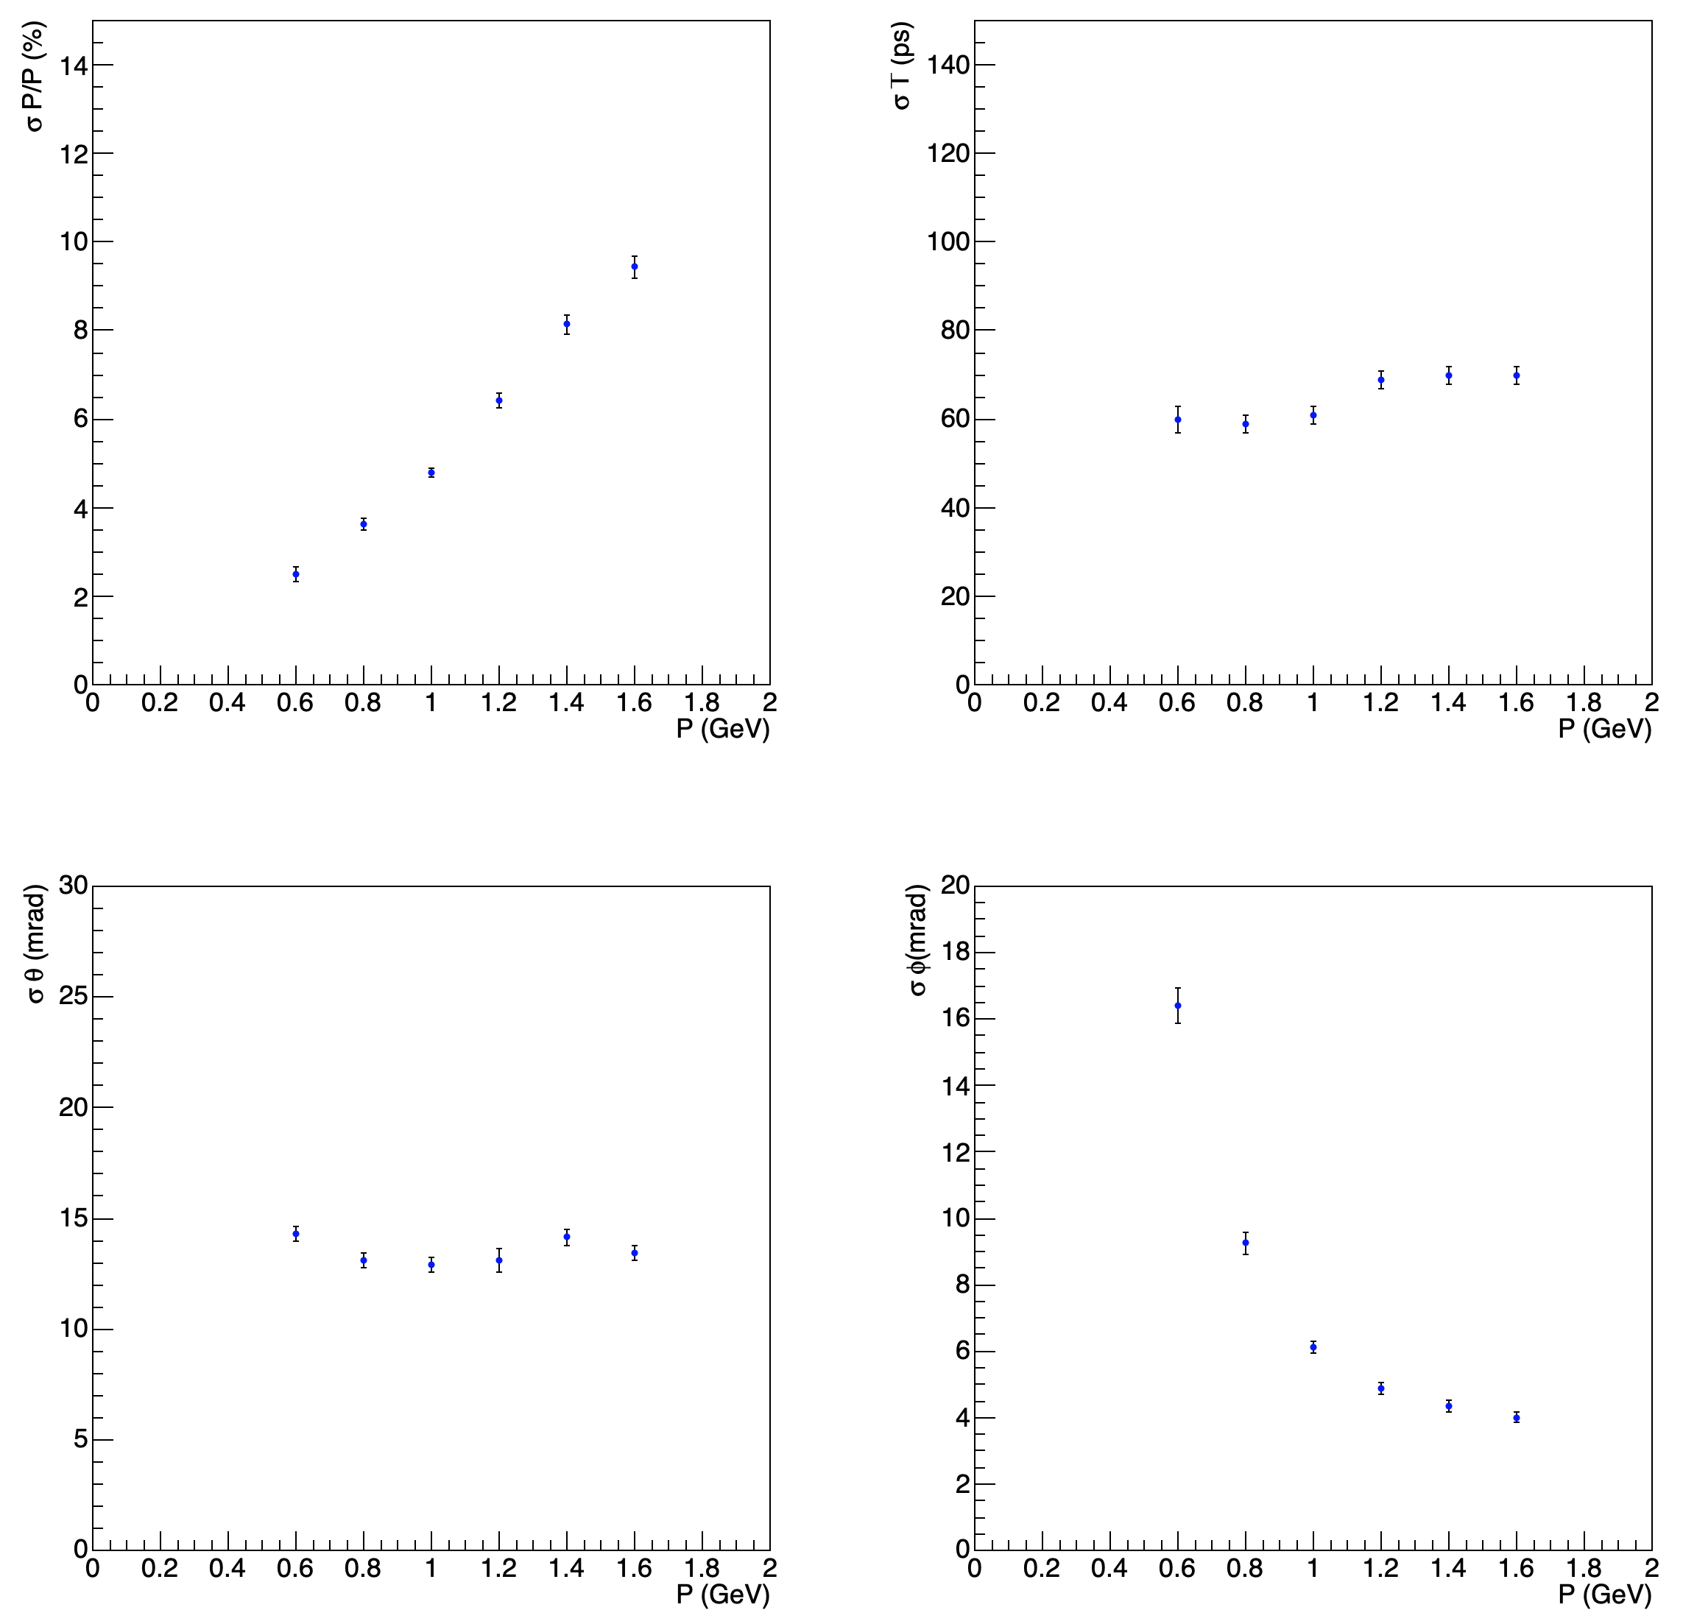
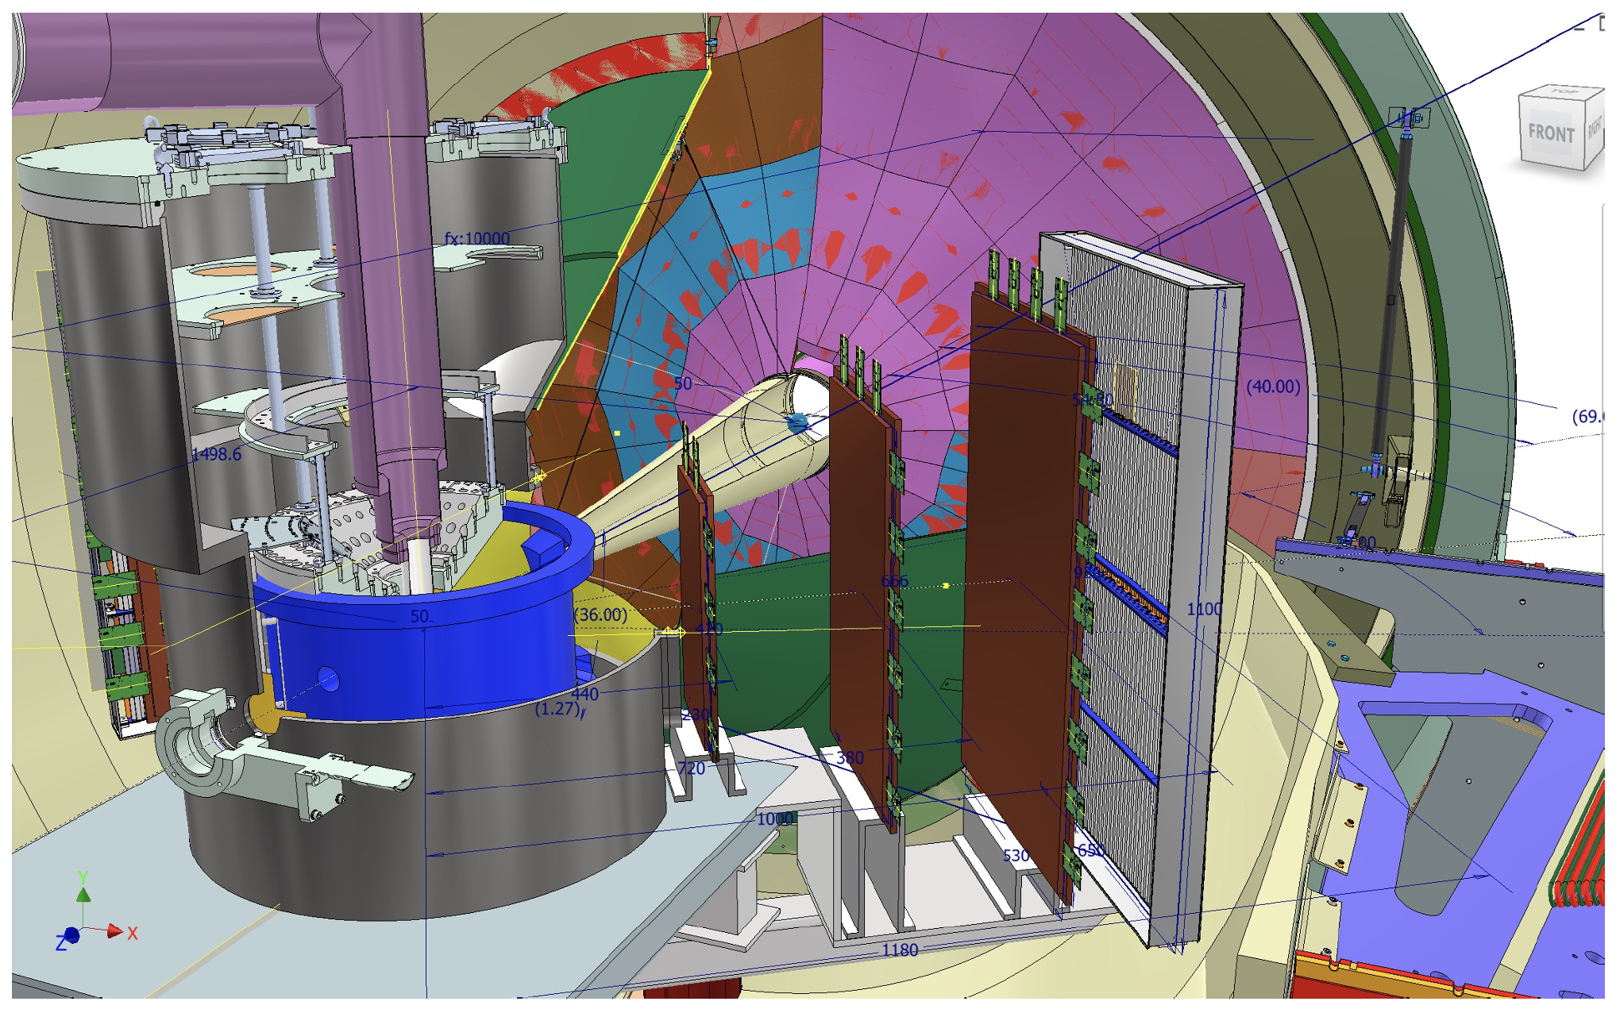
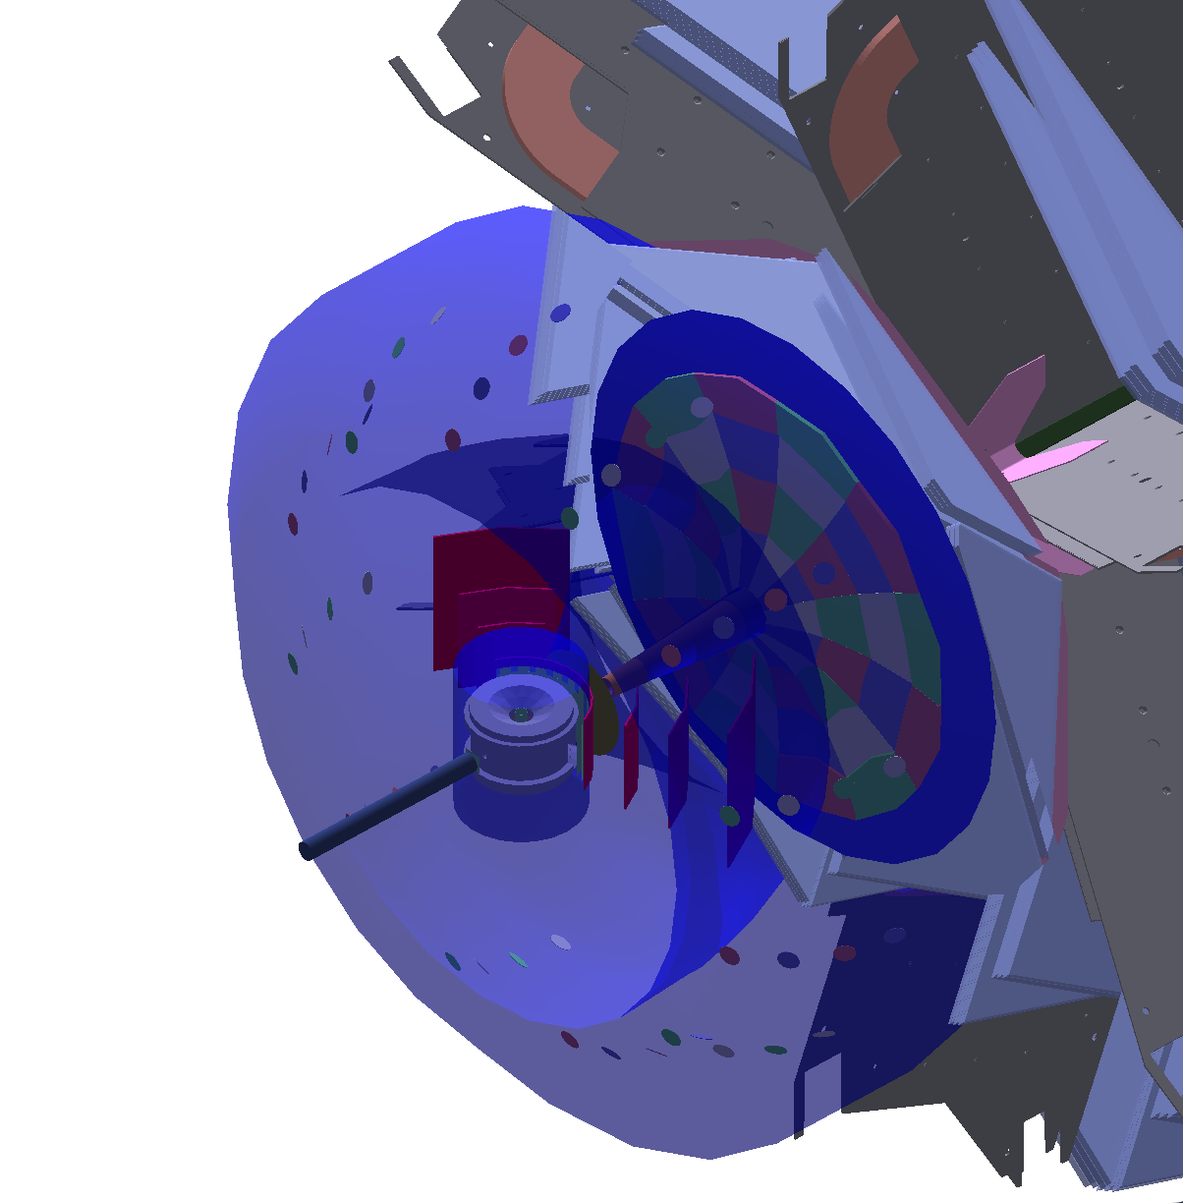
RGH Recoil
Simulated RGH recoil resolution
based on ongoing tech. development
and CLAS12 FD tracking resolution
CLAS12 Standard
Recoil concept
TOF
u-Rwell
L. L. Pappalardo - C.d.S. INFN Ferrara – 04/07/2025

Slide 15
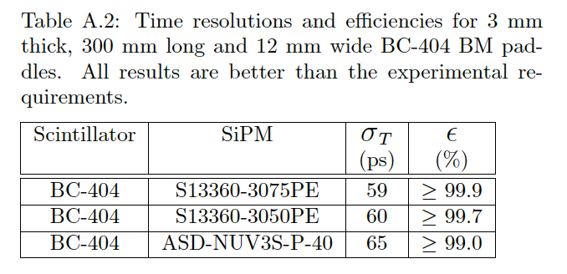
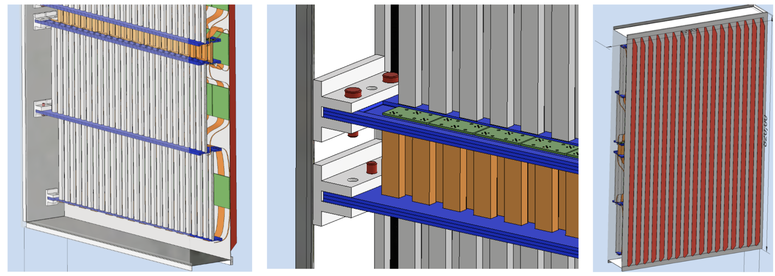
Recoil TOF Detector
Scintillating bars readout by SiPM Synergy with ePIC (dRICH tagger)
Proven to match 100 ps, e.g. by PANDA and MUSE.
✓ Flexible geometry to provide spatial matching and control of accidentals
✓ Compact layout
L. L. Pappalardo - C.d.S. INFN Ferrara – 04/07/2025

Slide 16
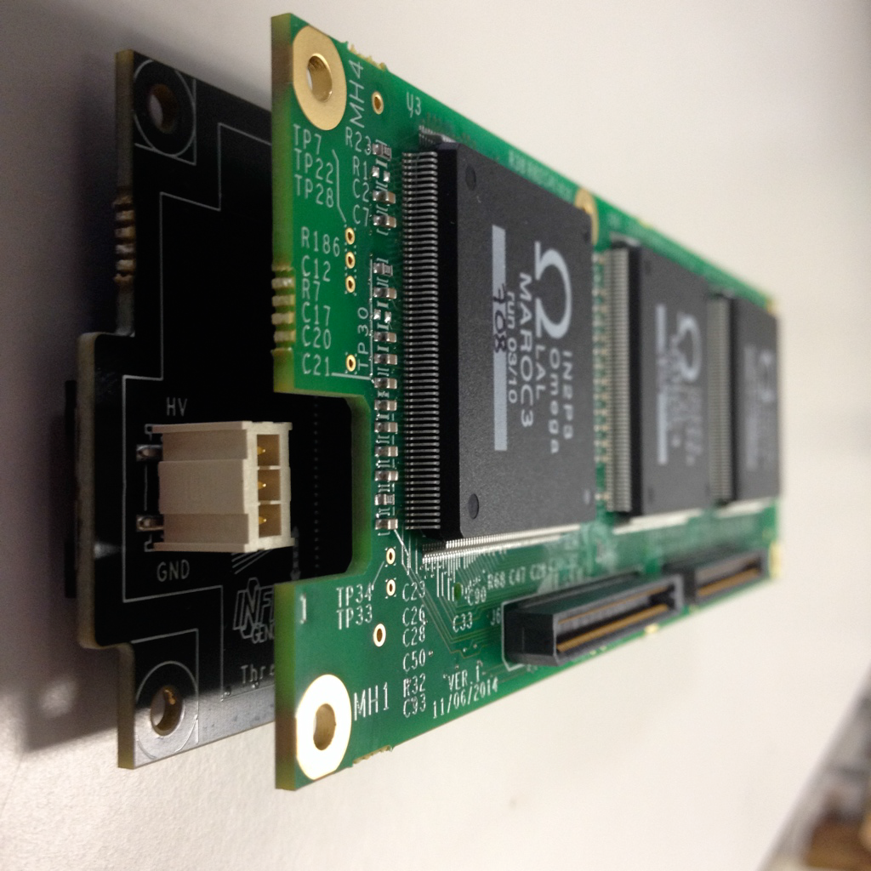
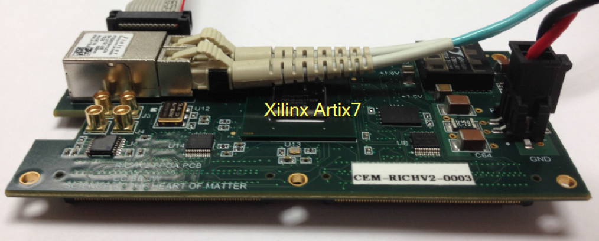
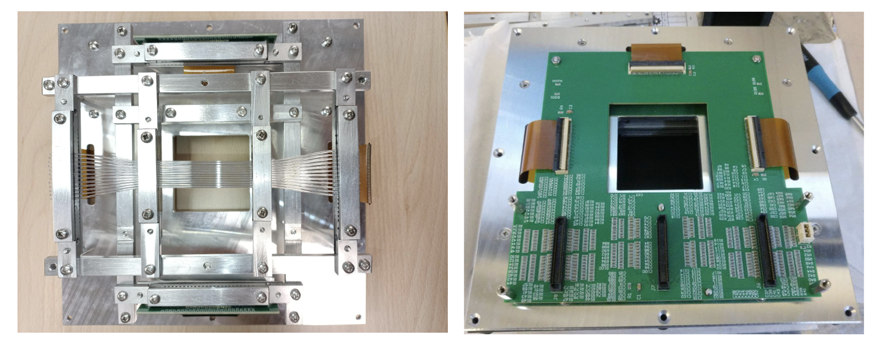
Scintillation+SiPM Detector
New potential application of the CLAS12 RICH Electronics reading SiPM
RICH readout
✓ MAROC dynamic range can
cope with multi-photon signals
✓ Clock distribution supports
100 ps readout precision
To be used as fast beam particle tracking with RICH prototypes
Potential use as recoil detector for CLAS12 – RGH (transversely polarized targets)
Developed thanks to L. Barion, M. Roberto, M. Cavallina
L. L. Pappalardo - C.d.S. INFN Ferrara – 04/07/2025

Slide 17
Il gruppo di Ferrara @ JLab
Responsabilita’:
M. C.: responsabile locale
M. C. : past-chair of the Jlab User Organization (till June ‘25)
M. C.: contact person for the RGH experiments with transversely polarized target
M. C. responsabile progetto RICH
M. C. & L.P. Co-spokesperson di diverse proposte di esperimento (PAC34,37,38,39)
Contributi principali del gruppo:
Data analysis
- Data analysis on kaon SIDIS
RICH detector
- Reconstruction and alignment algorithms
Magneti superconduttori
- Configurazione magnetica per transverse target
- Frozen field con magneti a bulk di superconduttore
Esperimenti con bersagli trasversi
- Recoil detector design
- Study scintillating-fiber (time) tagger
L. L. Pappalardo - C.d.S. INFN Ferrara – 04/07/2025

Slide 18
ePIC (R.L.: Marco Contalbrigo)
Nucleon structure and spin physics
Transverse momentum phenomena (TMDs) & 3D imaging
GPDs & mechanical properties of the nucleon
M. Contalbrigo is dRICH detector subsystem lead
co-coordinator of the dRICH R&D EIC Program (eRD102)
A. Saputi is Contact Person for dRICH mechanics
INFN-FE: Dual-radiator RICH (dRICH) in ePIC hadron end-cap
(project led by INFN)
L. L. Pappalardo - C.d.S. INFN Ferrara – 04/07/2025

Slide 19
EIC
Electron Ion Collider:
Strong interest in Italian nuclear physics
community (theory and experiment)
CD1 approval in June 2021
EPIC Coll. for 1st detector start in fall 2022
Detector subsystems defined in spring 2023
EIC_NET moved into ePIC in June 2024
ePIC pre-TDR expected at the end of 2025
CD2 expected in fall 2026
INFN Ferrara leading the dRICH subsystem
We recommend the expeditious completion of the EIC as the highest priority for facility construction.
L. L. Pappalardo - C.d.S. INFN Ferrara – 04/07/2025

Slide 20
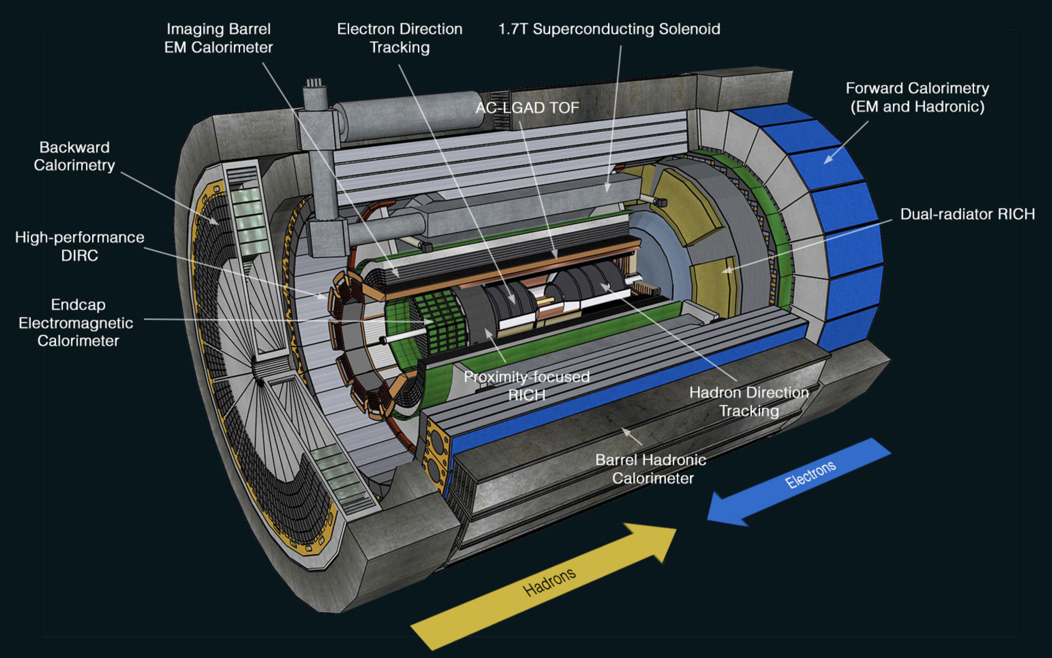
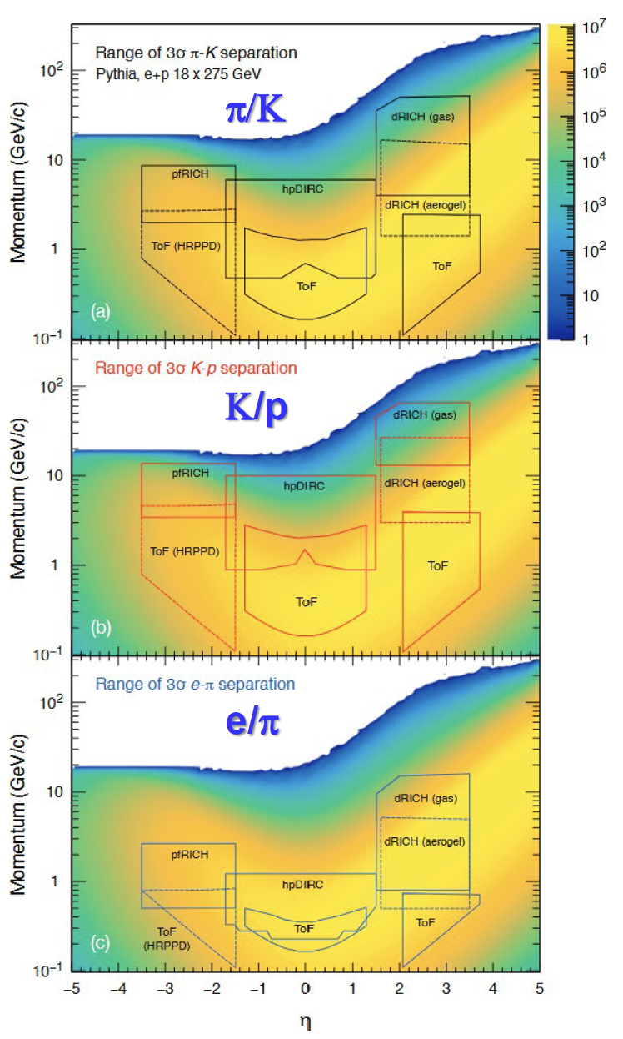
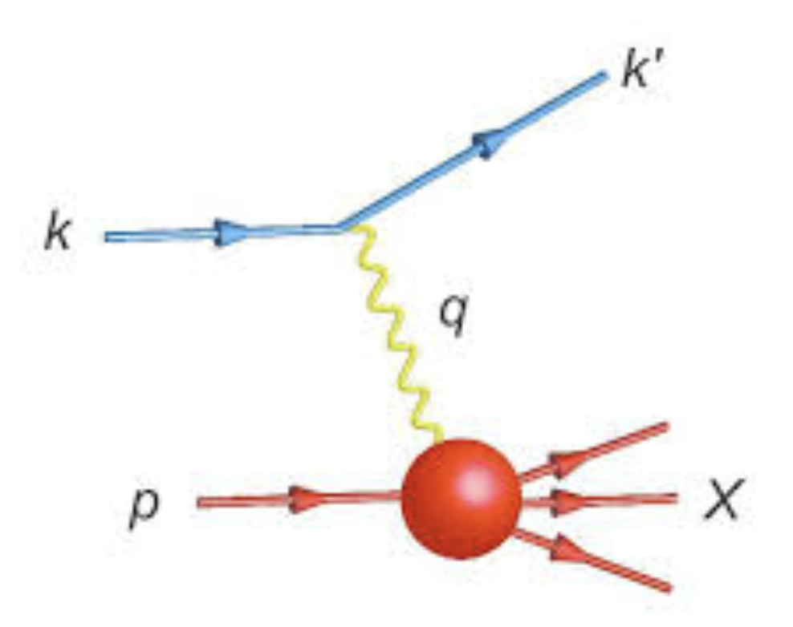
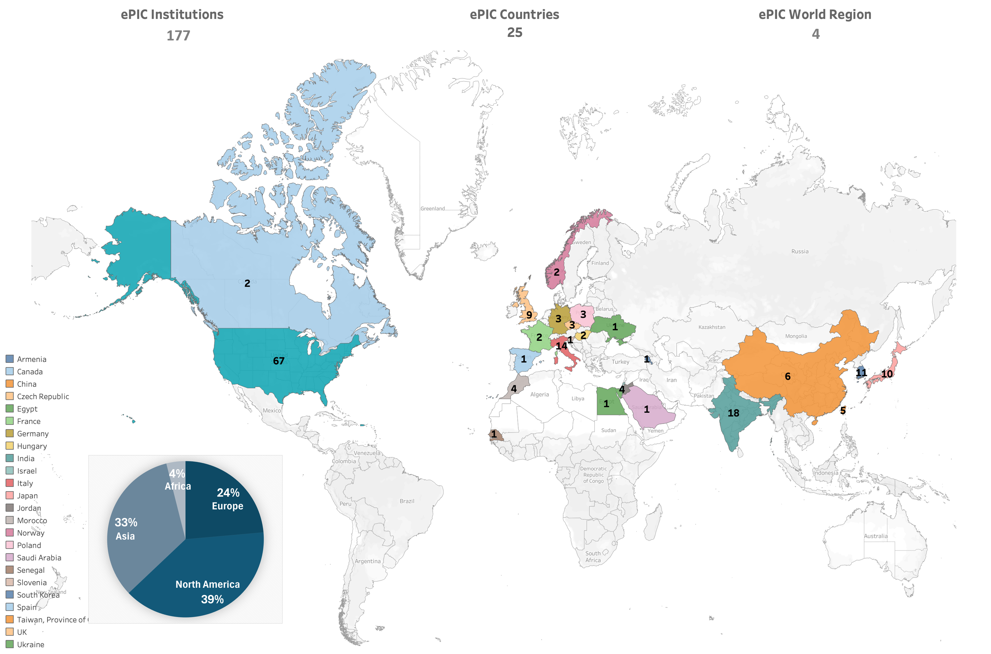
ePIC: The Collider Experiment
5-18 GHeV
41-275 GHeV
ePIC Collaboration
https://www.epic-eic.org
~1031collaborators, 25 countries, 177 institutions
US: 8 National Labs + 59 Universities
L. L. Pappalardo - C.d.S. INFN Ferrara – 04/07/2025

Slide 21
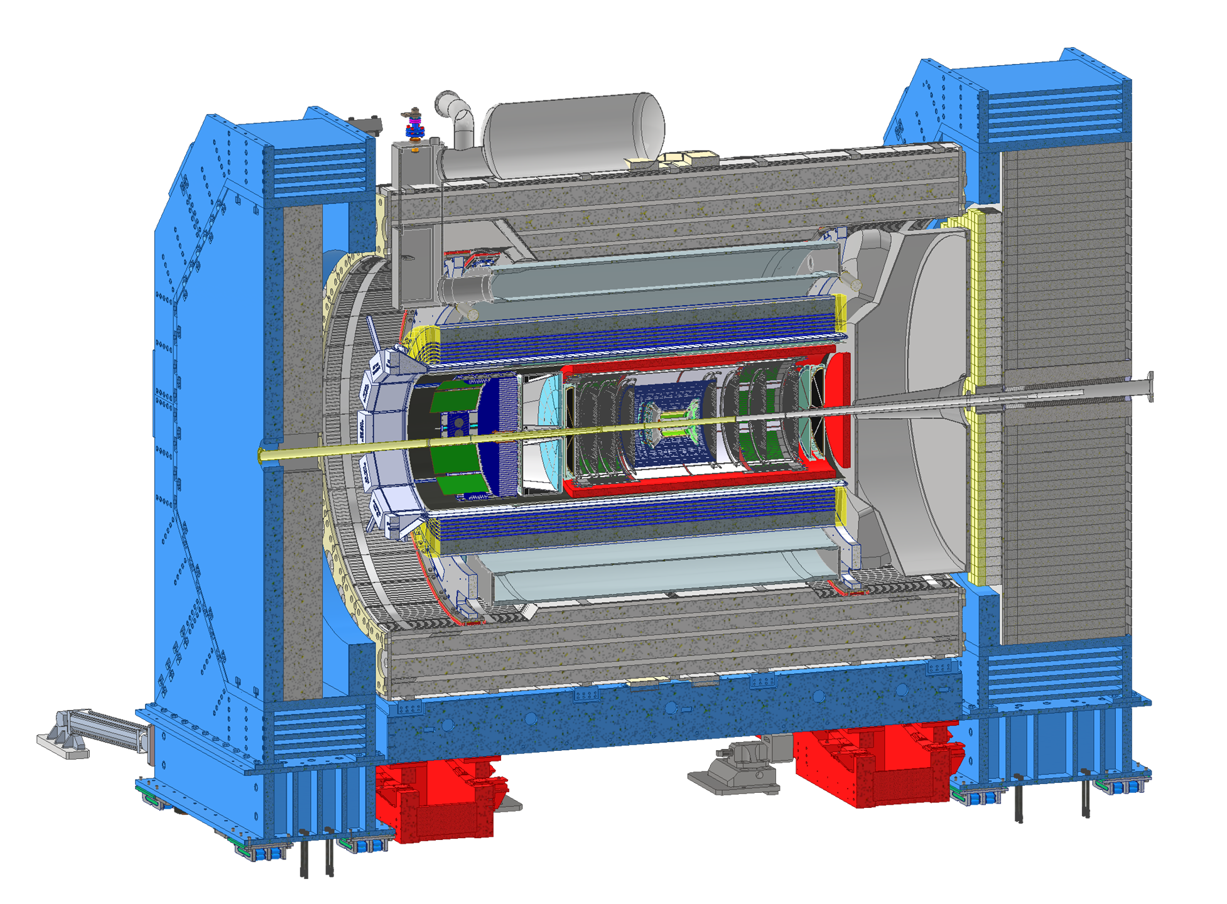
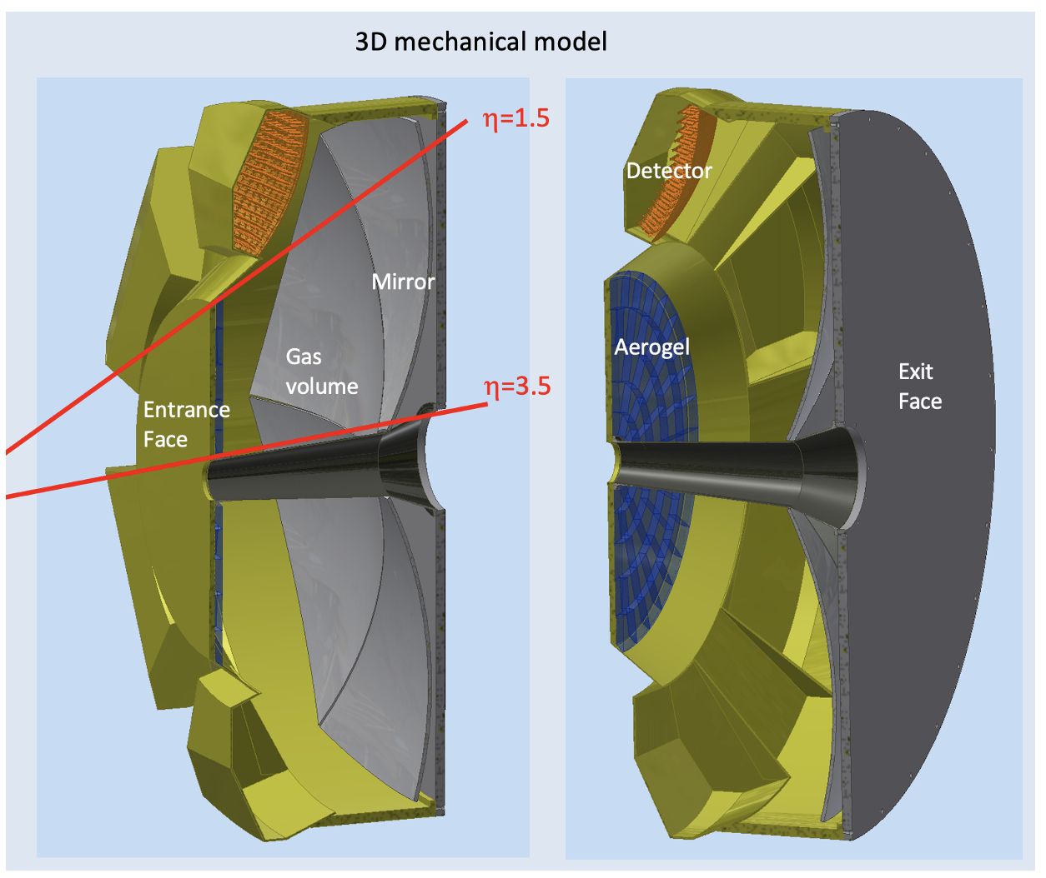
Dual-Radiator RICH
Goals:
Hadron 3σ−separation between 3 - 50 GeV/c
Complement electron ID below 15 GeV/c
Cover forward pseudorapidity 1.5 (barrel) - 3.5 (b. pipe)
Essential to access flavor information
4m
dRICH Features:
Extended 3-50 GeV/c momentum range --> Dual radiator
Single-photon detection in high Bfield --> SiPM
Limited space --> Compact optics with curved detector
L. L. Pappalardo - C.d.S. INFN Ferrara – 04/07/2025

Slide 22
dRICH Organization Chart
6.10.04 Particle Identification Level-3
CAM from DOE EIC Project
6.10.04.03 dRICH Level-4
CAM from Project + M. Contalbrigo (DSTC from EPIC )
Work packages lead from EPIC
Photo-Detector Level-5
R. Preghenella, INFN-BO, INFN-FE, INFN-CS, INFN-SA, INFN-LNF, INFN-CT, INFN-TS, NISER
F. Cossio, INFN-TO, INFN-BO
P. Antonioli, INFN-BO, INFN-FE
A. Saputi, INFN-FE, INFN-CT, INFN-GE, JLAB, BNL
F. Tessarotto, INFN-TS, BNL
A. Vossen, DUKE, JLab, INFN-FE
G. Volpe, INFN-BA, INFN-FE, Temple U., RICH Consortium
S. Dalla Torre, INFN-FE, INFN-TS, DUKE, INFN-FE
C. Chatterjee, INFN-TS, INFN-CS, INFN-GE, INFN-LNS, DUKE, CUK, CUH, Ramaiah U.
Front-end Asics Level-5
Data-acquisition Level-5
Mechanics Level-5
Gas radiator Level-5
Mirror Level-5
Aerogel Radiator Level-5
Pressurized RICH Level-5
Simulation
L. L. Pappalardo - C.d.S. INFN Ferrara – 04/07/2025

Slide 23
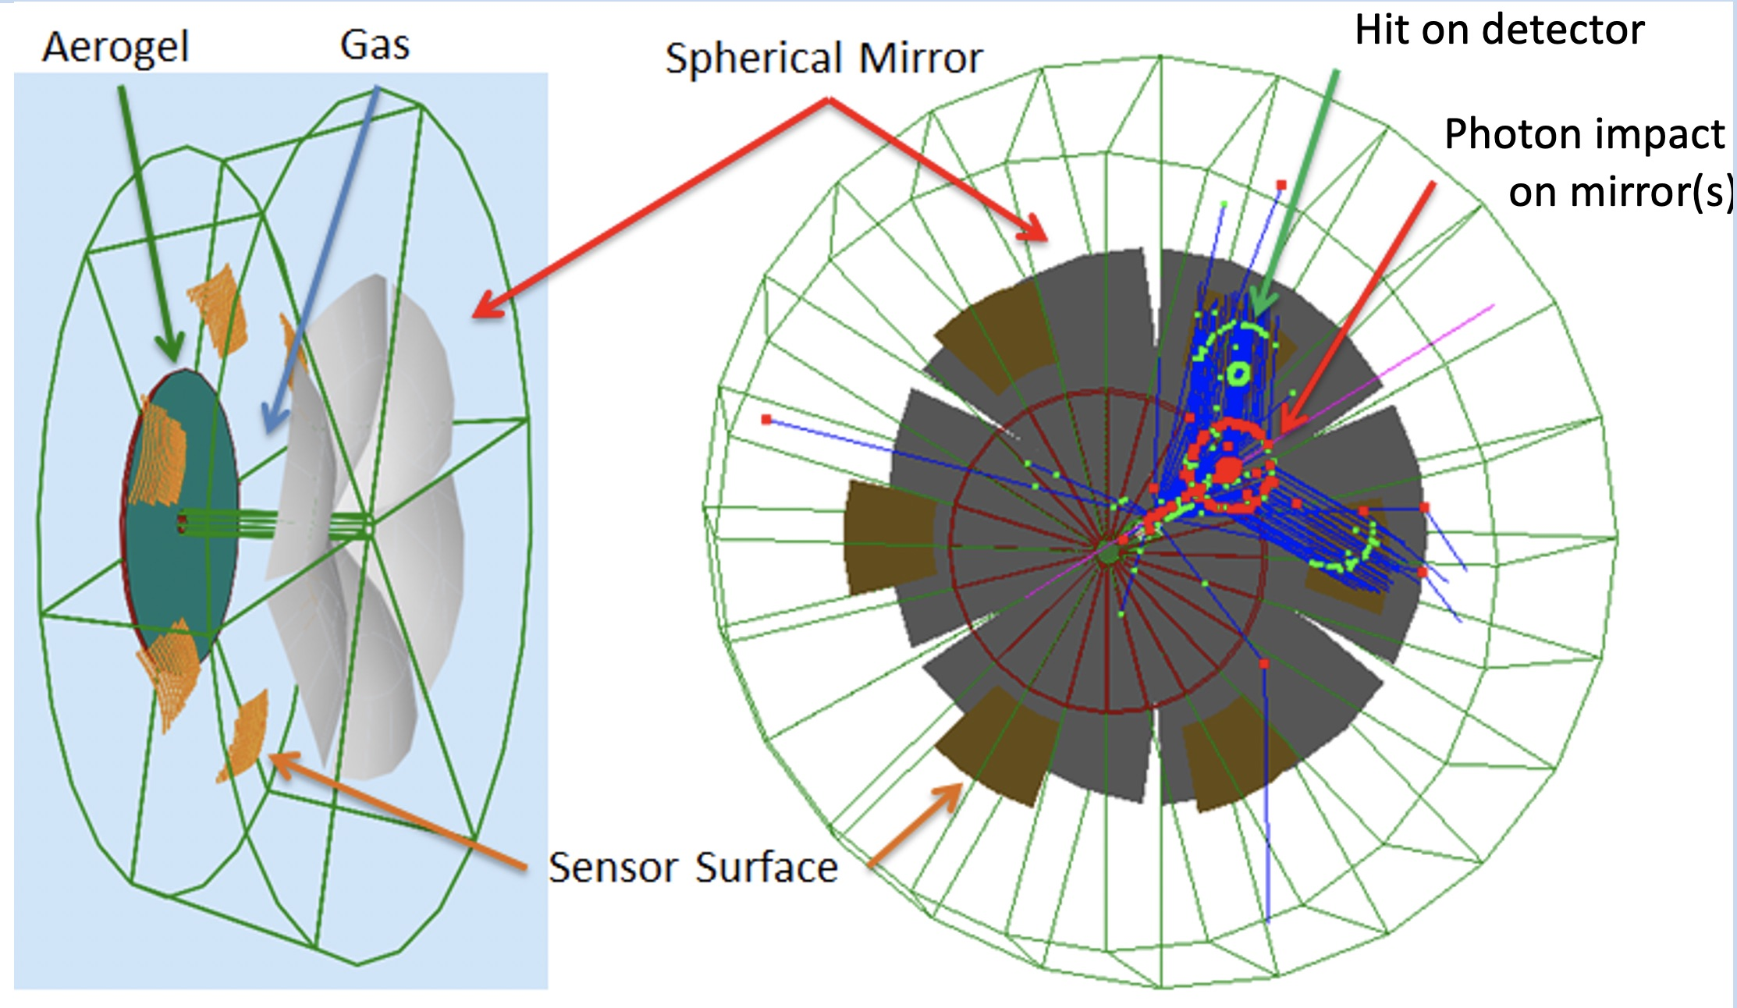
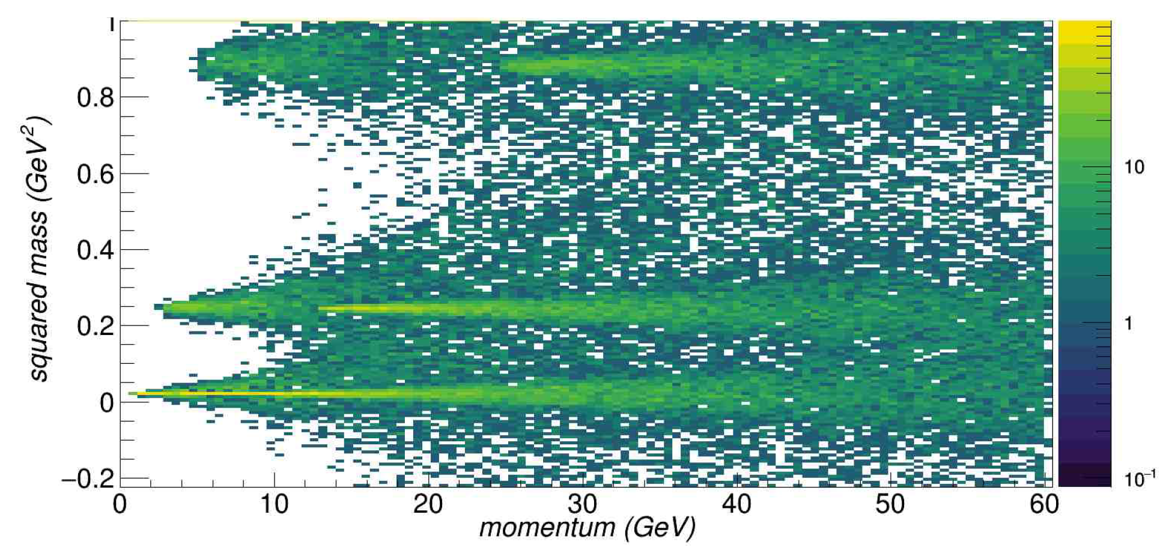
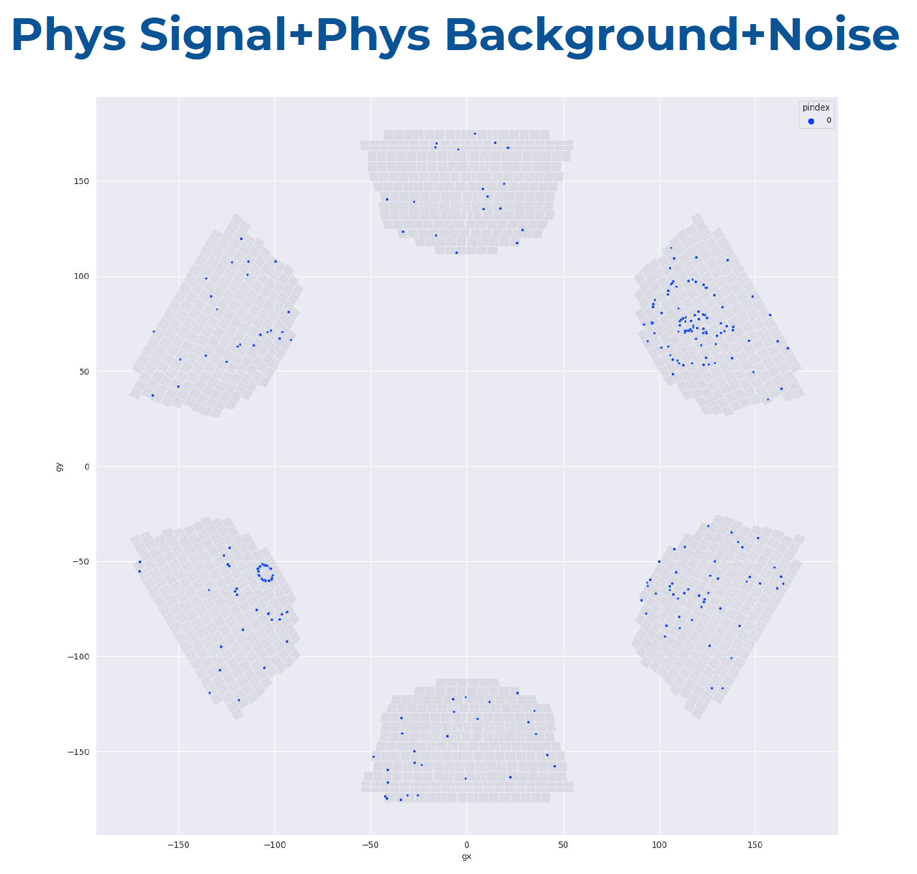
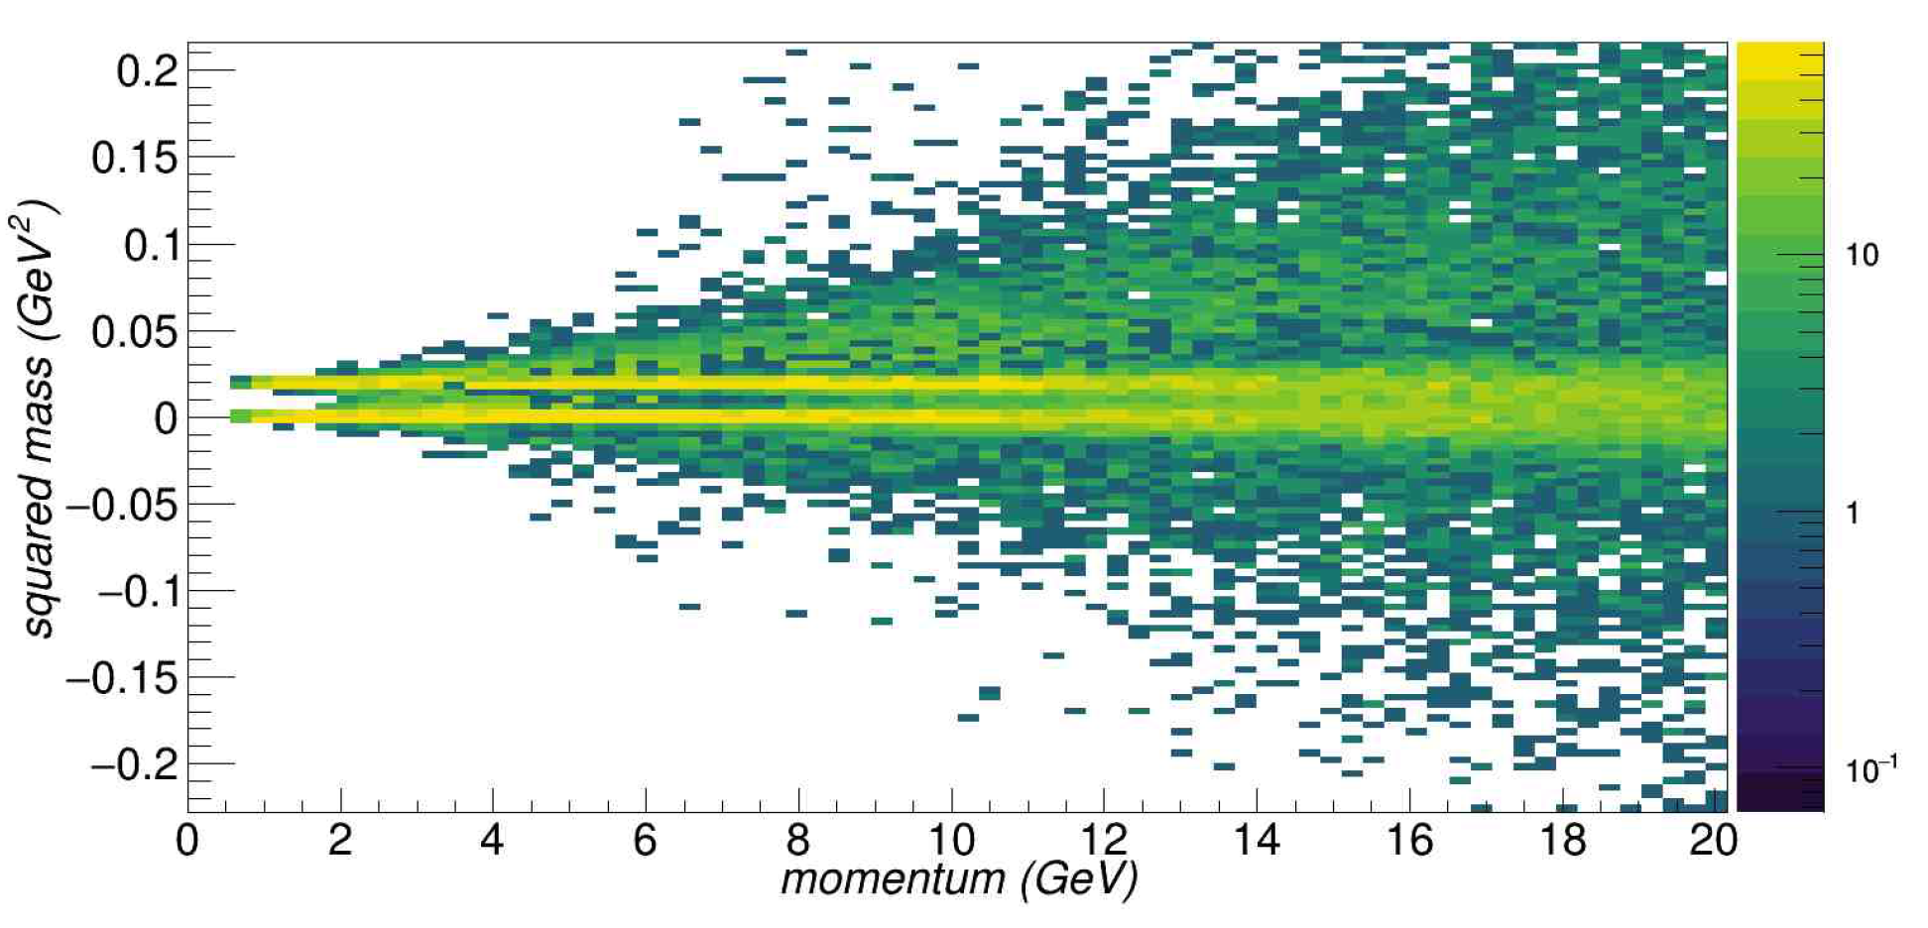
dRICH Performance
p
k
π
π
e
L. L. Pappalardo - C.d.S. INFN Ferrara – 04/07/2025

Slide 24
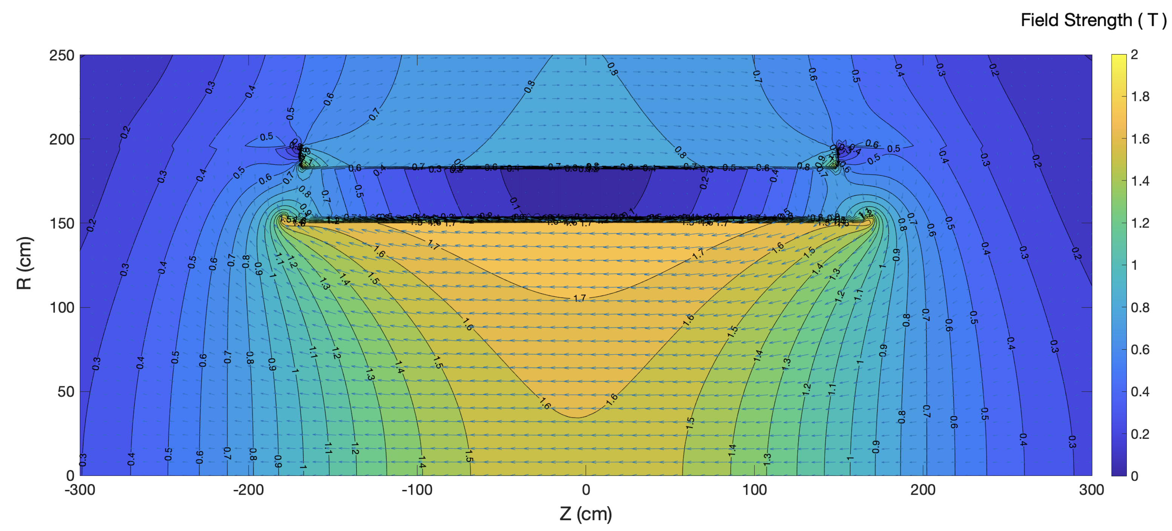
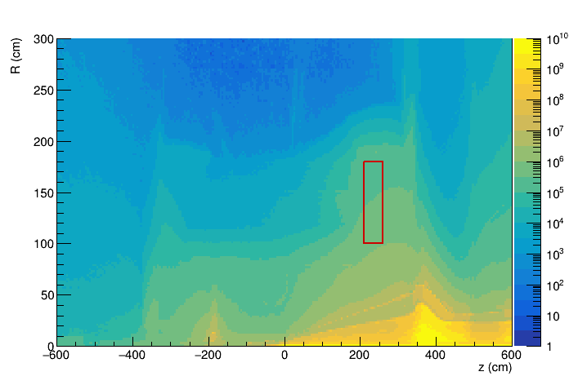
dRICH SiPM Sensors
1.7 T field
1-MeV neutron equivalent fluence (1 fb⁻¹ ep running)
ePIC background group
beam-beam interactions only
dRICH
dRICH
Benchmark fluence (10 x)
~ 10⁷ 1-MeV n_{eq}/cm² / fb⁻¹
Strong and not-uniform magnetic field
Moderate radiation levels (up tp 10¹¹ n_{eq}/cm²)
Usage of SiPM with
- low temperature working point
- periodic annealing at high temperature
(in-site by Joule effect)
L. L. Pappalardo - C.d.S. INFN Ferrara – 04/07/2025

Slide 25
dRICH Photodetector
Active area is shaped to resemble the focal surface and best exploits the focalization.
Electronics is minimized to fit the limited available space.
Heat exchanger
Cold plate
SiPM array
Photon Detector Unit (PDU):
Compact to minimize space
4x Hamamatsu S13361-3050HS SiPM arrays
4x Front-End Boards (FEB)
4x ALCOR chip (ToT discrimination)
1x Read-Out Board (RDO)
1x Cooling plate (< -30 C)
Flex PCB
Back-side
connectors
12 cm
FEB
(ALCOR)
Service
connections
RDO
SiPM array
ALCOR chip (TO)
RDO (BO)
L. L. Pappalardo - C.d.S. INFN Ferrara – 04/07/2025

Slide 26
dRICH Photon Detection Unit
Steadly progress of photodetector towards integrated design completion in 2026
/26
50 μm
75 μm
ALCOR 32 ch
Full size engineering
test article
2025
+ SiPM carrierv3
+ RDO
2026
+ ALCOR 64ch
+ FEB 64
Contributions by L. Barion, M. Cavallina, R. Malaguti
L. L. Pappalardo - C.d.S. INFN Ferrara – 04/07/2025

Slide 27
dRICH Base Prototype
GEM
Gas Vessel
MAPMTs
Aerogel
Design performance achieved with gas and aerogel
GEM
Development thanks to L. Barion, M. Cavallina, R. Malaguti
L. L. Pappalardo - C.d.S. INFN Ferrara – 04/07/2025

Slide 28
dRICH Mechanics
A detailed mechanical model of the single-vessel detector is outlined with composite materials
Shell
(CFRP bulk)
Recomm. (DAC): Provide material for the pending decision
on the single vs two vessel version of the detector.
Detector box
(aluminum)
Exit window
(CFRP sandwich)
Pipe
(bulk)
Entrance window
(CFRP sandwich)
Composite materials
Total wieght: ~ 2 ton
PDU detector
Quartz window
Detector box
Off-axis bore
Design thanks by A. Saputi
L. L. Pappalardo - C.d.S. INFN Ferrara – 04/07/2025

Slide 29
eRD102 Final Milestone – Real Scale Prototype
Engineering of all the mechanical details pursued with the real-scale prototype being realized in 2025
Aerogel support
Mirror mounting and alignment (aka NA62)
Vessel
PO issued
CFRP Layer
composition
Realization thanks to A. Saputi, M. Melchiorri, L. Barion, M. Cavallina, R. Malaguti
L. L. Pappalardo - C.d.S. INFN Ferrara – 04/07/2025

Slide 30
dRICH: Real Prototype Support & Services
Test-beam configuration
Cosmic configuration
Gas panel
Realization thanks to L. Barion, F. Evangelisti
L. L. Pappalardo - C.d.S. INFN Ferrara – 04/07/2025

Slide 31
dRICH R&D (eRD102) Timeline
Previous validations:
Dual-radiator concept
C₂F₆ radiator gas performance
Aerogel rafractive index
SiPM-ALCOR readout chain
EIC-drive readout plane
Temperature gradients
2025
2025 main goals:
Commissioning of real scale prototype
with demo components
ALCOR readout with RDO
Slot at SPS H8 in November
2026 main goals: Final test of performance with real-scale prototype completed with ALCORv64 & Master Panel
Development thanks to A. Saputi, M. Melchiorri, L. Barion, M. Cavallina, R. Malaguti
L. L. Pappalardo - C.d.S. INFN Ferrara – 04/07/2025

Slide 32
dRICH: Detector Box Engineering
Engineering of detector box
planned in 2026
Master Panel
Thermal models (INFN Torino)
Development thanks to A. Saputi, M. Melchiorri, L. Barion, M. Cavallina, R. Malaguti
L. L. Pappalardo - C.d.S. INFN Ferrara – 04/07/2025

Slide 33
ePIC: responsabilità
Responsabilita’:
M. C.: responsabile locale ePIC
M. C.: responsabile dRICH
A. S.: contact for dRICH mechanics
M. C.: co-coordinator eRD102
M. C.: IAC POETIC (Physics Opportunities at EIC) Conference
Contributi principali:
dRICH detector
- dRICH mechanics
- Prototyping
- Optical component characterization
- SiPM irradiation program
Electronics
- MAROC (reference) + ALCOR (INFN development)
L. L. Pappalardo - C.d.S. INFN Ferrara – 04/07/2025

Slide 34
Richieste ai Servizi
Servizio Meccanico
FE laboratory: supporto per misure e stazioni di test, preparazione test-beam
JLAB12
TTarget: supporto per test con doppio campo magnetico (Ferrara + LASA Milano)
Recoil: contributo meccanica tracciatore recoil
EIC_NET
dRICH: progettazione meccanica del rivelatore dRICH
dRICH: meccanica del prototipo dRICH e ingegnerizzazione detector box
Servizio Elettronico
FE laboratory: supporto per misure e stazioni di test, preparazione test-beam
JLAB12
TTarget: piccoli contributi alle misure con magneti superconduttori
TTarget: contributo lettura recoil detector (MAROC)
EIC_NET
dRICH: contributo piano di rivelazione curvo basato su SiPM + ALCOR
dRICH: master panel di controllo rivelatore
L. L. Pappalardo - C.d.S. INFN Ferrara – 04/07/2025

Slide 35
Manpower e richieste finanziarie per 2025
Anagrafica e afferenze (Ric. + Tecnol.)
Servizio meccanico ed elettronico
Name | JEDI | JLab12 | EIC_NET
N. Canale (dottorando) | 100
G. Ciullo (staff) | 70 | 20
M. Contalbrigo (staff) |  | 50 | 50
S. Dymov (post-doc) | 100
L. Del Bianco (staff) |  | 100
A. Kononov (dottorando) | 100
P. Lenisa (staff) | 75 | 30
A. Maragno (dottoranda) | 50 |  | 50
L. Pappalardo (RTD-B) |  | 30
L. Polizzi (dottorando) | 100 | 50 | 50
A. Seleev (assegnista) | 100
R. Shankar (dottorando) | 100
F. Spizzo (staff) |  | 50 | 30
S. Plavully (assegnista) |  | 20 | 80
A. Saputi |  |  | 10
A. Cotta Ramusino (staff) | 10
TOTALE/100 | 8.6 | 3.5 | 2.7
Name | JEDI | JLab12 | EIC_NET
L. Barion |  | 25 | 75
M. Cavallina | 10 | 10
M. Gambetti | 10
R. Malaguti |  | 20
M. Melchiorri |  |  | 10
S. Squerzanti |  | 20
TOTALE/100 | 0.2 | 0.5 | 0.1
Richieste finanziarie (k€)
Name | JEDI | JLab12 | EIC_NET | Dot.3
Missioni | 57 | 45 | 27 | 8
Trasp. |  | 2 | 4
Inv. | 9 |  | 9 | 15
Consumi | 34.5 | 10 | 49 | 6
Apparati
Altro |  |  |  | 3
TOTALE | 100.5 | 67 | 89 | 32
L. L. Pappalardo - C.d.S. INFN Ferrara – 04/07/2025

