Slide 1
Particle Identification
Lesson 2 - Methods
M. Contalbrigo – INFN Ferrara
2nd European School on the Physics of the EIC and Related Topics, 22th June – 2nd July, 2025
M. Contalbrigo
2nd European School on EIC Physics, 22th June – 2nd July, 2025
1

Slide 2
Arguments
Specific Particle-ID Detectors Time-of-Flight
Cherenkov Radiation
Reconstruction example
Analysis Methods Chi2
Maximum Likelihood
Machine Learning techniques
ePIC Requirements
ePIC Solutions pfRICH
TOF
hpDIRC
dRICH
M. Contalbrigo
2nd European School on EIC Physics, 22th June – 2nd July, 2025
2
Notes:
Vanno messi studi innovativi e pubblicazioni

Slide 3
PID by Tracking
Assume to know the momentum (by tracking the bending in a magnetic field)
Get the mass by measuring the velocity (βc)
p = γ m βc
Process | Particle | Equipment
Energy Loss (dE/dx) | Hadrons | Tracking
Transition Radiation (TDR) | Electrons | Tracking sensitive to X-ray
Time-of-Flight (TOF) | Hadrons | Timing
Cherenkov Radiation | Hadrons | Cherenkov
M. Contalbrigo
2nd European School on EIC Physics, 22th June – 2nd July, 2025
3

Slide 4
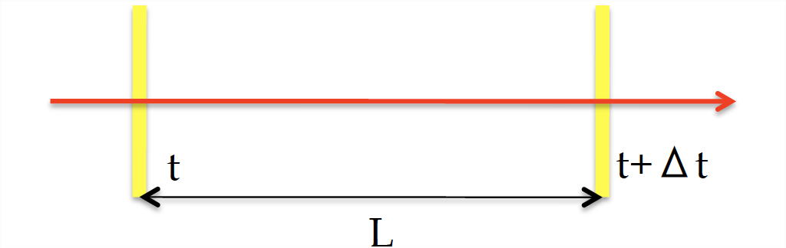
The T₀ Problem
In a time of flight application one needs two layers (impractical) or a reference t₀
with better (or comparable) precision with respect TOF.
The t₀ is typically given at the interaction point by back-tracking:
- Reference particle (e.g. lepton in deep-inelastic scattering)
- Average over particles (requires large multiplicity)
- Bunch RF information (require to “just” identify the beam bunch crossing)
M. Contalbrigo
2nd European School on EIC Physics, 22th June – 2nd July, 2025
4

Slide 5
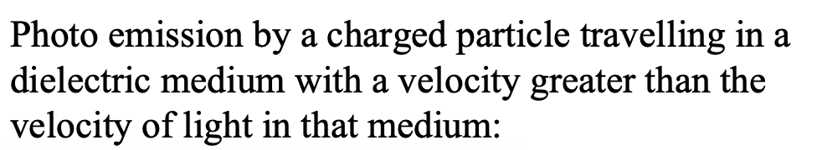
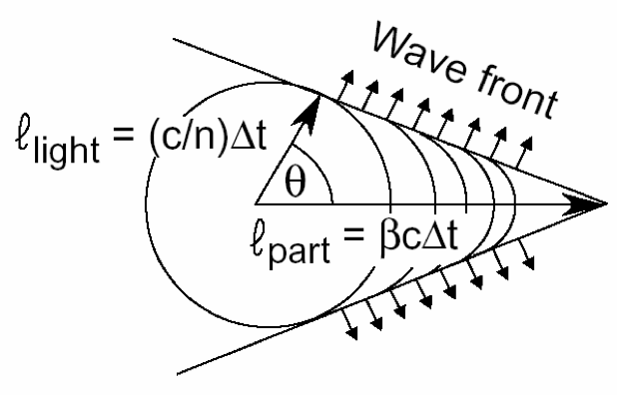
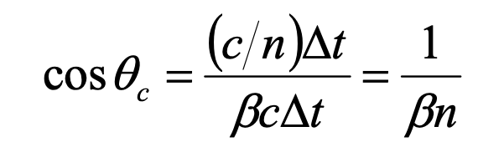
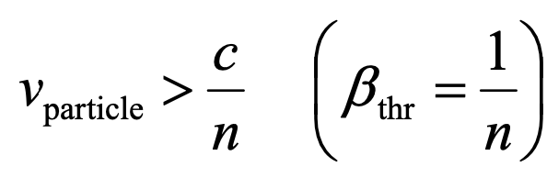

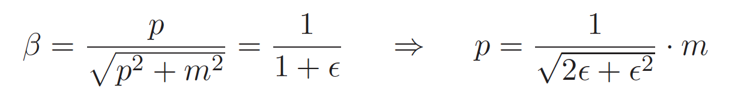
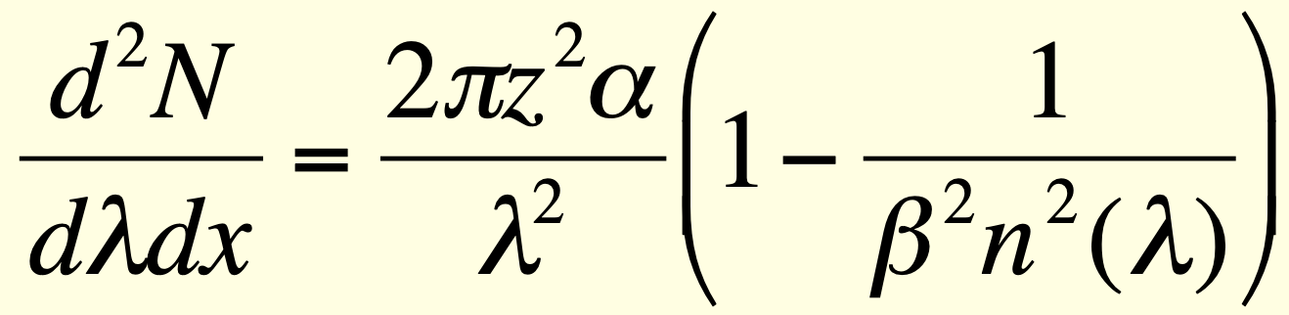
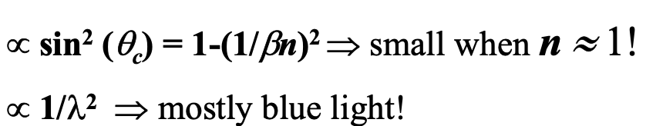
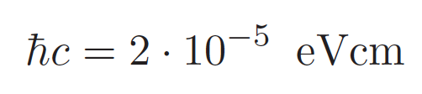
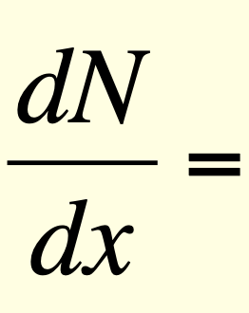
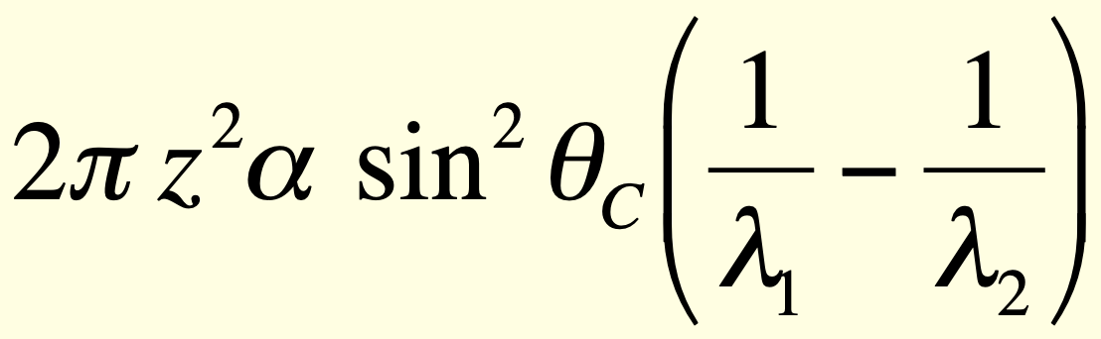
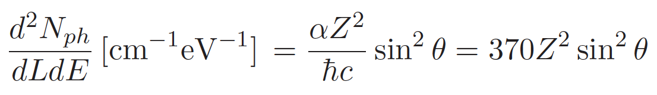
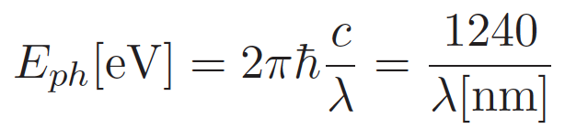
Cherenkov Radiation
Momentum threshold:
Scales with particle mass
Decreases with n
Photon yield:
M. Contalbrigo
2nd European School on EIC Physics, 22th June – 2nd July, 2025
5

Slide 6
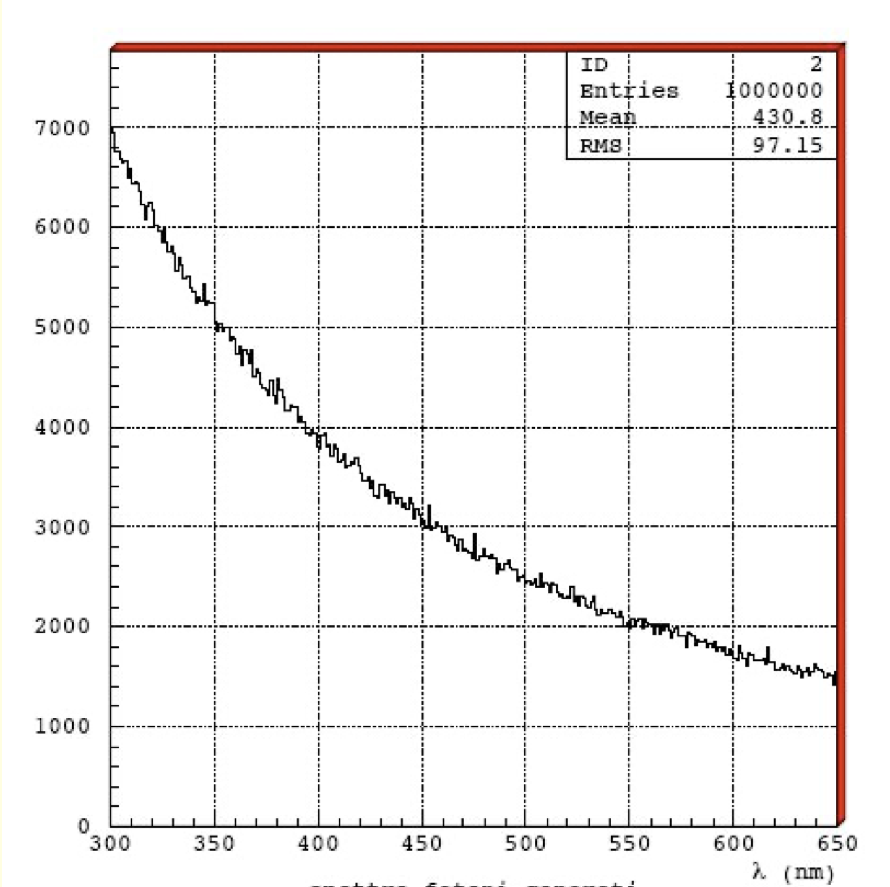
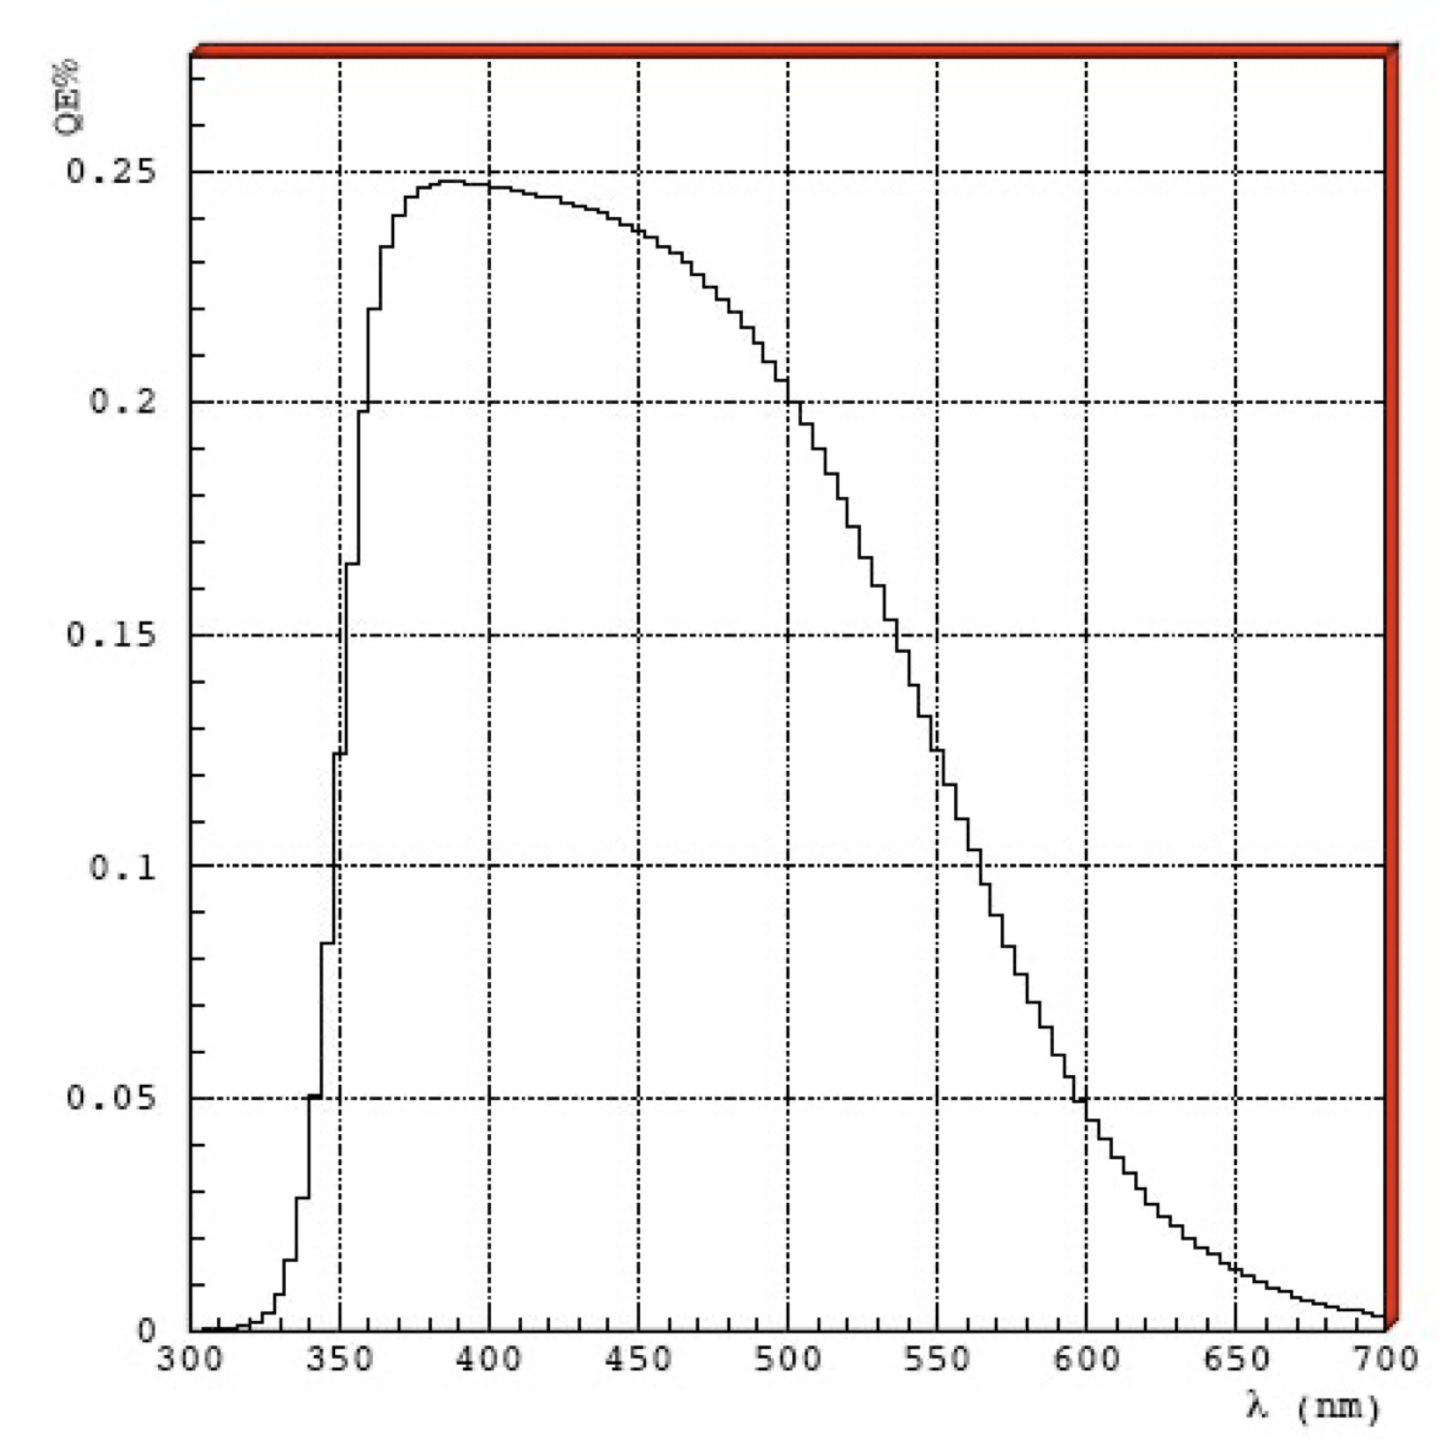
Photon Yield
Spectrum of Cherenkov photons
Typical sensitivity (quantum efficiency) of a PMT
4 eV
3 eV
2 eV
4 eV
3 eV
2 eV
M. Contalbrigo
2nd European School on EIC Physics, 22th June – 2nd July, 2025
6

Slide 7
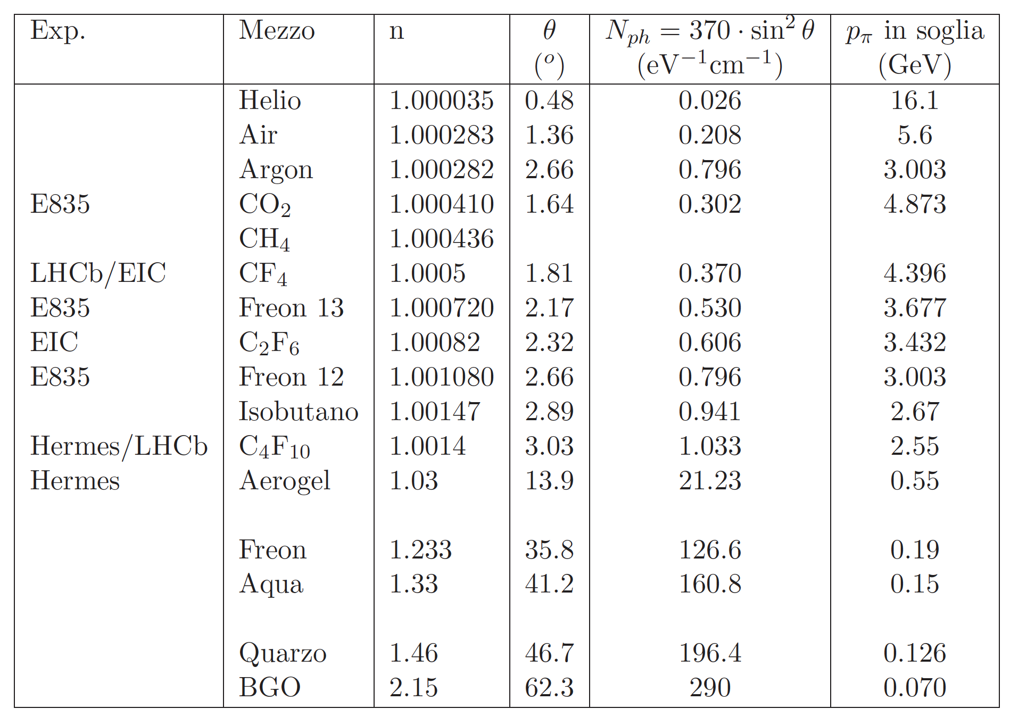
Cherenkov Radiators
requires
~ 1 m
ePIC
Real PID
starts at
3x (kaon)
COMPASS / LHCb
BELLEII / CLAS12
requires
~ few cm
(1.015-1.08)
~1 keV/cm
10⁻³ dE/dx
M. Contalbrigo
2nd European School on EIC Physics, 22th June – 2nd July, 2025
7

Slide 8
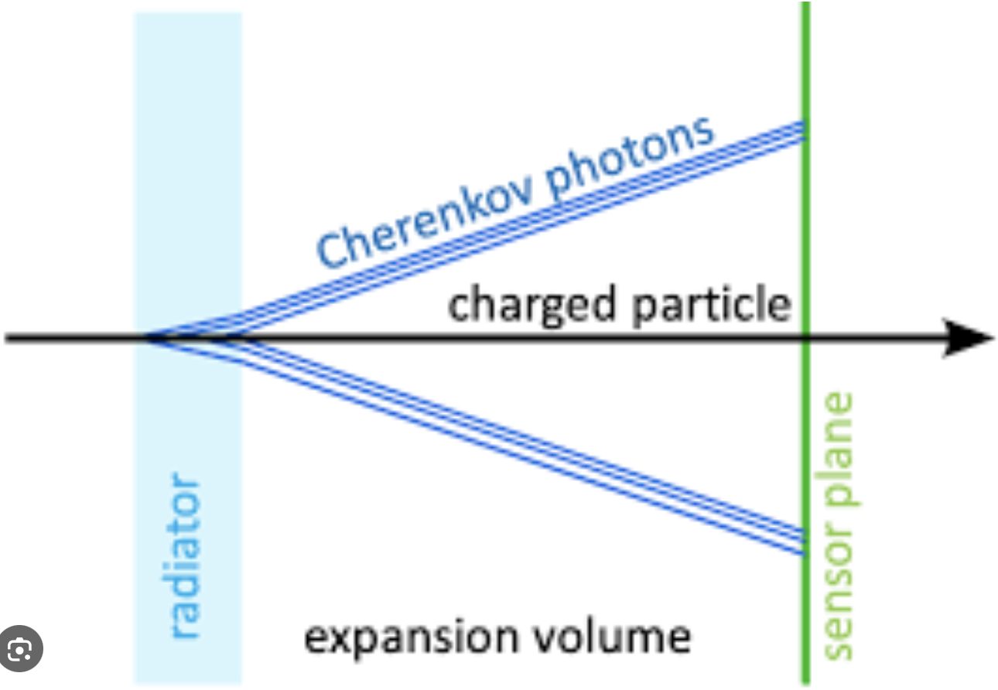
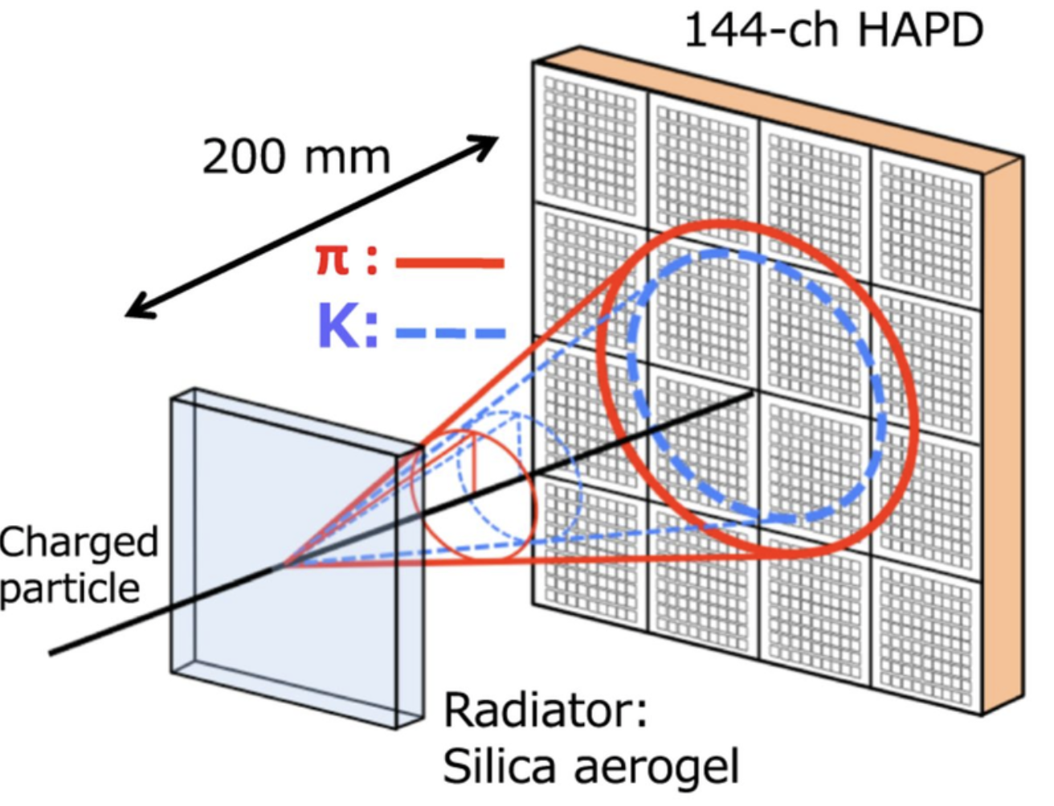
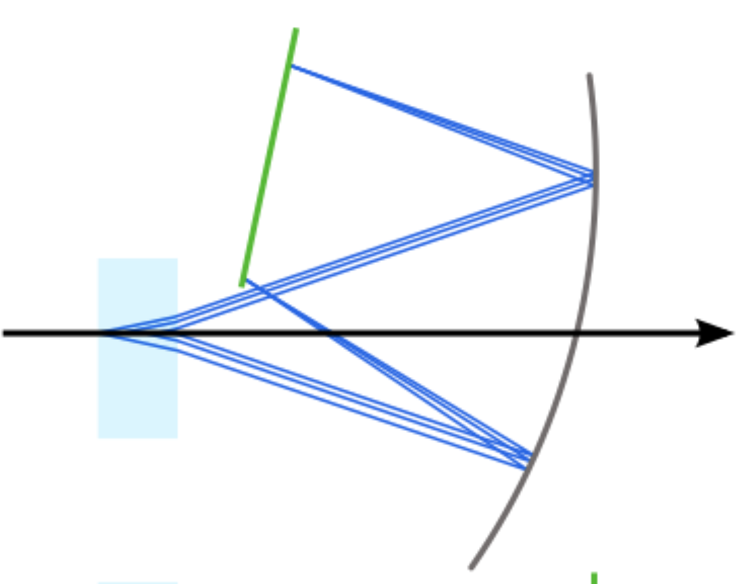
Photon Detection
Proximity focusing
Photon detector
Focusing mirror
M. Contalbrigo
2nd European School on EIC Physics, 22th June – 2nd July, 2025
8

Slide 9
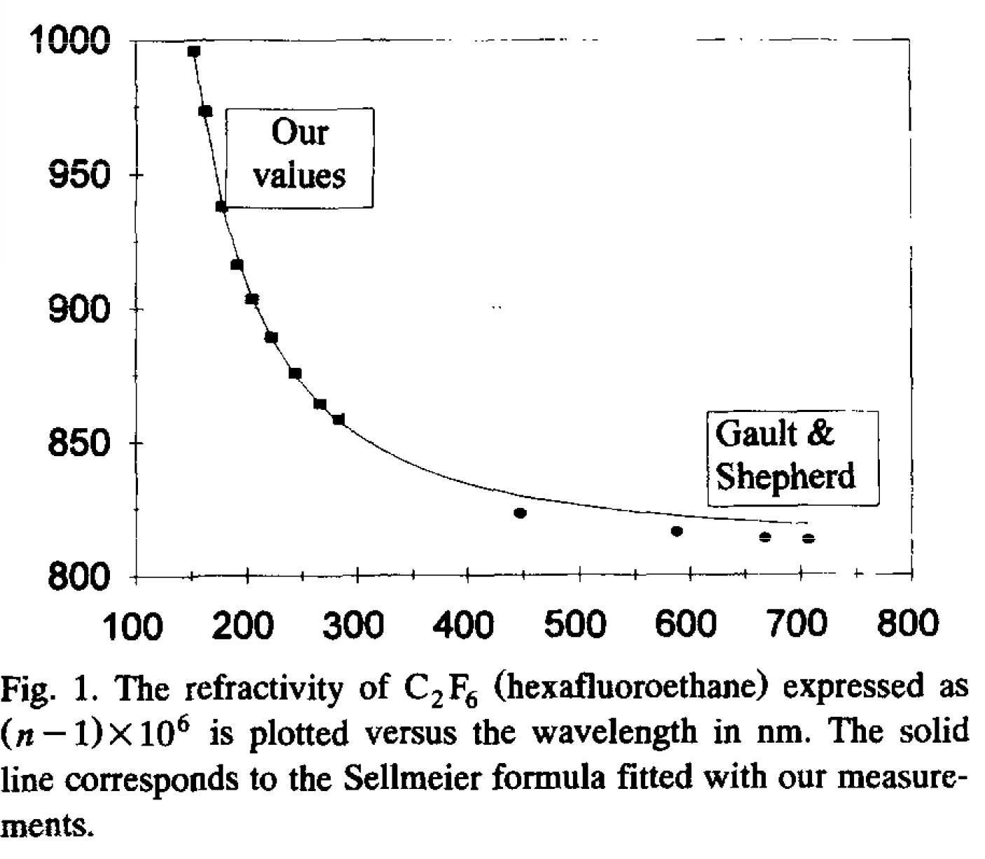
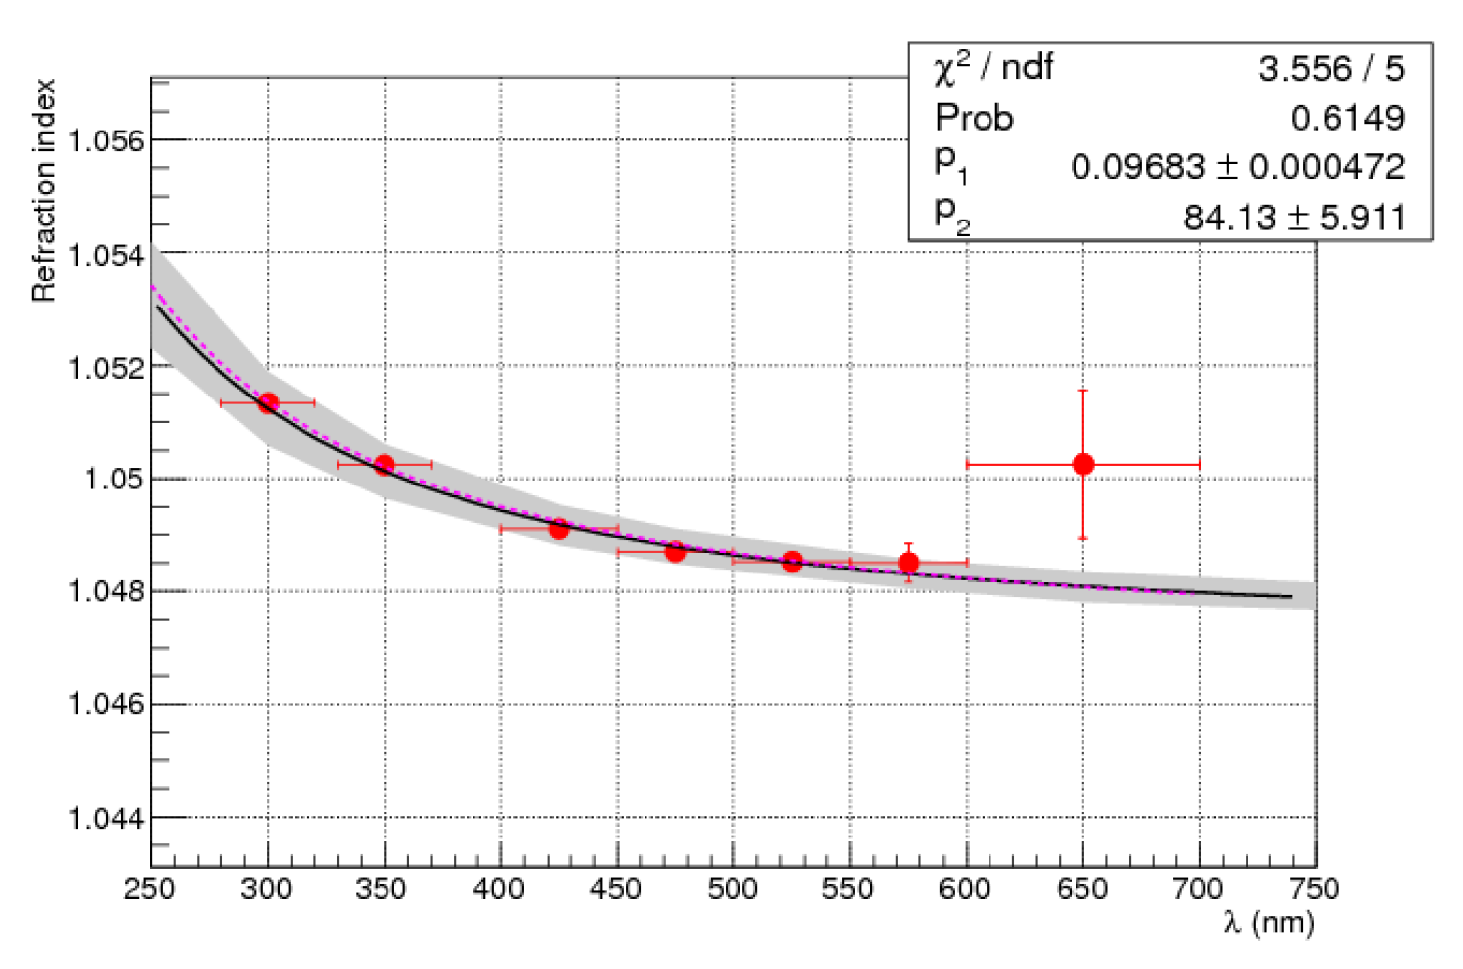
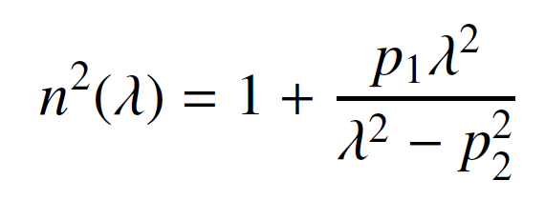
Chromatic Dispersion
Gas Radiator
Aerogel Radiator
X
Refractive index as a function of the Cherenkov light wavelength for the aerogel with n = 1.05 and trad = 20 mm obtained selecting pions with 8 GeV/c momentum.
X
Sellmeier parameterization
M. Contalbrigo
2nd European School on EIC Physics, 22th June – 2nd July, 2025
9

Slide 10
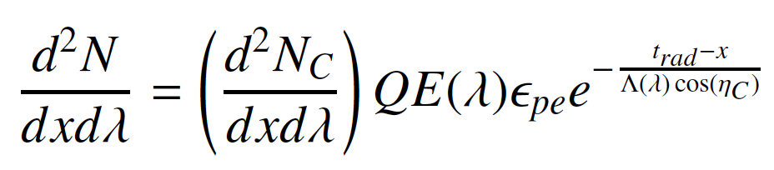

Cherenkov Resolution
$σ_{CH} \text{=}$ $\sqrt{σ_{co}^{2}+\frac{σ_{em}^{2} + σ_{ch }^{2}+{ σ}_{px}^{2}}{N_{pe}}}$
σ_{co} correlated uncertainty (tracking, misalignment, magnetic bending, multiple scattering, ….)
σ_{em} uncertainty on the photon emission point (radiator depth)
σ_{ch} radiator chromatic dispersion (uncertainty on the photon wavelength)
σ_{px} sensor spatial resolution (pixel size)
Q(λ) Sensor quantum efficiency ε_{pe} detection efficiency (sensor and mirror)
Λ(λ) Radiator transmission length t_{rad} radiator thickness
M. Contalbrigo
2nd European School on EIC Physics, 22th June – 2nd July, 2025
10

Slide 11
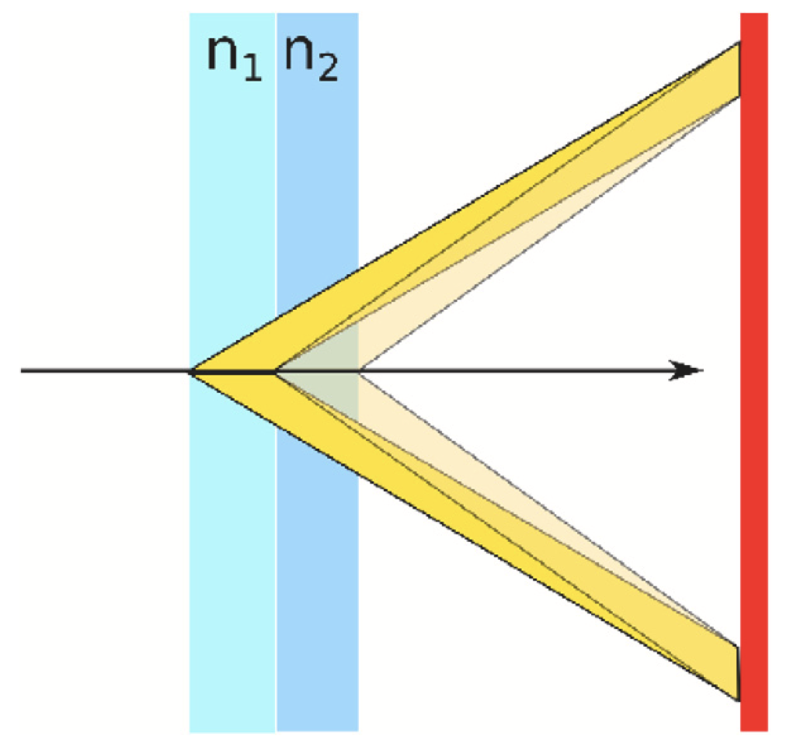
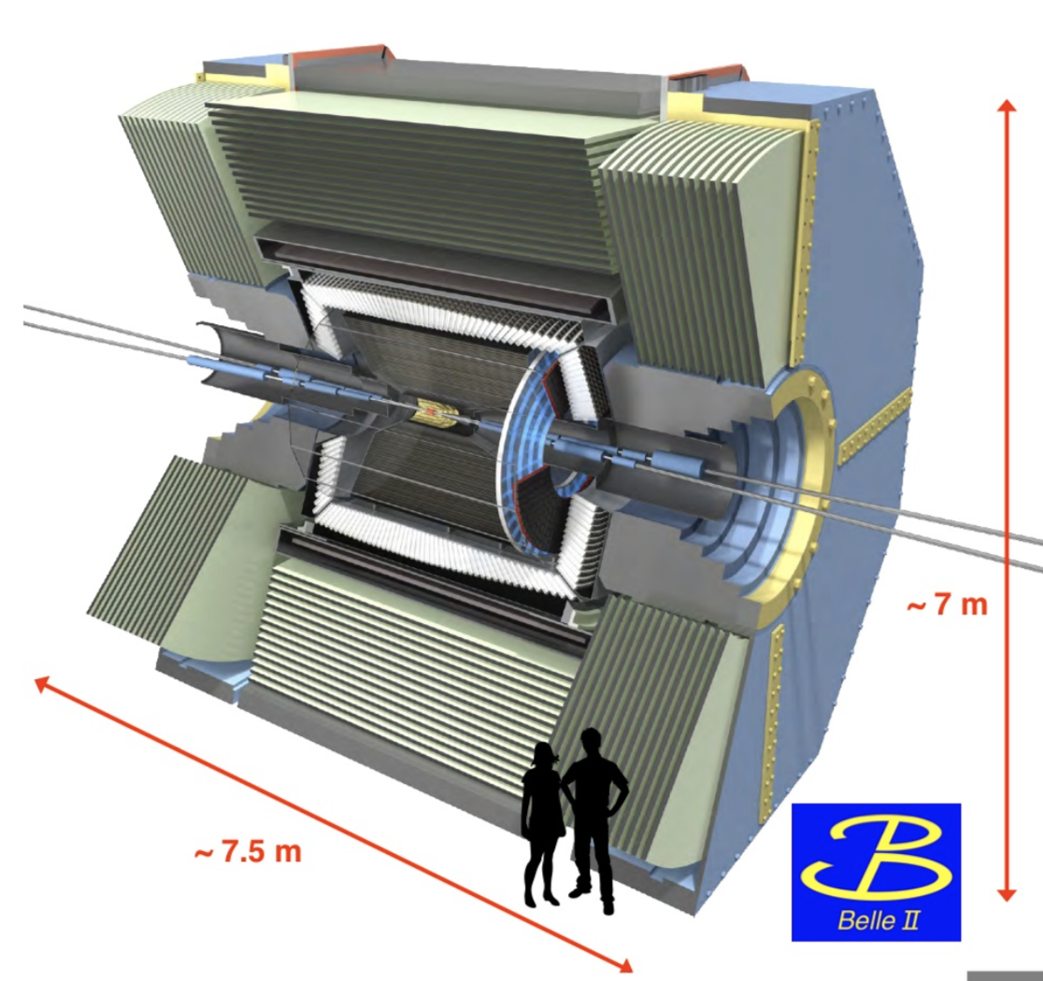
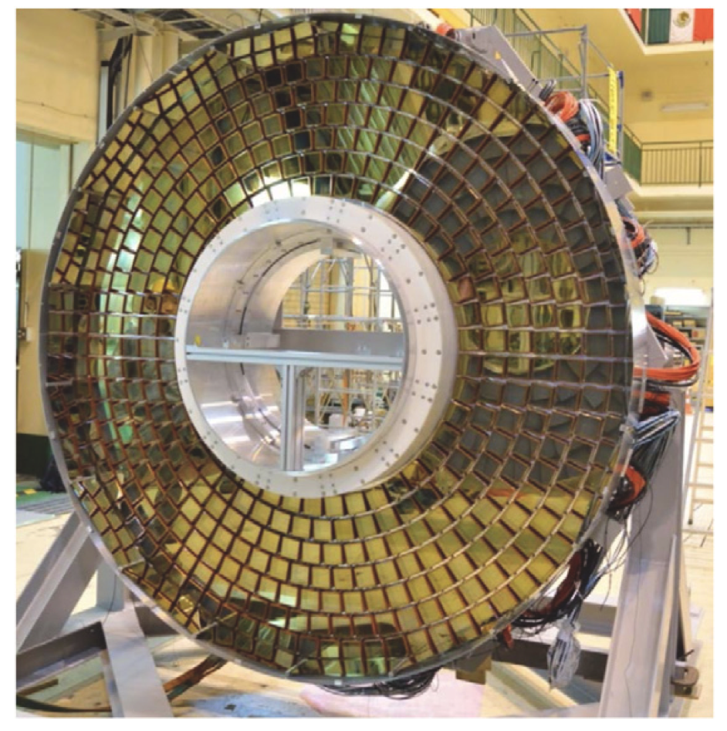
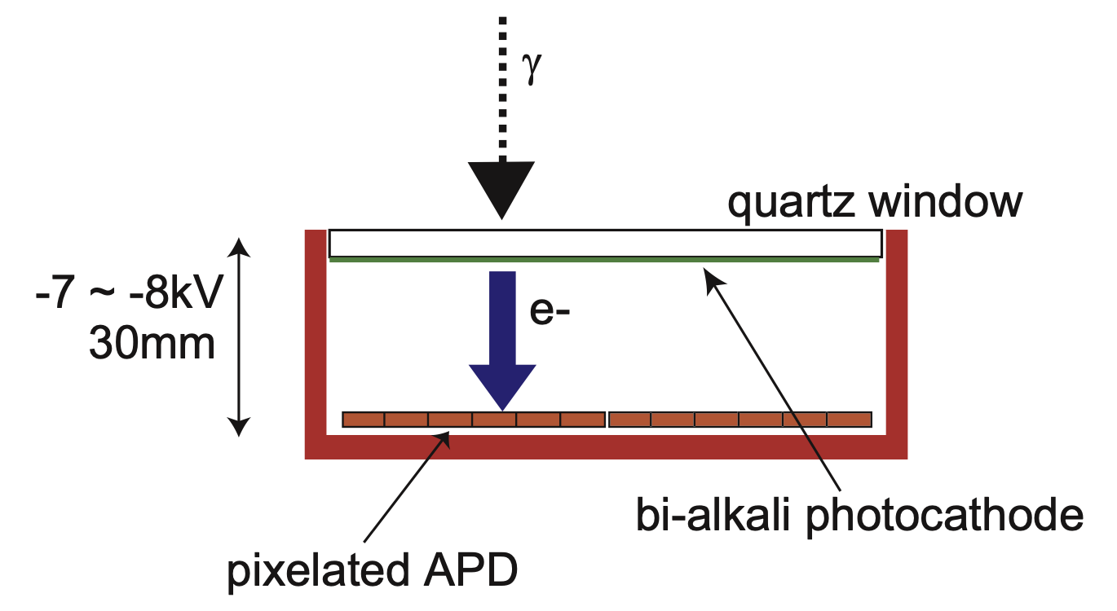
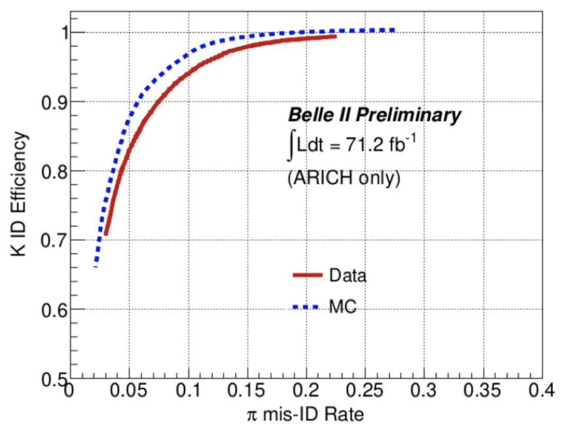
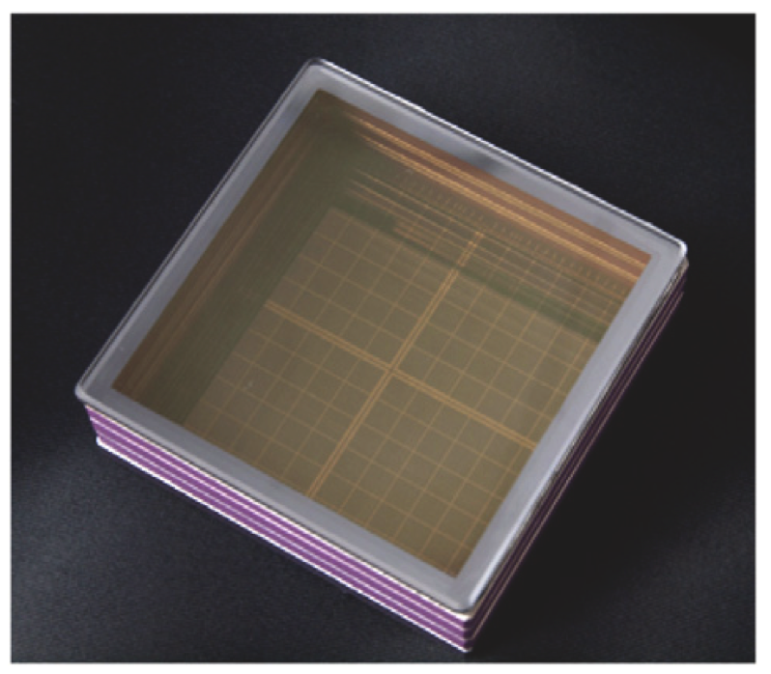
BELLE ARICH
1.045
1.055
Limited space --> Proximity focusing & radiator focusing
High B field (1.5T) --> Custom Hybrid photon detector
Super bialkali photocatode
Gain 4.5 10⁶
PDE ~ 28 %
17 cm
BELLE-II: B-factory
D⁰--> K⁻π⁺ 0.5 - 3.5 GeV/c
M. Contalbrigo
2nd European School on EIC Physics, 22th June – 2nd July, 2025
11

Slide 12
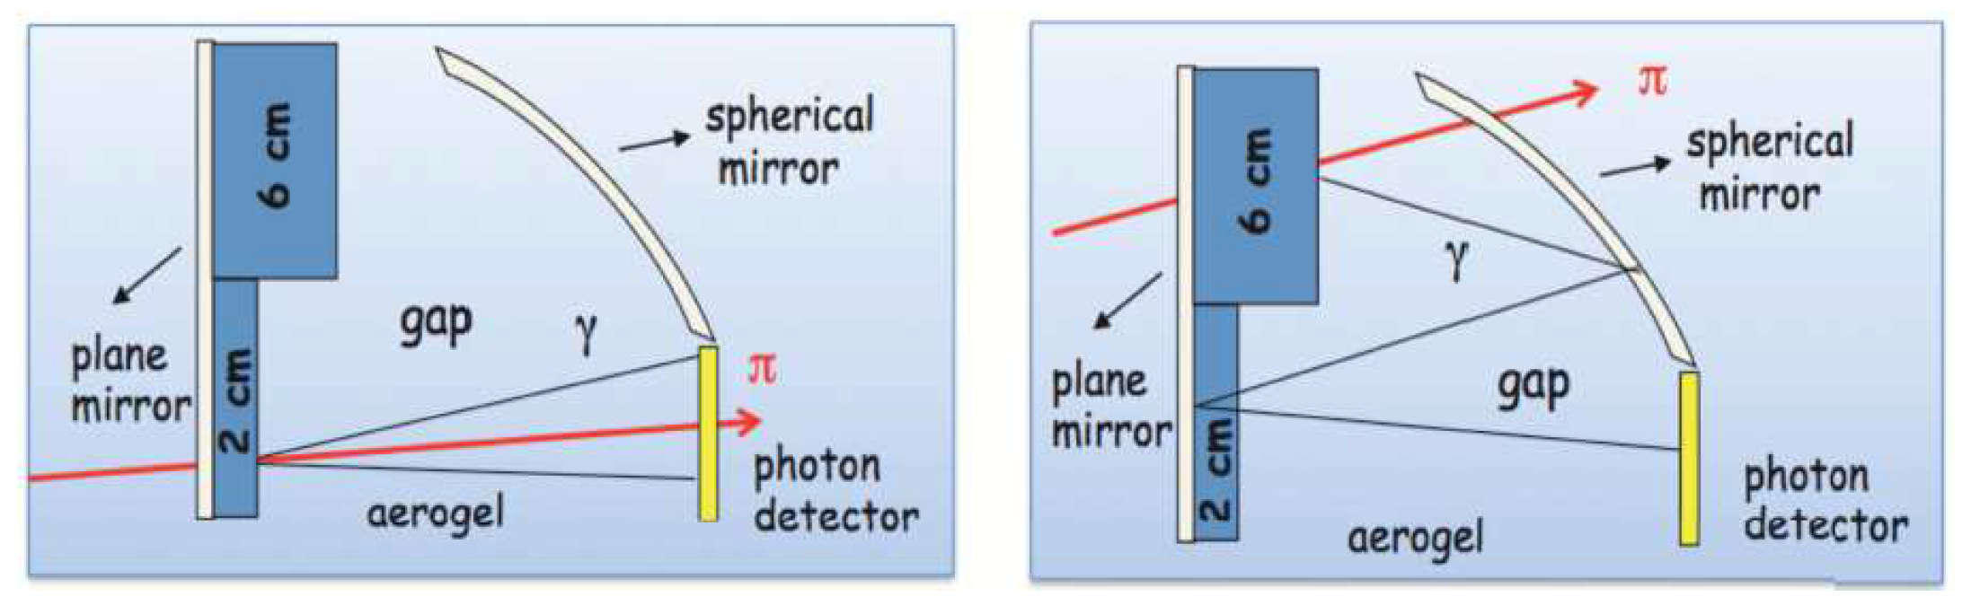
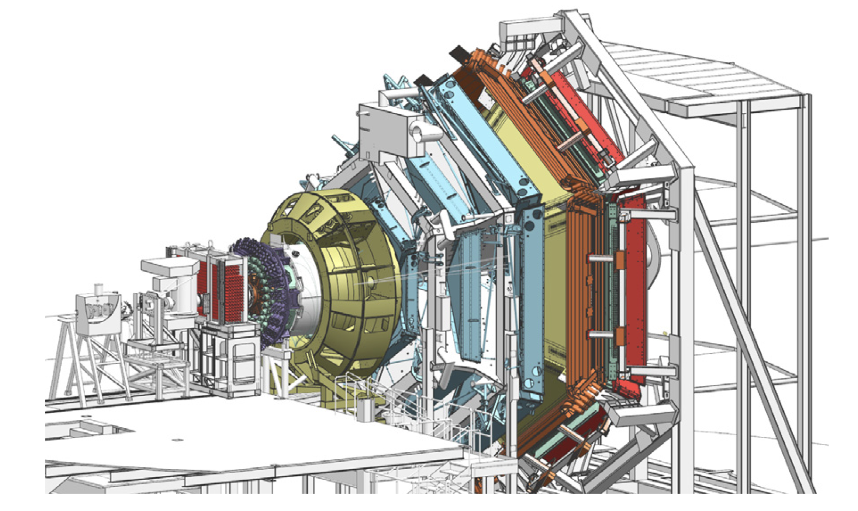
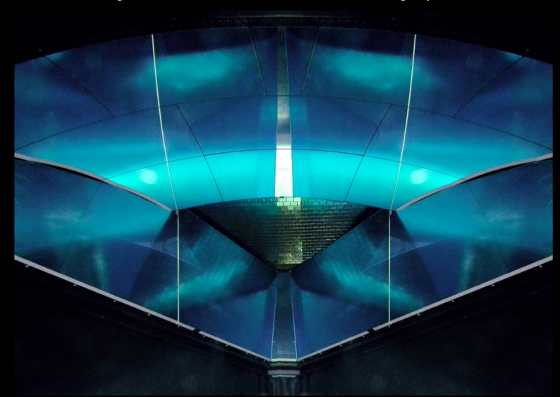
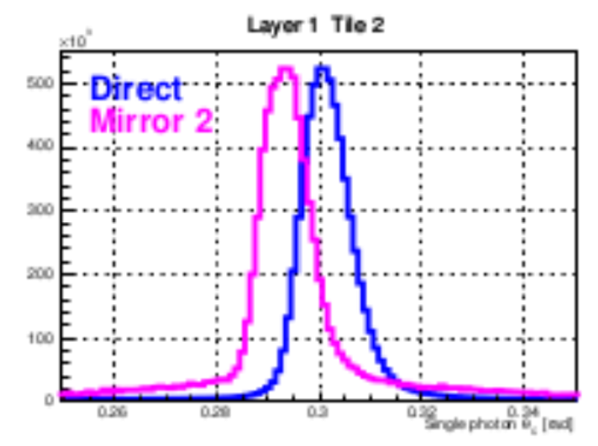
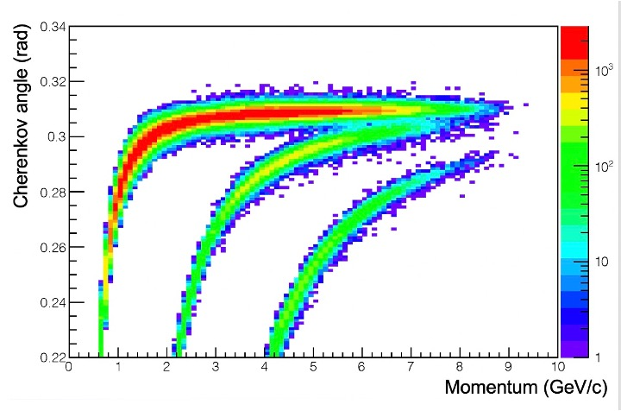
CLAS12 RICH
CLAS12: Nucleon structure
and spectroscopy
X
Electrons: direct vs spherical reflection
95 % kaon efficiency
(<1% pion mis-ID) up to 8 GeV/c
X
M. Contalbrigo
2nd European School on EIC Physics, 22th June – 2nd July, 2025
12

Slide 13
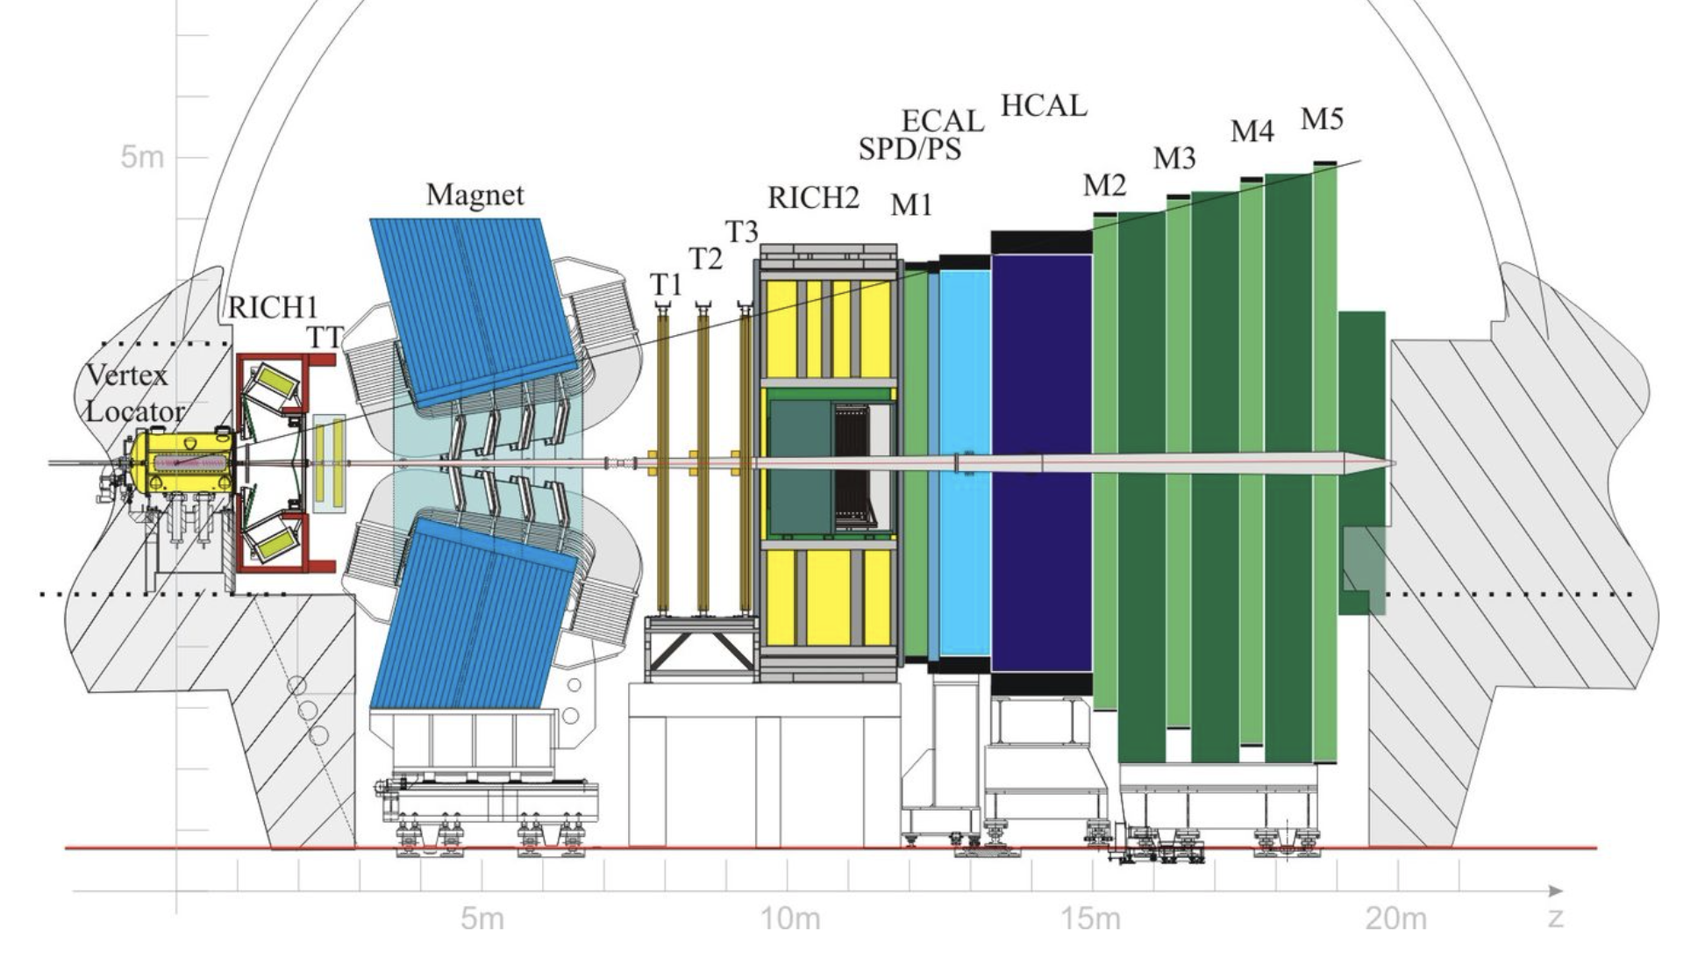
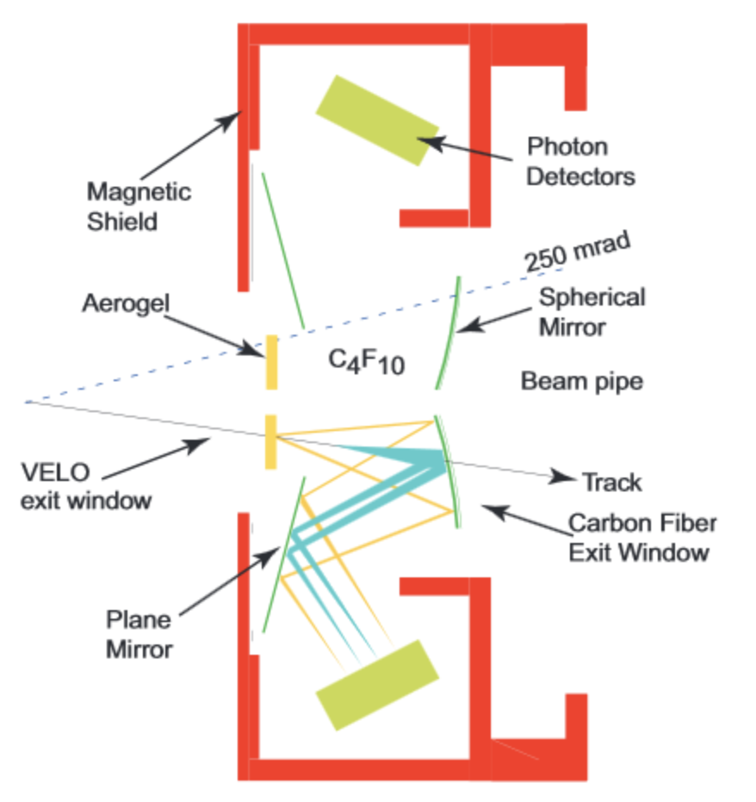
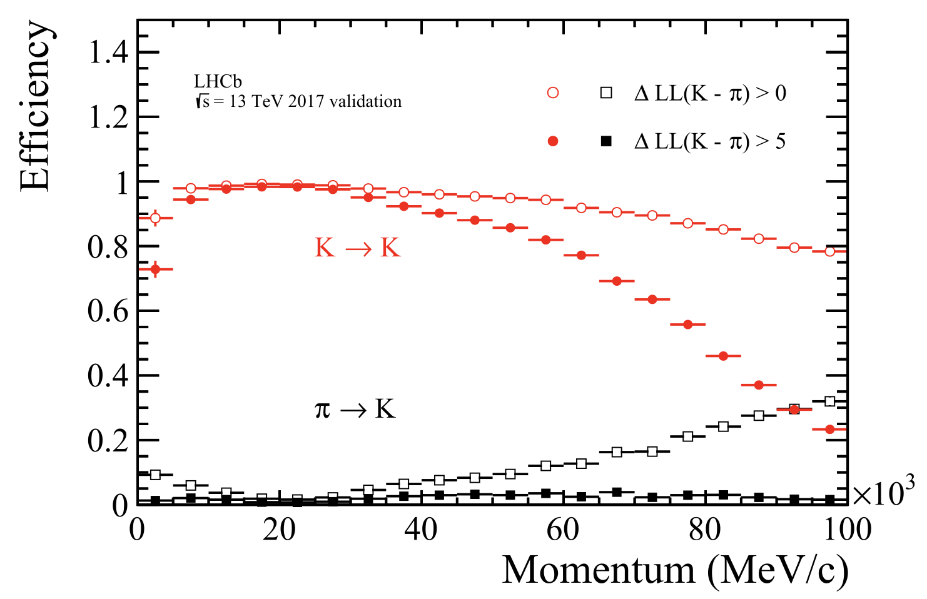
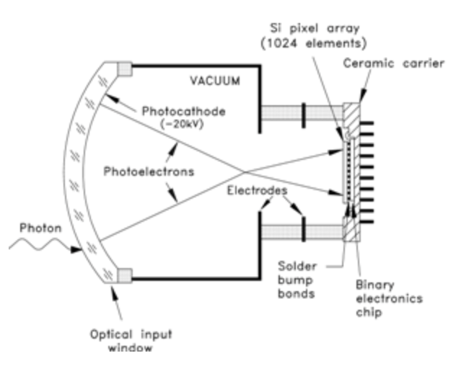
LHCb RICH
LHCb B physics
LHCb Precisin measurements of B-decays
and search fro BSM signals
RICH1: Aerogel (5 cm) n=1.03
2-10 GeV/c
C₄F₁₀ (85 cm) n=1.0014
up to 70 GeV/c
RICH2: CF₄ (196 cm) n=1.0005
up to 100 GeV/c
RICH1
Hybrid photomultiplier
Photocatode @ - 20 kV
Silicon sensor
M. Contalbrigo
2nd European School on EIC Physics, 22th June – 2nd July, 2025
13

Slide 14
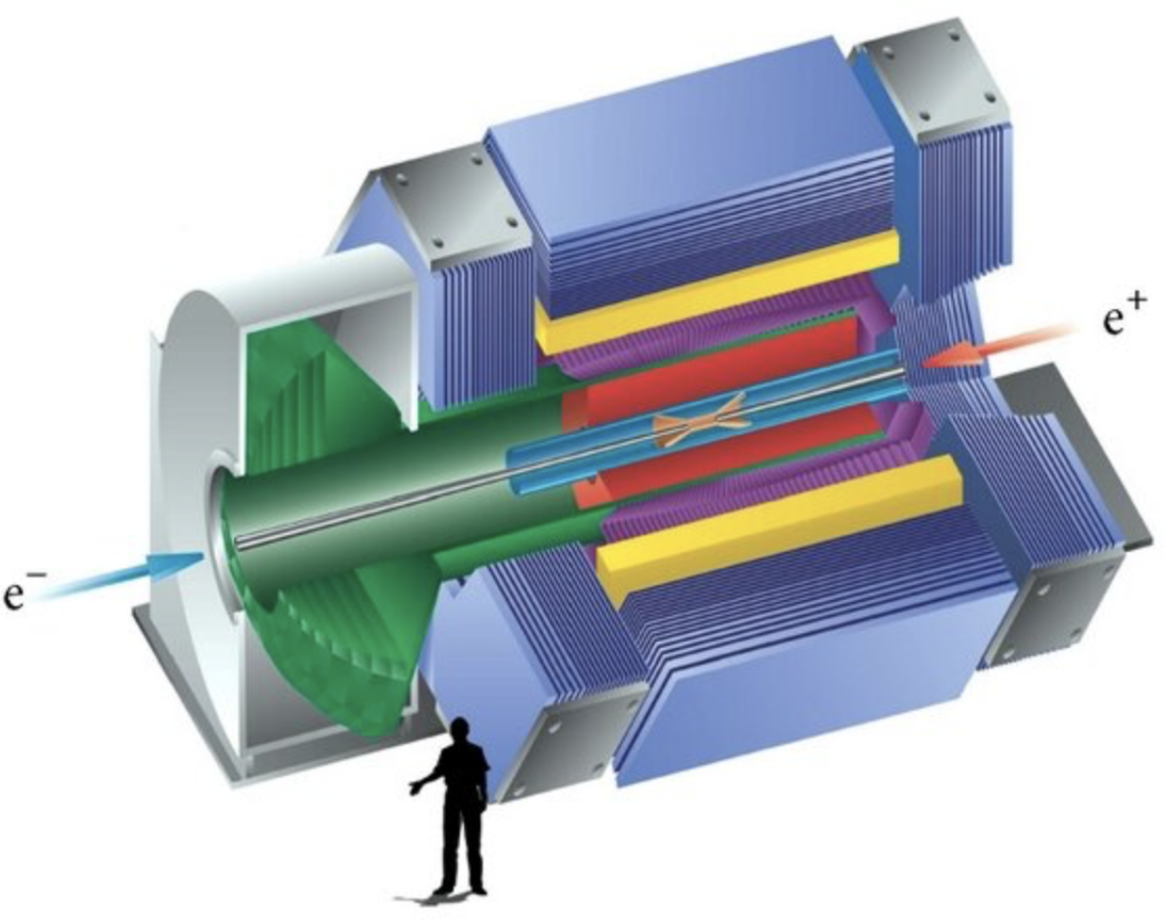
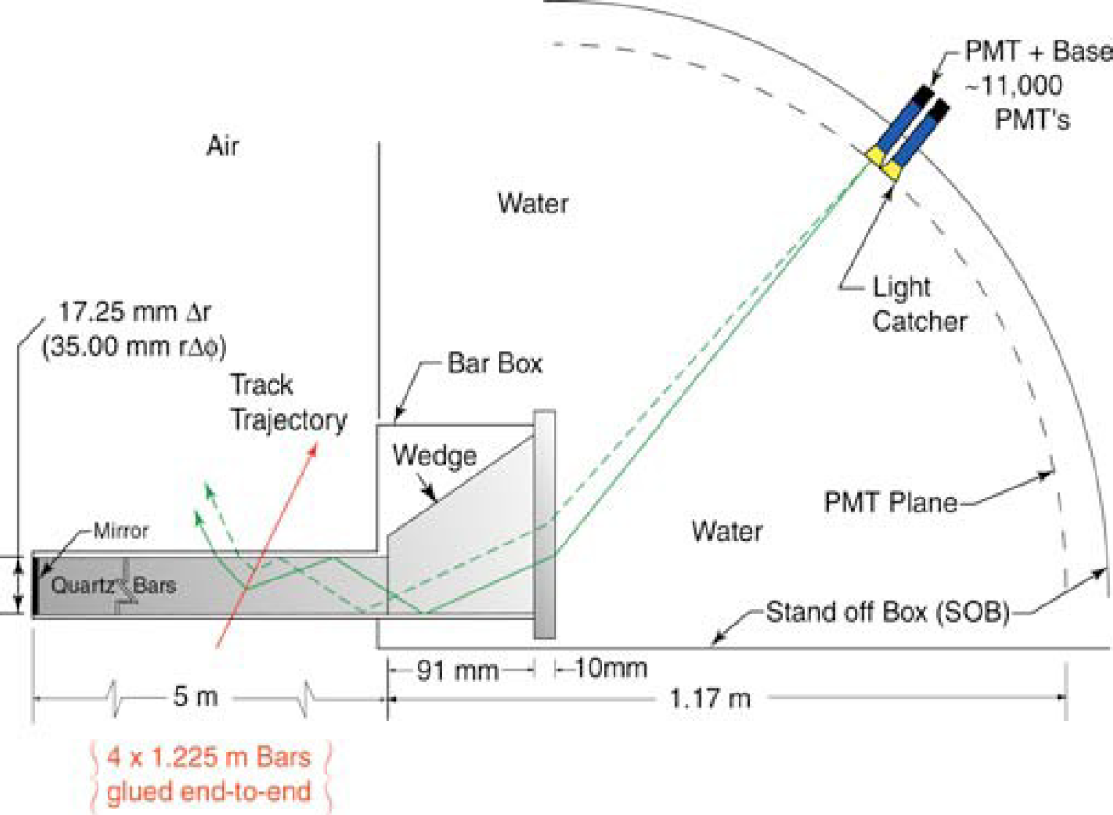
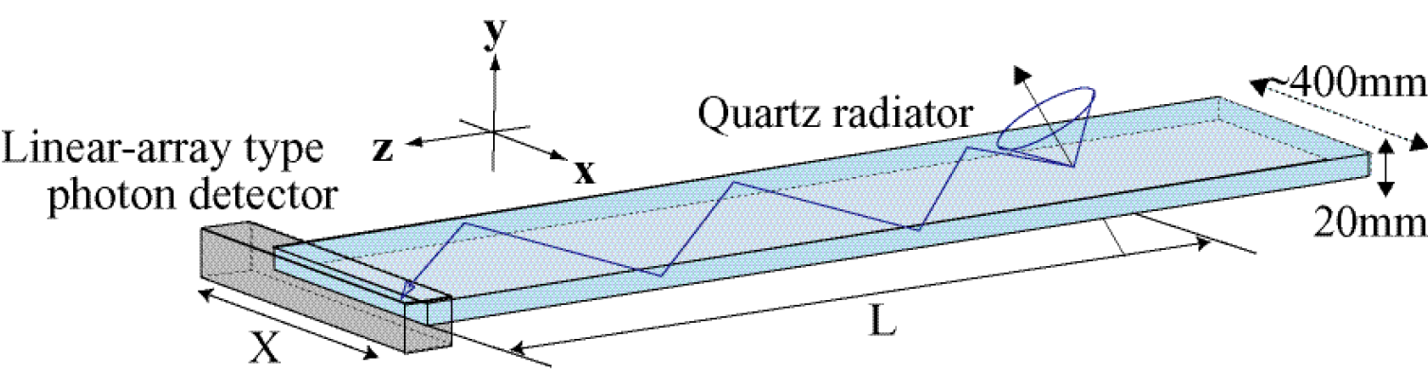
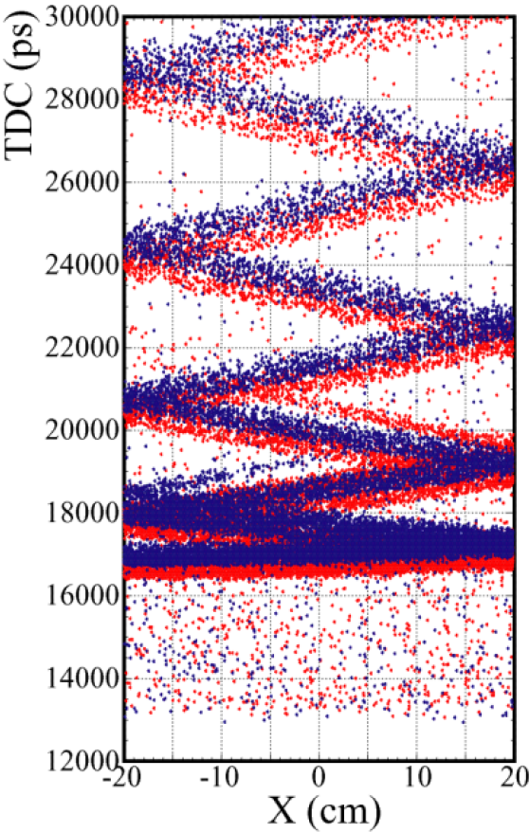
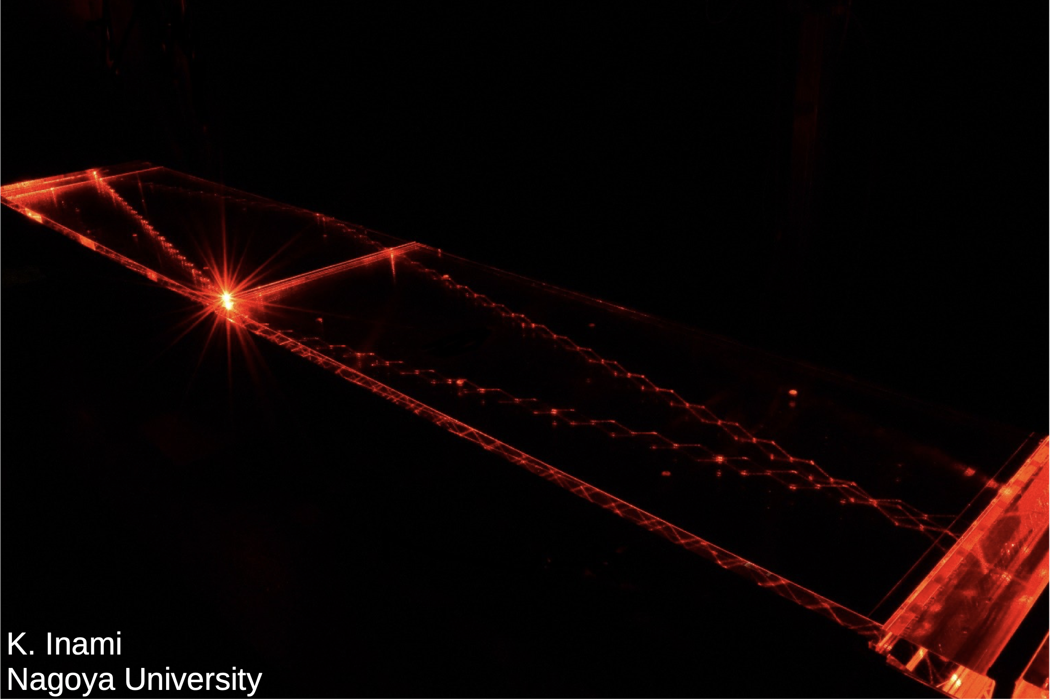
DIRC
Babar
Belle-II
B factory
X
X
B factory
Detection by internal reflection: compact detection volume (thickness)
Critical aspects: quartz surface quality (parallelism, roughness)
proper imaging system
2D imaging - Babar
X
X
Air
1D + time maging – Belle-II
M. Contalbrigo
2nd European School on EIC Physics, 22th June – 2nd July, 2025
14

Slide 15
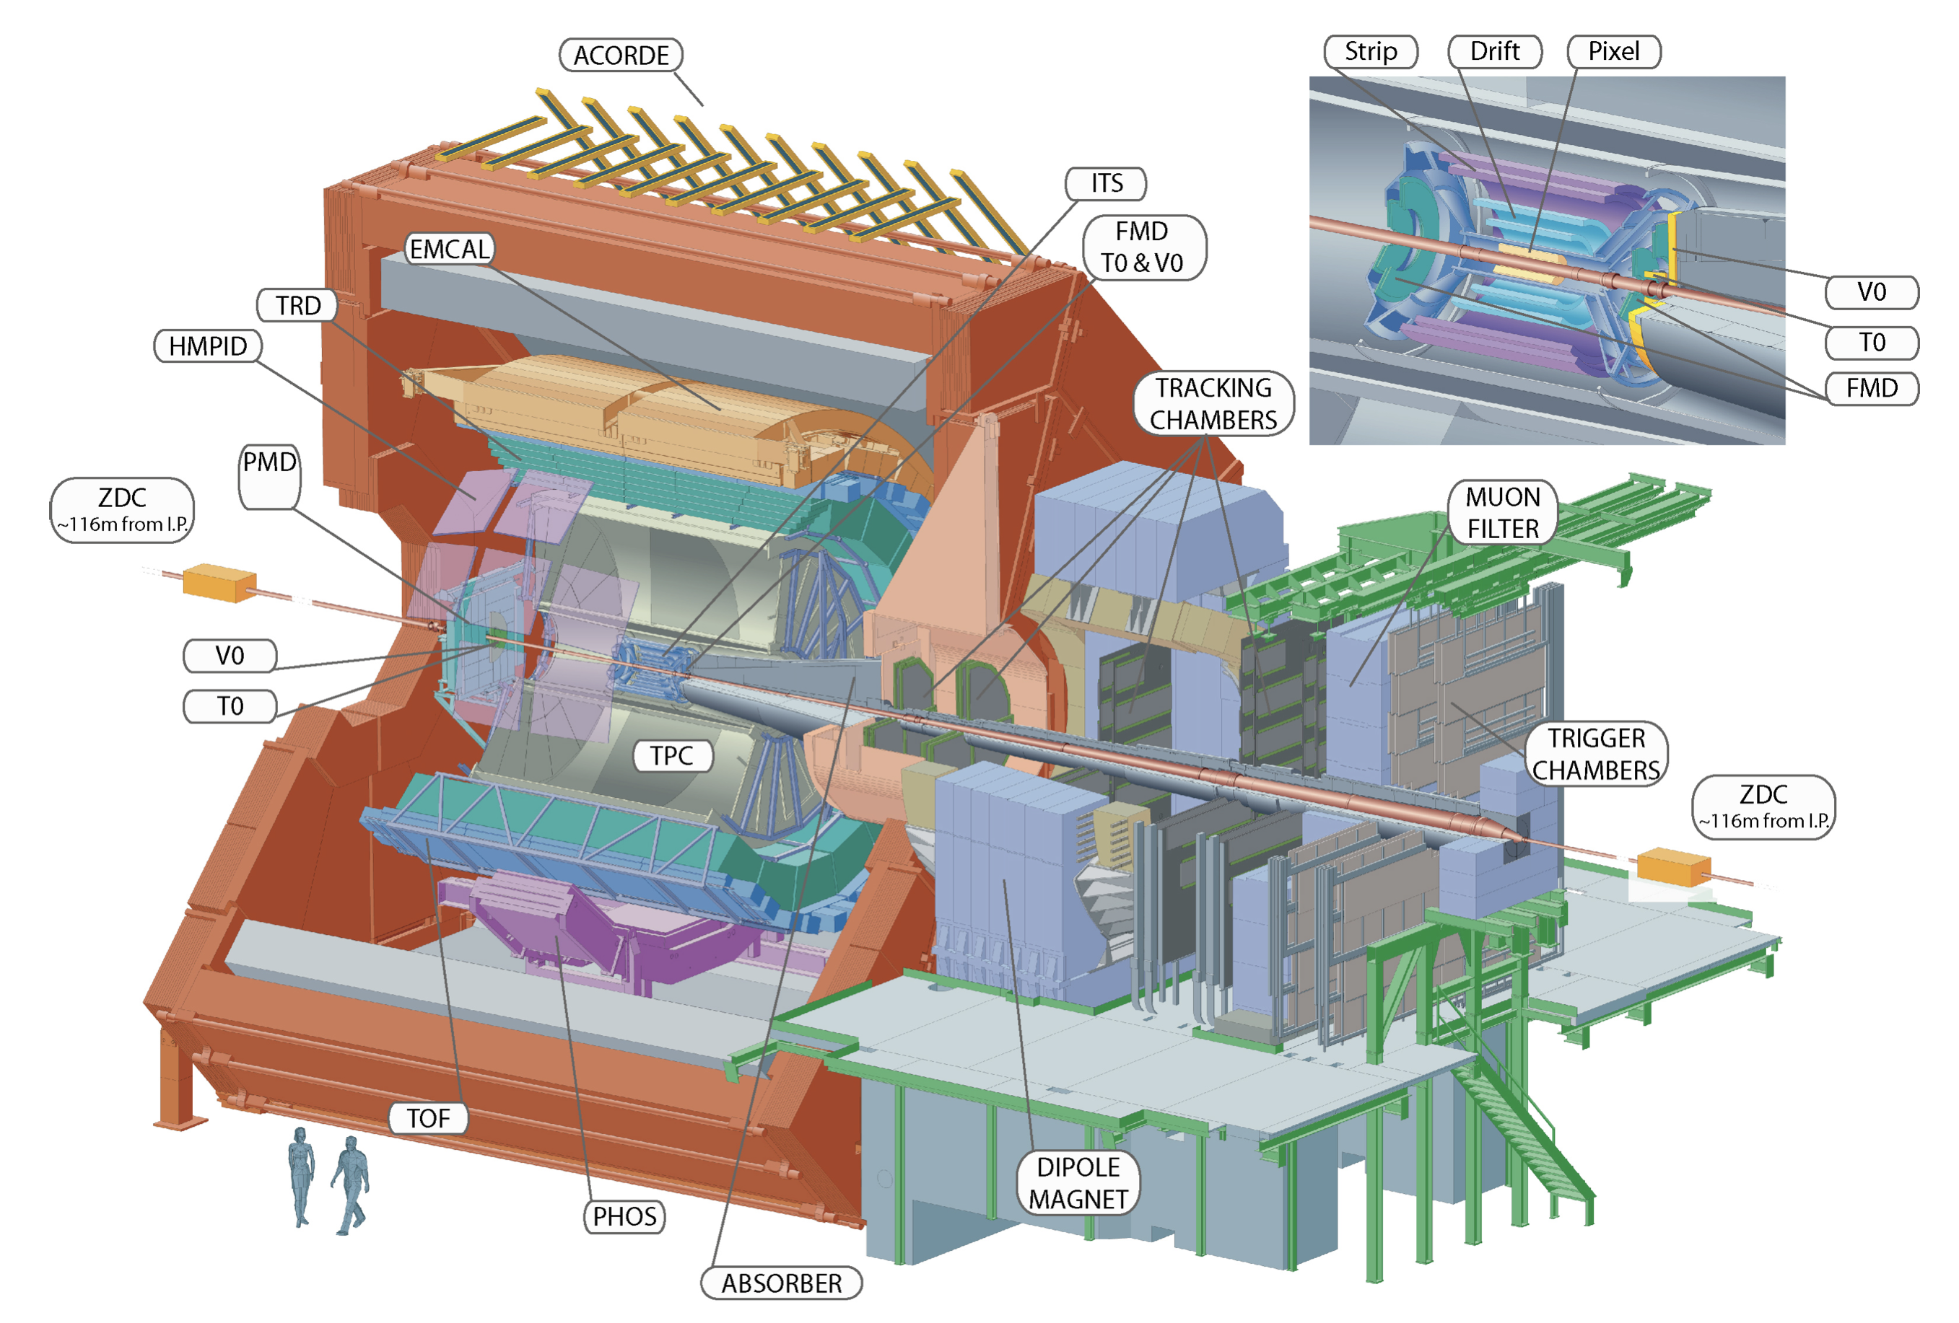
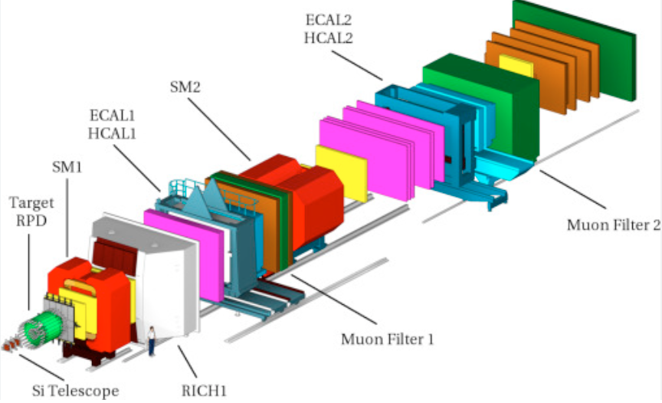
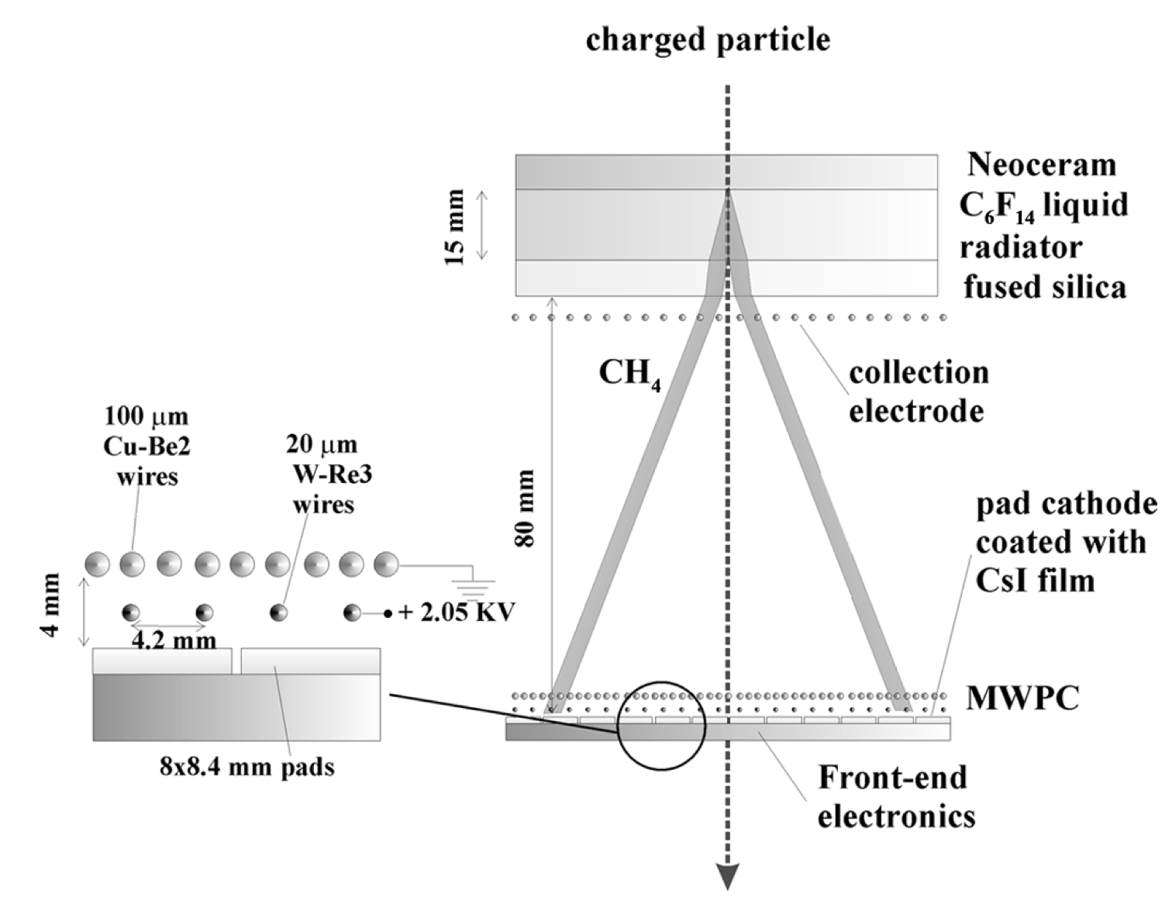
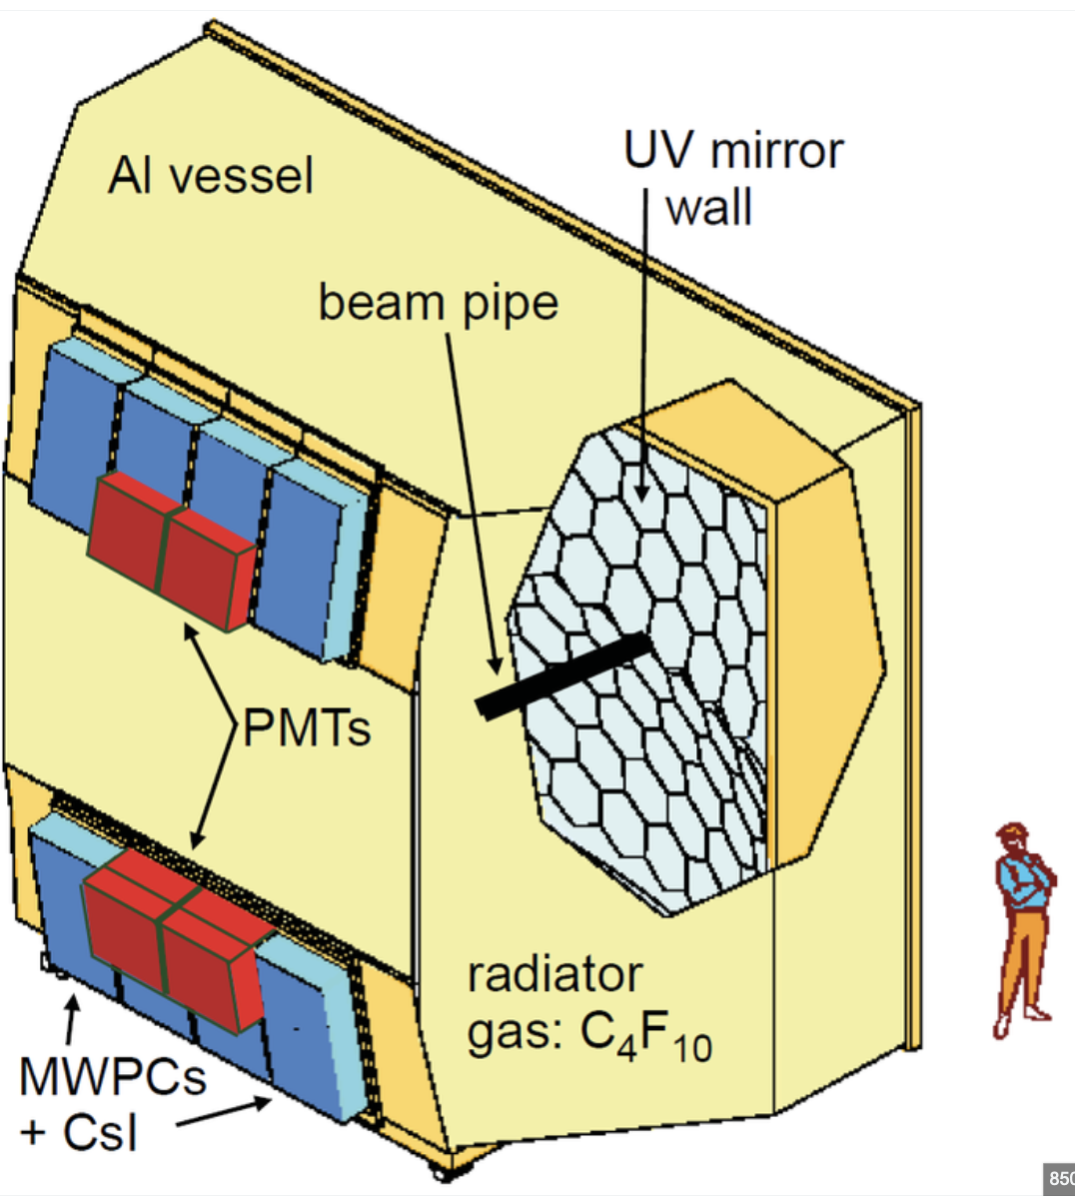
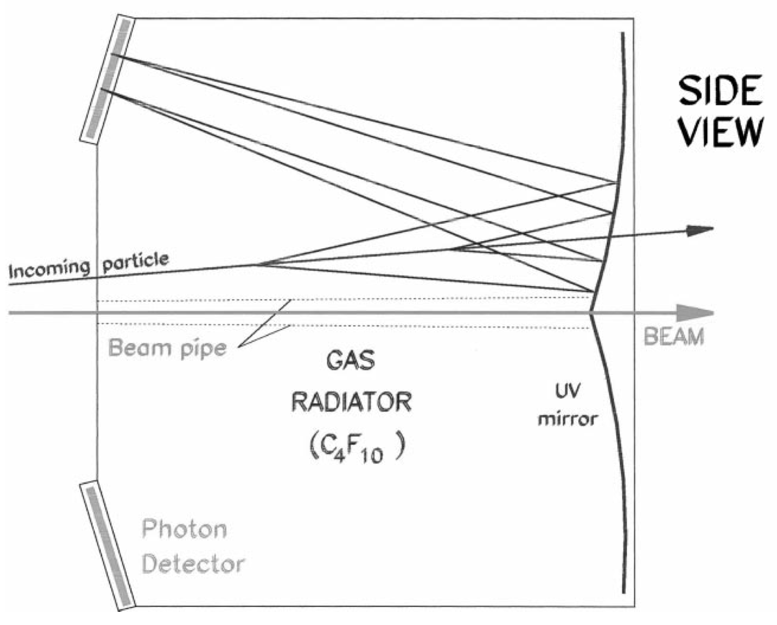
CsI Photocatode
ALICE: Quark-gluon plasma in heavy ion collisions
COMPASS: Nucleon structure and spectroscopy
Large instrumented area
Multi-wired proportional chambers with a CsI photocatode
Quantum efficiency is around 16-24% at 170 nm
High-Momentum PID
RICH
A = 11 m²
A = 5.3 m²
M. Contalbrigo
2nd European School on EIC Physics, 22th June – 2nd July, 2025
15

Slide 16
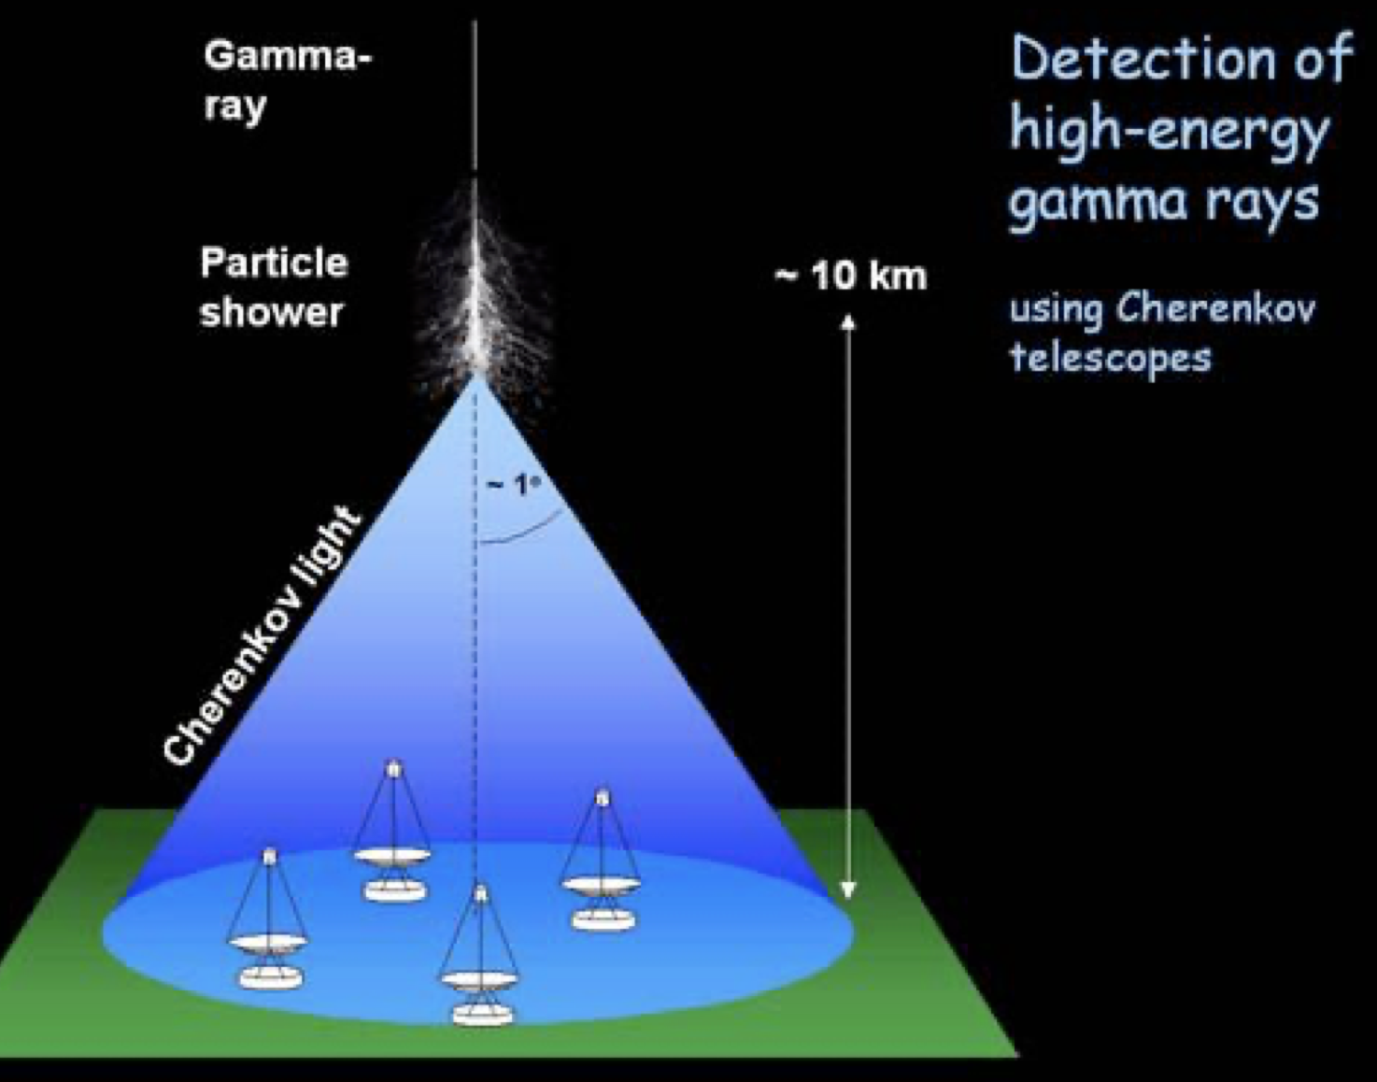
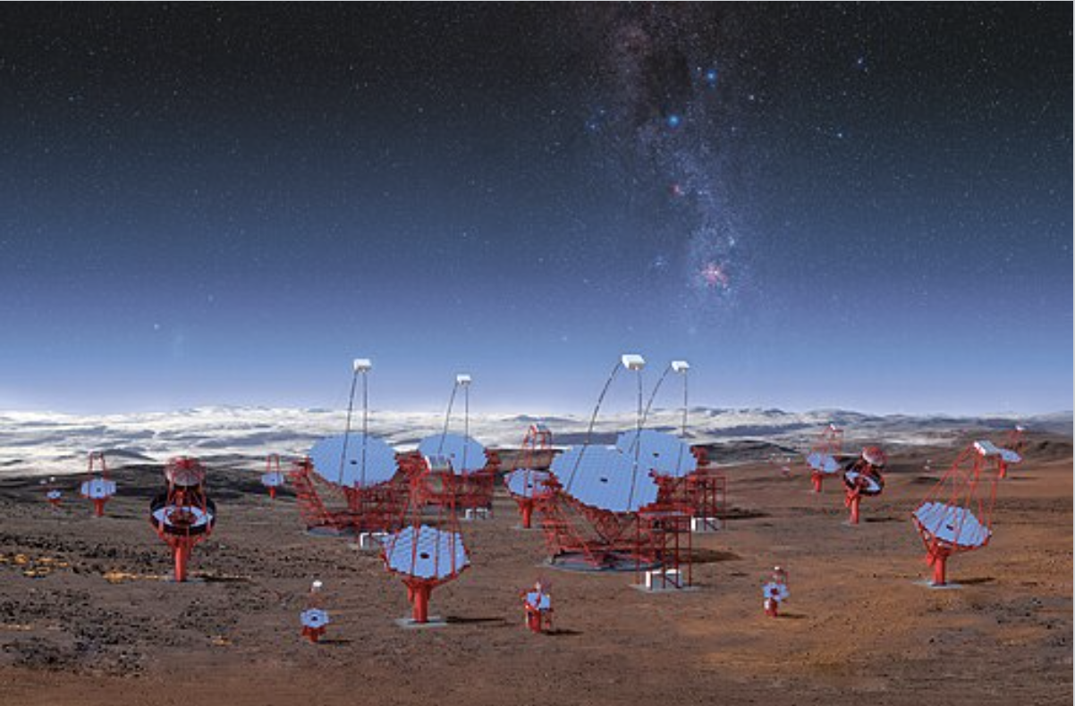

Cosmic Rays
A cosmic gamma ray generates a particle shower in the atmosphere
Showering charged particles generates Cherenkov radiation
The number of detected photons is proportional to the initial energy
Air refractive index is n = 1.00028
Threshold energy is 4.4 GeV for muons and 21 MeV for electrons
Cherenkov angle is 23 mrad ~ 1.3º
The shower maximum is at 10 km and generates a cone of 230 m
Extended detection pattern in
space and time gives the direction
M. Contalbrigo
2nd European School on EIC Physics, 22th June – 2nd July, 2025
16

Slide 17
PID Reconstruction
M. Contalbrigo
2nd European School on EIC Physics, 22th June – 2nd July, 2025
17

Slide 18



CLAS12 RICH
Goal: Hadron identification rom 3 GeV/c up to 8 GeV/c
mirrors
aerogel
Double
reflection
detector
Direct imaging
Hamamatsu H12700 (+ H8500)
< 1 cm spatial resolution
< 1 ns time resolution
Average gain ~ 2.7 10⁶
eq. to SPE ~ 400 fC
M. Contalbrigo
2nd European School on EIC Physics, 22th June – 2nd July, 2025
18
Notes:
Vanno messi studi innovativi e pubblicazioni

Slide 19

Geometry
M. Contalbrigo
2nd European School on EIC Physics, 22th June – 2nd July, 2025
19
Notes:
Vanno messi studi innovativi e pubblicazioni

Slide 20

Time
(t₀)
TOF
M. Contalbrigo
2nd European School on EIC Physics, 22th June – 2nd July, 2025
20
Notes:
Vanno messi studi innovativi e pubblicazioni

Slide 21

Ray Tracing
and time
M. Contalbrigo
2nd European School on EIC Physics, 22th June – 2nd July, 2025
21
Notes:
Vanno messi studi innovativi e pubblicazioni

Slide 22

Convergence
M. Contalbrigo
2nd European School on EIC Physics, 22th June – 2nd July, 2025
22
Notes:
Vanno messi studi innovativi e pubblicazioni

Slide 23

Reconstruction
M. Contalbrigo
2nd European School on EIC Physics, 22th June – 2nd July, 2025
23
Notes:
Vanno messi studi innovativi e pubblicazioni

Slide 24
PID Analysis
M. Contalbrigo
2nd European School on EIC Physics, 22th June – 2nd July, 2025
24

Slide 25





Analysis
Least squares
minimization
Likelihood
maximization
Machine learning
techniques
$$χ^{2}= \sum_{i=1}^{N}{ \frac{{{(x}_{i}−x(θ))}^{2}}{σ^{2}} }$$
π
Probabiliy
Probabiliy
p
k
Signal
Signal
M. Contalbrigo
2nd European School on EIC Physics, 22th June – 2nd July, 2025
25
Notes:
Vanno messi studi innovativi e pubblicazioni

Slide 26


Particle Identification
Best performance is with an holistic approach
Correlating featured signals from the same detector (dE/dx points, TRD layers, ring photons,….) or from different detectors
dE/dx
TRD
TOF
M. Contalbrigo
2nd European School on EIC Physics, 22th June – 2nd July, 2025
26
Notes:
Vanno messi studi innovativi e pubblicazioni

Slide 27




Holistic Approach
dE/dx
TRD
RICH
TOF
M. Contalbrigo
2nd European School on EIC Physics, 22th June – 2nd July, 2025
27
Notes:
Vanno messi studi innovativi e pubblicazioni

Slide 28



Extended Maximum Likelihood
Observe n events x_{i} and expect a total of μ
In the logL any constant is irrelevant, i.e. any term that does not depend
on the parameters θ.
In case f(x_{i};θ) is a binned PDF with poisson probability the above reduces
(except for a constant) to the binned maximum likelihood
L
M. Contalbrigo
2nd European School on EIC Physics, 22th June – 2nd July, 2025
28
Notes:
Vanno messi studi innovativi e pubblicazioni

Slide 29

Extended Maximum Likelihood
Taking a likelihood ratio, vs an ideal model corresponding to the measurement
(μ_{i}=n_{i}), provides a chi2-like estimator (goodness of fit) if μ_{i} are not too small
* μ_{i} is the expected yield in bin i (signal + background)
* pdf normalization to 1 is given by Poisson
* the μ_{i} – n_{i} term is optional (less stringent except close to threshold)
* one can have bins with zero counts (last term is taken to be zero)
M. Contalbrigo
2nd European School on EIC Physics, 22th June – 2nd July, 2025
29
Notes:
Vanno messi studi innovativi e pubblicazioni

Slide 30

Cherenkov Example
Measured values
$μi\left(θ\right)= ε\left(i\right) \frac{dφ}{2π} e^{−\frac{{\left(θ−θ_{i}\right)}^{2}}{2σ^{2}}}\frac{\text{d}θ}{\sqrt{2π}σ} e^{−\frac{{\left(t(θ)−t_{i}\right)}^{2}}{2σ_{t}^{2}}}\frac{dt}{\sqrt{2π}σ_{t}}$ + B(i)
Flat
probability
t may change due to
path (direct or reflected)
B
All these quantities are defined at pixel level
- dθ and dφ are known by RICH reconstruction.
- ε(i) can reflect dead (0) or hot (1) channels, or the quantum/reflection efficiency ([0:1])
- B(i) can be derived from random triggers or electron control sample
Reference values could accounts for second order effects
(photon path and pattern change among various mass hypotheses).
M. Contalbrigo
2nd European School on EIC Physics, 22th June – 2nd July, 2025
30
Notes:
Vanno messi studi innovativi e pubblicazioni

Slide 31


Likelihood Ratio
θ=θ_{i}
t=t_{i}
${μi}^{′}(θ)= ε\left(i\right) \frac{dφ}{2π} 1 \frac{\text{d}θ}{\sqrt{2π}σ} 1 \frac{dt}{\sqrt{2π}σ_{t}}$
One might take the likelihood ration with he model corresponding to the
“observed measurement” in which all the hit are at the right (expected) angle
$$−2lnλ\left(θ\right)=2 \sum_{i=1}^{N}{\left[μ_{i}\left(θ\right) −n_{i}+n_{i}ln\frac{μ_{i}^{′} (θ)}{μ_{i}(θ)}\right]}$$
$$=2 \left(N_{exp}−N\right)+\sum_{i=1}^{N}{\left[\frac{{\left(θ−θ_{i}\right)}^{2}}{σ^{2}}\right]+\left[\frac{{\left(t(θ)−t_{i}\right)}^{2}}{σ_{t}^{2}}\right]}$$
Should reduce to a sort of chi2.
Beyond non gaussian effects and the optional normalization term, the difference is in the
background that defines a sort of cutoff: an accepted hit that is background for all the
hypotheses does not count in the likelihood, whereas the ordinary chi2 weights anyway its
distance from the expected value (provides a preference) except it is explicity excluded
M. Contalbrigo
2nd European School on EIC Physics, 22th June – 2nd July, 2025
31
Notes:
Vanno messi studi innovativi e pubblicazioni

Slide 32

Extended Maximum Likelihood
Without 2(N_{exp}-N) term
M. Contalbrigo
2nd European School on EIC Physics, 22th June – 2nd July, 2025
32
Notes:
Vanno messi studi innovativi e pubblicazioni

Slide 33

Extended Maximum Likelihood
With 2(N_{exp}-N) term
M. Contalbrigo
2nd European School on EIC Physics, 22th June – 2nd July, 2025
33
Notes:
Vanno messi studi innovativi e pubblicazioni

Slide 34

Neural Networks
Classifier
Features of data
Identification
π
k
Connection
Connection: got a weight defining the strenght
Node: got an activation function for the output value from weighted inputs plus bias
M. Contalbrigo
2nd European School on EIC Physics, 22th June – 2nd July, 2025
34
Notes:
Vanno messi studi innovativi e pubblicazioni

Slide 35
NN Training
Classifier
Features of data
Identification
π
π
π
k
k
k
Connection
Connection: got a weight defining the strenght
Node: got an activation function for the output value from weighted inputs plus bias
During iterative learning, the network parameters are automatically tuned on training samples
to minimize the difference between estimate and correct answer in several cycles (epochs)
M. Contalbrigo
2nd European School on EIC Physics, 22th June – 2nd July, 2025
35
Notes:
Vanno messi studi innovativi e pubblicazioni

Slide 36
Neural Networks
Classifier
Features of data
Identification
π
?
π
k
k
Connection
The network is then ready to classify sets of data and represents a correlation map over distinctive features
Potential biases: relevance of the features, should bring discrimination power
type of classifier, should provide enough flexibility (e.g. node and layer number
goodness of training, should provide an acceptable convergence
training sample, pseudo-data should reflect the real data features
Critical as assumes an
a-priori knowledge
M. Contalbrigo
2nd European School on EIC Physics, 22th June – 2nd July, 2025
36
Notes:
Vanno messi studi innovativi e pubblicazioni

Slide 37
Analysis
Least squares
minimization
Likelihood
maximization
Machine learning
techniques
Correlations via covariance matrix
Correlations via multi-D p.d.f.
Correlations via NN training
$$χ^{2}= \sum_{i=1}^{N}{ \frac{{{(x}_{i}−x(θ))}^{2}}{σ^{2}} }$$
π
Probabiliy
π
Probabiliy
Population
p
p
k
k
Signal
Signal
Signal
M. Contalbrigo
2nd European School on EIC Physics, 22th June – 2nd July, 2025
37
Notes:
Vanno messi studi innovativi e pubblicazioni

Slide 38




Patter Recognition
π
k
p
TOP BELLEII
M. Contalbrigo
2nd European School on EIC Physics, 22th June – 2nd July, 2025
38
Notes:
Vanno messi studi innovativi e pubblicazioni

Slide 39







Online Filtering
Efficiency increase (resources saving) when useless degrees of freedom are removed, i.e. the NN architecture is aligned to the real detector layout
Scheme based on ePIC DAM (Felix) &
APEIRON communication network (INFN)
sub-sector integrated analysis
detector integrated analysis
Preliminary tests
Classifier
M. Contalbrigo
2nd European School on EIC Physics, 22th June – 2nd July, 2025
39
Notes:
Farsi spieare la latenza. Bisogna sapere ul data rate a cui sono arrivati (factor 2?)

Slide 40
ePIC PID Requirements
M. Contalbrigo
2nd European School on EIC Physics, 22th June – 2nd July, 2025
40

Slide 41


ePIC Detector
h (275 GeV)
e (18 GeV)
M. Contalbrigo
2nd European School on EIC Physics, 22th June – 2nd July, 2025
41
Notes:
Vanno messi studi innovativi e pubblicazioni

Slide 42


ePIC Environment
Magnetif field
Radiation Map
(1 MeV eq. neutron
fluence cm⁻² fb⁻¹)
M. Contalbrigo
2nd European School on EIC Physics, 22th June – 2nd July, 2025
42
Notes:
Vanno messi studi innovativi e pubblicazioni

Slide 43
ePIC PID Solutions
M. Contalbrigo
2nd European School on EIC Physics, 22th June – 2nd July, 2025
43

Slide 44


ePIC pfRICH
Proximity-Focusing Ring-imaging Cherenkov Detector (pfRICH)
Essential to access flavor information
Goals:
Hadron 3σ−separation up to 7 GeV/c
Complement electron ID below 3 GeV/c
Cover forward pseudorapidity -3.5 : -1.5 (e-endcap)
dRICH Features:
Limited space --> Simple geometry, gap minimized
Precise time information --> HRPPD
Single-photon detection in high Bfield --> HRPPD
M. Contalbrigo
2nd European School on EIC Physics, 22th June – 2nd July, 2025
44

Slide 45






HRPPD
A.V. Lyashenko e-Print: 2505.10658
C. Chatterjee PoS DIS2024 (2025) 266
Gain uniformity
λ = 365 nm
Average QE (5 over 7)
M. Contalbrigo
2nd European School on EIC Physics, 22th June – 2nd July, 2025
45

Slide 46

ePIC TOF
Time-of-Flight Detector (TOF)
Essential to access flavor information
Goals:
Hadron 3σ−separation up to 1.2 Gev/c (barrel)
Hadron 3σ−separation up to 2.5 Gev/c (h-endcap)
Cover mid-forward pseudorapidity -1.5 : 3.5
dRICH Features:
Precision in limited space --> silicon detector
Up to 2.5 GeV/c momentum range --> AC-LGAD
Coplement tracking --> AC-LGAD
M. Contalbrigo
2nd European School on EIC Physics, 22th June – 2nd July, 2025
46

Slide 47




AC-LGAD
LGAD adds a p+ layer with large Boron doping to create
a region of high field and concentrated avalanche
AC-coupling allows space precision without
affecting the uniformity of the gain layer
C. Chatterjee PoS DIS2024 (2025) 266
M. Contalbrigo
2nd European School on EIC Physics, 22th June – 2nd July, 2025
47
Notes:
Vanno messi studi innovativi e pubblicazioni

Slide 48

ePIC hpDIRC
High-Performance (dRICH)
Essential to access flavor information
Goals:
Hadron 3σ−separation between 3 - 6 GeV/c
Complement electron ID below 1.2 GeV/c
Cover forward pseudorapidity -1.5 - 1.5 (barrel)
dRICH Features:
Limited space --> Internal reflection
Up to 6 GeV/c momentum range --> Lens
Single-photon detection in high Bfield --> MCP-PMT
M. Contalbrigo
2nd European School on EIC Physics, 22th June – 2nd July, 2025
48

Slide 49




ePIC hpDIRC
Compact, high-performance (+50%) design
Quartz prism with focalizing sapphire lens
G. Kalicy NIMA 1062
(2024) 169168
Re-use of BABAR DIRC bars and cosmic test
M. Contalbrigo
2nd European School on EIC Physics, 22th June – 2nd July, 2025
49
Notes:
Vanno messi studi innovativi e pubblicazioni

Slide 50

ePIC dRICH
Dual-radiator Ring-imaging Cherenkov Detector (dRICH)
Essential to access flavor information
Goals:
Hadron 3σ−separation between 3 - 50 GeV/c
Complement electron ID below 15 GeV/c
Cover forward pseudorapidity 1.5 - 3.5 (h-cap)
dRICH Features:
Extended 3-50 GeV/c momentum range --> Dual radiator
Single-photon detection in high Bfield --> SiPM
Limited space --> Compact optics with curved detector
4m
M. Contalbrigo
2nd European School on EIC Physics, 22th June – 2nd July, 2025
50

Slide 51





ePIC dRICH
c. Chatterjee DIS2024 (2025) 266
Imaging study
Annealing study
C. Chatterjee PoS DIS2024 (2025) 266
M. Contalbrigo
2nd European School on EIC Physics, 22th June – 2nd July, 2025
51
Notes:
Vanno messi studi innovativi e pubblicazioni

Slide 52

ePIC PID System
+50% momentum reach with lens
Detectionin in high
B-field with SiPM
Precise timing with HRPPD
Precise tracking by AC-LGAD
M. Contalbrigo
2nd European School on EIC Physics, 22th June – 2nd July, 2025
52
Notes:
Vanno messi studi innovativi e pubblicazioni

Slide 53
Arguments
Specific Particle-ID Detectors Time-of-Flight
Cherenkov Radiation
Reconstruction example
Analysis Methods Chi2
Maximum Likelihood
Machine Learning techniques
ePIC Requirements
ePIC Solution pfRICH
TOF
hpDIRC
dRICH
M. Contalbrigo
2nd European School on EIC Physics, 22th June – 2nd July, 2025
53
Notes:
Vanno messi studi innovativi e pubblicazioni

