Slide 1
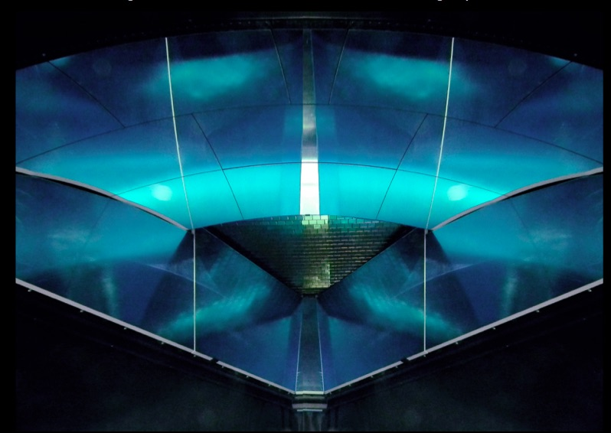
The Large-area Hybrid-optics CLAS12 RICH: First years of Data-Taking
M. Contalbrigo – INFN Ferrara – on behalf of the CLAS12 RICH group
RICH2022 - 11th International Workshop
on Ring-imaging Cherenkov Detectors
12th September 2022,
University of Edinburgh
Notes:
Vanno messi studi innovativi e pubblicazioni

Slide 2
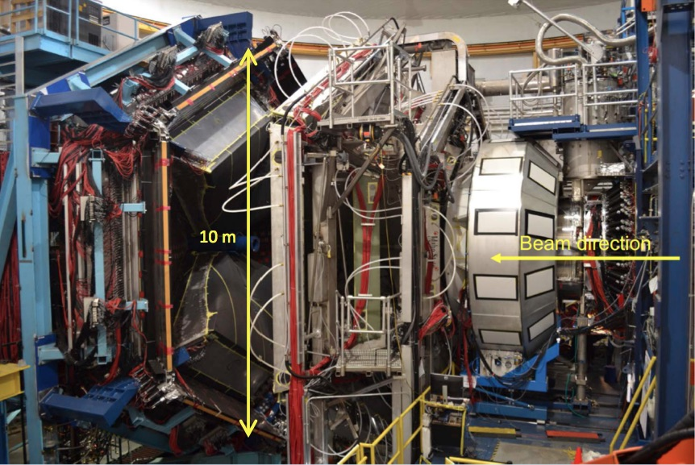
CLAS12
Large acceptance spectrometer. Operative since 02/18
Contalbrigo M.
RICH2022, 12th September 2022, Edinburgh
2
Notes:
Vanno messi studi innovativi e pubblicazioni

Slide 3
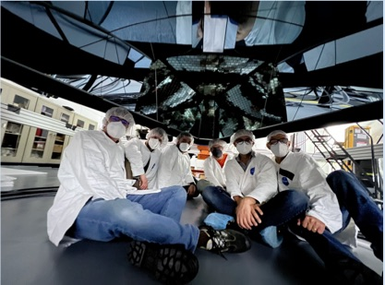
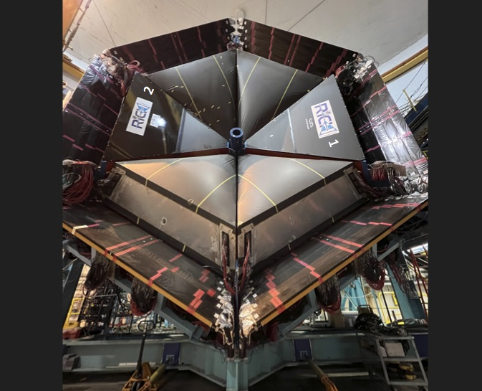
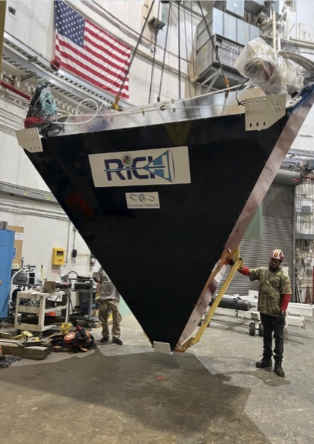
RICH @ CLAS12
Completed in June 2022 with the symmetric configuration dedicated to the runs with polarized targets (now ongoing)
2
1
Contalbrigo M.
RICH2022, 12th September 2022, Edinburgh
3
Notes:
Vanno messi studi innovativi e pubblicazioni

Slide 4
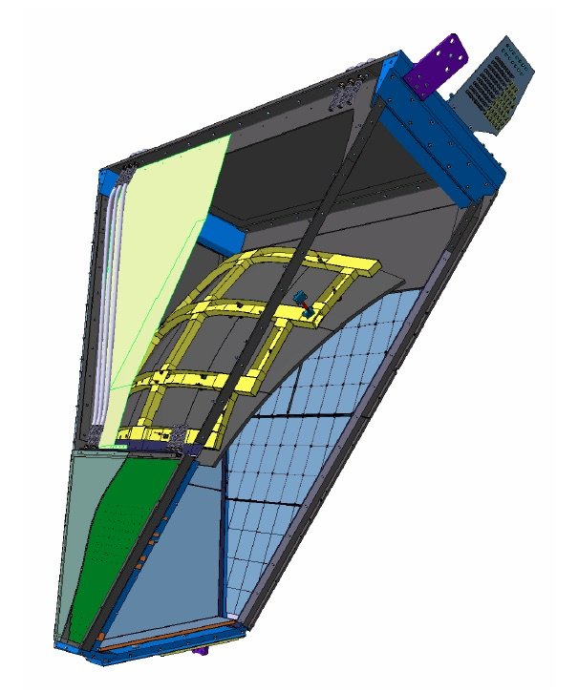
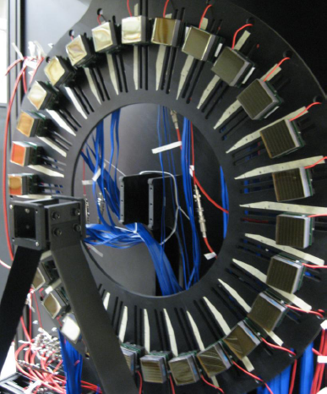
CLAS12 RICH
4 m
INSTITUTIONS
INFN (Italy) Bari, Ferrara, Genova, L.Frascati, Roma/ISS
Jefferson Lab (Newport News, USA)
Argonne National Lab (Argonne, USA)
Duquesne University (Pittsburgh, USA)
George Washington University (USA)
Glasgow University (Glasgow, UK)
Kyungpook National University, (Daegu, Korea)
University of Connecticut (Storrs, USA)
UTFSM (Valparaiso, Chile)
mirrors
aerogel
Double
reflection
detector
Direct imaging
Goal kaon-pion separation up to 8 GeV/c (prototype results):
@RICH2013
6 Gev/c
π
7 Gev/c
8 Gev/c
k
p
Cherenkov angle (mrad)
Contalbrigo M.
RICH2022, 12th September 2022, Edinburgh
4
Notes:
Vanno messi studi innovativi e pubblicazioni

Slide 5
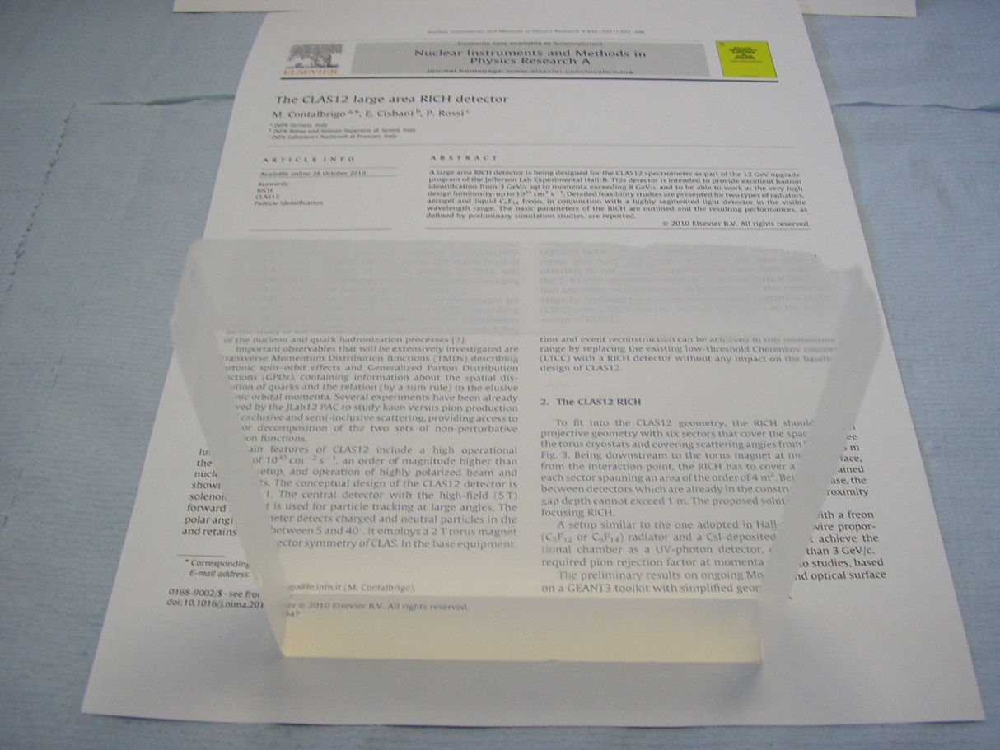
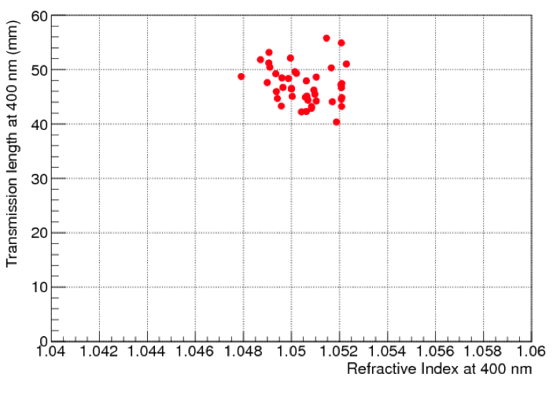
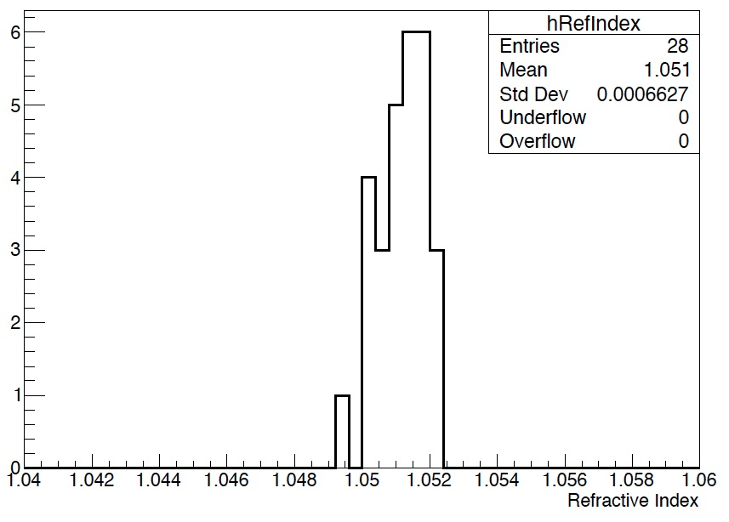
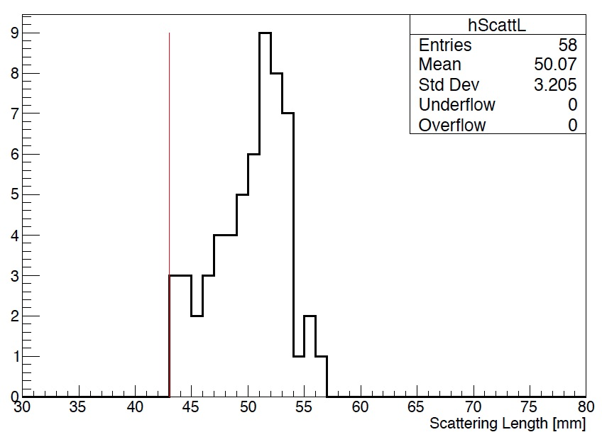
Aerogel
n=1.05, 20x20x3 cm³ aerogel tiles produced by the Budker and Boreskov Institutes of Novosibirsk
RICH1
In line with R&D achievements
RICH2 – 2 cm layer
RICH2 – 3 cm layer
Contalbrigo M.
RICH2022, 12th September 2022, Edinburgh
5
Notes:
Vanno messi studi innovativi e pubblicazioni

Slide 6
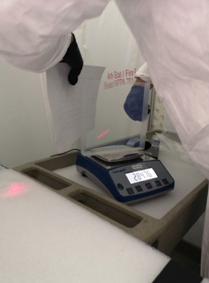
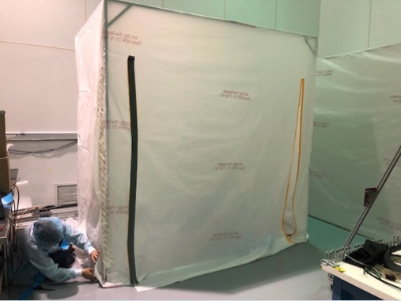
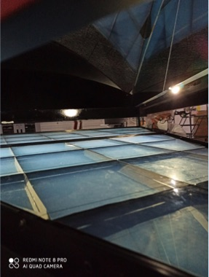
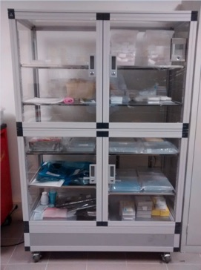
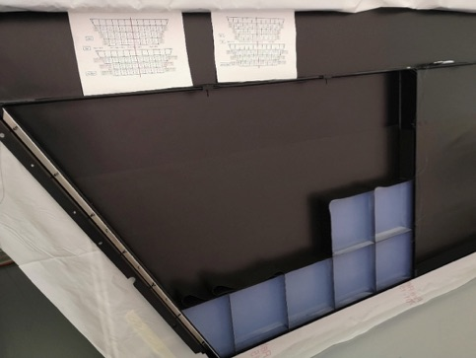
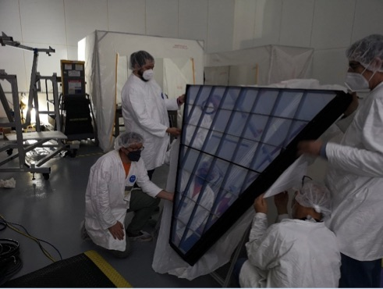
Aerogel Assembling
Hydrophilic & shaped by machine cutting: handling care, mechanically and optically isolated by thin foam strips
Contalbrigo M.
RICH2022, 12th September 2022, Edinburgh
6
Notes:
Vanno messi studi innovativi e pubblicazioni

Slide 7
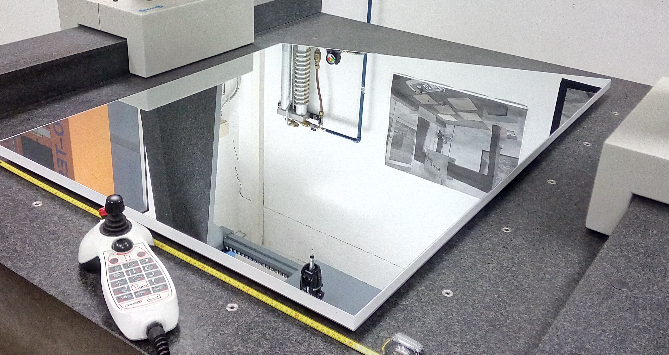
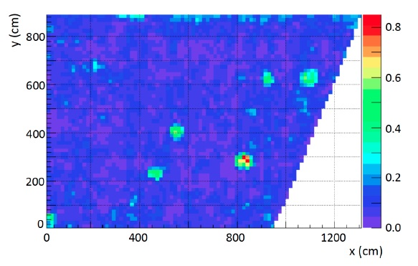
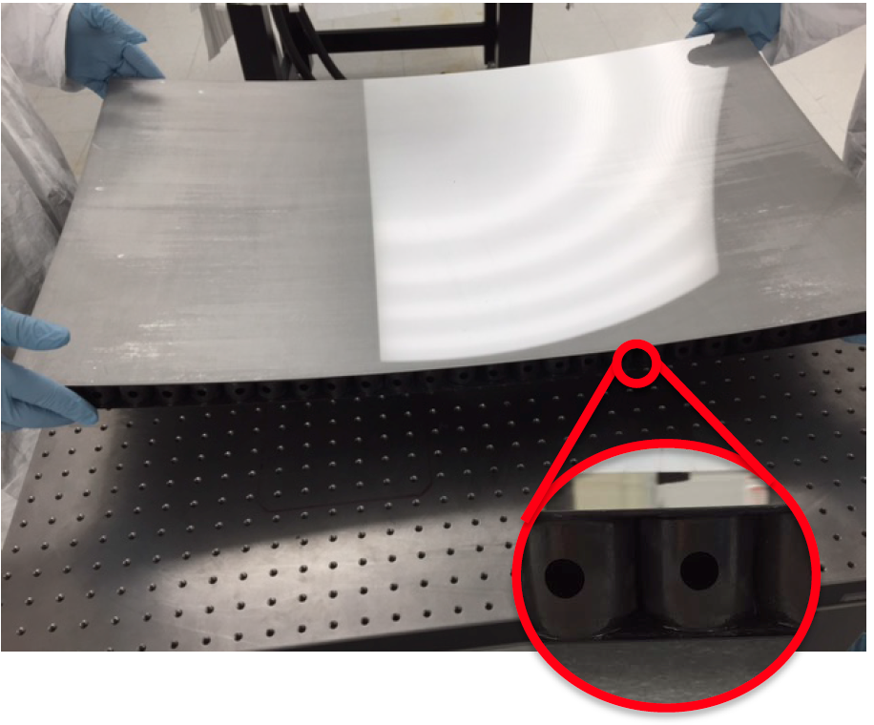
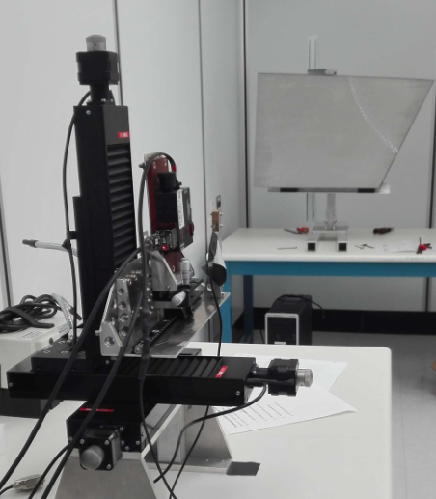
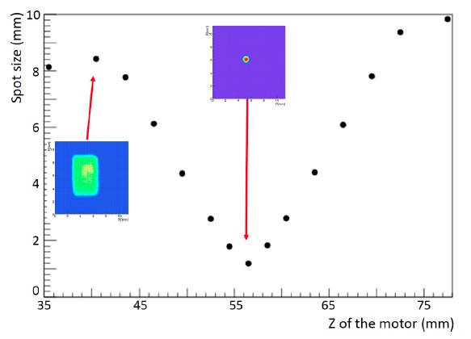
Mirrors
Glass-Skin Mirrors (planar) - Media-Lario, IT
Innovative technology never used in nuclear experiments (foils of 1.5 mm outside, 0.7 mm inside acceptance)
~ 1/5 cost for squared meter vs CFRP, surface defects (from dust on mold) within specifications
Carbon Fiber Mirrors (spherical) - Composite Mirror Applications, USA
to maximize lightness and stiffness. Consolidate technology (HERMES, AMS, LHCb)
~ 20 % material budget reduction vs precedents, radius and shape better (RICH1) or comparable (RICH2) than specs
Contalbrigo M.
RICH2022, 12th September 2022, Edinburgh
7
Notes:
Vanno messi studi innovativi e pubblicazioni

Slide 8
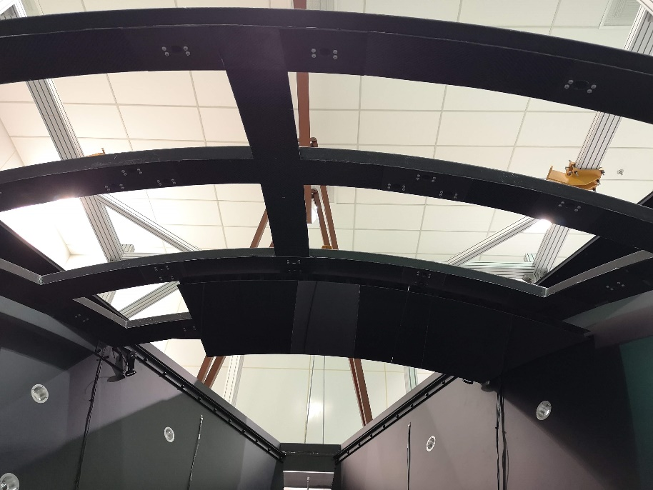
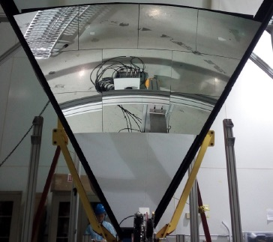
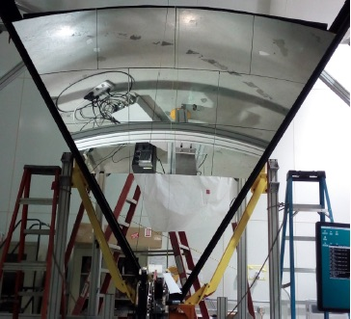
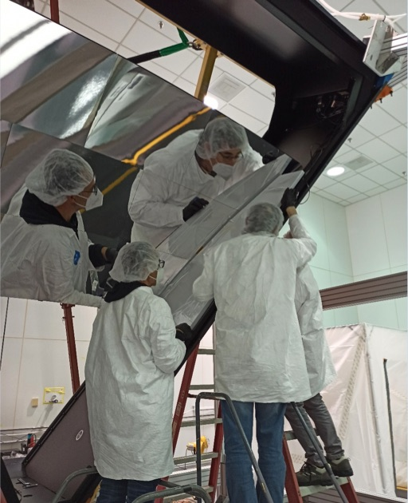
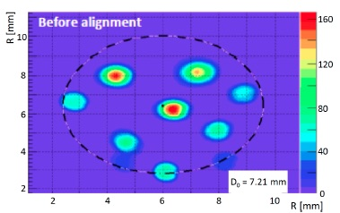
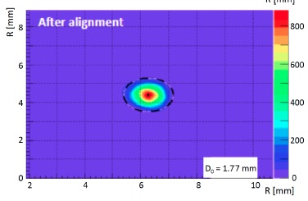
Mirror Assembling
Use of composite CFRP and Al materials (Tecnologie Avanzate, IT) to realize a light but stiff supporting structure
Mounting
Alignment
Contalbrigo M.
RICH2022, 12th September 2022, Edinburgh
8
Notes:
Vanno messi studi innovativi e pubblicazioni

Slide 9
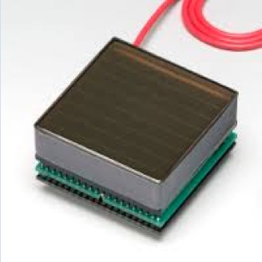
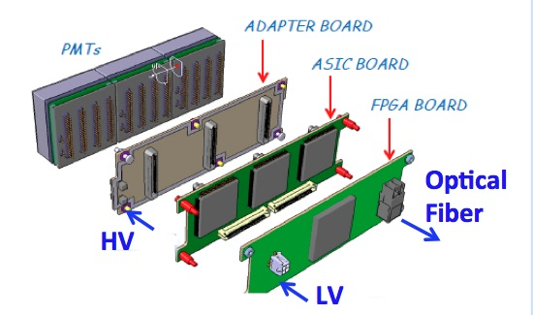
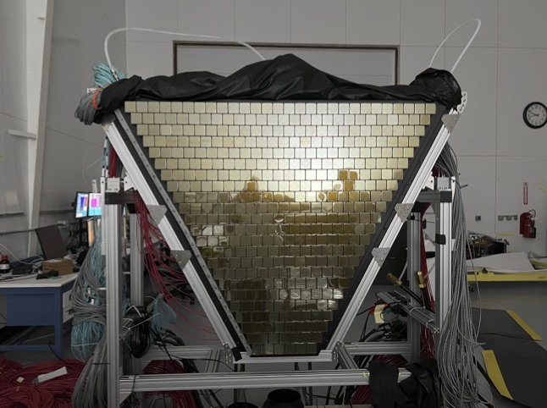
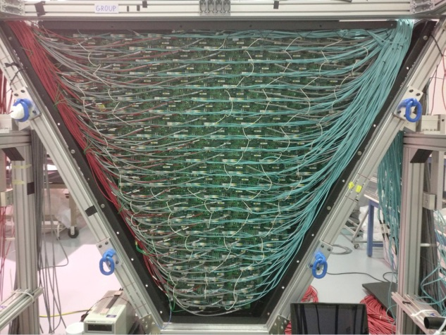
Photon Detector
Hamamatsu H12700 (+ H8500)
< 1 cm spatial resolution
< 1 ns time resolution
Compatible with the low torus fringe field
Average gain ~ 2.7 10⁶
eq. to SPE ~ 400 fC
Readout Electronics
Compact, modular (adapter, MAROC3, FPGA) and scalable
Threshold: Fraction (<10%) of SPE
Trigger latency (8 μs)
Optical ethernet (2.5 Gbps)
Contalbrigo M.
RICH2022, 12th September 2022, Edinburgh
9
Notes:
Vanno messi studi innovativi e pubblicazioni

Slide 10
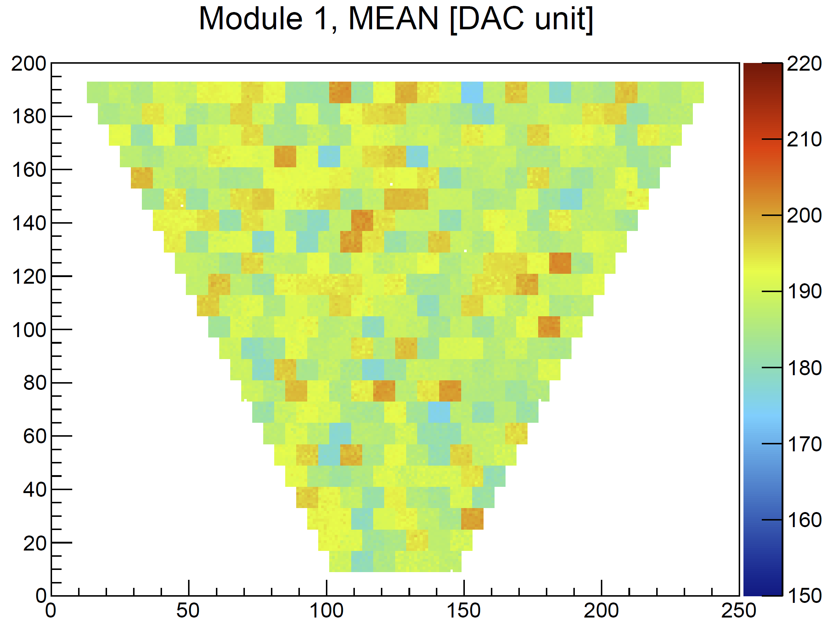
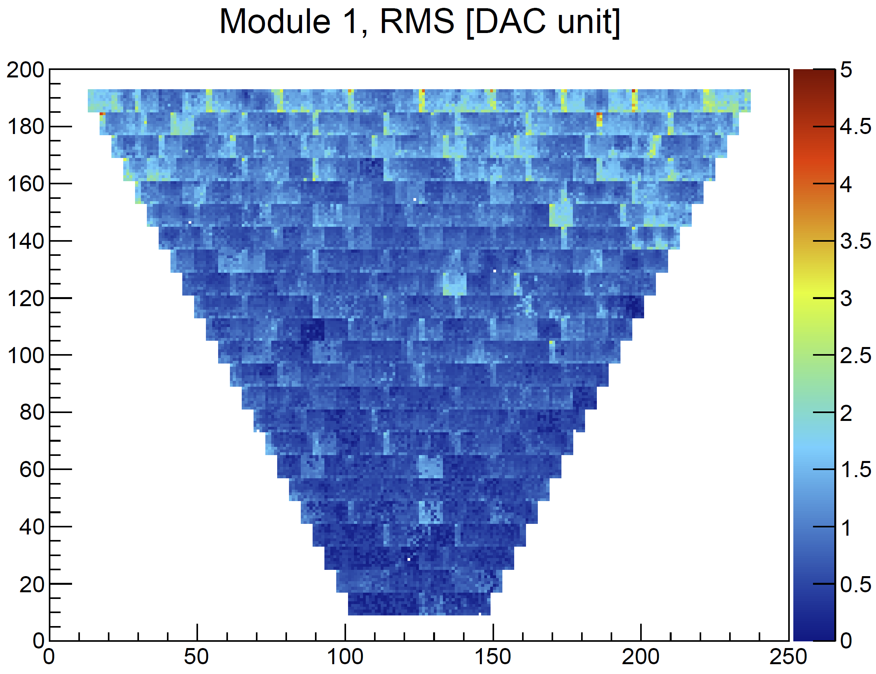
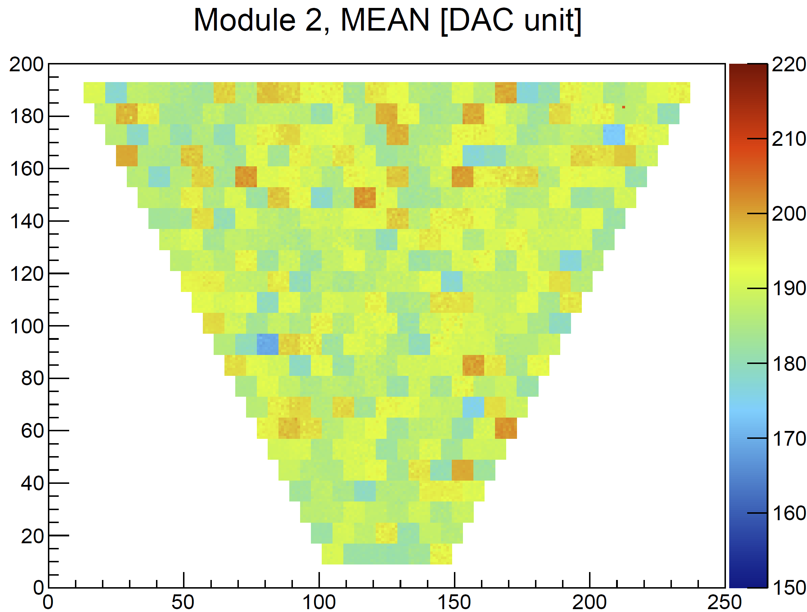
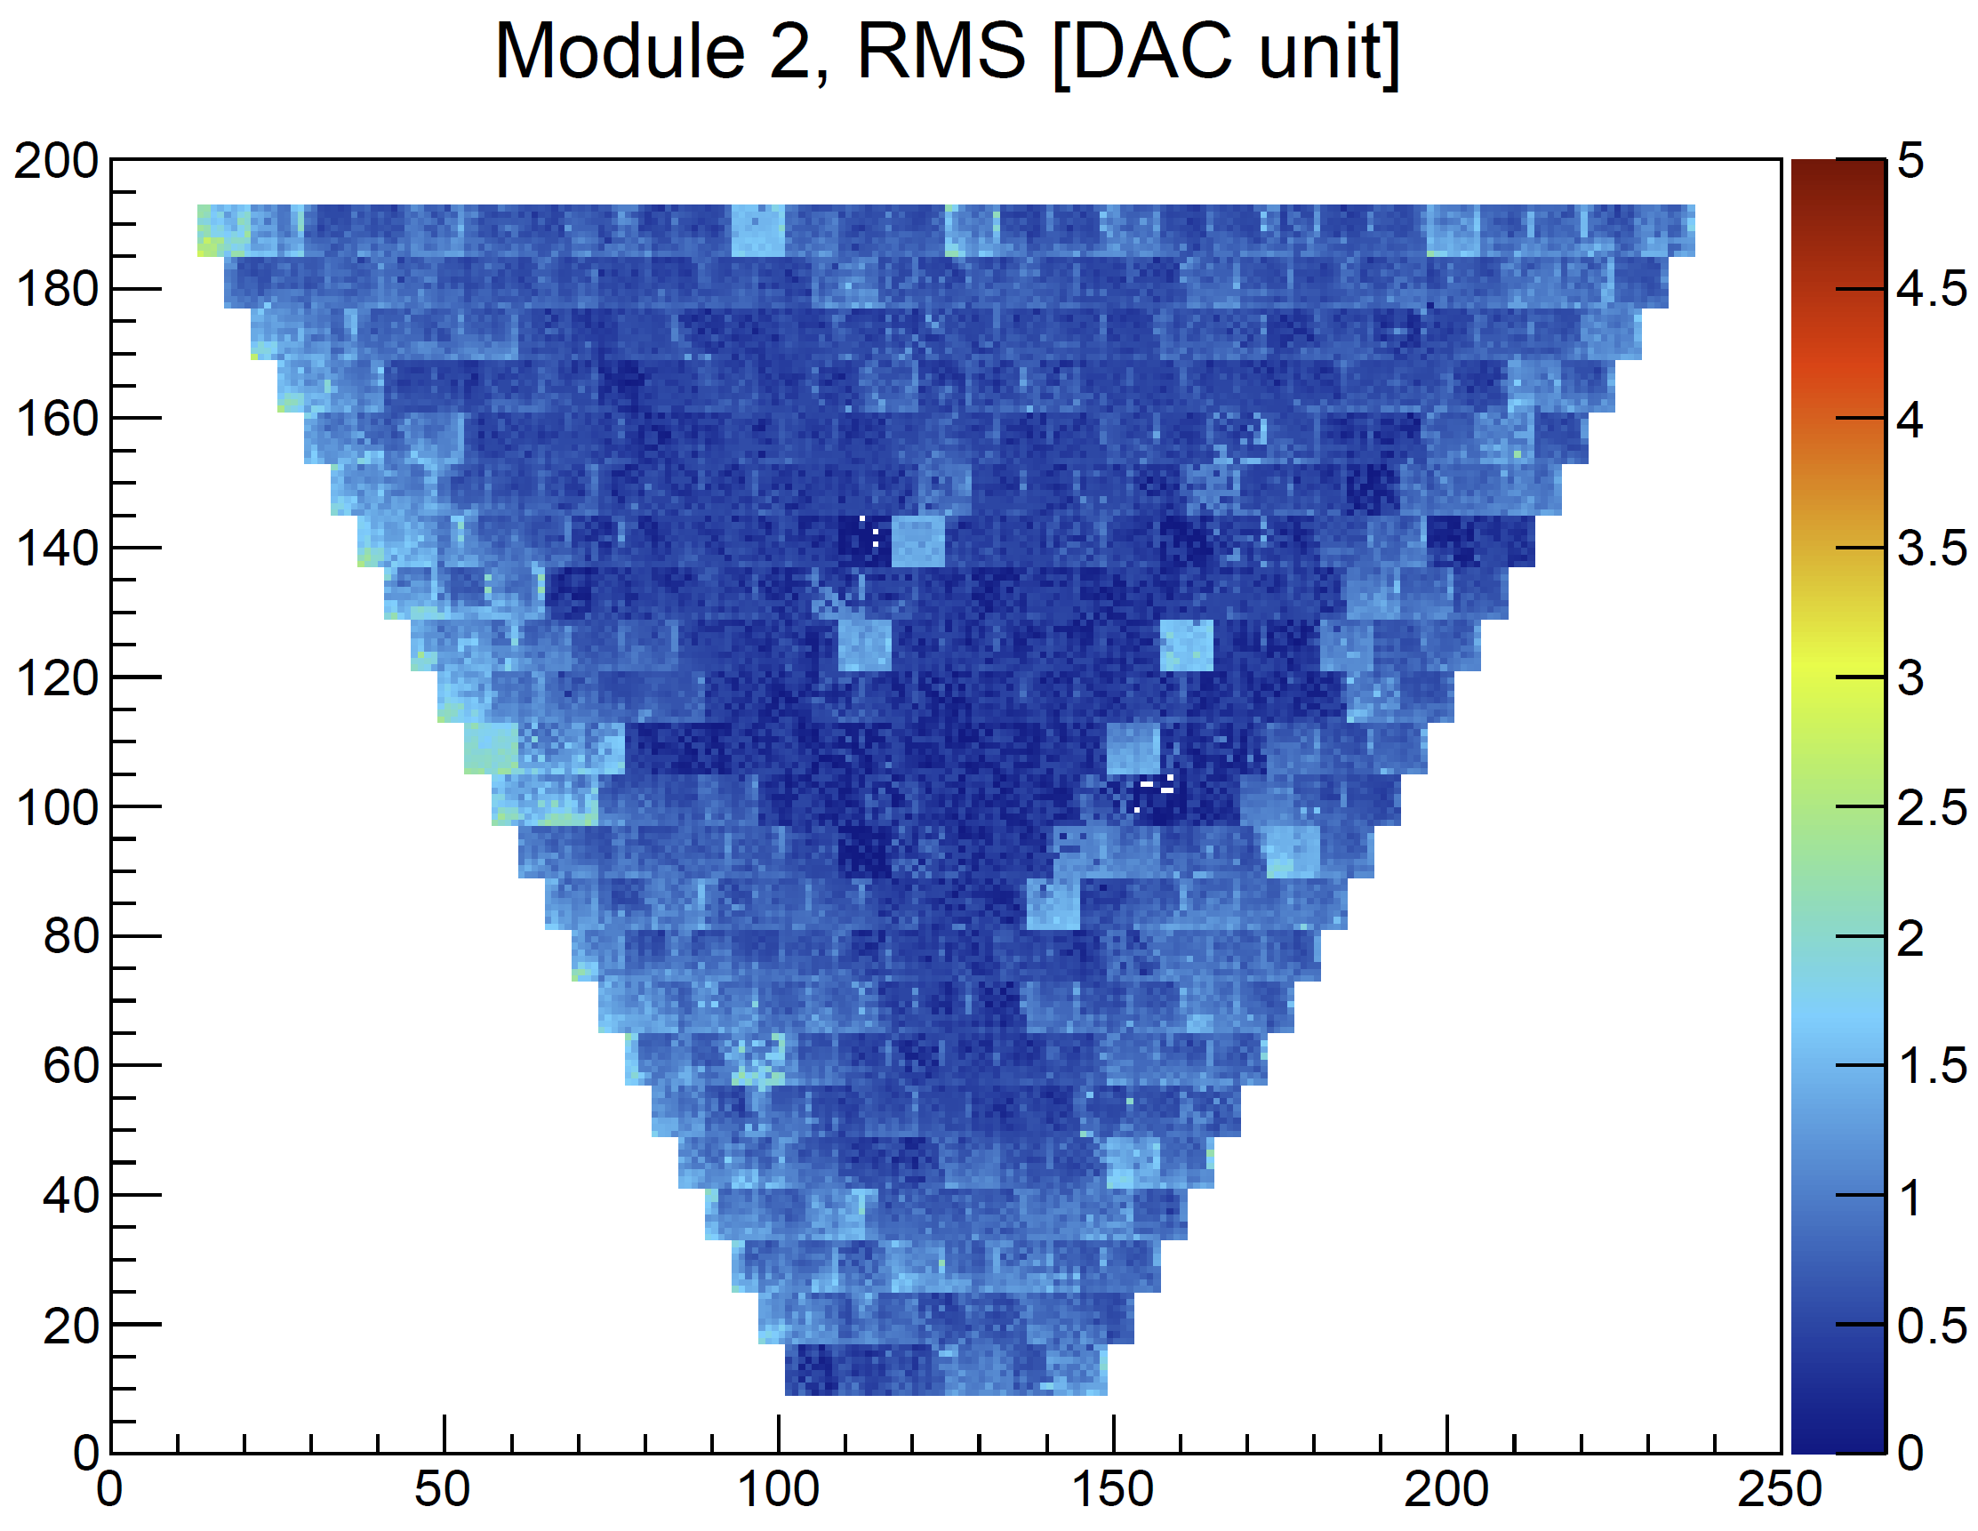
Pedestals
Contalbrigo M.
RICH2022, 12th September 2022, Edinburgh
10
Notes:
Vanno messi studi innovativi e pubblicazioni

Slide 11
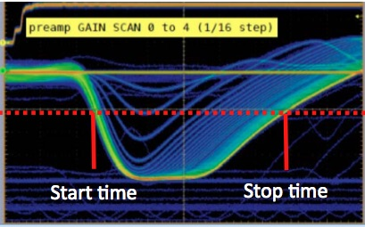
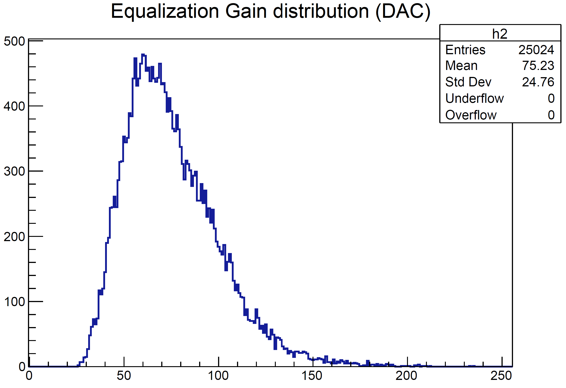
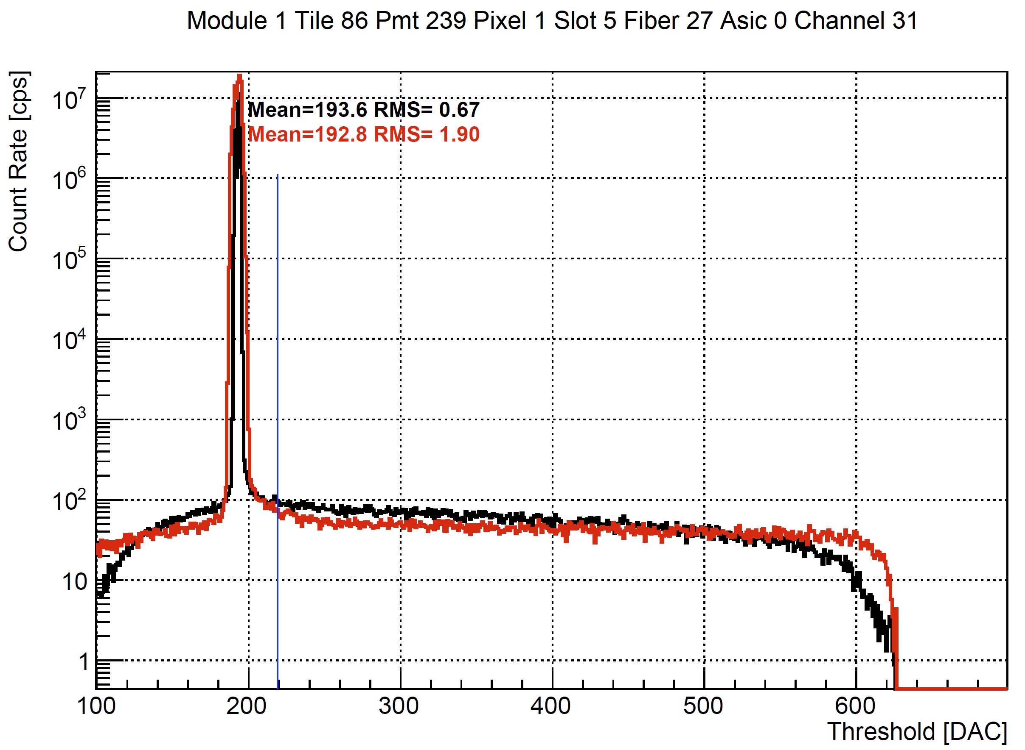
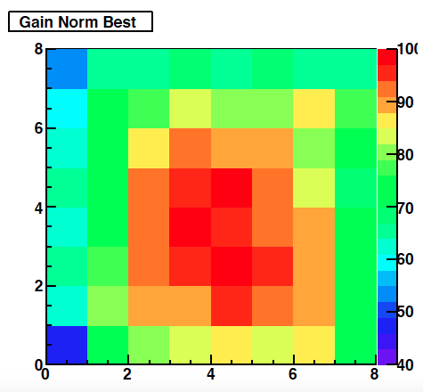
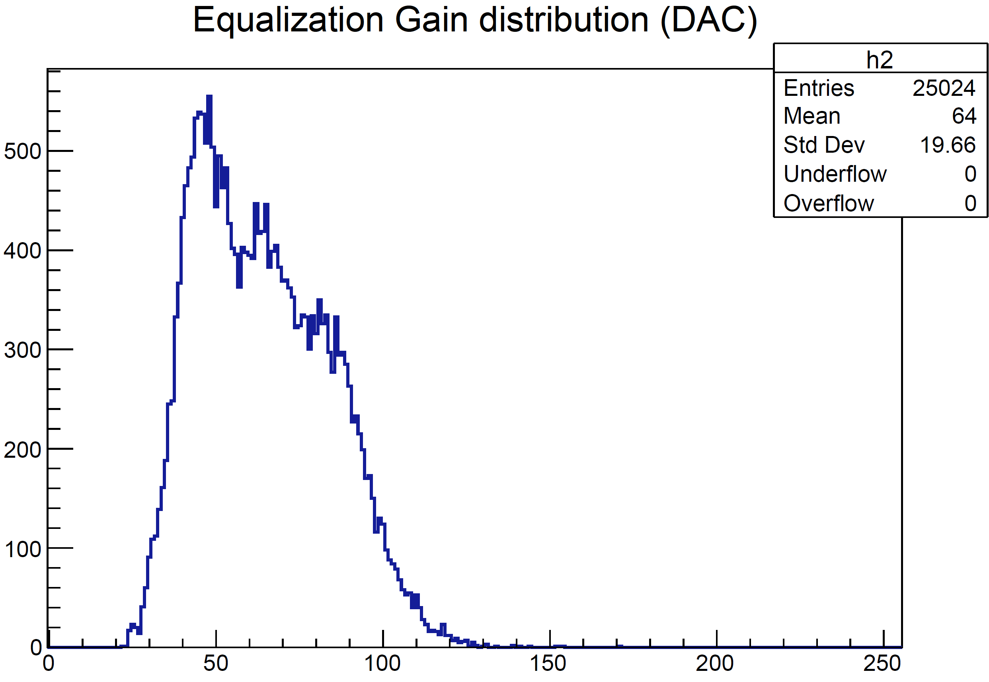
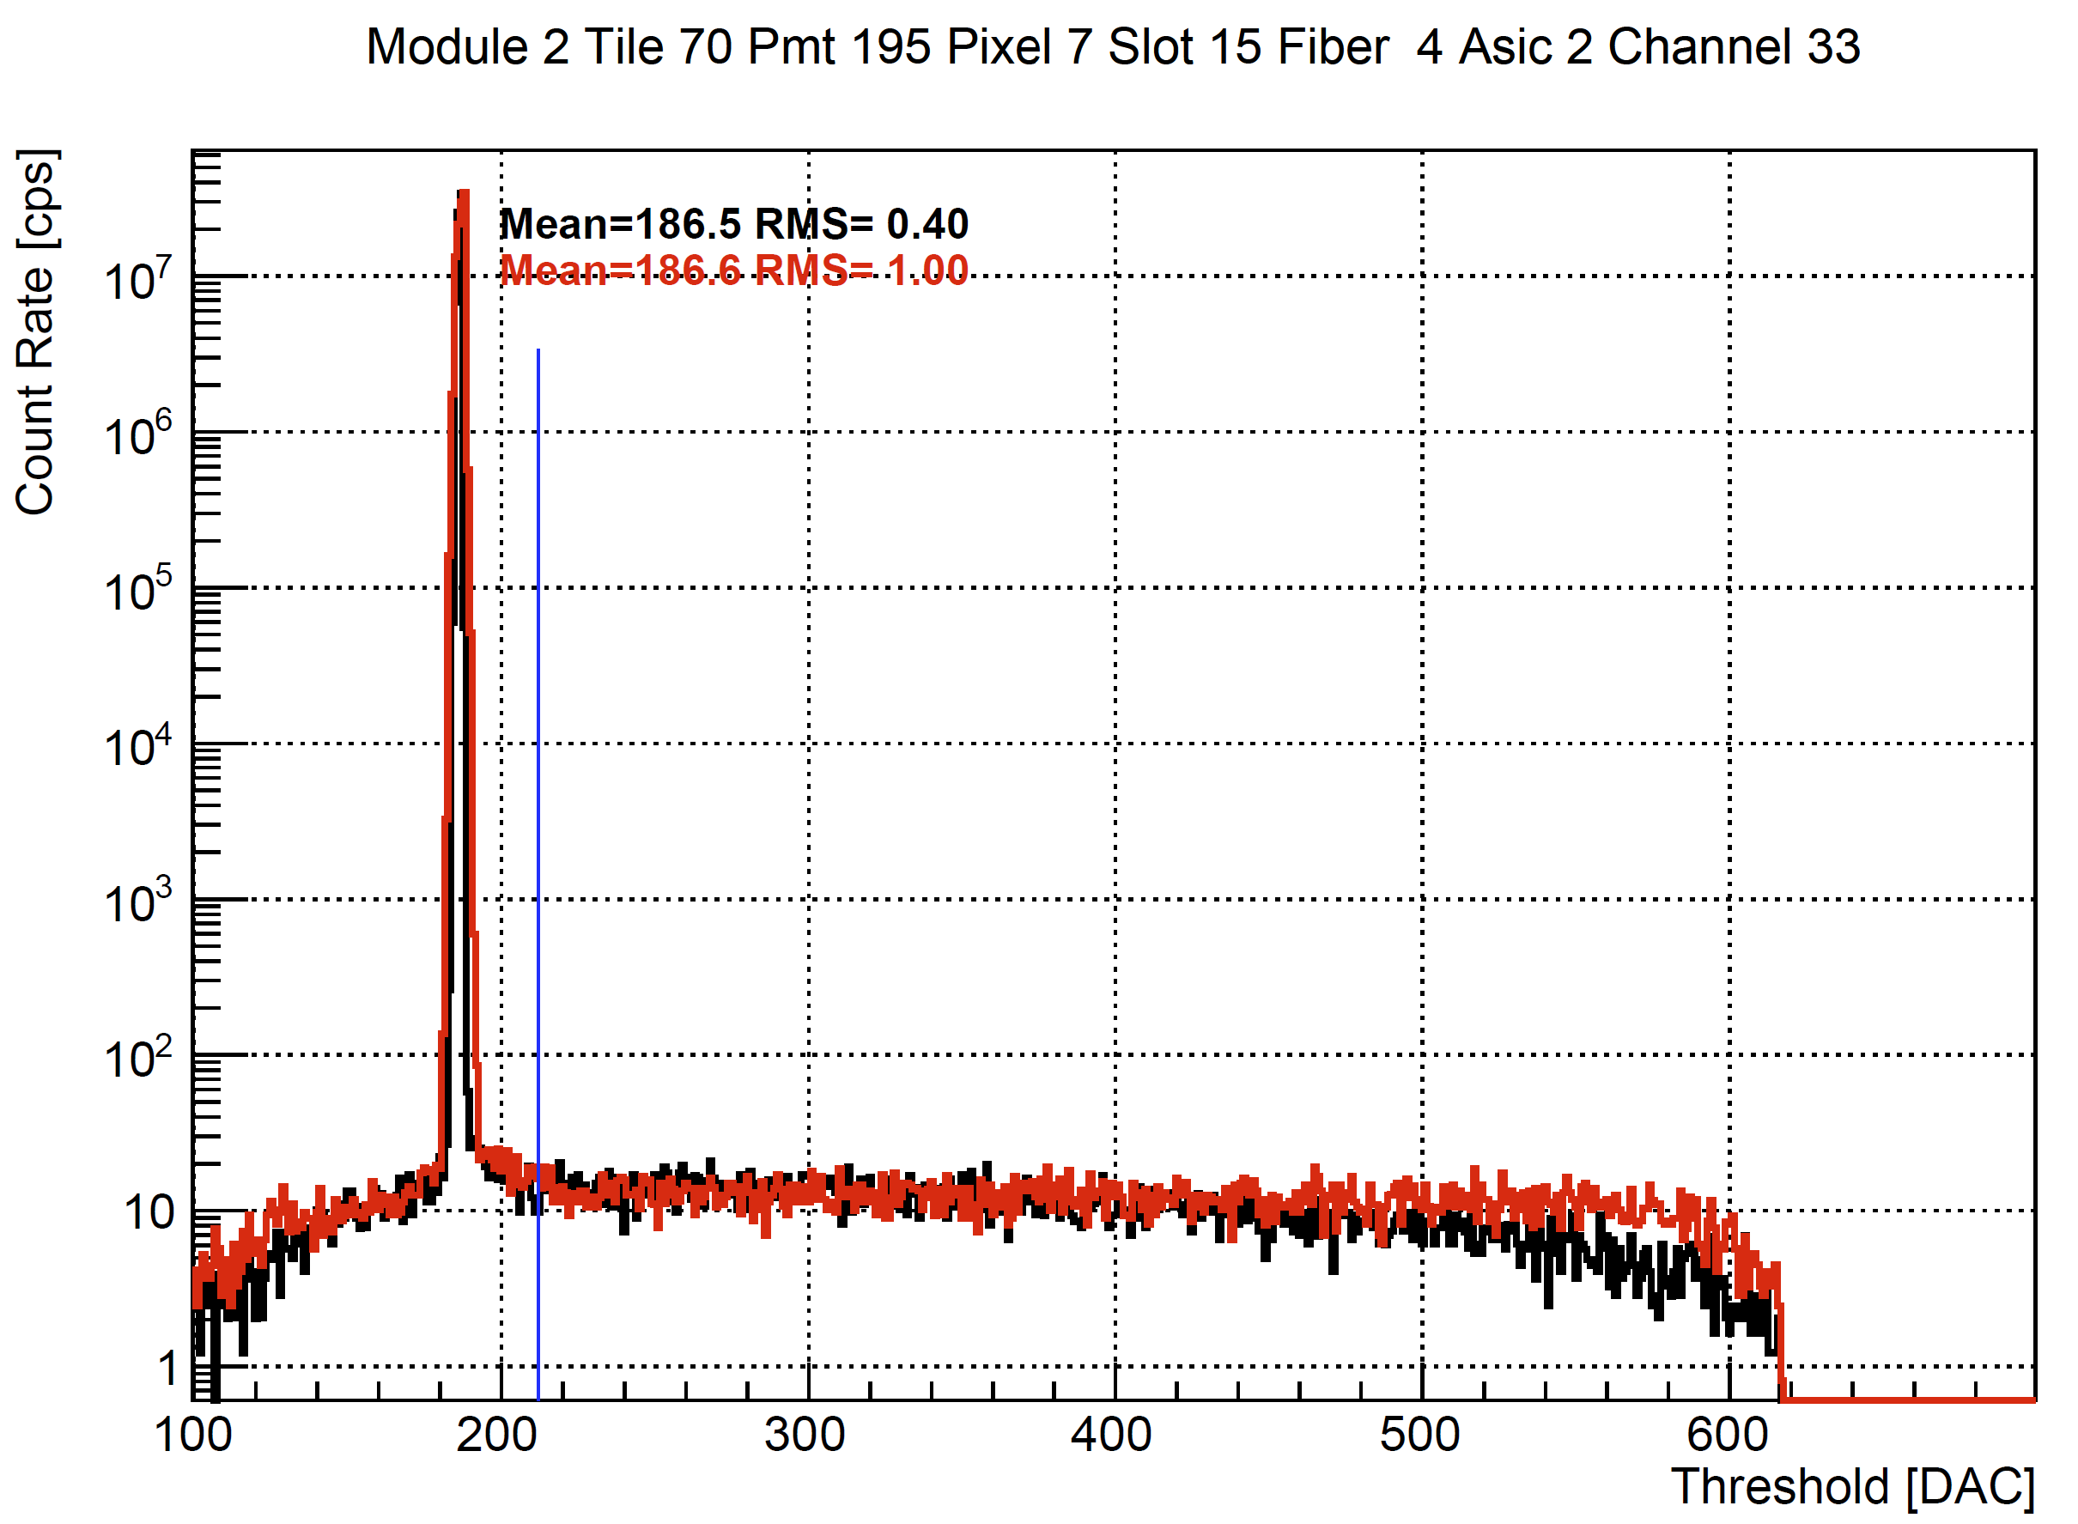
Gain Equalization
MAROC: ToT in an almost saturated regime
Pixel-by-pixel gain variation is compensated
by the front-end amplification stage
With equalization:
The plateau vs threshold is extended
Threshold at 25 DAC ( ~5 % SPE)
Dark counts
RICH1
Dark counts
RICH2
Contalbrigo M.
RICH2022, 12th September 2022, Edinburgh
11
Notes:
Vanno messi studi innovativi e pubblicazioni

Slide 12
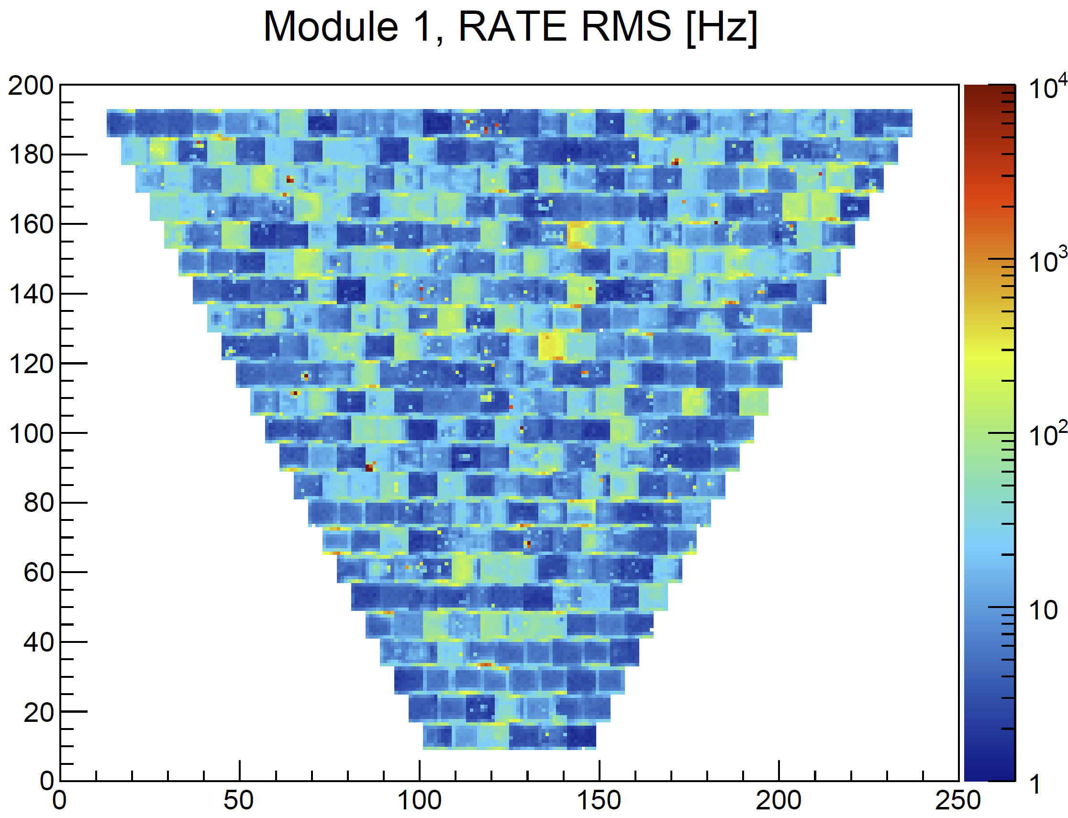
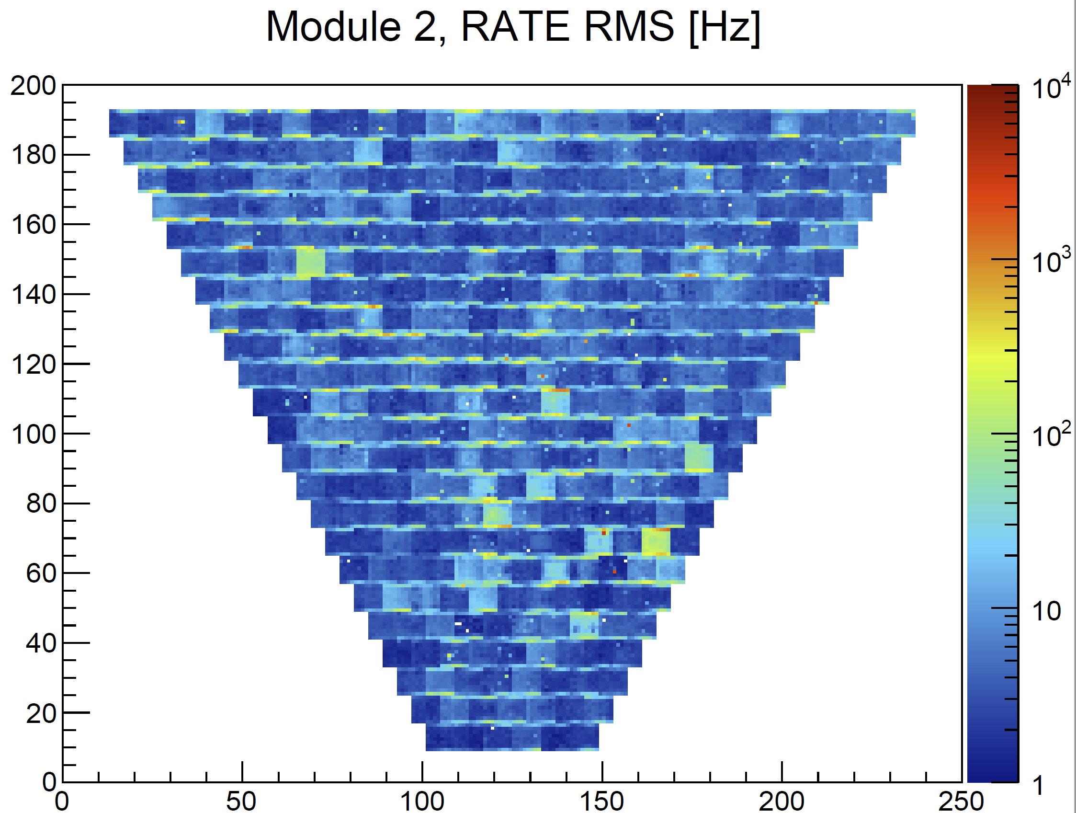
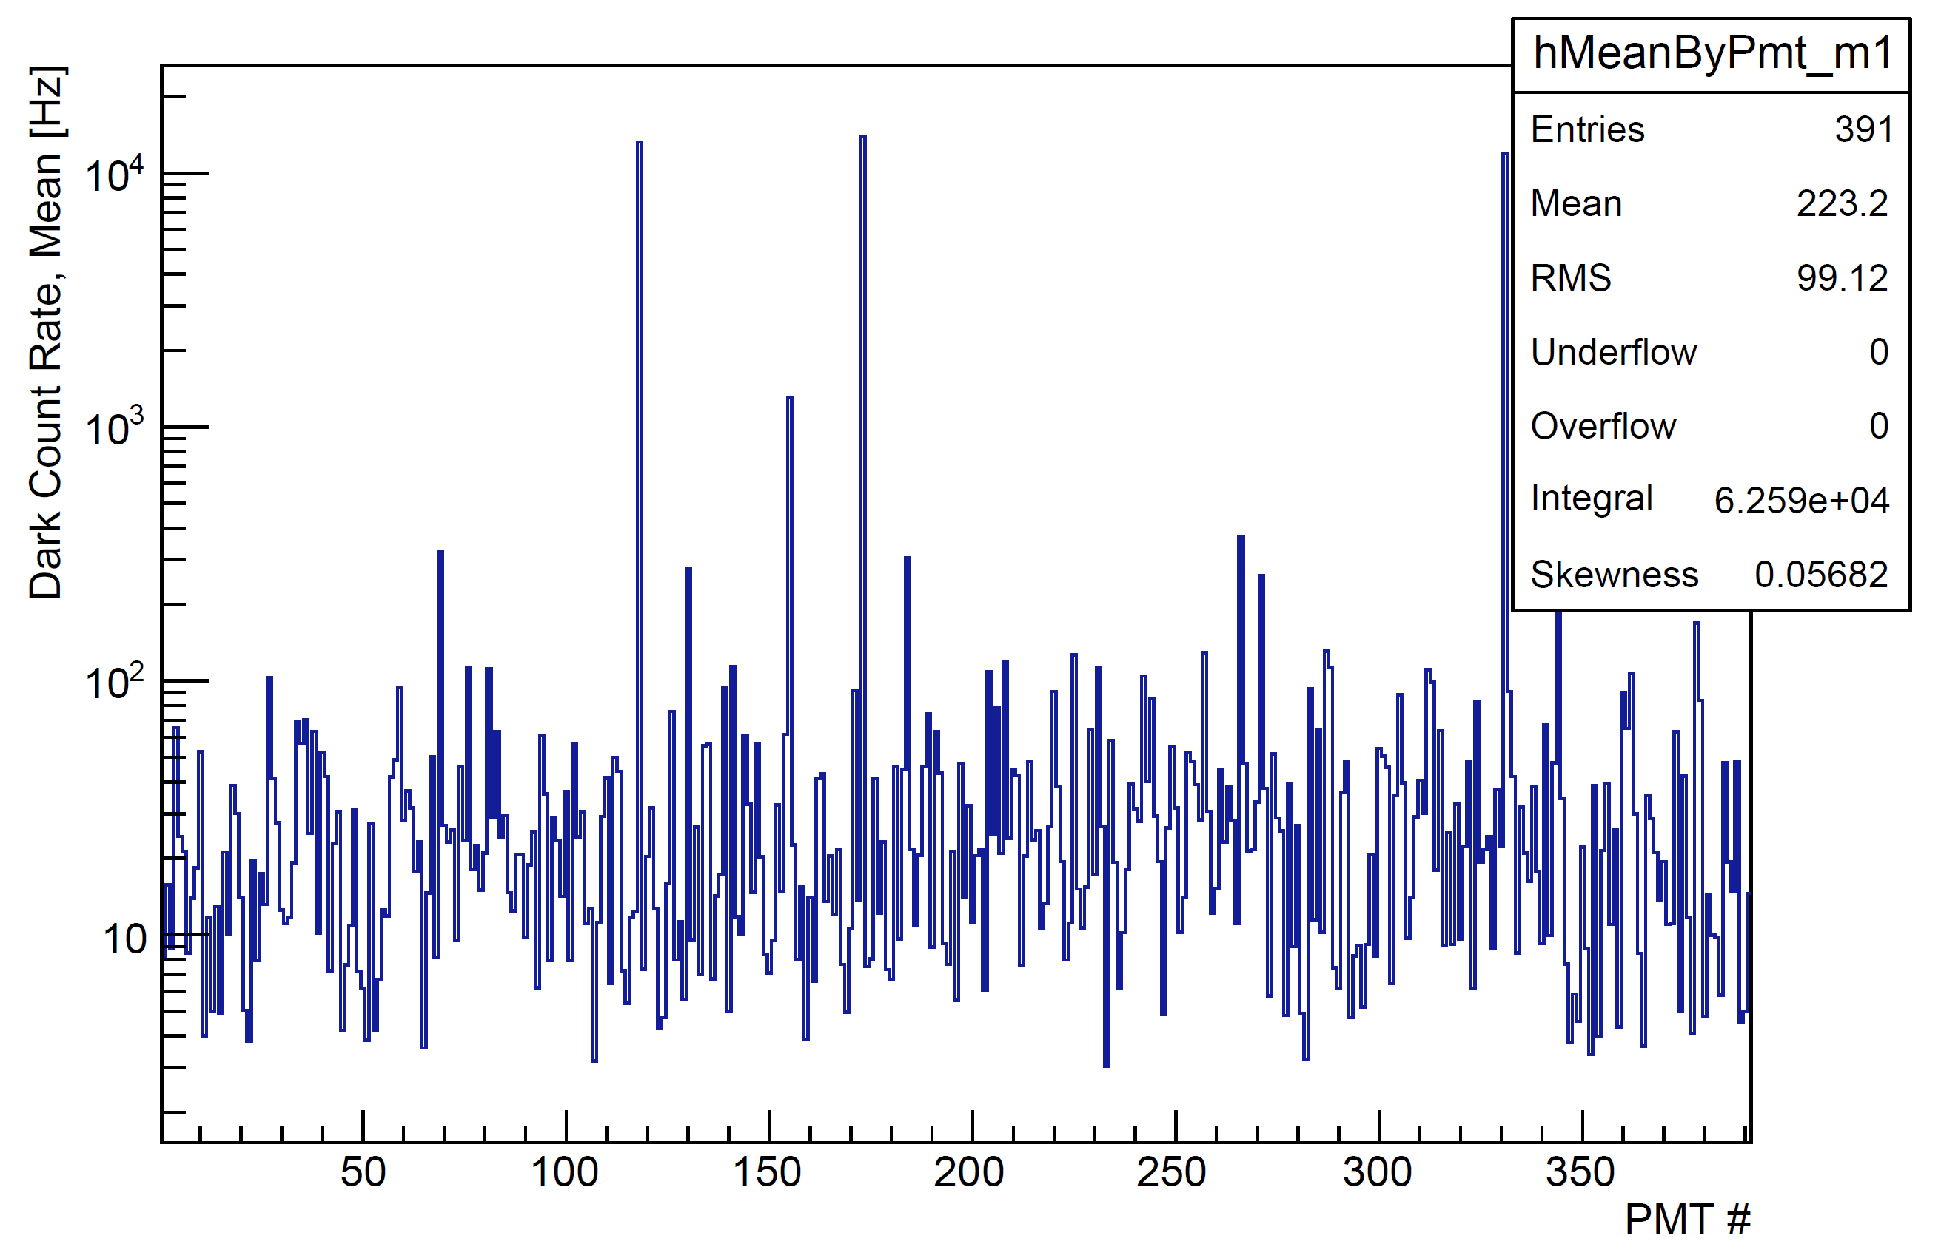
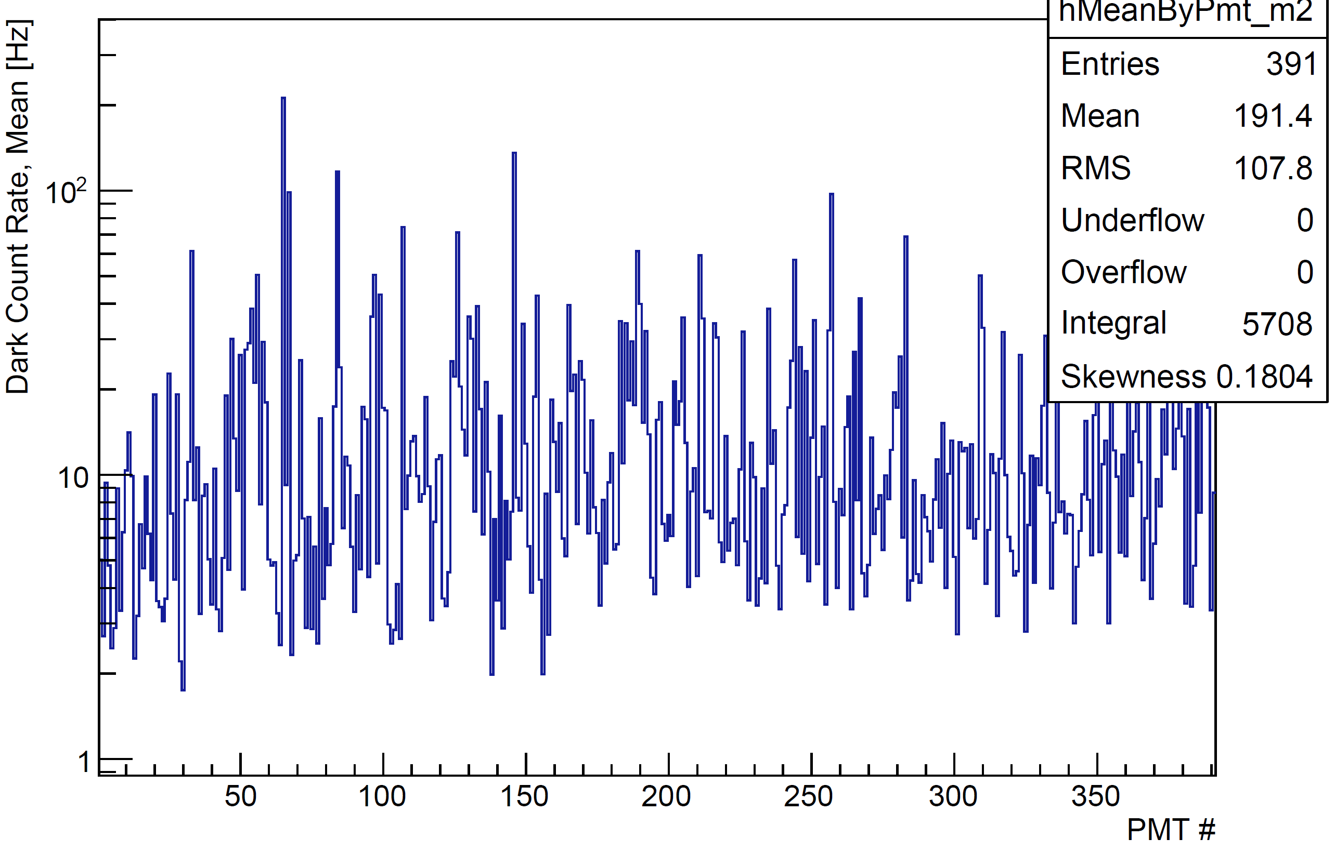
Dark Counts
100 Hz
1 kHz
Contalbrigo M.
RICH2022, 12th September 2022, Edinburgh
12
Notes:
Vanno messi studi innovativi e pubblicazioni

Slide 13
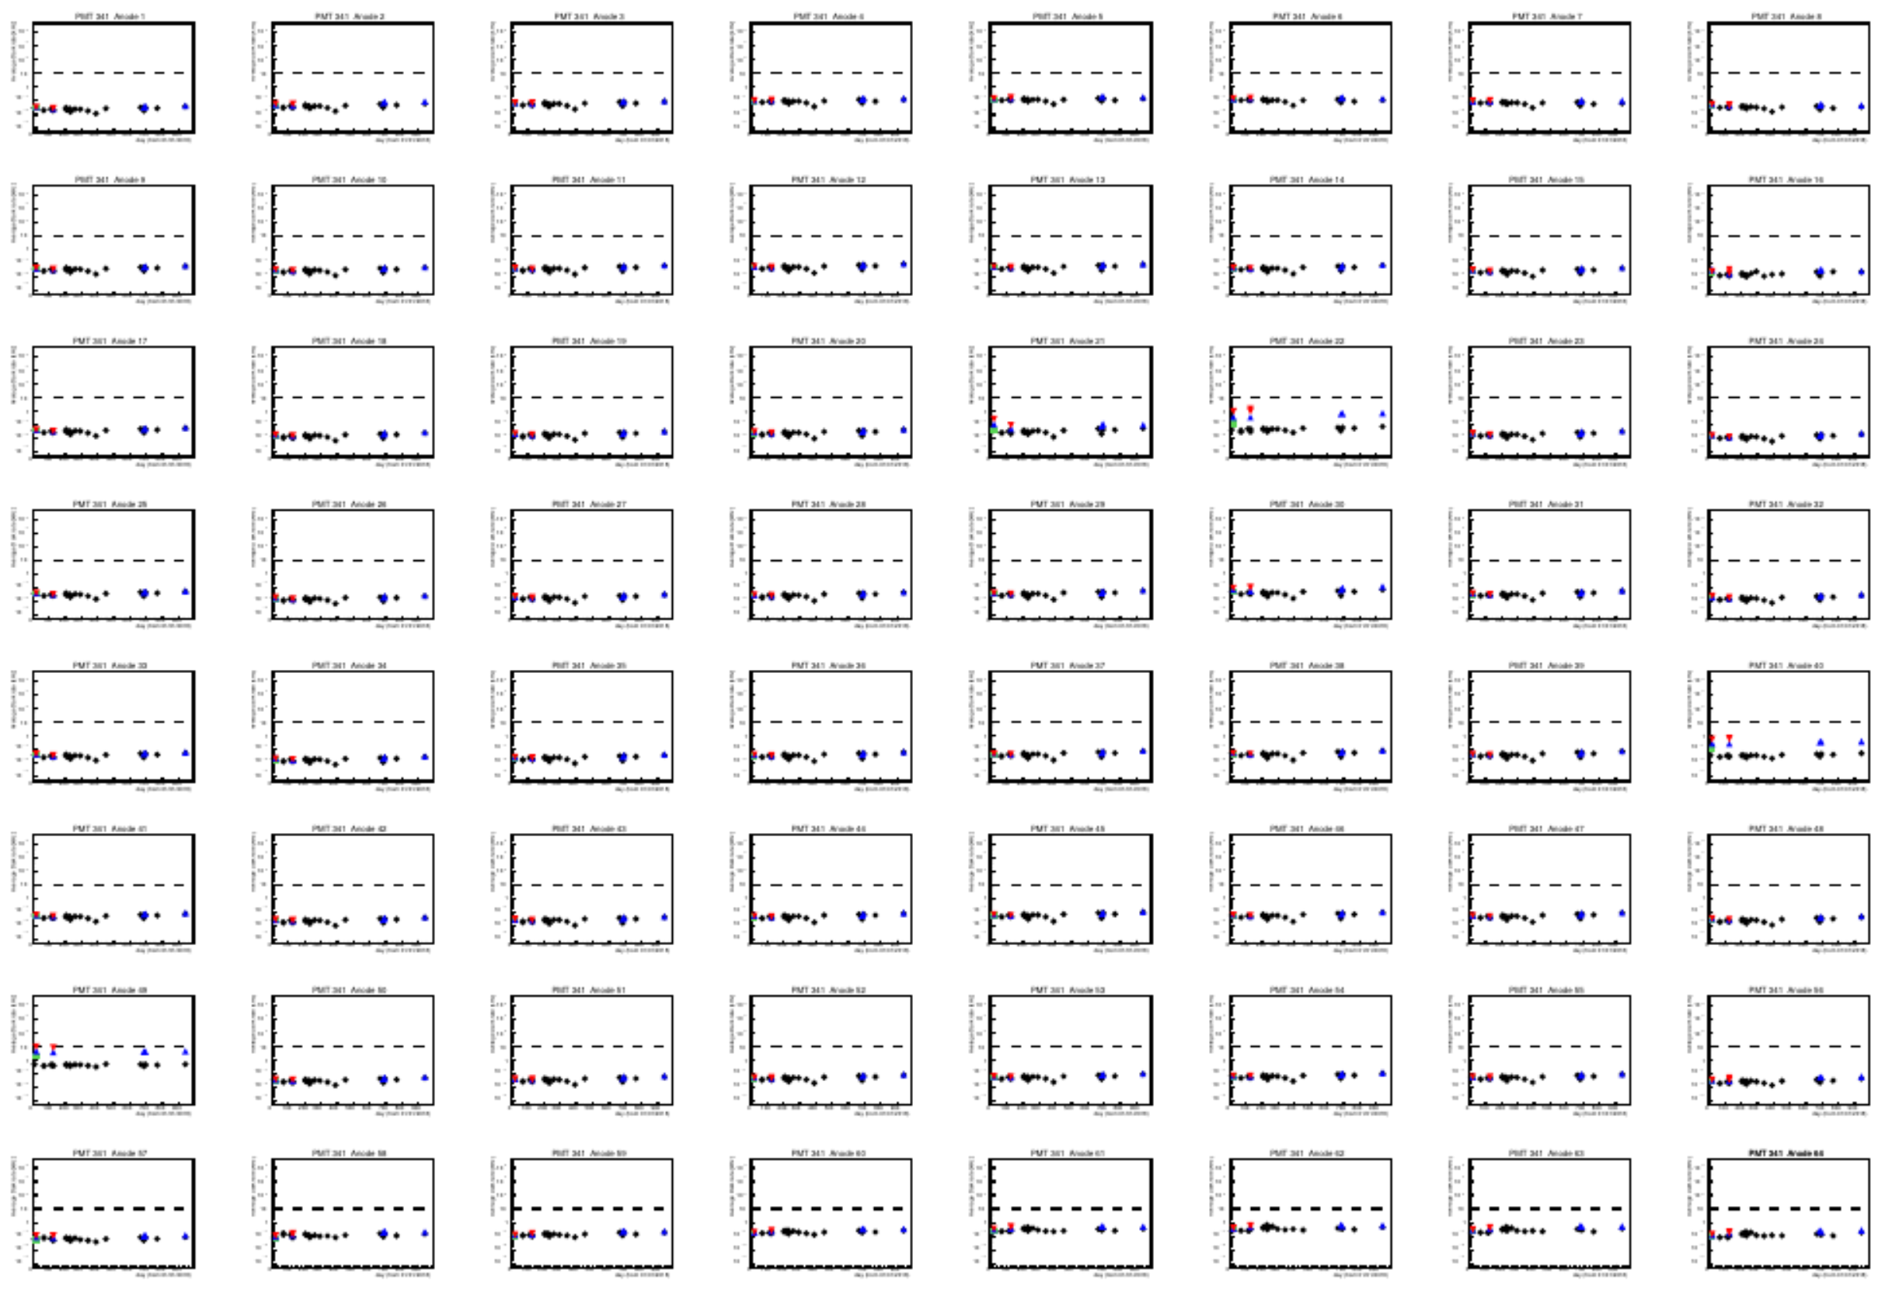
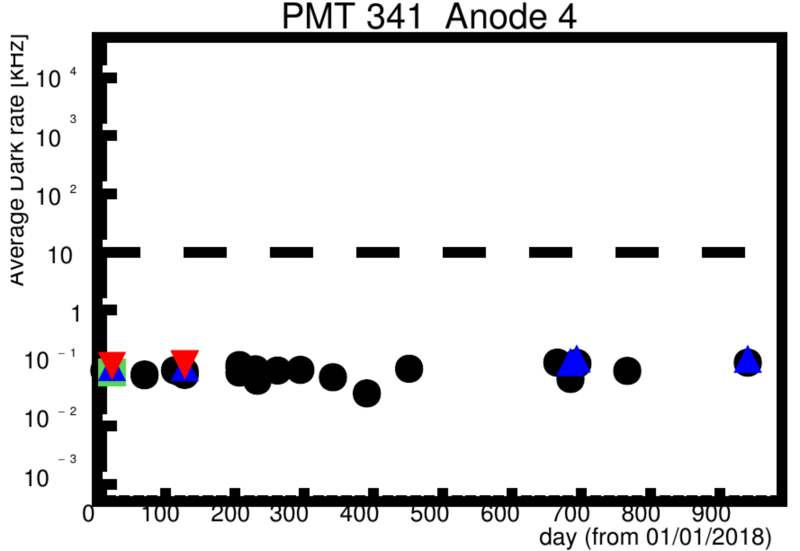
Dark Rate
PMT 341
Contalbrigo M.
RICH2022, 12th September 2022, Edinburgh
13
Notes:
Vanno messi studi innovativi e pubblicazioni

Slide 14
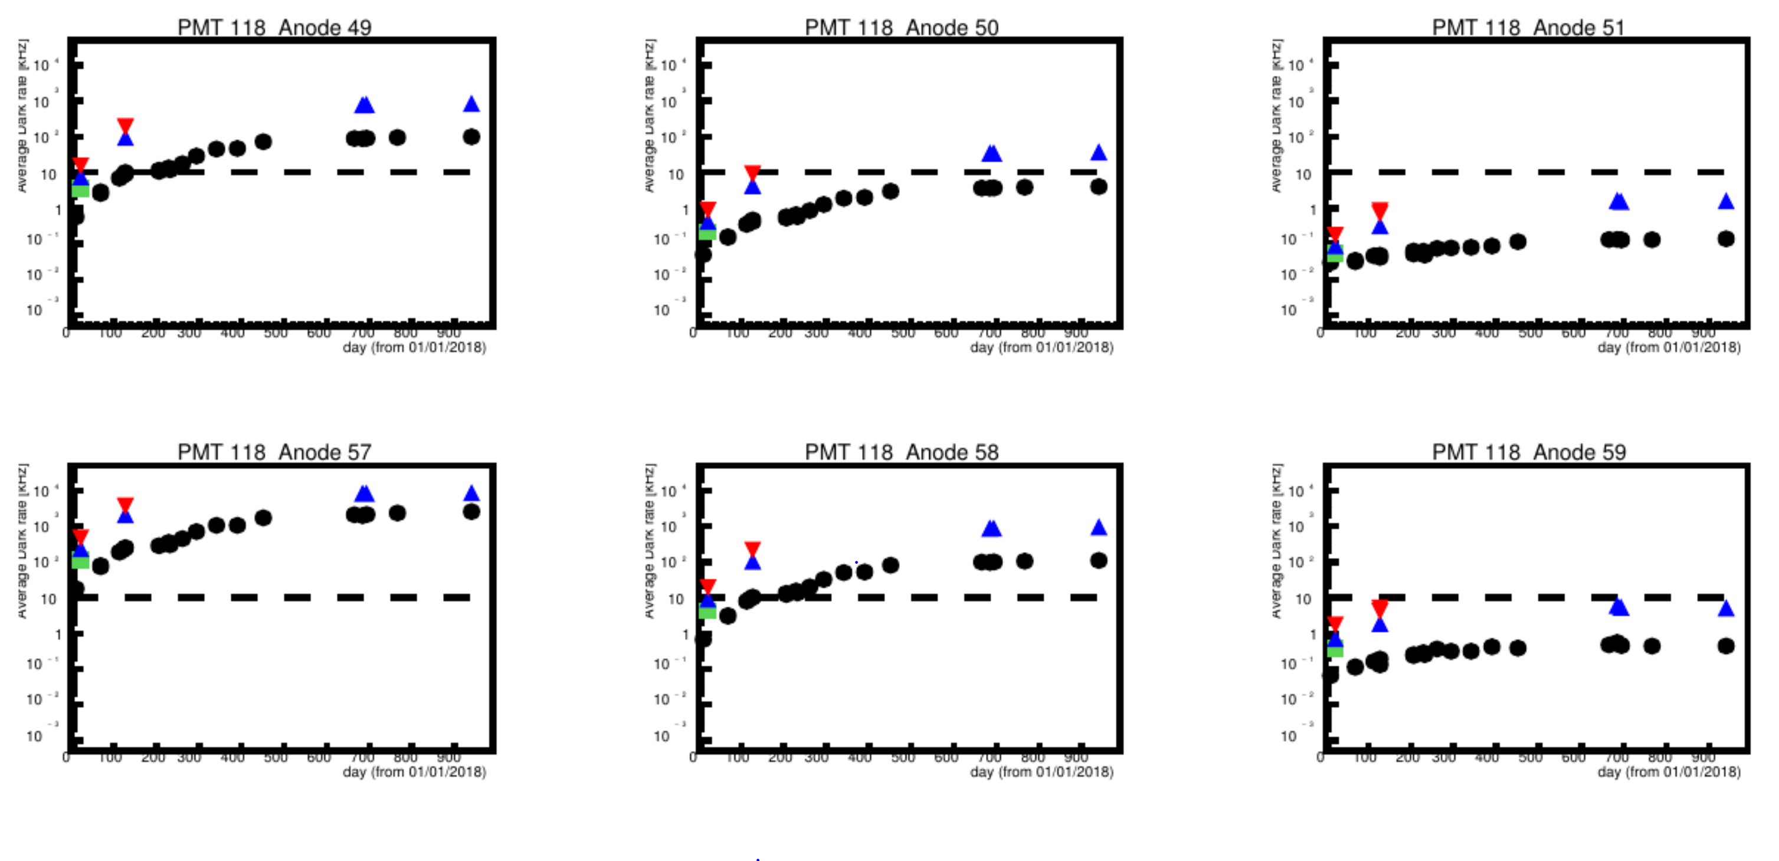
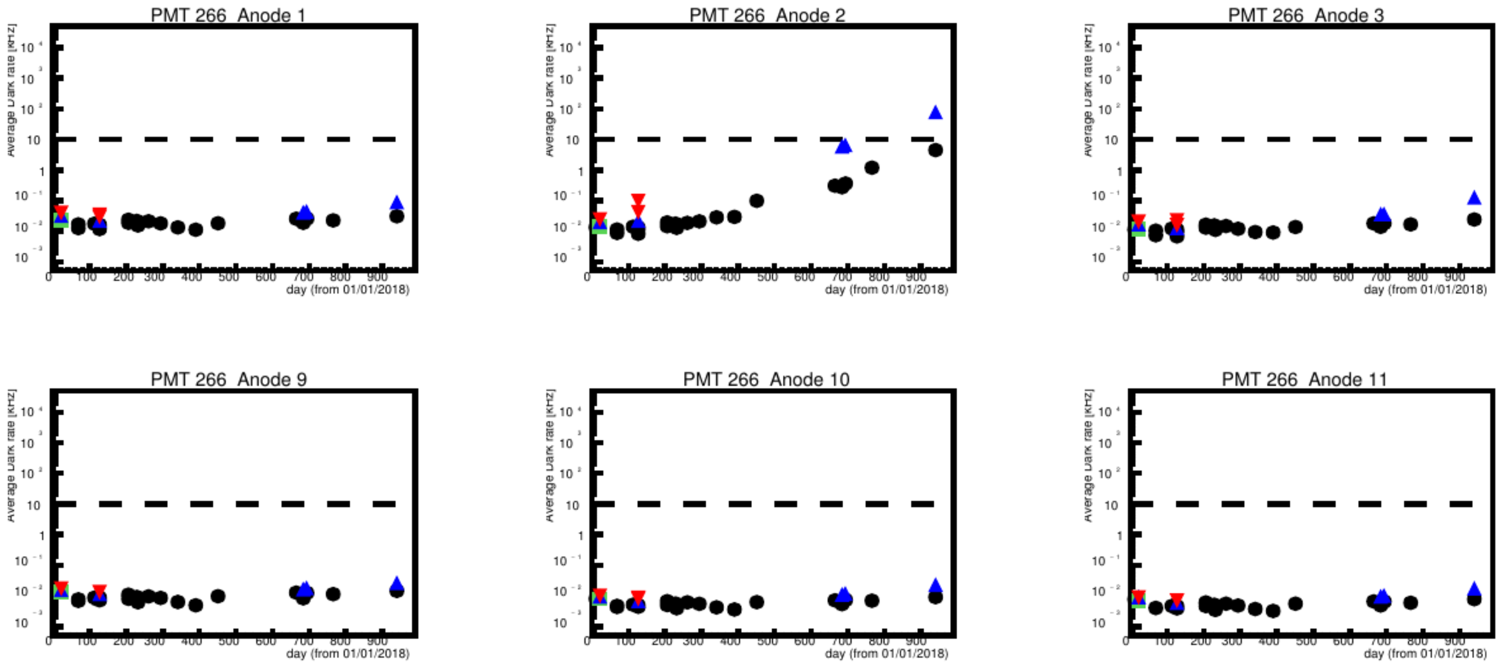
Dark Rate
High-dark rate channels
RICH1 ~ 10
RICH2 none so far
PMT 118 Anode 57
Problematic channel:
DR above 1 MHz
Going to saturation
Cross-talk on neighbors
PMT 266 Anode 2
Problematic channel:
Initial DR 13 Hz
Increasing to 4 kHz
Contalbrigo M.
RICH2022, 12th September 2022, Edinburgh
14
Notes:
Vanno messi studi innovativi e pubblicazioni

Slide 15
Time Walk
Run 5038 – Oct 18
Run 11328 – Jan 20
m₁
D₀
ns
ns
Contalbrigo M.
RICH2022, 12th September 2022, Edinburgh
15
Notes:
Vanno messi studi innovativi e pubblicazioni

Slide 16
Time Calibration
RICH time calibration with CLAS12 time-of-flight detector + bunch crossing
(ns)
ΔT (ns)
Requested to tag double reflections
ch
ch
Contalbrigo M.
RICH2022, 12th September 2022, Edinburgh
16
Notes:
Vanno messi studi innovativi e pubblicazioni

Slide 17
Cross-Talk
Analysis based on topology and signal shape
Optical
Optical
Signal
Electrical
Electrical
Residual cross-talk is removed after time calibration with TOF
Hit
Optical
& Electrical
Contalbrigo M.
RICH2022, 12th September 2022, Edinburgh
17
Notes:
Vanno messi studi innovativi e pubblicazioni

Slide 18
Photon Path Reconstruction
Trial
Complex geometry with various photon paths
(reflections) off the same particle
RICH hit
θ
From CLAS12:
particle momentum
photon emission point
From RICH:
hit time and position
Direct ray-tracing:
ray-trace a limited sample of photon trials
(selection of φ’s for given θ)
adjust the angles to match the hit
starting from the closest trial
(convergence in 2-3 iterations)
validate photon reconstructed
Cherenkov angle and transit time
DC track
φ
Contalbrigo M.
RICH2022, 12th September 2022, Edinburgh
18
Notes:
Vanno messi studi innovativi e pubblicazioni

Slide 19
Pattern Recognition
Photon path reconstruction allow to assign the photon to the most likely hypothesis:
- be robust and easy to control (easy to handle multi-reflections, up to e.g. 5)
- discriminate background (hit far from trials, no solution foreseeable)
- provide full information (photon path, time, position and component of each reflection)
- allow relation with nominal optical components, resolution and efficiency
Contalbrigo M.
RICH2022, 12th September 2022, Edinburgh
19
Notes:
Vanno messi studi innovativi e pubblicazioni

Slide 20
Alignment & Resolution
Alignment requires large statistics and full reconstruction to deal with the various photon paths
Angular resolution is comparable for direct and reflected photons
Direct photons: electrons vs pi+
Electrons: direct vs planar reflection
Electrons: direct vs spherical reflection
Before alignment
After alignment
Contalbrigo M.
RICH2022, 12th September 2022, Edinburgh
20
Notes:
Vanno messi studi innovativi e pubblicazioni

Slide 21
Angular Resolution
The goal of a pion-kaon 4σ separation at 8 GeV/c requires a resolution of 1.5 mrad*
(*forward region, less stringent requirements at large angles)
In line or better with respect the TDR targets:
- single-photon resolution of 4.5 ns
- number of photons around 18 for direct imaging
Contalbrigo M.
RICH2022, 12th September 2022, Edinburgh
21
Notes:
Vanno messi studi innovativi e pubblicazioni

Slide 22
Particle Identification
Check with semi-inclusive physics channel ep→eh⁺X
ep→eπ⁺n
background
ep→eK⁺Λ
signal
Contalbrigo M.
RICH2022, 12th September 2022, Edinburgh
22
Notes:
Vanno messi studi innovativi e pubblicazioni

Slide 23
Conclusions
CLAS12 RICH designed to provide hadron identification in the 3 to 8 GeV/c momentum range
A hybrid-optic design has been adopted to minimize the instrumented area to about 1 m²
Featuring:
- aerogel with status-of-the-art transmittance and unprecedented volume at n=1.05
- carbon fiber spherical mirrors with reduced material budget
- cost-effective glass-skin planar mirrors used for the first time
- large-area multi-anode photomultipliers adopted for the first time
- modular front-end electronics easy to adapt for other applications
(in use for GlueX DIRC, SOLID R&D, EIC dRICH R&D)
Discrimination down to few % of SPE
Time resolution of 1 ns
Negligible dead time at 30 KHz
Trigger latency up to 8 μs
RICH has successfully taken data, performance approaching specifications and supporting physics analysis
Contalbrigo M.
RICH2022, 12th September 2022, Edinburgh
23
Notes:
Vanno messi studi innovativi e pubblicazioni

