Slide 1
Attività Gruppo III
Paolo Lenisa
Consiglio di Sezione
Ferrara, 6 Luglio 2016

Slide 2
La fisica del Gruppo III a Ferrara
PANDA (?)
- charmonium
- exotic states (glueballs, hybrids, multiquark states)
- Hypernuclei
- mass and width modification inside nuclear matter
JLAB12 (R.L.: Marco Contalbrigo)
- spin physics
- transverse momentum phenomena (TMDs) & 3D imaging
- GPDs, EM Form Factors
PAX (R.L. & N. Paolo Lenisa)
- EDM, tests of fundamental symmetries

Slide 3
PANDA: la situazione (?)

Slide 4
L’Esperimento CLAS12 a JLab
Responsabile Locale
M. Contalbrigo

Slide 5
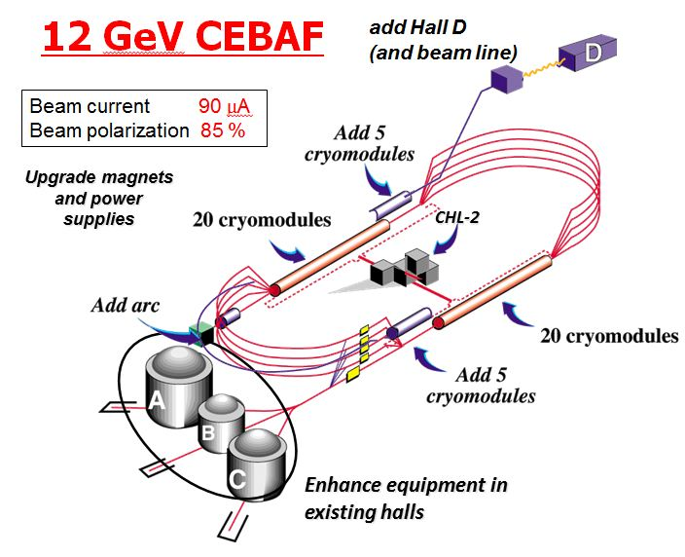
Towards the 12 GeV era

Slide 6
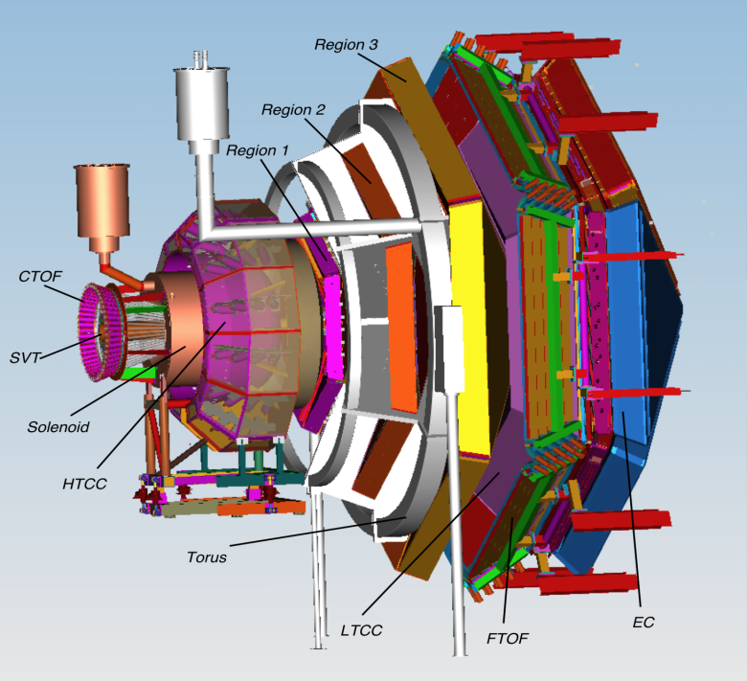
Towards the 12 GeV era
CLAS12 detector
Lumi up to
High polarized electron beams
H and D polarized target
Broad kinematic range
Very good PID
10³⁵ cm⁻² s⁻¹
Physics program:
Hadron spectroscopy
Nuclear effects in hadronization
Nucleon structure (TMDs, GPDs)

Slide 7
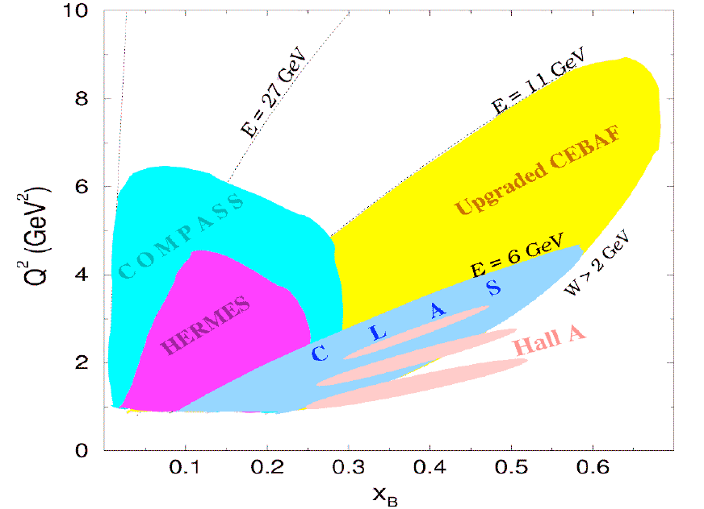
Towards the 12 GeV era

Slide 8
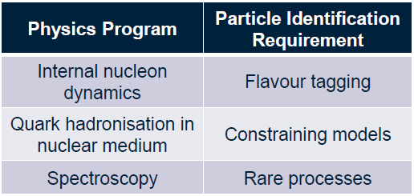
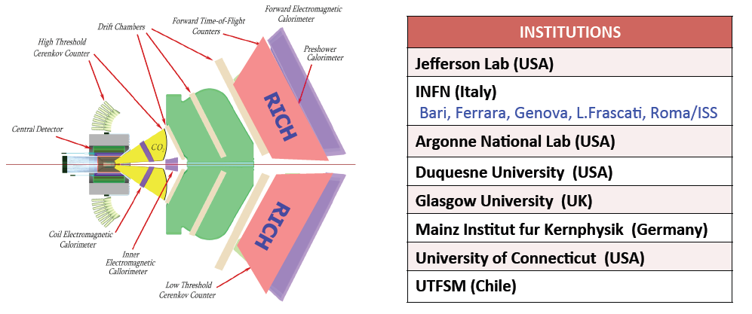
The CLAS12 RICH
Notes:
8

Slide 9
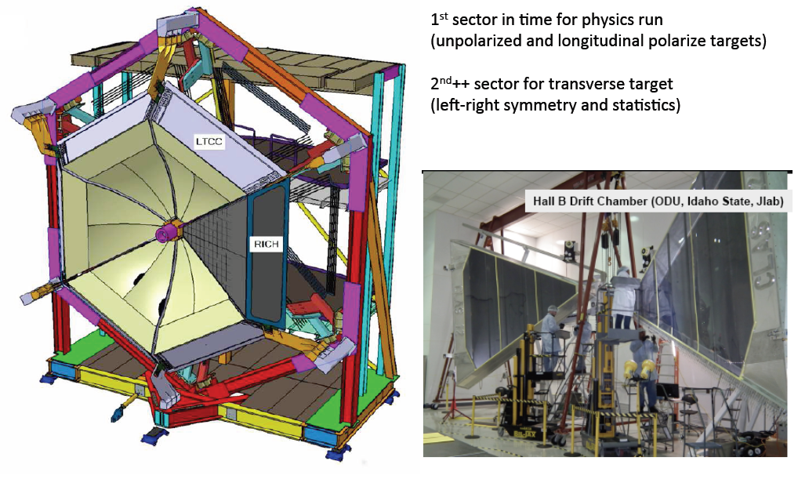
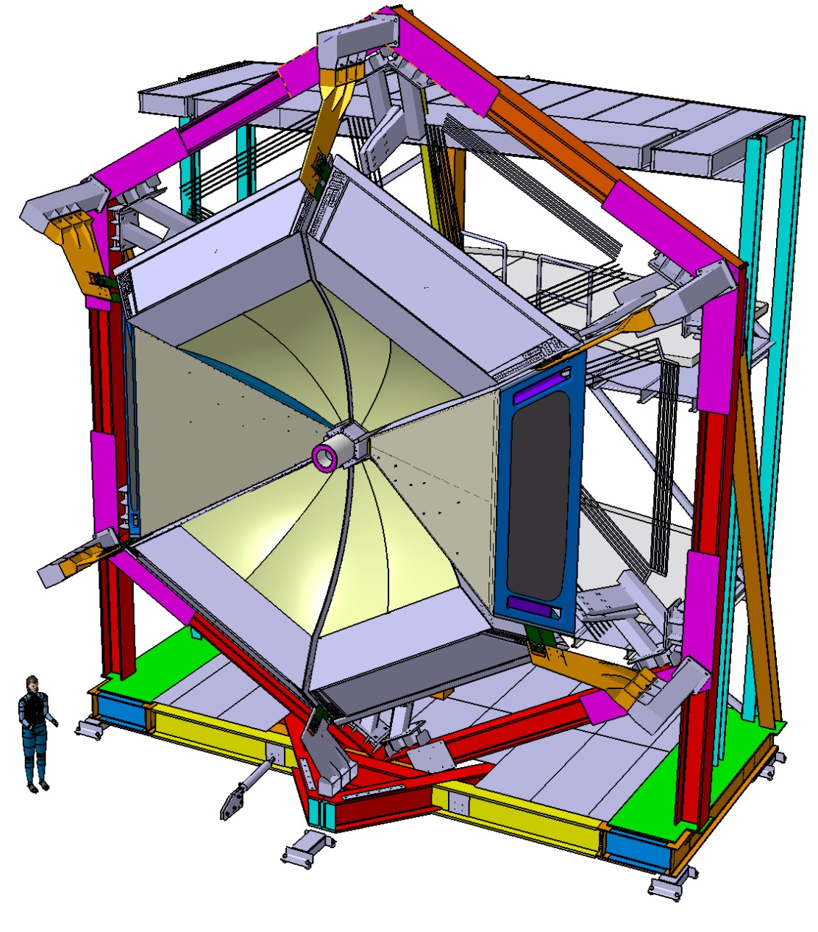
The CLAS12 RICH
RICH 2
RICH 1
Notes:
9

Slide 10
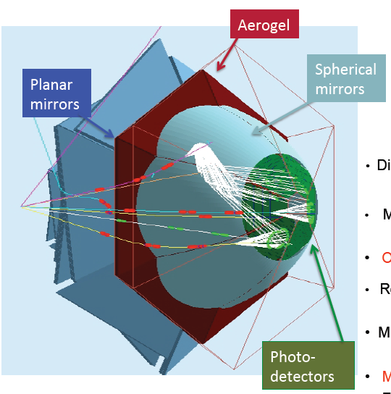
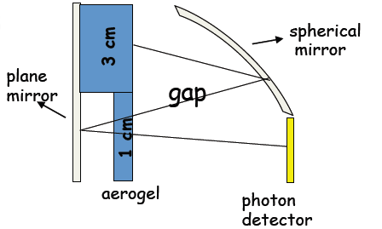
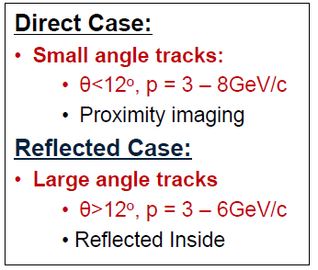
RICH: GEANT4 simulations
Notes:
10

Slide 11
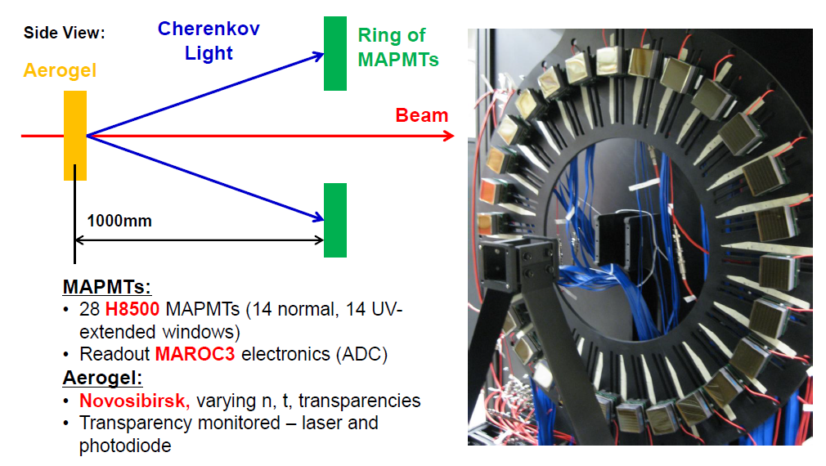
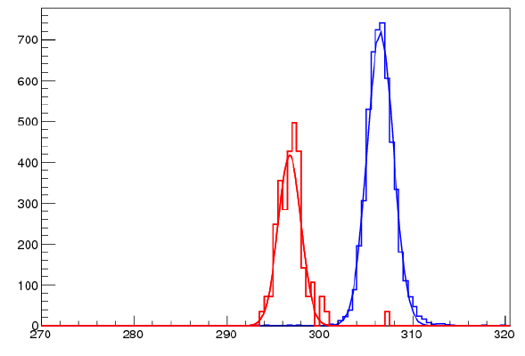
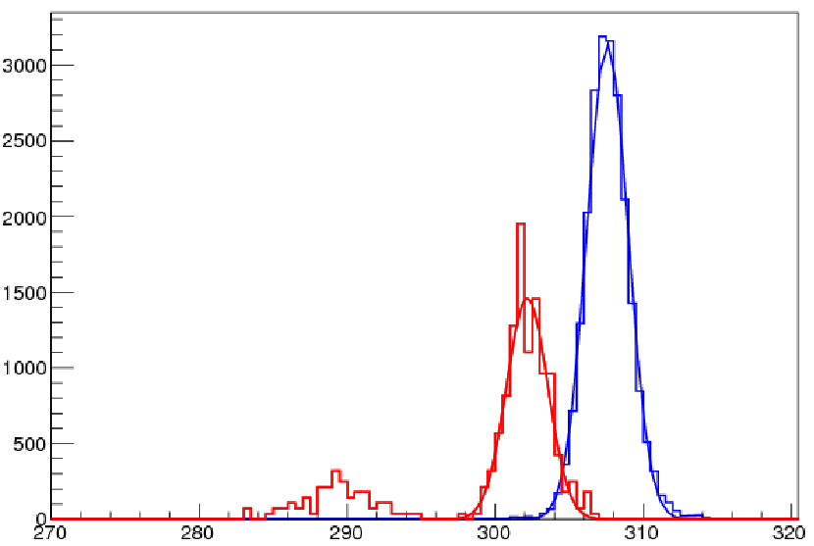
RICH: Prototype and CERN test-beams
Clear hadron separation up to the CLAS12 maximum momentum
p=6 GeV/c
p=8 GeV/c
π
K (x40)
P (x40)
Notes:
11

Slide 12
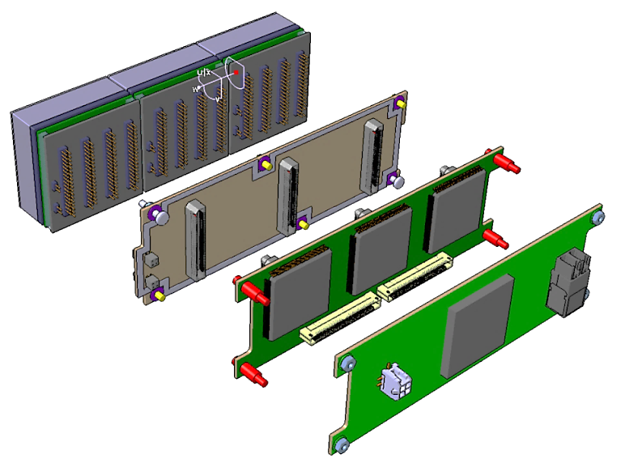
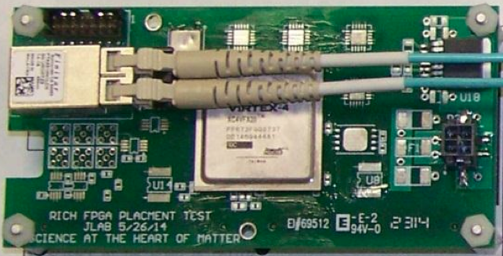
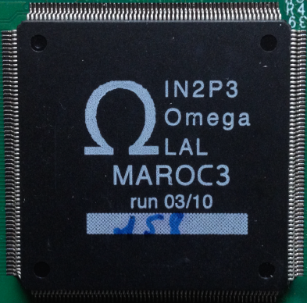
Front-End Electronics
PMTs
ADAPTER BOARD
FPGA board (Jlab)
ASIC BOARD
FPGA BOARD
ASICs board (Ferrara)

Slide 13
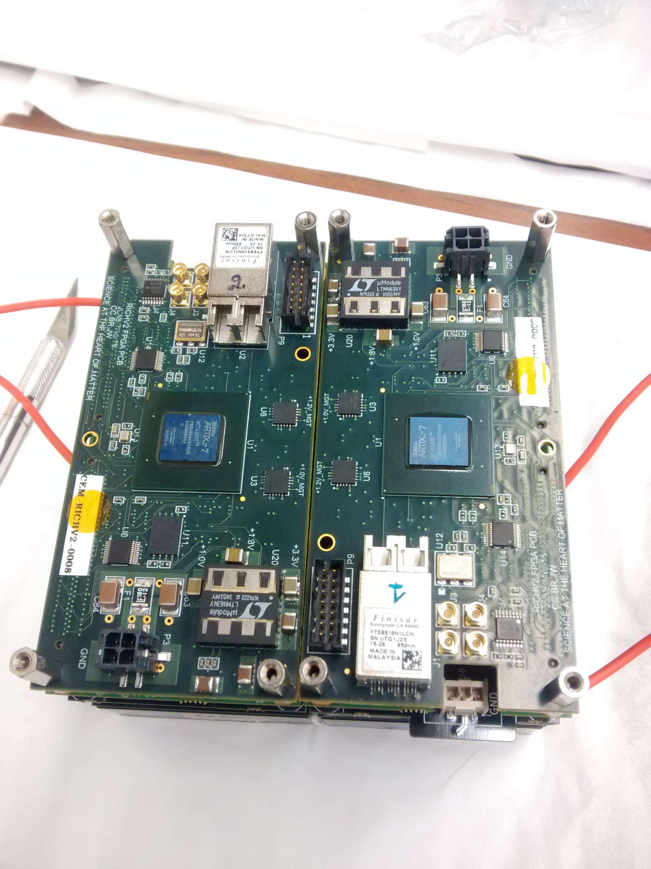
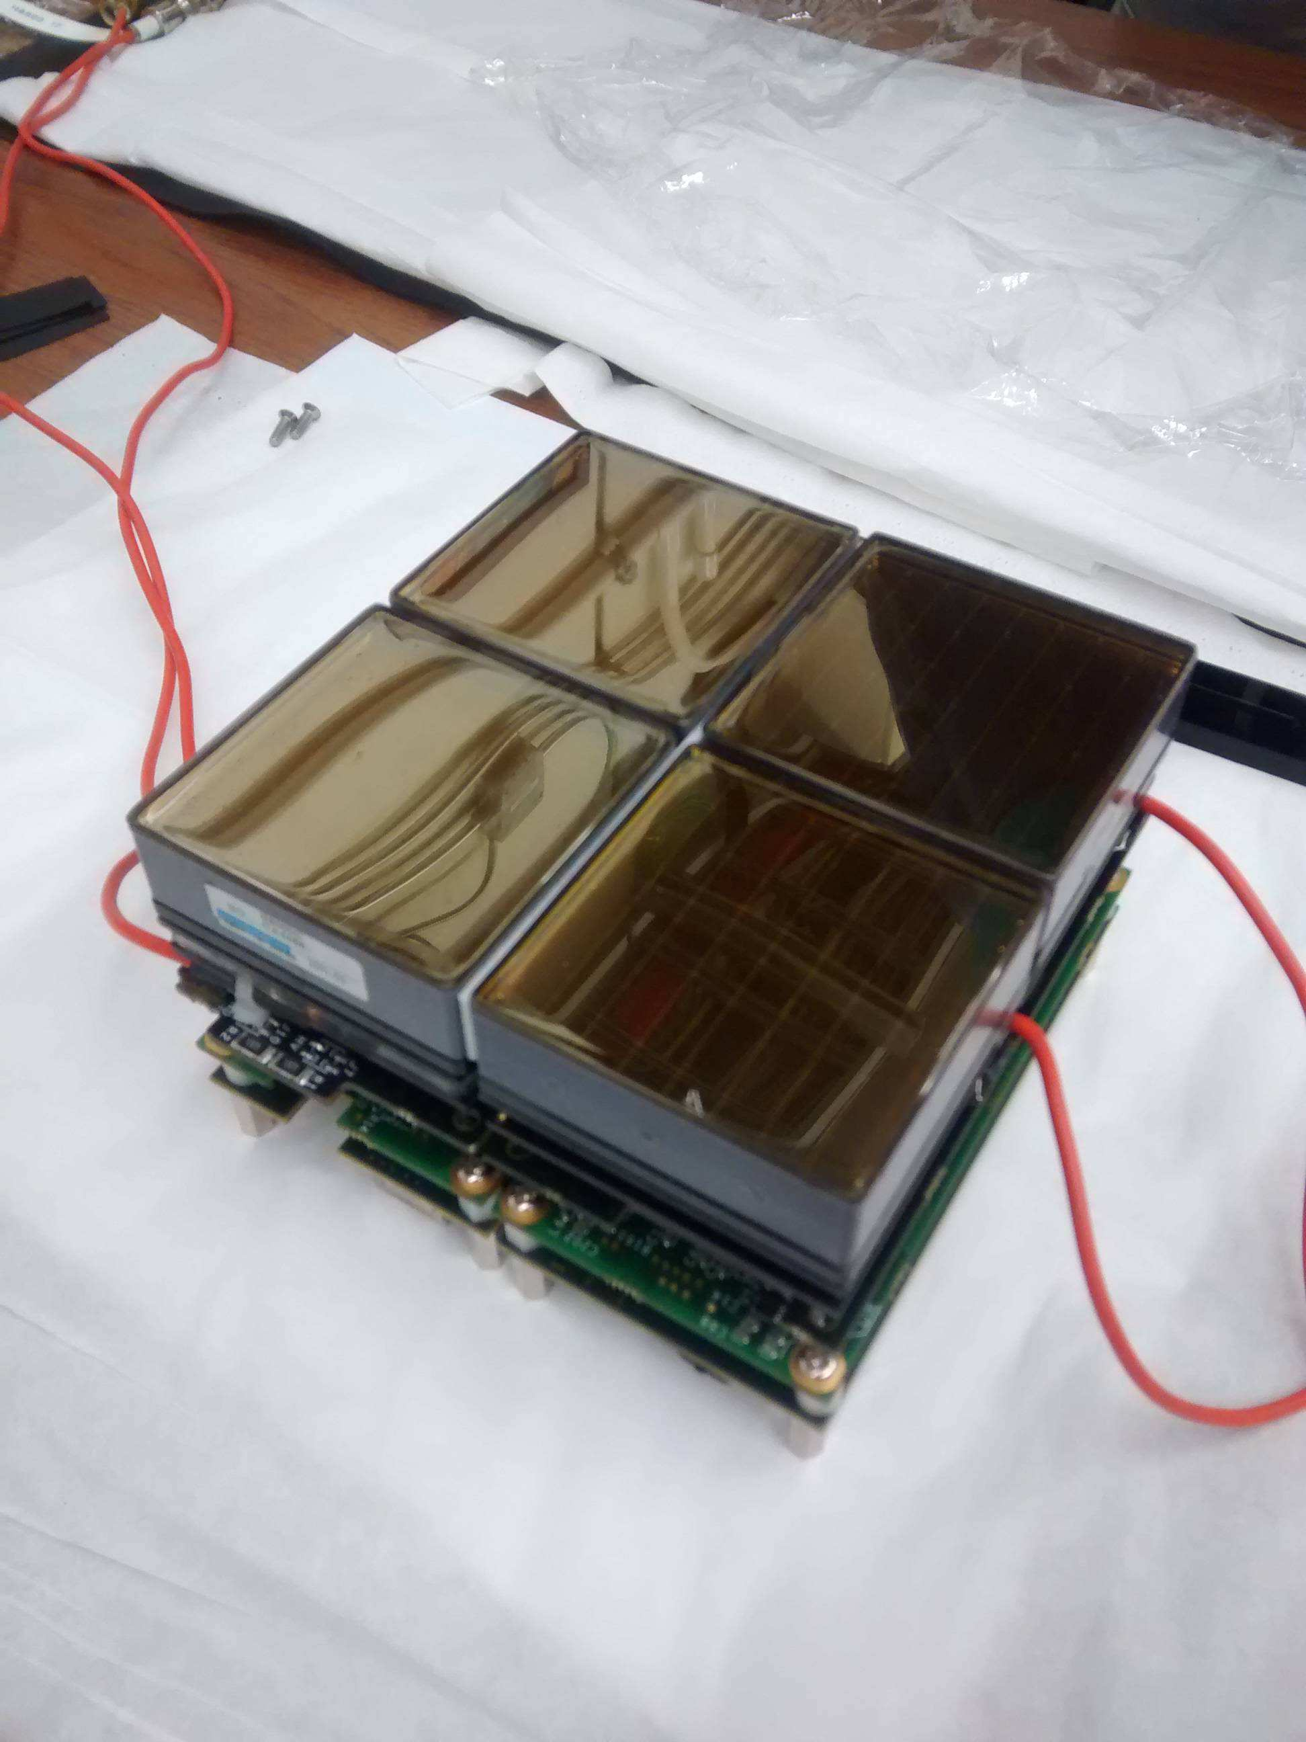
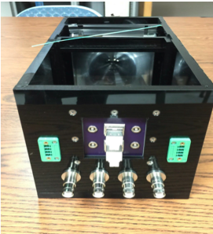
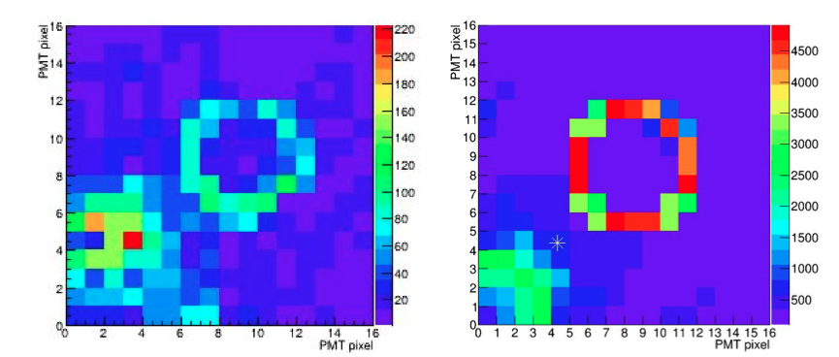
Test @ Fermilab (EIC R&D)
DATA
MC

Slide 14
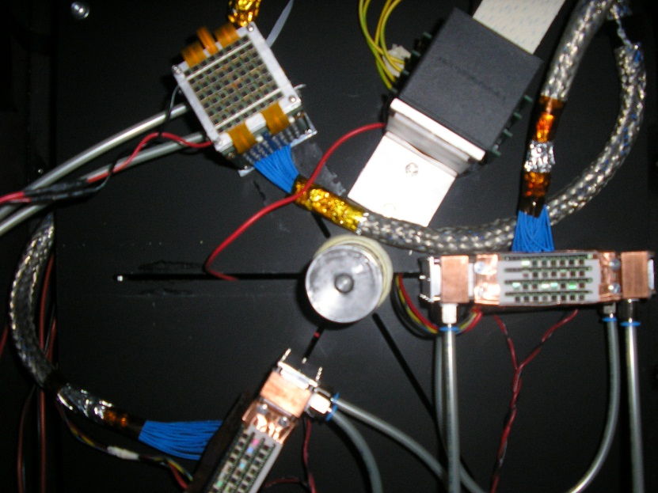
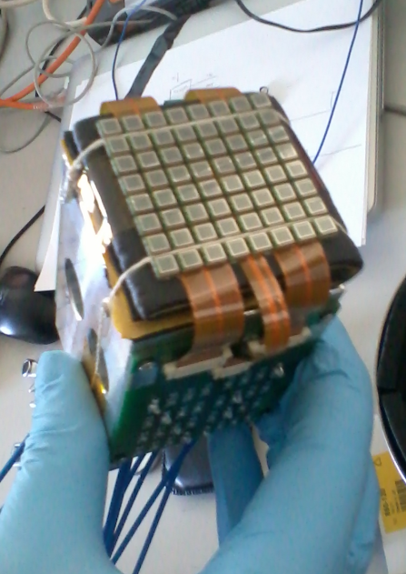
Activity with SiPM
SiPM might offer a cheaper and more efficient solution, expecially in a longer time perspective for other sectors
Notes:
14

Slide 15
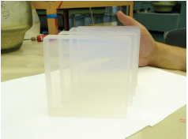
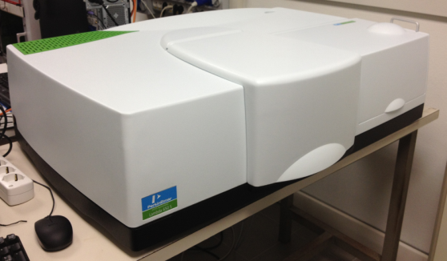
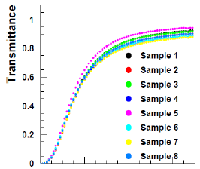
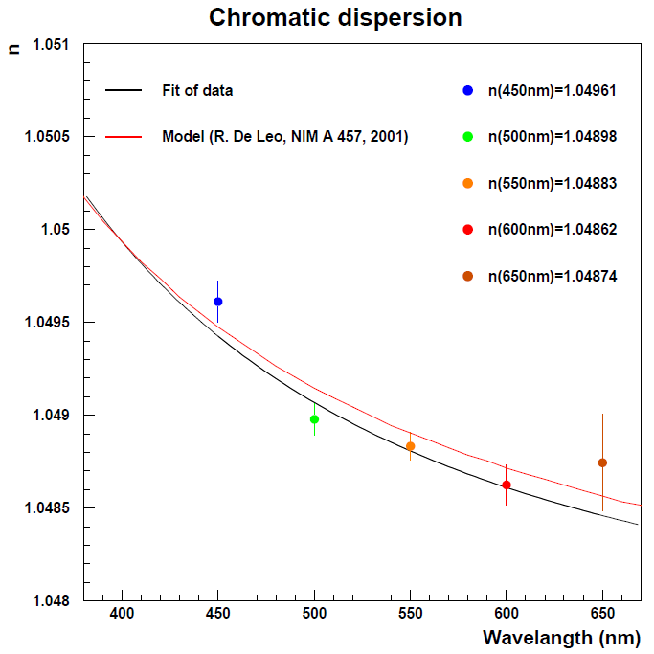
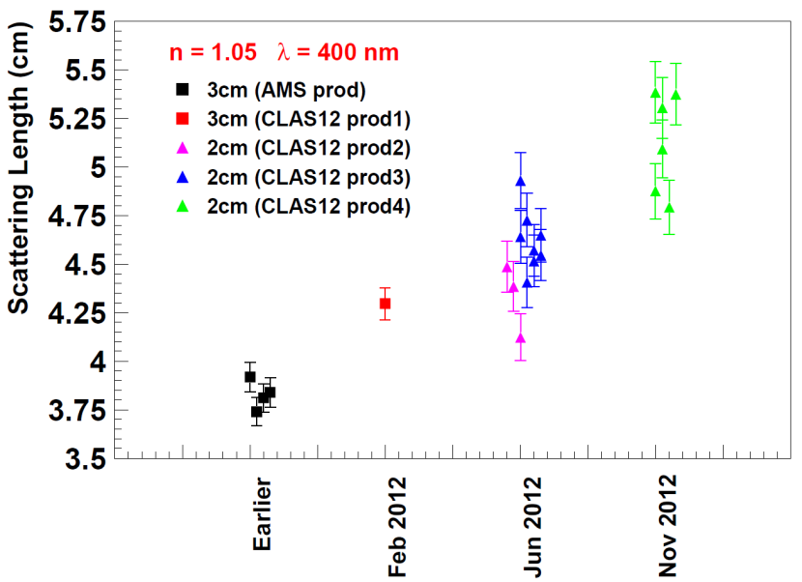
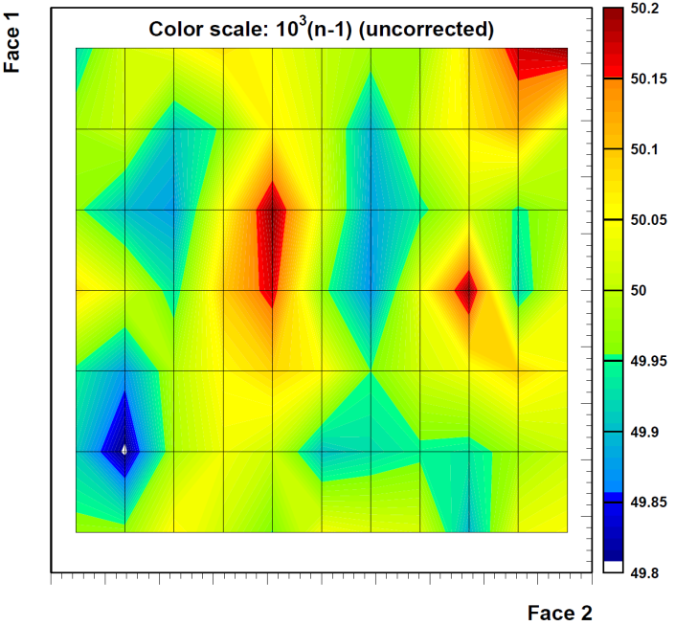
Ferrara Lab:
optical characterization of the aerogel radiator
Transmittance, absorption and scattering length measurements with spectrophotometer
Chromatic dispersion
Refractive index map
Aerogel quality significantly improved in time following the requirements of the project!

Slide 16
RICH Landscape
✔ Project Premiale CLASMED
✔ Gluex DIRC (at Jlab Hall-D) using RICH electronics design
✔ DOE funded R&D for a future EIC
EIC PID Consortium using RICH electronics for the prototype stage
Ferrara in 2017:
✔ RICH & CLASMED Project Coordination
✔ Electronic panel assembling and test
✔ Aerogel characterization and acceptance tests
✔ RICH installation and commissioning
✔ SiPM applications for RICH and Medical Imaging
GOAL: 1st sector ready for the first physics run in fall 2017

Slide 17
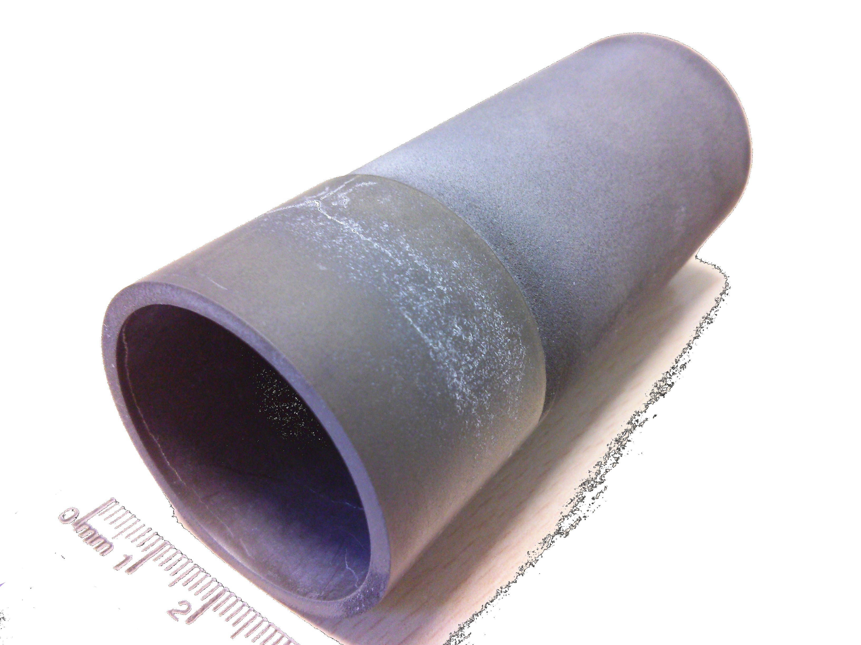
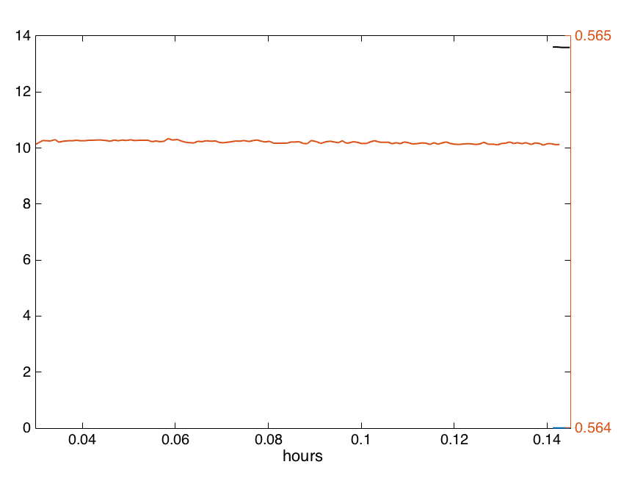
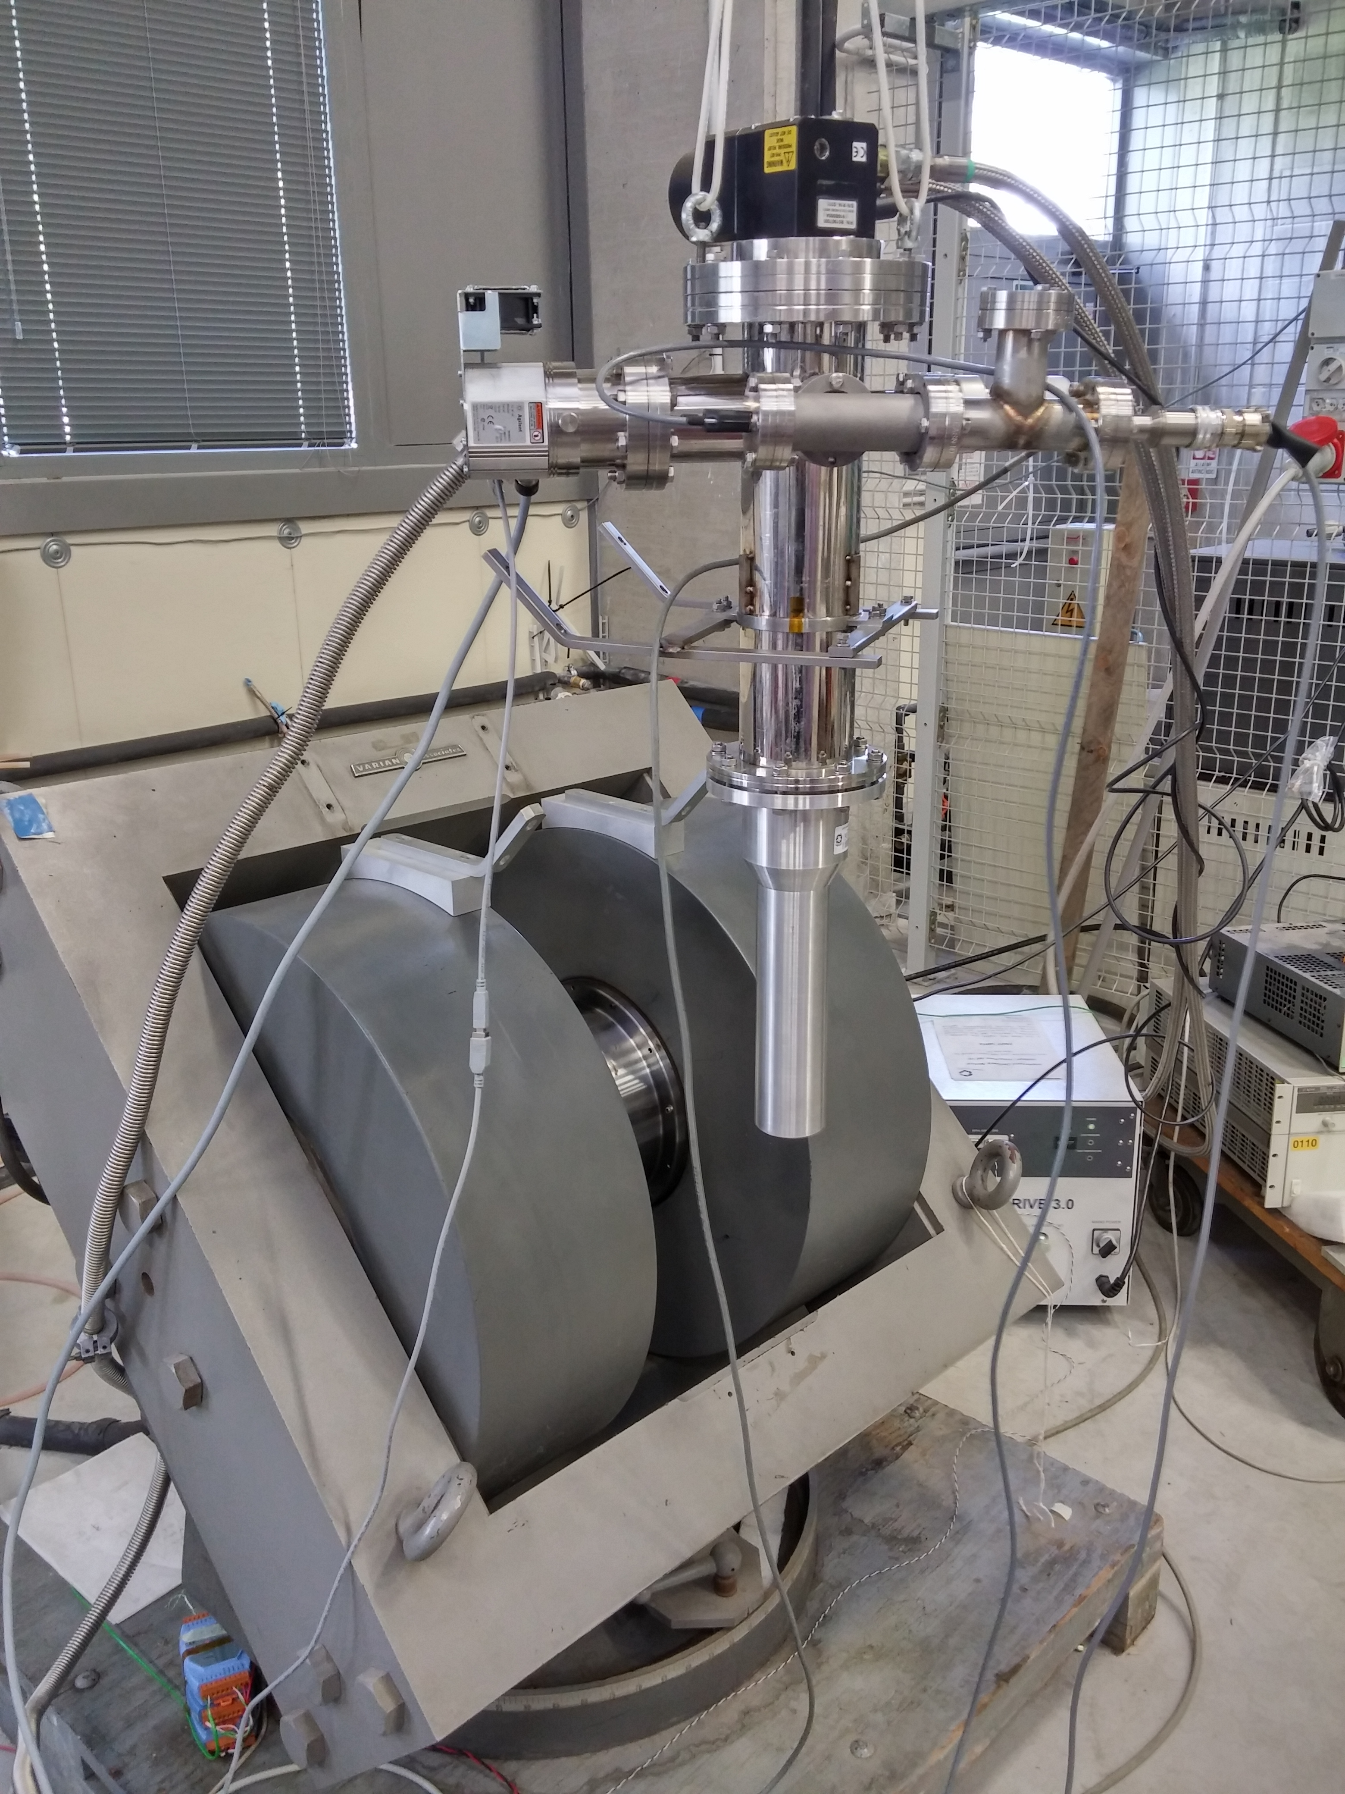
Magnet solutions for the Polarized Target
A new low-dilution HD-ice transversely polarized target is being developed at JLab
It requires a complicated holding filed to be inserted in the CLAS12 solenoid
Ferrara is testing diamagnetic high-Tc magnets (MgB₂ bulk material)
✔ No current leads
✔ Cu free
✔ Self tuning
When frozen it preserves the magnetic flux
(irrespective of external conditions and geometry)
By
K
T
Bz
Dipole field memorized by a MgB₂ cylinder
existing sample
diameter 39 mm
length 90 mm
thickness ~1 mm
(courtesy of G. Giunchi

Slide 18
Il gruppo di Ferrara @ JLAB12
Responsabilita’:
M. Contalbrigo: responsabile locale di JLab12
M. C. responsabile progetto RICH
M. C. & L.P. Co-spokesperson di diverse proposte di esperimento (PAC34,37,38,39)
Contributi principali:
RICH detector (M.C., A. Movsysian, L. Barion, M. Turisini, I. Balossino)
- Caratterizzazione proprieta’ ottiche radiatore aerogel (@ SILAB)
- Test su fascio elettronica di lettura (Fermilab)
- Stress test componenti (stabilita’ verso temperatura, umidita’. radiazione..)
- SIPM Applications on RICH and Medical Imaging
Configurazione magnetica per HD_Ice target (M.C., G. Ciullo, M. Statera, L. Barion)
Analisi dati CLAS6 (M.C., A. Movsisyan)

Slide 19
From PAX
Polarized Antiproton eXperiments
to JEDI
Jülich Electric Dipole moment Investigations

Slide 20
PAX (2005-2016)
Polarization technology for hadron-physics experiments.
Goal: production of first ever beam of polarized antiprotons by spin-filtering.
Application to FAIR facility to investigate single and double spin-asymmetries in p-pbar scattering.
First direct measurement of “transversity”.
Development phase with protons @ COSY – Jülich.
Achievements:
Demonstration of not appicability of spin-flip to polarized „in-situ“ a stored beam.
Successful test of transverse spin-filtering at COSY.
No access to CERN AD (a sad story)
External acknowledgment and financing:
ERC-Advanced Grant: POLPBAR (2010-2016)
Joint Research Activity PolAnti in HP2 and HP3
Byproduct: COSY has become a precision machine ready for new challenges!

Slide 21
JEDI (2016-2021)
Polarization technology for precision experiments.
Goals:
First measurement of deuteron – EDM at COSY.
Production of Technical Design Report for a first generation machine.
In addition:
Time Reversal Invariance Test at COSY
Longitudinal spin-filtering test at COSY (?)

Slide 22
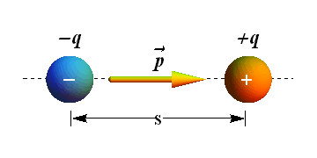
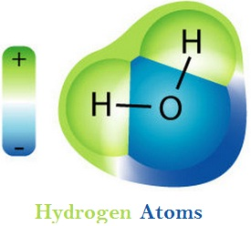
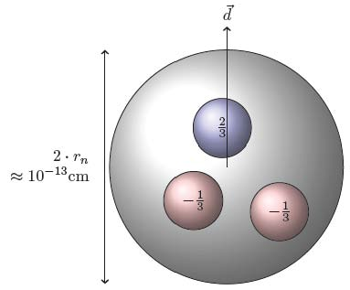
Electric Dipoles
Definition
$$\vec{p}=q∙\vec{s}$$
Charge separation creates an electric dipole
Orders of magnitude
 | Atomic physics | Hadron physics
Charges | e | e
|r₁-r₂| | 1 Å = 10⁻⁸ cm | 1 fm = 10⁻¹³ cm
naive expectation | 10⁻⁸ e cm | 10⁻¹³ e cm
observed | water molecule 2∙10⁻⁸ e cm | neutron < 3∙10⁻²⁶ e cm
H₂O molecule:
permanent EDM
(degenerate GS of different Parity)
EDM = 3∙10⁻²⁶ e cm → separation
between u and d quarks
< 5∙10⁻²⁶ cm

Slide 23
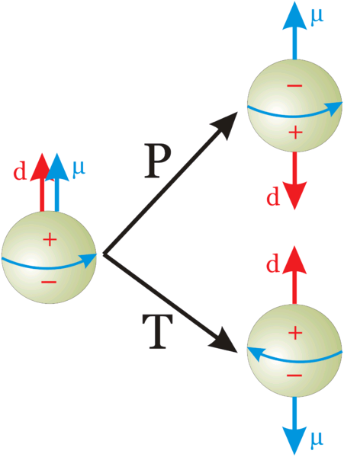
EDM of fundamental particles
Molecules have large EDM because of degenerated ground states with different parity
Elementary particles (including hadrons) have a definite partiy and cannot have EDM
Unless P and T reversal are violated
μ: magnetic dipole moment
d: electric dipole moment
Permanent EDMs violate P and T
Assuming CPT to hold, CP is violated also

Slide 24
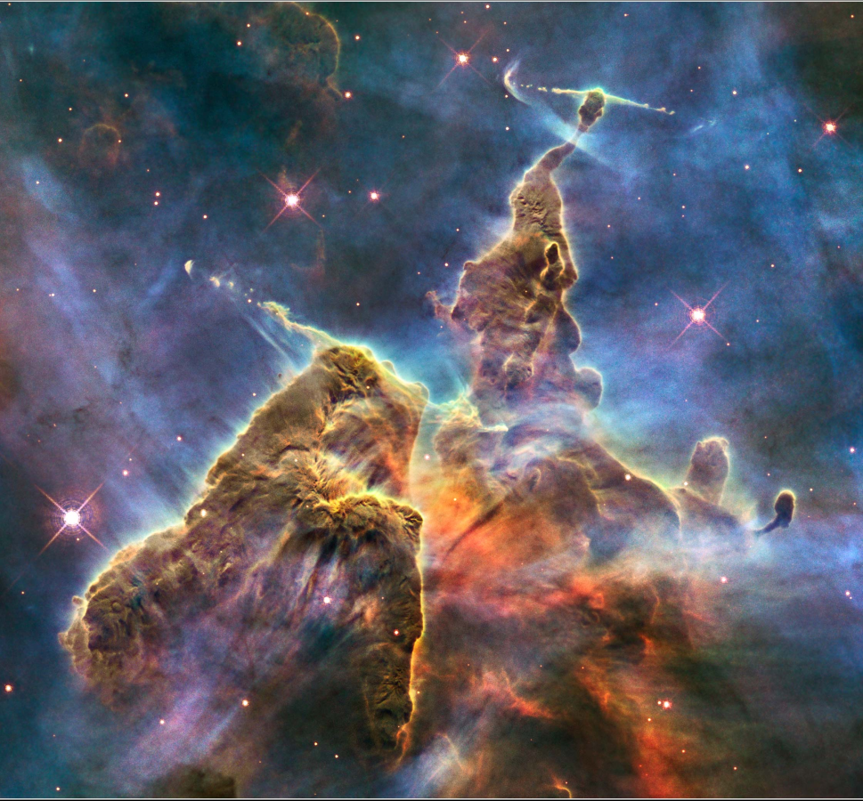
Matter-Antimatter asymmetry
Equal emounts of matter and antimatter at the Big Bang.
Universe dominated by matter.
 | Observed | SM prediction
 | 6x10⁻¹⁰ | 10⁻¹⁸
1967: 3 Sacharov conditions for baryogenesis
Baryon number violation
C and CP violation
Thermal non-equilibrium
New sources of CP violation beyond SM to explain this discrepancy
They could manifest in EDM of elementary particles
Carina Nebula (Largest-seen star-birth regions in the galaxy)

Slide 25
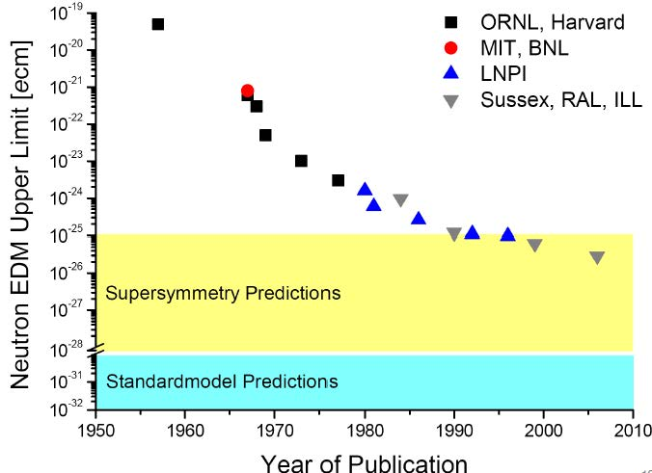
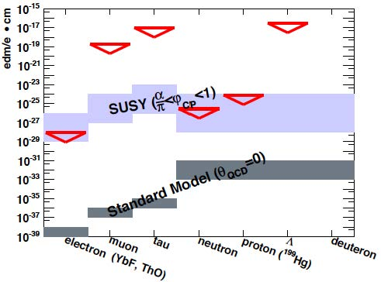
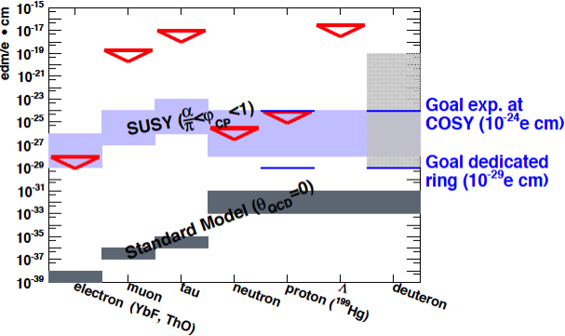
EDM: upper limits
History of neutron EDM
EDM limits

Slide 26
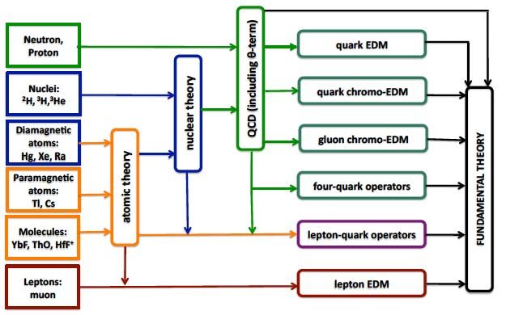
Why charged particles EDMs?
No direct measurements for charged particles exist;
Partially higher sensitivity (compared to neutrons):
Longer life-time;
More stored protons/deuterons;
Complementary to neutron EDM:
d_{d}=d_{p}+d_{n} -> access to θ_{QCD}
EDM of one particle alone not sufficient to identify CP-violating source

Slide 27
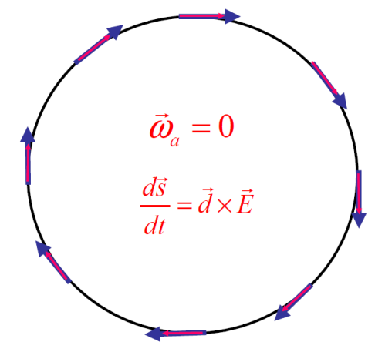
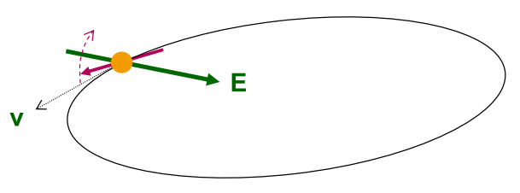
EDM of charged particles: use of storage rings
PROCEDURE
Place particles in a storage ring
Align spin along momentum ( →freeze horizontal spin precession)
Search for time development of vertical polarization
$$\frac{d\vec{s}}{dt}=\vec{d}×\vec{E}$$

Slide 28
Requirements
POLARIMETER
The sensitivity to polarization must by large (0.5).
The efficiency of using the beam must be high (> 1%).
Systematic errors must be managed (< 10^{‒6}).
N.P.M. Brantjes et al. NIMA 664, 49 (2012)
POLARIZED BEAM
Polarization must last a long time (> 1000 s).
Polarization must remain parallel to velocity.
LARGE ELECTRIC FIELDS (E=10 MV/m).
SYSTEMATIC ERROR PLAN

Slide 29
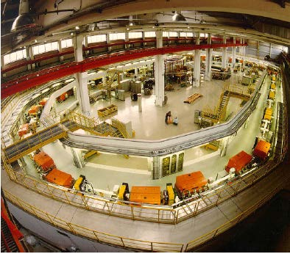
COoler SYnchrotron (FZ-Jülich, GERMANY)
COSY provides polarized protons and deuterons with p = 0.3–3.7 GeV/c
Ideal starting point for charged particles EDM search

Slide 30
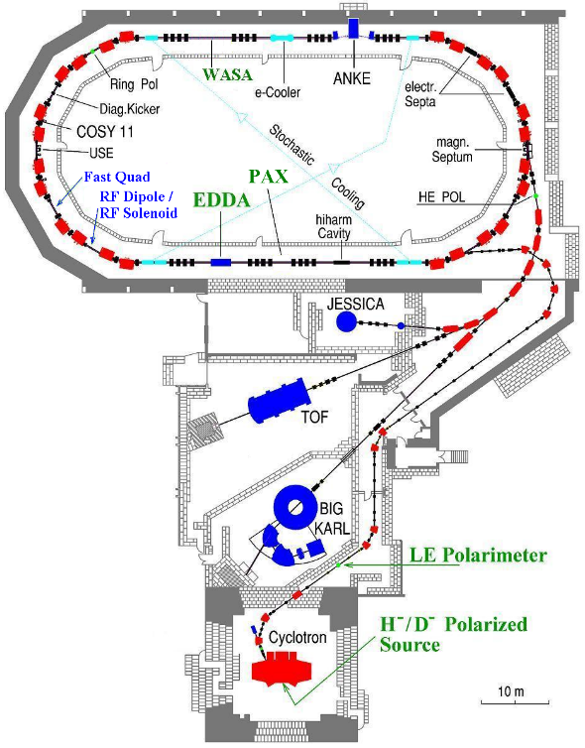
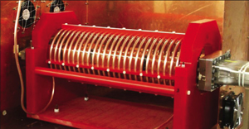
COoler SYnchrotron (FZ-Jülich, GERMANY)
Momentum: <3.7 GeV/c
Circumference: 183 m
Polarized proton and deuteron
Beam polarimeter (EDDA detector )
Instrumentation available for manipulation of
- beam size (electron/stochastic cooling, white noise)
- polarization (RF solenoid)

Slide 31
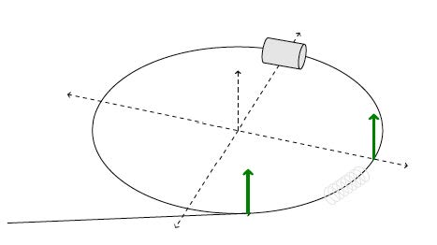
Experimental tests at COSY
Inject and accelerate polarized deuterons to 1 GeV/c

Slide 32
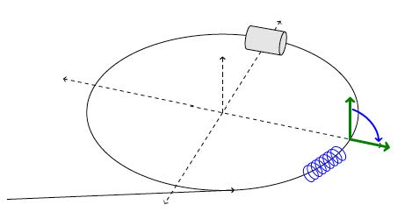
Experimental tests at COSY
Inject and accelerate polarized deuterons to 1 GeV/c
Flip spin in the horizontal plane with help of solenoid

Slide 33
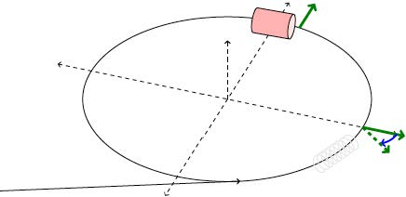
Experimental tests at COSY
Inject and accelerate polarized deuterons to 1 GeV/c
Flip spin in the horizontal plane with help of solenoid
Extract slowly (100 s) beam on target
Measure asymmetry and determine spin precession

Slide 34
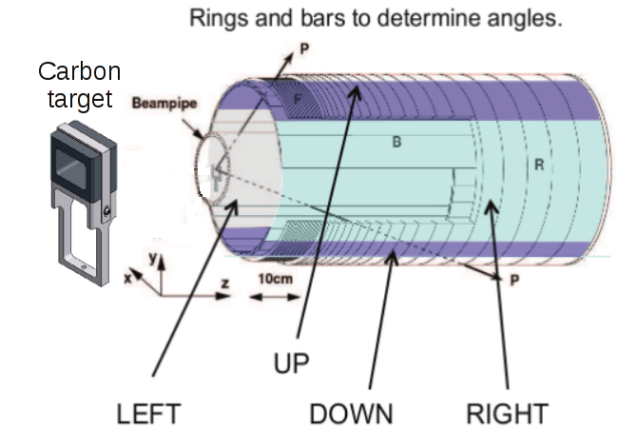
EDDA beam polarimeter
ASYMMETRIES
beam
VERTICAL polarization
Analyzing power
HORIZONTAL polarization
Analyzing power
Beam moves toward thick target continuous extraction
Elastic scattering (large cross section for d-C)

Slide 35
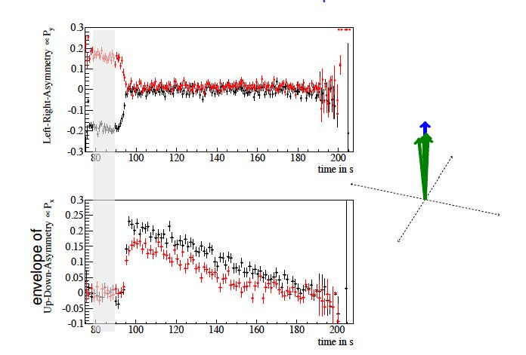
Spin-precession measurement

Slide 36
Results: spin coherence time
Short Spin coherence time:
Unbunched beam:
Δp/p=10⁻⁵->Δγ/γ=2x10⁻⁶, T_{rev}=10⁻⁶s
Decoherence after < 1s
Bunching eliminates 1st order effect in Δp/p:
SCT τ = 20 s
Long Spin coherence time:
Betatron oscillations cause variation of orbit length
Correction wit sextupoles
SCT τ = 400 s

Slide 37
Spin-tune
Spin tune ν_{s}= γG = nb. of spin rotations/nb. of particle revolutions
Deuterons: p_{d}= 1 GeV/c (γ=1.13), G = - 0.14256177 (72) -> ν_{s} = γG ≈ - 0.161

Slide 38
Results: Spin-tune measurement
Precision: 10⁻¹⁰ in one cycle of 100 s (angle precision: 2π10⁻¹⁰ = 0.6 nrad)
It can be used as a tool to investigate systematic errors
Feedback system to keep polarization aligned with momentum in a dedicated ring or at with respect to RF Wien filter (-> next slides)

Slide 39
Application: Spin feedback system
Simulation of an EDM experiment using μ:
Polarization rotation in horizontal plane (t = 85 s)
RF solenoid (low amplitude) switched on (t = 115 s)
COSY-RF controlled in steps of 3.7 mHz (f_{rev}=750603 Hz) to keep spin phase atRF-solenoid constant
Polarization “rotates” back to vertical direction

Slide 40
FE contribution: development of a high-efficieny polarimeter

Slide 41
Development of SiPM based readout system (L. Barion, S. Basile, R. Malaguti, P.L.)
Polarimeter
LYSO crystal
SiPM

Slide 42
JEDI: Summary and Outlook
EDMs high sensitive probes of CP violation.
Storage ring and polarization technology pave the way to charged particle EDM.
High technical challenge.
First promising results at COSY:
Spin coherence time: few hundred seconds.
Spin tune measurement: 10⁻¹⁰ in 100 s.
Spin feedback system: allows to control spin.
Simulations: to understand systematics.
Goal: first direct measurement of deuteron EDM in 2018-19

Slide 43
Test of Time Reversal Invariance at COSY
Experiments:
Measurements of EDM test T and P symmetries (T-odd and P-odd)
Proposed measurement is a direct test of T-symmetry (T-odd P-even)
- Experimental situation
← Proposed measurement

Slide 44
Concept of the experiment
Vector polarized proton beam vs
Tensor polarized deuteron target
→sensible to A_{y,xz}
Time reversal b) equivalent to:
- inversion of proton beam polarization c)
- inversion of deuteron target polarization d)
Different cross sections for a) vs c) or d) ↦ time reversal violation

Slide 45
Measurement at COSY
PAX installation at COSY:
Atomic beam source (d↑ target)
Openable storage cell
Si-detector (beam polarimetry)
Sensitive beam current monitor installed:
Difference in cross-section origins different beam lifetimes

Slide 46
Ferrara responsibility (V. Carassiti, S. Sguerzanti, P.L.): polarimeter (Si-detector) design and construction
openable cell
mechan. support
- 3 layers of Si det.
- front-end electr.
- cooling
QUADRANT
TARGET CELL
SUPPORT
COOLING
FEED-THROUGH

Slide 48
Detector tests and electronic readout (A. Kononov, A. Cotta)

Slide 49
FE responsibility (V. Carassiti. S. Sguerzanti, P.L.): design and realization of an openable storage cell
1st prototype realized and tested at COSY
new design and realization in 16
Compatibility with silicon detector

Slide 50
Ferrara responsibility (G. Ciullo, A. Pesce): polarized target and polarimeter
ABS
Breit-Rabi
polarimeter
New perspective:
Target compatible for H and D running

Slide 51
Responsibilities and external funding
EDM
SCT data analysis: V. Rolando
Polarimeter development: S. Basile, L. Barion, V. Carassiti, R. Malaguti, P.L.
TRIC
Polarized Target: G. Ciullo, A. Pesce
Detector coordination: V. Carassiti, S. Sguerzanti, P.L.
EXTERNAL FINANCES:
The project has been awarded an ERC-Advanced Grant: srEDM
Total sum: 2.4 Meuro
Duration: 5 Years
Consortium:
FZ-Juelich – prof. H. Stroeher (PI)
RWTH Aachen – prof. J. Praetz
University of Ferrara – prof. P. Lenisa
JRA – sredm in Hadron Physics Horizon
Spokespersons: P. Lenisa, J. Praetz

Slide 52
Composizione del Gruppo
 |  | PAX | JLAB12
I. Balossino | Dottoranda |  | 100%
L. Barion | Assegnista | 30 % | 70%
S. Basile | Dottorando | 100 &
S. Bertelli | Assegnista | 100 %
G. Ciullo | R | 80 % | 20%
G. Cibinetto | RTD | 30%
A. Drago | Prof. Associato |  | 20%
M. Contalbrigo | R | 20 % | 80%
A. Kononov | Borsista | 100 %
P. Lenisa | Prof. Associato | 80 % | 20%
A. Movsisyan | Assegnista |  | 100%
L. Pappalardo | RTD |  | 20 %
A. Pesce | Assegnista | 100%
V. Rolando | Assegnista | 100 %
F. Spizzo | R | 30% | 70%
M. Turisini | Dottorando |  | 100%
V. Carassiti | DT (Mecc) | 30%
A. Cotta Ramusino | DT (Elettr.) | 10%
R. Malaguti |  |  | 20%
Landi |  | 20%
Squerzanti |  | 30%
TOT FTE |  | 7.0 | 6.0
Richieste finanziarie JLab12
Missioni | 80 k€
Trasp. | 5 k€
Inv. | 10 k€
Consumi | 15 k€
Apparati | 100 k€
TOTALE | 210 k€
Richieste finanziarie PAX
Missioni | 60 k€
Trasp. | 5 k€
Consumi | 45 k€
TOTALE | 110 k€

Slide 54
Systematics
One major source:
Radial B_{r} field mimics EDM effect
Example: d = 10⁻²⁹ e cm with E = 10 MV/m
If μB_{r}≈dE_{r} this corresponds to a magnetic field:
(Earth magnetic field = 5 ∙ 10 ⁻⁵ T)
Solution
Use two beam running clockwise and counterclockwise.
Separation of two beams sensitive to B

