Slide 1
Attività Gruppo III
Paolo Lenisa
Consiglio di Sezione
Ferrara, 5 Luglio 2018

Slide 2
La fisica del Gruppo III a Ferrara
JLAB12 (R.L. & R.N: Marco Contalbrigo)
- spin physics
- transverse momentum phenomena (TMDs) & 3D imaging
- GPDs, EM Form Factors
JEDI (R.L. & R.N. Paolo Lenisa)
- EDM, tests of fundamental symmetries

Slide 3
Collaborazione JLab12
Responsabile Locale e Nazionale
M. Contalbrigo

Slide 4
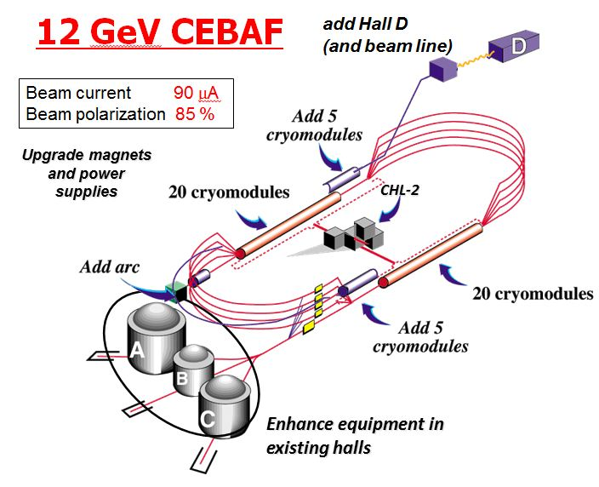
Towards the 12 GeV era

Slide 5
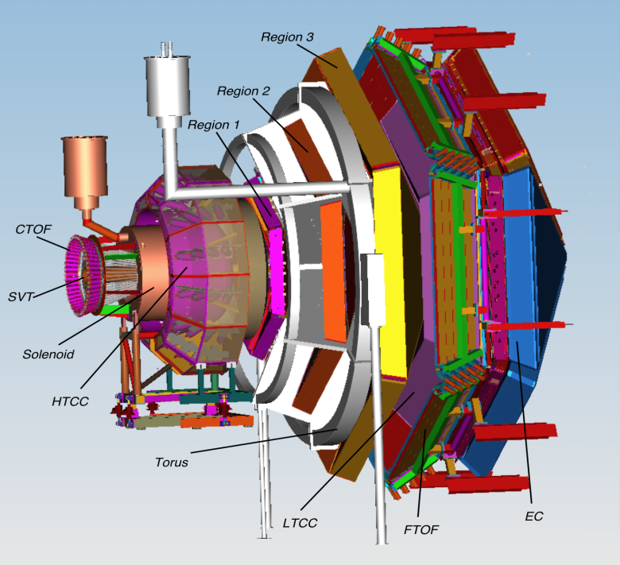
Towards the 12 GeV era
CLAS12 detector
Lumi up to
High polarized electron beams
H and D polarized target
Broad kinematic range
Very good PID
Physics program:
Hadron spectroscopy
Nuclear effects in hadronization
Nucleon structure (TMDs, GPDs)
5

Slide 6
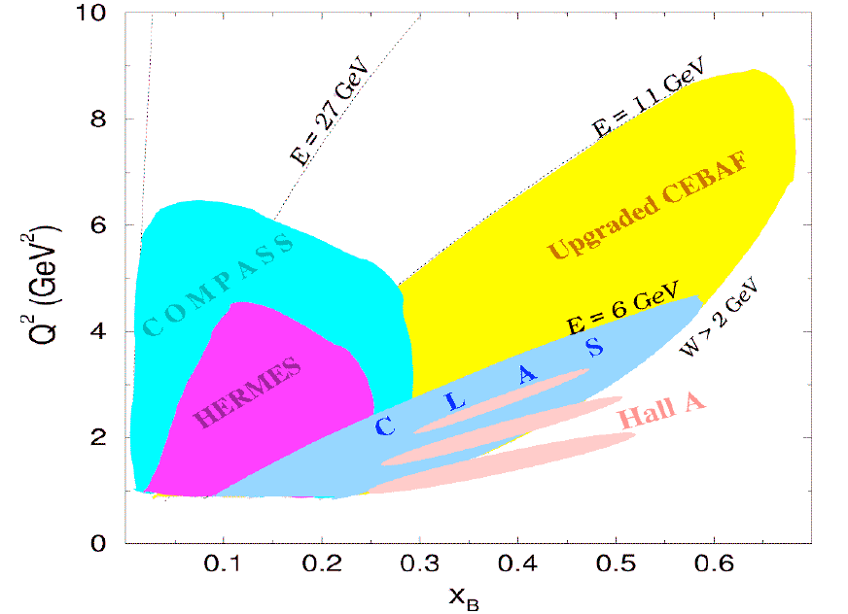
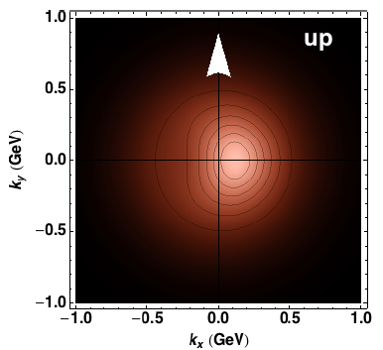
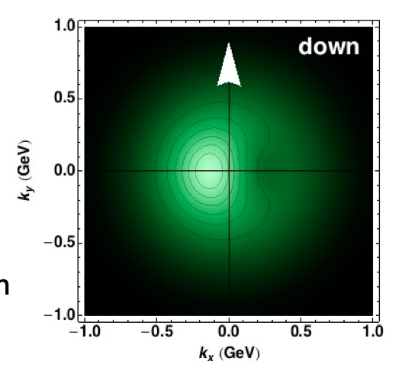
Towards the 12 GeV era
Investigating QCD spin-orbit
and dynamic effects
6

Slide 7
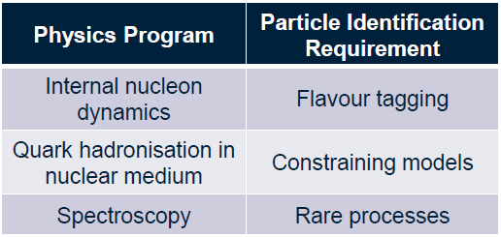
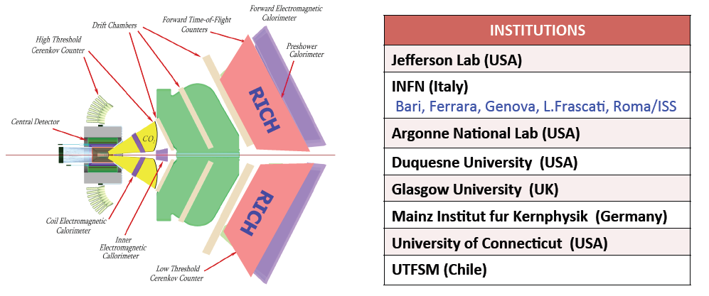
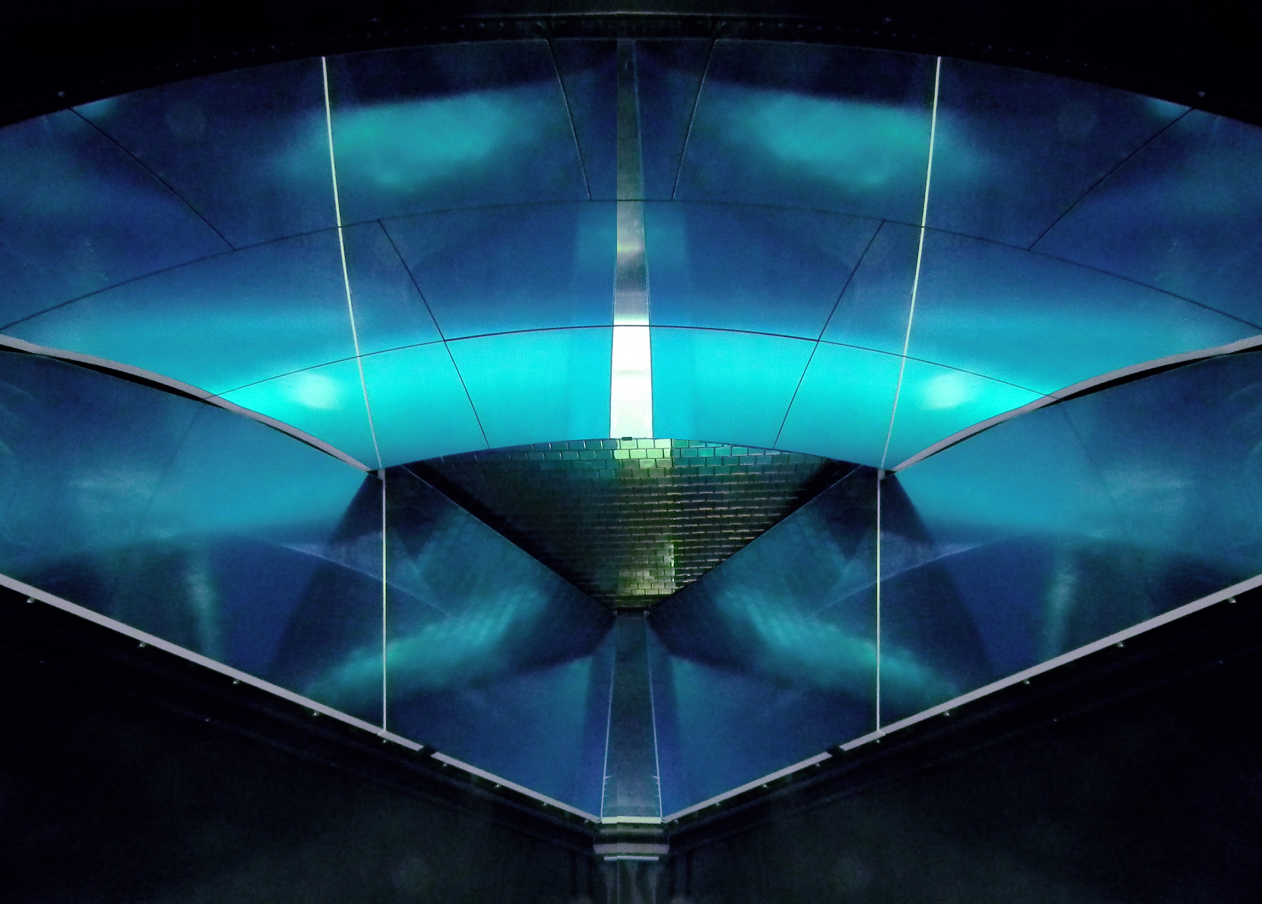
The CLAS12 RICH
INSTITUTIONS
INFN (Italy) Bari, Ferrara, Genova, L.Frascati, Roma/ISS
Jefferson Lab (Newport News, USA)
Argonne National Lab (Argonne, USA)
Duquesne University (Pittsburgh, USA)
George Washington University (USA)
Glasgow University (Glasgow, UK)
J. Gutenberg Universitat Mainz (Mainz, Germany)
Kyungpook National University, (Daegu, Korea)
University of Connecticut (Storrs, USA)
UTFSM (Valparaiso, Chile)
Notes:
7

Slide 8
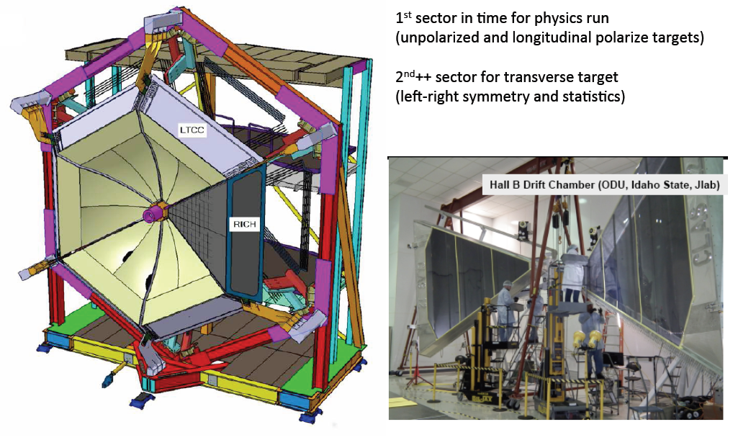
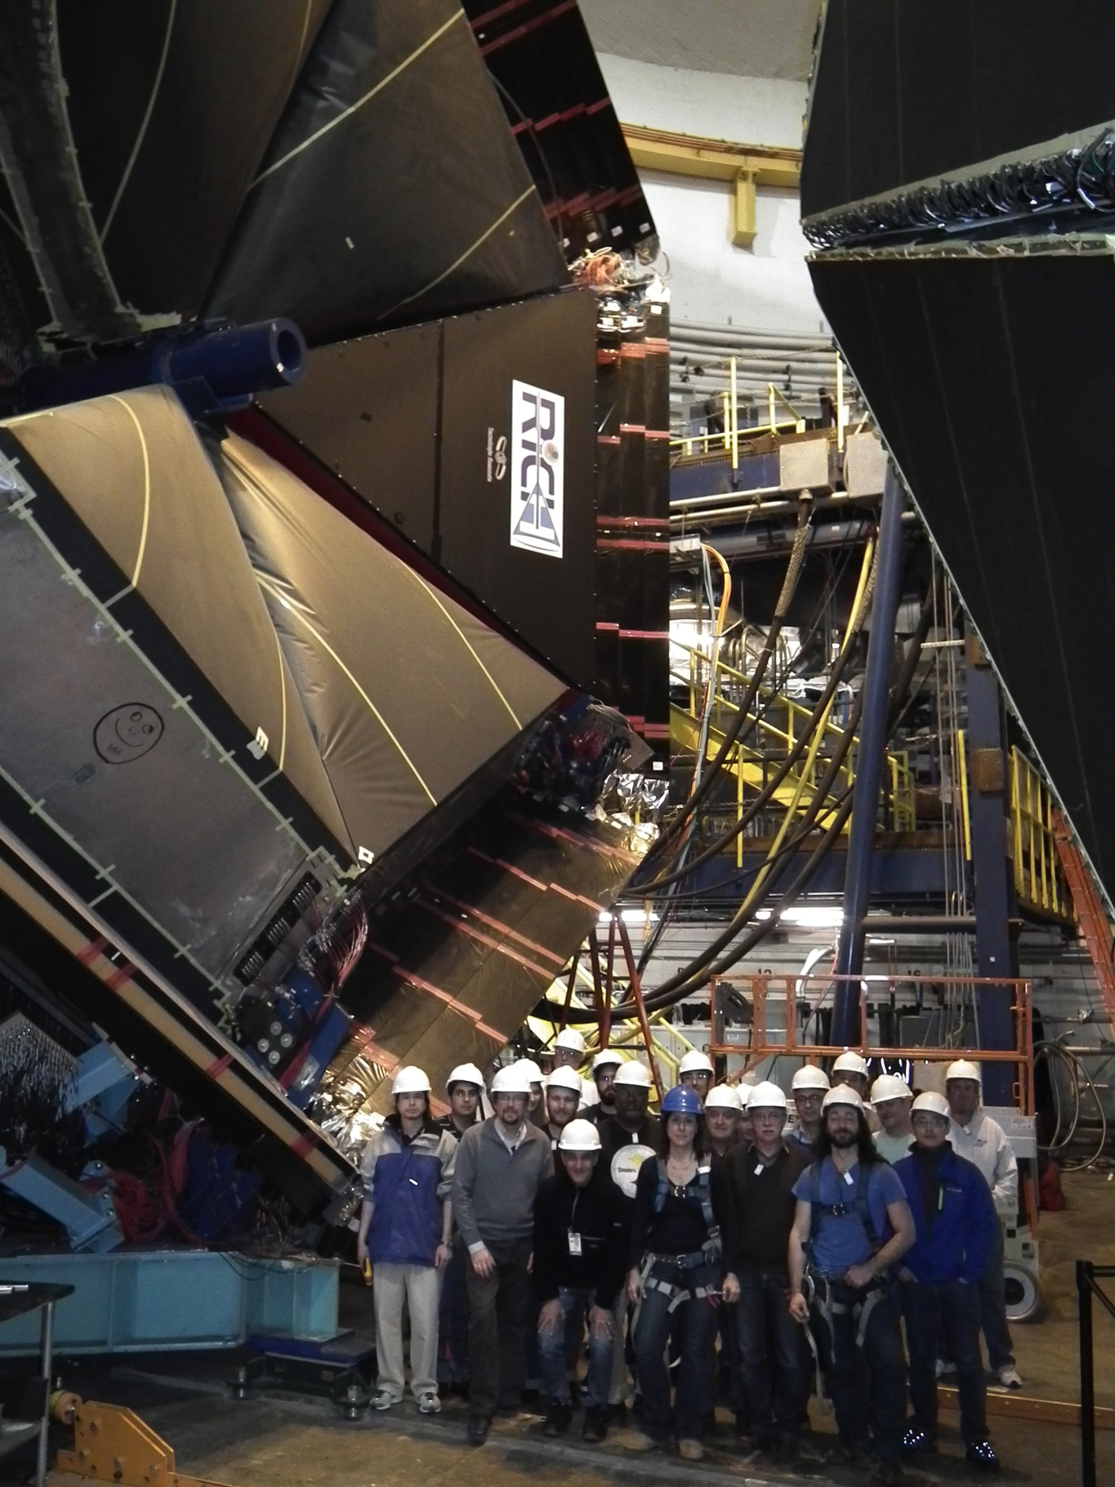
The CLAS12 RICH
Notes:
8

Slide 9
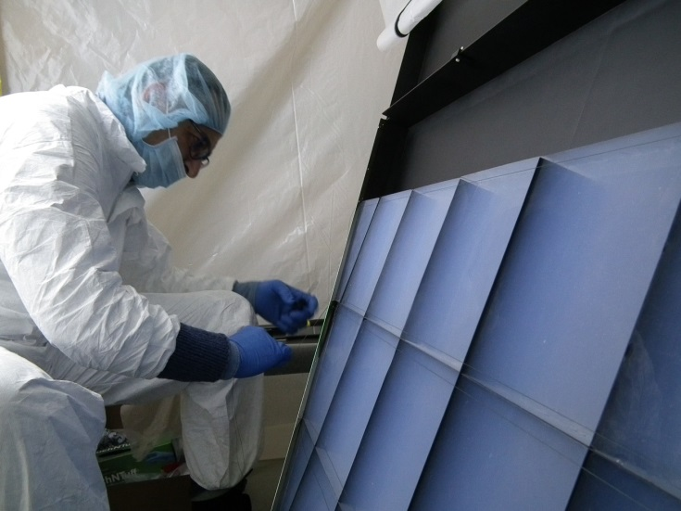
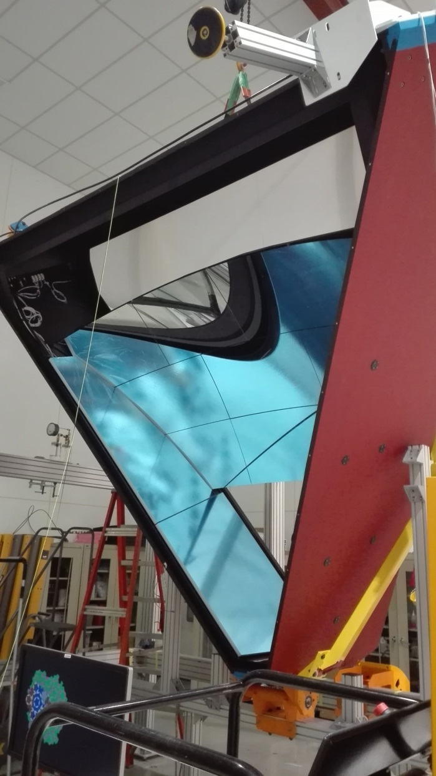
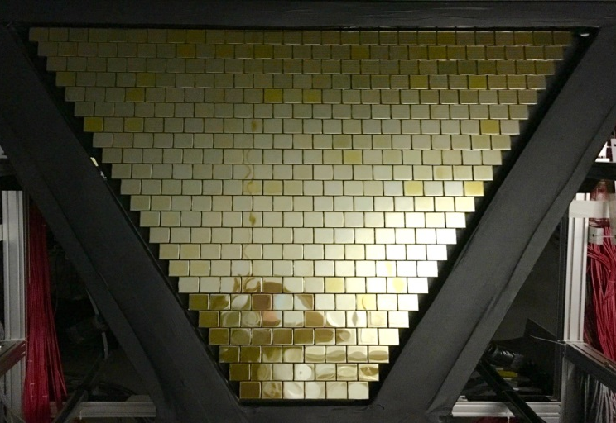
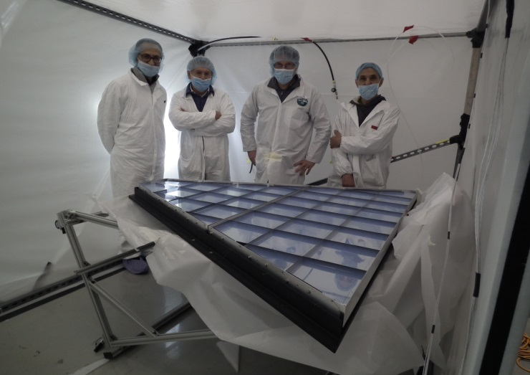
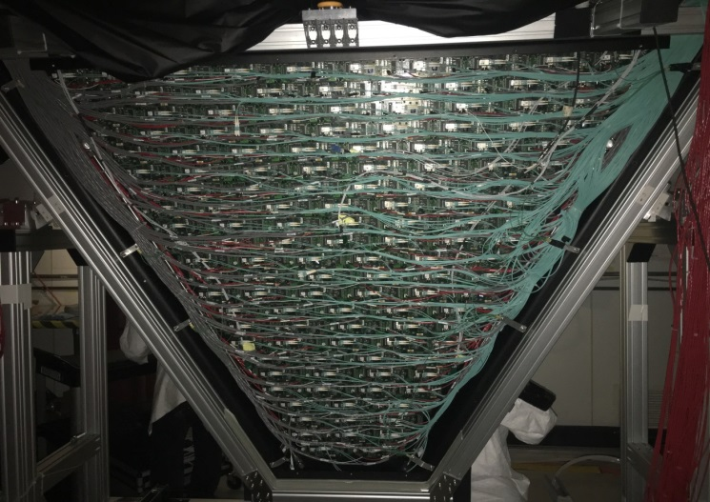
The CLAS12 RICH
First module assembled in November 2017
Notes:
9

Slide 10
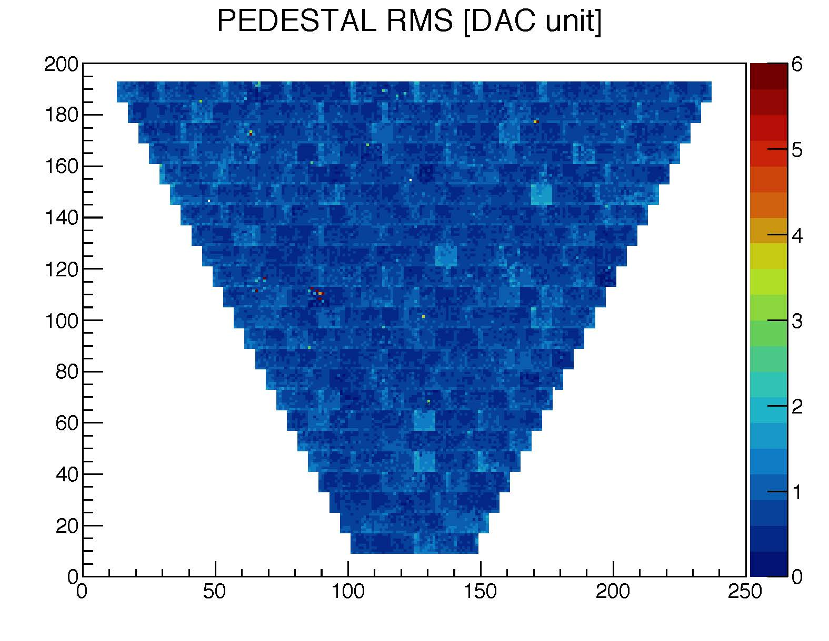
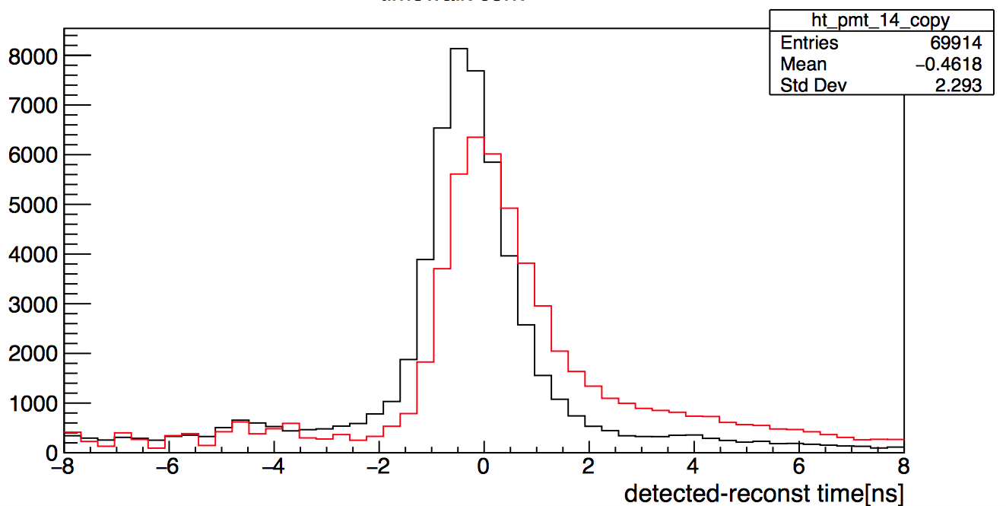
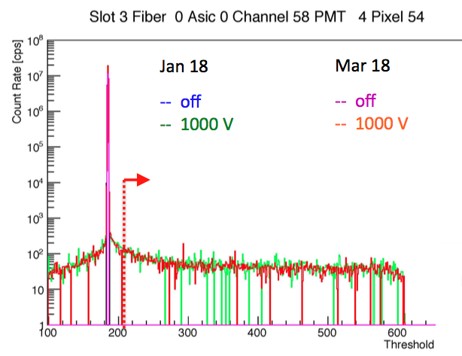
Pedestal rms at the limit of sensitivity (1 DAC)
RICH: Online Peformance
RICH stability
Pedestal rms at limit of sensitivity (1 DAC)
RICH timing
In line with 1 ns resolution expectation
Δt = meas. time – reconstructed time
Reconstructed time:
Event start time + particle path
Single hits (photons) time walk correction
-- before
-- after
Pedestal ~ 2 months stability
Notes:
10

Slide 11
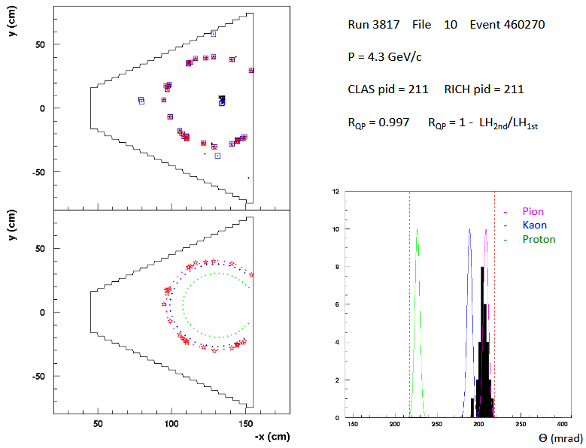
RICH: Event Reconstruction
Notes:
11

Slide 12
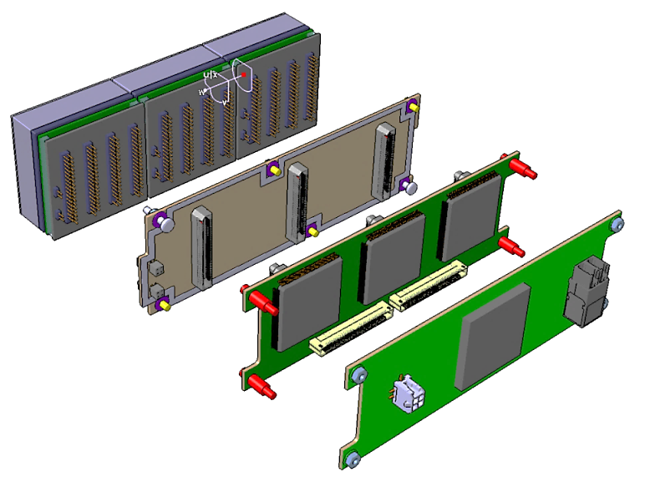
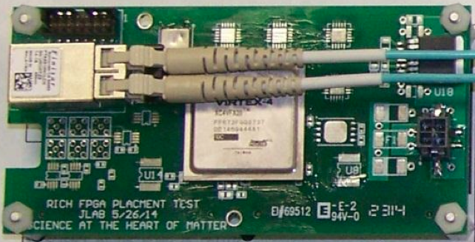
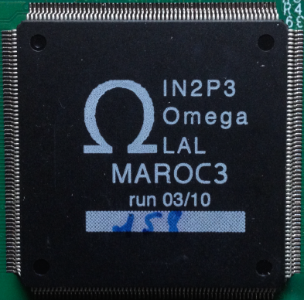
Front-End Electronics
Compact and modular electronics to readout multi-anode PMTs
Several groups (JLab DG) and experiments (Gluex, EIC, SOLID) manifest interest for using it
PMTs
ADAPTER BOARD
FPGA board (Jlab)
ASIC BOARD
FPGA BOARD
ASICs board (Ferrara)

Slide 13
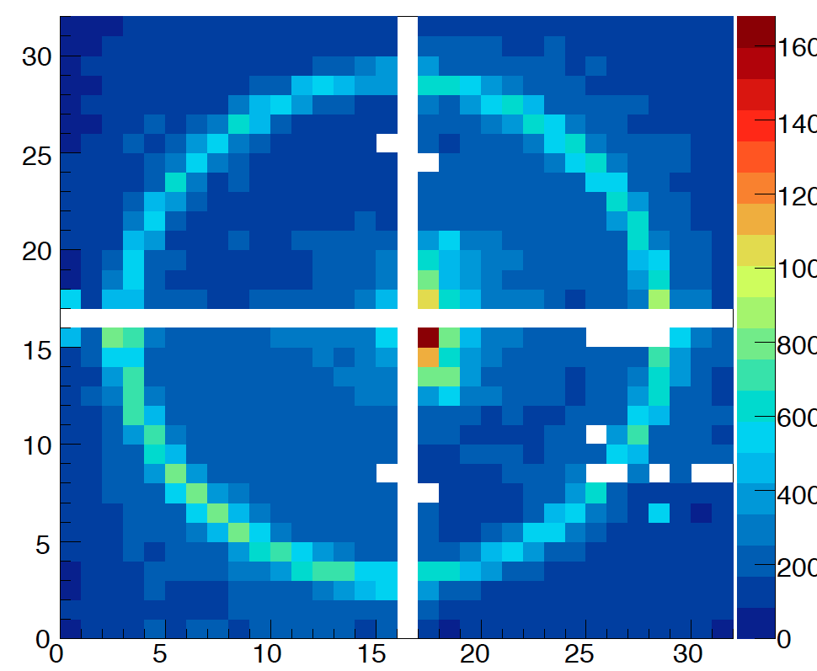
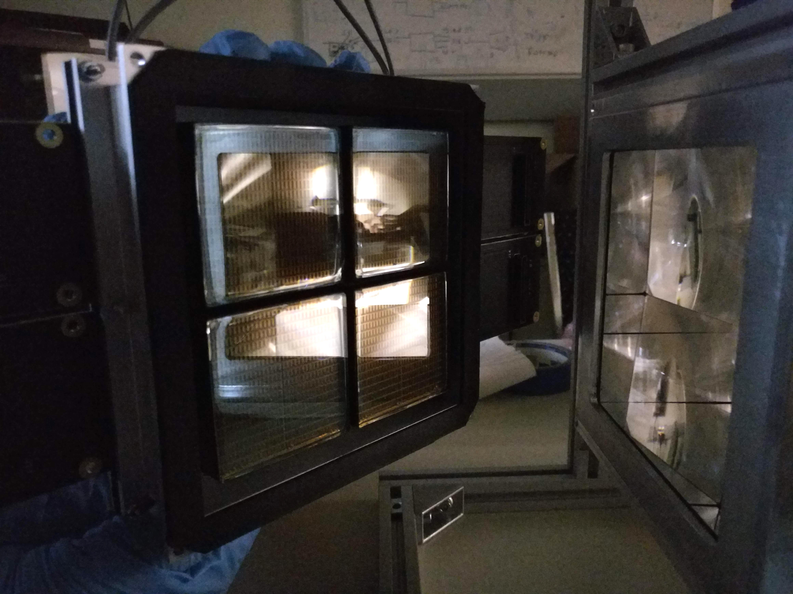
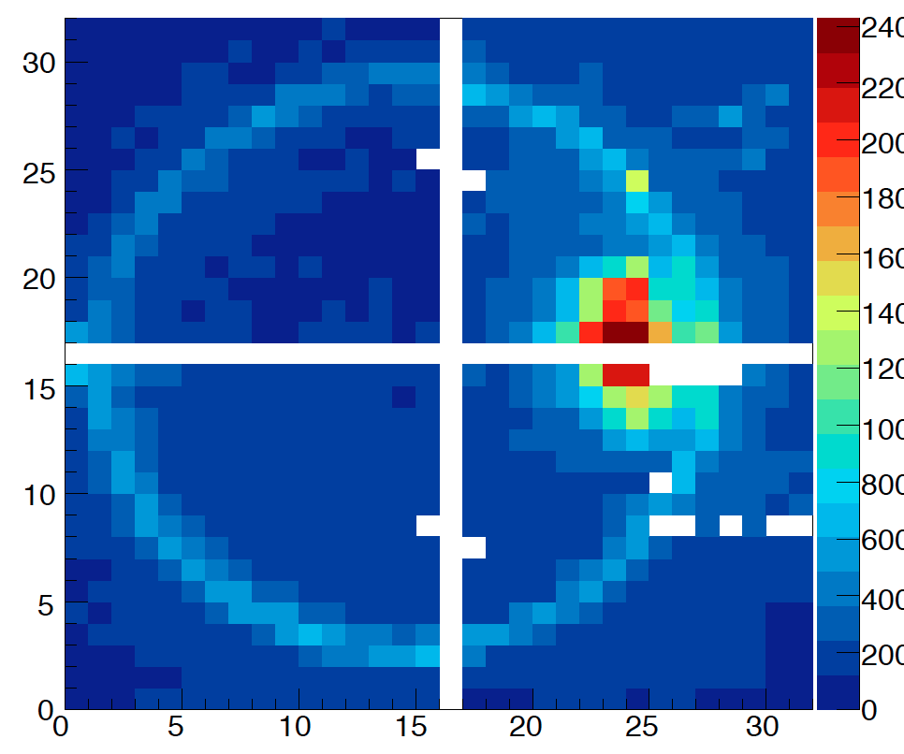
mRICH2 Test (EIC R&D)
beam
Test of a modular RICH using fresnel lens to
- focalize the ring
- reducing gap size to ~ 20 cm
- center the ring
MC

Slide 14
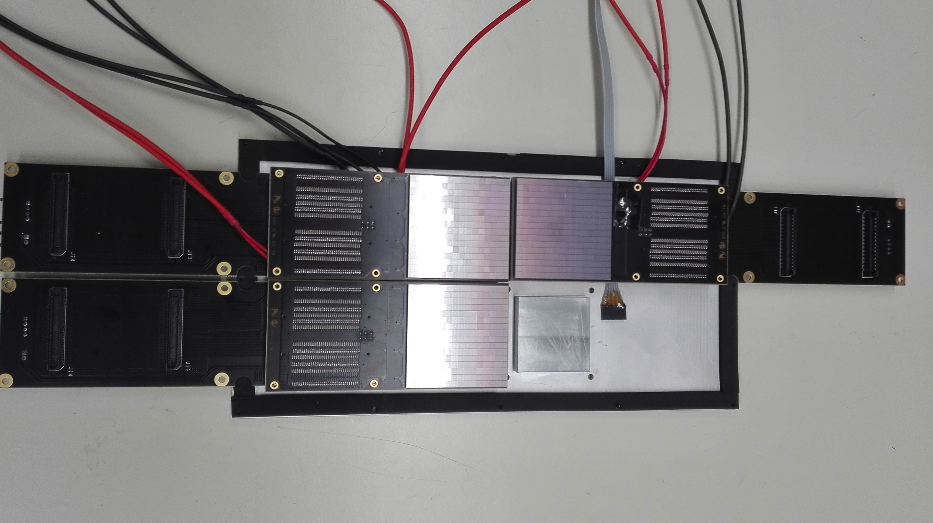
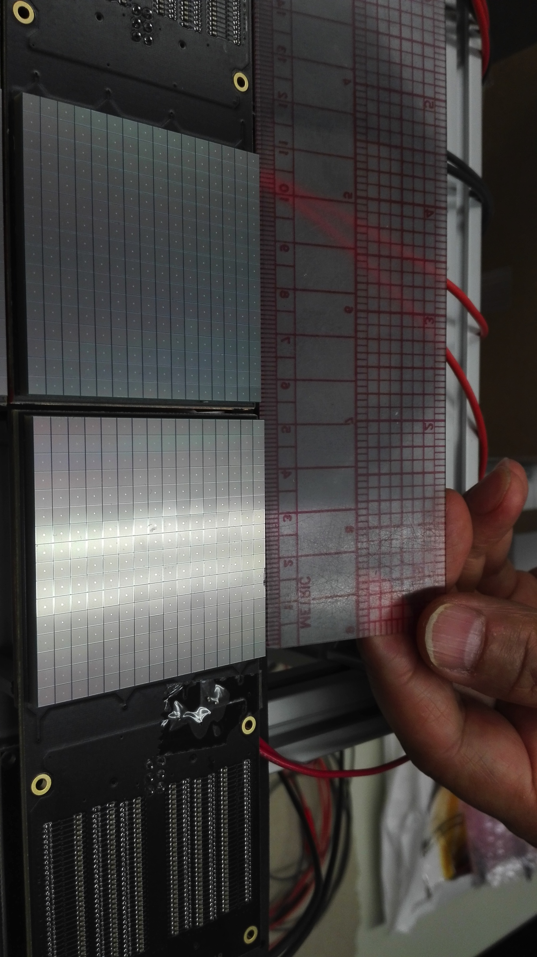
Activity with SiPM
Cooling plate
Machined @ Ferrara
Front-end electronics
designed @ Ferrara
SiPM might offer a cheaper and more efficient solution, expecially in a longer time perspective for other sectors
Notes:
14

Slide 15
RICH Landscape
✔ Project Premiale CLASMED
✔ Gluex DIRC (at Jlab Hall-D) using RICH electronics design
✔ DOE funded R&D for a future EIC
EIC PID Consortium using RICH electronics for the prototype stage
Ferrara in 2017:
✔ RICH & CLASMED: M. Contalbrigo Project Coordinator
✔ Particle ID studies at CLAS12
✔ Start construction of the second RICH sector
✔ Evaluate the SiPM option for Cherenkov applications
✔ SiPM applications for RICH and Medical Imaging
GOAL: 2nd sector ready for the polarized physics runs in fall 2020

Slide 16
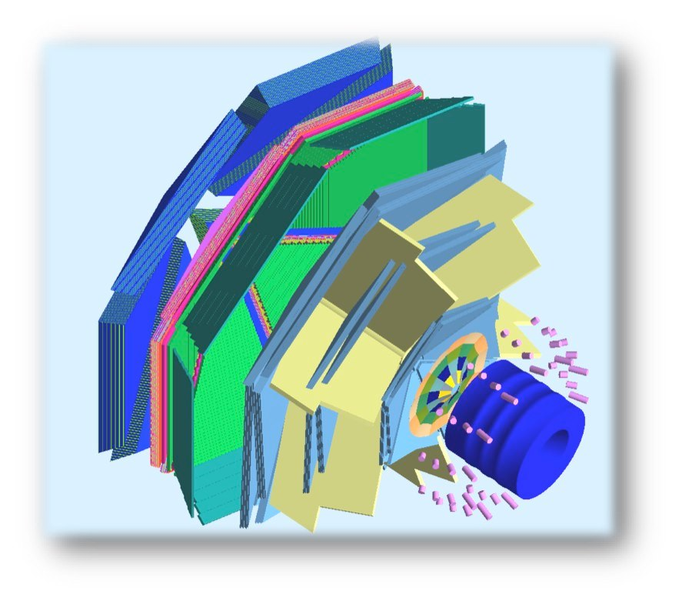
HD-ICE TRANSVERSE TARGET (L. Barion, G. Ciullo, M. Contalbrigo, P.L., M. Statera, F. Spizzo)
CLAS12
HD-ice
polarized
tracking solenoid
design field 5 T longitudinal
HDice target working field 2 T
4K L-He cryostat
diameter 440 to 942 mm
length 1500 mm
HDice Transverse Target:
high polarization
φ 25 mm – Length 25 mm
transverse field 0.5-1.25 T
target
superconducting
solenoid
polarized
e⁻ beam
superconducting
torus

Slide 17
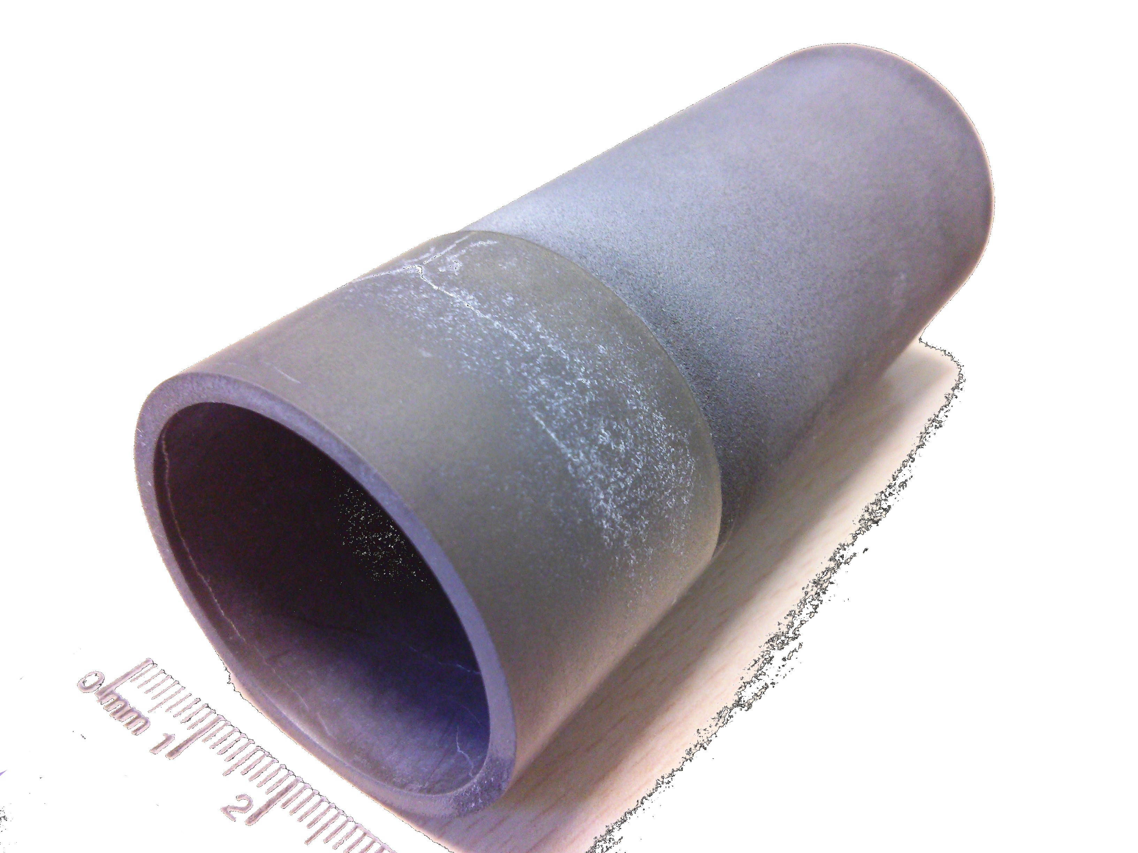
BULK TRANSVERSE MAGNET
By
bulk cylinder
MgB₂
longitudinal shield
transverse magnetization
Bz
features
no current leads
Cu free
self tuning
few mm thickness
external magnet
for magnetization
existing sample (courtesy of G. Giunchi)
diameter 39 mm
length 90 mm
thickness ~1 mm

Slide 18
FERRARA SETUP
coldhead
support (316L)
resistive magnet
transverse field
custom poles
max field about 1 T
vacuum chamber (316L and Al)
liquid free cryostat
controlled cylinder temperature
minimum temperature <20 K
ΔB/B < 2 10⁻³
(on cylinder volume)
turbo
Al chamber
chamber (316L)
support (nylon)
pole
(ARMCO)
cylinder
resistive coil
iron yoke

Slide 19
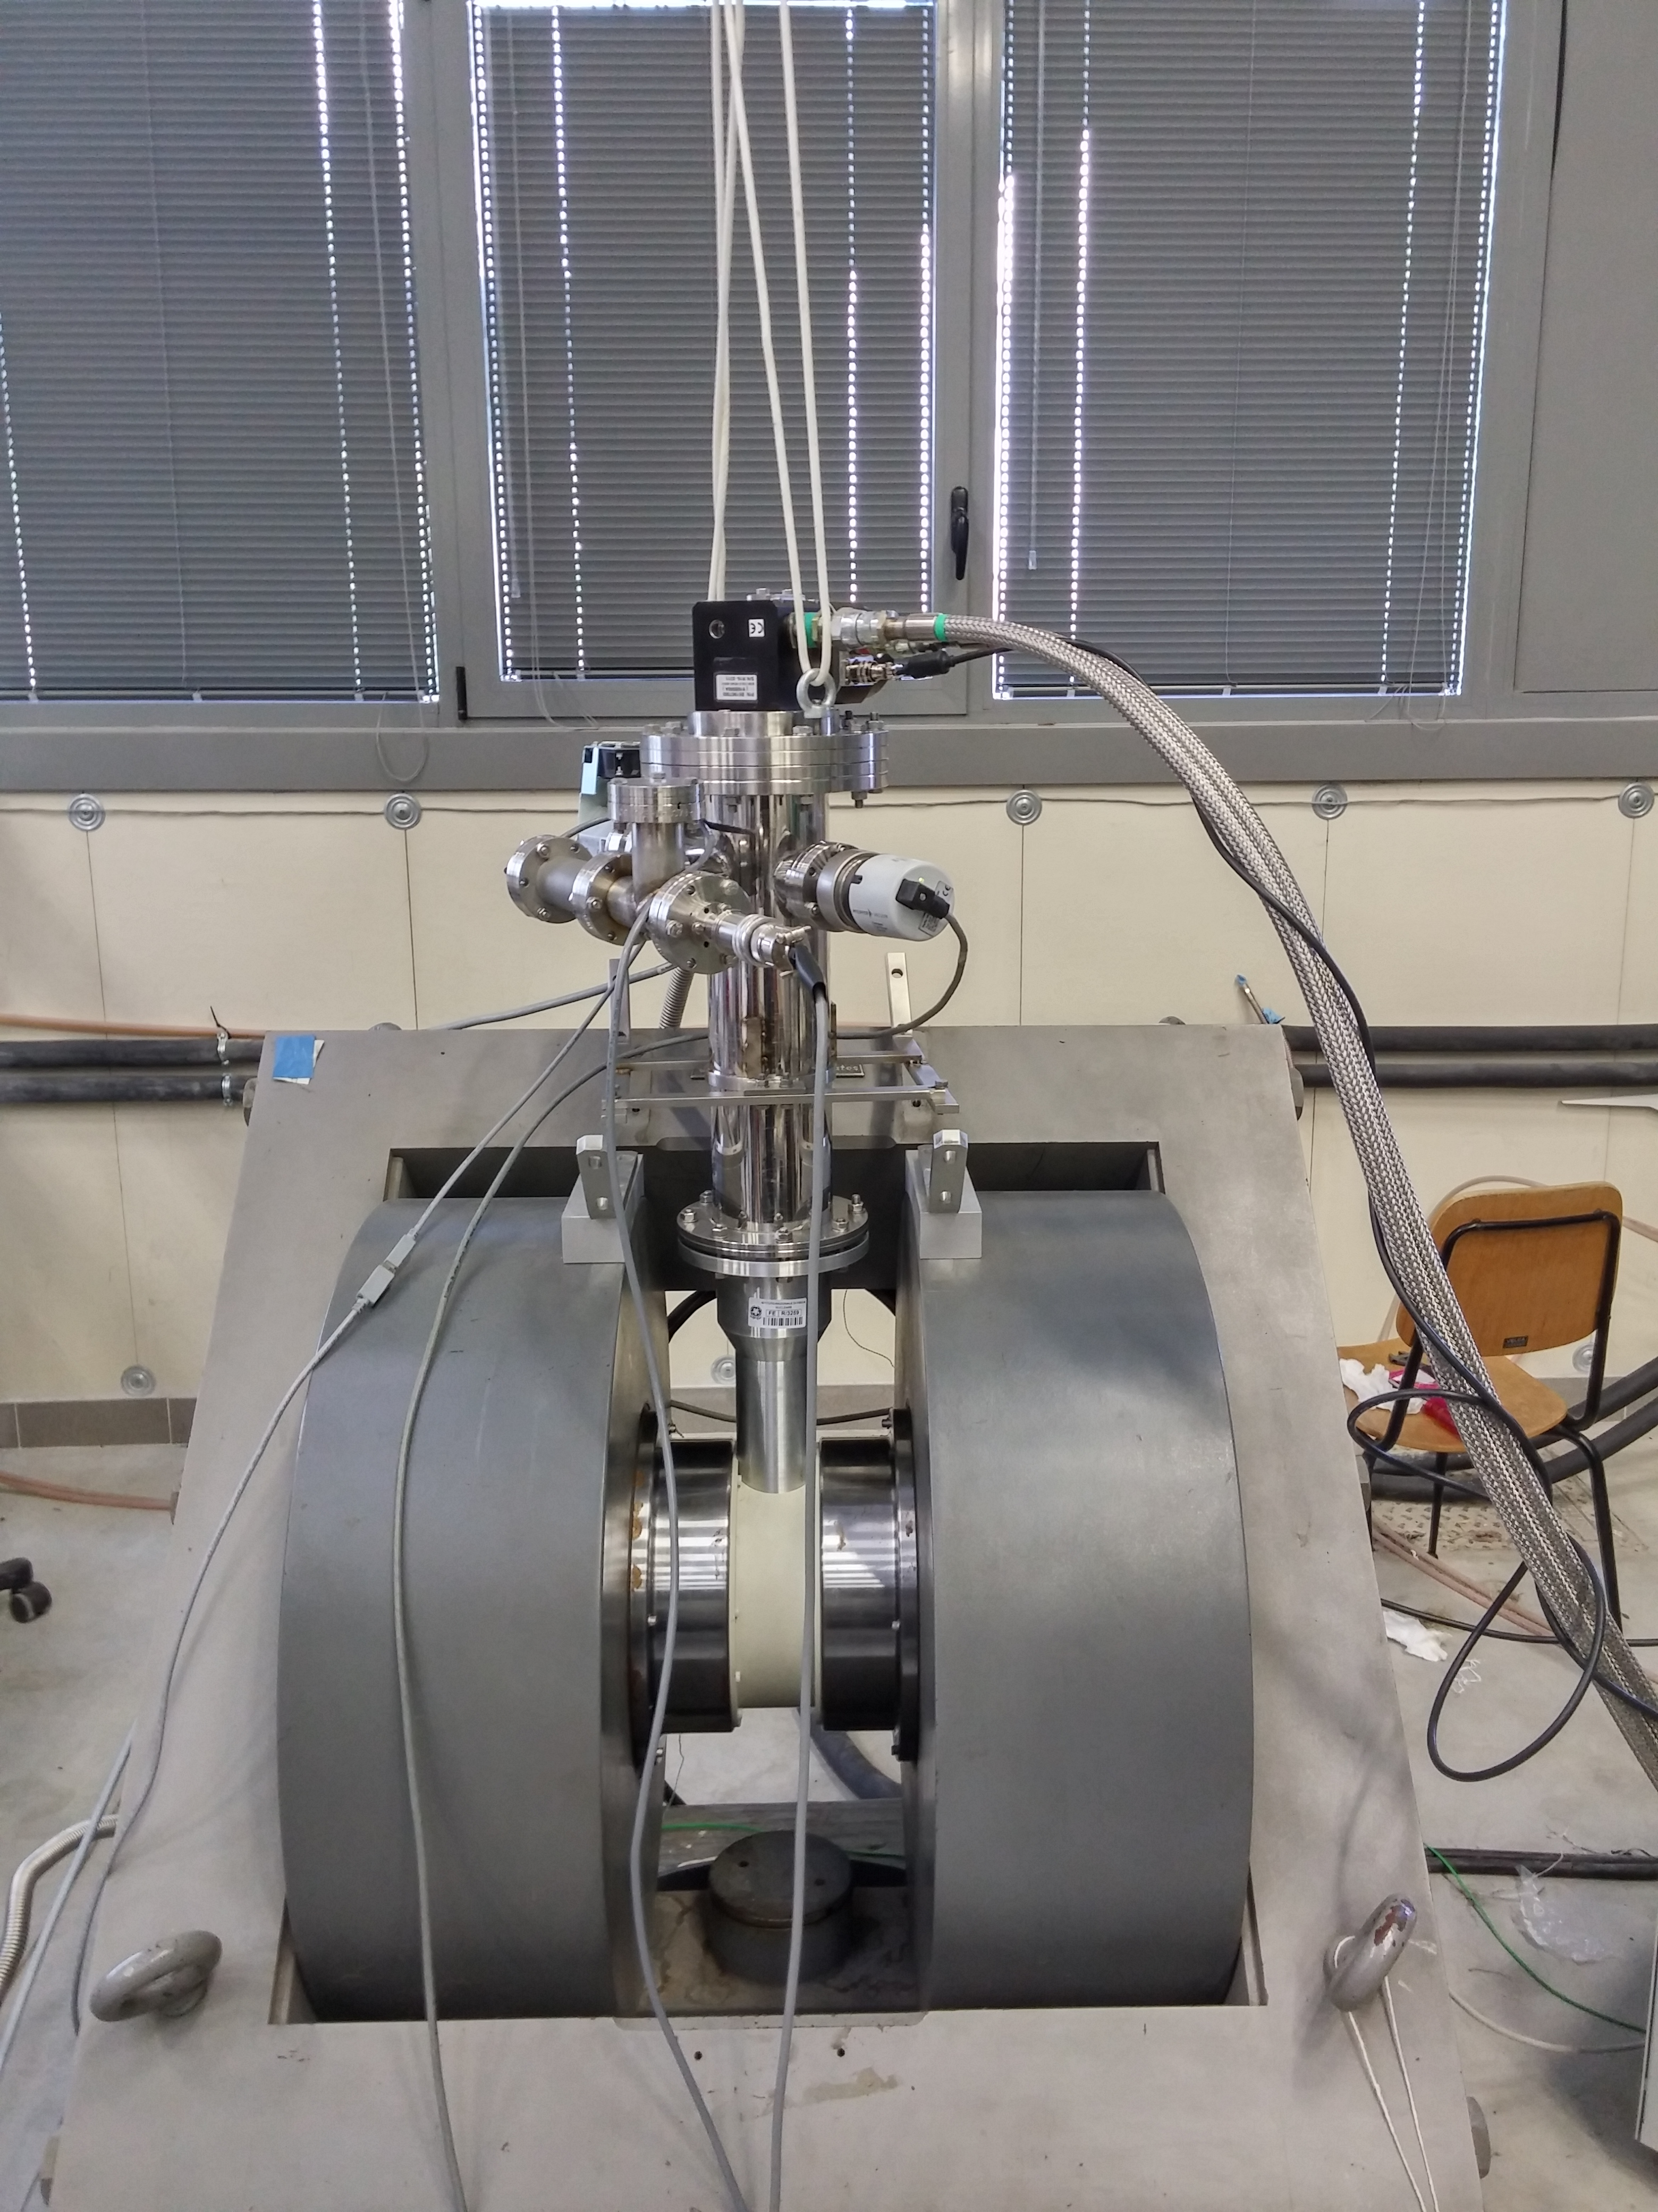

Slide 20
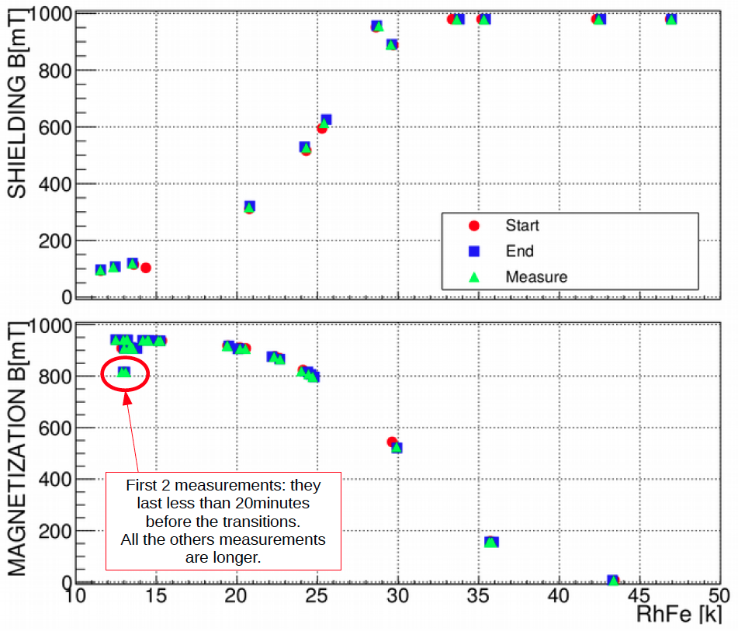
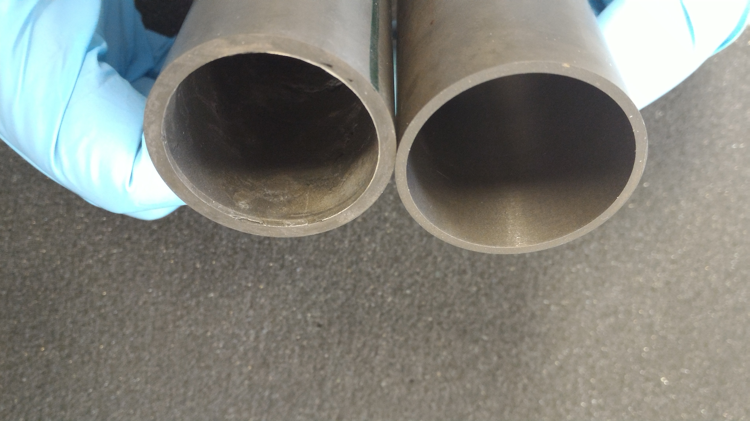
MAGNETIZATION and SHIELDING
Caratterizzazione Campo
verso temperatura
Utile per definire modello
ed estrapolare a
condizioni di esperimento

Slide 21
Il gruppo di Ferrara @ JLAB12
Responsabilita’:
M. C.: responsabile locale e nazionale di JLab12
M. C. responsabile progetto RICH
M. C. & L.P. Co-spokesperson di diverse proposte di esperimento (PAC34,37,38,39)
Contributi principali:
RICH detector (M.C., A. Movsysian, L. Barion, A. Scarabotto)
- Caratterizzazione proprieta’ ottiche radiatore aerogel (@ SILAB)
- Test su fascio elettronica di lettura (Fermilab)
- Stress test componenti (stabilita’ verso temperatura, umidita’. radiazione..)
- SIPM Applications on RICH and Medical Imaging
Configurazione magnetica per HD_Ice target (M.C., G. Ciullo, L. Barion, M. Statera)
Analisi dati (M.C., A. Movsisyan)

Slide 22
JEDI
Jülich Electric Dipole moment Investigations

Slide 23
JEDI (2018-2022)
Polarization technology for precision experiments.
Search for electric dipole-moments in storage rings:
First measurement of deuteron – EDM at COSY.
Production of Technical Design Report for a first generation machine.
In addition:
Time Reversal Invariance Test at COSY
Longitudinal spin-filtering test at COSY (?)
Internal target at LHCb (-> CSN1) ?

Slide 24
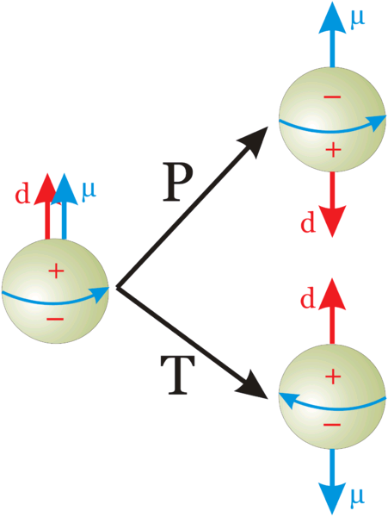
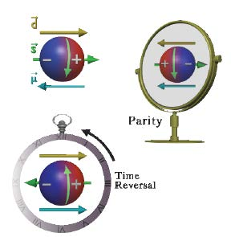
EDM of fundamental particles
Elementary particles (including hadrons) have a definite partiy and cannot have EDM
Unless P and T reversal are violated
s: spin
μ: magnetic dipole moment
d: electric dipole moment
Permanent EDMs violate P and T
Assuming CPT to hold, CP is violated also

Slide 25
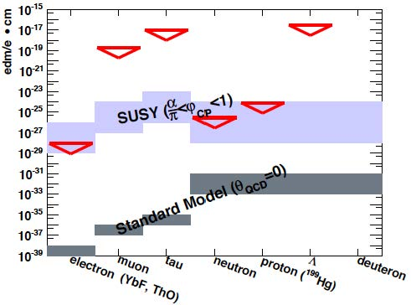
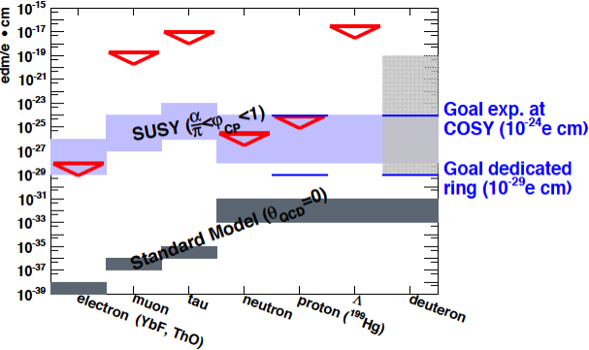
EDM: upper limits

Slide 26
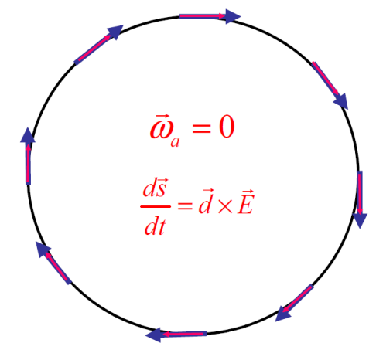
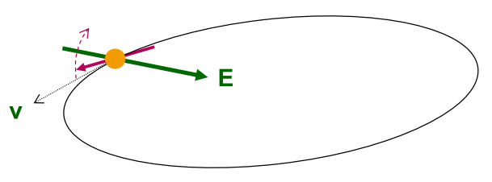
EDM of charged particles: use of storage rings
PROCEDURE
Place particles in a storage ring
Align spin along momentum ( →freeze horizontal spin precession)
Search for time development of vertical polarization
$$\frac{d\vec{s}}{dt}=\vec{d}×\vec{E}$$

Slide 27
Requirements
POLARIMETER
The sensitivity to polarization must by large (0.5).
The efficiency of using the beam must be high (> 1%).
Systematic errors must be managed (< 10^{‒6}).
POLARIZED BEAM
Polarization must last a long time (> 1000 s).
Polarization must remain parallel to velocity.
LARGE ELECTRIC FIELDS (E=10 MV/m).
SYSTEMATIC ERROR PLAN

Slide 28
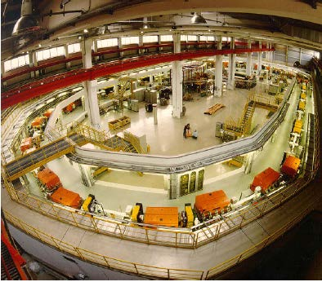
COoler SYnchrotron (FZ-Jülich, GERMANY)
COSY provides polarized protons and deuterons with p = 0.3–3.7 GeV/c
Ideal starting point for charged particles EDM search

Slide 29
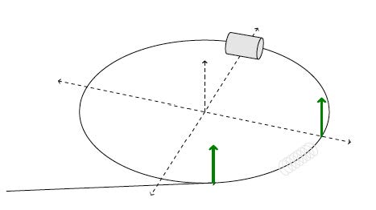
Experimental tests at COSY
Inject and accelerate polarized deuterons to 1 GeV/c

Slide 30
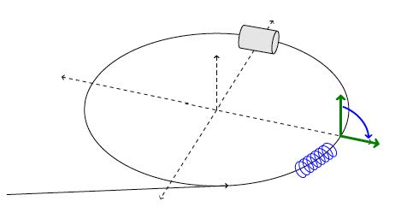
Experimental tests at COSY
Inject and accelerate polarized deuterons to 1 GeV/c
Flip spin in the horizontal plane with help of solenoid

Slide 31
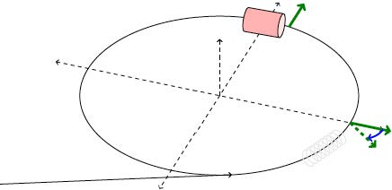
Experimental tests at COSY
Inject and accelerate polarized deuterons to 1 GeV/c
Flip spin in the horizontal plane with help of solenoid
Extract slowly (100 s) beam on target
Measure asymmetry and determine spin precession

Slide 32
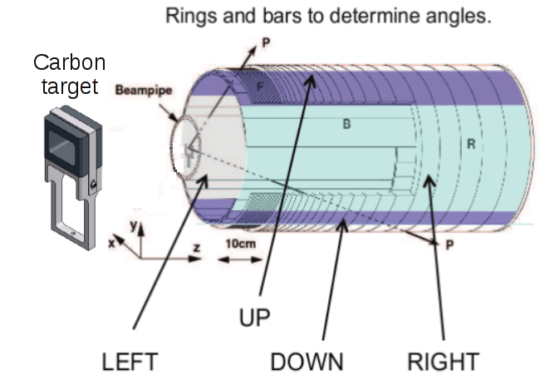
EDDA beam polarimeter
ASYMMETRIES
beam
VERTICAL polarization
Analyzing power
HORIZONTAL polarization
Analyzing power
Beam moves toward thick target continuous extraction
Elastic scattering (large cross section for d-C)

Slide 33
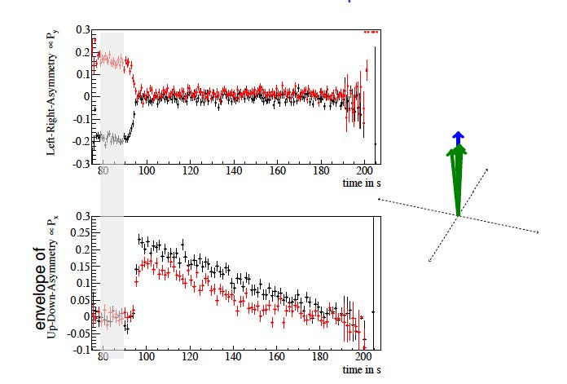
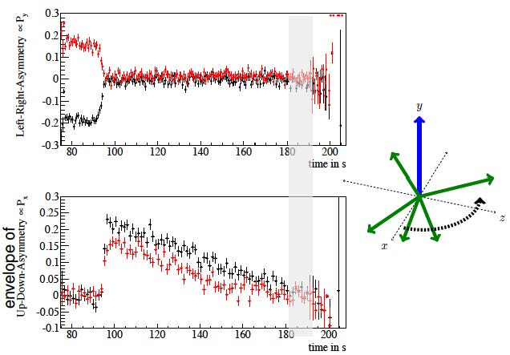
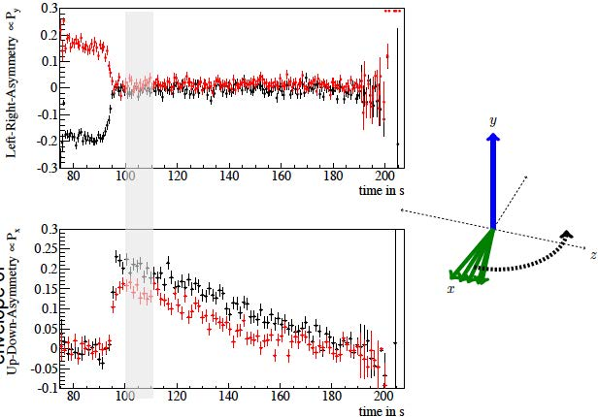
Spin-precession measurement

Slide 34
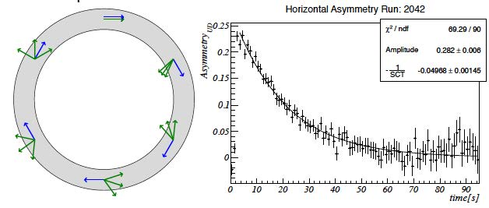
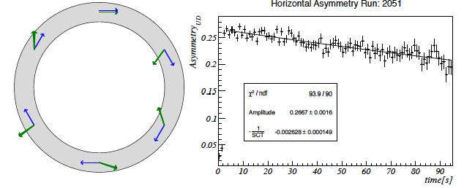
Results: spin coherence time
Short Spin coherence time:
Unbunched beam:
Δp/p=10⁻⁵->Δγ/γ=2x10⁻⁶, T_{rev}=10⁻⁶s
Decoherence after < 1s
Bunching eliminates 1st order effect in Δp/p:
SCT τ = 20 s
Long Spin coherence time:
Betatron oscillations cause variation of orbit length
Correction wit sextupoles
SCT τ > 1000 s

Slide 35
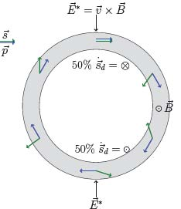
The goal:
first direct measuerement of deuteron EDM
with RF-technique
Pure magnetic ring (existing machines)
Problem: precession caused by magnetic moment:.
- 50 % of time longitudinal polarization || to momentum
- 50 % of time is anti-||
E* in particle rest frame tilts spin (due to EDM) up and down
→ No net EDM effect

Slide 36
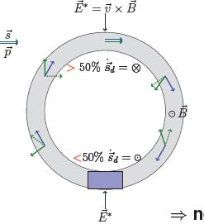
The goal:
first direct measuerement of deuteron EDM
with RF-technique
Pure magnetic ring (existing machines)
Problem: precession caused by magnetic moment:.
- 50 % of time longitudinal polarization || to momentum
- 50 % of time is anti-||
E* in particle rest frame tilts spin (due to EDM) up and down
→ No net EDM effect
Solution; use of resonant „magic“ Wien-filter in ring (E+vxB=0)
E*=0 → particle trajectory not affected
B*≠0 → magnetic moment is influenced
→ net EDM effect can be observed!

Slide 37
Magic RF Wien filter
Avoids coherent betatron oscillations of beam. .
First direct measurement at COSY.
⇒ E_{R}= - γ x B_{y} „Magic RF Wien Filter“ no Lorentz force
First prototype successful commissioning in 2015
New „wave-guide“ device designed and construced: test started June 2017
GOAL: 1st ever measurement of deuteron EDM before 2021

Slide 38
INFN contribution: development of a new high-efficieny polarimeter

Slide 39
Development of SiPM based readout system (L. Barion, S. Basile, R. Malaguti, P.L.)

Slide 40
Complementary measurement:
Test of Time Reversal Invariance at COSY
EDM: test T and P symmetries (T-odd and P-odd)
TRIC: fdirect test of T-symmetry (T-odd P-even)
- Direct tests of Time Reversal Invariance: experimental situation
← Proposed measurement

Slide 41
Concept of the experiment
Vector polarized proton beam vs
Tensor polarized deuteron target
→sensible to A_{y,xz}
Time reversal b) equivalent to:
- inversion of proton beam polarization c)
- inversion of deuteron target polarization d)
Different cross sections for a) vs c) or d) ↦ time reversal violation

Slide 42
Measurement at COSY
PAX installation at COSY:
Atomic beam source (d↑ target)
Openable storage cell
Si-detector (beam polarimetry)
In addition:
- Sensitive beam current monitor
Measurement:
Comparison of beam-lifetimes
Different spin configurations

Slide 43
INFN contribution:
design and construction of the beam/target polarimeter and the openable storage cell

Slide 44
Quadrants assembly (A. Kononov)

Slide 45
Design and realization of an openable storage cell (S. Sguerzanti, V. Carassiti)

Slide 46
Detector assembly (S. Sguerzanti, V. Carassiti. A. Kononov, G. Ciullo)

Slide 47
Polarized target and polarimeter (G. Ciullo, A. Pesce)
ABS
Breit-Rabi
polarimeter
Last achievement
Target compatible for H and D running
(Without vacuum breaks!)

Slide 48
Successful commissioning
(S. Dymov)
p-d identification
Polarization measurement (Ay)
Polarization along the cell

Slide 49
Responsibilities + external funding
EDM
Co-Spokesperson: P.L.
SCT data analysis: S. Dymov, D. De Rosa
New polarimeter: S. Basile, L. Barion, V. Carassiti, P.L.
Control system for RF-Wien filter: G. Tagliente
TRIC
Management: P.L.
Polarized target and polarimeter: G. Ciullo, A. Pesce
Detector: V. Carassiti, S. Dymov, A. Kononov, P.L.
Interlock and slow control: G. Tagliente
EXTERNAL FINANCES:
ERC-Advanced Grant: srEDM
Total sum: 2.4 Meuro
Duration: 5 Years
Consortium:
FZ-Juelich – prof. H. Stroeher (PI)
RWTH Aachen – prof. J. Praetz
University of Ferrara – prof. P. Lenisa
New application: H2020 – SPIN for FAIR
Principal Investigator: P. L.
Host Institution: FZ-Juelich

Slide 50
Manpower e richieste fianziarie
Name | JEDI | JLAB | CC3M
S. Basile (dottorando) | 100
S. Bertelli (RTD-A) | 100
G. Ciullo (Staff) | 70 | 20
A. Drago (Staff) |  | 20
M. Contalbrigo (Staff) | 20 | 50
S. Dymov (Post Doc) | 100
A. Kononov (dottorando) | 100
P. Lenisa (Staff) | 75 | 20 | 5
L. Pappalardo (RTD-A) |  | 20
A. Pesce (Post Doc) | 100
F. Spizzo (Staff) | 20 | 80
V. Carassiti (staff) | 30
A. Cotta Ramusino (staff) | 10
Total | 705 | 210
Richieste finanziarie JLab12
Missioni | 60 k€
Trasp. | 5 k€
Inv. | 10 k€
Consumi | 15 k€
Apparati | 100 k€
TOTALE | 190 k€
Richieste finanziarie PAX
Missioni | 60 k€
Consumi | 40 k€
TOTALE | 100 k€

Slide 51
Other activities:
Collaboration with CSN1
“Polarized internal gas target for LHCb”
Physics goals:
Large-x gluon, antiquark and heavy-quark content in the nucleon and nucleus.
Dynamics and spin of gluons in (un)polarised nucleons
Heavy-ion collisions towards large rapidities
(Possible) timeline:
Design and realization of an openable storage cell for LHC (unpolarized gas)
Installation in 2020-21
Design and construction of a polarized target
Installation in 2024-25

Slide 52
SPIN 2018 23rd International Spin-Physics Symposium Ferrara, 10-14 September 2018

Slide 53
Installation in the COSY ring

