Slide 1
The Italian Collaboration at JLab

Slide 2
INFN @ JLab
INFN presence since the beginning (1991)
Exp Users: ~60 scientists, including ~15 students (PhD and post-doc)
Th Support: ~ 30 scientists, including ~ 10 students
Experiment
Theory
Spokespersonship: > 20% of approved 12 GeV experiments
Responsibility roles: Hardware, Analysis, Coordination
P. Rossi Deputy Associate Director
M. Battaglieri: Hall-B Leader
R. De Vita: Hall-B Software Responsible
M. Contalbrigo: Chair CLAS deep-process working group
M. De Napoli: HPS Executive Committee member
A. Celentano: Chair of HPS Publications Committee
MoU: Renovated in September 2017
PAC members: INFN members since 1991
now: A. Bacchetta INFN-PV
External Funds: CLASMED Italy MIUR priority project
STRONG-2020 EU JRA “3D nucleon”
DeLightDMA Italian grant for “dark matter”
LiQuHaS Italy-Poland exchange program
Probes EU staff exchange program
Nucleon 3D structure & dynamics
Spectroscopy and exotic states
Nuclear potentials and astrophysics
* Light dark matter search
2

Slide 3
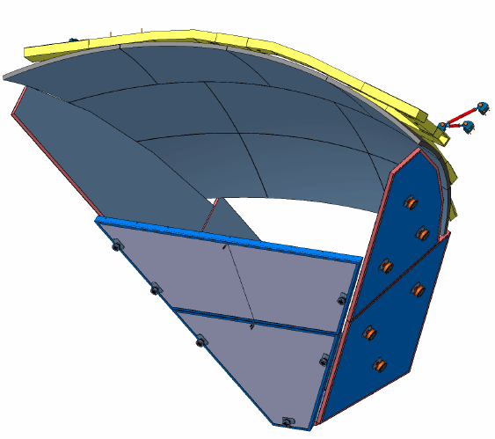
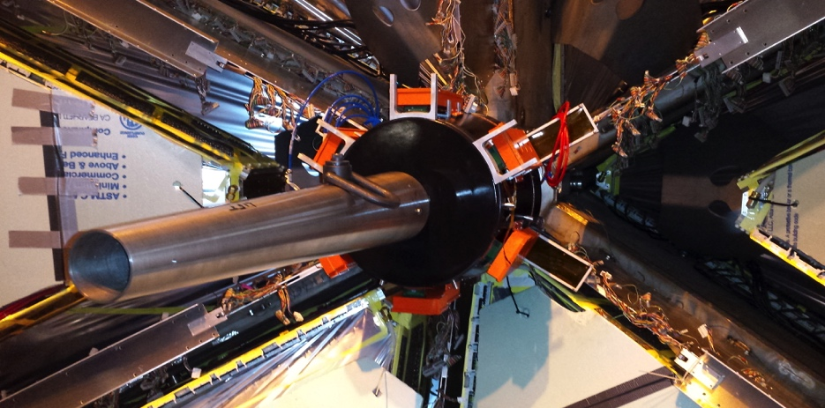
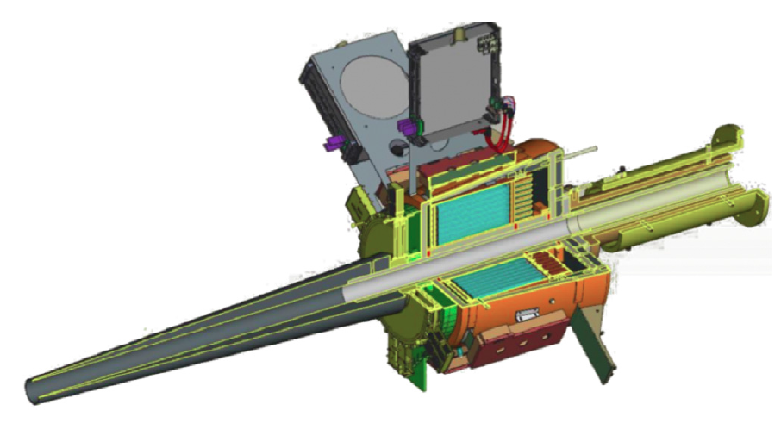
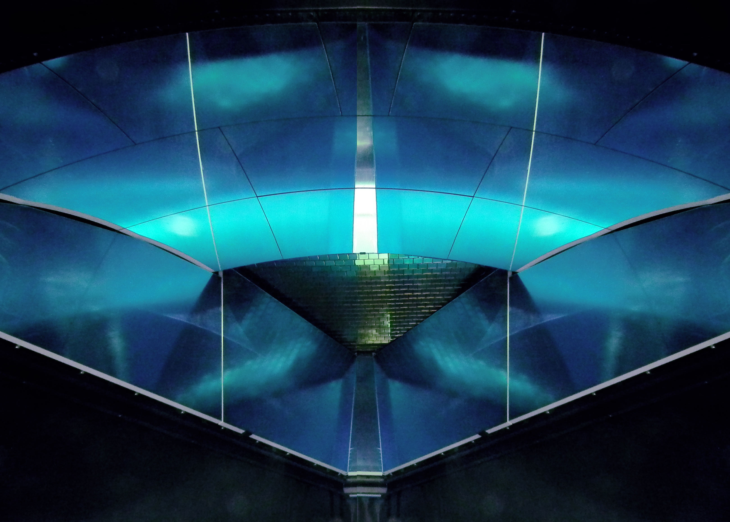
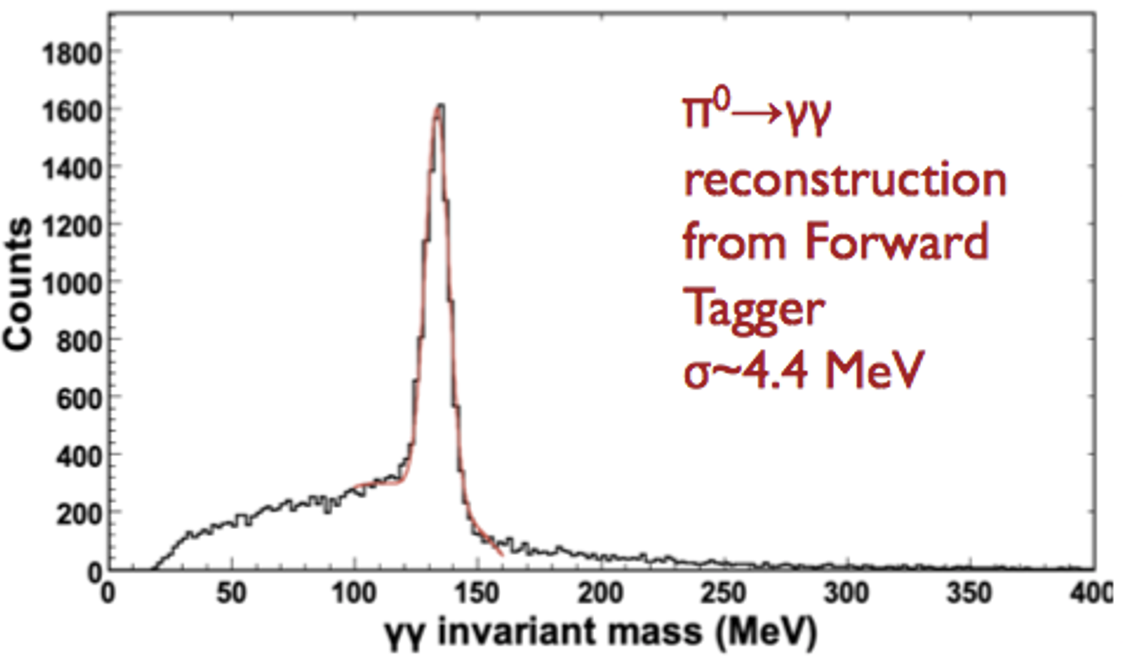
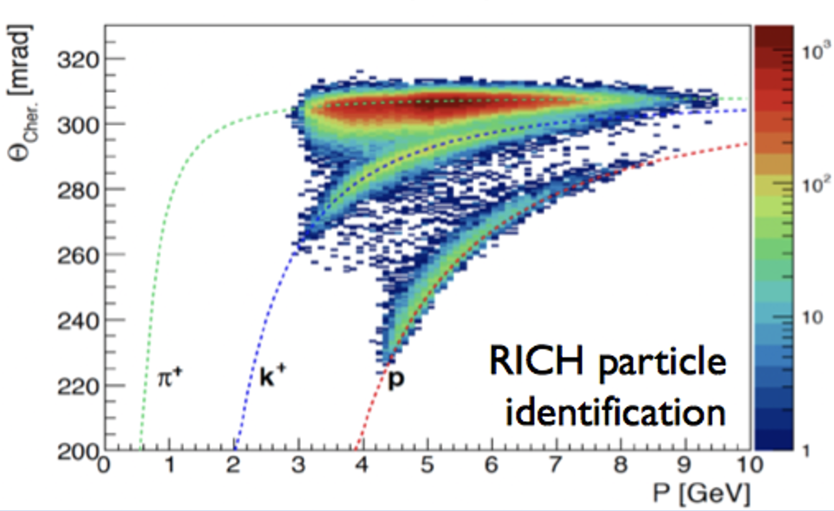
Hardware Projects
3

Slide 4
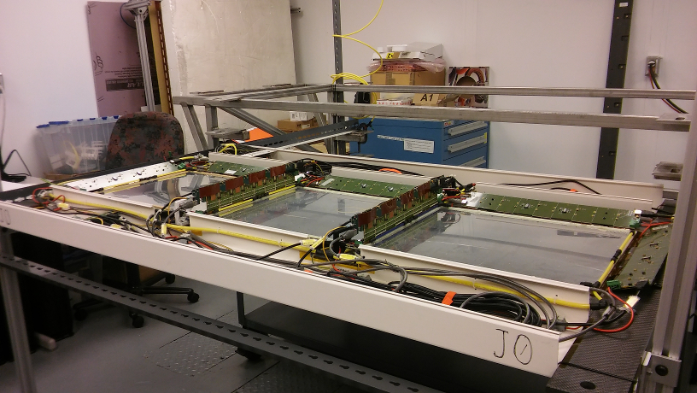
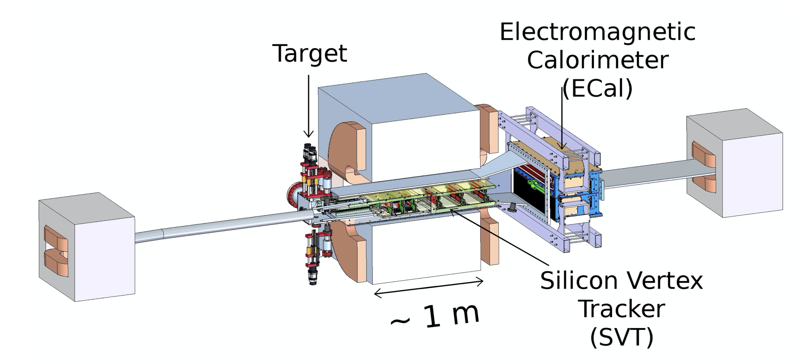
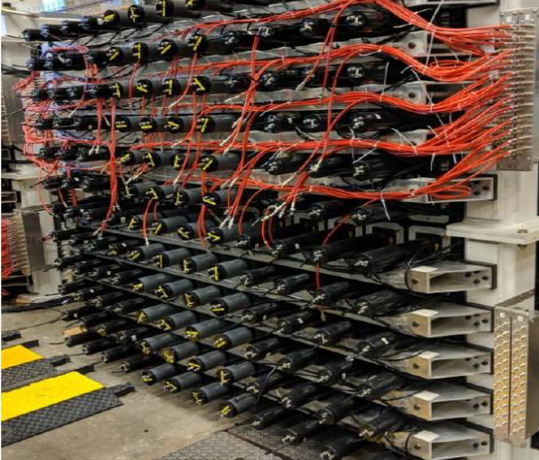
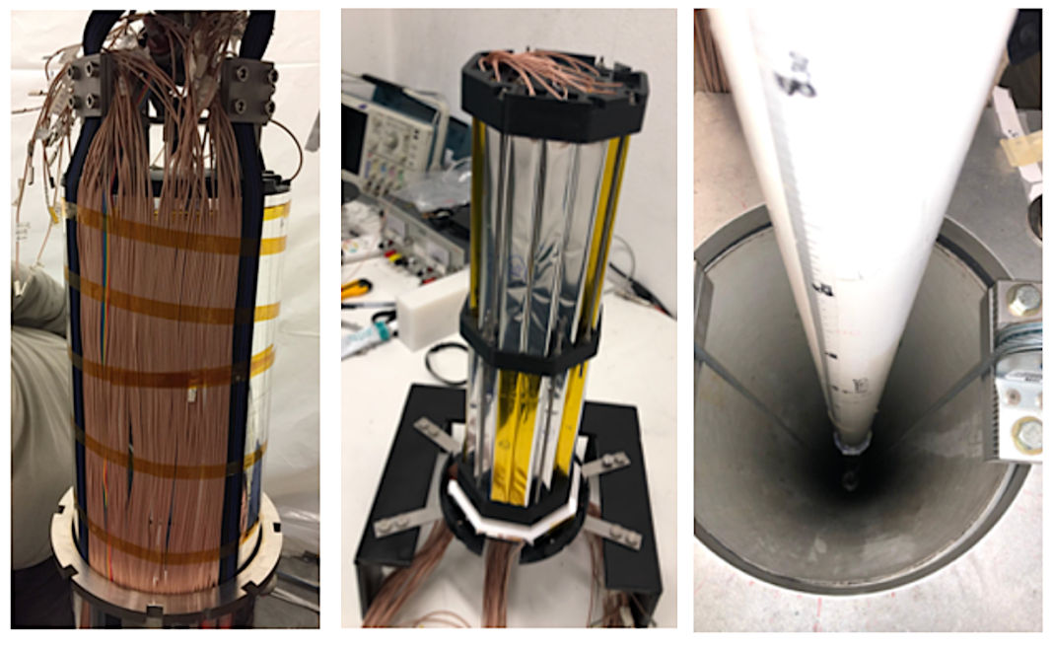
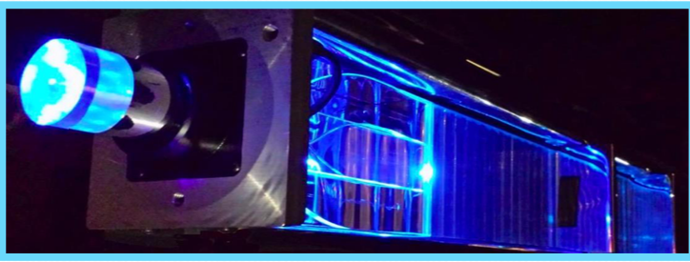
Main Hardware Contributions
Super Big-Bite Experiment in Hall-A
Light-Dark Matter Experiments
SBS Tracker GEM + SiD
Heavy-photon search (HPS) experiment
Beam-dump experiment (BDX)
BDX-MINI successful run in 2020 accepted by EPJC
SBS Hadronic Calorimeter
Loi for a full scale detector submitted for a NSF grant (13 M$)
4

Slide 5
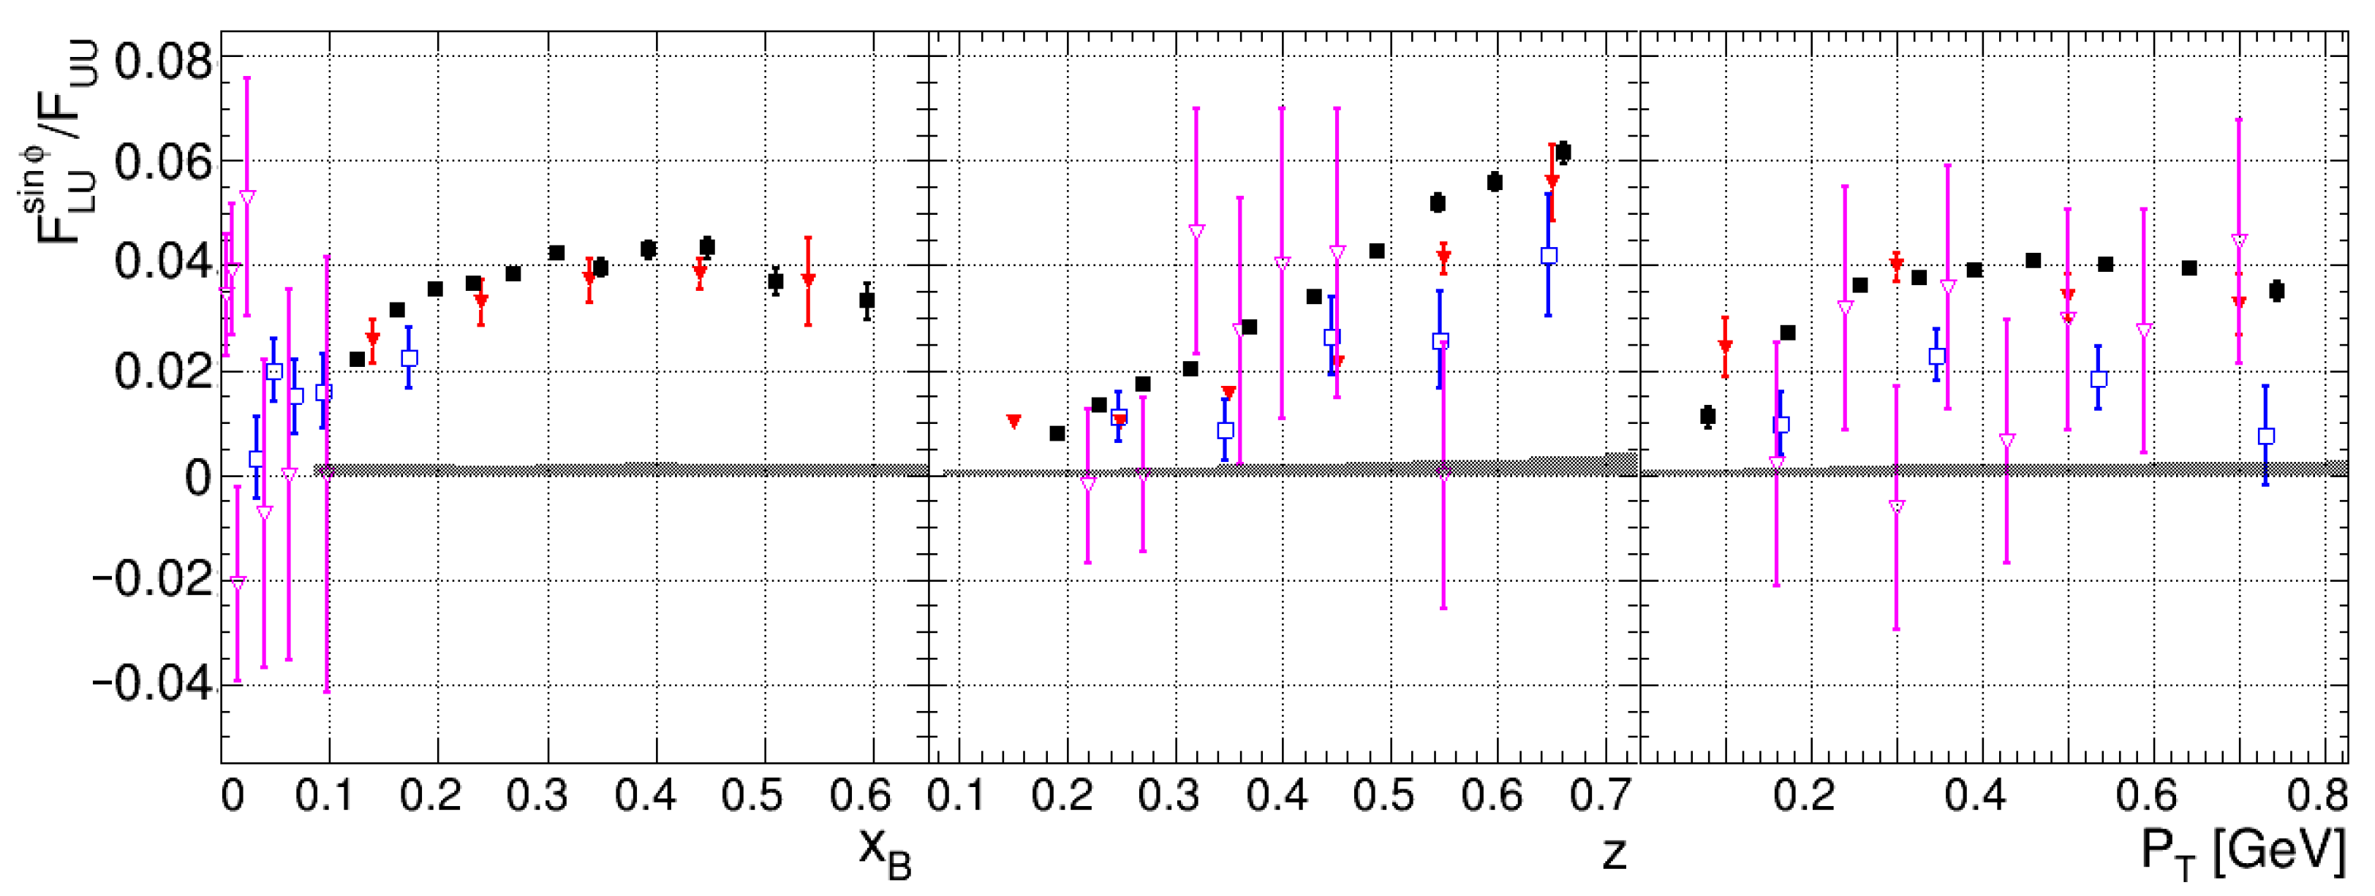
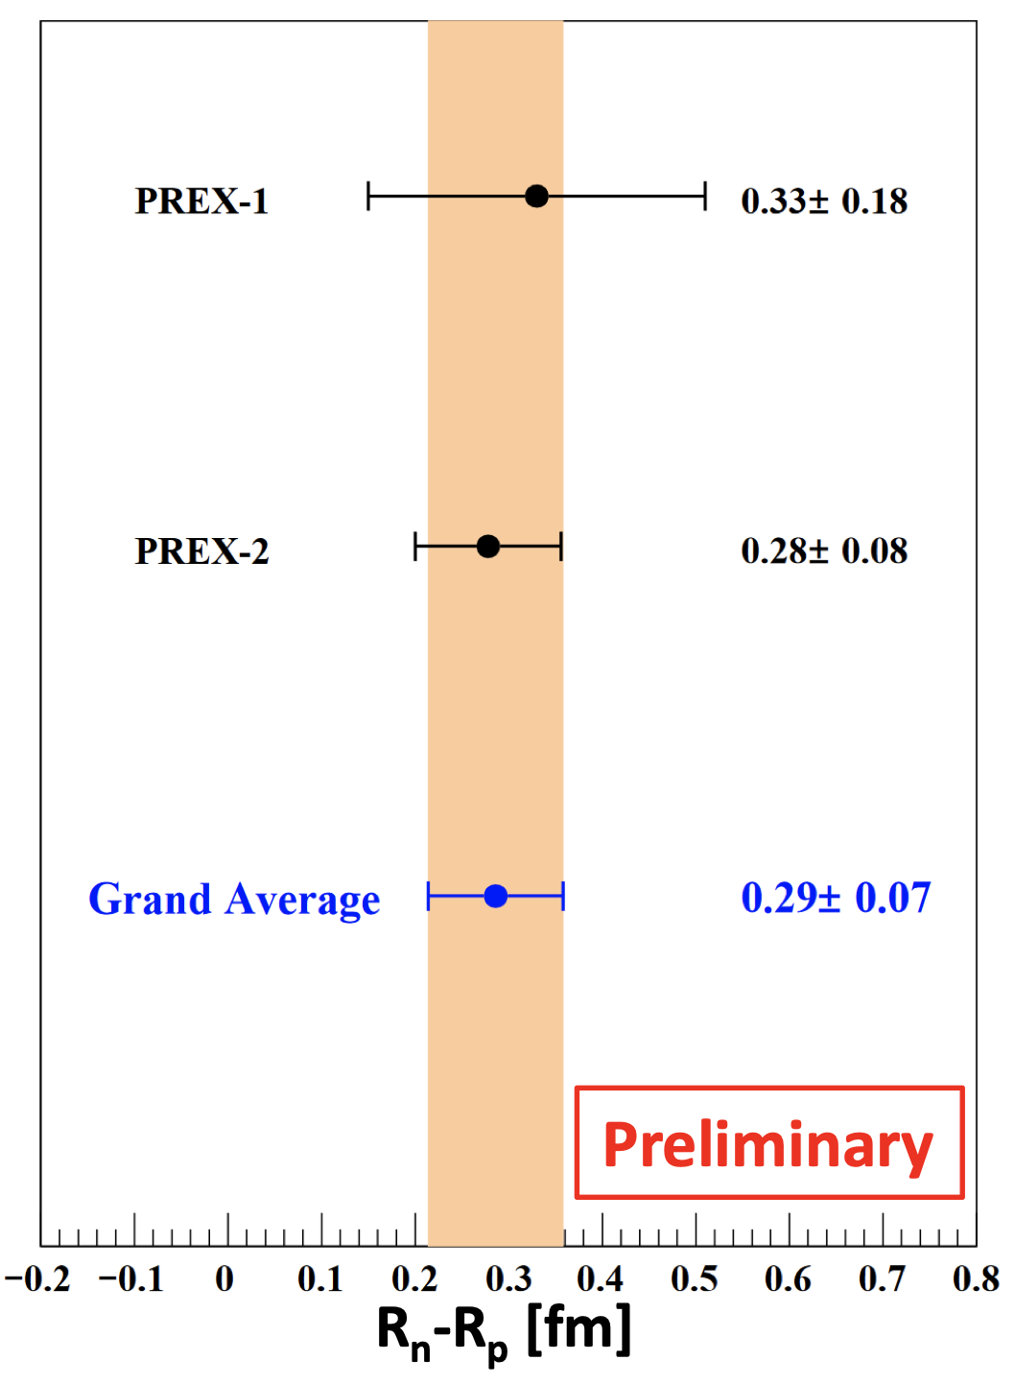
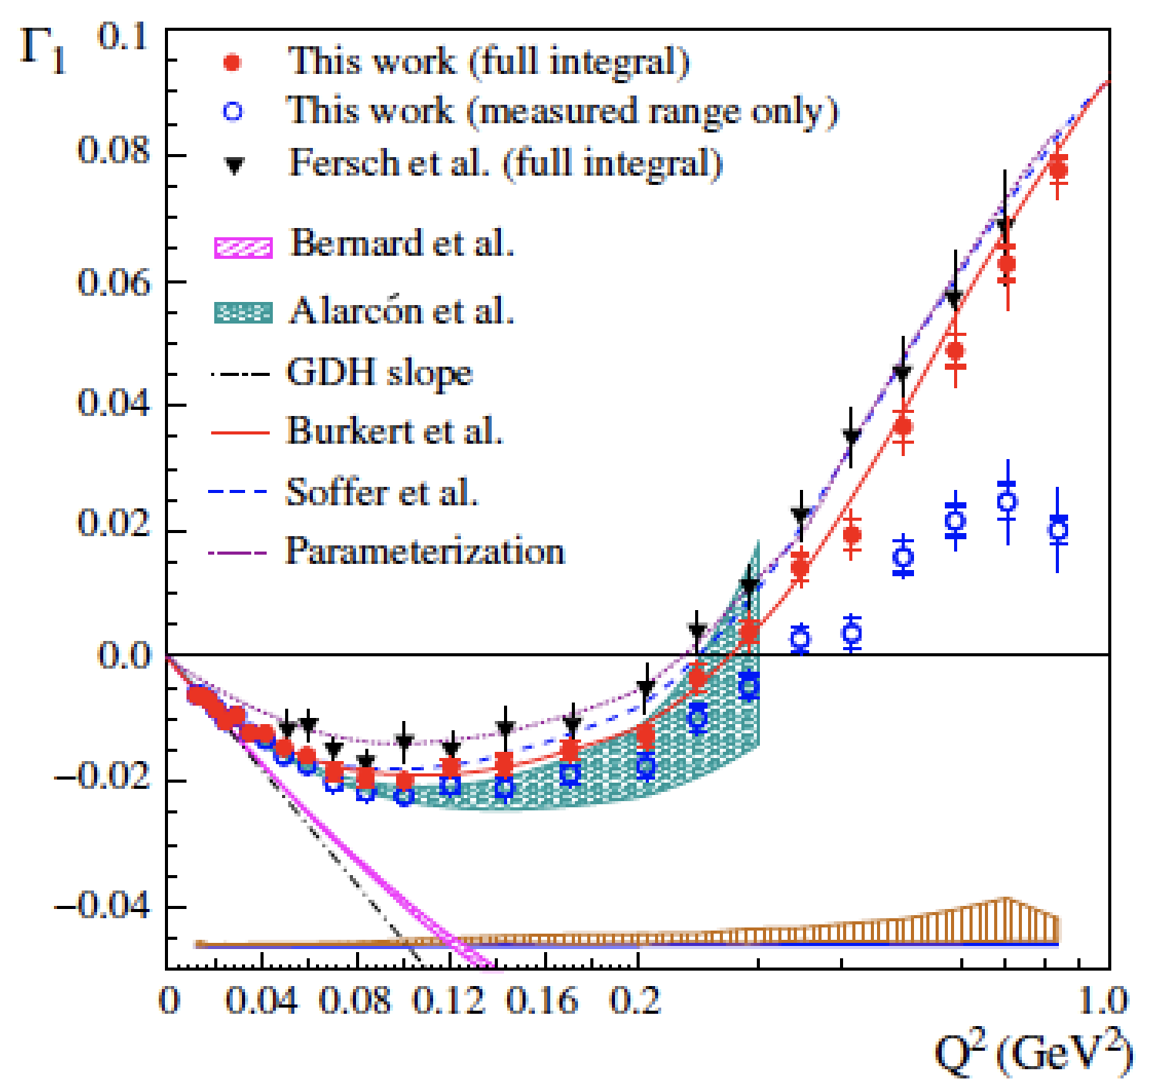
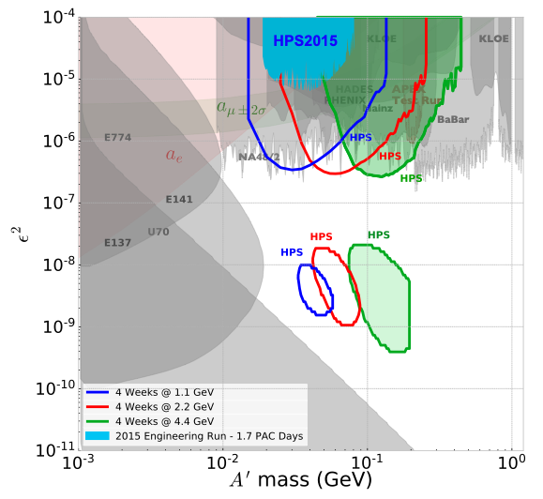
Recent Physics Highlights
First results from CLAS12: beam-spin asymmetry for semi-inclusive
pion production (ep→ e’π, ππX) submitted to PRL
PREX-II Neutron skin and neutron
star EOS presented at APS 20
CLAS12
CLAS
HERMES
COMPASS
Hall-A Deep-virtual Compton
scattering on neutron (en→e’nγ)
CLAS meas. of proton spin strucutre at
long Distances accepted by Nature
HPS pilot exclusion and projections
Phys. Rev. D 98 (2018) 9, 091101
5

