Slide 1
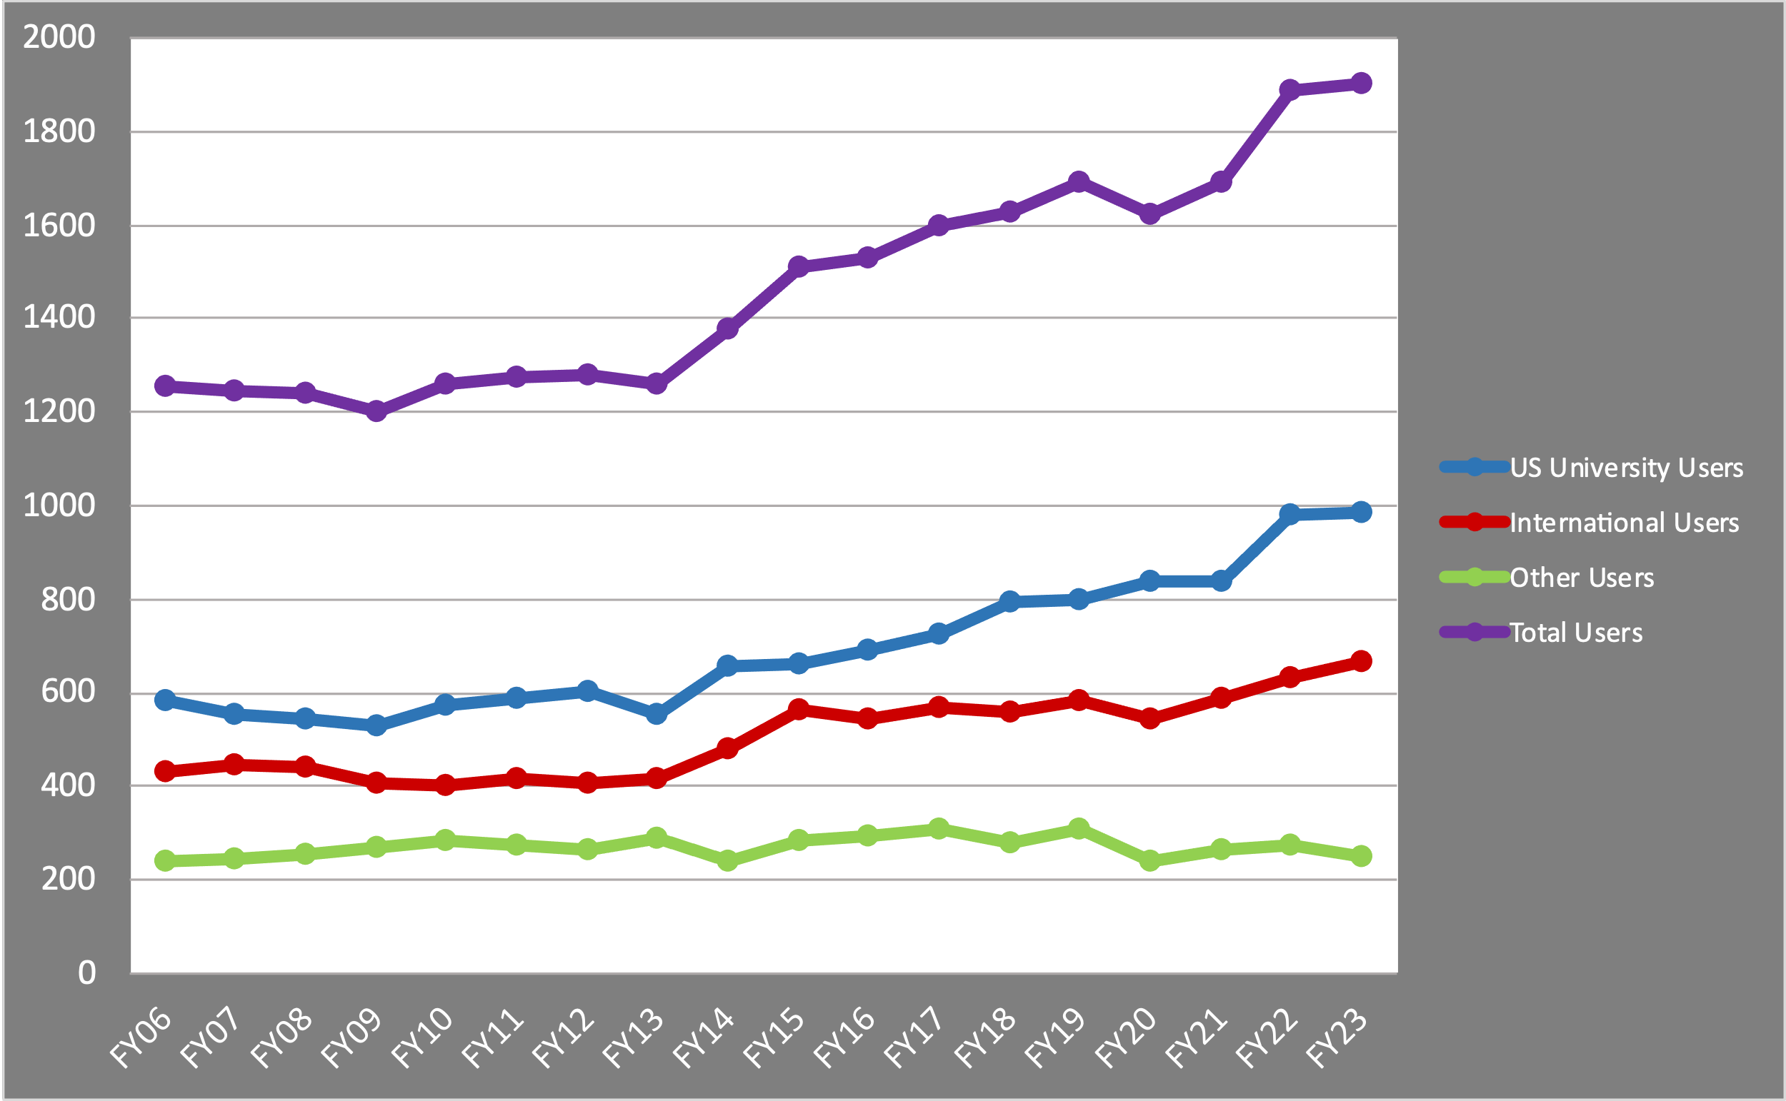
Marco Contalbrigo
INFN Ferrara
JLab User Organisation
Board of Directors Chair
JLUO Annual Meeting
June 10-12, 2024
1900

Slide 2
JLUO Annual Meeting, June 11, 2024
2

Slide 3
JLUO Annual Meeting, June 11, 2024
3

Slide 4
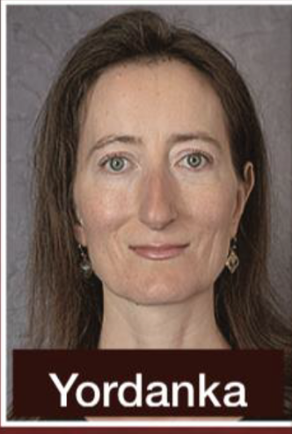
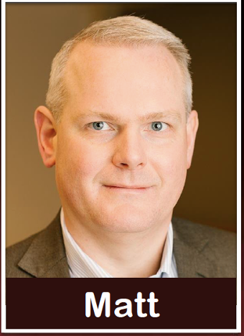
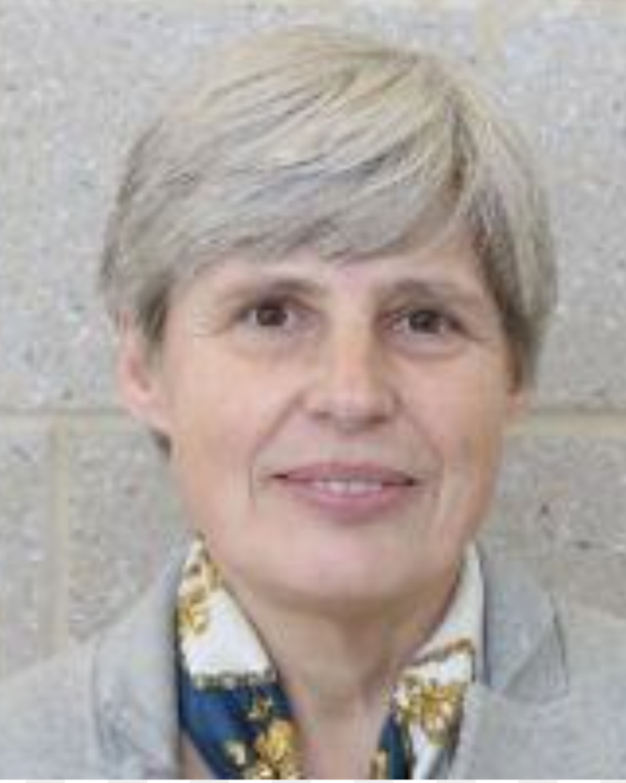
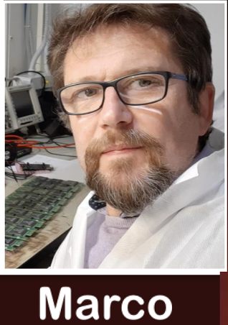
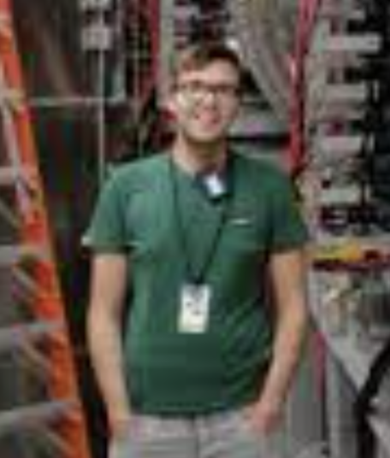
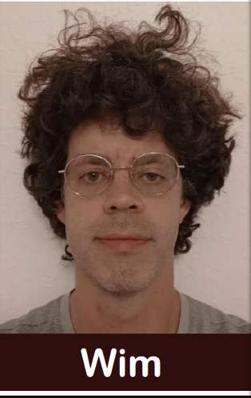
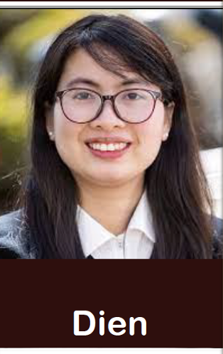
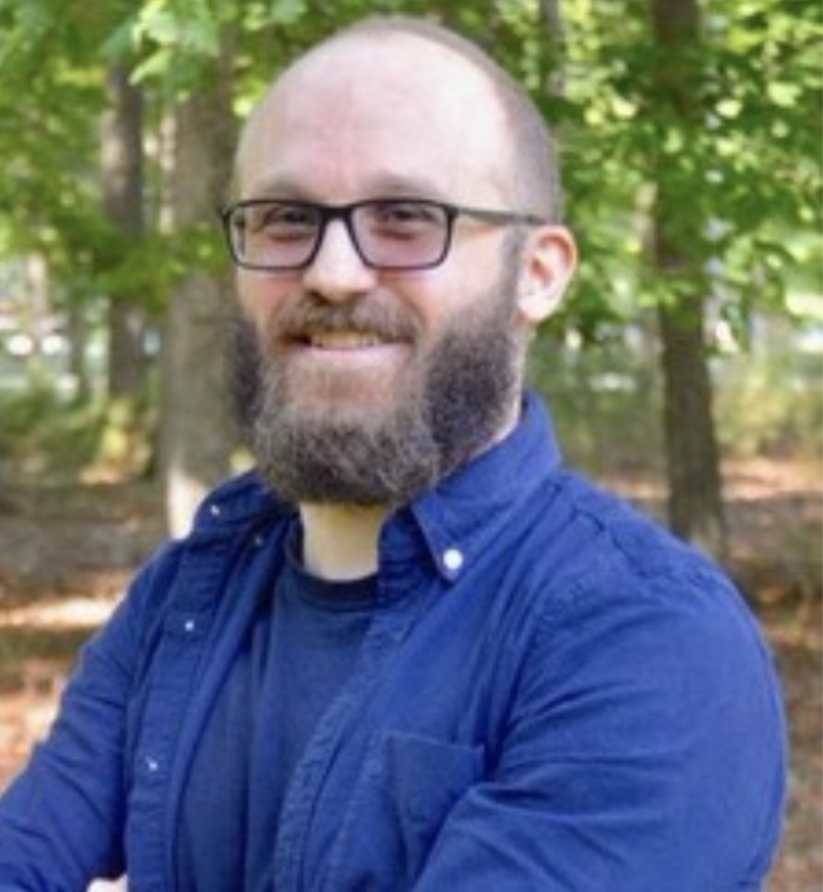
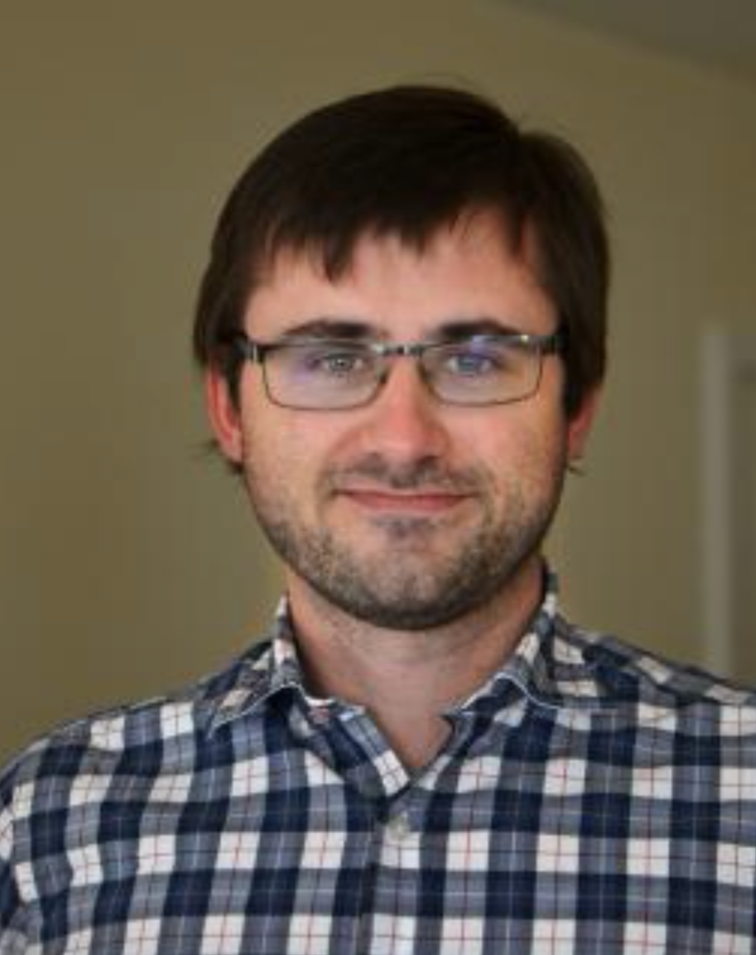
2024-2025
Ioana
Cristiano
Raphael
Stephen
JLUO Annual Meeting, June 11, 2024
4

Slide 5
Examples of User Representation Activites
Program Advisory Committee (PAC)
JLUO Chair is a member of the PAC, and the JLUO chair-elect joins the PAC meetings, with a
unique charge to observe deliberations and the interactions between PAC members and
proposers and ensure a fair process. JLUO BoD suggests new PAC members to C. Keppel.
Director’s Inclusion and Diversity Council (DIEA Council)
JLUO Chair, O. Cortes Becerra, H. Szumilla-Vance (stepping out)
JLab Radiation Review Panel (JRRP)
Sean Dobbs replacing Charles Hyde after a long service
ePAS Advisory Team (eTAS) H. Szumilla-Vance
Space & Renvation Committees JLUO Chair
JLUO Annual Meeting, June 11, 2024
5

Slide 6
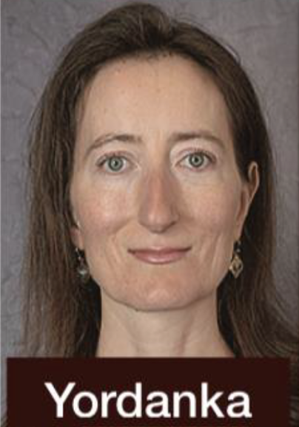
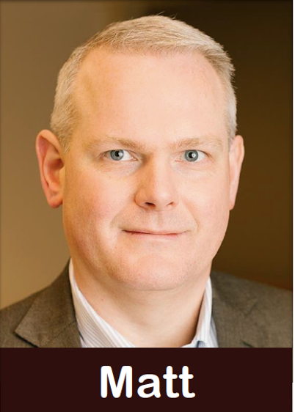
Program Advisory Committee (PAC)
Presence of chair-elect
Positive impact, good chance for consistent cooperation
Jeopardy process
Identified reason of improvement
New indications:
status report is mandatory
request of additional PAC days
requires a new proposal
JLOU Representatives at PAC52
JLUO Annual Meeting, June 11, 2024
6

Slide 7
Examples of User Representation Activites
Program Advisory Committee (PAC)
JLUO Chair is a member of the PAC, and the JLUO chair-elect joins the PAC meetings, with a
unique charge to observe deliberations and the interactions between PAC members and
proposers and ensure a fair process. JLUO BoD suggests new PAC members to C. Keppel.
Director’s Inclusion and Diversity Council (DIEA Council)
JLUO Chair, O. Cortes Becerra, H. Szumilla-Vance (stepping out)
JLab Radiation Review Panel (JRRP)
Sean Dobbs replacing Charles Hyde after a long service
ePAS Advisory Team (eTAS) H. Szumilla-Vance
Space & Renvation Committees JLUO Chair
JLUO Annual Meeting, June 11, 2024
7

Slide 8
Holly Szumila-Vance, Simonetta Liuti, Olga Cortes Becerra
Scientific User
Focus Group
JLUO Annual Meeting, June 11, 2024
8

Slide 9
First Focus Group Meeting: led by T. Keppel on March 7 at 11:30 am
JLUO Annual Meeting, June 11, 2024
9

Slide 10
Examples of User Representation Activites
Program Advisory Committee (PAC)
JLUO Chair is a member of the PAC, and the JLUO chair-elect joins the PAC meetings, with a
unique charge to observe deliberations and the interactions between PAC members and
proposers and ensure a fair process. JLUO BoD suggests new PAC members to C. Keppel.
Director’s Inclusion and Diversity Council (DIEA Council)
JLUO Chair, O. Cortes Becerra, H. Szumilla-Vance (stepping out)
JLab Radiation Review Panel (JRRP)
Sean Dobbs replacing Charles Hyde after a long service
ePAS Advisory Team (eTAS) H. Szumilla-Vance
Space & Renovation Committees JLUO Chair
JLUO Annual Meeting, June 11, 2024
10

Slide 11
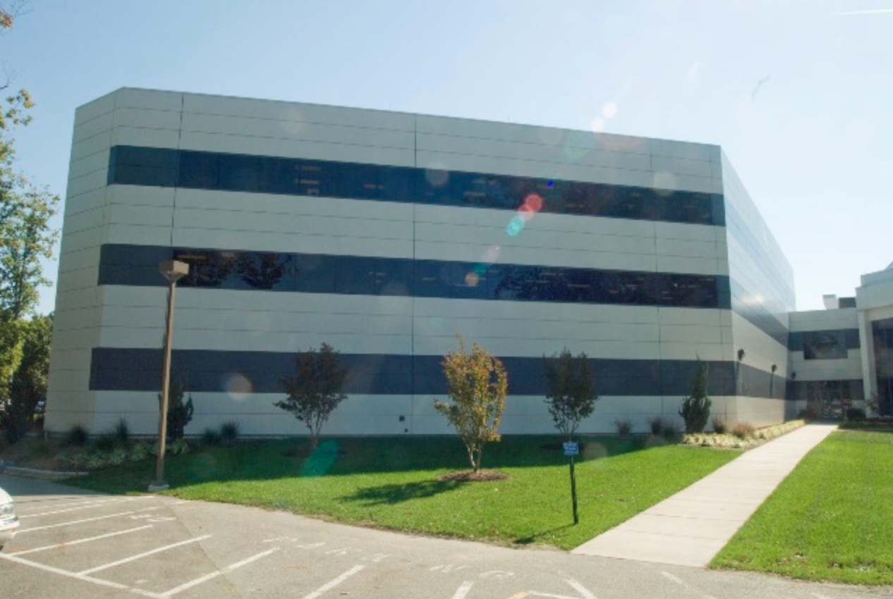
Study group for user space
(organized by JLUO Board)
Chair: Yordanka Ilieva
Members:
Sean Dobbs, Rachel Mongtomery,
Annalisa D'Angelo, Kent Paschke,
Chaden Djalali, Zhiwen Zhao,
Amy Schertz.
JLUO Annual Meeting, June 11, 2024
11

Slide 12
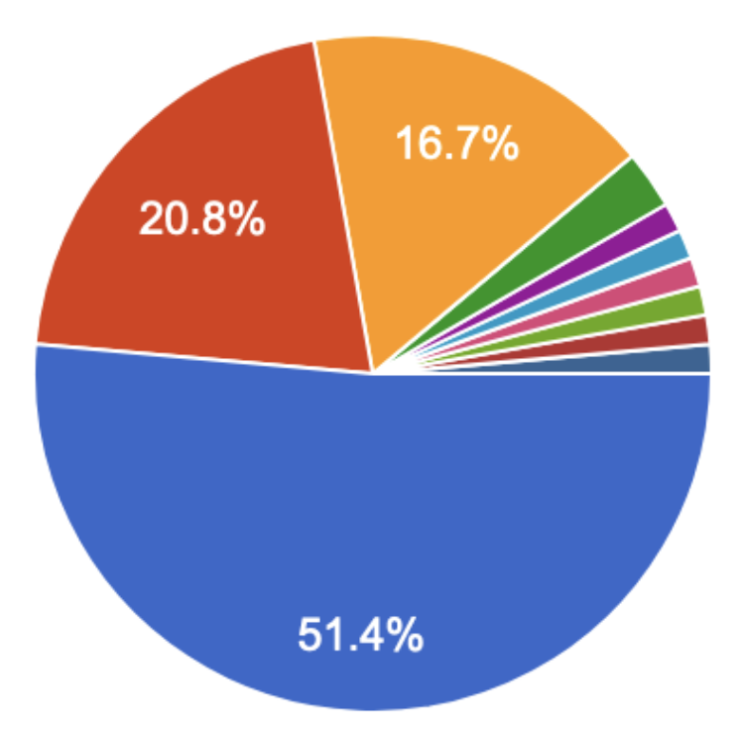
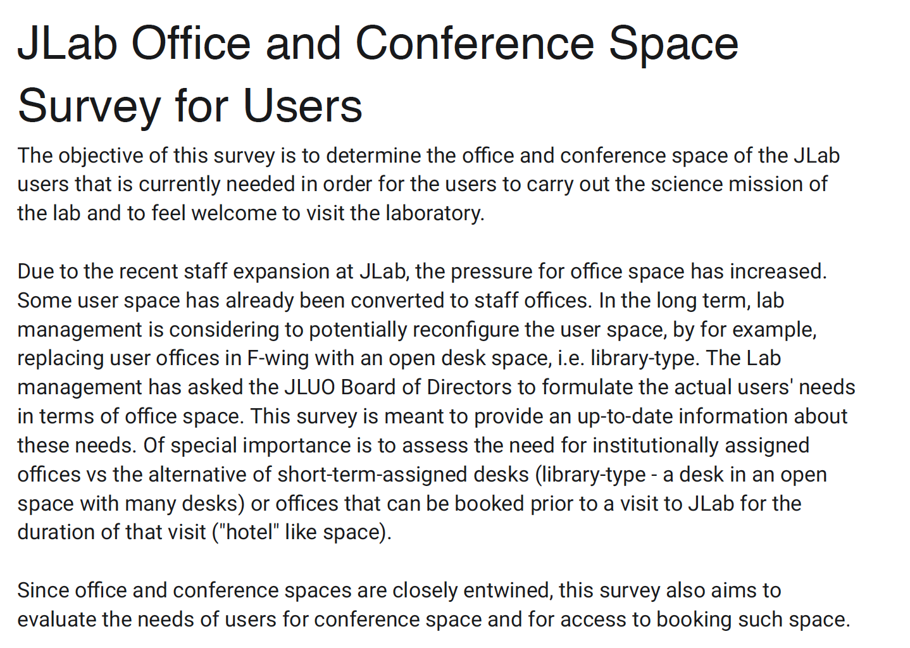
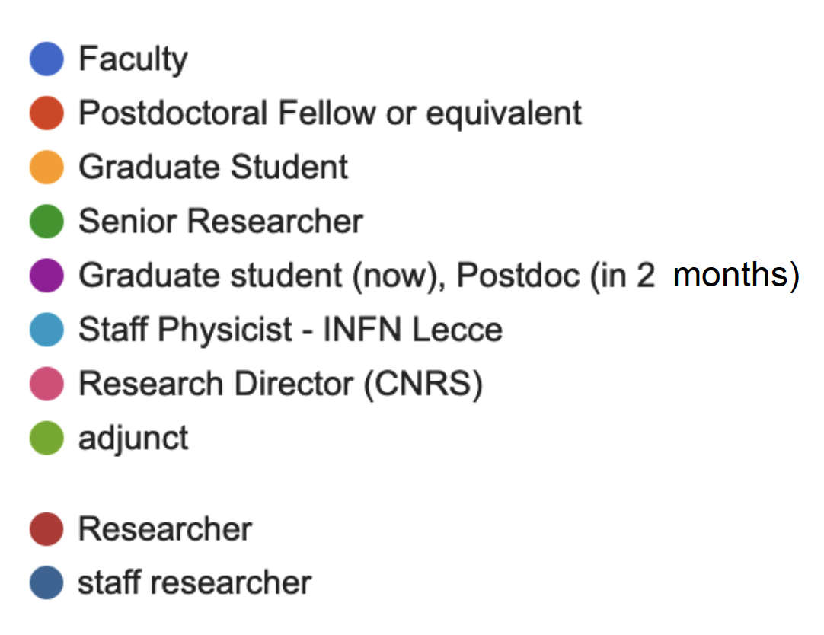
Space Survey
72 responses
JLUO Annual Meeting, June 11, 2024
12

Slide 13
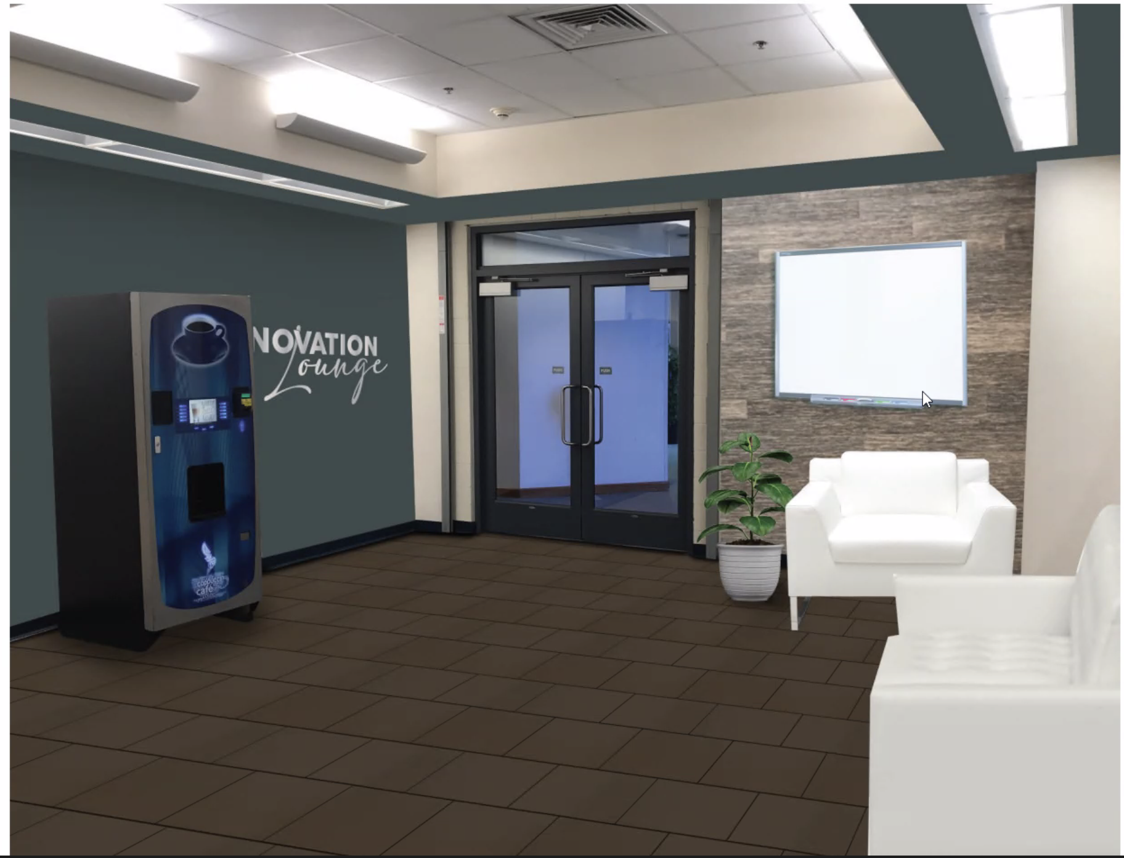
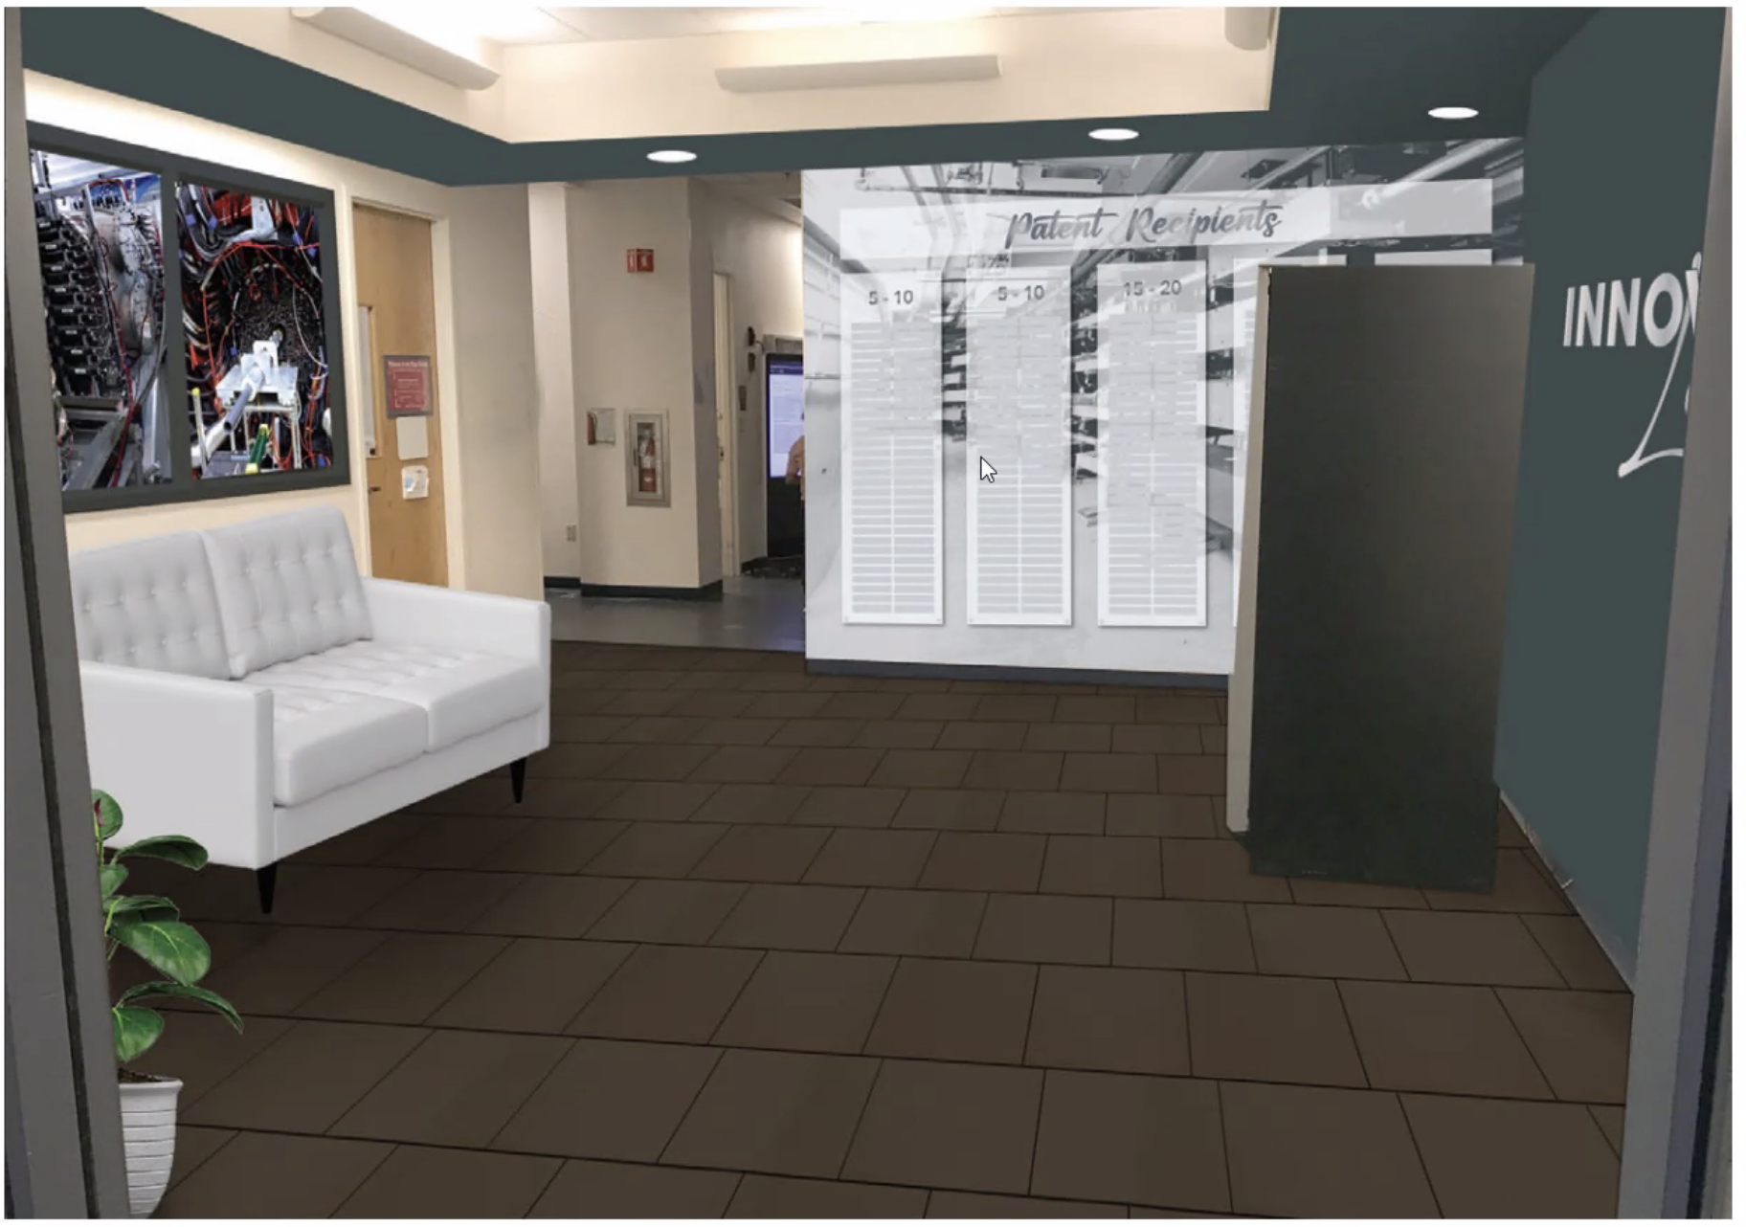
New social area
Part of UGBoD recommendations: Innovation lounge in F101
(patents, new achievements, awards & honor plaques)
Patent plaques
Whiteboard
Info point
Bookcase
Small table
JLUO Annual Meeting, June 11, 2024
13

Slide 14
e-Print: 2306.09360
JLUO Annual Meeting, June 11, 2024
14

Slide 15
Examples Community Building Activities
Organize the Annual Meeting
Occasion to share last developments and discuss new opportunities.
Rich program for students and early career researchers.
Organize Satellite Meetings at APS and DNP
To reach out users far from the lab and promote JLab science
Promote Nuclear Physics Day on the Hill
Manage JSA Awards Thsis Prize, Post-doc Prize, Poster Prize
Pursue several (young) user support Initiatives
Lunch Seminars, Software Carpentery Workshop, Child Care, Business Travel, …
Most of JLUO Activities are possible thanks to the JSA Initiatives Found (IF)
JLUO Annual Meeting, June 11, 2024
15

Slide 16
10 - 12 June
@ JLab
2024
in 2023
JLUO Annual Meeting, June 11, 2024
16

Slide 17
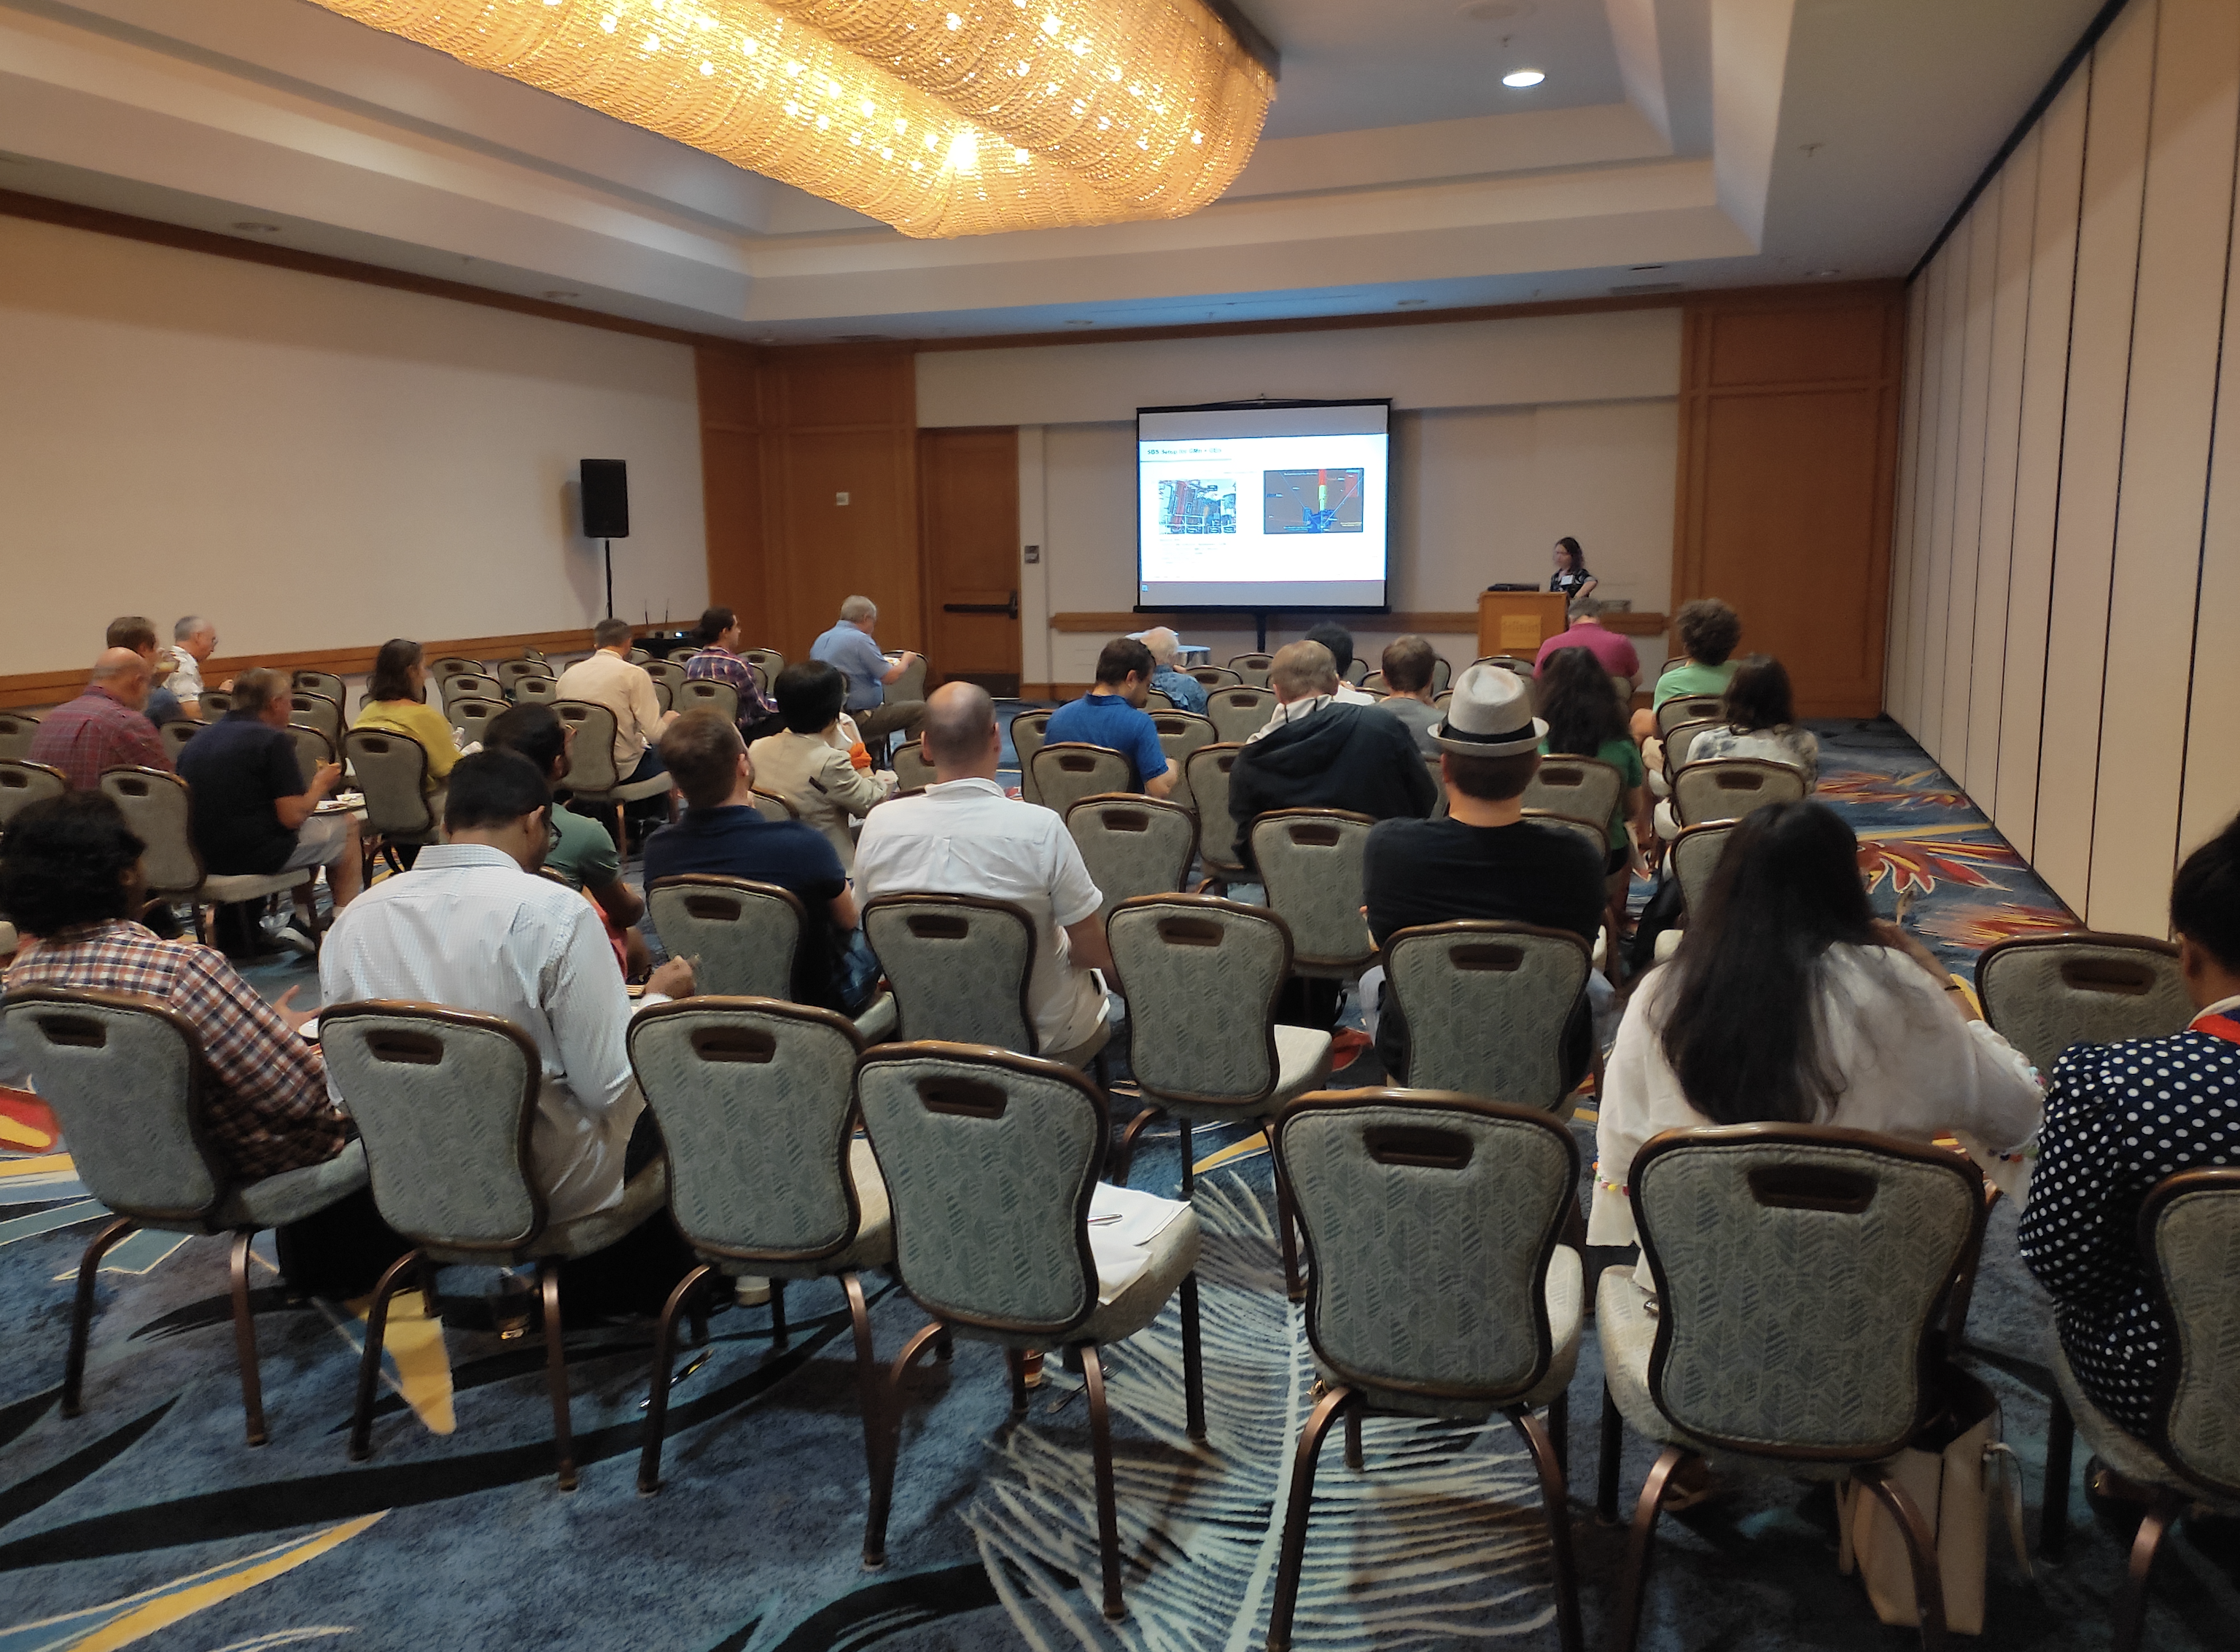
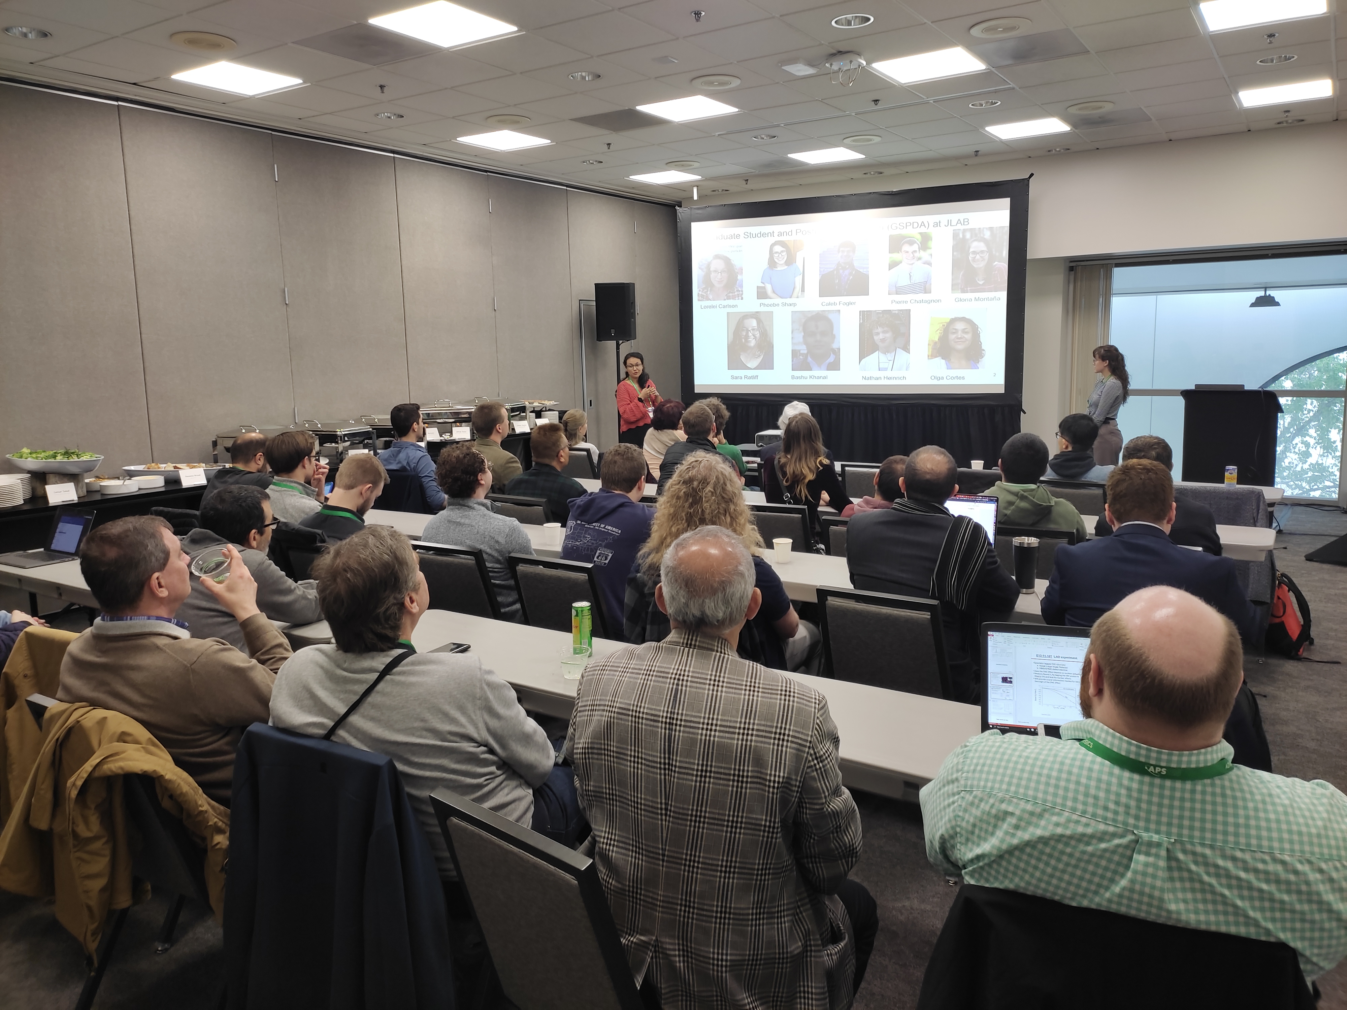
Satellite Meetings
Hall-A Presentation at DNP
Waikoloa Village HW, November 23
GSPDA Presentation at APS,
Sacramento CA, April 24
Typical: more than 40 attendees, presentations by JLUO, JLab, Experimental Halls, ….
JLUO Annual Meeting, June 11, 2024
17

Slide 18
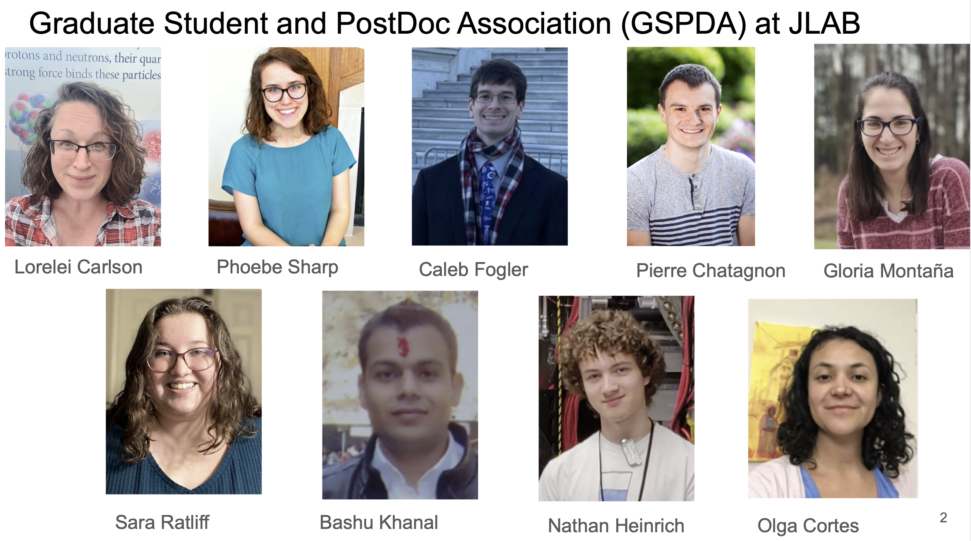
JLUO Annual Meeting, June 11, 2024
18

Slide 19
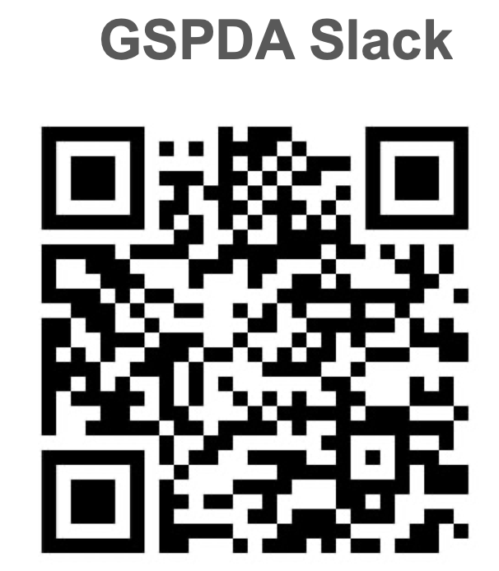
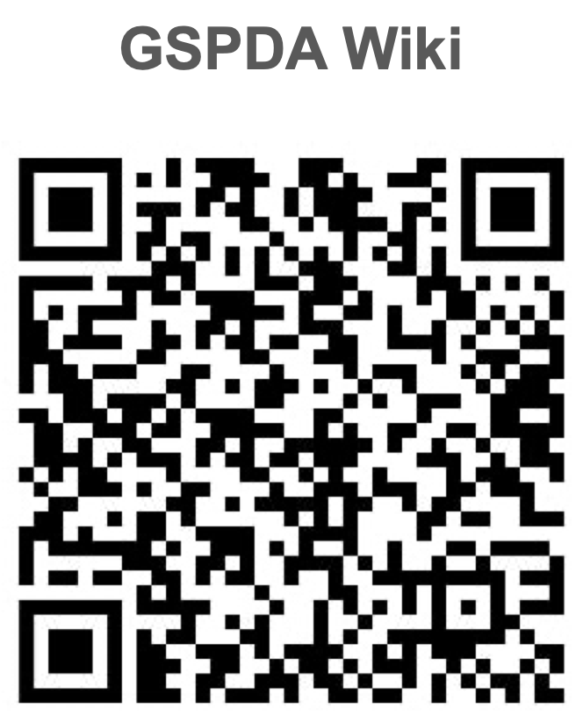
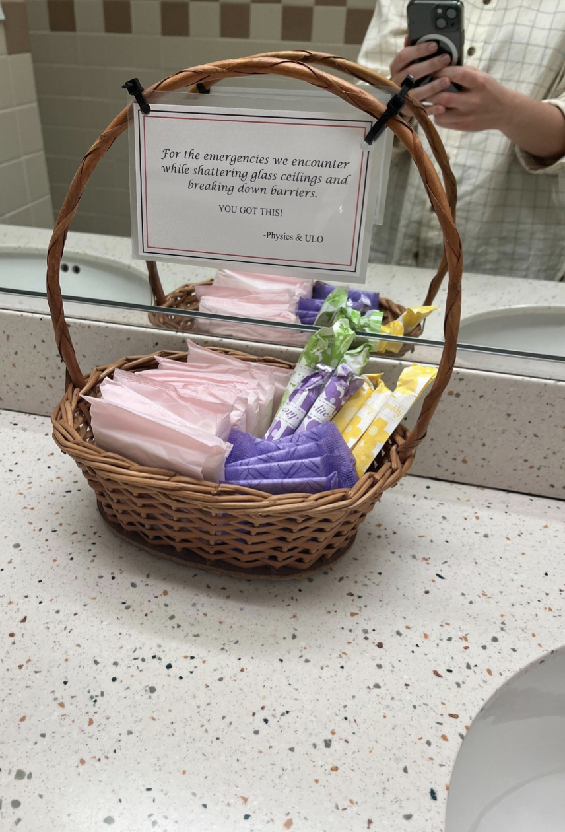
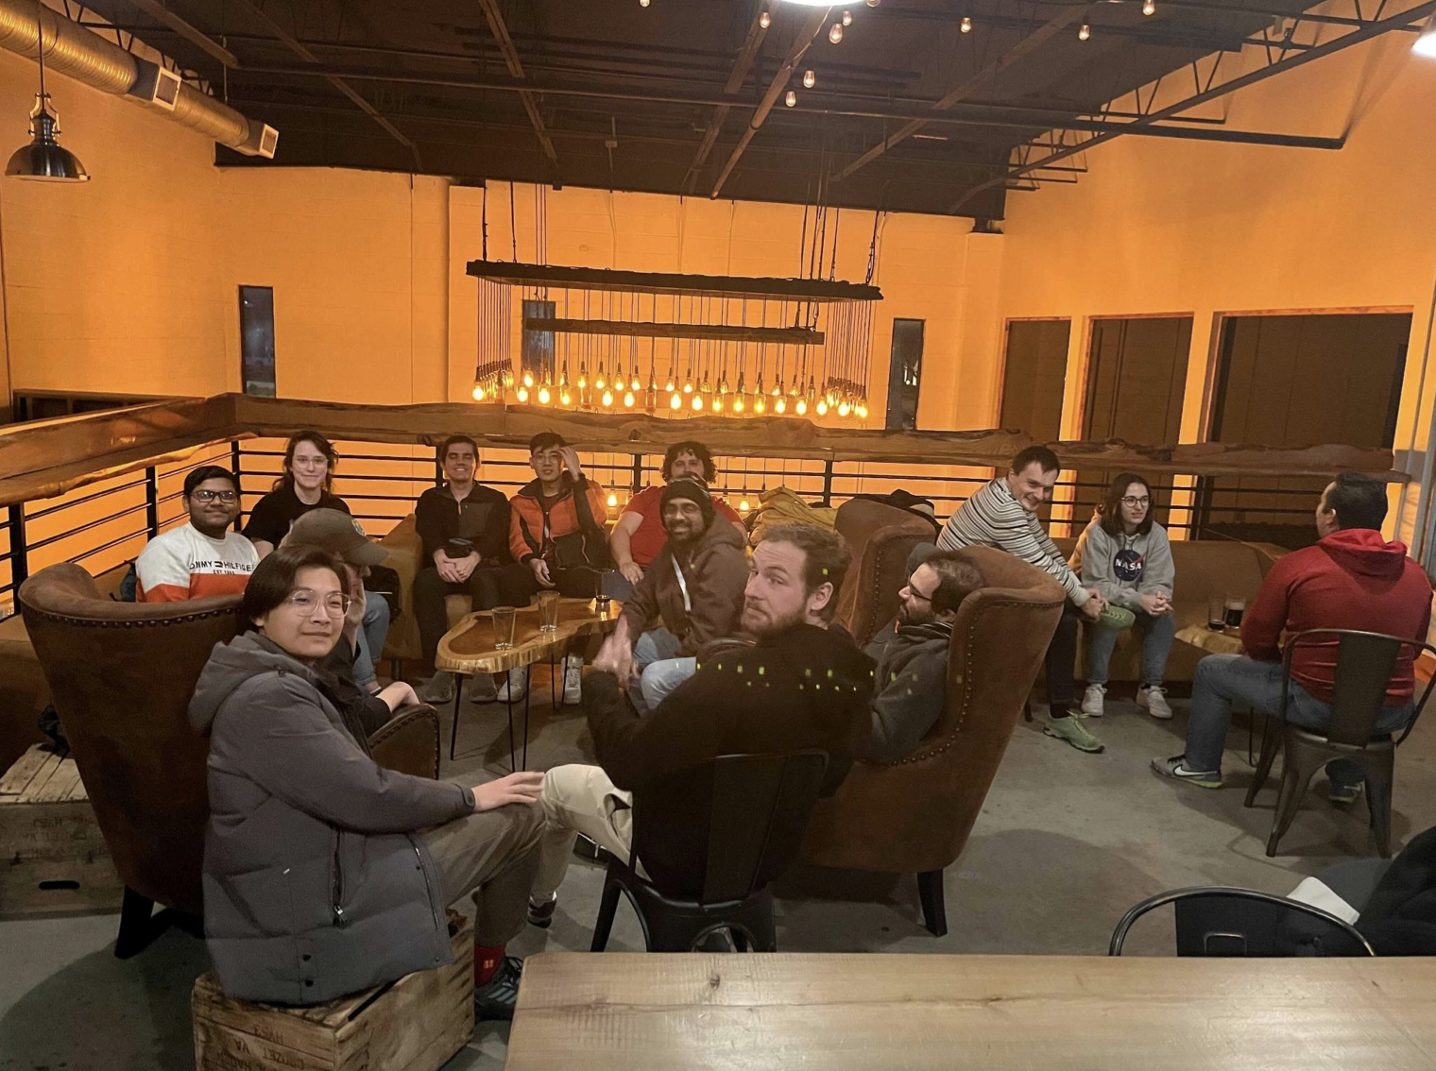
Hygiene Baskets
Resources for users at JLab
Taco Tuesday
Every Tuesday
Tradition at Tradition
Every other Thursday
JLUO Annual Meeting, June 11, 2024
19

Slide 20
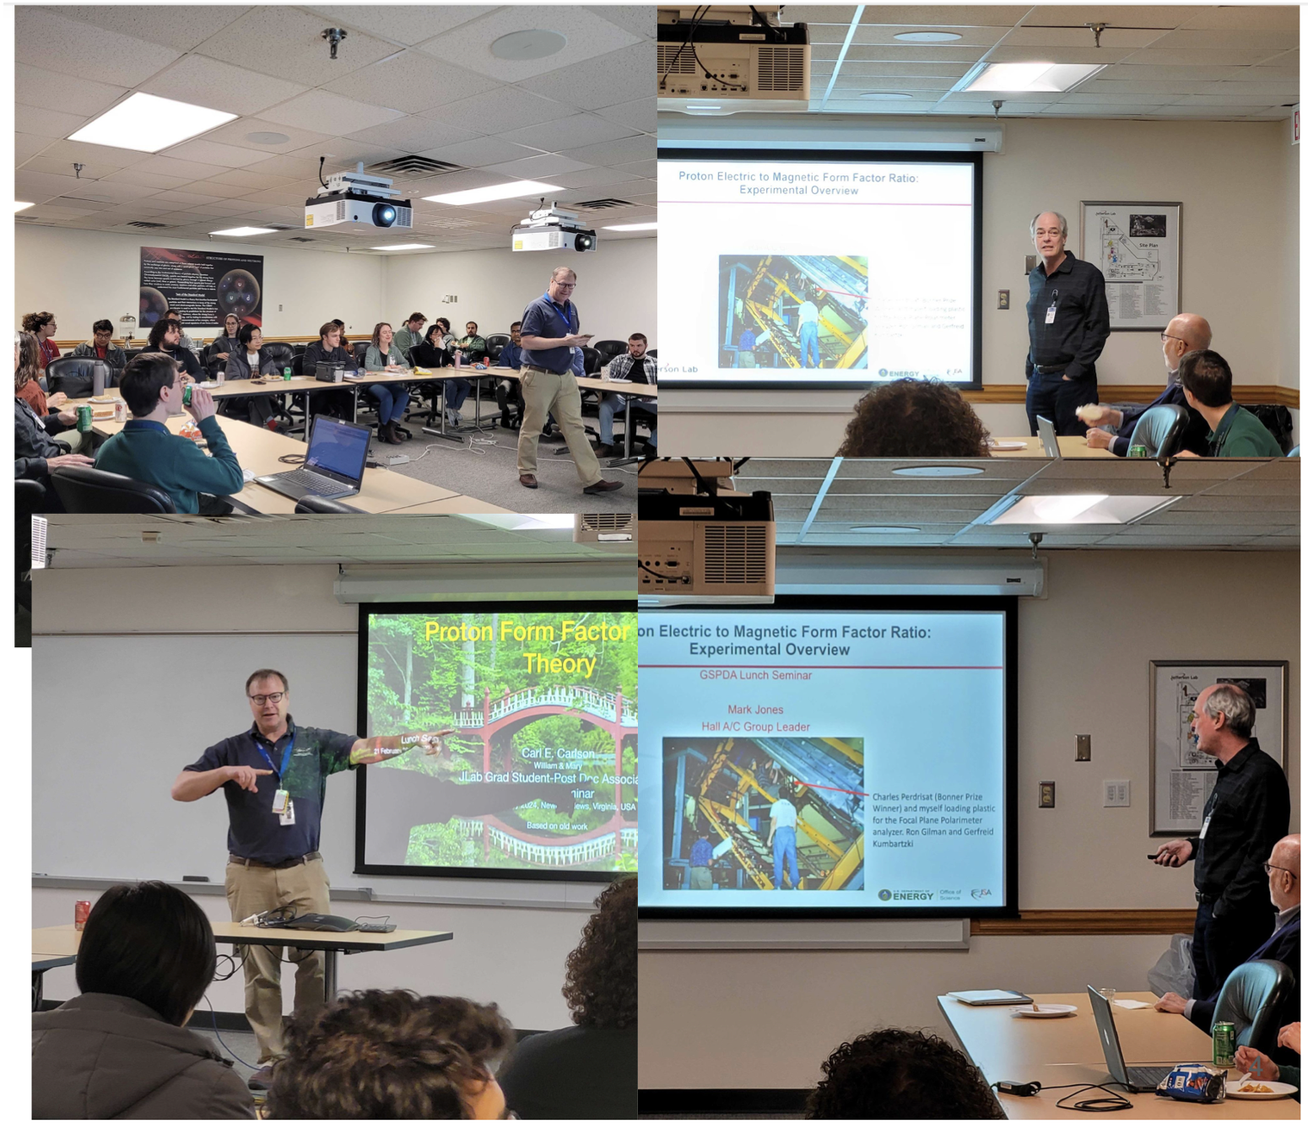
Lunch Seminars
2023 Annual Meeting:
Negotiation workshop
Industry Panel
Work-Life balance
February ‘24:
Dueling Theorist and Physicist
Protonf Form Factor Ratios
April ‘24:
AAAS Fellowship Q&A
Additional funds granted to
better support the initiative
(after an unexpected cut)
JLUO Annual Meeting, June 11, 2024
20

Slide 21
54 partecipants (10 from JLab) for 25 state offices
JLUO Annual Meeting, June 11, 2024
21

Slide 22
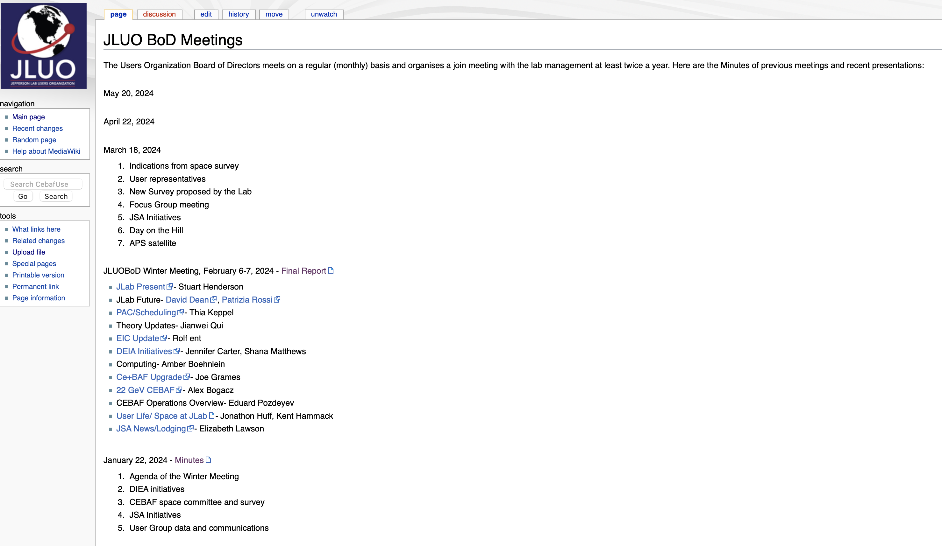
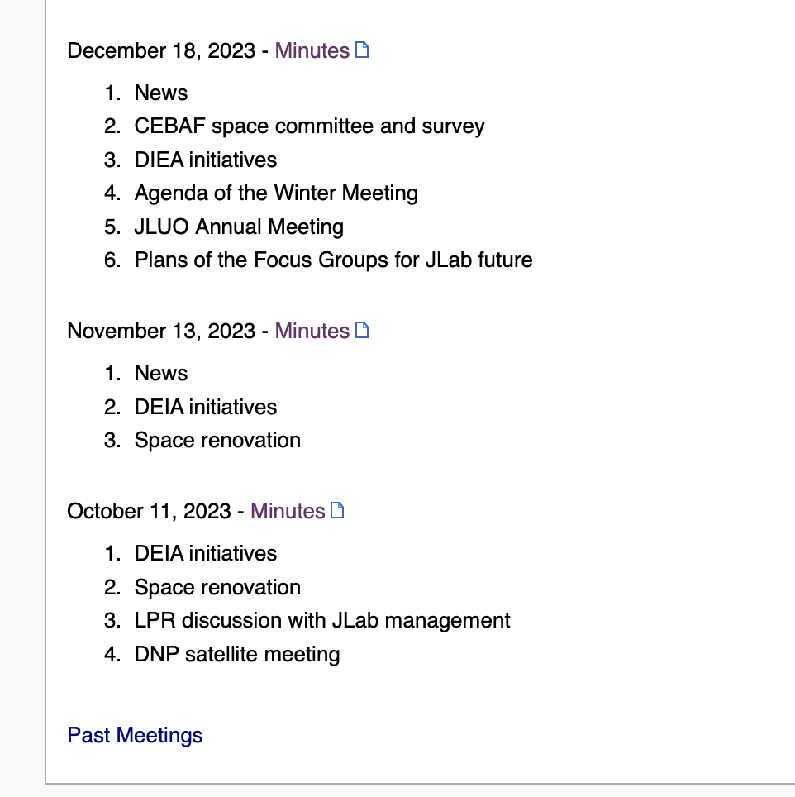
JLUO BoD Meetings
JLUO Annual Meeting, June 11, 2024
22

Slide 23
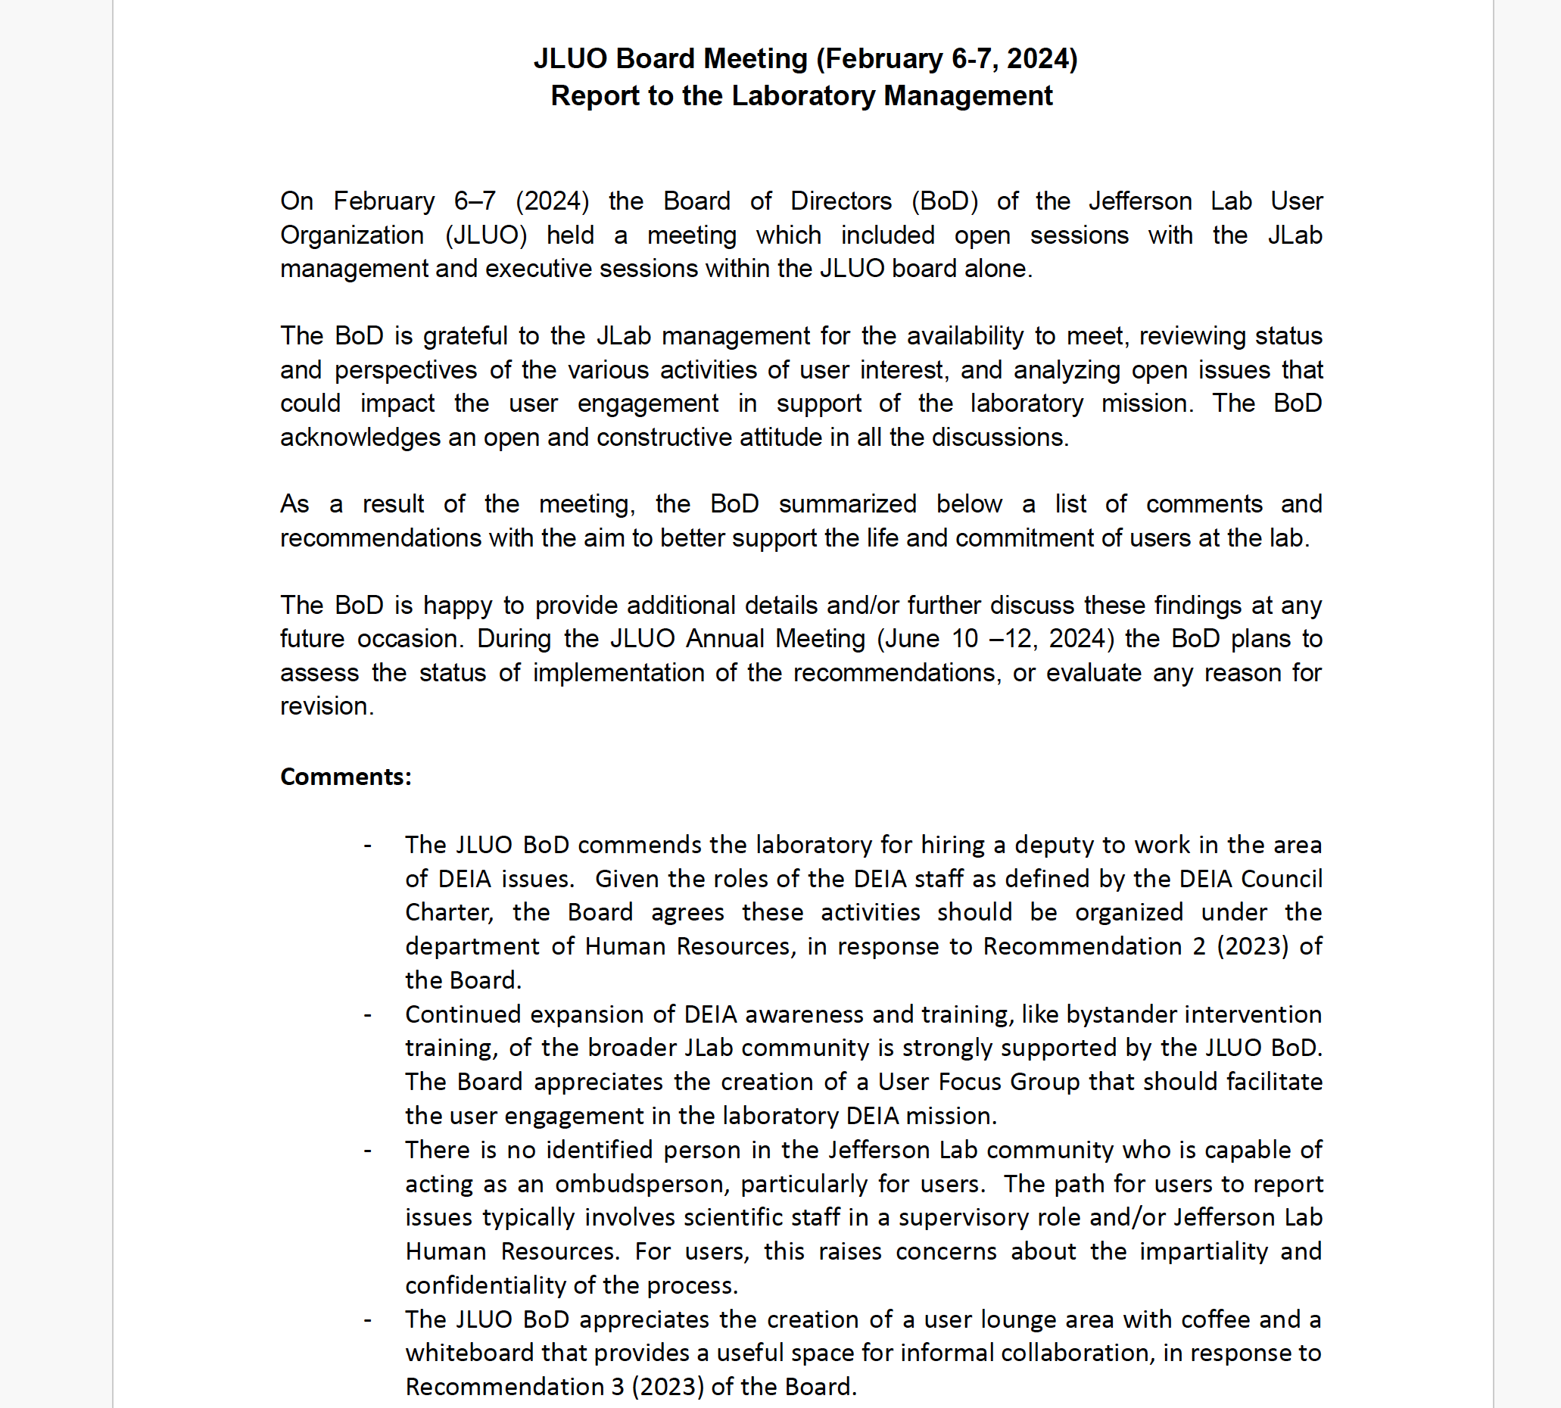
Winter
Meeting
Report
JLUO Annual Meeting, June 11, 2024
23

Slide 24
Outlook
JLUO is a vibrant community:
strong commitment for the present
wide engagment for the future at JLab
special care for inclusion and early-career stage
Ongoing:
JLUO Annual Meeting, June 11, 2024
24

