Slide 1
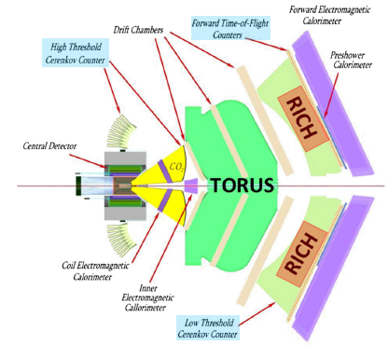
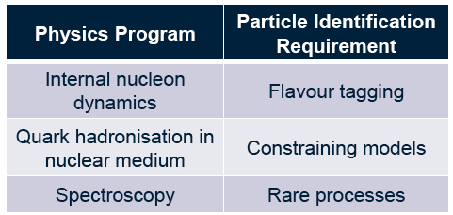
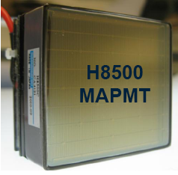
Integrated Electronics for Large Area Photon Detectors
CLAS12 experiment at JLab:
RICH to identify hadrons in the 3-8 momentum range:
large proximity-focusing devices with aerogel radiator
and visible Cherenkov light detection
Integrated electronics (i.e. with MARCO3, NINO or CLARO chip) for innovative photodetectors has
potential impact in High-energy Physics (Cherenkov detectors) and Nuclear Medicine (PET, SPECT)
Under study:
SiPM matrices
Large area, relatively low-cost
multianods PMTs
Alternatives: micro-channel plate LAPP
or gaseous detectors GEM with suitable photo-converters

