Slide 1
Attivita’ della Collaborazione Italiana
al Thomas Jefferson National Accelerator Facility
Contalbrigo Marco - INFN Ferrara

Slide 2
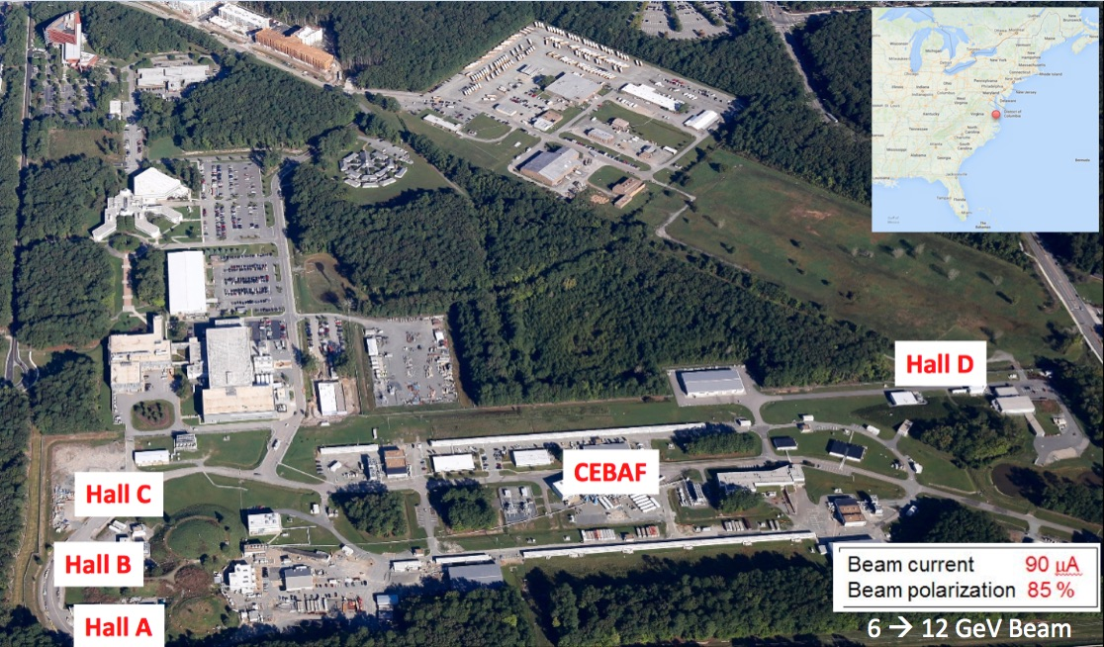
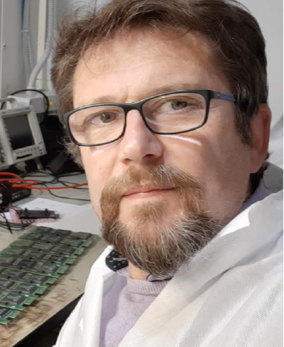
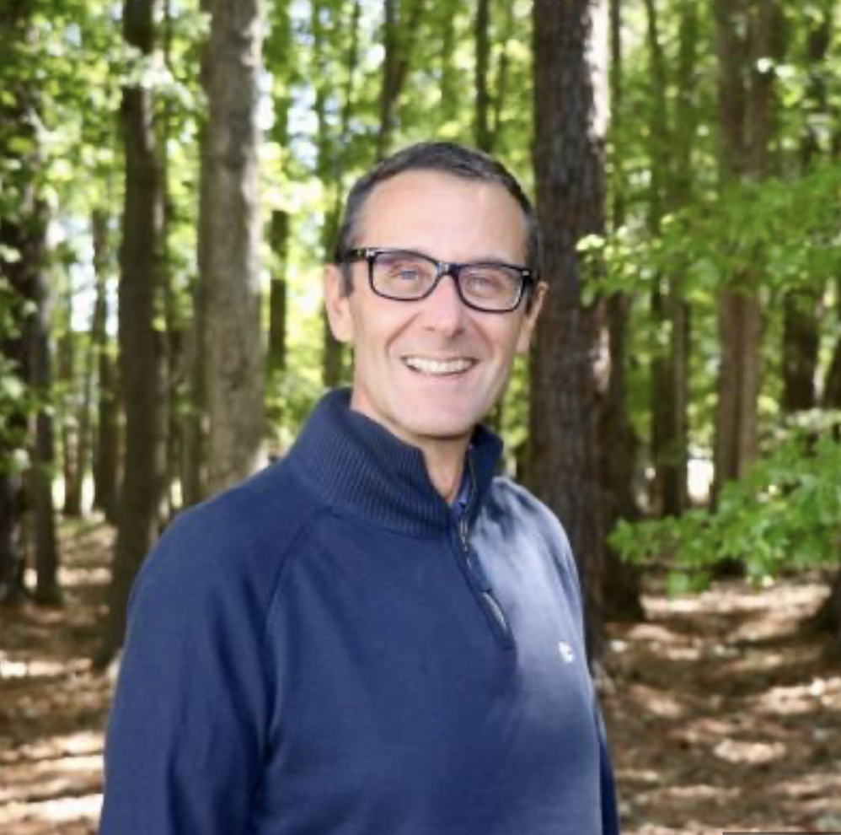
INFN@ JLab
INFN presence from the beginning (1991) Italian spokespersonship: > 20% of approved experiments
Deputy AD
Patrizia
Rossi
JLUO Chair
Marco
Contalbrigo
Hall-B Leader
Marco
Battaglieri
[till 12/21]
Alessandra Filippi: Chair of HPS Editorial Board
HPS Executive Committee member
Lucilla Lanza: CLAS Speaker Committee member
Andrea Celentano: HPS Publication Committee member
Marco Mirazita: CLAS Service Work member
Evaristo Cisbani: SBS Coordinating Committee member
Raffaella De Vita: Hall-B Software Coordinator and CCC member [till 07/23]
Contalbrigo Marco: CLAS DPWG Chair and CCC member [till 09/22]
Marzio de Napoli: HPS Executive Committee member [till 05/23]
Contalbrigo M.
CSN3, 19 September 2023
2
Notes:
Vanno messi studi innovativi e pubblicazioni

Slide 3
Long Range Plan
Long Range Plan (fall 2023):
Priority: Complete approved program at Jefferson Lab (included SOLID)
Initiative: Preparatory work for the 22 GeV upgrade
Series initiated
with J-FUTURE
March 22, Messina
Completed at JLab
in January 2023
arXiv: 2306.09360
Contalbrigo M.
CSN3, 19 September 2023
3
Notes:
Vanno messi studi innovativi e pubblicazioni

Slide 4
CEBAF Upgrade
Contalbrigo M.
CSN3, 19 September 2023
4
Notes:
Vanno messi studi innovativi e pubblicazioni

Slide 5
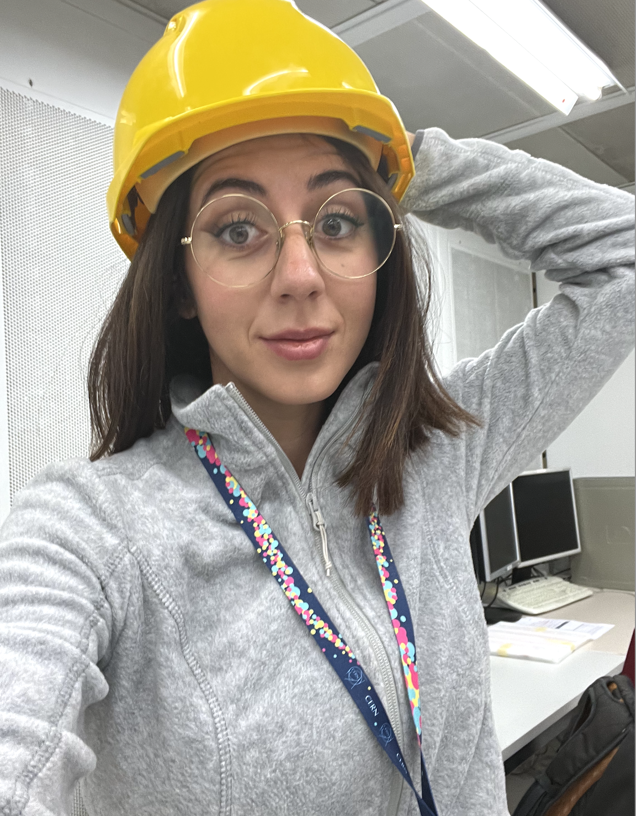
JLab12 Italia
Contac Person for JLab12 Computing: Mariangela Bondi’
FTE: stable number (around 28) in the past 4 years
PhD students:
Stefano Grazzi GE
Simone Vallarino FE
Antonino Fulci CT
Marco Spreafico GE
Antonio Riggio CT
Elena Sidoretti RM2
Tommaso Vittorini* GE
in 23/24 Academic year
Completion
3rd year
2nd year
* PNRR, sinergy with nu-BDX
Contalbrigo M.
CSN3, 19 September 2023
5
Notes:
Vanno messi studi innovativi e pubblicazioni

Slide 6
INFN 12 GeV Projects
RM1, CT, BA Nucleon 3D FE, LNF,GE
E07-109 Proton form factor ‘22 E06-112 Quark dynamics ‘18
E17-004 Neutron form factor ‘22 E12-008 TMDs ‘18
E09-018 SIDIS off neutron (³He) ’23 C11-111 TMDs ‘21
C12-009 Dihadron probes ’21
Spectroscopy
GE, RM2, TO, PV
E11-005 ‘18
MESONX
E12-001A ‘18
J/psi and penta-quark
E16-010 ‘18
Hybrid Baryons
Nuclear Potentials
RM1
E17-003 ‘18
Lambda-nn off trithium (³H)
E11-101 ‘19
PREX-II: neutron skin
E15-008 ‘24
Lambda hypernuclei
Tracker
HCAL-J
RICH
PolTarget
Forward
Tagger
Hall-A
Hall-B
Cristal Calorimetry
Dark Sector
GE, CT, PV, LNS, RM2, TO, PD
E11-006 HPS ‘17 E16-001 BDX ‘24
Contalbrigo M.
CSN3, 19 September 2023
6
Notes:
Vanno messi studi innovativi e pubblicazioni

Slide 7
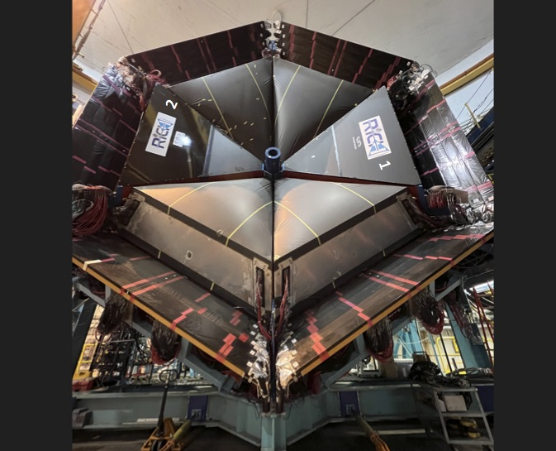
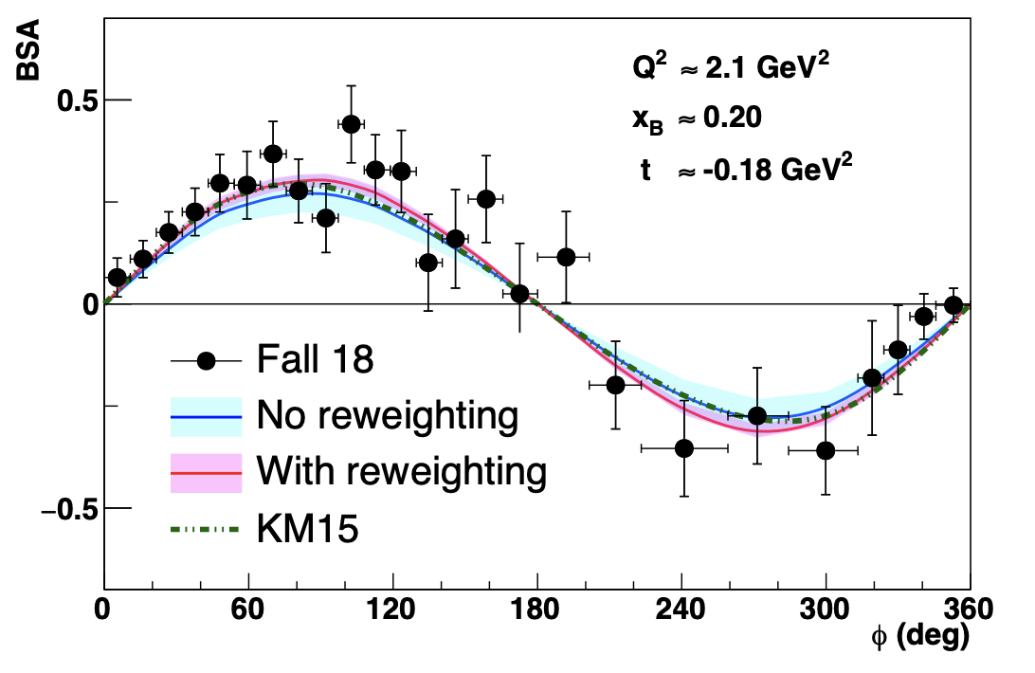
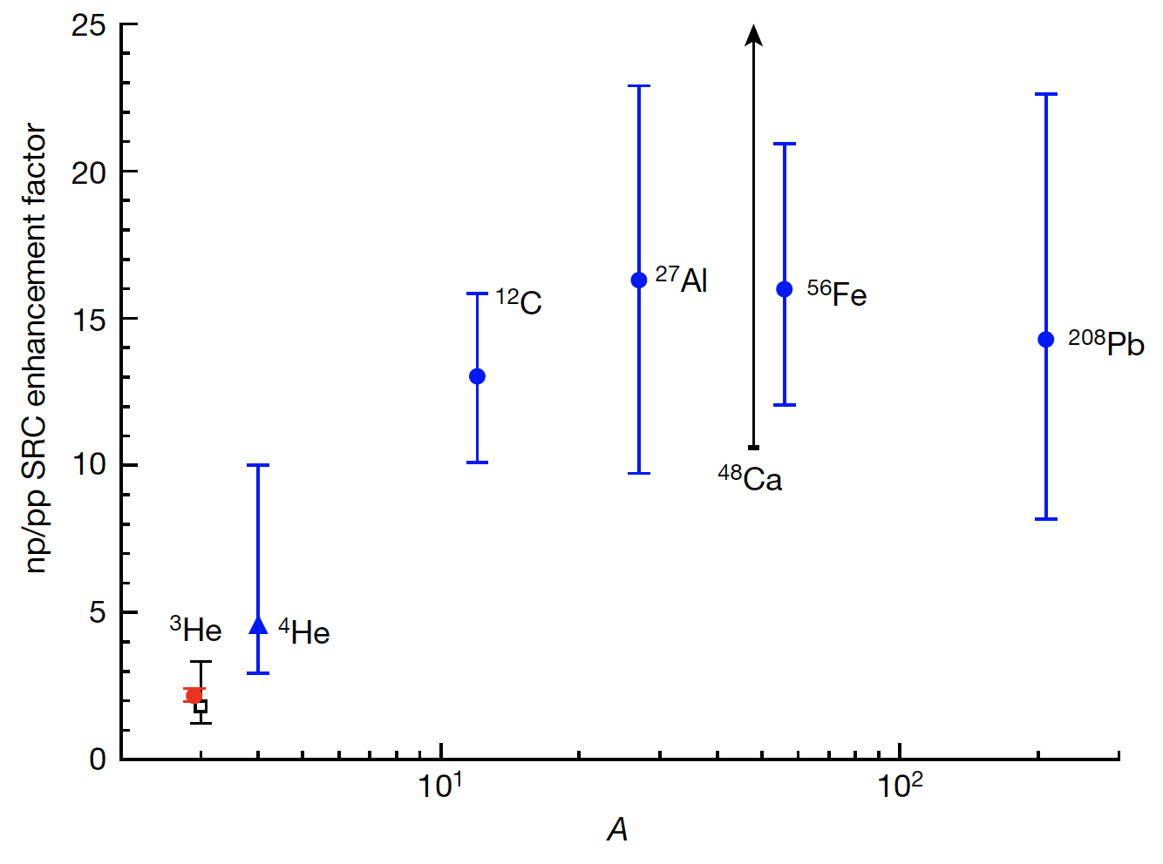
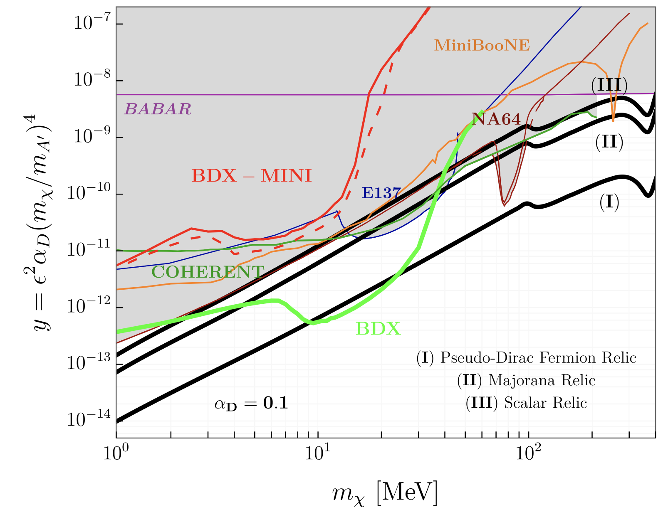
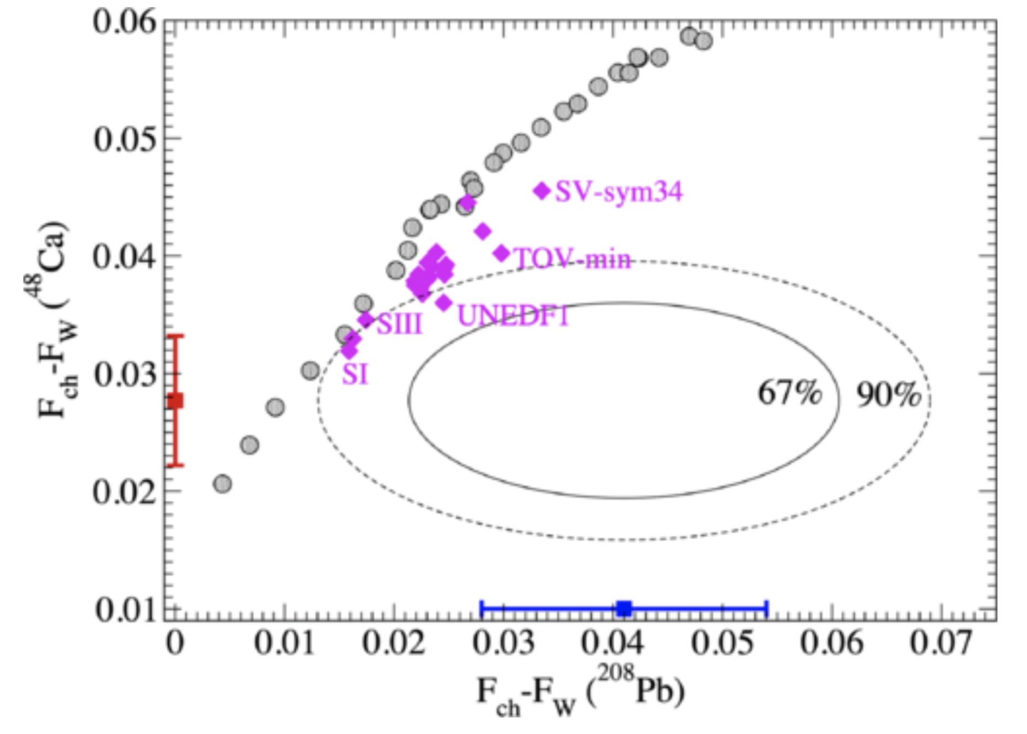
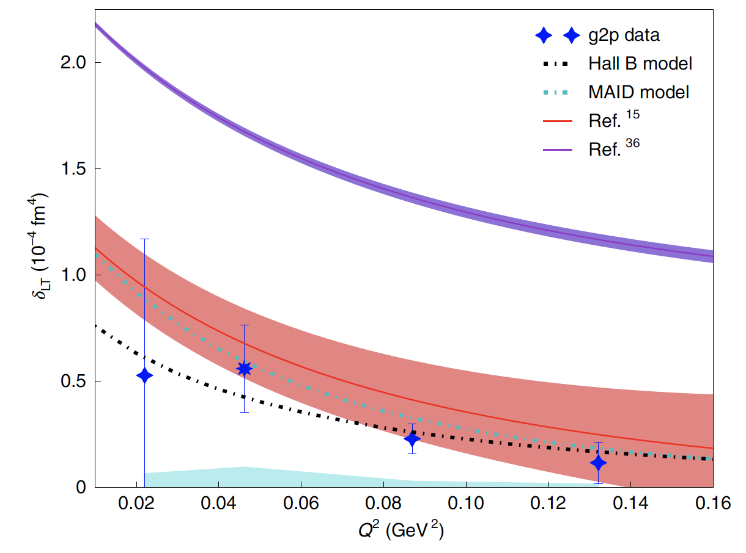
JLab Highlights
Hall-B: RICH installation completed
First run with a polarized target
Hall-A: Fully operational SBS spectrometer
CLAS12: PRL 130 (2023) 21, 211902
First CLAS12 Measurement of DVCS Beam-Spin Asymmetries in the Extended Valence Region
The first CLAS12 measurement of the DVCS beam-spin asymmetry off unpolarized proton targets, greatly extends the x and Q² phase space beyond the existing data in the valence region with unprecedented statistical precision.
Hall-A: Nature 609 (2022) 41-46
Revealing short-range structure of the mirror nuclei
³H and ³He
Hall-A measurement of np/pp short-range corelation ratio in mirror nuclei ³H and ³He is an order of magnitude more precise than previous experiments, and finds a marked deviation from the near-total np dominance observed in heavy nuclei.
Dark matter: PRD 106 (2022) 072011
Dark matter search with DBX-mini experiment
The BDX-mini pilot experiment probed to be sensitive to the parameter space covered by some of the most sensitive experiments to date, and demonstrates the discovery potential of the next generation beam dump experiment planned at intense electron beam facilities.
CREX: PRL 129 (2022) 042501
Precise determination of the neutral weak form factor of ⁴⁸Ca.
CREX has performed a precise determination of the neutron skin thickness of the ⁴⁸Ca nucleus. Together with the PREX measurement on ²⁰⁸Pb, it provides constraints on the density dependence of the symmetry energy of nuclear matter.
Hall-A: Nature Phys. 18 (2022) 1441-1446 Proton spin structure and generalized polarizabilities in the strong QCD regime
Hall-A measurement of the spin structure function g2 accesses generalized polarizabilities that are fundamental quantities describing the nucleon’s response to an external field, and benchmarks the Chiral perturbation theory predictions.
Contalbrigo M.
CSN3, 19 September 2023
7
Notes:
Vanno messi studi innovativi e pubblicazioni

Slide 8
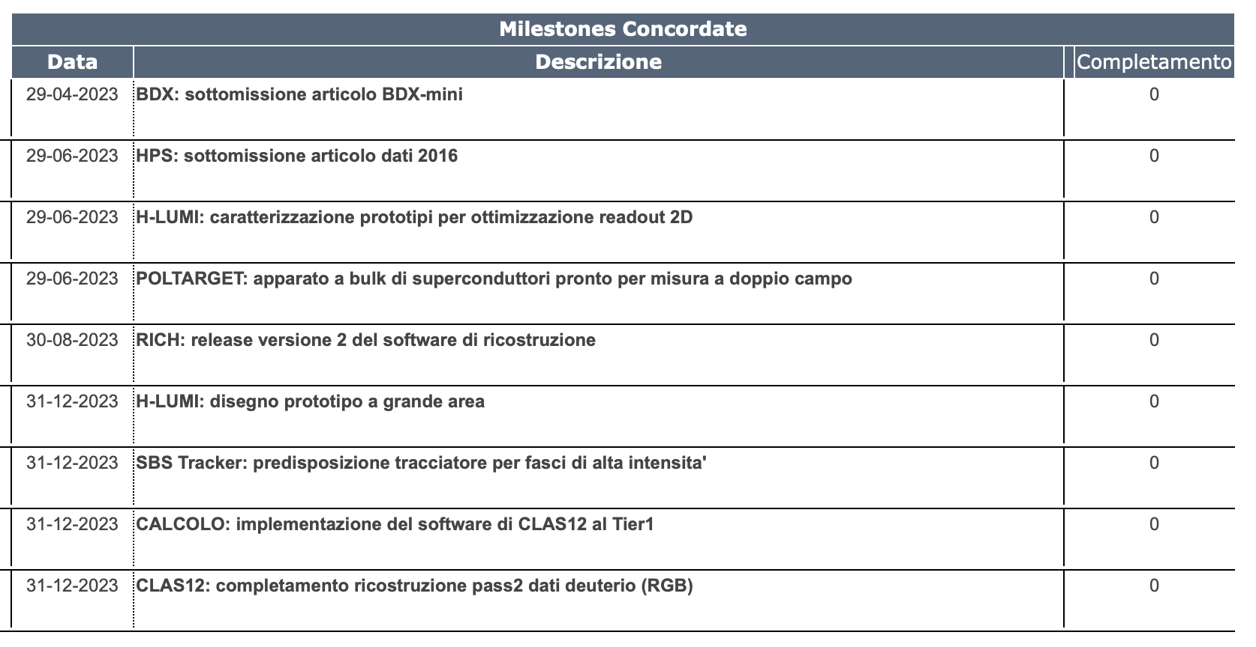
Milestones 2023
100 %
100 %
100 %
100 %
100 %
100 %
100 %
0 %
100 %
Contalbrigo M.
CSN3, 19 September 2023
8
Notes:
Vanno messi studi innovativi e pubblicazioni

Slide 9
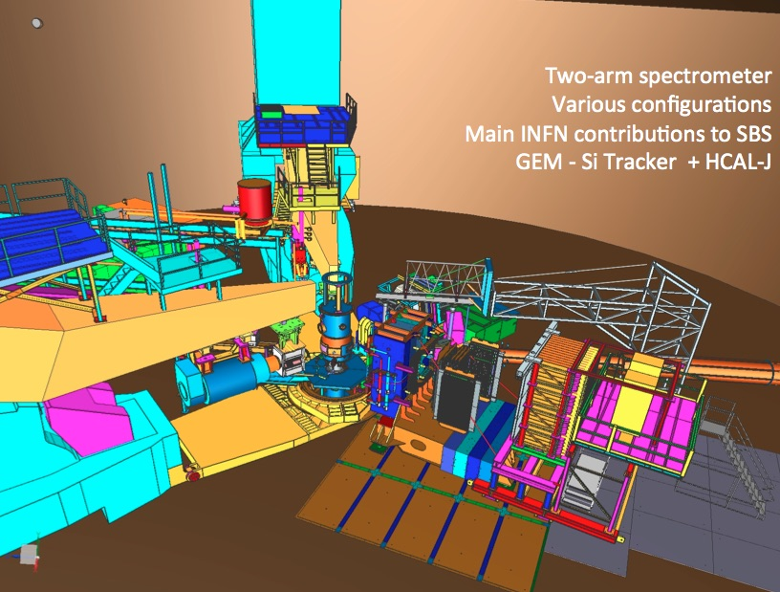
Hall-A Beam Schedule
Hall-A:
2018 Fall : Experiments with Tritium target
2019/2020 : PREX-II / CREX
: SBS
++ : GMp5
: GEn
: GEp
INFN: SBS tracker, HCAL
SBS - G_{e}^{N}
SBS - G_{e}^{P}
Contalbrigo M.
CSN3, 19 September 2023
9
Notes:
Vanno messi studi innovativi e pubblicazioni

Slide 10
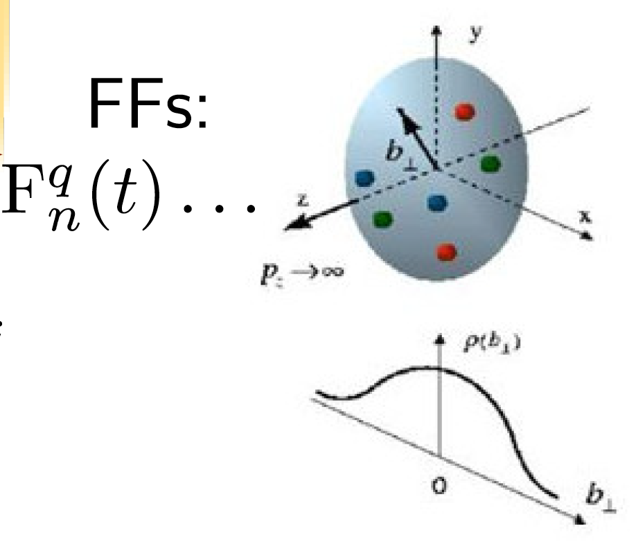
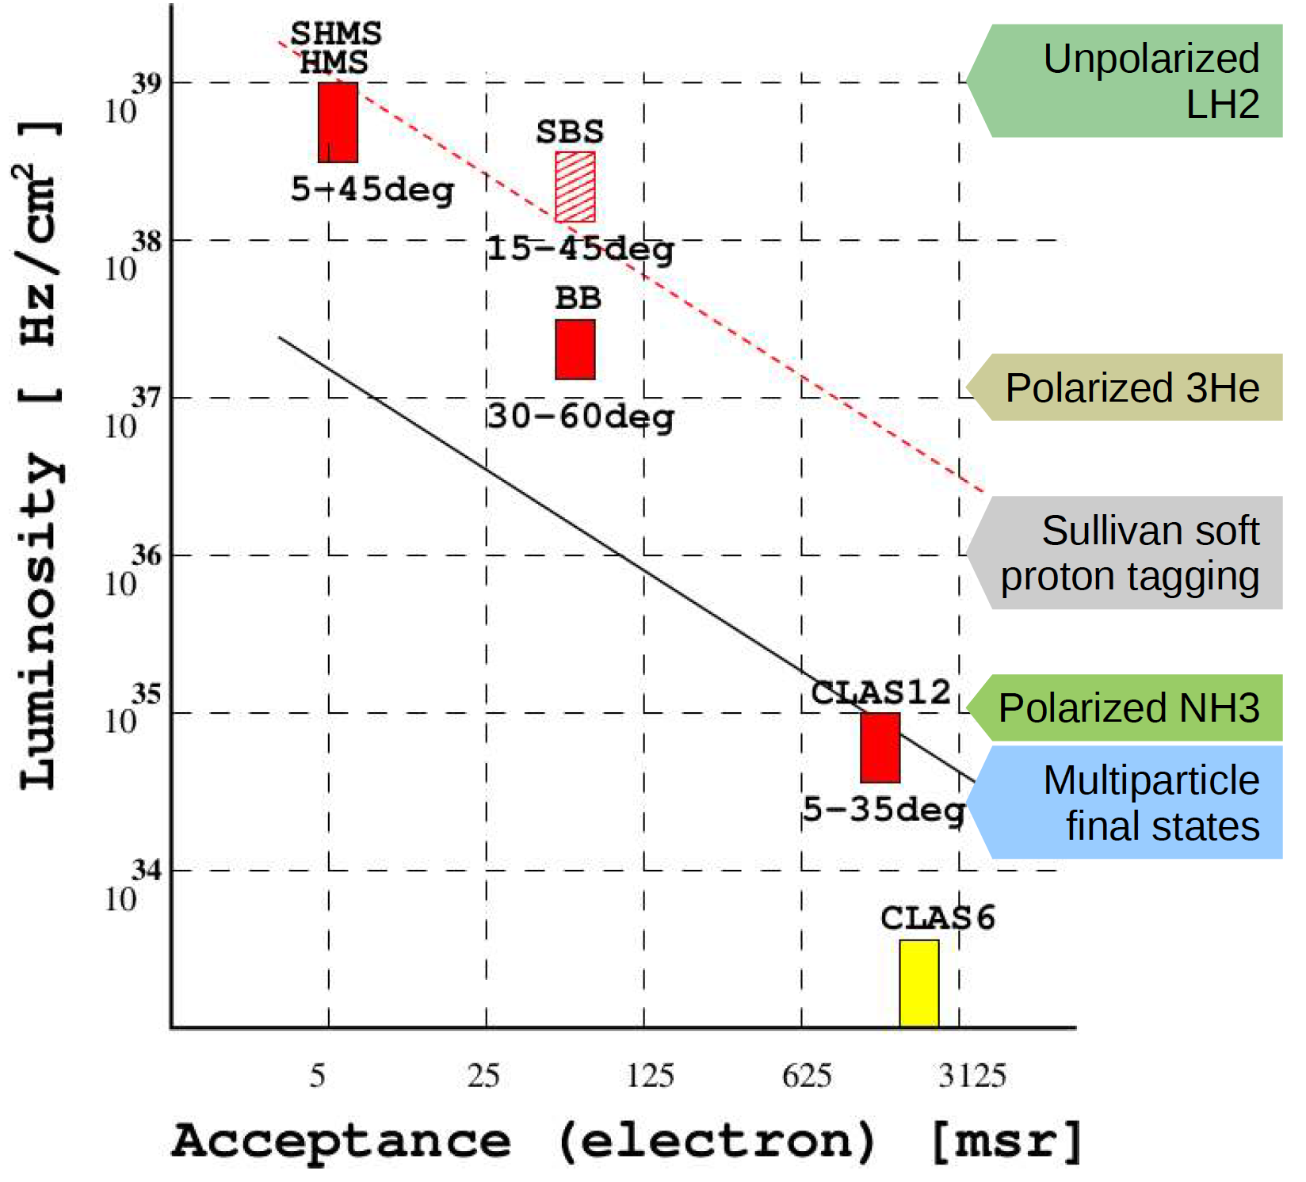
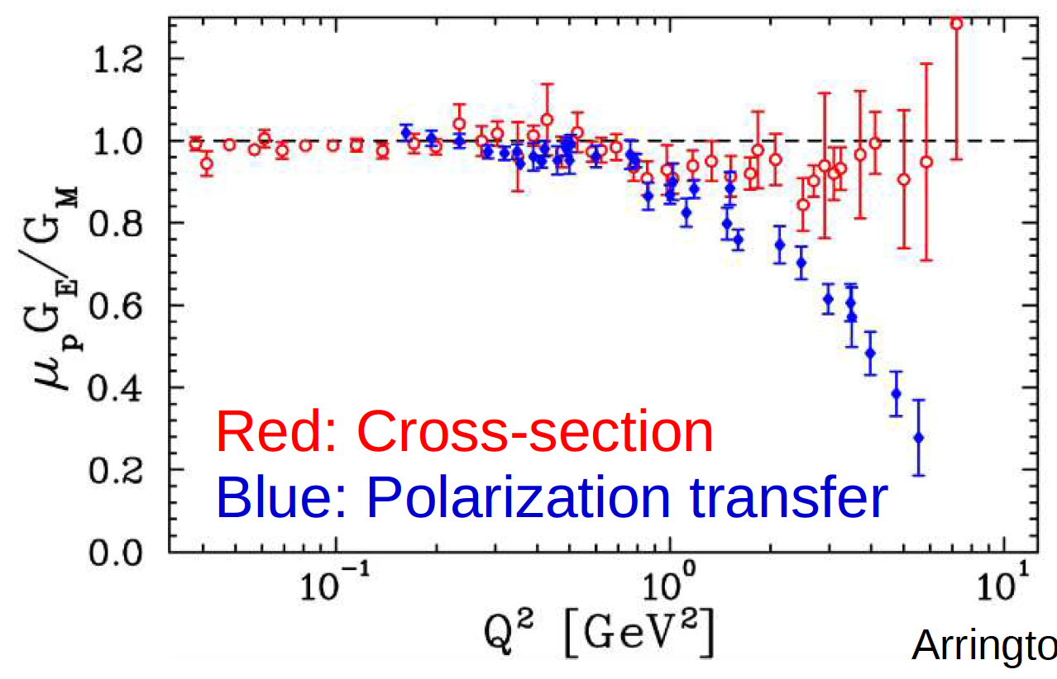
SBS in Hall-A
Trade-off between
luminosity and acceptance
J. Arrington et al, PRC 76 (2007) 035205
Contalbrigo M.
CSN3, 19 September 2023
10

Slide 11
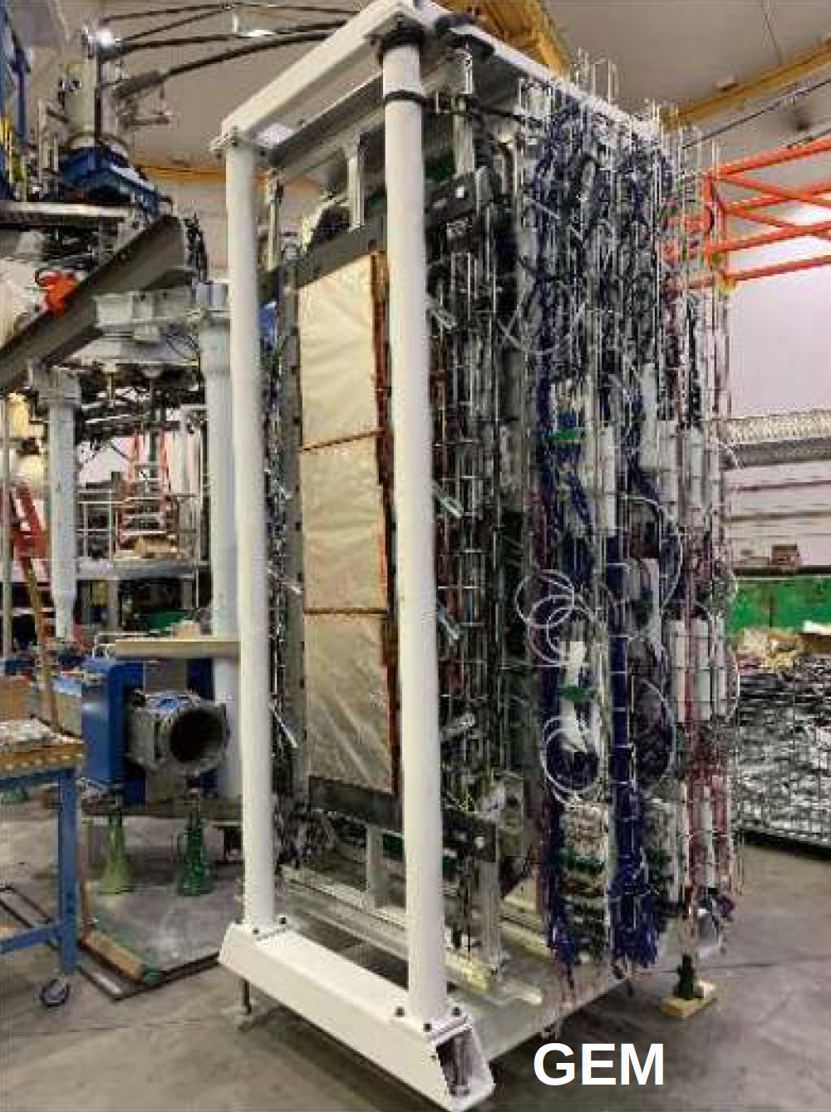
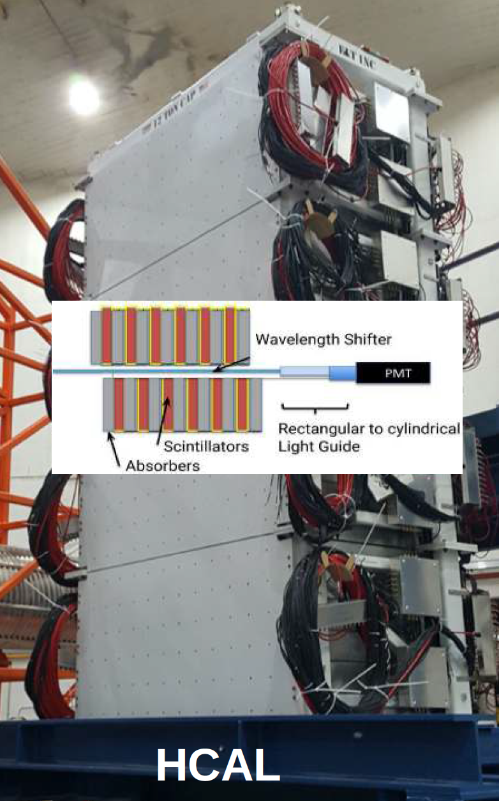
INFN in Hall-A
APV/MPD based readout electronics
Refurbished for high beam intensity
Movable platform & light guides
Milestone
Contalbrigo M.
CSN3, 19 September 2023
11

Slide 12
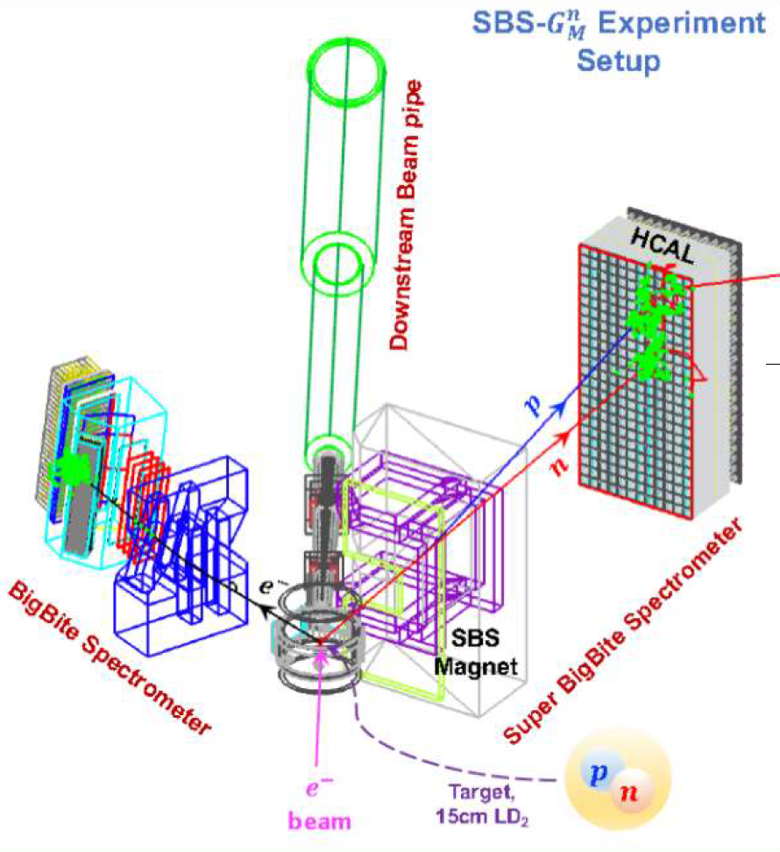
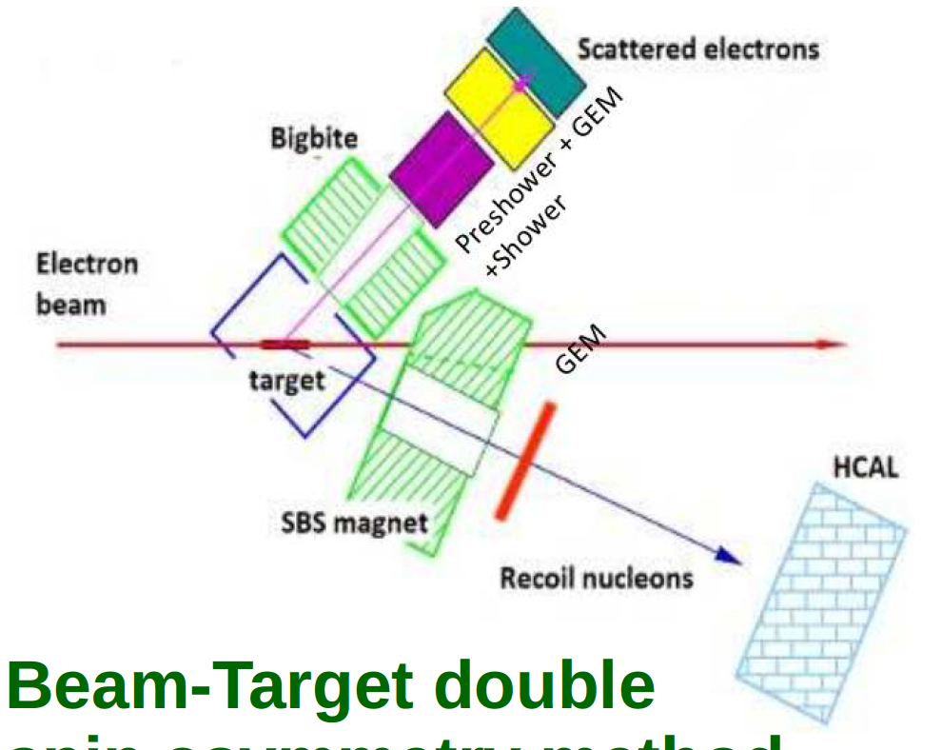
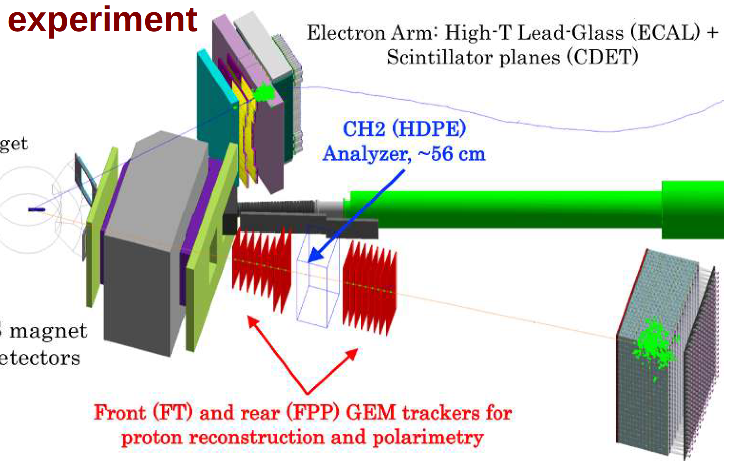
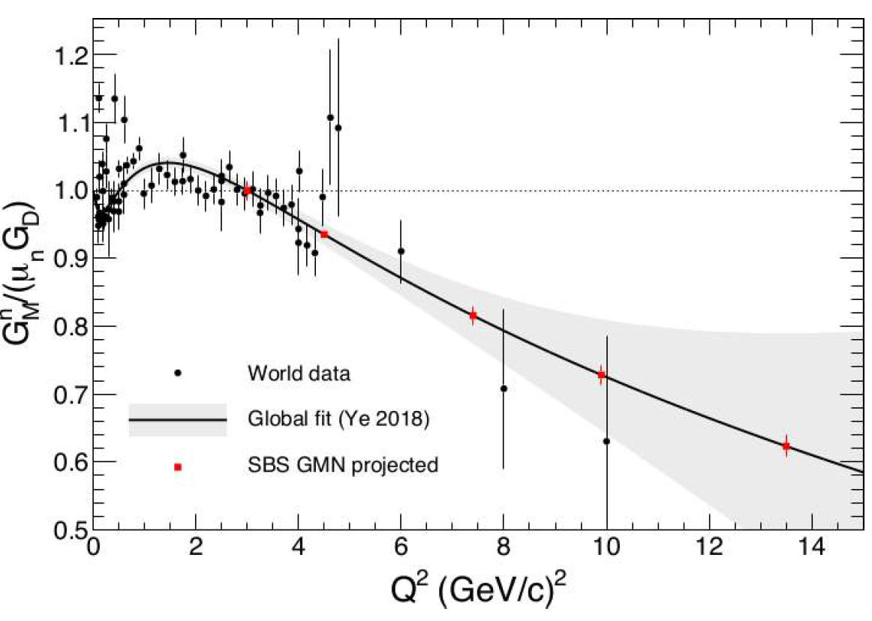
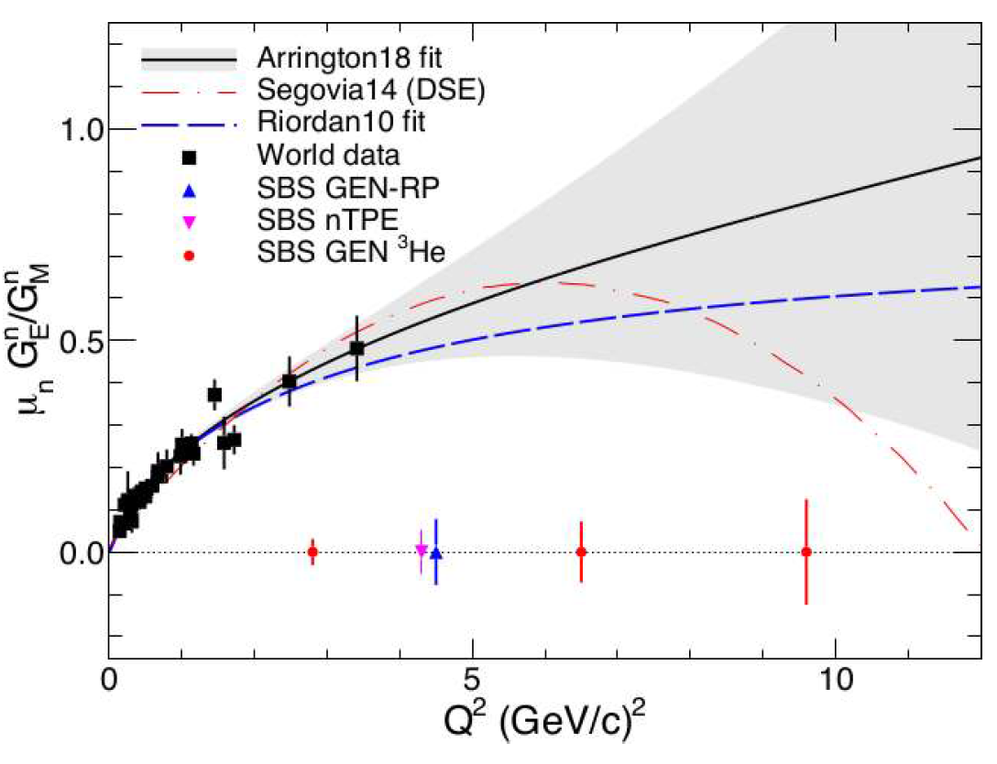
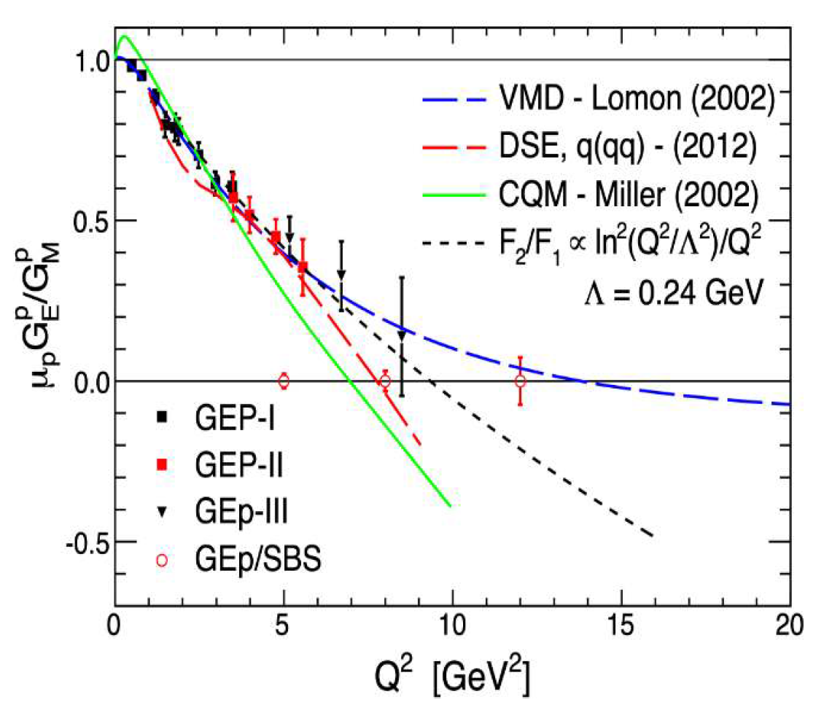
SBS in Hall-A
n
n
n
p
p
G_{M}
G_{E}
G_{M}
G_{E}
G_{M}
D/H ratio method
Double-spin asymmetry
Polarization transer
Done
2023
2024-2025
Contalbrigo M.
CSN3, 19 September 2023
12

Slide 13
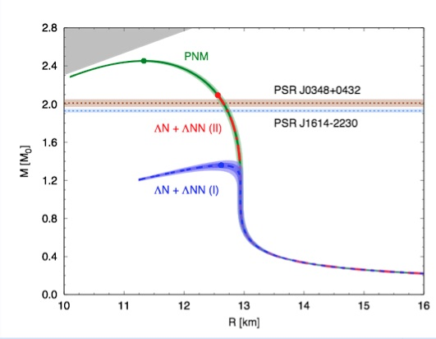
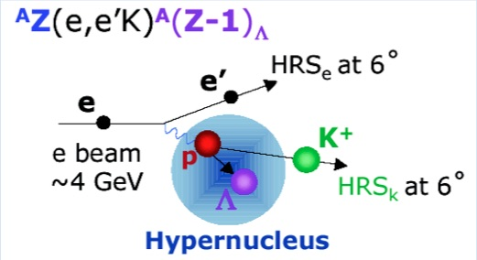
Hyper-Nuclei Program
Two main topics: Neutron star feature explanation
Search for Charge Symmetry Breaking in Hyperon-nucleon interaction
New experiments (F. Garibaldi, G.M. Urciuoli) conditionally approved by JLab PAC48 :
Studying Λ interactions in nuclear matter with ²⁰⁸Pb(e,e’K)²⁰⁸_{Λ}Tl and ^{40,48}Ca(e,e’K)^{40,48}K reactions
Determining the unkown Λ-n interaction by investigating the Λnn resonance
High accuracy measurement of nuclear masses of Λ hyperhydrogens (³_{Λ}H and ⁴_{Λ}H)
Suggestion: move to Hall-C to anticipate
(extend) the program and run in to 2025.
D.Lonardoni et al., Phys. Rev. Lett. 114, 092301 (2015)
Contalbrigo M.
CSN3, 19 September 2023
13

Slide 14
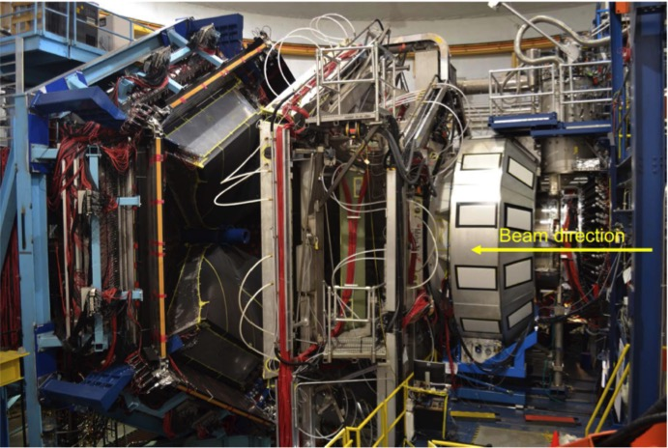
Hall-B Beam Schedule
CLAS12:
2018/2019. : RGA/RGB (H/D target)
2018 Nov – Dec : RGK-I (beam E)
2020 : BoNUS (tagged D)
2021 Fall : RG-M (nuclear)
2022/2023 : RG-C (polarized)
2023/2024 : RG-K (beam-E)
10 m
INFN: FT, RICH, PolTarget , High-Lumi
RGC: Polarized target
RGK: beam energy
RICH2
FT
FT
Contalbrigo M.
CSN3, 19 September 2023
14
Notes:
Vanno messi studi innovativi e pubblicazioni

Slide 15
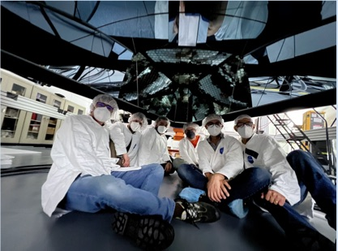
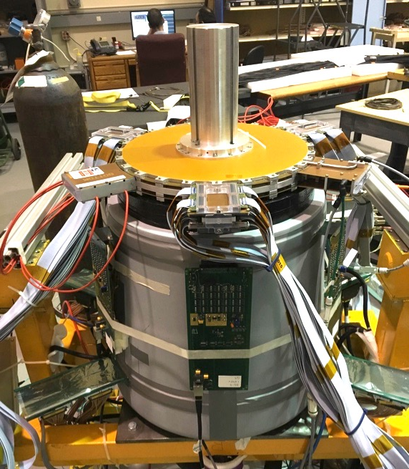
INFN @ CLAS12
Forward Tagger completed in 2018
Small-angle calorimeter (nucleon 3D)
Quasi-real photoproduction regime (spectroscopy)
RICH completed in 2022
Hadron ID in the 3-8 GeV/c momentum range
MIUR priority project (“premiale”)
Contalbrigo M.
CSN3, 19 September 2023
15
Notes:
Vanno messi studi innovativi e pubblicazioni

Slide 16
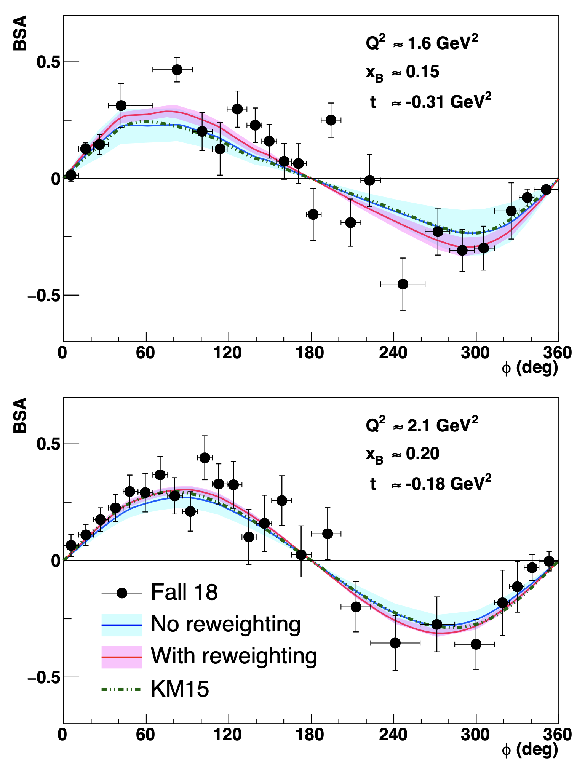
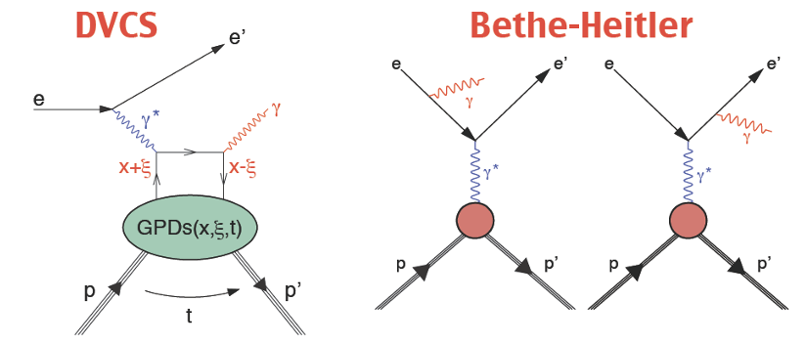
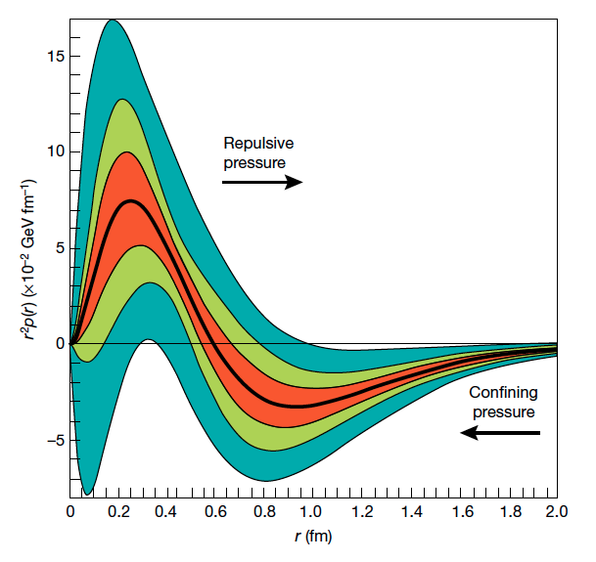
Exclusive Physics @ CLAS12
e p → e p γ
CLAS12
G. Christiaens et. al. [arXiv: 2211.11274]
Accessing GPDs
GPDs are related to the proton momentum-energy tensor
V.Burkert++
[Nature 577 (2018)]
Contalbrigo M.
CSN3, 19 September 2023
16
Notes:
Vanno messi studi innovativi e pubblicazioni

Slide 17
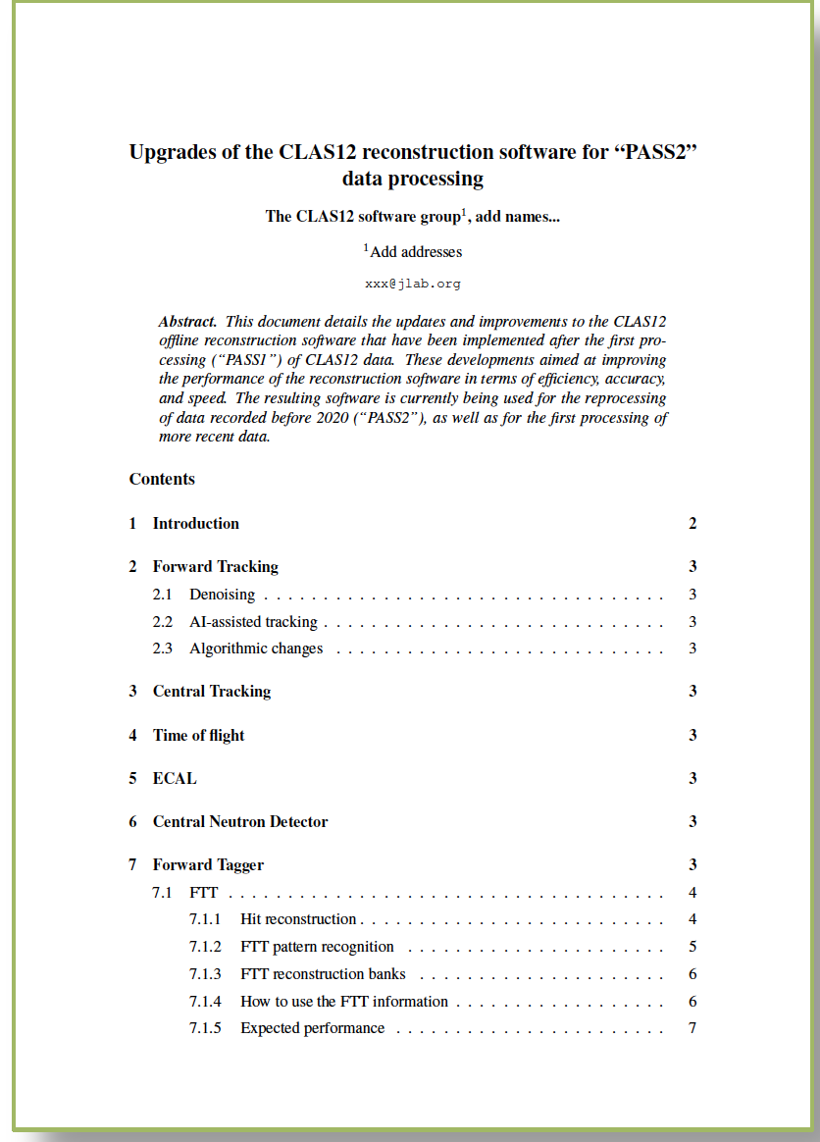
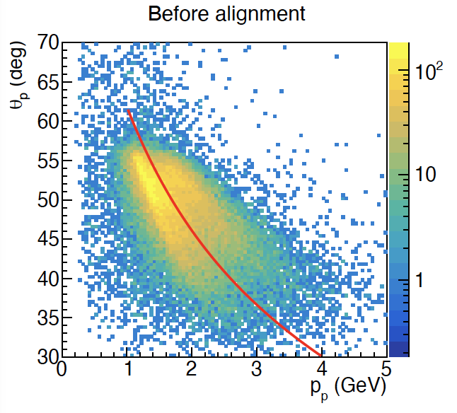
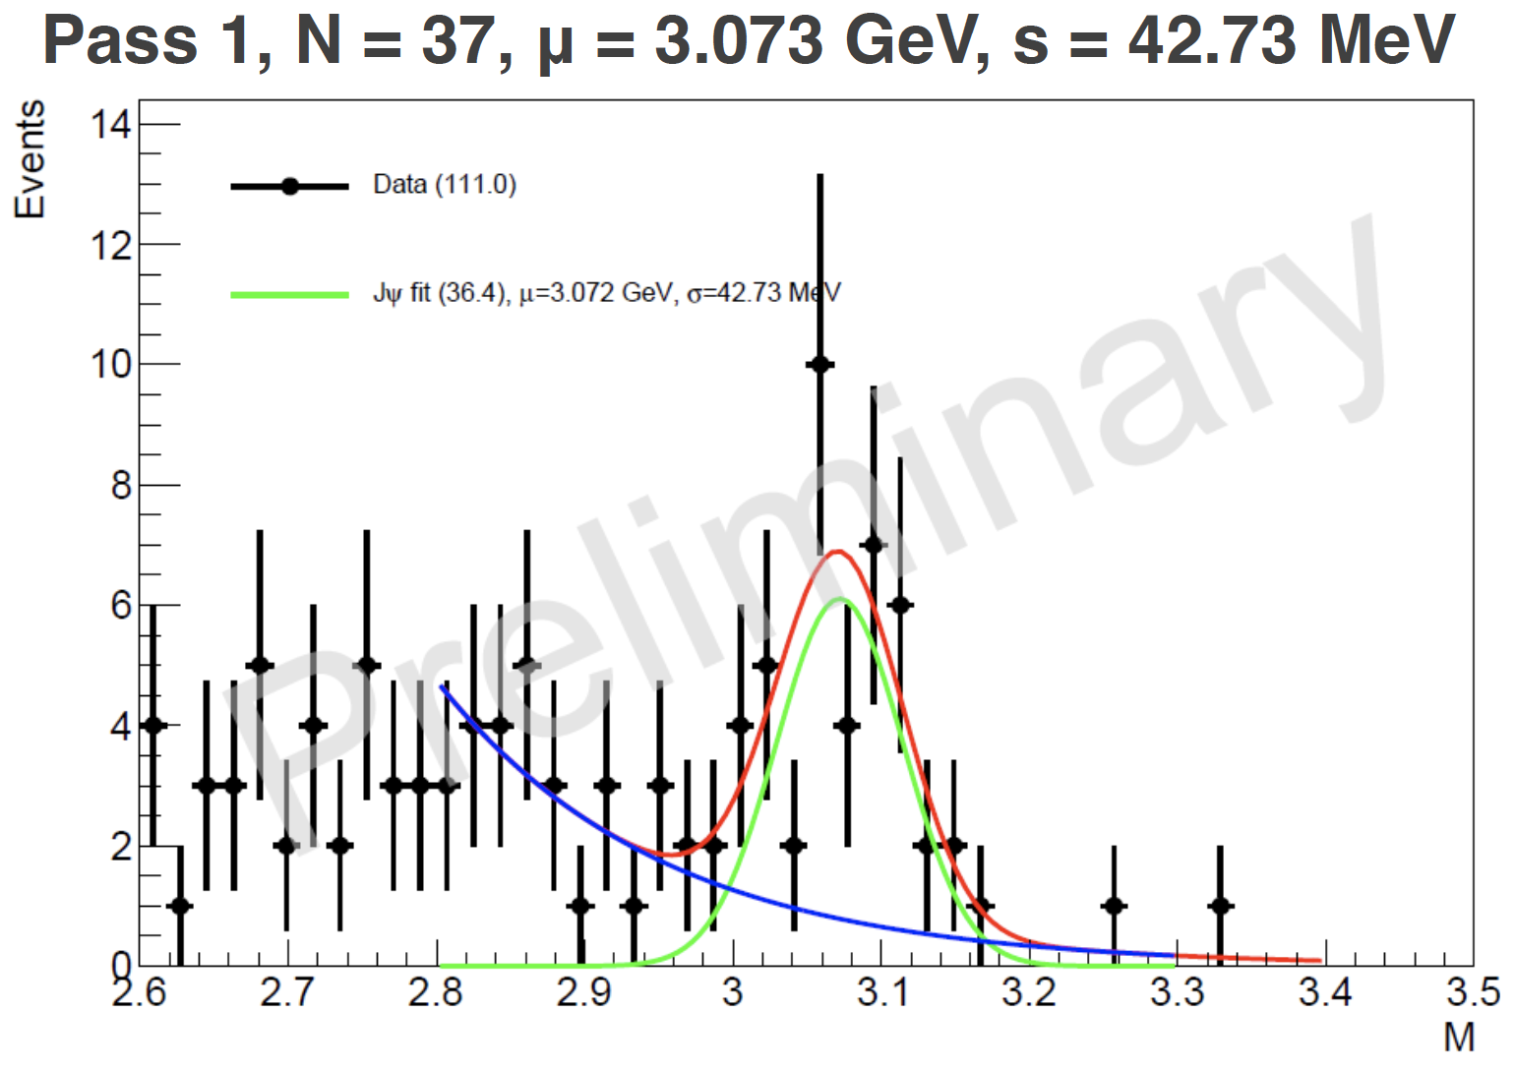
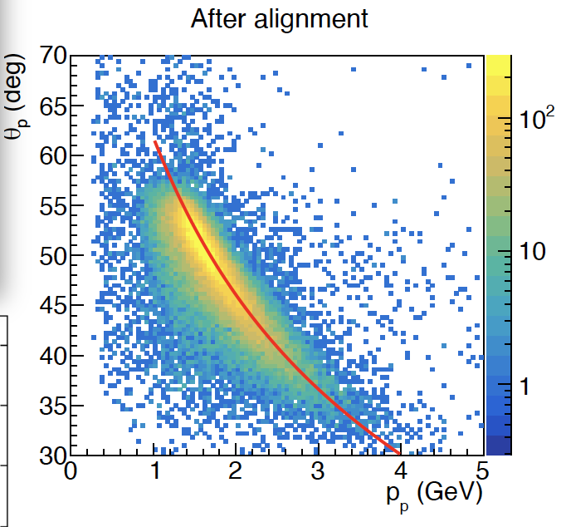
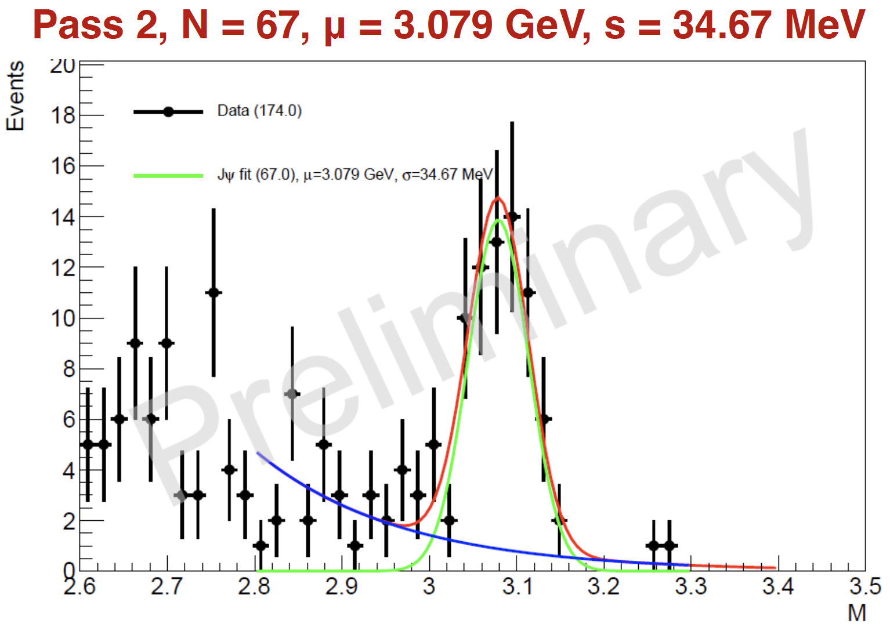
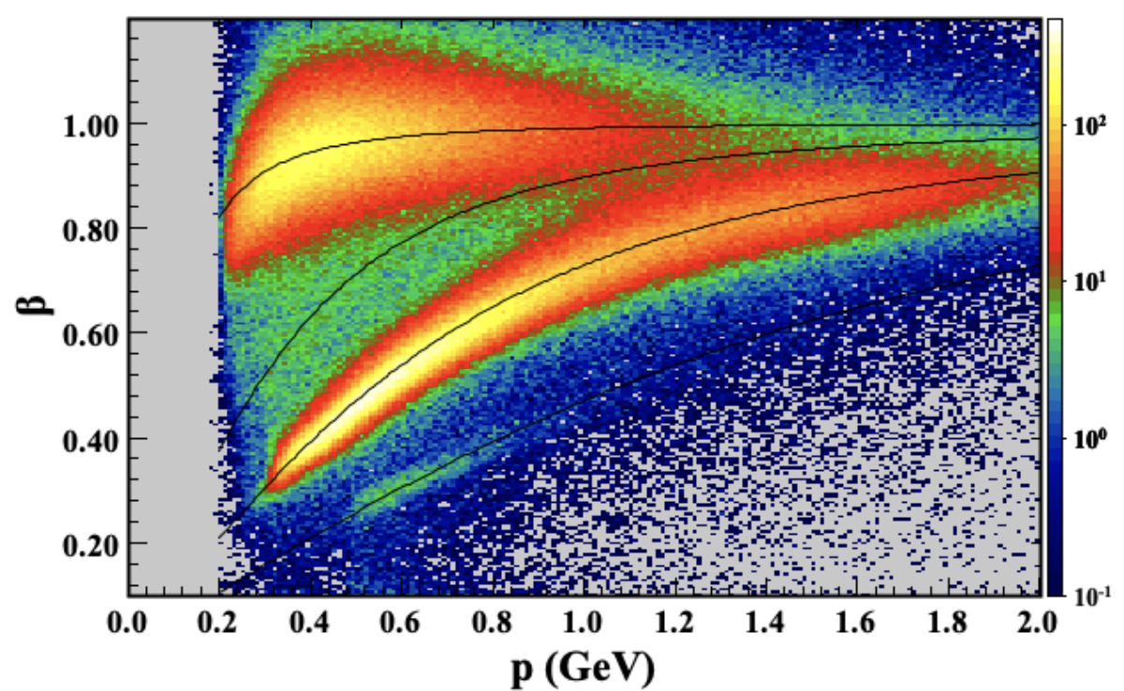
Pass-2 Reprocessing
Started in May 2023 with RGB
Milestone
Protons in Central Detector
J/Psi in Forward Detector
PID in Central Detector
Contalbrigo M.
CSN3, 19 September 2023
17
Notes:
Vanno messi studi innovativi e pubblicazioni

Slide 18
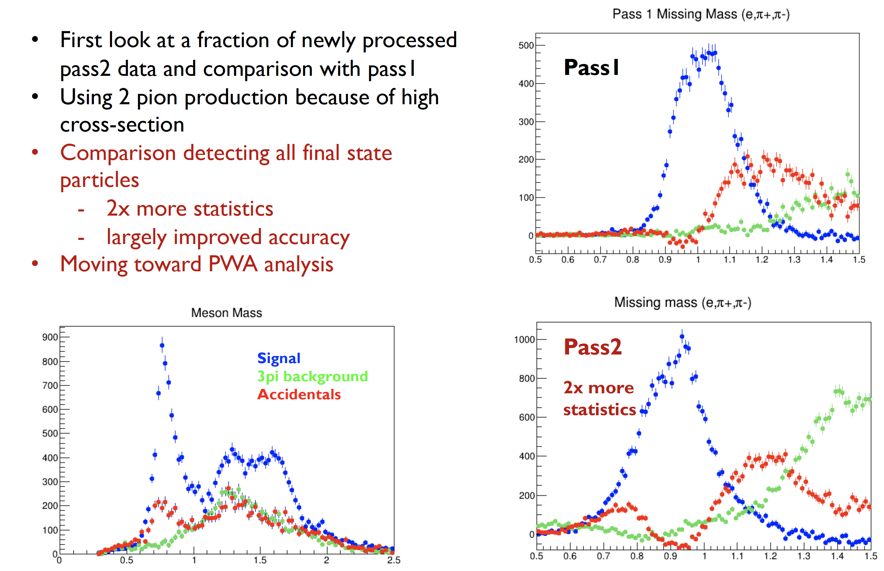
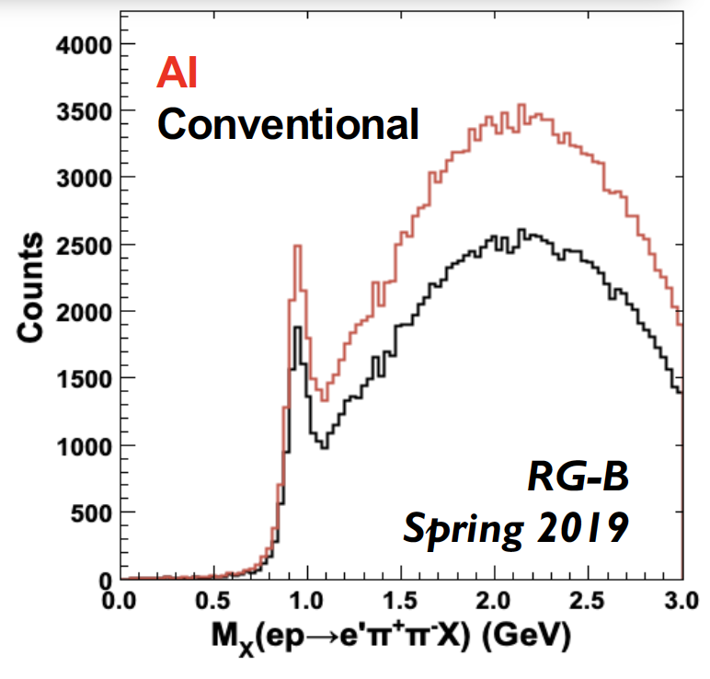
Meson-X
Contalbrigo M.
CSN3, 19 September 2023
18
Notes:
Vanno messi studi innovativi e pubblicazioni

Slide 19
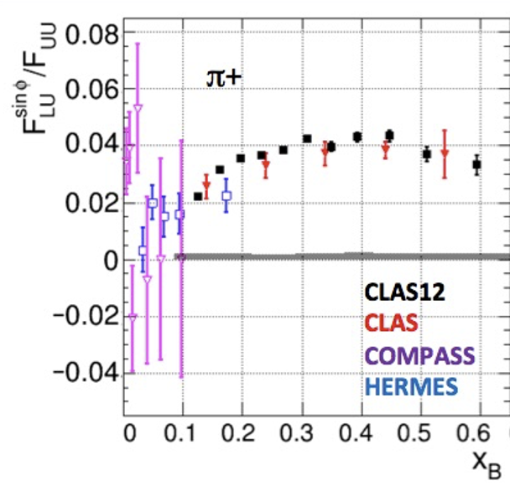
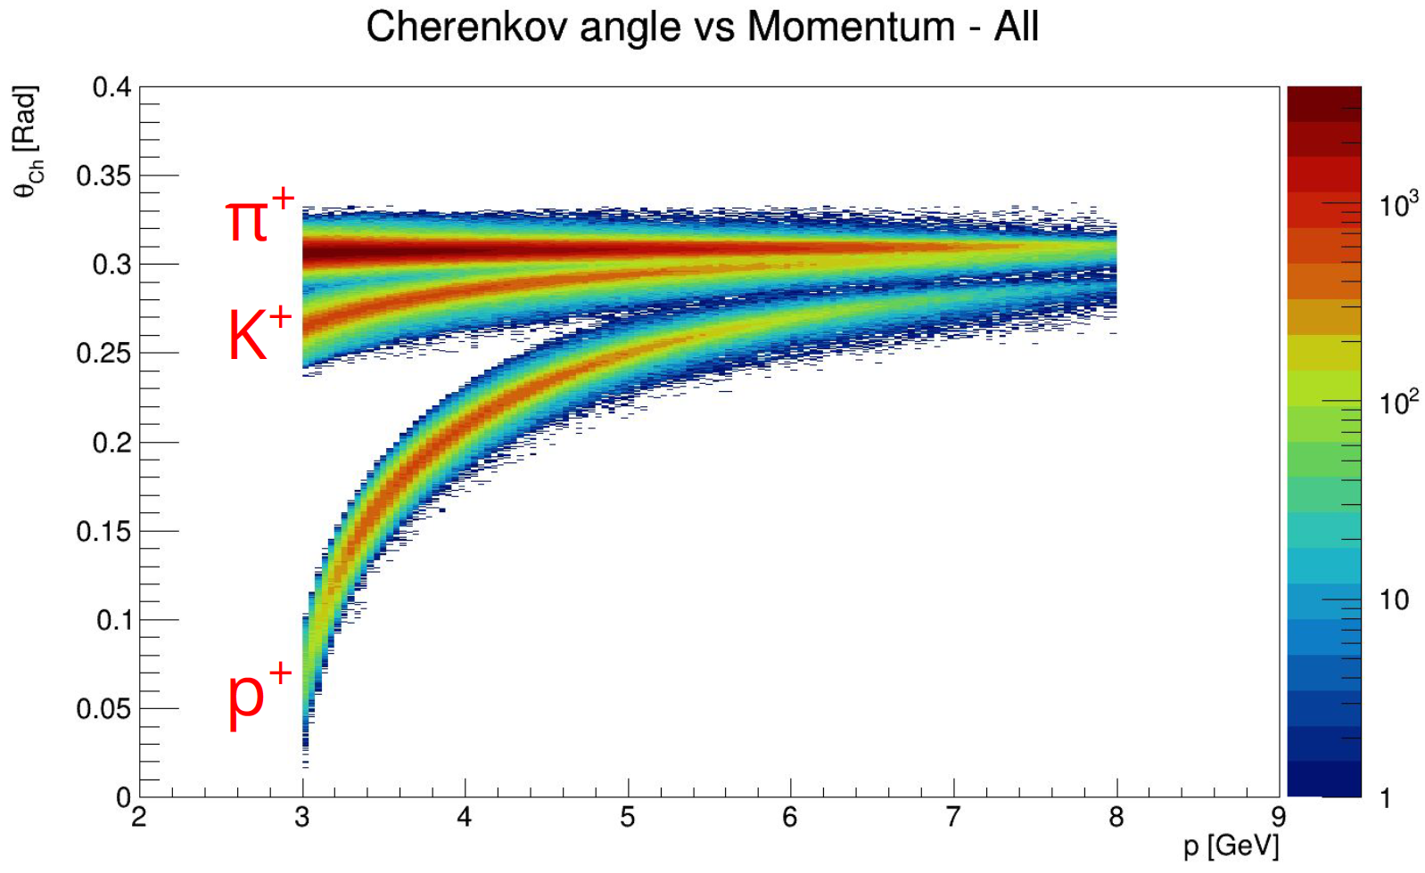
RICH in Pass2
Semi-inclusive physics with unprecedented coverage of valence & flavor sensitivity
Milestone
17%
0.5 %
Contalbrigo M.
CSN3, 19 September 2023
19
Notes:
Vanno messi studi innovativi e pubblicazioni

Slide 20
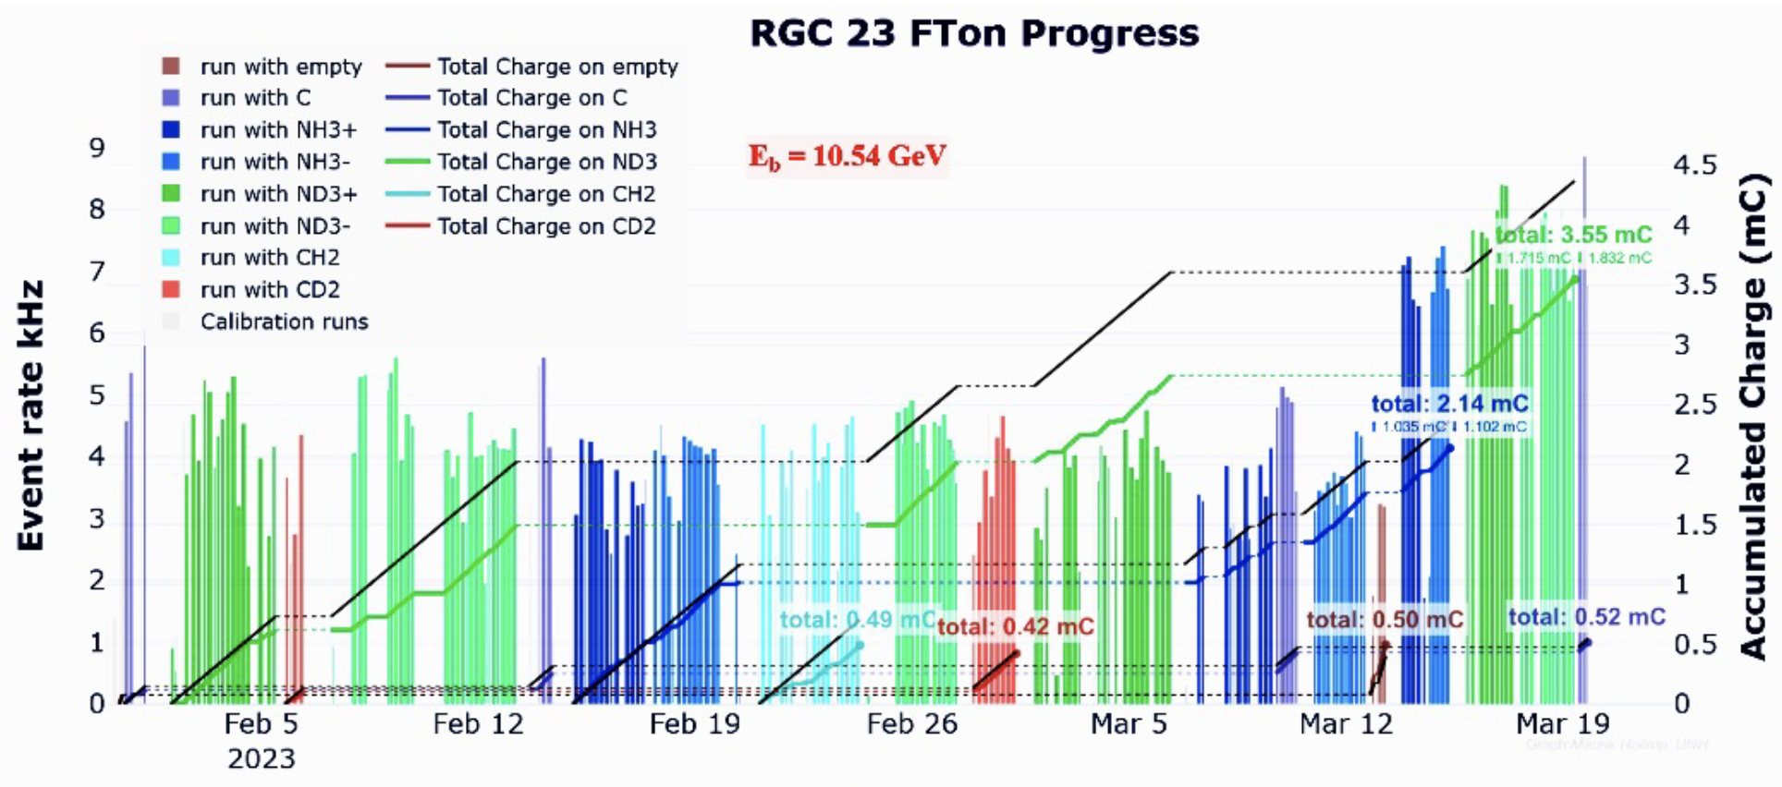
RG-C Longitudinally Polarized Target
Highest degree of HD₃ polarization ever achieved at JLab
High radiation due to rastered beam and target irradiation, effect fully recoverable by thermal annealing
Contalbrigo M.
CSN3, 19 September 2023
20
Notes:
Vanno messi studi innovativi e pubblicazioni

Slide 21
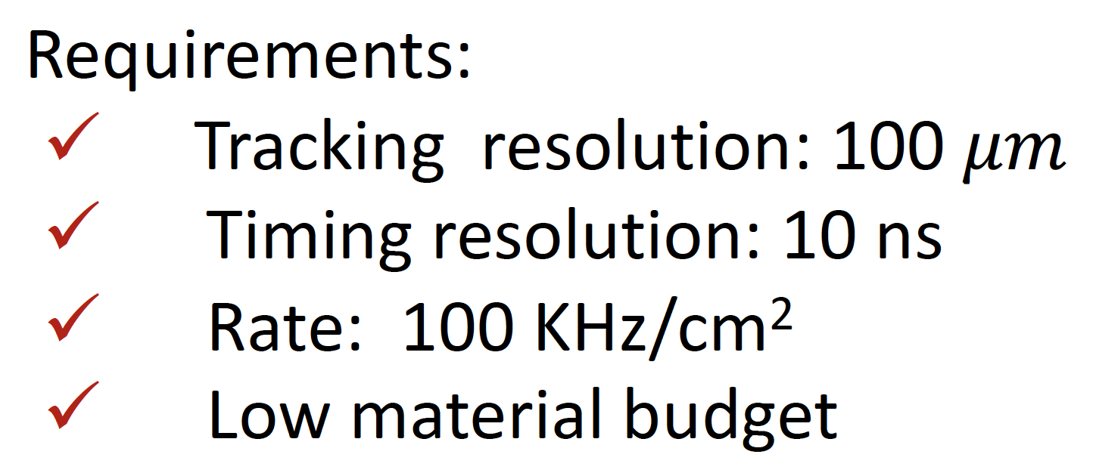
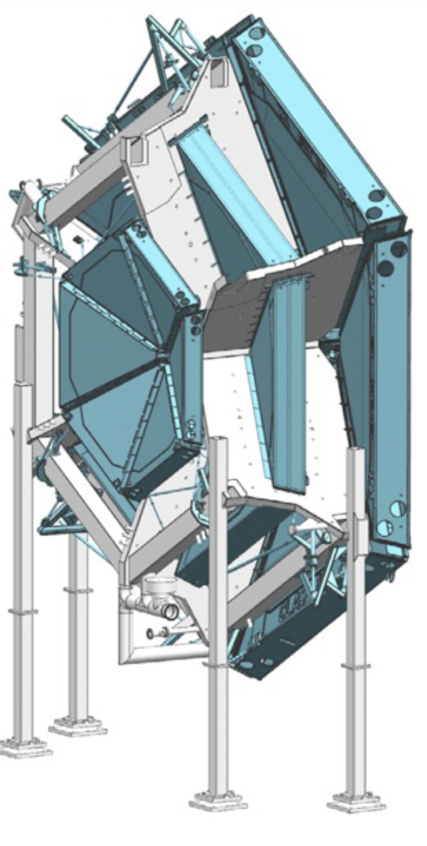
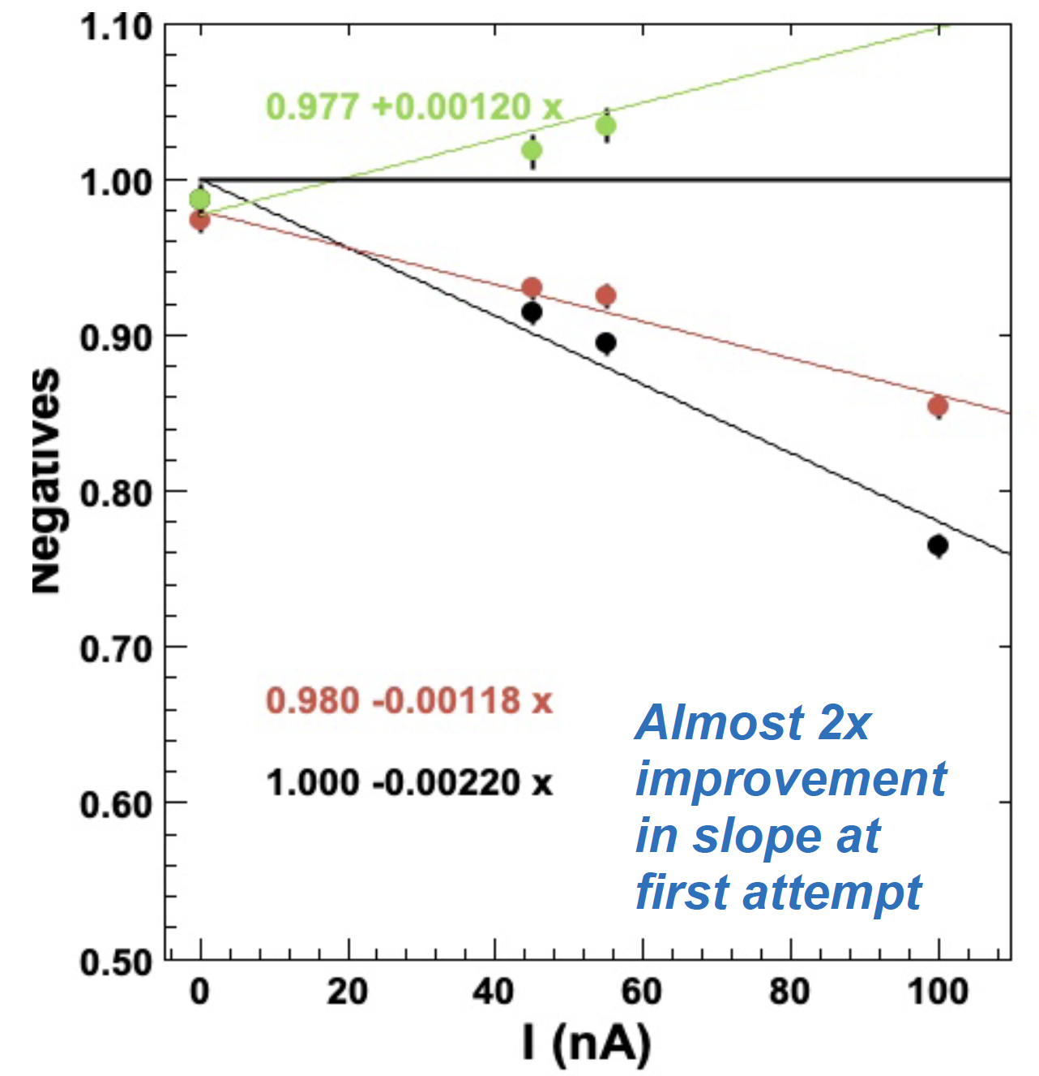
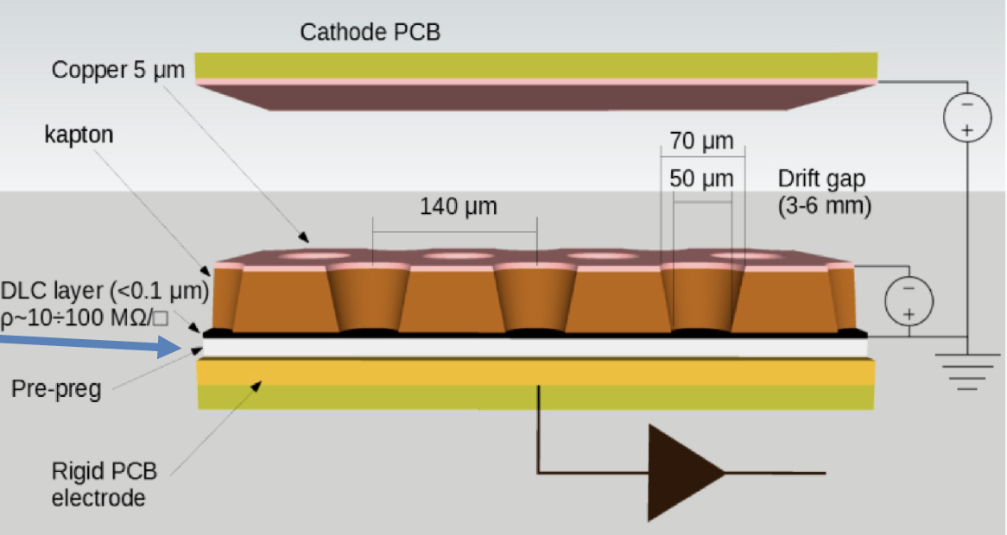
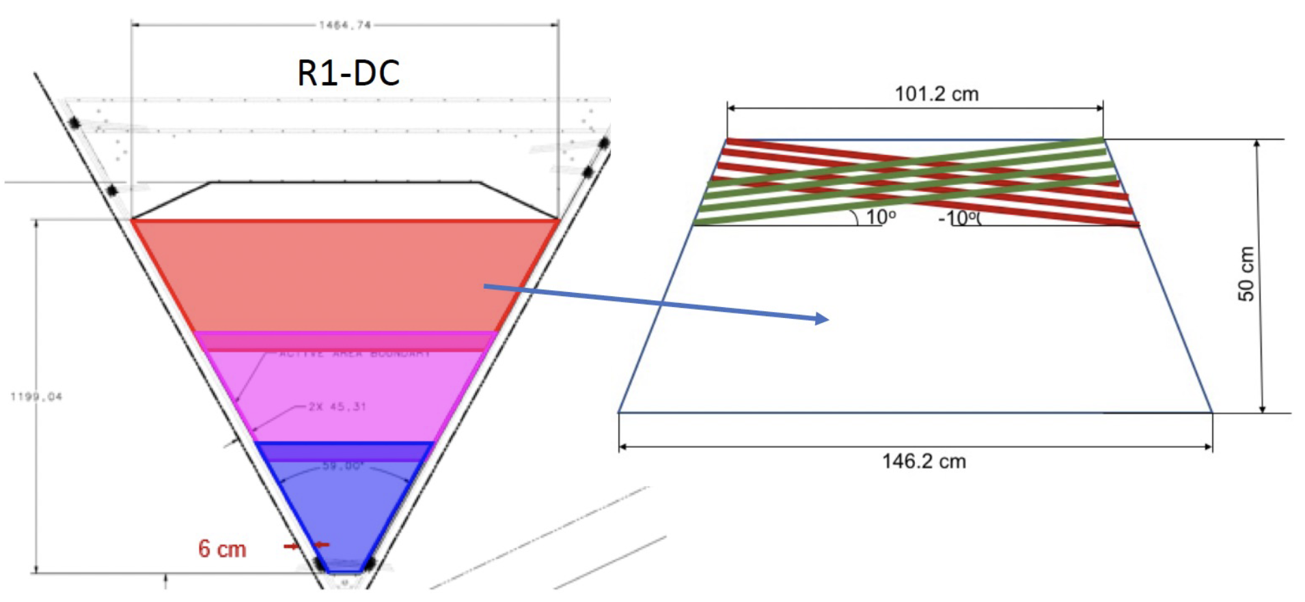
High-Lumi Project
Stage1: x2 luminosity Stage2: x10 luminosity
Contalbrigo M.
CSN3, 19 September 2023
21
Notes:
Vanno messi studi innovativi e pubblicazioni

Slide 22
High-Lumi Beam Tests
US beam-test of a large area mRwell during RG-C hampered by gas leaks
Contalbrigo M.
CSN3, 19 September 2023
22
Notes:
Vanno messi studi innovativi e pubblicazioni

Slide 23
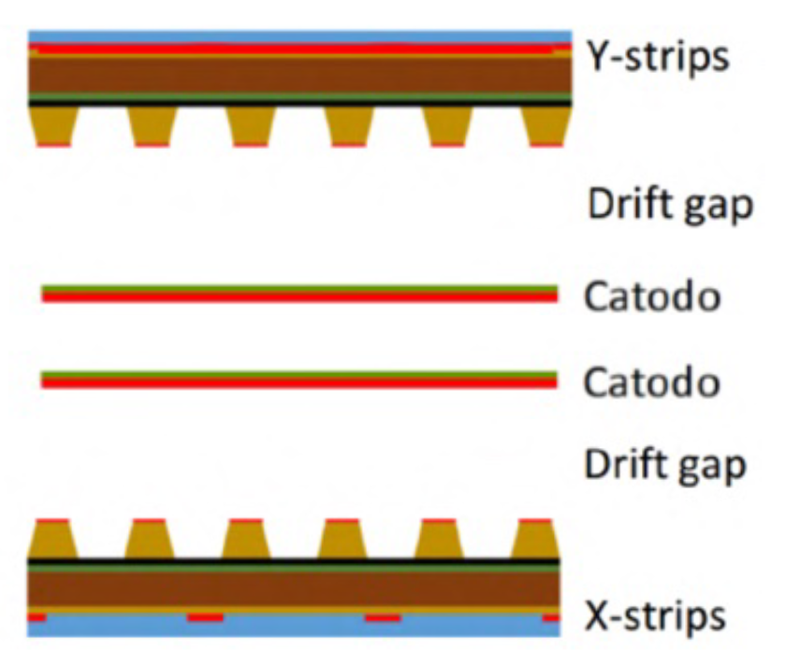
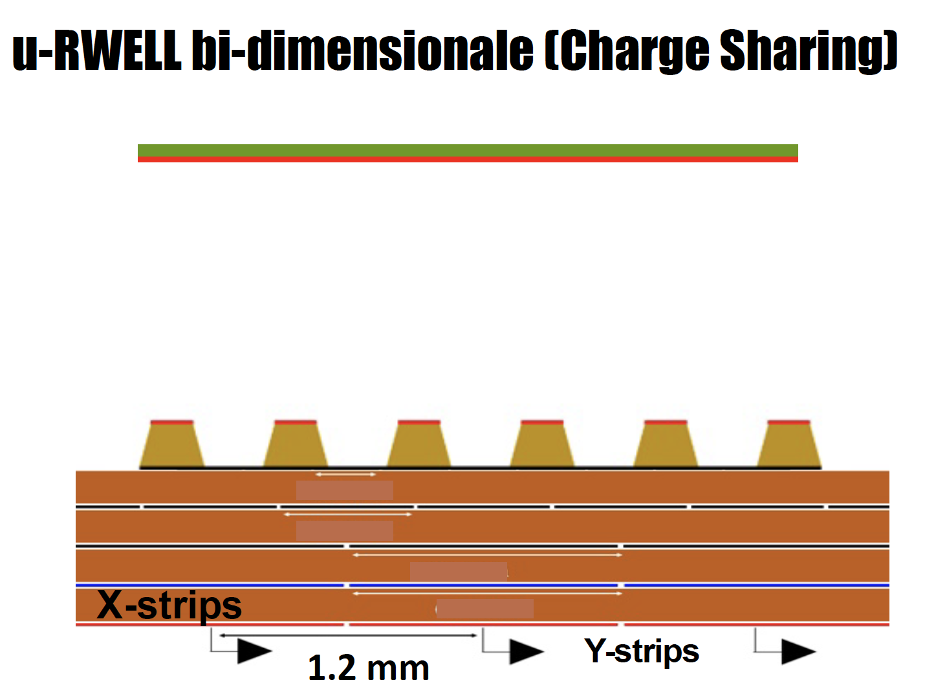
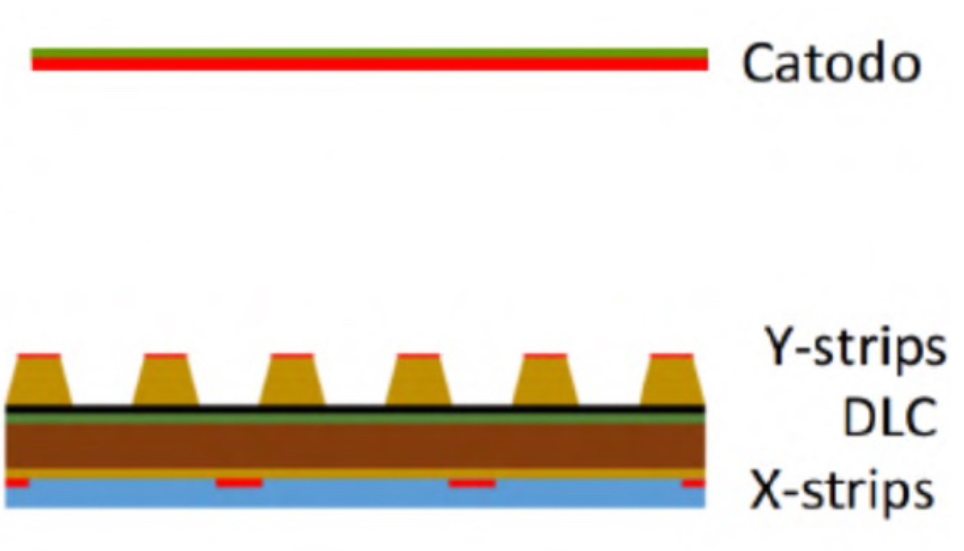
High-Lumi 2D Prototypes
Standard 2x 1D detectors
Pitch: 780 μm
Channels: 128
Area: 10x10 cm²
Standard 2D on the bottom
Pitch: 780 μm
Channels: 128
Area: 10x10 cm²
Standard 2D with capacity sharing
Pitch: 1200 μm
Channels: 83
Area: 10x10 cm²
Drift gap
October ‘22
June ‘23
Tested @ CERN
with APV25 readout
Milestone
Contalbrigo M.
CSN3, 19 September 2023
23
Notes:
Vanno messi studi innovativi e pubblicazioni

Slide 24
High-Lumi Next Steps
Large area prototypes
2D optimization
Milestone
40 x 46 cm² detector
2D readout scheme with capacity sharing
Capacity sharing with 2 layers
Cosmic stand (CT)
Plastic scintillators trigger
Readout evolution (GE)
VMM3 chip & SRS-VMM3 system
Future synergies/applications:
Recoil detector for CLAS12 RG-H
Forward tracking disks for EIC
Will be tested with X-ray and cosmic rays
@ LNF and Tor Vergata
Contalbrigo M.
CSN3, 19 September 2023
24
Notes:
Vanno messi studi innovativi e pubblicazioni

Slide 25
RG-H Transversely Polarized Target
Spin-orbit in QCD
?
?
Sivers effect:
Correlation between nucleon spin and
collective motion of the partons
Tranversity & Tensor Charge
Fundamental quantity related to BSM searches
(tensor coupling, particle EDM)
Contalbrigo M.
CSN3, 19 September 2023
25
Notes:
Vanno messi studi innovativi e pubblicazioni

Slide 26
RG-H Magnet
5T external massive magnet
Decision by summer 2024
2T light internal bulk magnet
Compensating chicane
New concept pre-conditioned MgB₂ bulk superconductor
- No coil shaping within experiment
- No current leads, just low T
- Minimum material, large acceptance
New support design ?
High-lumi is essential, no recoil detection
Contalbrigo M.
CSN3, 19 September 2023
26
Notes:
Vanno messi studi innovativi e pubblicazioni

Slide 27
New Test Cryostat
100 cm
Rapid
access
Heater
Cold
head
Sample holder
4K cold stage
10 cm
Hall
Milestone
Hall
T
Probe
holder
Contalbrigo M.
CSN3, 19 September 2023
27
Notes:
Vanno messi studi innovativi e pubblicazioni

Slide 28
The MgB₂ samples
Goal:
✓ Reproducibility (same or equivalent sample)
✓ Different grain size and thickness
(sample optimization)
#6
#1
Flux jumps decreasing with T
Contalbrigo M.
CSN3, 19 September 2023
28
Notes:
Vanno messi studi innovativi e pubblicazioni

Slide 29
MgB₂ Performance
The MgB₂ sample could sustain (or screen) the wanted field, but not (yet) in a reproducible way
Observed for all samples except the first that came as leftover from a past development
Modification to prevent sample rotation + new controlled production negotiated with the manufacturer
Contalbrigo M.
CSN3, 19 September 2023
29
Notes:
Vanno messi studi innovativi e pubblicazioni

Slide 30
LASA
Ultimate test with transverse dipole + longitudinal solenoid shield
Research Magnets
SOLEMI 1: solenoid NbTi 8 T, 535 mm room temperature bore
(refurbished by IRIS)
Contalbrigo M.
CSN3, 19 September 2023
30
Notes:
Vanno messi studi innovativi e pubblicazioni

Slide 31
JLab and HEP
Hadronic cross-section & PDFs
Technology
Data Science
Accelerator Science
Theory & Lattice
Superconducting RF
MPDG developing center
Largest number of theory joint position
Many developing centers with Universities
Largest number of users ~ 1900
1/3 US Nuclear Physics PhD theses
Contalbrigo M.
CSN3, 19 September 2023
31
Notes:
Vanno messi studi innovativi e pubblicazioni

Slide 32
Heavy Photon Search
Milestone
Mass bump
Detached vtx
Unexplored regions with discovery potential
Still 107 PAC-approved data-taking days left
PRD 108 (2023) 1, 012015
arXiv: 2212.10629
2016 Run: Analysis published
2019 Run: Upgraded detector & data-taking completed
32
Contalbrigo M.
CSN3, 19 September 2023
32
Notes:
Vanno messi studi innovativi e pubblicazioni

Slide 33
JLab Upcoming
BDX experiment: light dark matter search and weak
interacting particle beams.
Moller experiment: electro-weak coupling off Z-pole
in electron-electron scattering. Funded to start in 2026.
INFN Leadership, EIC/PNRR synergy on streaming readout
Approved by PAC in 2018 with A rating, confirmed in 2023.
Investment plan (0.5-0.7 Meu) presented to CSN3 in 2017.
BSM: Precision Test
Contalbrigo M.
CSN3, 19 September 2023
33
Notes:
Vanno messi studi innovativi e pubblicazioni

Slide 34
Beam Dump eXperiment
December ‘19 – fall ’20
E_{e} = 2.2 GeV 2.5 x 10²¹ EOT
Despite the small scale, BDX-mini is
competitive with LDM experiments (NA64, E137,..)
Milestone
After unblinding no excess found
ECAL + veto attivo
Beam off
arXiv: 2208.01387
PRD 106 (2022), 7,072011
Contalbrigo M.
CSN3, 19 September 2023
34
Notes:
Vanno messi studi innovativi e pubblicazioni

Slide 35
Secondary Beams
Opportunities with the intense beam and existing infrastructure
sBDX:
Dark scakar search (into gammas)
nu-BDX:
Weinberg angle by
coherent neutrino scattering
Contalbrigo M.
CSN3, 19 September 2023
35
Notes:
Vanno messi studi innovativi e pubblicazioni

Slide 36
Light Dark Matter
Funds for the dark-matter activity has not been assigned (yet)
Pretty reasonable request, present funding is at a level so critical to obstruct the activity
Contalbrigo M.
CSN3, 19 September 2023
36
Notes:
Vanno messi studi innovativi e pubblicazioni

Slide 37
Milestones 2024
Contalbrigo M.
CSN3, 19 September 2023
37
Notes:
Vanno messi studi innovativi e pubblicazioni

Slide 38
Funding Plan
(All but ME) | 2020 Assigned | 2021 Assigned | 2022 Assigned | 2023 Assigned | 2024 Expected | 2025 Expected | 2026 Expected
SBS Traker + HCAL (Hall-A) | 30 | 44 | 25 | 36 | 5 | 10 | 0
FT (HallB) | 10 | 10 | 6 | 40 | 5 | 10 | 10
RICH (HallB) | 300 | 290 | 35 | 18 | 5 | 10 | 10
PolTarg (HallB) | 35 | 40 | 70 | 70 | 30 | 50 | 60
High-Lumi (HallB) | - | - | - | - | 90 | 100 | 100
HPS+BDX (HallA+B) | 60 | 20 | 30 | 6 | 65* | 170* | 200*
Hyper + WACS (Hall-A) | - | 10 | 0 | 0 | 0 | 10 | 20
Calcolo** (HallA+B) | 60 | 10 | 3 | 130 | 0 | 30 | 30
Total (HallA+B) | 435 | 424 | 180 | 300 | 200 | 390 | 430
* Assuming to start experiment in 2026; CSN3 should expect a plan by beginning of 2024
** Computing & Tier1
Contalbrigo M.
38
Contalbrigo M.
CSN3, 19 September 2023

Slide 39
Probes
EU RISE program supporting secondments for researsh and innovation
in cooperation with Fermilab, gravitational interferometers and J-PARC users
Probes covers part of the travel expenses of ordinary missions to JLab.
Travel budget saved thanks to Probes:
Probes | 2021 | 2022 | 2023
Spent | 0 | 35 | 35*
Saved | 0 | 14 | 15-20*
*Projected
Contalbrigo M.
CSN3, 19 September 2023
39
Notes:
Vanno messi studi innovativi e pubblicazioni

Slide 40
Conclusions
Vibrant and acknowledged INFN community
Capitalizing the 12 GeV production upgrade
At work for upcoming compelling programs
(BDX, Transverse targets, High-Lumi, Hypernuclei)
Important synergy with EIC activity
Pursuing for new approaches
(positrons, high-energy)
to exploit existing infrastructure
and boost the physics program
Contalbrigo M.
CSN3, 19 September 2023
40

Slide 41
Neutron Skin
Neutron rich matter study at accelerators:
Parity violating asymmetry in electron scattering
to probe neutrons and measure the neutron skin
²⁰⁸Pb well described by density functional theory
Ab initio calculations describe light to medium nuclei
⁴⁸Ca could provide a bridge and differentiate among models
(LIGO)
(JLab)
arXiv: 2308.16449
Contalbrigo M.
CSN3, 19 September 2023
41

Slide 42
RG-K Analysis
Beam-recoil transferred polarization in K+Y electroproduction
Contalbrigo M.
CSN3, 20 September 2022
42

