Slide 1
RICH GEMC Geometry
Contalbrigo Marco & Luciano Pappalardo
INFN Ferrara
Rich Meeting, December 16 2011

Slide 2
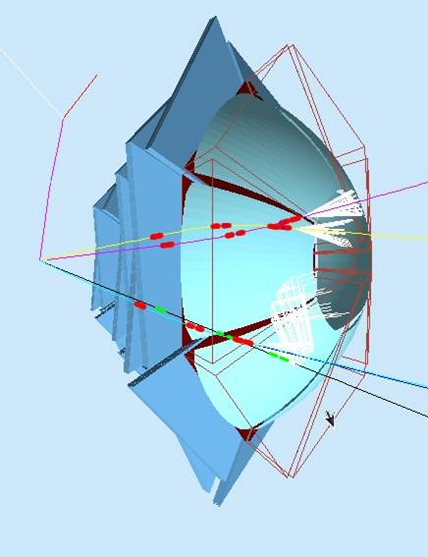
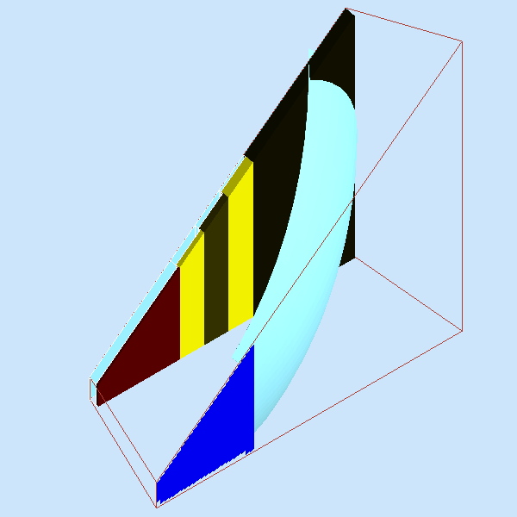
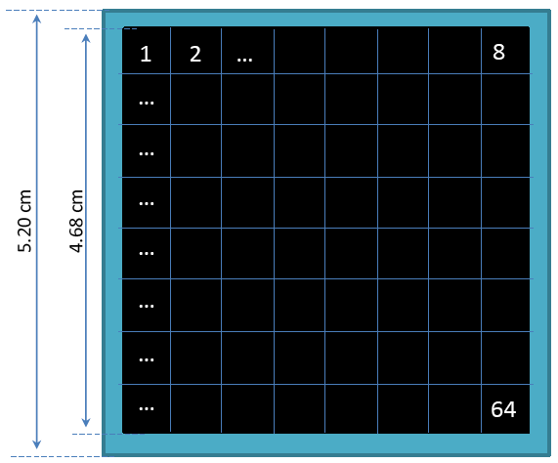
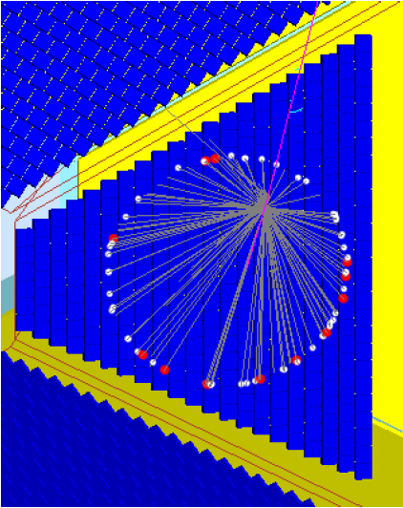
The RICH
Pixalization + Q.E.
Detector
Pool: INFN Fe (M. Contalbrigo,
L. Pappalardo)
Argonne (N. Baltzell,
A. El Alaoui)
spherical
mirror
3 cm
plane
mirror
gap
Design: 50%
Material 80%
Geometry: 50%
Pixalization: 50%
V(t): 0%
Inefficiency: 0%
1 cm
Beam
aerogel
photon detector
Contalbrigo M.
2

Slide 3
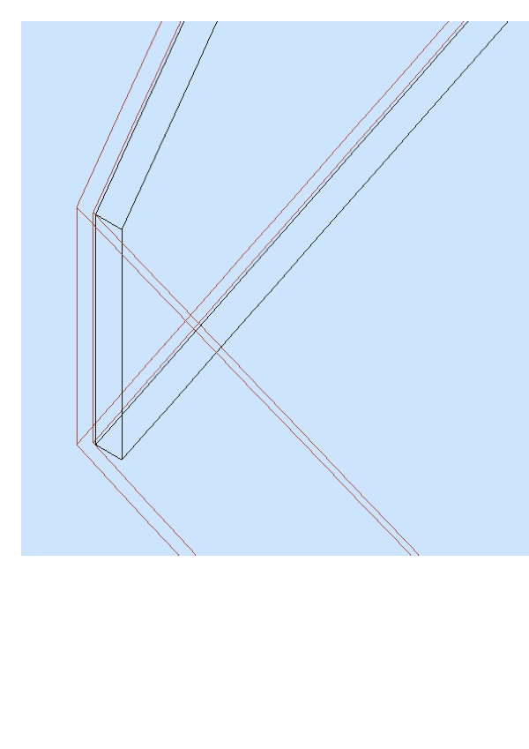
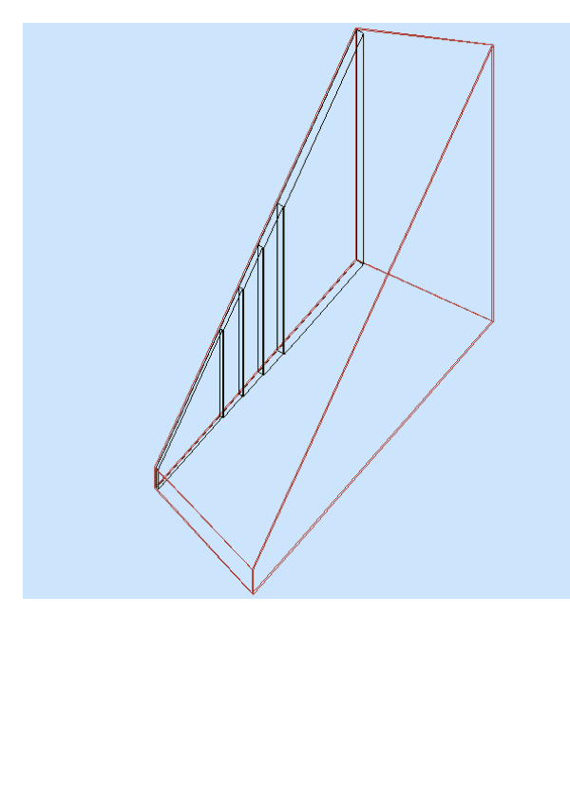
The RICH Basic Structure
RICH Box
(opt_air)
Aerogel
RICH Gap
(opt_air)
RICH structure: can be upgraded to a mirror and used to isolate the sector
Contalbrigo M.
3

Slide 4
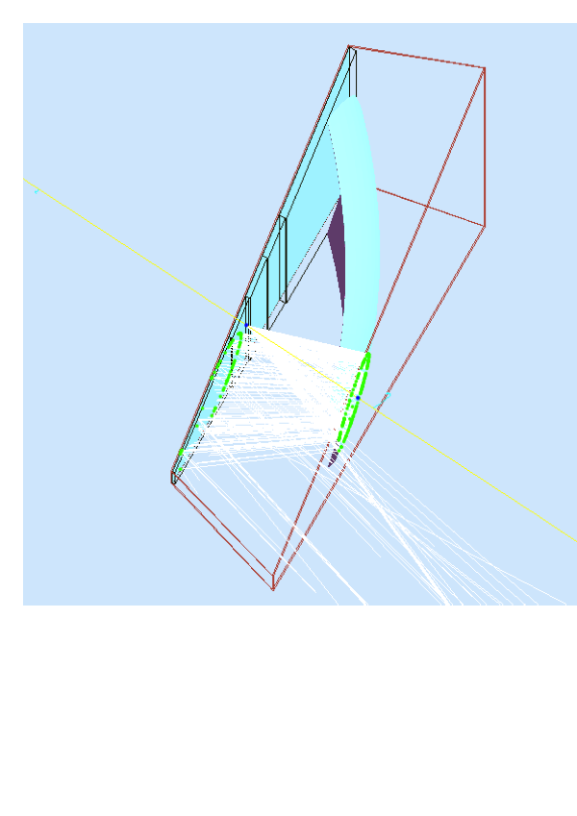
The Open or Isolated Sector
Open Sector
Pre Mirror Only
Isolated Sector
Internally reflecting
structure
Contalbrigo M.
4

Slide 5
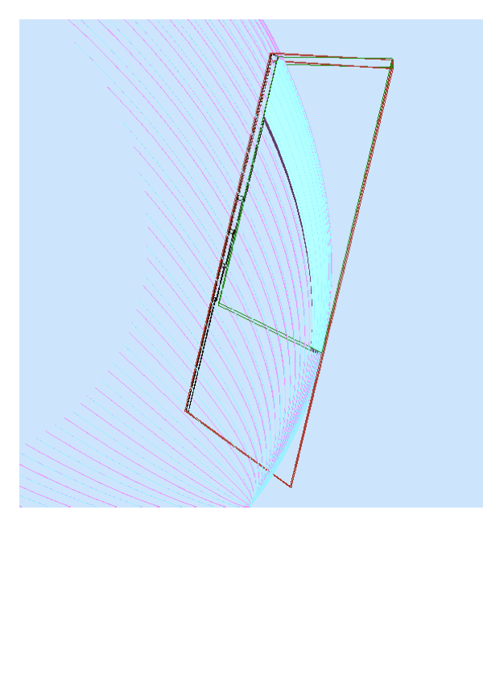
The Mirror Geometry
Mirror Basic Shape
Dummy Box
just to cut
the mirror
Contalbrigo M.
5

Slide 6
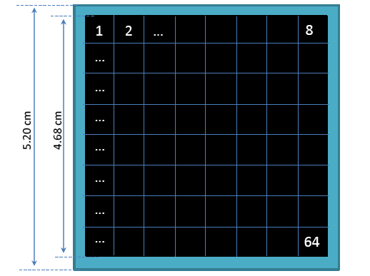
The H8500 MA-PMTs
Number of anode pixels: 64 (8x8 matrix)
Pixel size / Pitch at center: 5.8 x 5.8 / 6.08 mm
Effective area: 49 x 49 mm
Dimensional Outline: 52 x 52 x 28 mm
Packing density (Effective Area / Esternal Size) : 89 %
52 mm
48.36 mm
(6.08 x 7 + 5.8)
6.08 mm
Contalbrigo M.
6

Slide 7
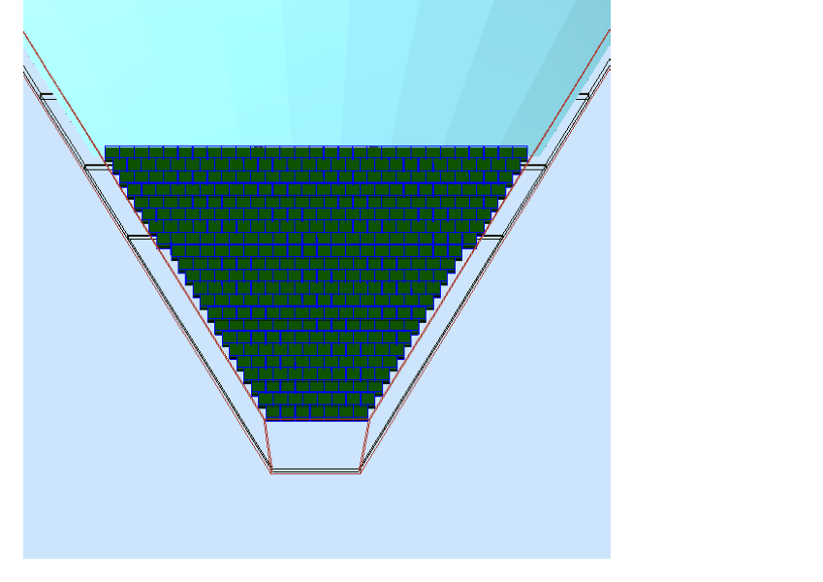
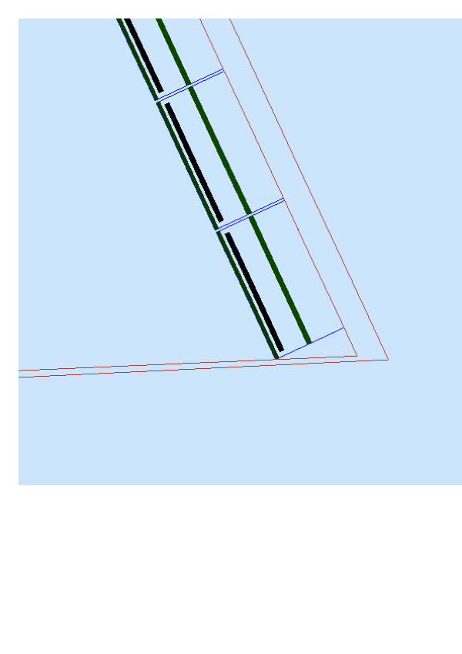
The MA-PMTs
Mirror
RICH Box
(opt_air)
RICH Gap
(opt_air)
MA-PMTs
PhWindow
(glass)
PMT Socket
(copper)
PMT arrays are
horizontally centered
PhCath
(air_opt)
Different types of
MA-PMTs in principle
Supported
(only H8500 completed)
my $type=0;
my $MAPMT_TYPEs = 4 ;
my @MAPMT_name = ('H8500', 'H8500_03', 'R8900', 'R8900_C');
my @MAPMT_color = ('0000ee', '0000ee', 'ff44ff', 'ee99ff');
2my @MAPMT_DX = (52./2., 52./2., 25./2., 25./2.);
my @MAPMT_DY = (52./2., 52./2., 25./2., 25./2.);
my @MAPMT_DZ = (28./2., 28./2., 25./2., 25./2.);
my @MAPMT_DXSPACE = (1.0/2., 0.0/2., 0.0/2., 0.0/2.);
my @MAPMT_DYSPACE = (1.0/2., 0.0/2., 0.0/2., 0.0/2.);
Contalbrigo M.
7

Slide 8
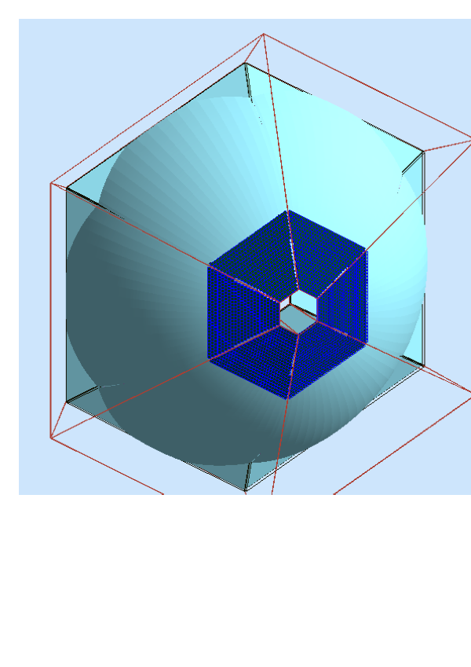
Outlook
Clean text and uniform nomenclature
Put comments
Group relevant parameters
- Isolated Sector Flag
- MA-PMT type
Put on the repository
Contalbrigo M.
8

