Slide 1
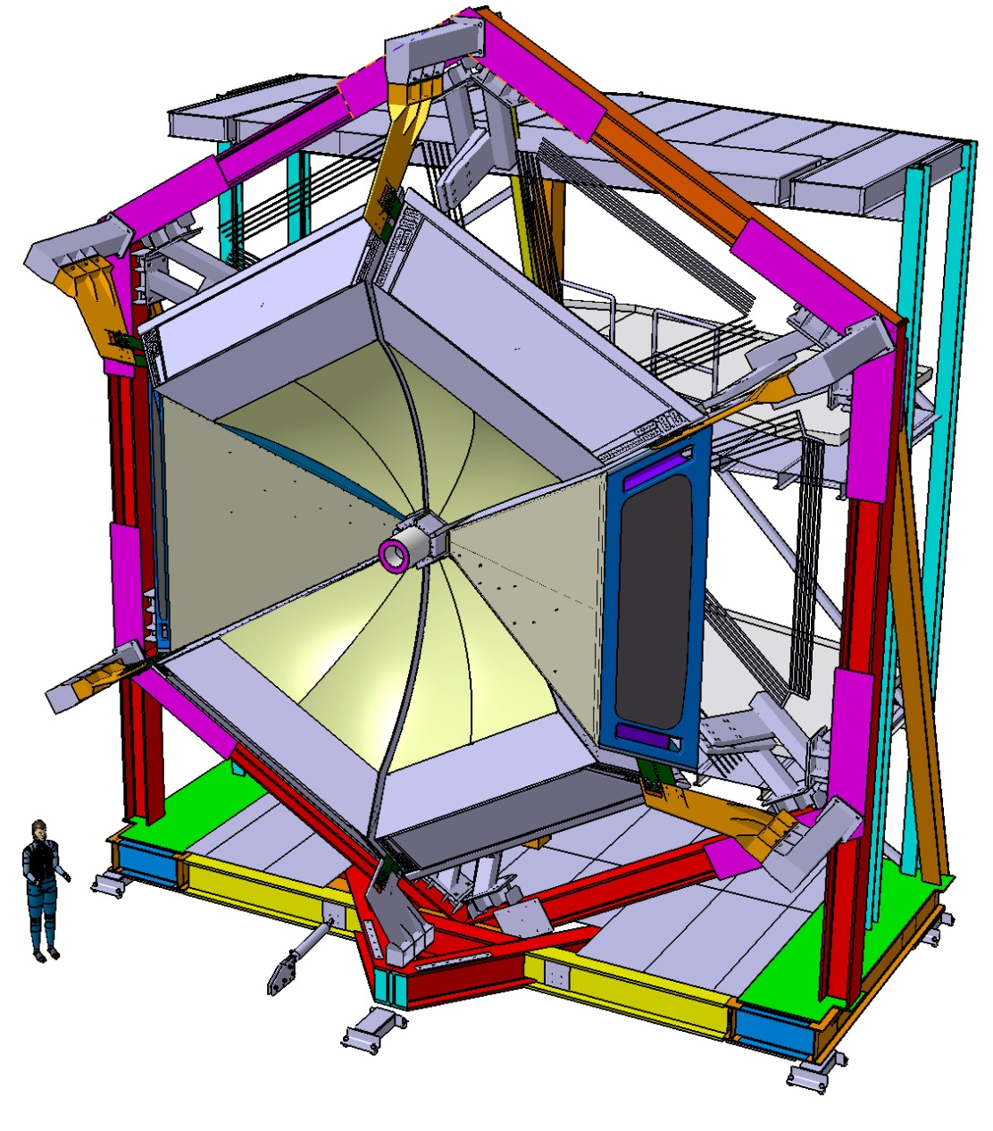
CLAS12-RICH Responsibility, Manpower & Summary
June 13th 2016
Charge 6:
Are the responsibilities for carrying out each job identified, and are the manpower and other resources necessary to complete them on time
In place?

Slide 2
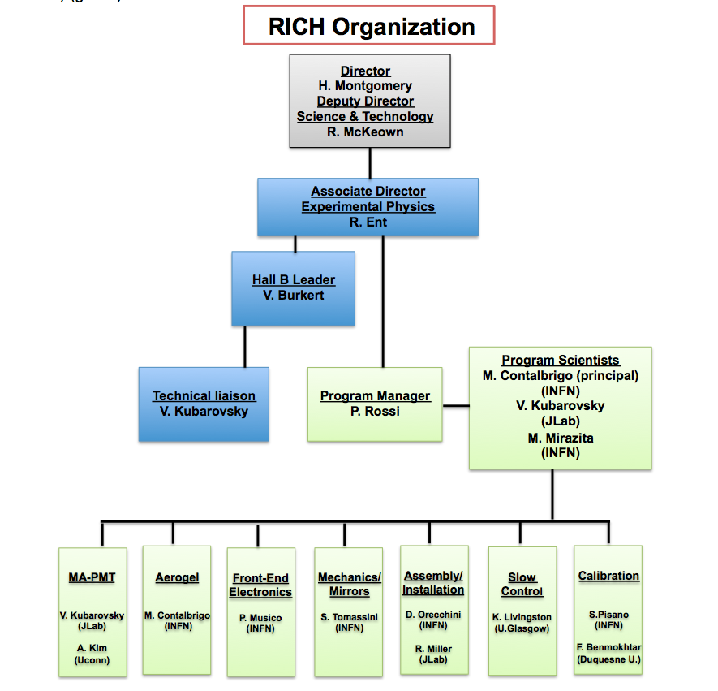
The RICH Management Plan
Responsibility during construction
identified in the
RICH Management Plan
CLAS12 RiCH Readiness Review, 13th June 2016
2

Slide 3
The RICH Crew
MA-PMTs
V. Kubarovsky (JLab)
A. Kim (UCONN)
++ students
Software
F. Benmokhtar (DU)
S. Pisano (LNF)
K. Livingston (UG)
N. Baltzell
M. Turisini
B. Raydo
++ students
Electronics
B. Raydo (JLab)
M. Turisini (INFN-FE)
P. Musico (INFN-GE)
C. Cuevas (JLab)
R. Malaguti (INFN-FE)
G. Mini (INFN-GE)
E. Cisbani (ISS)
Mechanics & Gas
S. Tomassini (LNF)
D. Orecchini (LNF)
G. Fuga (LNF)
S. Squerzanti (INFN-FE)
V. Lucherini (LNF)
R. Perrino (INFN-BA)
K. Bailey (ANL)
T. O’Connor (ANL)
@ JLab:
Hall-B liaison V. Kubarovsky
Gas system: G. Jacobs (DSG)
Component validation, storage: L. Tyler et al. (DSG)
Power lines: C. Cuevas & B. Raydo (FE)
Installation: R. Miller
Mirrors
M. Mirzita (LNF)
S. Tomassini (LNF)
I. Balossino (INFN-FE)
L. Barion (INFN-FE)
G. Angelini (GWU)
++students
Aerogel
M. Contalbrigo (INFN-FE)
M. Mirazita (LNF)
A. Movsysian (INFN-FE)
L. Pappalardo (INFN-FE)
++students
CLAS12 RiCH Readiness Review, 13th June 2016
3

Slide 4
The RICH Crew
MA-PMTs
V. Kubarovsky (JLab)
A. Kim (UCONN)
++ students
Software
F. Benmokhtar (DU)
S. Pisano (LNF)
K. Livingston (UG)
N. Baltzell
M. Turisini
B. Raydo
++ students
Electronics
M. Turisini (INFN-FE)
B. Raydo (Jlab)
P. Musico (INFN-GE)
C. Cuevas (JLab)
R. Malaguti (INFN-FE)
G. Mini (INFN-GE)
E. Cisbani (ISS)
Mechanics & Gas
S. Tomassini (LNF)
D. Orecchini (LNF)
G. Fuga (LNF)
S. Squerzanti (INFN-FE)
V. Lucherini (LNF)
R. Perrino (INFN-BA)
K. Bailey (ANL)
T. O’Connor (ANL)
@ JLab:
Hall-B liaison: V. Kubarovsky
Gas system: G. Jacobs (DSG)
Component validation, storage: L. Tyler et al. (DSG)
Power lines: C. Cuevas & B. Raydo (FE)
Installation: R. Miller
Mirrors
M. Mirzita (LNF)
S. Tomassini (LNF)
I. Balossino (INFN-FE)
L. Barion (INFN-FE)
G. Angelini (GWU)
++students
Aerogel
M. Contalbrigo (INFN-FE)
M. Mirazita (LNF)
A. Movsysian (INFN-FE)
L. Pappalardo (INFN-FE)
++students
Responsible during
Physics run and
Maintenance
CLAS12 RiCH Readiness Review, 13th June 2016
4

Slide 5
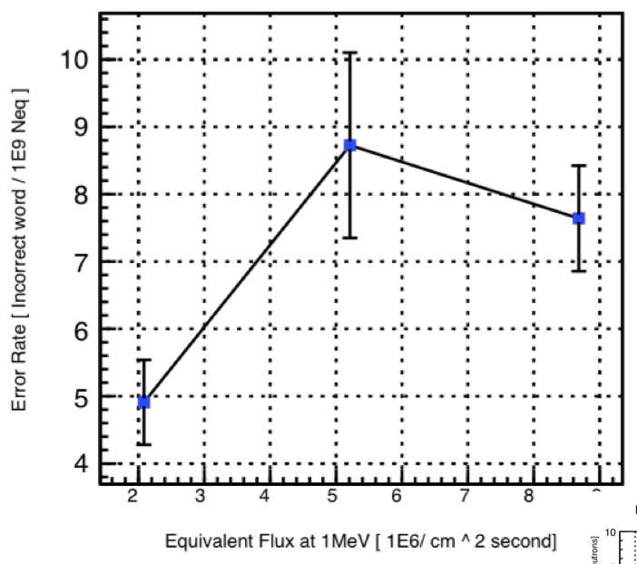
CLAS12 RICH Recommendations
Several recommendations referred to the Management Plan and Schedule [PR 2013, MR 2014, PMR 2015]
✔ Accomplished in accordance to JLab management and DOE
✔ DOE relaxed supervision after project mid-term review
A more quantitative evaluation of the front-end electronic FPGA board design and component choices such as the FPGA and the fiber transceiver should be made to establish that radiation effects in close proximity to the beam line will not compromise the performance of the readout electronics. [PR 2013]
Radiation tests performed with neutron and gammas:
✔ ~ 1 error/day in the FPGA volatile configuration over the full RICH
✔ No error in the non-volatile memory after ~ 50 years*
✔ Hardware issues only after 20 years* [*CLAS12 years at full lumi]
transceiver (with n) and voltage regulators (with γ)
Cabling, PMTs and electronics were mentioned, so ensure the procurements of these
items are acceptable per JLab electrical and fire protection guidance. [MR 2014]
✔ We accounted for the cable fire rating requirements and RICH services design was reviewed by C. Cuevas.
CLAS12 RiCH Readiness Review, 13th June 2016
5
Notes:
Prendere codice di Matteo

Slide 6
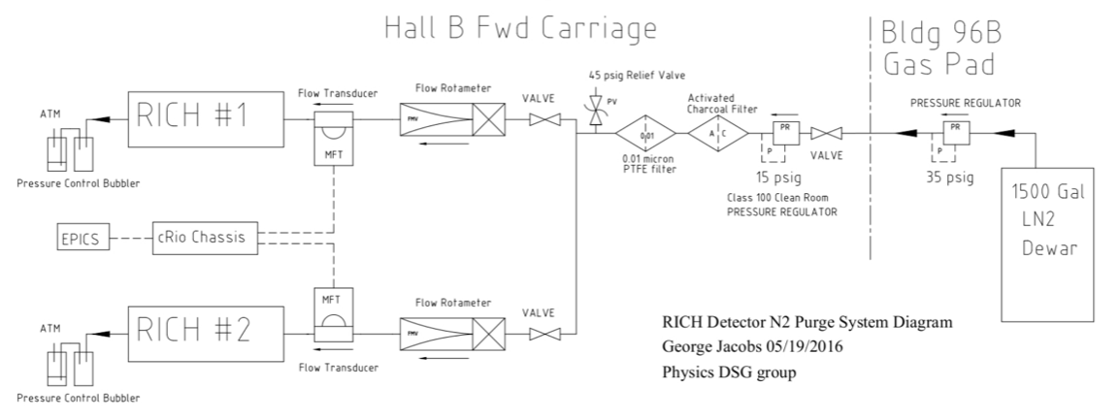
CLAS12 RICH Recommendations
A properly sized relief valve will be required after the pressure regulator, preferably a properly sized 15 psig relief to eliminate pressure system requirements downstream. The pressure regulator used must be for pure gas and have the proper outlet pressure range of 0‐15psig. [MR 2014]
The controller for the N2 system shall be an Allen Bradley CompactLogix to match the other Hall B gas system controllers for ease of programming and maintenance. [MR 2014]
✔ accounted for in the G. Jacobs design
The internal pressure of the RICH detector from the N2 dry gas system shall be included in the FEA analysis of the detector. The statement: “pressure: wanted levels of~30-40 mbar are not expected to affect mechanics significantly” must be confirmed via analysis. [MR 2014]
✔ We reduced the overpressure to 0.5 mbar
The dry nitrogen volume, allbeit relatively small, shall have an approved oxygen deficiency hazard safety review per JLab ODH guidance. [MR 2014]
✔ no need as we are going to replace a volume of LTCC freon with the same volume of RICH nitrogen
CLAS12 RiCH Readiness Review, 13th June 2016
6
Notes:
Avrei dovuto mettere l’immagine dei conti FEA di Sandro

Slide 7
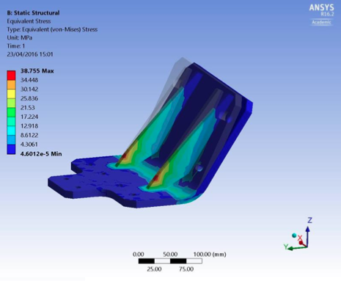
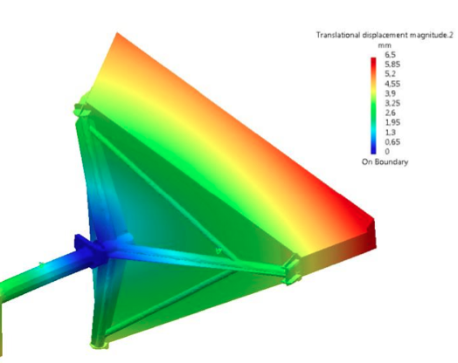
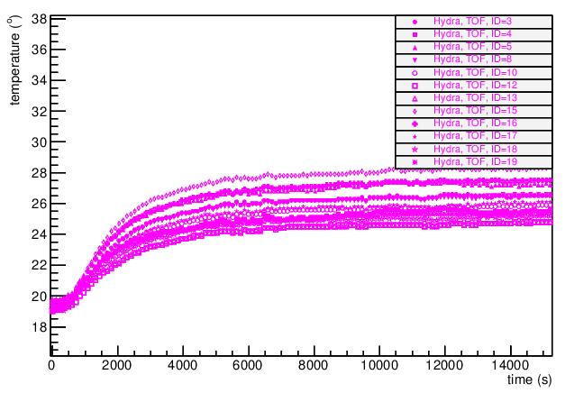
CLAS12 RICH Recommendations
Studies of mechanical deformations and resulting stresses on the entire
detector should include operation, installation, transportation, maintenance
(local fixture(s) ), and earthquake loads. [PR 2013].
The RICH project should provide all engineering calculations necessary to
demonstrate code compliance for all appropriate equipment and operating
conditions thereof. [PMR 2015]
✔ Relevant calculations has been performed at each stage
of the project and reviewed by JLab experts (B. Miller)
✔ RICH underwent a mechanical review in June 2014.
The RICH detector group should show by analysis that the steady state temperature of the FTOF panel 1B
will not exceed 30C. It is acceptable to extend the RICH detector 1 inch downstream at the electronics box
location to install insulation to reduce the heat load on the FTOF. The insulation must not interfere with
the FTOF panel 1B cables. [MR 2014]
✔ Maximum temperature value revised to 100 F
✔ Air-cooling validated by extensive tests performed at LNF
Final optimization before entering the Hall
The final design of the dry nitrogen piping and ventilation systems
shall be reviewed by a Jlab engineering subject matter expert(s).
✔ Done by G. Jacobs and reviewed by M. Saptarshi
CLAS12 RiCH Readiness Review, 13th June 2016
7
Notes:
Va letto che ha scrito Saptashi!!!

Slide 8
CLAS12 RICH Summary
Goal: RICH ready for October 2017 run
✔ Several reviews validated the design and monitored the progresses
(DOE has relaxed the supervision after mid-term review)
✔ Construction follows a Management Plan
✔ Assembling planned and described in a dedicated document
✔ Installation procedure derived from LTCC in collaboration with JLab
✔ Safety considerations accounted and documented
✔ A (preliminary) Task Hazard Analysis has been performed:
gas system risk code after mitigation = 1
CLAS12 RiCH Readiness Review, 13th June 2016
8
Notes:
Prendersi il documento di G. Jacobs

Slide 9
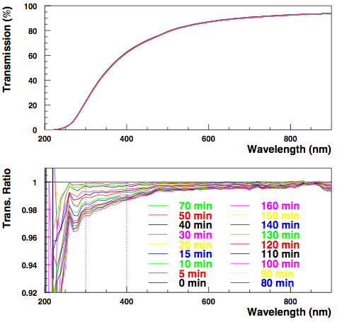
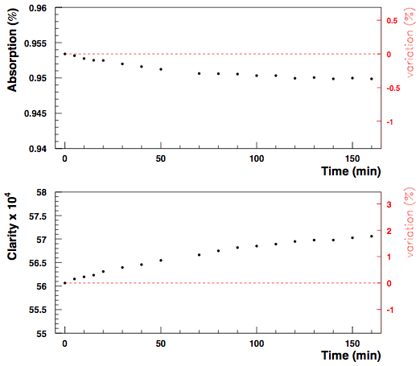
Aerogel Characteristics in the Air
Transmission vs Time
Absorption and Clarity @ 400 nm
Monitoring the time dependence of the transmission of aerogel tile
in environment of non-zero relative humidity (~ 40 %)
CLAS12 RiCH Readiness Review, 13th June 2016
9

Slide 10
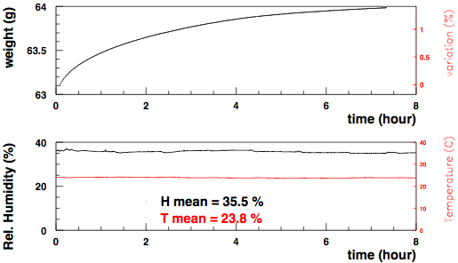
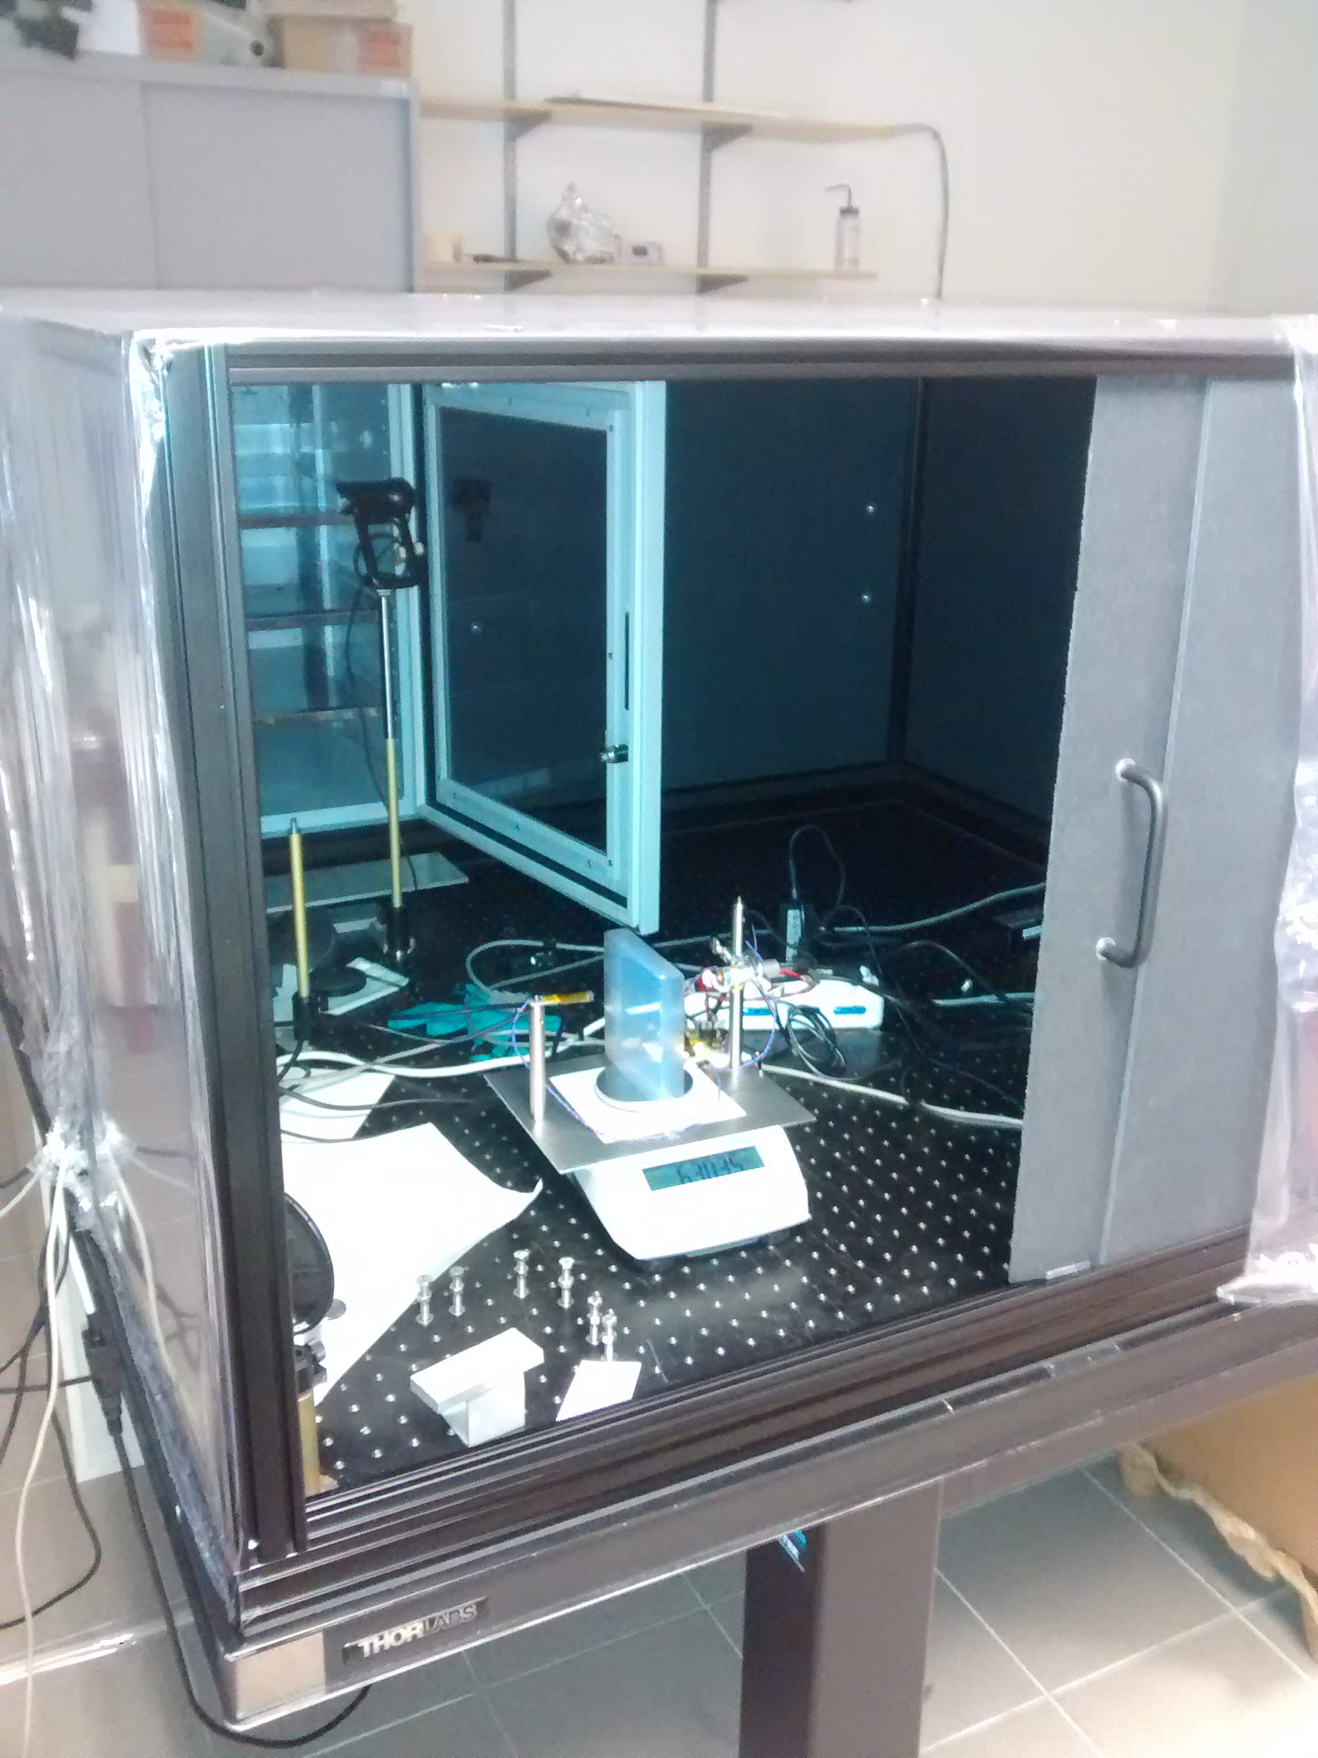
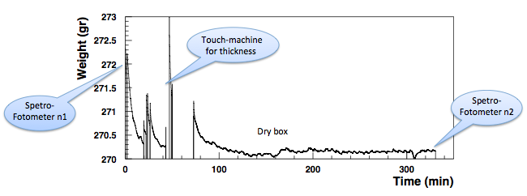
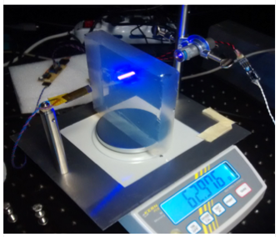
Aerogel Weight
In Air ( ≈ 40 % RH)
Inside Dry-Box ( ≈ 1 % RH)
hour)
CLAS12 RiCH Readiness Review, 13th June 2016
10

Slide 11
CLAS12 RICH Project Midterm Status
Charge 1:
Have the ESH&Q considerations been properly included in the design of
the detector?
No hazardous material
Gas and Cooling systems authorized by design authority (in progress)
Interlock for cooling implemented
Reviewed by M. Saptarshi:
Tank (200 psi): McMaster Part # 9554K71
Relief (90 psig): McMaster Part # 4700K83
Relief (175 psig): McMaster Part # 4700K15
Charge 2:
Are the specific documentation and procedures to operate safely and
efficiently the detector, in place and adequate? This includes initial operation.
ESAD document
RICH Operational Manual
Commissioning Document
CLAS12 RiCH Readiness Review, 13th June 2016
11
Notes:
Non doveva esserci questo in progress!!

Slide 12
CLAS12 RICH Project Midterm Status
Charge 3:
Has the detector been completed towards operation? If not, what are the
completion/commissioning schedule and tasks?
Detector under construction
A Management Plan define responsibilities and milestones
Hardware and software tasks have been identified
Detailed schedule exists for construction, assembling, installation
Charge 4:
Have all the jobs that need to be done to safely mount the detector been
identified and defined adequately?
All systems are verified prior of installation
Installation procedure derived from the LTCC
Special care planned during transportation and lifting
The space for services has been allocated
CLAS12 RiCH Readiness Review, 13th June 2016
12

Slide 13
CLAS12 RICH Project Midterm Status
Charge 5:
Has the detector ownership, maintenance and control been defined
during beam operations?
Slow control and interlock ensure safety
RICH run is a shared duty between INFN and JLab
Charge 6:
Are the responsibilities for carrying out each job identified, and are the manpower
and other resources necessary to complete them on time in place?
All phases have a plan with assigned manpower
CLAS12 RiCH Readiness Review, 13th June 2016
13
Notes:
Dire meglio chi fa cosa.

Slide 14
CLAS12 RICH Readiness Review
BACKUP SLIDES
CLAS12 RiCH Readiness Review, 13th June 2016
14
Notes:
Dire meglio chi fa cosa.

Slide 15
CLAS12 RICH Readiness Review
CLAS12 RiCH Readiness Review, 13th June 2016
15
Notes:
Dire meglio chi fa cosa.

