Slide 1
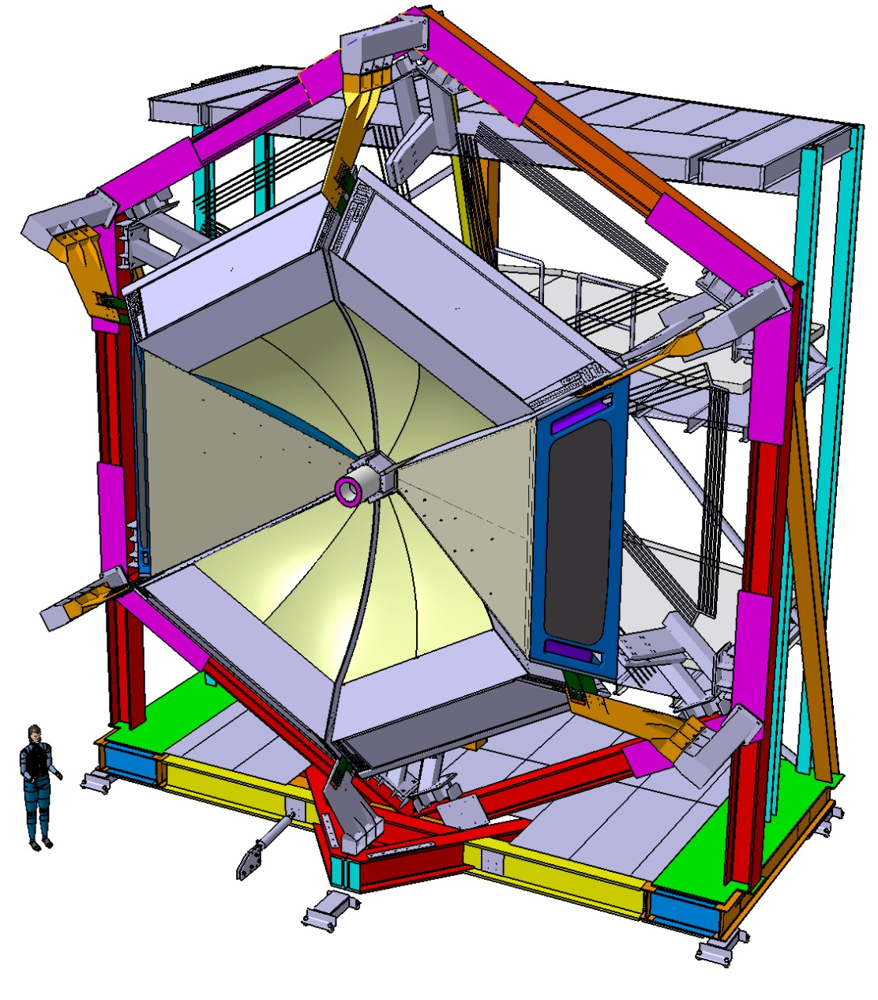
CLAS12-RICH Project-Status & Tasks Towards Completion
June 13th 2016
Charge 3:
Has the detector been completed towards operation? If not, what are the completion/commissioning schedule and tasks?

Slide 2
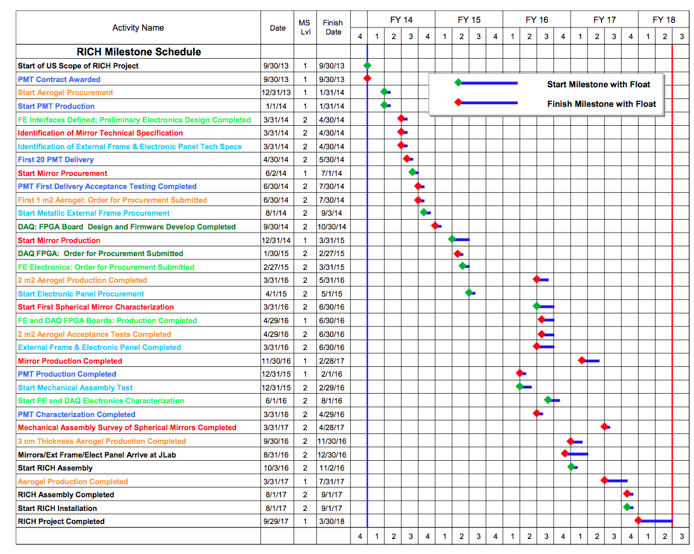
Project Milestones
CLAS12 RiCH Readiness Review, 13th June 2016
2

Slide 3
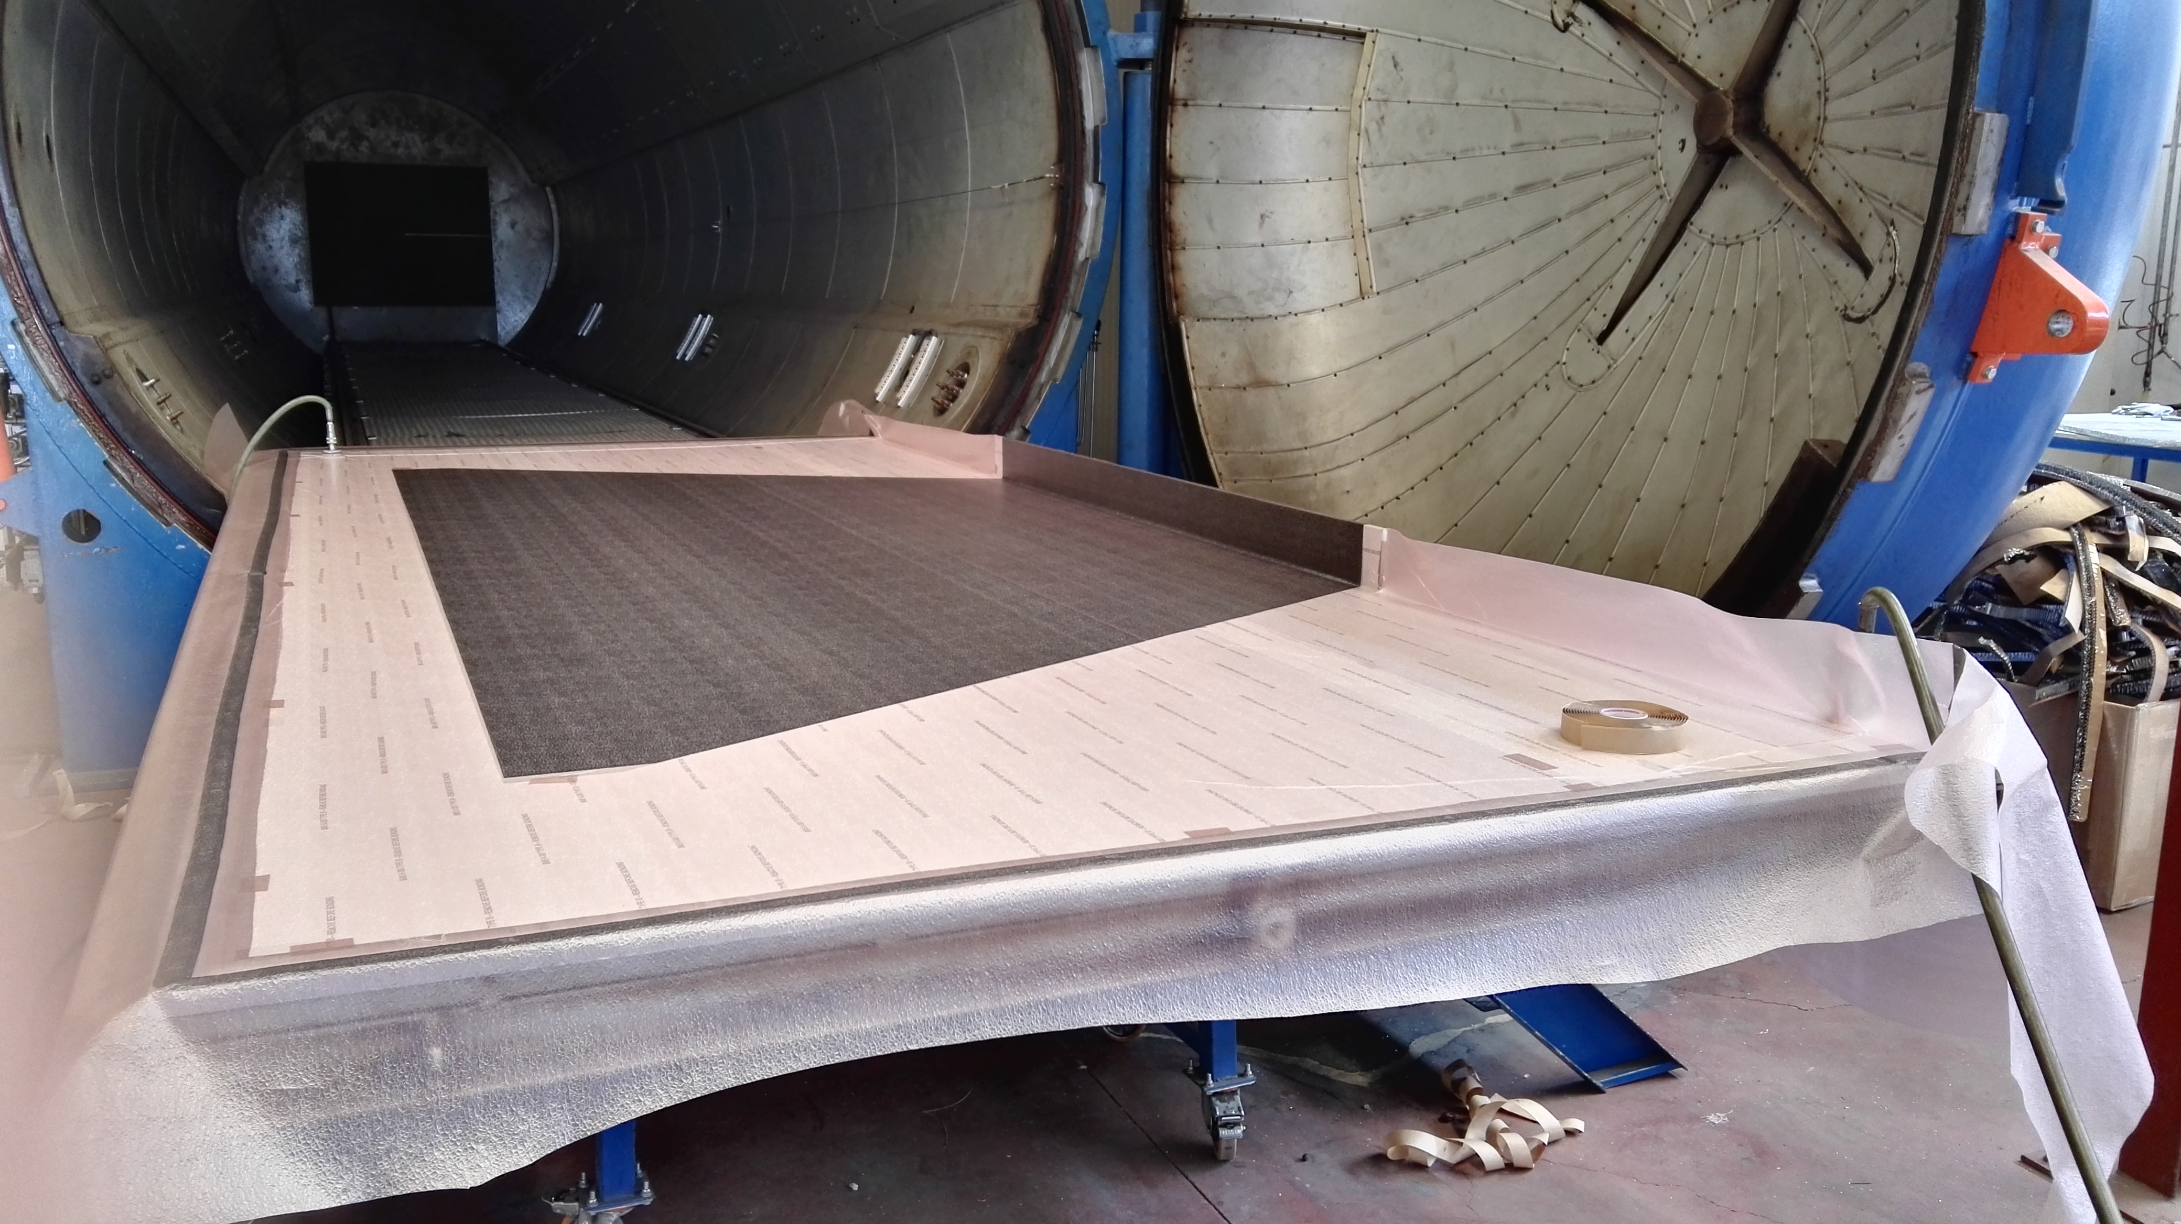
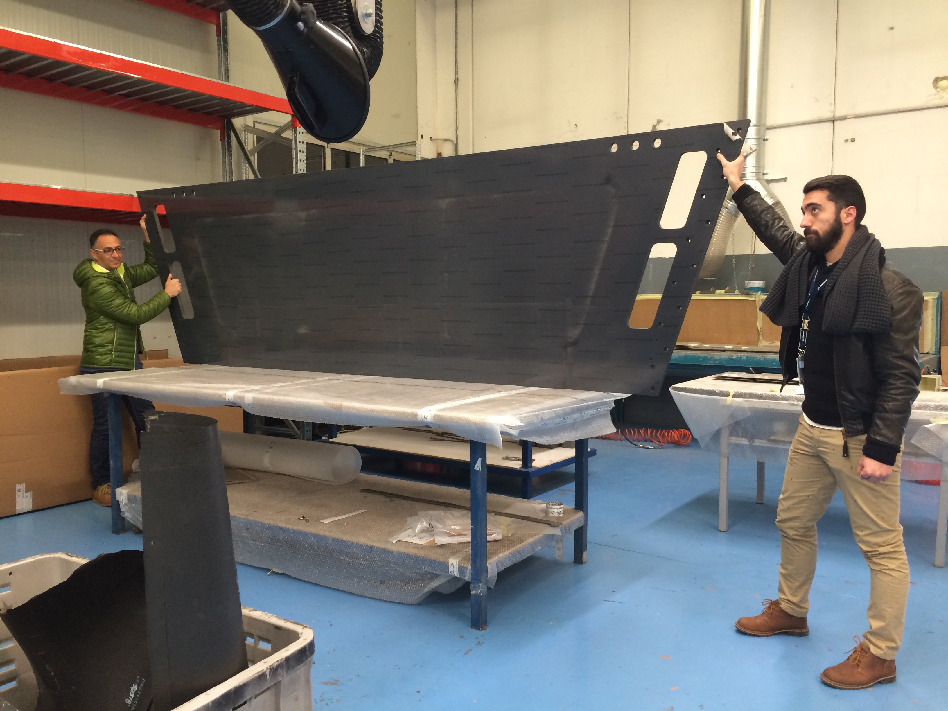
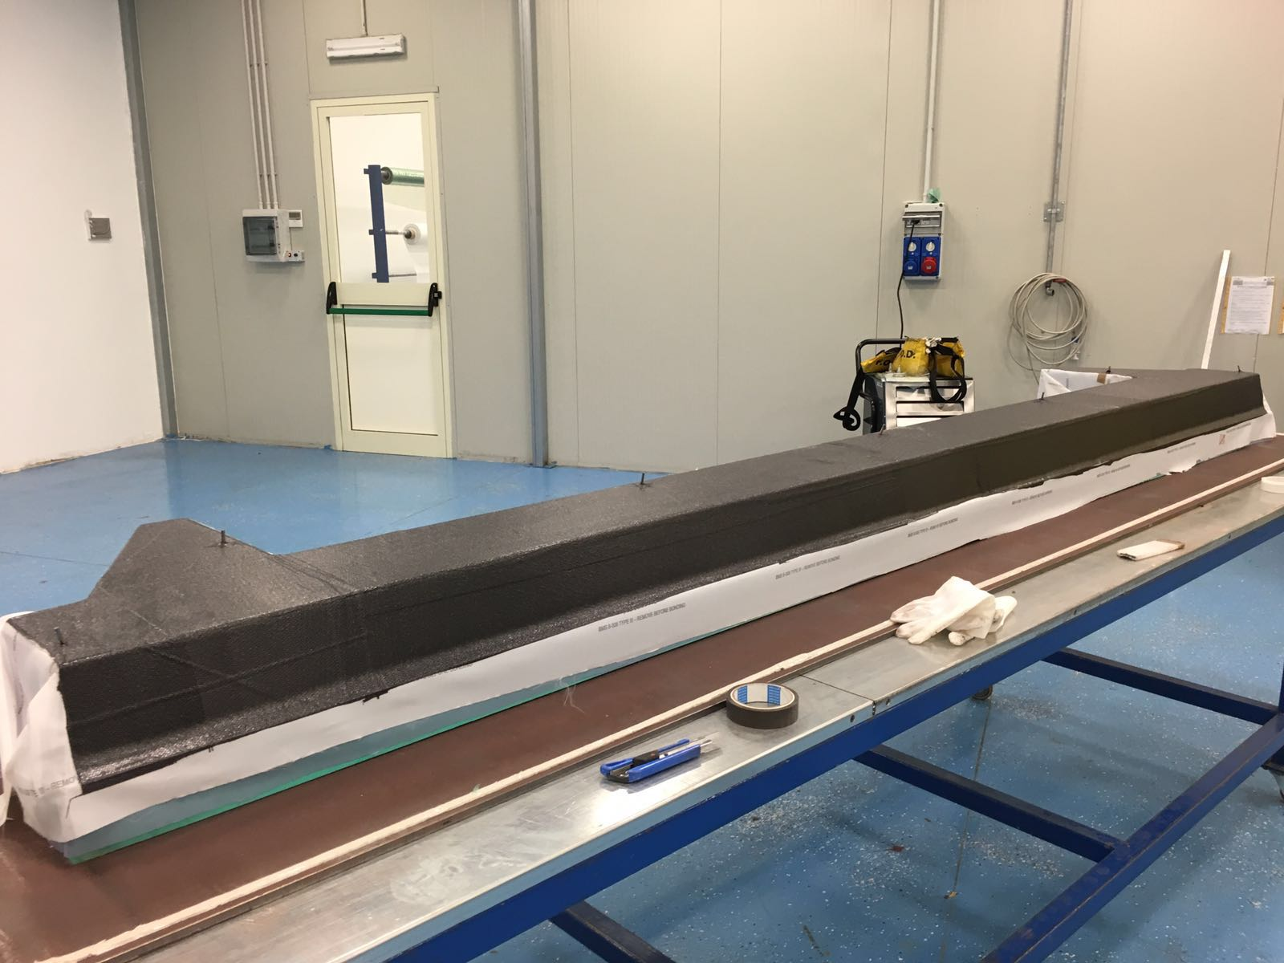
Mechanics
3m diameter autoclave housing large panels
CFRP Top Panel
CFRP Reinforcing Ribs
Assembling test ongoing in Italy
Delivery expected before the summer
Next:
- Closing panel (Argonne)
- Cart and joints for Installation (LNF)
CLAS12 RiCH Readiness Review, 13th June 2016
3

Slide 4
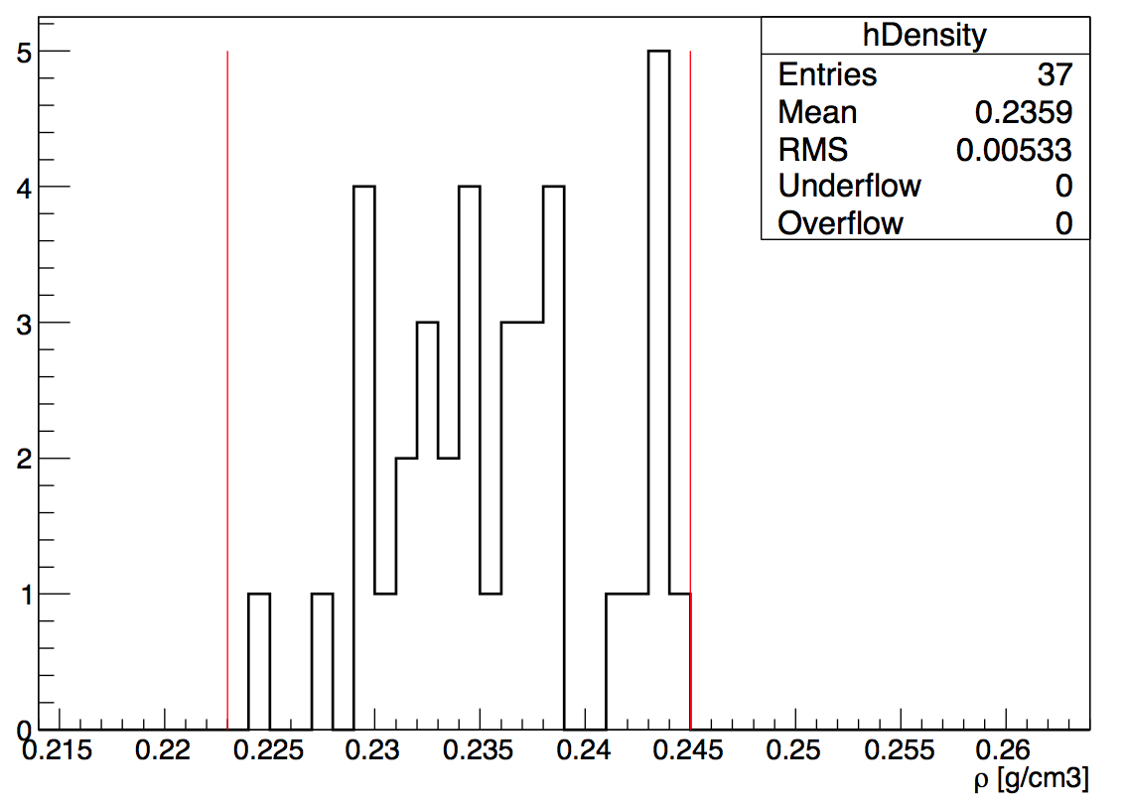
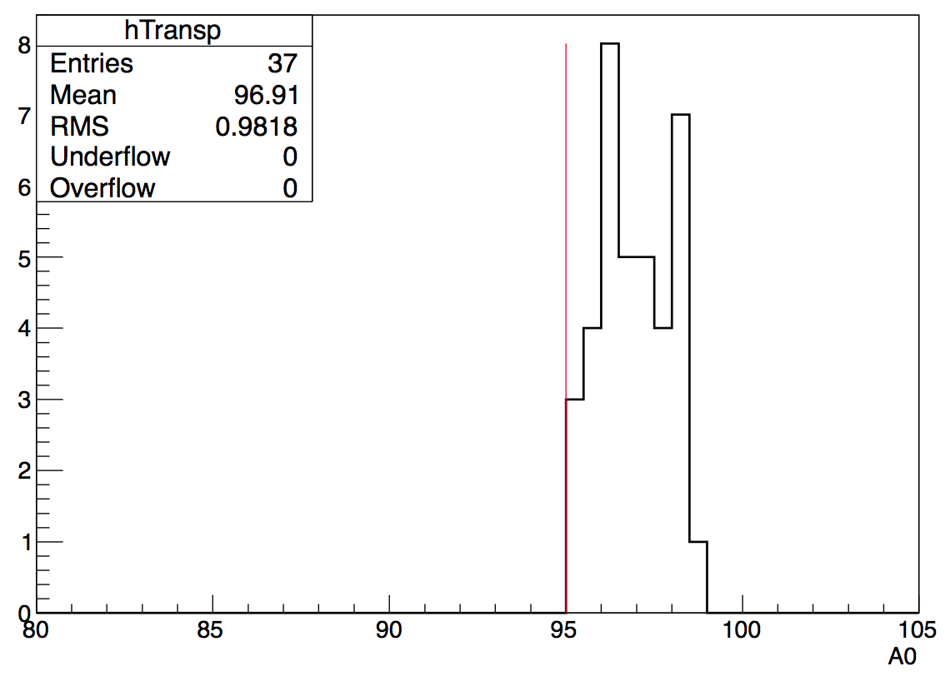
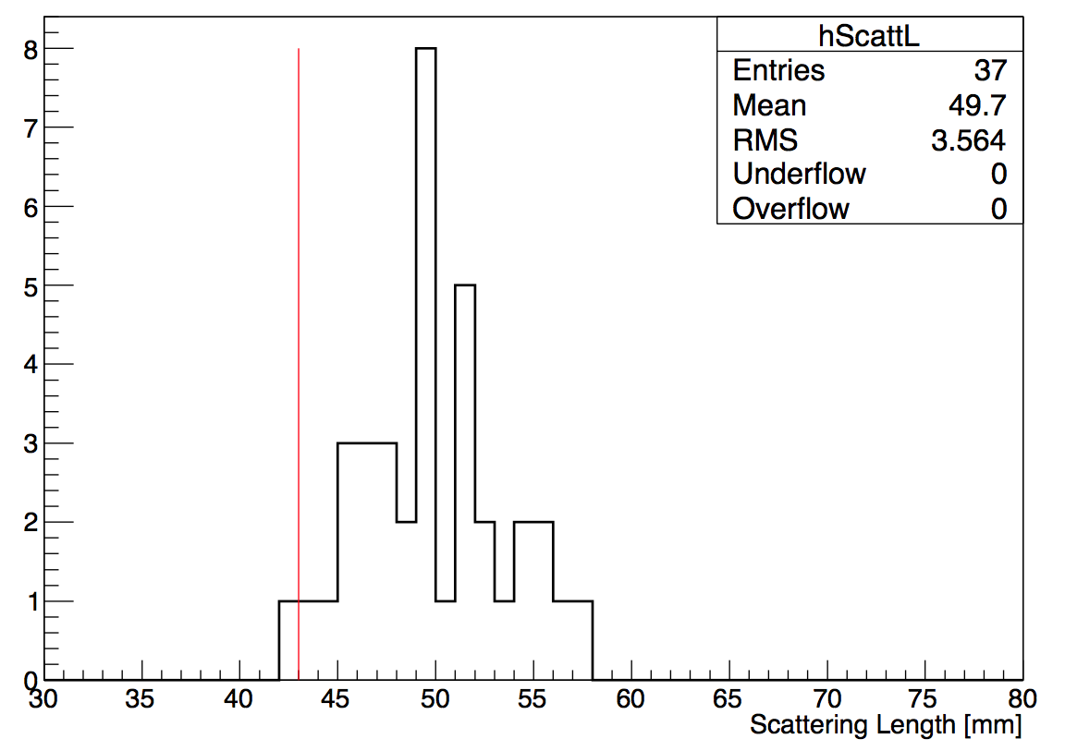
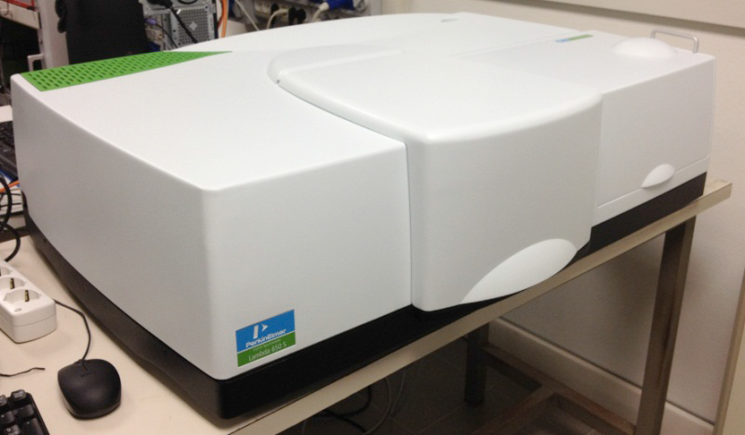
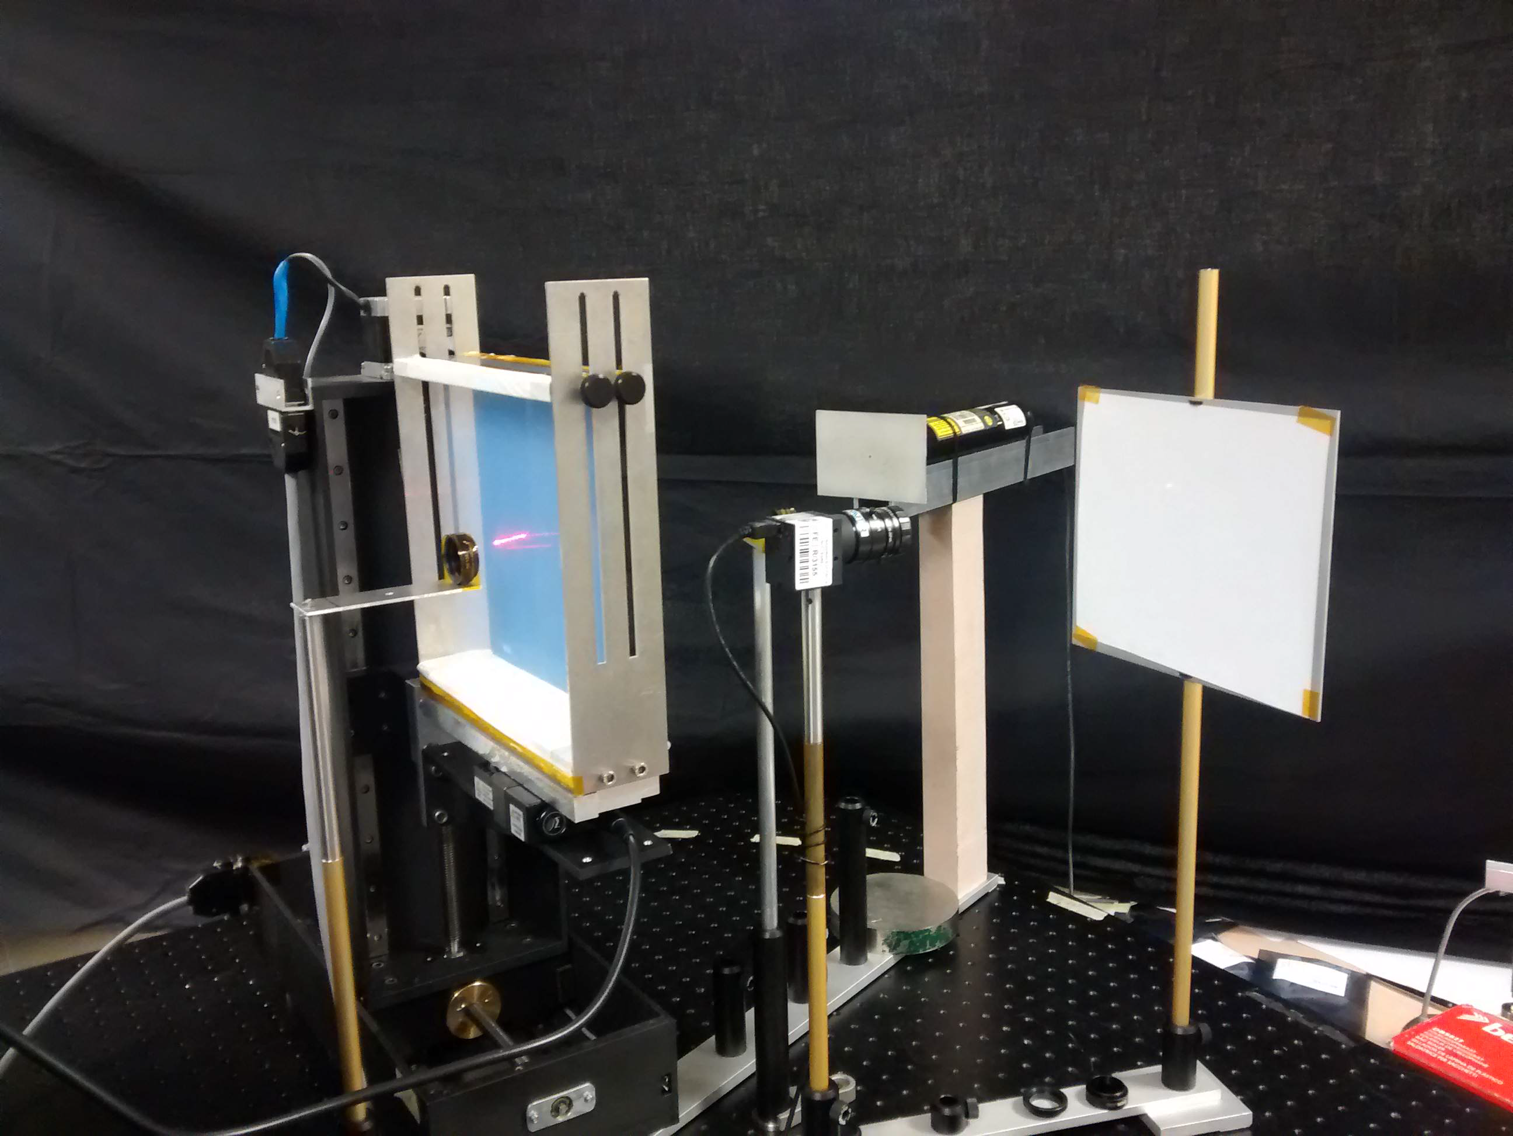
Aerogel
A₀ > 95 %
<L_{sc}> ~ 50 mm
All tiles are measured at the production
site (Novosibirsk) before delivery approval.
Acceptance tests at JLab and CUA.
Stress tests and optical study at Ferrara.
Same spectrophotometer with
large sample compartment
available @ FE and CUA.
3 cm layers:
Production tiles fulfill specifications
Tile delivery proceeds steadily
36 tiles out of foreseen 72 approved
Laser bench @ FE for
specific light propagation
Tests (FS, double passage)
Next: start 2cm layer production
CLAS12 RiCH Readiness Review, 13th June 2016
4

Slide 5
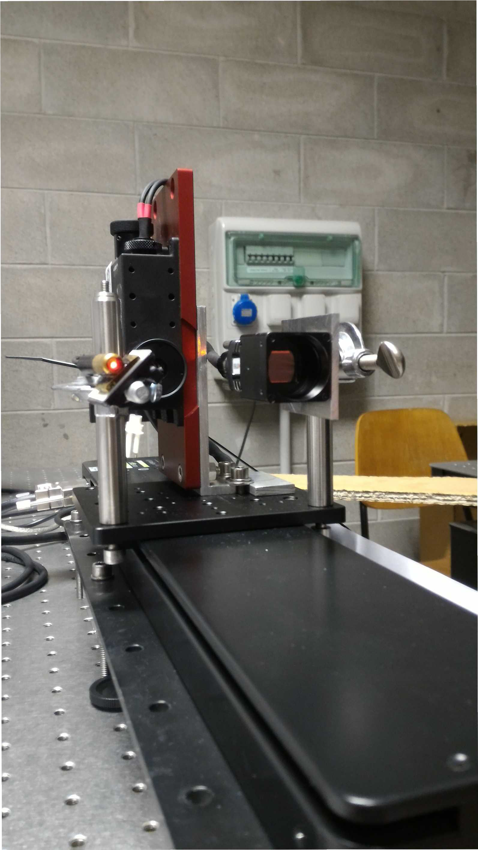
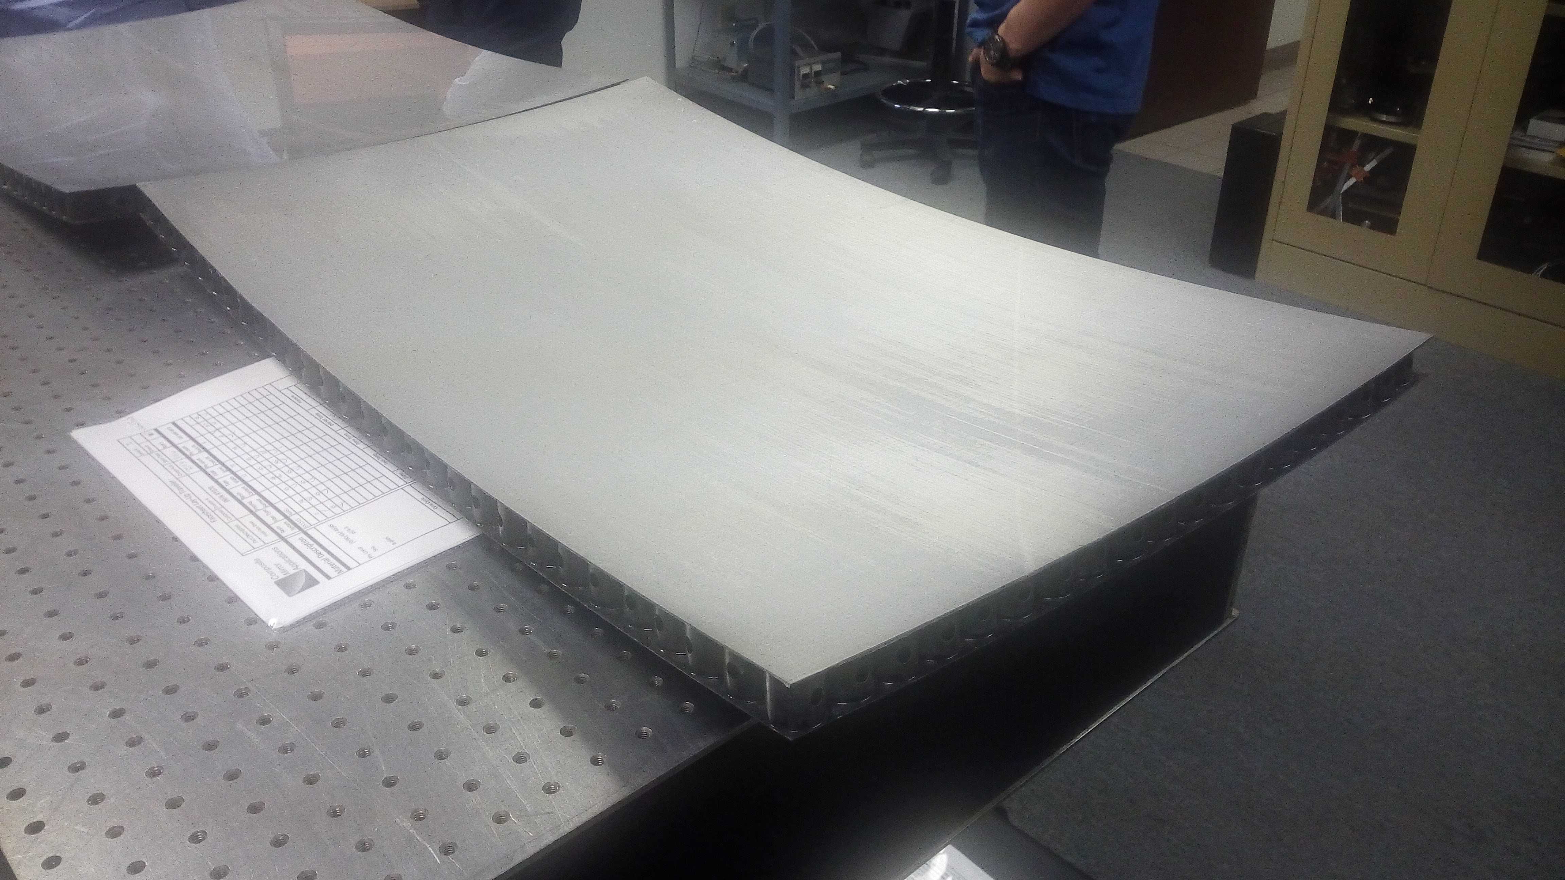
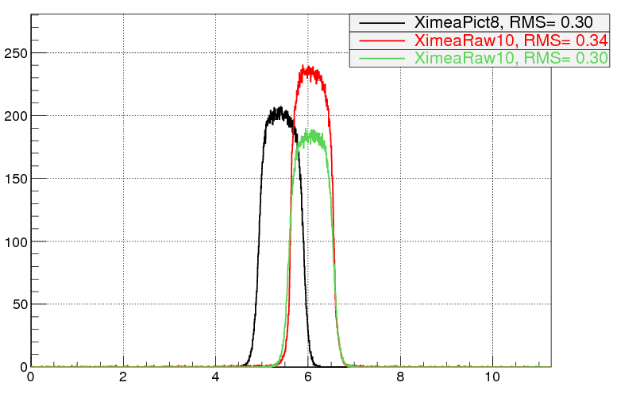
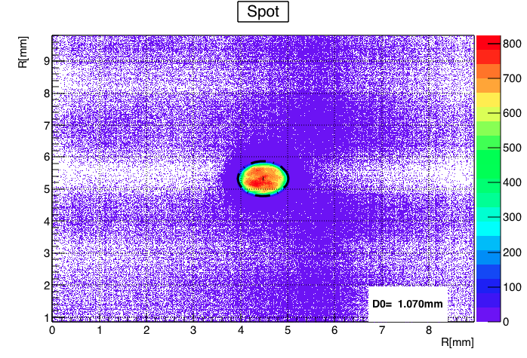
Spherical Mirrors
Surface analyzer
(waveform sensor)
Spot image sensor
(point-like source)
Mechanical guide
(along optical axis)
Reflected image comparable
with the 1 mm source size
and stable over time
Produced at CMA (Tucson, AZ)
4 Mirror delivered (out of 10)
Surface accuracy better than specifications
Areal density better than LHC-b
Next (LNF):
- Mockup for assembling
- Support structure
CLAS12 RiCH Readiness Review, 13th June 2016
5

Slide 6
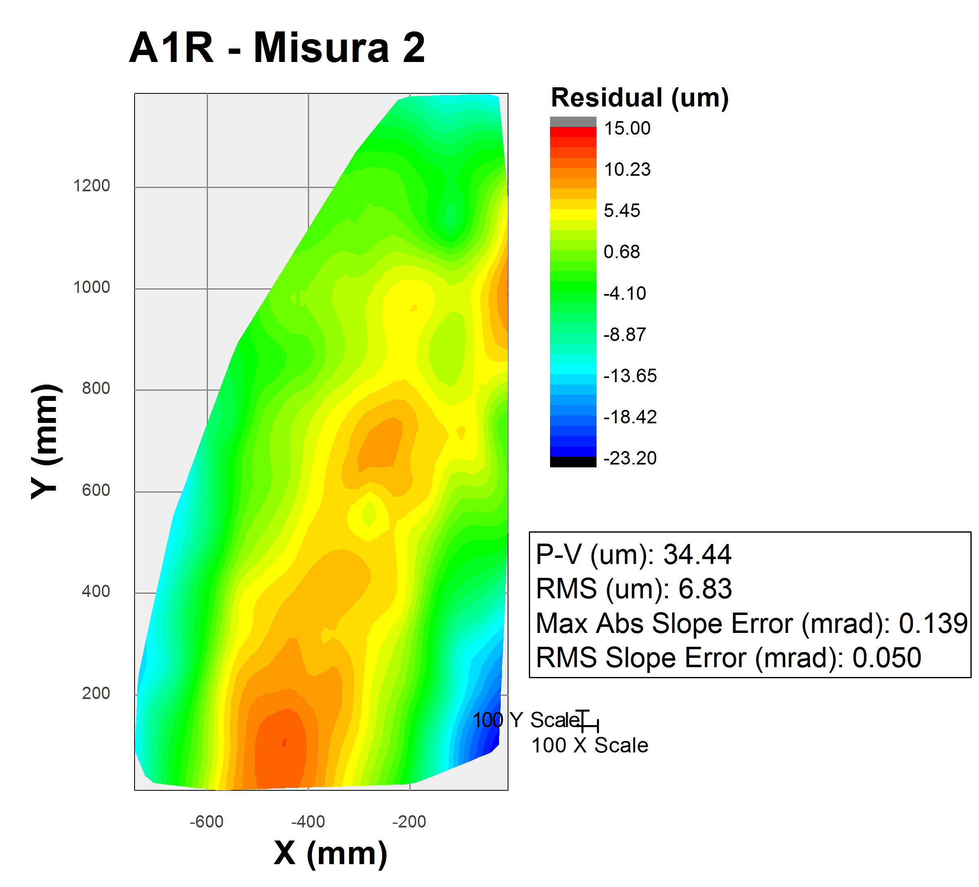
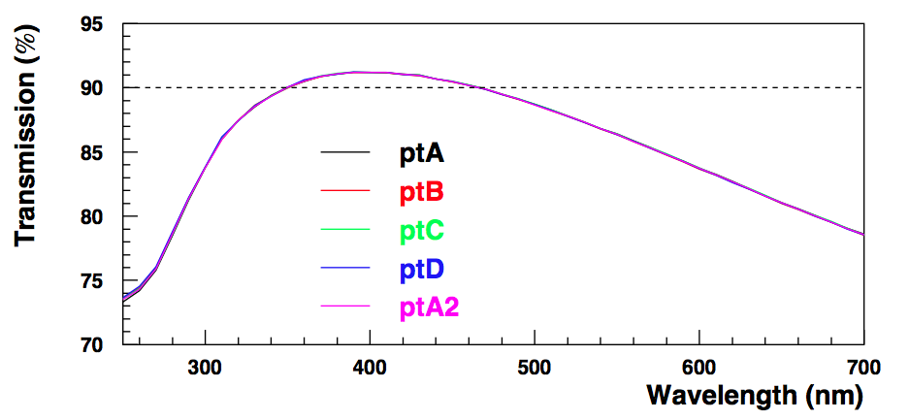
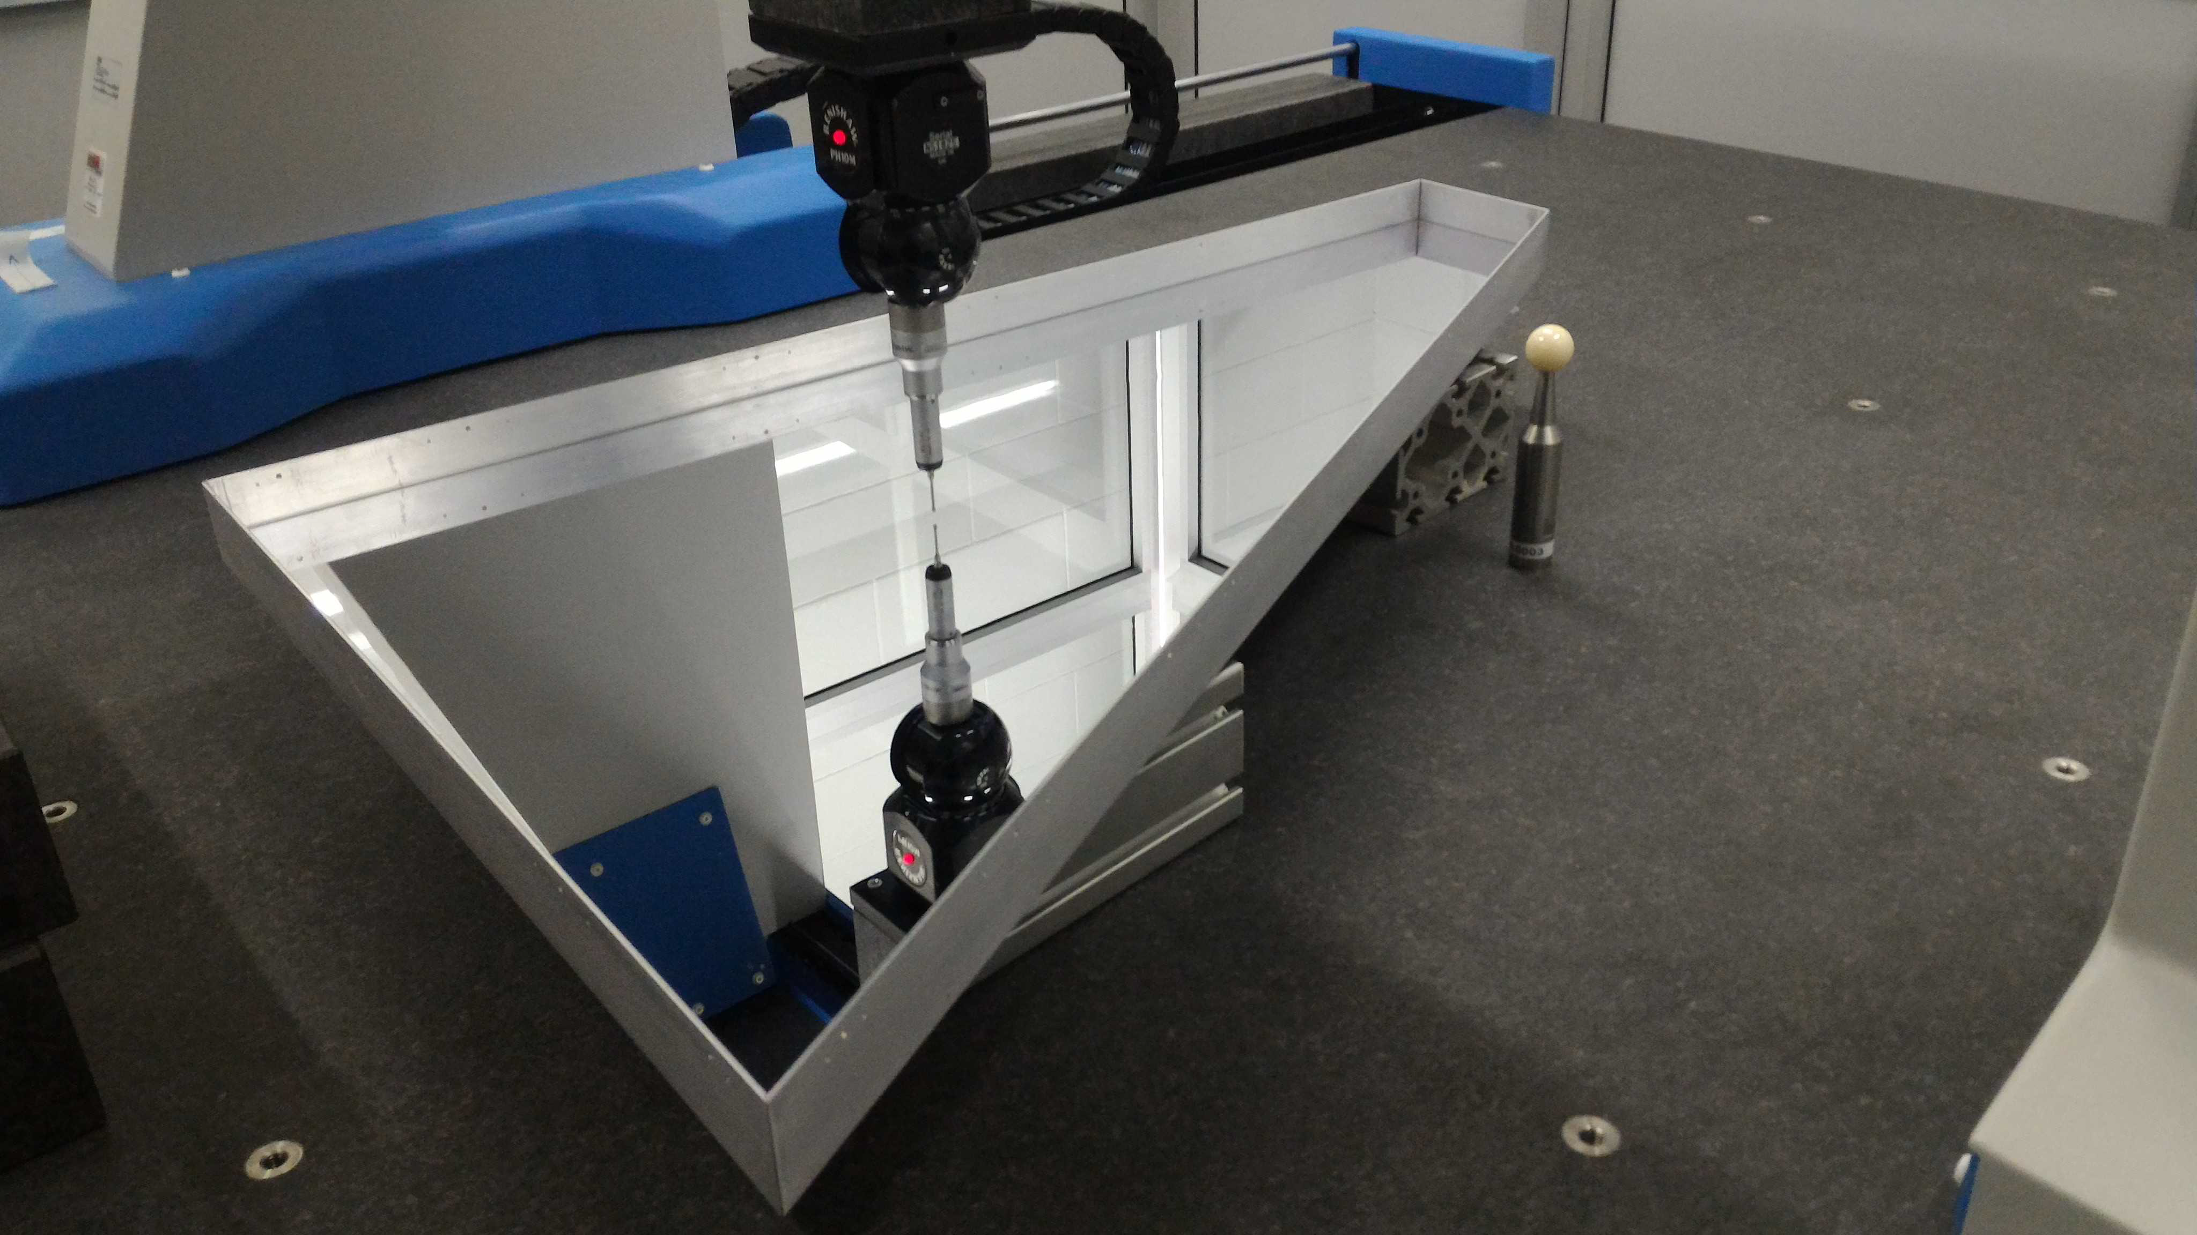
Planar Mirrors
Produced at Media-Lario (Bosisio Parini, Italy)
2 Mirror produced (out of 7)
Surface accuracy better than specifications
Reflectivity fulfilling specifications
Next (LNF):
- Validate aerogel assembling procedure
CLAS12 RiCH Readiness Review, 13th June 2016
6

Slide 7
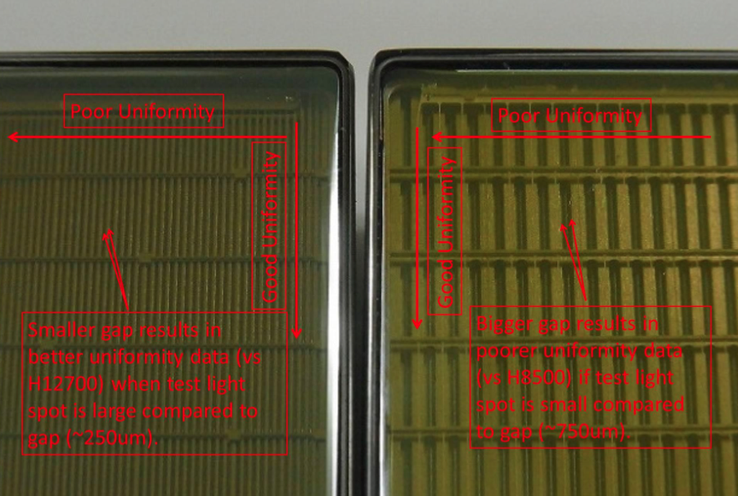
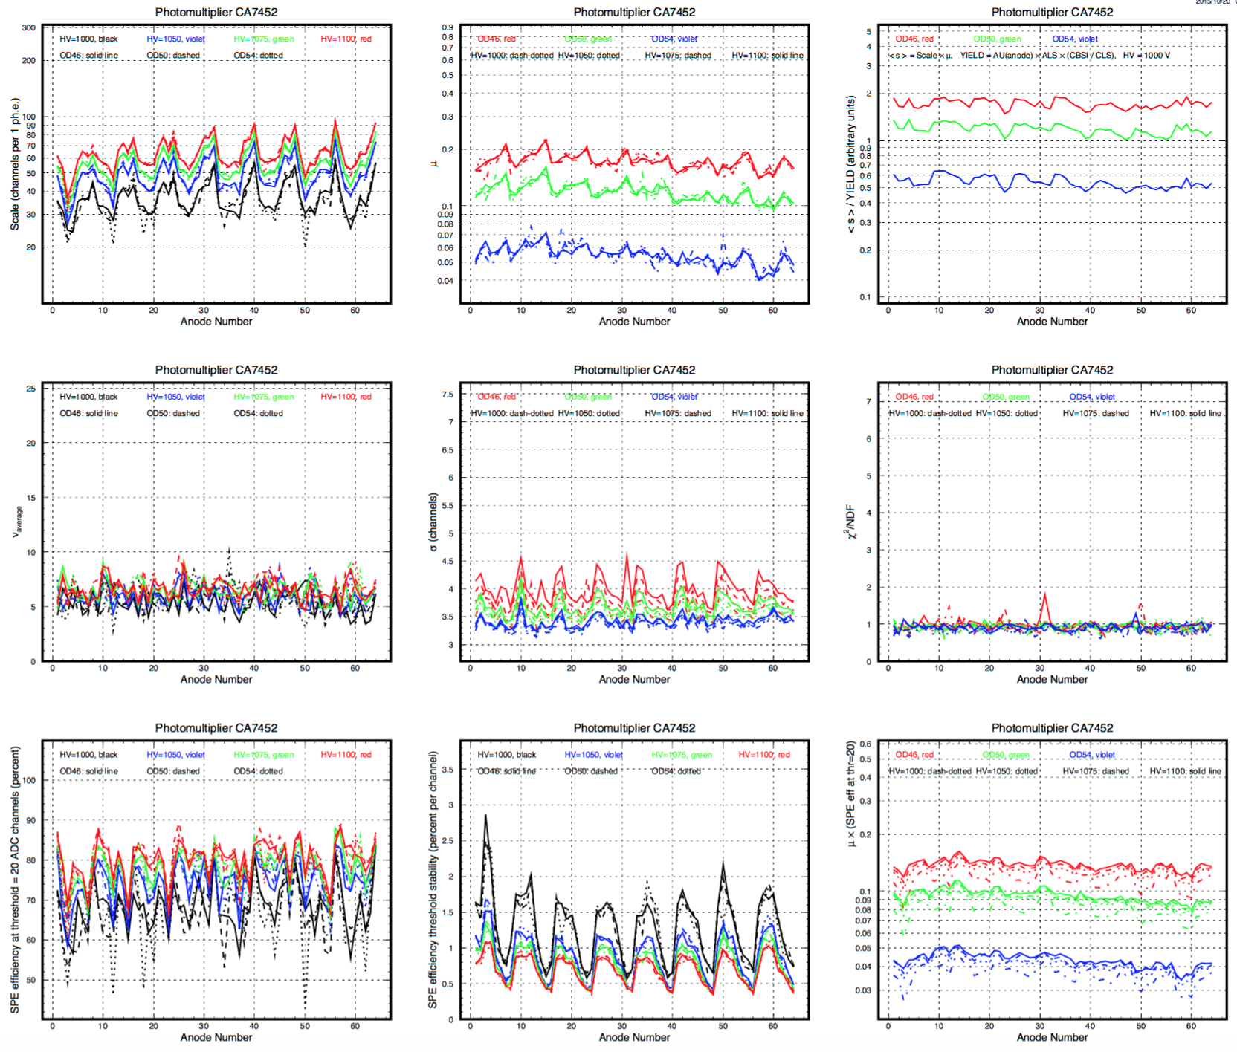
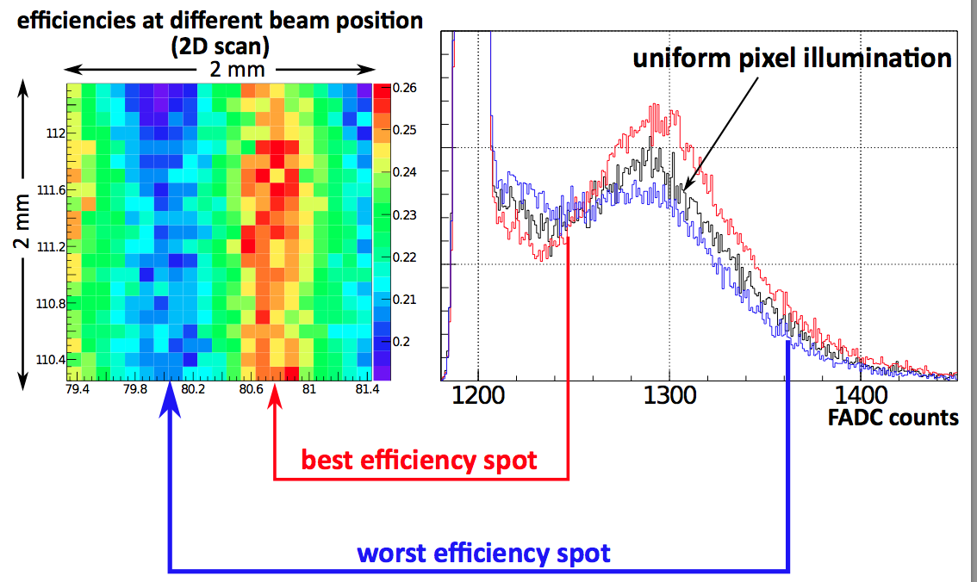
MA-PMT Photon Detector
H12700
Full characterization done on a pulsed-laser bench
H8500
All MA-PMTs delivered
2 out of 391 rejected and substituted
Stand-alone characterization done
Storing info into CLAS12 database (JLab/DU)
Next (FE + JLab):
- Characterization with RICH electronics
CLAS12 RiCH Readiness Review, 13th June 2016
7
Notes:
Ricordarsi quanti sono gli h8500

Slide 8
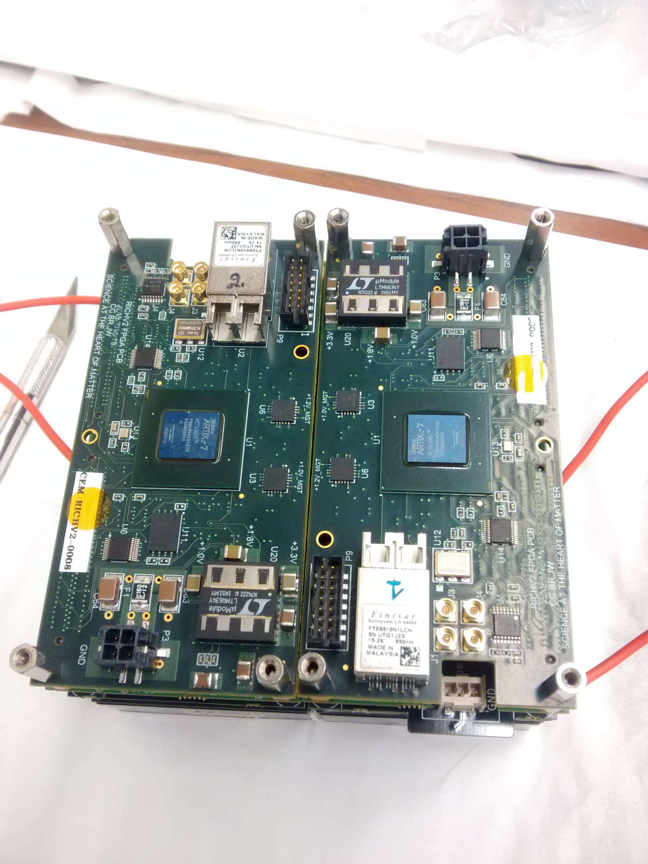
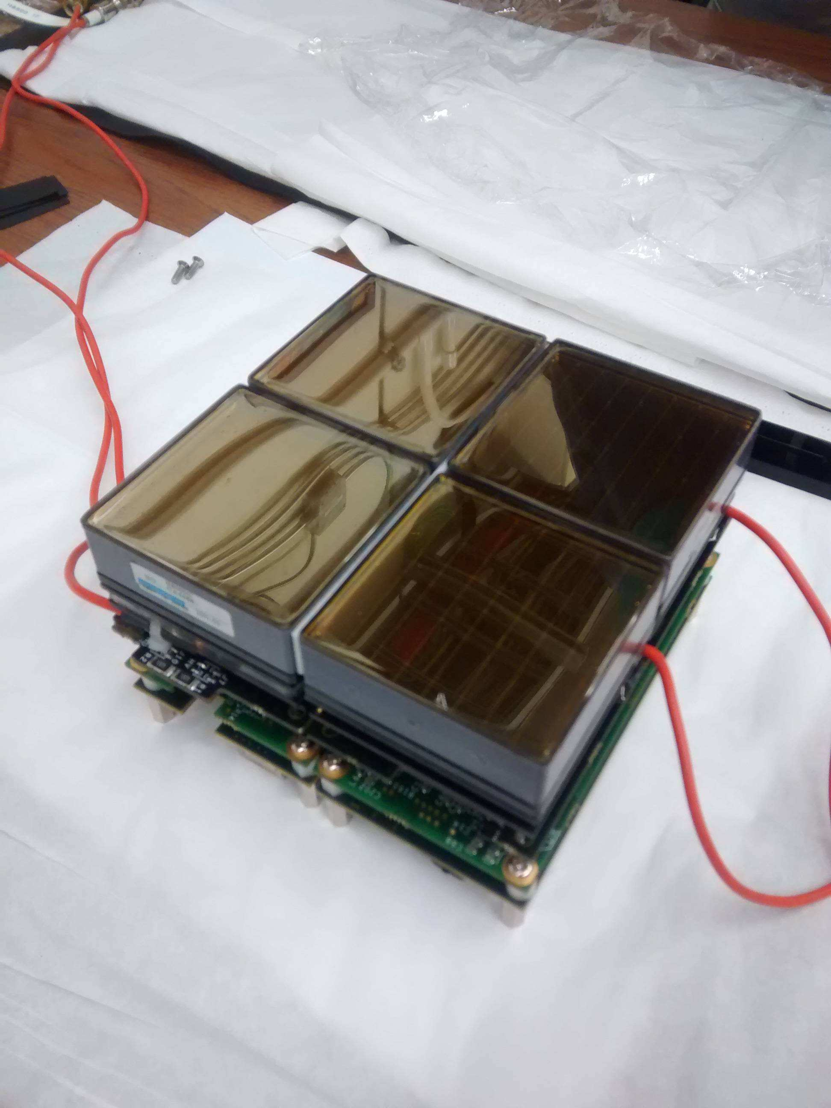
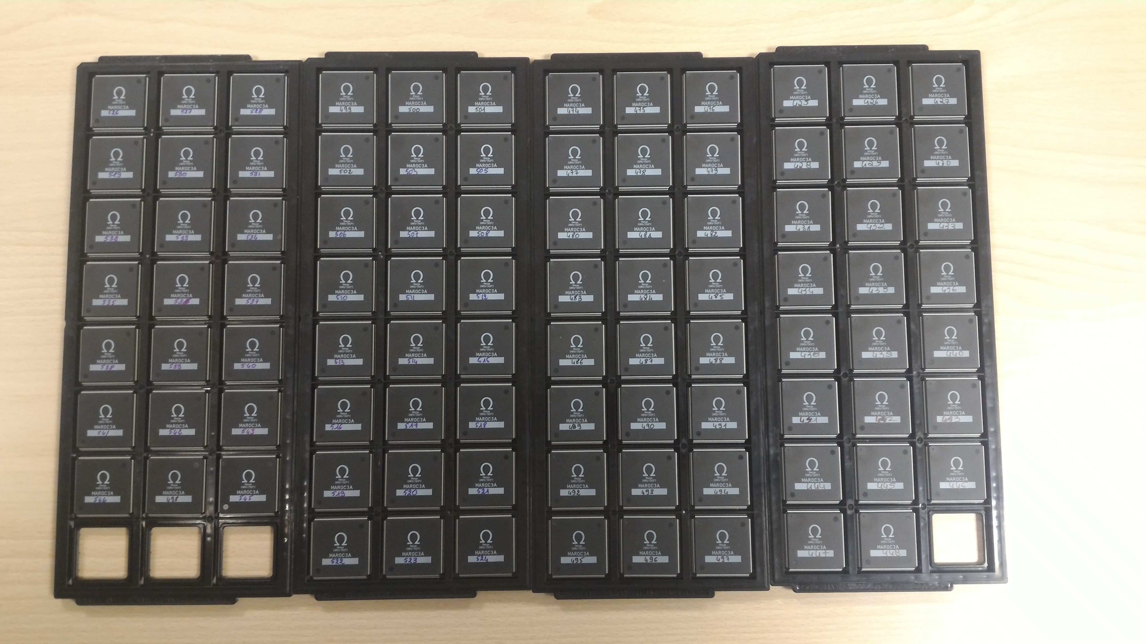
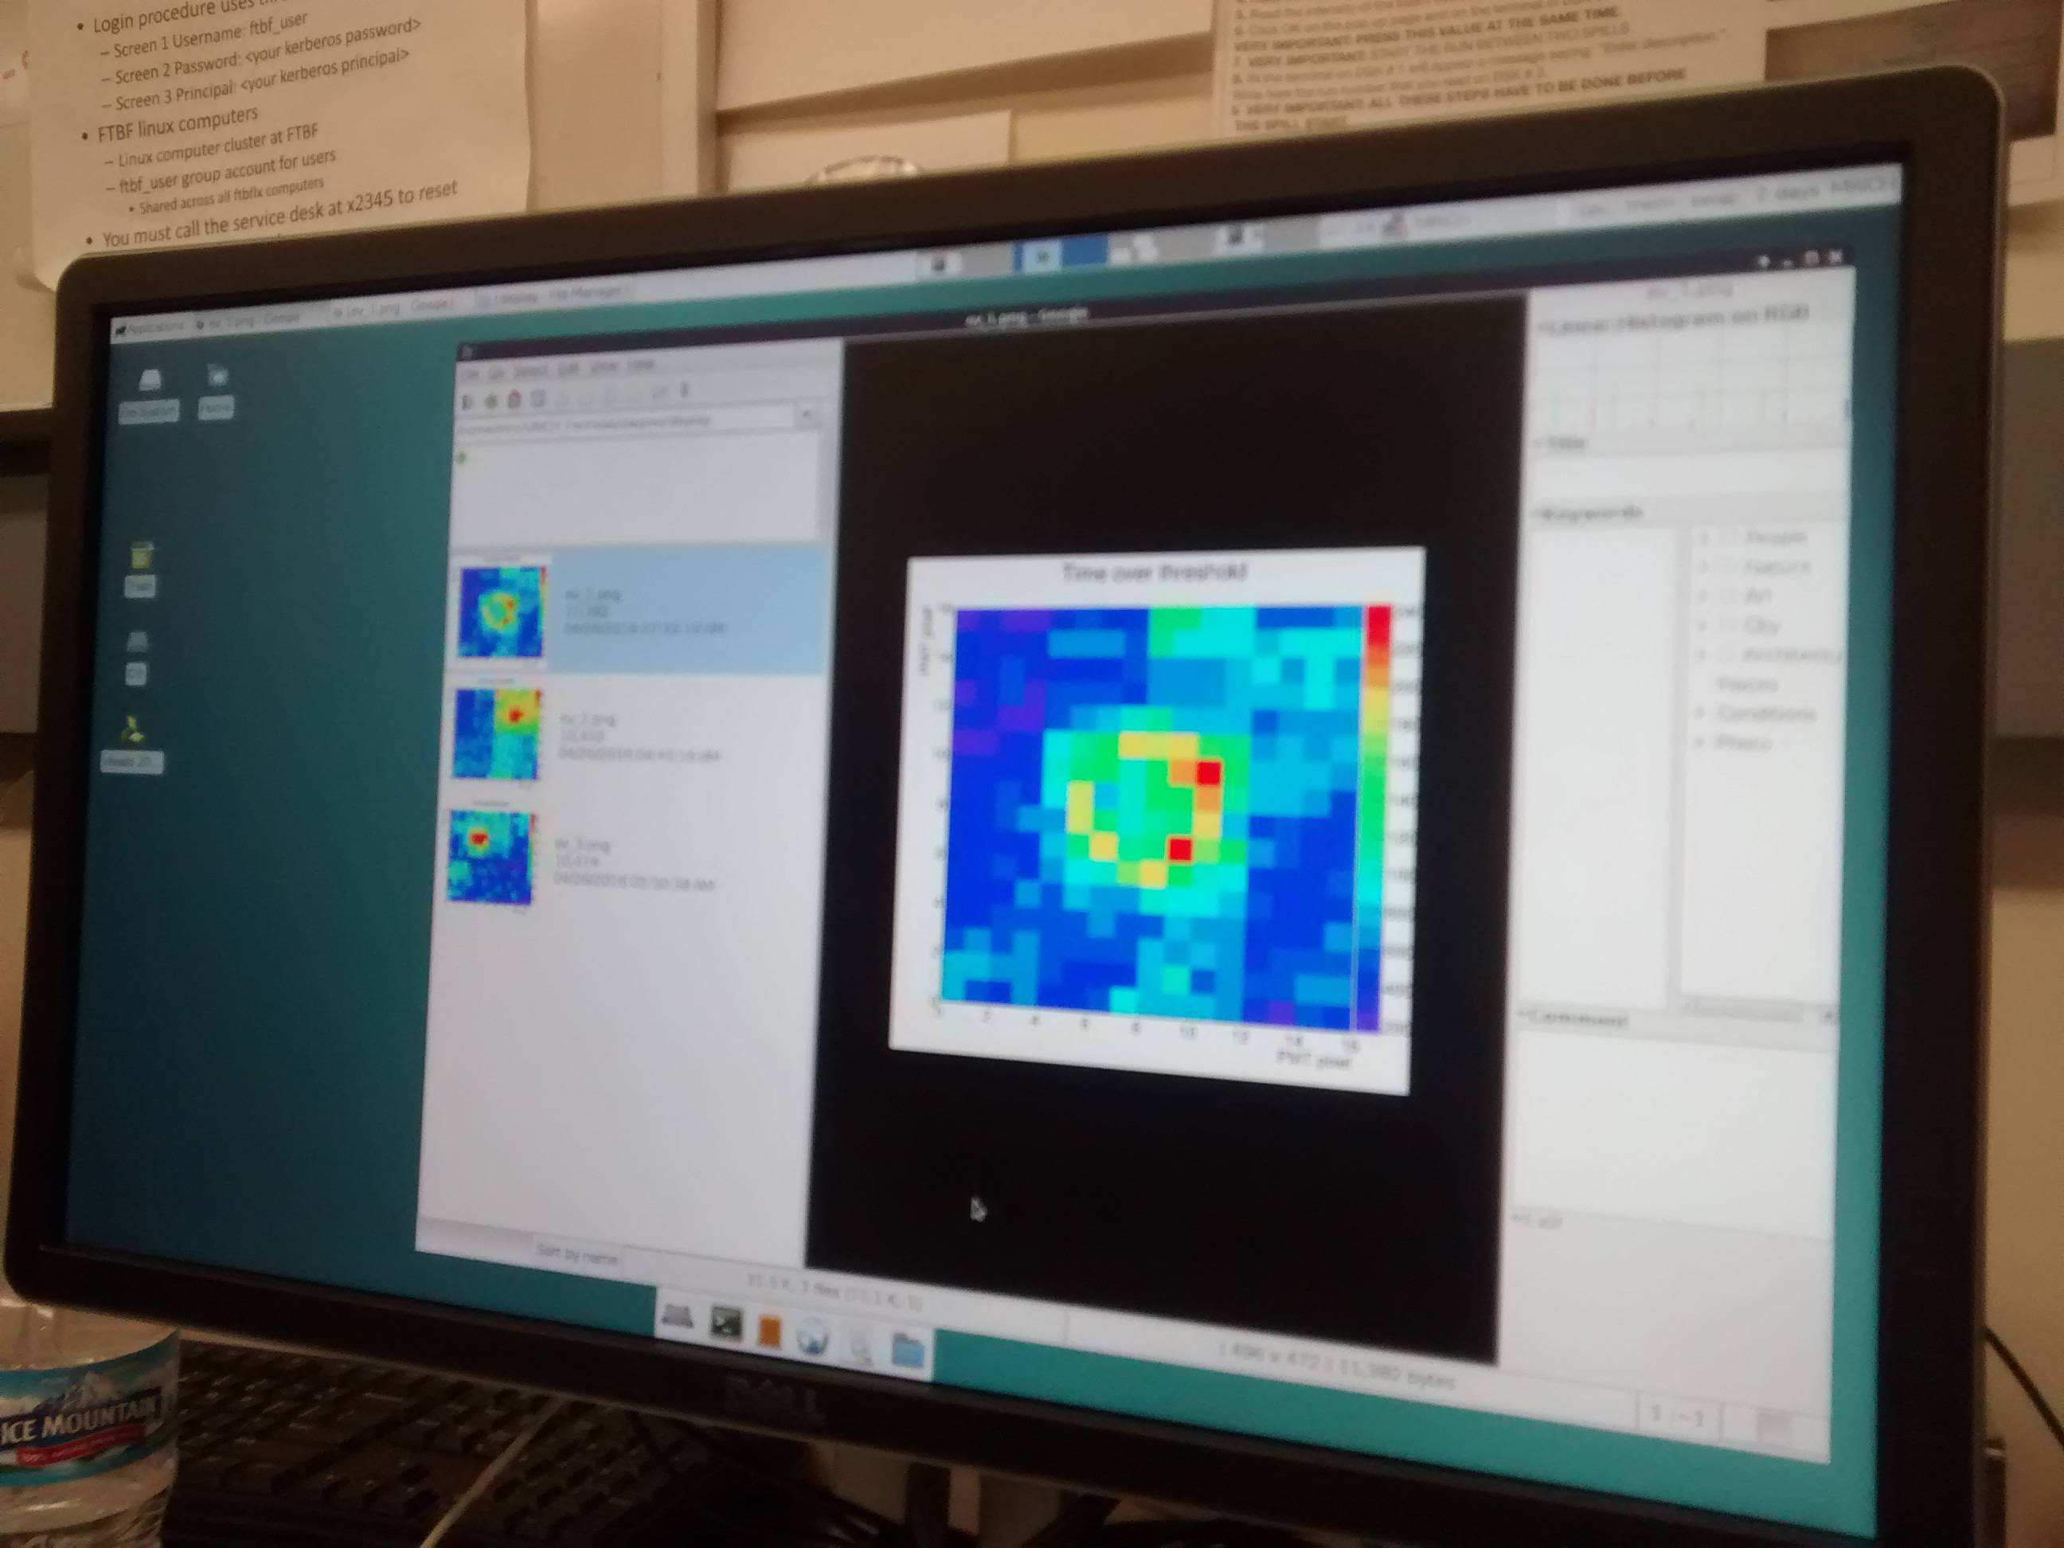
Electronics
FPGA:
- Production done
- Stand-alone validation done
Asics+Adapter
- Pre-production done
- Stand-alone validation done
- All MAROC3A chips delivered
Succesfully Test-Beam @ Fermilab
Next (FE):
- Complete production before summer
CLAS12 RiCH Readiness Review, 13th June 2016
8

Slide 9
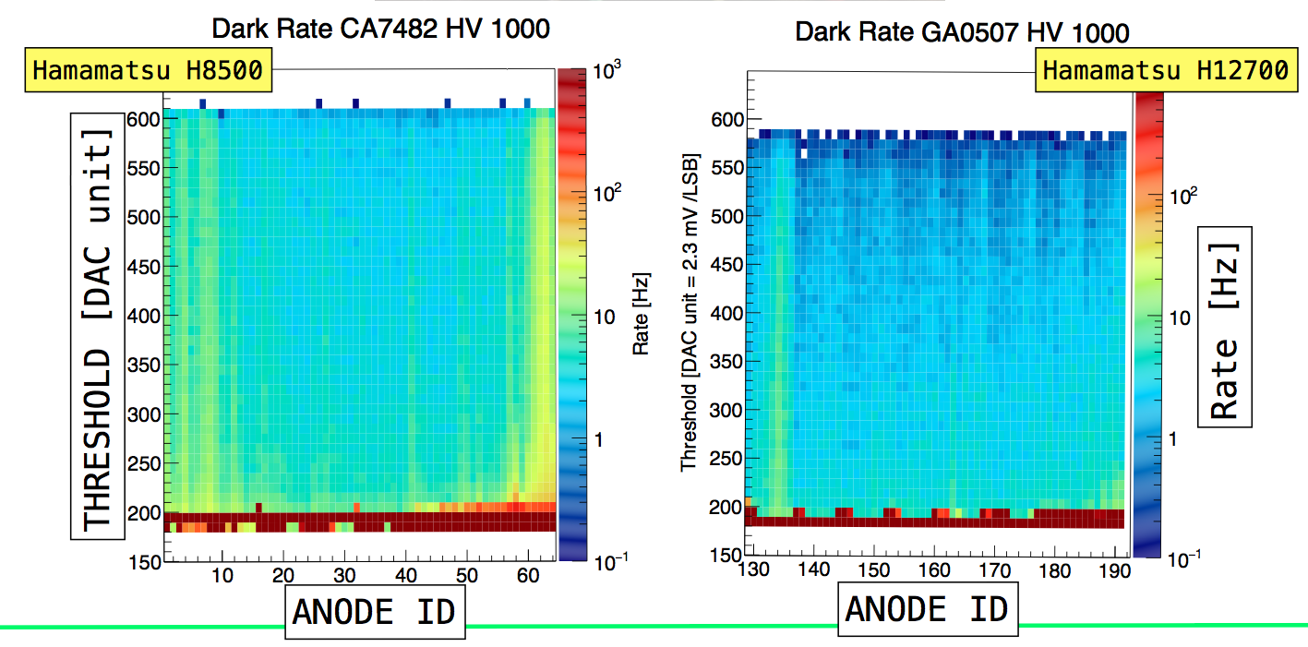
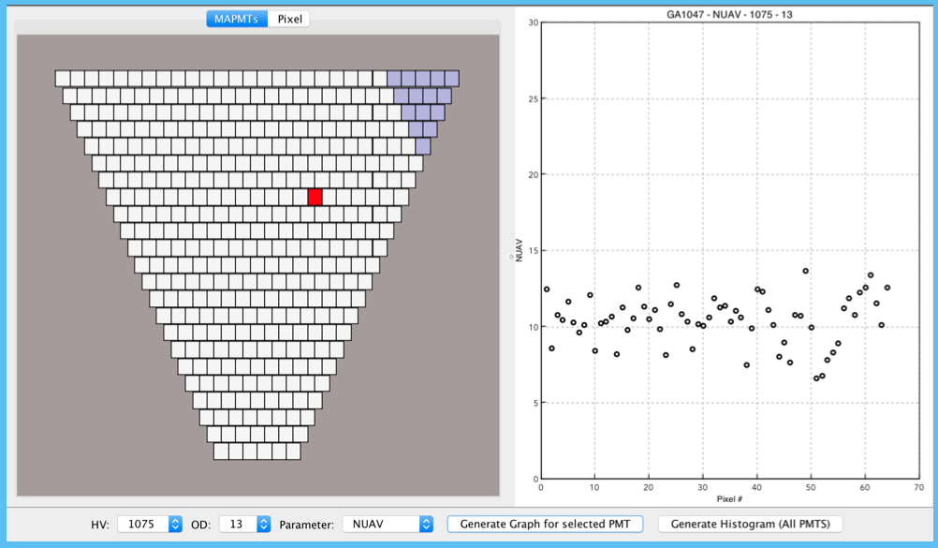
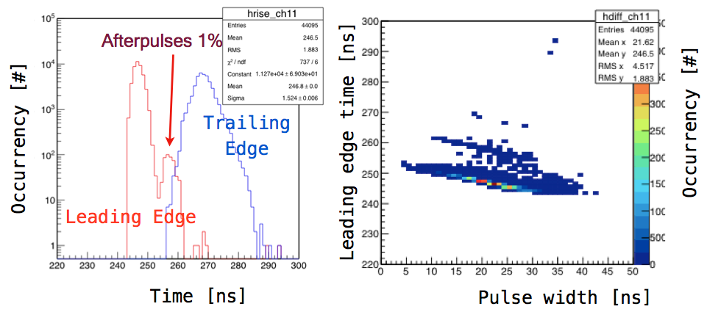
Electronics
Noise, single (photo)-electron signal
Time resolution with pulsed laser
Preliminary Tests Done
Developing characterization procedures
Next (FE + JLab):
- Characterization with MA-PMTs
- Store relevant information on CLAS12
database
CLAS12 RiCH Readiness Review, 13th June 2016
9

Slide 10
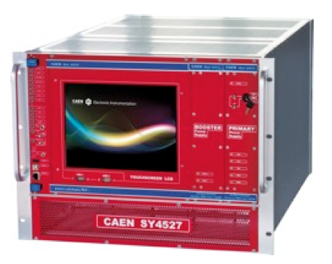
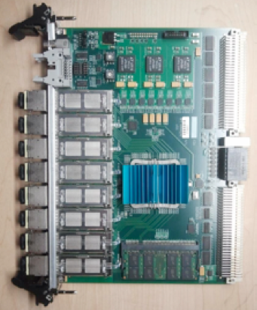
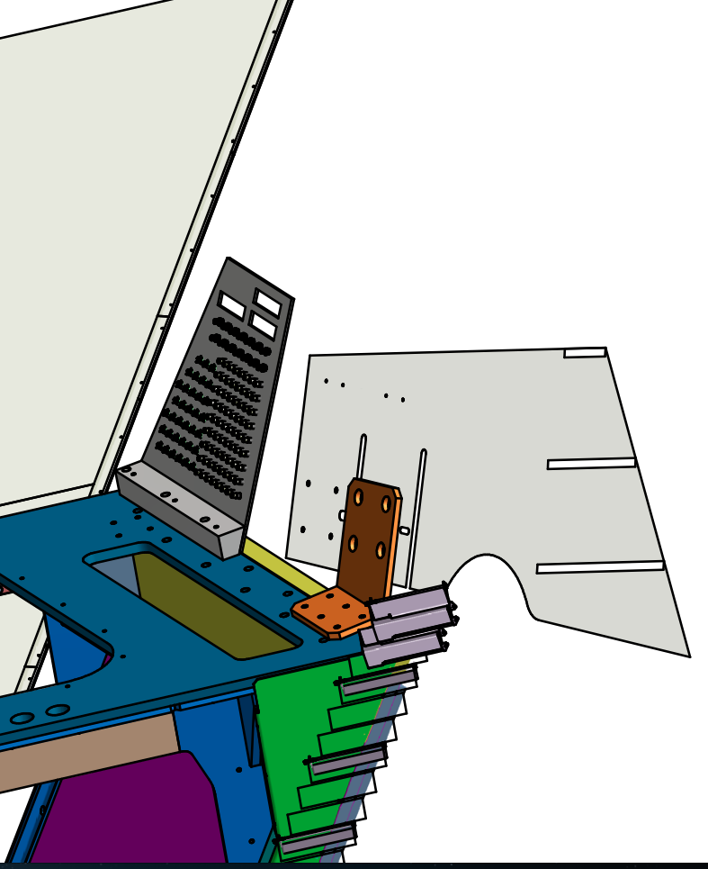
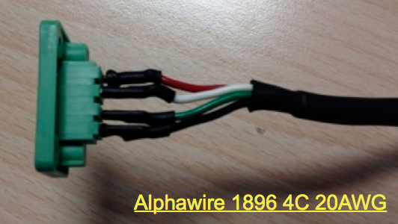
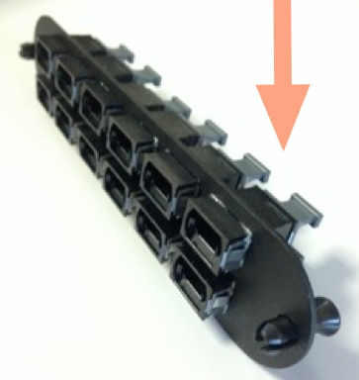
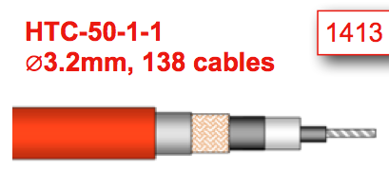
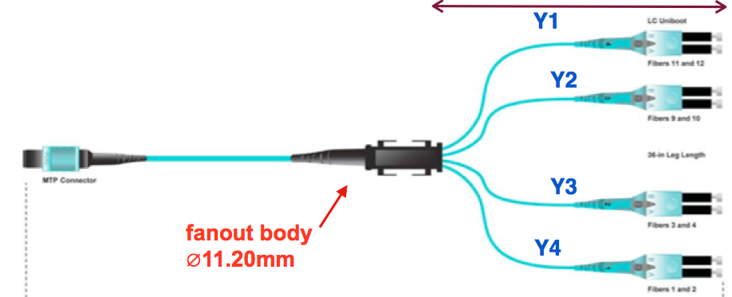
Services: Powers and DAQ
SY4527 LV & HV Power Supply
(compatible with EPICS)
5 SSP Fiber-Optic DAQ
(compatible with CLAS12)
Service
Loglines
LV
HV
CLAS12 RiCH Readiness Review, 13th June 2016
10
Notes:
Qua mi fanno il culo di sicuro sui LV.

Slide 11
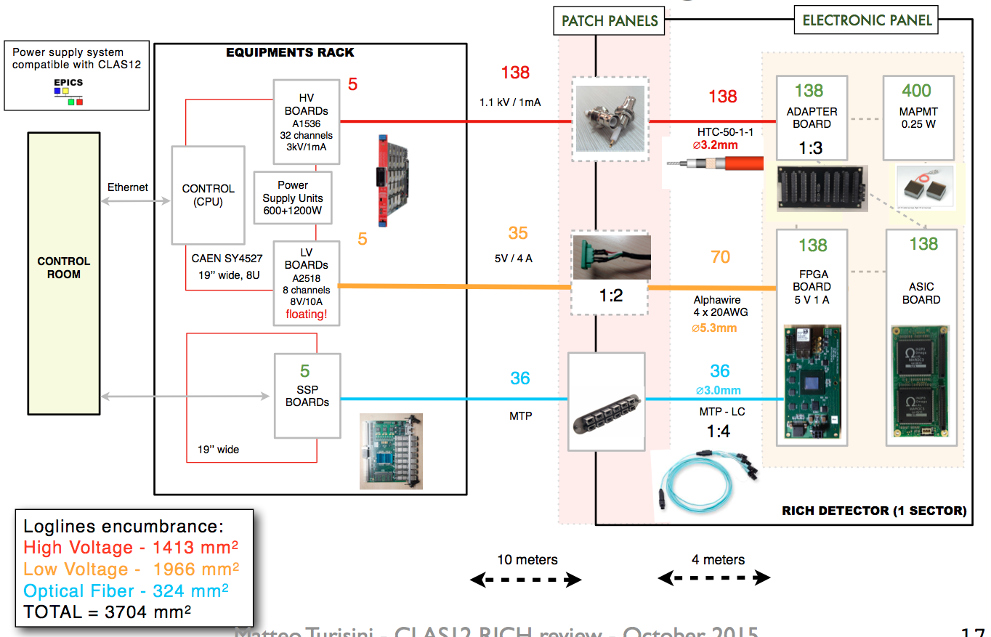
Services: Backend Electronics
CLAS12 RiCH Readiness Review, 13th June 2016
11

Slide 12
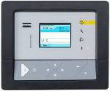
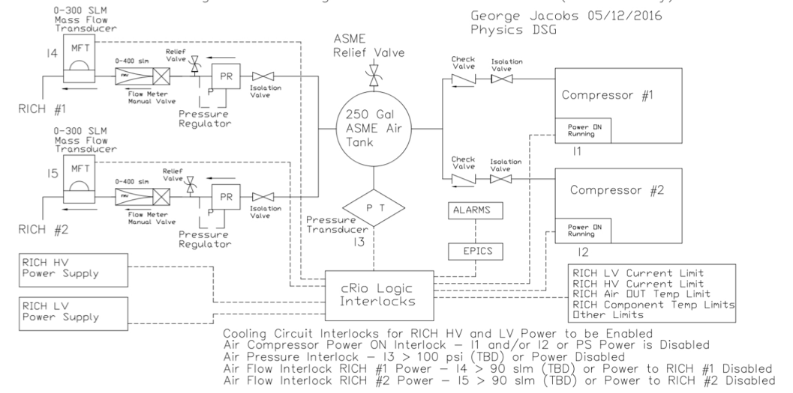
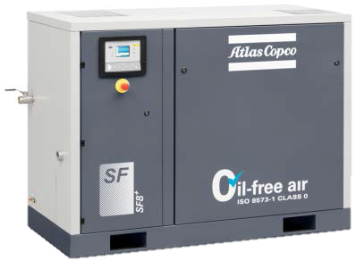
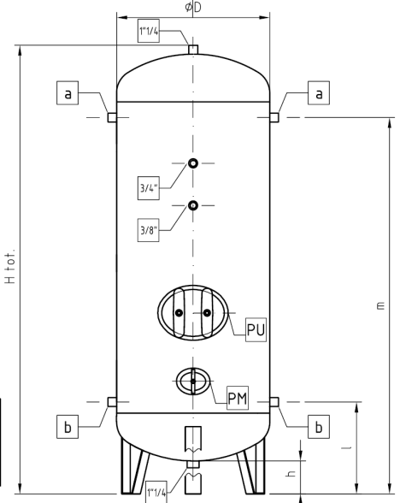
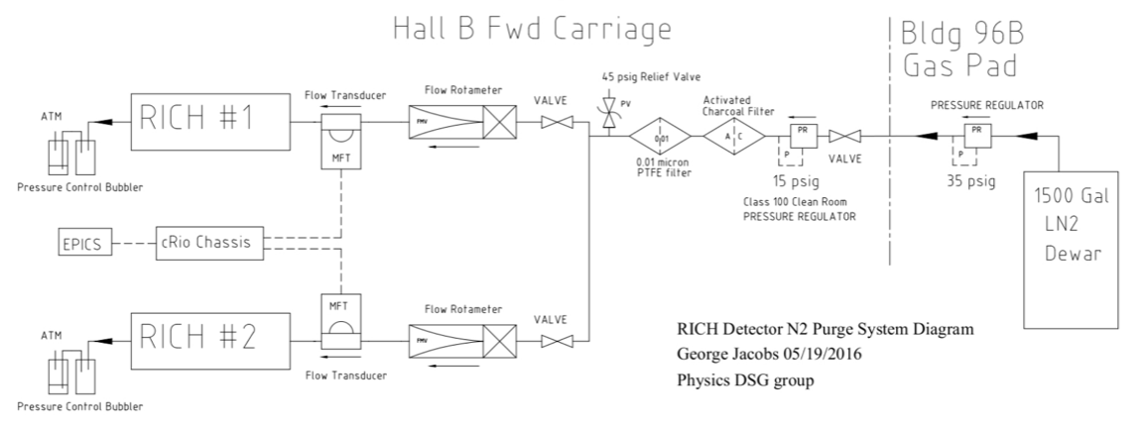
Services: Gas Systems
To electronics
RICH Cooling Circuit
Diagram with Interlock
(G. Jacobs)
RICH N₂ Pure Gas
System Diagram
(G. Jacobs)
CLAS12 RiCH Readiness Review, 13th June 2016
12

Slide 13
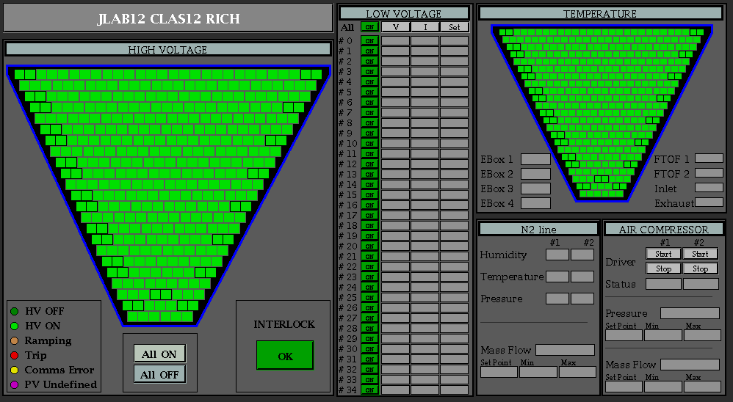
Software
DAQ and Calibration:
- Tested on PCI-e optical link
Next: SSP and CODA
Reconstruction:
Full chain under development:
- gemc simulation
- coatjava based reconstruction
- java based event display
Next:
Optimize for KPP
Slow Control:
Basic hardware supported by CLAS12
- SY4527 power supply
- cRio for gas systems
SSP will provide temperature and
bias voltages for all chips
Next: Implementation within CLAS12
CLAS12 RiCH Readiness Review, 13th June 2016
13

Slide 14
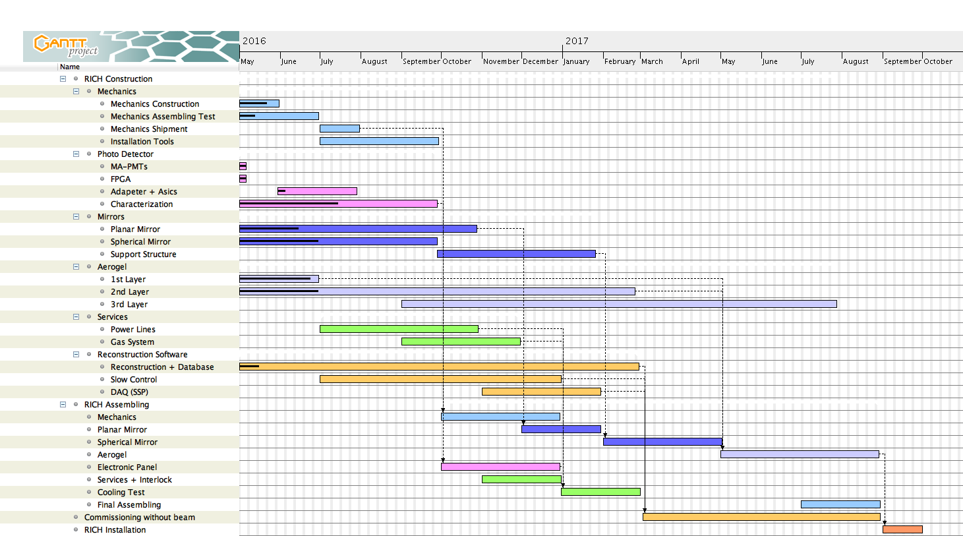
Tasks Toward Completion
Component production organized subject to assembling schedule
Critical path: 4 months
contingency included
CLAS12 RiCH Readiness Review, 13th June 2016
14

Slide 15
CLAS12 RICH Status
✔ Components
- Under production
- Performance in line or better than the design specification
- Deliveries organized subject to assembling schedule
✔ Assembling & Installation
- Start foreseen in October 2016
- Almost 1 year before installation
- Comprises commissioning of all systems without beam
✔ Operation
- Hazard identified
- Services defined to be compatible with CLAS12
- Slow control and Interlock under development
- Reconstruction software under development
CLAS12 RiCH Readiness Review, 13th June 2016
15

