Slide 1
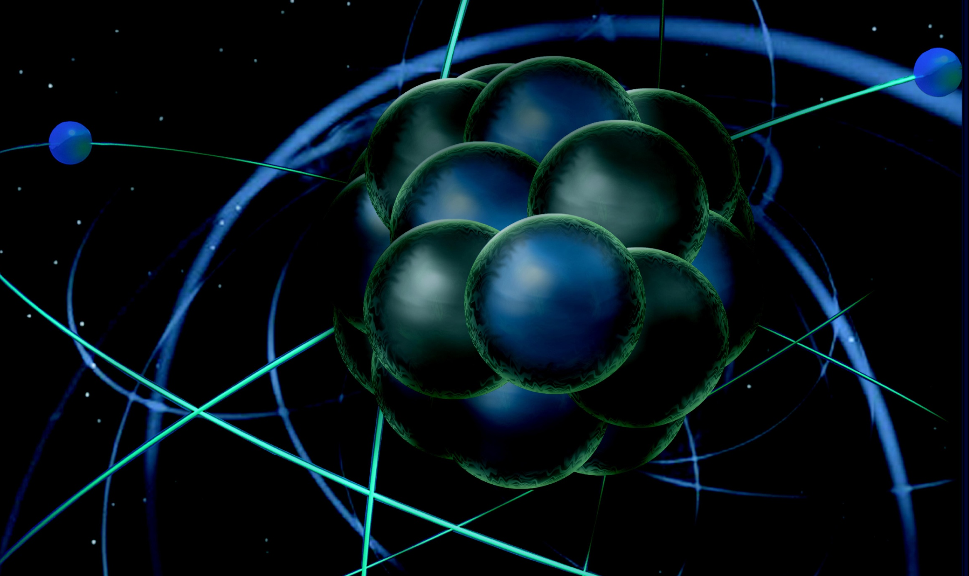
Readiness Review Process
Rolf Ent
Hall B RICH Review
September 05+06, 2013

Slide 2
Readiness Review Process
Jefferson Lab experiments typically use a combination of base equipment and new, often JLab-user led and constructed, equipment.
How do we integrate such new equipment effectively and safely?
Outline:
Experimental Readiness Review Process in the 4 & 6 GeV era
Management self-assessment for "Installation of New Equipment Involving Multiple Groups”.
New Experimental Readiness Review Process in the 12 GeV era
Implications for RICH

Slide 3
Experiment Systems Readiness Process - General
Experiment Systems Readiness reviews are standalone reviews required prior to delivery of any beam to the respective Hall. The Experiment Systems Readiness Process has been used effectively for all JLab experiments since the start of experiments in 1995.
Experiments went through different levels of readiness reviews depending
on being categorized as “Experiments using major new apparatus”.
Goal: assure that the equipment can be safely and effectively operated, and
to document operational procedures appropriate for its commissioning.
All 12-GeV equipment will undergo an Experiment Systems (Hall A, B, C,
and D) Readiness review as a modular piece of the overall Accelerator Readiness
Review (ARR) process.
Basic commissioning of components initiated under JLab Temporary
Operational Safety Procedures (Chapter 3320, “Temporary Work Permits”)
Checkout of full equipment with beam requires
Conduct of Operations (COO)
Radiation Safety Assessment Document (RSAD)
Experimental Safety Assessment Document (ESAD)
Safety Checklists

Slide 4
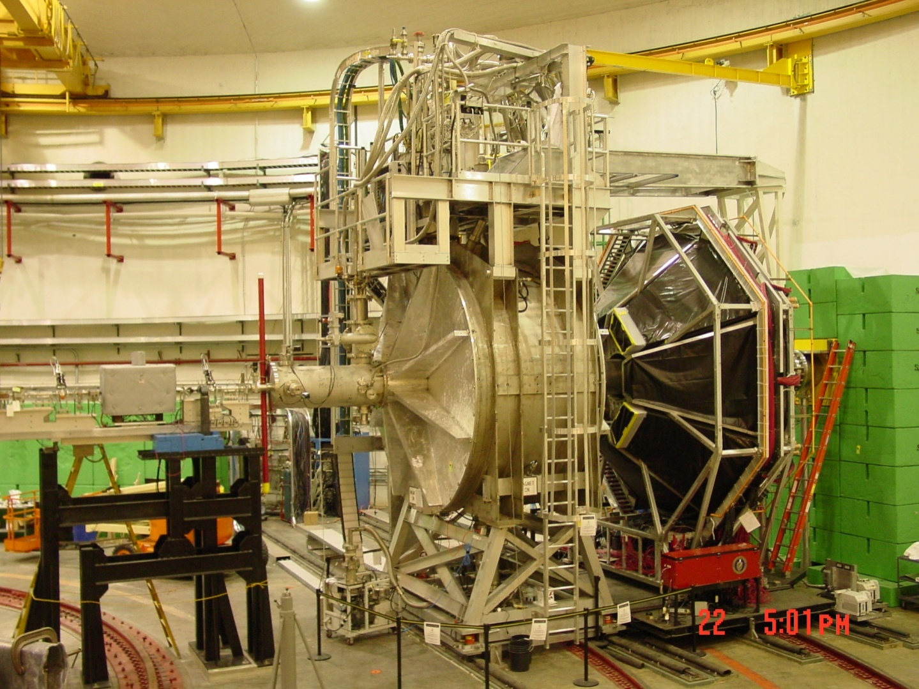
Experiment Systems Readiness Process - Example
G0 Experiment in Hall C as example of “Experiments using major new apparatus”. Series of Equipment Readiness, Safety, and Documentation reviews during design & construction phases before operations.
detectors
beam line
target service
vessel
SC magnet

Slide 5
G0 Safety and Technical Reviews (2002 only)
Date | System | Scope | Reviewers
Feb. 11-12 | Target | Engineering & Safety Review | J. Kilmer (FNAL), J. Mark (SLAC), J. Domingo (JLab), D. Kashy (JLab), W. Vulcan (JLab), M. Seely (JLab)
May 01 | Magnet + Target | TOSP for Vacuum Evacuation | ESH&Q + Subject Matter Experts (SME)
May | Target | Punchlist Items Review | J. Domingo (JLab,), D. Kashy (JLab), W. Vulcan (JLab)
May | Target | TOSP Neon Test | ESH&Q + SME
May | Target | TOSP Hydrogen Cooldown | ESH&Q + SME
Jun. 24-25 | Magnet | Engineering & Safety Review | B. Schneider (JLab), A. Visser (FNAL), J. Gomez (JLab), A. Guerra (JLab)
July | Magnet | TOSP Magnet Cooldown | ESH&Q + SME
Aug. 09 | G0 | RSAD | ESH&Q (Radiation Control Group)
Aug. 14 | G0 | Full EH&S Review (I) (Last Readiness Review) | G. Dodson (ORNL), J.P. Chen (JLab), B. Manzlak (JLab), E. Smith (JLab), M. Spata (JLab), W. Vulcan (JLab)
Aug. 21 | G0 | TOSP G0 Beam Tests | ESH&Q + SME
Sep. 09 | G0 + Magnet | TOSP Powering of the G0 SMS and G0 Beam Tests | ESH&Q + SME
Sep. 16 | G0 | COO and ESAD | ESH&Q + SME
Sep. 19 | G0 | Full EH&S Review (II) (Last Readiness Review) | G. Dodson (ORNL), J.P. Chen (JLab), B. Manzlak (JLab), E. Smith (JLab), N. Okay (JLab), W. Vulcan (JLab)
G0 Experiment in Hall C as example of “Experiments using major new apparatus”. G0 reviews in 2002, the year of final installation and commissioning (many more before th

Slide 6
Experiment Systems Readiness Process - findings
Performed a Management Self-Assessment process at the end of the 6-GeV era to look at “Installation of New Equipment Involving Multiple Groups”.
Asked group to fold in experience of Hall C/Qweak and Hall A/g2p experiments, Hall B/HDICe, and earlier reports/lessons learned on for instance Hall C/HKS, Hall A/PREX, etc. Both staff and users were polled.
Two findings
Experiment Readiness Review Process has not been followed thoroughly for the last couple of projects
Not well defined what constitutes an experiment with major new apparatus
Readiness Review process and reviews should be clearly articulated
Design changes were allowed until very (too) late
Identification of beam and lab infrastructure requirements need to be done early
Experiment Readiness Review Process not commonly known
Discrepancies in knowledge amongst Hall C vs. other Halls
Discrepancies in knowledge amongst Physics Division vs. other Divisions
Discrepancies in knowledge amongst Staff vs. Users
Two noteworthy practices
Roles and Responsibilities seemed to be well known.
The existing model seems to work well, with very good communication, coordination, and cooperation.

Slide 7
Revised READINESS REVIEW PROCESS @ 12 GeV
Jefferson Lab has revisited the experimental readiness review process in preparation of the 12-GeV startup.
That means:
Partly correcting the Experiment Readiness Review web pages
Folding in feedback from the management self-assessment for "Installation of New Equipment Involving Multiple Groups”.
The document, expected to be officially released with the completion of the web pages, will give the guidance for running experiments in the 12 GeV era.

Slide 8
Readiness Review Process – Flow Chart
PROPOSAL PHASE
Submitting Proposals
TAC & PAC Process
Director’s Decision
⬇
PRELIM. PLANNING PHASE
Exp. Description and Requirements
Exp. Readiness Review Calendar
⬇
PESAD, specific equipment reviews
Complete Conceptual Designs & “1st” Readiness Review
DESIGN PHASE
⬇
Fabrication of the equipment
Test of the individual elements of the equipment (OSP/TOSP)
CONSTRUCTION PHASE
SCHEDULING OF EXPERIMENT
by JLab
Construction near-completed, designs frozen
“2nd” Readiness Review before submitting scheduling request
⬇
EQUIPMENT INSTALLATION
“Final” readiness review
Final ESAD & RSAD
COO
Safety Checklist(s)
Experimental Procedures
DECOMMISSIONING
RUN THE EXPERIMENT

Slide 9
Readiness Review Process – Web Pages
http://www.jlab.org/user_resources/PFX/NP-PFX/
Or as text only version:
http://www.jlab.org/user_resources/PFX/NP-PFX/text.html

Slide 10
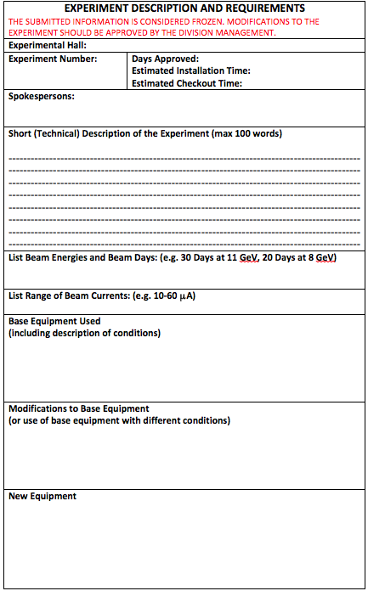
By the spokespersons

Slide 11
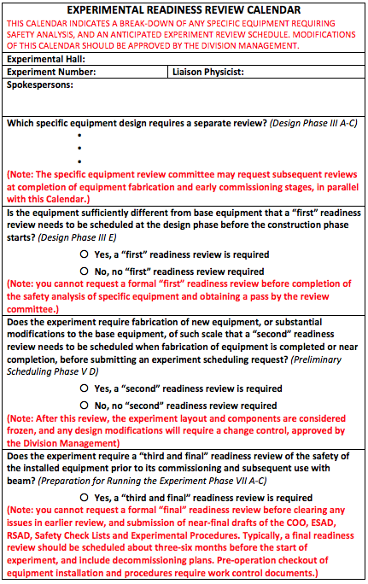
By the Division Safety Officer

Slide 12
ESH&Q Integration for RICH in Physics
Fully integrate ESH&Q into planning and design
Perform hazard analysis for new scope
No hazard found requiring PESAD/1st readiness review of RICH
Coordination of work with outside institutions
Design and safety reviews of major subsystems
Prepare for “2nd” readiness review stage before scheduling request
Integration of assembly and commissioning tasks
Design changes where appropriate, e.g.,
No flammable gases, environmental-friendly where possible
Reduce voltage where possible
Freeze design after “2nd readiness review” to prevent surprises for installation and running.

Slide 13
“Final” READINESS REVIEW
Concentrates on ESH
Final readiness documents for experiments include:
Conduct of Operations (generic for all Halls, A-D)
Experiment Safety Assessment Documents
(<40 page document of generic form)
Radiation Safety Assessment Documents (no changes)
Safety Checklists
Experimental Procedures (these are for the users, they can be on wikis or as “one-pagers” in the Hall documentation)
Includes planning for decommissioning, if applicable
We plan to independently construct an “Operations Manual” for experts that simply links all TOSPs used for commissioning the new equipment – the RICH would be folded in here.
RICH can be declared “base equipment” only by the Division Safety Officer

Slide 14
Readiness Review Process - Summary
The Experiment Systems Readiness Process has been used effectively
for all JLab experiments since the start of experiments in 1995
The existing model seems to work well, with very good communication, coordination, and cooperation amongst multiple divisions, and
roles and responsibilities well defined (work coordinator, physics liaison, accelerator liaison, engineering coordinator)
Nonetheless, the process was not well known and not always followed
Revisited experiment systems readiness process to
Clarify review process from the start – communicated to users
Update web pages for consistency – in progress
Update safety documentation and Hall safety walkthrough to become
as generic as possible for all Halls (A-D)
COO generic document
ESAD generic format (draft)
RSAD generic format
Safety checklists
Experimental procedures for users (wiki or “how-to’s”)
Operations Manual for experts
Safety Walkthroughs generic format (draft)
- Include decommissioning in reviews
RICH comes in at “2nd readiness review”: review before scheduling request

