Slide 1
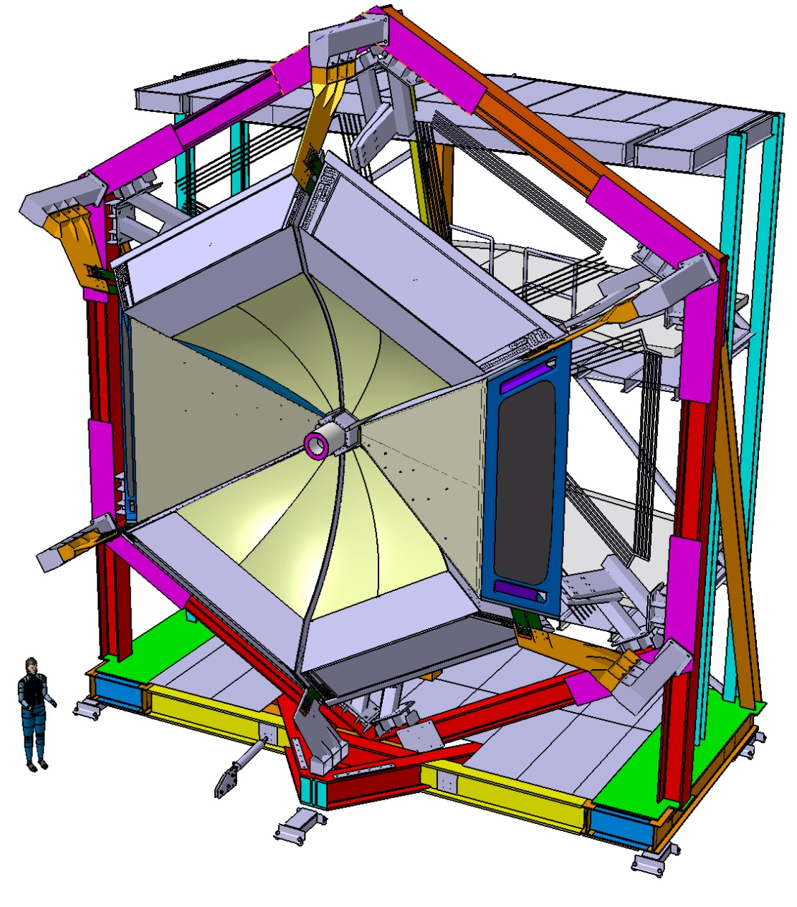
CLAS12 RICH- Mid Term Review
RICH Installation
and
integration in CLAS12
October 13th 2015
D. Orecchini, S. Tomassini

Slide 2
Outline
Assembly of the detector in the clean room at JLab.
RICH transportation to the Hall B
RICH Installation in the CLAS12 apparatus.
Utilities
Conclusions.

Slide 3
RICH assembly operation plan
The delivery of the components will start after summer:
aerogel (October)
1st CFRP mirror (March 2016)
RICH mechanical Case (March 2016)
The CFRP Mirror test will start in March 2016 in the dark room.
The assembly of the RICH module will start in October 2016 (according to the management plan) and will last till the transportation in Hall B (June 2017).
The mechanical assembly requires:
Clean room:
storage of aerogel
storage and test (dark room) of the mirrors
assembly and alignment of the mirrors
installation of the aerogel in the front panel
Normal room:
storage of the RICH module before the beginning of the assembly operations
assembly and tests of the electronic panel
The areas must also allow the survey of the module before the installation in Hall B

Slide 4
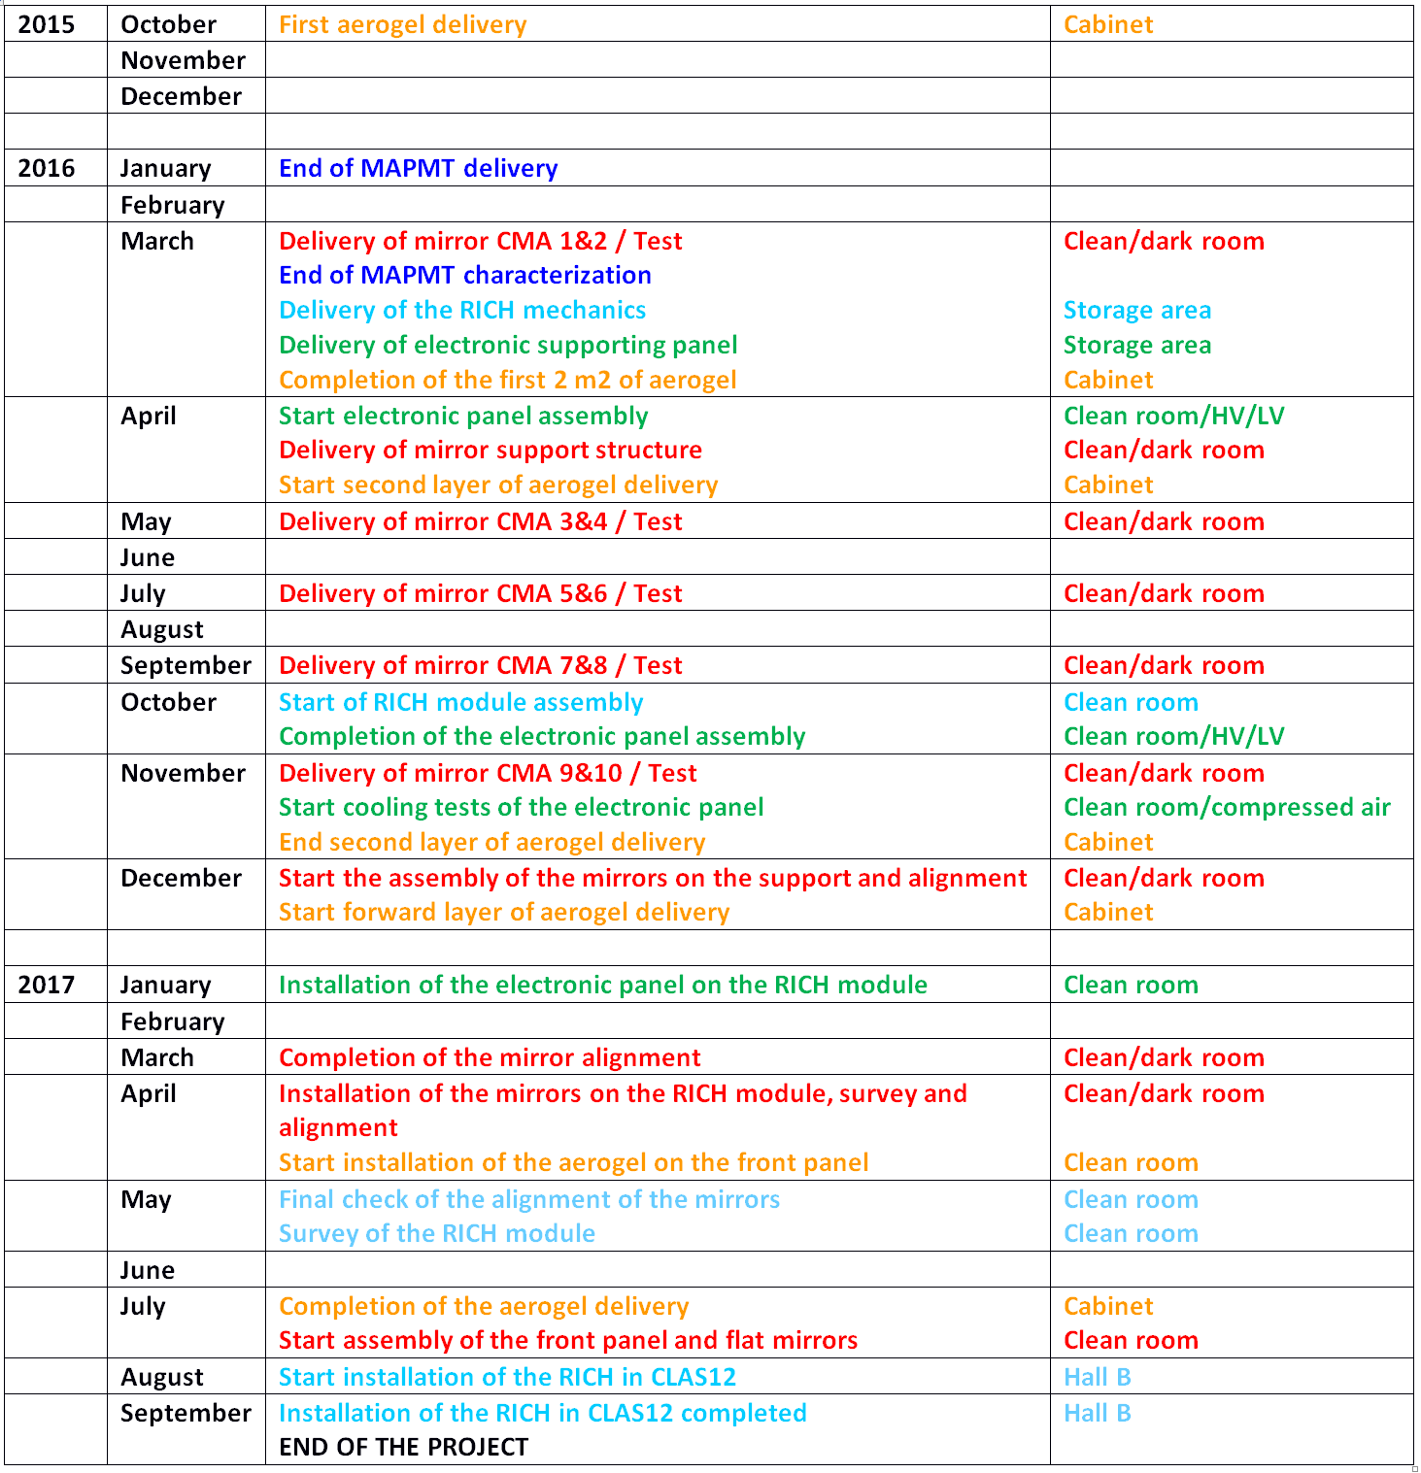
RICH assembly time schedule
More details in the assembly document
M. Mirazita

Slide 5
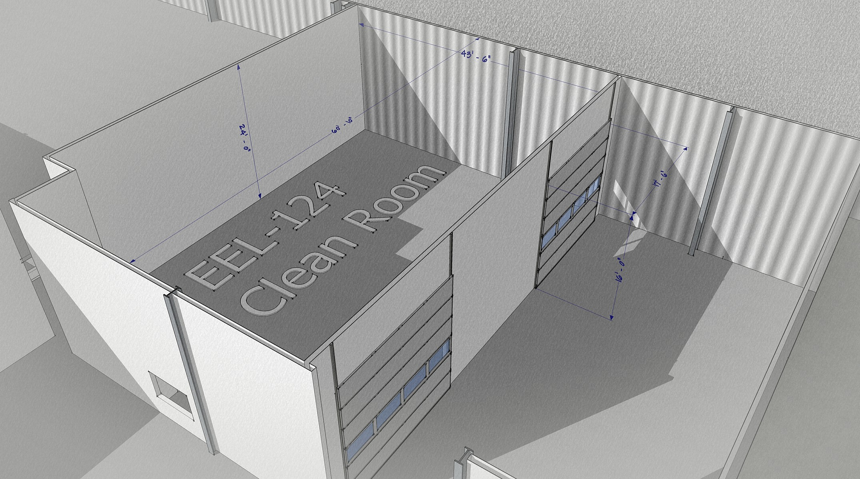
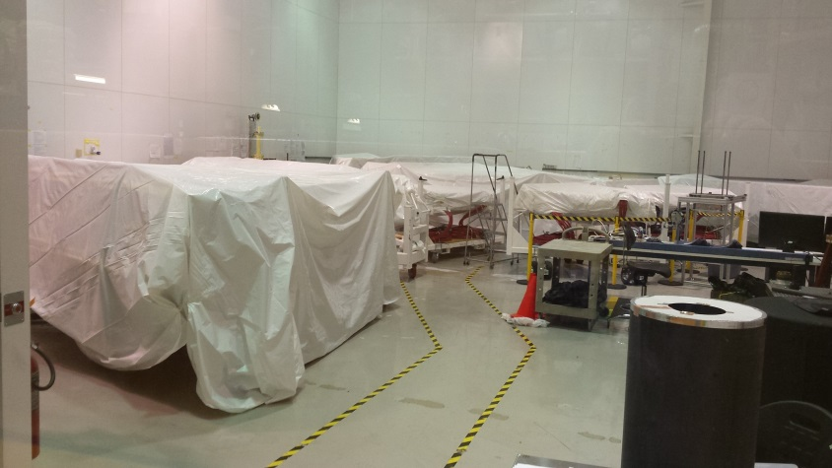
CLAS12 – RICH ASSEMBLY : EEL-124
Discussed and agreed with Walt Ackers
13.30m
7.30m
18.30m
5.35m
4.85m
CLEAN ROOM
Has been used to assemble the Drift chambers
Available since OCTOBER 2016 after the installation of the Drift chambers
Small areas inside the room will be available since first delivery of materials

Slide 6
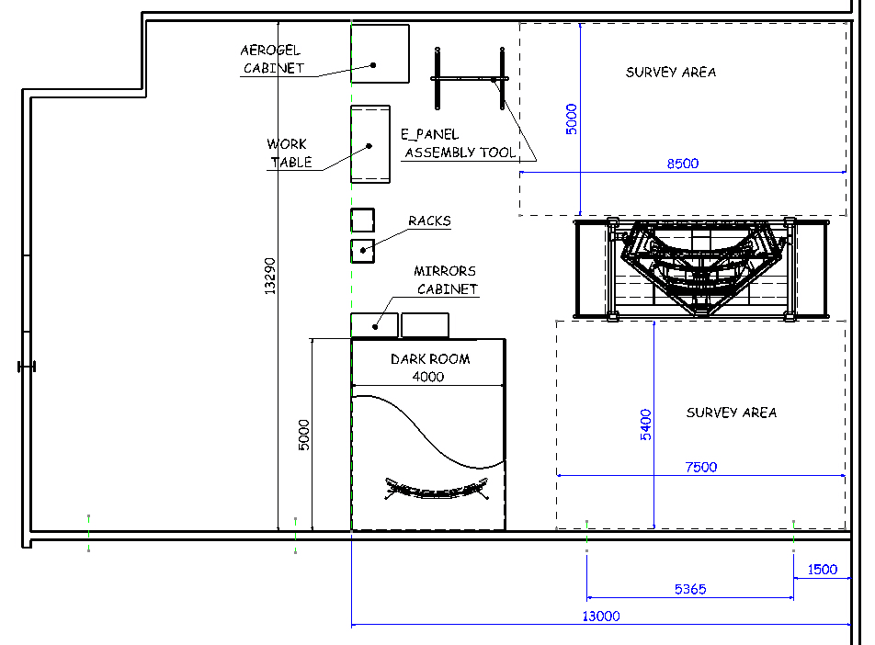
RICH ASSEMBLY AREA LAYOUT IN EEL-124
AREA FOR ASSEMBLY AND SURVEY
ASSEMBLY AREA.
all the assembly operations will be performed in EEL-124
Dark Room is a removable enclosure
AREA FOR ASSEMBLY AND SURVEY
DARK ROOM
The dark room must be available since the delivery of the first CFRP mirror

Slide 7
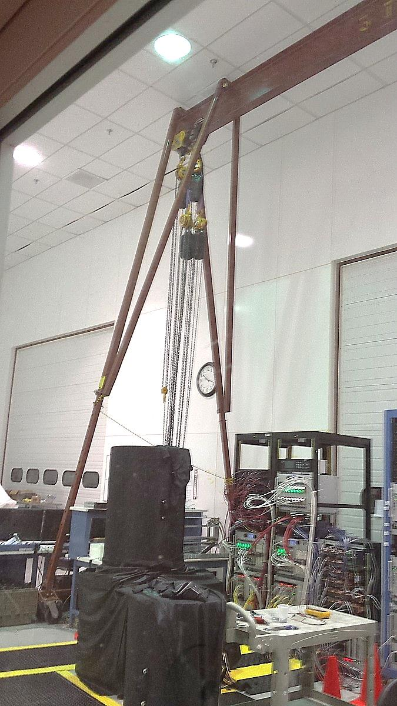
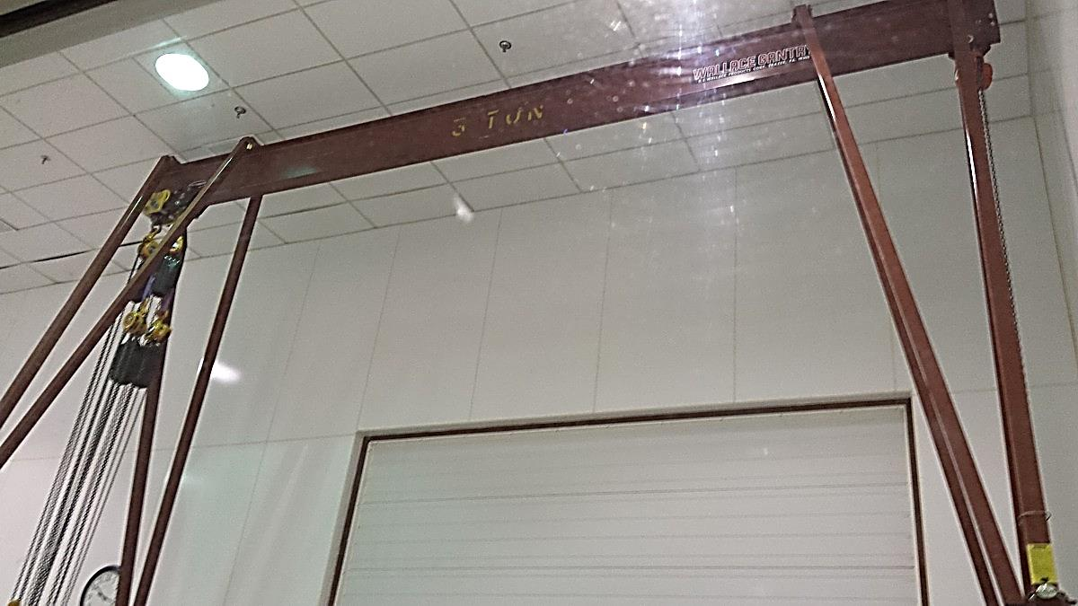
CLEAN ROOM EEL-124
Is equipped with a Gantry Crane Capacity 3 TON
A Gantry Crane will be used for mechanical assembly of the RICH case. The rotation of the RICH, once the assembly will be completed, will be performed by means of a winch.

Slide 8
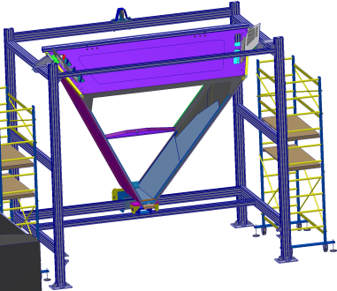
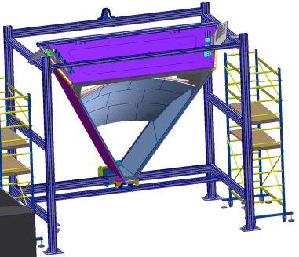
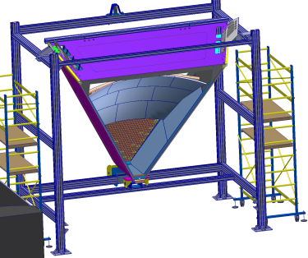
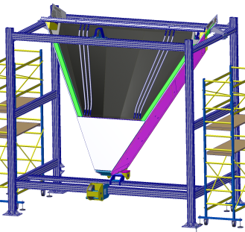
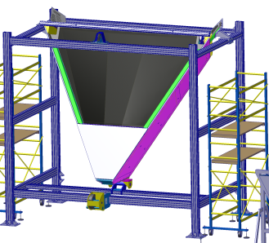
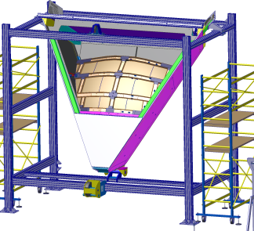
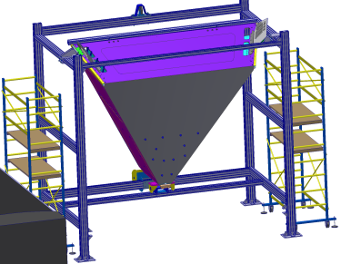
List of operations before the RICH module rotation and transportation to Hall B
Mechanical assembly of the RICH case after the delivery to Jlab
Installation of the glass lateral mirrors
Installation of the spherical mirror
Alignment of the mirrors wrt the reference system
Installation of the electronic panel, cable trays
Cabling and Piping (cooling air and purging nitrogen)
Installation of the exit panel
Installation of the frontal panel
Light tightness test and sealing if necessary
Rotation and transportation of the RICH module to the hall B

Slide 9
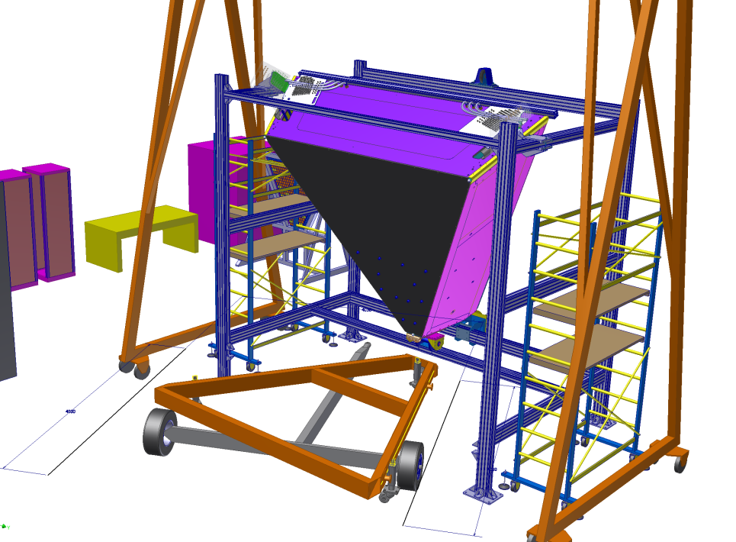
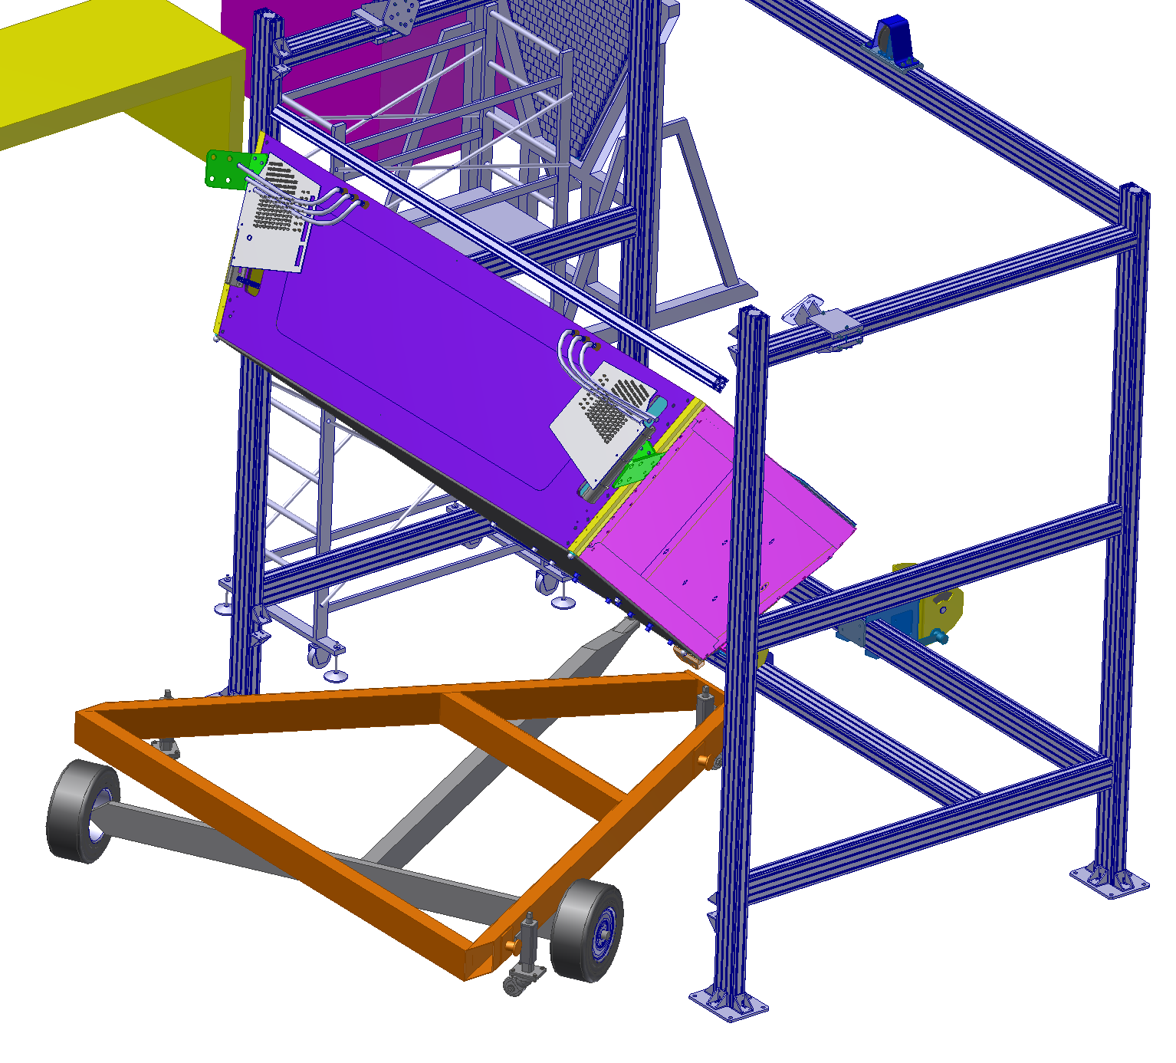
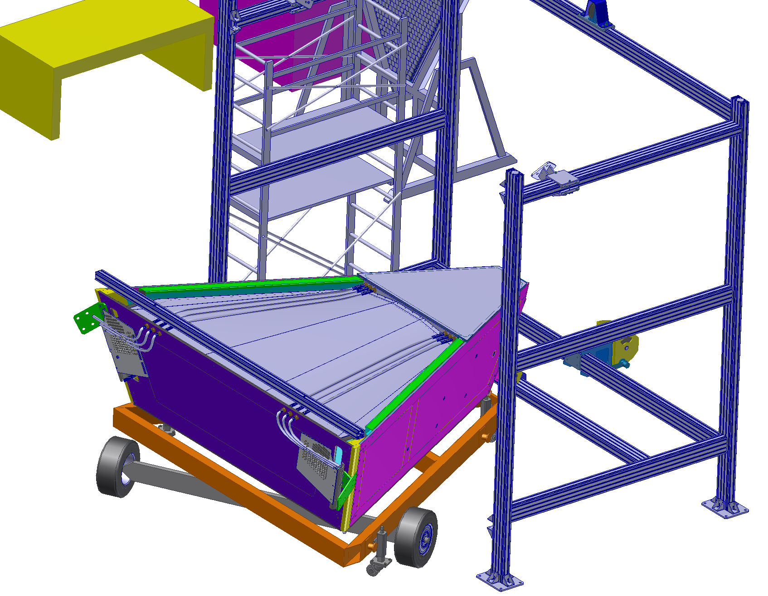
Rotation of the RICH module
ROTATION STEP_1
ROTATION STEP_2
TROLLEY
THE RICH HAS BEEN ASSEMBLED
THE RICH IS ROTATED BY THE WINCH
THE RICH IS SECURED ON THE TROLLEY
THE TROLLEY IS ROLLED OUT THE CLEAN ROOM
ROTATION STEP_3

Slide 10
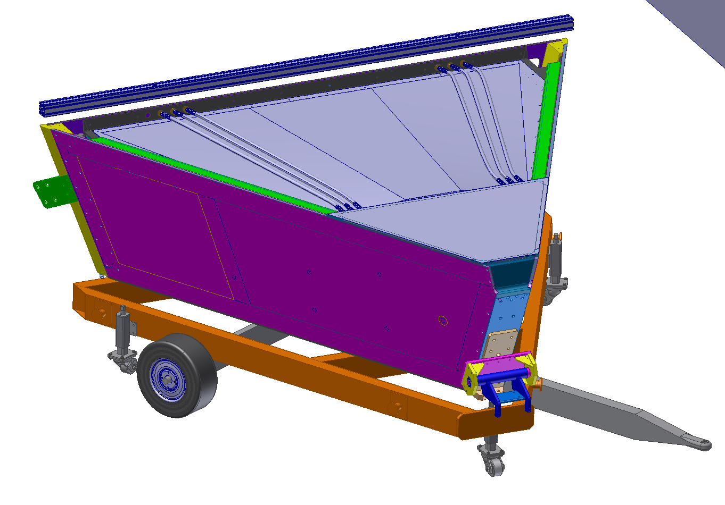
TROLLEY FOR THE TRANSPORTATION
The volume will be closed and sealed in its final assembly and the inner volume will be temporarily fluxed by dry nitrogen
RICH MODULE
AN EXPECIALLY DESIGNED TROLLEY WILL BE USED TO TRANSPORT THE RICH TO THE HALL B IN ORDER TO REDUCE AS MUCH AS POSSIBLE THE RISK OF BREAKING THE AEROGEL TILES AND TO NOT STRESS THE AEROGEL SUSPENTION SYSTEM
The system can be safely pulled by a Forklift or electric tractor …
Low pressure tires to damp vibrations
TROLLEY
Jackable wheels for fine adjustment

Slide 11
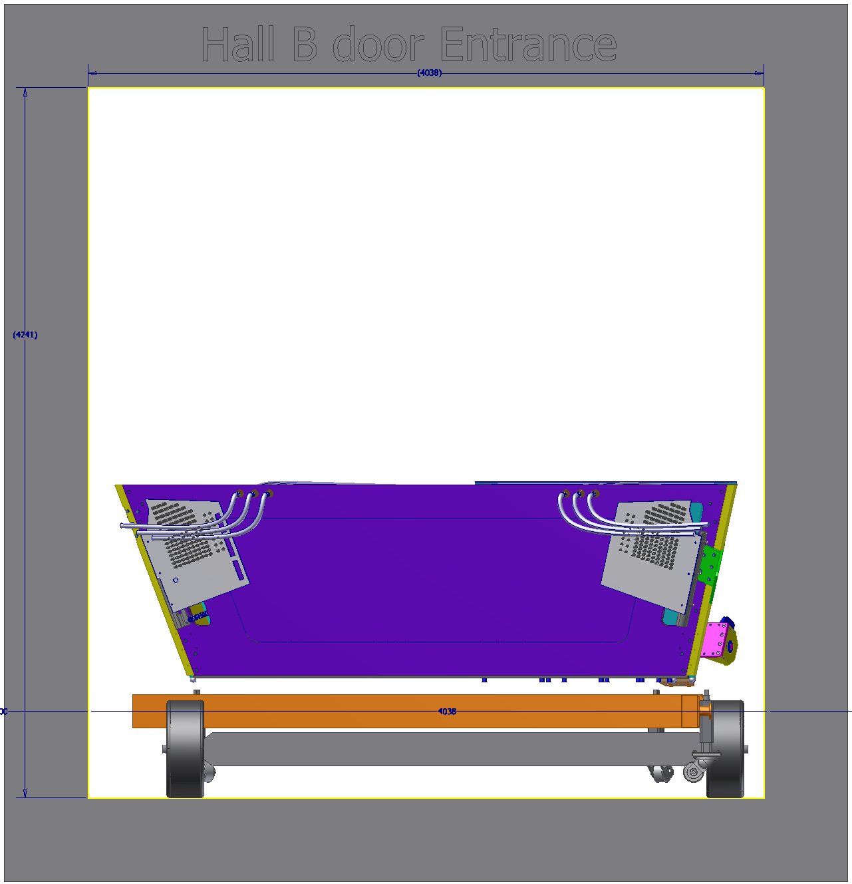
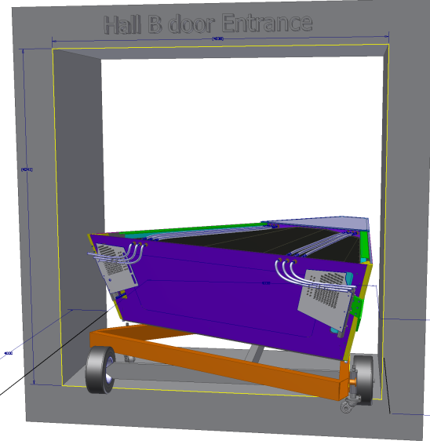
Hall B ENTRANCE
To easily enter the hall B door, the trolley has an asymmetric shape
There are 10 cm of clearance on each side of the door
One stirrup must be dismounted and the two patch panels must be folded

Slide 12
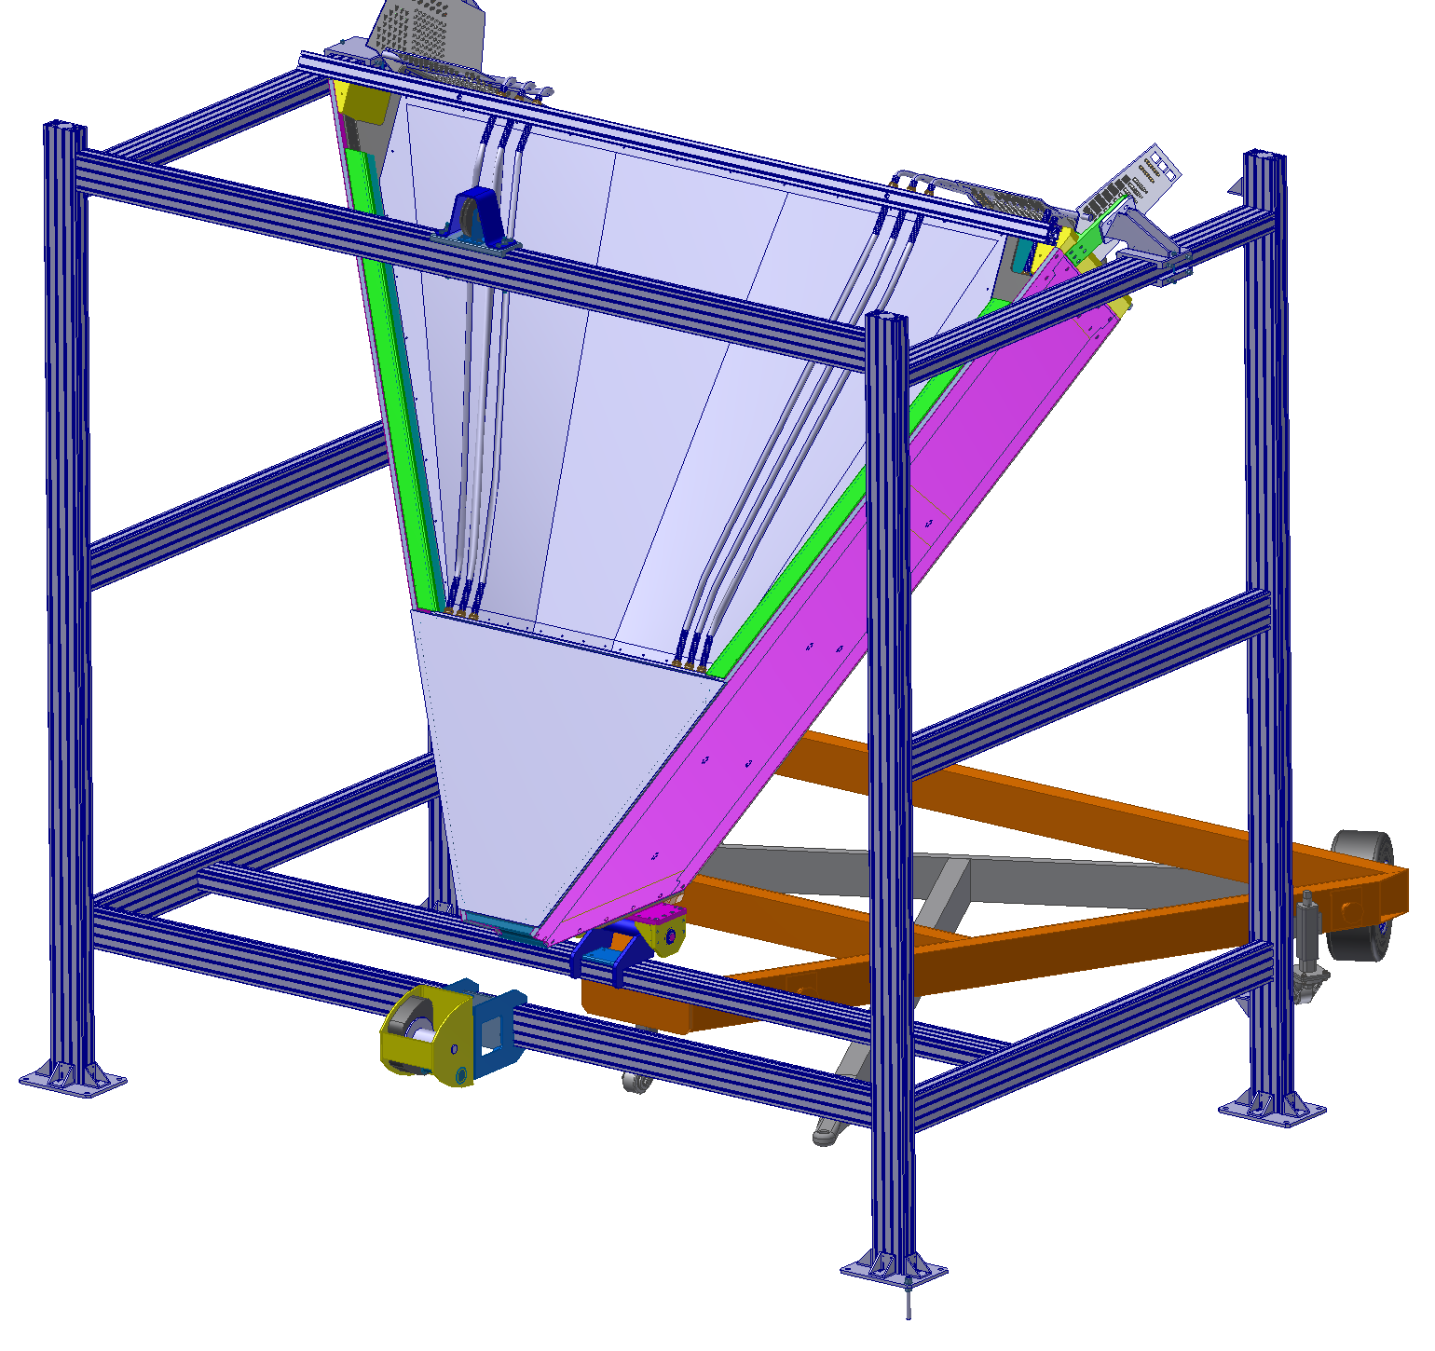
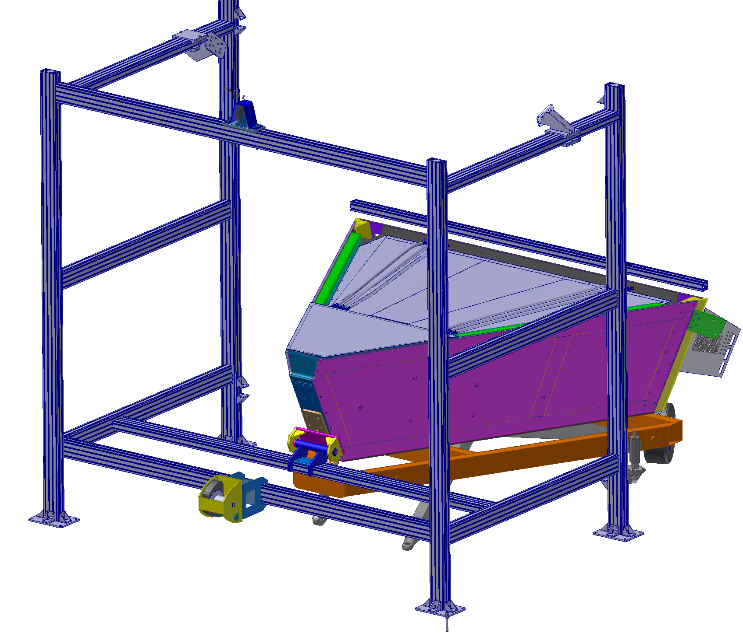
Back Rotation once in hall B
The assembly structure will be dismounted and remounted in Hall B
The RICH will be back rotated to the position ready to attach the lifting tool

Slide 13
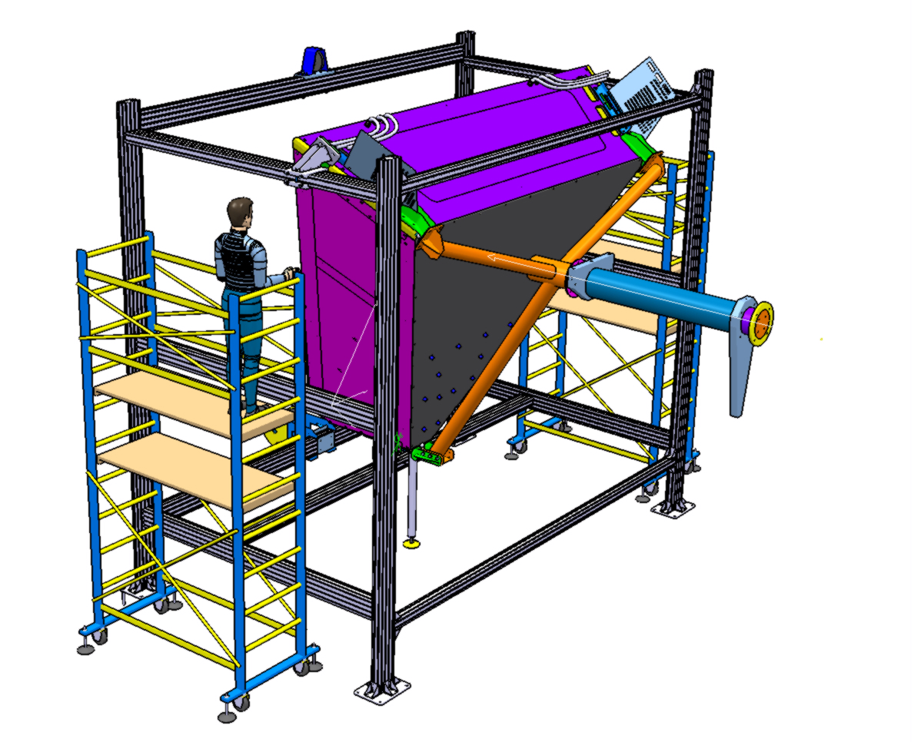
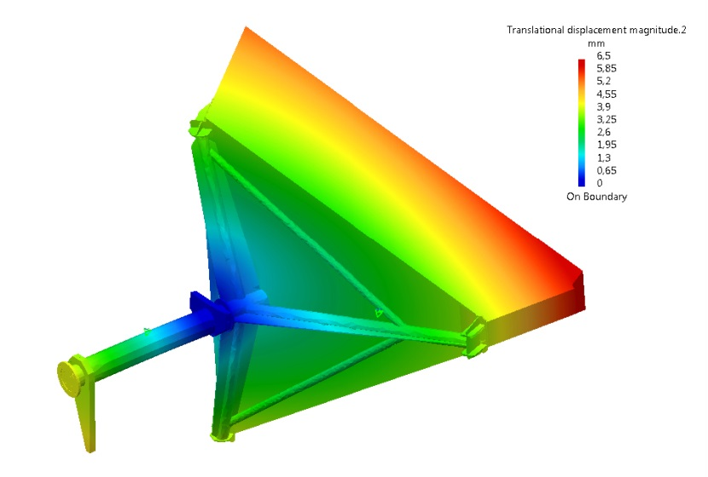
LIFTING TOOL INSTALLATION
Crane
Counter Weight
A TRIPOD FOR RIGGING THE RICH MODULE ON THE FORWARD CARRIAGE IS UNDER DEVELOPMENT
Details in the Dario’s presentation
LIFTING TRIPOD

Slide 14
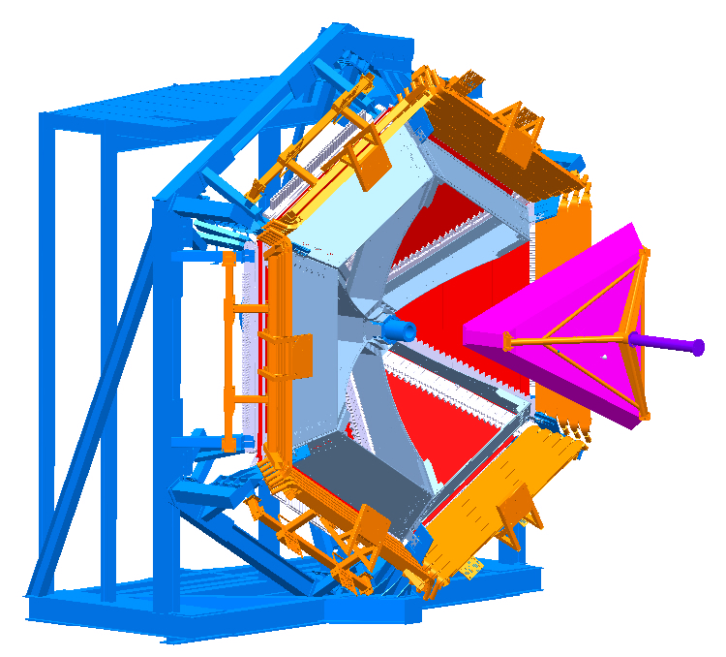
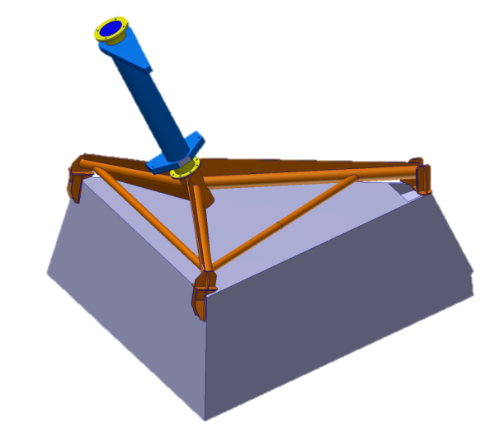
Installation in CLAS12
The module will be rotated by means of the hall B crane
Crane
Crane
Counter Weight
Counter Weight

Slide 15
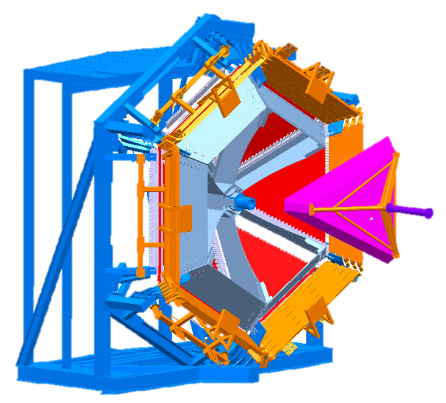
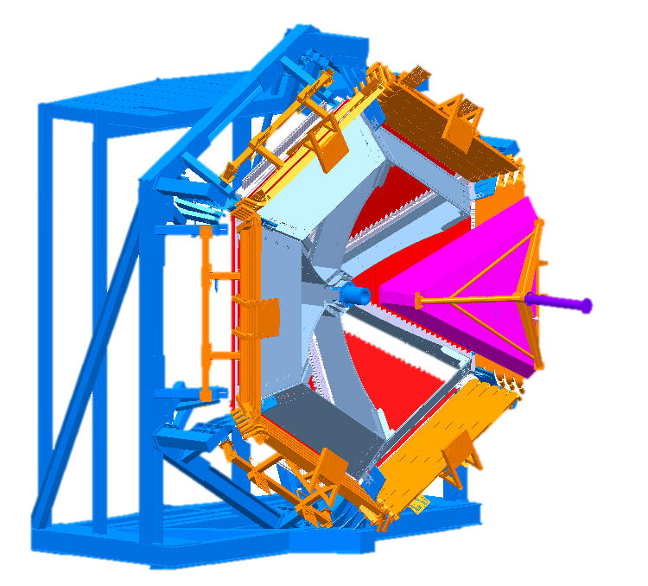
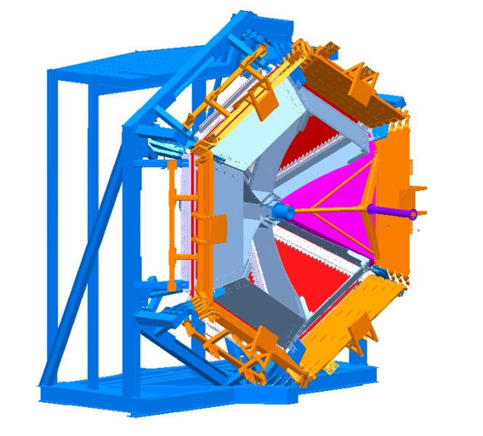
Installation in CLAS12 cont’
1
2
3

Slide 16
UTILITIES
Compressed air to cool down the electronic panel to keep safe the FTOF
Limit temperature is 100F on the FTOF panel
Purging Nitrogen to reduce the relative humidity inside the RICH as required to maintain the aerogel performances
Total volume is 5 m^3

Slide 17
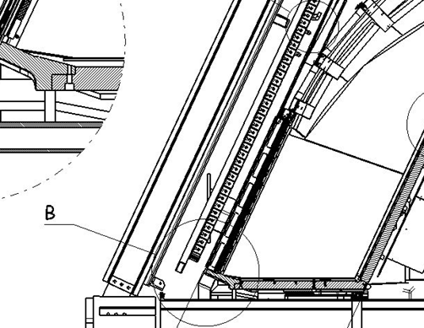
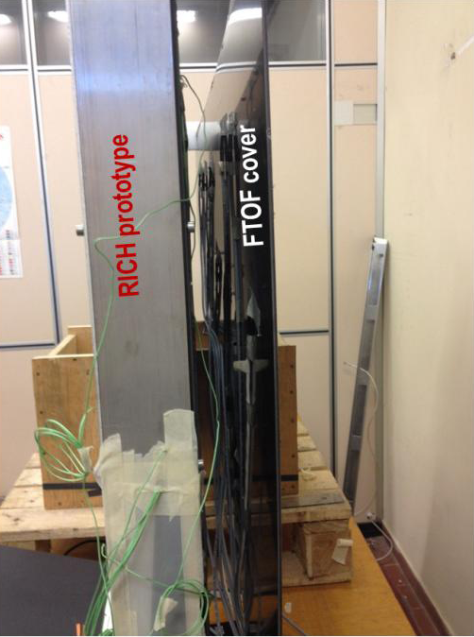
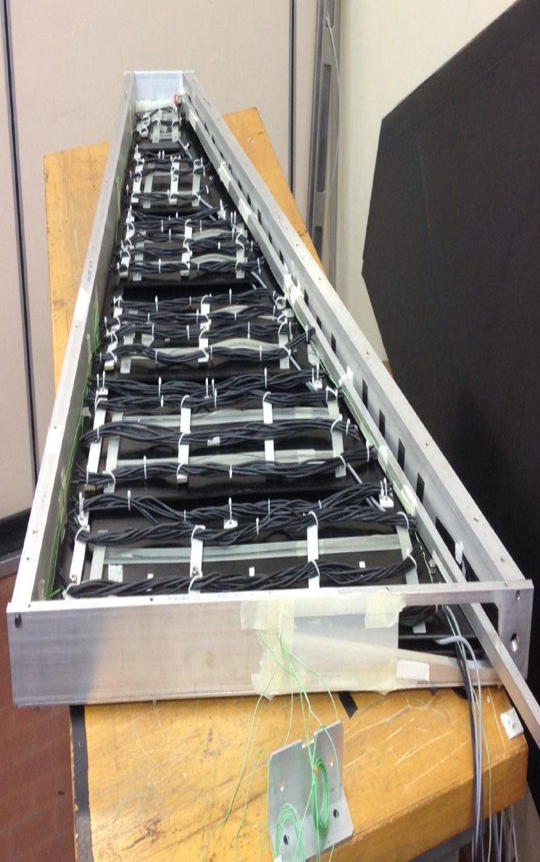
Electronic Box: Test Cooling Setup
Prototype of half of the electronic panel made of Aluminum and PVC and resistive wires to simulate the heating.
The box is sealed and has an air inlet and outlet
- 50W on the ASIC plane
- 150W on the FPGA plane
Fresh air fluxed inside the box from a compressor
Temperatures measured in few points inside and outside the box
Cover
TOF
Elec. Panel
Temperature limit for TOF operation
is 100 °F /38 °C
M. Mirazita, V. Lucherini

Slide 18
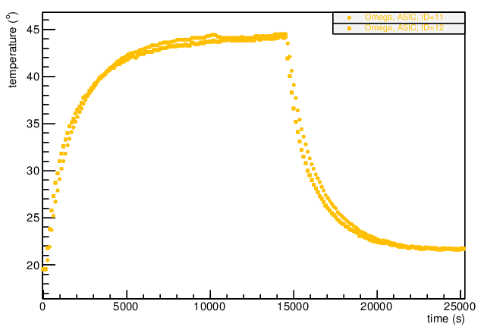
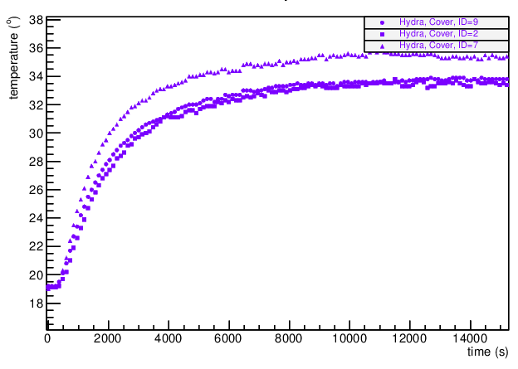
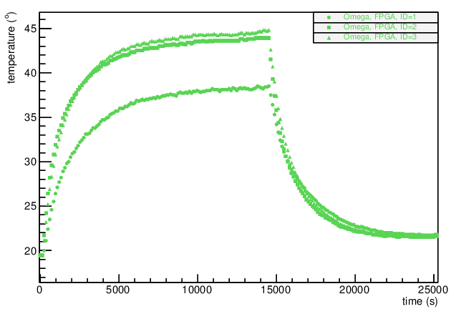
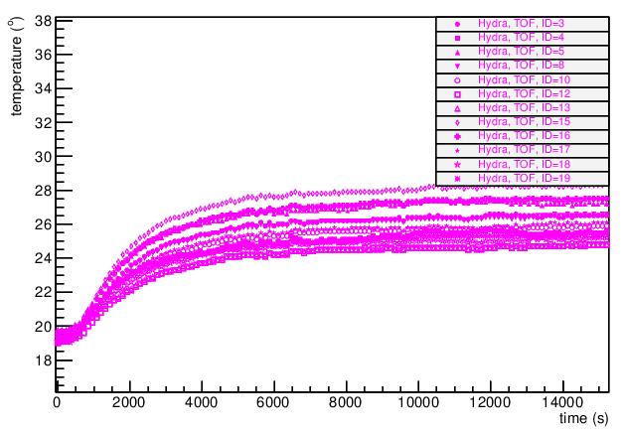
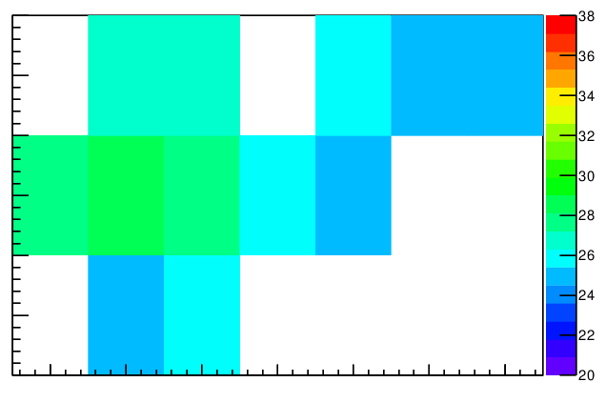
Measured Temperatures
Air flow is 100 l/min, inlet temperature scaled to 20 °C
Inner
temperatures
ASIC
RICH cover
Temp vs Time
FPGA
FTOF
Surface map
Temp
FTOF Temp vs Time
M. Mirazita, V. Lucherini
Tmax~28C well below the requirements

Slide 19
Effect of gravity
gravity
Tmax ~ 37.6 degC
gravity
Tmax ~ 37.8 degC
The Effect of natural convection can be neglected
R. Perrino – INFN-Lecce

Slide 20
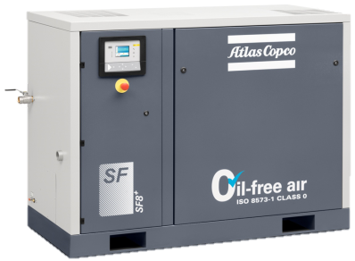
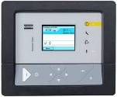
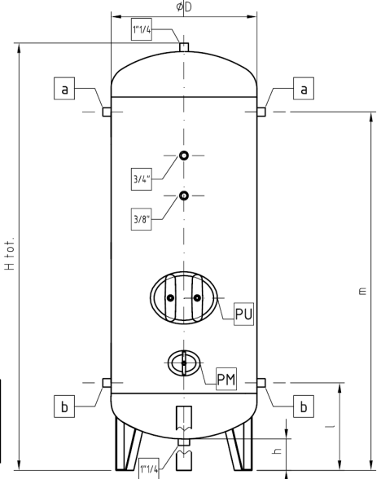
Utilities: Compressor Layout
SF11-8 MC FF
SF11-8 MC FF
Flow rate | 20,2 l/s
Elec. Power | 10,4 kW
Dew Point T | 3 °C
Dimensions | 1,4x0,7x1,8m
Weight | 515 kg
Noise Press | 60 dB(A)
Installation area: 10 m^2
Cost: ∼30k€
To the Electronic Box
M. Mirazita, V. Lucherini

Slide 21
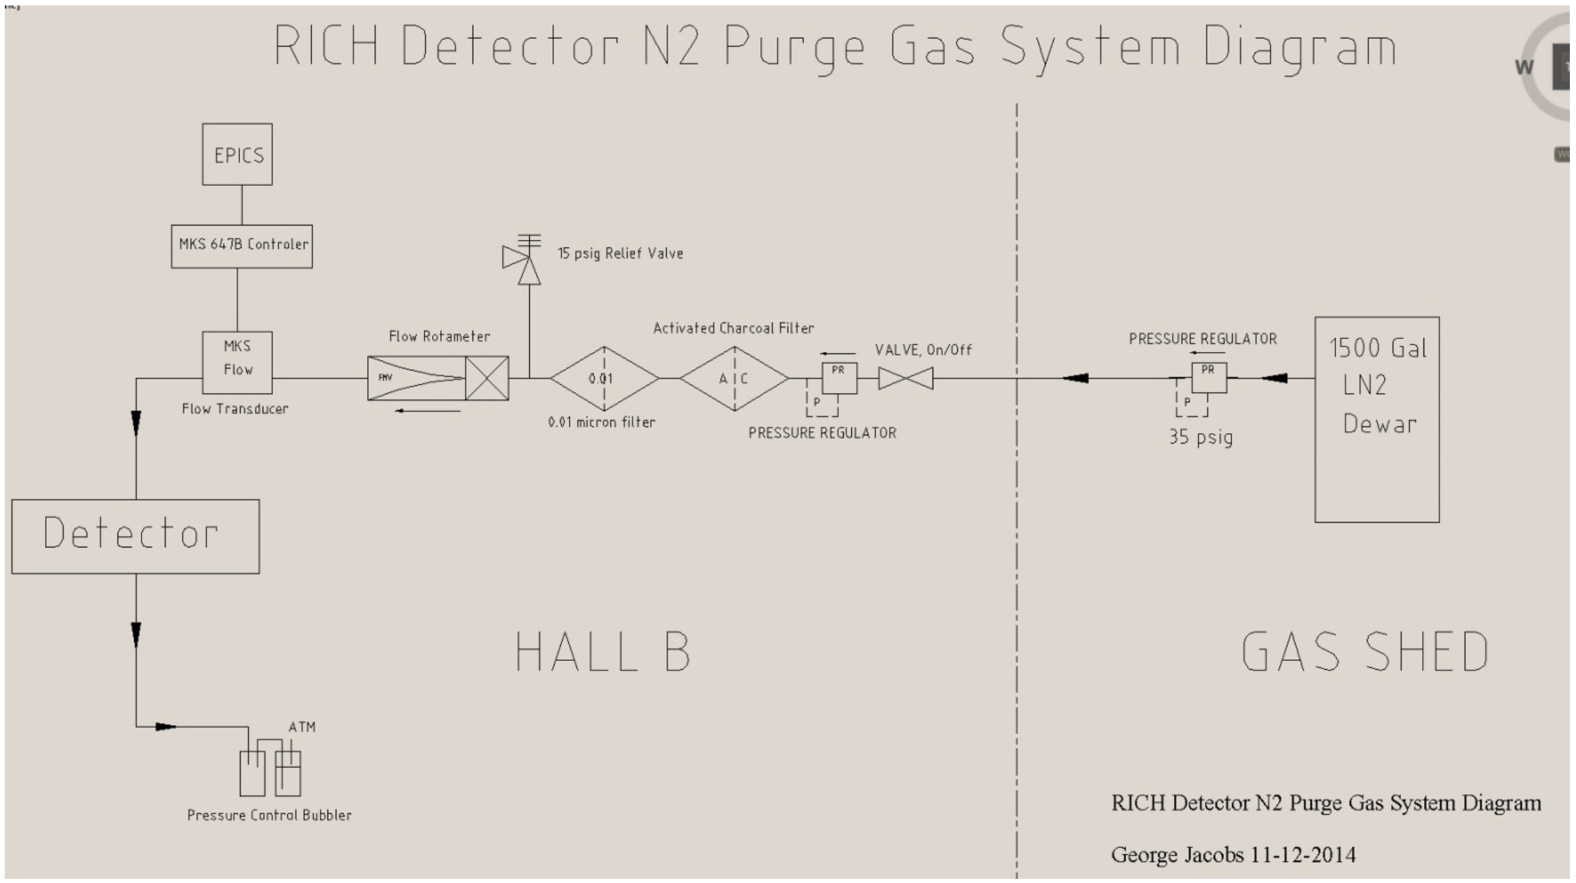
UTILITIES: Purging Nitrogen
Δp= 0.5 mbar
Flow rate ≅ 5 m^3/day

Slide 22
Slow control
Elements to be controlled
Electronics and MAPMT
High Voltage
Low Voltage
Services
Nitrogen gas system
- humidity, pressure, flow rate
Electronic cooling system
- inner temperature
- air temperature, humidity, flow rate
Air Compressors
- Functioning status
Only instrumentation compatible with JLab will be used (e.g. CAEN HV power supply)
In charge of Glasgow group

Slide 23
CONCLUSIONS
The assembly procedures in the clean room have been defined
The RICH will be transported in the Hall B fully assembled and sealed, safe condition for the aerogel
Installation in CLAS12 must be done by minimizing the potentially risky movements
Preliminary design of the services done, finalization in collaboration with JLab
Slow control will be required to manage standard equipment for JLab

Slide 24
Spare Slides

Slide 25
Geometry
(Code: Comsol Multiphysics 3.2)
Physics
Inner air volume only
3 holes for fresh air inlet
Power source on boundary 3: 200 W/m²
Fresh air inlets on boundary 6: defined through inlet velocity and temperature
All other boundaries are adiabatic
ON/OFF Gravity volume force along coordinate of choice (e.g. X)
Boundary 8: convective outflow
gravity
Z
Boundary 6: simulates fresh air inlets
Y
X
Boundary 3: large flat heat source

Slide 26
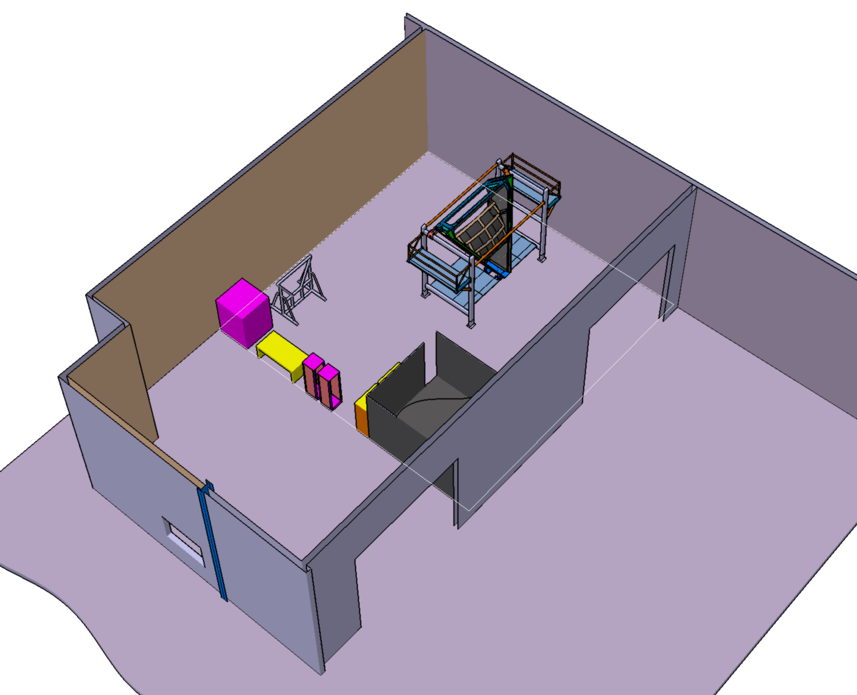
CLAS12 RICH Assembly area in EEL124

