Slide 1
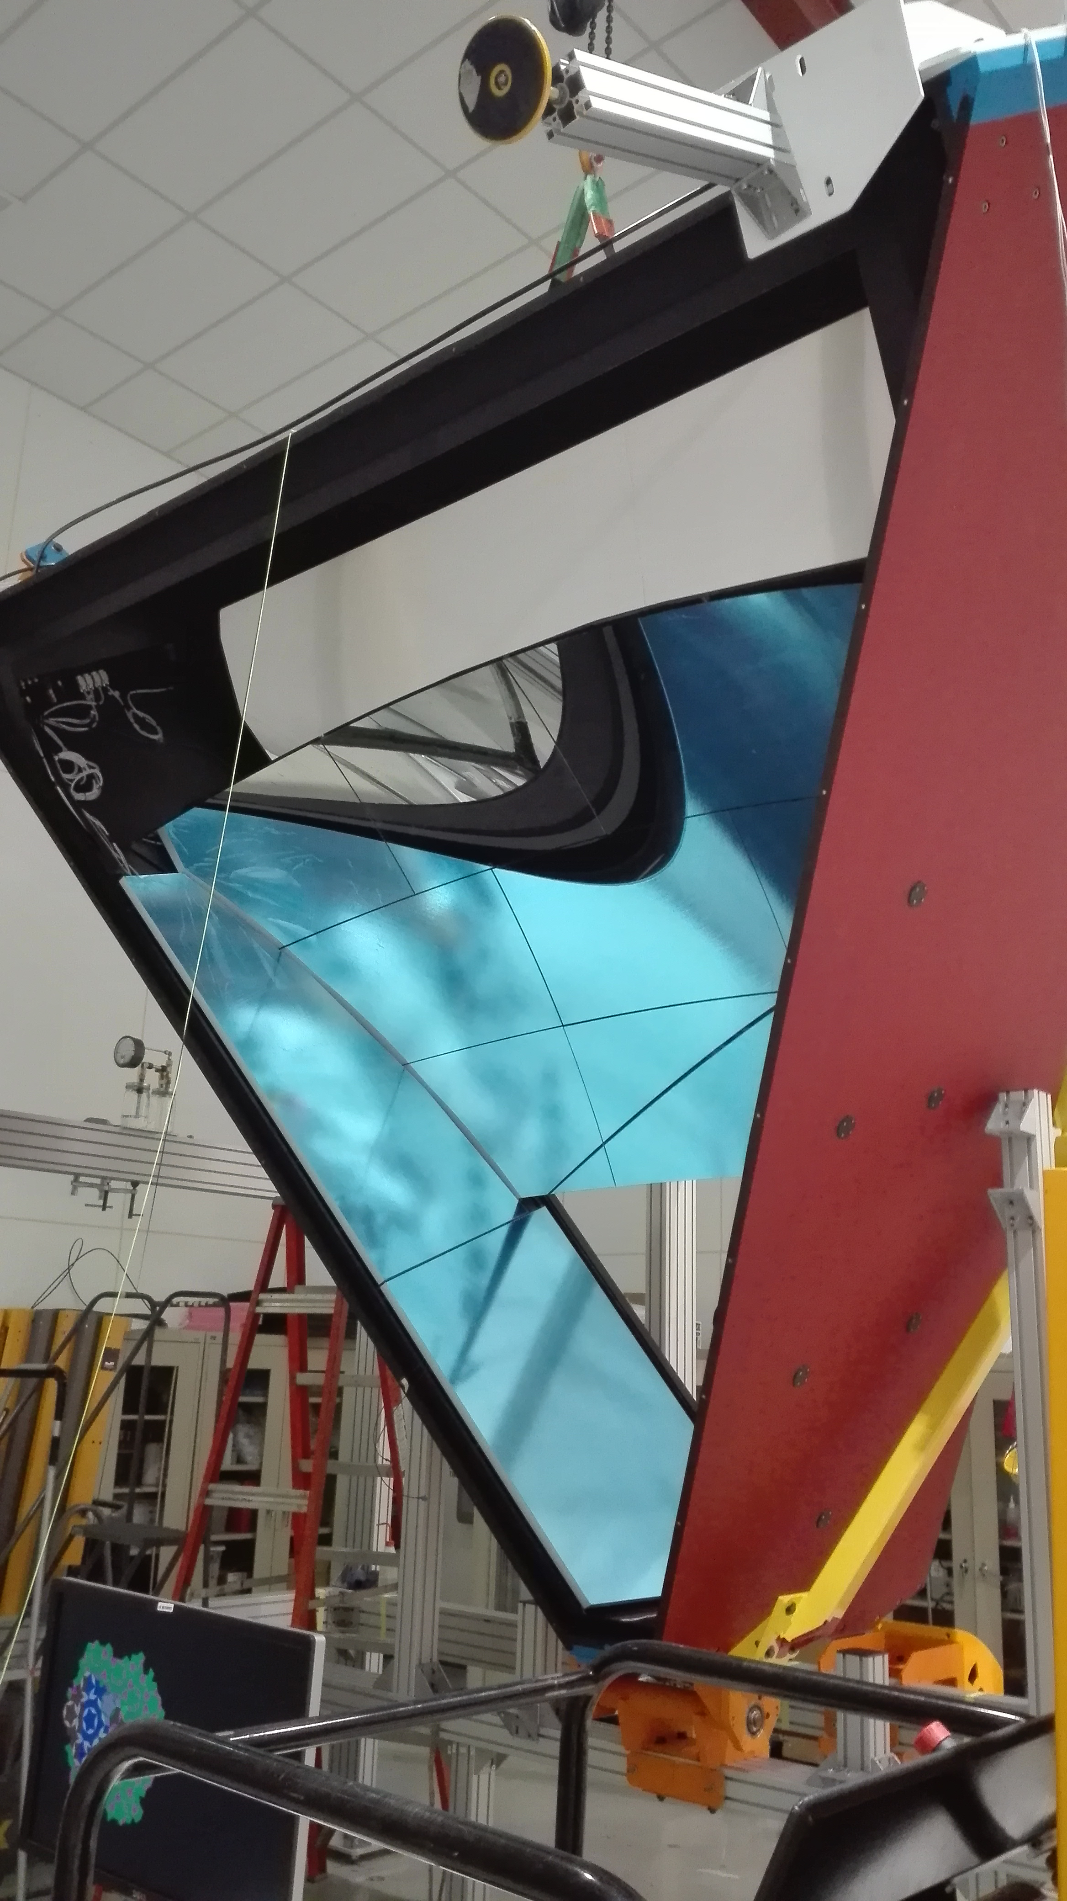
CLAS12 RICH
At the beginning of the summer we got a
last-minute issue with both mirror producers
Spherical mirrors:
chemical residuals not visible before coating
Planar mirrors:
shortage of the glass-skin material
This is solved now. The mirror were installed
last week, about 2 months behind schedule.
Contalbrigo M.
HALL-B Meeting, 20 November 2017, JLab
1
Notes:
Vanno messi studi innovativi e pubblicazioni

Slide 2
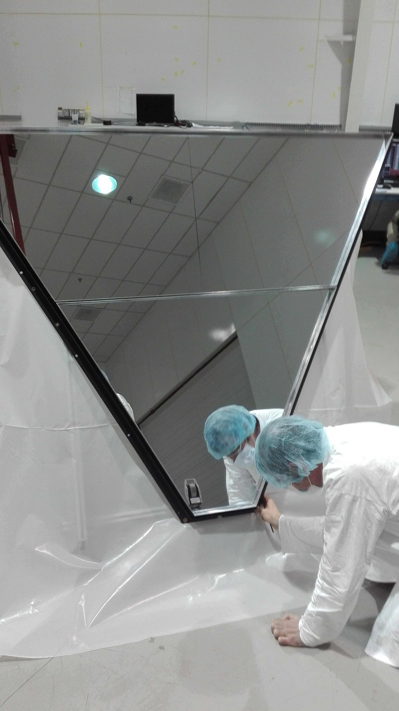
CLAS12 RICH
At the beginning of the summer we got a
last-minute issue with both mirror producers
Spherical mirrors:
chemical residuals not visible before coating
Planar mirrors:
shortage of the glass-skin material
This is solved now. The mirror were installed
last week, about 2 months behind schedule.
Contalbrigo M.
HALL-B Meeting, 20 November 2017, JLab
2
Notes:
Vanno messi studi innovativi e pubblicazioni

Slide 3
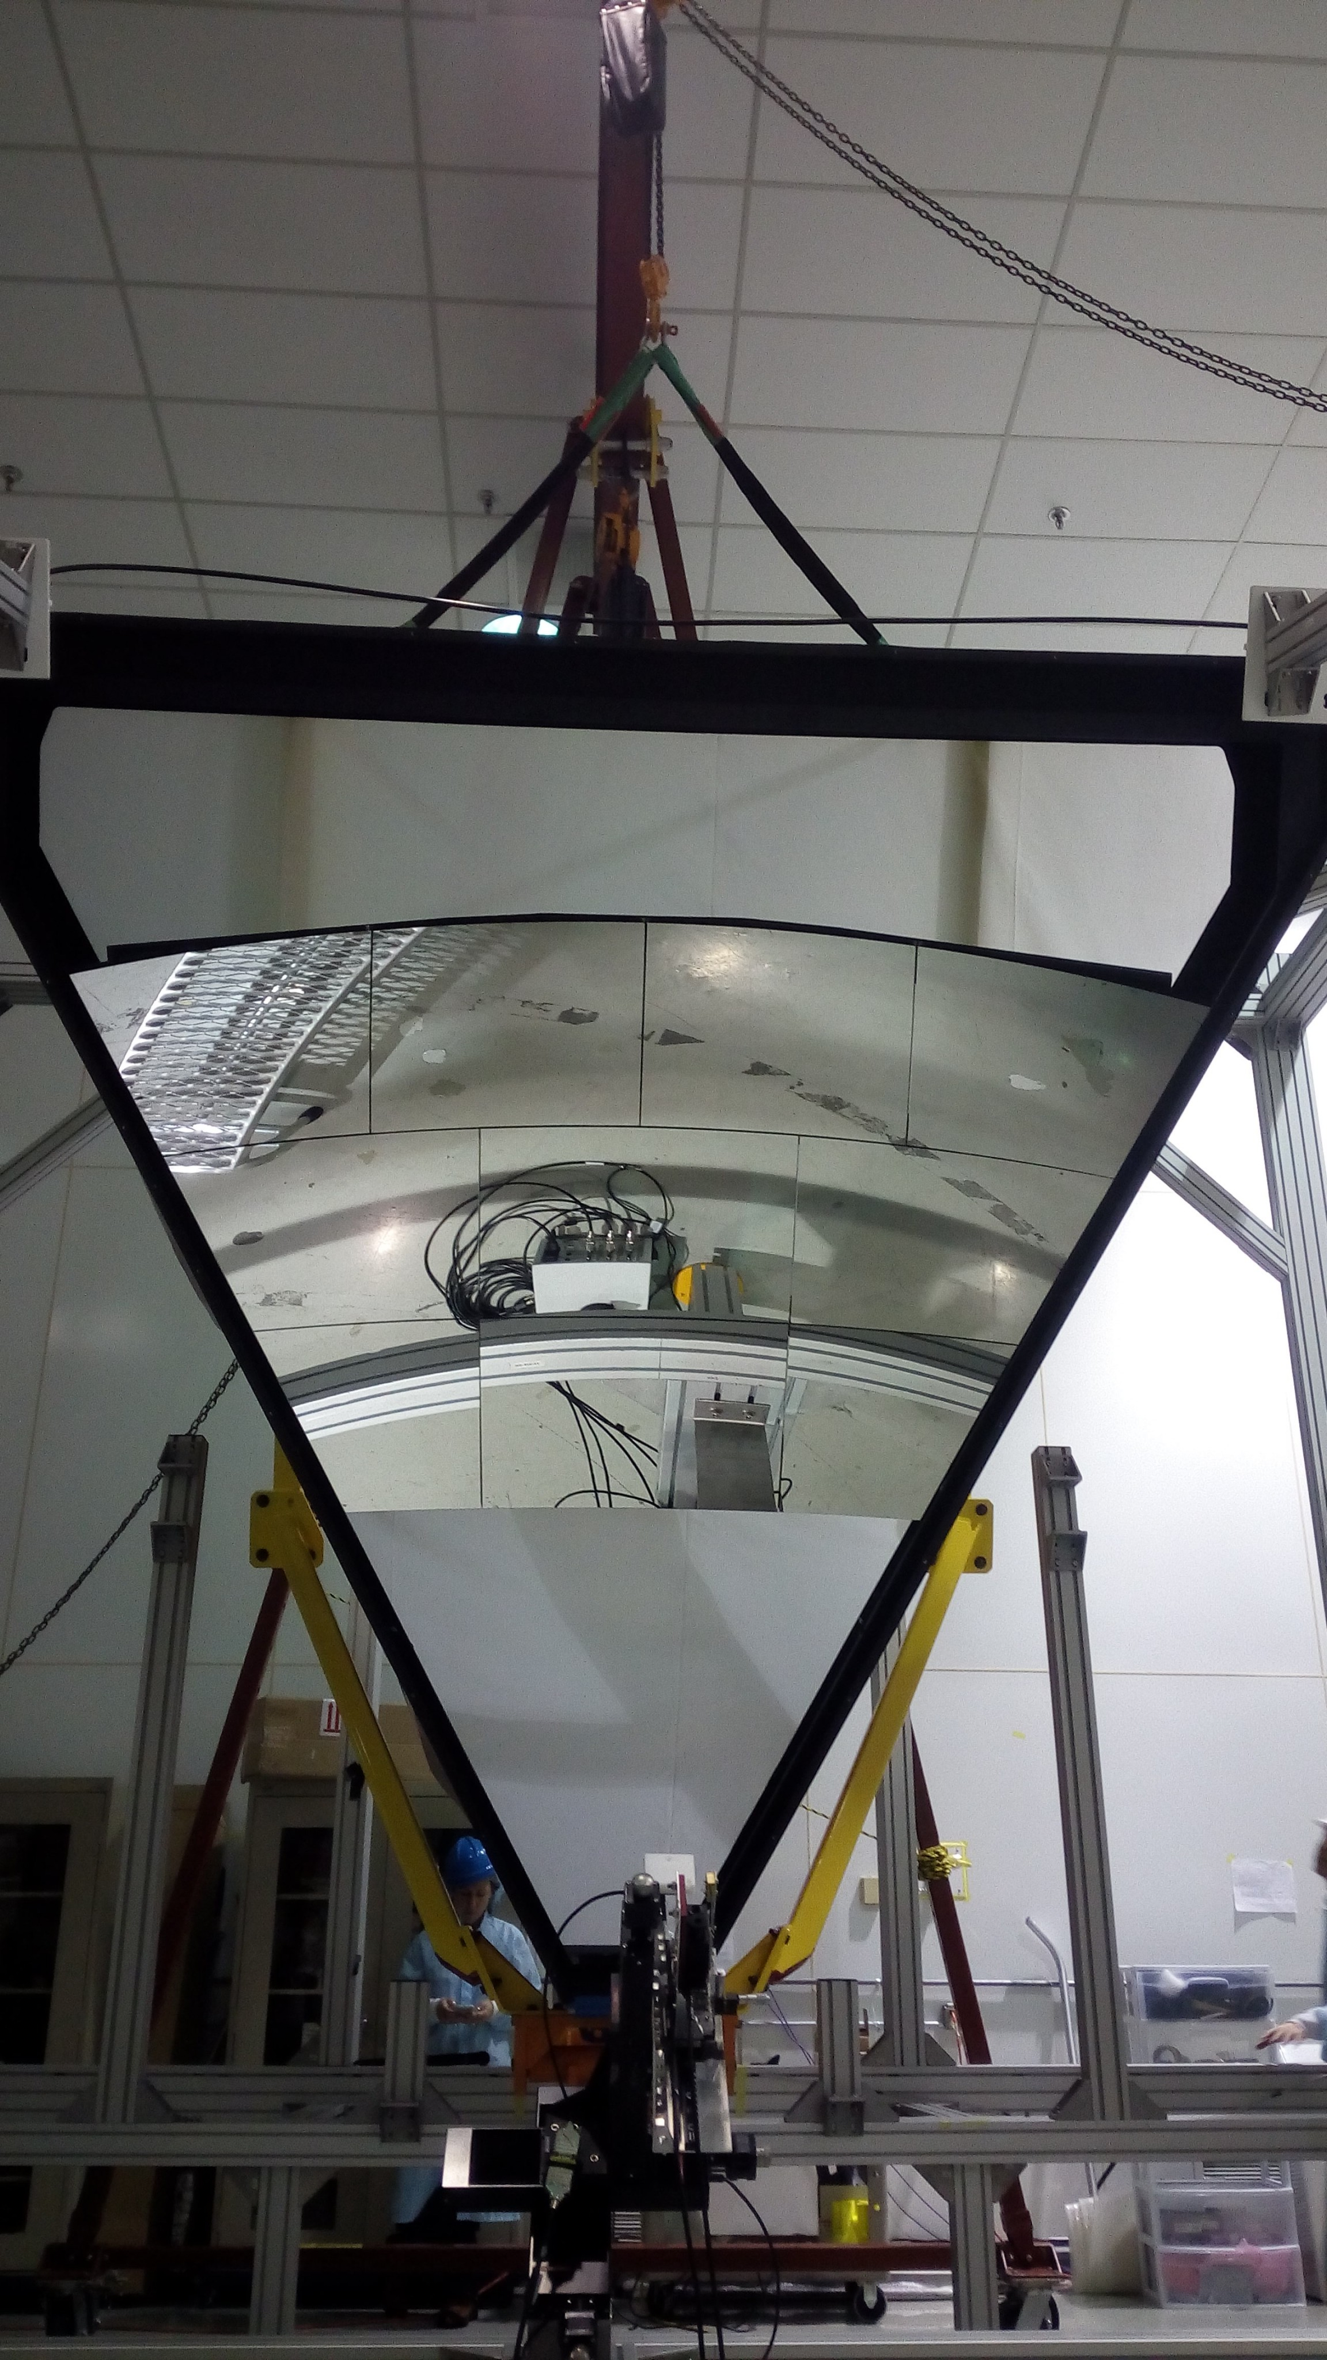
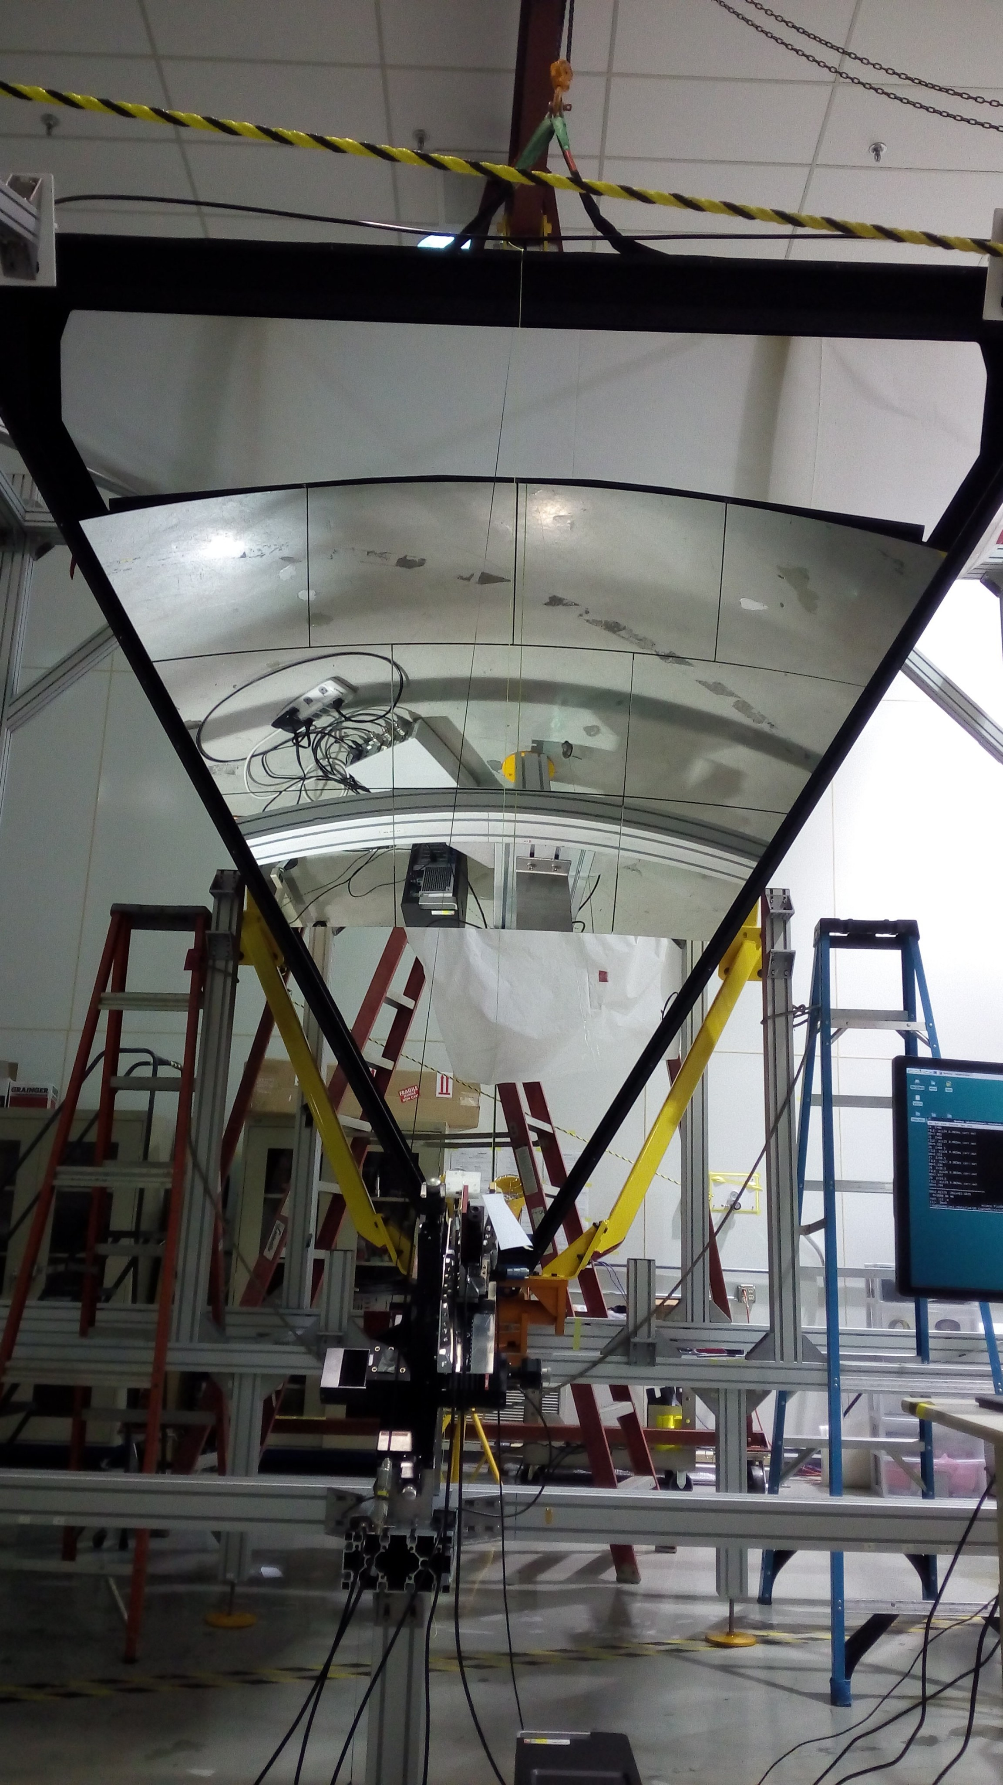
Mirror Alignment
Contalbrigo M.
HALL-B Meeting, 20 November 2017, JLab
3
Notes:
Vanno messi studi innovativi e pubblicazioni

Slide 4
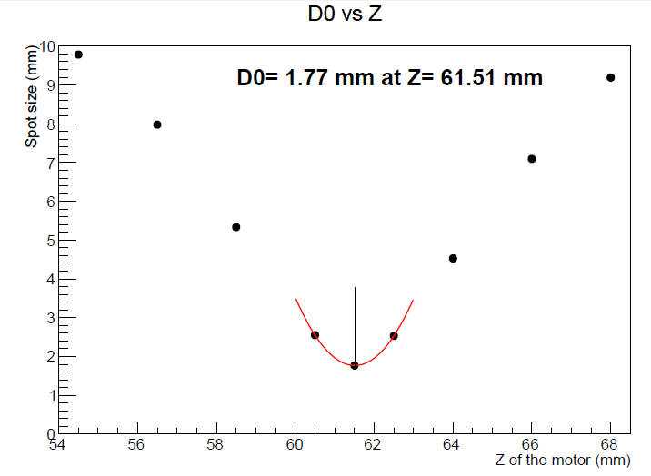
Mirror Alignment
Point-like source image
Contalbrigo M.
HALL-B Meeting, 20 November 2017, JLab
4
Notes:
Vanno messi studi innovativi e pubblicazioni

Slide 5
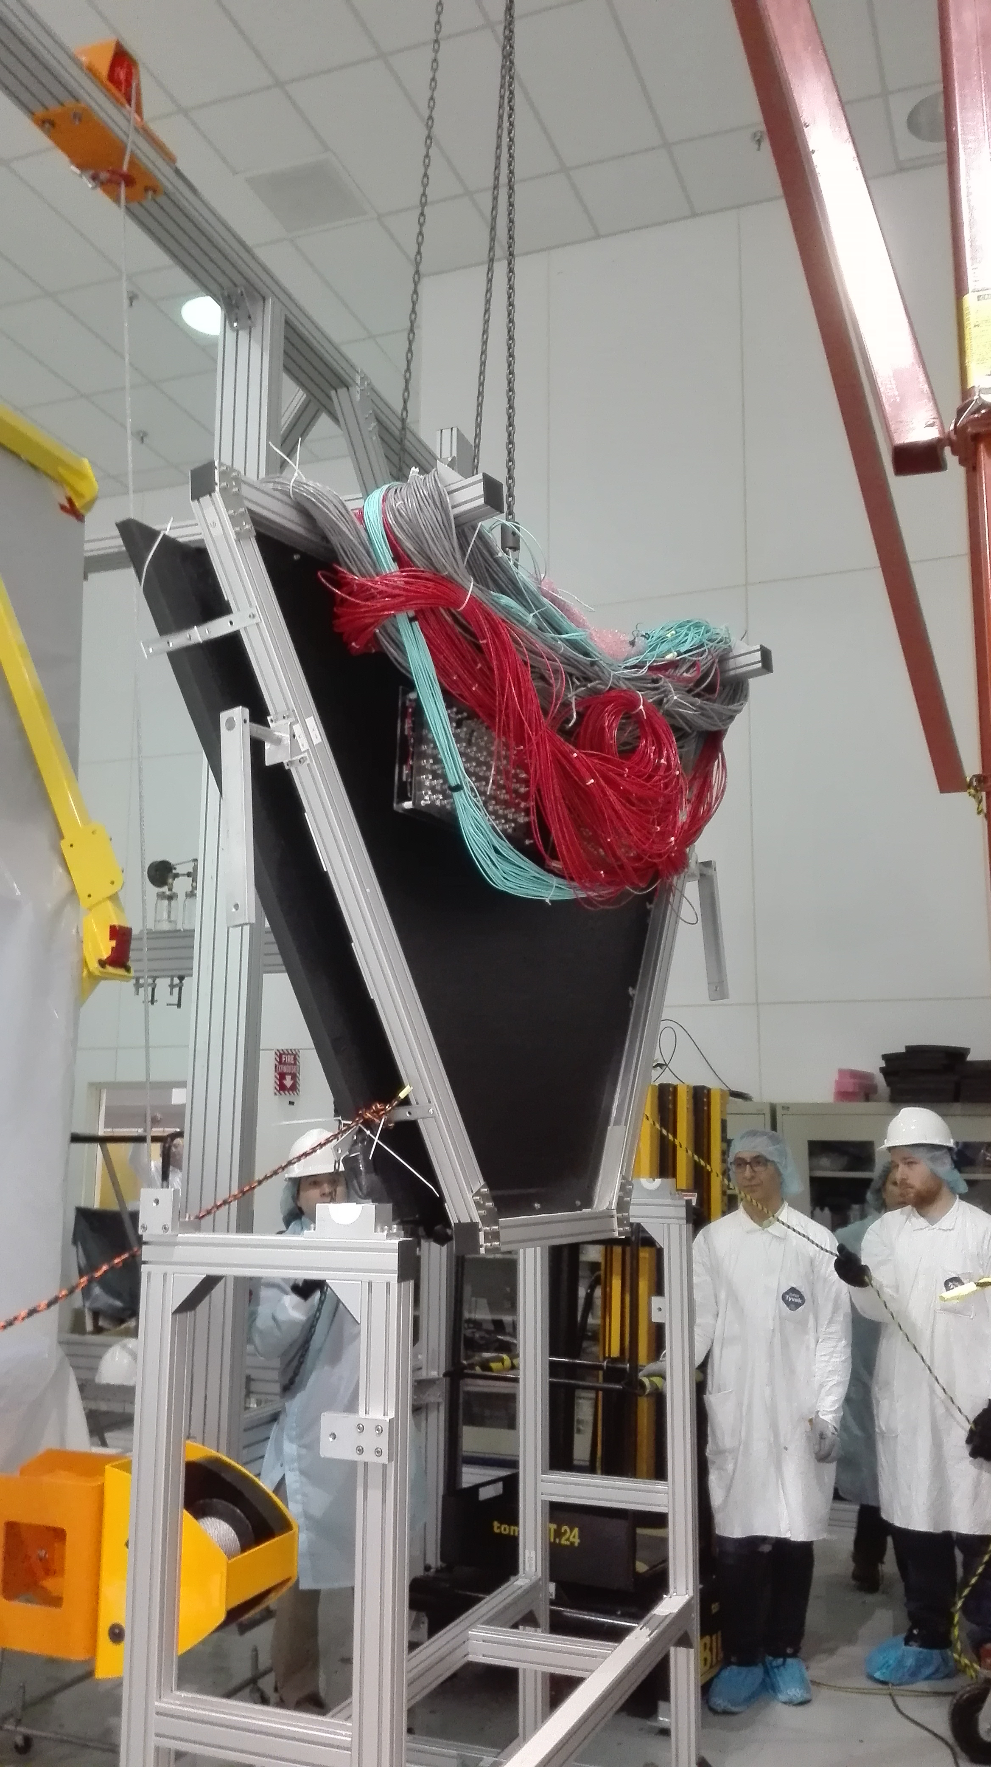
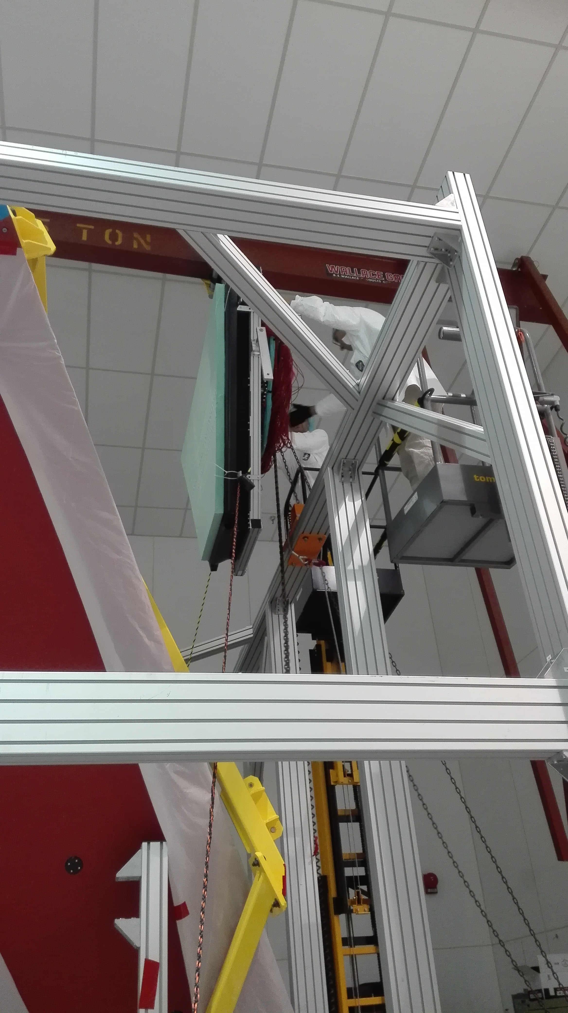
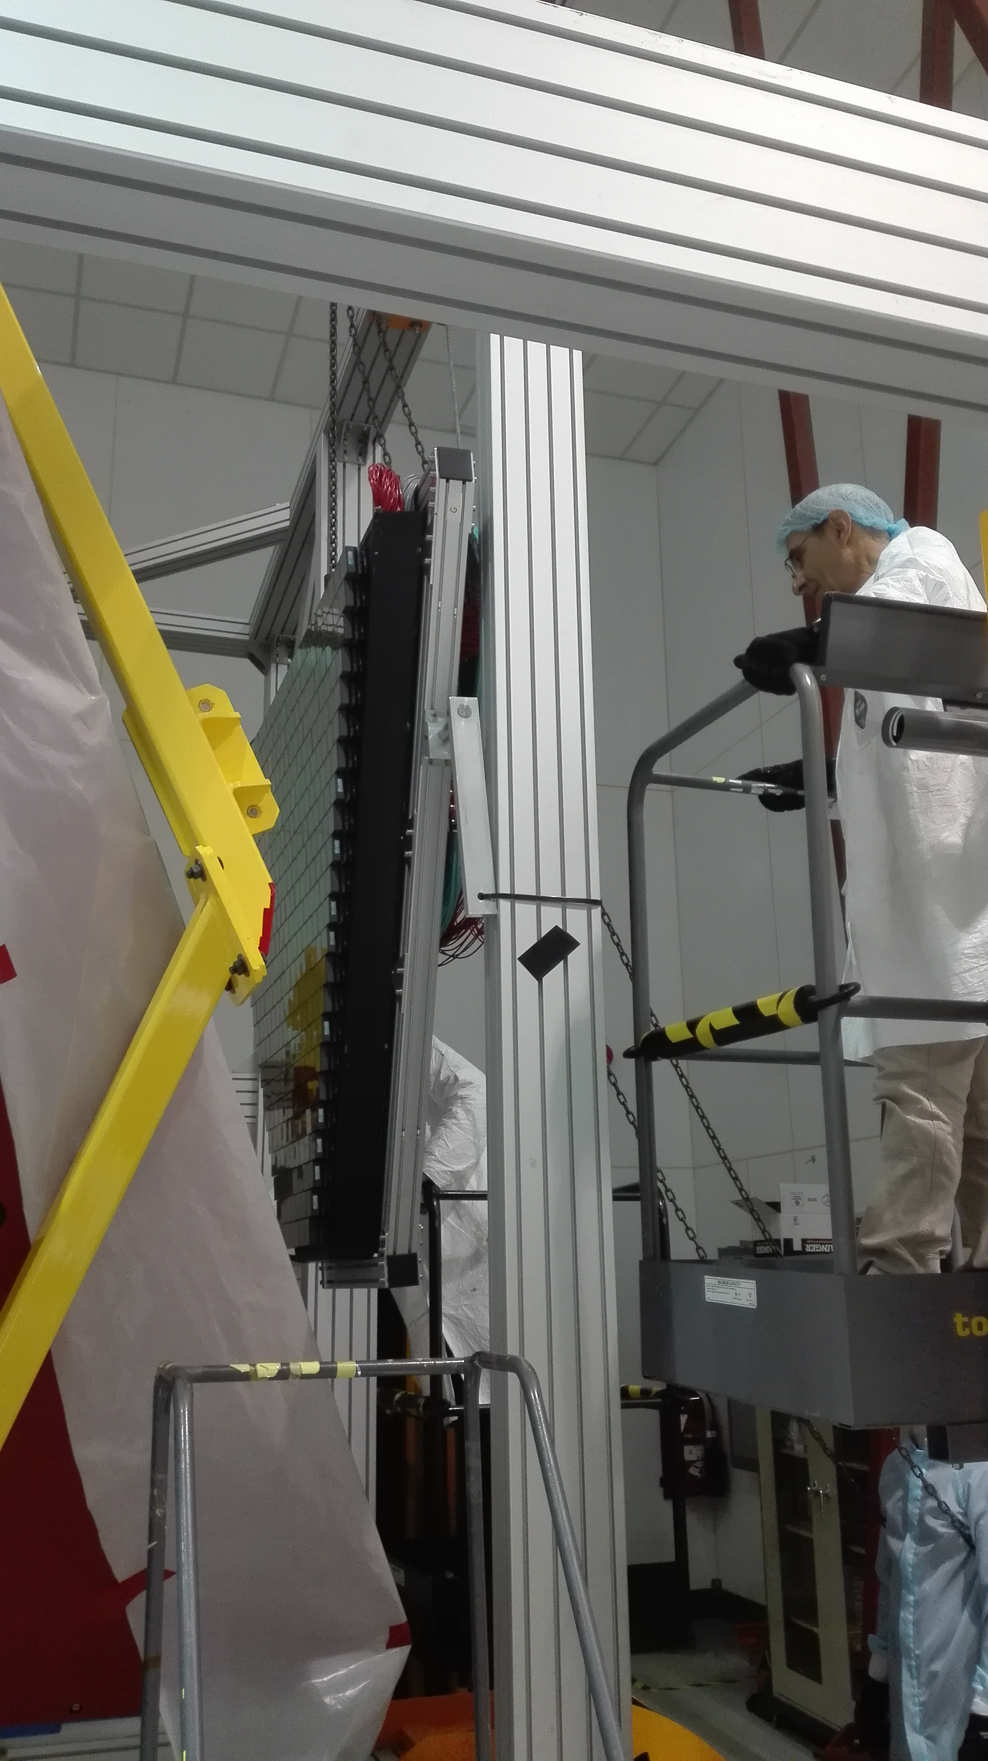
Electronic Panel Installation
Contalbrigo M.
HALL-B Meeting, 20 November 2017, JLab
5
Notes:
Vanno messi studi innovativi e pubblicazioni

Slide 6
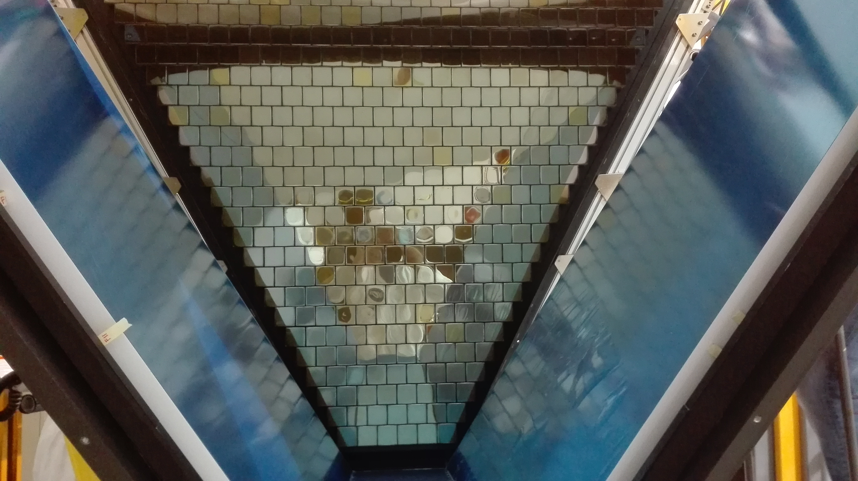
Electronic Panel Installation
Contalbrigo M.
HALL-B Meeting, 20 November 2017, JLab
6
Notes:
Vanno messi studi innovativi e pubblicazioni

Slide 7
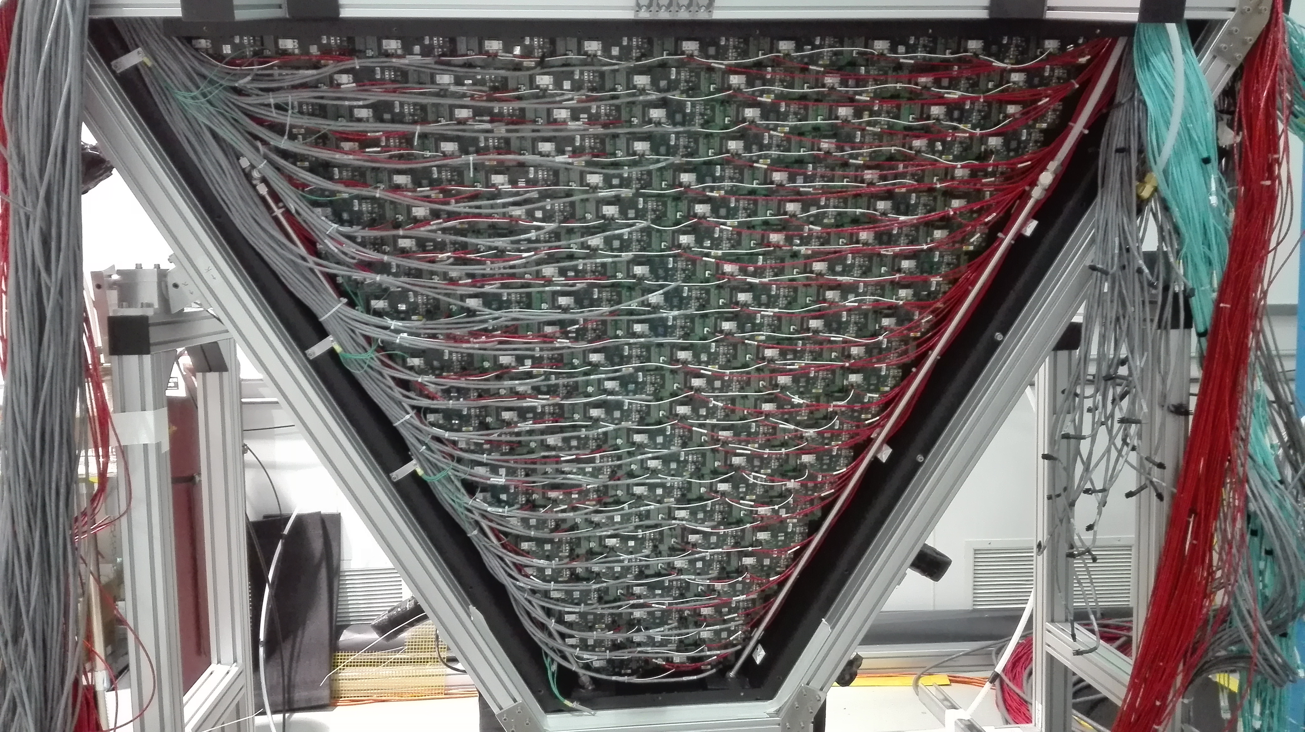
Electronic Panel
Contalbrigo M.
HALL-B Meeting, 20 November 2017, JLab
7
Notes:
Vanno messi studi innovativi e pubblicazioni

Slide 8
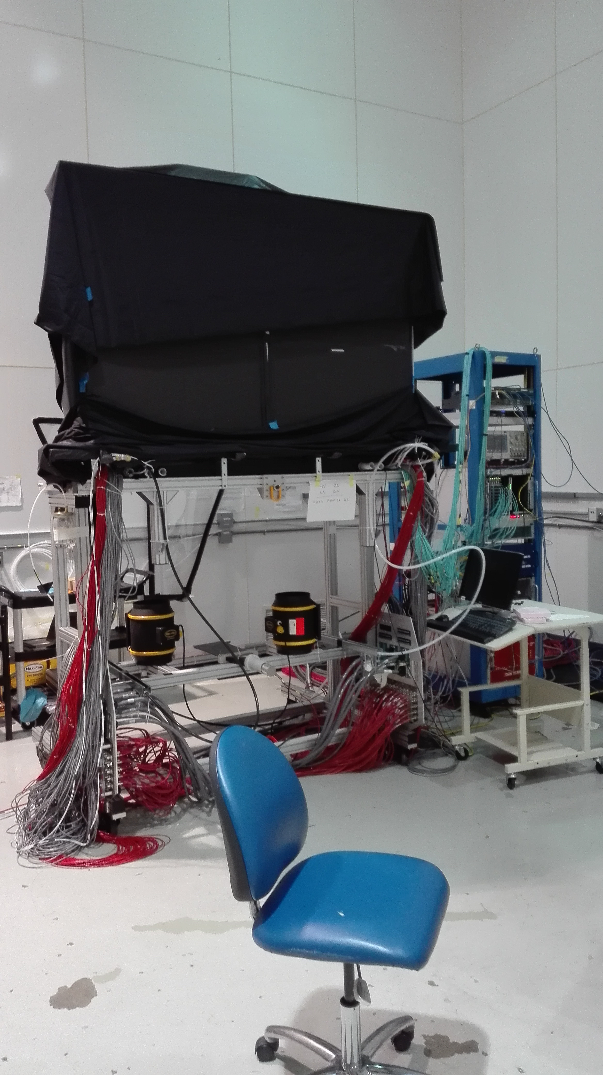
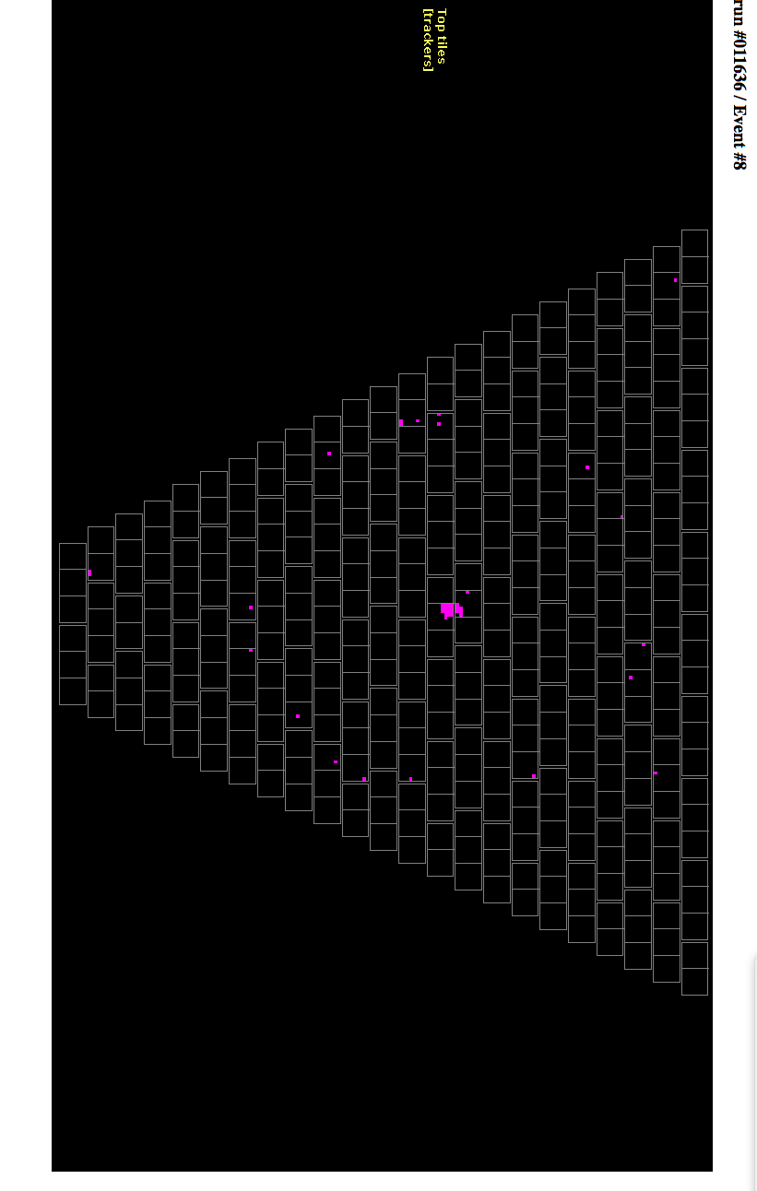
Cosmic Stand
Contalbrigo M.
HALL-B Meeting, 20 November 2017, JLab
8
Notes:
Vanno messi studi innovativi e pubblicazioni

Slide 9
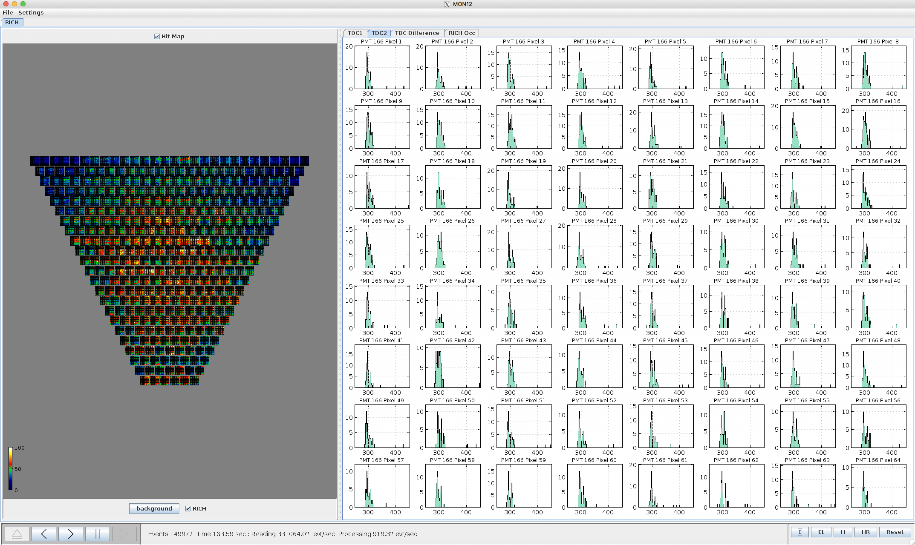
Online Monitor
Contalbrigo M.
HALL-B Meeting, 20 November 2017, JLab
9
Notes:
Vanno messi studi innovativi e pubblicazioni

Slide 10
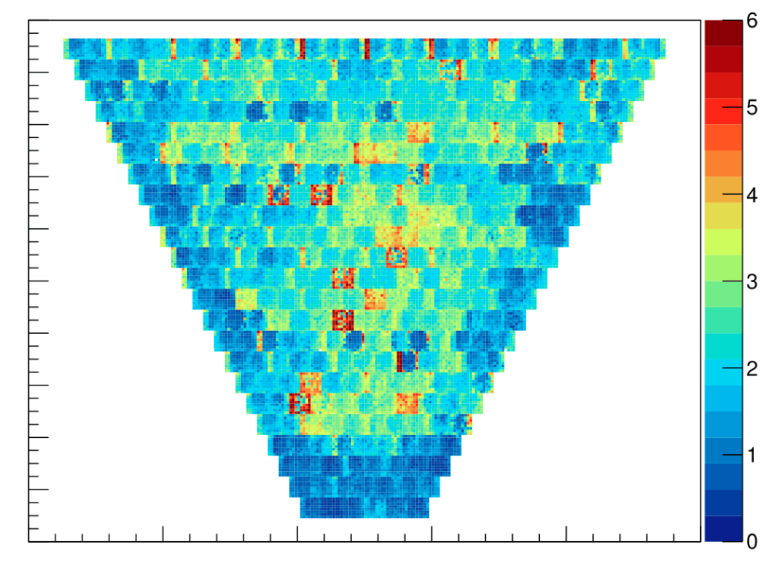
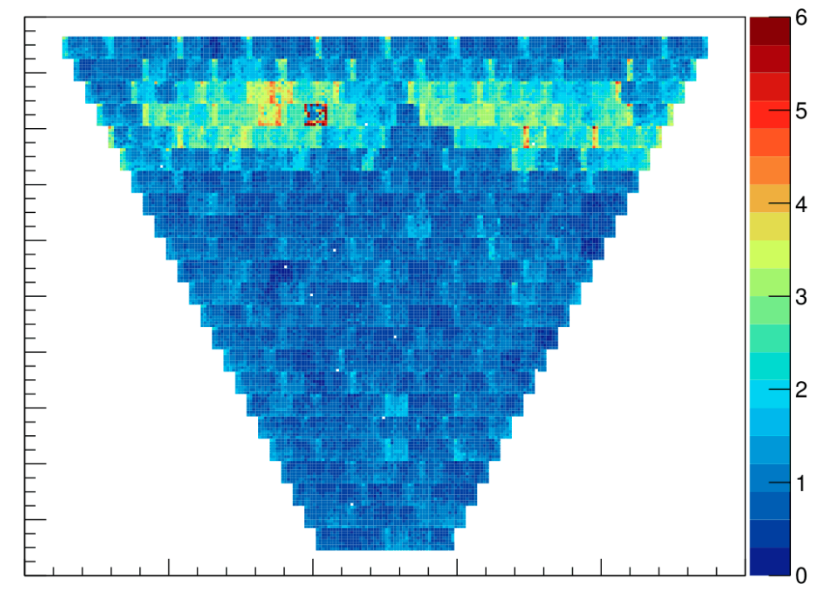
Pedestal RMS Distribution
TDC discriminator baseline
1 DAC ~ 1 mV
Typical single-photon signal
around 400 DAC
Improvement in progress
(jumpers between boards)
Contalbrigo M.
HALL-B Meeting, 20 November 2017, JLab
10
Notes:
Vanno messi studi innovativi e pubblicazioni

Slide 11
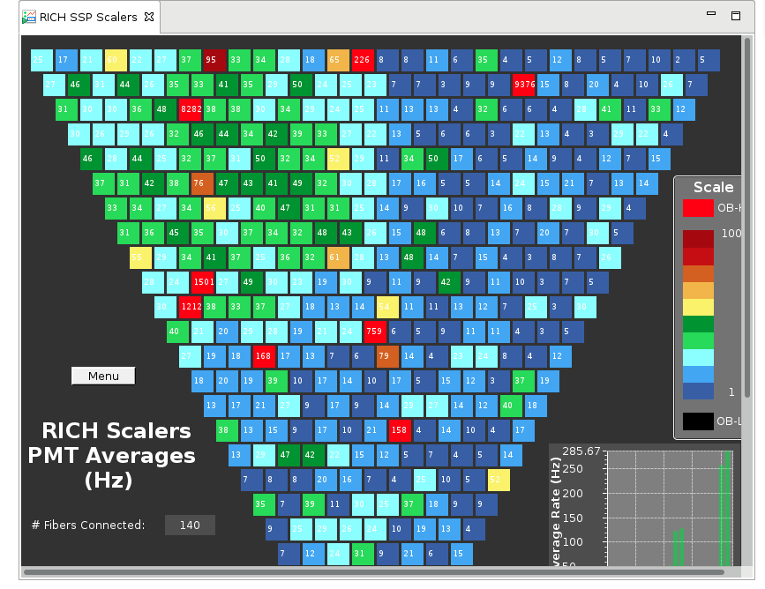
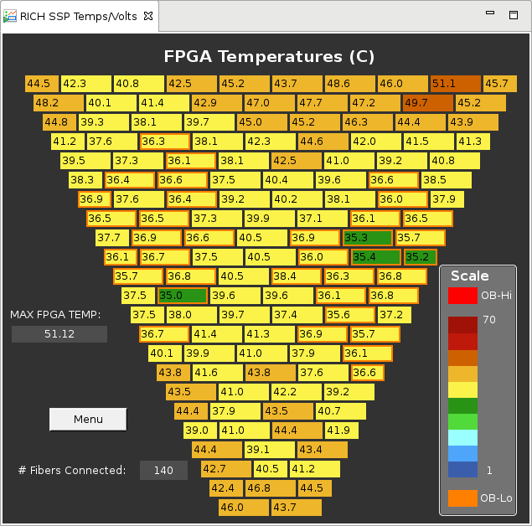
Slow Control
Scalers
Hot or dead channels
LED single photon illumination
Temperature Map
Upgraded to software interlock
Contalbrigo M.
HALL-B Meeting, 20 November 2017, JLab
11
Notes:
Vanno messi studi innovativi e pubblicazioni

Slide 12
CLAS12 RICH
RICH was planned to be ready for installation middle of November
About 1 month ago we reviewed the schedule with Hall-B management
In principle possible, but too tight and risky :
not compatible with all functionality tests
no real benefit from Hall-B cosmic (due to geometry)
not sure about beam availability
To not interfere with CLAS12 schedule we agreed to decouple RICH
RICH installation planned at beginning of January,
during the engineering run break.
Contalbrigo M.
HALL-B Meeting, 20 November 2017, JLab
12
Notes:
Vanno messi studi innovativi e pubblicazioni

