Slide 1
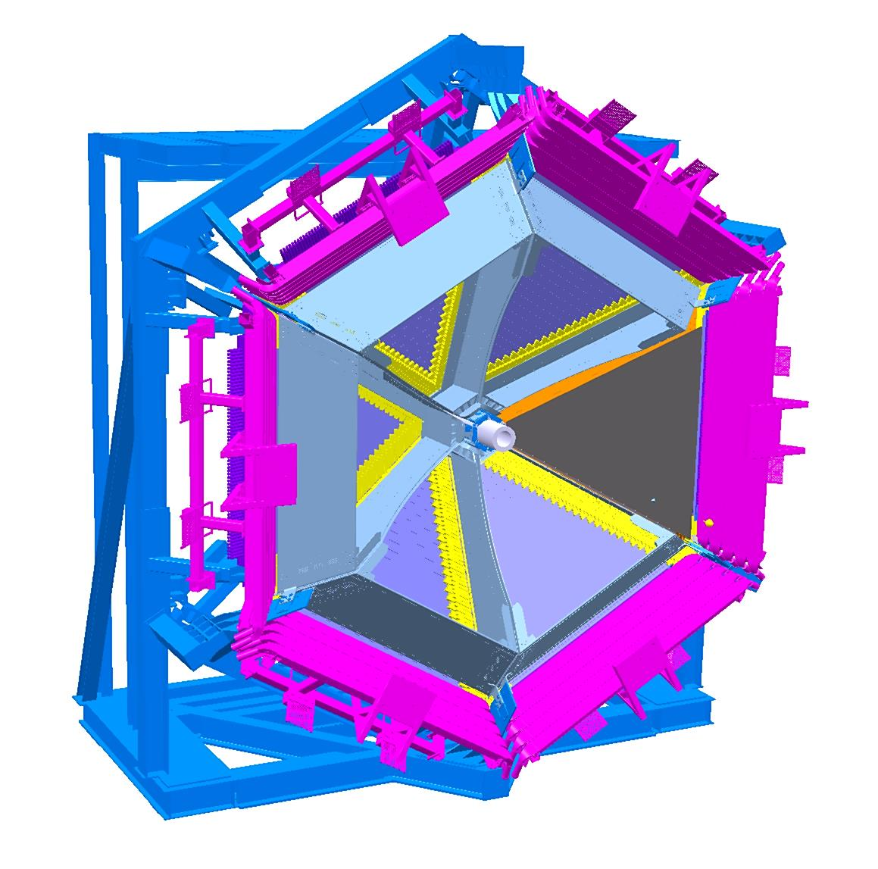
CLAS12 – RICH MECHANICS REVIEW
RICH MODULE
RICH MODULE INTEGRATION IN CLAS_12 – LAST LAYOUT
INFN-LNF / D. Orecchini – S. Tomassini – 06/24-25/2015
SLIDE 1

Slide 2
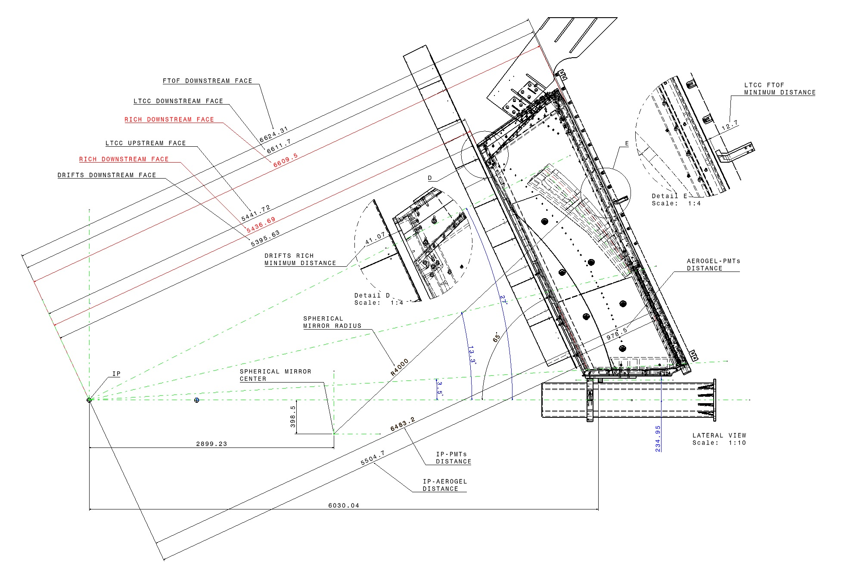
CLAS12 – RICH MECHANICS REVIEW: RICH INTEGRATION IN CLAS_12 STATUS
DRIFT CHAMBERS
TOF REGION_1
RICH MODULE
BEAM PIPE
CHECKING OF INTEGRATION OF THE RICH MODULE IN CLAS_12, HAS BEEN DONE , IN COLLABORATION WITH THE JLAB ENGINEERING SERVICE.
INFN-LNF / D. Orecchini – S. Tomassini – 06/24-25/2015
SLIDE 2

Slide 3
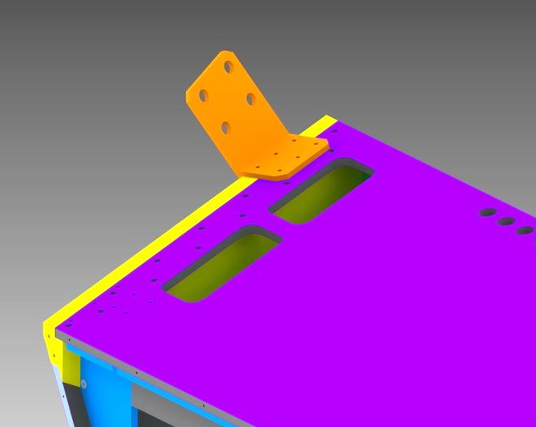
CLAS12 – RICH MECHANICS REVIEW: RICH INTEGRATION IN CLAS_12 STATUS
LEFT HOOKING STIRRUP
RIGHT HOOKING STIRRUP
TOPICS UNDER DEVELOPMENT
THE BEAM PIPE HOOKING COLLAR POSITION WILL BE DEFINED BY JLAB E_SERVICE IN JULY 2015
THE HOOKING STIRRUPS POSITION WILL BE DEFINED BY JLAB E_SERVICE IN JULY 2016 (+/-10mm).
SLOTS WILL BE PROVIDED INSTEAD OF HOLES .
BEAM PIPE HOOKING COLLAR
INFN-LNF / D. Orecchini – S. Tomassini – 06/24-25/2015
SLIDE 3

Slide 4
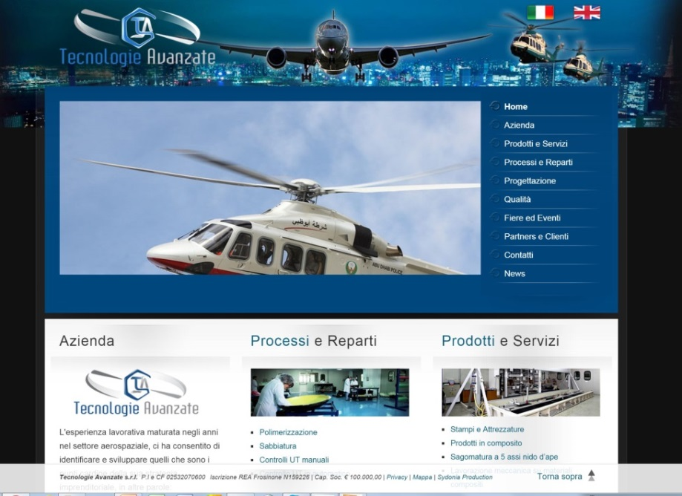
CLAS12 – RICH MECHANICS REVIEW: RICH SUPPORT STRUCTURE STATUS
RICH SUPPORT STRUCTURE TENDER
TENDER STARTED IN DECEMBER 2014
TENDER INVITATION S ENT TO THE FIRMS IN APRIL 2015
TENDER ASSIGNED IN MAY 2015
ADMINISTRATIVE PROCEDURE COMPLETED
CONSTRUCTION ALREADY STARTED
ASSEMBLY TEST FOR DECEMBER 2015
DELIVERED AT JLAB PLANNED FOR MARCH 2016
INFN-LNF / D. Orecchini – S. Tomassini – 06/24-25/2015
SLIDE 4

Slide 5
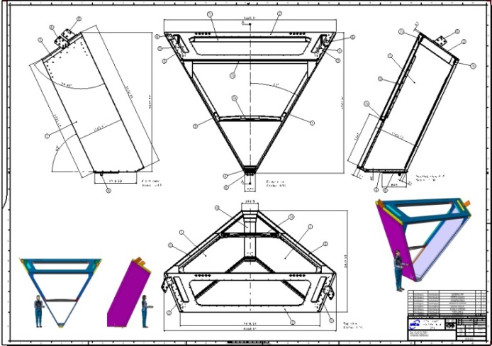
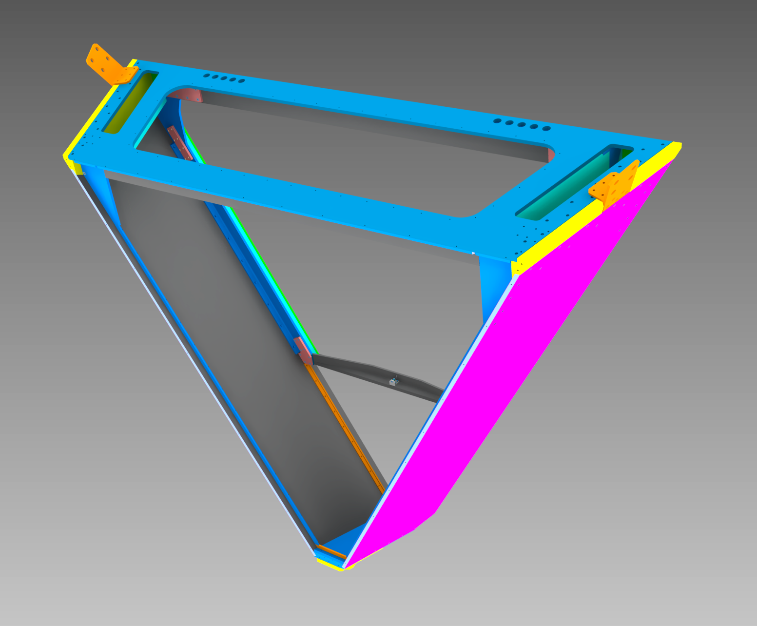
CLAS12 – RICH MECHANICS REVIEW: RICH SUPPORT STRUCTURE STATUS
FRAME FOR FRONTAL PANEL
(CFRP)
TOP PLATE
(ALUMINUM ALLOY)
4200mm
RICH SUPPORT STRUCTURE
(FRONT VIEW)
1150mm
3650mm
LATERAL PLATE
(ALUMINUM SKINS PLUS HONEYCOMB CORE)
LATERAL PLATE
(ALUMINUM SKINS PLUS HONEYCOMB CORE)
FRAME FOR E_PANEL
(CFRP)
LOWER PLATE
(ALUMINUM ALLOY)
270mm
INFN-LNF / D. Orecchini – S. Tomassini – 06/24-25/2015
SLIDE 5

Slide 6
CLAS12 – RICH MECHANICS REVIEW: RICH MODULE STATUS
TOP PLATE
(ALUMINUM ALLOY)
FRAME FOR BACKWARD PANEL
(CFRP)
CABLES RACEWAYS
(ALUMINUM ALLOY)
CABLES RACEWAYS
(ALUMINUM ALLOY)
LATERAL PLATE
(ALUMINUM SKINS PLUS HONEYCOMB CORE)
LATERAL PLATE
(ALUMINUM SKINS PLUS HONEYCOMB CORE)
CENTRAL CORE
ALUMINUM HONEYCOMB 23mm Thickness
(IN YELLOW)
FRAME FOR E_PANEL
(CFRP)
RICH SUPPORT STRUCTURE
(REAR VIEW)
LATERAL FRAME
(ALUMINUM ALLOY 23mm Thickness)
INFN-LNF / D. Orecchini – S. Tomassini – 06/24-25/2015
SLIDE 6

Slide 7
CLAS12 – RICH MECHANICS REVIEW: RICH SUPPORT STRUCTURE STATUS
TOP PANEL UPDATE
CENTRAL CLOSING PANEL
(NOMEX HONEYCOMB: 10 Kg)
PREVIOUS VERSION
TOTAL WEIGHT: 140Kg
TOP PLATE
(ALUMINUM ALLOY: 130 Kg)
NEW SOLUTION PROPOSED BY TECNAVAN
MATERIAL BUDGET GAIN:
FROM 17.4% X_0 TO 9.0% X_0
TOTAL WEIGHT: 80Kg
OUTER FRAME: MONOLITIC CARBON FIBER
CENTRAL ZONE: NOMEX HONEYCOMB (ARAMID FIBER)
SKINS: CFRP
INFN-LNF / D. Orecchini – S. Tomassini – 06/24-25/2015
SLIDE 7

Slide 8
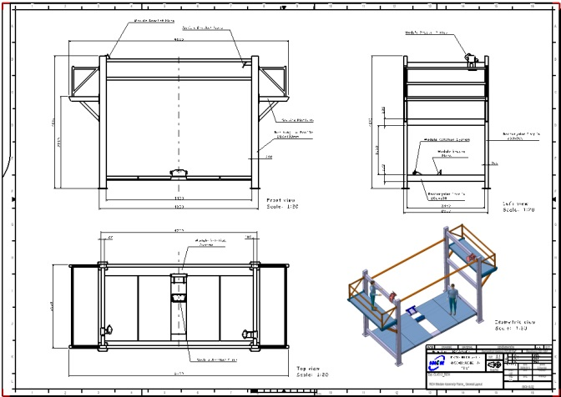
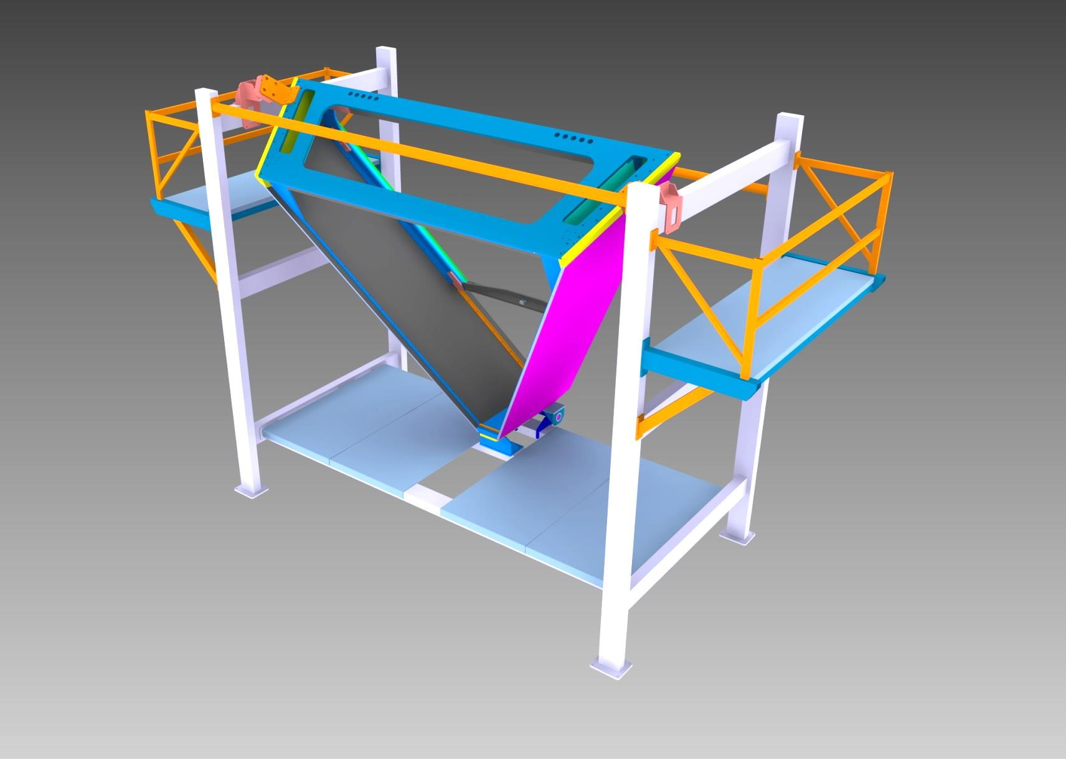
CLAS12 – RICH MECHANICS REVIEW: RICH SUPPORT STRUCTURE STATUS
SERVICES BALCONIES
RICH MODULE
RICH MODULE ASSEMBLY STRUCTURE
TOGHETER WITH THE TENDER OF THE RICH SUPPORT STRUCTURE, HAS BEEN ASSIGNED ALSO THE REALIZATION OF THE “RICH MODULE ASSEMBLY STRUCTURE”
IT ‘S NECESSARY TO THE ASSEMBLY OF THE RICH
ASSEMBLY STRUCTURE
INFN-LNF / D. Orecchini – S. Tomassini – 06/24-25/2015
SLIDE 8

Slide 9
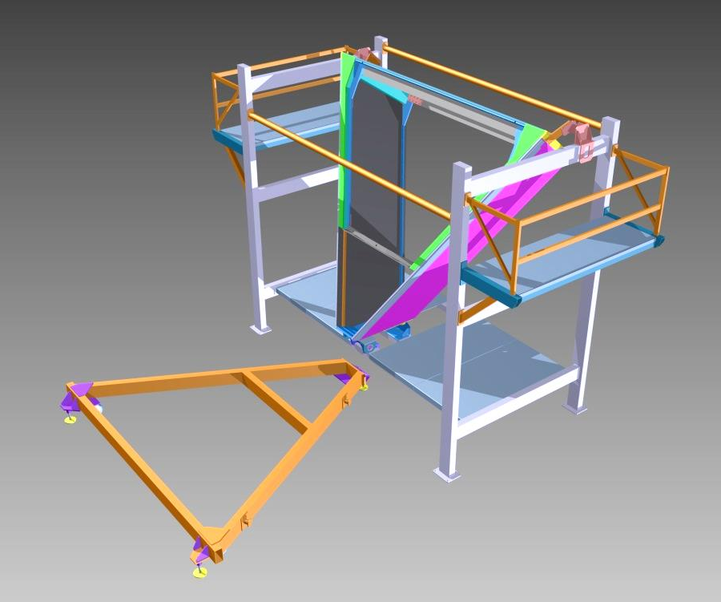
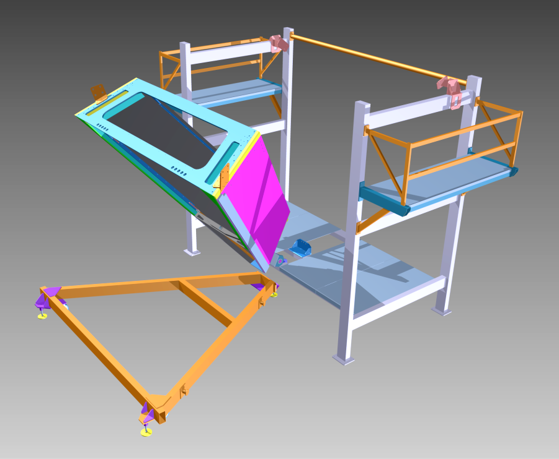
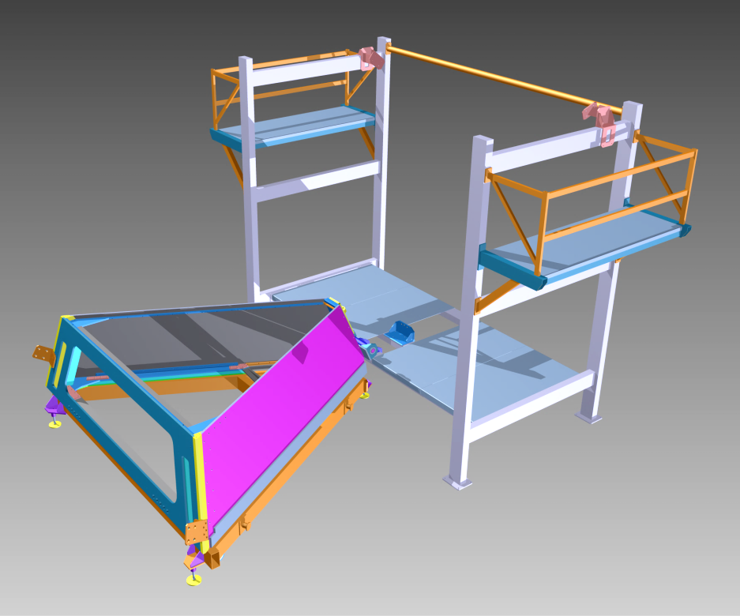
CLAS12 – RICH MECHANICS REVIEW: RICH SUPPORT STRUCTURE STATUS
ROTATION STEP_1
ROTATION STEP_2
TROLLEY
- RICH MODULE ROTATION STEPS
THE RICH HAS BEEN ASSEMBLED
THE RICH IS ROTATED BY THE CRANE
THE RICH IS PLACED ON A TROLLEY
THE TROLLEY IS MOVED OUT OF THE ASSEMBLY ROOM
ROTATION STEP_3
INFN-LNF / D. Orecchini – S. Tomassini – 06/24-25/2015
SLIDE 9

Slide 10
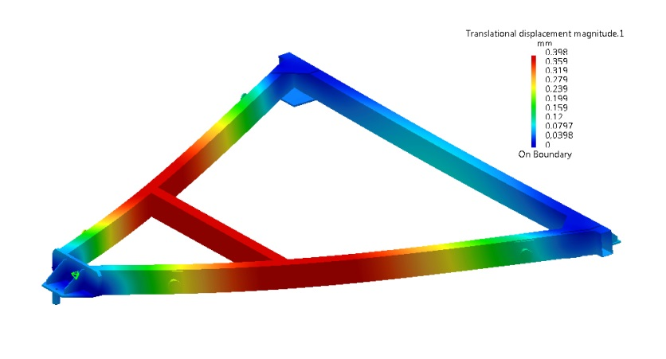
CLAS12 – RICH MECHANICS REVIEW: RICH SUPPORT STRUCTURE STATUS
TROLLEY FOR MOVING RICH MODULE
RICH MODULE
TROLLEY
A DEDICATED TROLLEY IS UNDER DEVELOPMENT TO OPTIMIZE THE MOVING OF THE RICH MODULE
TWO HYPOTESIS ARE UNDER DISCUSSION:
A) TO REALIZE A TROLLEY SUITABLE ONLY FOR MOVING OUT THE RICH OUTSIDE
THE CLEAN ROOM. THEN, BY THE HALL CRANE IT WILL BE PLACED ON A TRUCK
AND CARRIED IN HALL B.
B) TO REALIZE A TROLLEY SUITABLE TO CARRY THE RICH FROM THE CLEAN
ROOM , DIRECTLY TO THE HALL B, TOWED BY AN ELECTRIC FORKLIFT.
INFN-LNF / D. Orecchini – S. Tomassini – 06/24-25/2015
SLIDE 10

Slide 11
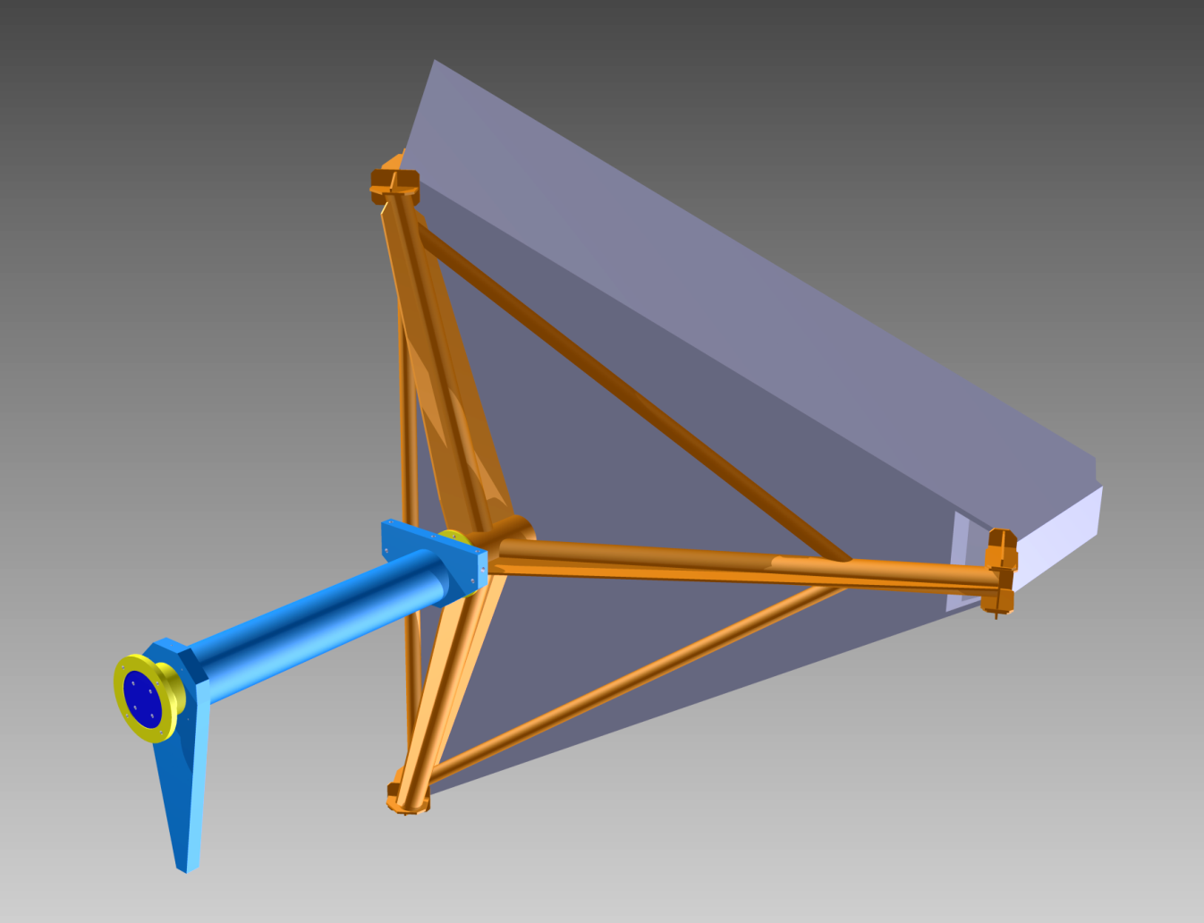
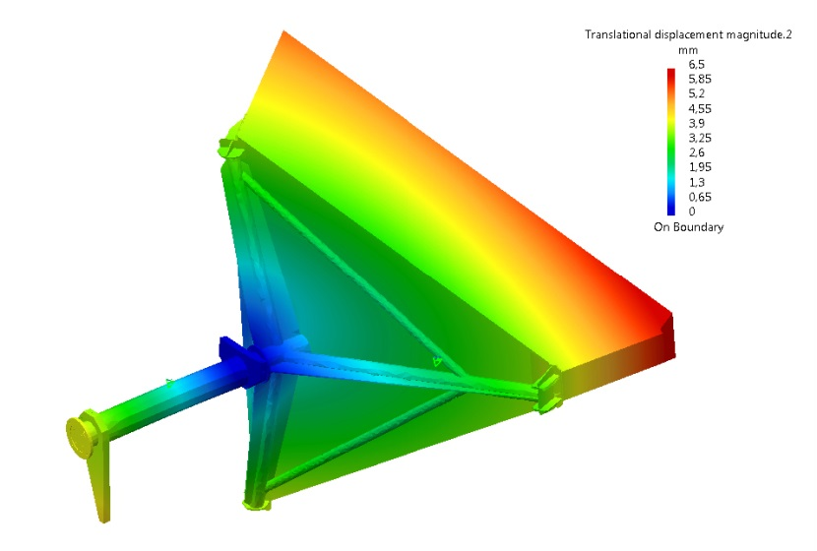
CLAS12 – RICH MECHANICS REVIEW: RICH SUPPORT STRUCTURE STATUS
A TRIPOD FOR LIFTING RICH MODULE
ARMS OF HOOKING
RICH MODULE
A TRIPOD FOR RIGGING THE RICH MODULE INSIDE THE FORWARD CARRIAGE IS UNDER DEVELOPMENT
LIFTING TRIPOD
BASICALLY IS THE SAME TOOL USED TO RIGGING THE LTCC MODULE.
THE ARMS OF HOOKING (GEOMETRY AND STIFFNESS) HAVE BEEN MODIFIED
SLIDE 11
INFN-LNF / D. Orecchini – S. Tomassini – 06/24-25/2015

Slide 12
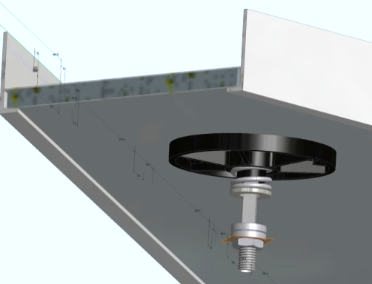
CLAS12 – RICH MECHANICS REVIEW: FRONTAL PANEL STATUS
SUPPORT PANEL
- 2 SKINS (CFRP)
- NOMEX HONEYCOMB CORE
AEROGEL TILES 30+30mm=60mm
IN THICKNESS (NO MIRROR)
MIRRORS:
- 2 GLASS SKINS 0.7mm IN THIKNESS
- ALUMINUM HONEYCOMB CORE
2° FLAT MIRRORS PLUS
AEROGEL TILES 20mm IN THICKNESS
1° FLAT MIRRORS PLUS
AEROGEL TILES 20mm IN THICKNESS
FRAME 40x10-1mm (ALUMINUM)
SUPPORT (ABS)
SLIDE 12
INFN-LNF / D. Orecchini – S. Tomassini – 06/24-25/2015

Slide 13
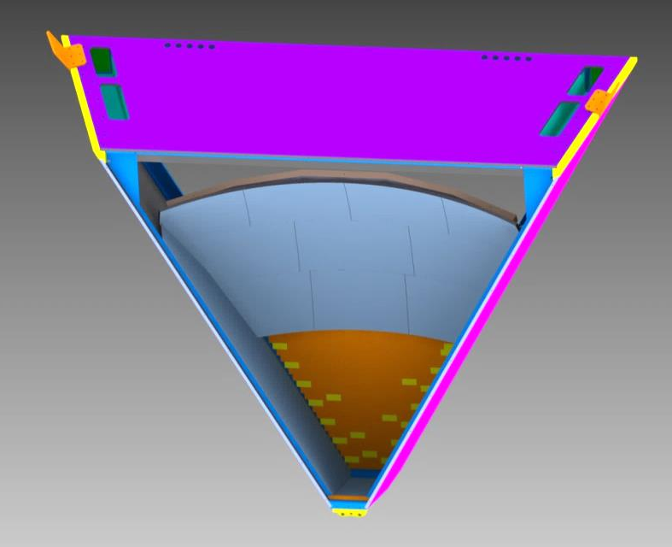
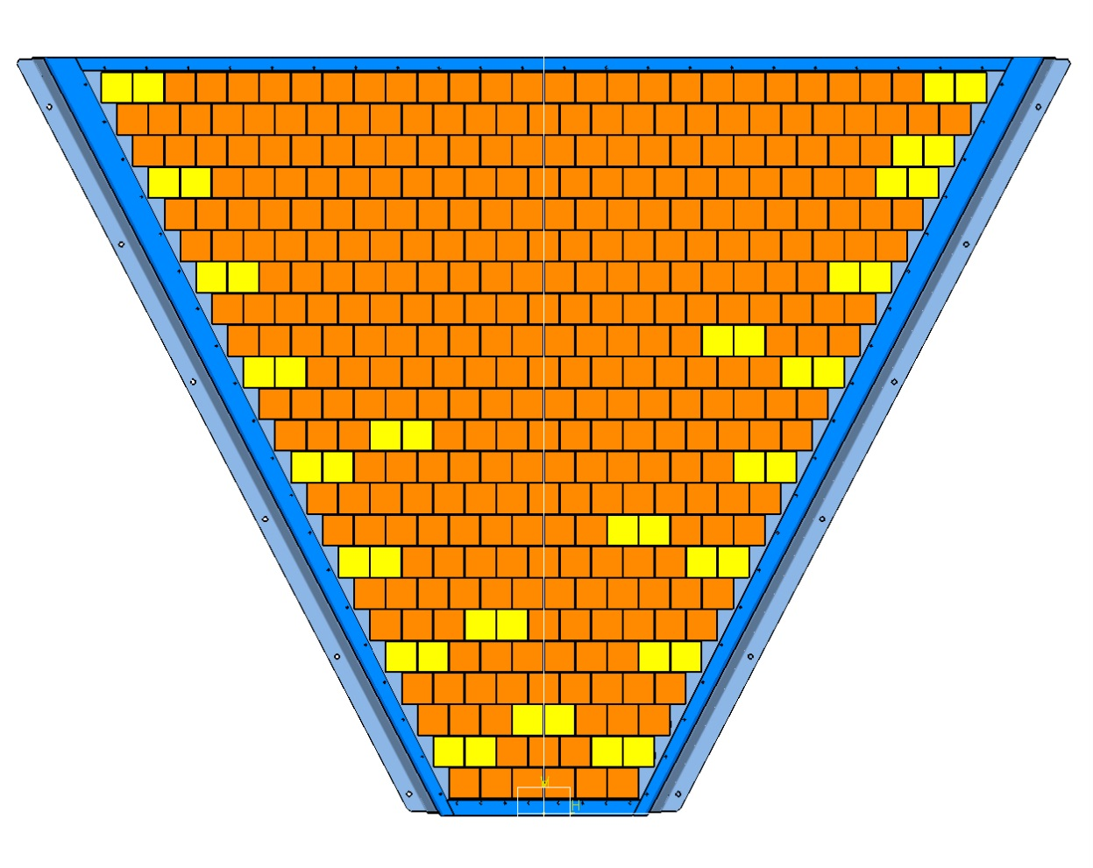
CLAS12 – RICH MECHANICS REVIEW: E_PANEL STATUS
1680mm
3 PMT’s TILES
(IN ORANGE)
2 PMT’s TILES
(IN YELLOW)
E_PANEL MAIN NUMBERS:
- 391 PMTs
- 23 LAYERS
(1° LAYER > 6 PMTs)
(23° LAYER > 28 PMTs)
- 2 PMTs TILES: 23 > 23x2= 46 PMTs
- 3 PMTs TILES: 115 > 115x3= 345 PMTs
(-3 PMTs TILES HAVE BEEN PREFERRED)
HEIGHT 1270mm
350mm
SLIDE 13
INFN-LNF / D. Orecchini – S. Tomassini – 06/24-25/2015

Slide 14
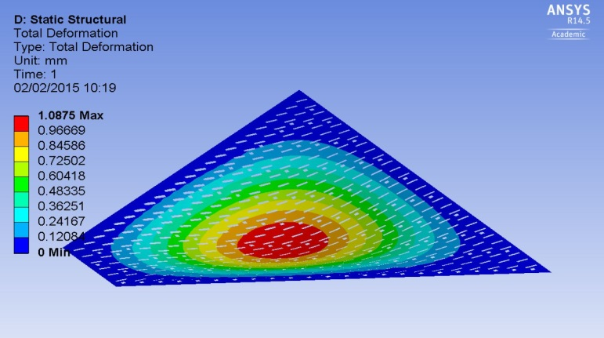
CLAS12 – RICH MECHANICS REVIEW: E_PANEL STATUS
THE SUPPORT PANEL IS MADE OF
2 ALUMINUM SKINS PLUS
ROHACELL OR HONEYCOMB CORE
SLOTS FOR HOUSING OF CONNECTORS
2 PMT’s TILES
OUTER FRAME
(ALUMINUM ALLOY)
3 PMT’s TILES
AREA SIMULATED WITH
PROTOTYPE
SLIDE 14
INFN-LNF / D. Orecchini – S. Tomassini – 06/24-25/2015

Slide 15
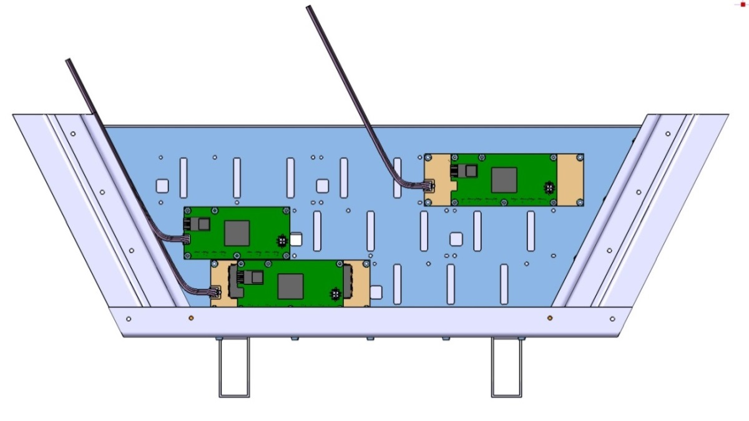
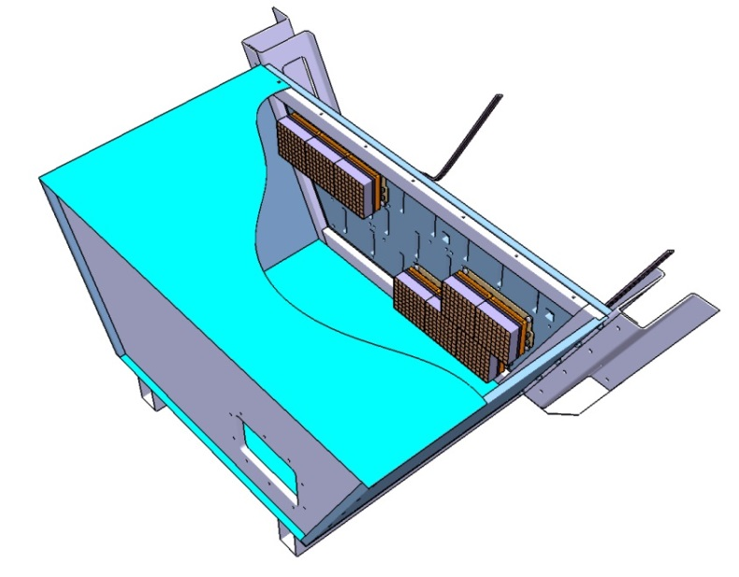
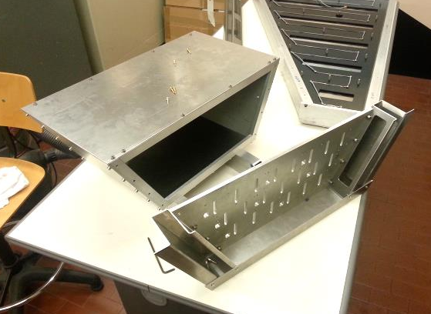
CLAS12 – RICH MECHANICS REVIEW: E_PANEL STATUS
PMT’s TILES
CABLES RACEWAY
THE AIM OF THE PROTOTYPE IS:
- TO TEST THE MECHANICAL COUPLING
BETWEEN THE COMPONENTS;
- TO TEST THE LIGHT-TIGHT PERFORMANCES;
- TO TEST THE CABLING ROUTING.
PRELIMINARY RESULTS:
- COUPLING BETWEEN ADAPTER BOARD AND SUPPORT
PANEL … GOOD (BLACK PLASTIC SCREWS TO IMPROVE) ;
- COUPLING BETWEEN ADAPTER / ASIC / FPGA … PERFECT;
- LIGHT-TIGHT … GOOD BUT TO BE IMPROVE AROUND THE
HV CONNECTOR;
- CABLING ROUTING STILL TO DO.
SLIDE 15
INFN-LNF / D. Orecchini – S. Tomassini – 06/24-25/2015

Slide 16
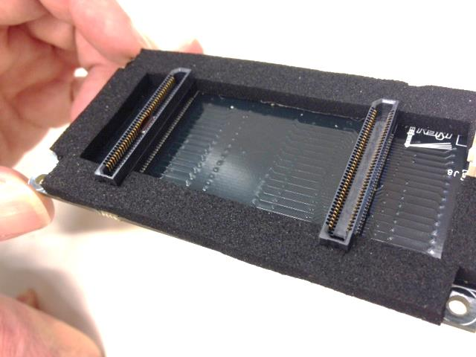
CLAS12 – RICH MECHANICS REVIEW: E_PANEL STATUS
ADAPTER BOARD
A NEW SEAL IS UNDER DEVELOPMENT
NEW SEAL
OLD SEAL
- THE NEW ONE WILL BE REALIZED:
- 1) NOT COMMERCIAL, BUT MADE DIRECTLY FROM OUR DESIGN
- 2) REALIZED IN TWO SOLUTIONS THAT WILL BE TESTED:
A) EPDM (FOAM)
B) VITON
ASIC BOARD
FPGA BOARD
SLIDE 16
INFN-LNF / D. Orecchini – S. Tomassini – 06/24-25/2015

Slide 17
CLAS12 – RICH MECHANICS REVIEW: CABLING STATUS
SCHEMATIC CABLES ROUTING
CABLES
RACEWAY
- THE CABLES RACEWAYS ARE INTEGRATED ON THE
RICH SUPPORT STRUCTURE AND THEY ARE UNDER
CONSTRUCTION;
- THE INTEGRATION OF THE CONNECTORS WITH THE
PATCH PANELS IS UNDER DEVELOPMENT.
E_PANEL ELECTRONIC BOARDS
INFN-LNF / D. Orecchini – S. Tomassini – 06/24-25/2015
SLIDE 17

Slide 18
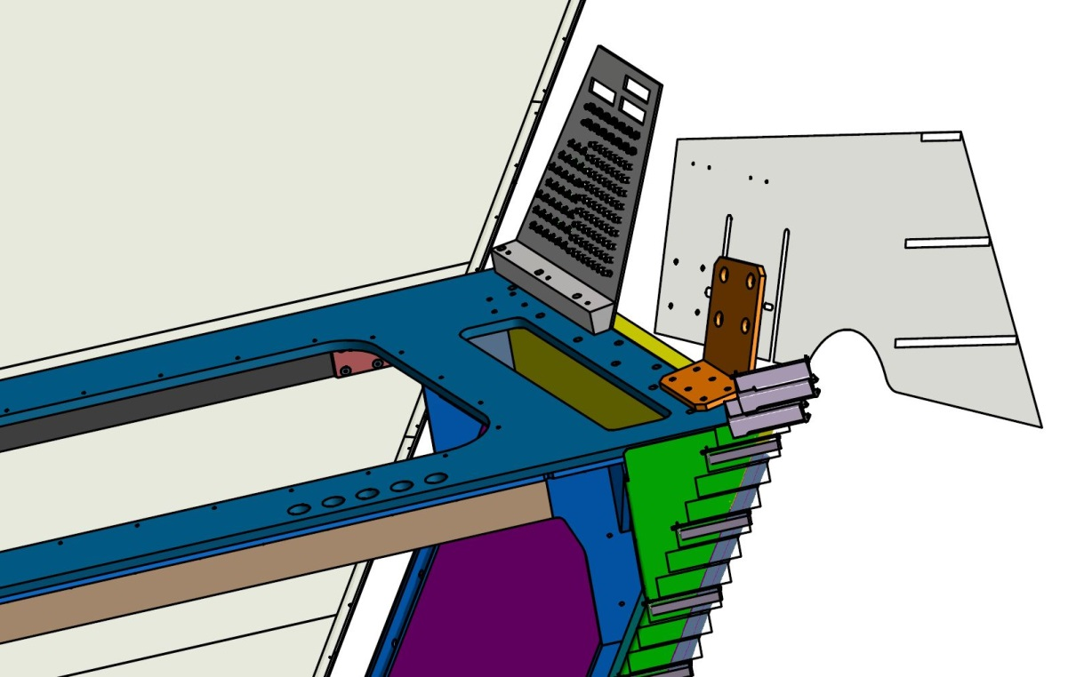
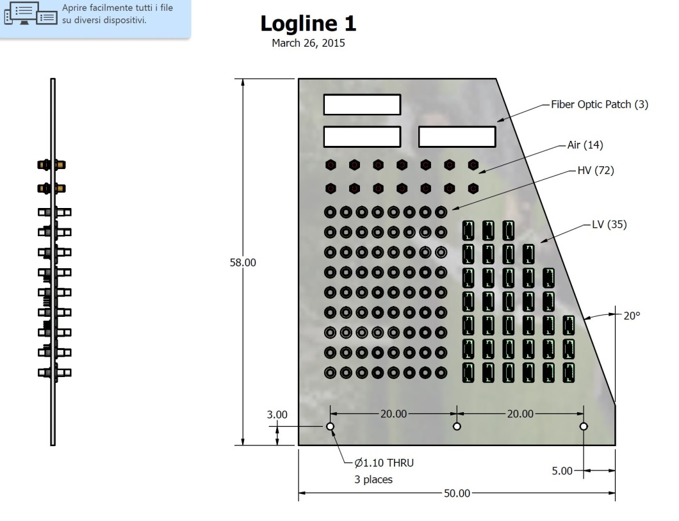
CLAS12 – RICH MECHANICS REVIEW: PATCH_PANELS STATUS (By Kevin Bailey – Argonne)
PATCH PANEL
TOP PANEL
THE P_PANELS ARE UNDER DEVELOPMENT BY AN ARGONNE COLLABORATION (K. Bailey)
- THE ACTUAL VERSION IS PLACED ON THE SIDES OF THE
TOP PANEL;
- DURING THE ASSEMBLING ON THE FORWARD CARRIAGE,
IT WILL BE ROTATE IN HORIZONTAL POSITION;
- THE CHECKING WITH THE “TOF REGION 2” HAS BEEN
MADE.
INFN-LNF / D. Orecchini – S. Tomassini – 06/24-25/2015
SLIDE 18

Slide 19
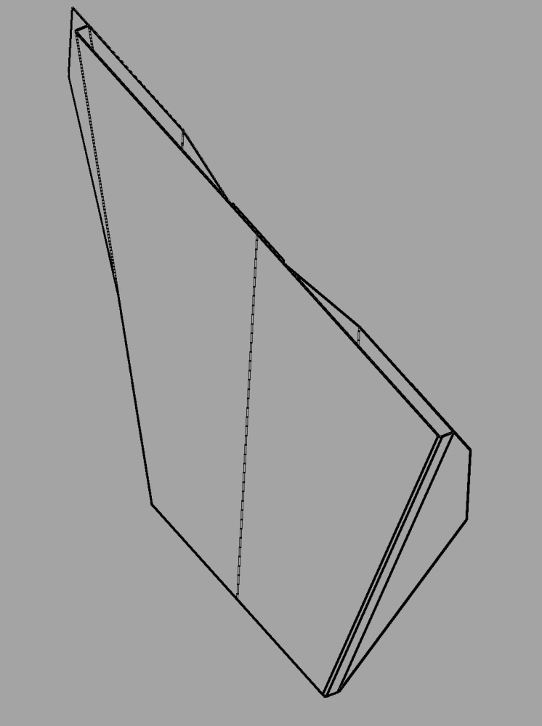
CLAS12 – RICH MECHANICS REVIEW:BACKWARD PANEL STATUS (By Kevin Bailey – Argonne)
COMPONENTS STILL UNDER DEVELOPMENT ....
HOLES ON TOP PANEL FOR EVACUATION EXAUST AIR
CHIMNEY FOR EVACUATION EXAUST AIR, ARE DIRECTLY BUILT IN THE BACKWARD PANEL
BACKWARD PANEL (CFRP)
THE COOLING SYSYTEM OF THE HEAT PRODUCED BY THE ELECTRONICS OF THE E_PANEL IS UNDER DEVELOPMENT IN LNF
E_PANEL
INFN-LNF / D. Orecchini – S. Tomassini – 06/24-25/2015
SLIDE 19

