Slide 1
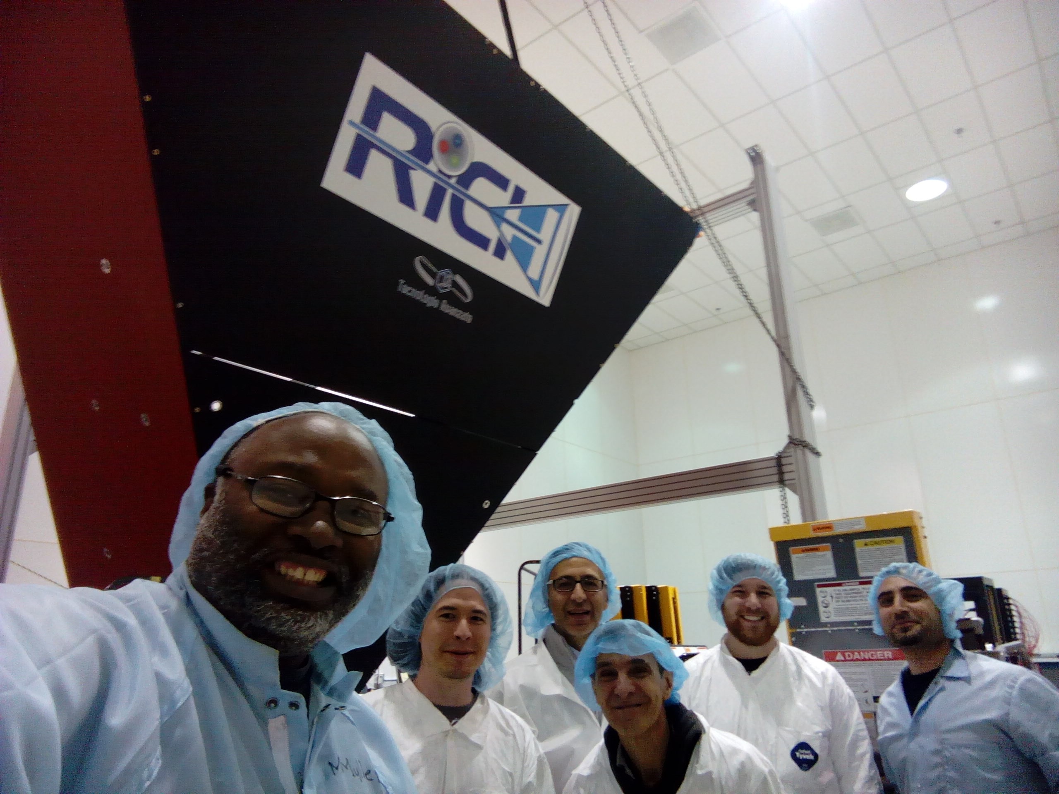
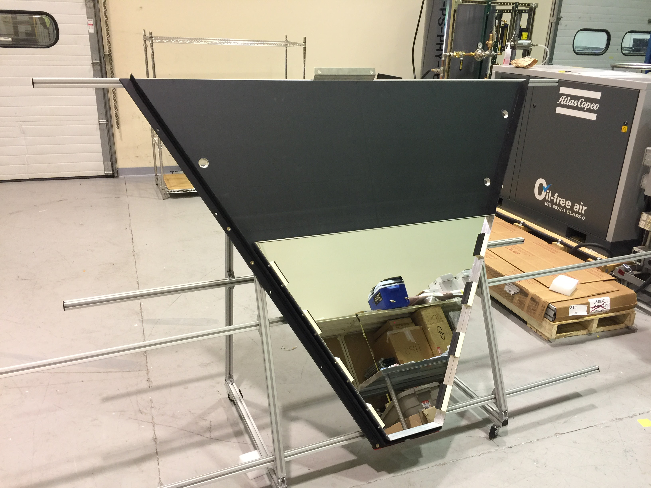
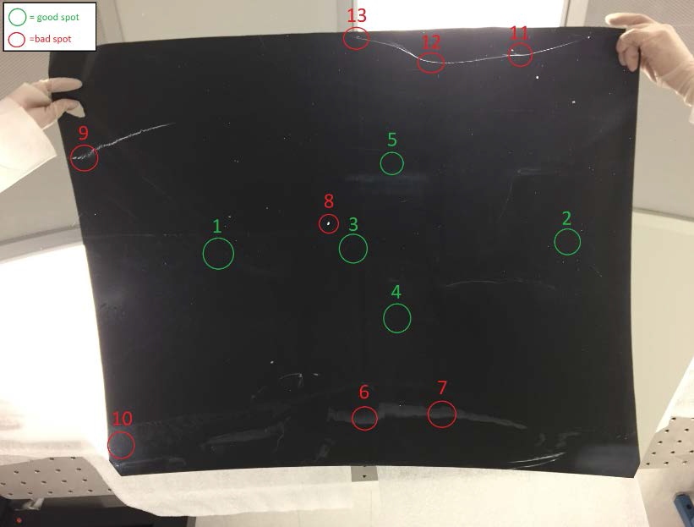
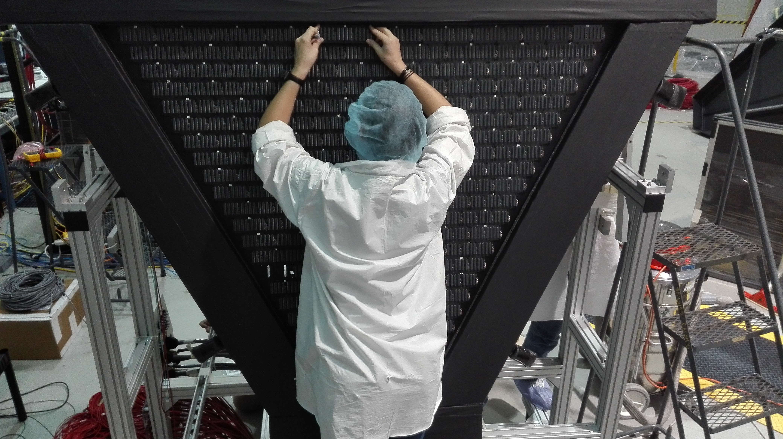
CLAS12
RICH Detector
Hall B
Mechanical structure
Mechanical structure ready
Installation tools in preparation
Aerogel
Baseline production done
Working on additional spares
RICH assembling on track for installation middle of November
Mirrors
Spherical reveal defects after coating
Resurface done, coating ongoing
Lateral mirrors at JLab
Front mirrors being delivered
PMT + Electronics
Being assembled
02/10/17
CLAS collaboration meeting, JLab
1

Slide 2
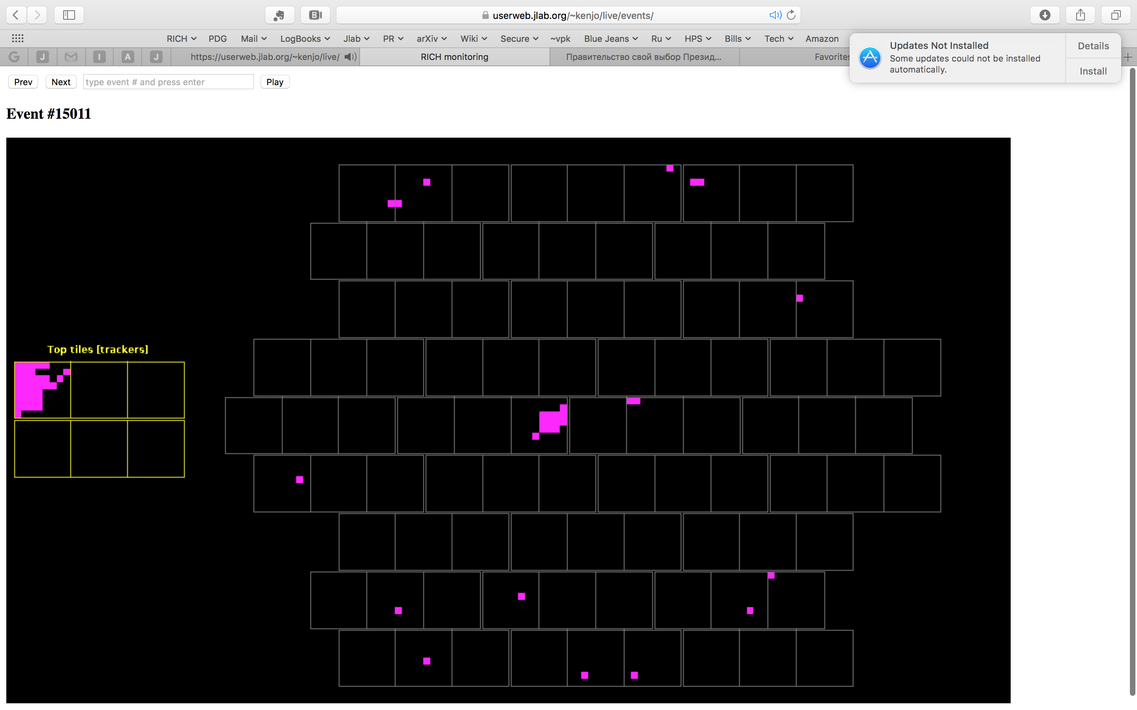
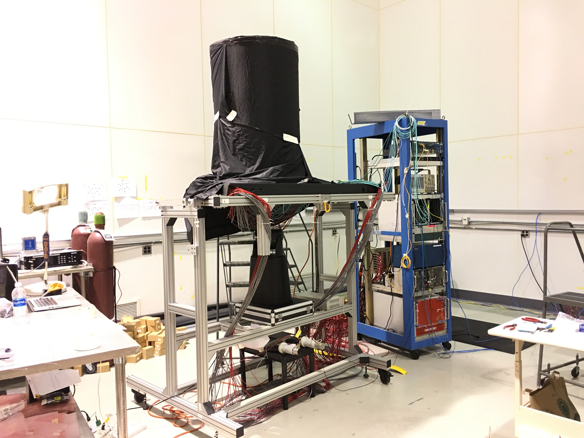
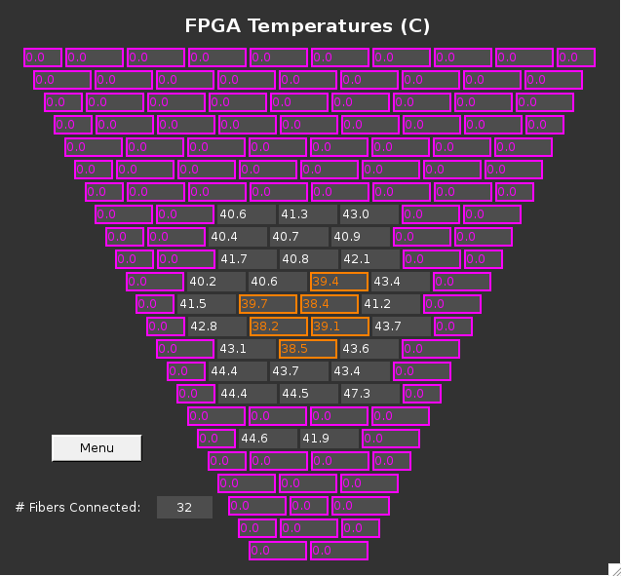
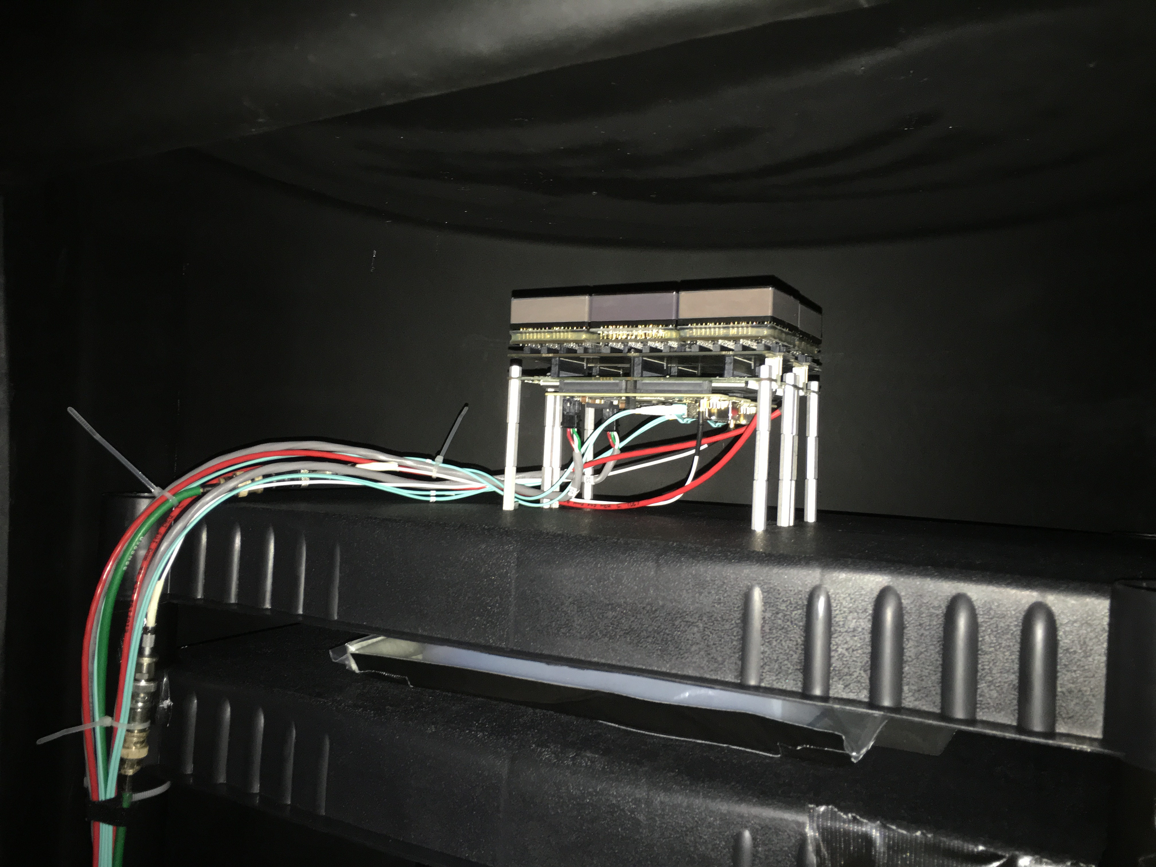
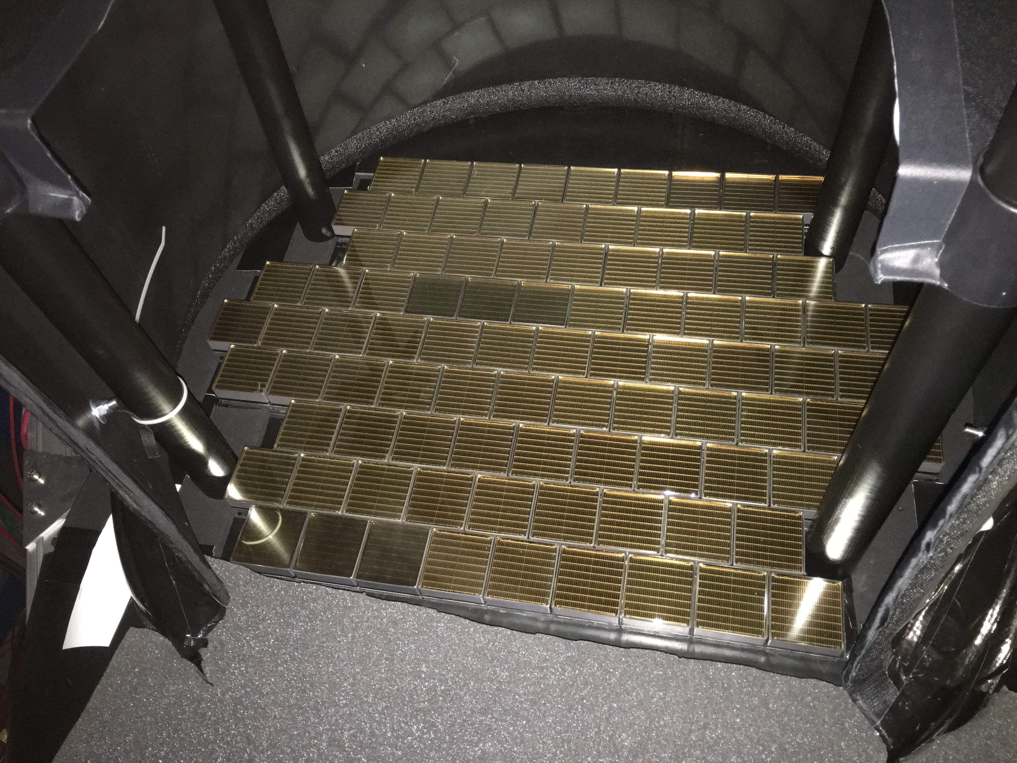
CLAS12
RICH Detector
Hall B
First stage cosmic run successfully completed
Trigger and tracking station
PMT plane
02/10/17
CLAS collaboration meeting, JLab
2

