Slide 1
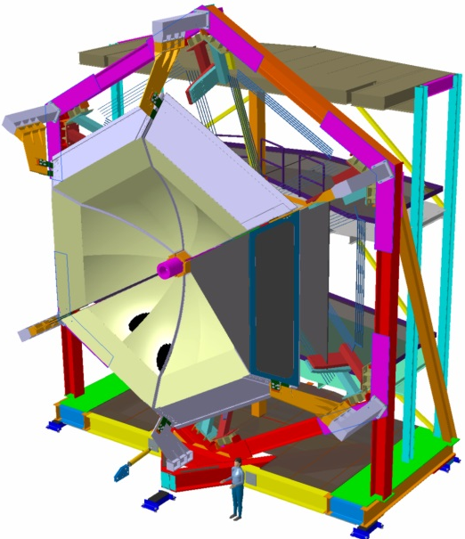
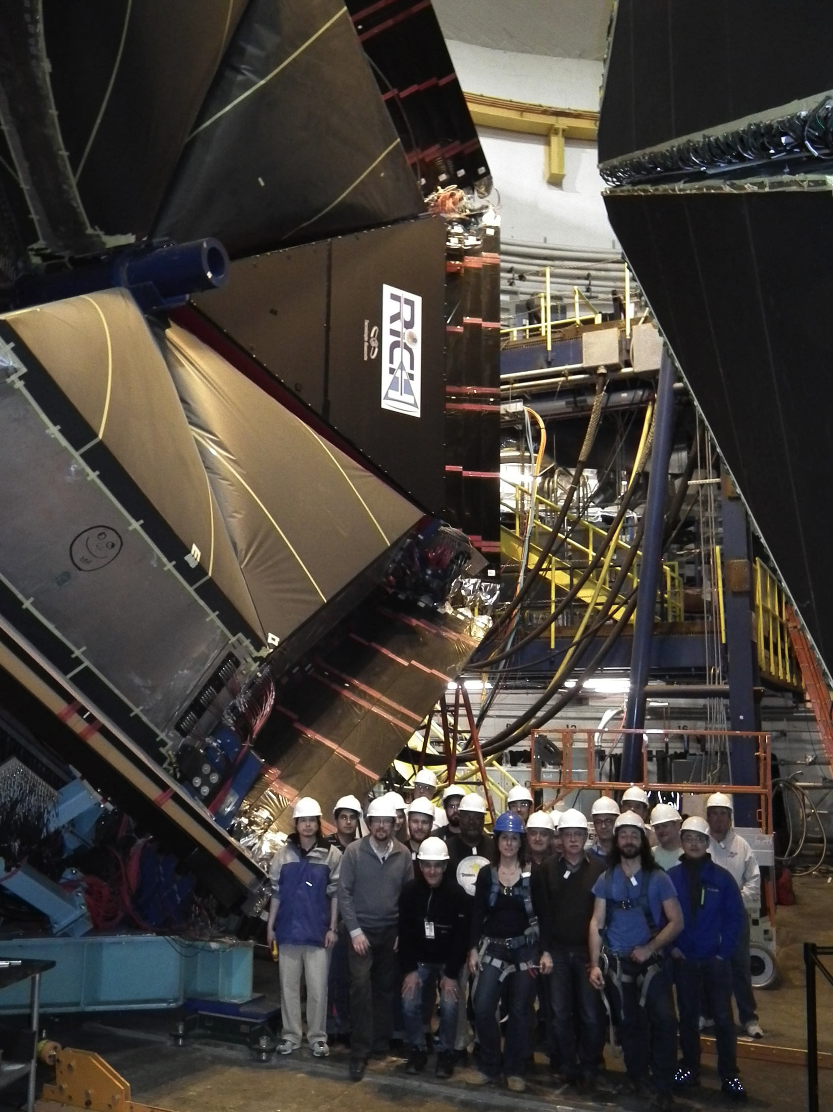
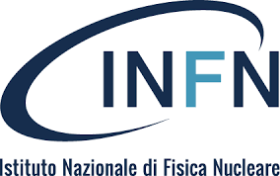
CLAS12 – RICH
The Ring Imaging Cherenkov detector (RICH) is designed to improve CLAS12 particle identification in the momentum range 3-8 GeV/c and will replace one sector of the existing LTCC detector.
The RICH design incorporates aerogel radiators, visible light photon detectors, and a focusing mirror system which will be used to reduce the detection area instrumented by photon detectors to ~1 m² . Multi-anode photomultiplier tubes (MA-PMTs) provide the required spatial resolution and match the aerogel Cherenkov light spectrum (visible and near-ultraviolet region).
For forward scattered particles (θ< 13º) with momenta 3 - 8 GeV/c, a proximity imaging method with thin (2 cm) aerogel and direct Cherenkov light detection will be used.
For larger incident particle angles of 13º<θ<25º and momenta of 3 - 6 GeV/c, the Cherenkov light will be produced by a thicker aerogel (6 cm), focused by a spherical mirror, undergo two further passes through the thin radiator material and a reflection from planar mirrors before detection.
RICH - TECHNICAL PARAMETERS
PARAMETER | DESIGN VALUE
Momentum range | 3-8 GeV/c
π/K rejection factor | Not less than 500
Κ/p rejection factor | Not less than 100
Angular coverage | 5º to 25º
Cherenkov light radiator | Aerogel
Aerogel refraction index | 1.05
Photodetector | 64 channels photomultipliers (MA-PMTs)
Number of PMTs | 391
Total number of readout channels | 25024
Electronics | MAROC3 and FPGA on detector boards fully integrated into the CLAS12 DAQ
Data transfer to CLAS12 DAQ | Fiber optics cables
Spherical mirror | Carbon-fiber-reinforced polymer (CFRP) Radius of curvature =2700 mm Area= 3.38 m²
Flat mirror | Sandwich with glass skin (0.7+0.7 mm) and Al honeycomb core 8.6 mm thick

Slide 2
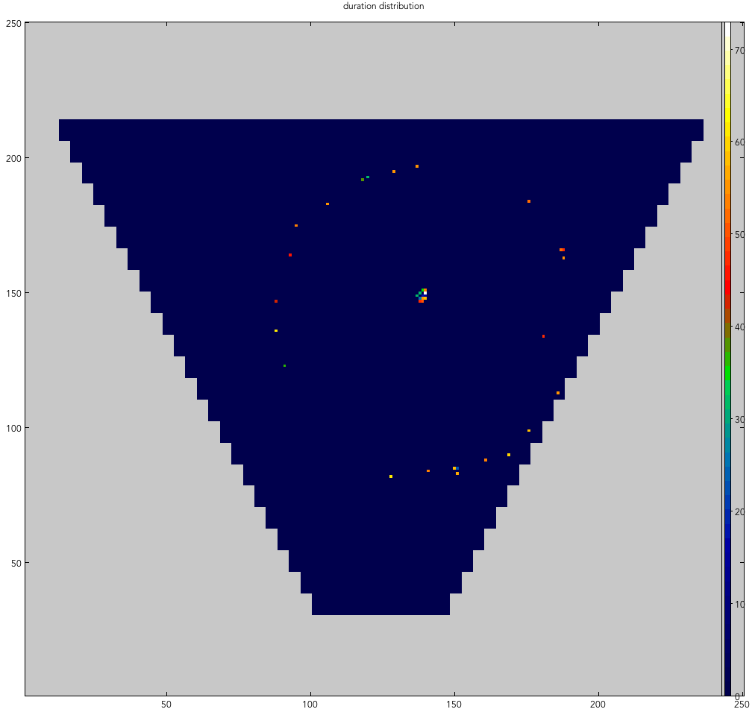
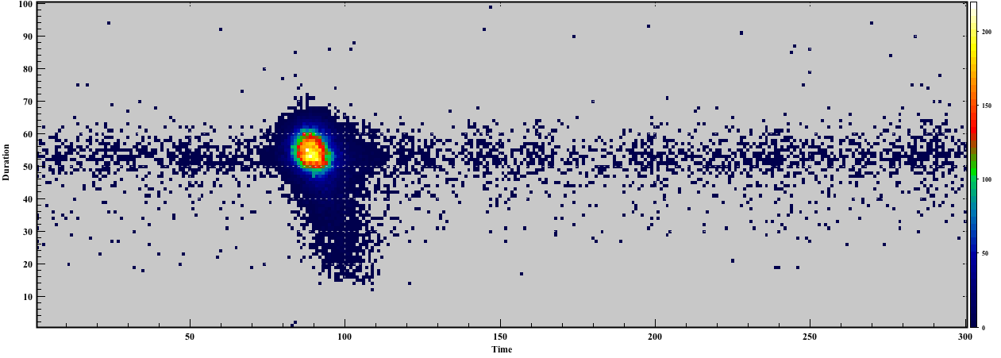
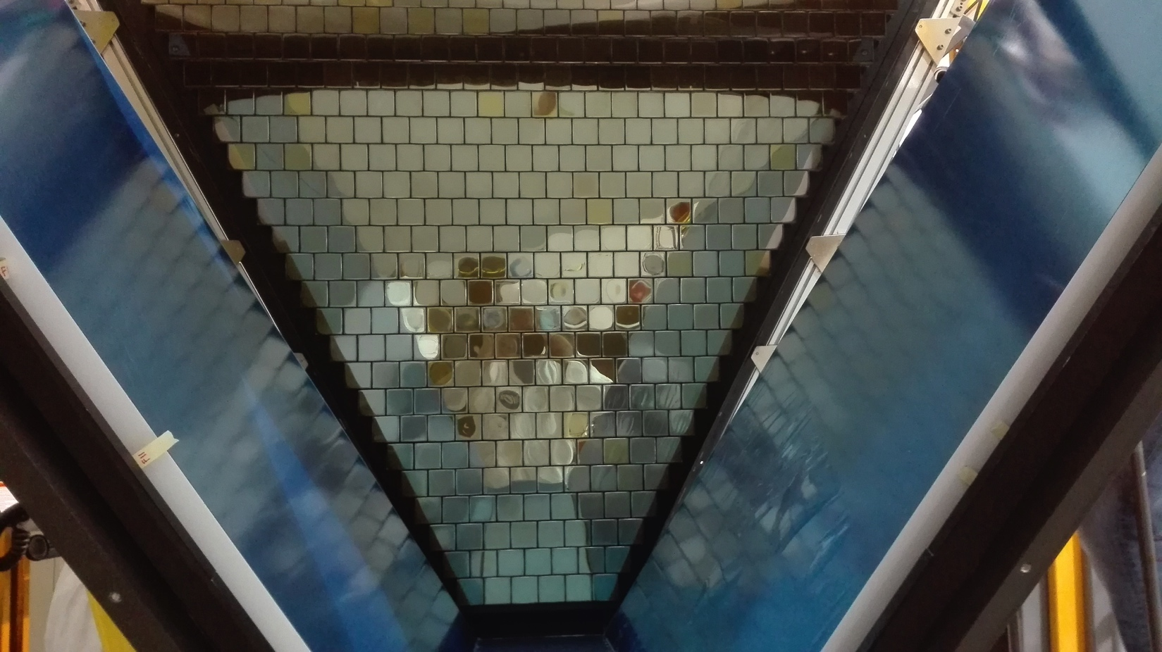
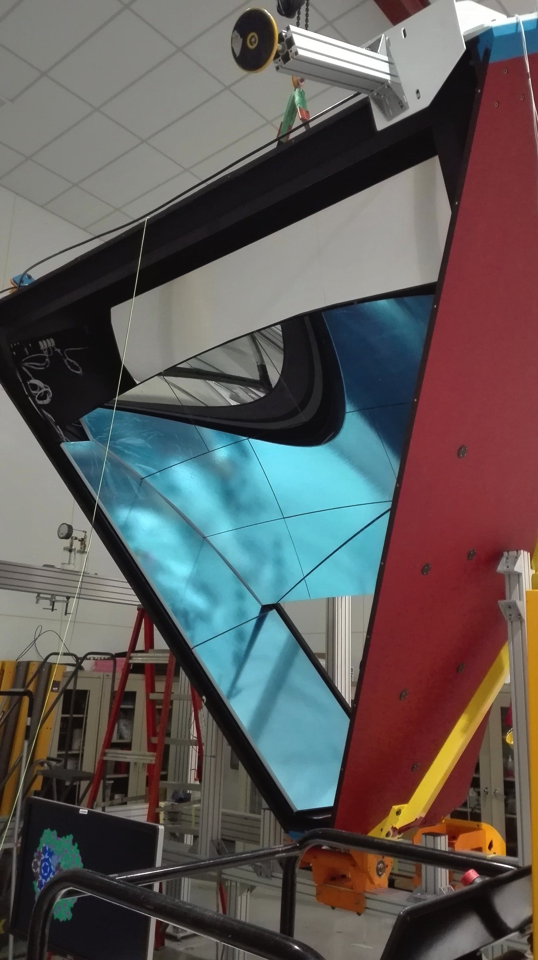
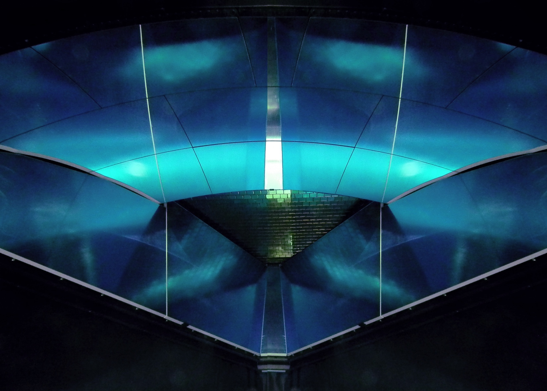
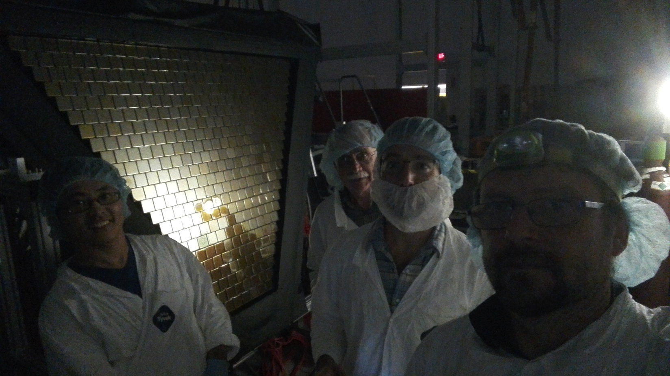
Project Leadership
The RICH collaboration includes INFN (Italy), JLab, Argonne National Lab, Duquesne University (DUQ), University of Connecticut (UCONN), George Washington University (GWU), Kyungpook National University (Republic of Korea), Universidad Tecnica Federico Santa Maria (Chile), University of Glasgow (UK).
Significant dates
Sep. 2013: Physics Division review with DOE observers.
Sep. 2013: RICH project start.
Oct. 2015: Mid-term project review.
Jun. 2016: Readiness review.
Dec. 2017: 1st module complete.
Jan. 2018: 1st module Installation and data-taking start.
RICH online monitor
Single photon TDC
Aerogel
RICH direct view
RICH mirror system
RICH aerogel wall
RICH structure
RICH MA-PMT plane
Main Project Features
MA-PMTs: First use in RICH of multi-anode 80 H8500 and 350 H12700 PMTs.
Electronics: Modular front-end with local dead-time free signal processing, typical pedestal width at the level of 1% SPE signal and time resolution of 1 ns.
Aerogel: Unprecedented transparency and size at n=1.05.
Planar Mirrors: First use of skin-glass mirrors in nuclear physics experiment.
Spherical mirrors: Carbon fiber evolution of LHCb mirrorrs (30% lighter).
Mechanics: Composite material structures derived from aero industry.

