Slide 1
CLAS12 RICH ERR Recommendations
1. The Physics Division requires that an Operational Safety Procedure (OSP) be developed for the assembly and testing of each of the pieces of Ancillary Equipment for CLAS12. Work with the RICH technical liaison and JLab management to write, review, approve and implement the OSP for these activities. We encourage the Hall B staff to work with the collaboration to develop the necessary controlled documents for the safe operation outside the hall in a format that would facilitate integration of the procedures into the Operational Safety Procedures for CLAS12.
The OSP for run CLAS12 RICH in Hall-B has been written, and is in the process of review and approval.
For the commissioning without beam, the RICH will be operated in EEL-124 with the same configuration, services and safety systems (i.e. interlock) foreseen for the standard operations in Hall-B. As a consequence, the procedures for CLAS12 RICH testing in EEL-124 are the same as the one for running in Hall-B. The relative OSP will derive from the one approved for Hall-B. The details of the EEL-124 setup will be described in the commissioning manual.
The RICH assembling THA is in preparation. It will be based on the procedures already tested when the RICH module was pre-assembled at the company in Italy for delivery approval.
CLAS12 Readiness Review, 6-7th December 2016
1
Notes:
Dire meglio chi fa cosa.

Slide 2
CLAS12 RICH ERR Recommendations
2. The Operation Manual for the sub-system must be completed and reviewed as part of the CLAS12 Experimental Readiness Review.
The RICH Operation Manual is part of the CLAS12 Operational Manual and
has been submitted to the CLAS12 ERR.
3. Develop documentation for shift personnel. This documentation should be concise, accessible to anyone taking shifts, and clearly specify which operations are authorized for shift takers and which are only for experts
The crucial safety information and procedures are outlined in ESAD document.
The slow control to monitor and operate the RICH is described in the Operation Manual.
The ordinary job of shift personnel will be documented in the Operation Manual
as defined during the RICH commissioning.
4. The air-cooling and nitrogen gas systems are pressure systems and approvals from the Pressure Systems design authority are required before operation.
The Pressure System design is being approved as part of OSP.
CLAS12 Readiness Review, 6-7th December 2016
2
Notes:
Dire meglio chi fa cosa.

Slide 3
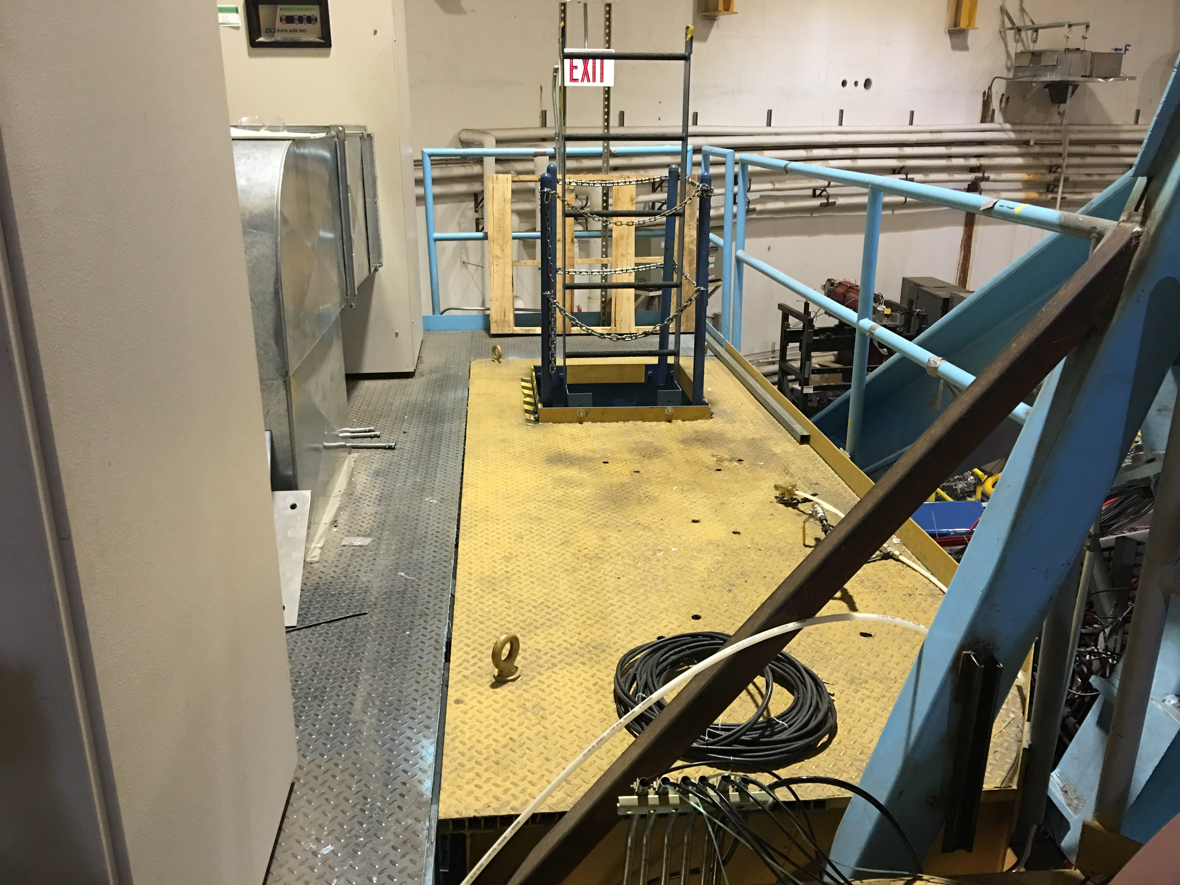
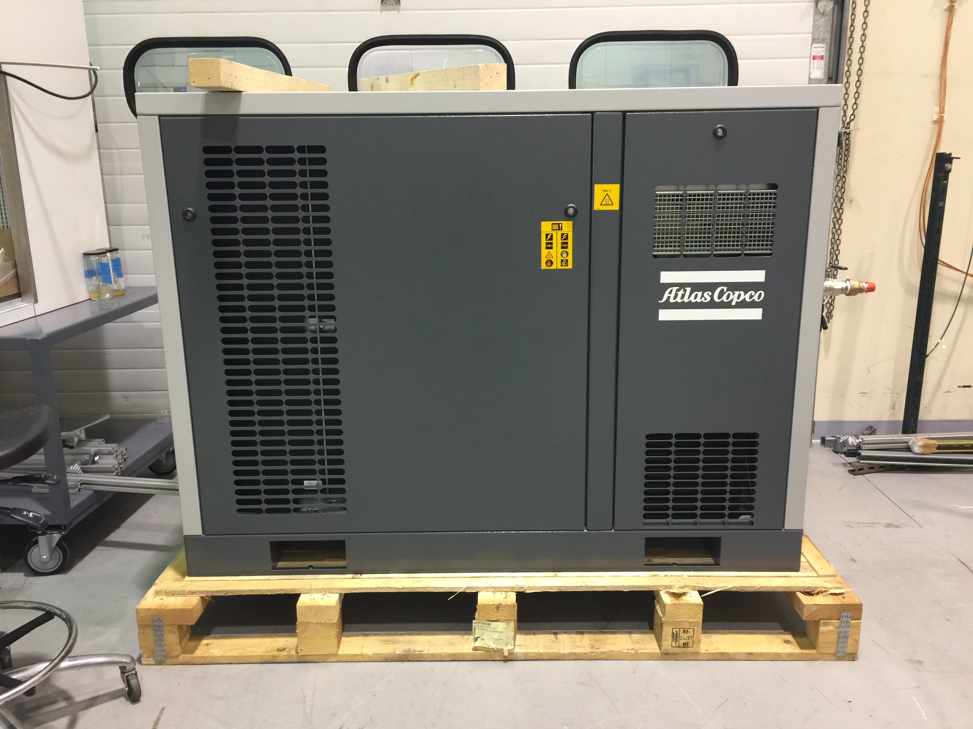
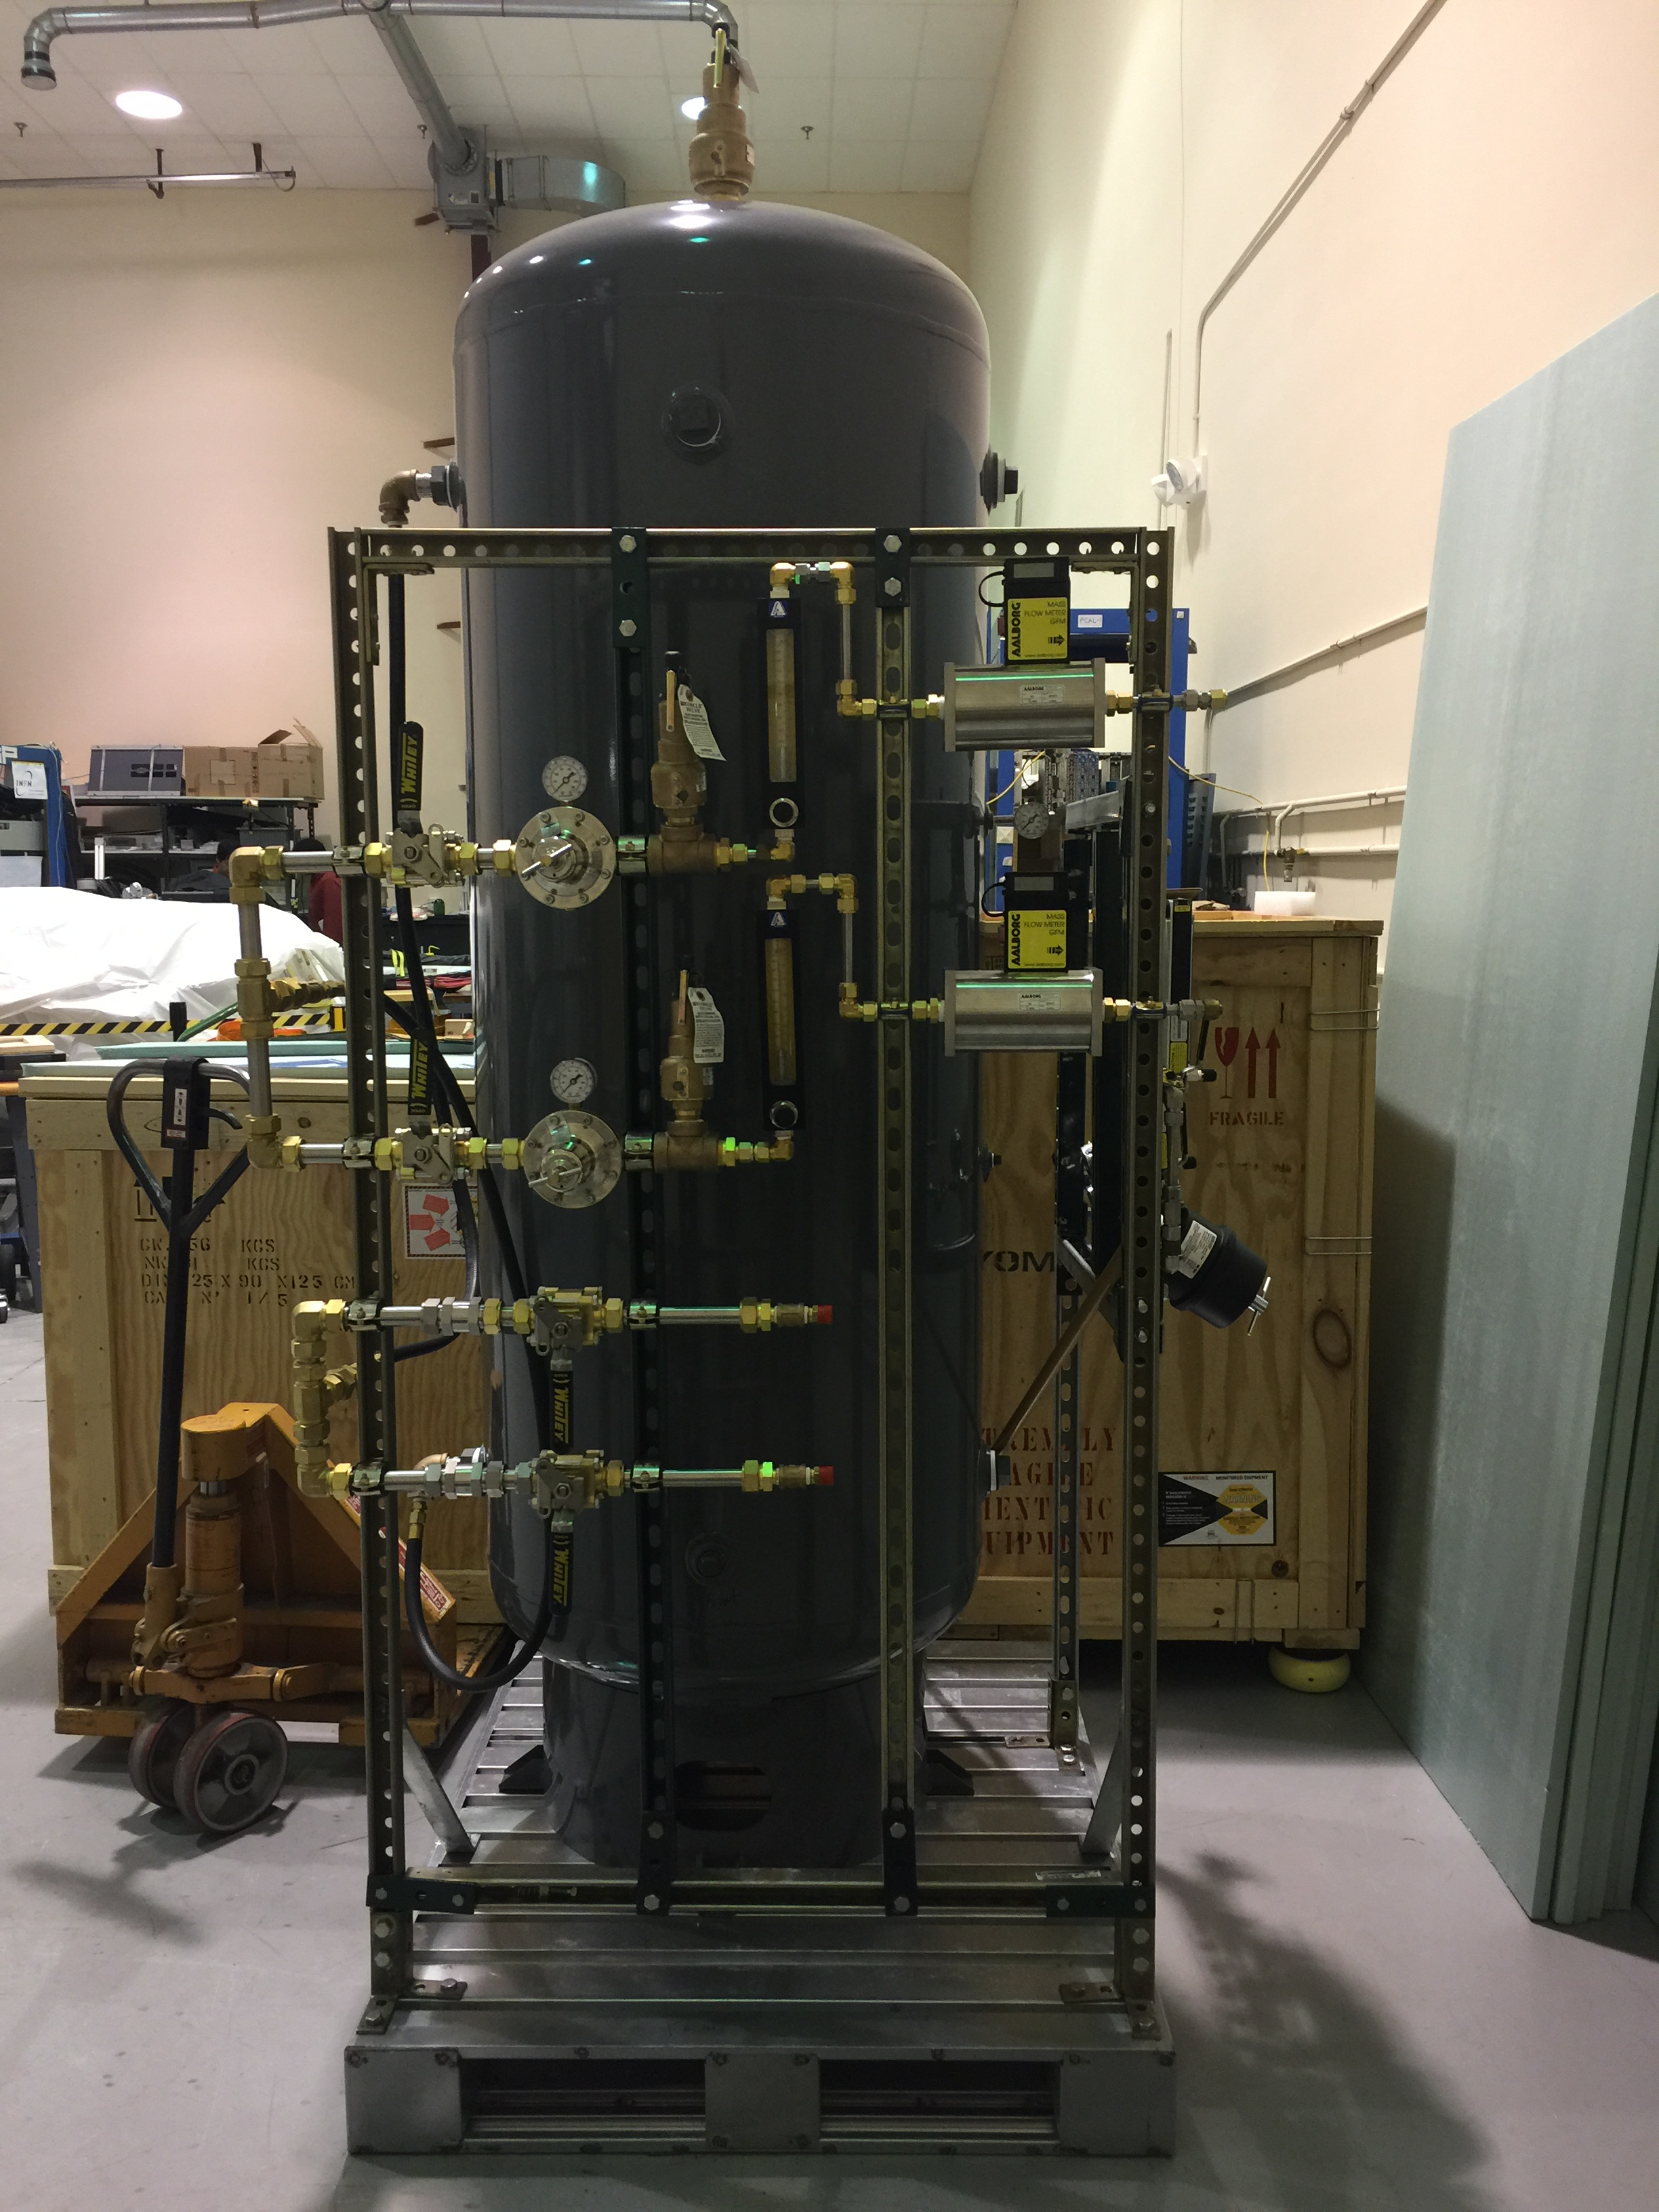
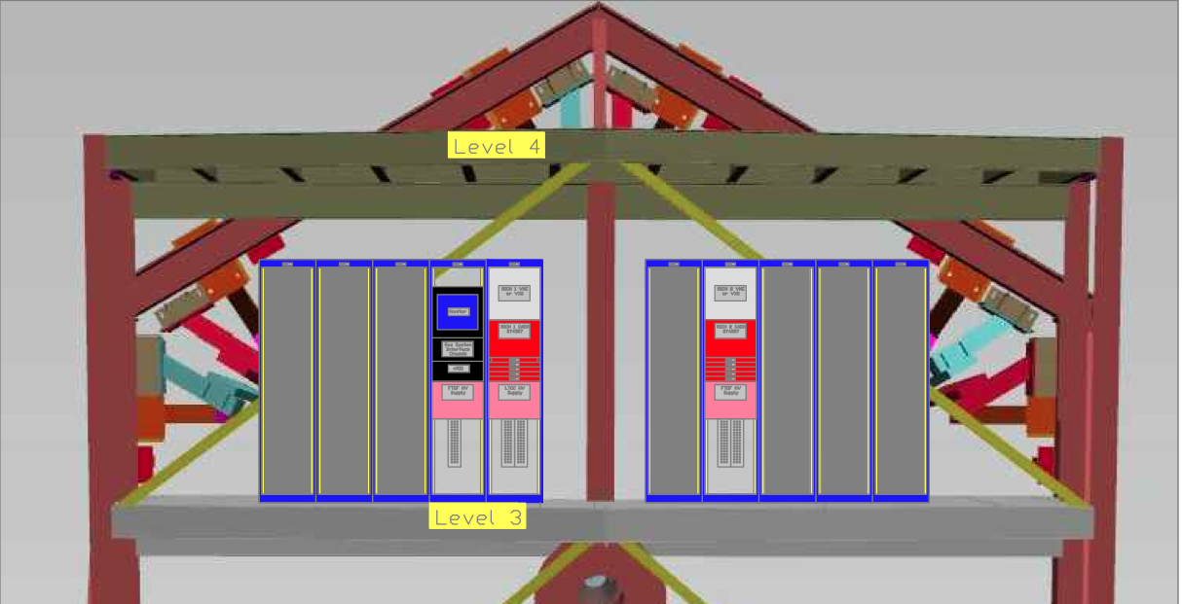
CLAS12 RICH ERR Recommendations
5. The space for compressors and cabling must be clearly identified and reserved for RICH use.
Gas system on level 4: compressors (Left) tank + panels (Right)
Power supply + DAQ on level 3:
C3-5: CAEN SY4527, R649 distribution
C3-6 (or C2-4) VSX crate with fiber distribution
Cable path and length approved by Eugene Pasyuk
CLAS12 Readiness Review, 6-7th December 2016
3
Notes:
Dire meglio chi fa cosa.

