Slide 1
JLab12 (R.N. & R.L.: Marco Contalbrigo)
Nucleon structure and spin physics
Transverse momentum phenomena (TMDs) & 3D imaging
GPDs & EM Form Factors of the nucleon
M. Contalbrigo elected Chair of the JLab User Organization
(1600 users from US and all over the World)
M. Contalbrigo PI of the CLAS12 RICH detector
M. Contalbrigo contact person for RGH group of experiment
with transversely polarized target
L. L. Pappalardo - C.d.S. INFN Ferrara – 05/07/2023

Slide 2
Jlab12 Italia (R.N. & R.L. M. Contalbrigo)
L. L. Pappalardo - C.d.S. INFN Ferrara – 05/07/2023

Slide 3
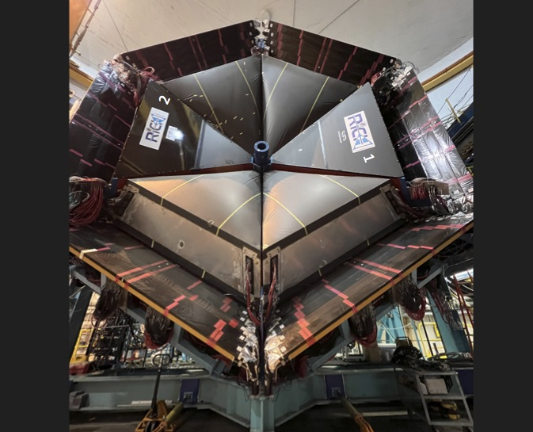
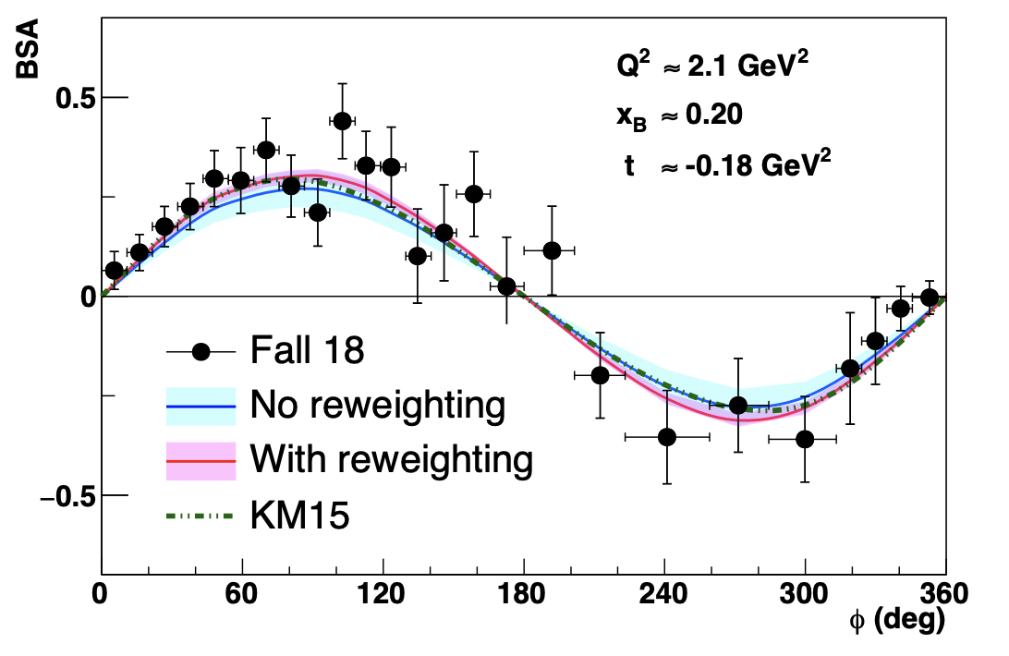
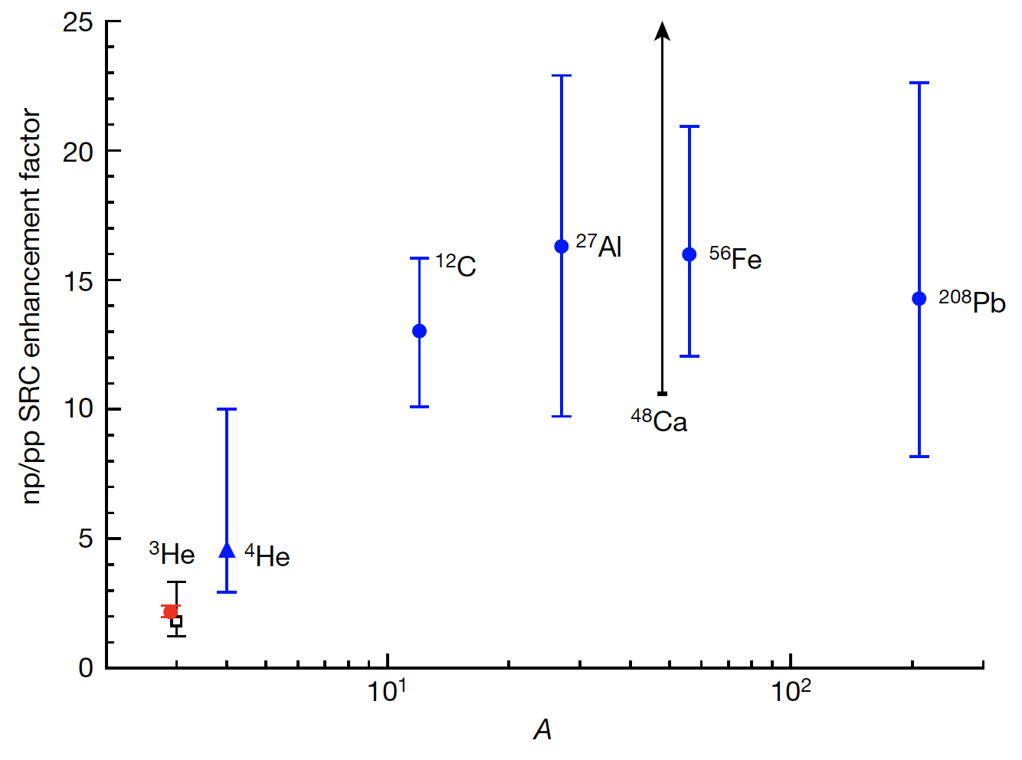
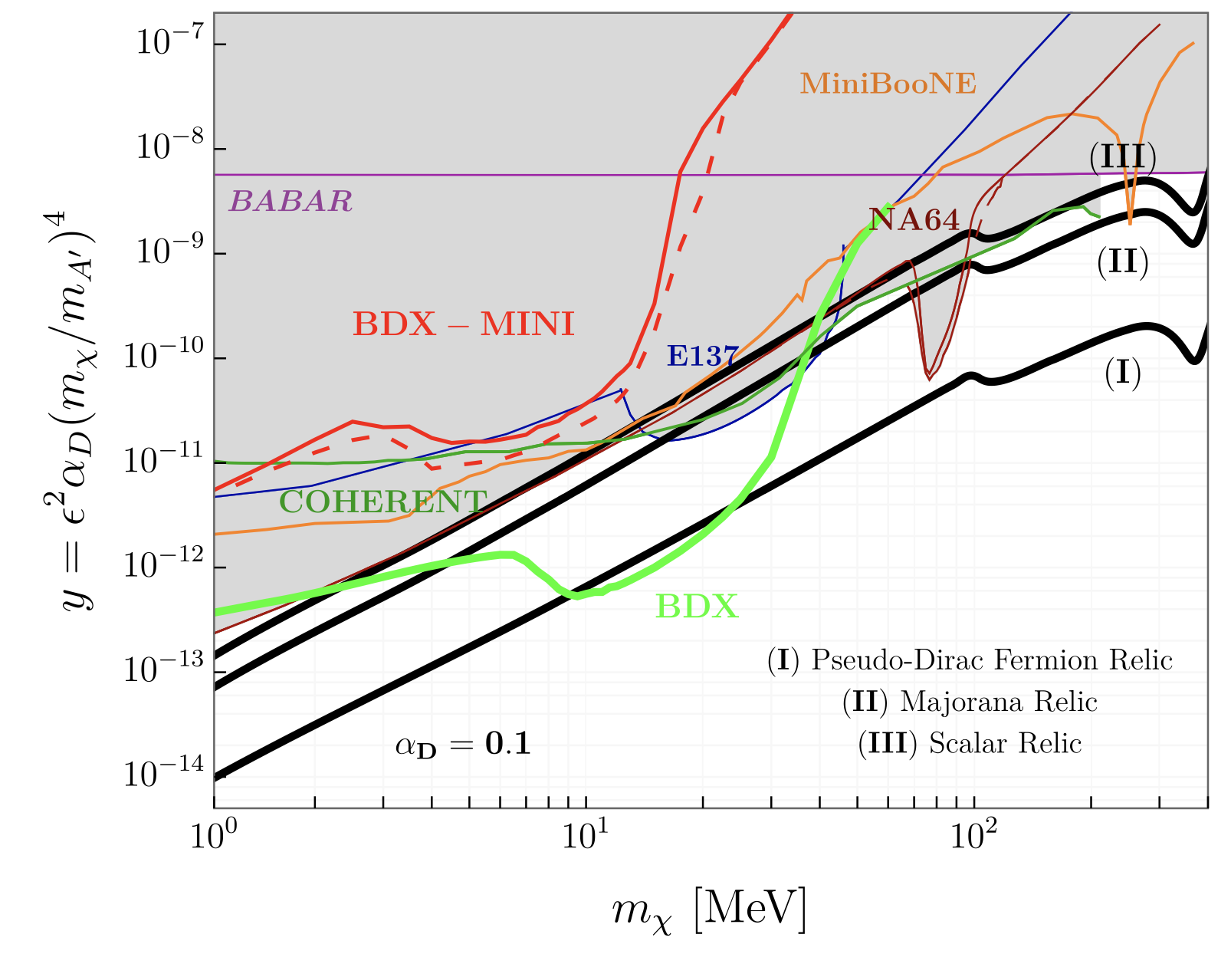
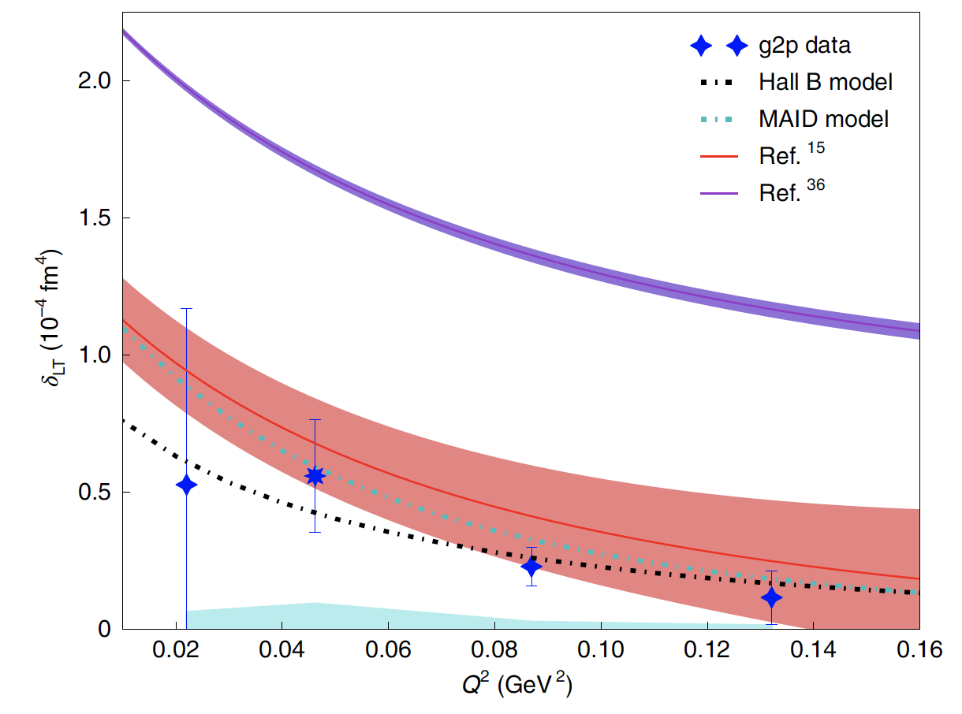
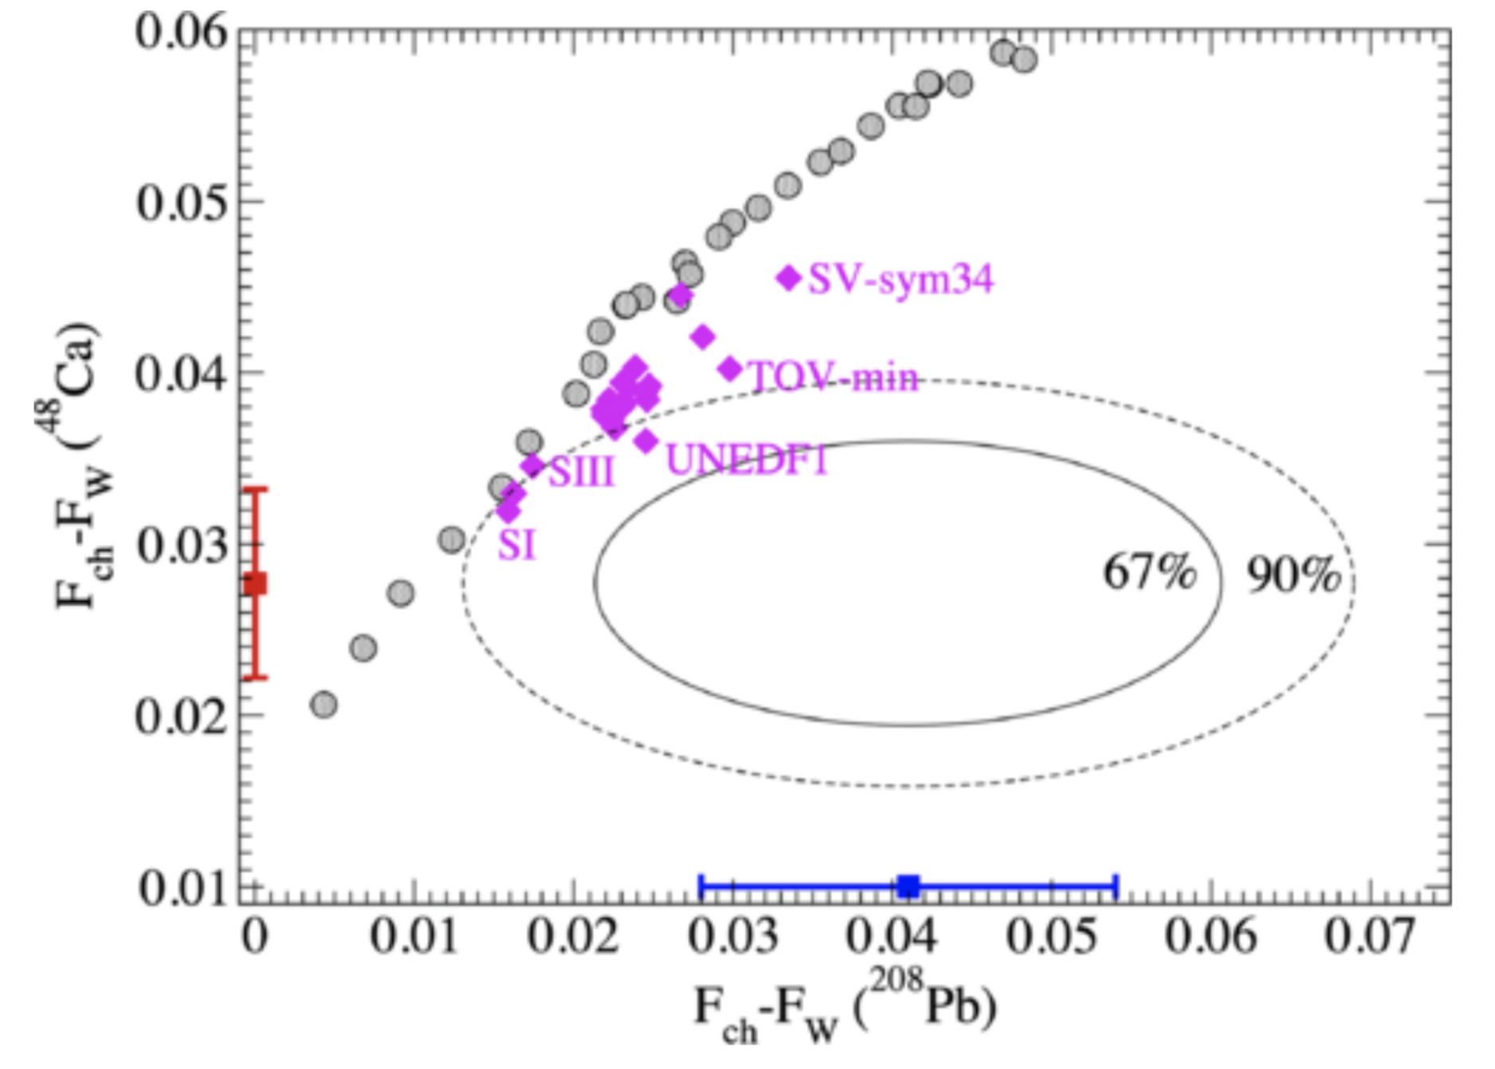
Hall-B: RICH installation completed
First run with a polarized target
Hall-A: Fully operational SBS spectrometer
CLAS12: PRL 130 (2023) 21, 211902
First CLAS12 Measurement of DVCS Beam-Spin Asymmetries in the Extended Valence Region
The first CLAS12 measurement of the DVCS beam-spin asymmetry off unpolarized proton targets, greatly extends the x and Q² phase space beyond the existing data in the valence region with unprecedented statistical precision.
Hall-A: Nature 609 (2022) 41-46
Revealing short-range structure of the mirror nuclei
³H and ³He
Hall-A measurement of np/pp short-range corelation ratio in mirror nuclei ³H and ³He is an order of magnitude more precise than previous experiments, and finds a marked deviation from the near-total np dominance observed in heavy nuclei.
Dark matter: PRD 106 (2022) 072011
Dark matter search with DBX-mini experiment
The BDX-mini pilot experiment probed to be sensitive to the parameter space covered by some of the most sensitive experiments to date, and demonstrates the discovery potential of the next generation beam dump experiment planned at intense electron beam facilities.
Hall-A: Nature Phys. 18 (2022) 1441-1446 Proton spin structure and generalized polarizabilities in the strong QCD regime
Hall-A measurement of the spin structure function g2 accesses generalized polarizabilities that are fundamental quantities describing the nucleon’s response to an external field, and benchmarks the Chiral perturbation theory predictions.
CREX: PRL 129 (2022) 042501
Precise determination of the neutral weak form factor of ⁴⁸Ca.
CREX has performed a precise determination of the neutron skin thickness of the ⁴⁸Ca nucleus. Together with the PREX measurement on ²⁰⁸Pb, it provides constraints on the density dependence of the symmetry energy of nuclear matter.
L. L. Pappalardo - C.d.S. INFN Ferrara – 05/07/2023

Slide 4
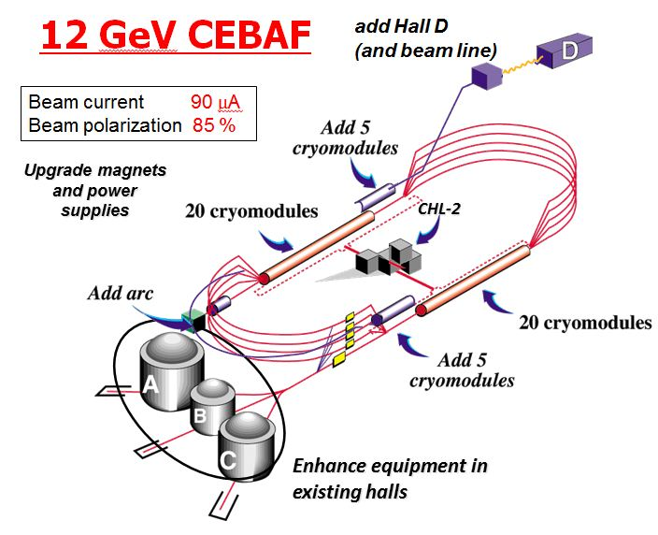
CLAS12 Experiment in Hall-B
L. L. Pappalardo - C.d.S. INFN Ferrara – 05/07/2023

Slide 5
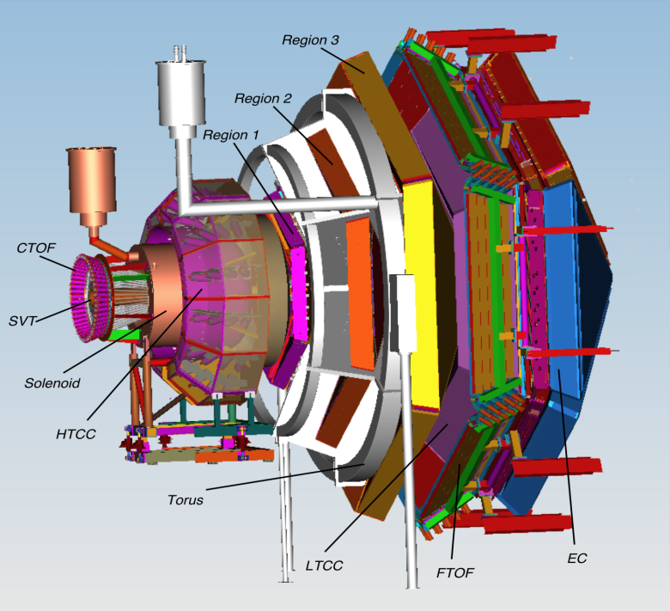
CLAS12 Experiment in Hall-B
CLAS12 detector
Lumi up to ${10}^{35} {cm}^{−2}s^{−1}$
High polarized electron beams
H and D polarized target
Broad kinematic range
Very good PID
L. L. Pappalardo - C.d.S. INFN Ferrara – 05/07/2023

Slide 6
CLAS12 Experiment in Hall-B
CLAS12 detector
Lumi up to ${10}^{35} {cm}^{−2}s^{−1}$
High polarized electron beams
H and D polarized target
Broad kinematic range
Very good PID
Physics program:
Hadron spectroscopy
Nuclear effects in hadronization
Nucleon structure (TMDs, GPDs)
L. L. Pappalardo - C.d.S. INFN Ferrara – 05/07/2023

Slide 7
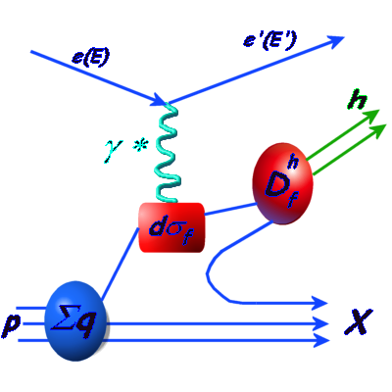
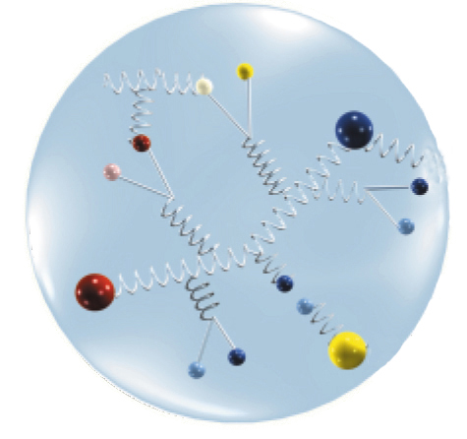
CLAS12 Experiment in Hall-B
TMDs depend on $x$ and $p_{T}$
Describe correlations between $p_{T}$ and quark or nucleon spin (spin-orbit correlations)
Provide a 3-dim picture of the nucleon in momentum space (nucleon tomography)
FF
L. L. Pappalardo - C.d.S. INFN Ferrara – 05/07/2023

Slide 8
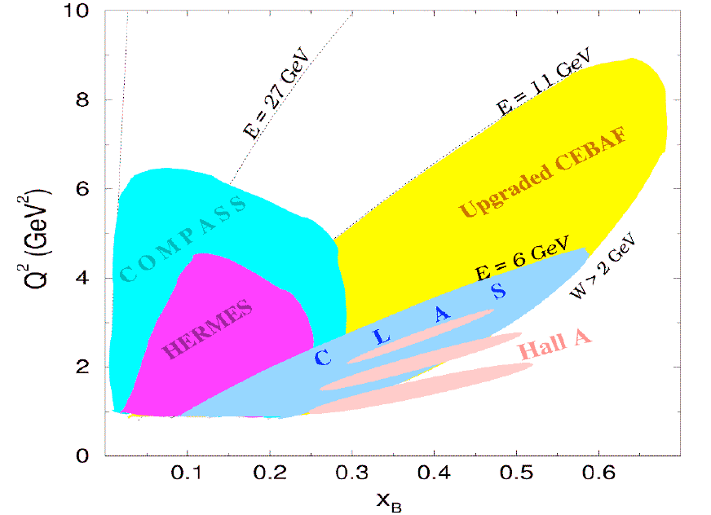
CLAS12 Experiment in Hall-B
TMDs depend on $x$ and $p_{T}$
Describe correlations between $p_{T}$ and quark or nucleon spin (spin-orbit correlations)
Provide a 3-dim picture of the nucleon in momentum space (nucleon tomography)
FF
L. L. Pappalardo - C.d.S. INFN Ferrara – 05/07/2023

Slide 9
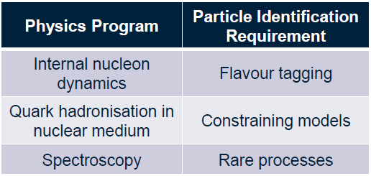
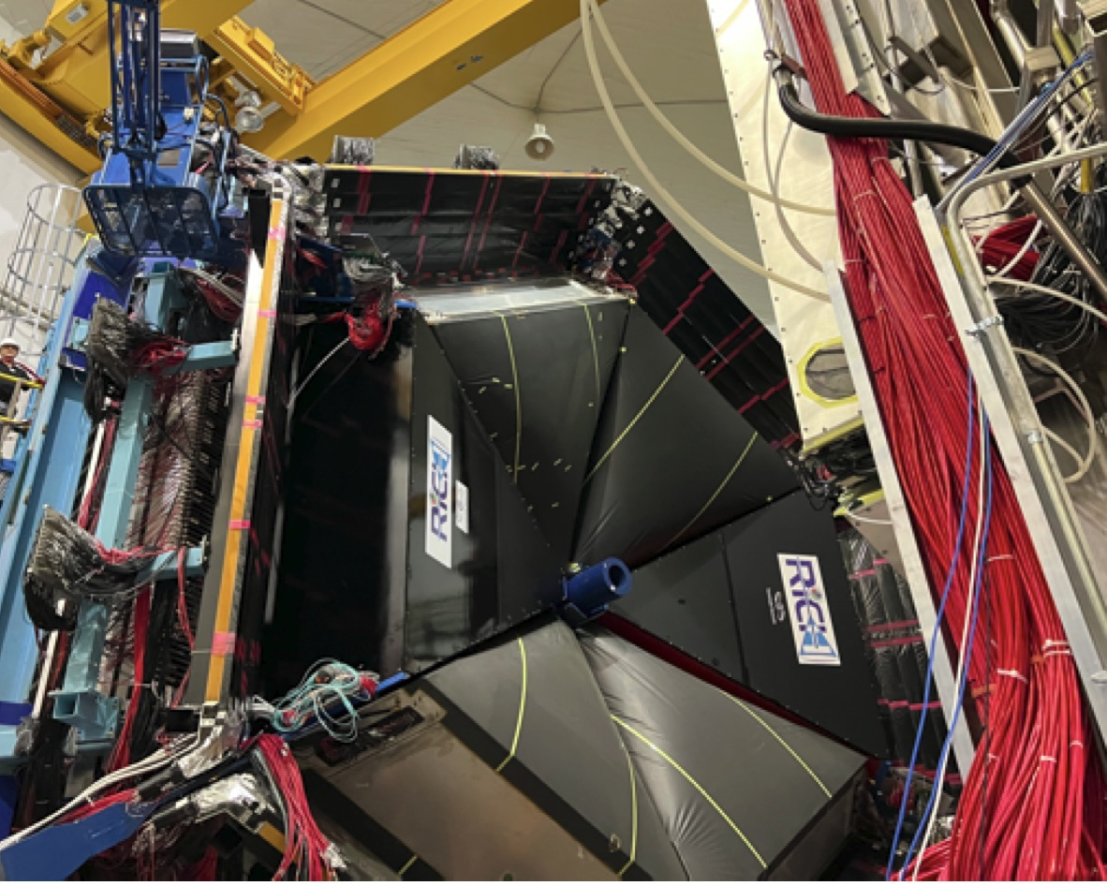
The RICH detector project (INFN)
Completed with 2nd module in June 2022
INSTITUTIONS
INFN (Italy) Bari, Ferrara, Genova, L.Frascati, Roma/ISS
Jefferson Lab (Newport News, USA)
Argonne National Lab (Argonne, USA)
Duquesne University (Pittsburgh, USA)
George Washington University (USA)
Glasgow University (Glasgow, UK)
J. Gutenberg Universitat Mainz (Mainz, Germany)
Kyungpook National University, (Daegu, Korea)
University of Connecticut (Storrs, USA)
UTFSM (Valparaiso, Chile)
L. L. Pappalardo - C.d.S. INFN Ferrara – 05/07/2023

Slide 10
The RICH Front-End electronics
Compact and modular electronics to readout multi-anode PMTs
FPGA Board (JLab)
ASIC Board (Ferrara)
Adopted by other experiments:
Gluex, SOLID, EIC R&D...
Adapted to different sensors:
Multi-anode PMT H12700, H13700
SiPM array S12642, H13361
Developed thanks to Roberto M., L. Barion
L. L. Pappalardo - C.d.S. INFN Ferrara – 05/07/2023

Slide 11
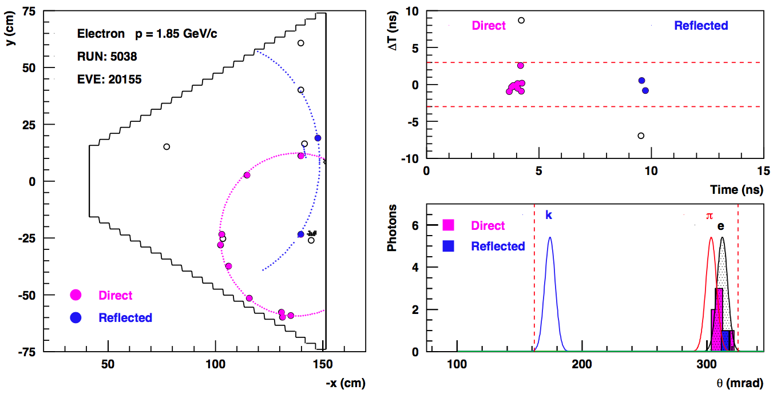
The RICH Reconstruction
Completed for the CLAS pass-2 data reprocessing (started in spring 2023)
Single-photon pattern recognition based on space and time
L. L. Pappalardo - C.d.S. INFN Ferrara – 05/07/2023

Slide 12
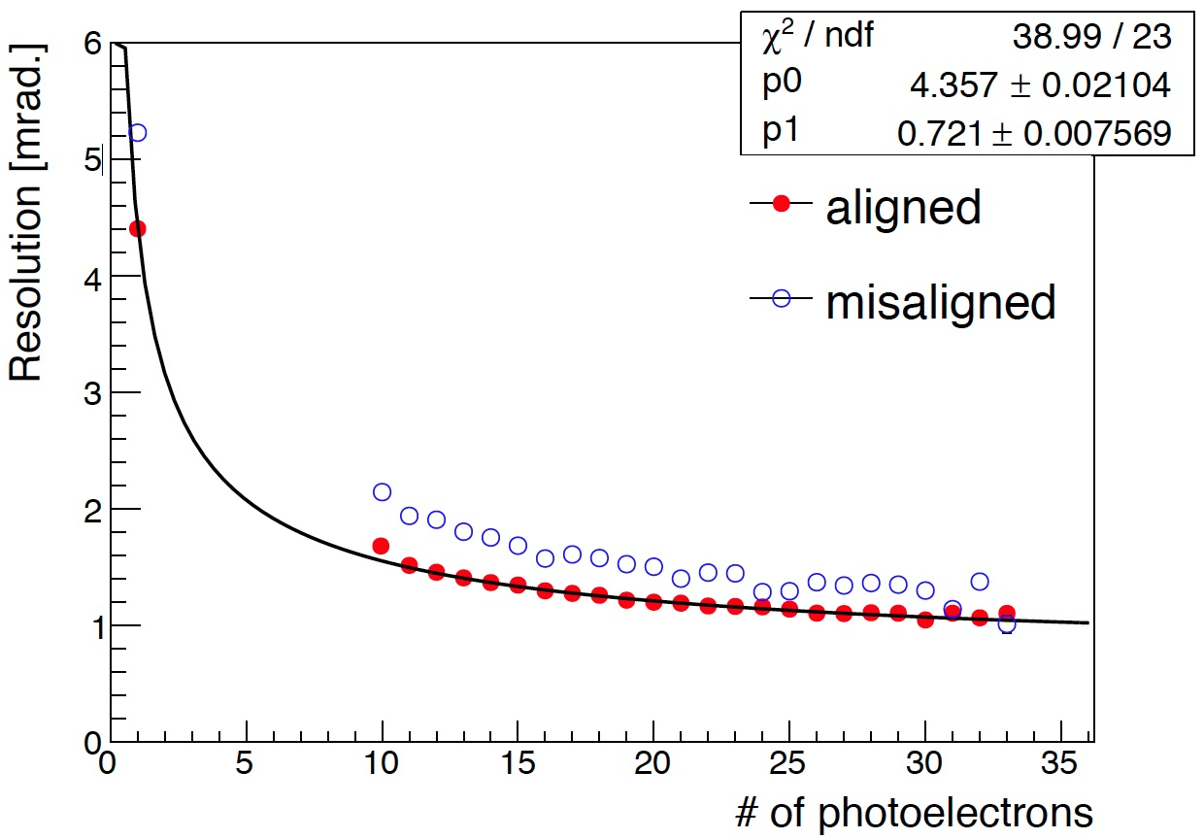
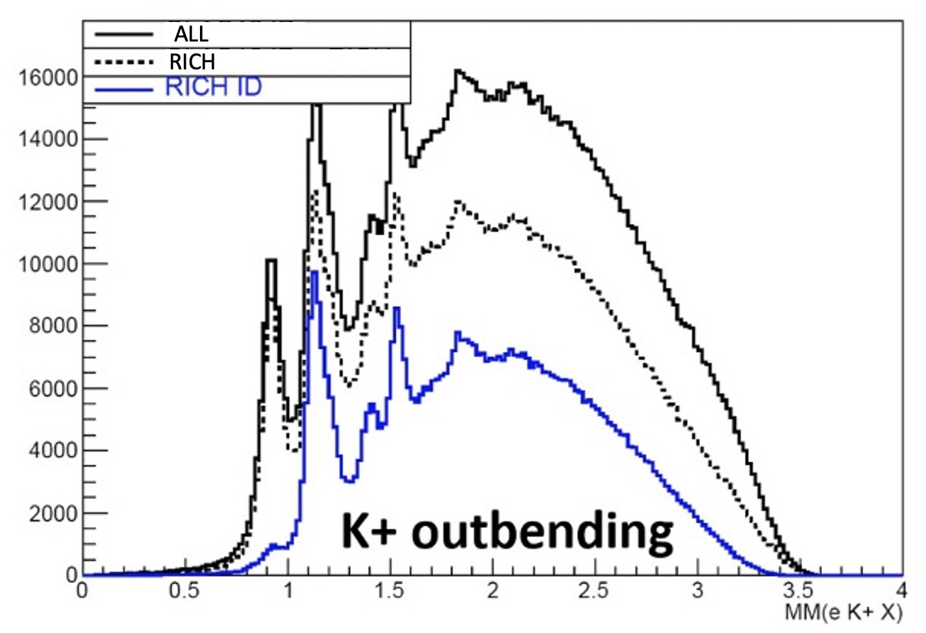
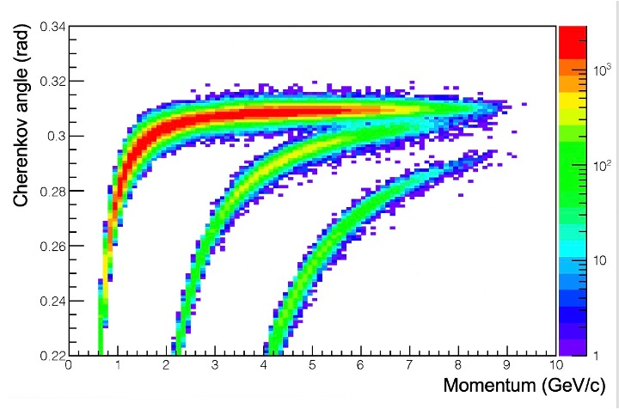
The RICH Reconstruction
Check with semi-inclusive physics channel ep→eh⁺X
ep→eπ⁺n
background
ep→eK⁺Λ
signal
L. L. Pappalardo - C.d.S. INFN Ferrara – 05/07/2023

Slide 13
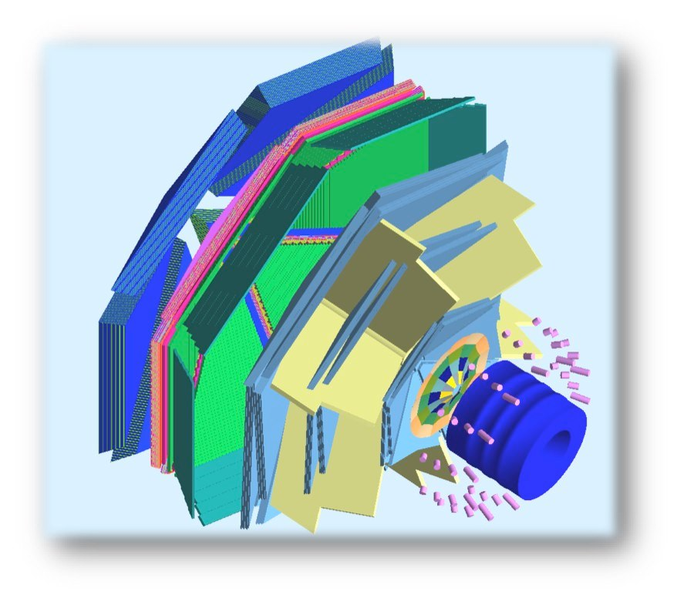
The Transverse target
Internal Target
To maintain transverse spin polarization
within the CLAS12 solenoid and preserve wide acceptance for the final-state particles, new magnetic solutions are required.
target
superconducting
solenoid
polarized
e⁻ beam
superconducting
torus
L. L. Pappalardo - C.d.S. INFN Ferrara – 05/07/2023

Slide 14
The Transverse target
Internal Target
To maintain transverse spin polarization
within the CLAS12 solenoid and preserve wide acceptance for the final-state particles, new magnetic solutions are required.
Tracking solenoid
design up to 5 T longitudinal
4K L-He cryostat
length 1500 mm
target
Transverse Target:
high polarization
d 25 mm – Length 10 mm
transverse field up to 2 T
superconducting
solenoid
polarized
e⁻ beam
superconducting
torus
L. L. Pappalardo - C.d.S. INFN Ferrara – 05/07/2023

Slide 15
Transverse target: bulk transverse magnet
Alternative to the use of a massive 5 T magnet to increase acceptance (for recoil)
A hollow bulk superconductor is able to provide a transverse holding field inside, while adjusting its internal currents to shield any outside field, without the need of a current supply!
magnetization
L. L. Pappalardo - C.d.S. INFN Ferrara – 05/07/2023

Slide 16
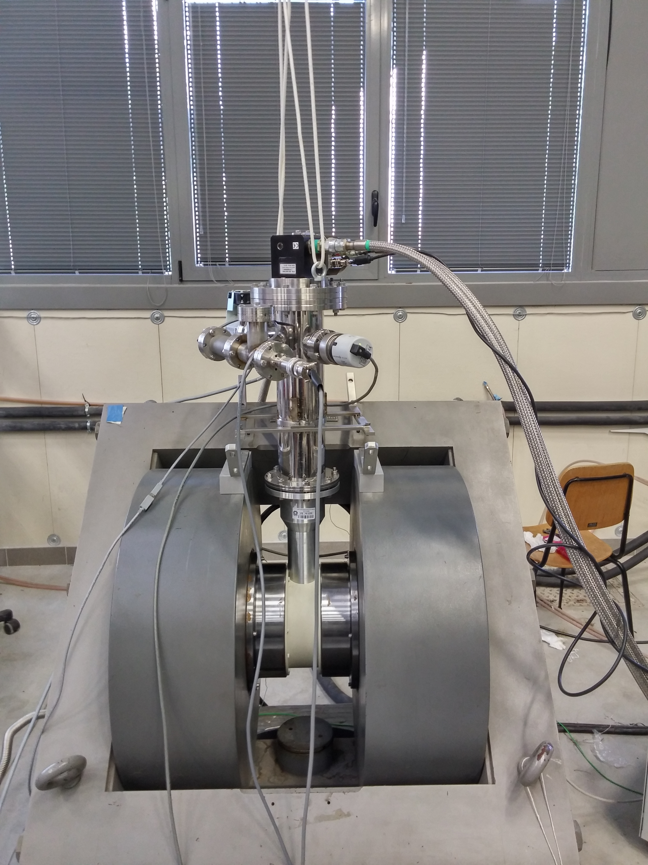
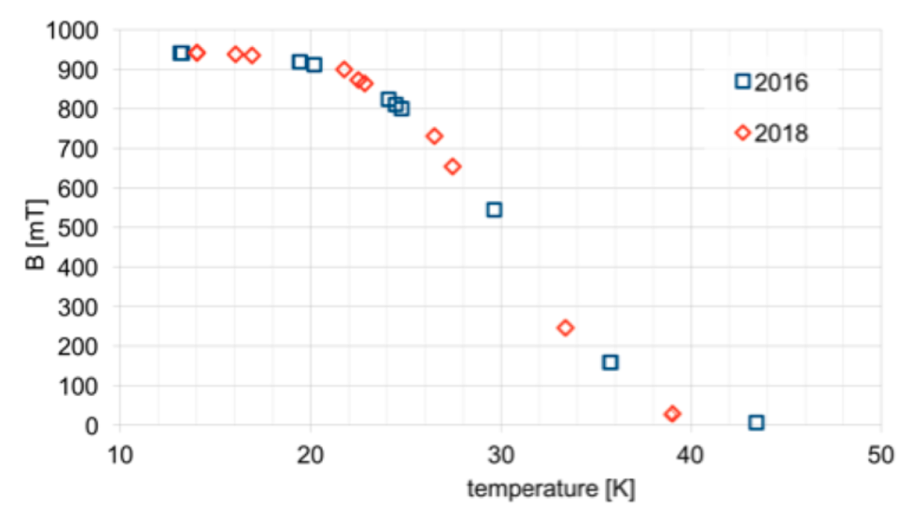
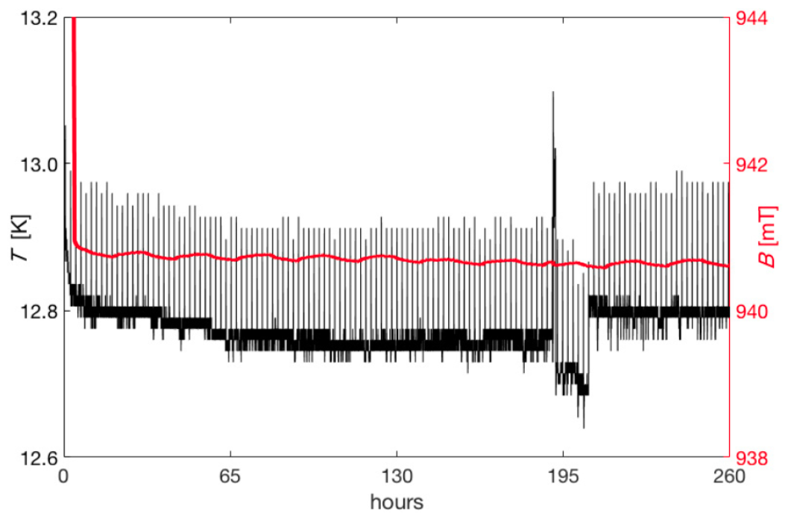
Transverse target: the Ferrara setup
Dipole field frozen for days inside a MgB₂ cylinder:
After cooling down the MgB2 cylinder inside a dipole field of about 1T, the external field is zeroed and the dipole field at the center of the cylinder measured.
With the decrease of the temperature below the transition point, an increasing fraction of the original field is trapped.
At the minimum temperature of 12.8 K reachable by the setup, a field of about 940 mT is preserved for days, without any significant degradation
Field vs
Temperature
L. L. Pappalardo - C.d.S. INFN Ferrara – 05/07/2023

Slide 17
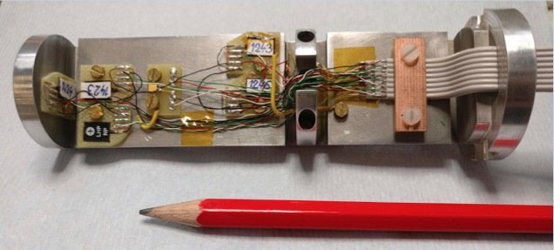
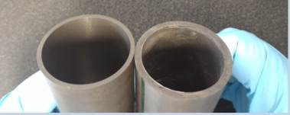
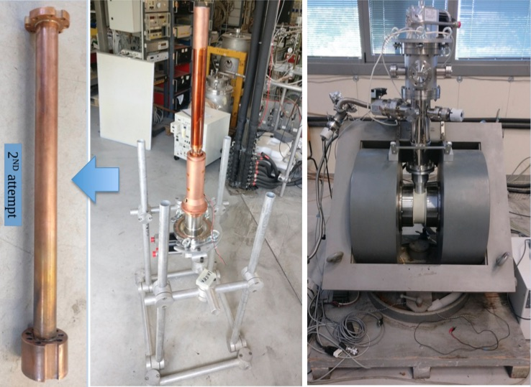
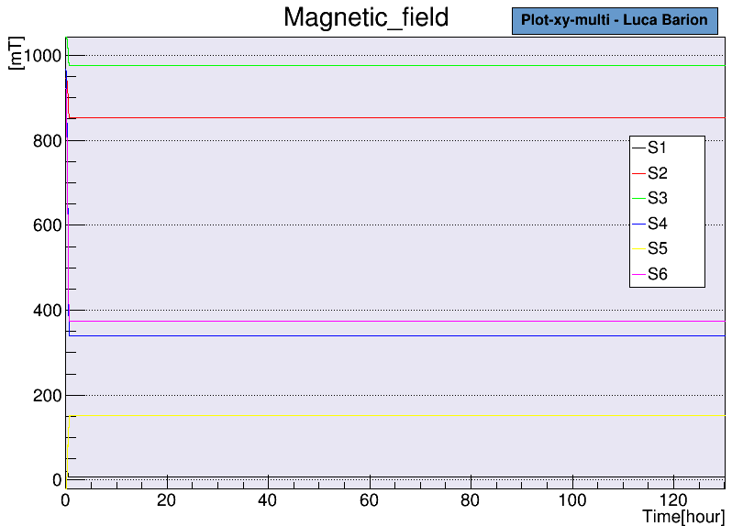
Transverse target: the new cryostat
New concept:
pre-conditioned bulk superconductor
- new cryostat
- new holder probe (6x)
- smart MgB2 sample exchange
Magnetization @ 1 T
Developed thanks to L. Barion, M. Cavallina
L. L. Pappalardo - C.d.S. INFN Ferrara – 05/07/2023

Slide 18
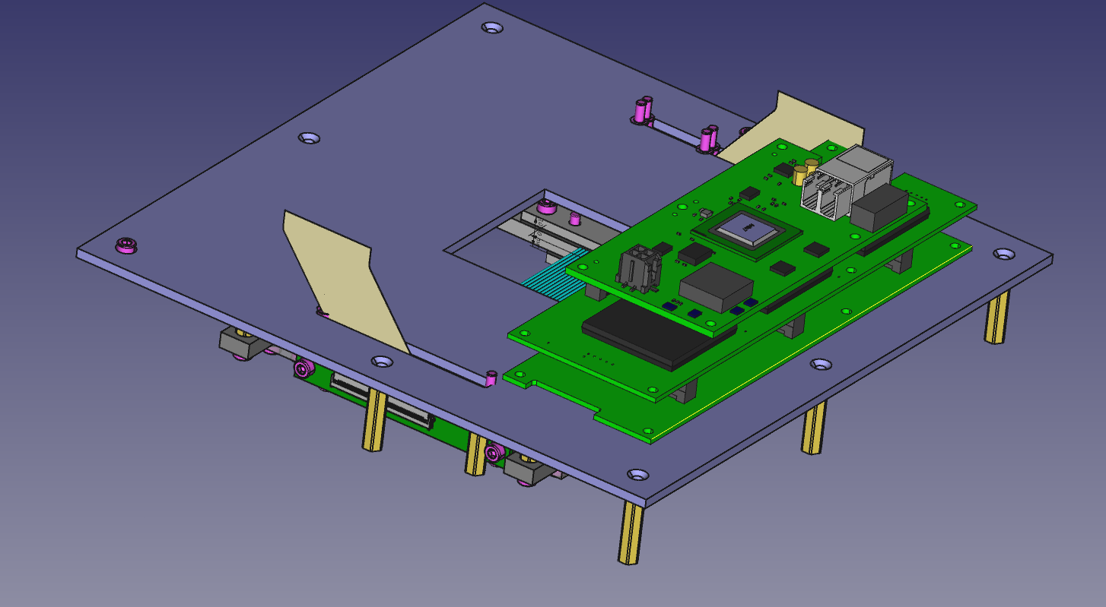
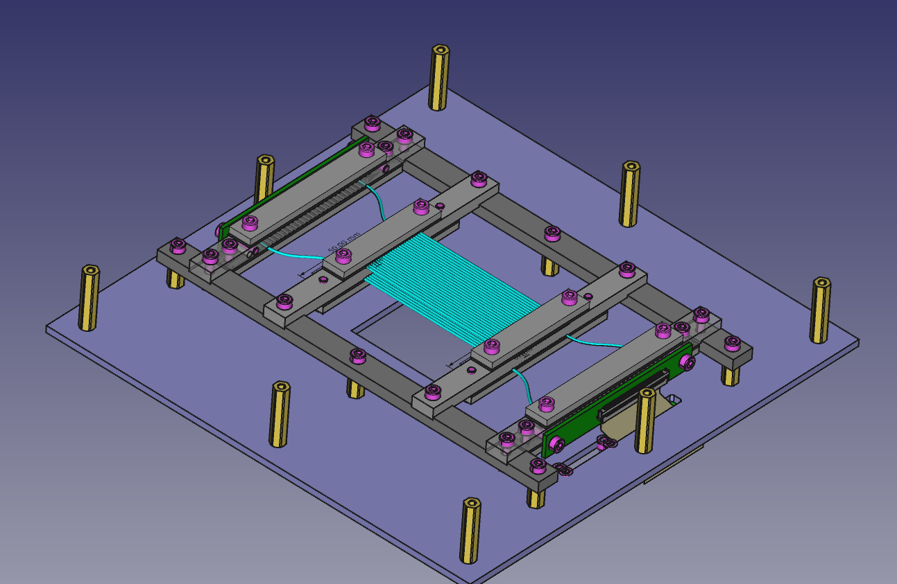
Sintillating Fiber Detector
New potential application of the CLAS12 RICH Electronics reading SiPM
To be used as fast beam particle tracking with RICH prototypes
Potential use as recoil detector for CLAS12 – RGH (transversely polarized targets)
Developed thanks to L. Barion, M. Roberto, M. Cavallina
L. L. Pappalardo - C.d.S. INFN Ferrara – 05/07/2023

Slide 19
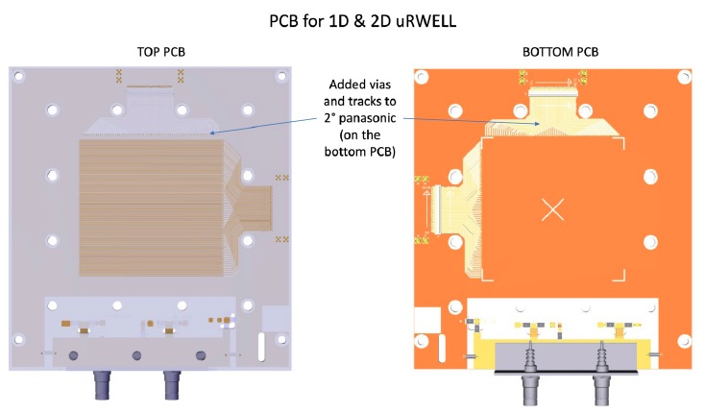
μ-Rwell @ CLAS12
Substitute first tracking chamber layer to increase the luminosity (x 2)
Develop a recoil detector for RGH- experiments with transversely polarized target
μ-Rwell technology features compactness, easy assembling, easy powering, instrinsic spark quenching
is new, only small prototypes have been tested → require extensive R&D
@INFN: RM2 and G. Bencivenni
with support from other groups
2022: 10x10 cm² prototype readout
Compare 780 μm vs 300 μm pitch
2023: 50x50 cm² prototype
Study charge collection, time and spatial resolution
Requirements: σ_{s} ~ 100 mm
Δt ~ 10 ns
Eff > 95%
Mechanical stability study thanks to M. Melchiorri
L. L. Pappalardo - C.d.S. INFN Ferrara – 05/07/2023

Slide 20
Il gruppo di Ferrara @ JLab
Responsabilita’:
M. C.: responsabile locale e nazionale di JLab12
M. C. : chair of the Jlab User Organization
M. C.: contact person for the RGH experiments with transversely polarized target
M. C. responsabile progetto RICH
M. C. & L.P. Co-spokesperson di diverse proposte di esperimento (PAC34,37,38,39)
Contributi principali del gruppo:
Data analysis
- Data analysis on kaon SIDIS
RICH detector
- Reconstruction and alignment algorithms
Magneti superconduttori
- Configurazione magnetica per transverse target
- Frozen field con magneti a bulk di superconduttore
- Recoil detector design
High-luminosity
- Study micro-Rwell mechanical stability with light structure
L. L. Pappalardo - C.d.S. INFN Ferrara – 05/07/2023

Slide 21
EIC-NET (R.L.: Marco Contalbrigo)
INFN Network for preliminary studies on the EIC project
M. Contalbrigo is dRICH detector subsystem lead
co-coordinator of the dRICH R&D EIC Program (eRD102)
A. Saputi is Contact Person for dRICH mechanics
dRICH: Dual-radiator RICH for the EIC hadron end-cap (project led by INFN)
L. L. Pappalardo - C.d.S. INFN Ferrara – 05/07/2023

Slide 22
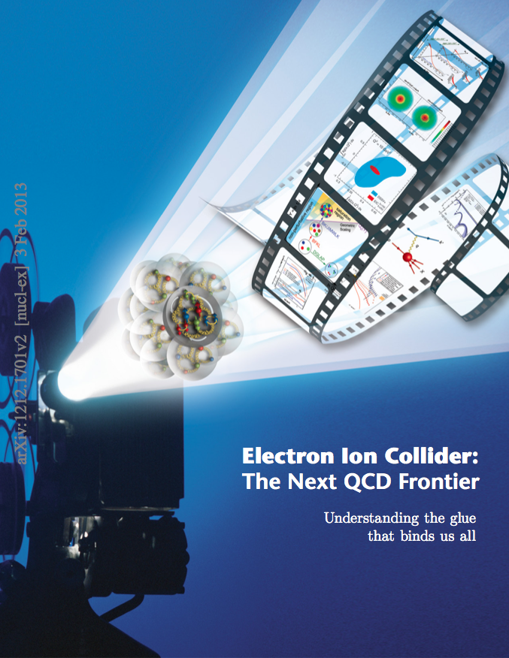
EIC_NET
Electron Ion Collider:
Strong interest in Italian nuclear physics
community (theory and experiment)
CD1 approval in June 2021
EPIC Coll. for 1st detector start in fall 2022
Detector subsystems defined in spring 2023
TDR expected at the end of 2024
CD2 & 3 expected in spring 2025
(start of construction)
INFN Ferrara leading the dRICH subsystem
L. L. Pappalardo - C.d.S. INFN Ferrara – 05/07/2023

Slide 23
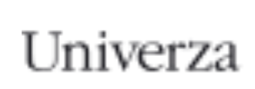
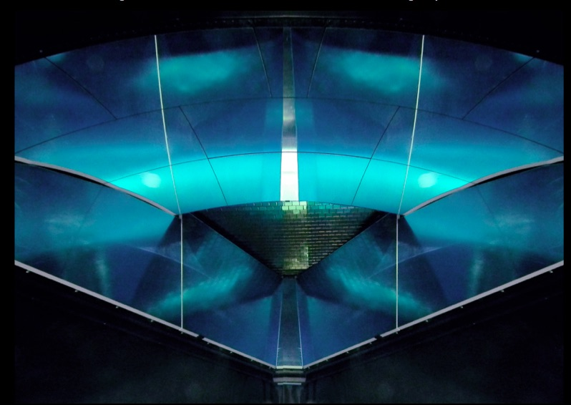
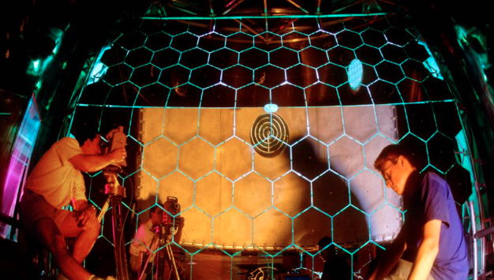
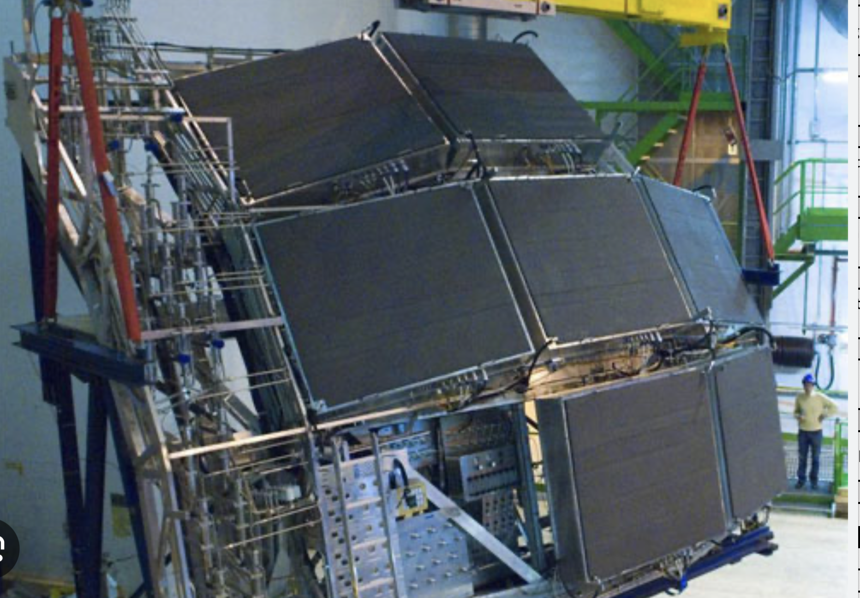
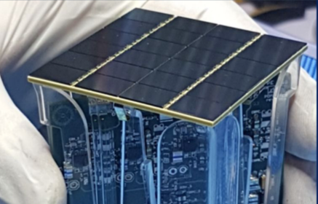
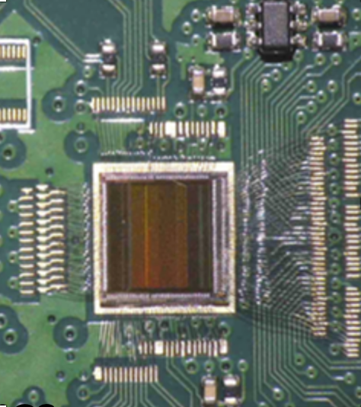
EIC_NET: The dual RICH
Compact cost-effective solution for particle identification in the high-energy endcap at EIC
dRICH
EPIC
EIC RICH Consortium
BA, BO, CS, CT, FE ,
GE, LNF, LNS, RM2,
SA, TO, TS
…..
p: 41 GeV, 100 to 275 GeV
p/A beam
e beam
e: 5 GeV to 18 GeV
Background Expertise:
CLAS12 RICH COMPASS RICH ALICE HMPID DARKSIDE ALCOR
L. L. Pappalardo - C.d.S. INFN Ferrara – 05/07/2023

Slide 24
EIC_NET: dRICH Organization Chart
6.10.04 Particle Identification Level-3
CAM from DOE EIC Project
6.10.04.03 dRICH Level-4
CAM from Project + DSTC from EPIC (M. Contalbrigo)
Work packages lead from EPIC
Photo-Detector Level-5
R. Preghenella, INFN-BO, INFN-FE, INFN-CS, INFN-SA, INFN-LNF, INFN-CT, NISER
F. Cossio, INFN-TO, INFN-BO
P. Antonioli, INFN-BO, INFN-FE
A. Saputi, INFN-FE, INFN-CT, INFN-GE, JLAB, BNL
F. Tessarotto, INFN-TS, BNL
A. Vossen, DUKE, INFN-FE
G. Volpe, INFN-BA, INFN-FE, RICH Consortium
INFN-TS, DUKE, INFN-FE
Front-end Asics Level-5
Data-acquisition Level-5
Mechanics Level-5
Gas radiator Level-5
Mirror Level-5
Aerogel Radiator Level-5
Simulation
L. L. Pappalardo - C.d.S. INFN Ferrara – 05/07/2023

Slide 25
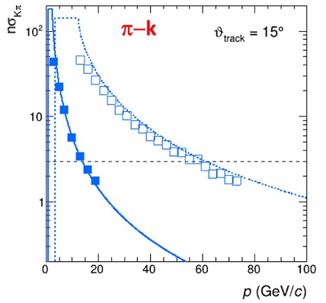
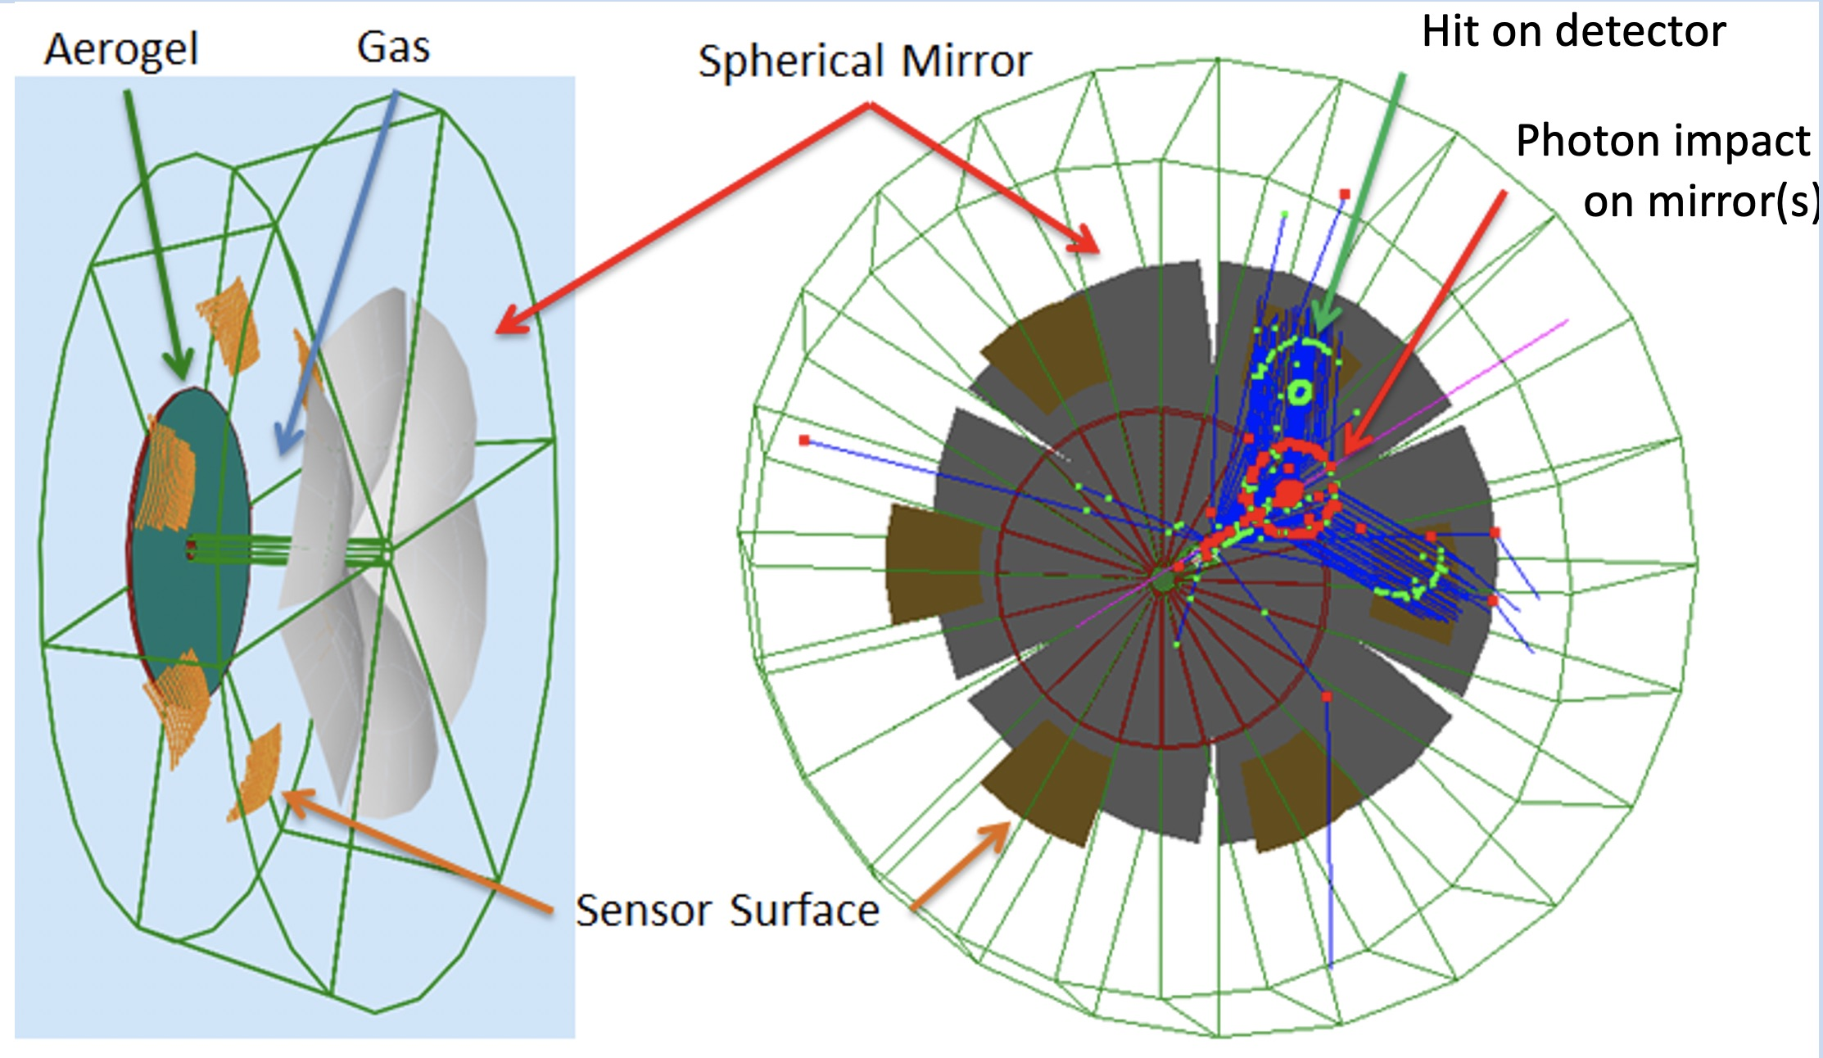
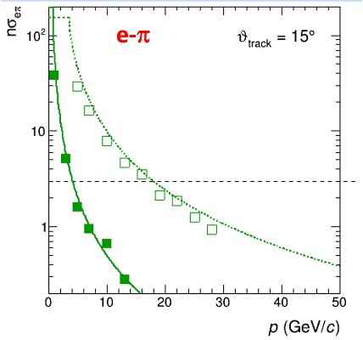
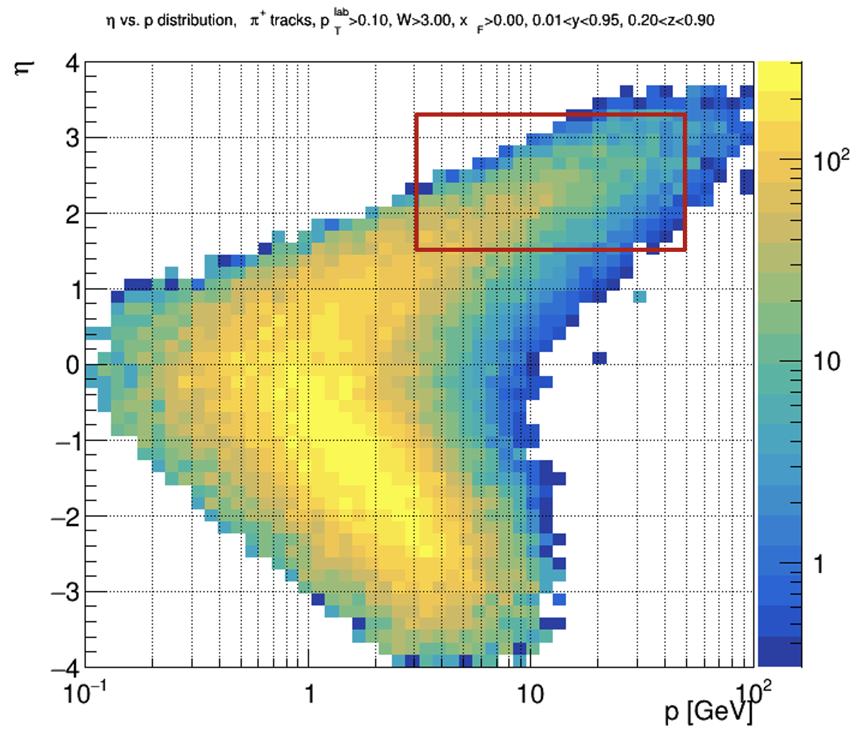
EIC_NET: Baseline Design
Main cover wide momentum range 3 - 50 GeV/c
features work in high (~ 1T) magnetic field
fit in a quite limited (for a gas RICH) space
ATHENA case
Essential for semi-inclusive physics
due to absence of kinematics constraints at event-level
dRICH: cost-effective compact solution
Radiators: Aerogel (n_{AERO}~1.02) + Gas (n_{C2F6} ~ 1.0008)
Detector: 0.5 m²/sector, 3x3 mm² pixel → SiPM option
L. L. Pappalardo - C.d.S. INFN Ferrara – 05/07/2023

Slide 26
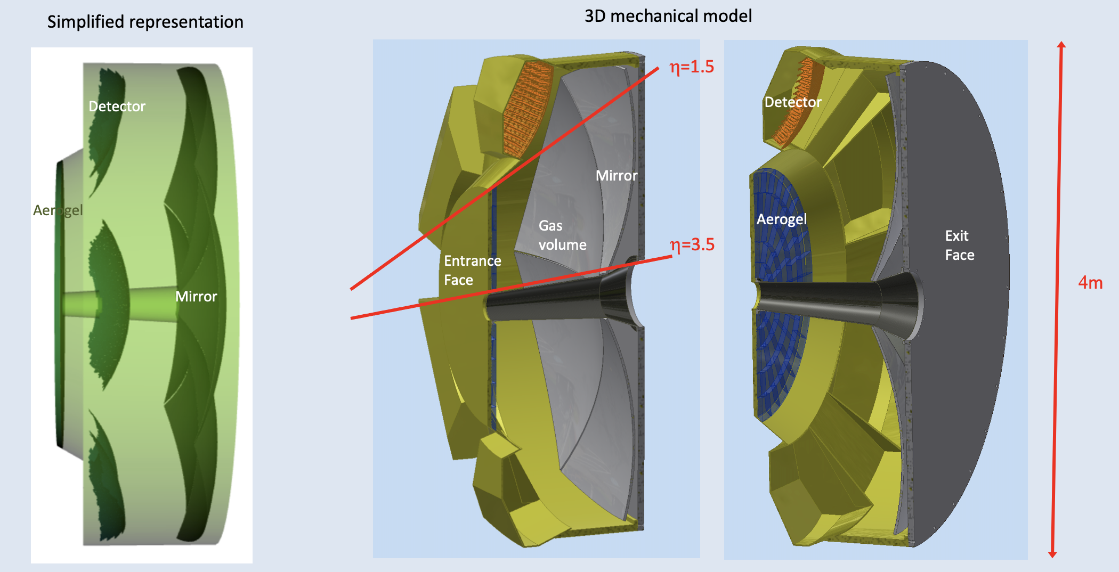
EIC_NET: Mechanics
Design thanks to A. Saputi, L. Barion
Windows: sandwich panel made of two ~1 mm carbon fiber reinforced epoxy skins separated by 30 mm PMI foam or Al honeycomb (~ 1% X₀)
Shells: 3 mm (inner tube) to 8 mm (outer tube) thick carbon fiber epoxy composite (~ 4% X₀)
Skins formed with two layers of balanced weave laminate with fibers at 0º/90º and +/- 45º for uniform stiffness
L. L. Pappalardo - C.d.S. INFN Ferrara – 05/07/2023

Slide 27
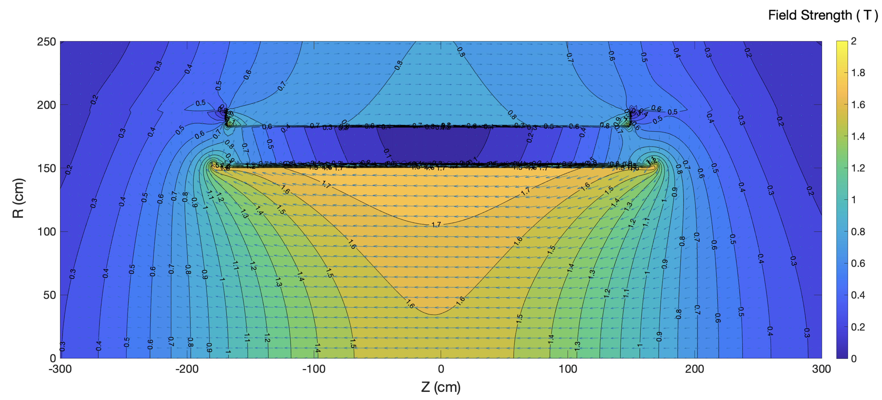
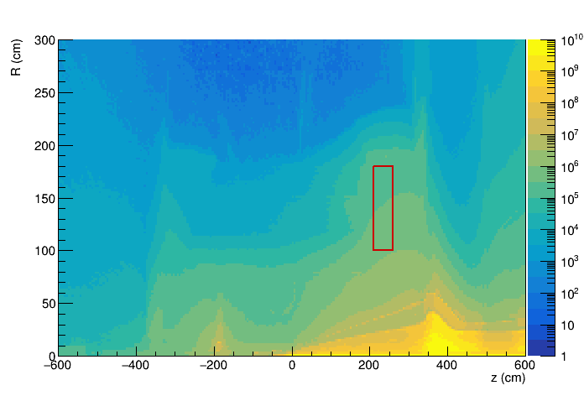
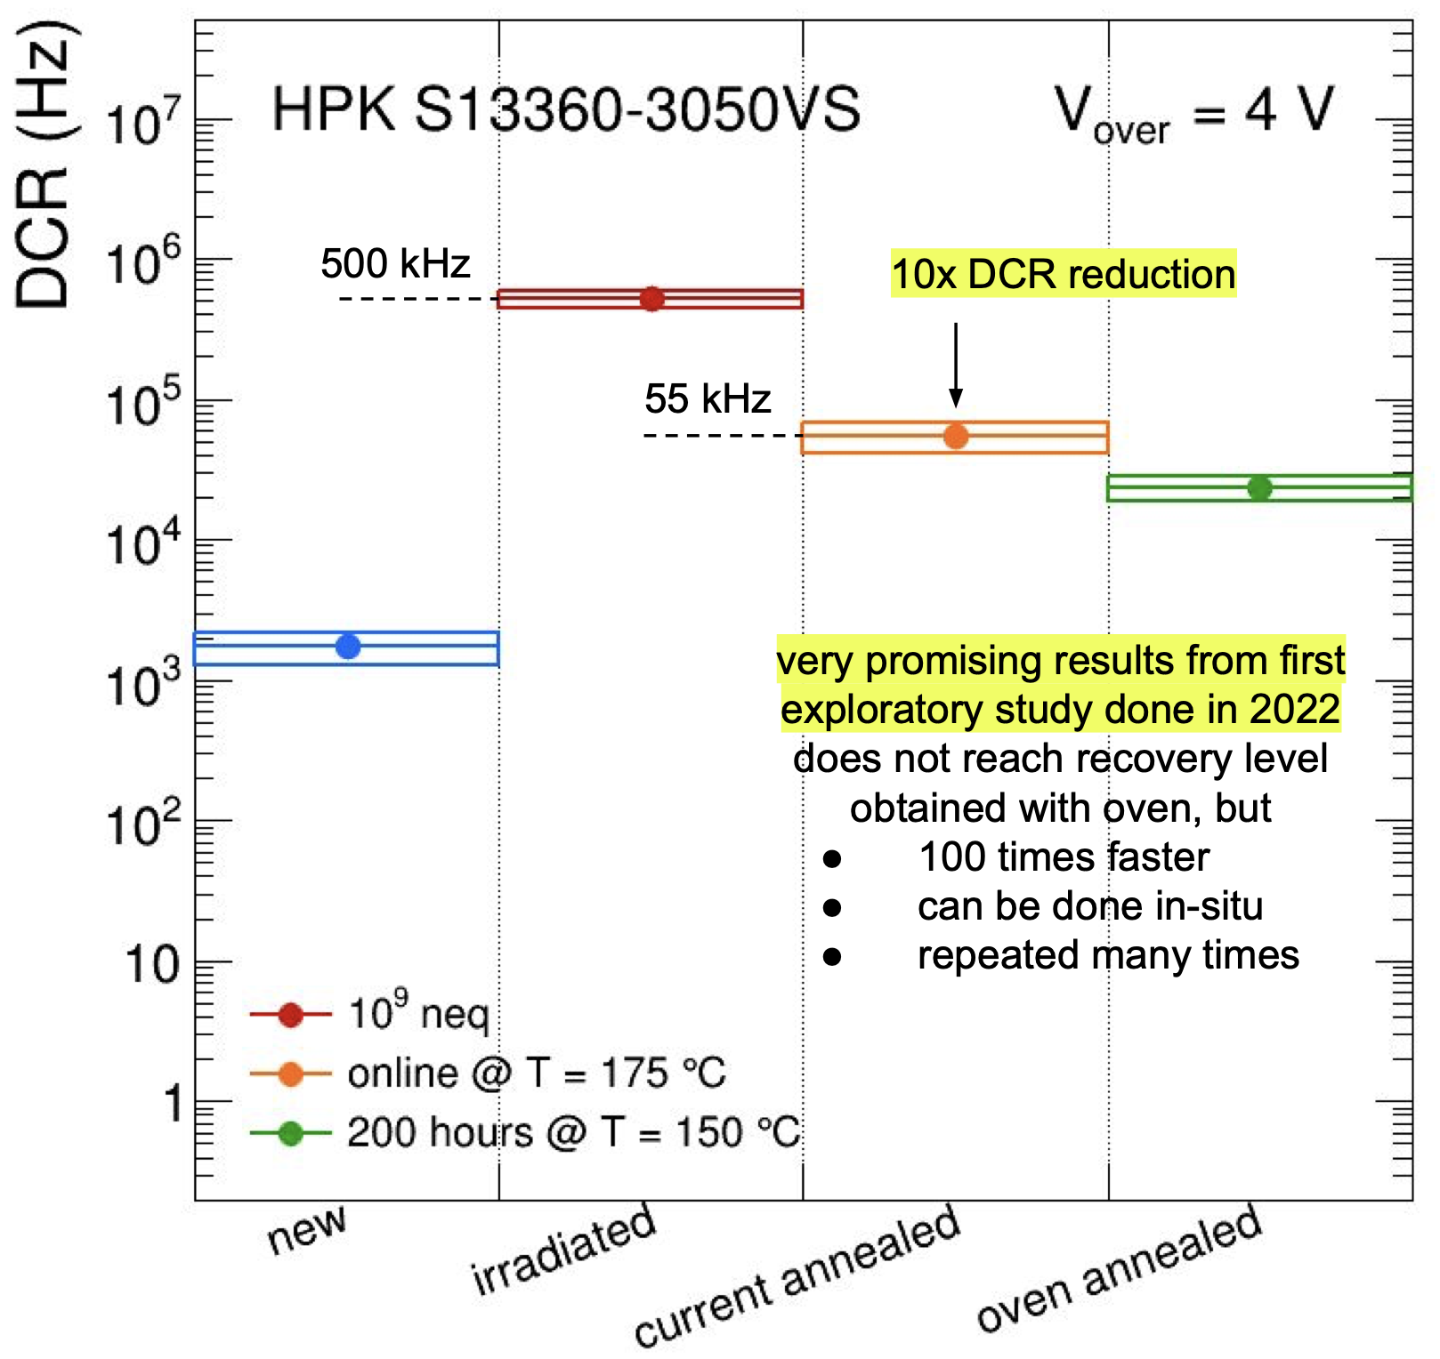
EIC_NET: SiPM
1.7 T field
1-MeV neutron equivalent fluence (1 fb⁻¹ ep running)
ePIC background group
beam-beam interactions only
dRICH
dRICH
Benchmark fluence (10 x)
~ 10⁷ 1-MeV n_{eq}/cm² / fb⁻¹
R. Preghenella, NIIMA 1046 (2023) 167661
Strong and not-uniform magnetic field
Moderate radiation levels (up tp 10¹¹ n_{eq}/cm²)
Usage of SiPM with
- low temperature working point
- periodic annealing at high temperature
(in-site by Joule effect)
L. L. Pappalardo - C.d.S. INFN Ferrara – 05/07/2023

Slide 28
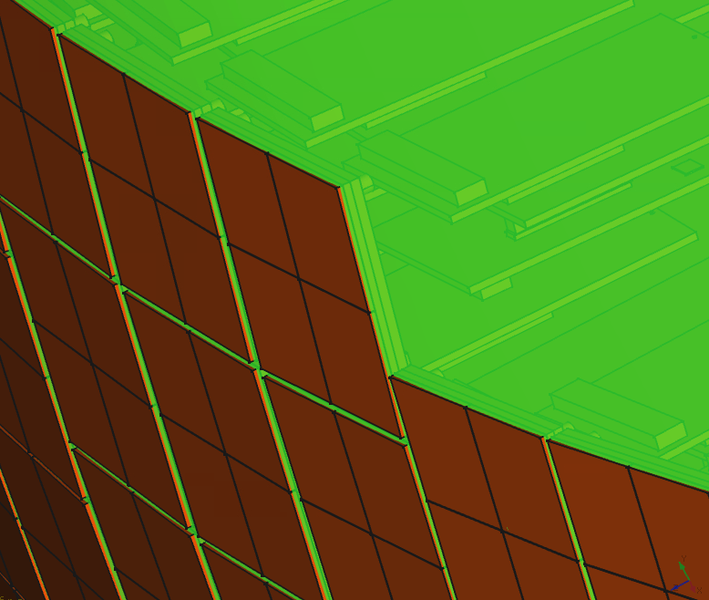
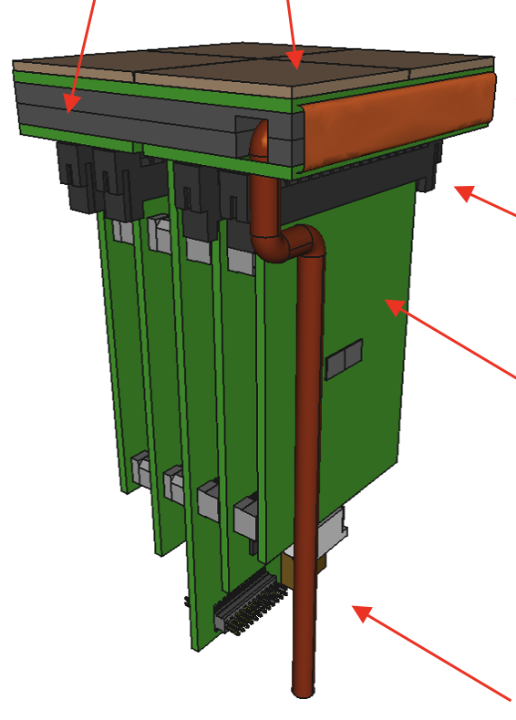
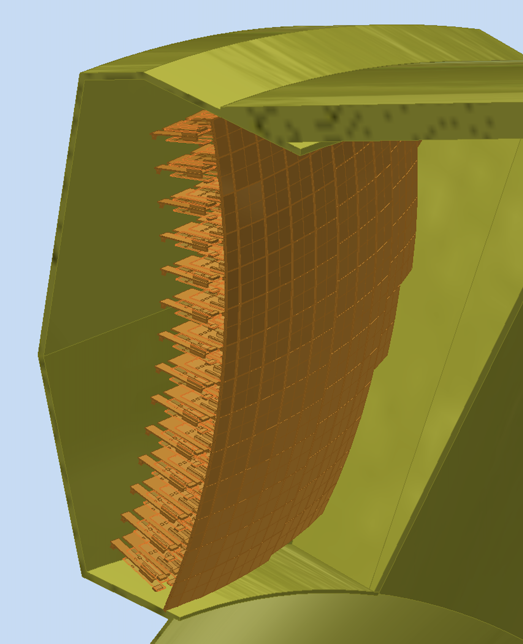
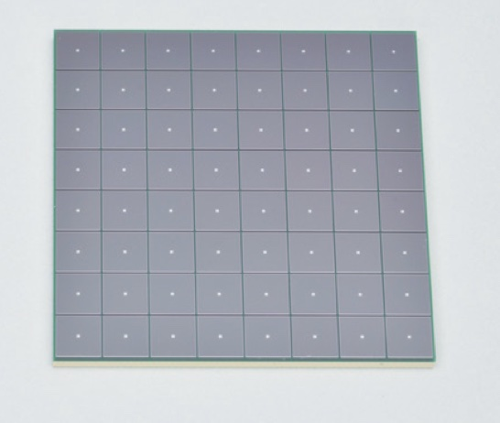
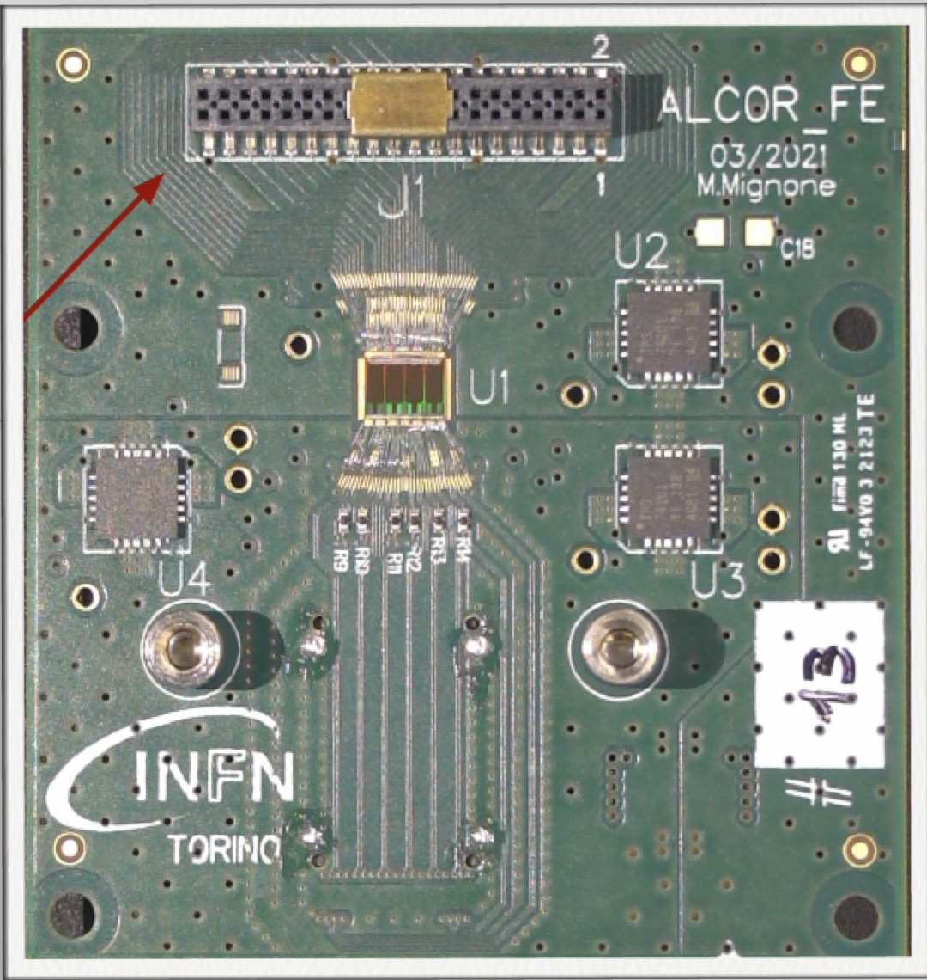
EIC_NET: Photo-Detector
Active area is shaped to resemble the focal surface and best exploits the focalization.
Electronics is minimized to fit the limited available space.
Heat exchanger
Cold plate
SiPM array
Photon Detector Unit (PDU):
Compact to minimize space
4x Hamamatsu S13361-3050HS SiPM arrays
4x Front-End Boards (FEB)
4x ALCOR chip (ToT discrimination)
1x Read-Out Board (RDO)
1x Cooling plate (< -30 C)
Flex PCB
Back-side
connectors
12 cm
FEB
(ALCOR)
Service
connections
RDO
Detector box:
Shaped to fit the space
Quartz window
Cooling for sensors and electronics
Power distributing patch panel
Heat insulation
SiPM array
ALCOR chip
Design thanks to L. Barion, A. Saputi
L. L. Pappalardo - C.d.S. INFN Ferrara – 05/07/2023

Slide 29
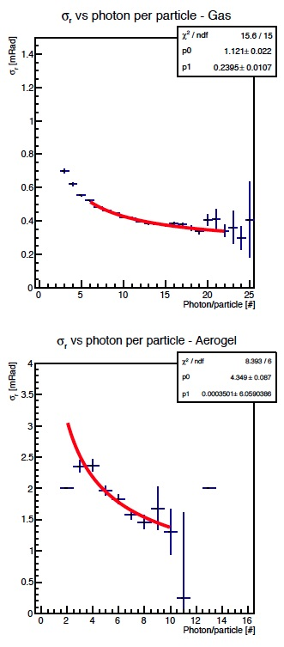
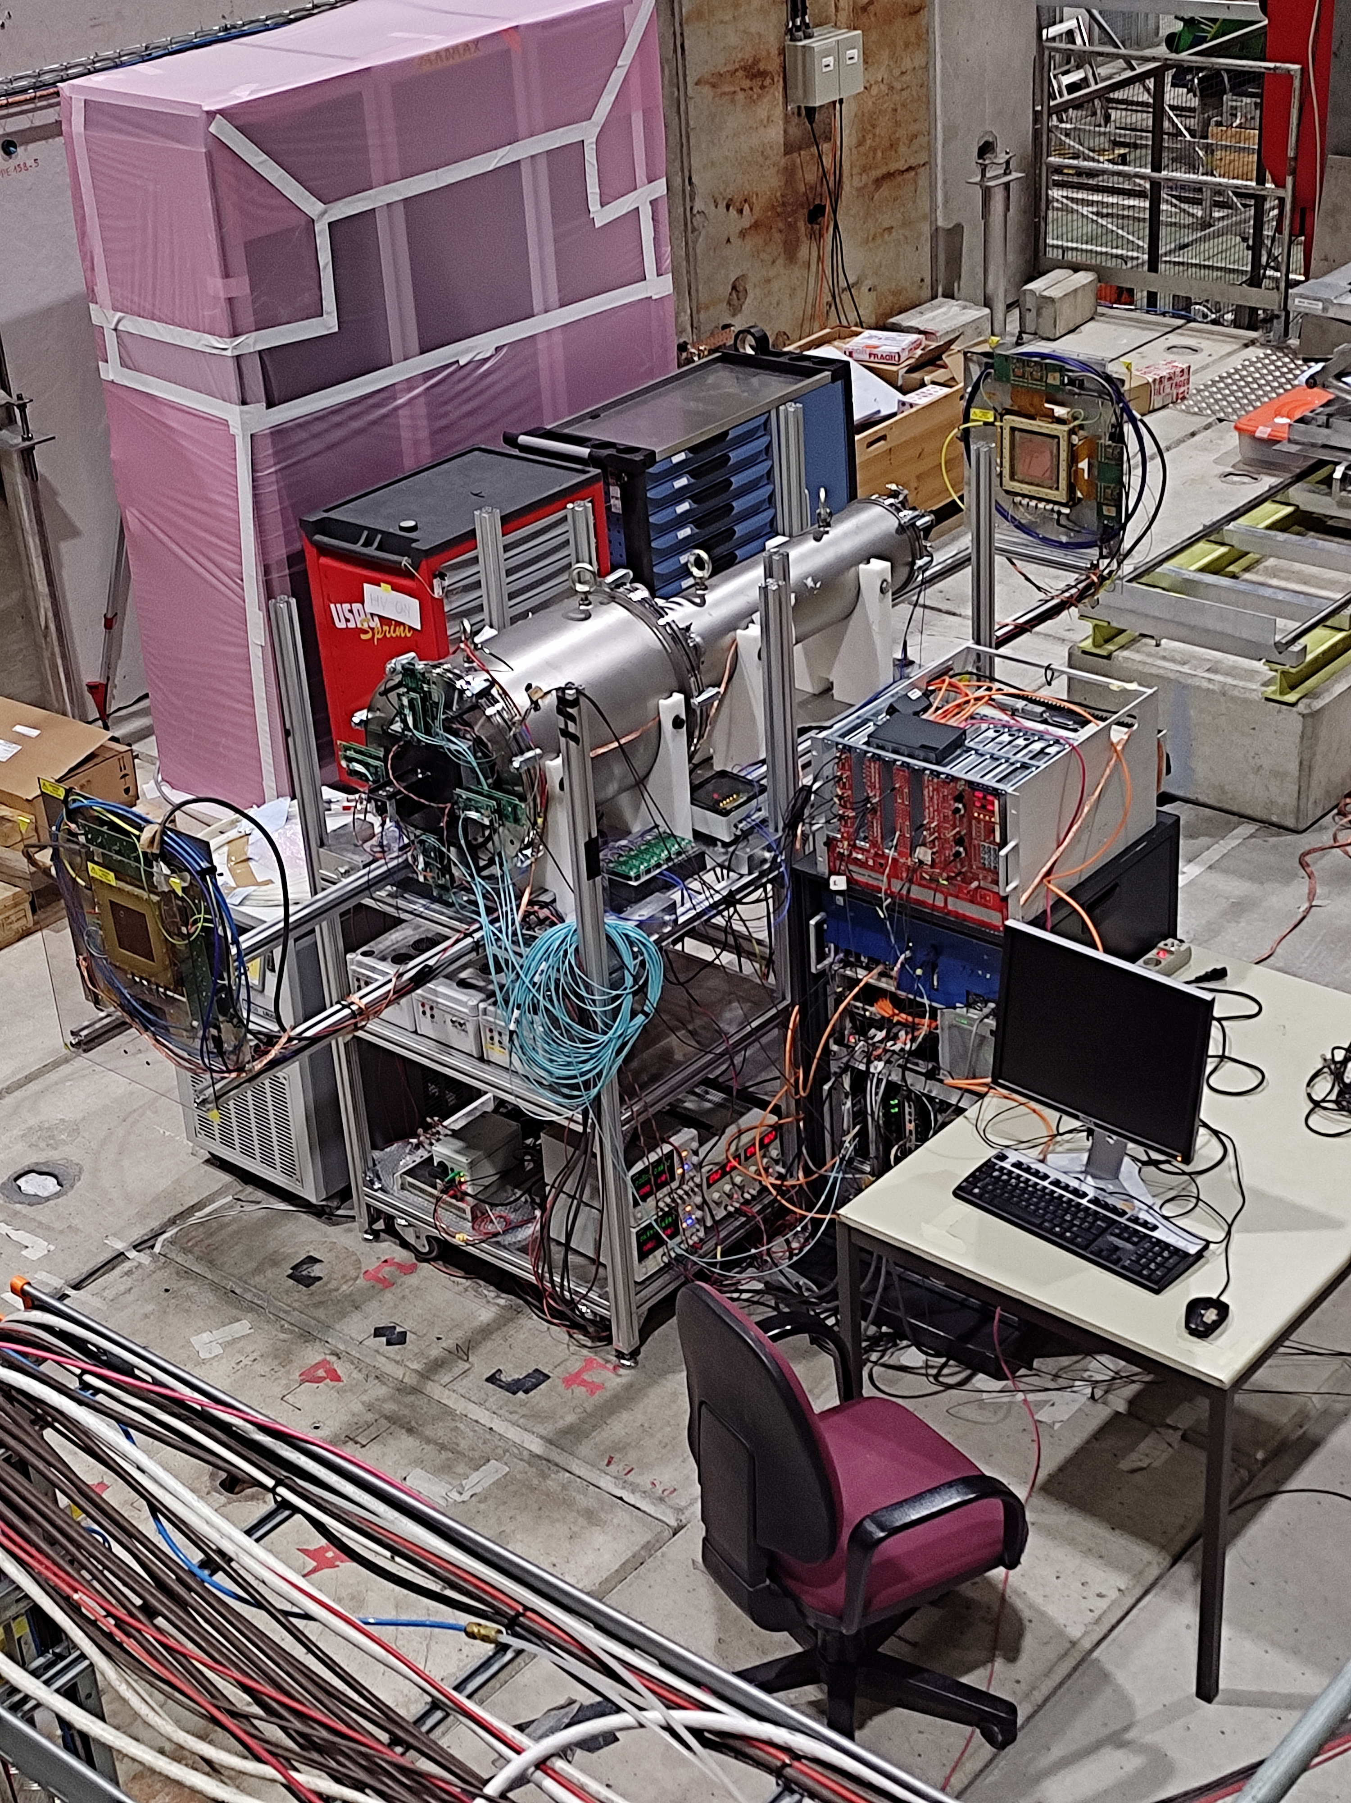
EIC_NET: dRICH Prototype
Operative prototype commissioned. Double ring imaging achieved. Performance in line
with expectations except for aerogel single-photon angular resolution (worse by a factor ~ 1.5)
Reference readout from CLAS12 RICH:
H13700 MA-PMTs + ALCOR3 ToT chip
Expected SPE ~ 1 mrad
GEM
Gas Vessel
$$✓$$
MAPMTs
Aerogel
Expected SPE ~ 3 mrad
GEM
$$✓$$
Gas ring coverage: 60%
Aerogel ring coverage: 40 %
Optics at variance with respect EIC
Realization thanks to L. Barion, M. Cavallina, R. Malaguti
L. L. Pappalardo - C.d.S. INFN Ferrara – 05/07/2023

Slide 30
EIC_NET: dRICH Prototype
L. L. Pappalardo - C.d.S. INFN Ferrara – 05/07/2023

Slide 31
EIC_NET: dRICH Aerogel
Aerogel Factory (BELLE-II)
Initial evaluation & Reproducibility
on small samples in sinergy with ALICE
Laser spot bradening: Y profile
Transmittance & Transflectance
No aerogel
3 x 2 cm aerogel
Touch Probe: planarity and thickness
10x10x2 cm³ tile
(from ALICE)
Density & refractive index
0.3 mm
5 mm pass
CLAS12 RICH quality assurance laboratory @ INFN-FE being refurnished
L. L. Pappalardo - C.d.S. INFN Ferrara – 05/07/2023

Slide 32
EIC_NET: dRICH Mirror
CMA Carbon fiber mirrors (HERMES, AMS, LHCb, CLAS12)
cost-effective light & stiff solution:
roughness driven by mandrel 1-2 nm rms
surface accuracy better than 0.2 mrad
radius reproducibility better than 1 %
3.5 m
Mirror aberrations
CLAS12 RICH quality assurance laboratory @ JLab being refurnished in collaboration with DUKE
L. L. Pappalardo - C.d.S. INFN Ferrara – 05/07/2023

Slide 33
EIC_NET: dRICH Prototype Highlight
Realization of a suitable detector plane for the dRICH prototype (23/10): Design ready, procurement aligned to 2023 test-beam campaign.
Hamamatsu S13361-3050
ALCOR chip
$$✓$$
MPPC arrays selected with irradiation campaign
Front-end re-design completed
ALCOR v2 (bwetter dynamic range and rate)
ToT architecture, streaming mode ready
50 ps time bin
500 kHz rate per channel
cryogenic compatible
$$✓$$
8x8 array
50 μm cell
Excellent fill factor
Best DCR
S14160 alternative
Multi-wafer run done
Version2:
32 channels
Extended dynamic range
Improved digital time
$$✓$$
Integrated Cooling/ In-situ annealing
New EIC-driven readout unit
Streaming readout
Cooling plate
Peltier cells
Annealing circuitry
$$✓$$
2023:
1 RDO per chip
2024:
1 RDO per PDU
Development
Kit KC705
Realization thanks to L. Barion, M. Cavallina, R. Malaguti
L. L. Pappalardo - C.d.S. INFN Ferrara – 05/07/2023

Slide 34
EIC_NET: dRICH Prototype Milestones
2023: EIC-driven detector plane
Initial characterization of realistic aerogel
and mirror components (23/04);
Projected performance of the baseline detector
as integrated into EPIC (23/06);
Assessment of the dRICH prototype performance
with the EIC-driven detection plane (23/10).
$$✓$$
$$✓$$
$$✓$$
Test beam planned in August and October 2023
New EIC-driven readout unit
2024: Real-scale prototype for TDR (1 sector)
Mechanical structure
Realistic optics (off-axis)
ALCOR64 FEB + RDO
Aerogel and mirror demonstrator
Realization thanks to L. Barion, M. Cavallina, R. Malaguti
L. L. Pappalardo - C.d.S. INFN Ferrara – 05/07/2023

Slide 35
EIC_NET: responsabilità
Responsabilita’:
M. C.: responsabile locale EIC_NET
M. C.: responsabile dRICH
A. S.: Contact for dRICH mechanics
M. C.: co-coordinator eRD102
M. C.: IAC POETIC (Physics Opportunities at EIC) Conference
Contributi principali:
dRICH detector
- dRICH mechanics
- Prototyping
- Optical component characterization
- SiPM irradiation program
Electronics
- MAROC (reference) + ALCOR (INFN development)

Slide 36
Richieste ai Servizi
Servizio Meccanico
FE laboratory: supporto per misure e stazioni di test, preparazione test-beam
JLAB12
TTarget: supporto per test con doppio campo magnetico al LASA di Milano
High-Lumi: simulazioni stabilita’ meccanica μ-rwell
Recoil: contributo meccanica tracciatore recoil
EIC_NET
dRICH: progettazione meccanica del rivelatore dRICH
dRICH: meccanica del prototipo dRICH
Servizio Elettronico
FE laboratory: supporto per misure e stazioni di test, preparazione test-beam
JLAB12
TTarget: piccoli contributi alle misure con magneti superconduttori
TTarget: contributo per recoil detector (μ-rwell e/o fibre scintillanti)
EIC_NET
dRICH: contributo piano di rivelazione curvo basato su SiPM + ALCOR

Slide 37
Manpower e richieste finanziarie per 2021
Anagrafica e afferenze (Ric. + Tecnol.)
Servizio meccanico ed elettronico
Name | JEDI | JLab12 | EIC_NET
N. Canale (dottorando) | 100
G. Ciullo (staff) | 70 | 20
M. Contalbrigo (staff) |  | 50 | 50
S. Dymov (post-doc) | 100
L. Del Bianco (staff) |  | 100
A. Kononov (dottorando) | 100
P. Lenisa (staff) | 75 | 20
A. Maragno (dottoranda) | 100
L. Pappalardo (RTD-B) |  | 30
A. Pesce (post-doc) | 100
A. Seleev (assegnista) | 100
R. Shankar (dottorando) | 100
F. Spizzo (staff) |  | 80 | 20
S. Vallarino (dottorando) |  | 100
V. Carassiti | 10
A. Cotta Ramusino (staff) | 10
TOTALE/100 | 8.6 | 4.0 | 0.7
Name | JEDI | JLab12 | EIC_NET
L. Barion |  | 25 | 75
M. Cavallina | 10 | 10
M. Gambetti | 10
R. Malaguti |  | 20
M. Melchiorri |  |  | 10
S. Squerzanti |  | 20
TOTALE/100 | 0.2 | 0.5 | 0.1
Richieste finanziarie (k€)
Name | JEDI | JLab12 | EIC_NET | Dot.3
Missioni | 57 | 45 | 15 | 8
Trasp. |  | 5
Inv. | 9 |  |  | 15
Consumi | 34.5 | 15 | 20 | 6
Apparati |  | 20
Altro |  |  |  | 3
TOTALE | 100.5 | 85 | 35 | 32

