Slide 1
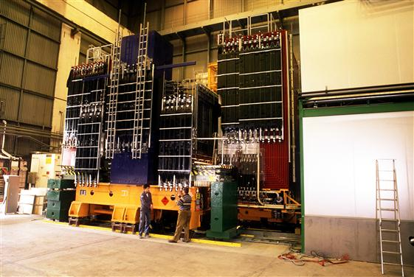
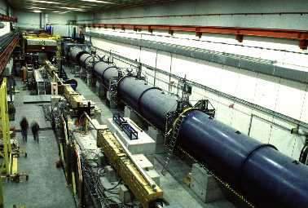
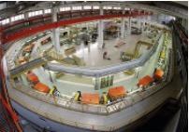
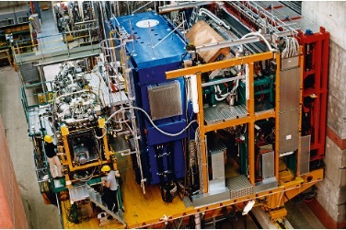
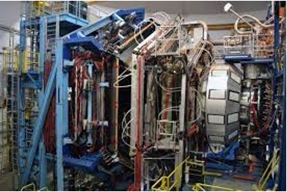
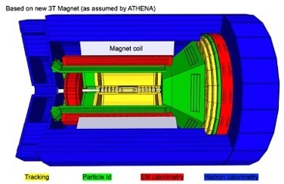
M. Contalbrigo
MC contriuted to the BSM studies in the electro-weak sector (ν oscillations, K_{L} rare decays)
and in estalishing a new investigation paradigm in the strong sector (nucleon 3D):
Strong force dynamics in the confined state probed by parton transverse degreees of freedom
MC is CERN
SPSC member
NOMAD
Neutrino oscillaitons
NA48
CP-violation in kaon sector
COSY
Spin in accelerators for BSM physics
HERMES
Spin physics
CLAS/CLAS12
Strong force dynamics (intensity)
EIC
Strong force dynamics (energy)

Slide 2
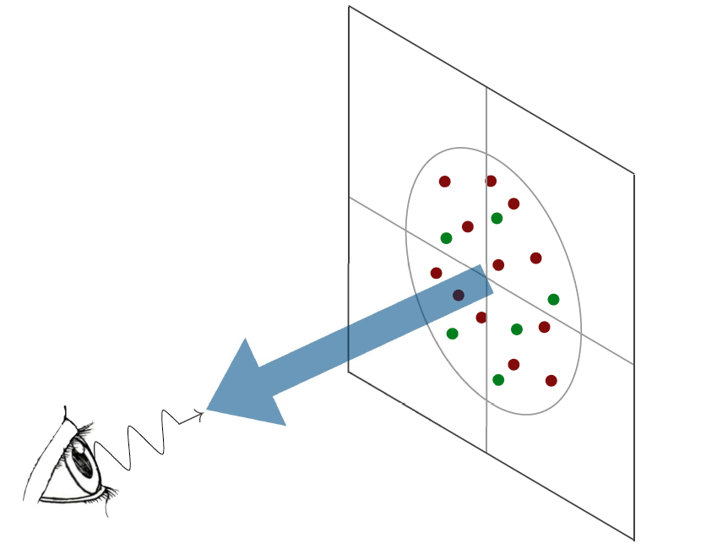
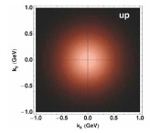
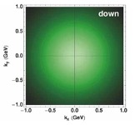
Nucleon 3D
Parton tranverse degrees of freedom carry unprecedented information on peculiar strong force dynamics
Quark up
SIDIS ep→e’X h
Transverse
momentum
Excusive ep→e’p’h (γ)
k_{T}
b_{T}
b_{T}
Transverse position
Transverse position
Quark down
Longitudinal momentum
k⁺=xP⁺
Longitudinal momentum
k⁺=xP⁺
l
l
Photon Virtuality
Q²
Photon Virtuality
Q²
Transverse plane
Transverse plane
l
l
Impact on precise physics
up to LHC (W mass, low pT)
Hard Scale (High Energy Probe)
Confinement Scale

Slide 3
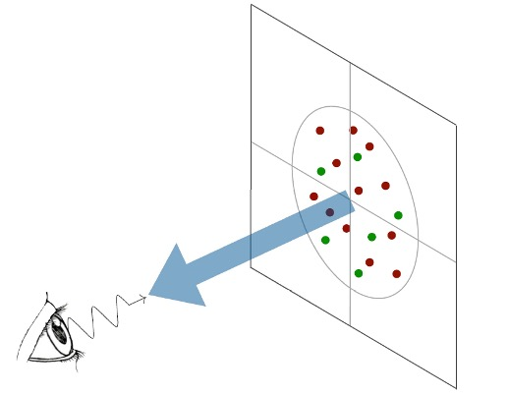
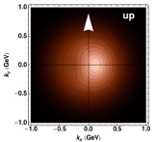
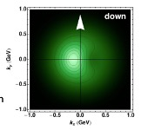
Nucleon 3D
Parton tranverse degrees of freedom carry unprecedented information on peculiar strong force dynamics
Quark up
SIDIS ep→e’X h
Spin
Transverse
momentum
Excusive ep→e’p’h (γ)
k_{T}
b_{T}
b_{T}
Transverse position
Transverse position
Quark down
Longitudinal momentum
k⁺=xP⁺
Longitudinal momentum
k⁺=xP⁺
l
l
Photon Virtuality
Q²
Photon Virtuality
Q²
Transverse plane
Transverse plane
l
l
QCD spin-orbit effects
Natural asymmetries
(SSA, DY Lam-tung, e+e-)
Hard Scale (High Energy Probe)
Confinement Scale

Slide 4
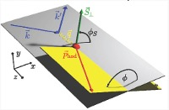
SIDIS Cross-Section

Slide 5
SIDIS Cross-Section

Slide 6
SIDIS Cross-Section
Parton fragmentation function
Hard scattering
+
+
Parton distribution function
+
+
TMD Factorization
holds for p_{T}<<Q
Wide kinematic coverage is needed to resolve the convolution

Slide 7
M. Contalbrigo
MC contriuted to the BSM studies in the electro-weak sector (ν oscillations, K_{L} rare decays)
and in estalishing a new investigation paradigm in the strong sector (nucleon 3D):
Strong force dynamics in the confined state probed by parton transverse degreees of freedom
MC is CERN
SPSC member
HERMES @ DESY (precursors)
First obsrvations 2001-2012
Deputy spokesperson
Analysis Corrdinator
Physics WG convener
Editorial Borad member
Run coordinator
Polarized target
Target coordinator

Slide 8
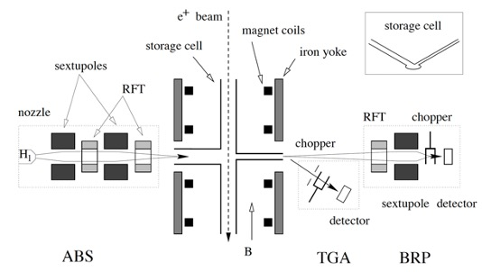
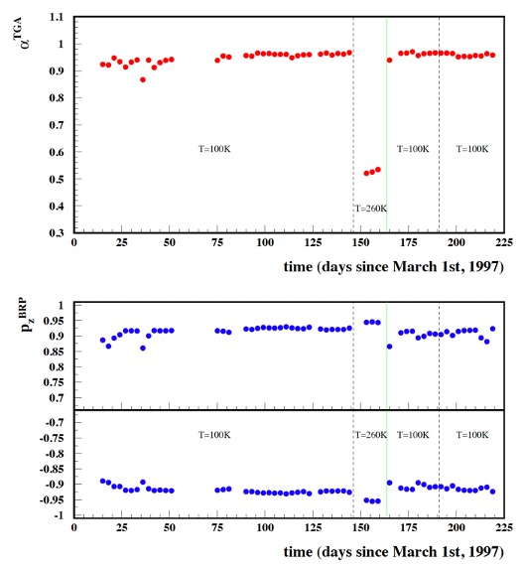
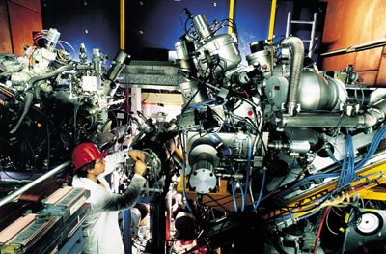
HERMES TARGET
MC as Target Coordinator maintenance and analysis
Unique target internal to a high-energy acelerator ring
Unpolarized gas, polarized hydrogen and deuterium
No dilution of not polarized nuclear elements (vs NH₃)
Target cell to increase x 100 density
Temperature 60-100 K
Areal density 1-2 10¹⁴ nucleons/cm²
Spin flip every 1 -3 minutes
P ~ 85 % longitudinal, ~ 73 % transverse
1997 Hydrogen run: atomic fraction and polarization

Slide 9
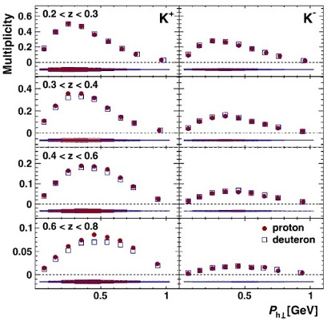
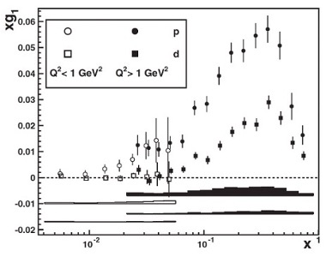
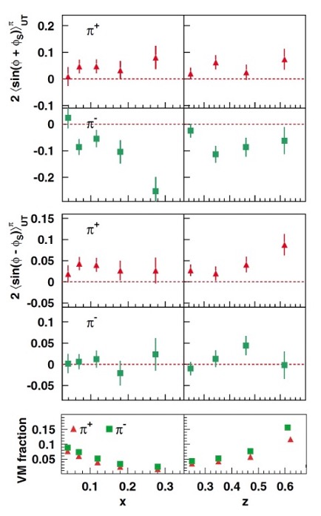
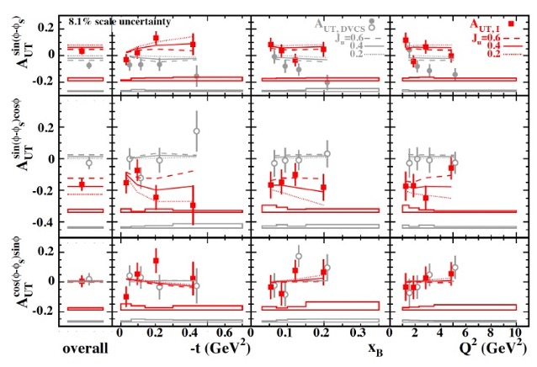
HERMES
MC as Deputy Spokesperson, Analysis Coordinator, EB member
Several first observations, limited in statistics
but all configurations available ad pure target
Most precise flavor
separated multiplicity
Axial charge
Most precise ΔΣ = 0.330 +/- 0.039
First Sivers and Transversity evidence
First Compton scattering with trasnversely polarized target
Tensor charge
Angular momentum

Slide 10
M. Contalbrigo
MC contriuted to the BSM studies in the electro-weak sector (ν oscillations, K_{L} rare decays)
and in estalishing a new investigation paradigm in the strong sector (nucleon 3D):
Strong force dynamics in the confined state probed by parton transverse degreees of freedom
MC is CERN
SPSC member
HERMES @ DESY (precursors)
First obsrvations 2001-2012
CLAS/CLAS12 @ JLab (luminosity)
Valence region 2010-
MC is NFN National Responsible
MC as INFN Gr3 Coordinator
FE group: 8 researchers
JLab Collaboration ~ 50 researchers
Responsible of laboratories:
Cherenkov detectors
Photosensors
Superconducting magnets
Activity Leader
Hadron Physics 3
Strong 2020
Training Degree, PhD, Postdoc
Deputy spokesperson
Analysis Corrdinator
Physics WG convener
Editorial Borad member
Run coordinator
Experiment spokesperson
CLAS Coord. Committee member
Physics WG convener
Run coordinator
Chair of Jlab User Organization
RICH Project Leader
PI CLASMED project
Compact SC magnets
Polarized target
Target coordinator
Spokesperson transverse target RG
Polarized target

Slide 11
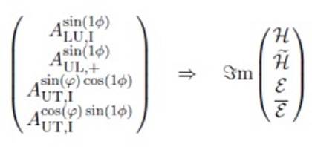
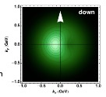
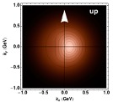
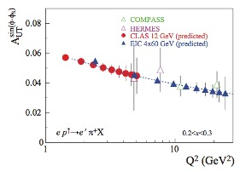
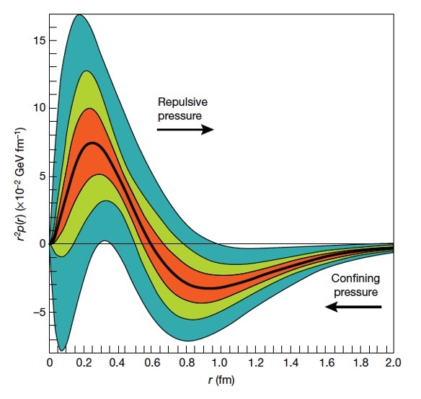
Transversely Polarized Target
MC is spokesperson of transverse target experiments
Exclusive physics and mechanical properties
Most sensitive configuration for
QCD spin-orbit effects
Tensor charge of the nucleon
SIDIS spin-orbit and and tensor charge

Slide 12
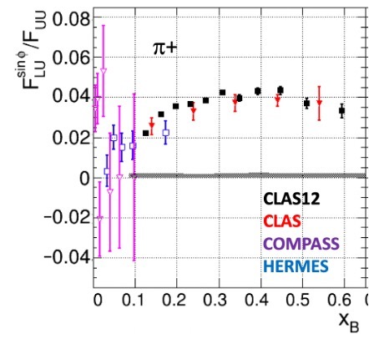
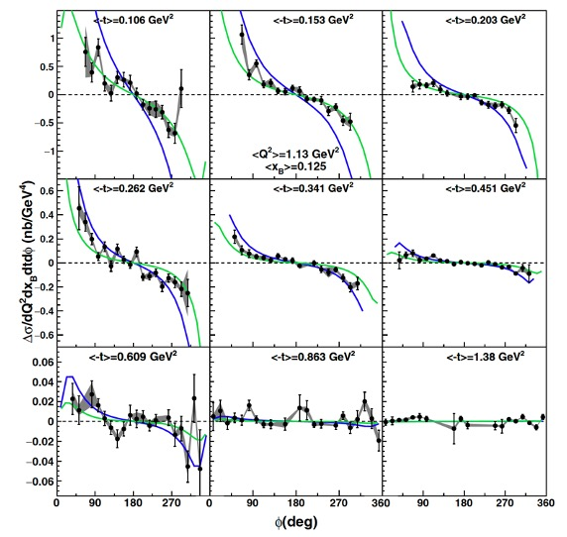
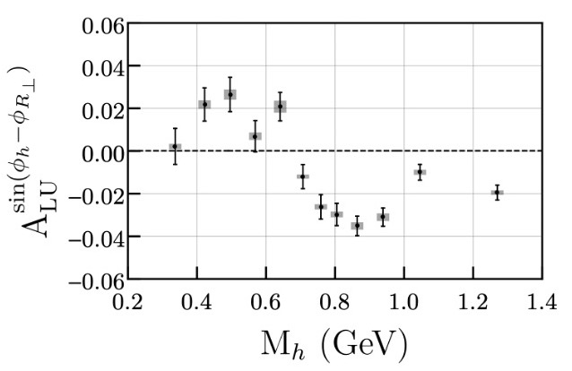
CLAS12 @ Jefferson Lab
MC is chair of Deep-Process Working Group since 2016. First CLAS12 publications came from DPWG.
Unprecedented precision, valence region coverage, discovery potential.
SIDIS physics and tensor charge
Exclusive physics and mechanical properties
ep → e’hX
S. Diehl et al., e-Print: 2101.03544
ep → e’p’γ
N.Hirlinger et. al. PRC 98 4 (2016) 045203
Superior
Precision
(valence)
Cross
section
ep → e’hhX
T.B. Hayward et al., PRL 126 (2021) 152501
New evidence of
spin-orbit effect

Slide 13
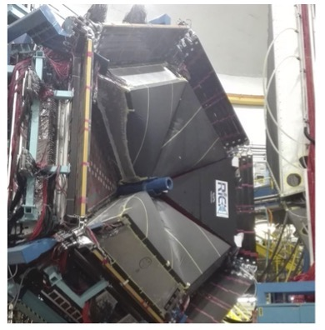
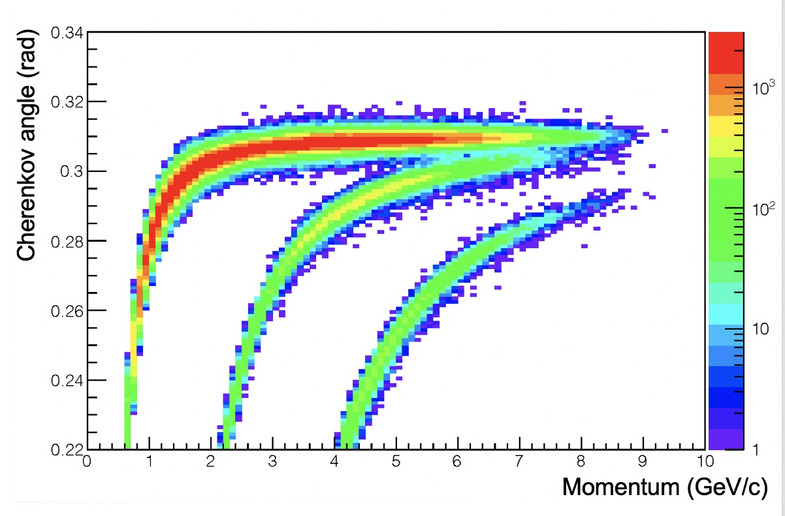
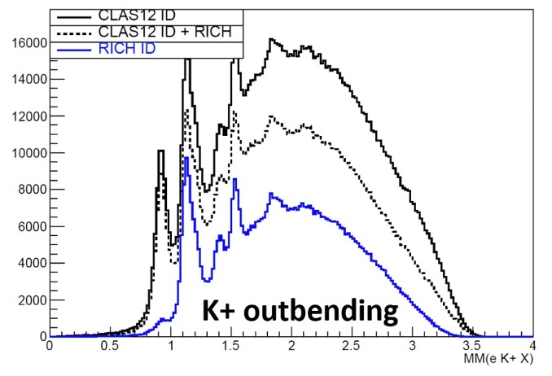
CLAS12 RICH
RICH detector to access the strange (kaon) sector
MC is RICH Project Leader and PI of CLASMED
Coordination
Design
Front-end electronics
Optical component R&D and characterization
First module installed in 2018 before data-taking
Second symmetric module expected in 2022, before polarized runs
Good hadron separation (direct light)
Effective suppression of mis-identifications (direct light)
Λ
p
π
k
p

Slide 14
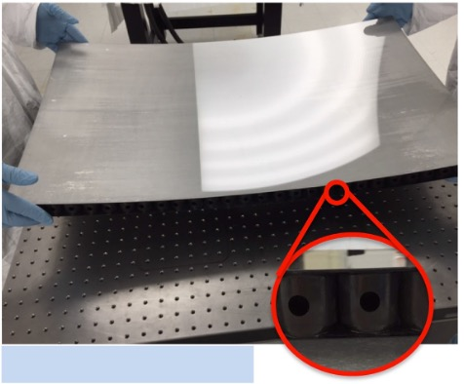
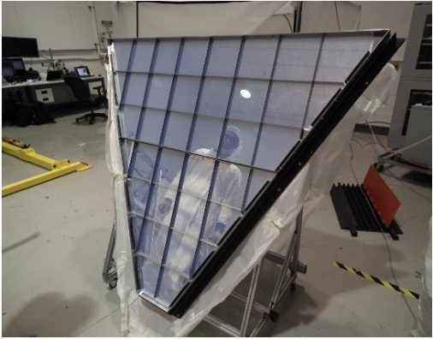
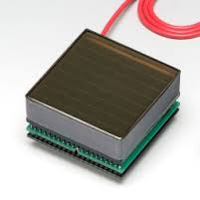
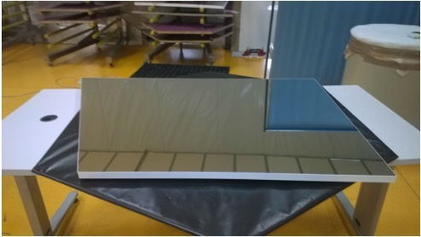
RICH Achievements
Aerogel
World leading transparency
at such large refractive indexes and volumes
Carbon Fiber Mirrors (spherical)
to maximize lightness and stiffness. Consolidate technology (HERMES, AMS, LHCb) but ~ 30 % material budget reduction
Photon Detector
First use of H8500/H12700 flat panel multi-anode PMTs
64 pixels on a 5x5 cm² area
Glass-Skin Mirrors (planar)
Innovative technology never used in nuclear exps. ~ 1/5 cost for squared meter vs CFRP

Slide 15
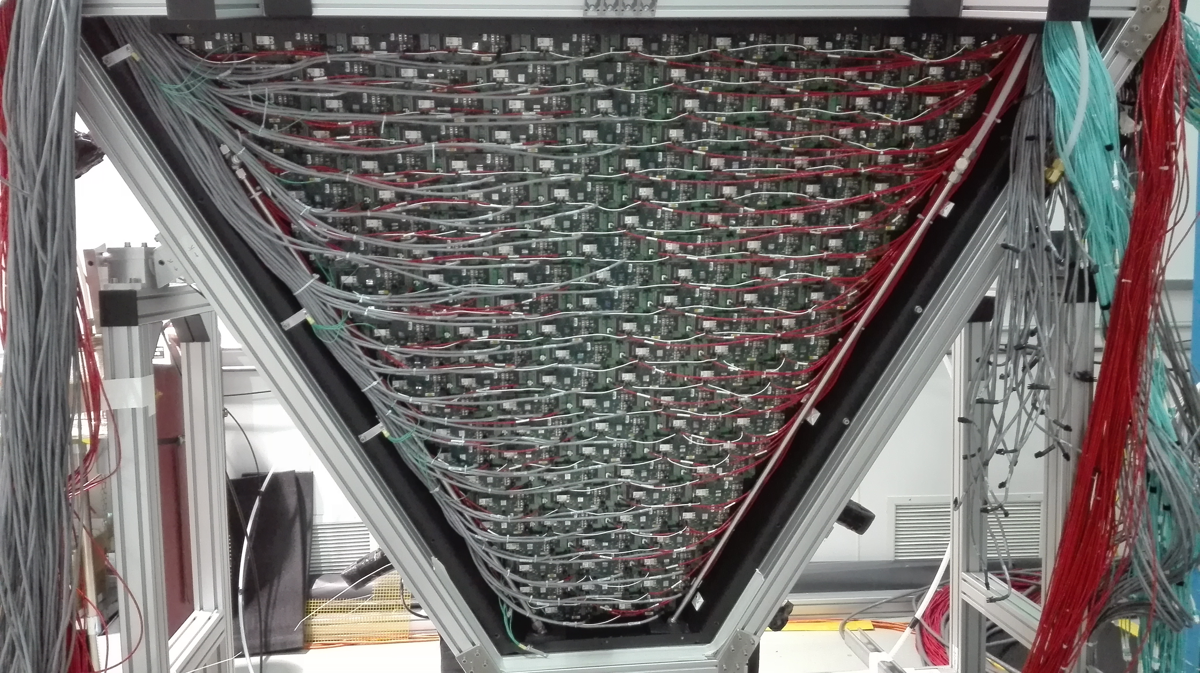
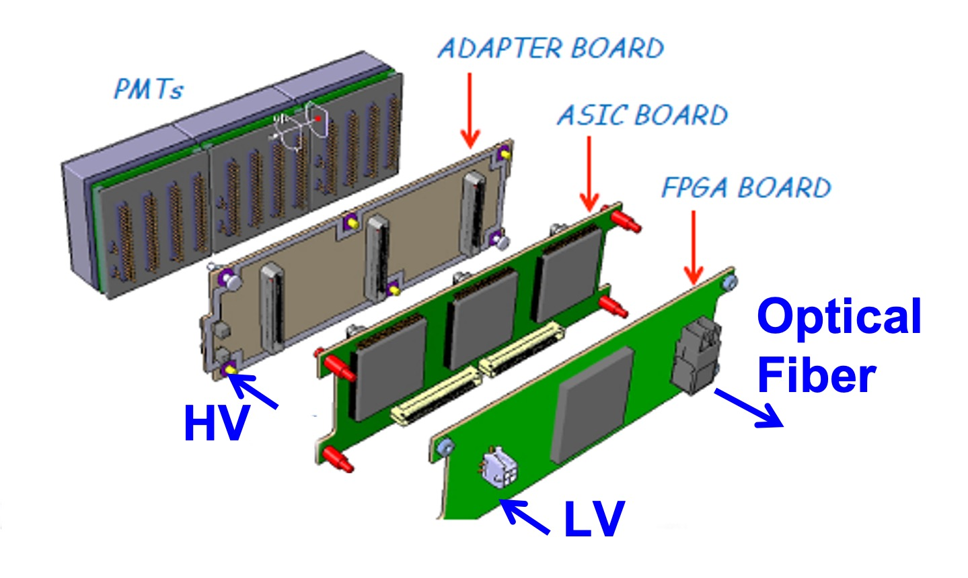
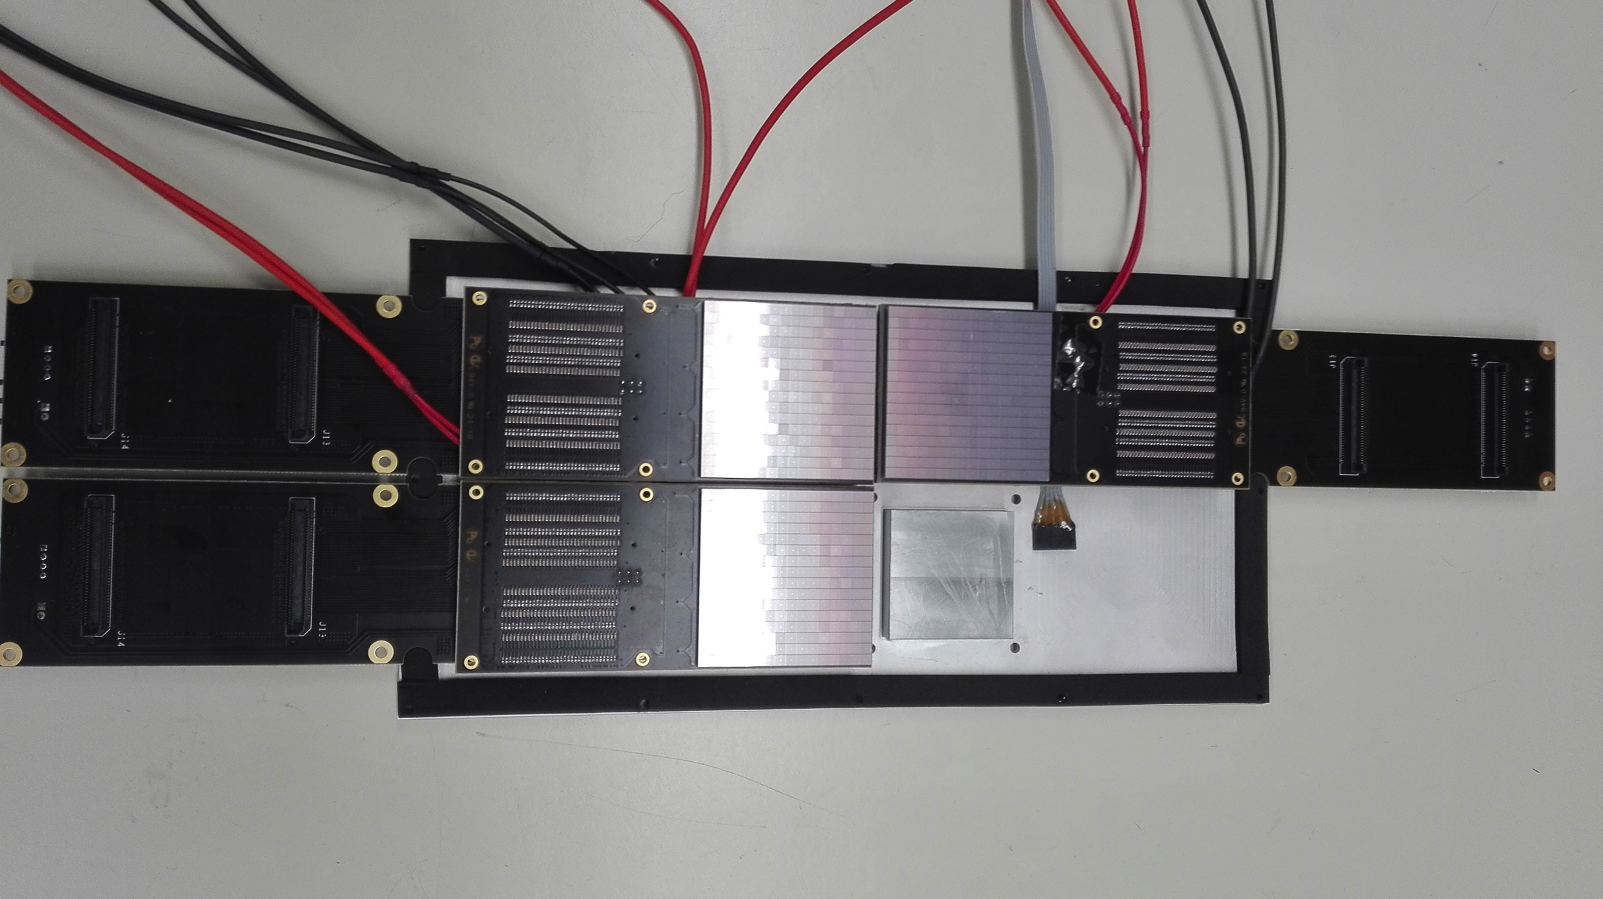
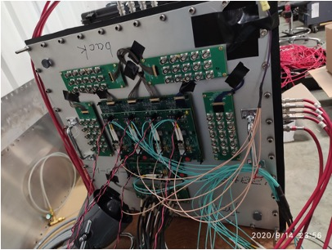
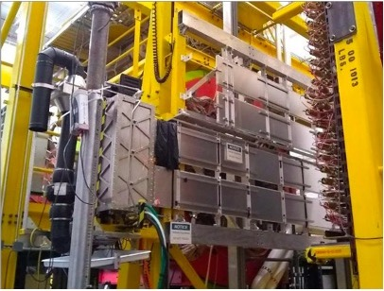
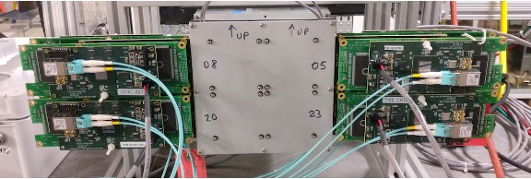
RICH Electronics
Readout Electronics
Compact (matches sensor area)
Modular Front-End (Mechanical adapter, ASIC, FPGA)
Scalable fiber optic DAQ (TCP/IP or SSP)
Tessellated (common HV, LV and optical fiber)
Developed for CLAS12 RICH
Coupled to cool SiPM matrices for EIC
Adopted by Gluex DIRC
Upgraded for SOLID R&D
Coupled to H13700 for EIC mRICH / dRICH
Proposed for INFN TechTranfer

Slide 16
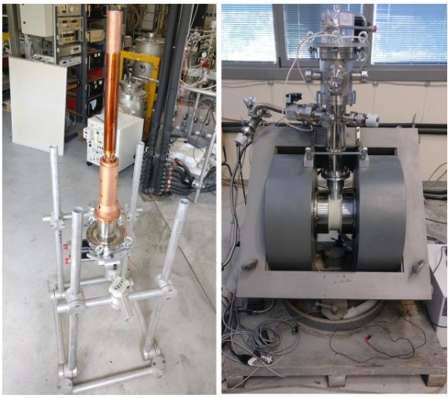
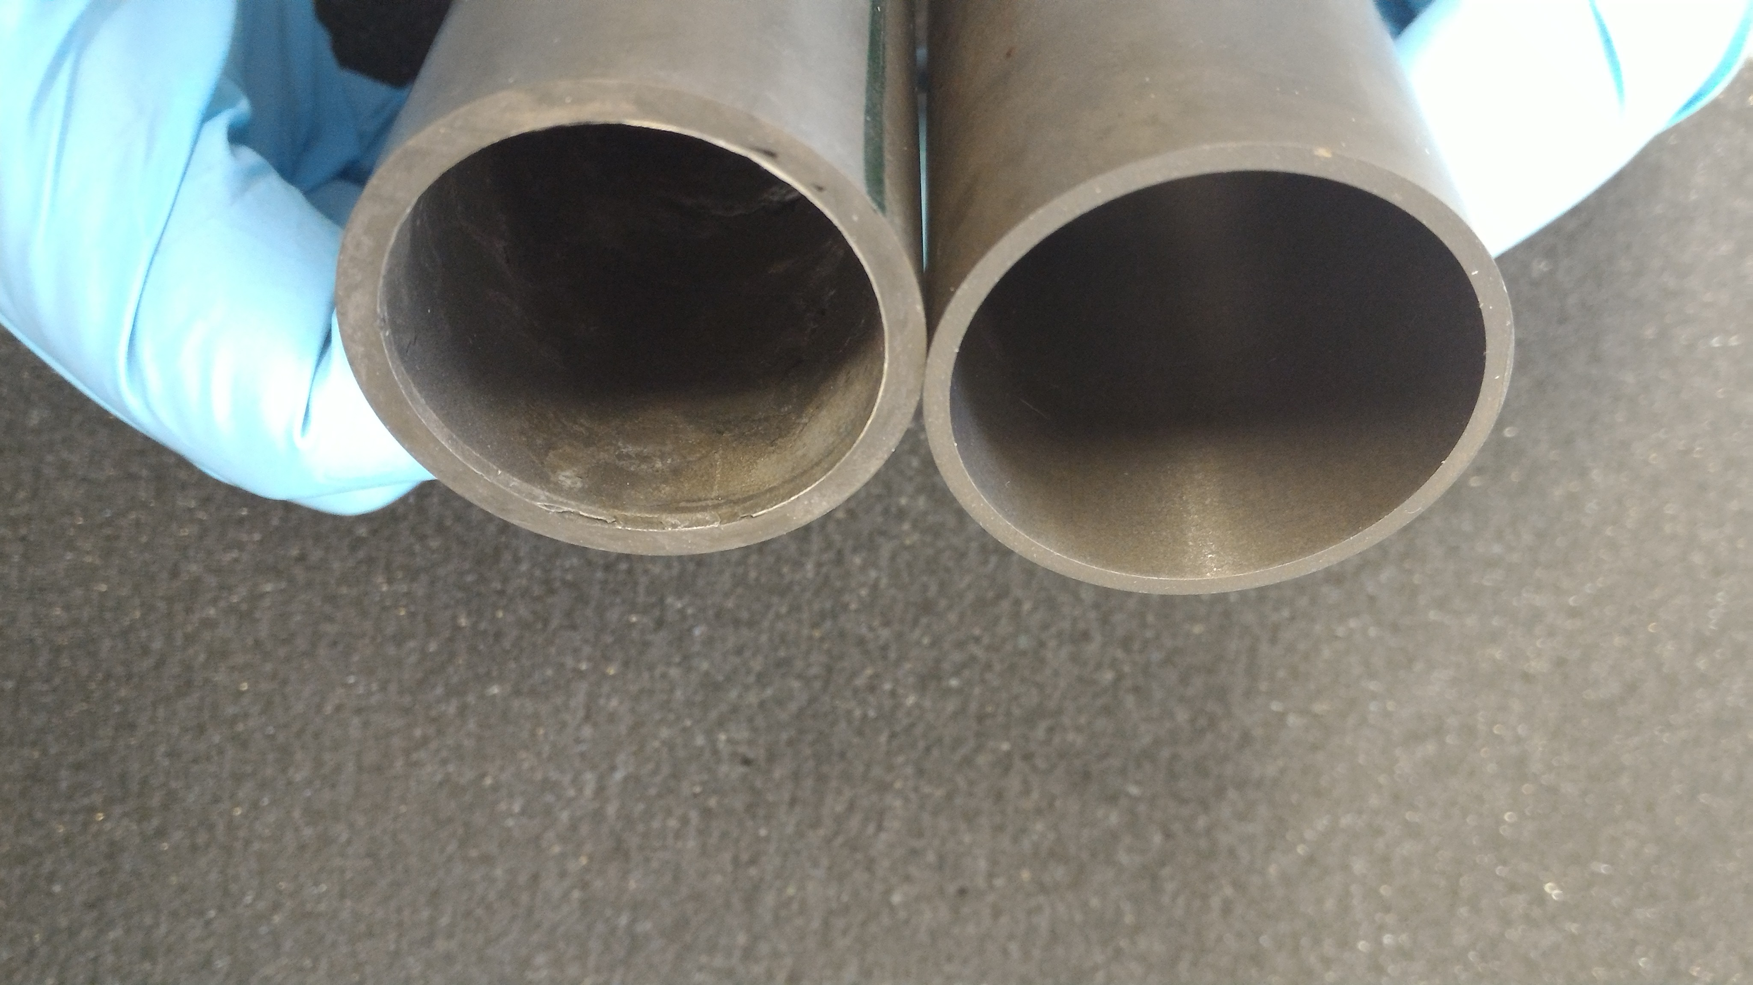
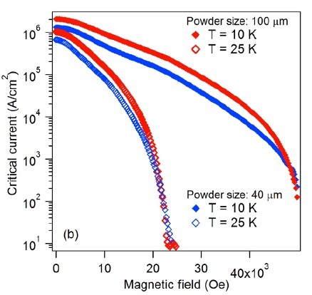
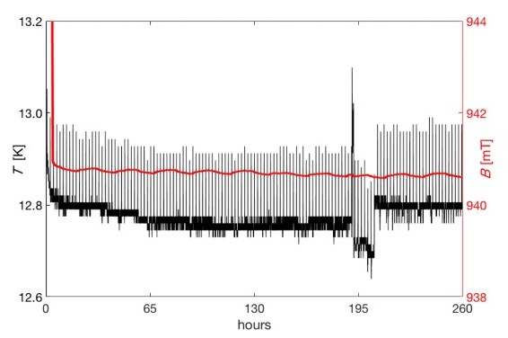
High-Temperature Bulk SC Magnets
MC is activity leader
Test-stand with normal conductor dipole
Bulk MgB₂ magnet (cylinder)
Freezes the field at transition (~40 K)
Minimum material budget (no copper safe ring)
While cool, does not require current leads
No destructive quenches
Decouple mechanics from field shape
Optimization of the composite powders
Long stability test (up to one month)

Slide 17
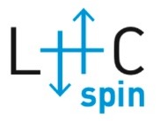
M. Contalbrigo
MC contriuted to the BSM studies in the electro-weak sector (ν oscillations, K_{L} rare decays)
and in estalishing a new investigation paradigm in the strong sector (nucleon 3D):
Strong force dynamics in the confined state probed by parton transverse degreees of freedom
MC is CERN
SPSC member
HERMES @ DESY (precursors)
First obsrvations 2001-2012
CLAS/CLAS12 @ JLab (luminosity)
Valence region 2010-
Deputy spokesperson
Analysis Corrdinator
Physics WG convener
Editorial Borad member
Run coordinator
Experiment spokesperson
CLAS Coord. Committee member
Physics WG convener
Run coordinator
RICH Project Leader
PI CLASMED project
Compact SC magnets
Super-Hermes. PAX / EDM search
Polarized target
Target coordinator
Spokesperson transverse target RG
Polarized target

Slide 18
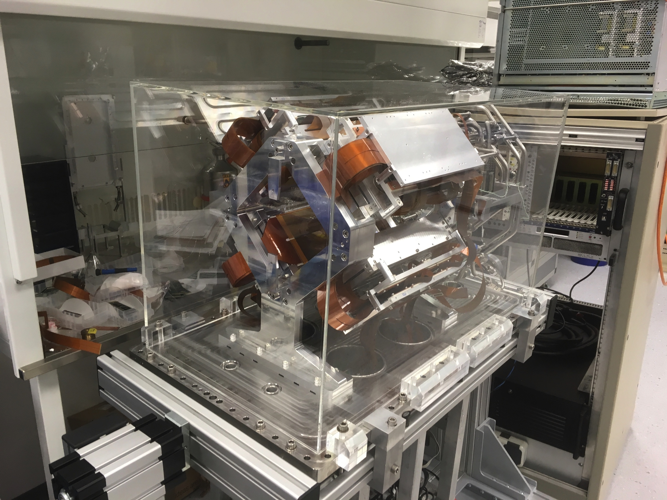
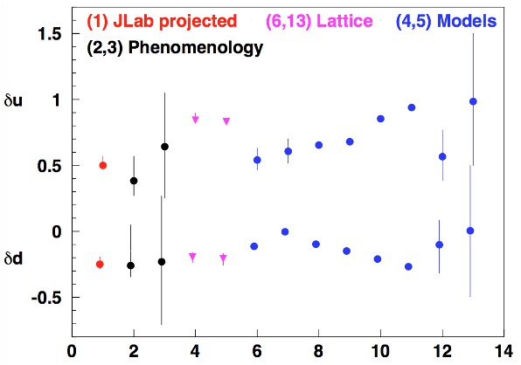
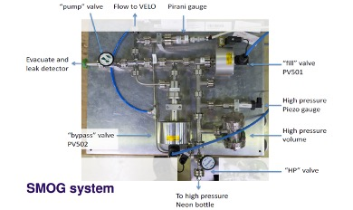
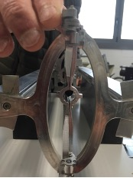
Transverse Polarization Spin-off
Tensor Charge measures transverse quark
polarization in a transversely polarized nucleon
Spin manipulation program at FZJ
PAX, Fundamental symmetries, EDM
Universality: Polarized target @ LHCb
Polarized antiproton beams
BSM Physics: Tensor coupling & EDM search
Fixed target program at LHCb. (LCH bridge to EIC)
Phase I: unpoalrized SMOG2
Phase II: plarized LHCspin
PREFER: polarized fusion
COLUMBUS: test-bench fot
superconducotr at working temperature

Slide 19
Transverse Polarization Spin-off
Tensor Charge measures transverse quark
polarization in a transversely polarized nucleon
Spin manipulation program at FZJ
PAX, Fundamental symmetries, EDM
Universality: Polarized target @ LHCb
Polarized antiproton beams
Fixed target program at LHCb. (LCH bridge to EIC)
BSM Physics: Tensor coupling & EDM search
Phase I: unpoalrized SMOG2
Phase II: plarized LHCspin
Propaedeutic studies ongoing at COSY, Juelich FZ

Slide 20
M. Contalbrigo
MC contriuted to the BSM studies in the electro-weak sector (ν oscillations, K_{L} rare decays)
and in estalishing a new investigation paradigm in the strong sector (nucleon 3D):
Strong force dynamics in the confined state probed by parton transverse degreees of freedom
MC is CERN
SPSC member
HERMES @ DESY (precursors)
First obsrvations 2001-2012
CLAS/CLAS12 @ JLab (luminosity)
Valence region 2010-
EIC @ BNL (energy)
Extended coverage 2031-
Deputy spokesperson
Analysis Corrdinator
Physics WG convener
Editorial Borad member
Run coordinator
Experiment spokesperson
CLAS Coord. Committee member
Physics WG convener
Run coordinator
POETIC IAC member
PSQ@EIC OC member
Yellow-report author
RICH Project Leader
PI CLASMED project
Compact SC magnets
RICH for particle ID
Photo-detection in high-B
Super-Hermes. PAX / EDM search
Polarized target
Target coordinator
Spokesperson transverse target RG
Polarized target

Slide 21
Dual Radiator RICH for EIC
MC is IAC member and YR author
SIDIS physics
Complementarity of 2 IPs
MC is PID R&D activity leader
dRICH (mRICH)
SiPM and readout electronics
dRICH: effective solution, part of EIC reference detector
Lead by INFN, being selected for targeted R&D
Challenge 1: wide coverage (3-60 GeV/c, 5-25 deg)
Two radiators Aerogel (n_{AERO}~1.02) + Gas (n_{C2F6} ~ 1.0008)
Challenge 2: Single-photon detection in ~1T magnetic field
Silcon Photomultipliers
21

Slide 22
dRICH Prototype
MC is PID R&D activity leader
Cherenkov signal by cool SiPM (-30º)
readout by ALCOR chip
30 mm
15 mm
Inner gas volume
with mirrors
22

Slide 23
SiPM Program
MC is PID R&D activity leader
Custom laboratory characterization: annealing and low-T working point
Current vs overvoltage Dark count from high-frequency sampling
T = -30 C
ToT readout (ALCOR) to study readout specs
23

Slide 24
M. Contalbrigo
MC contriuted to the BSM studies in the electro-weak sector (ν oscillations, K_{L} rare decays)
and in estalishing a new investigation paradigm in the strong sector (nucleon 3D):
Strong force dynamics in the confined state probed by parton transverse degreees of freedom
MC is CERN
SPSC member
HERMES @ DESY (precursors)
First obsrvations 2001-2012
CLAS/CLAS12 @ JLab (luminosity)
Valence region 2010-
EIC @ BNL (energy)
Extended coverage 2031-
Deputy spokesperson
Analysis Corrdinator
Physics WG convener
Editorial Borad member
Run coordinator
Experiment spokesperson
CLAS Coord. Committee member
Physics WG convener
Run coordinator
POETIC IAC member
PSQ@EIC OC member
Yellow-report author
RICH Project Leader
PI CLASMED project
Compact SC magnets
RICH for particle ID
Photo-detection in high-B
Super-Hermes, PAX / EDM search
Polarized target
Target coordinator
Spokesperson transverse target RG
Polarized target

Slide 26
10
DVCS @ CLAS
Interference magnifies the rare DVCS signal and provide access to the QCD scattering amplitude
Cross-section measurements are
challenging but provide the most
complete information to theory
Analysis coordination
Result review coordination
Complementary channel
Transverse target experiments
Systematics on:
Radiative corrections
π0 background
Acceptance
VGG model
KMSC calc.
BH only
N.Hirlinger et. al. PRC 98 4 (2016) 045203

Slide 27
9
TMD Review
Compendium of first 10 years of observations
Critical discussion of present understanding
Most urgent theoretical and experimental validations
Future perspectives for precision
Several results (HERMES, JLab)
Projections of future proposals (Jlab, EIC)
Connections (low-x, QGP, BSM)
Coparison among experiements
Extraction methods and systematics

Slide 28
8
CLAS12 RICH
1.5 mrad resolution provides 4σ separation at 8 GeV/c
Design & simulations
Aergoel R&D, handling and characterization
Mirrors for hybrid optics validation
SiPM sensors and electronics
Data analysis
In 6 months: TDR
DOE review & approval
MIUR priority project
New method to measure dominant chromatic effect
Achieved ~ 0.0050 μm⁴ cm⁻¹ aerogel clarity

Slide 29
8
CLAS12 RICH
Resolution is not degraded by designed hybrid optics
gap not
optimized
H8500
mirrors + aerogel
plane
mirror
6 GeV beam
beam
Radiator
curved mirror
Aerogel
Proof-of-principle of SiPM use with respect H8500 multi-anode reference
Cooled SiPM as
good as PMTs

Slide 30
7
CLAS12 TPE
Wide range of intermediate hadronc states
1γ 2γ interference sensitive to the beam charge
Coordination analysis
Review analysis
Review paper
Study of radiative corrections for hadronic tensor
Complementary measurement:
OLYMPUS With independent beams
HERMES. Tw-photon exchnge in DIS
CLAS: Unique terziary beam for simultaneous
Measurement, wide acceptnace decouple ε and Q²
OLYMPUS PRL118 (2017) 9, 092501

Slide 31
6
HERMES MULTI
Analysis coordination
Multi-D unfolding of experimental effect
Systematic evaluation method
Editorial review of the article
Target
Coordination and maintenance
Calibration and analysis
Most precise favor separated multiplicities
Comparison with phenomenological fits
Related to
TMD evolution
Precision physics (W mass)
Hadronizaion in cold nuclear media

Slide 32
5
HERMES SIVERS
Flavor separation
Analysis coordination
Un-binned maximum likelihood
Systematic evaluation method
Editorial review of the article
Target
Coordination and maintenance
Calibration and analysis
No evidence of higher-twist or exclusive decay contamination

Slide 33
4
HERMES G₁
Target
Coordination and maintenance
Calibration and analysis
Tensor polarization
Analysis coordination
Extraction method validation
Systematic evaluation
Most precise deuteron measurement
determination of ΔΣ (axial charge)

Slide 34
3
HERMES A_{UT}
Target
coordination and maintenance
calibration and analysis
Analysis coordination
Extraction method validation
Systematic evaluation
First evidence for
Transversity: quark polarization
related to Tensor charge & BSM
Collins function: spin-orbit in fragmentation
Sivers function: spin-orbit in the nucleon

Slide 35
2
NOMAD νμ → νe
Electron preliinary selection
Electron energy reconstruction
ECAL calibration with π⁰
Off-time muon background in ECAL
Sum-up bremsstrahlung photons
Account for DC material (early shower development)
Preliminary ν_{μ}→ ν_{τ} oscillation analysis
To be compared with 2.1% E_{brem} resolution

Slide 36
1
NA48 Direct CP
Beam intensity monitor
Equalization
Random triggers for accidentals
Systematics due to accidentals
Neutral decays
Neutral trigger and identification
Rare neutral decays (3π⁰, π⁰γγ, γγ, )

