Slide 1
ELECTRONICS
Goals:
Provide a reference readout system for prototypes performance assessment
Developed a generic DAQ system compatible with the Consortium needs
Test applications with innovative sensors (SiPM)
Progress in 2nd half 2018 on:
3 mm² pixel readout compatibility (H13700 and SiPM)
Pulsed laser test benches for detailed characterization
Radiation tolerance study for SiPM
Notes:
Fare una immagine del PMT sulla risoluzione

Slide 2
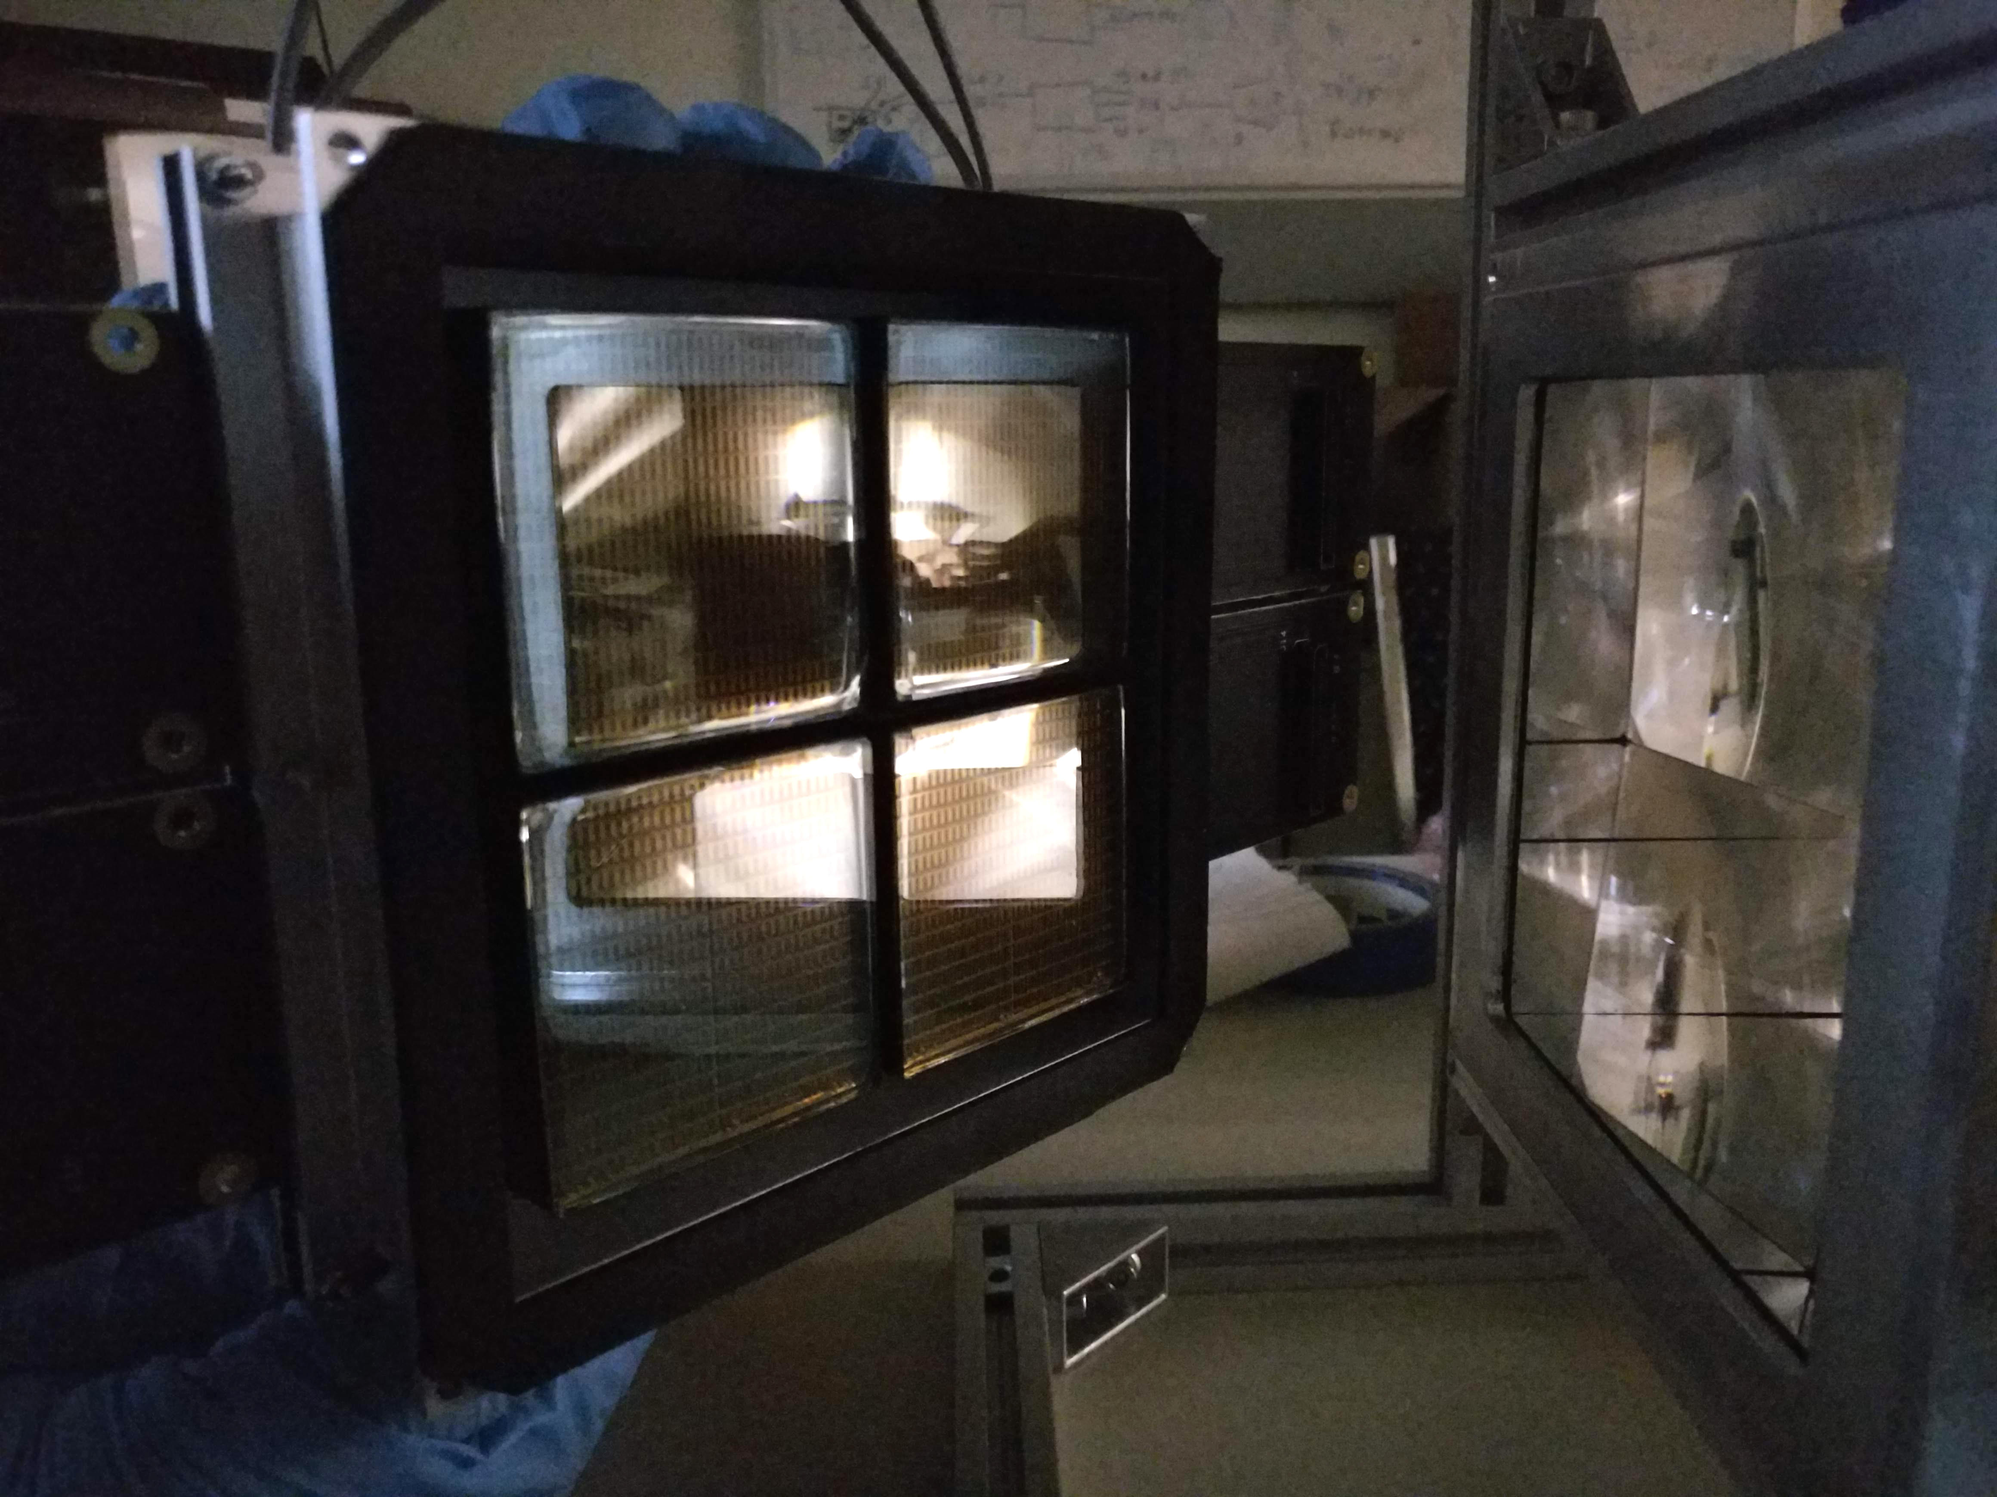
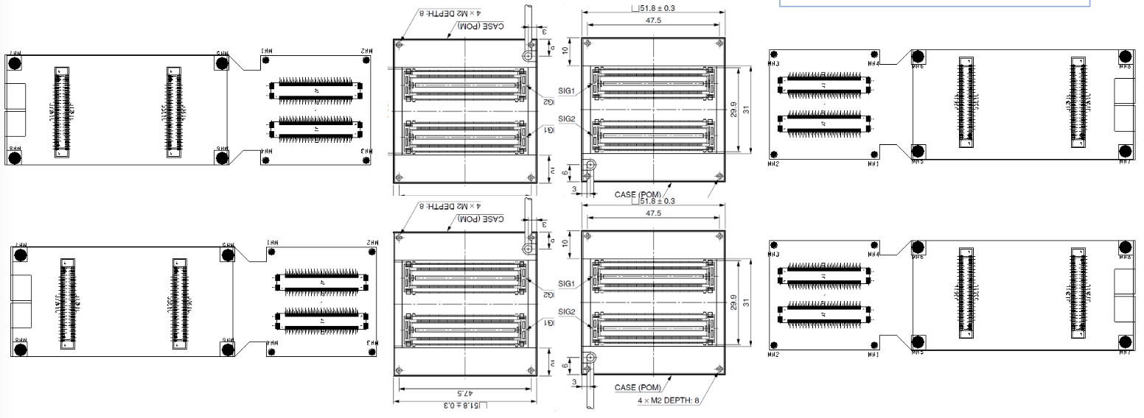
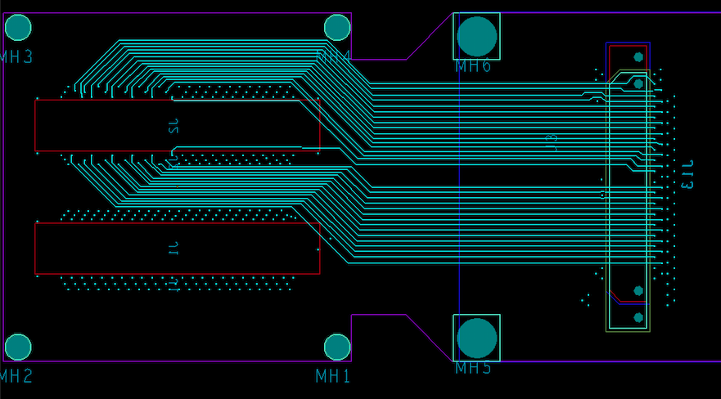
H13700 READOUT
Derived from CLAS12 RICH readout:
1024 channels
MAROC 64 channel parallel digitalization
FPGA generated 1 ns timestamp
DAQ protocol based on VME/VSX SSP
Custom adapter boards
- Compact distribution
Use of existing MAROC boards
Light and gas tightness
Notes:
Fare una immagine del PMT sulla risoluzione

Slide 3
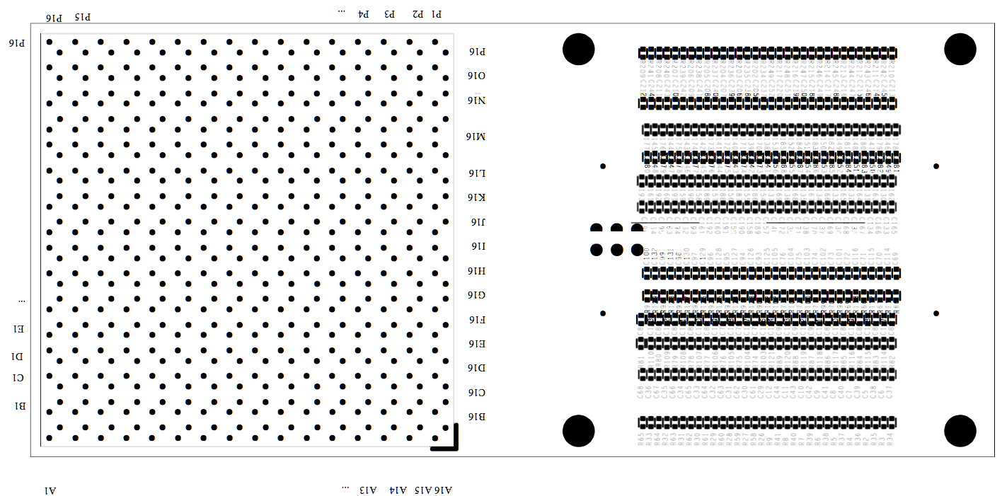
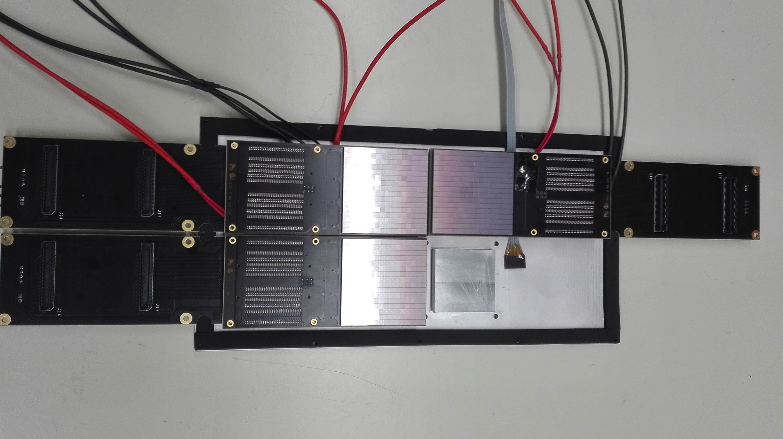
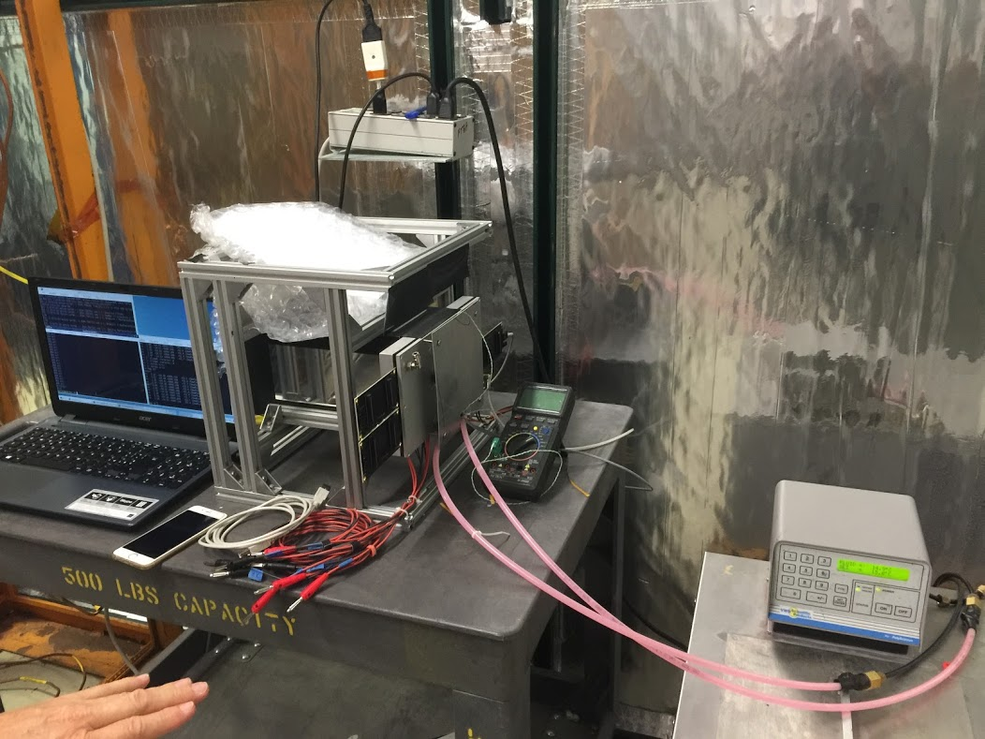
SIPM READOUT
Dedicated board for readout and cooling
of a surface Mounting SiPM Matrix
SiPM might offer a cheaper and more efficient solution, expecially in a longer time perspective for other sectors
Robust device with low sensitivity to magnetic field
Fast improvement in dark rate and cost
but so far missing radiation hardness
Challenge: cooling integrated into the sensitive readout
Custom cooling plate
Soldered to the board
Peltier cell cooling
Down to -30º in N₂
Contalbrigo M.
eRD14 PID Consortium – 01/07/19
3
Notes:
Fare una immagine del PMT sulla risoluzione

Slide 4
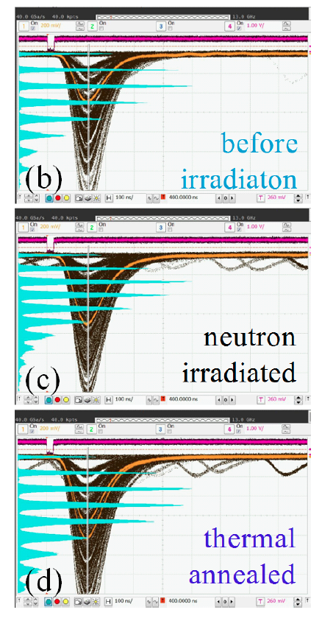
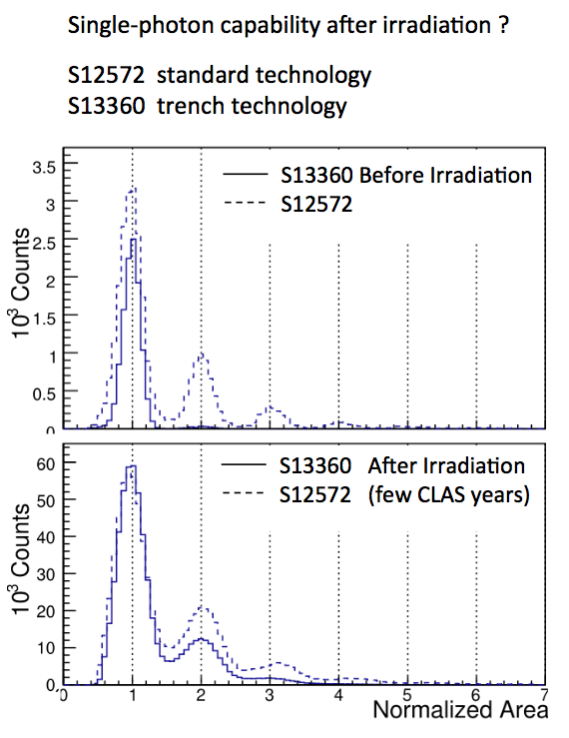
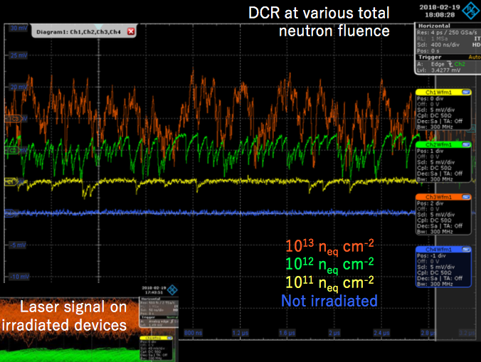
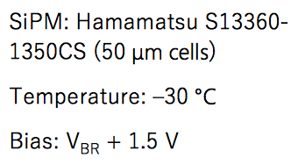
SIPM RADIATION TOLERANCE
T. Tsang et al.
JINST 11 (2016) P12002
I. Balossino et al.
NIMA 876 (2017) 89
Paolo Carniti
@ RICH 2018
T= 84 K
10⁹ n_{eq} cm²
Annealing at 250 ºC
T= 0 C
few 10⁹ n_{eq} cm²
Notes:
Fare una immagine del PMT sulla risoluzione

Slide 5
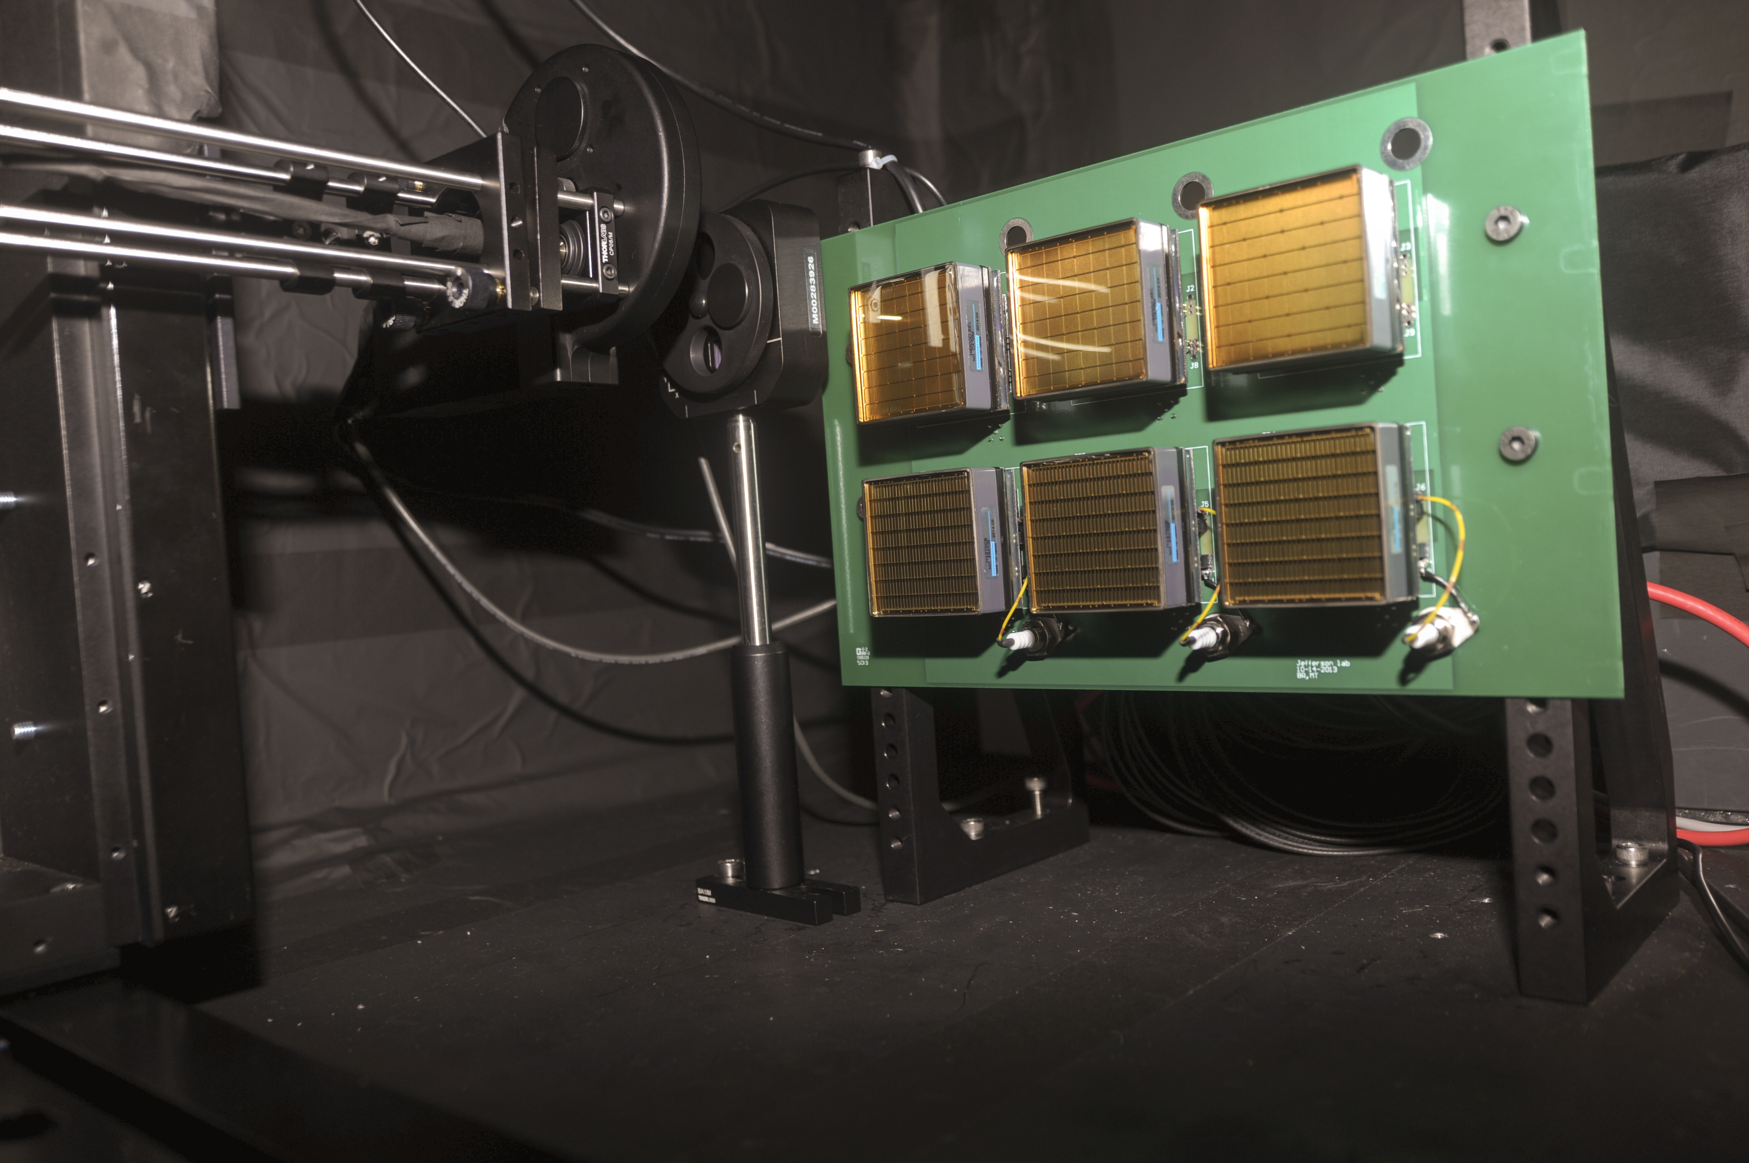
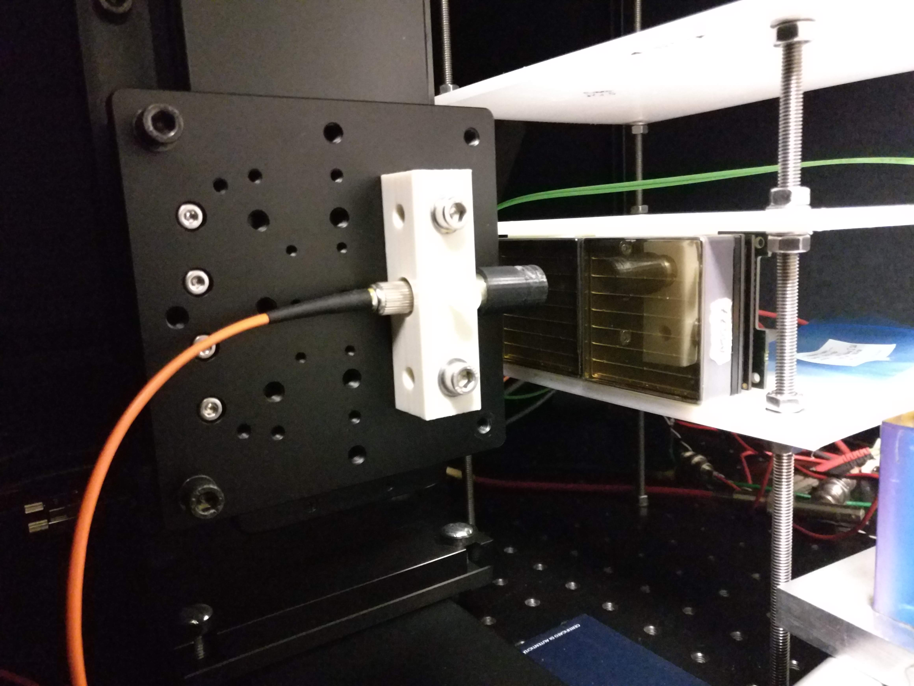
PULSED LASER TEST BENCHES
Detailed characterization
Sensors: gain, efficiency, cross-talk, radiation tolerance
Electronics: gain, cross-talk, thresholds, time resolution
JLab
632 nm picosecond pulsed laser light
Light diffuser to illuminate the whole MAPMT surface
Standardized system with CLAS12 electronics
H8500 6x6 mm² pixel sensor so far
Laser head +
diffuser
MAPMT holder
Ferrara
632 nm and 407 nm picosecond pulsed laser light
Light concentrator to scan the pensor surface
Flexible layout supporting various sensors and
Front-End electronics
Laser head +
collimator
MAPMT holder
Notes:
Fare una immagine del PMT sulla risoluzione

