Slide 1
eRD14 – EIC PID consortium
- An integrated program for particle identification (PID) for a future Electron-Ion Collider (EIC) detector.
M. Alfred, B. Azmoun, F. Barbosa, L. Barion, W. Brooks, T. Cao, M. Chiu, E. Cisbani, M. Contalbrigo, S. Danagoulian, A. Datta, A. Del Dotto, M. Demarteau, A. Denisov, J.M. Durham, A. Durum, R. Dzhygadlo, C. Fanelli, D. Fields, Y. Furletova, C. Gleason, M. Grosse-Perdekamp, J. Harris, M. Hattawy, X. He, H. van Hecke, T. Horn, J. Huang, C. Hyde, Y. Ilieva, G. Kalicy, A. Kebede, B. Kim, E. Kistenev, M. Liu, R. Majka, J. McKisson, R. Mendez, I. Mostafanezhad, P. Nadel-Turonski, K. Peters, R. Pisani, W. Roh, P. Rossi, M. Sarsour, C. Schwarz, J. Schwiening, C.L. da Silva, N. Smirnov, J. Stevens, A. Sukhanov, X. Sun, S. Syed, R. Towell, G. Varner, R. Wagner, C. Woody, C.-P. Wong, W. Xi, J. Xie, Z.W. Zhao, B. Zihlmann, C. Zorn.
Contacts:
P. Nadel-Turonski <turonski@jlab.org>,
Y. Ilieva <jordanka@physics.sc.edu>
Generic Detector R&D for an Electron Ion Collider
Advisory Committee Meeting, BNL, January 24-25, 2019

Slide 2
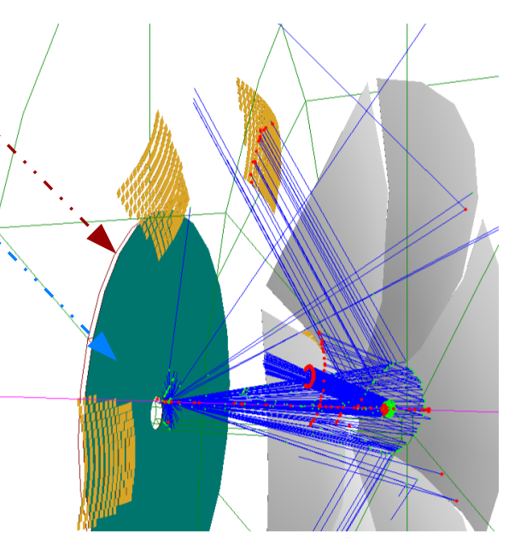
Dual-radiator RICH (dRICH)
Goal:
Provide hadron identification (π/K/p) from 3 to 50 GeV/c (3 sigma) and electron identification (e/π) up to 15 GeV/c, in the forward ion-side endcap of the EIC detector, covering polar angles up to ~25 deg.
Progress in 2nd half of 2019:
Prototyping
Consolidated prototype design
Started procurement of prototype components
Finalized Bayesian Optimization Method for detector design, tested on dRICH
Detailed analysis of the event-based reconstruction algorithm performance

Slide 3
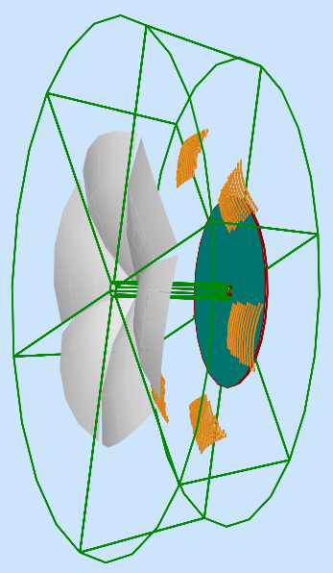
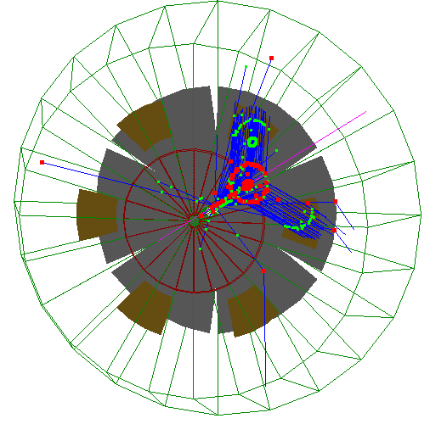
dRICH in EIC - baseline model
Aerogel
Gas
Spherical Mirror
Hits on detector
Photon impact
on mirror(s)
Available:
detailed simulation model including photon scattering in aerogel and 3 T central magnetic field
event-based reconstruction
Sensor Surface
Demand excellent performance from aerogel!
Radiators: Aerogel (4 cm, n_{(400nm)}∼1.02) + 3 mm acrylic filter, Gas (1.6 m, n_{C2F6}∼1.0008)
6 Identical Open Sectors (Petals):
Large Focusing Mirror with R ∼2.9 m
Optical sensor elements: ∼4500 cm²/sector, 3 mm pixel size, UV sensitive, out of charged particles acceptance
Advantages:
Full momentum, continuous coverage
Relatively simple geometry/optics
Expected to be Cost Effective (respect to 2 x detectors solution)

Slide 4
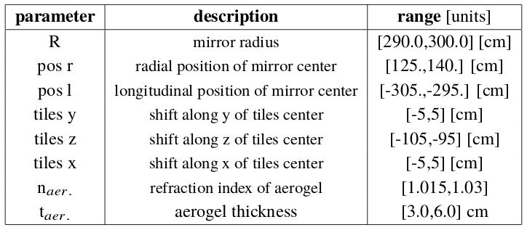
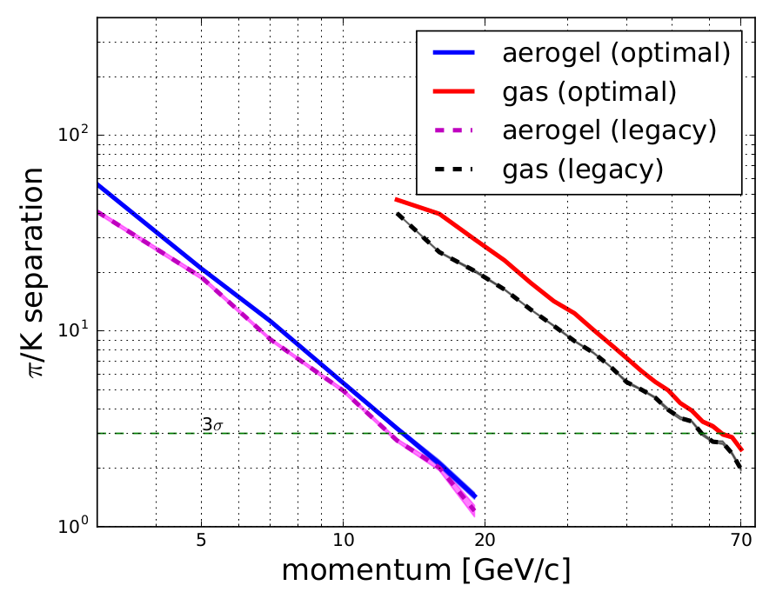
dRICH Performance Optimization
Combine detailed MonteCarlo simulations with Bayesian Approach to efficienty maximize a proper Figure of Merit (π-K Cherenkov angles separation in critical phase spaces regions, e.g. aerogel-gas transitions, high momentum limit …)
Current implementation uses 8 independent parameters (can be extended easily) →
The method provides optimized performances and hints on relevance of different detector features
It can be ported to any detector development (or combination of detectors) where detailed MonteCarlo exists
arXiv:1911.05797 submitted to JINST

Slide 5
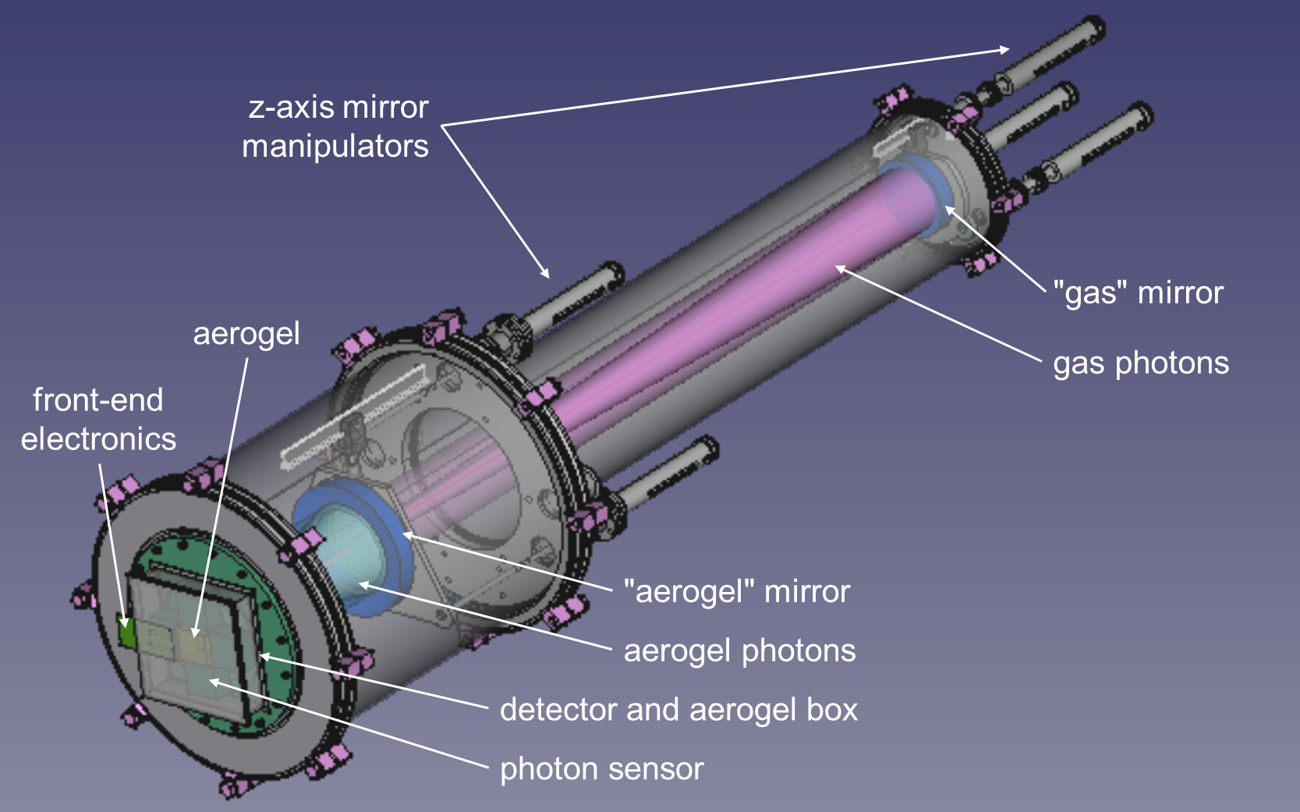
dRICH prototype (a new detector …)
Design in an advanced stage, mechanical details being finalized
Standard Vacuum Technologies to optimize gas handling
Two tuneable mirrors system for using the same detector
Common (limited) sensitive surface for both aerogel and gas photons
Detector and aerogel box isolated from the gas tank

Slide 6
FY20 outlook
Activity | T1 | T2 | T3 | T4
Prototype Component procurement
Prototype construction
Prototype simulation analysis
Prototype lab test
Aerogel-gas long term test
Sensor characterization (mRICH + dRICH)
Electronics test and integration (mRICH + dRICH)
Contract awarded for mechanics and aerogel, funds secured for mirror system and
at least the cheaper freon gas. Sensor characterization campaign initiated.
Important components (electronics and sensors) of the dRICH prototype are shared with the mRICH development
CLAS12 infrastructures available in Ferrara/JLab is used for aerogel-gas studies and photon sensors characterization

